Slide 1
Nutritional assessment
Contents
Definition
Classification
Advantages and dis advantages of each assessment methods

Slide 2
definition
Nutritional assessment is the process of estimating the nutritional position of an individual or group, at a given point in time, by using proxy measurement of nutritional adequacy.
It provides an indication of the adequacy of the balance between dietary intake and metabolic requirement.
Can take one of four forms , surveillance, screening or intervention:
Surveys
Surveillance
Screening or
Intervention

Slide 3
Assessment methods
Direct methods
ANTHROPOMETRY
BIOPHYSICAL METHOD
CLINICAL METHOD
DIETARY METHOD
Indirect methods
Ecological methods; use population as a whole
Functional method; uses the effect of each diet on the body system
Vital statics. Uses mortality and morbidity figure to asses nutritional status

Slide 4
We will see only the direct methods
Anthropometric Method of Nutritional assessment
Measurement of the variations of the physical dimensions and the gross composition of the human body at different age levels and degrees of nutrition
Used for assessment of growth in developing countries
Anthropometric assessment is done for two purposes
Anthropometric measurements of growth
Anthropometric measurements of body composition
Measurement of fat
Measurement of fat-free mass

Slide 5
Weight
Weight can be measured with a :
Hanging spring scale (< 2 years children)
Beam balance (> 2 years)
Portable electronic scale
Calibration needed after every measurement
Remove or make allowance for clothing
Wait until the subject calm or remove the cause of anxiety

Slide 8
Recumbent length
Measured in children:
Younger than 24 months
Fewer than 85cm long if age is not known
Who are too ill to stand
Correct measurement of length requires that:
Child is relaxed with no shoes on
Child lies parallel to the long axis of the board
Crown of the head is against the fixed board
Movable board is brought up against the heels

Slide 9
Measuring length of the children 0-23 months

Slide 10
Measuring length of the children 0-23 months

Slide 11
Standing height
Measured in children
Over 24 months of age
85-110 cm tall if age is not known
To measure height, the:
The child stands barefoot wearing little clothing
Child faces forward with legs straight
Head, shoulder blades ,buttocks and heels contact the vertical board
Movable headboard is gently lowered
Height is recorded to the nearest 0.1cm

Slide 12
Child Height Measurement - Height for Children 24 Months and Older

Slide 13
Head circumference
It is an indicator of chronic malnutrition in under two children
Not useful for above two children
Measuring head circumference:
Tape should rest at occipital protuberance and supra-orbital ridge
Hair crushed adequately
Ears shouldn’t be under tape
Position should be maintained at the time of reading
Head wear should be removed ( as the culture permits)
Tape should not be stretchable
Measurement recorded to the nearest 1mm

Slide 14
Height-for-age (HFA)
Is a measure of stunting
Can indicate past malnutrition
Is a reasonable predictor of long term mortality
Is less useful measure of growth over time than weight-for-age
Weight-for-height
Weight-for-height (WFH)
Is a measure of wasting when low
Indicates recent or current malnutrition
Is a good predictor of short term mortality
Doesn't require that the age of the child is known
Requires that two measurements are made

Slide 15
Weight for age
Weight-for-age (WFA)
Is a composite measure of undernutrition when low
Fails to distinguish between wasting and stunting
Is a good predictor of long term mortality
Is the preferred measure of growth over time unliklly stunting.
Head circumference for age
An index of chronic malnutrition for under two children due to:
IUGR /LBW
Malnutrition during first few months of life

Slide 16
Body mass index ( BMI)
Described by weight in kg divided by height in meter square
Commonly used weight for height ratio
Well correlated with adiposity of in most younger and older adults ( sometimes excessive BMI could be from adiposity, muscularity, or edema)
Gives no indication about the distribution of the body fat
Misclassification is common
Lean individuals
Very short individuals ( <150cm) or very muscular
Abnormal relationship between leg and trunk length
( e.g. Australian Aboriginals) – ratio of sitting height to standing height can be used

Slide 17
Classification of over weight ,obesity and CED in adults ( WHO, 2000)
Body mass index | Grade
<16 | Grade III CED
16.0-16.9 | Grade II CED
17.0-18.5 | Underweight (grade I, CED )
18.5-24.9 | Normal
25.00-29.99 | Overweight ( pre-obese)
30-34.9 | Class I obese
35-39.9 | Class II obese
>40 | Class III severe obesity

Slide 18
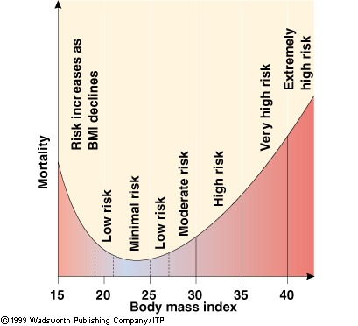
Relationship between obesity and mortality

Slide 19
Anthropometric assessment of body composition
It is based on a model in which the body consists of two chemically distinct compartments
Fat and
Fat free mass ( skeletal muscle , non-skeletal muscle, and soft lean tissue and the skeleton)
Assessment of body fat
It is the most variable component of the body which varies with age ,sex and weight
Measured by:
Skin fold thickness
Waist-to-hip circumference ratio

Slide 20
Skin fold thickness
Provides an estimate of the size of subcutaneous fat depot
Assumptions:
Thickness to the subcutaneous adipose tissue reflects a constant proportion of the total body fat
The selected skin fold sites are representative
Selected sites :
Biceps and Triceps ( mid point of the arm),
Sub-scapular ( left arm and shoulder relaxed )
Supra-iliac ( above iliac crest at mid axillary line and
Mid axillary ( on the Axillary line at the level of xyphoid process )
Best measured by precision skin fold thickness calipers

Slide 21
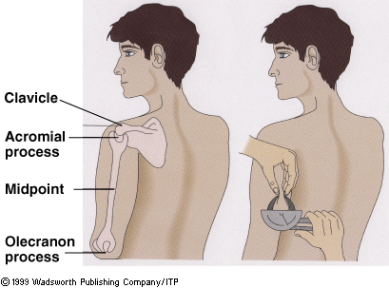
Skin fold measurement

Slide 22
Waist to hip circumference ratio
Measured midway between the lowest rib cage and the anterior superior iliac spine divided by the circumference of the hip measured at the level of the greater trochanter of the femur ( widest point at the buttock)
Used to distinguish lower trunk ( hip and buttocks) and fatness in upper trunk (waist and abdomen)
Overnight fasting is needed
If the ratio is > 1 in male and >0.85 in female there is high risk of cardiovascular complication and related deaths

Slide 23
Mid upper arm circumference (MUAC)
MUAC in children is measured between ages 12 and 59 months with a tape. It is important that:
MUAC is measured on the midpoint of the left arm
The arm hangs freely alongside the body
The tape is flat around the skin

Slide 24
MUAC in children aged 12-59 months
Wasting overestimated in younger children and underestimated in older ones
Is a measure of wasting when low
Is a very good predictor of short term mortality
Requires a single quick measurement with simple equipment
Has relatively large observer variability
( within and between)

Slide 25
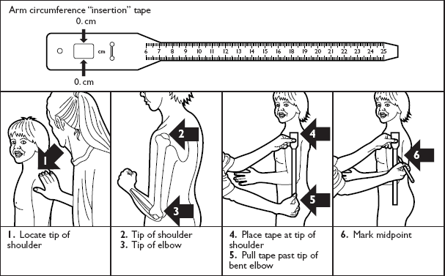
Child Mid-Upper Arm Circumference Measurement

Slide 26
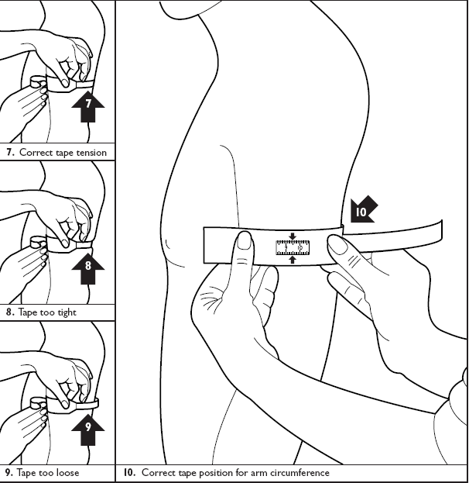

Slide 27
Pros and cons of anthropometric measurement
Pros | Cons
Quick Cheaper Give gradable results More accepted by the community Not invasive Can be accurate and precise provides that standardized methods are used Can be used in evaluation of changes in nutritional status Used in screening tests | Difficult in selecting appropriate cut-off point Limited diagnostic relevance ( only for type II nutrients) Considerable potential for inaccuracy Need for reasonably precise age in children

Slide 28
CLINICAL METHOD
Changes in the superficial tissues or in organs near the surface of the body, which are readily seen or felt upon examination.
These include changes in:
Eyes
Skin
Hair or
Thyroid gland

Slide 29
Common indicators
Edema
Dyes-pigmentation of the hair
Angular Stomatitis
Corneal lesions
Swelling (enlargement) of glands
Xerosis, etc.

Slide 30
ADVANTAGES
Fast & Easy to perform
Inexpensive
Non-invasive
Limitation:
Specificity is low; many of the signs are associated with a number of nutritional disorders as well as non-nutritional disorders.
Sensitivity is low; sign may appear in the recovery as well as the deficiency state

Slide 31
Laboratory assessment of nutritional status
.

Slide 32
Are used to determine the amount of nutrients ( proteins, amino acids, Fe, Vitamin ), in cellular components influenced by nutrients
( hemoglobin ,enzymes) , or metabolites
( pyruvate , xanthuric acid), in tissues ( organs muscles ) and body fluids ( blood ,urine)
Detects sub clinical deficiency states

Slide 33
Advantages and dis advantages
ADVANTAGES
Detects sub clinical deficiency states
limitation
tests can be complex
requires expensive equipment
needs highly trained staff.
Involves invasive procedure

Slide 34
Dietary method of nutritional assessment
Contents
Level of assessment
Classification of dietary methods
Limitation and dis advantages

Slide 35
Measuring food consumption at the national level
Food balance sheet
Provides a comprehensive picture of patterns of country’s food supply during specified reference period, calculated from the annual production of food, changes in stokes, imports , exports, and distribution of food over various uses within the country.
Total diet studies
Studies specifically designed to establish by chemical analysis the dietary intake of food contaminants by a person consuming a typical diet
Food are collected from different places and prepared table ready, homogenized and analysed in central laboratories

Slide 36
Measuring food consumption at the household level
Food account method- daily record of all food entering the household, either purchased , received as gifts, or produced for HH use during the specified period ( e.g 7ds)
Household food record method- emphasizes the food actually consumed by the household members rather than purchased or obtained

Slide 37
Measuring food consumption of individuals
two assessment methods
Quantitative daily consumption methods ( current intake)
Consists of recalls or records designed to measure the quantity of the individual food consumed over a 1-day period.
Dietary history and food frequency questionnaire used to obtain retrospective information on the patterns of food use during a longer , less precisely defined time period

Slide 38
24 hour recall method
Subjects are asked to remember whatever they consumed within the last 24 hours. This includes all beverages, snacks, dessert, etc
This is not sufficient to describe an individual’s usual intake of food and nutrients
Multiple single day recalls increase the validity
Use of standardized protocol
Pretesting before wider application

Slide 39
Advantage:
Relatively cheap
Quick
Less respondent burden
No chance for the respondents to change their dietary habit
Disadvantages
It doesn’t indicate the usual intake unless conducts for representative days for a particular nutrient intake
Respondent memory laps
Social desirability bias ( the flat slop syndrome )
Has less precision
Accuracy depends on the respondents ability to estimate the portion sizes

Slide 40
Estimated food records
The respondent is asked to record , at the time of consumption all food and beverages ( including snakes) eaten in household measures for a specified period of time
Standard household measures should be used
Number of days included depends on the objective ( average intake or usual intake)
The approach varies with the objective to be met
Weekends should be proportionately included

Slide 41
Con…
Advantages
Less respondent burden
Cheaper than WRM
Less time is used
Disadvantages
Estimation of portion size
Social desirability biase

Slide 42
Weighed record method
The most precise method available for measuring usual food and nutrient intake of individuals
In weighed record method the subject, parent, or caretaker is instructed to weigh all foods and beverages consumed during the time period
For mixed dishes the weight of the ingredients
( raw and after cooking) should be measured
Amount of food taken outside home recorded
( measure with duplicate bought from the restaurant)

Slide 43
Advantages:
It is more accurate ( high reproducibility)
There is no respondent memory loss
Disadvantage
High respondent burden
Change of the dietary habit during survey due to fear of burden ( fear of burden or impressing the investigator)
Needs literate and numerate respondents
Costly

Slide 44
Dietary history
Assess the nutrient intake over a longer period of time,( often a month) usually to see the association between diet and disease
Conducted by trained interviewer
Has three components
Interview on the overall pattern of eating ( e.g. what do you usually eat for breakfast?)
Frequency of consumption of specific food item
Subjects record their intake for three days

Slide 45
Advantage
Indicate dietary habit of an individual or group of people
It can be applied to a specific dietary habit or intake of specific nutrient of interest ( alcohol intake, fat intake )
Less respondent burden
Disadvantage
Overemphasizes the regularity of the dietary pattern
Very difficult to validate
Need highly trained interviewer

Slide 46
Food frequency questionnaire
Uses comprehensive list of specific food items to record intakes over a given period.
Record can be obtained by interview or self administered questionnaire. ( computerized in the west currently)
Should feature simple, well-defined foods and food categories
Open-ended questions should be avoided

Slide 47
Advantage
Useful to rank individuals broad categories of low , medium and high intake of specific food
Identify food patterns associated with inadequate intake of specific nutrient
Rapid with low respondent burden
Disadvantage
Difficult to develop FFQ in multi-cultural society where different staple foods are consumed
It needs literate and numerate subjects

Slide 48
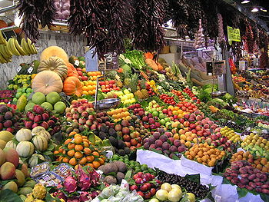
Thanks all of you

