Slide 1
Abnormal Labor pattern
(Labor Dystocia)
By Yibelu Bazezew

Slide 2
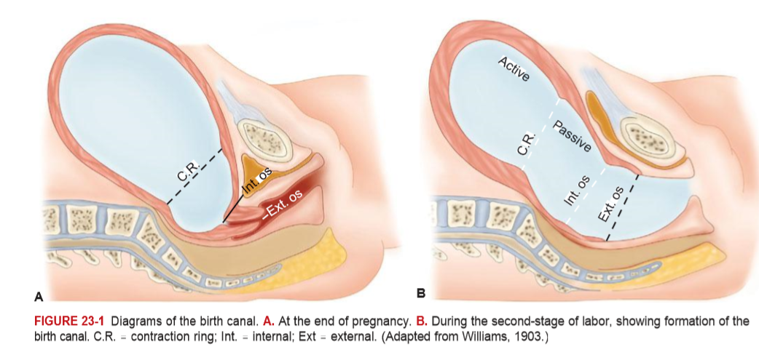

Slide 3
Learning objectives
At the end of this session the students will be able to:
  Define abnormal labor pattern
  Discuss classifications of abnormal labor patterns
  Outline etiologies of abnormal labor patterns
  Discuss the diagnosis of abnormal labor patterns
  Describe management options of abnormal labor patterns

Slide 4
Definition of Abnormal labor
Is labor that deviated from the course of the normal labor & delivery
Conditions of abnormal labor can include the following
  Stage is not lasting in normal duration
  Major Maternal and fetal complications may exist
  Complicated pueperium
  May not start at term
  Parturition with any risk
  Labor may not start spontaneously
  Presentation is not vertex

Slide 5
Dystocia ( difficult labor): is any labor in which the pattern of labor progress is significantly different from accepted and recognized patterns of labor progress in terms of:
  Cervical changes
  Descent of fetal presenting part or
  Profile of uterine contractions(frequency &/or duration)
It is often used interchangeably to denote an abnormal labor pattern

Slide 6
Dystocia ( difficult labor) cont……
Causes of Dystocia: Mainly the 4 Ps
Mainly it arises from four distinct abnormalities that may exist singly or in combination:
1. Power(expulsive force) abnormalities
Uterine contractions may be insufficiently strong or inappropriately coordinated to efface and dilate the cervix—uterine dysfunction
There may be inadequate voluntary maternal muscle effort during second-stage of labor

Slide 7
Abnormalities of the powers(expulsive forces)
Abnormalities of the "powers" constitute uterine activity that is ineffective in eliciting the normal progress of labor.
Ineffective uterine action characteristically falls into one of two categories:
  Hpotonic: with a normal pattern of low-pressure contractions
  Hypertonic: with a discoordinated pattern of high-pressure contractions.

Slide 8
2. Passenger abnormality
Abnormalities of presentation, position, or development of the fetus
3. Passage abnormality
  Abnormalities of the maternal bony pelvis— Pelvic contraction
  Abnormalities of soft tissues of the reproductive tract that form an obstacle to fetal descent
4. Psychological factor
5. Physician factor- unnecessary intervention

Slide 9
Common Clinical Findings in Women with Ineffective Labor patterns
Inadequate cervical dilation or fetal descent:
    Protracted labor—slow progress
    Arrested labor—no progress
    Inadequate expulsive effort—ineffective pushing
Fetopelvic disproportion:
    Excessive fetal size
    Inadequate pelvic capacity
    Malpresentation or position of the fetus

Slide 10
Diagnosis of abnormal labor patterns - Steps
Document the following parameters against time
  Uterine contraction profile
  Cervical dilatation/effacement
  Descent of fetal presentation
Compare against normal patterns for respective parity, identify any deviations and then classify into respective abnormal patterns
Look for specific etiology responsible for the abnormal labor patterns by carefully assessing the four determinants of labor progress (P’s of labor)

Slide 11
Evaluation for causes of abnormal labor patterns – Assessment of the four P’s of labor
Assessment of powers of labor:
  Palpation of uterine contractions
  External tocodynamometer
  Intrauterine pressure catheter monitoring

Slide 12
Assessment of the passenger
  Size, number, presentation, position and anomalies of the fetus by Leopold's palpations and ultrasonography
Assessment of the passages
  Bony pelvis – clinical pelvimetry
  Soft tissue dystocia – vaginal exam
Assessment of maternal emotional status and pain control

Slide 13
Mgt of abnormal labor pattern
depends on specific etiology diagnosed
Power abnormalities
  Uterine inertia – Augmentation
  Secondary powers failure – Instrumental assistance
Passenger abnormalities
  Often caesarean deliveries required
  Destructive deliveries in cases of fetal deaths
Abnormalities of the passages
  Often Caesarean delivery
  Episiotomy for perineal level obstruction

Slide 14
Classifications of abnormal labor patterns :
Four major groups:
Prolongation disorders
Protraction disorders
Arrest Disorders
Precipitate labor

Slide 15
Prolongation Disorders
Prolonged latent phase of labor
Definition – A latent phase lasting more than 14 hours in a multigravida and 20 hours in a primigravida
    Lasting more than 8 hours after true labor is diagnosed
The latent phase of labor:
  begins with the onset of regular uterine contractions
  extends to the beginning of the active phase of cervical dilatation.
Challenge in diagnosis
  due to the problem in diagnosing the exact time of onset of labor.

Slide 16
Causes of prolonged latent phase include:
  Excessive sedation or sedation given before the end of the latent phase
  Use of general anesthesia before labor enters the active phase
  Labor beginning with an unfavorable cervix
  Uterine dysfunction characterized by weak, irregular, uncoordinated, and ineffective uterine contractions, and
  Fetopelvic disproportion.

Slide 17
Treatment options in prolonged latent phase primarily consist of therapeutic rest regimens or active management of labor(taking an intervention).
After 6–12 hours of rest with hydration, 85% of patients spontaneously enter the active phase of labor, and further progression in dilatation and effacement may be expected.

Slide 18
10% of patients :
  will have been in false labor and
  can be allowed to return home to wait for the onset of true labor if no other indications for delivery are present.
In the remaining 5% of patients:
  uterine contractions remain ineffective in producing dilation;
  in the absence of any contraindication, augmentation with oxytocin infusion may be effective in progression to the active phase of labor.

Slide 19
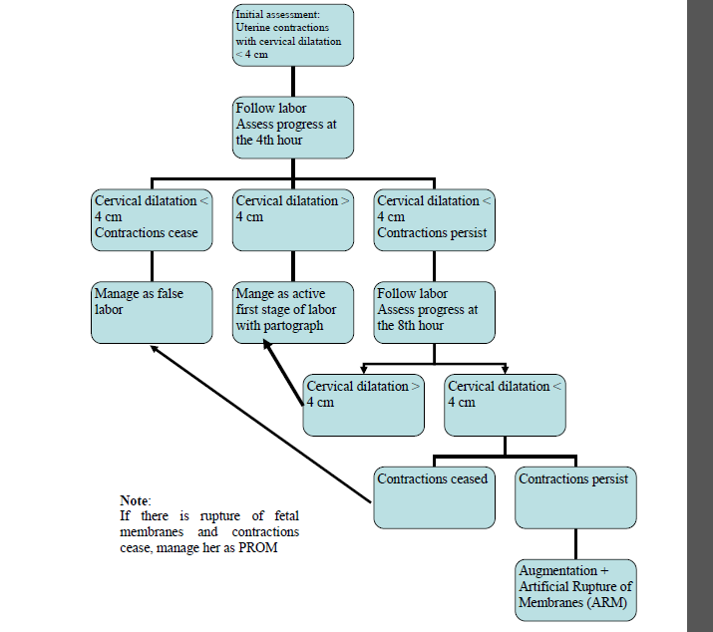
Diagnosis and management of prolonged latent phase of labor

Slide 20
Active- phase Disorders
Labor abnormalities in the active phase of labor are clinically divided into either:
    Slower-than-normal progress: protraction disorder or
    Complete cessation of progress: arrest disorder
A woman must be in the active phase of labor with cervical dilatation to at least 4 cm to be diagnosed with either of these abnormalities.

Slide 21
Protraction Disorders
Two protraction disorders
1.Protracted (slow rate) cervical dilatation
  A cervical dilatation less than 1.2 cm/hr for nulliparas and
  For multiparas it is defined as less than 1.5 cm/hr during active phase of labor
2. Protracted descent
  Descent of the fetal presentation less than 1 cm per hour for nulliparas and less than 2 cm per hour for multiparas

Slide 22
Arrest Disorders
Defined as a complete cessation of dilatation or descent.
Two arrest disorders
1. Arrest of Cervical Dilatation
  No cervical dilatation for 2 or more hours in the active phase of labor
2. Arrest of descent
  No descent for more than 2 hours

Slide 23
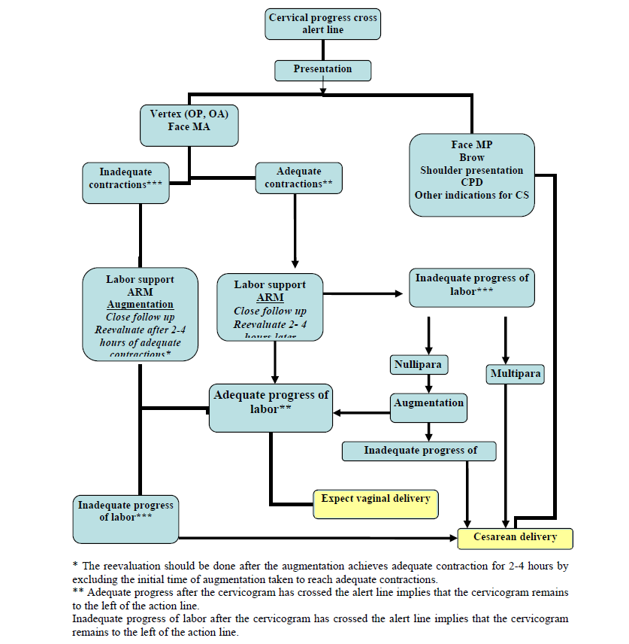
Management of abnormal active phase 1st stage of labor
Notes:
Inadequate progress of labor after the cervicogram has crossed the alert line implies that the cervicogram reaches to or crosses the action lineeee ……

Slide 24
Abnormalities in Second stage of labor
Abnormalities of descent and rotation
Abnormal progress in the second stage is entertained if there is no progressive descent (or head rotation to a favorable position) with each uterine contraction
Progress in the second stage is monitored mainly by descent of the presenting part

Slide 25
Prolonged second stage: The median duration of 2nd stage of labor is 50 minutes in nulliparas and 20 minutes in multi parous.
But arbitrary definition of prolonged 2nd stage are
  2hrs in nulliparas & extended to 3 hrs when epidural anesthesia used;
  1hr for multi paras and extended to 2 hrs when epidural anesthesia used.

Slide 26
The duration of 2nd stage has no relationship to perinatal out come if fetal distress and traumatic deliveries are excluded
Management
In the absence of fetal heart rate abnormality,
if mother is well hydrated & reasonably comfortable and
if there is some progress of descent or rotation regardless of how slow, there is no need for operative delivery.

Slide 27
CPD may be apparent in second stage of labor – cesarean delivery is indicated in the presence of clear evidence of CPD
Evaluate uterine action and if failure of descent and rotation is due to inadequate uterine action oxytocin augmentation should be done.
Prolongation secondary to malpositions & malpresentation is managed according to the malposition & malpresentation diagnosed

Slide 28
Precipitate labor
Defined as delivery in less than 3 hours from onset of contractions.
Precipitate dilatation can be defined as cervical dilatation occurring at a rate of 5 cm or more per hour
Precipitate labor may result from:
    Extremely strong uterine & abdominal contractions
    Abnormally low resistance of the soft parts of the birth canal
    Absence of painful sensations and thus a lack of awareness of vigorous labor(rarely).
The initiating mechanism for extraordinarily forceful uterine contractions usually is not known
Abnormal contractions may be associated with administration of oxytocin.

Slide 29
Maternal Effects of precipitate labor
Maternal complications are rare if the cervix and birth canal are relaxed
However, when the birth canal is rigid and extraordinary contractions occur, uterine rupture may result
Extensive Lacerations of the birth canal ( cervix, vagina, vulva, or perineum) are common
The uterus that has been hypertonic with labor
  tends to be hypotonic in the postpartum
    predisposing to postpartum hemorrhage

Slide 30
Fetal and Neonatal Effects of precipitate labor
Adverse perinatal outcomes from precipitous labor may be increased considerably for several reasons.
The turbulent uterine contractions, often with negligible intervals of relaxation, prevent appropriate uterine blood flow and fetal oxygenation, as a result, perinatal mortality is increased secondary to possible decreased uteroplacental blood flow(hypoxia)

Slide 31
Perinatal intracranial hemorrhage
  may result from trauma to the fetal head pushing against unyielding maternal tissue with contractions.
Finally, during an unattended birth, the newborn may fall to the floor and be injured, or it may need resuscitation that is not immediately available

Slide 32
Treatment of precipitate labor
If oxytocin administration is the cause of abnormal contractions, it may simply be stopped.
  The problem typically resolves in less than 5 minutes
The patient should be placed in the lateral position to prevent compression of the inferior vena cava.

Slide 33
If excessive uterine activity is associated with FHR abnormalities and this pattern persists despite discontinuation of oxytocin, a beta-mimetic such as 125–250 mcg of terbutaline can be given by subcutaneous or slow intravenous injection if no contraindications are present.
Physical attempts to retard delivery are absolutely contraindicated.

Slide 34
Obstructed labour

Slide 35
Learning Objectives
To define obstructed labor
To list the important causes of obstructed labor
To enumerate the immediate and late complications of obstructed labor.
To discuss the clinical features of obstructed labor.
To outline the management of obstructed labor.
To discuss the prevention of obstructed labor.

Slide 36
Introduction
Obstructed labor is failure of descent of the fetus in the birth canal for mechanical reasons arising from either the passage or passenger in spite of good uterine contractions.
Modern Obstetric care has led to the virtual disappearance of obstructed labor in developed countries,
However , in underdeveloped countries obstructed labor is a common problem.
It is one of the five leading causes of direct maternal death

Slide 37
Intro..........
It was estimated to be the most disabling of all maternal conditions.
It accounts for about 8% of maternal deaths globally.
In Ethiopia we host the biggest fistula hospital in the world due to obstructed labor.
Obstructed labor is an outcome of a neglected and mismanaged labor.

Slide 38
Importance
is one of the major causes of maternal and perinatal mortality in developing countries.
Its incidence is mainly related to
  the availability, accessibility and quality of ante partum and Intrapartum services in the community
  to a lesser extent to the incidence of fetopelvic disproportion in the community.
should never occur in communities where obstetric care is optimal even if disproportion is prevalent.
Therefore, is considered as a sign of major failure in obstetric care

Slide 39
Causes
Obstructed labor is usually an end result of improperly managed CPD
Maternal causes:
1.Bony obstruction : e.g.
  Contracted pelvis,
  Abnormal shaped pelvis,
  Tumours of pelvic bones
2.Soft tissue obstruction
  Uterus –myoma,
  Cervix - cervical dystocia
  Vagina – septum, stenosis, or tumors
  Ovaries – impacted ovarian tumors
  Trauma to bony pelvis, congenital deformity of bony pelvis

Slide 40
Causes of OL.....
Fetal causes:
1.Malpresentations and malposition:
    Persistent occipito-posterior and deep transverse arrest,
    Persistent mento-posterior and transverse arrest of the face presentation.
    Brow presentation,
    Shoulder,
    frank breech.

Slide 41
Causes
2. Large sized fetus ( macrosomia)
3. Congenital anomalies :
    Hydrocephalus
    Fetal Ascites
    Fetal tumors
4. Locked and conjoined twins

Slide 42
Diagnostic approach
OL is an emergency condition and requires a concerted team approach.
A rapid assessment of any patient on first contact is essential to identify critical patients and immediately instituting life saving measures.
Besides the prolonged labor, a woman with OL may have life-endangering signs such as loss of consciousness, breathing difficulty, bleeding, fever, or shock.
The general condition and vital signs (respiratory rate (RR), blood pressure (BP), pulse rate (PR) and temperature) may indicate the critical condition of the patients
The management should incorporate close monitoring, comprehensive clinical evaluation and essential investigations.

Slide 43
History
Age, height, gait, and any disability affecting the pelvis or lower limbs
Gravidity, parity
Gestation age
History of current labor:
  Prolonged labor often extending to days rather than hours
  Prolonged rupture of membranes
  Painful contractions (contractions eventually might cease due to uterine hypotonia or rupture)

Slide 44
Change of labor pain characteristics to continue generalized abdominal pain (peritoneal irritation due to hemoperitoneum, infection and meconium) which may be preceded by a sudden sever pain at the time of uterine rupture (described some times as “something gives away”).
The woman may also give a feeling that the “fetus is moving upwards”.

Slide 45
Past obstetric history:
  Any complications during previous pregnancy
  Reasons for any previous operative deliveries (instrumental deliveries , CS etc)
  Previous stillbirth or early neonatal death and cause, if known, and whether associated with prolonged labor
Medical history, in particular rickets, osteomalacia, or pelvic injury

Slide 46
PHYSICAL FINDINGS
The physical findings depend on the duration, complications, cause of the obstruction and gravidity.
For example, a primigravida with prolonged labor due to CPD is prone to atonic uterus with fistula formation while a multipara will have continued stronger contractions till the uterus ruptures.

Slide 47
PHYSICAL FINDING
General examination
Exhausted, tired and anxious(from severe pain, lack of sleep and in adequate diet)
Fluid and electrolyte imbalance
  a. Dehydration
  - Cracked lips, dry tongue
  - Hot, dry and inelastic skin
  - Scanty highly concentrated urine
  b. Metabolic acidosis
- Ketosis (from catabolism of fat in the absence of carbohydrates)
-Acidemia (accumulation of anions due to ↓ed urine out put)

Slide 48
Physical findings…….
  Intrapartum infection
    Prolonged rupture of membrane
    Repeated digital examinations
    Manipulation (application of local medicines)
  Rapid pulse and often febrile
  Hypotension or shock (septic or hemorrhagic due to infection or uterine rupture)

Slide 49
    Abdominal examination
Hypotonic or hyperactive uterine contractions depending on the progress of labor
The cause of the obstruction may be evident on abdominal examination (abnormal lie, big baby)
Fetal parts may not be felt easily
Distended hypoactive bowels due to electrolyte deficit (hypokalemia)
FHR (Tachycardia or bradycardia or may be absent)
Bladder often distended.

Slide 50
In multiparous woman and in a primigravid patient with advanced obstructed labor the three tumour abdomen may be evident (bladder, lower and upper uterine segments separated by pathological Bandl’s ring)
Bandl’s ring is a late sign of obstructed labor
It is the retraction ring which becomes visible and/or palpable during obstructed labor
It can be seen as a depression across the abdomen at about the level of the umbilicus.

Slide 51
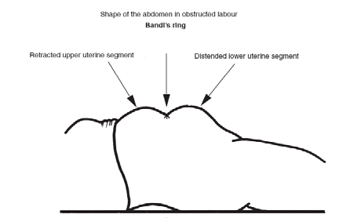
The ‘three tumor abdomen” is a warning sign of an impending uterine rupture.
The three tumors are due to:
Grossly thickened and retracted
upper uterine segment above Bandl’s ring;
Thinly distended LUS bellow
the ring;
Fully distended or/and edematous bladder further distending the lower abdomen.

Slide 52
Vaginal examination
Vaginal examination will reveal edematous vulva and cervix.
Foul smelling meconium stained liquor,
Severe caput and moulding
The cervix may or may not be fully dilated and the station may be high or low depending on the level of obstruction.
Catheterization is often difficult because of the impacted presenting part necessitating insertion of two fingers behind symphysis pubis to pass Foley catheter and urine is blood stained.

Slide 53
After uterine rupture
History
  Continuous and very severe abdominal pain
  Cession of uterine contraction
  Vaginal bleeding
General examination
  Extremely anxious, distressed, with dehydration and shock
  Pulse and BP may be absent
  Low blood pressure

Slide 54
Abdominal examination after uterine rupture
  Greatly distended, tender abdomen and uterus is difficult to feel
  Fetal parts are easily felt
  Lie and presentation may be difficult to detect as the baby has been displaced into the peritoneal cavity.,
  Positive shifting dullness -suggestive of hemoperitoneum
  Abdominal paracentesis - frank blood
  Absent FHR
Vaginal examination
  Impacted fetal head or receded above the pelvic brim
  Catheterization – blood stained urine

Slide 55
MANAGEMENT
Treatment Plan
The initial management of OL and ruptured uterus involves two concurrently on going activities:
    Resuscitation and monitoring of the life endangering conditions such as shock,& sepsis and
    Identifying the cause of OL and other complications and treating accordingly

Slide 56
MANAGEMENT
RESUSCITATION:
If delivery is not imminent or likely to be so shortly, resuscitation is the first step before facilitating transfer of the patient to higher health institution.
In a hospital admit the patient straight to the delivery unit or operating theatre
Update Hct, Blood group and Rh type, and white blood cell count
Start intravenous fluid right away to correct dehydration
Vital signs should be checked regularly.

Slide 57
Resuscitation
    Fluid and electrolyte replacement
Shock, dehydration add ketotic
Rehydration with ctystaloids of intravenous fluids and at least 1 liter should be run fast
Start Oxygen 6 lit/min if there is fetal distress or maternal distress
If the patient is in shock (hemorrhagic or septic), treat shock aggressively.

Slide 58
With the ongoing resuscitation, preparation for operative interventions (e.g., availing cross matched bloods,organizing the OR), has to be undertaken so that measures to stop bleeding (e.g., hysterectomy for ruptured uterus) are done as soon as possible.
Whenever there is ongoing bleeding (as in ruptured uterus), laparotomy should not be delayed till patient is resuscitated out of shock.

Slide 59
Start broad spectrum antibiotics.
Give antibiotics if there are signs of infection, or the membranes have been ruptured for 12 hours or more.
  Ampicillin
  Chloramphenicol and
  Gentamycin.
  Clindamycin and Metronidazole iv are alternatives to Chloramphenicol

Slide 60
    Control infection with
  Broad spectrum antibiotics
  Ampicillin 2gm IV, QID plus Chloramphenicol 1gm IV, QID and Gentamycin 80mg IV, TID OR
  Ceftriaxon 1gm IV, BID plus Metronidazole 500gm IV, TID AND
Crystalline penicillin 2 mega units IV Q 2 hourly (For infections by gas-forming organisms)
  Hydrocortisone initial dose 200-400 mg IV followed by 100-200 mg IV, 4 hourly (If there is septic shock).
  A titrated infusion of Dopamin for hypovolumic shock with low urine out put and not corrected with IV fluids.

Slide 61
MANAGEMENT
Insert indwelling catheter into the urinary bladder.
If uterine rupture is strongly suspected, prepare two units of blood.
Give sometime for the patient and family before major operative delivery and provide reassurance.

Slide 62
Operative delivery
A balanced decision should be taken on the method of delivery and there is no place for “wait and see” policy in obstructed labor.
The obstruction should therefore be relieved by operation (abdominal or vaginal)
Choice of the operative intervention should depend on:
  Fetal condition (dead or alive)
  Station or descent of the presenting part
  The presence or absence of evidence of imminent or overt uterine rupture
  Fetal presentation
  Extent of cervical dilatation
  The cause of obstruction

Slide 63
Operative delivery
Vaginal:
    Episiotomy
    Instrumental delivery
    Destructive delivery
  An operative vaginal delivery should never be tried if there is uterine rupture as it can cause:
      extension of the rupture
      release of the tamponade effect of the presenting part aggravating blood loss
  Explore the uterus after any vaginal operative delivery.

Slide 64
Operative delivery
Episiotomy
  Episiotomy may be the only intervention required in a patient with the presenting part in the perineum.
  This is often the case when obstruction is due to tight perineum.
  Obstructed labor due to CPD at the outlet level, such as due to occiput posterior position, could be effected by gross episiotomy.

Slide 65
VACUUM AND FORCEPS DELIVERY
No major degree CPD
Mild-moderate moulding
OT or OP position with no or minimal CPD
Descent not more than 1/5 above brim
Other pre-conditions for forceps and vacuum are met
The fetus must be alive especially for vacuum delivery

Slide 66
DESTRUCTIVE DELIVERIES
Destructive operations (craniotomy, decapitation, evisceration and cleidotomy) are indicated if:
  The baby is dead or hopelessly malformed
  Descent is 2/5 or below pelvic brim
  No evidence of imminent or overt uterine rupture.
  Cervix should be fully dilated.

Slide 67
CESAREAN SECTION
Cesarean section is indicated if:
The fetus is alive and exceptional conditions for instrumental delivery are not satisfied
      Alive fetus with incomplete cervical dilatation or high station
      Alive fetus with Brow or Mentoposterior position
  Alive or dead fetus with evidence of imminent uterine rupture
  Dead fetus with unmet criteria for destructive/ instrumental vaginal delivery

Slide 68
If Ruptured uterus is exist:
Destructive vaginal operation is a contraindication in ruptured uterus.
Through a subumbilical vertical skin incision, one of the following operative procedures is undertaken for rupture of the uterus:
  Repair of uterine tear (with or without tubal ligation)
  Total hysterectomy
  Subtotal hysterectomy

Slide 69
  Repair of uterine tear (with or without tubal ligation)
  Tear is not too large
  Recent rupture
  Edge clean and easy to see
  Little or no infection
  Preservation of fertility or menstruation is needed

Slide 70
Total hysterectomy
  Extensive tear
  Rupture compromising blood supply of uterine muscle( Necrotic edges)
  Tears difficult to stitch such as posterior tears and extension into the Vagina
  Grossly infected uterus
  Rupture after prolonged labor

Slide 71
Subtotal hysterectomy
  Similar conditions as total hysterectomy that are related to infection and tear
  Relative ease /simplicity of procedure than total hysterectomy
  May preserve sexual pleasure

Slide 72
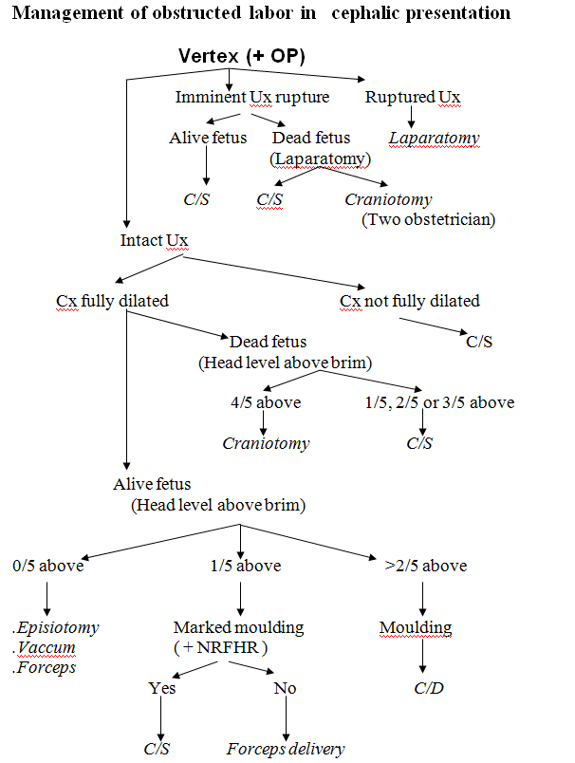

Slide 73
Postoperative care and follow up
Intensive resuscitation and monitoring should be continued till condition improves
  Blood transfusion
  Antibiotics IV till fever free for 2-3 days
  Investigation including blood and urine culture and sensitivity as indicated
  Analgesics including pethidine
  Breast care for those with stillbirths or neonatal deaths
  Close monitoring to identify complications early (e.g., abscess)

Slide 74
,
Explain condition and counsel on future pregnancy
  Repaired uterine rupture without tubal ligation or CS: always hospital
Delivery
  Total or sub-hysterectomy or tubal ligation: infertility
  Severe postpartum infection: possibility of ectopic pregnancy in future pregnancy and need for early check up if pregnant; infertility
  Fistula care and follow-up: Women with fistula are kept in the hospital until infection is controlled.
  They should be explained about when and where they can have the fistula repair. Usually, the fistula repair is undertaken 2-3 months after delivery.

Slide 75
Follow up schedule of women with OL after discharge depends on the type of complications, operative procedure and residence of the patient.
It is advisable to keep patients till infection and acute conditions are well controlled, especially in women coming from rural and distant areas.
Besides the basic postpartum care, the follow up care focuses on the specific complication sustained after OL.

Slide 76
Complications
Maternal and neonatal mortalities and morbidities are greatly increased in OL due to complications arising from prolonged labor, mechanical effects of the obstruction or/ and operative interventions.
Maternal complications
    Infection (sepsis, abscess and peritonitis) and septic shock leading to various organ failure (temporary or permanent)
    Hemorrhage (APH, PPH)– shock and anemia
    Urinary or/ and rectal fistula: more common in nullipara mainly due to pressure necrosis of the vaginal wall entrapped between the fetal head and bony pelvis. Some are due to operative complications used to relieve the obstruction (e.g. bladder injury during CS or craniotomy).

Slide 77
Ruptured uterus: more common in multipara
Nerve injury: e.g., drop foot(sciatic and/ or common perineal nerve palsy)
Infertility following postpartum PID or hysterectomy
Psychological trauma due to the painful labor experience, loss of the baby, fistula and social isolation
Fetal loss and maternal death

Slide 78
Fetal complications
    Cerebral birth trauma
    Asphyxia
    Early neonatal infection
    Congenital pneumonia
    Seizure disorder ± neurological deficit
    Mental retardation

Slide 79
PREVENTION
Obstructed labor is preventable!!
Good obstetric service including universal ANC
Risk assessment: bony deformity, big baby, malpresentation, malposition, pelvic assessment antenatally for selected patients
Careful assessment of labor progress with Partograph (early recognition of CPD)
Good nutritional supply since childhood
Avoid early marriage
Promote family planning services
Maternal waiting area (MWA) for high risk mothers in remote area
Elective caesarean delivery when indicated

Slide 80
Group Assignment with presentation
Feto-Pelvic Disproportion
Cephalopelvic Disproportion(CPD)

Slide 81
References
Obstetrics ,Normal and problem pregnancies, Fifth edition. Steven G Gabe,2002
Williams obstetrics,24rd edition .
UpTo Date- 21.6

Slide 82
Thank You!!!

