Slide 1

DMU
HEALTH SCIENCE COLLEGE
DEPARTMENT OF MIDWIFERY
LABOR AND DELIVERY FOR 2nd YEAR REGULAR BSC MIDWIFERY STUDENTS
By :Misganaw Fikrie(BSC , MSC in Clinical M/W)

Slide 2
Outline
Shock and AFE
Shoulder dystocia
Cord prolapse and Uterine rupture
Preeclampsia and Eclampsia
Instrumental delivery
V-BAC

Slide 3
Hemorrhagic shock
Shock is a state in which the circulatory system fails to maintain adequate perfusion to sustain the physiologic needs of organ tissues leading to malfunction of total cellular metabolism.
It is an immediate life-threatening condition that needs prompt recognition and intensive treatment.
Hemorrhage is one of the five major common causes of maternal deaths in Ethiopia. It accounts for about 25% of the deaths.

Slide 4
Shock…
Diagnosis of shock
  Fast (PR > 110 per minute), weak pulse
  Low blood pressure (systolic BP less than 90 mm Hg)
Other symptoms and signs of shock include:
  Sweating or cold clammy skin
  Rapid breathing (rate (RR) more than 30 per minute or more)
  Anxiousness, confusion or unconsciousness
  Pallor of conjunctiva, palms or mouth
  Scanty urine output(less than 30 ml per hour)
  Delayed capillary refill

Slide 5
The stages of shock
Three stages
STAGE I(compensated or nonprogressive)
  Heart beats fast
  Slight vascular constriction throughout the body
  Renal retention of fluids
  All this serves to maximize blood flow to the most important organs and systems
  Symptoms are few and treatment can completely halt any progression

Slide 6
Shock…
STAGE II (decompensate or progressive)
  Compensation methods begin to fail
  Systems of the body are unable to improve perfusion any longer
  The patient is symptomatic
  Oxygen deprivation in brain:- confusion, disorientation
  With quick and appropriate Rx it can be reversed

Slide 7
Shock…
STAGE III (irreversible)
  the heart’s functioning continues to spiral downward and the kidneys usually shut down completely
  Cells in organs and tissues throughout the body are injured and dying.
  It’s end point is DEATH.

Slide 8
Methods of estimating blood loss
1) Visual estimation:
  inacurrate unless providers are trained
  underestimates PPH by 30-50%
  2) The collection drip method
  Simple and more accurate
3) Estimation with clinical symptoms
4) other methods

Slide 9
MANAGEMENT PRINCIPLES OF OBSTETRIC HEMORRHAGE
ABC of life
Drugs
Maintaining core circulation :- use of NASG
Blocking or removing source of bleeding (Managing the cause)

Slide 10
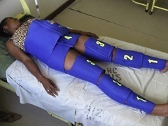
NASG (Non-pneumatic anti shock Garment)

Slide 11
NASG…
Light weight (1.5kg)
Inexpensive ($57)
Washable neoprene suit composed of articulated horizontal segments
Reusable (40-50X)
Applies 20-40 mmHg circumferential counter pressure to the lower body to reverse hypovolumic shock by shunting blood to the vital core organs

Slide 12
NASG…
With proper monitoring, NASG can be used safely and comfortably for 24-48 hrs
Doesn't affect microcirculation
No report of limb ischemia
It can be easily packed into a bag for storage

Slide 13
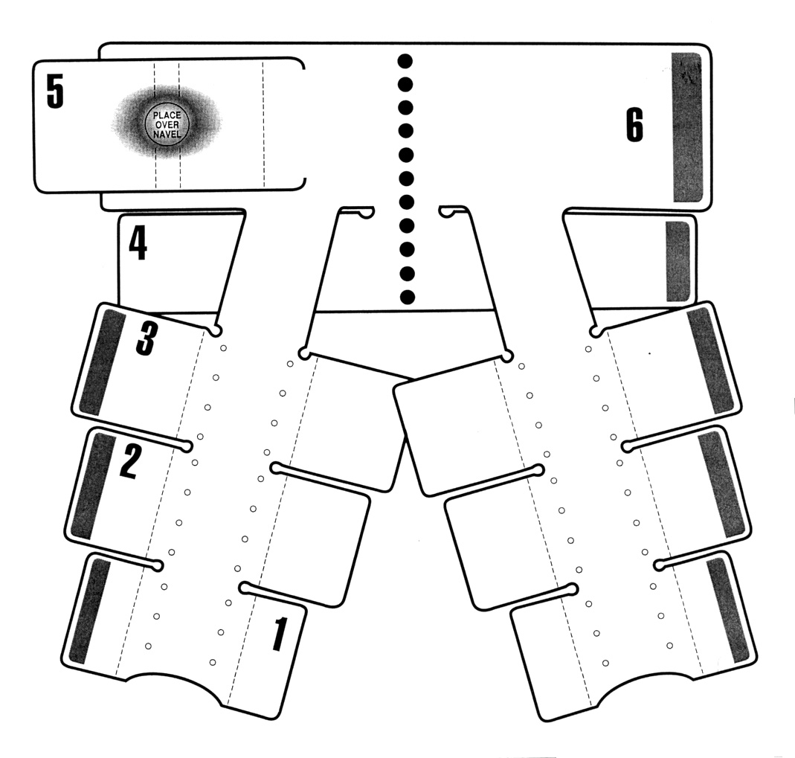
Developed by Dr. Ralph Pelligra, MD, NASA, Ames Research

Slide 14
History of NASG
In 1903, George Crile developed the first hypovolumic compression suit . Temporarily abandoned after the introduction of safe blood transfusion
Reintroduced during WWII, when anti gravity suit (G-suit) was developed to prevent syncope during rapid ascent.
Modified from a full body suit to a half suit, called military/medical anti shock trouser (MASTs) or pneumatic anti shock garments (PASGs)
NASG is developed by Dr. Ralph Pelligra of the NASA in 1971.
In 1991 recognised by US food and drug administration.

Slide 15
NASG…
NASG reverse hypotension by at least three different mechanisms:
By increasing peripheral vascular resistance,
By a tapenade effect on intra-abdominal bleeding and
By auto transfusion of blood from the lower extremities and abdomen to the head and upper trunk.
With the mechanism of auto transfusion, it reduces the potential spaces where haematomas may form and supports the central circulation by redistributing blood to the vital organ systems.
Auto transfusion occurs from the splanchnic bed as well.
Thus, MAST application increases the peripheral resistance and venous return through compression of the inferior vena cava and limb vasculature.

Slide 16
Components of NASG
Valcro fastenings : to tighten
Small foam ball: compress uterus
markings : show how to apply
Compressional suit : 6 segments
  Segment 1: applied to the distal part of the lower leg starting from the ankle
  Segment 2: on the proximal part of lower leg (calf)
  Segment 3 : on thigh (below pubic bone and above knee)
  Segment 4: on area of pubic bone
  Segment 5: over umbilical area
  Segment 6: used to close segment 5

Slide 17
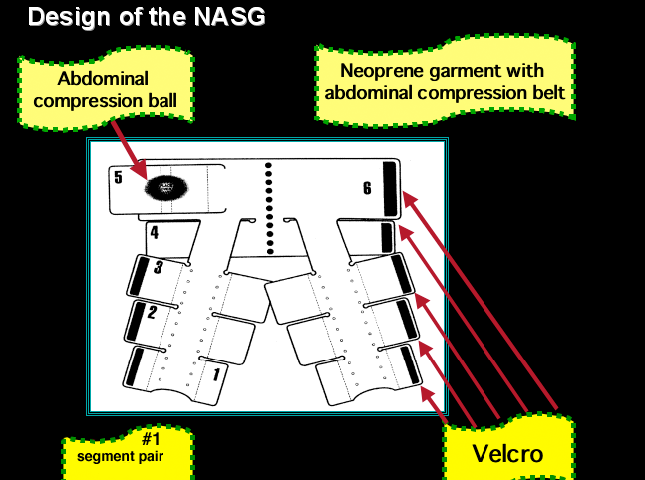

Slide 18
Benefits of NASG
Stabilizes pts while evaluating for causes, transporting and preparing for definitive surgical Rx.
May stop bleeding and prevent surgery
May reduce or prevent blood transfusion and associated problems
Can be applied by any trained HCP

Slide 19
NASG benefit…
Results in translocation of 1.5-2.0 liters of blood from the lower body to the head and chest.
It can be applied by any trained health care personnel
Beneficial in; -Ruptured abdominal aortic aneurysm (AAA)
-Pelvic fracture,
-Anaphylactic shock refractory to standard
therapy
-uncontrollable lower extremity hge

Slide 20
Indications
Initial control of hemorrhage
Shock
  PPH-any cause
  Ectopic Px
  Post CS hemorrhage
  Traumatic hemorrhage below the diaphragm
NB: Sign & symptoms of acute Hge seen with 1L blood loss and 1.5L in normal and abnormal Px respectively.
  Apply the NASG after 750 ml of blood loss, before sign of shock occurs.
Urinary Catheter – placed as soon as possible to monitor UOP

Slide 21
Contraindications
Viable fetus in-utero
Pulmonary edema
Bleeding above the diaphragm
CHF due to MS
  NB: A major cause of morbidity & mortality when using the NASG is premature and inappropriate release of external counter pressure.

Slide 22
Who can apply the NASG?
Doctors
Midwives
Nurses
HEW
Health attendants
Ambulance drivers
Etc.

Slide 23
NASG…
Application can be for
  General application
  Application for short women
  Application for unconscious women

Slide 24
Steps of application
A. General application:
  Step 1:place under the woman, the top of NASG should be at the level of the lower rib
    Starting at ankles close segment #1
    Make sure for tightness –(snap it - sharp sound)
  Step2: close segment #2 on each leg tightly
    Leave women’s knee free
  Step 3: apply segment #3 at thigh
  Step 4: apply segment #4 at pelvic area
  Step 5: apply segment #5 with pressure ball directly over her umbilicus then close the NASG with segment #6
    NB: Only one person must apply pelvic and abdominal segments to avoid too much pressure that compromises the patient’s breathing

Slide 25
NASG…
When you finish
  Make sure the patient can breath normally with the NASG segment #6 in place
  If breathing difficulty or uncomfortable – adjust abdominal panel
  If hot- try a fan, cool breeze, and/or cold compression
  If itchy but stable – remove single leg panel briefly, apply lotion and quickly reapply the panel
  Make sure the NASG stretches, allowing room for your hand to fit between the woman’s abdomen and the NASG

Slide 26
NASG…
B. Application for short women (if very small garment is not available) –fold segment #1
C. Application for unconscious patients
Two people are required but the final segment should be closed using only the strength of one person

Slide 27
Removal of the NASG
Indication for removal
  Intravascular volume re-expanded with blood and saline
  V/S stable, systolic BP > 100 / PR < 100
  Hgb > 7 / Hct > 20%
The NASG should only be removed
  under medical supervision
  When the woman is stable
  According to outlined time
  At hospital level with good facilities (definitive mx of obst. Hge is available)

Slide 28
Steps
  Step 1: Wear glove
  begin removing only when the woman is stable for at least two hrs:
  Bleeding has decreased to less than 50ml/hr
  Hgb >7 /Hct >20 (unless low previously)
  PR < 100 & systolic BP > 100
  The woman is conscious & aware
Step2: wait 15 min for redistribution of blood to occur b/n removing each segments
  Always with the lowest segment and proceed upwards
  Take BP & PR before and after removing each segment

Slide 29
Steps…
Step 3: if PR and BP stable 15min later remove the next segment
Step4 &5: after 15 mins take PR & BP if stable remove the next segment, continue till all parts of the NASG are removed
NB: use rule of 20
  If BP fall by 20mmHg or PR increased by 20 BPM after a segment is removed
    Rapidly replace all segments and consider the need for more saline or blood transfusions and evaluate for source of bleeding and manage according.

Slide 30
Avoiding adverse events in using NASG
Only one person should apply the pelvic and abdominal sections of the NASG
Monitor UOP
Ensure airway protection and aspiration prevention as required
Ensure one to one nursing care throughout
Relative or supporter for unconscious patients
Explain the procedure for the patient when return to consciousness
Never open the abdominal panel first

Slide 31
Performing vaginal procedures with NASG
Its design permits complete perineal access
Obst hge can be treated with garment
The ff vaginal procedures can be performed with NASG
  Repair of episiotomy or vaginal and Cx lacerations
  Manual removal of placenta
  Bimanual compression (external or internal)
  D&C
  D&E
  MVA

Slide 32
Abdominal surgery with the NASG
To obtain hemostasis can be performed with the NASG in place
The abdominal & pelvic panels must be opened,but only immediately before the first incision
Procedures include:
  C/S
  Laparotomy
  Repair of Ux rupture
  Laparoscopy
  Hysterectomy
  Removal of placenta accreta
  Salpingectomy /salpingostomy
  Etc

Slide 33
NASG…
Prepare for surgery be ready to do operation
Step1: Remove only segments #4, #5 & #6
  With the abdominal portion removed, much of the benefit of the NASG is lost , and the patient may go back into shock
Step2:operate quickly
Step3 : replace segments #4, #5 and #6 as soon as the procedure is complete

Slide 34
NASG…
Washing and drying NASG
Wear heavy duty gloves
Prepare 0.05 bleach in a plastic container
Sock the NASG in this solution for 10’
Completely submerge the NASG, you may need to put a brick on it
Wash the garment with cool water & detergent, by hand washing or a machine.
If NASG is hand washed squeeze & air dry it, keep away from plants like grass.
Do not machine dry it
It is best to wash the NASG alone

Slide 35
Storing the NASG
It should be stored where it is visible& easily accessible
Put the folded NASG in to a clear plastic bag so that it is visible , but will not get wet or dusty
If there is more than one NASG in a facility, each NASG location should clearly indicate the others.

Slide 36
NASG…
NB: use of anti shock garment does not avert the necessity for evaluation to identify cause of shock, management of fluid and blood replacement, and appropriate therapy for coagulopathy.

Slide 37
Reading assignment
Amniotic fluid embolism (AFE)
Medical management of shock
CPR

Slide 38
Shoulder Dystocia
  failure of the shoulders to spontaneously traverse the pelvis after delivery of the fetal head
  It occurs in 0.2 to 3 percent of all births and represents an obstetric emergency .
  anticipated only rarely, as many occur in the absence of identifiable risk factors
Most cases can’t be accurately predicted or prevented

Slide 39
Shoulder Dystocia……
Risk factors
Maternal
  obesity
  multiparity
  diabetes
  posterm __ because of ed birth wt
  prior shoulder dystocia _17%
  Macrosomia
  Instrumental midpelvic delivery
  Prolonged 2nd stage

Slide 40
Shoulder Dystocia……
DIAGNOSIS — Shoulder dystocia is a subjective clinical diagnosis.
It should be suspected when the fetal head retracts into the perineum (ie, turtle sign) after expulsion due to reverse traction from the shoulders being impacted in the pelvic inlet.
The diagnosis can be made when the routine practice of gentle, downward traction of the fetal head fails to accomplish delivery of the anterior shoulder.

Slide 41
Shoulder Dystocia……
Maternal consequences
  PPH- atony, laceration
Fetal consequences
   fetal morbidity and mortality
  Brachial plexus injury due to down ward traction on the brachial plexus during delivery of the ant shoulder

Slide 42
Shoulder Dystocia……
MX of shoulder dystocia
  Techniques used to free the ant shoulder from its impacted position
Moderate suprapubic pressure with down ward traction to the fetal head
The MC Roberts maneuver
-hyperflexion of maternal legs upon to the abdomen
Cause straightening of the sacrum relative to the lumbar vertebrae

Slide 43
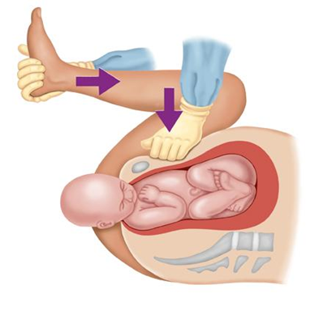
Shoulder Dystocia…

Slide 44
Shoulder dystocia…..
Rotation of the symphysis pubis toward the maternal head
  Decrease In angle of pelvic inclination
  Pelvic rotation cephalad tends to free the impacted ant shoulder
Woods cork screw maneuver
* rotating the post shoulder 180 in a cork screw fashion
* impacted ant shoulder could be released

Slide 45
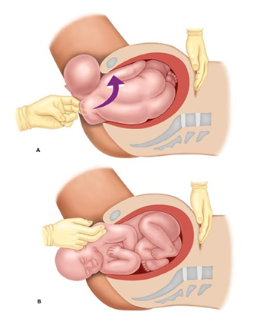
Shoulder dystocia…..

Slide 46
Shoulder dystocia…..
Delivery of the post shoulder
- sweeping the post arm of the fetus across the chest ffed by delivery of the arm
- the shoulder then rotated into one of the oblique ø of the pelvis with delivery of the ant shoulder

Slide 47
Shoulder dystocia…..
5. Rubin
a. The fetal shoulders are rocked from side to side by applying force to the maternal abdomen
b. The pelvic hand pushes accessible fetal shoulder toward the ant. surface of the chest
- results in abduction of both shoulders
- produce smaller shoulder to shoulder diameter

Slide 48
Shoulder dystocia…..
6. Fracture of the clavicle
- by pressing the ant clavicle against the ramus of the pubis
- to free the shoulder impaction
7.Zavanelli maneuver
- cephalic replacement into the pelvis and then c/ delivery

Slide 49
Shoulder dystocia…..
8.Hibbard
pressure applied to the fetal jaw and neck in the direction of the maternal rectum with strong fundal pressure to free the ant shoulder

Slide 50
Shoulder Dystocia…
Other fetal causes of dystocia
  Hydrocephalus
-Enlargement of the fetal abdomen
  distended bladder
  ascites
  enlarged kidneys or liver

Slide 51
Cord prolapse
Cord presentation and prolapse describe a situation in which the umbilical cord is felt anterior to the fetal presenting part on vaginal examination.
If the membranes are intact it is a cord presentation while with ruptured membranes it is identified as a prolapsed cord. As long as the membranes are not ruptured, the risk of compression and asphyxia is low.

Slide 52
Cord prolapse…
Cord prolapse can be overt, being felt inside the cervix, the vagina or even hanging outside the introitus.
“Occult” cord prolapse with the cord anterior to the presenting part in the lower segment but not felt on digital vaginal exam has also been described.
Cord prolapse can occur in vertex and frank breech presentations(0.5%); complete breech (5%); footling breech (15%) and shoulder presentation ( 20%).

Slide 53
Etiology of Cord Prolapse
Malpresentations in labor
PROM
Amniotomy with a high fetal station
Polyhydramnios with sudden membrane rupture
Second twin delivery
Internal podalic version
Cephalopelvic disproportion in labor

Slide 54
Complications of Cord Prolapse
Cord compression and constriction of umbilical vessels due to cold exposure outside the introitus can lead to fetal asphyxia and death.
Partial cord occlusion may give the fetus some time but in complete cord occlusion the fetus can die of asphyxia in 5-7 minutes if cord compression is not immediately relieved.
There is increased maternal risk from cord prolapse because of emergency operative vaginal or abdominal delivery performed in order to salvage the fetus.

Slide 55
Diagnosis of Cord Presentation/Prolapse
Vaginal exam- cord hanging outside the introitus; felt in the vagina or inside the cervix anterior to the presenting part
  Check for pulsation and its rate
  Replace the cord immediately into the vaginal ( not inside the uterus) canal if outside the introitus
If membrane is intact, cord presentation is diagnosed
In all malpresentations, a careful search for cord presentation or prolapse should be made
Occult cord prolapse can only be diagnosed by detection of abnormal fetal heart rate patterns
In cases of malpresentations, sonographic search can also be made for cord anterior to the fetal presentation

Slide 56
Outline of Management of Cord Presentation/Prolapse
Immediate management | Delivery
If cord is pulsating: Put mother in knee-chest position Initiate oxygen administration by face mask 5L/min Insert bladder catheter and infuse the bladder with 0.5L of saline Replace the cord into the vaginal canal ( not into the uterus) Push fetal presenting part upwards via the examining hand in the vagina to relieve compression of the cord by the presentation Prepare for immediate delivery | Non-pulsatile cord: Manage as any other labor as the cord prolapse will not alter the course of labor Pulsatile cord: Second stage of labor: Expedite delivery by forceps delivery if other conditions for forceps delivery are met. Breech extraction if other conditions for breech extraction are met. Internal podalic version with breech extraction if sudden prolapse during delivery of second twin. First stage of labor: Expedited caesarean delivery.

Slide 57
Uterine rupture
Is catastrophic event by which integrity of the uterine wall is breached.
Is life threatening for mother and fetus

Slide 58
Uterine rupture…
Etiology
1.Spontaneous uterine rupture -uterine rupture without any external trauma
2.Traumatic uterine rupture -uterine rupture following iatrogenic or accidental trauma
Presence of scar
1.Rupture of an unscarred uterus
2.Rupture of a scarred uterus – “Uterine Scar Dehiscence”

Slide 59
Uterine rupture…
Extent
1.Complete uterine rupture
rent of myometrium and serosa
the uterus communicates directly with the peritoneal cavity
bleeding will occur within the peritoneum.
2.Incomplete uterine rupture
-rent of myometrium but with intact serosal cover -the rupture does not reach the visceral peritoneum
-bleeding will occur behind the visceral peritoneum

Slide 60
Uterine rupture…
Timing
1.Antepartum uterine rupture- uterine rupture before the onset of labor – usually scar dehiscence
2.Intrapartum uterine rupture- uterine rupture during labor
Anatomic
1.Fundal uterine rupture
2.Lower segment uterine rupture – transverse; vertical
3.Posterior uterine rupture
4.Uterine rupture with vaginal extension

Slide 61
causes
Abnormal labor
1. Obstructed labor
2 .Precipitate labor
3.Uterine hypertonus during oxytocin induction/augmentation
Trauma
1. Car accident; Seat belt injury
2.Fall accident with abdominal trauma
3.Missile injury
4.Domestic violence

Slide 62
Causes…
Iatrogenic
1.External or internal versions
2.Total breech extractions
3.Difficult forceps ( mid) deliveries
4.Difficult embryotomy procedures
5.Abdominal massage by a traditional labor attendant
Uterine scar
Caesarean; myomectomy; metroplasty; previous repaired rupture; previous uterine perforation

Slide 63
Cause…
Spontaneous
-Certain antepartum or intrapartum ruptures occur without any obvious explanations; extremely rare occurrence

Slide 64
Symptom of rupture of uterine
Severe abdominal pain
Symptoms of -hypovolumia -shock -dizziness, -weakness, -sweating, -delirium and coma, etc
In labor- cessation of typical labor pains and replacement with diffuse generalized abdominal pain

Slide 65
Symptoms…
Vaginal bleeding
Cessation of fetal movement
Respiratory difficulty
Fever, chills, rigors
History of previous uterine surgery in some mothers

Slide 66
Sign of uterine rupture
Hypovolumia and shock
Acute cardio respiratory distress
Pallor
Dry mucosal surfaces
Tender abdomen
Easily palpable fetal parts
Fetal distress or death

Slide 67
Signs…
Evidence of fluid in abdomen
Features of obstructed labor on vaginal examination
- Vaginal bleeding -High head
-cervical dilatation is decreased
-Blood concentrated urine (bladder damaged)
  -Offensive vaginal discharge

Slide 68
Management of Uterine Rupture
Resuscitation
Administer oxygen by face mask
Open wide bore IV access
Fluid resuscitation with crystalloids/colloids
Administration of broad spectrum antibiotics
Type and cross match blood for possible transfusion
Catheterize bladder and monitor input-output
Insert NG tube if food ingested recently or labor prolonged for days to avoid aspiration
Administer antacids
Prepare for emergency surgery or refer

Slide 69
Mgt…
Immediate Laparotomy
Type of surgery performed depends on:
- Parity and future fertility needs
-Hemodynamic status and ability to withstand prolonged anesthesia
-Site and extent of rupture
-Presence or absence of overt uterine and intra abdominal infection

Slide 70
Treatment options
1.Total abdominal hysterectomy
-High parity with no future fertility needs - Grossly infected uterus -Gross intra abdominal infection -Posterior uterine rupture -Ragged rupture impossible to repair -Extensive tear difficult to repair

Slide 71
Mgt…
2.Subtotal abdominal hysterectomy
-All the above indications for total hysterectomy but the overall status of the client does not warrant prolonged anesthesia time and the experience of the surgeon makes him/her feel that he can perform subtotal hysterectomy faster than total hysterectomy

Slide 72
Mgt…
3.Repair of rupture with tubal ligation
-All the indications for total hysterectomy present -Tear is simple and repairable -No evidence of gross infection -The status of the patient makes her unable to withstand long anesthesia

Slide 73
Mgt…
4.Repair without tubal ligation
-Very low parity with future fertility needs; -No gross infection - Anterior repairable tear -client informed upon discharge on future delivery care

Slide 74
Complications of Uterine Rupture
Hypovolemic shock
Septic shock
Stillbirth and early neonatal death
Hysterectomy and loss of fertility
Concomitant bladder injury
Post partum anemia
Maternal mortality

Slide 75
Preeclampsia/ Eclampsia
Introduction
Complicates 7-10% of pregnancies
  70% Preeclampsia-eclampsia
  30% Chronic hypertension
Eclampsia 0.05% incidence
20% of Maternal Deaths*
Cause of 10% of Preterm birth*
Etiology unknown
Preeclampsia: raising BP after 20 wks of gestation with protein uria.

Slide 76
Diagnosis
Measure blood pressure in the sitting /left lateral lying position, with the cuff at the level of the heart.
Allow women to sit quietly for 5-10 minutes before measuring the blood pressure
-to avoid “white coat hypertension”

Slide 77
Definitions
Hypertension
diastolic BP of ≥110 mmHg on any occasion
OR
diastolic BP of ≥ 90 mmHg on any two or more
consecutive occasons ≥ 4 h/6h apart
Severe hypertension
diastolic BP of ≥ 120 mmHg on any occasion
OR
diastolic BP of ≥ 110 mmHg on any two or more
consecutive occasons ≥ 4 h/6h apart

Slide 78
Def…
Proteinuria
one 24 h urine collection with a total protein
excretion of > 300 mg/24h
OR
two midstream or catheter specimens of urine
(collected > 4h apart) with + or more on
reagent strip testing

Slide 79
Classification
1. Gestational Hypertension
2 .Preeclampsia
3 .Eclampsia
4 .Chronic Hypertension
5 .Superimposed preeclampsia
6. Atypical preeclmpsia

Slide 80
1. Gestational Hypertension
B/P > 140/90 mmHg for 1st time during pregnancy after 20 wks G.A. or 1st 24 hrs post partum.
  No proteinuia
  Mild HPN & must return with in 6 weeks P.partum
  It is a Dx of exclusion .Final dx made only postpartum. When it resolve
Pregnancy outcome ➔similar to normotensive preg
In general, most cases of gestational hypertension
develop at or beyond 37 weeks’ gestation, and thus,
the overall pregnancy outcome is usually similar to that
seen in women with normotensive pregnancies

Slide 81
2. Preeclampsia
-is a syndrome characterized by the new onset of hypertension and proteinuria after 20 weeks of gestation .
pregnancy specific syndrome of reduced organ perfusion secondary to vasospasm and endothelial activation.
incidence nullipara = 3-7% multipara 0.8-5%

Slide 82
Risk factors for PE
Nulliparity
Obesity
Age <20 or > 35 yrs
Family hx of PE, PE in previous pregnancy.
Multiple gestation
Low socioeconomic status
H. Mole
Poor outcome of previous pregnancy (IUGR, SB ,abruption)

Slide 83
Risk factor…
Pre-existing medical – genetic conditions
    Chr.Htn
    Renal disease
    DM (type I)
Thrombophilia's ( antiphospholipid
syndrome., protein C,S deficiency )

Slide 84
PE…
Mild PE
DBP < 110 mmHg & systolic B/P <160
Proteinuria 1+
No other sign of severity
Severe PE
-Systolic B/P > 160 or DBP > 110 on at least two occasions 6hrs apart with a patient at bed rest
- Proteinuria > 5gm /24hrs or >=+3

Slide 85
SPE…
Oliguria (< 400ml /24hrs)
Pre monitory Sx of eclampsia (Imminent)
- cerebral Visual Disturbance, headache, RUQ or epigastric pain
Thrombocytopenia(Platelet<100,000/mm3)
Pulmonary edema
Deranged LFT or RFT
HELLP syndrome. & DIC
Convulsion (Eclampsia)
IUGR

Slide 86
Etiology & pathogenesis
Etiology – Unknown
- «Disease of theory, » some of theories
Abnormal trophoblast invasion
Immunological maladaptive tolerance
Maternal maladaptation to cardiovascular or inflammatory changes of normal pregnancy
Genetic predisposition

Slide 87
Etio…
Abn. Trophoblast invasion
Defective vascular response to placentation due to inhibition of 2nd wave of endovascular trophoblast →occur often at16 week.
Incomplet trophoblastic invasion
Immunological factors
when formation of blocking Abs to placental antigenic sites impaired
-1st pregnancy, pregnancy in multipara by a new partner

Slide 88
SYSTEMIC ENDOTHELIAL DYSFUNCTION
All of the clinical features of preeclampsia can be explained as maternal responses to generalized endothelial dysfunction
Disturbed endothelial control of vascular tone causes hypertension, increased vascular permeability results in edema and proteinuria, and abnormal endothelial expression of procoagulants leads to coagulopathy.
These changes also cause ischemia of target organs, such as the brain, liver, kidney, and placenta.

Slide 89
Endothelial dysfunction…
Laboratory evidence supporting generalized endothelial dysfunction in preeclamptic women
Decreased production of endothelial-derived vasodilators -nitric oxide and prostacyclin
increased production of vasoconstrictors -endothelins and thromboxanes.
Enhanced vascular reactivity to angiotensin II

Slide 90
SPE management
Objective
Preserve health of mother & fetus
Prevent progression to eclampsia
Delivery of alive, mature fetus
* Once Dx is made definitive Rx is delivery
* Precise Knowledge G.A →Important for Mx.
Management principle
Hospitalization → at time of Dx
Purpose →Evaluate maternal & fetal condition

Slide 91
Hospital mgt…
Maternal follow up
  Weight →on admn. & every other day
  B/P → Q 4 hrly
  Daily clinical Hx →premonitory Sx
  Urine protein →every 48 hrs
Hct, Plc, RFT, LFT, uric Acid, coagulation profile →weekly or 2x/week.
Daily FHR Auscultation & fetal mov’t count
Fetal growth: clinical & U/Sound
Fetal Well being →NST/BPP (2x/week)
Diet: Regular, no salt restriction

Slide 92
Hospital mgt…
All should be delivered if disease develop >34 week G.A or prior to 34 weeks if there is
- Maternal (Fetal) distress
- Labor or Prom
- Severe IUGR
Anticonvulsant →to prevent convulsion
Antihypertensive →To control B/P in safe range
Induction of labor→ Delivery
  Admit to labor & delivery area.
  Anti-convulsant → parenteral route to prevent seizure

Slide 93
Indication to Delivery in PE
>37 wks with if not severity feature
> 34 wks with severe PE
< 34 wks with any of
  maternal or fetal Distress
  Severe IUGR
  HELLP syndrome
  Pulm. Edema
  Deranged LFT/RFT
  Uncontrolled B/P despite Appropriate drugs
Imminent eclampsia (persistent severe symptoms)

Slide 94
Mgt..
Steroid
➔All pts with severe PE < 34 wks
→prevent RDS, treatment of thrombocytopenia
Interapartum care
Maternal – V/S Q 30min
Avoid fluid overload,
input/output every 1 hr.
FHR monitor Q 15min or EFM
Shorten 2nd stage labor – Instrumental delivery
Fluid –125ml/hr, U.O.P > 30ml/hr
Active Mx of 3rd Stage

Slide 95
Eclampsia
Occurrence of seizure or coma in woman with PE that cannot be attributed to other cause
Incidence: 1 in 147 to 1 in 3,448
Twin: 3.6%
S& Sx Disease of young primigravida with > 90% had no ANC

Slide 96
Eclampsia…
Most common last trimester & wide spectrum of Sn & Sx ranging from:
Extremely B/P <-- --> minimal B/P
proteinuria 4+ <-- --> No proteinuria (14%)
G.Edema <-- -->No Edema (26%)
Patellar reflex 4+ <-- --> normal reflex
1st warning sign may be excessive Wt gain

Slide 97
Eclampsia…
Convulsion --> premonitory Sx before convulsions
Antepartum (25%) ,Intra partum (50%) ,Post partum (25%)
Seizure is grandmal (G.Tonic – clonic)
Begine facial twitching →All muscles contract & relax
Duration of coma after convulsoin is variable
Fever > 39⁰c→ V.grave sign (CNS hage)

Slide 98
. Necessary equipments for management of Eclampsia
1.Adult ambubag with mask
2.Airway (spatula)
3.Nasal prong
4.Freeflow oxygen
5.Suction machine
6.Equipments for IV securing
7.Equipments for catheterization
8.Equipments for lab investigation
9.Blanket & pillow
10.Medications

Slide 99
Necessary equ’ts…
-Anticonvulsants .MgSO4
.diazepam
.phenytoin
-Antihypertensives .hydralazine
.aldomate
.nifedipine
-Calcium gluconate
-Antipain
-Antibiotics
11.Gloves .clean
.sterile

Slide 100
Necessary equ’ts…
12.Syringes .20 CC
. 10 CC
.5 CC
13.NG tube .for feeding
.for medication
14.Reflex hammer
15.Documentation forms .Eclampsia form
.V/S sheet
.medication form
16.stop watch
17. V/S equipments

Slide 101
Eclampsia mgt…
Objective 1. Control of convulsion
2.Anti hypertensive to control B/P
3. Delivery once patient is stable
General Measures
Patient should not be left alone
Prevent maternal injury during convulsion
Mouth gug (padded tounge blade --> preventt tounge bite & air way obstruction)
Avoid risk of Aspiration --> LL position, clear airway
--> Chest auscultation

Slide 102
Eclampsia mgt…
prophylactive antibiotics
Maintain adequate 02
Give anticonvulsant (Mg so4) to control convulsions
Monitor B/P Q 15 min & watch for fluid over load
Monitor input & output
Spectrum Mx
Anti hypertensive (Lower DBP< 110mmHg)
Anti convulsant
Fluid therapy 60-150ml 1hr 5% D/N/S unless extr fluid loss
Delivery →after stabilization
    Labor start spontaneously in most cases
    Oxytocin induction if no C/I
    C/S →obstetric reason

Slide 103
DDX
All pregnant women & convulsion should be considered Eclampsia till other cause R/O
Epilepsy
encephalitis,
meningitis
Cerebral malaria
cerebral tumor
Hypertensive encephalopathy

Slide 104
Chronic Hypertension
-BP 140/90 mm Hg before pregnancy or diagnosed before 20 weeks' gestation or Hypertension first diagnosed after 20 weeks' gestation and persistent after 12 weeks' postpartum
-Other factor that may be suggestive of Chronic HPN.
  Retinal change →fundoscopy
  Cardiac -ECG
  Associated renal dis. Or medical illness
  Multiparty with previous Hx of HPN

Slide 105
superimposed Upon Chronic Hypertension
Hypertension and no proteinuria < 20 weeks:
New-onset proteinuria after 20 weeks
Hypertension and proteinuria < 20 weeks:
Sudden increase in proteinuria
Sudden increase in BP in women whose hypertension was well controlled
Thrombocytopenia (platelet count <100,000 cells/mm3)
Increase in ALT or AST to abnormal levels

Slide 106
Atypical eclampsia
is the occurrence of eclampsia before the 24th week of gestation and after the 7th day post partum. The risk of seizure decreases dramatically after 48 hours post delivery.
Other causes of seizure need to be ruled out by all diagnostic means available before atypical eclampsia is diagnosed.
Eclampsia is derived from the Greek word “eclampien” meaning “lightening” indicating the sudden and disturbing nature of the presentation (seizure) to the mothers’ relatives in a woman who was apparently healthy with no significant symptoms of illness and was expecting a normal delivery
Early detection of preeclampsia and appropriate management with seizure prophylaxis reduces the risk of eclampsia significantly

Slide 107
Take home
Hypertensive disorder of pregnancy is major cause of maternal death
Cause not clearly known: disease of theories
Pathophysiology is generalized vasospasm resulting in multi organ failure
Once Dx is made definitive Rx is delivery
Salt restriction has no role
Diuretics are indicated in case of pulmonary edema or cardiac failure.

Slide 108
Reading Assignment
Drug managements of preeclampsia/Eclampsia

Slide 109
Instrumental Delivery
Forceps
- is an instrument designed to assist with delivery of the baby’s head.
Have two matched parts that articulate or lock
Each part contain:
1. blade
2. shank
3. Lock
4. Handle

Slide 110
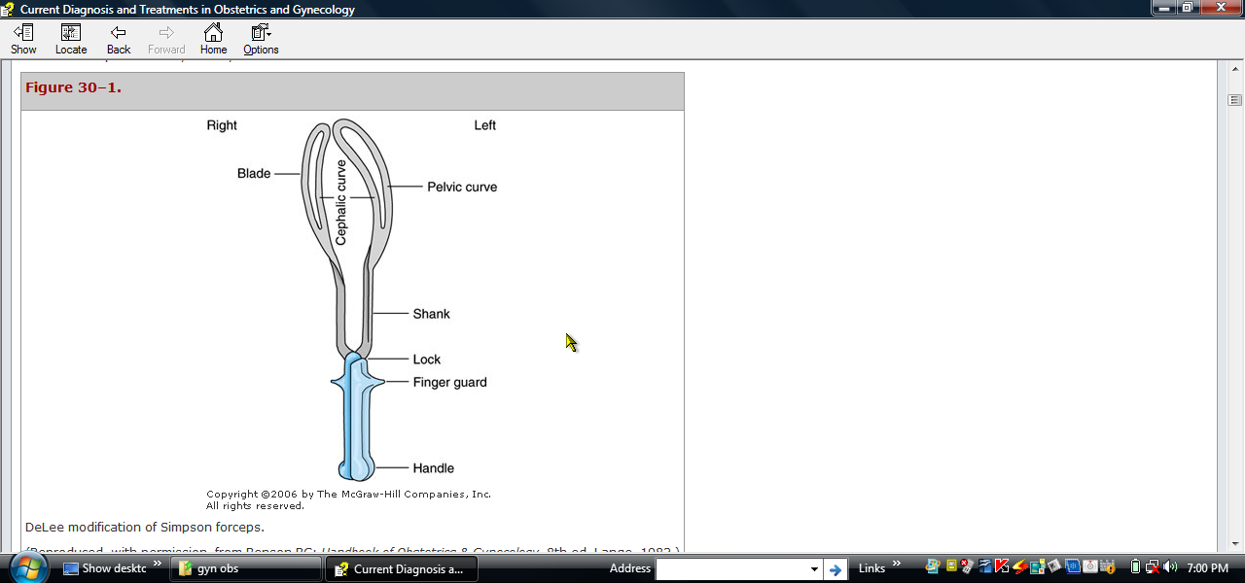
Forceps…

Slide 111
Forceps…
Each blade has two curves
A. Cephalic
B. pelvic
The tip of each blade called toe
Functions of forceps
1) Traction
2) Compression effects
This is minimal effect to grasp skull
3) Rotation of the head
4) Protective cage
When applied on premature baby, it protects from pressure of birth canal

Slide 112
Indications
Non reassuring fetal heart rate pattern
For purpose of shortening of second stage of labor
Prolonged second stage of labor or dystocia
Maternal exhaustion
Inadequate maternal expulsive efforts
Delivery of after coming head in breech presentation

Slide 113
Prerequisite
Complete cervical dilation
Membrane rupture
Vertex presentation or by face with chin anterior
Head engaged
Empty bladder
No evidence of CPD
Adequate analgesia
C\S capability
Experienced operator
Baby should be alive
BUT FIRST OF ALL NEED CONCET OF THE mother

Slide 114
(Before forceps application )
Documentation: -
  All instrumental deliveries should be dictated in medical record as any surgical procedure & it should include:
  Consent of the patient,
  indication for operation,
  anesthesia,
  personnel involved,
  type of instrument,
  At the end resulting maternal & fetal complications or injuries and blood loss.

Slide 115
Before application…
Anesthesia:-
Catheterization:-
Internal examination: -
  To asses the state of cervix & membranes, presentation & position
Episiotomy: -
  If needed during traction when the perineum bulges.

Slide 116
APPLICATION
Forceps — Appropriately applied forceps grasp the occiput anterior (OA) fetal head such that:
The long axis of the blades corresponds to the occipitomental diameter
The tips of the blades lie over the cheeks
The blades are equidistant from the Saggital suture,
Saggital suture lies in the midline of the shanks
No maternal tissue has been grasped.

Slide 117
Complications / Dangers
Complications/dangers of forceps delivery: - are mostly due to faulty technique rather than the instrument.
Maternal-
  Injury-.
    Extension of the episiotomy involving anus & rectum.
    Vaginal lacerations and cervical tear if cervix was not fully dilated.
  Post partum hemorrhage –.
    Due to trauma, Atonic uterus

Slide 118
Complication…
  Shock
    Due to blood loss, dehydration or prolonged labor.
  Sepsis
    Due to improper asepsis
  Delayed or long-term sequel
    Chronic low backache,
    genital prolapsed &
    incontinence.

Slide 119
Complication…
Fetal
  Trauma-
    Intracranial hemorrhage.
    Cephalic hematoma.
    Facial nerve injury.
    Injury to the soft tissues of face & forehead.
    Skull fracture.
  Fetal death-around 2%.

Slide 120
Prophylactic/Elective forceps
Refers to outlet forceps delivery, only to shorten the second stage of labor to prevent anticipated maternal or fetal complications in:
Eclampsia
Heart disease
Previous c.s.
Post maturity
Low birth wt babies

Slide 121
Reading Assignment
Types of forceps???

Slide 122
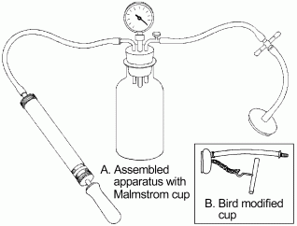
Vacuum Extractor Assisted Delivery

Slide 123
Application
check should be undertaken prior to application and traction to fetal head
Cup directly over the Saggital suture at approximately 3cm anterior to posterior fontanel.
No maternal tissue should be included under the cup

Slide 124
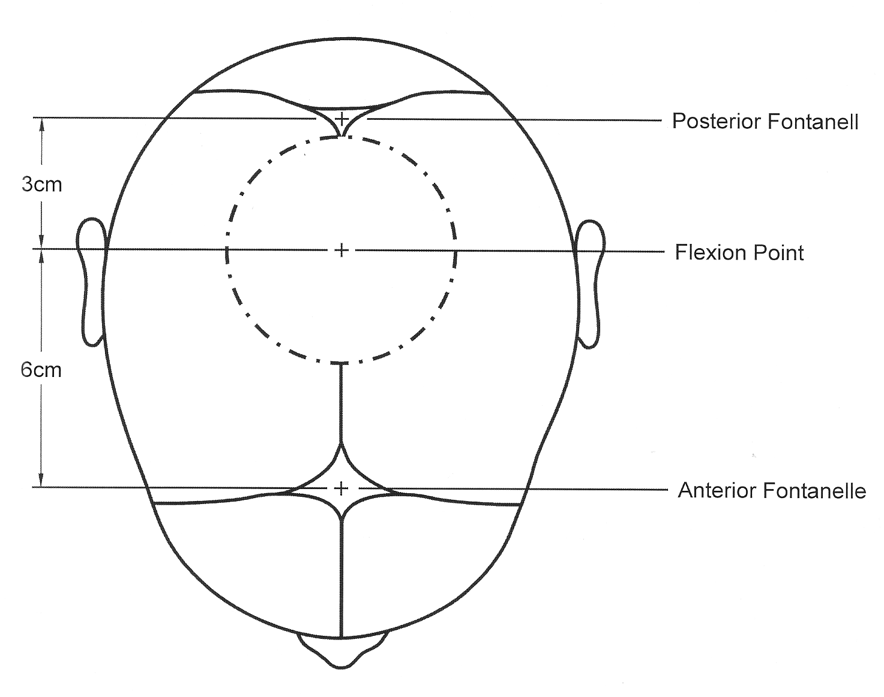
Courtesy of Aldo Vacca, M.D.

Slide 125
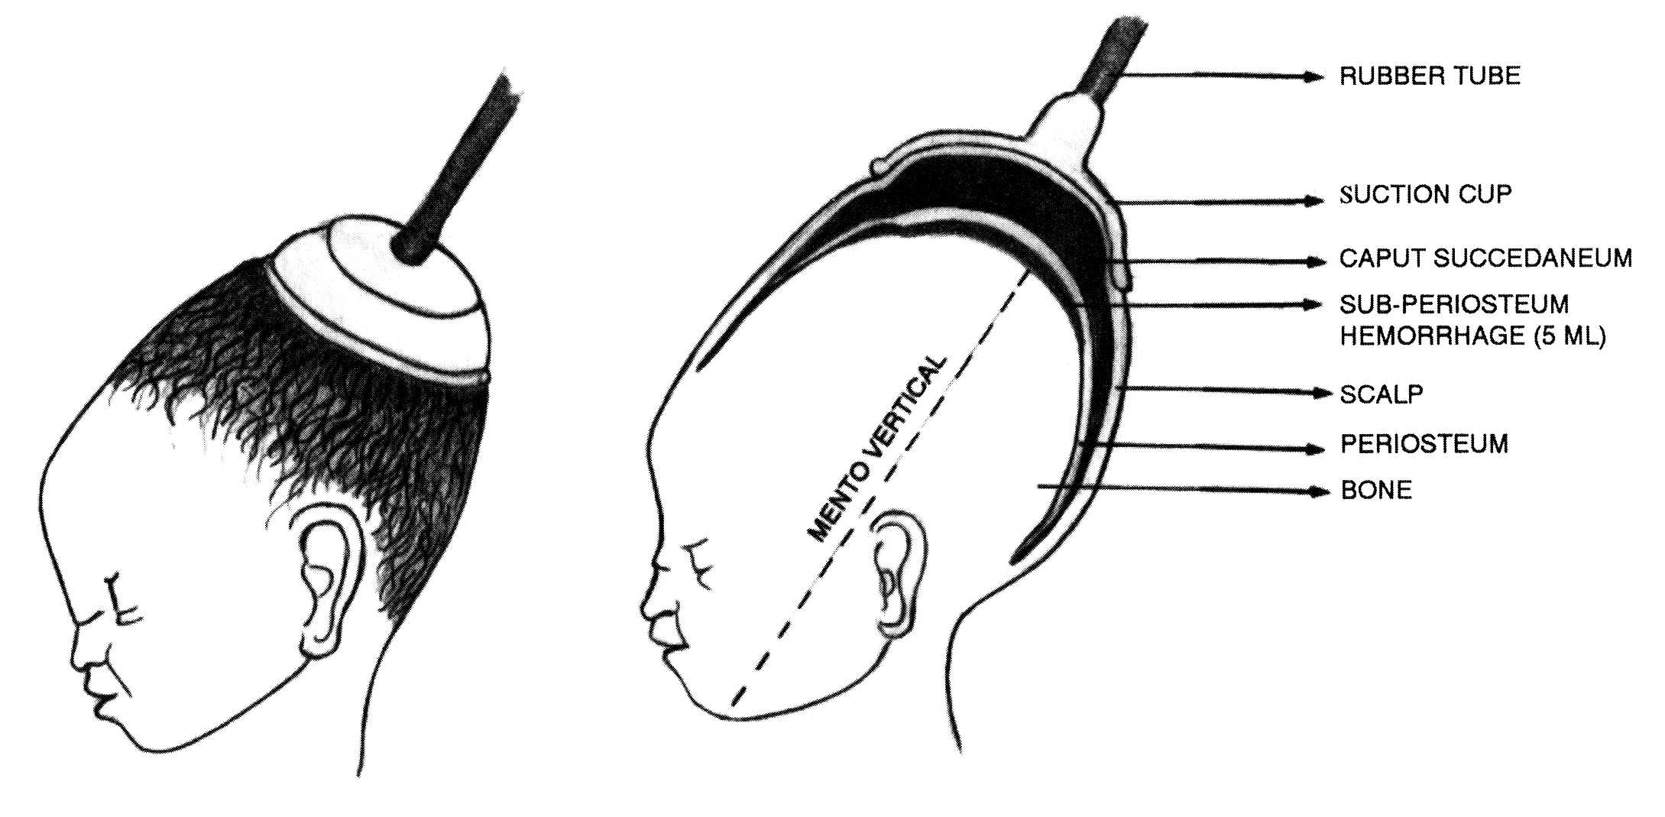
Application
Clinical and Technical Principles

Slide 126
Indication of vacuum application:-
Almost the similar except for after coming head in breech & premature baby
1)Maternal Indications:-
Maternal physical distress
Pt.. With cardiac disease/ hypertension
2)Obstetric indications:-
Delay second stage of labor
Prolonged labor
Mal rotation of fetal head
Delivery of second child in twins.

Slide 127
Indication…
(3) Fetal indications: -
  Fetal distress in second stage when prospect of vaginal delivery is safe: -
    Abnormal heart rate pattern
    Passage of meconium
  Cord prolapse in second stage
  Post maturity

Slide 128
Effectiveness
Vacuum failure rates~ 10%
Metal cups have slightly higher success rates than plastic cups, but also higher rates of adverse outcomes
Greater failure rate of vacuum versus forceps when the position was posterior and elastic cup was used.
Inadequate strength & frequency of contractions
Factors determining effectiveness of vacuum:-
Cup design, size, shape, traction site attachment, strength of maternal effort &coordination with traction
Fetal size , CPD, station
Techniques of traction

Slide 129
Contraindications
CPD
Moderate or severe caput
Prematurity
Breech, footling, face, brow, shoulder, or transverse presentation
Unengaged vertex
Estimated fetal weight less than 2kg or greater than4kg.
Congenital anomalies (hydrocephalus )
Recent scalp blood sample

Slide 130
Delivery using ventouse: contd…
Prerequisites
  Vertex presentation with fetal position identified
  Fully dilated cervix
  Engaged head:
  Ruptured membranes
  Term fetus
  Alive fetus
Preparation
  Empty bladder
  Local anesthesia infiltration for episiotomy
  Assembled and tested vacuum extractor

Slide 131
Vacuum extraction techniques
The pressure is slowly raised 0.1 kg/cm/min. until it reaches 0.8 kg/cm.
Adequate preasure is ranged from 0.2kg/cm-0.8kg/cm
The Total time taken should be about 8 minutes.

Slide 132
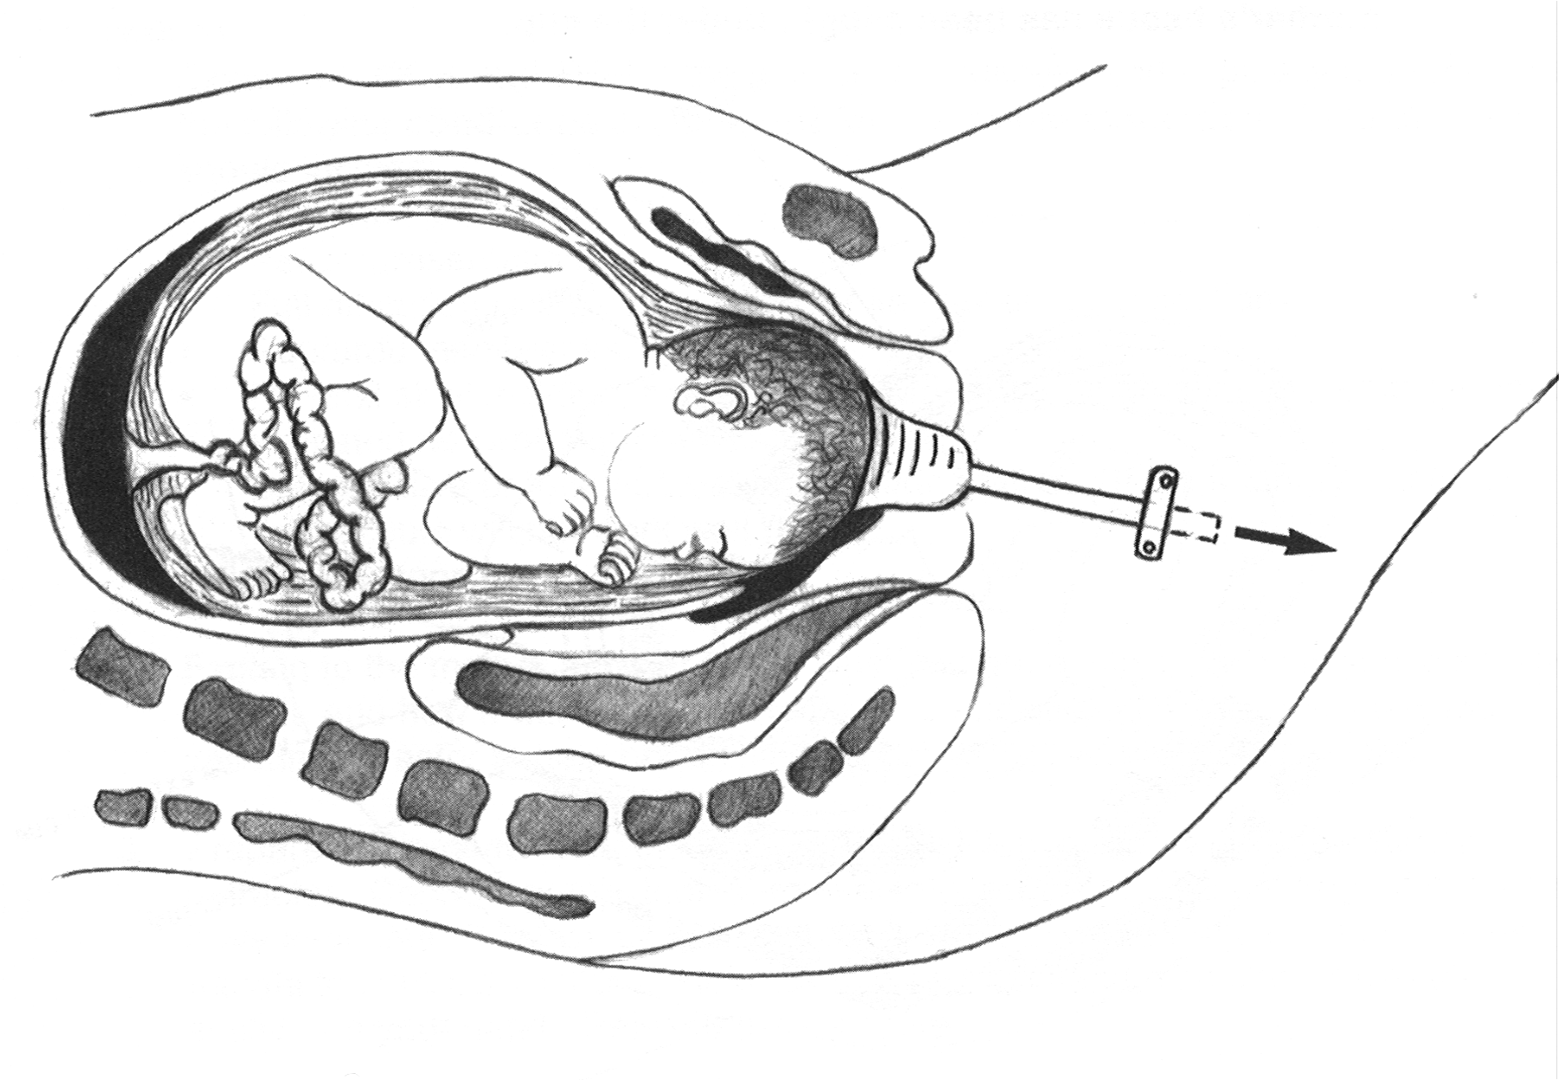
Delivery using ventouse:
Pulling Downward

Slide 133
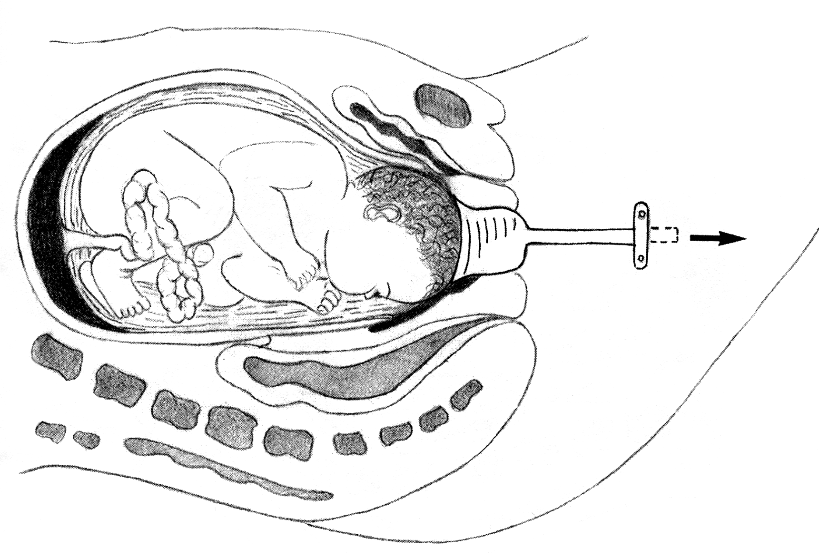
Delivery using ventouse:
Pulling Horizontal

Slide 134
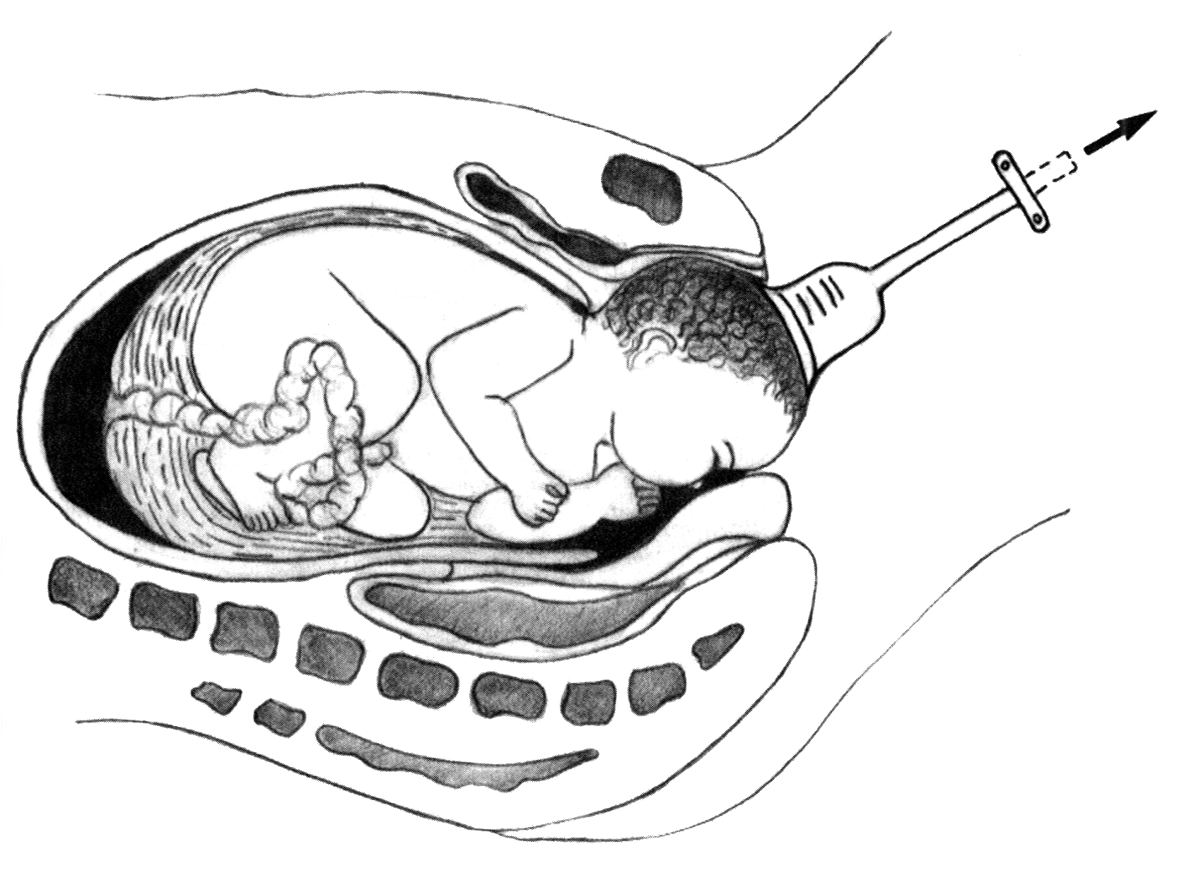
Delivery using ventouse:
Pulling Straight Up

Slide 135
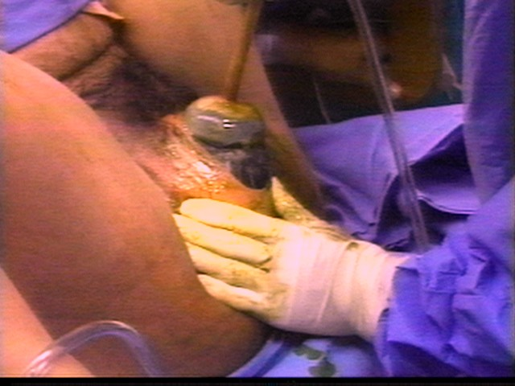
Delivery using ventouse:
Crowning

Slide 136
Delivery using ventouse:
FAILURE
Vacuum extraction failed if:
  The head does not advance with each pull;
  The fetus is undelivered after three pulls with no descent,
  The cup slips off the head twice at the proper direction of pull with a maximum negative pressure.
Every application should be considered a trial of vacuum extraction.

Slide 137
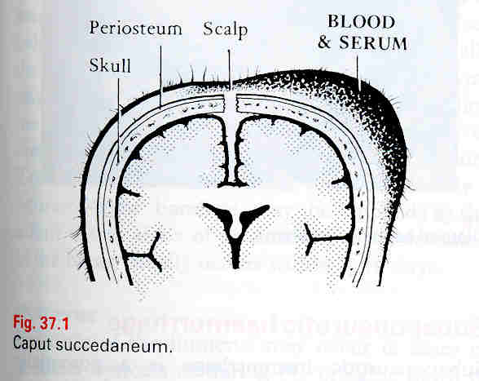
Complications
Caput
Results from pressure applied to fetal scalp from:
artificial Caput occurs at vacuum cup application site; also called chignon
Resolves spontaneously in a few days
Scalp aberration
Cephalic hematoma
Intracranial damage

Slide 138
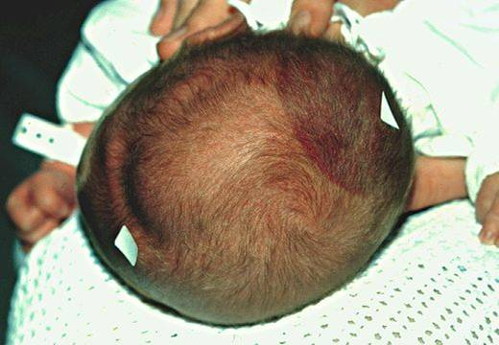
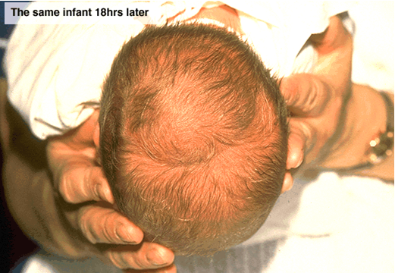
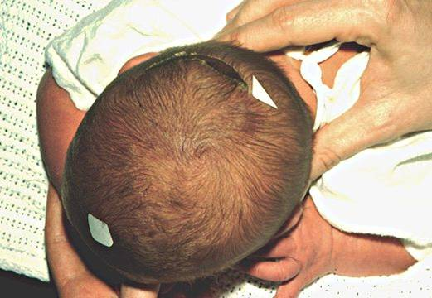
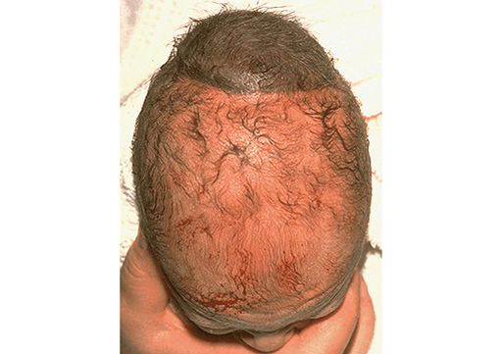
Cephalohematoma
Cup mark
Scalp abrasion
Dark chignon
Courtesy of Ross McQuivey, MD

Slide 139
Complications of Vacuum delivery:-
Maternal complications :-
Vaginal lacerations & hemorrhage.
Annular detachment of cx.
V.V.F. is also reported.

Slide 140
Advantages of Vacuum Compared to Forceps
Fewer reproductive tract injuries
Allows autorotation of fetal head
Less maternal discomfort during & after delivery
Less anesthesia is necessary
Less maternal blood loss
Easier to learn
Appropriate for midwifery management

Slide 141
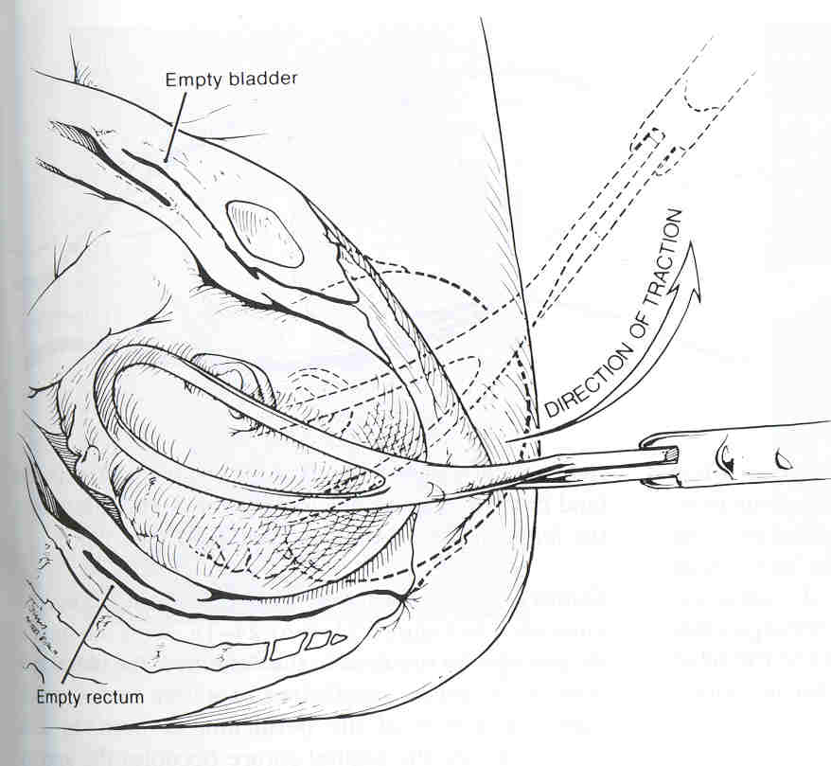
Advantages of Forceps Compared to Vacuum
minimal contractions are needed
Easier to apply with caput
Used with breech presentation
Pre-term use less controversial
Rotation of fetal head accepted practice
unlikely to detach from the head

Slide 142
V-BAC
A trial of labor and vaginal birth in a woman with a previous caesarean section
Prior to the introduction of VBAC, there was a policy of “ Once a caesarean; always a caesarean”
In nearly 35% of caesarean deliveries globally, a previous caesarean section contributes to the decision to the caesarean delivery
VBAC plays a key role in reducing the incidence of caesarean sections
VBAC has a 60-80% success of vaginal delivery

Slide 143
Advantages and Risks
Advantages
  Reduction of cost and complications of a caesarean
  Maternal satisfaction because of a vaginal delivery
Risks
  Scar dehiscence and uterine rupture - < 2% in cases of a previous lower segment caesarean section
  Failure and progressing to caesarean after labor
  Fetal distress and demise in cases of dehiscence and rupture

Slide 144
Prerequisites – vary in different protocols
In Ethiopia
  Only one previous transverse lower segment caesarean
  Singleton, vertex, less than 4 kg estimated weight
  Adequate pelvic capacity; no pelvic contraction
  Spontaneous labor onset; no oxytocin use
  No other significant obstetric complications e.g. post term, APH, IUGR, preeclampsia etc
  No documented fetal distress
  Conducted in a facility equipped and staffed for conducting a caesarean

Slide 145
Conduct of VBAC
In a facility equipped for major surgery
Obtain maternal informed consent for VBAC after detailed explanations of benefits and risks
Careful monitoring ( every 15 minutes)- fetal heart beat; maternal vital signs; vaginal bleeding, unusual abdominal pain; lower abdominal tenderness
Continuous electronic monitoring whenever available
Avoid oxytocin use
Partographic monitoring of labor
‘One to one’ labor monitoring
Intervene if labor progress is abnormal
Make sure that blood is typed and facilities for cross match and transfusion are readily available

Slide 146
Diagnosis of Scar Dehiscence
Signs of scar dehiscence
  Fetal heart rate abnormalities
  Vaginal bleeding
  Lower abdominal tenderness
  Unusual lower abdominal pain
  Maternal vital signs derangement
    Tachycardia; hypotension
  Detection of dehiscence by uterine exploration after delivery

Slide 147
Towards a safe motherhood
Thank you

