Slide 1
Medial Parasitology II
Notes:
Biological feature of parasite
Relation b/n human and parasite
Prevention and treatment

Slide 2
What is medical parasitology?
Phylum Sarcomastigophora
    Amoeba
    Flagellates
Phylum Apicomplexa
Phylum Microsporodia
Phylum Ciliophora
Medical
Protozoology
Human/medical Parasitology
Medical
Helminthology
Class Nematoda
Class Trematoda
Class Cestoda
Medical
Arthropodology
Class Insecta
Class Arachnida
Class Crustacea
Class Chilopoda

Slide 3
Parasites are our problems
Six major tropical diseases to which WHO pays great attention include:
    Malaria,
    Schistosomiasis,
    Filariasis,
    Leishmaniasis,
    Trypanosomiasis and
    Leprosy.
Five of them are parasitic diseases except leprosy.
All the above diseases are prevalent in Ethiopia

Slide 4
Symbiosis
Any association more or less permanent is called a symbiosis, with each member a symbiont.
Two different organisms live together and interact,
one partner lives in or on another one’s body.
  3 types:
    Mutualism
    Commensalism
    Parasitism

Slide 5
Mutualism
  Permanent association between two different organisms that life apart is impossible,
  Two partners benefit each other,
  The mutuals are metabolically dependent on one another;
  One cannot survive in the absence of the other.
  Eg. association between certain species of flagellated protozoa(Trichonympha) living in the guts of termites

Slide 6
Commensalism
  Association of two different organisms
  One partner is benefited while the other neither benefited nor injured, such as E. Coli and man.
Parasitism
  Association of two different organisms
  One partner is benefited while the other is injured, such as most pathogenic parasites and man.

Slide 7
Symbiosis
severe
To one
Parasitism
Unilateral benefit
benefit
harm
Commensalism, shelter & food
Mutualism
reciprocal benefit
none
both
partial
complete
dependency

Slide 8
Parasite and types of parasites
Parasite:-
are organisms that live in or on the body of another living being (host) and obtain shelter and nourishment from it.
parasites spend all or parts of their life with host.
In parasitism, parasite is the benefited partner.
In another words
  A small organism (Parasite) has the potential to harm a larger organism (Host), and relies on said host for nutrients and shelter (a Niche).
  The parasite generally has a much higher reproductive capability compared to its host.

Slide 9
Parasites can be
endoparasite
ectoparasite
temporary parasite
permanent parasite
obligatory parasite
facultative parasite
pathogenic parasite
opportunistic parasite………
Read their difference and similarity???

Slide 10
Hosts and types of hosts
Host: Hosts are organisms which harbors the
parasite.
      In parasitism, it is the injured partner
Types of Hosts
    Definitive host
    Intermediate host
  What about other type of host??

Slide 11
Definitive host:-
  What characterizes the primary host?
    Where sexual reproduction takes place.
    Normally where the adult parasites live.
    Normally the larger of the hosts, usually a vertebrate.
    Convention - (parasites which only reproduce asexually)
    Only one or a few can act as a definitive host

Slide 12
Intermediate host:-
      Asexual multiplication takes place
      may harbor many immature stages of a parasite;
      e.g., Cercaria, Redia and Sporocysts which are all immature stages of Fasciola in the snail intermediate host.
    Some parasites:
      require more than one intermediate host which are then designated as first, second intermediate,

Slide 13
INTRODUCTION TO MEDICAL PROTOZOLOGY

Slide 14
Lecture outcomes
Identify the general characteristics of protozoans
Describe the general morphology and cellular organization of parasitic protozoa
Describe the locomotory and reproduction system of protozoa
Explain the feeding, metabolism, and excretion in parasitic protozoa.
Describe the classification of parasitic protozoa
Describe the general characteristics of the five main groups and any sub-groups of the parasitic protozoa

Slide 15
What are Protozoa?
Protozoa means
proto = first
zoa = animals
Is single-celled eukaryotic organisms
Belongs to kingdom Protista
Vary in size (1-200 micro meter).

Slide 16
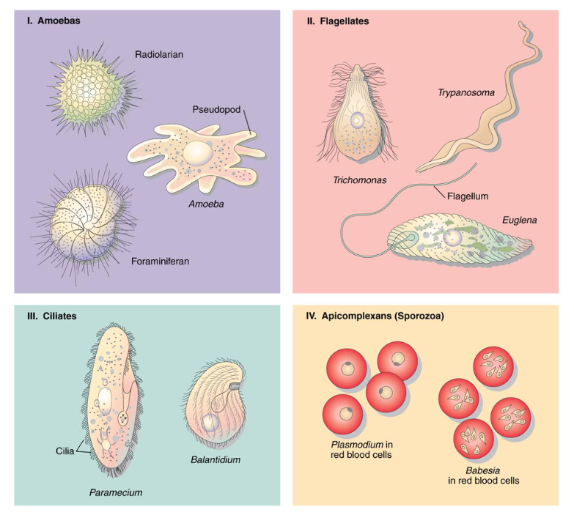
Protozoan diversity
protozoa are extremely diverse
organisms and found in a variety of
niches
>200,000 named species
Most species are free-living in
  Freshwater
  marine environments
  decaying organic matter and soil
Some are beneficial to mankind by:
  being part of the food chain
  serving as experimental subjects.

Slide 17
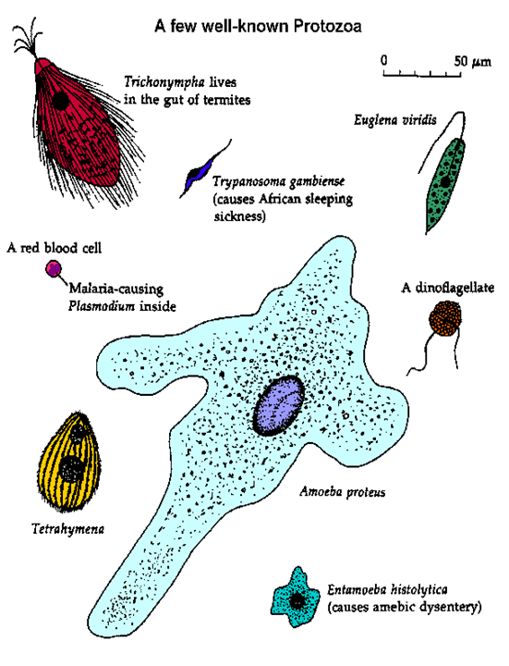
Protozoan Diversity
Few are adapted to a parasitic life but all plant and animal species have at least one protozoan parasite
~10,000 are parasites in a wide range of hosts
    Vertebrate
    invertebrate
    Plants
~20 human pathogens
  Adapted to life in a wide range of sites within the host

Slide 18
Ecological Niches in the Human Body:
  Skin: Leishmania
  Eye: Acanthamoeba
  Mouth: Amoebae and flagellates (usually non-pathogenic)
  Gut: Giardia, Entamoeba (and invasion to liver), Cryptosporidium, Isospora, Balantidium
  Genito urinary tract: Trichomonas
  Bloodstream: Plasmodium, Trypanosoma
  Spleen: Leishmania
  Liver: Leishmania, Entamoeba
  Muscle: Trypanosoma cruzi
  CNS: Trypanosoma, Naegleria, Toxoplasma, Plasmodium

Slide 19
Importance of protozoa
Medical importance
  Cause of more sickness and death, than any other disease-causing organisms
  reduced working capacity
  Loss of productivity
Veterinary importance
  Loss of productivity
  Death
  reduced meat and milk production,
  reduced reproductive potential
  reduced working capacity
  Potential losses

Slide 20
General morphology
Protozoa exhibit a wide variety of morphologies
Size: range from 1 to 150um
  The smaller members, 1-10um
    include most of the intracellular parasites
    e.g: Leishmania,Toxoplasma)
  The largest member is the ciliate
  e.g: Balantidium coli
Shape:
  No single shape that represent all
  Ranges from amorphous shapeless amoeba to relatively rigid forms

Slide 21
Structure
Protozoa have relatively complex and specialized internal structure which perform:
  The functions of locomotion, metabolism, and reproduction.
  The same physiological functions performed by many cells in a more complex organism. These are

Slide 22
Cell membrane
Thin membrane called plasma lemma
Also called pellicle (ciliates) or ectoderm or outer membrane
Microtubules line outer membrane (subpellicular microtubules
Cytoplasm
Ectoplasm= outer transparent layer
  Locomotion,
  protection
  Sensation,
  Excretion Ingestion of food etc
Endoplasm= inner granular layer
  Nutrition
  Reproduction etc

Slide 23
Nucleus
Two morphologically distinct nuclei:
  Vesicular
    with a clearly defined internal space
    scattered chromatin,
    Karyosome
      nucleoli-like body
      contains DNA in apicomplexans
      but lacks DNA in parasitic amoebas
    Most protozoa of humans exhibit the vesicular type.
  Compact
    appears to be a solid mass
    densely packed chromatin

Slide 24
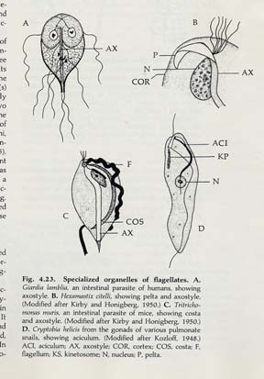
Other structure
Axostyle:
  Supporting structure embedded along the longitudinal axis on the cytoplasm (some flagellates).
Costa:
  Rodlike structure that runs along base of undulating membrane.

Slide 25
Other structure
Pelta:
  crescent shaped membrane in certain flagellates (Trichomonas)
Cytostome or cell mouth for
  ingesting fluids (flagella pocket
  may serve same function)
Contractile vacuoles,
  Presumably for osmoregulation
  (Often seen in sarcodinas and ciliates)

Slide 26
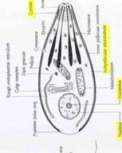
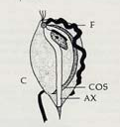
Other organelles
Apical complex
Undulating membrane

Slide 27
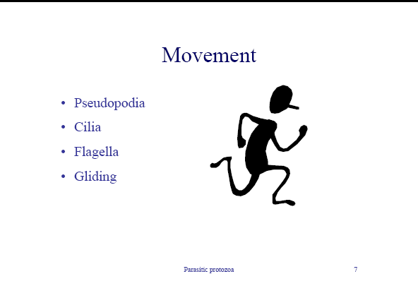
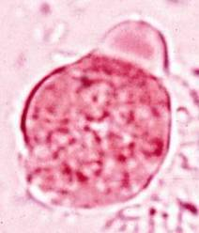
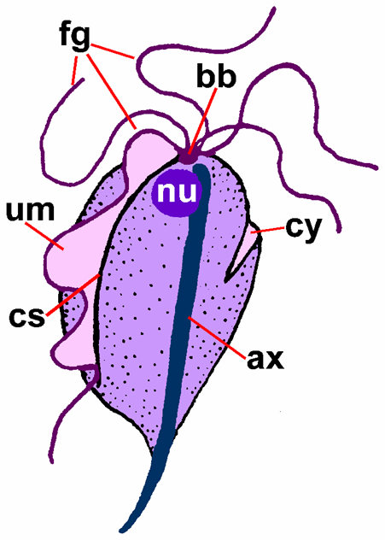
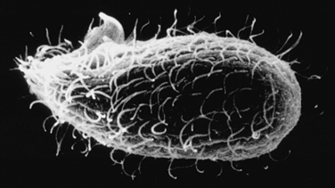
Structures that mediate locomotion or

Slide 28
Protozoan Reproduction
1. Asexual reproduction
  Fission
    Division follows a sequence:
    organelles then nucleus then cytoplasm
  Binary fission
    Each parent gives rise to two progeny
    Transverse/longitudinal
    the most common form of reproduction

Slide 29
Protozoan Reproduction
  Multiple fission/Schizogony-
    Rapid organelle and nuclear divisions occur at the cell periphery.
    Cytoplasmic segmentation to form separate organisms called merozoites.
    The Parent or multinucleated cell is called the schizont or segmenter and the daughter cells are merozoites
  Endopolyogeny
    Daughter cells form in the center of the mother cell (internal budding).
    Endodyogeny is a form of endopolyogeny where two daughters are formed

Slide 30
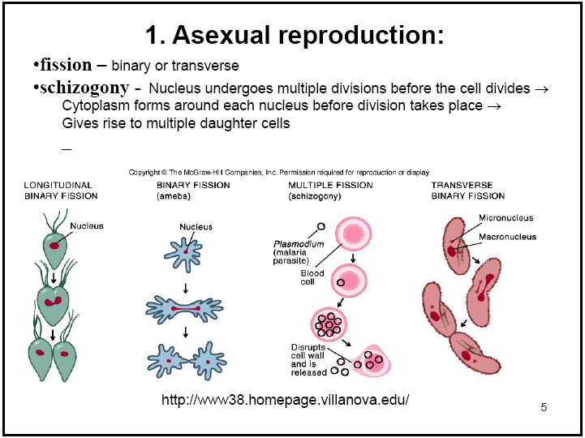

Slide 31
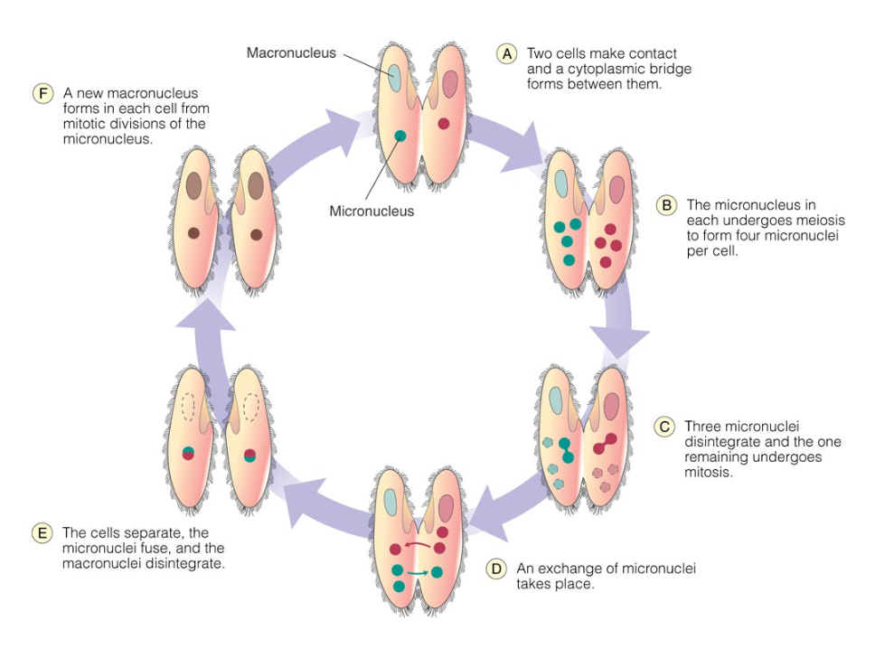
Protozoan Reproduction
Sexual Reproduction
  Conjugation
  Specialized sexual reproduction (mostly in ciliates)
  Involvies nuclear exchange and union (similar to prokaryotes) after cells join

Slide 32
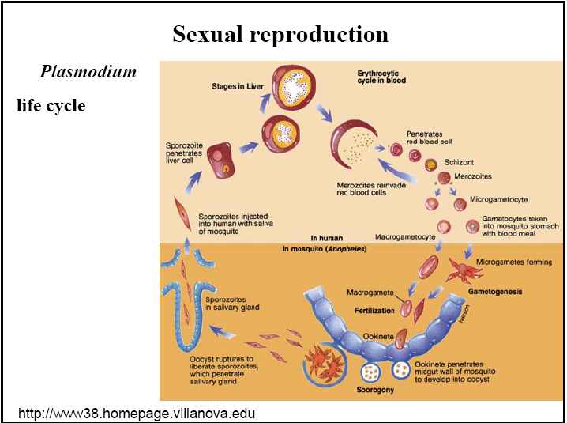
  Syngamy
  -union of the entire cell (gametes fuse)
  - in this process, sexually differentiated cells, called gametes, unite permanently and a complete fusion of the nuclear material takes place. The resulting product is then known as a zygote.
  .

Slide 33
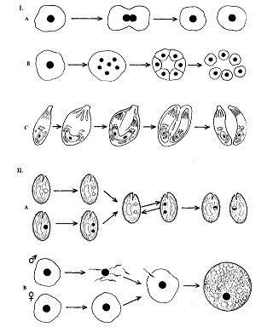
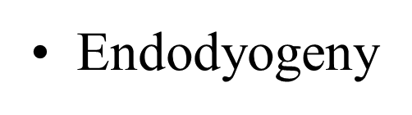
General Protozoan Reproduction
Binary Fisión
Asexual Reproductions
Múltiple Fisión
Conjugation
Sexual Reproductions
Singamy

Slide 34
Feeding mechanisms
Most parasitic protozoa are heterotrophic Procuring nutrients mostly bacteria
  ingest particulates (phagotrophy)
  Phagocytosis
    Engulfment of solid material
    predation on bacteria or other protozoa
  Pinocytosis
    Invagination of membrane surrounding liquids

Slide 35
Feeding mechanisms
  Cytostomal feeding
    Food is ingested at a definite site, using a specialized feeding structure
  Diffusion =absorb solutes (osmotrophy) through
  cell membrane
  Food may be retained in special intracellular reserves, or vacuoles.
Some protozoan are photosynthetic (autotrophy) or combination

Slide 36
Excretion mechanisms
Undigested particles and wastes are extruded at the cell surface by mechanisms that are the reverse of those used in ingestion
  diffusion (primary mechanism)
  contractile vacuole

Slide 37
Respiration/Metabolism
Both aerobic (Malaria) and anaerobic respiration (dysenteric amoeba)
Most parasitic protozoa are facultative anaerobes
They can live in reduced oxygen environments (facultative or aerotolerant anaerobes; e.g. Amoeba).
In few parasitic spp studied, metabolic paths similar to all eukaryotes (bad for drug development)

Slide 38
Protozoa life cycle stages/terms
Most protozoa exist as Vagetative or Resístanse forms:
  Vagetative forms: trophzotes, zoitos
    stage of active feeding and reproduction, &
    commonly the pathogenic protozoan form.
    Formed by asexual fission (mitosis), or
    also by gamete fusion in the Sporozoans.

Slide 39
Protozoa life…
  Resístanse forms: cyst/oocyst
  Stage of inactivity
  Most resisiant stage = hard to kill.
  Multiplication occurs within cysts of some protozoa = “excystation” releases multiples, ex. Entamoeba, giardia.

Slide 40
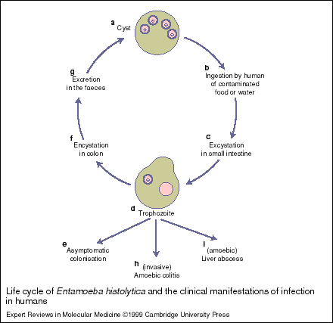
Protozoa life cycle
Standard non-Sporozoan intestinal life cycle
Variations of the basic life cycle occur in members of the sporozoan classes.

Slide 41
Encystation
Many protozoa form cysts – round cytoplasmic mass surrounded by a rigid or semi-rigid cyst wall secreted by organism.
Function:
  Protect against unfavorable external environmental conditions.
  Are the site for morphogenesis and nuclear division.
  Are the infective or transmissible form of parasite.

Slide 42
Conditions for encystment:
loss of food source
Desiccation
increase in tonicity (salts)
change in O2 concentration
- change in pH
- temperature change

Slide 43
Sporozoa life cycle stages/terms
Oocyst:
  results from fusion of gametes in the Sporozoa.
  Infective stage in most cases:
  passed in host feces in case of intestinal protozoans, or
  in blood in gut of the mosquito vector in the case of Plasmodium.
  Sporozoites form in oocyst in host via mitosis (asexual fission)..

Slide 44
Sporozoa life cycle stages/terms
Sporozoite:
special term for trophozoite in Sporozoans.
Formed by mitosis within oocyst & infects new host cells;
  intestinal mucosa cells in intestinal protozoans, or
  hepatocytes in case of Plasmodium.
Mitosis (“schizogeny”) of these cells results in formation of merozoites.

Slide 45
Sporozoa life cycle stages/terms
Merozoite:
results from mitotic fission (schizogeny) of sporozoites.
May infect same cell type as sporozoite or a different host cell:
RBCs causing clinical malaria in the case of Plasmodium.
can also go through meiosis to form gametes.
Gametocyte:
result of merozoite cell fission via Meiosis.
Fusion of these results in formation of oocyst

Slide 46
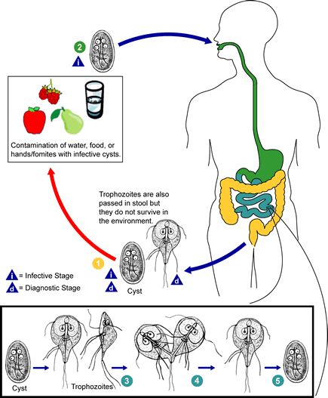
Why study life cycles?
  Control.
  Treatment.
  Epidemiology.

Slide 47
Protozoan Taxonomy
Confused, controversial and constantly changing
No universal agreement = many systems & frequent changes
Several bases of classification,
  light microscope = Originally based on motility
  electron microscope =Ultrastructural criteria used since 1960’s
  4-6 phyla? In the kingdom Protista

Slide 48
Molecular data can help with evolutionary relationships
  Monophyletic groups
    Descended from common ancestor
    Kinetoplastids, apicomplexa, ciliates
  Polyphyletic groups
    Multiple ancestors
    Amoebas and flagellates

Slide 49
Taxonomic classification of protozoa
Sub kingdom |  | Phylum |  | Sub-phylum |  | Genus- examples |  | Species- examples
Protozoa |  | Sarcomastigophora further divided into |  | Sarcodina move by pseudopodia |  | Entamoeba |  | E. histolytica
 |  |  |  | Mastigophora move by flagella |  | Giardia |  | G. lamblia
 |  | Apicomplexa no organelle of locomotion |  |  |  | Plasmodium |  | P. falciparum, P. vivax, P. malariae, P. ovale
 |  | Ciliophora move by cilia |  |  |  | Balantidium |  | B. coli
 |  | Microspora Spore-forming |  |  |  | Enterocyto-zoa |  | E. bienusi

Slide 50
Sarcodina:
Pseudopod
  Literally= false foot.
    Entamoeba,
    Iodamoeba,
    Endolimax,
    Naegleria (CNS),
    Acanthamoeba (CNS)
Entamoeba
Trophozoite
E. hystolitica

Slide 51
The Flagellates (Mastigophora)
Move by means of rotation of a whip-like organelle called a Flagellum (plural: flagella)
The flagella can also be used for gathering and sorting food.
Most are spindle shaped with flagella projecting from anterior end.
The Outer membrane is covered with a tough pellicle.

Slide 52
Con..
Respiration, food absorption, and excretion is performed by osmosis and active transport across the cell membrane.
Some species have organelles for the purpose of food ingestion (gullet or cytostome), and for excretion (cytopyge).
Encystation may be used by these organisms in response to adverse environment and/or for reproduction.

Slide 53
Con…
The parasitic members of this class are divided into two groups:
  The lumen flagellates, which inhabit the body orifices, the intestines and the bladder; and
  The blood and tissue flagellates.
several genera
  Giardia, Chilomastix, Dientamoeba,
  Trypanosoma, Leishmania, Trichomonas
  Members pathogenic to man includes G. lamblia, T.vaginalis and species of the trypanosoma and leishmamia

Slide 54
IMPORTANT TERMS USED IN RELATION TO FLAGELLATES
Flagellum:
  An elongated hair-like organelle used for locomotion.
  At ultrastructure level it reveals one pair of central tubules and nine pairs of peripheral tubules.
Undulating membrane:
  Is a membranous structure which connects the flagellum to the body of the parasite.
  It is thrown into folds as the parasite moves, giving itan undulating appearance.
Costa:
  A cytoplasmic thickening seen at the base of the undulating membrane in some flagellates

Slide 55
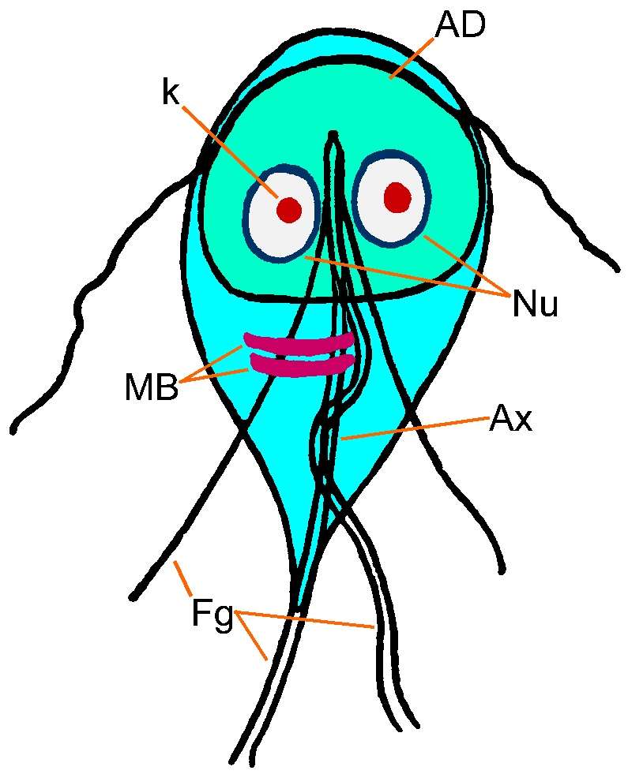
Axostyle:
  A central supporting rod seen in some flagellates.
Axoneme:
  A delicate filament extending from the region of the kinetoplast to the cell membrane.
  It represents the cytoplasmic part of the flagellum.

Slide 56
Giardia intestinalis
Cyst
Trophozoite

Slide 57
Trichomonas
T. vaginalis
T. intestinalis

Slide 58
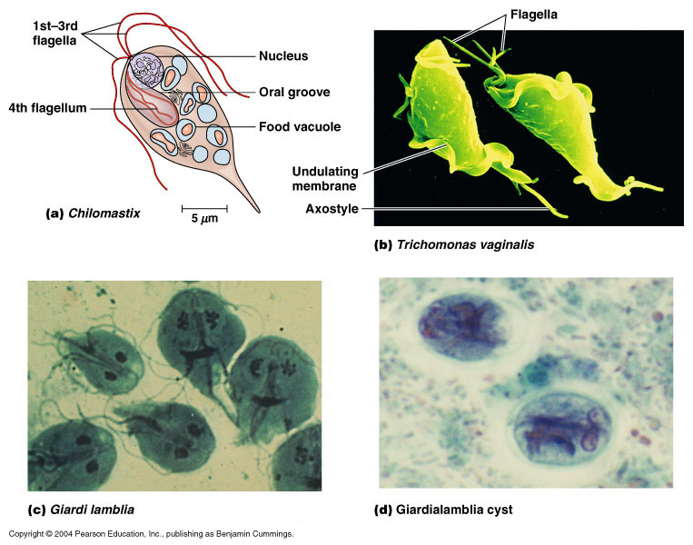

Slide 59
Trypanosoma
Notes:
Trypomastigote

Slide 60
Leishmania
Amastigote
Promastigote

Slide 61
C. Apicomplexans (Phylum Apicomplexa

Slide 62
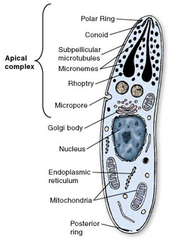
Apicomplexans (Phylum Apicomplexa)
Have specialized organelles at tip (apex) of cells that penetrate host tissues.
Not motile in their mature form.
Obligate intracellular parasites.
All are parasites(Important pathogens:)
Life cycles that typically include asexual and sexual phases

Slide 63
part of the life cycle occurs inside certain host cell types
  -usually 2 or more hosts
  several forms (vs only troph & cyst)
  some forms motile by “gliding”, hitching a ride in infected cells, etc.

Slide 64
Diversity
Are an extremely large and diverse group (>5000 named species).
Seven species infect humans
1. Intestinal coccidian
    Cryptosporidium
    Isospora
    Cyclospora
2. Blood and tissue coccidian
    Plasmodium
    Toxoplasma
    Babesia
    Sarcocystis

Slide 65
Plasmodium
Zygote
Oocyst
Sporozoites
Male
Female
Merozoites
Gametes
Gametocytes

Slide 66
Toxoplasma gondii (Toxoplasmosis)
Bradyzoite
Sporulated
oocyst
Oocyst
Merozoite
Gamete
Sporocyst

Slide 67
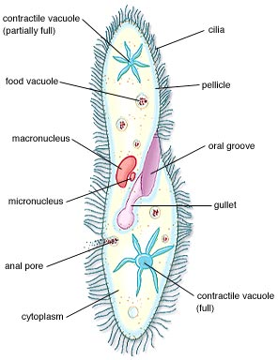
Ciliates (Phylum Ciliophora)
Characteristics:
Move and obtain food using
cilia
Relatively rigid pellicle and more or less fixed shape
Distinct cytostome (mouth) Structure
Dimorphic nuclei, typically larger macronuclei and one more smaller micronuclei
some ciliates even possess an anal pore
Only known human pathogen is Balantidium coli

Slide 68
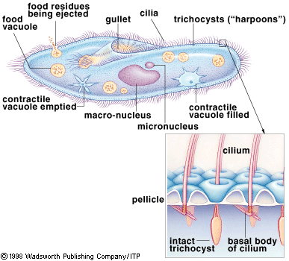

Slide 69
Microsporans (Phylum Mycrospora)???
Obligate intracellular parasites, lack mitochondria and microtubules.
Discovered in 1984 to cause chronic diarrhea and conjunctivitis, mainly in AIDS patients.

Slide 70
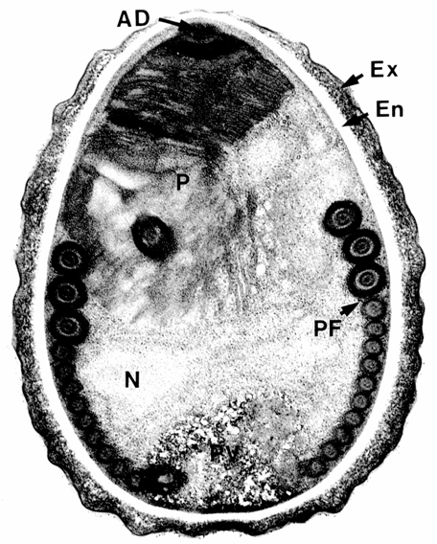
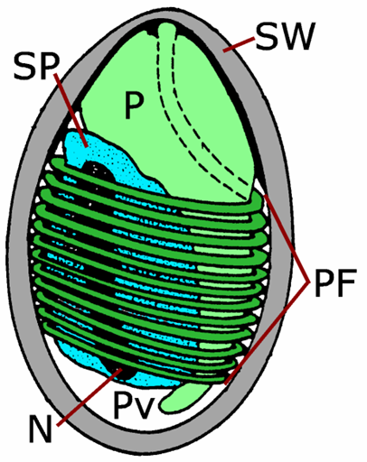

Slide 71
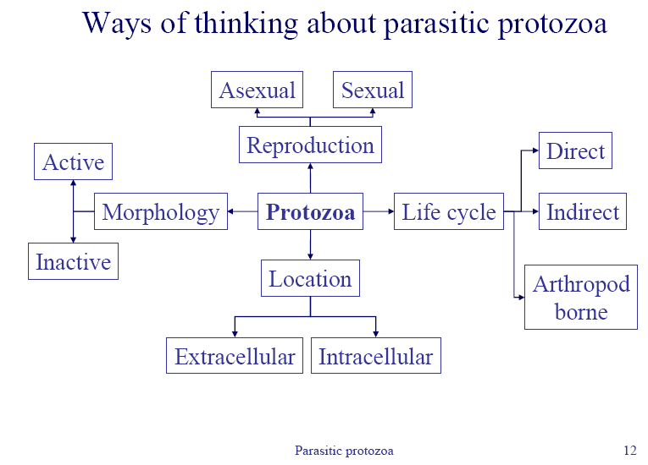

Slide 72
Intestinal protozoa

Slide 73
Intestinal protozoa
The most common intestinal protozoan are
1. Ameba:
Entamoeba histolytica
Entamoeba dispar
Entamoeba coli
Entamoeba hartmanni
Endolimax nana
Iodamoeba bütschlii
  2. Flagellates:
Giardia lamblia
Dientamoeba fragilis
Chilomastix mesnili
Trichomonas hominis
Enteromonas hominis
Retortamonas intestinalis
  Other:
Blastocystis hominis
Balantidium coli
3. Apicomplexa:
Cryptosporidium hominis
Cryptosporidium parvum
Cyclospora cayetanensis
Isospora belli

Slide 74
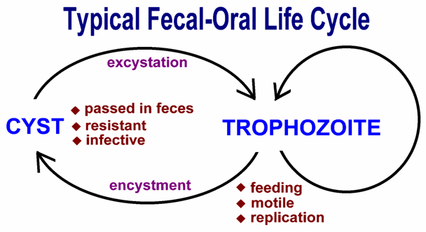
Common characteristics
1.Typical fecal-oral life cycle

Slide 75
2. Fecal-Oral Transmission
Zoonosis
  Entamoeba = no
  Cryptosporidium = yes
  Giardia = controversial
Poor personal hygiene
  Food handlers
  Institutions
  Children in day care centers
Factors intestinal protozoan transmission
Water-borne epidemics
Male homosexuality
  Oral-anal contact

Slide 76
Control/prevention
Improve personal hygiene
  Especially institutions
Treat asymptomatic carriers
  Eg, family members
Health education
  Hand-washing
  Sanitation
  Food handling
Protect water supply
Treat water if questionable
  Boiling
  Iodine
  Not chlorin

Slide 77
Amoeba
Introduction
Amoeba (plural amoebae)= Protists that moves by
means of pseudopods
Amoeba = Greek word amoibe, means change
Most Amoeba are free-living widely distributed mostly in
-aquatic environment
-fresh water, salt water, wet soil, on water plants
Few of the parasitic and free-living amebas cause human disease

Slide 78
General characteristics
Locomotion and digestion
  are accomplished by the use of the pseudopodia.
  Once the food substance is contained within the cell, the organism goes through the processes of enzymatically breaking down and absorbing the nutrients.
  Egestion of unused residue is performed by the expulsion of the vacuole out of the cell.

Slide 79
Respiration and reproduction
Respiration is performed by simple absorption of dissolved oxygen from the liquid environment.
Excretion of gases and waste is performed by diffusion out of the organism through the cell membrane.
Liquid regulation inside the body is controlled by Contractile vacuoles
  serve as two-way pumps that control the hydrostasis between the organism and the environment.
These organisms reproduce through asexual reproduction consisting of simple cell division.

Slide 80
Amoeba has two forms(stage)
Trophozoite
  Motile ,actively feeding stage
Cyst
  Is the non-motile form, which is protected by a distinct membrane or a cyst wall.
  This is the infective stage of most Amoeba
    exception are Dientamoeba fragilis and Entamoeba gingivalis

Slide 81
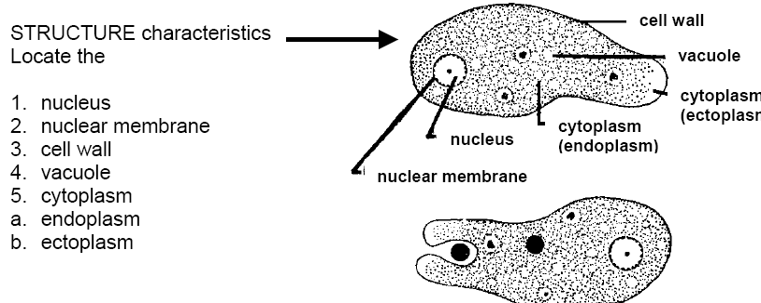
Basic structural and functional characteristics
Cell membrane

Slide 82
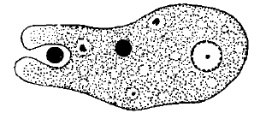
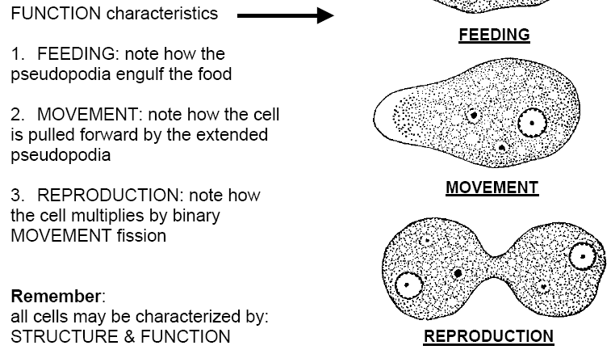

Slide 83
Pseudopod
  Literally= false foot.
  temporary cytoplasmic processes formed at the surface of the trophozoite
Ectoplasm
  external hyaline portion of the cytoplasm which is generally visible in a moving trophozoite
Endoplasm
  Is the internal granular portion of the cytoplasm which contains various food inclusions.

Slide 84
Chromatoid body
  Is the RNA-protein complex which stains deeply with basic dyes but not with iodine.
  It is found in the genus Entamoeba
Glycogen vacuole
  Is a glycogen reserve which stains deeply with iodine and is found mainly in the cysts.
Food Vacuole
  A membrane bound vesicle in the cytoplasm formed around an ingested food particle.
Contractile vacuole
  A membrane bound vesicle in the cytoplasm which collects and expels water from the cell. This is found in the free-living amoebae.
Chromatin
  Is the substances in the cell nucleus which stains with basic dyes.

Slide 85
Pre-Cyst
  Is the rounded form of trophozoite which precedes the cystic stage. It differs from the cyst in not having a cyst wall.
Excystation
  Is the process of emergence of the trophozoite from the cyst.
Encystation
  Is the process of formation of the cyst from the trophozoite.
Metacyst
  Is the trophozoite which emerges from the cyst..

Slide 86
Taxonomy
Phylum Sarcomastigophora
Sub-Phylum Sarcodina
Class Lobosea
  Order Amoebida
  Sub order Tubulina
    Genera: Entamoeba, Iodamoeba, Endolimax- parasitic
    Sub order Acanthopodina
    Genera: Acanthamoeba - Free living
  Order Schizopyrenida
    Genera: Naegleria - Free living

Slide 87
Classification….
The Amoeba
Parasitic Ameba:
Intestinal
Entamoeba histolytica
Entamoeba dispar
Entamoeba coli
Entamoeba hartmanni
Endolimax nana
Iodamoeba bütschlii
Mouth
E. gingivalis
Free living Ameba:
Pathogenic
Naegleria fowleri
Acanthamoeba spp
Balmuthia Mandrilarias

Slide 88
Classification….
1- pathogenic:
  intestinal amoeba: E- histolytica.
2- non pathogenic:
  ►Mouth amoeba: E- gingivalis
  ►intestinal amoeba: E- coli, endolimax nana, iodamoeba butschlii

Slide 89
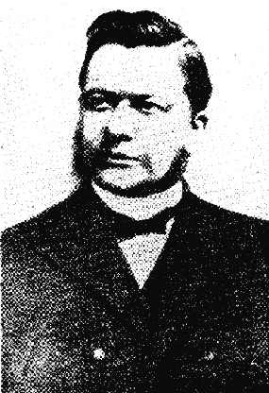
Entamoeba histolytica
History
Alexandrewitch Lösch
describes amoebae associated
with severe dysentery in a patient
  He transferred amoebae to a dog by rectal injection, which became ill and showed ulceration of colon
  Patient who died from infection showed similar ulcers upon autopsy

