Slide 1
Flagellates
Luminal (intestinal, urogenital& oral) flagellates
Haem(blood & tissue) flagellates

Slide 2
    Luminal (intestinal,urogenital& oral) flagellates
Intestinal Flagellates:
  Giardia lamblia
  Dientamoeba fragilis
  Chilomastix mesnili
  Trichomonas hominis
  Enteromonas hominis
  Retortamonas intestinalis
Urogenital flagellates
  Trichomonas vaginalis
Oral flagellates
  Trichomonas tenax

Slide 3
Luminal (intestinal,urogenital& oral) flagellates
General characteristis
  Usually posses 2-6 flagella(~ 8 flagella.)
  Inhabit the intestinal, urogenital and oral cavity
  Direct life cycle/no biological vector
  All have trophozoites and cyst stage except the Trichomonas species
  All are comensal/ non-pathogenic/except G.lamlia and T. vaginalis

Slide 4
Giardia lamblia
Epidimology
worldwide distribution
  higher prevalence in tropical or developing countries (20%)
  1-6% in temperate countries
most common and easly recognized protozoa in stools
  ~200 million cases/yr
giardiasis
  often asymptomatic
  acute or chronic diarrhea

Slide 5
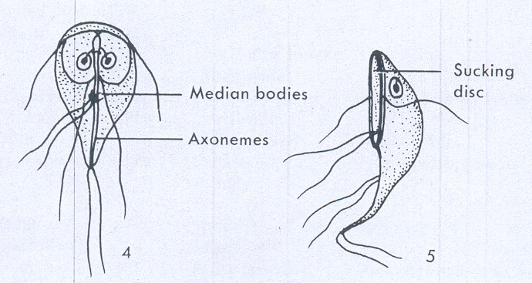
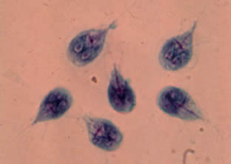
Giardia lamblia
Trophozoite stage
Typical Characteristics:
Size range: 8-20 um
Shape: Pear/teardrop
Motility : “Falling leaf”
Appearance: Bilaterally symmetrical
Nuclei: Two ovoidal-shaped, each
with a large Karyosome
No peripheral chromatin
Flagella: Four pairs arising from the ventral side :
One pair anterior end
One pair posterior end
Two pairs central laterally

Slide 6
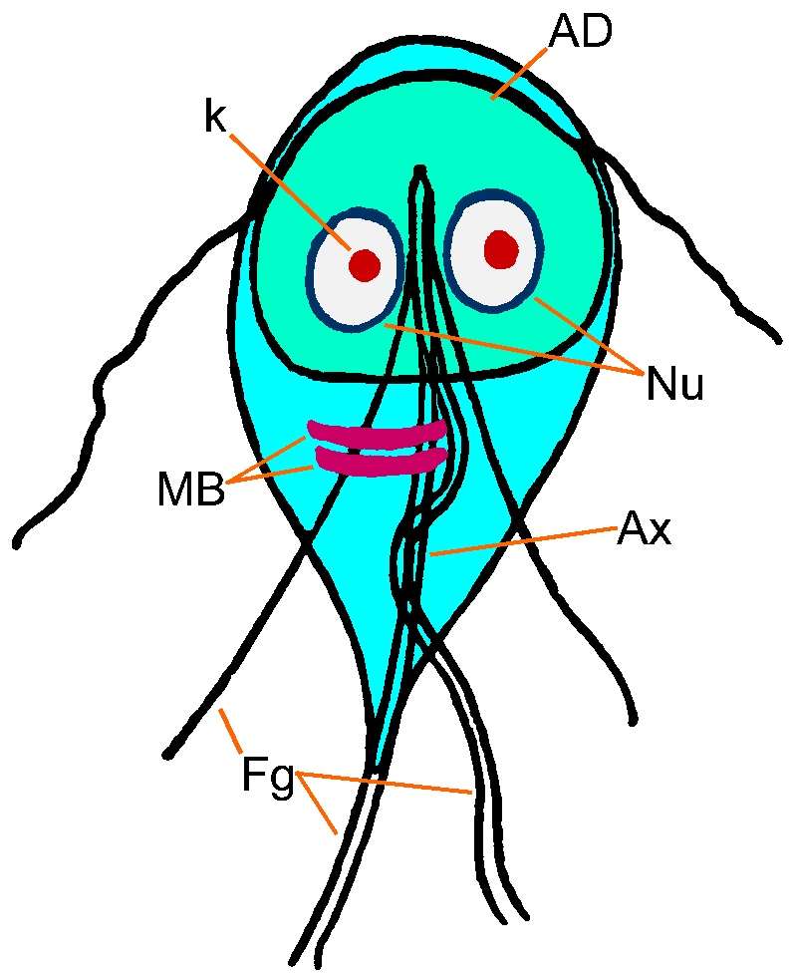
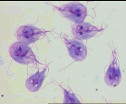
Other Features of Trophozoites
Adhesive disk (not always evident)
occupies 1/3 to ½ of the area
(used for attachment)
Axoneme (axostyle) arising from the
anterior end and protrudes
beyond the posterior end
dividing the body into 2 halves
= 2 pairs of blepharoplast
1 pair near anterior end
1 pair at caudal end
2 parabasal body (median bodies)
posterior to the sucking disc

Slide 7
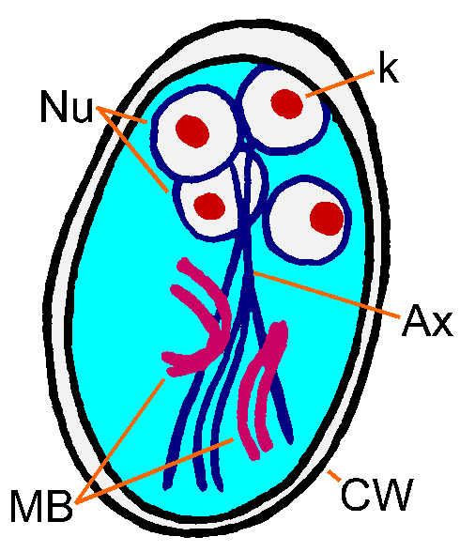
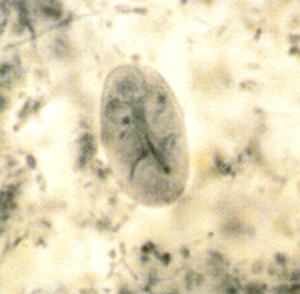
Giardia lamblia
Cyst
Typical Characteristics:
Size range: 11-14 um
Shape: Ovoid ellipsoidal or may
appear round
Nuclei: -2-4 located at one end
young cyst 2 nuclei,
mature cyst 4 nuclei
- Central Karyosome
- No peripheral chromatin
Cyst wall- smooth, thick and doubly contour set apart from cytoplasm
Notes:
Other structures:
Two or four median bodies, axonem and other remnant organelles of the trophozoite are also found inside

Slide 8
Transmission
Giardia is transmitted via the cyst stage
    1- Ingestion of faecally contaminated food
    or water with cyst
    2- Person to person
    3- Sexually among homosexual (feco-oral contact)

Slide 9
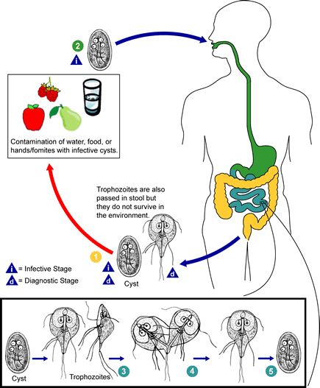
Habitat
  Small intestine
  ( duodunum & jejunum)

Slide 10
Life Cycle.
1.Life cycle is direct - no intermediate host.
2. When cyst is ingested, the organisms escape from the cyst in the duodenum.
3. Attach via adhesive disk to microvillar surface of epithelium of upper two-thirds of the small intestine.
4.They divide by longitudinal fission.
5. Encystment occurs in lower intestinal tract.
6. Freshly passed cysts are infective
7. Trophozoites are found in diarrheic stools; cysts are found in formed stools.

Slide 11
Cyst survive
  cool, moist conditions
    for long periods
  in cold water:
    2 months at 8°C
    1 month at 21°C
Some cysts can survive –13°C for 2 weeks
Relatively resistant to chlorination, particularly if the water is cold
The amount of chlorine in drinking water is not sufficient to kill G. lamblia

Slide 12
Cont…
Cysts are susceptible to:
  desiccation and direct sunlight
Cysts and trophozoites are susceptible to:
  1% sodium hypochlorite
  2% glutaraldehyde or quaternary
  ammonium disinfectants.
They can also be killed by boiling for at least 1 minute.

Slide 13
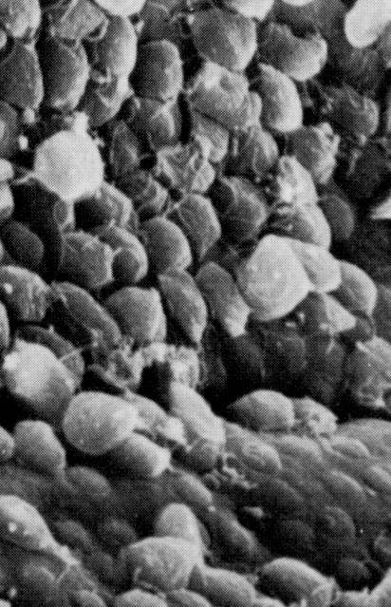
Pathogenesis
Epithelial damage
  Villus blunting
  Crypt cell hypertrophy
  Cellular infiltration
Malabsorption develops
Enzyme deficiencies
  Lactase (lactose intolerance)
  Steatorhae
  Foul smelling diarrhea
Possible Mechanisms
mechanical irritation
obstruction of absorption

Slide 14
Clinical Features and Symptoms
one of the more common diarrheal disease seen among travelers to foreign countries
Outcomes may be
  Asymptomatic/latent
  Acute short-lasting diarrhea
  Chronic/nutritional disorders

Slide 15
Acute Symptoms
Develops after an incubation period of 1 to 14 days (average of 7 days) and usually lasts 1 to 3 weeks
Sudden explosive, watery diarrhea, bulky, frothy,
greasy, foul-smelling stools, no blood or mucus
Upper gastro-intestinal uneasiness, bloating, flatulence,
belching, cramps, nausea, vomiting, anorexia
Usually clears spontaneously (undiagnosed), but can persist or become chronic
Irregular excretion of cysts:
10 days lasting negative phases possible (>1 stool analysis)

Slide 16
Subacute/Chronic
recurrent diarrheal episodes
cramps uncommon
sulfuric belching, anorexia, nausea frequent
can lead to weight loss and failure to thrive
The more chronic stage is associated with
  vitamin B12 malabsorption,
  disaccharidase deficiency and
  lactose intolerance
stools become steatorrheic (fatty stool) containing large amount of fats and mucus but no blood

Slide 17
Laboratory Diagnosis:
Macroscopic
  Stool:
    is usually offensive, bulky, pale, mucoid (fatty), diarrheic (watery) but
    there is no blood in the stool.
Microscopy
  Finding the trophozoite stages in fresh diarrhoeic stool
  Finding the trophozoite stages in duodenal aspirate
  Finding cyst stage in formed stool
  String (entero test)
Immunological methods
Molecular methods

Slide 18
Microscopy
  Finding the trophozoite stages in fresh diarrhoeic stool
    wet mounts or stained
    Identity or confirm in stained smeer
  Finding the trophozoite stages in duodenal aspirate
  Finding cyst stage in formed stool.
    wet mounts or stained
    Concentration of cyst
        Formol-ether/zink-sulphate
  trophozoites and cysts are excreted irregularly
  Collect stool at 3 non-consecutive days

Slide 19
Examination of stool for trophpzoites
Make a thin preparation of faeces
Examine with 1st -10X, then with 40X
Detect motile flagellates
Confirm the identity in stained preparation using fields modified thin film staining technique
if Girdiasis is suspected and no flagellates are found in wet mount, always do stained preparation

Slide 20
Characteristics used to distinguish flagellate species
Trophozoites
  Motility
  Shape
  Number of nuclei.
    The appearance of the nucleus is not commonly used to distinguish species.
  Other features such as undulating membrane, sucking disk, and prominent cytostome.
  Number and location of flagella.
    Although vary with the species, they are often difficult to see and count.
    Therefore, the number and location of flagella are not practical diagnostic features for routine identification.

Slide 21
Examination of stool for trophpzoites
Trophozoite: -Size: 10-21 by 5-15μm
        Shape: pear-shaped
        Motility: Progressive, rapid, tumbling
        and spinning linked to a“falling leaf”
        typical shape with 8 flagella
        concavity at the anterior end
        Stained
Two nuclie
Axonems
Parabasal body

Slide 22
Trichrome stain
Trophozoites
  appear as pear-shaped organisms,
  Measure 12 to 15 μm (range: 10 to 20 μm).
  contain two anteriorly placed nuclei and
  8 flagella (rarely seen because they stain poorly).
Cysts
  appear ovoid to ellipsoid in shape.
  Nuclei and intracytoplasmic fibrils are visible.

Slide 23
Examination of stool for cyst
Note:
  Several specimen need to be examined
  .Use concentration technique whenever possible
  Make saline/eiosine preparation in one end and Dobell’s iodine on the other end of slide
  Identify the cysts with 40x objective
  Examine the overall
    shape,
    size and
    contents of cyst- Fibrils
    Number of nuclei

Slide 24
Examination of stool for cyst. diagnostic feature; oval shape, small size & contents
Cyst
  oval shape with thick cyst wall
  Size: 8-12μm,.
  Contains : thread-like remains of flagella; axonemes and parabasal bodies folded as S-shaped placed length wise in the center of the cyst (stained with iodine)
-Nuclei: 2-4 nuclei at one pole( difficult to see).
  Cytoplasm:
        clear when unstained; yellowish green or bluish in iodine solution.
        Finely granular cytoplasm clearly separated from cyst wall.
.

Slide 25
G.lambilia trophozoites in duodenal aspirate
Enterotest.
    A gelatin capsule attached to a long string.
    The end of the string remains outside the mouth and is taped to your cheek.
    The gelatin capsule is then swallowed
    The capsule dissolves in the stomach and the string passes into the upper part of the small intestine (duodenum).
    The string is left in place for 4 to 6 hours or overnight. Then it is withdrawn and the end is examined under the microscope for parasites that have become attached.

Slide 26
Differentiation of G.lamblia from non-pathogenic intestinal flagellates that can be fond in stool
Trophozoites:
    can be easily differentiated from the non- pathogenic by their shape and movement (in fresh sample)
    because they have two nucleus and more no of flagella. (stained)
    D.fragilis has two nuclei is but this organism has no flagella or median bodies and looks like a small amoeba.

Slide 27
Cyst:
    Cyst of non pathogenic intestinal flagellates can be easily differentiated from those of G.lamblia(8-12μm)
        they are smaller and do not have the same characteristic appearance of G. lamblia (do not contain remains of flagella).
        C.mesnili(5-7 μm) cysts have remains of flagella and cytosome but they are lemon shape .
        D. fragilis does not have cyst stage.

Slide 28
Immunodiagnosis
Antigen test
    Detection of Girdia specific antigen in faecal specimen using monoclonal antibody
    EIA tchnique, ELISA

Slide 29
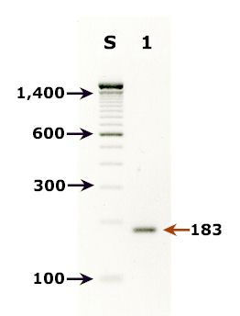
Molecular Diagnosis
2% agarose gel analysis of a PCR diagnostic test for detection of Giardia DNA.
PCR was performed using primers JW1/JW2.
1Lane S: Molecular base pair standard (100-bp ladder).
  Black arrows show the size of standard bands.
Lane 1: Giardia intestinalis positive fecal specimen.
  The red arrow shows the diagnostic band for G. intestinalis

Slide 30
Treatment
Control
Drug of Choice
metronidazole
750 mg/tid/5d
>90% cure rate
Alternatives
tinidazole (single dose)
paromomycin (pregnancy)
quinicrine
furazolidone
avoid fecal-oral transmission
improve personal hygiene
  especially institutions
treat asymptomatic carriers
  eg, family members
health education
  hand-washing
  sanitation
  food handling
protect water supply
How to get rid of Giardia in water?:
* boiling (at least 1 minute)
* filtration (1μm pores) 􀀮
* chemical treatment (Iodine, …) 􀀯

Slide 31
Other Flagellates Found in Human Feces
Chilomastix mesnili
Pentatrichomonas hominis
  formerly called Trichomonas hominis
Enteromonas hominis
Retortamonas intestinalis
Dientamoeba fragilis
  no flagella (discuss with amebas)

Slide 32
Chilomastix mesnili
Distribution: cosmopolitan
Habitat: large intestine (colon & caecum)
Morphology
  the largest flagellate found in man
  Has both trophozoites and cyst stage

Slide 33
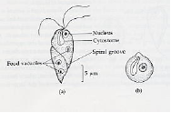
Trophozoite :-
  Size: 6-20 by 3-10μm
  Shape: Triangular and tapered at one end
  Motility: spiral in one definite direction.
  Cytoplasm:
  Spiral groove that makes asymmetrical flagellate
  cytostome (mouth-like cleft) at the rounded end.
  Nucleus: one nucleus, easily visible in unstained preparation
  Flagella: Six flagella. Three anterior free flagella,
Morphological distinctions:
-symmetric,
-4flagellar,
-Spiral groove
- Single nucleus
-cytostome.

Slide 34
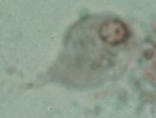
Unstained
  Pointed tail
  3 anterior filagella
  Spiral groove
  Motility-rotary
Stained
  1 nucleus
  Cytosome with fibril
Chilomastix mesnili

Slide 35
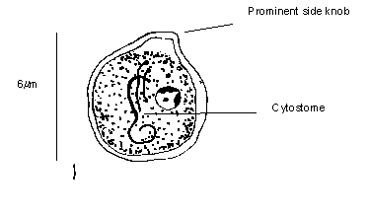
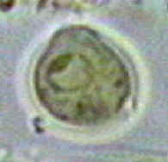
Cyst:- Size: 6-8 by 4-6μm
    Shape: pear or lemon shaped
    Cystostome and remains of locomotory organelles can be seen.
    Nucleus: single; .

Slide 36
Pentatrichomonas hominis
Distribution:
  it is probably the most common intestinal flagellates next to Giardia lamblia .
Habitat: Large intestine.
Morphology: has trophozoite stage only

Slide 37
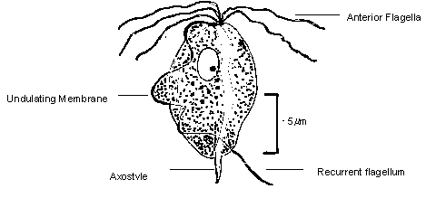
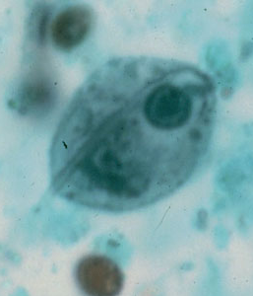
Trophozoite
unstained
Size: 10-15μm, pyriform (oval
with two pointed poles)
4 anterior flagella(3-5)
Motility: whirls and turns (jerky)
in all directions, seeming
to vibrate.
Undulating membrane and costa
reach full length of the body.
Axostyle extend beyond the body
Stained
Single nucleus
Costa
Conspicuous cytostome
semi- rigid axostyle

Slide 38
Enteromonas hominis
Cosmopolitan in distribution
Is a small flagellate and is rarely encountered in man.

Slide 39
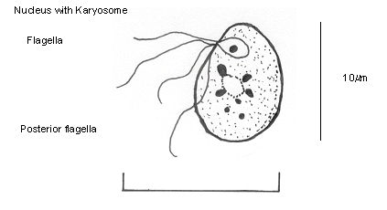
Morphology of the trophozoite
Oval in shape and 4-10m m in length.
Have 4 flagella, 3 anterior flagella and one adheres to the body ending in a tail,
motility: jerky rotational movement.
Have one nucleus with a large karyosome that is evident in a stained preparation.

Slide 40
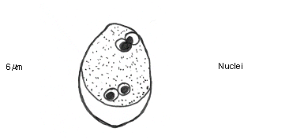
Morphology of the cyst
oval in shape
Size: 6-8m m
They have up to 4 nuclei with a bipolar tendency.

Slide 41
Retortamonas intestinalis
Retortamonas intestinalis like E.hominis is a small flagellate
and is rarely encountered.
It is found in both warm and temperate climates

Slide 42
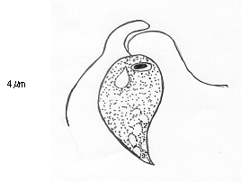
Morphology of trophozoites
is small, 4-9µm.
Its movement is jerky and rotational
has 2 anterior flagella and a prominent cytosome that can be seen in an unstained preparation.
It has a relatively large nucleus at the anterior end with a small compact karyosome

Slide 43
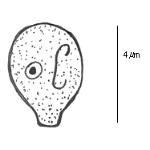
Morphology of the cyst
small and pear shaped.
Size: 4-7µm
Has one large nucleus frequently near the centre.
The fibril arrangement from the nucleus is suggestive of a birds beak.
This is characteristic of R. intestinalis cysts.

Slide 44
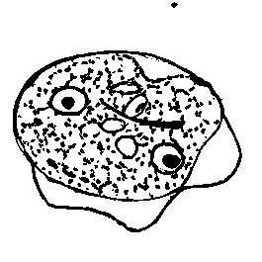
Dientamoeba fragilis
Trophozoite:-
  Size: 3-22 μm
  Motility: Either non-motile (most often), or very actively motile in very fresh fluid stools with fan-like multiple pseudopodia .
-It becomes non-motile under the cover slip or disintegrates immediately.
  Cytoplasm: clear ectoplasm.
  Nucleus: Usually one or two nuclei but 3or 4 nuclei may be found
- rarely. Karyosomes split into 4-6
granules.
  Inclusion bodies: Bacteria

Slide 45

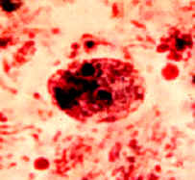
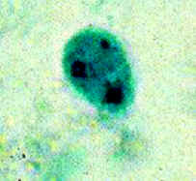

Slide 46
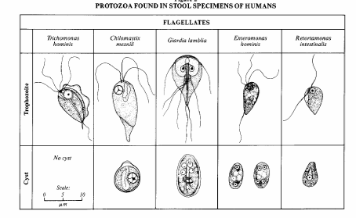

Slide 47
Species | Size (length) | Shape | Motility | Number of Nuclei | Number of Flagella* | Other features
Trichomonas hominis | 8-20m m Usual range, 11-12m m | Pear Shaped | Nervous Jerky | 1 Not visible in unstained mounts | 3-5 anterior. 1 posterior. | Undulating membrane extending length of body.
Chilomastix mesnili | 6-24m m. Usual range, 10-15m m | Pear Shaped | Stiff Rotary | 1 Not visible in unstained mounts | 3 anterior. 1 in cytostome | Prominent cytostome extending 1/3 –1/2 length of body. Spiral groove across ventral surface.
Giardia lamblia | 10-20m m. usual range, 12-15m m. | Pear Shaped | "Falling Leaf" | 2 Not visible in unstained mounts | 4 lateral. 2 ventral. 2 caudal. | Sucking disc occupying 1/2 -1/3 of ventral surface.
Enteromonas hominis | 4-10m m. usual range 8-9m m. | Oval | Jerky | 1 Not visible in unstained mounts | 3 anterior. 1 posterior. | One side of body flattened. Posterior flagellum extends free posteriorly.
Retortamonas intestinalis | 4-9m m. Usual range, 6-7m m. | Pear Shaped Or oval | Jerky | 1 Not visible in unstained mounts | 1 anterior. 1 posterior. | Prominent cytostome extending approx 1/2 length of body
summary

Slide 48
Urogenital flagellates

Slide 49
Learning Objectives:
Upon completion of this unit of instruction and lecture, the student will be able to:
  Discuses epidemiology of T.vaginalis
  Outline the morphology of T. vaginalis
  Explain transmission and Illustrate the life cycle of T.vaginalis
  Discuses the clinical feature of T.vaginalis
  Discuss prevention and control of T.vaginalis infection
  outline the laboratory diagnosis of T. vaginalis

Slide 50
Outline of Lecture
Characteristics of urogenital flagellates
T.vaginalis
  Geographic distribution
  Morphology, Transmission, Life cycle and Clinical features
  Prevention and control
  Microscopic examination of smear of vaginal or uretheral discharge
    Wet mount
    Giemsa/field stained
    Acridine orange stained
    in vitro culture in Diamond's medium

Slide 51
Urogenital flagellates
General feature
  Inhabit the urogenital tract of male and female
  Has only trophozoite stage
  Most frequent STD pathogen
  longitudinal binary fission
TRICHOMONADS

Slide 52
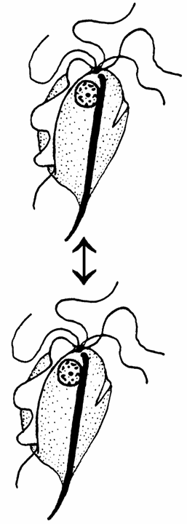
Trichomonas vaginalis
Distribution:-World wide .
Habitat:- uro-genital tract
  females: vagina
  males: urethra, prostate, Transmission: trophozoite stage
  transmitted during sexual
  intercourse
  -non-sexual contact possible
-common STD
        co-infection w/other STDs
        more prevalent in at risk groups
both sexes equally susceptible
symptoms more common in females
sexual intercourse

Slide 53
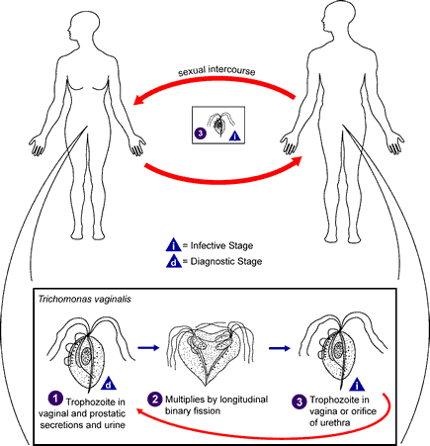
Life cycle

Slide 54
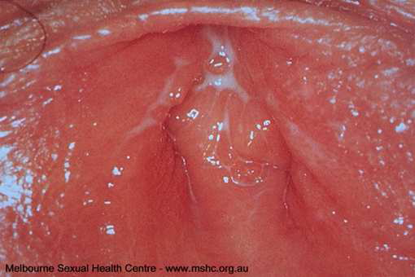
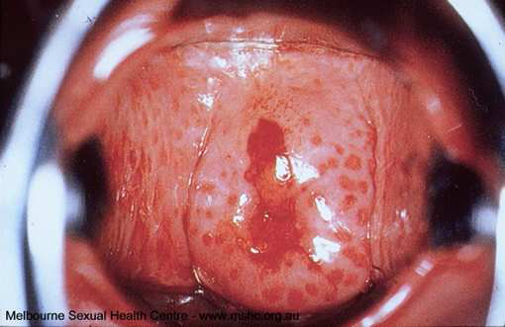
Pathology
Trichomonas vaginitis
Inflammation
Erosion
Discharge
itching, burning
urethritis, dysuria
dermatitis

Slide 55
Clinical manifestations
In females:
ranges from asymptomatic, to mild or moderate irritation, to extreme vaginitis
  50-75% abnormal discharge (frothy, yellowish or greenish)
  25-50% pruritis
  50% painful coitus
onset or exacerbation often associated with menstruation or pregnancy
vaginal erythema, ‘strawberry cervix’ (~2%)

Slide 56
Clinical manifestations
In males:
50-90% are asymptomatic
Mild dysuria or pruritus
Minor urethral discharge

Slide 57
Laboratory diagnosis
Finding the trophozoit in smear of vaginal or uretheral discharge
  Wet mount
  Giemsa/field stained
  Acridine orange stained
Occasionally in urine sediment of men and women
in vitro culture in Diamond's medium

Slide 58
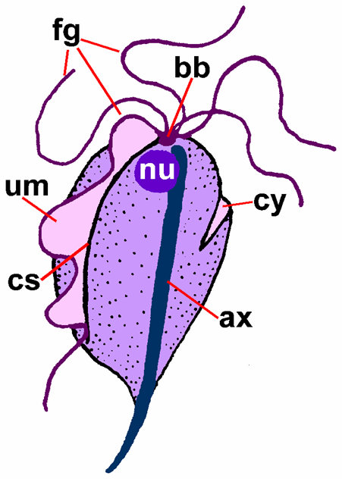
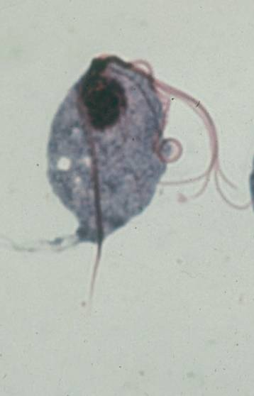
Morphology: Has trophozoite stage only
Trophozoite
Size 15-25 by 5-12μm, is the largest Trichomonas.
Shape: pyriform
Motility: Jerky (on-spot), non-directional motility .
undulating membrane :Short extending along two third of the body.
In Giemsa/field stain
Nucleus: Single
Flagella: 3-5 anterior free flagella
Axostyle- extends beyond the body
U.m bordred by flagella
In acridne orange: flagellates fluoresce orange among green pus cell

Slide 59
TREATMENT
metronidazole (Flagyl)
  250 mg (3/d) for 5-7 days
  single 2 g dose
simultaneous treatment of partner! (85-90% cure rate)
PREVENTION
limit # of sexual partners
condoms

Slide 60
Blood and Tissue flagellates
Notes:
Kinetoplastids: due to kinetopalst

Slide 61
Learning objective
At the end of this unit the students will be able to:
Describe the epidemiological aspects of blood & tissue flagellates
Discuss the general characteristics of blood & tissue flagellates
Explain the life cycle of each blood & tissue flagellates
Apply the necessary laboratory procedures for the detection and identification of blood & tissue flagellates

Slide 62
Blood and Tissue flagellates
Belonging to the family Trypomastidae
Six genera but only two of them are responsible to cause disease to man
    Genus Leishmania
    Genus Trypanosoma
Notes:
Leptomonas
phytomonas
Endoutrypanwn

Slide 63
General Characteristics blood & tissue flagellates
  Reproduces by longitudinal binary fission
  Biological insect vectors as intermediate hosts & human as definitive host
  The species are morphologically indistinguishable, but they can be differentiated on the basis of on their
    clinical features, geographical distribution, serologic tests
  The different developmental forms are differentiated on the basis of
a) Presence or absence of free flagellum
b) Presence or absence of undulating membrane
c) Position of the kinetoplast relative to the nucleus

Slide 64
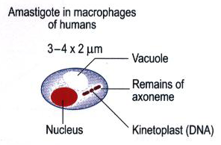
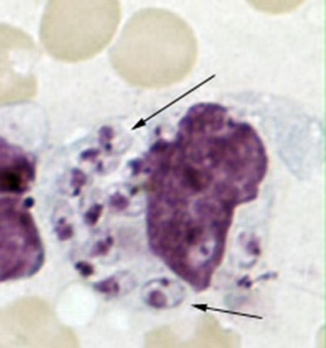
The following are the main developmental forms
Amastigote (Leishmanial form)
  Rounded body, central nucleus and eccentric kinetoplast visible
  no free flagellum,
  No undulating membrane
  The only intracellular forms of all leishmania species and Trypanosome cruzi

Slide 65
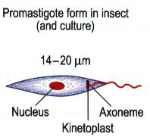
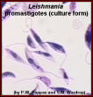
Promastigote (Leptomonad) form
  Elongated body, central nucleus, anterior kinetoplast
  Single anterior flagellum arises from kinetoplast
  found in the invertebrate host, and in culture media (of all Leishmania species)

Slide 66
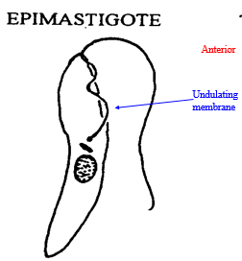
3.Epimastigote /crithidial/ forms
Elongated body, single free flagellum, single nucleus
Has undulating membrane,
Kinetoplast is just anterior to the nucleus
Found in the invertebrate host and
In culture media of Trypanosome species

Slide 67
  Trypomastigote
  Pleomorphic, it can be as “U” or “C” shaped,
  Central nucleus, posterior kinetoplast
  Single Flagellum arises posteriorly
  Has undulating membrane
  Found in the peripheral blood of vertebrates and is the diagnostic stage of Trypanosome species

Slide 68
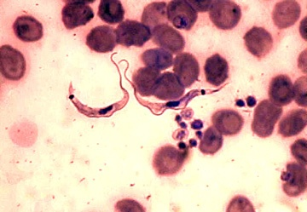
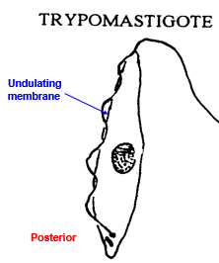

Slide 69
5. Metacyclic Trypomastigote /Trypanosomal Forms
Morphologically similar to trypomastigote stage but it is short and stumpy
Final developmental stage in the gut of the insect vectors
Infective stage of Trypanosomes species

Slide 70
Leishmania species
Causative agent of Leishmaniasis
Obligate intracellular protozoa of the genus Leishmania
Named after Leishman, who first described it in London in May 1903
In the human host, Leishmania are intracellular parasites that infect the mononuclear phagocytes
Notes:
Myrid

Slide 71
Con…
Human infection is caused by about 21 of 30 species that infect mammals. These include:
  L. donovani complex
    L. donovani,
    L. infantum,
    L. chagasi;
  L. mexicana complex
    L. mexicana
    L. amazonensis
    L. venezuelensis;

Slide 72
  L. braziliensis complex
    L. braziliensis
    L. peruviana
  L. guyanensis complex
    L. guyanensis
    L. panamensis
  L. tropica, L. major & L. aethiopica
Leishmaniasis can easily classified clinically as
  Visceral leishmaniasis
  Cutaneous leishmaniasis
  Mucocutaneous leishmaniasis
  Diffuse cutaneous leishmaniasis
Notes:
L. Pifanoi
L. gerbill

Slide 73
Cont…
Cutaneous leishmaniasis (CL): Most common form, and relatively benign self-healing skin lesions (localized or simple)
Diffuse cutaneous leishmaniasis (DCL): Rare cutaneous infection with non- ulcerating nodules resembling lepromatous leprosy
Mucocutaneous Leishmaniasis (MCL): Simple skin lesions that metastasize to mucosa especially nose and mouth region
Visceral Leishmaniasis (VL): Generalized infection of the reticuloendothelial system, high mortality response

Slide 74
Con…
These different forms of the disease is caused by the different species of Leishmania
Cutaneous leishmaniasis(CL) caused by
  L. tropica
  L. major
  L. aethiopica
  L. panamensis
  L. guyanensis
  L. peruviana
Visceral leishmaniasis(VL)
Also called Kala azar, Dum- Dum fever, death fever , tropical spleenomegaly
  L. donovani
  L. infantum
  L. Chagasi

Slide 75
Con …
3. Mucocutaneous leishmaniasis(MCL)
  L. panamensis
  L. guyanensis
  L. bazilliensis
  L. aethiopica
4. Diffuse cutaneous leishmaniasis(DCL)
  L. amzonensis
  L. aethiopica

Slide 76
Geographical distribution
350 million people are at risk in 88 countries around the world
    72 of which are developing countries
An estimated 12 million cases world wide
1.5 to 2 million new cases occur every year
    CL form representing 50 to 75% of all new cases
Notes:
Most of the affected countries are in tropics and sub tropics
90% of all visceral leishmaniasis (VL) cases occur in Bangladesh, Brazil, India, Nepal and Sudan;
90% of mucocutaneous leishmaniasis (MCL) occurs in Bolivia, Brazil and Peru
90% of cutaneous leishmaniasis (CL) cases occur in Afghanistan, Brazil, Iran, Peru, Saudi Arabia and Syria.
leishmaniasis are related to environmental changes such as deforestation, building of dams, new irrigation schemes, urbanization and migration of non-immune people to endemic areas. They seriously hamper socioeconomic progress. Epidemics have significantly delayed the implementation of numerous development programmes.

Slide 77
Geographical distribution
Most of the affected countries are in tropics and sub tropics
    90% of all VL cases occur in Bangladesh, Brazil, India, Nepal and Sudan;
    90% of all MCL cases occurs in Bolivia, Brazil and Peru
    90% of all CL cases occur in Afghanistan, Brazil, Iran, Peru, Saudi Arabia and Syria

Slide 78
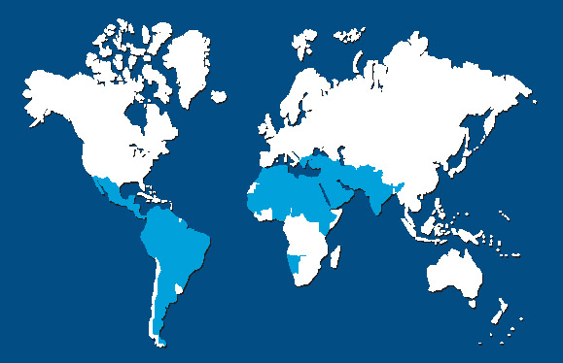
Global Status
new world:
south and central America
old world:
Asia, Africa, Europe
L. infantum
( L. chagasi )
L.mexicana
L.brazilliensis
L. peruviana
L.panamensis
L.guyanensis
L.amzonensis
L. donovani
L. infantum
L. tropica
L. major
L. aethiopica

Slide 79
Geographical distribution of leishmaniasis is limited by:
  The distribution of the sand fly,
  Its tendency to take blood from humans or animals only
  Its capacity to support the internal development of specific species of Leishmania
In Ethiopia
  Four species of Leishmania is found, namely,
    L. aethiopica,
    L.major
    L. tropica
    L. donovani

Slide 80
The incidence of leishmaniasis is increasing, mainly because of:
  Man-made environmental changes
  Poverty and malnutrition
  Movement of susceptible populations into endemic areas

Slide 81
In Ethiopia:
Visceral leishmaniasis (VL)
  L. donovani
  Occurs mainly in arid and semiarid lowlands below 1,300 m altitude
  Important endemic foci include
    Gelana focus at lake abaya,
    The segen valley (Aba- Roba focus) in Knoso Wereda
    The Omo river plains and
    The Metema and Humera plains in north western Ethiopia
Notes:
visceral leishmaniasis (VL) and is widely distributed throughout the lowlands of north-western Ethiopia.

Slide 82
Cutaneous leishmaniasis
  L. aethiopica, L.major and L. tropica
  Endemic at altitudes 1400 - 2700 m in most administrative region
  Prevalence rates of 5.5 – 40% were reported from villages in Shewa , Wello and G. Gofa with the highest rate in Ocholo village in G. Gofa
  Rock (Procavia habessinica) & tree (Heterhyrax brucei ) hyraxes serving as reservoir host for L. aethiopica

Slide 83
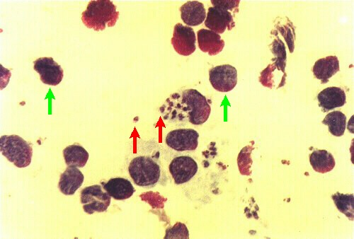
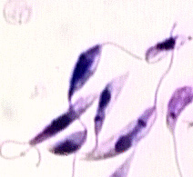
Habitat & morphology
Promastigote
Elongated, with flagella
(10-20 µm long)
Occur extracellularly in the insect midgut & in artificial culture
Motile
Amastigote
Round (3-7 µm diameter)
Occurs intracellularly, in mammalian
Non-motile

Slide 84
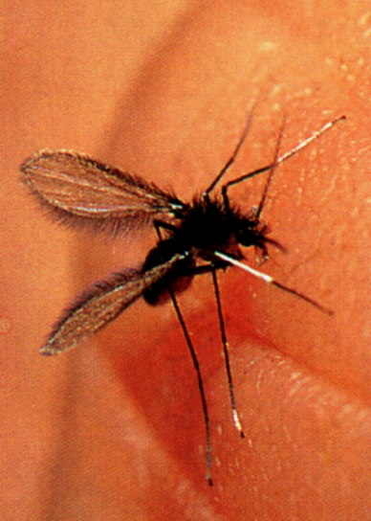
Transmission and life cycle
Common mode of transmission.
  Bite of infected female sandfly
    Phlebotomus in Old world
    Lutzomyia in New world
Uncommon modes of transmission:
  Congenital transmission,
  Blood transfusion,
  Rarely, inoculation of cultures.

Slide 85
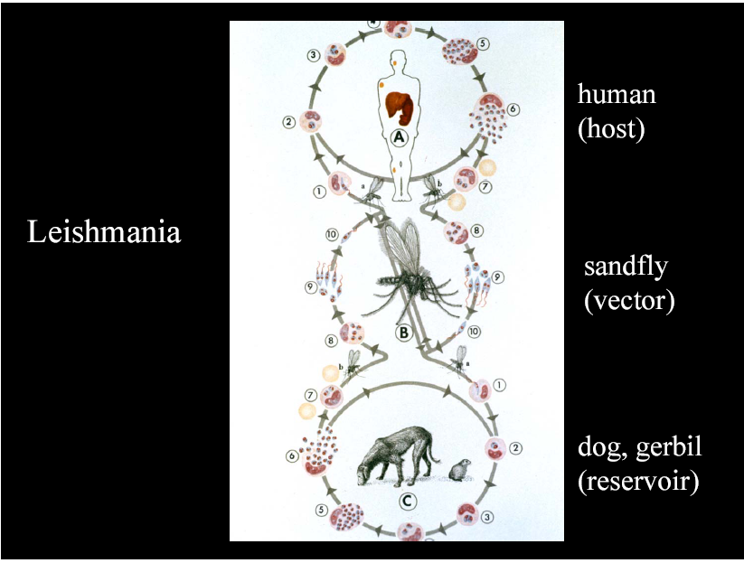

Slide 86
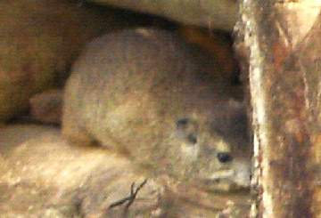
Mammalian R. Hosts
Rodents
Gerbils
Hyraxes
Bats
Porcupines
Opossums
Sloths
Primates
Dogs
Foxes
Anteaters
. . . . .

Slide 87
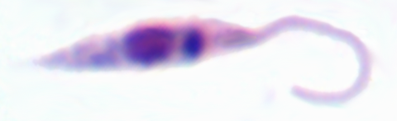
General life cycle of Leishmania species
Female sandflies inject promastigotes stage during blood meals
About 30 species of sand flies acts a vector

Slide 88
Life cycle…
    Promastigotes are phagocytized by macrophages & transform into intracellular amastigotes form
    Amastigotes multiply by binary fission, rapture from macrophages, and infect new cells
    In VL the amastigotes are carried through blood circulation , then invade and multiply in the macrophages of spleen, liver, bone marrow, lymph glands
    In CL, MCL, DCL – the amasigote multiply in skin macrophages (histocytes)

Slide 89
Life cycle …
Sandflies become infected during blood meals when they ingest macrophages infected with amastigotes
The host cell break down and releasing the amasigotes which is then transform to promastigotes
Multiply , fill the lumen of the gut and migrate to the proboscis

Slide 90
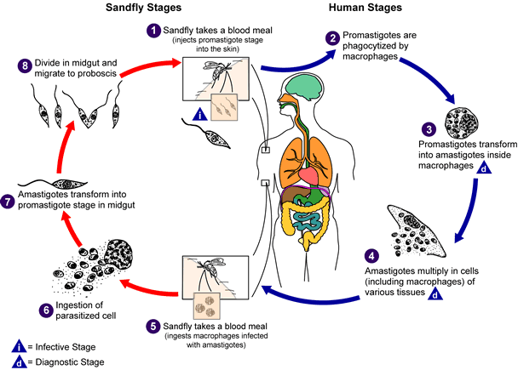
Life cycle…
Notes:
When the sandfly takes a blood meal the valve cannot close and blood moves back into the mouthparts and the bite wound.
This regurgitation like activity results in an expulsion of promasitigotes from the anterior portions of the sandfly gut into the bite wound of the mammalian host.

Slide 91
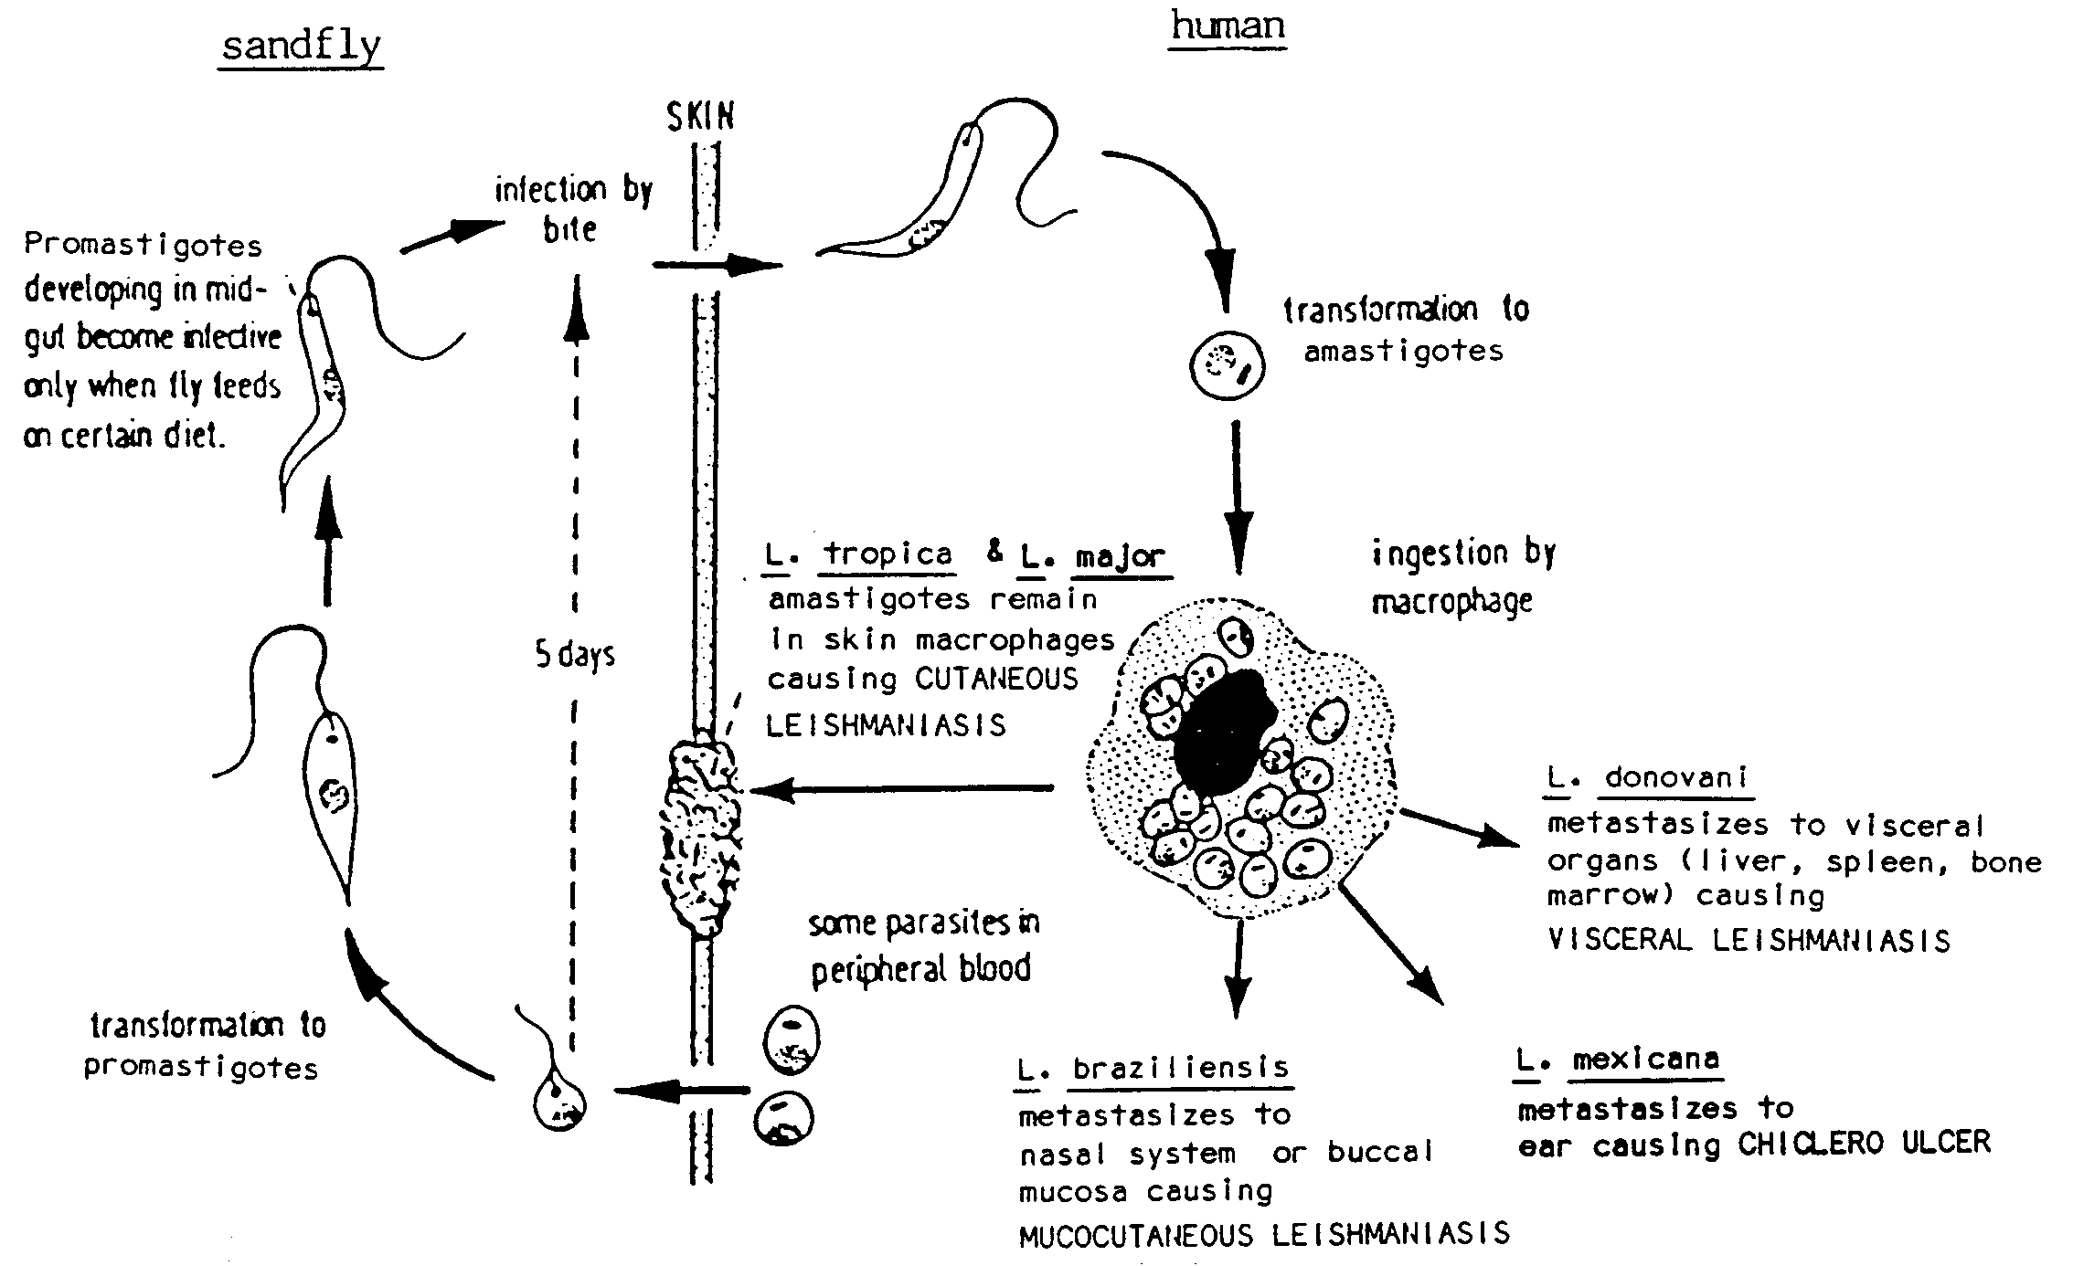
Life cycle…

Slide 92
Pathogenesis
Entrance into the host and establishment of infection by leishmania is enhanced by saliva from the vector
Two substances were involved
    Maxadilin, or maximum dilation molecule: keeps the capillary bed open at the site of feeding for about 48 hours
    SIP or salivary immunosuppressive protein: restrains the immune system’s early efforts to eliminate the parasites
Infective promastigotes entering the blood of the vertebrate are covered by two key molecules:
    The protein gp 63 and
    lipophosphoglycan (LPG)
      Both mediate the uptake of promastigotes by macrophages
The promastigotes are engulfed & form phagosome
Notes:
Entrance into the host and establishment of infection by leishmanias is enhanced by saliva from the vector. Early experiments showed that the probability of infection as well as the increases in the numbers of amastigotes was many times greater when sand fly saliva was administered with the promastigotes

Slide 93
Pathogenesis…
Phagosome fuse with the lysosome to form a phagolysosome
  As the promastigotes transform into amastigotes, which produce compounds that counter lysosomal enzymes
    The gp 63 molecule inactivates proteolytic enzymes
    LPG protects against other enzymes
Leishmanial organisms are able to survive the highly acidic environment of lysosmes by regulating their internal P^{H}
Notes:
The promastigotes are engulfed by macrophages and contained in a so-called phagosome. The phagosome, in turn, fuses with a lysosome to form a phagolysosome. These organelles contain numerous enzymes, which normally break down organic compounds. As the promastigotes transform into amastigotes, they produce an arsenal of compounds to counter lysosomal enzymes such as catalase, superoxide dismutase, and glutathione peroxidase. The gp 63 molecule inactivates proteolytic enzymes and LPG protects against other enzymes.

Slide 94
Clinical features and pathology
Cutaneous leishmaniasis (CL)
  most common form,
  Relatively benign self-healing skin
  lesions (localized or simple CL)
  Leishmaniasis recidivans (LR): rare hypersensitive dermal
Diffuse cutaneous leishmaniasis (DCL)
  Rare cutaneous infection with non- ulcerating Nodules resembling lepromatous leprosy

Slide 95
Cont…
Mucocutaneous Leishmaniasis (MCL)
  - simple skin lesions that metastasize to
  mucosa especially nose and mouth
  region
Visceral Leishmaniasis (VL)
  Generalized infection of the reticuloendothelial system of the visceral organ, high mortality response

Slide 96
Cutaneous Leishmaniasis
Causative agents
Leishmania tropica
Leishmania major
Leishmania aethiopica
Leishmania mexicana
Leishmania peruviana
Leishmania panamensis
Leishmania guyanensis

Slide 97
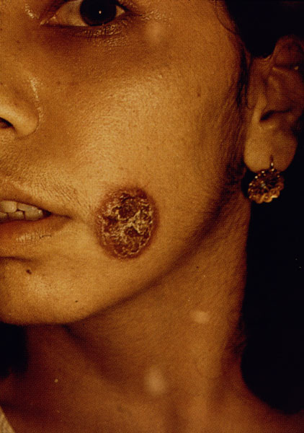
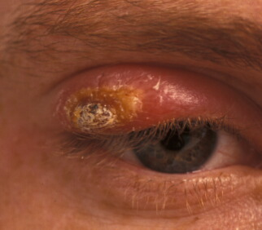
Old World CL
L. Tropica
  SW Asia, N.Africa
  Anthroponotic or dog reservoir
  dry ,urban ,chronic, old world oriental sore
  'dry painless lesion’
    25-70mm diameter
Notes:
dry, crusted/scabbed appearance

Slide 98
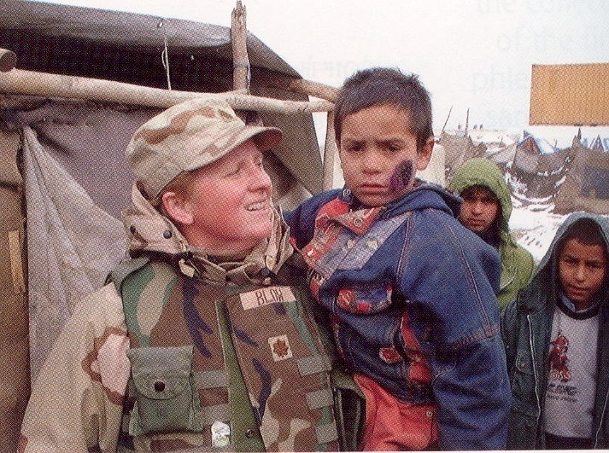
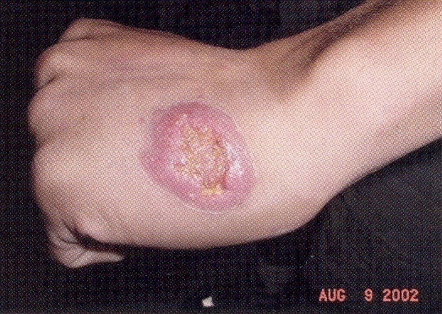
L. tropica
Soldier in Afghanistan with Leishmania tropica on hand
Officer holding Iraqi child with Leishmania tropica on face

Slide 99
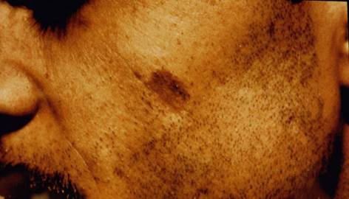
L. tropica
Are self-healing,1-2yrs
Often leave disfiguring scars
Immune to re-infection
Rarely develop multiple un-healing lesion known as leishmaniasis recidivans (LR)
hyper-pigmentation of scar
Notes:
Darkening of the skin

Slide 100

Leishmaniasis Recidivans (LR)
multiple un healing lesions, often on the face
Relapsing leishmaniasis
Often due to inadequate treatment or allergic state
Nodular lesions or rash around central healing
Can last for many years and difficult to treat
Untreated LR is destructive and disfiguring

Slide 101

L. major
central Asia, middle East, Africa
rural (rodent reservoir)
wet oreintal sore
Early papules is inflamed (5-10mm)
Develop to large uneven ulcer
Self-healing (3-6mths)
Protect against reinfection & also with L. tropica
ulcers are moist or open with seropurulent exudate

Slide 102

L. infantum
  Mediterranea, Europe
  dermotrophic strains recently recognized
L. aethiopica
  Highlands of Kenya and Ethiopia
  Similar to oreintal sore
  Self-heal 1-3 yrs
  Can cause DCL in patients also cause MCL
Notes:
L. aethiopica however, can cause diffuse cutaneous leishmaniasis (DCL) in patients with little or no cell-mediated immunity against the parasite. This is an incurable condition characterized by the formation of disfiguring nodule over the surface of body. The nodule contains large number of amastigote. L. aethiopica can also cause mucocutaneous leishmaniasis.

Slide 103

New World CL
L. mexicana)
Initially, the lesion is a small, red papule up to 2 cm in diameter
Change in size and appearance over time
Chiclero Ulcer

Slide 104


L. mexicana
chronic ulcerated, papular, or nodular lesion
lesion is painless, non-tender, non-pruritic
Lesions of the body tend to self-healing but those on the ear may last up to 30 years and entirely destroy the pina of the ear

Slide 105

Diffuse Cutaneous Leishmaniasis
Caused by L. aethiopica and L. amazonensis
Skin lesion develop over large areas of the body
Scaly, not ulcerated, nodules
Chronic and painless
Numerous parasites in lesions
Seldom heal despite treatment
Notes:
DCL caused by L. amazonensis is resistant to treatment. With L. aethiopica relapses tend to occur after treatment.

Slide 106



Slide 107

Mucocutaneous Leishmaniasis
Primarily L. braziliensis : known as espudia
Two stages
  simple skin lesion
  2º mucosal involvement
Metastasis via blood or lymphatic systems
Can occur after primary lesion (up to 16 years)
Frequently in naso-pharyngeal mucosae
  Junction of skin and mucosa
Notes:
MCL is caused by new world leishmania species, L. braziliensis, L. panamensis and occasionally by L.guyanensis. In immunosuppressed persons, mucosal lesion can be caused by L.donovani, or L. major or L.infantum.

Slide 108

Mucocutaneous Leishmaniasis
Variable types and sizes of lesions
  chronic and painless
Non-ulcerative type
  local edema (upper lip)
Ulcerative type
  rapid and extensive mutilation

Slide 109



Mucocutaneous Leishmaniasis
Disfiguration is often extreme with complete destruction of the
    nasal septum, perforation of the palate and damage of the tissues of the lips and larynx
    'tapir' nose

Slide 110
Visceral Leishmaniasis
Caused by the Leishmania donovani complex,
    Leishmania donovani
    L. infantum
    L. chagasi
Reticulo endothelial system affected
  spleen, liver, bone marrow, lymph nodes
Onset is generally insidious
The disease may be asymptomatic and self-resolving but usually runs a chronic course and may be fatal without treatment
Untreated VL carries have progressive disease
  75-95% mortality
Death usually occurs because of severe secondary bacterial infections in advanced disease
Pneumonia is the common complication
Notes:
VL caused by the Leishmania donovani complex,
Leishmania donovani
L. infantum
L. chagasi
The clinical features of VL caused by different species are different, and each parasite has a unique epidemiological pattern. On the Indian subcontinent, the disease is almost exclusively caused by L.donovani. L. infantum is responsible for VL in children in the Mediterranean basin. L.chagasi causes VL in children in Latin America, where lymphadenopathy is a dominant clinical feature.
Some VL cases affected their lungs, pleura, oral mucosa, larynx, oesophagus, stomach, small intestine

Slide 111

Clinical Presentation
Incubation period
  Generally 2-6 months
  Can range 10 days to years
Fever, malaise, weakness
Wasting despite good appetite
Spleeno- and hepatomegaly, enlarged lymph nodes
  Epistaxis (nose bleeding) and bleeding of gums
Depressed hematopoiesis
  severe anemia
  leucopenia
  thrombopenia
Notes:
thrombopenia → petechial hemorrhages in mucosa

Slide 112

Profile view of a teenage boy suffering from visceral leishmaniasis. The boy exhibits splenomegaly, distended abdomen and severe muscle wasting.

Slide 113


Visceral Leishmaniasis
A 12-year-old boy suffering from visceral leishmaniasis. The boy exhibits splenomegaly and severe muscle wasting
Enlarged spleen and liver in an autopsy of an infant dying of visceral leishmaniasis.

Slide 114
Post Kala Azar Dermal leishmaniasis (PKDL)
Cutaneouse form of leishmaniasis, which can occur after resolution (after treatment and recovery) of VL
It require expensive and prolonged treatment
characterized by hypo pigmented and raised erythematous patches on the face, trunk of the body and limbs
May develop in to nodules and resembles those of lepromatous leprosy, fungi infections or other skin disorders
Occasionally there is ulceration of lips and tongue
occurs in 1-3% of Indian and 50% of Sudanese VL patients
easily cured with treatment (in contrast to DCL)

Slide 115


PKDL….

Slide 116
Leishmaniasis and HIV Infection
lei…
Co existence of leishmaniasis with HIV infection is a serious concern
Leishmaniasis is spreading in several areas of the world because of the rapidly spreading epidemic AIDS
  The immune deficiency has lead to increased susceptibility to infections, including leishmaniasis
Co-infection with HIV has lead to the spread of leishmaniasis, typically a rural disease, into urban areas

Slide 117
Leishmaniasis and HIV Infection…
In patients infected with HIV, leishmaniasis accelerates the onset of AIDS
  by cumulative immunosuppression and
  by stimulating the replication of the virus
It may also change asymptomatic Leishmania infections into symptomatic infections

Slide 118
Laboratory Diagnosis of CL, MCL, DCL
Suspected because of:
  geographical presence of parasite
  history of sandfly bite
  positive skin lesion:
    chronic, painless, ‘clean’ ulcer
    nasopharyngeal lesions
    nodular lesions
Laboratory diagnosis:
Demonstration of parasite amastigotes (scrapings, biopsy, aspirates)
Culture from ulcer material
Leishmainin test
serology?

Slide 119
1. Collection and examination of slit skin smears for amastigotes
Should be taken from the inflamed raised swollen edge of an ulcer or nodule not from its base or centre which usually contains only necrotic tissue
If bacterial infection is present, examination for Leishmania amastigotes is best delayed until antimicrobial treatment has been completed and the bacterial infection has cleared.
Notes:
Collection and examination of slit skin smears for amastigotes
Procedure
1.Cleanse the area with a swab soaked in 70% v/v alcohol. Allow to dry completely.
2.Firmly squeeze the edge of the lesion between the finger and thumb to drain the area of blood (protective rubber gloves should be worn).
3.Using a sterile scalpel blade, make a small cut into the dermis and blot away any blood. Scrape the cut surface in an outward direction to obtain tissue juice and cells.
4.Spread the material on a clean slide using a circular motion and working outwards to avoid damaging parasites in those parts of the smear that have started to dry. The smear must be thinly spread and not left as a thick ‘dab’ smear. Parasites will be difficult to find in thick smears.
5.When dry, fix the smear by covering it with a few drops of absolute methanol (methyl alcohol). Fix for 2-3 minutes
6.Stain the smear using the Giemsa technique or rapid field’s technique
7.When the smear is dry, spread a drop of immersion oil on it and examine first with the 10x and 40 x objectives to detect macrophages which may contain amastigote (the parasites can also found out side macrophage cells). Use the 100x oil immersion objective to identify the amastigotes , adding further drop of oil if required .

Slide 120

Make incision in active part of lesion

Slide 121

Scrape cells from incision

Slide 122


Prepare Giemsa-stained smear

Slide 123
Amastigote

Slide 124
2. Culture of ulcer material
When cutaneous leishmaniasis is suspected and parasites cannot be found in smears
Material for culture is best obtained by injecting and then aspirating a small quantity of sterile physiological saline in and out of the hardened margin of the ulcer
A few drops of the final aspirate is used to inoculate the culture medium
Notes:
.L tropica grows rapidly in culture. L. braziliensis grows more slowly in culture than L. Mexicana and the promastigotes are smaller.

Slide 125

aspiration and culture

Slide 126

promastigotes following in vitro culture

Slide 127
3.Leishmainin or Montenegro test
The antigen is prepared from killed promastigotes of L. braziliensis , L. mexicana or L. tropica with a concentration of 10x10⁶ parasites per ml
Positive reaction: when the area of indurations is 5mm in diameter or more
Notes:
Leishmainin test
In this test, 0.1ml of well-shaken antigen is injected intradermally into the inner surface on the forearm. It is preferable to perform tests with an accompanying control solution. The diameter of indurations is measured at 48 and 72 hours .
Positive reaction
The reaction is considered positive when the area of indurations is 5mm in diameter or more.
A positive reaction may be found in many persons from endemic areas who show no visible skin lesions but have been exposed to infection (test remains positive for life). A positive leishmanin test in children under 10 years of age from endemic areas is highly suggestive of the disease. In persons entering an endemic area for the first time the development of skin lesions and positive leishmanin test indicate cutaneous leishmaniasis.
Negative reaction
A negative reaction may be found in some 15% of patients with uncomplicated cutaneous leishmaniais especially in patients infected with L.aethiopica. The test is usually negative in active visceral leishmaniasis and diffuse cutaneous leishmaniasis. There are no significant cross-reactions with other diseases.

Slide 128

3. Leishmainin…
leishmanin skin test, Montenegro reaction
Intradermal inoculation of leishmanin
  Suspension of whole or disrupted promastigotes
  Preferably from local area
  Include negative control
Induration ± erythema in 48-72 hours

Slide 129
4.Serology
Because of the poor antibody response in CL, serological tests are of little value in diagnosis

Slide 130
Diagnosis Visceral leishmaniasis
Demonstration of parasite in tissues by
    Light microscopic examination of the stained specimen,
    Culture
    Animal inoculation
Detection of parasite DNA in tissue samples
Immuno-diagnosis:
    Antigen detection
    Antibody detection

Slide 131
1. Demonstration of the parasite
Finding of amasigote from aspirate
Aspirate %positive
Spleen …………………………………….95-98%
Bone marrow …………………………….64-86%
Enlarged lymph node …………………About 64%
Buffy coat (India) ………………………….67-99%
Buffy coat (Africa)……………….........About 50%

Slide 132
Examination of aspirates for amastigotes
Splenic aspiration
Must not be performed without training and experience
Before performing a splenic aspiration the following tests must be performed:
    Platelet count and prothrombin time
    Hemoglobin
Notes:
Splenic aspiration
WHO advises that a splenic aspiration must not be performed without training and experience because it may lead to fatal haemorrhage if done incorrectly. Whenever possible laboratory staff should assist the medical officer performing the aspiration to ensure films of the correct thickness are made air dried rapidly and methanol fixed immediately.
Before performing a splenic aspiration the following tests must be performed:
Platelet count and prothrombin time to check for abnormal bleeding. The aspiration should not be performed if the patient’s platelet count is below 40x10⁹/1 (40,000/mm³) or the prothrombin time is 5 seconds or more longer than that of the control
Hemoglobin to check that the patient is not severely anemic
Note: After collecting a splenic aspirate the patient’s pulse and blood pressure should be monitored for up to 8 hours
Method of examining splenic, bone marrow and lymph node aspirates
1.Immediately after aspiration make at least 2 thinly spread smears of the aspirate on clean slides. Only a small quality of aspirate is required. Dilution with blood should be avoided
Note: If culturing facilities are available aseptically dispense any remaining aspirate
into sterile culture medium.
2. Air dry the smears as rapidly as possible. Fix by covering each smear with a few drops of absolute methanol (methyl alcohol) or if more convenient immerse the slides in a container of methanol. Fix for 2-3 minutes.
3. Stain the smears by the rapid Field’s technique for thin films or by the Giemsa staining technique
4. When dry, spread a drop of immersion oil on the smear and examine microscopically. Use the 40x objective to scan the smear for large mononuclear phagocytic cell containing groups of amastigotes. Use the 100x objective to identity the amastigotes (add a further drop of oil if necessary)
Other findings in aspirates
Other parasites which may be found and should be reported in aspirates include malaria and trypanosomes. If a smear contains pigment and eosinophils this may indicate Schistosoma infection. Eosinophils are absent or scanty in visceral leishmaniasis.
Note: Smears that contain abnormal cells which could be malignant cells should be sent to a cytology laboratory for reporting. Any remaining aspirate and unstained fixed smears should also be sent.

Slide 133
Examination of Buffy coat preparations for amastigotes
VL parasites can be detected in stained Buffy coat smears prepared from EDTA (sequestrene) anticoagulated venous blood
Notes:
Examination of Buffy coat preparations for amastigotes
Procedure
1.Collect about 7ml of venous blood. Dispense about 2ml into an EDTA containing tube and mix gently. Dispense the remainder into a dry glass tube (to provide serum for the formol gel test).
2.After performing a hemoglobin, white cell count and platelet count and making a thin blood film ,centrifuge the EDTA blood in narrow bore tubes, e.g. eppendrof plastic tubes or glass tubes 6x50mm. Centrifuge for 15 minutes at medium to high speed, i.e. RCF about 1000g to obtain the Buffy coat (cream colored layer of white cells and platelets above the red cells).
Filling narrow bore tube: Using a long stemmed plastic bulb pipette or Pasteur pipette;
aspirate the blood from the EDTA container. Insert the tip of the pipette to the bottom of the
tube and fill the tube(s) with blood withdrawing the pipette as the tube fills.
3.Using a plastic bulb pipette or Pasteur pipette carefully remove and discard the plasma above the Buffy coat. Transfer the Buffy coat to a slide and mix .Place a drop on another slide and spread to make a thin smear. Air-dry the smear and fix it with methanol for 2 minutes.
4.Stain the smear by Giemsa technique or field’s rapid techniques.
5.When dry, spread a drop of immersion oil on the film and examine microscopically. Use the 40x objective to scan the smear for monocytes containing groups of amastigotes. Occasionally amastigotes can be detected in neutrophils. Use the 100x objective to identify the intracellular amastigotes (add a further drop of oil if necessary). The small amastigotes may also be seen lying between cells.

Slide 134

Amastigotes (*) of Leishmania donovani in the cells of a spleen. The individual amastigotes measure approximately 1 µm in diameter.

Slide 135

Amastigotes of Leishmania in a macrophage from a lymph node of a dog.

Slide 136

Leishmania (Leishman-Donovan or LD bodies). Lying in macrophage cells from liver. Giemsa.

Slide 137

A macrophage filled with Leishmania amastigotes.

Slide 138
Culture
Cultures are required for:
Obtaining a sufficient number of organisms to use an antigen for immunologic diagnosis and speciation,
Obtaining parasites to be used in inoculating susceptible experimental animals,
In vitro screening of drugs, and
as a supplement to other methods or to provide a diagnosis when routine methods have failed

Slide 139
Culture…
Leishmania strains can be maintained as promastigotes in artificial culture medium
Some of the culture media used are :
  Novy –Nicolle-MacNeal(NNN),
  M199, or Grace’s
  Tobies medium
  Hokymers medium

Slide 140
Animal inoculation
Inoculation of laboratory animals (such as hamsters, mice or guinea pigs) with infected specimen
Not usually employed as a diagnostic test, since several months may be required to obtain a positive result.
Can be infected via many routes, including across mucous membranes, intraperitoneal and intrasplenic routes

Slide 141
Animal inoculation…
Both amastigotes and promastigotes can infect the animal
The animal is examined weekly for signs of infection
In the absence of signs of obvious infection, the animal is generally sacrificed after 4 months, at which point liver and spleen samples are examined for the presence of the parasite

Slide 142
2. Detection of parasite DNA in tissue samples
By using molecular techniques like PCR
Highly sensitive and specific tool for diagnosis of both VL and PKDL
Useful method for species identification
Used to distinguish between relapse and reinvention in treated VL patients

Slide 143
3. Immunodiagnosis
Antigen detection
More specific than Ab –based tests
Ag detected quite early
The amount of detectable Ag tends to decline rapidly following chemotherapy
Useful in the diagnosis of disease in cases where there is deficient antibody production (as in AIDS patients)
Notes:
A new latex agglutination test (KATEX) for detecting leishmanial antigen in urine has sensitivities between 68 and 100% and a specificity of 100% in preliminary trials

Slide 144
B. Antibody detection.
Direct agglutination test (DAT)
  Is a rapid and reliable screening test for VL
  Sensitivity of 91-100% and specificity of 72-100%
  Some cross reaction with leprosy, Chagas disease, malaria and schisotomiasis may occur
  May also yield positive result for long time after complete cure
Notes:
Direct agglutination test (DAT)
-DAT is a rapid and reliable screening test for visceral leishmaniasis. When compared with the indirect fluorescent antibody test (IFAT) and counter immunoelectrophoresis (CIE) techniques, the DAT gives positive results in the highest proportion of clinically proven case.
-The antigen used in the test is a suspension of trypsin treated amastigotes (10⁷/ml) obtained from local strains preserved in formalin and stained with Coomasie brilliant blue. The test is performed in V shaped wells in micro titration plates with the patient’s serum being serially diluted. The test requires overnight incubation at room temperature. The endpoint to the test is taken as the last well where agglutination is seen, i.e, the well before a clear sharp-edged blue spot ‘button in the bottom of the well’ (like that seen in the control well). Titres of or greater than 1 in 3200 are usually reported as positive with the titre stated.

Slide 145
rK39 antigen strip test to diagnose visceral leishmaniasis
Has high sensitivity and specificity for active kala-azar
The nitrocellulose strips used in the test are impregnated with recombinant K39 antigen
Can be used to test peripheral (finger prick) blood samples
Notes:
New K39 antigen strip test to diagnose visceral leishmaniasis
The K39 antigen is immobilized on a small rectangular piece of nitrocellulose membrane in a band form, and goat anti-protein A is attached to the membrane above the antigen band. After the finger is pricked, half a drop of blood is smeared at the tip of the strip, and the lower end of the strip is allowed to soak in 4 to 5 drops of phosphate-buffered saline, placed on a clean glass slide or tube. If the antibody is present, it will react with the conjugate (protein A colloidal gold) that is predried on the assay strip. The mixture moves along the strip by capillary action and reacts with K39 antigen on the strip, yielding a pink band. In the strip of patients who are infected, two pinkish lines appear in the middle of the nitrocellulose membrane (the upper pinkish band serves as a procedural control).

Slide 146
Rapid latex agglutination test
Quicker and easier to perform and interpretable than the DAT
  Equal volumes of test serum and sensitized dyed latex particles are mixed on a cavity microscope slide and rotated for up to 2 minutes.
  A positive test is shown by agglutination.
Shown an estimated sensitivity 100% and specificity 98%.
Yield positive result for long time after complete cure
Some cross reaction with malaria ,Tuberculosis or typhoid fever may also occur.
Notes:
VL patients coinfected with HIV: Sera from patients may be (but not always) non-reactive in serodiagnostic tests, including the DAT and latex agglutination test for VL .

Slide 147
Formol gel (aldehyde) test
  Non-specific test which detects marked increases in IgG
  Simple, low cost and widely used to assist in the diagnosis of VL
  Positive in 94% of patients with VL which becomes positive about 3 months after infection and negative about 6 months after successful treatment
  Transfer about 1ml of serum to a small tube. Add 2 drops of concentrated formalin solution and mix. Allow to stand for up to 2 hours.
Notes:
Formol gel (aldehyde) test
Method
1. Collect about 5ml of venous blood in a dry glass tube and leave to clot. When the clot begins to retract (30-60 minutes after collection). Centrifuge the blood to obtain clear serum. If a centrifuge is not available, leave the specimen to separate overnight.
2. Transfer about 1ml of red cell free serum to a small tube. Add 2 drops of concentrated formalin solution and mix. Allow to stand for up to 2 hours. Most positive tests, however, can be read after a few minutes.
Positive test: Serum whitens and gels usually within 20 minutes (often within minutes).
Note: In early infections, whitening and gelling of the serum may take up to 2 hours.
Negative test: Serum remains unchanged or gelling only occurs within 2 hours. A negative test cannot exclude VL (test only becomes positive about 3 months after infection).
Note: patients with multiple myeloma can also give a positive formol gel test. Other conditions such as chronic liver disease, malaria, trypanosomiasis and leprosy are also associated with raised globulin levels but not usually as raised as to give a positive formol gel test. Raised IgG levels are also found in patients with pulmonary tuberculosis. In typhoid, hemolytic anemia, chronic myeloid leukemia and infective endocarditis the formol gel test is negative. Variable results are found in VL patients infected with HIV.

Slide 148
Other tests
Haematological investigations including:
  Measurement of the hemoglobin anaemic
  Total and differential white cell (leucocytes) count: leucopenic
  Platelet (thrombocyte) count: thrombocytopenic
  A raised ESR
  Plasma albumin levels are greatly reduced
  Total protein raised in patients with VL

Slide 149
Treatment
Treatment
Sodium stibogluconate (Pentostam)
Pentamidine isethionate
amphotericin B
Cryotherapy and thermotherapy

Slide 150
Prevent and control
Early detection by serological diagnosis (VL) and treatment of infected persons
Personal protection from sand fly bites by:
  Using insect replants
  Avoiding endemic areas especially at times when sand flies are most active
  Use of pyrethroid impregnated bed nets and curtains
3. Vector control by the use of light traps, sticky paper traps, or residual insecticide spraying of houses

Slide 151
Prevent and control…
4. Destruction of stray dogs and infected domestic dogs
5. Elimination and control of rodents
6. Sitting human dwellings away from the habitats of animal reservoir hosts where sand flies are known to breed

Slide 152
The Trypanosomes

Slide 153
Learning Objectives:
After taking this unit the student will be able to:
Identify the general feature of the Genus Trypanosoma
List the causative agent of African Sleeping Sickness
List the vector responsible for transmission of African Sleeping Sickness
Describe the morphology of the different stage of the trypanosomes causing African Sleeping Sickness

Slide 154
Learning Objectives….
After taking this unit the student will be able to:
Discuss the epidemiology, habitat, life cycle, pathogenesis and clinical aspects of T. brucei gambiense and T. brucei rhodesiense
Explain the difference between west and east african Trypanosomiasis
Discuss the laboratory diagnosis of African trypanosomiasis

Slide 155

Trypanosomes
General Feature
  actively motile flagellated protozoa that live in blood and lymph node
  Vector:- tsetse fly, bug

Slide 156

Classified in to two groups based on the type of development in the insect vector and mode of transmission

Slide 157
Genus Trypanosoma
Two distinct forms occur in humans
  African Trypanosomiasis
    Trypanosoma brucei gambiense
    Trypanosoma brucei rhodesiense
    Transmitted by the Tsetse fly
  American Trypanosomiasis
    Trypanosoma cruzi
    Transmitted by the Tritomine bug

Slide 158
African Trypanosomiasis

Slide 159


Slide 160


Slide 161
Human African Sleeping Sickness
Trypanosoma brucei exists in 2 morphologically identical subspecies:
  Trypanosoma brucei gambiense
    Causes a slowly developing disease
    Disease: West African or Gambian African sleeping sickness
  Trypanosoma brucei rhodesiense
    Causes a rapidly progressing disease
    Disease: East African or Rhodesian African sleeping sickness
Notes:
Geographical Dist: Central & West Africa
Zimbabwe

Slide 162
Geographical distribution
Trypanosoma brucei gambiense is found West and western central Africa, extending from Senegal across to Sudan and down to Angola
Trypanosoma brucei rhodesiense is found in East Africa, Central Africa, and Southern Africa, extending from Ethiopia down to Botswana

Slide 163
In Ethiopia
  Animal trypanosomiasis (Nagana or gendi) always has been a problem in many parts of Ethiopia
  T.b. rhodesiense is singled out as the species occurring in Ethiopia
    the Sleeping sickness foci are limited to Gambela (the areas along Baro, Gilo and Akobo rivers), Gamo Gofa (from Mursi-Bodi district), Kefa (from maji), and Welega ( from the settlement area in the Anger-Didesa valley)

Slide 164
Habitat
Trypomastigotes: In blood vessels & intercellular spaces of Lymph nodes, spleen, liver, Brain, CSF
  Seen in vertebrate host (human, dog, goat & cattle)
Procyclic trypomastigotes: In the mid and fore gut of the Glossina spp.
Epimastigote & Metacyclic trypomastigotes
  seen in the salivary gland of Glossina spp.

Slide 165

Transmission
Mode of Transmission:
1. bite of infected tse-tse fly
2. congenital
3. blood transfusion
Vector : Tse-Tse fly – Glossina spp.
1. G. palpalis
2. G. tachinoides
3. G. morsitans
4. G. pallidipes
T. b. gambiense
T. b. rhodesiense

Slide 166

Notes:
Animal hunted for food or sport

Slide 167


Slide 168
Life cycle of African trypanosomiasis
During a blood meal on the mammalian host, an infected tsetse fly (genus Glossina) injects metacyclic trypomastigotes into skin tissue
The parasites enter the lymphatic system and pass in to the blood stream
  transform into blood stream trypomastigotes , are carried to other sites throughout the body, reach other body fluids (e.g., lymph, spinal fluid), and continue the replication by binary fission

Slide 169
Life cycle…
The tsetse fly becomes infected with blood stream trypomastigotes when taking a blood meal on an infected mammalian host
In the fly’s midgut, the parasites transform into procyclic trypomastigotes, multiply by binary fission , leave the mid gut, and transform into epimastigotes
The epimastigotes reach the fly’s salivary glands and continue multiplication by binary fission and transform into metacyclic trypomastigotes

Slide 170


Slide 171
Pathogenesis
An exact pathogenesis of sleeping sickness is not known, although immune complexes and inflammation have been suspected to be the mechanism of damage to tissues
The immune response against the organism help to eliminate the parasite but it is not protective
Antigenic variation
Trypanosomes are covered with a glycoprotein surface coat called variable surface coat glycoprotein (VSG)

Slide 172
Pathogenesis…
VSG is major component ‘surface coat “ covering blood steam trypomastigotes
  Immunoglobulin directed against these VSG recognize the trypanosomes and destroy it until the organism vary their VSG
  Periodically (every 5-7 days ) the parasite will express a different VSG gene which is antigenically distinct from the previously expressed VSG
It also causes severe depression of cell mediated and humoral immunity to other antigens
  Results in death

Slide 173
Pathology and clinical features
Mechanism of pathogenesis
Mortality due to over all disruption of normal physiological process
Antigenic variation and hosts immune reactions (immuno pathogenesis and inflammation)
Brain Edema=due to hypoglycemia
Host cell lysis
Anemia due to RBC lysis

Slide 174
Con…
The release of trypanosome components lytic to RBC
  Antibody mediated lysis and phagocytosis of opsonized erythrocytes
  Suppression of RBC replenishment by erythroposis=BM
Tyrosine depletion
Neurological symptoms(interference with protein and neurotransmitter synthesis in the brain
-Inflammatory cytokines and
-nitric oxide production: Intracranial hypertension and interfering of neurotransmitter
Notes:
Production of TNF-α and other cytokines which could then induce nitric oxide.
Nitric oxide is known to affect neuronal function and, `it could also lead to intracranial hypertension through its vasodilator activity / interfering with neurotransmission

Slide 175

Clinical feature and pathology

Slide 176


Slide 177


Slide 178


Slide 179

Notes:
Fatigability , confusion , drowsiness ,(uncontrollable urge to sleep day time which may alternate with night time insomnia ), wasting and emaciation

Slide 180


Slide 181


Slide 182

Notes:
Mayalgias: pain in muscle
Demise : rapid change

Slide 183
Laboratory diagnosis
A definitive diagnosis requires detection of trypanosomes
  In blood,
  Lymph nodes,
  CSF,
  Skin chancre aspirates, or
  Bone marrow.
Empiric treatment with subsequent symptomatic improvement is the usual diagnosis in areas where diagnostic studies are not readily available.

Slide 184
Laboratory diagnosis…
Lymph node aspirate
  Is commonly used as a rapid test for trypanosomes at a high dry magnification (X 400).
  It requires immediate search for parasites because they are mobile for only 15-20 minutes.
Blood smear
  A wet smear of unstained blood for mobile trypanosomes, again for 15-20 minutes
  Giemsa-stained thick smear (more sensitive)
  wright and leishman stains are inadequate.
  Better assays
  Hematocrit centrifugation technique for buffy coat examination,
  Miniature anion-exchange centrifugation technique, which filters out the red cells but not the trypanosomes.
Chancre aspirate
  Can be used as a wet preparation, especially in the east African form of the disease, but a blood smear is more sensitive.

Slide 185
Laboratory diagnosis…
CSF assay
  Lumbar puncture should always be performed in patients with parasitemia or lymphadenopathy.
  The double centrifugation technique is the most sensitive method to detect the trypanosomes.
  Other CSF findings include elevated WBC count, elevated IgM, and elevated total protein levels.
Others testes
  Antibody detection in the CSF and enzyme-linked immunoassay (ELISA), polymerase chain reaction (PCR).

Slide 186


Slide 187


A
B
A: Trypansoma brucei sp. in thick blood smears stained with Giemsa.
B: Trypanosoma brucei sp. in thin blood smears stained with Giemsa

Slide 188


C: Trypanosoma brucei sp. in thin blood smears stained with Wright-Giemsa.
D: Trypanosoma brucei sp. in a thin blood smear stained with Giemsa

Slide 189


Slide 190
General
  In African trypanosomiasis, the most significant abnormalities are anemia, hypergammaglobulinemia, elevated erythrocyte sedimentation rate (ESR), thrombocytopenia, and hypoalbuminemia, but not eosinophilia or abnormal liver function.
  In the West African form of the disease, the total immunoglobulin M (IgM) level is notably higher in blood and CSF (along with high CSF protein).

Slide 191
Treatment
Suramin and pentamidine are the recommend drugs during the acute stage without CNS involvement,
whereas melarsoprol or eflornithine are recommend if the CNS is involved.

Slide 192


Slide 193


Slide 194
Human African Trypanosomiasis, Summury
West African East African
Agent: T. brucei gambiense T. brucei rhodesiense
Vector: Riverine tsetse fly savanna tsetse fly
Distribution: west/central africa east/south africa
Reservoir: human antelope/cattle
Disease: chronic (years) rapid progression: 1-4 weeks
Mortality: 70% 100%
At risk: rural persons rural, visitors to game
reserves

Slide 195
American Trypanosomiasis

Slide 196
American Trypanosomiasis
  Caused by Trypanosoma cruzi
Geographical distribution: Central and S. America
Habitat
  Amastigotes: Intracellular forms in the reticuloendothelial cells and tissues of brain, muscles, Lymph nodes, liver, Spleen, bone marrow
  Epimastigotes: In the mid-gut of the insect vector (bug)

Slide 197

Trypomastigot: In the mid-gut of the vector and; in the blood circulation & intercellular spaces of man
Metacyclic Trypomastigote: In the mid gut and in the faeces of the insect vector
Triatomine bug

Slide 198
Transmission and Life Cycle
Transmission to human host : An infected triatomine insect vector (or “kissing” bug) takes a blood meal and releases metcyclic trypomastigotes in its feces
  Less common transmission :
      blood transfusion ,
      transplacental ,
      organ transplantation or
      accidental ingestion infected insects
Metacyclic trypomastigotes enter the host, through intact mucosal membranes, such as the conjunctiva, as the bite wound is rubbed or scratched

Slide 199
Life Cycle…
Metacyclic trypomastigotes invade histiocytes & differentiate into intracellular amastigotes
The amastigotes multiply by binary fission & differentiate into trypomastigotes, & then are released into the circulation
Trypomastigotes infect cells from a variety of tissues and transform into intracellular amastigotes in new infection sites
  Clinical manifestations can result from this infective cycle
The “kissing” bug becomes infected by feeding on human or animal blood that contains circulating parasites
The ingested trypomastigotes transform into epimastigotes in the vector’s midgut
The parasites multiply in the midgut and differentiate into infective metacyclic trypomastigotes in the hindgut

Slide 200


Slide 201
Pathogenesis of Chagas disease
It is not completely understood, but likely results from:
  Parasite-mediated tissue destruction,
  Inflammation and fibrosis resulting from immune responses generated to parasites and residual parasite antigen,
  Parasite-induced microvascular spasm and ischemic damage and/or
  Autoimmune responses
    Antigen mimicry
Notes:
Mimic
Trans sialdase/TS- that suppressed IL-12 &Tcell activation
-induces lymphocyte apoptosis
its ability for intracellular growth
By incorporating host cell proteins onto its outer surface
Ability to “cleave” antibodies present on its surface
Presence of circulating trypomastigotes for short period of time
Its ability to stimulate an autoimmune response

Slide 202

Clinical feature and Pathology
  Chagas' disease can be divided into three
1.The primary lesion
Chagoma, appearing at the site of infection, within a few hours of a bite, as slightly raised, flat non-purulent erythematous lesion
  usually found on the face, eyelids, cheek, lips or the conjunctiva
  Many patients develop conjunctivitis and unilateral edema of the face and eyelids known as Romana's sign

Slide 203
2.Acute Stage
Appears 7-14 days after insect bite
characterized by restlessness, sleeplessness, malaise, chills, fever and bone and muscle pains
Diffuse myocarditis, sometimes accompanied by serious pericarditis and endocarditis
In children, Chagas' disease may cause meningo-encephalitis and coma
Death occurs in 5-10 percent of infants
Notes:
Corresponds to appearance of trypomastigotes in the blood with systematic invasion of other organ systems

Slide 204
3. Chronic Stage:
Approximately 10-20% of victims develop a chronic disease
Many of these cases will be asymptomatic for long period of time
The symptoms depend on organ affected and the extent of organ damage
    Myocardial cells are invaded and destroyed leading to cardiomegaly, myocardial insufficiency
    Destruction of nerves innervating the digestive tract leads to diminished peristaltic activity and inability to swallow with gross enlargement of the esophagus (megaesophagus) and colon(megacolon)
Notes:
The pathological effects of acute phase Chagas' disease largely result from direct damage to infected cells. In later stages, the destruction of the autonomic nerve ganglions may be of significance. Immune mechanisms, both cell mediated and humoral, involving reaction to the organism and to autologous tissues have been implicated in pathogenesis.
T. cruzi stimulates both humoral and cell mediated immune responses. Antibody has been shown to lyze the organism, but rarely causes eradication of the organism, perhaps due to its intracellular localization. Cell mediated immunity may be of significant value. While normal macrophages are targeted by the organism for growth, activated macrophages can kill the organism. Unlike T. brucei, T. cruzi does not alter its antigenic coat. Antibodies directed against heart and muscle cells have also been detected in infected patients leading to the supposition that there is an element of autoimmune reaction in the pathogenesis of Chagas' disease. The infection causes severe depression of both cell mediated and humoral immune responses. Immunosuppression may be due to induction of suppressor T-cells and/or overstimulation of macrophages.

Slide 205
Laboratory Diagnosis
1. Blood film -wet film for motility
-thin and / or thick stained blood films
    Trypamastigote stage during acute stage
2. Culture of blood
3. Serological diagnosis to detect anti- T.cruzi antibodies
4. Xenodiagnosis
  in chronic and subacute infections where their number in the blood is usually very few
  uninfected, susceptible, laboratory reared triatomine bugs are starved for 2 weeks and
  then fed on the patients blood
  If trypanosomes are ingested they will multiply and develop into epimastigotes which can be found 25-30 days later in the faeces or rectum of the bug

Slide 206
Treatement
Antiparasitic drugs :Nifurtimox and benznidazole
  Treat acute or congenital cases to prevent chronic disease
  Administer long term
Chronic stage
  Organ Transplantation
  Surgery

