Slide 1
PROTOZOAZ
Intestinal Protozoa
Blood and tissue protozoa

Slide 2
Intestinal protozoa

Slide 3
Objectives
After taking this unit the student will be able to:
list common intestinal protozoa that affects human
Identify the common characteristics of intestinal protozoa
Explain the general characteristics of amoeba

Slide 4
Outline
Common feature of intestinal protozoa
Introduction to Amoeba
Important terminology
Basic structural and functional characteristics of amoeba
Taxonomic Classification of Amoeba

Slide 5
INTESTINAL PROTOZOA
Amoeba/Ameba:
Entamoeba histolytica
Entamoeba dispar
Entamoeba coli
Entamoeba hartmanni
Endolimax nana
Iodamoeba bütschlii
  Flagellates:
Giardia lamblia
Dientamoeba fragilis
Chilomastix mesnili
Trichomonas hominis
Enteromonas hominis
Retortamonas intestinalis
Apicomplexa:
Cryptosporidium hominis
Cryptosporidium parvum
Cyclospora cayetanensis
Isospora belli
  Other:
Blastocystis hominis
Balantidium coli

Slide 6
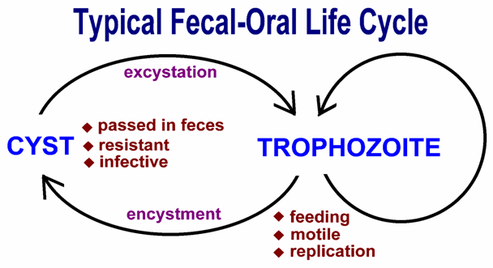
COMMON CHARACTERSTICS
TYPICAL FECAL-ORAL LIFE CYCLE

Slide 7
Fecal-Oral Transmission Factors
Poor personal hygiene
  Food handlers
  Institutions
  Children in day care centers
Developing countries
  Highly endemic
  Poor sanitation
  Travelers diarrhea
Water-borne epidemics
Male homosexuality
  Oral-anal contact
Zoonosis
  Entamoeba = no
  Cryptosporidium = yes
  Giardia = controversial

Slide 8
Control/Prevention
Improve personal hygiene
  Especially institutions
Treat asymptomatic carriers
  E.g, family members
Health education
  Hand-washing
  Sanitation
  Food handling
Protect water supply
Treat water if questionable
  Boiling
  Iodine

Slide 9
The Amoeba

Slide 10
Introduction
Amoeba (plural amoebae)= Protists that moves by
means of pseudopods
Amoeba = Greek word amoibe, means change
Most Amoeba are free-living widely distributed mostly in
aquatic environment
  -fresh water - salt water,
-wet soil, -on water plants leaves
Few of the parasitic and free-living amoebas produce
human disease

Slide 11
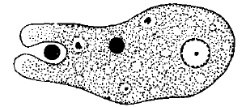
General characteristics
LOCOMOTION AND DIGESTION
  Locomotion and ingestion are accomplished by the use of the pseudopodia.
  Once the food substance is contained within the cell, the organism goes through the processes of enzymatically breaking down and absorbing the nutrients.
  Egestion of unused residue is performed by the expulsion of the vacuole out of the cell.

Slide 12
RESPIRATION AND REPRODUCTION
Respiration is performed by simple absorption of dissolved oxygen from the liquid environment.
Excretion of gases and waste is performed by diffusion out of the organism through the cell membrane.
Liquid regulation inside the body is controlled by Contractile vacuoles
  serve as two-way pumps that control the hydrostasis between the organism and the environment.
These organisms reproduce through asexual reproduction consisting of simple cell division.

Slide 13
AMOEBIC STATE:
Amoeba has two forms(stages)
I. Trophozoite
  Motile ,actively feeding stage
II. Cyst
  Is the non-motile form, which is protected by a distinct membrane or a cyst wall.
  This is the infective stage of most Amoeba
    exception are Dientamoeba fragilis and Entamoeba gingivalis

Slide 14
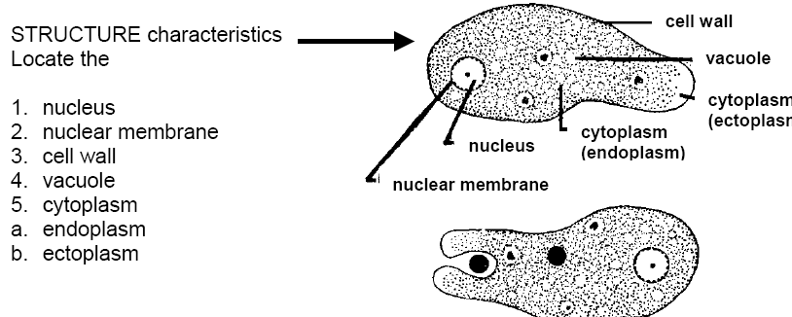
BASIC STRUCTURAL AND FUNCTIONAL CHARACTERISTICS
Cell membrane

Slide 15
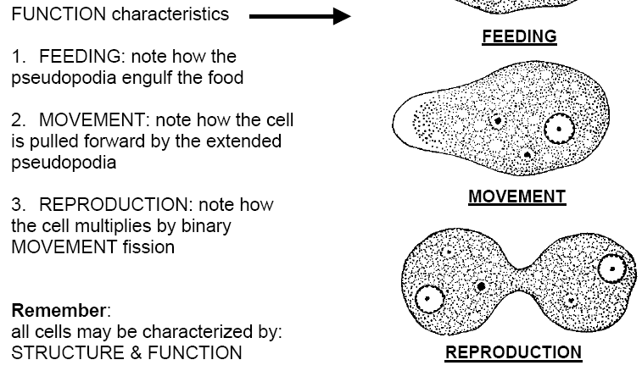

Slide 16
IMPORTANT TERMS USED IN RELATION TO AMOEBAE
Pseudopod
  Literally= false foot.
  temporary cytoplasmic processes formed at the surface of the trophozoite
Ectoplasm
  external hyaline portion of the cytoplasm which is generally visible in a moving trophozoite
Endoplasm
  Is the internal granular portion of the cytoplasm which contains various food inclusions.

Slide 17
Chromatoid body
  Is the RNA-protein complex which stains deeply with basic dyes but not with iodine.
  It is found in the genus Entamoeba
Glycogen vacuole
  Is a glycogen reserve which stains deeply with iodine and is found mainly in the cysts.
Food Vacuole
  A membrane bound vesicle in the cytoplasm formed around an ingested food particle.

Slide 18
Contractile vacuole
  A membrane bound vesicle in the cytoplasm which collects and expels water from the cell. This is found in the free-living amoebae.
Chromatin
  Is the substances in the cell nucleus which stains with basic dyes.
Pre-Cyst
  Is the rounded form of trophozoite which precedes the cystic stage. It differs from the cyst in not having a cyst wall.

Slide 19
Excystation
  Is the process of emergence of the trophozoite from the cyst.
Encystation
  Is the process of formation of the cyst from the trophozoite.
Metacyst
  Is the trophozoite which emerges from the cyst..

Slide 20
Taxonomy
Phylum Sarcomastigophora
Sub-Phylum Sarcodina
Class Lobosea
  Order Amoebida
  Suborder Tubulina
    Genera: Entamoeba, Iodamoeba, Endolimax- parasitic
    Suborder Acanthopodina
    Genera: Acanthamoeba - Free living
  Order Schizopyrenida
    Genera: Naegleria - Free living

Slide 21
Classification….
The Amoeba
Parasitic Ameba:
Intestinal
Entamoeba histolytica
Entamoeba dispar
Entamoeba coli
Entamoeba hartmanni
Endolimax nana
Iodamoeba bütschlii
Mouth
E. gingivalis
Free living Ameba:
Pathogenic
Naegleria fowleri
Acanthamoeba spp
Balmuthia Mandrilarias

Slide 22
Classification….
1- Pathogenic:
  intestinal amoeba: E. histolytica.
2 - Non pathogenic:
  ►Mouth amoeba: E. gingivalis
  ►intestinal amoeba: E. coli, Endolimax nana, Iodamoeba butschlii
3- free living pathogenic amoeba
_ Naegleria spps and others

Slide 23
Summary
Intestinal protozoa :- that inhabit the intestinal tract
Has a typical fecal-oral life cycle
High prevalence in areas of poor sanitary condition
Amoeba
  few are parasitic and causes diseases to humans
  Move by pseudopodia
  exist both as trophozoite and cyst
  Replication: binary fission

Slide 24
Pathogenic amoeba
Entamoeba histolytica

Slide 25
After taking this lesson the student will be able to:
  Discuses the epidemiology, life cycle, and clinical aspects of E. histolytica
  Discuses the pathology of Entamoeba histolytica.

Slide 26
Outline
E. histolytica
  History
  Epidemiology
  Morphology
  Transmission and life cycle
  Pathology and clinical manifestation

Slide 27
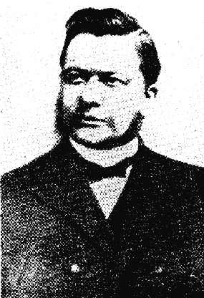
Entamoeba histolytica
causative agent of amebiasis
History
1873, Alexandrewitch Lösch
describes amoebae associated
with severe dysentery in a patient
  He transferred amoebae to a dog by rectal injection, which became ill and showed ulceration of colon
  Patient who died from infection showed similar ulcers upon autopsy

Slide 28
EPIDIMOLOGY
Cosmopolitan distribution principally
  In tropical countries with warm climates and bad sanitary conditions (fecalism).
  It is more frequent in poorest areas with contaminated water, bad management of waste, and bad drainage system.

Slide 29
Amebiasis- is the 3rd leading cause of death worldwide,
~ 10% of world’s population may be
infected with E. histolytica / E. dispar.
worldwide incidence = 0.2-50%(tropics)
  500 million people worldwide infected
  100 million people suffer acute symptoms
  100,000 people die every year

Slide 30
  Note
    Since more survey to determine the prevalence are made on stool examination which includes E. dispar
    Therefore, the current epidemiology of amoebiasis doesn’t show the true prevalence of E histolytica

Slide 31
Molecular Epidemiology
Molecular probes used to survey for E. Dispar and E. Histolytica
  E. Dispar ~10-fold > E. Histolytica
  Discrete endemic pockets of E. Histolytica
Many(90%) asymptomatic E. histolytica infections
~10% of the E. histolytica Infections are associated with invasive amebiasis
~25% seropositive for E. histolytica in endemic areas
Notes:
E.Dispar

Slide 33
Habitat and Morphology
E. histolytica has both trophozoite and cyst forms.
The trophozoites are microaerophilic,
  dwell in the lumen or wall of the colon,
  feed on bacteria and tissue cells,
  multiply rapidly in the anaerobic environment of the gut.
  When diarrhea occurs, the trophozoites are passed unchanged in the liquid stool.
Cyst
  Found in the stool of chronic dysenteric patients & carriers

Slide 34
Morphology
Trophozoite
  Size: 11 to 60μm
  Shape: elongated form when actively motile & rounded form when at rest
  Motility: Active, Progressive , directional amoeboid motility in
fresh stool specimen with
-Pseudopodia: Finger like, broadly rounded end

Slide 35
con…
Cytoplasm: Well differentiated into ectoplasm & endoplasm
- May contain ingested host’s RBC in dysenteric
specimen
Nucleus: Single nucleus, not visible in the motile form but in iodine stained smear clearly seen
Nucleus
-Vesicular type ;
- Nucleoplasm: clean
-Peripheral chromatin: finely granular & evenly distributed
-Karysome: small, discrete & usually centrally located

Slide 36
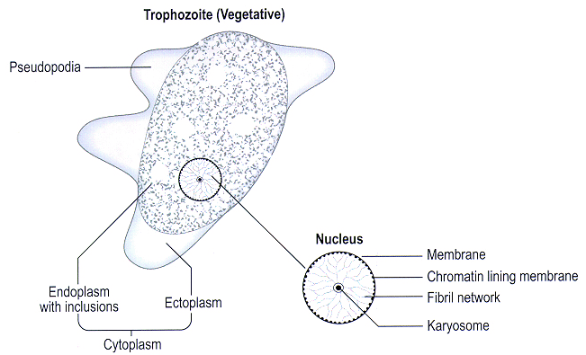
Cont….

Slide 37
Cysts of E. histolytica/E. dispar
Cyst
  Size: 11-20μm
  Shape: Spherical
  Cytoplasm: Yellowish-gray and granular in iodine stained
smear
  Chromatoid bodies : if present cigar-shaped
,rounded ends, diagnostic feature
  Glycogen : diffused, in vacuoles for young cysts
.

Slide 38
Cysts of E. histolytica/E. dispar…
Nucleus
Number: 1-4 ;the mature cyst has 4 nuclei
Peripheral chromatin: finely granular & evenly distributed
Karyosomes : small, discrete & usually centrally located
Nucleoplasm : clean

Slide 39
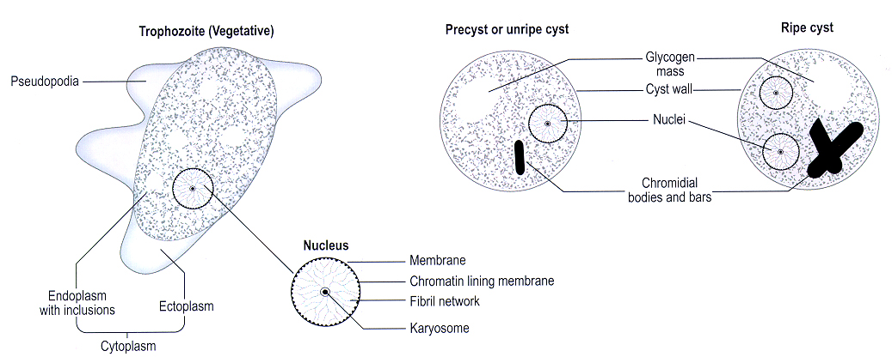
Cysts of E. histolytica/E. dispar

Slide 40
TRANSMISSION AND LIFE CYCLE

Slide 41

Transmission
Fecal-oral route
Humans are the only host of E. histolytica
There are no animal reservoirs.
  Ingestion of mature cyst (tetra nucleated cyst) from contaminated hands ,food, water, hands or objects as well as by sexual contact and geophagy
    average infective dose exceeds 1000 cyst, but
    Ingestion of a single cyst has been known to produce infection

Slide 42
Location in host:
  Colonization is most intense in areas of fecal stasis such as the cecum and rectosigmoid but may be found throughout the large bowel.
  May be carried to liver, lungs, and other body parts if it perforates the intestines

Slide 43
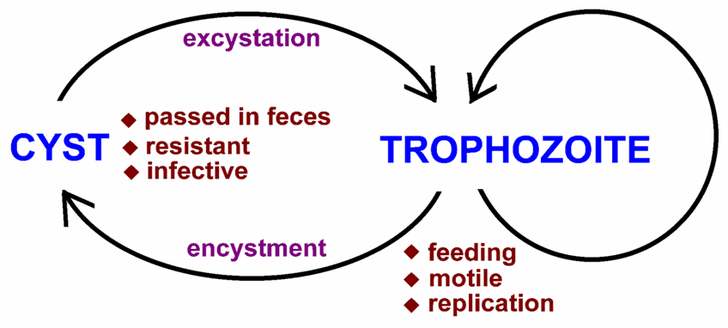
E. Histolytica Life Cycle
Definitive Host: Humans
Intermediate Host: None

Slide 44
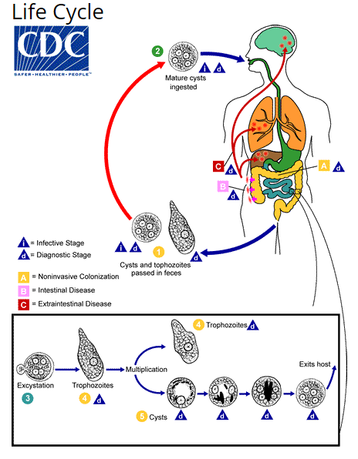

Slide 45
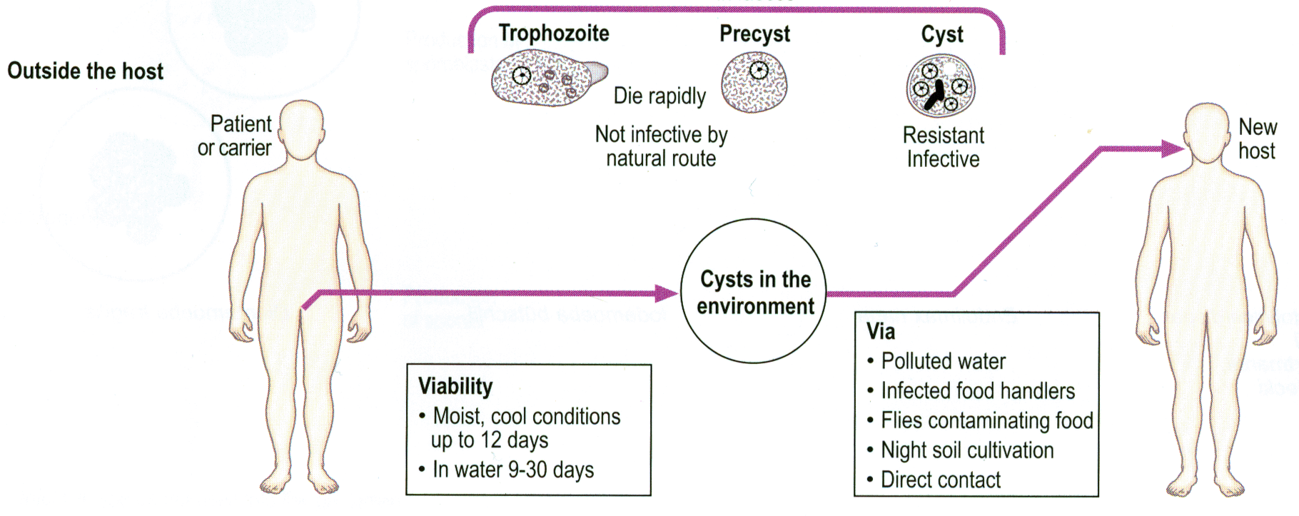
Life cycle…..
Humans are the only reservoir excreting up to 45 million cysts daily
Mature cysts can survive in envt.
temp up to 55°C,
Norm Chlorine conctentration
gastric acid.

Slide 46
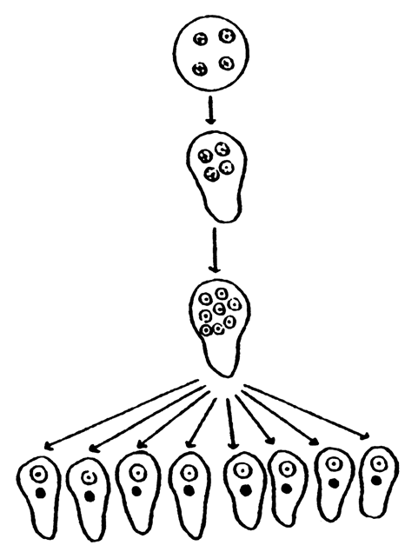
Excystation
In response to gastric acid, ingested cysts release trophozoites
in the upper intestine occurs in small intestine
nuclear division (4→8)
cytoplasmic divisions (8 amebala)

Slide 47
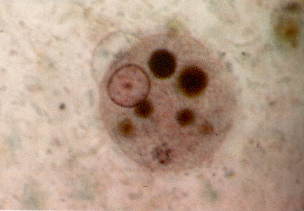
trophozoites colonize large intestine
feed on bacteria and debris
replicate by binary fission

Slide 48
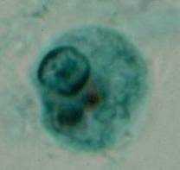
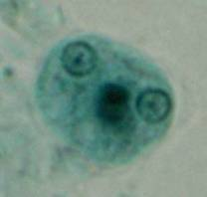
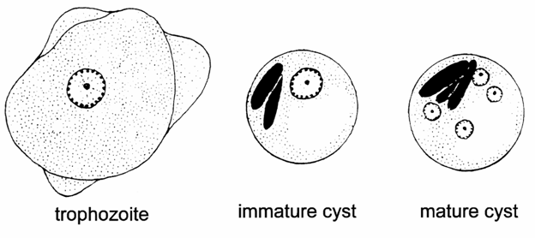
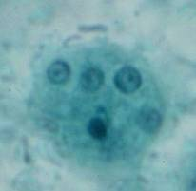
Encystation
trophozoite rounds up
secretion of cyst wall
aggregation of ribosomes (= chromatoid bodies)
2 rounds of nuclear division (1→4 nuclei)
survive weeks to months

Slide 49
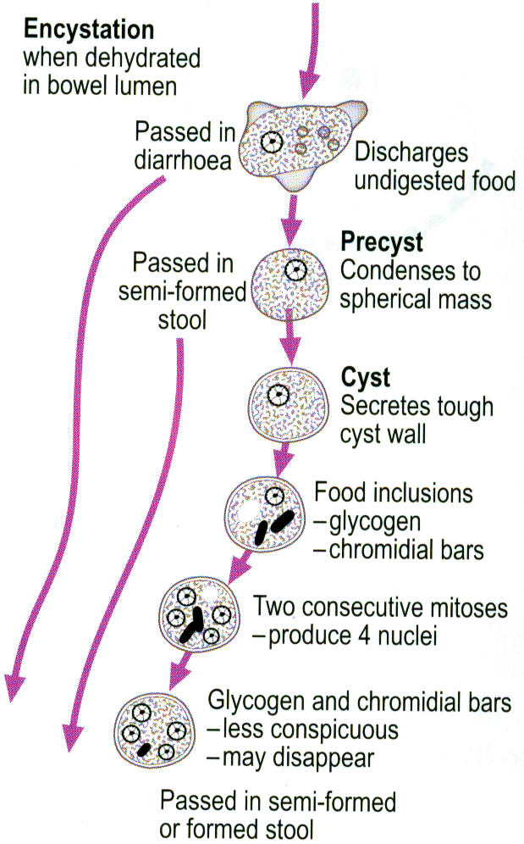

Slide 50
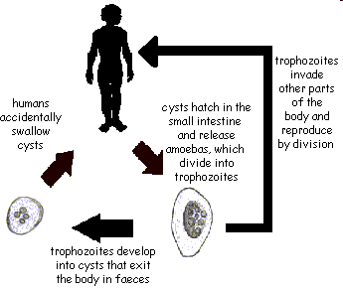
Events on Amoebiasis

Slide 51
PATHOGENESIS AND PATHOLOGY OF AMEBIASIS
Three key virulence factors:
  Amebic lectin: binds parasite to galactose-containing sugars on host cells
  Amoebapores: adherence-dependent cytolysis
  Cysteine protease: cleaves antibodies and C3 and degrade mucosal layers
Trophozoites ingest human cells
The incubation period
  Range from a few days to months or years with 2-4 weeks being the most common.
Transitions from one type of intestinal syndrome to another can occur and
Intestinal infections can give rise to extraintestinal infections.

Slide 52
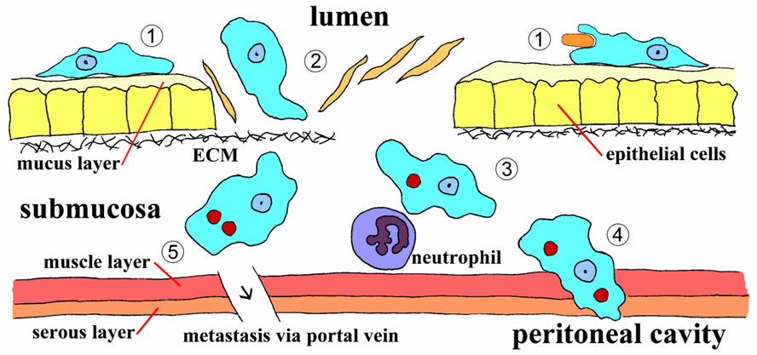
Cont …
Invasion of intestinal mucosa by E. histolytica is an active process mediated by the parasite and distinct steps can be recognized

Slide 53
Trophozoites adhere to the mucus layer (step 1). This adherence probably does not contribute to pathogenesis
Depletion of the mucus barrier allows for the trophozoite to come in contact with epithelial cells. Epithelial cells are killed in a contact dependent manner leading to a disruption of the intestinal mucosa (step 2).
The trophozoites will continue to kill host cells in the submucosa and further disrupt the tissue as they advance (step 3).
Disruption of the intestinal wall (step 4) or
Metastasis via the circulatory system (step 5) is also possible.

Slide 54
1. NON-INVASIVE
Trophozoites:
  colonize , adhere to the mucus layer and ingest bacteria and cellular debris from the lumen.
  Usually asymptomatic, or
  Exhibits symptoms ranging from mild abdominal discomfort to non-dysenteric diarrhea and cramps.

Slide 55
2. INVASIVE
The non-invasive infection can persist or progress to an invasive by:
  Penetration of mucus layer
  Contact-dependent killing of epithelial cells
  Breakdown of tissues (extracellular matrix)
  Contact-dependent killing of neutrophils, leukocytes

Slide 56
Cont...
Invasive
  necrosis of mucosa → ulcers, dysentery
  ulcer enlargement → severe dysentery, colitis,
  peritonitis
  metastasis → extra-intestinal amebiasis

Slide 58
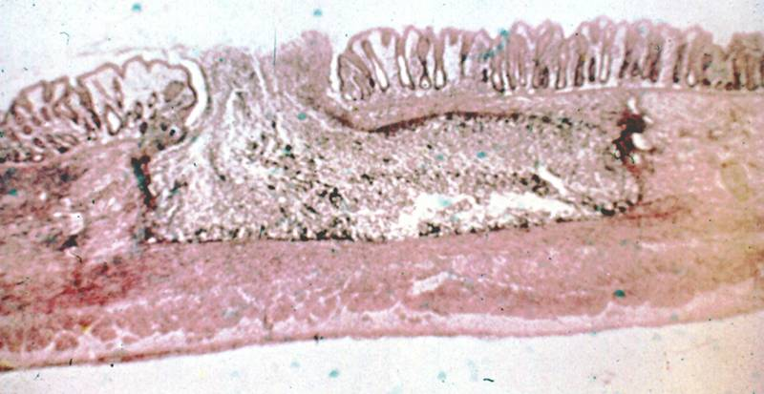
Once the lesion penetrates below the superficial epithelium, it meets the resistance of the colonic musculature and spreads laterally in the submucosa
‘flasked-shaped ulcer’ trophozoites at boundary of necrotic and healthy tissue
Trophozoites ingesting host cells
Dysentery (blood and mucus in feces)

Slide 59
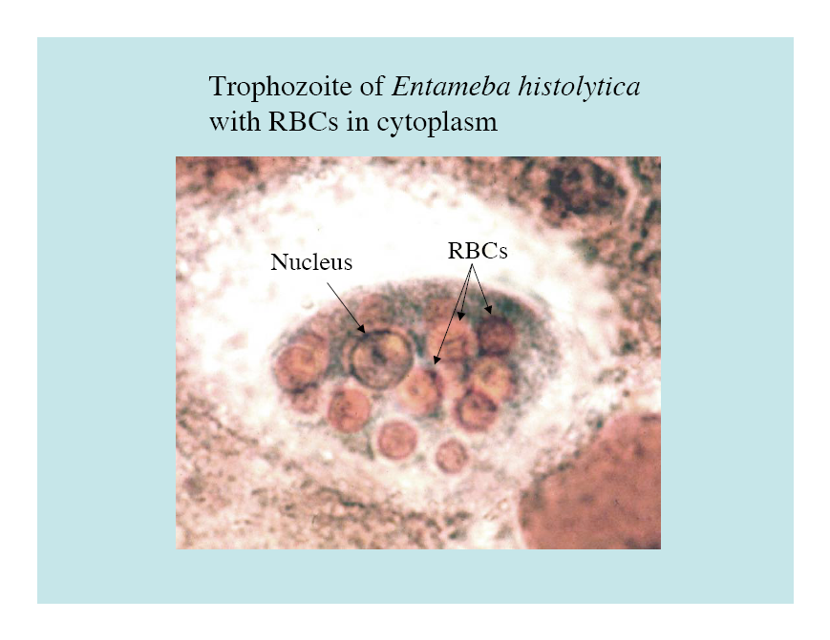
‘hematophagous’ trophozoites

Slide 60
Ulcer Enlargement can lead to secondary infection and extraintestinal lesions
Ameba expand laterally and downward into lamina propria
Localized sloughing (ulcers coalesce)
Perforation of intestinal wall
  Peritonitis
  2º bacterial infections
  Local abscesses
  Ameboma (=amebic granuloma)
ameboma = inflammatory thickening of intestinal wall around the abscess (can be confused with tumor)

Slide 61
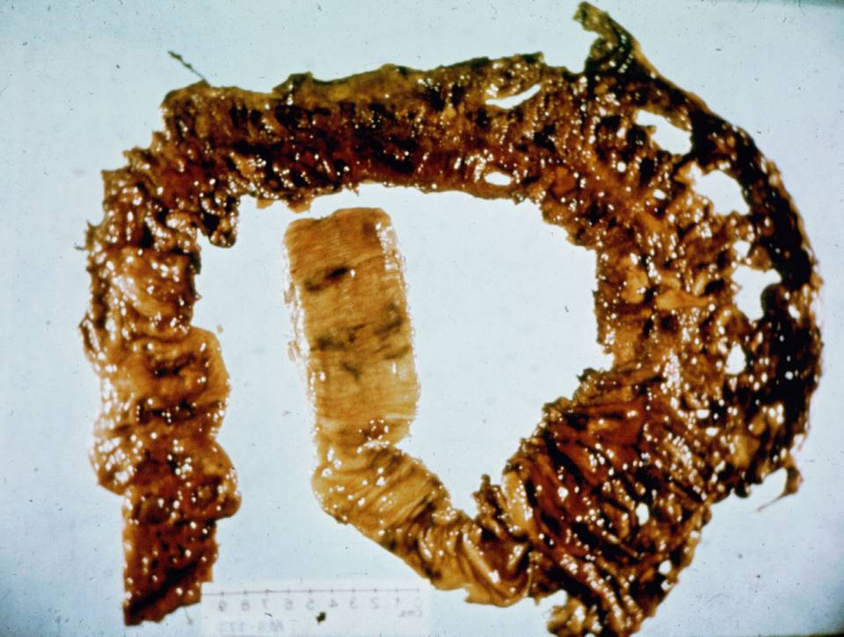
perforation of intestinal wall

Slide 62
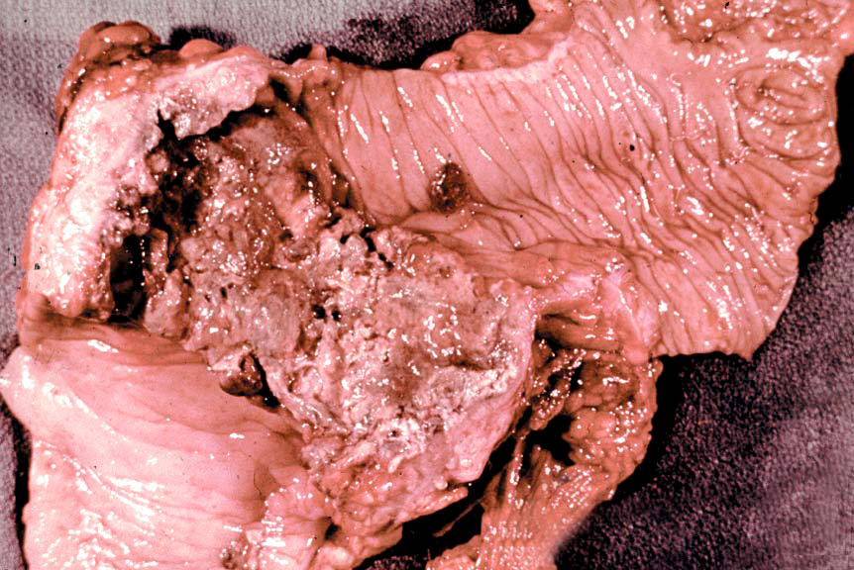
Gross pathology of large intestine due to Entameba histolytica

Slide 63
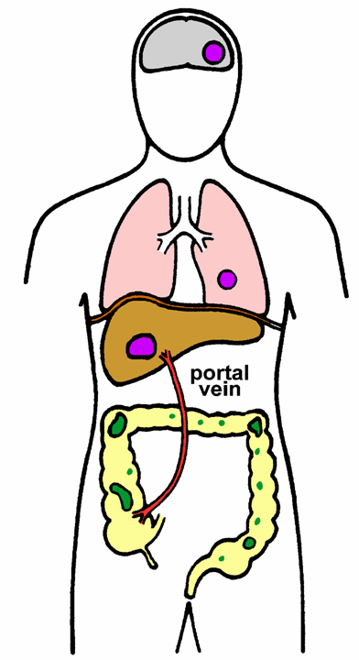
Extraintestinal amebiasis
Metastasis via blood stream
Primarily liver (portal vein)
  Other sites less frequent
Ameba-free stools common
High antibody titers
Hematogenous spreading of trophozoite

Slide 64
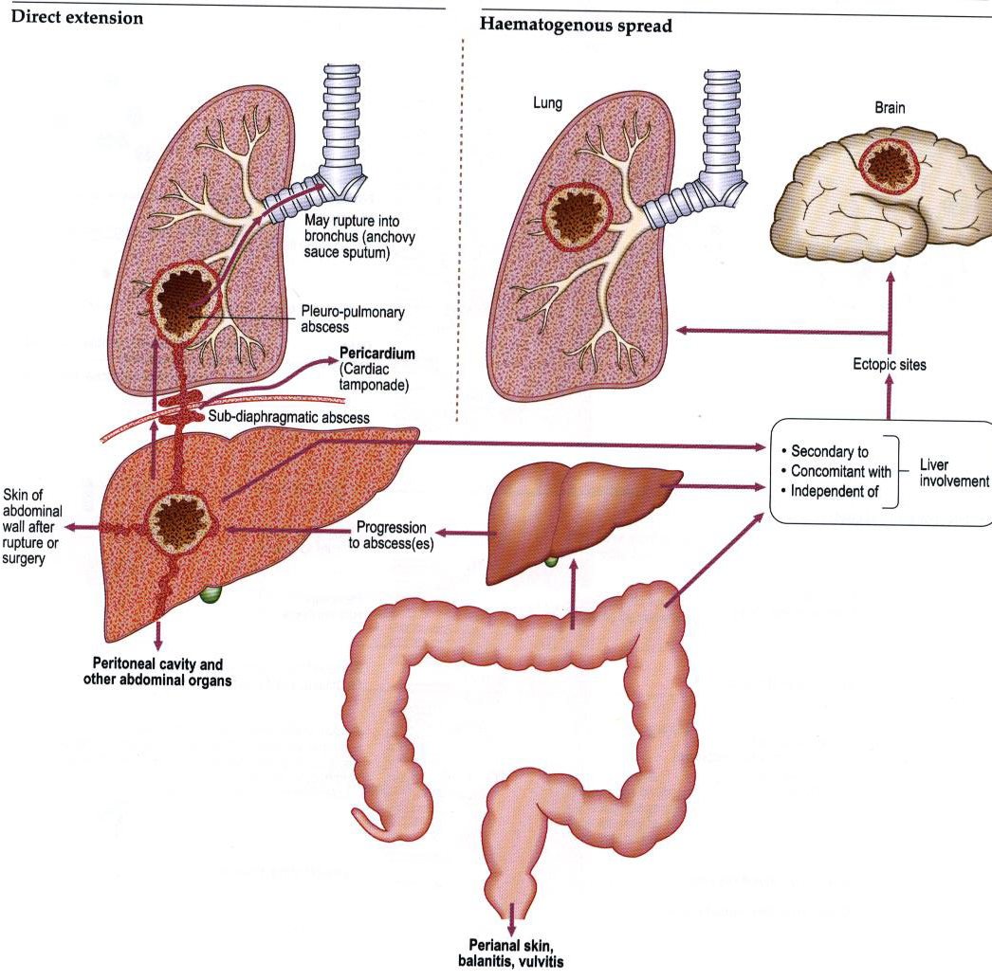

Slide 65
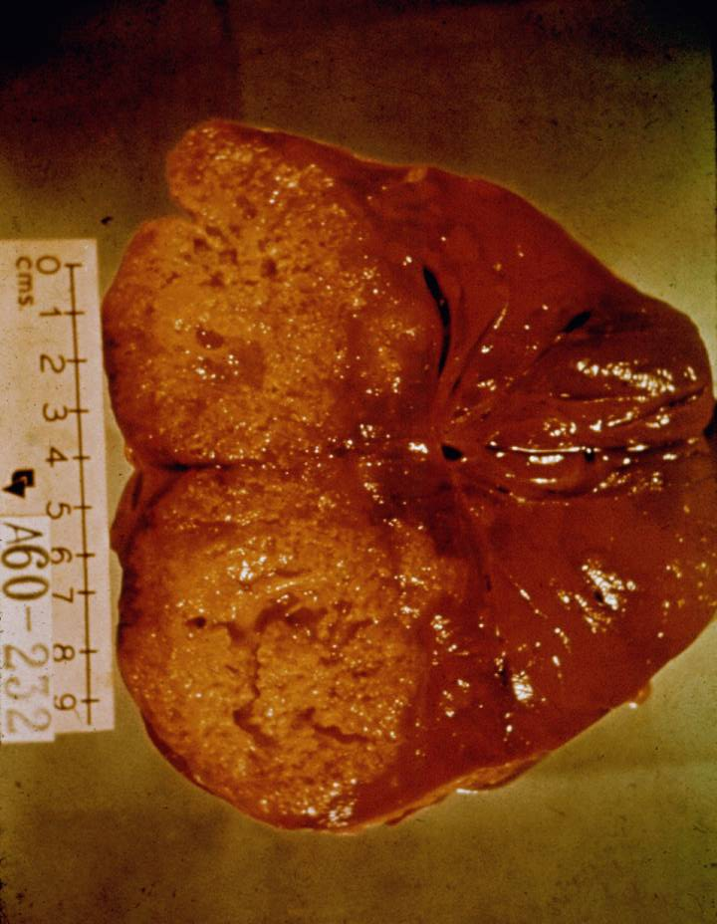
Amebic liver abscess
Most common form of extraintestinal amebiasis
symptoms are right upper quadrant pain and fever
Acute as well as chronic illness, with gradual or sudden onset

Slide 66
Amebic Liver Abscess
Fast growing abscess filled with:
chocolate-colored ‘pus’
  necrotic material
  usually bacteria free
  amoebae are found only at borders
lesions expand and coalesce
further metastasis, direct extension or fistula

Slide 67
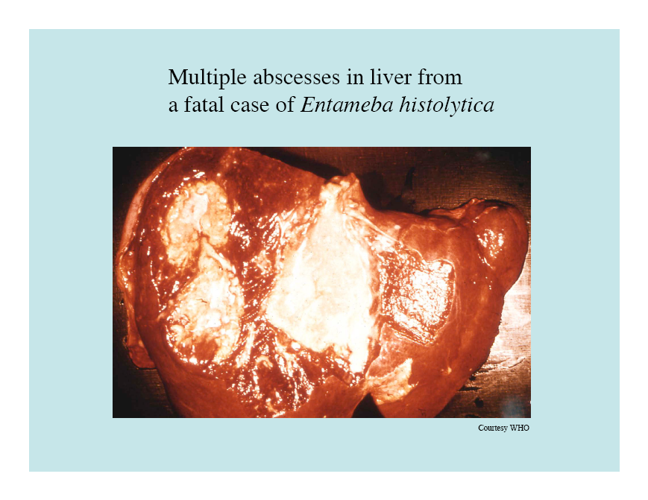

Slide 68
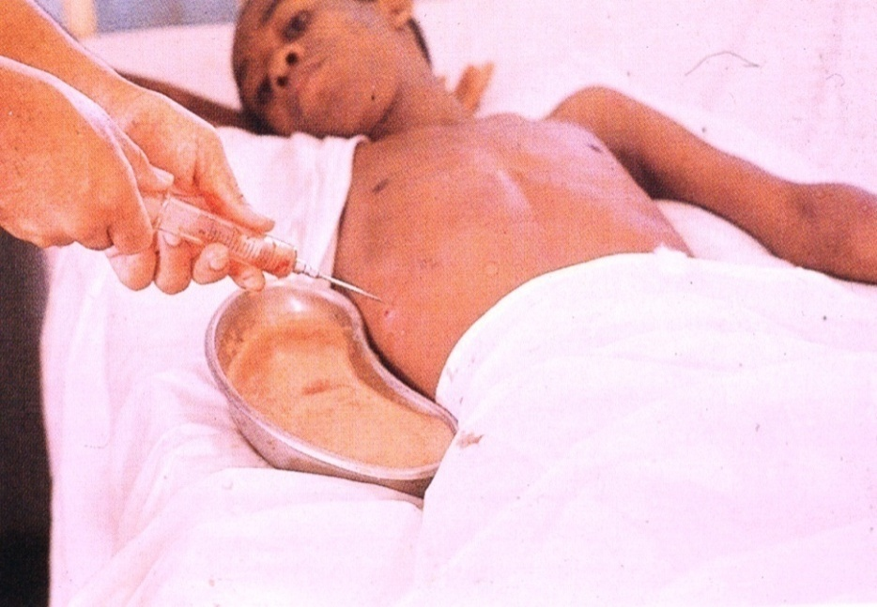
Amebic liver abscess
30-50% of patients with liver abscess show also pneumonic involvement
Rupture is again a major thread, especially rupture into the pericardium
Draining abscesses is today only performed in extreme cases when rupture is feared
Responds well to chemotherapy

Slide 69
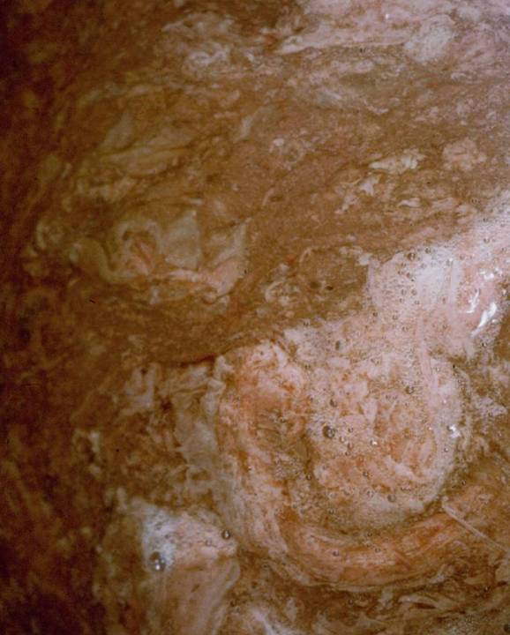
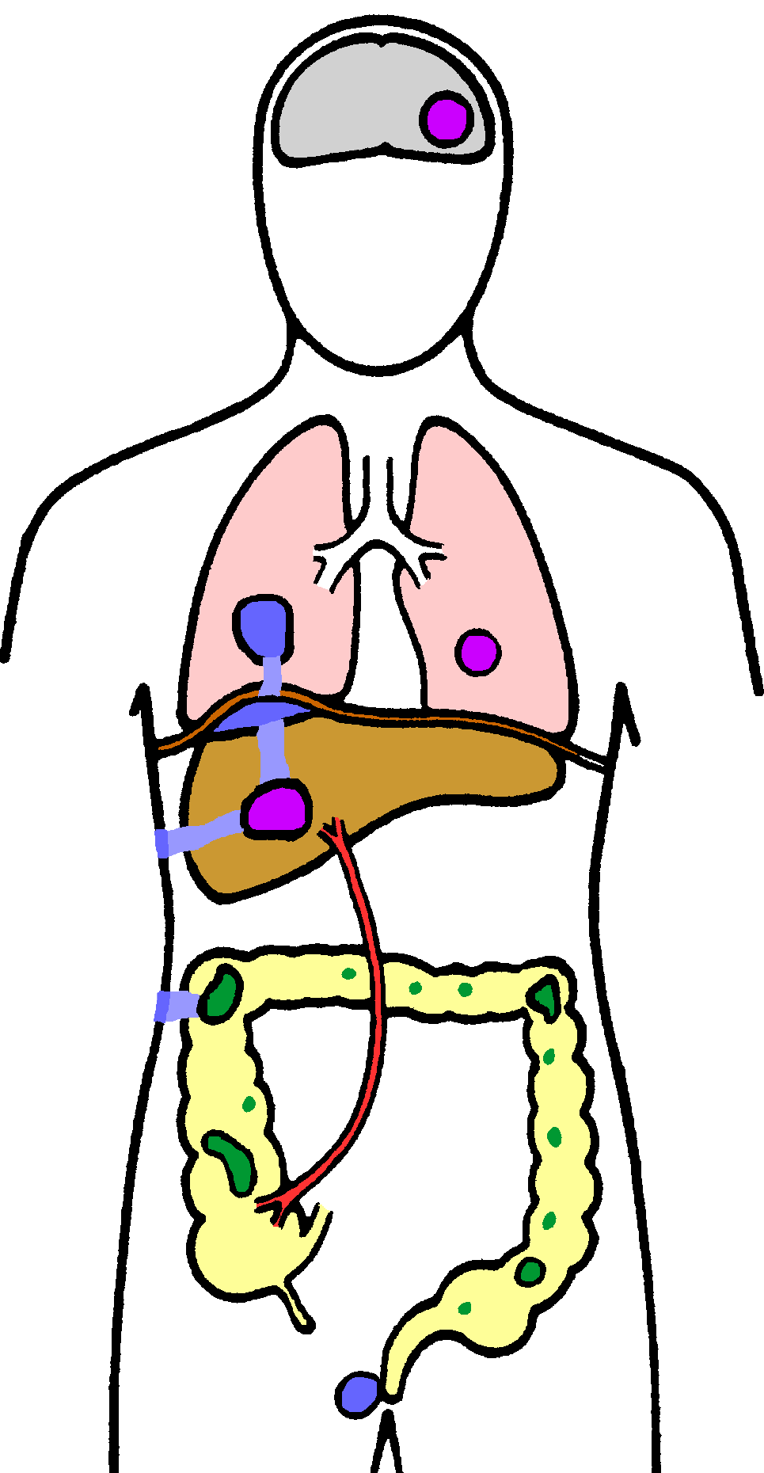
Pulmonary Amebiasis
rarely primary
rupture of liver abscess through diaphragm
2º bacterial infections common
fever, cough, dyspnea, pain, vomica
Notes:
An abscess cavity in the lungs

Slide 70
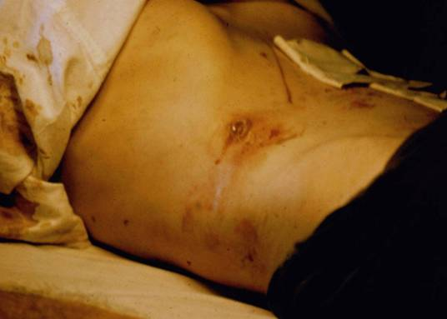
Cutaneous Amebiasis
Intestinal or hepatic fistula
Mucosa bathed in fluids containing trophozoites
  Perianal ulcers
  Urogenital (e.g: labia, vagina, penis)

Slide 71
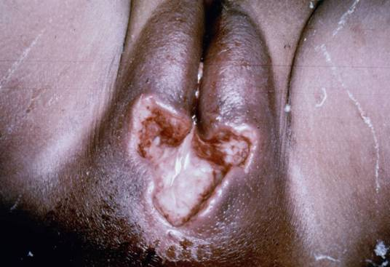
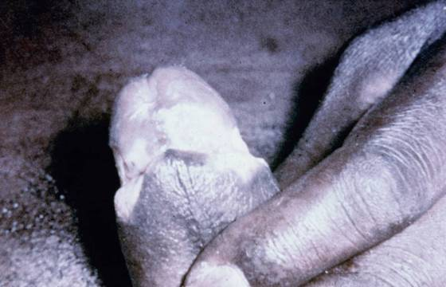
Cutaneous Amebiasis
intestinal or hepatic fistula
mucosa bathed in fluids containing trophozoites
  perianal ulcers
  urogenital (eg, labia, vagina, penis)

Slide 72
CLINICAL MANIFESTATION
Amebiasis presents a wide range of clinical syndromes
Depends on:
  host’s previous exposure to parasite
    Chronic, high-level exposure- asymptomatic.
    Less frequent exposure- severe symptoms.
  on nutritional status of host
  what organ the parasite invades.
    Abdominal cavity
      Peritonitis, abdominal pain, cramping, and anemia
    Liver
      Symptoms are similar to hepatitis
    Lungs, brains, or heart
      May cause the death of the host.

Slide 73
Intestinal Symptoms
Range
  mild to severe
Non dysenteric
  Diarrhea, - cramps,
  Flatulence, - nausea
Dysenteric
  blood/mucus in stools
  cramps/pain, tenesmus
Ameboma
  palpable mass
Liver symptoms
  Symptoms are similar to hepatitis
Lungs, brains, or heart
  May cause the death of the host

Slide 74

Treatment
Several drugs are available to clear symptomatic and asymptomatic enteric (luminal) infection
Tinidazole
Metronidazole (Flagyl) is the drug of choice for invasive amoebiasis (and should be combined with a lumen acting drug as it is not fully effective on luminal stages)
Metronidazole is a prodrug which is activated by an enzyme involved in the microaerobic fermentation metabolism of E. histolytica
Notes:
Metronidazole is the drug of choice for extra-intestinal amebiasis

Slide 75
Quiz
Adherence, cytotoxicity, and disruption of the tissues are important factors in the pathogenesis of E. histolytica. Parasite proteins which could play a role in these processes include:
1. ______________
2. _____________
3.______________ respectively.

Slide 76
Non pathogenic Amebae in Human Intestines
Entamoeba hartmanni –group 1
Entamoeba coli -group 2
Endolimax nana –group 3
Iodamoeba bütschlii -group 4
Entamoeba gingivalis- group 5

Slide 77
Non pathogenic Amebae in Human Intestines
Outline
  Geographical distribution
  Morphology
  Transmission and life cycle
  clinical manifestation

Slide 78
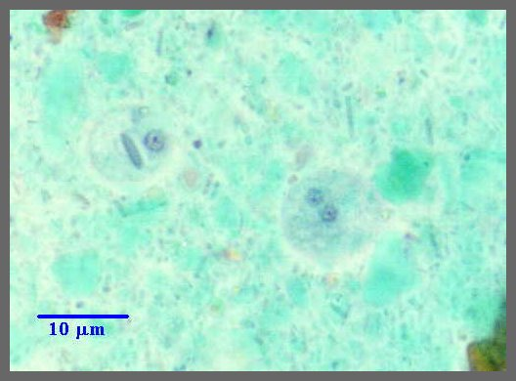
Entamoeba hartmanni
Geographic distribution: Cosmopolitan
Definitive Host: Humans
Intermediate Host: None
Mode of transmission: Ingestion of food and water contaminated by feces.

Slide 79
E. hartmanni Life Cycle
Trophs in large intestines
Binary Fission
Ingested
Cyst
Out into environment
Change in chemistry as troph moves down colon tells the troph to form a cyst.

Slide 80
Location in definitive host: Cecum and large intestine
Pathology and Treatment: None.
  Harmless commensal that does not lyse host cells.
  Eats bacteria in intestines.
Diagnosis: Important to distinguish between it and E.histolytica
  E. hartmanni is much smaller

Slide 81
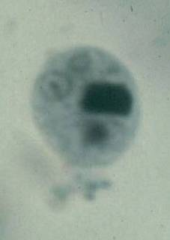
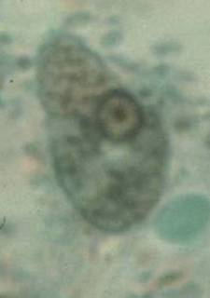
Entamoeba hartmanni
cysts
  6-8 μm
  4 nuclei (mature)
  blunt chromatoid bodies
  CB persist in mature cysts
trophozoites
  8-10 μm
nuclear structure
  peripheral chromatin
  small karyosome
< 10 μm = E. hartmanni
> 10 μm = E. histolytica
‘small race’ of E. histolytica
designated species in 1957

Slide 82
Entamoeba coli
Definitive Host: Humans
Intermediate Host: None
Geographic distribution: Cosmopolitan
  Much more common than E. histolytica
Mode of transmission: Ingestion of contaminated food and water.
Notes:
Can survive environmental conditions that kill E. histolytica so more common.

Slide 83
E. coli Life Cycle
Trophs in large intestines
Binary Fission
Ingested
Cyst
Out into environment
Change in chemistry as troph moves down colon tells the troph to form a cyst.

Slide 84
Location in Definitive host: Cecum and large intestine.
Pathology and Treatment: None
  Harmless commensal
  Feeds on bacteria, yeast, and wastes in intestines
Diagnosis: Important to distinguish between it and E. histolytica
  Avoid unnecessary treatment
  8 nuclei in cyst vs. 4 in E. histolytica
  Different shape nuclei.

Slide 85
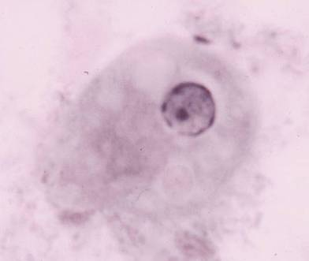
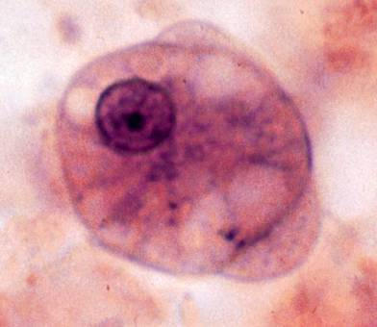
Entamoeba coli
trophozoites
  20-25 μm
  broad blunt pseudopodia
nuclear structure
  peripheral chromatin
  small karyosome
  irregular peripheral chromatin?
  eccentric karyosome?

Slide 86
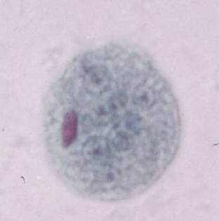
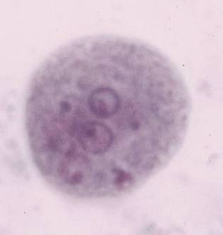
Entamoeba coli
cysts
  15-25 μm
  8 nuclei (mature)
  pointed chromatoid bodies (less prominent)

Slide 87
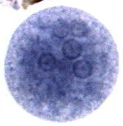
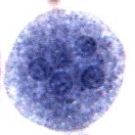
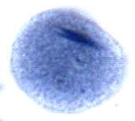
Entamoeba coli - Cyst
Usually more than 4, up to 8 nuclei.
Chromatin bars (C) have splinter-like ends (below)
C

Slide 88
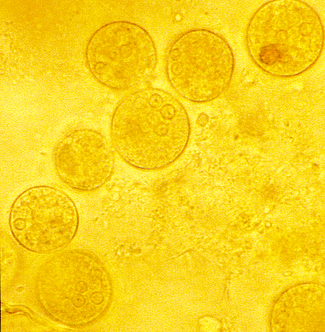

Slide 89
Endolimax nana
Definitive Host: Humans
Intermediate Host: None
Geographic distribution: Cosmopolitan
Mode of transmission: Ingestion of contaminated food and water.

Slide 90
E. nana Life Cycle
Trophs in large intestines
Binary Fission
Ingested
Cyst
Out into environment
Change in chemistry as troph moves down colon tells the troph to form a cyst.

Slide 91
Location in Definitive host: Cecum and large intestine.
Pathology and Treatment: None
  Harmless commensal
  Feeds on bacteria
Diagnosis: Important to distinguish between it and E. histolytica
  Avoid unnecessary treatment
  Much smaller with different nuclei

Slide 92
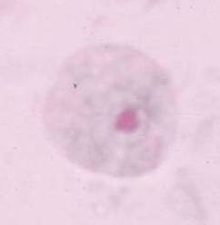
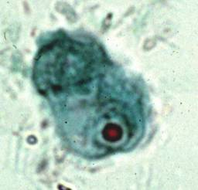
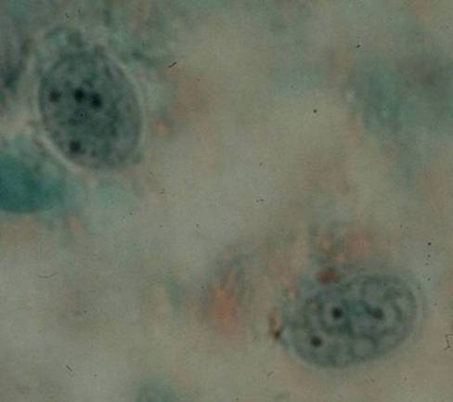
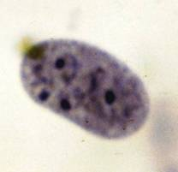
Endolimax nana
cysts
  6-8 μm
  4 nuclei
trophozoites
  8-10 μm
nuclear structure
  no peripheral chromatin
  large karyosome

Slide 93
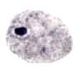
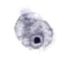


Endolimax nana - troph
Large endosome in the nucleus
Very small size

Slide 94



Endolimax nana - cyst
Very small size.
Up to four nuclei
  With very large endosome.

Slide 95
Iodamoeba buetschlii
Definitive Host: Humans, other primates, and pigs.
  Most common in pigs
    Probably the original host
Intermediate Host: None
Geographic distribution: Cosmopolitan
Mode of transmission: Ingestion of contaminated food and water.

Slide 96
I. buetschlii Life Cycle
Trophs in large intestines
Binary Fission
Ingested
Cyst
Out into environment
Change in chemistry as troph moves down colon tells the troph to form a cyst.

Slide 97
Location in Definitive host: Cecum and large intestine.
Pathology and Treatment: None
  Harmless commensal
  Feeds on bacteria, yeast, and wastes in intestines
Diagnosis: Important to distinguish between it and E. histolytica
  Avoid unnecessary treatment
  Large, clear vacoule in trophs and cysts
  Different shape nuclei.

Slide 98

Iodamoeba bütschlii
cysts
  10-12 μm
  1 nucleus
  glycogen vacuole
trophozoites
  12-15 μm
nuclear structure
  no peripheral chromatin
  large karyosome

Slide 99



Iodamoeba butschlii - troph
Larger than E. nana
Large endosome in nucleus
Many clear vacoules

Slide 100



Iodamoeba butschlii - cyst
Very similar to E. nana but larger
Large endosome in single nucleus
Large, single, clear vacoule.

Slide 101
Entamoeba gingivalis
Definitive Host: Humans. Also other primates, dogs, and cats.
Intermediate Host: None
Geographic distribution: Cosmopolitan
  About 50% of the population have it.
  Up to 95% of “unhealthy” mouths have it.
Mode of transmission: Direct oral contact (kissing).

Slide 102
E. gingivalis Life Cycle
Trophs in mouth
Binary Fission
Direct oral contact passes it to next host.
No cyst stage. Never goes out to external environment.

Slide 103
Location in Definitive host: Mouth, particularly along gums line. Also in tonsils.
Pathology and Treatment: None
  More common in mouths with gingivitis and tonsillitis
  Probably doesn’t cause disease
    Most likely due to abundance of food in “dirty” mouth.
Diagnosis: Sample of scrapings from teeth

Slide 104

Other Entamoeba
E. gingivalis
oral cavity
no cyst stage
trophozoites nearly identical to E. histolytica
periodontal disease?

Slide 105
Remember
Definitive Host
Intermediate host
Geographic distribution
Mode of transmission
Location in definitive host
Pathology
  Disease, symptoms, diagnosis, treatment
Life Cycle

Slide 106
LABORATORY DIAGNOSIS OF
AMOEBIASIS

Slide 107
Laboratory Learning Objectives:
Upon completion of this unit of instruction and laboratory experience, the student will be able to:
  Differentiate and identify Amoebas by stage, genus, and species
  Differentiate cyst forms from trophozoite forms of E. histolytica
  Distinguish trophozoite and cyst forms of E. histolytica from other non pathogenic amoeba and artifacts in stool spesmen
  Identify the specimen of choice for recovery of specific protozoan organisms.
  Identify the special technique required for recovery of specific protozoan organisms.
  Describe the Microscopy, Immunodiagnosis, Molecular and Culture based diagnosis of Amoeba

Slide 108
Outline
Basic guidelines
Microscopic examination of faecal specimens
Differential characteristics of amoeba by: -
  stage(trophozoites/cyst)
  Genus
  species
Immunodiagnosis
  Antigen detection
  Antibody detection
Molecular-based diagnosis
Culture method

Slide 109
Basic guidelines
Multiple stool samples (at least 3) should be tested before a negative result is reported
To maximize recovery of cysts, stool samples in formalin, or other fixatives, should be concentrated prior to microscopic examination (e.g.,10 min at 500 × g when using the formalin-ethylacetate concentration procedure)

Slide 110
Basic guidelines
Exception: Specimens to be used for EIA or rapid cartridge assays should NOT be concentrated because antigens are lost during the procedure!
Choice of diagnostic techniques depends on available equipment and reagents, experience, and considerations of time and cost.

Slide 111
Microscopy
Intestinal amoebiasis
Microscopic examination
  Examination of fresh dysenteric faecal specimen or rectal scraping for motile trophozoites
    wet mounts
      Fresh stool
    Permanently stained preparations (e.g. trichrome).
      Fresh stool
      Preserved stool

Slide 112
Microscopic examination
  Examination of formed or semi-formed faecal specimen for cysts
      Fresh stool
      Smear after concentration
      Preserved stool

Slide 113
Microscopic examination
Correct identification Amoeba depends on:
  Proper collection of stool and preparation of slides
  Systematic microscope technique
  Knowing and observing the morphology of the species.

Slide 114
Specimen Collection and processing
Collect the stool in a dry, clean, leak proof container.
Make sure no urine, water, soil or other material gets in the container.
Fresh stool should be examined, processed, or preserved immediately.
Preserve the specimen as soon as possible in two different preservatives(10% formalin and PVA (polyvinyl-alcohol …),
Specimen collection may need to be repeated if the first examination is negative.
  If possible, three specimens passed at intervals of 2-3 days should be examined

Slide 115
COLLECTION OF STOOL
TROPHOZOITE
CYST
5% OR 10%
FORMALIN
PVA/SAF
PERMENANT
STAINED SMEAR
Trichrome or
Iron haematoxylin
CONCENTRATION
WET MOUNT
TROPHOZOITE
OR CYST
GENERAL
MORPHOLOGY
PRECISE
MORPHOLOGY

Slide 117

Distribution of protozoa in relation to stool consistency

Slide 118
PREPARATION OF SLIDES
In many instances amebae can be identified by examining two types of preparations;
  1. Initial Wet Mount Slide
  2. Concentrate Wet Mount Slide

Slide 119
2. Permanent Stain Slide, IF:
  The presence of trophozoites is suggested by the consistency (watery, loose, soft) of fresh specimen and the presence of blood and/or mucus
  Necessary for the identification of organisms unidentified in the wet mounts
  A permanent record is desired

Slide 120
3. Culture Slides (wet mount and permanent stain):
  IF culture has been prepared as a result of earlier indication of possible presence of amebae

Slide 122
TEMPORARY WET MOUNTS
Three general types of solutions (reagents)
  saline sustains both trophozoites and cysts
  Dobell's iodine makes clearer nuclei in cysts
The Initial (Formalin), Concentrate, and Culture Wet Mounts do not require saline since the samples for them are liquid enough.

Slide 124
PREPARATION OF PERMANENT STAIN SLIDES
The slide is prepared:
  If consistency of the fresh specimen and the presence of blood and/or mucus suggest the presence of trophozoites,
  When necessary for identifying organisms unidentified in the wet mounts, and
  For permanent record

Slide 125

PERMANENT STAIN SLIDES CAN BE PREPARED

Slide 126
Systematic microscope technique
  1

Slide 127

Most Amoeba exist as:
STAGE (trophozoite or cyst) is determined by the overall shape of the organism and the presence of certain bodies in its cytoplasm.
-contain bacteria and food particles -contain RBC
-show motility
Most have
-more irregular shape
-uninuclear
-chromatoid bodies
-glycogen vacuole
-inclusion mass M
-smooth and rounded
-more than one nucleus

Slide 128
GENUS is determined by the presence or absence of PERIPHERAL CHROMATIN in the nucleus and/or CHROMATOlD BODIES in the cytoplasm.

Slide 129

Characteristics used to distinguish species
Nuclear Morphology(trophozoite & Cyst)

Slide 130
Characteristics used to distinguish species of intestinal amebae
Trophozoites
Motility- progressive or nonprogressive.
Cytoplasm
  Appearance-finely granular, coarsely granular, or vacuolated.
  Inclusions-erythrocytes, bacteria, molds.

Slide 131
Nucleus
  Number present.
  Peripheral chromatin- present or absent. If present, the distribution along the inner surface of the nuclear membrane and the size of the granules are important.
  Karyosome- location and size.
Size
  Sizes overlap, but they can be used as a secondary distinguishing feature.
  Size is the chief criterion for distinguishing Entamoeba histolytica from Entamoeba hartmanni.

Slide 132
Cysts
  Nucleus
    Number present.
    Peripheral chromatin-present or absent.
    If present, the distribution of the granules along the inner surface of the nuclear membrane
    Karyosome- location and size.
  Cytoplasm
    Chromatoid bodies-present or absent.
    If present, the shape is important.
    Glycogen- appearance.

Slide 133
Size
  Sizes overlap, but they can be used as a secondary distinguishing feature.
  Size is the major criterion for distinguishing Entamoeba histolytica from Entamoeba hartmanni.
Shape
  Shapes vary, but they may be useful as a secondary distinguishing feature.

Slide 135

5. Identify Species
Type of motility
Type of Pseudopodia
Suggestive
Confirmatory

Slide 136


Characteristics used to distinguish species
Cysts
Size
Shape
No of Nucleus

Slide 137
Both unstained and stained preparations are necessary to demonstrate all of the features.
Species identification of trophozoites can rarely be made from single features, such as nucleus or cytoplasm, or from a single organism.
Several features and several organisms should be examined.
Cysts are less variable and can usually be more easily identified than trophozoites.

Slide 138
Trichrome stain
Trophozoites
  measure 15 to 20 μm (range may be 10 to 60 μm).
  Presence of one nucleus with evenly arranged chromatin on the nuclear membrane and
  a small, centrally located karyosome are morphological features of trophozoites.
  The cytoplasm is finely granular and few ingested bacteria or debris may be present.
  Presence of red blood cells within the cytoplasm of trophozoites is a diagnostic feature for the identification of E. histolytica.
  Ingested RBCs are not frequently seen; in the absence of this diagnostic characteristic E. histolytica/E. dispar should be reported.

Slide 139

E.histolytica
Trophozoite
  15 to 20 µm (range 10 to 60 µm
  has a single nucleus,
  centrally placed karyosome and
  uniformly distributed peripheral chromatin.
  has a cytoplasm with granular or "ground- glass" appearance

Slide 140

Entamoeba histolytica/E. dispar,
Cysts
  Measure 12 to 15 µm.
  are usually spherical
  Mature cysts have 4 nuclei.
  The nuclei have characteristically centrally located karyosomes,
  And fine, uniformly distributed peripheral chromatin.
  chromatoid bodies with typically blunted ends.

Slide 141
Trichrome stain
Cysts
  12 to 15 μm (range 10 to 20 μm) and
  have 1 to 4 nuclei. Chromatoid bodies
  with bluntly rounded ends may also be present.

Slide 142


Slide 143


Slide 144

Entamoeba cysts (light microscopy)
E. coli
E. histolytica

Slide 145


Slide 146


Slide 147
SIMILAR ORGANISMS AND ARTIFACTS
Some of the most difficult problems in the correct identification of amebae in stool specimens are caused by:
  the presence of free-Iiving amebae, other protozoa, and the many confusing elements whose structures are similar to those of amebae.
  Some of these "artifacts" are pictured below.
  Look closely and note how their characteristics differ from the classic amebae you have learned:

Slide 148


Slide 149
Low sensitivity of microscopic examination
Many E.histolytica infections were confused with E.dispar
The only way to distinguish E.dispar from E.histolytica microscopically is erythrophagocytosis.
False-positive results due to misidentification of macrophages and nonpathogenic species of Entamoeba

Slide 150
Immunodiagnosis
Antibody Detection
Amoebiasis can be diagnosed by a serological test.
  Because anti-E. histolytica antibodies are produced by hosts infected with E. histolytica but not by carriers of E. dispar,
  Of patients with current cases of amoebiasis, 75% - 85% have IgG anti-E. histolytica antibodies present in their blood.
  This technique is used most often for diagnosing chronic or extra-intestinal infections

Slide 151
TECHNIQUE
  IHA test, Enzyme immunoassay (EIA) etc..
  IHA test has been replaced by EIA test kits for routine serodiagnosis .
  The EIA test detects antibody specific for E. histolytica in :
    95% of patients with extraintestinal amebiasis,
    70% of patients with active intestinal infection, and
    10% of asymptomatic persons who are passing cysts of E. histolytica

Slide 152
The persistence of the antibodies
  Detectable IgG antibody levels can remain high for years after the infection, and
  In 90% of people who have recovered from a case of amoebaisis.
  the serological test can only be used to determine if a person has ever had amoebiasis and
  gives no indication of the current state of the infection. in areas where amoebiasis is endemic
Currently, research is being done on an anti-E. histolytica IgM antibody that is present in patients with chronic infections, but does not persist in the serum after recovery

Slide 153
2. Antigen Detection
  Useful to distinguish between pathogenic and nonpathogenic infections.
  Using monoclonal antibodies, it can distinguish between E. histolytica and E. dispar infections.
  Currently kit is available:
    which detects only pathogenic E. histolytica infection in stool;
    which detect E. histolytica antigens in stool but do not exclude E. dispar infections.
  Antigen detection using ELISA can be performed rapidly and easily, making it the diagnostic test method of choice for clinical use in the developing world

Slide 154
Enzyme immunoassays (EIA)
Immunoassay kits are commercially available that detect E. histolytica.
Currently, these tests require the use of fresh or frozen stool specimens and cannot be used with preserved specimens.

Slide 155
Rapid immunochromatographic cartridge assay
A rapid cartridge is available that detects antigens of E. histolytica/E. dispar,
  however this assay does not distinguish between E. histolytica and E. dispar.
  This assay also detects antigens of Giardia and Cryptosporidium.
Stool samples must be fresh or frozen and should not be concentrated prior to testing.
Borderline positives and questionable negatives should be further confirmed by additional testing.
This assay is quick and easy to perform and no special equipment is needed.

Slide 156
Cultivation of Amoeba
LABORATORY GROWTH
  Trophozoites are facultative anaerobes that require complex media for growth.
  Most require the addition of live bacteria for successful isolation.
  Sterile culture techniques (axenic) have been developed, however, and
  are essential for the preparation of the purified antigens required for serologic testing, zymodeme typing, and characterization of virulence factors.
  Such techniques are generally available only in research laboratories.

Slide 157
Cultivation of Amoeba
Cultivation increases the possibilities of finding an organism by permitting the amebae to multiply.
Cultures are primarily research tools rather than diagnostic tools.
  Culture method is not currently available and not readily usable for routine diagnosis
  It requires a week to complete and are negative in many microscopy-positive samples,
  in some cases due to delays in sample processing or due to the institution of antiamebic therapy prior to stool collection

Slide 158
Cultivation of Amoeba
Xenic in which the parasite is grown in the presence of an undefined flora. D. fragilis ,B. coli, E. histolytica and B. hominis
Monoxenic in which the parasite is grown in the presence of a single additional species E. histolytica and B. coli
Axenic in which the parasite is grown in the absence of any other metabolizing cells. G. intestinalis, E.histolytica and B.hominis
Isoenzyme analysis of cultured Amebae enables the differentiation of E. histolytica from E. dispar

Slide 159

ENTAMOEBA HISTOLYTICA
And other intestinal amoebae

Slide 160
Molecular technique
Polymerase Chain Reaction (PCR) can be used to amplify specific strands of E. histolytica DNA or RNA, so that it can be more easily observed in dilute samples (especially environmental samples.)
PCR methods offer sensitivity and specificity
It may be not well suited for use in developing countries where amoebiais is endemic as it is time-consuming, cumbersome, and expensive

Slide 161
Moreover.
  E.histolytica trophozoites can be isolated from tissue biopsies or ulcer scrapings.
  Barium enemas can be used to view abscesses, ulcers, and amoebomas in the colon, and ultrasound, CT and MRI scans of the abdomen can help identify liver abcesses.

Slide 162


Slide 163
Sigmoidoscopic examinations.
  When amebiasis is suspected and stool samples are negative, material for examination may be collected by sigmoidoscopy.
  The procedure should be performed after a normal bowel movement or two to three hours after administration of a cathartic.
  The specimen is collected with a pipette rather than with a swab by aspirating material from any visible lesion and from the mucosa.
  Examination of sigmoidoscopic material should be done immediately, but fixation can be done with polyvinyl alcohol (PVA) after the wet preparation.

Slide 164
Liver abscesses.
  Exudates aspirated from the liver may contain trophozoites of Entamoeba histolytica.
  The first portion of the specimen does not usually yield organisms, but the second (reddish) portion does.
  Aspirates should be examined microscopically with wet preparations as well as with permanent stains.

Slide 165
Non pathogenic Amebae in Human Intestines
Entamoeba coli
Entamoeba hartmanni
Endolimax nana
Iodamoeba bütschlii

Slide 166
Entamoeba hartmanni
cysts
  6-8 μm
  4 nuclei (mature)
  blunt chromatoid bodies
  CB persist in mature cysts
trophozoites
  8-10 μm
nuclear structure
  peripheral chromatin
  small karyosome
< 10 μm = E. hartmanni
> 10 μm = E. histolytica
‘small race’ of E. histolytica
designated species in 1957

Slide 167
Entamoeba coli
trophozoites
  20-25 μm
  broad blunt pseudopodia
nuclear structure
  peripheral chromatin
  small karyosome
  irregular peripheral chromatin?
  eccentric karyosome?

Slide 168
Entamoeba coli
cysts
  15-25 μm
  8 nuclei (mature)
  pointed chromatoid bodies (less prominent)

Slide 169
Entamoeba coli - Cyst
Usually more than 4, up to 8 nuclei.
Chromatin bars (C) have splinter-like ends (below)
C

Slide 171
Endolimax nana
cysts
  6-8 μm
  4 nuclei
trophozoites
  8-10 μm
nuclear structure
  no peripheral chromatin
  large karyosome

Slide 172
Endolimax nana - troph
Large endosome in the nucleus
Very small size

Slide 173
Endolimax nana - cyst
Very small size.
Up to four nuclei
  With very large endosome.

Slide 174
Iodamoeba bütschlii
cysts
  10-12 μm
  1 nucleus
  glycogen vacuole
trophozoites
  12-15 μm
nuclear structure
  no peripheral chromatin
  large karyosome

Slide 175
Iodamoeba butschlii - troph
Larger than E. nana
Large endosome in nucleus
Many clear vacoules

Slide 176
Iodamoeba butschlii - cyst
Very similar to E. nana but larger
Large endosome in single nucleus
Large, single, clear vacoule.

Slide 177
Other Entamoeba
E. gingivalis
oral cavity
no cyst stage
trophozoites nearly identical to E. histolytica
periodontal disease?

Slide 178
Table 3.1: Differential characteristics of intestinal amoebae (live specimens)
- | E. histolytica | E. hartmanni | E. coli | E. polecki | E.nana | l. butschlii | D.fragilis*
TraphozoiteMovement | Active especially in acute dysentery | Sluggish | Sluggish | sluggish | Sluggish | Active | Active often multiple pseudopods
Inclusions | Red cell in case of tissue invasion | No red cells | No red cells | No red cell | No red cell | No red cell | No red cell

Slide 179
Table 3.2: Differential characteristics of intestinal amoebae (stained specimens)
- | E. histolytica | E. hartmanni | E. coli | E. polecki | E. nana | I.butschlii | D.fragilis
TrophozoiteNo. of nuclei | 1 | 1 | 1 | 1 | 1 | 1 | 2
Karysome(Nucleolus) | Usually central small | Usually central small | Usually central small | Usually central small | Large | Large generally irregular | Large may be fragmented
Peripheral chromatin | Usually symmetrical fine | Usually symmetrical fine | Usually symmetrical fine | Usually symmetrical fine | Usually symmetrical fine | Incon-spicuous | Incon-spicuous

Slide 180
Flagellates
Luminal (intestinal, urogenital& oral) flagellates
Haem(blood & tissue) flagellates

