Slide 1

college of Health Science
Department of Environmental Health Science
Environmental Biological Analysis
For 2rd yr Environmental Health Students
Course code- Envh3141
E_{t} CTS credits: 3(27hrs) by Alebachew Shimelash(Bsc.MPH in Env’al)
March, 2020
Debre Markos, Ethiopia

Slide 2
Chapter One
Introduction to Environmental Biological Analysis

Slide 3
Introduction
What is Environmental Biological Analysis?
The biological methods used for assessing water quality includes collection, counting and identification of aquatic organisms; biomass measurements; measurements of metabolic activity rates; toxicity tests; bioaccumulation; biomagnifications of pollutants; and processing and interpretation of biological data.
It is the identification and determination of biological organisms from samples of different environmental components
What are these biological organisms?
  Microbes like Bacteria
  Macro invertebrates
  Diatoms
  Zooplanktons
  Phytoplankton
  Fishes etc.

Slide 4
Why we need to analyze biological organisms?
Because bacteria are pathogenic to human
The presence or absence of bacteria indicates whether our water supply or food is fit for consumption or not
Suppose you have found Salmonella typhi or Vibrio cholerae in your water or food.
What comes into your mind?
What will be your measure?

Slide 5
What are the sources of microbes in water, soil, air or food?
Liquid waste from toilets, septic tanks effluents
Solid wastes
Food processing industries
Agricultural areas etc.
Why we need to analyze macroinvertebrates and diatoms?
To determine the quality of surface water, usually for rivers
For example if you want study the impact of untreated industrial wastes on aquatic organisms, macroinvertebrates and diatoms are best options

Slide 6
Why we need to analyze Zooplanktons and Phytoplanktons?
To determine the quality of water in lakes, wetlands, oceans
The presence or absence or abundance of certain species of zooplankton or phytoplankton in lakes or oceans indicate whether that lakes have good or bad quality
For example, the presence of more cyanobacteria (phytoplankton) and rotifers (zooplankton), reveal that the lake have degraded quality
Notes:
Ecosystem is a biological community of interacting organisms and their physical environment.

Slide 7
So far we have seen the importance of analyzing biological organisms that are taken from samples of different environment components
But what is sample and what are the next step that should be followed before the analysis?
Sample: is a small portion of a certain environmental entity that assumed to represent the whole: Example taking 0.5L of water from eight different parts of lakes
The most important information you should know before you enter in to the lab is that how you should work in the lab i.e. lab safety.

Slide 8
Safety in the Laboratory
Laboratory Safety: is a careful process of performing lab activities, with the goal of preventing injuries and diseases from occurring among students, scientists, and laboratory staff
Lab safety rules inform about specific precautions to be taken when performing lab activities
What kind of injuries, accidents or diseases do you expect in the biological laboratory?
What should be the safety rules in such lab? Discuss with your buddies

Slide 9
General lab safety rules
Always wear protective clothing when working with chemicals
Shorts and sandals should not be worn in the lab at any time.
Always tie back loose hair and clothes.
Always wear googles or safety glasses to prevent getting materials in to your eyes
Always read the labels on chemicals and notice all warnings
Never look directly in to a test tube or flask. Look at the contents from the side
Never play around or during experiments
Always wash your hands after handling lab materials

Slide 10
Lab safety rules…
Keep your lab clean during and after.
Wear gloves when using any hazardous or toxic agent.
Do not use any equipment unless you are trained and approved as a user by your supervisor.
Never eat, drink, smoke or smell the chemicals
Keep the work area clear of all materials except those needed for your work.
Coats should be hung in the hall or placed in a locker

Slide 11
Lab safety rules…
You should be responsible for the proper disposal of used material in appropriate containers
Sterilize contaminated materials by autoclaving before discarding them.
Never pipette anything by mouth
Equipment Failure: If a piece of equipment fails while being used, report it immediately to your lab assistant or tutor. Never try to fix the problem yourself because you could harm yourself and others.

Slide 12
Working alone in the laboratory
Hazardous materials are found in every research laboratory.
Researchers/practitioners must recognize that risk of serious accident or injury in the laboratory is minimized by the presence of two or more people in the laboratory at all times.
This ensures that at least one person will be able to provide assistance or notify emergency personnel if an accident or injury does occur.
Responsibility of the next-to-last person to leave the laboratory
The penultimate person to leave the laboratory has a responsibility to notify the remaining person that he/she is leaving
Thus no one should unexpectedly find himself or herself alone in the laboratory

Slide 13
Responsibility of the last person(s) to leave the laboratory
Walk through the laboratory, inspecting for unsafe conditions and injured persons.
Turn off all equipment and instrumentation that can be shutdown without compromising safety or the outcome of experiments.
Ensure that all hoods ashes are lowered.
Turn off the lights.
Close and lock all doors.
Visit a neighboring research group on the way out to check on colleagues there.

Slide 14
Quality assurance
The standard operating procedures and made available to all personnel involved
This includes the details of field sampling techniques (e.g. length of time required for an invertebrate kick sample, precise orientation of an artificial substrate in relation to flow direction, etc.) as well as the laboratory-based procedures
all personnel use exactly the same procedures for a particular monitoring programme
Relevant observations should be recorded at all steps in the procedure

Slide 15
Quality assurance
Any deviations from the standard operating procedure should be recorded
It is necessary to use generally accepted and standardized methods
With the increasing interest in, and use of, biological approaches an increasing number of methods are being tested and standardized at national and international level
The precision of the methods should be known and, where possible, acceptable limits of accuracy should be set according to the requirements of the monitoring programme rather than defined by the easiest method available

Slide 16
Quality control
In a quality control system, implementing the following steps properly ensures that the results delivered are acceptable and verifiable by another laboratory
Check on the performance of the instruments;
Calibration or standardization of instruments and chemicals;
Adoption of sample check system as a batch control within the laboratory
External check: interlaboratory exchange programme.

Slide 17
Standard operating procedure
In a laboratory, an SOP may be prepared for:
Safety precautions
Procedures for operating instruments;
Analytical methods and preparation of reagents;
Registration of samples and proper documentation .

Slide 18
Standard solution
A solution of accurately known strength (or concentration) is called a standard solution.
It contains a definite number of gram equivalent or gram mole per litre of solution.
If it contains 1g equivalent weight of a substance/compound, it is 1N solution.

Slide 19
Standard solution
Characteristics primary standard
It must be obtainable in a pure form or in a state of known purity.
It must react in one way only under the condition of titration and there must be no side-reactions.
It must be non-hygroscopic.
it should have a large equivalent weight in order to reduce the error in weighing.
An acid or a base should preferably be strong,

Slide 20
Standard solution
A primary standard solution is one that can be prepared directly by weighing the material and with which other solutions of approximate strength can be titrated and standardized. Some primary standards are
Acids:
potassium hydrogen phthalate,
benzoic acid;
Bases:
sodium carbonate,
borax;
Oxidizing agents:
potassium dichromate,
potassium bromate;
Reducing agents:
sodium oxalate,
potassium ferrocyanide;
others:
sodium chloride
potassium chloride.

Slide 21
Standard solution
Secondary standard solutions are those that are prepared by dissolving a little more than the gram equivalent weight of the substance per litre of the solution, and then their exact standardization is done with primary standard solution.
Some secondary standards are:
acids:
sulphuric acid,
hydrochloric acid;
base:
sodium hydroxide.

Slide 22
Standardization of Acids and Bases
Reagents and Apparatus
a)Glassware: (1L volumetric flask, 10 or 25mL Mohr pipette, 1L glass stock acid bottle, 500mL Erlenmeyer flask (3), 50mL burette, 1L polyethylene stock NaOH bottle)
b)Concentrated sulfuric acid (H₂SO₄): 17.6M (35.2N), molecular weight of 98.079.
c)Sodium hydroxide (NaOH): molecular weight of 39.997.
d)Tris-(hydroxy methyl)amino methane (TRIS): molecular weight of 121.135.

Slide 23
Standardization of Acids and Bases
e)Potassium hydrogen phthalate (KHP): molecular weight of 204.223.
f)Bromcresol Green: prepared by the TA by dissolving 0.1g bromcresol green into 100mL deionized water and adding 3drops of 0.2N NaOH.
g)Phenolphthalein: prepared by the TA by dissolving 0.2g phenolphthalein into 200mL deionized water and 200mL 95% ethanol.

Slide 24
Preparation of standard solution
Desired Component | hydrochloric Acid (HCl) | Sulfuric Acid (H₂SO₄)
Specific gravity (20/4°C) of ACS-grade conc. acid | 1.174–1.189 | 1.834–1.8
Percent of active ingredient in conc. reagent | 36–37 | 96–98
Normality of conc. reagent | 11–12 | 36
Volume (mL) of conc. reagent to prepare 1 L of:
18N solution | - | 500 (1 + 1)
6N solution | 500 (1 + 1) | 67 (1 + 5
1N solution | 67 (1 + 5 | 28
0.1N solution | 8.3 | 2.8
Volume (mL) of 6N reagent to prepare 1 L of 0.1N solution | 17 | 17
Volume (mL) of 1N reagent to prepare 1 L of 0.02N solution | 20 | 20

Slide 25
Preparation of standard solution
Alkaline Solutions
a. Stock sodium hydroxide, NaOH, 15N (for preparing 6N, 1N, and 0.1N solutions):
Cautiously dissolve 625g solid NaOH in 800mL distilled water to form 1L of solution
Remove sodium carbonate precipitate by keeping solution at the boiling point for a few hours
in a hot water bath or by letting particles settle for at least 48h in an alkali-resistant container
(wax-lined or polyethylene) protected from atmospheric CO₂ with a soda lime tube.

Slide 26
Preparation of standard solution
Alternatively prepare dilute solutions by dissolving the weight of solid NaOH indicated in the next table in CO₂ -free distilled water and diluting to 1000mL.
Check solutions periodically.
Protect them by attaching a tube of CO₂ absorbing granular material such as soda lime or a commercially available CO₂ -removing agent.*#(1)

Slide 27
Preparation of standard solution
Use at least 70cm of rubber tubing to minimize vapor diffusion from bottle.
Replace absorption tube before it becomes exhausted. Withdraw solution by a siphon to avoid opening bottle.
b. Ammonium hydroxide solutions, NH₄OH: Prepare 5N, 3N, and 0.2N NH₄OH solutions by diluting 333mL, 200mL, and 13mL, respectively, of the concentrated reagent (sp. gr 0.90, 29.0%, 15N) to 1000mL with distilled water.

Slide 28
Preparation of standard solution
Preparation of uniform sodium hydroxide solutions
Normality of NaOH Solution | Required Weight of NaOH to Prepare 1000 mL of Solution(g) | Required Volume of 15N NaOH to Prepare 1000 mL of Solution(mL)
6 | 240 | 400
1 | 40 | 67
0.1 | 4 | 6.7

Slide 29
Preparation of standard solution
Indicator Solutions
Phenolphthalein indicator solution:
Use either the aqueous (1) or alcoholic (2) solution.
1) Dissolve 5g phenolphthalein disodium salt in distilled water and dilute to 1L.
2) Dissolve 5g phenolphthalein in 500mL 95% ethyl or isopropyl alcohol and add 500mL distilled water.
If necessary, add 0.02N NaOH drop wise until a faint pink color appears in solution 1) or 2).
b. Methyl orange indicator solution:
Dissolve 500mg methyl orange powder in distilled water and dilute to 1L.

Slide 30
Chapter 2
Instrument and equipment used in biological analysis of water waste water soil and air

Slide 31
Instruments and Equipment used in Biological Analysis
Equipments/instruments are materials or an items that are used for a particular purpose.
There are different equipments that are used in the biological a analysis of water/wastewater, soil and air.
They are used for:
  Preparing samples for testing or visualization,
  Dissecting specimens,
  Mixing chemicals and reagents
  Sterilization etc

Slide 32
Microscopes
They are high-powered, extremely expensive, and sensitive pieces of equipment that can make even the smallest parts of a single cell seem clear
Light microscopes magnify cells up to 1,000 times where as electron microscopes can magnify objects 200,000 times
For objects smaller than 0.2 micrometers, an electron microscope must be used.
Electron microscopes allow to see objects that are as small as 0.2 nanometers (nm).

Slide 33
Microscopes are used for
  Identification
  protozoa
  bacteria
  Macroinvertebrates and counting of Phytoplankton Zooplanktons

Slide 34
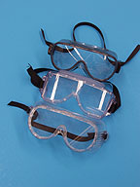
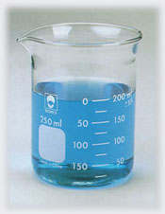
Goggles
Protects eyes from broken glass, chemicals and flames.
Beaker
Measures liquids (but not very accurately)
Used to hold or mix chemicals

Slide 35
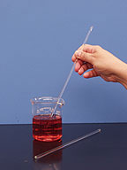
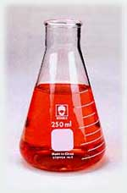
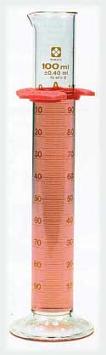
Stirring Rod
Glass rod used for stirring
Be careful since they may break easily
Erlenmeyer Flask
Used for mixing
Measures liquids but not accurately
Used in titrations
Media preparation
Graduated Cylinder
Measures volumes of liquids accurately

Slide 36


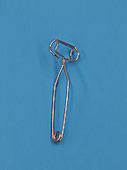
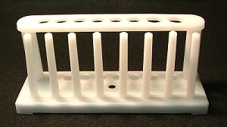
Test Tube
Mix chemicals
Holding small amounts of chemicals
Use for fermentation
Test Tube Holder
It holds a test tube
Test Tube Rack
Holds test tubes in a vertical position.
Allows for clear sight.

Slide 37
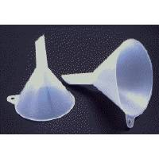
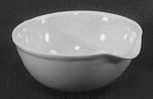
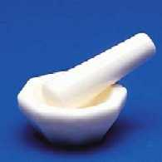
Funnel
Holds filter paper for filtering solutions.
Transferring liquids to smaller narrow necked containers
Evaporating Dish
Holds small volumes of liquids being evaporated
Mortar and Pestle
Used for grinding crystal

Slide 38
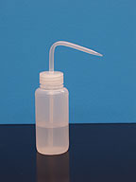
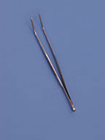
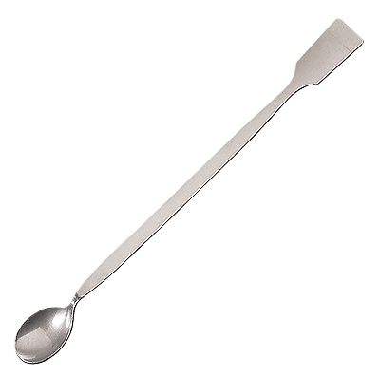
Wash Bottle
Dispenses water for rinsing equipment
Use during diatom sampling
Forceps
Used to pick up small items
Used to pick Macroinvertebrates
Spatula
Used to transfer solids from one container to another

Slide 39
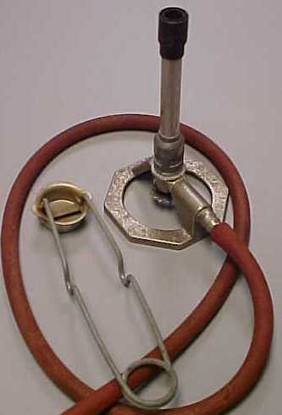
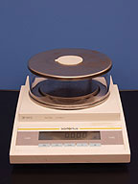
Bunsen Burner
Used for sterilization
Electronic Balance
Measures mass in grams

Slide 40
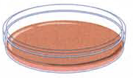
Petri dish
Used to culture microbes for growth and identification
Sample bottle
Glass
Plastic

Slide 41
Equipments Used for Sampling and Identification of Macroinvertebrates
  Kick-net
  Sorting tray
  Sieve
  Forceps
  Vials
  Petri dish
  Microscope

Slide 42
Equipments for Zooplankton and Phytoplankton
Zooplankton net
Plastic bottle
Volumetric flask
Measuring cylinder
Sedimentation tube
Glass cover
Slides
Pipet
Brown bottle
Bucket
Microscope

Slide 43
Operation of Equipments
Incubators
Incubators maintain a uniform and constant temperature in all areas
The incubator must provide sufficient space for the daily work load
Incubators equipped with high-temperature heating units are unsatisfactory, because such sources of heat, when improperly placed, frequently cause localized overheating and excessive drying of media, with consequent inhibition of bacterial growth

Slide 44
Autoclaves
Used for sterilization of media and glassware
Use autoclaves of sufficient size to prevent internal crowding;
It should constructed to provide uniform temperatures within the chambers (sterilizing temperature of 121°C);
Equipped with an accurate thermometer
The autoclave must be free of steam leaks
Equipped with pressure gauge
Should capable of reaching the desired temperature within 30 min.

Slide 45
When sterilizing broths, the complete sterilization cycle from the time the door is sealed to the time it is opened must not be greater than 45 minutes.
Set the timer for 45 minutes and use an accurate watch or stopwatch to time it at appropriate sterilization intervals used within your lab.

Slide 46
Culture Tubes
Culture tubes must be of sufficient size so that the total volume of medium and inoculums does not fill the tube more than 2/3.
Tubes more than 2/3 full are subject to contamination and are potentially more hazardous to work with
The diameter of Durham tubes (small inverted tubes used for trapping gas) must not be less than 40% of the culture tube
Aluminum, plastic, or stainless steel caps must be used to cover the test tubes.
Cotton plugs are not acceptable because they do not prevent contamination as well as caps, and are inconvenient to use

Slide 47
Hot air sterilizing oven
The oven must be of sufficient size to prevent internal crowding
The oven must be constructed to give a uniform sterilization temperature of 170°C or greater.
Equip oven with an accurate thermometer that can be read while the oven is in operation, that includes the range of 160 - 180 °C.

Slide 48
Optical Counting Equipment
Pour and spread plates: Use Quebec-type colony counter which gives satisfactory visibility.
Membrane filters: Use a binocular microscope
Refrigerator
Use a refrigerator maintaining a temperature of 1 to 4.4°C to store samples, media, reagents, etc
Do not store volatile solvents, food, or beverages in a refrigerator with media
Temperature-Monitoring Devices: Use glass or metal thermometers graduated to 0.5°C to monitor most incubators and refrigerators

Slide 49
Sample bottles
For bacteriological samples, use sterilizable bottles of glass or plastic of any suitable size and shape
Use bottles capable of holding a sufficient volume of sample for all required tests and an adequate air space, permitting proper washing, and maintaining samples uncontaminated until examinations are completed.
Plastic bottles of suitable size, wide-mouthed, and made of nontoxic materials that can be sterilized repeatedly are satisfactory as sample containers.
Before sterilization, cover tops and necks of sample bottles having glass closures with aluminum foil

Slide 50
Sterilization of materials
Steam sterilization is generally considered a more effective type of sterilization than dry heat
Steam under pressure provides a more uniform temperature and penetrates most materials more rapidly and thoroughly than hot air
Dry heat sterilization is more suitable for the sterilization of glassware, since contact with steam during autoclaving may introduce water condensate and/or chemical contamination from boiler water
Dry-heat sterilize all glassware, including glass membrane filter funnels and pipets, for at least two hours at 170 °C
Liquids, stainless steel membrane filtration units, plastics, and other materials which might be distorted or destroyed by hot air must be sterilized by steam under pressure

Slide 51
Water/wastewater Sampling, Transportation and Storage
Sampling: is a process of taking a portion of water/wastewater from surface water, ground water or from certain waste streams
To obtain a true indication of the nature of Water or Wastewater, the sample should actually be representative of the source.
Having satisfied this requirement, the appropriate analysis must be carried out using standard procedures

Slide 52
Water Sampling for Microbial Examination
Water samples for microbial testing must be collected in a sterile glass bottle
Care must be taken to prevent accidental contamination of the water during its collection and transport to the laboratory
The sample bottle should be fitted with round glass stoppers or screw caps
The stopper or cap and neck of the bottle should be protected from contamination by a suitable cover either of paper or thin aluminum foil

Slide 53
Sampling for Microbial Examination…
Dechlorination of samples
If the water to be examined is likely to contain chlorine compounds or other halogens, add a reducing agent to the sample collection containers. Example Na₂S₂0_{3.} Why?
Dechlorinating agent neutralizes any residual halogen and prevents their action on microbes during sample transit
The examination then will indicate more accurately the true microbial content of the water at the time of sampling

Slide 54
Actions needed during sampling
When the sample is collected, leave ample air space in the bottle (at least 2.5cm) to facilitate mixing by shaking before examination
Keep sampling bottle closed until it is to be filled
Do not contaminate the inner surface of the stopper or cap and neck of the bottle
Fill container without rinsing and replace/recap the stopper or cap immediately
The volume of sample should be sufficient to carryout all tests required, preferably not less than 100ml

Slide 55
Data needed to be recorded for identification of sample
Supplement the sample by complete and accurate identification and description.
  Sample Code
  Reasons for examination (routine sample, research, practice).
  Source from where the water has been collected
  Whether the water has been filtered, or chlorinated
  If the water is from a well, give details of depth, whether covered or uncovered, and whether recently constructed or altered

Slide 56
Identification of Data…
If the sample is spring water, describe whether the sample was taken directly from the spring or from a collecting chamber
If the water is a river or stream, mention the depth at which the sample was collected, and whether there had been heavy rainfall or flooding
If the water is from a lake or reservoir, give the exact position, and the depth at which it was collected, and whether there had been heavy rainfall or flooding

Slide 57
Identification of Data…
Indicate the temperature of the source of the sample
Mention any possible sources of pollution in the area, and their approximate distance from the sampling point.
Indicate the date and time when the sample was taken

Slide 58
Chapter three
Sampling methods transportation and storage for various environmental parameter

Slide 59
Sampling methods transportation and storage for various environmental parameter
Water quality has many meanings depending on whether the water to be used for :-
domestic,
commercial,
industrial or
recreational purposes.
The primary aim of the guide line values for drinking water quality is the protection of public health

Slide 60
Cont--
To gain a true picture of a particular sample, it is often necessary to measure several different properties by carrying out an analysis of physical, chemical or bacteriological characteristics.
One of the key elements in the quality control of drinking water is the microbiological examination of water.
This is affected by analyzing water samples collected from the water supply system

Slide 61
Collecting sample requirements
Samples should be properly planned and ideally carried out with sufficient frequency to enable any temporal (seasonal) variations in the quality of the water to be detected.
Samples should be collected, stored and dispatched in suitable sterilized bottles.
The volume of water collected should be large enough to permit an accurate analysis.
The sampling points in the water supply system should be selected, such that the samples obtained are as representatives possible.

Slide 62
Field work and sampling.
The field work associated with the collection and transport of samples will account more than half of proportion of the total cost of a monitoring program.
The sample collection process should be coordinated with the laboratory so that analysts know:-
How many samples will be arriving?
The appropriate time of their arrival.
The analysis that are to be carried out and
The appropriate quantities of reagent or chemical prepared.
It is a good practice to prepare a checklist to prevent missing or forgotten objects before a sampling expedition is under taken.

Slide 63
Check list for preparing for field work.
A. Paper work.
Itinerary.
Inventory details of sampling station, maps
List of samples required at each sampling stations.
B. Coordination.
Local coordination: ex:-To ensure access to sites on restricted areas.

Slide 64
Con---
Institutional coordination: ex:-For travel arrangements as well as permission to visit the sampling area.
Notify laboratory: The expected date and time of sample arrival, so that reagents and other laboratory facilities should be arranged.
Check any available source of information on local weather condition

Slide 65
Sampling.
Sample bottle, preservatives marker and pens.
Sample storage/transit containers and icepacks.
Filtering apparatus(if required)
Samplers.
Rubber boots, waders(plastic boot).
Standard operating procedure for sampling.
Spares of all of the above items, if possible and when appropriate.

Slide 66
D. documentation
Pens/pencils.
Sample labels.
Field note book
Report format.
E. Safety.
First aid kit.
Waders, gloves, etc…
Fire extinguisher (if appropriate).

Slide 67
F. Onsite testing
List of analysis to be performed on site.
Check stocks of consumables (including distilled water, pH, buffer, standards and blanks);
Check and calibrate meters(pH, conductivity, dissolved oxygen, turbidity, thermometers).
Standard operating procedures and equipment manuals.

Slide 68
G. Transport.
Does assigned vehicle have sufficient capacity for personnel supplies and equipments?
Is other means of transport such as airplane, mule or others?
H. double check.
When was equipment last calibrated?
Itinerary against travel details on inventory.
Accessories for equipment and meters (including, cables, chargers, and spare parts).

Slide 69
Collection of water samples.
A. Sample container
Sample containers should be used only for water samples and never for the storage of chemicals or other liquids.
Glass containers are commonly used and are appropriate for samples for many analyses, but plastic containers are preferred for samples intended for certain chemical analysis.
Plastic has the obvious advantage that it is less likely to break than glass.
They should have screw caps of a type that will maintain an effective seal, even after they have been sterilized many times in an autoclave.

Slide 70
B. Holding time and temperature
Start microbiological examination of water sample promptly after collection to avoid unpredictable changes
If samples cannot be analyzed within one hour after collection, use an ice cooler for storage during transport to laboratory
Refrigerate these samples up on receipt in the laboratory and process within 2hour.
Hold the temperature of samples below 10 ⁰c during maximum transport time of 6 hours

Slide 71
B. Holding time and temperature.
Transport to the laboratory as quick as possible for examination, ideally within 6 hours of collection, but never more than 24 hours latter.
When local conditions necessitate delays in delivery of samples longer than 6 hours, consider either making field examinations using field laboratory facilities located at the site of collection or using delayed incubation procedure (should be kept cool and in dark, preferably at 4-100c).

Slide 72
C. Sample size and frequency of sampling.
The volume sample should be sufficient to carry out all tests required; preferably not less than 100ml.
Examination of drinking water should be both frequent and regular.
The frequency of sampling will depend on the:
  The quality of the source.
  The treatment the water receives.
  The risk of contamination.
  The previous history of the supply.
  The size of the population served.

Slide 73
D. Water Sampling Techniques
Generally three types of sampling are adopted for collecting water samples.
Grab sampling
Composite sampling
Integrated sampling
Grab /Catch / “spot” or “snap” /sampling
The sample is collected at a particular time, depth and place that represents the composition of the source at that particular point and time.
It is the simplest sample;

Slide 74
2. Composite samples.
A mixture of grab samples is collected at the same sampling point at different time intervals.
Samples made up of several different parts, are often needed to fulfill some specific monitoring objectives. Composite samples may be of the following.

Slide 75
Composite Samples
Advantages of Composite Samples:
- reduced costs of analyzing a large number of samples.
- more representative samples of varied conditions.
- larger sample sizes when amounts of test samples are limited.
Disadvantages of Composite Samples
- loss of analytic relationships in individual samples.
- potential dilution of any parameter below detection levels.
- increased potential analytical interferences.
- increased possibility of analytic interactions

Slide 76
3. Discharge integrated
It is first necessary to collect samples and to measure the rate of discharge at regular intervals over the period of interest.
A common arrangement is, to sample every 2h over a 24h period.
The composite sample is then made by mixing portions of the individual sample that are proportional to the range of discharge at the same sample was taken.

Slide 77
B. Depth integrated:
Most commonly made up of two or more equal parts collected at predetermined depth intervals between the surface and the bottom
A. Area integrated.
Made by mixing equal volumes of water collected at a sampling station at regular time interval.

Slide 78
Environmental sampling techniques
General guidelines of environmental sampling techniques
Volume of samples depends on the type of analysis to be conducted.
Minimum sample required depends on the concentration of the analyses present.
Should take enough for all analyses and additional for any Quality analysis/Quality control work required.
Heterogeneous samples generally require larger amounts to be representative of sample variations.
Taking too much sample can lead to problems with storage and transportation and analysis.

Slide 79
Refrigeration
(cool 2⁰c-8⁰c)
Microbial degradation
Chemical reaction
Proper container
(glass or plastic Cap/septum amber bottle
Volatilization
Adsorption
Absorption
diffusion
Photo reaction
Chemical reaction
Acid Base Biocide
Sample preservation and storage
Fig: methods of sample preservation to minimize potential changes of analytes during sample
transportation and storage

Slide 80
Sample preservation
Preservation methods are generally limited to PH control chemical addition refrigeration and freezing
Method of preservation are relatively limited and are intended generally to
Retard biological action
Retard hydrolysis of chemical compound and complexes
Reduce volatility constituents
Reduce absorption effect

Slide 81
Good sampling practices
Wash hands to mid arms with antibacterial soap before sampling.
Use clean laboratory gloves and put the gloves on aseptically.
Use a permanent marker to clearly label the sample bags/containers.
Use brief descriptions that clearly identify the sampling area or site and record the same descriptions on the sample submission form.
While sampling, avoid touching the inside of the sampling tube or culture plates.

Slide 82
Chlorinated water sample.
Add a reducing agent to containers intended for the collection of water having residual chlorine or other halogen unless they contain broth for direct plating of samples.
Sodium thiosulphate (Na₂S₂O₃) is a satisfactory de-chlorinating agent that neutralizes any residual halogens and prevents continuation of bactericidal action during sample transit.
The concentration of dechlorinating agent may be reduced.0.1ml of a 3% solution of Sodium thiosulphate

Slide 83
Wastewater.
For sampling chlorinated wastewater effluents add sufficient Sodiumthiosulphate to a clean sample bottle to give a concentration of 100mg/l in the sample.
In a 120ml bottle, 0.1ml of a 10% solution of Sodium thiosulphate will neutralize a sample containing about 15mg/l of residual chlorine.

Slide 84
Unchlorinated water samples
To prepare sample bottles, they should be washed with a non-ionic detergent sand rinsed at three times(five is better) with distilled or de-ionized water before autoclaving.
New bottles require the same preparation.
If distilled de-ionized water is not available, clean chlorine free water may be used.
When we collect water samples high in copper or zinc and wastewater samples high in heavy metals, use sample bottles containing a chelating agent that will reduce metal toxicity.

Slide 85
Con--
the container be clearly labeled with
The name, concentration and quantity of the preservative chemical, volume of the sample variables is to be analyzed.
If preservatives are not added to containers in the laboratory, the chemicals, pipettes, and directions for adding preservatives must be included in the kit of supplies and equipment taken on the sampling expedition

Slide 86
treated water entering the distribution.
Any source of water that have treatment should be examined daily for Coliform organisms,
The sample should be taken at the point at which the water enters the distributions system
In piped water supplies, contamination of the distribution system increases with the length of pipe work and the number of plumbing systems attached it

Slide 87
Cont-
The following minimum sampling frequencies are recommended for waters in the distribution system
Population served | Minimum number of samples.
Less than 5000 pop. | 1 sample for month.
5000-100,000. | 1sample/5000 pop/month.
More than100,000 | 1sample/10,000 pop/month

Slide 88
Untreated water and unpiped supplies.
The quality of water will vary with both season and proximity to source of population.
The frequency of sampling for bacteriological examination of particular water should therefore be established by the appropriate control agency and it should reflect local circumstances including the results of sanitary surveys.

Slide 89
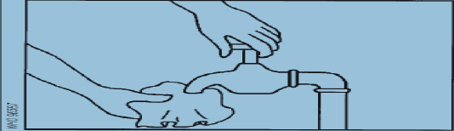
Untreated water and un piped supplies
Sampling from a tap or pump outlet
A. Clean the tap
Remove from the tap any attachments that may cause
splashing ,
Using a clean cloth, wipe the outlet to remove any dirt.

Slide 90
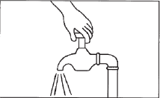
Con--
B. Open the tap
Turn on the tap at maximum flow and let the water run for 1–2 minutes.
Note: Some investigators do not continue to stages C and D but take the sample at this stage; in this case, the tap should not be adjusted or turned off, but left to run at maximum flow.

Slide 91
Con--
The results obtained in this way will provide information on the quality of the water as consumed.
If the procedure is continued to stages C and D, however, the results represent the quality of the water excluding contamination by the tap

Slide 92
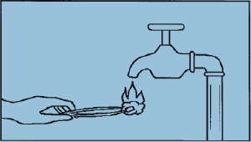
C. Sterilize the tap
Sterilize the tap for a minute with the flame from a gas
burner, cigarette lighter, or an ignited alcohol-soaked
cotton-wool swab

Slide 93
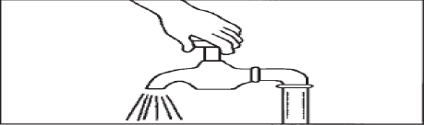
D. Open the tap before sampling
Carefully turn on the tap and allow the water to flow for1–2minutes at a medium flow rate.
Do not adjust the flow after it has been set.

Slide 94
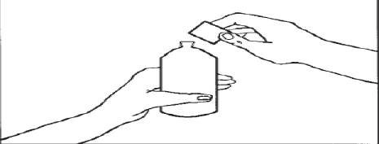
E. Open the sterilized bottle
Take out a bottle and carefully
unscrew the cap or pull out the stopper.

Slide 95
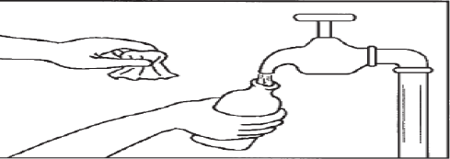
F. Fill the bottle
While holding the cap and protective cover face Downwards (to prevent entry of dust, which may Contaminate the sample), immediately hold the bottle under the water jet, and fill.

Slide 96
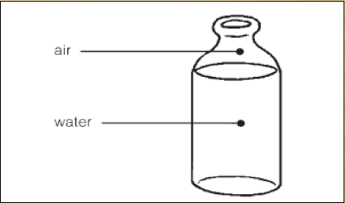
Small air space should be left to make shaking before analysis easier.

Slide 97
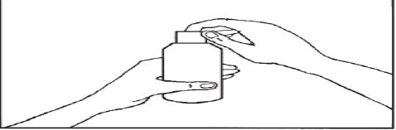
G. Stopper or cap the bottle
Place the stopper in the bottle or screw on the cap and fix the brown paper protective cover in place with the string.
Sampling from a water course or reservoir Open the sterilized bottle as described in section 1A.
A. Fill the bottle Holding the bottle by the lower part, submerge it to a depth of about 20cm,with the mouth facings lightly upwards.

Slide 98
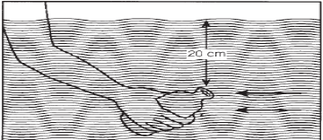
If there is a current, the bottle mouth should face towards the current.
The bottle should then be capped or stoppered as described previously.

Slide 99
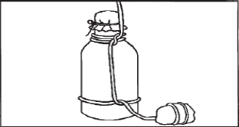
Con--
Sampling from dug wells and Similar sources
A. Prepare the bottle
With a piece of string, attach a clean weight to the sampling bottle.

Slide 100
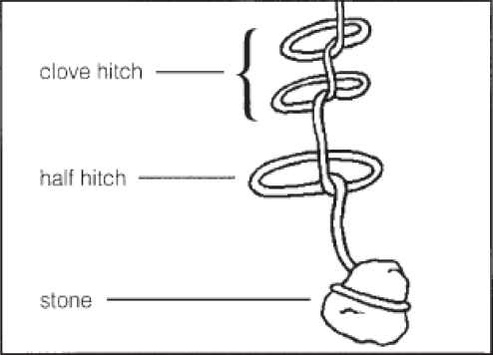

Slide 101
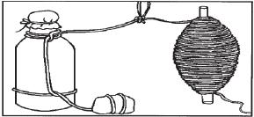
B. Attach the bottle to the string
Take a 20m length of clean string rolled around a stick and tie it to the bottle string.
Open the bottle as described in section1A.

Slide 102
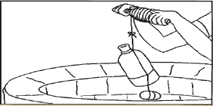
C. Lower the bottle
Lower the bottle, weighed down by the weight, into the well, unwinding the string slowly.
Do not allow the bottle to touch the sides of the well.

Slide 103
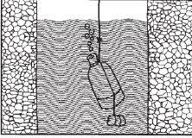
D. Fill the bottle
Immerse the bottle completely in the water and lower
It well be low the surface without hitting the bottom or disturbing any sediment.

Slide 104
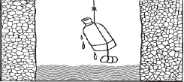
E. Raise the bottle
Once the bottle is judged to be filled, rewind the string on the stick to bring up the bottle.
If the bottle is completely full, discard some water to provide an air space.
Stopper or cap the bottle as described previously.

Slide 105
Sampling procedure for surface water
Surface water and wastewater sampling
Fresh surface waters
Flowing waters, static waters and estuaries.
Wastewaters
Mine drainage, landfill leachate, industrial effluents etc.
Differ in their characteristics and samples collection is specific for each streams and rivers.
Size and amount of turbulence impact representativeness of samples.

Slide 106
Surface water and wastewater sampling
When water has to be submitted to bacteriological analysis, special precautions must be taken to prevent the slightest risk of contamination.
Special apparatus that permits mechanical removal of bottles topper below water surfaces is required to collect samples from depth of a lake or reservoir.

Slide 107
Sampling surface water
Two different types of samples can be taken from rivers, lakes and similar surface waters. Such as:
1. Grab samples.
2. Composite samples.
Small streams(<20ft wide) possible to select a location where a grab
Sample represents the entire cross-section.
Larger streams and rivers require multiple samples across the channel width(Also at least one vertical composite(surface, middle, bottom))
Pond sand impoundments use a single vertical composite at deepest point.

Slide 108
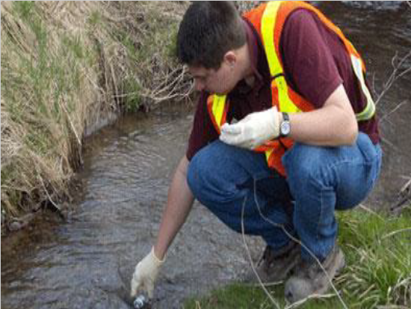
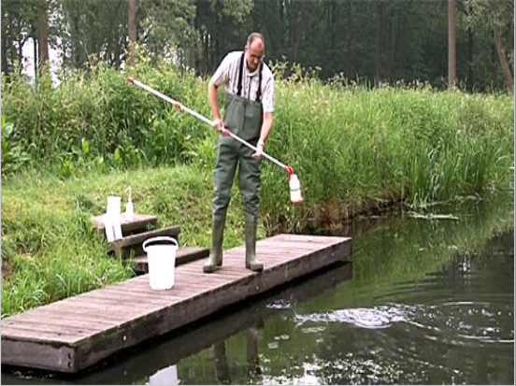
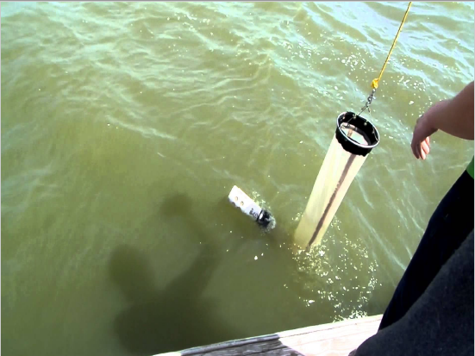

Slide 109
Information to be supplied with water samples.
Bottles should be transported or dispatched in a strong box, to prevent breakage.
There should be sufficient space in the box to include bags of freezing mixture to keep the samples cool.
Boxes holding, 6 or 12 bottles are ideal.

Slide 110
Suggested form to accompany water samples.
Name of responsible body __________.
Sample site__________.
Place_________________.
Source______________.
Sender______________
Date of collection_______.
Time of collection________.
Presence of chlorine_______.
Residual chlorine__________.
Type of taste______________.
Name and signature of the sampler___.
Results
Total coli form______________.
Fecal coli form_____________.
Laboratory sample number____________.
Water bacteriological -Good_______. -bad ---
Action taken __________________

Slide 111
Soil and sediment sampling
Sediments are treated similarly with regard to post-sampling pretreatment (homogenizing, splitting, drying and sieving)
Horizontal(grab),vertical(core) sampling or composite sampling is common(except for VOCs).
Non soil/sediment or no sieved materials should be noted and not discarded.
Sediments from lakes, ponds and reservoirs should be collected at the deepest point(contaminants tend to concentrate in fine grained material in depositional zones.

Slide 112
Soil sampling
Isolation and identification of important microbes
Rhizobium
A well-established symbiotic relationship exists between Rhizobium species and leguminous plants, as a result of which elemental N is fixed or converted to ammonia.
A specific Rhizobium culture for a specific legume crop that has a high ability for infection, nodulation, N2-fixation and antibiotic resistance is needed.
Rhizobium it is an aerobic and gram-negative microbe, and abundant in the root nodules of leguminous crops

Slide 113
Soil sampling
Isolation
Rhizobium strains can be isolated from the root nodules of legumes
The apparatus required consists of:
An incubator
Sterilized water
Petri dish
Glass rod;
Test-tube (sterilized)
Inoculation needle.
The reagents
Ethyl alcohol (95%).
Mercuric chloride (0.1 %weight/volume).
Congo red yeast extract mannitol agar (CRYEMA) plate.

Slide 114
Soil sampling
Identification
The following culture tests need to be carried out in order to check whether the Rhizobium colony as developed in the above incubation is pure or contaminated with common contaminants such as Agrobacterium.
Growth in alkaline medium:
Agrobacterium radiobacter can be detected by drawing streaks on Hoffer’s alkaline medium (pH 11.0) where Rhizobium does not grow, while A. radiobacter does.
Growth in glucose peptone agar:
Rhizobium shows little or no growth on glucose.
Gram test:
It should test negative.

Slide 115
Soil sampling
Azotobacter
Azotobacter is a non-symbiotic, aerobic, free-living bacteria.
It is capable of fixing N and synthesizing growth-promoting substances and vitamins.
It is found mainly near the rhizosphere.
its population varies but rarely exceeds 102–103/g soil.

Slide 116

Soil sampling
Isolation
apparatus
test-tubes;
Petri dishes;
glass rods;
inoculation needles;
pipettes;
conical flasks.
The reagents required are:
sterile water;
Jensen’s medium.
The microbes are isolated from the soil sample (collected from the rhizosphere)

Slide 117
Soil sampling
Identification
Azotobacter different species ability to produce different pigment thus facilitating their identification.
chroococcum – brown; beijerinckii – light brown; vinelandi – greenish yellow; insignis – light brown; agilis – green; macrocytogenes – purple.
Although pigment production does not give a confirmation of the species, it is a good indication of their presence.
The secretion of gum or polysaccharide is another important characteristic, as is the formation of cysts by all the species (for withstanding adverse conditions).

Slide 118
Soil sampling
Azospirillum organisms
are Gram-negative, curved, and rod-shaped of varying size.
is a spiral-shaped N-fixing bacteria that produces hormones and vitamins.
Important species are brasilense and lipoferum.
It is widely distributed in soils and grass roots.
They contain poly-B-hydroxybutyrate granules and shows spiral movements.
Isolation :Occurs both inside and outside plant root

Slide 119
Soil sampling
The apparatus
an incubator;
sterilized water;
a Petri dish;
a glass rod;
a test-tube (sterilized);
an inoculation needle.
The reagents required are:
Ethyl alcohol.
0.1 percent mercuric chloride.
Phosphate buffer.

Slide 120
Soil sampling
Identification
They form white pellicles on semi-solid calcium malate medium.
They are producers of strong bases.
they grow in a medium containing bromothymol blue indicator, they change the colour of the medium to blue.

Slide 121
Soil sampling
Phosphate solubilizing micro-organisms
Soil bacteria of the genera Pseudomonas, Bacillus and certain fungi of the genera Penicillium and Aspergillus
Able to solubilize insoluble forms of P owing to their secretion of organic acids.
help in the solubilization of P from phosphate rock and other sparingly soluble forms of soil P by reducing their particle to nearly amorphous forms.

Slide 122
Soil sampling
They are present in abundance in the rhizosphere.
they are isolated directly from the soil by the soil serial dilution method
Isolation
The apparatus required consists of:
a test-tube (sterilized);
an inoculation needle.
The reagent required is sterile water.
an incubator;
sterilized water;
a Petri dish;
a glass rod;

Slide 123
Soil sampling
Inoculation of culture medium
This is a method by which micro-organisms are transferred from any source (purified culture) to the medium for their multiplication in a laboratory.
To avoid any contamination, inoculation is done in a laminar air-flow chamber aseptically as follows:
1. Select a pure culture of the micro-organism to be multiplied.
2. Take a specific culture medium in a sterilized flask/tube (already prepared and kept ready).
3. Hold the pure culture tube between thumb and forefinger in such a way that the cotton plug of the tube is towards the body of the worker.

Slide 124
Soil sampling
4. Remove the cotton plug from the tube/flask containing the culture, take the pure culture from the tube using a sterilized platinum needle and transfer it to the medium in the flask/tube. Plug the inoculated tube/flask, keep it in the incubator at 28+- 2 °C for 3–5 days to allow the microbes to grow.
When a large volume of culture medium is required for mass production of biofertilizer, multiplication is done in large flasks (2–5 litres) in a rotary shaker or in fermenters.

Slide 125
Air and stack emission sampling
Sources
Ambient air, indoor work place air and stack/emission exhausts.
Concentrations for most atmospheric pollutants are very low.
Large variation in analyze concentration due to changes in meteorology.
Meteorological parameters must be noted.
Ventilation system scan alter air flow and add pollutants.
Sampler location will influence the results obtained.
Household chemical scan add compounds to the air.

Slide 126
Indoor air
Bacteria or yeast & mold
Air Plates are used to find out the total bacterial or the yeast and mold load in ambient air.
Generally, if you have results that are greater than 20CFU then further monitoring is needed in the facility.
Air plates can be placed on any surface to collect samples.
Open Air Vents, Counter Tops, Flat Surfaces

Slide 127
Indoor air
How to air sample
Wash hands to mid-arms with antibacterial soap before sampling.
Use clean laboratory gloves.
Put the gloves on aseptically and avoid touching the inside of the air plates.
Place the air plates on a flat surface and open the lid and place lid at an angle on the plate
Leave air plates open and exposed for 15minutes.

Slide 128
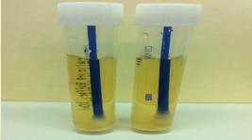
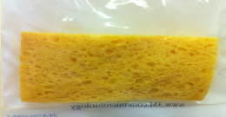
HARD SURFACE SAMPLING (SPONGES OR SWABS)
SWABS are best for small crevices or uneven surfaces,
Example: drains and grates
SPONGES are best for smooth and flat surfaces,
Example: floors, walls,

Slide 129
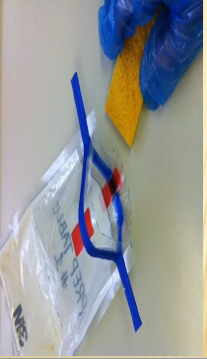
Sampling with sponge
With bag still sealed, push the sponge towards the opening of the bag.
Open the bag without touching the sponge or inside of the bag.
With the sterile gloves on, remove the sponge from the bag careful to only touch the sides of the sponge.
Gently wipe the sponge in a 10”x10” target area.
wipe 10 times vertically and 10 times horizontally.
Place the sponge back in the bag, expel excess air, and fold the top 3-4 times to seal.

Slide 130
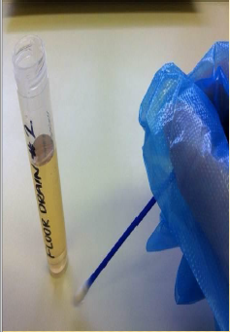
SAMPLING WITH SWAB
Use clean laboratory gloves or the aseptic gloves provided.
With the sterile gloves on, unscrew the cap of the swab container carefully, only touch the lid and not the swab.
Gently wipe the swab over a 2”x2” target area.
wipe vertically and horizontally.
Place the swab back into the tube and screw closed.

