Slide 1
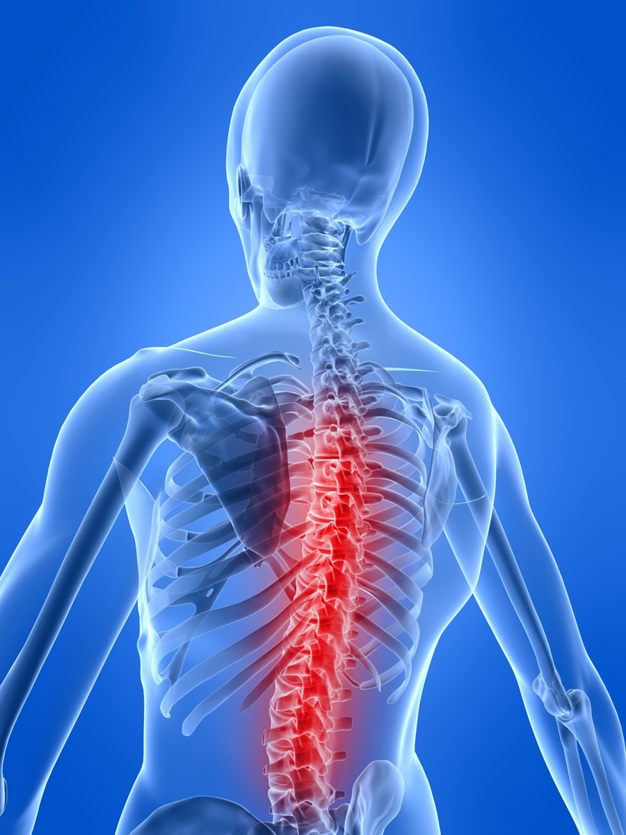
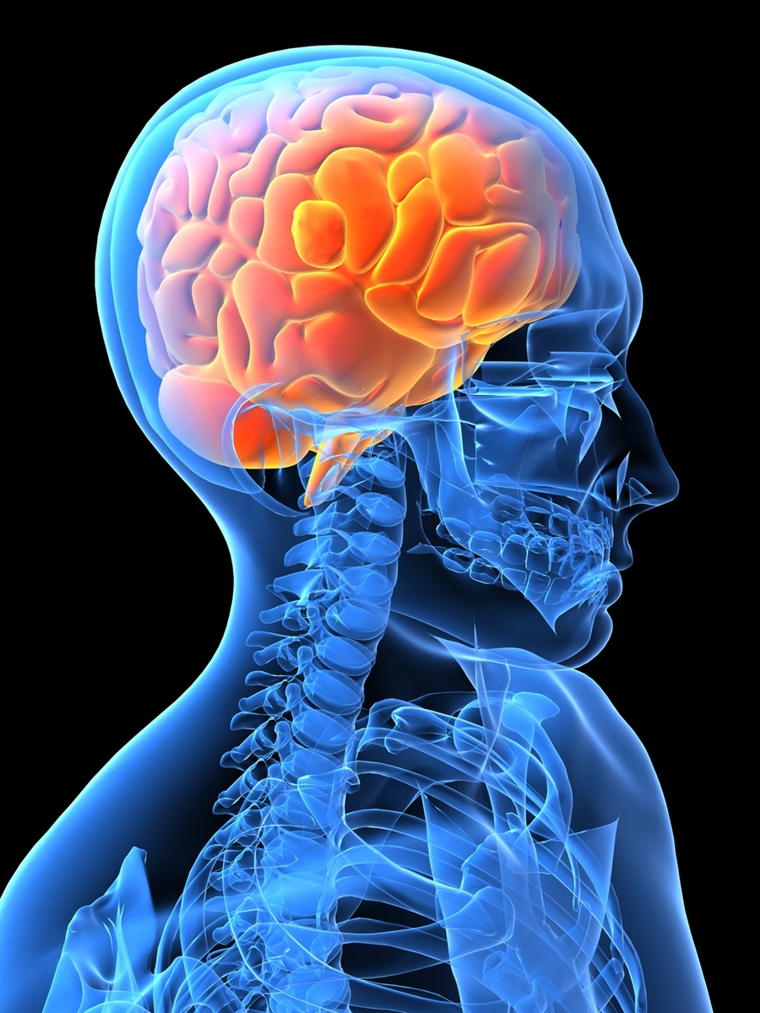
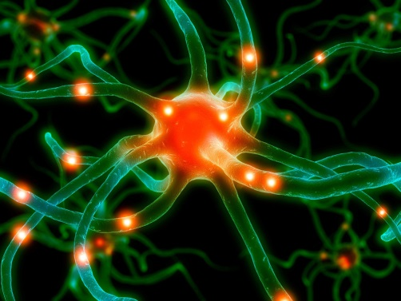
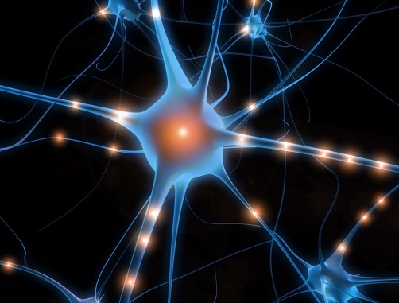
DISORDERS OF THE NERVOUS
SYSTEM
By. Fentahun Minwuyelet
(BSC, MSC in AHN)

Slide 2
Out line
Head ache
Epilepsy
Altered level of consciousness
Increased intracranial pressure
Bells palsy
Guillain Barre syndrum
Trigeminal neurelagia
Parkinson’s diseases
Alzheimer's diseases
Multiple sclerosis
Myasthenia gravis
Stroke
Meningitis
Brain abscess
Brain injury

Slide 3
Objectives
After completing this chapter students should differentiate different types of:-
headaches and their management
Epilepsy and their management
Define what Bell’s palsy and GBS as well as their clinical presentation
Identify different types of head and spinal cord injury
Define Parkinson's and Alzheimer's diseases and Multiple sclerosis their nursing role
Differentiate the two stroke type and their managements
Define meningitis and understand different causative agents of meningitis.

Slide 4
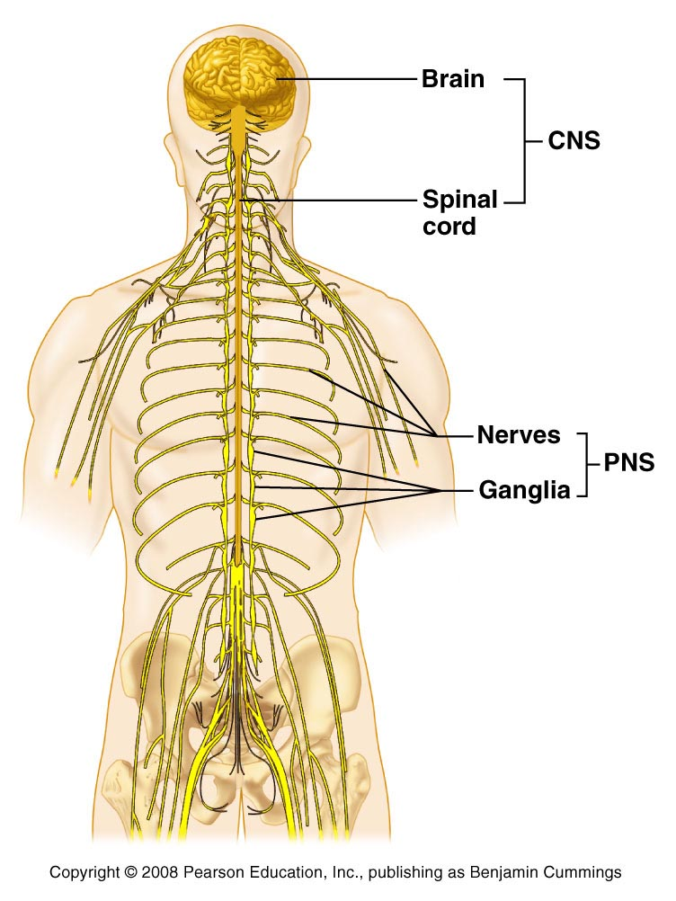
Anatomical and physiological overview
Central Nervous System (CNS)
Brain and spinal cord
Peripheral Nervous System
Cranial nerves (12)
Spinal nerves (31 pair)
All branches of nerves
(nerve: bundle of fibers outside of CNS)

Slide 5
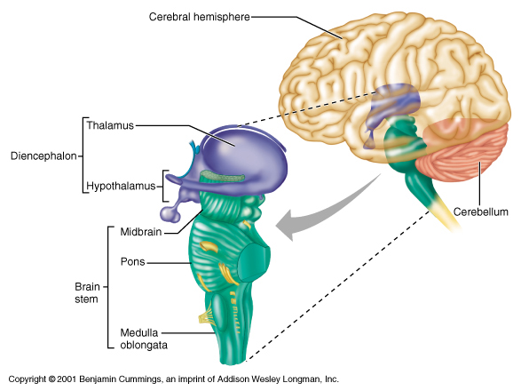
Central Nervous system
The brain – parts and their function
Cerebrum
Diencephalon
Brain stem
cerebellum

Slide 6
Central Nervous …
Cerebral Lobes: Outer part with Rt/Lt hemisphere and had four lobes
Frontal
Personality, behavior, emotions, intellect
Parietal
Primary center for sensation
Occipital
Primary visual receptor center
Temporal
Primary auditory receptor center

Slide 7
Central Nervous …
Diencephalon: its has 3 main component
Thalamus: most sensory nerve tracts from CNS to cebral cortex
Hypothalamus: temperature, hunger, thirst sensation such as sexual pleasure, feeling relaxed and good after meal, anger; fear and response to stress
Epithalamus: the pineal body (gland)

Slide 8
Central Nervous …
Cerebellum
Operates below conscious level
Motor coordination of voluntary movements, equilibrium, muscle tone, posture.
Brain stem: Central core of brain 3 parts:
Midbrain (CN;III,IV)
Pons (CN;V,VI,VII)
Medulla (CN;VIII-XII)

Slide 9
Central Nervous …
Spinal cord
Structure occupying upper 2/3 vertebral canal
Consists of 31 pairs of spinal nerves
Ascending/descending fiber tracts between brain and spinal nerves; mediates reflexes

Slide 10
Central Nervous …
Ascending tracts within the spinal cord carry sensory information from the body, upwards to the brain, such as touch, skin temperature, pain and joint position.
Descending tracts within the spinal cord carry information from the brain downwards to initiate movement and control body functions.

Slide 11
Peripheral Nervous System
Carries:
sensory messages to central nervous system (CNS)
motor function messages from CNS to muscles and glands
autonomic messages to internal organs and blood vessels

Slide 13
The Autonomic nervous system
Innervates most body organs
Regulates the activities of internal organs such as the heart, lungs, blood vessels, digestive organs, and glands
Maintain and restore internal homeostasis
Controls and regulates involuntary body functions
Comprise the
Sympathetic and
Parasympathetic branches

Slide 14
Continue…
SNS
Mainly excitatory
Initiates the ‘fight flight’ response to stress
Major neurotransmitter-norepinephrin
PSNS
Mainly regulatory
controls mostly visceral functions
Controls secretary and excretory functions
Its activity dominates the SNS when there is no stress

Slide 15
Neurotransmitters
Communicate messages from one neuron to another or from a neuron to a specific target tissue
Manufactured and stored in synaptic vesicles
Enable conduction of impulses across the synaptic cleft
Have affinity for specific receptors in the postsynaptic bulb. When released, the neurotransmitter crosses the synaptic cleft and binds to receptors in the postsynaptic cell membrane
Can either excite or inhibit the target cell’s activity

Slide 16
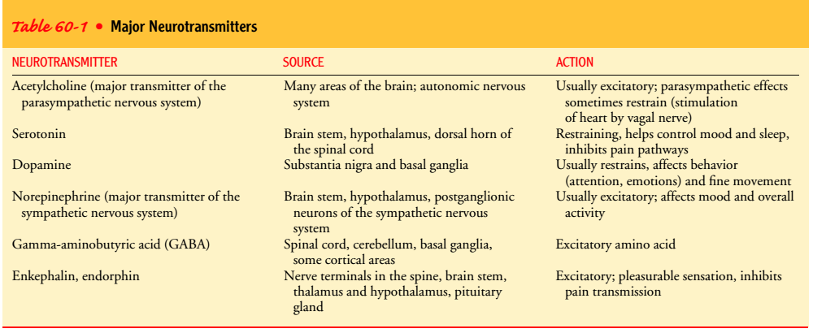
various types of neurotransmitters

Slide 17
The menings
Dura mater
The outermost layer
Covers the brain and the spinal cord.
Is tough, thick, inelastic, fibrous, and gray process
The subdural space is between the dura and the arachnoid layer

Slide 18
Continue….
Arachnoids substance
The middle membrane; an extremely thin, delicate membrane that closely resembles a spider web
It appears white because it has no blood supply.
Contains the choroid plexus, which is responsible for the production of cerebrospinal fluid (CSF).

Slide 19
Continue…
In the normal adult, approximately 500 mL of CSF is produced each day; all but 125 to 150 mL is absorbed by the arachnoid villi
The subarachnoid space is located between the arachnoid and pia layers and contains the CSF.
Pia mater
the innermost membrane
a thin, transparent layer that hugs the brain closely and extends into every fold of the brain’s surface.

Slide 21
Cerebrospinal fluid
CSF, a clear and colorless fluid with a specific gravity of 1.007
Is produced in the ventricles and is circulated around the brain
The spinal cord through the ventricular system
There are four ventricles: the right and left lateral, and the third and fourth ventricles
The fourth ventricle supplies CSF to the subarachnoid space and down the spinal cord

Slide 22
Reflexes
Reflexes are rapid, automatic response to stimuli
Four important properties of a reflex
1. Reflexes require stimulation- they are not spontaneous actions but response to sensory input
2. Reflexes are quick
3. Reflexes are involuntary
4. Reflexes are stereotyped- they occur essentially the same way
Reflexes are mediated by chains of neurons known as reflex arcs

Slide 23
Components of reflex arc
1. Receptor - site where stimulus acts and transformed in to nerve impulse
2. Sensory neuron- transmit the afferent neuron to the CNS
3. Integration center- located in the CNS act as a synapse b/n sensory and motor neurons
4. Motor neuron- conduct efferent impulse from integration center to effectors
5. Effectors- muscles or glands that response to efferent impulses by contracting or secreting

Slide 24
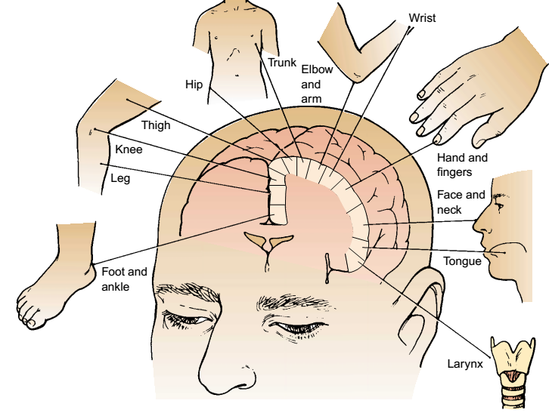
Diagrammaticrepresentationofthecerebrumshowinglocationsforcontrolofmotormovementof various parts of the body

Slide 25
Disorders of the nervous system

Slide 26
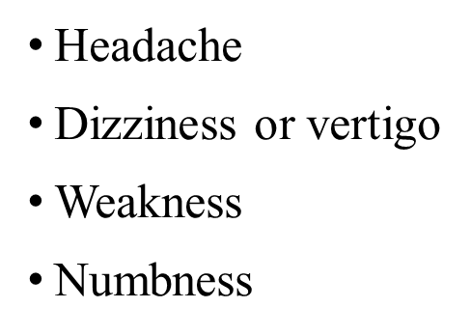
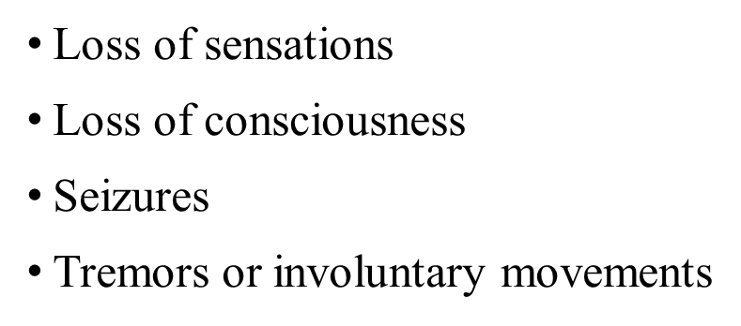
Common or Concerning Symptoms of the Nervous System
Observing mental status, speech, and language
Observing sensorium, memory, abstract thinking ability, speech, mood, emotional state, perceptions, thought processes, ability to make judgments

Slide 27
Assessment of the Neurologic System
Testing cranial nerves (I-XII)
Testing Motor function: giant, Romberg's, rapid alternative, finger to nose
Testing Sensory function: light touch, sharp/dull, streognosis, and graphesthesia
Testing Reflexes: Biceps, Triceps, Brachioradialsis, Patellar (knee) , Achilles, Plantar (Babinski), and Abdominal
NB: Always consider left to right symmetry)

Slide 28
Continue…..
Disorder of the nervous system may involve the following:-
Vascular Dos: Stroke, traumatic brain hemorrhage
Infections Dos: Meningitis, encephalitis, polio, and epidural abscess
Structural Dos: brain and spinal cord injury, Bell’s palsy, GBS, peripheral neuropathy, brain tumors, cervical spondylosis, carpal tunnel syndrome etc..
Functional Dos: headaches, epilepsy, dizziness, Trigeminal neuralgia
Degeneration Dos: Parkinson’s DS, Alzheimer’s Ds, Multiple sclerosis, amyotrophic lateral sclerosis, huntington choria

Slide 29
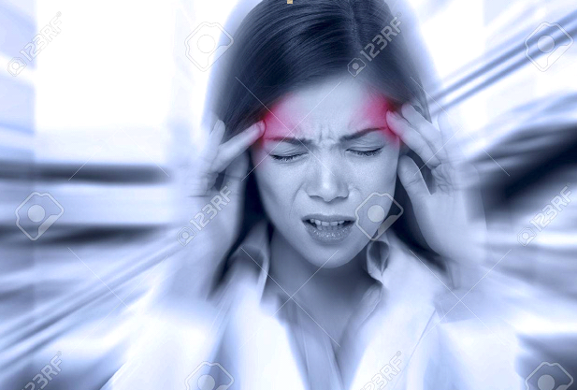
Head ache
Head ache

Slide 30
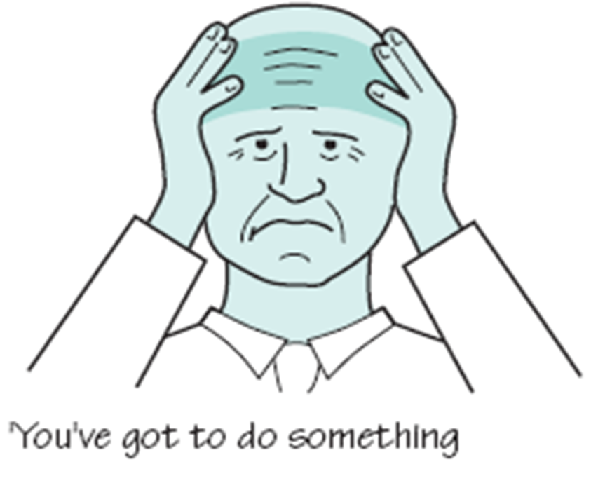
Head ache
Are the most common patient complaints
Usually occurs as a symptom of an underlying disorder rather than a disease itself
It is mostly a manifestation of others diseases
Head ache majorly classified into three
Tension HD
Cluster HD
Migraine HD

Slide 31
Etiology
Intracranial tumors , Trauma and hemorrhages
Genetic (CH,MH)
Stress, allergens, seasonal changes, vasodilator, alcohol smokers
Gender (male CH, Female MD)
CNS infections
Acute systemic infection
Cerebral hypoxia
Severe HPN
Acute or chronic disease of the eye, ear, nose or throat
Sinusitis
Tooth disease

Slide 32
1. Tension Headache (TTH)
It is muscle contraction head ache
Is described as a tight band like discomfort, may be described as “a weight on top of my head”
Characterized by a steady, constant feeling of pressure that usually begins in the forehead, temple, or back of the neck

Slide 33
Continue…
The pain typically build slowly, fluctuates in severity & may persist up to 15 days
It is often band like which is Cause by:
Muscle contraction
Fatigue
Stress or anxiety ,depression and poor posture
It can be either episodic (frequent and infrequent) or chronic.

Slide 34
Continue…
Episodic tension headache usually is associated with a stressful event.
This headache type is of moderate intensity, self-limited, and usually responsive to nonprescription drugs
Chronic tension headache often recurs daily
It is associated with contracted muscles of the neck and scalp.
This type of headache is bilateral and usually occipitofrontal.

Slide 35
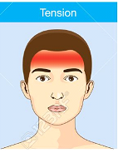
Diagnosis of TTP C/M
International Head Society(IHS) diagnostic criteria for TTH states that two of the following characteristics must be present:
Pressing or tightening
(nonpulsatile quality)
Frontal-occipital location
Bilateral - Mild/moderate intensity
Not aggravated by physical activity

Slide 36
C/M….
Pain onset: throbbing quality and is usually more gradual, more variable in duration, more constant in quality
Duration of 30 minutes to 7 days
No nausea or vomiting (anorexia may occur)
Photophobia and/or phonophobia
Pain described as Bilateral ,"fullness, tightness/squeezing, pressure," or "bandlike"

Slide 37
c/m….
May occur acutely under emotional distress or intense worry
Insomnia
Often present upon rising or shortly thereafter
Muscular tightness or stiffness in neck, occipital, and frontal regions
Difficulty concentrating, no prodrome

Slide 38
Physical Examination
Vital signs should be normal.
Normal neurologic examination
Tenderness may be elicited in the scalp or neck
Pain should not be elicited over temporal arteries or positive trigger zones.
Some patients with occipital tension HD may be very tender when upper cervical muscles are palpated.
Pain associated with neck flexion and stretching

Slide 39
Prognosis
Tension-type headaches (TTH) may be painful, but are not harmful.
Most cases are intermittent and do not interfere with work or normal life span.
However; they may become chronic if life stressors are not changed

Slide 40
2. Cluster headache(HD)
Have a cyclical pattern of one to three short-lived attacks of :
Periorbital pain lasting from 4 to 8 weeks
Headache lasts between 15 min & 3 hours
Come in clusters- `may occur 1 to 8 times a day
May awaken the patient from sleep

Slide 41
Continue…
Are unilateral
Characterized by excruciating pain localized to the eye and orbit and radiating to the facial and temporal regions
Also known as histamine headache, is a primary neurovascular headache disorder
The Pathophysiology and etiology of which are not well understood.

Slide 42
Continue…..
As the name suggests, CH involves a grouping HDS,
Usually occur over a period of several weeks.
According to IHS; CH has the following characteristics
It severe or very severe, strictly unilateral pain (orbital, supraorbital, or temporal pain)
That last 15-180 minutes
Occur from once every other day to 8 times a day
One or more ( of parasympatatic symptoms
No other contributing disorder

Slide 43
Continue…
CH may be usefully classified into 2 main forms as follows:
Episodic CH, in which at least 2 cluster phases lasting 7 days to 1 year are separated by a cluster-free interval of 1 month or longer
Chronic CH, in which the clusters occur more than once a year without remission or the cluster-free interval is shorter than 1 month

Slide 44
Clinical presentation
Attacks of CH are typically short and occur with a clear periodicity, more on sleep of REM or early morning hours.
Not usually accompanied by symptoms such as nausea, vomiting, photophobia, or osmophobia.
Character - Excruciating, stabbing, sharp, and lancinating (as if the eye is being pushed out), rather than throbbing
Location – Unilateral, in the periorbital, retro-orbital, or temporal regions,

Slide 45
C/M Continue…
Radiate - First and second divisions of the trigeminal nerve (neck, cheek, jaw, occipital, nuchal, and carotid artery)
Onset – Sudden, peaking in 10-15 minutes
Duration - 15 minutes to 3 hours per episode
Frequency - May occur 1-8 times a day for as long as 4 months (often nocturnal)
Periodicity - Circadian regularity

Slide 46
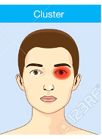
C/M Continue…
Cranial parasympathetic symptoms:
1. lacrimation (84-91%) or
(conjunctival injection
2. Nasal stuffiness (48-75%) or
(rhinorrhea)
3. Eyelid edema
4. Miosis or ptosis
5. forehead and facial perspiration (26%)
6. Sense of agitation and restlessness
Precipitated by Alcohol,Tinbaco, hot weather, watching television, nitroglycerin, stress, relaxation, extreme temperatures, glare, allergic rhinitis, and sexual activity.

Slide 47
Physical Examination
Distinctive facial appearance - Leonine facies, multifurrowed and thickened skin with prominent folds, a broad chin
Parasympathetic over activity - Ipsilateral lacrimation, rhinorrhea or congestion
Ocular sympathetic paralysis - Mild Horner syndrome (eg, ptosis, miosis, and anhidrosis), which may persist between attacks
Bradycardia
Facial flushing or pallor
Scalp and facial tenderness
Ipsilateral carotid tenderness (in some patients)

Slide 48
Prognosis
Generally, CH is a lifelong problem. Potential outcomes include the following:
Recurrent attacks
Prolonged remissions
Possibility of transformation of an episodic cluster to a chronic cluster and vice versa

Slide 49
3. Migraine Headache
A chronic neurovascular disorder characterized by recurrent attacks of severe headache and autonomous nervous system dysfunction
The two most prevalent types of migraine:
Migraine without aura
Most migraine sufferers experience two to four headaches per month
Most migraine headaches last at least four hours.
Headaches may begin at any time of the day or night

Slide 50
Continue…
Migraine with aura
This type of migraine begins with an aura (a manifestation of neurological symptoms).
Generally, the aura begins from five to thirty minutes before the actual onset of the headache.
The aura can include vision may be see wavy or jagged lines, dots or flashing lights; or, you experience tunnel vision or blind spots in one or both eyes
Hearing , hallucinations
Disruptions in smell (such as strange odors),
Abnormal taste or touch .

Slide 51
Continue…
Others Classify of migraine is as follows:
Migraine without aura (formerly, common migraine)
Migraine with aura (formerly, classic migraine)
Probable migraine without aura
Probable migraine with aura
Chronic migraine
Chronic migraine associated with analgesic overuse
Childhood periodic syndromes that may not be precursors to or associated with migraine
Complications of migraine
Migrainous disorder not fulfilling above criteria

Slide 52
Continue…
Is a complex disorder characterized by recurrent episodes of headache,
Most often unilateral and in some cases associated aura with visual or sensory.
Migraine is most common in women and has a strong genetic component.
Usually develops over 5–20 minutes and lasts less than 60 minutes

Slide 53
Continue…
Caused by constriction & then dilation of the cerebral arteries.
Individuals who have migraines are frequently described As Perfectionists, inflexible & ambitious.

Slide 54
Signs and symptoms
Throbbing or pulsatile headache, with moderate to severe pain that intensifies with movement or physical activity
Unilateral and localized pain in the frontotemporal and ocular area, but the pain may be felt anywhere around the head or neck
Pain builds up over a period of 1–2 hours, progressing posteriorly and becoming diffuse
Headache lasts 4–72 hours
Nausea (80%) and vomiting (50%), including anorexia and food intolerance, and light-headedness
Sensitivity to light and sound

Slide 55
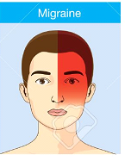
Diagnosis of MD
The diagnosis of migraine is based on Hx and IHS diagnostic criteria.
Patients must have had at least 5 headache attacks that lasted 4–72 hours and had at least 2 of the following characteristics:
Unilateral location
Pulsating quality
Moderate or severe pain intensity
Aggravation or causing avoidance of
routine physical activity
(eg, walking or climbing stairs)

Slide 56
Continue…
In addition, during the headache the patient must have had at least 1 of the following:
Nausea and/or vomiting
Photophobia and phonophobia
No other contributing disorders

Slide 57
Physical examination
Cranial/cervical muscle tenderness
Horner syndrome (ie, relative miosis with 1–2 mm of ptosis on the same side as the headache)
Tachycardia or bradycardia
Hypertension or hypotension
Hemisensory or hemiparetic neurologic deficits (ie, complicated migraine)
Adie-type pupil (ie, poor light reactivity, with near dissociation from light

Slide 58
Diagnosis for all types of headache
History – determines:
Location of the pain, intensity & paths of radiation.
Character of the headache (e.g. sharp, dull, throbbing).
Mode of headache onset, duration & frequency.
Precipitating factors.
- Psychosocial assessment
- Physical examination
- Neurological diagnostic testes include
Imaging: X-ray, CT scan, MRI studies
EEG
LP with CSF exam

Slide 59
Management
Non-Pharmacological
Relaxation
Destruction
Cold/heat application
Sleep and massage
Hydration( fluid), diet vit B2
Elimination of factors (physical, psychological, environmental) that precipitates illness

Slide 60
Pharmacological management
Abortive medications include the following
Treating the underlying pathologic process
Selective serotonin receptor (5-hydroxytryptamine–1, or 5-HT1) agonists (triptans)
Ergot alkaloids (eg, ergotamine, dihydroergotamine [DHE]), ergotamine with caffeine
Opioids- tramadol, codeine, morphine

Slide 61
Continue…
Nonsteroidal anti-inflammatory drugs (NSAIDs)
Glucocorticoid drug: dexamethasone, betamethasone hydrocortisone etc to Rx recurrence,
Combination products
Antiemetic: metoclopromide; prochlorperazine etc

Slide 62
Preventive/prophylactic medications
The indications for prophylactic migraine therapy:
Frequency of migraine attacks is greater than 2 per month
Duration of individual attacks is longer than 24 hours
The headaches cause major disruptions in the patient's lifestyle, with significant disability that lasts 3 or more days
Abortive therapy fails or is overused
Symptomatic medications are contraindicated or ineffective
Use of abortive medications more than twice a week
Migraine variants such as hemiplegic migraine or rare headache attacks producing profound disruption or risk of permanent neurologic injury

Slide 63
Continue…
Prophylactic medications include the following:
Antiepileptic drugs
Beta blockers
Tricyclic antidepressants
Calcium channel blockers
Selective serotonin reuptake inhibitors (SSRIs)
NSAIDs
Serotonin antagonists

Slide 64
Nursing role
Assist patient in identifying situations that seem to precipitate attacks.
Support patient in modification of life-style & development of insight
Provide dark, quit environment /particularly for migraine /
If patient is nauseated:
Administer antiemetic
Offer small frequent sips of fluid as tolerated
Assist with mouth care

Slide 65
Convulsive /Seizure/ disorders
Epilepsy/ Seizures
Epilepsy describes a condition in which a person has recurrent seizures due to a chronic, underlying process.
This definition implies that a person with a single seizure, or recurrent seizures due to correctable or avoidable circumstances, does not necessarily have epilepsy.
Are paroxysmal, uncontrolled electrical discharges of brain neurons that interrupt the normal function

Slide 66
Continue….
Resulting in episodes of abnormal motor, sensory, autonomic, or psychic activity (or a combination of these)
Is one of the most neurological problems affecting people irrespective of sex, race, and geographical location
Around 50 million people affected with epilepsy world wide
A part or all of the brain may be involved

Slide 67
Classification
Partial seizures that begin in one part of the brain
Generalized seizures that involve electrical discharges in the whole brain

Slide 68
Etiology
Idiopathic (genetic, developmental defects)
About 3/4 of all cases - idiopathic
Acquired seizures include:
Hypoxemia ,fever (childhood), head Injury,
Hypertension, heart, stroke, CNS infections,
Metabolic and toxic conditions (eg, renal failure, hyponatremia, hypocalcaemia, hypoglycemia, pesticides),
Brain tumor, drug and alcohol withdrawal, allergies, Cerebrovascular disease , toxemia of pregnancy, lung and liver diseases

Slide 69
Risk factors of epilepsy
Age : more on child and old adult
Family history
Head injury
Stroke and other vascular diseases
Dementia
Brain infection
Childhood seizure to adult
Neural developmental disability

Slide 70
Classification
1.GENERALIZED SEIZURE
DESCRIPTION
Grandmal (tonic clonic
Body becomes rigid, jaw clenched - Tonic (30-60 sec.)
Stool and urine may be passed involuntarily
In 1-2 minutes convulsion movements begin to subside. (clonic)
Patient relaxes and lies in deep sleep
At this point breathing is chiefly abdominal
Post seizure patient may be confused and can suffer from headaches, nausea and malaise
Petitmal
Transient loss of consciousness 5-30 seconds may noticed
Normal activity is stopped for a few seconds
Patient/ client appears dazed
It is common in children and rare in adults

Slide 71
Continue…
Myoclonic
Intermittent, clonic system of twitching of muscle or muscles. The client loss consciousness for a moment & then confused
Akinetic (Atonic seizures)
Complete or partial loss of muscle movements
NB: Colonic seizure W/C cause frequent jerking movement where as Tonic seizure which cause rigidity of muscle

Slide 72
2. PARTIAL OR FOCAL SEIZURES
DESCRIPTION
Simple partial seizures
Only a finger, a hand or a mouth may jerk
(shake)
The individual may speak, nonsense, appear dizzy
Unusual, unpleasant, sight, odors, tastes, sound is experienced
No loss of consciousness

Slide 73
Partial complex seizures
Temporal lobe seizures psychomotor seizures
The individual remains motionless, or moves automatically, but inappropriate to time and place
The individual experiences, excessive emotions of fear, anger, and irritability
Clouding of consciousness with out any motor or sensors components is present
The individual is not aware of what happened
Jacksonian seizures
Limited to one extremity, and or leg
Becomes generalized from leg to the rest of the body

Slide 74
Pathophysiology
Messages from the body are carried by the neurons (nerve cells) of the brain by means of discharges of electrochemical energy that sweep along them
These impulses occur in bursts whenever a nerve cell has a task to perform.
Sometimes, these cells or groups cells continue firing after a task is finished.
During the period of unwanted discharges, parts of the body controlled by the errant cells may perform erratically.

Slide 75
Continue…
Resultant dysfunction ranges from mild to incapacitating and often causes unconsciousness
When these uncontrolled, abnormal discharges occur repeatedly, a person is said to have an epileptic syndrome
Epilepsy is not associated with intellectual level, but pts. who are developmentally disabled because of serious neurologic damage, however, have epilepsy as well

Slide 76
Clinical Manifestations
Depending on the location of the discharging neurons, seizures may range from a simple staring episode to prolonged convulsive movements with loss of consciousness
Pattern of the seizures indicates the region of the brain in which the seizure originates

Slide 77
Clinical manifestation …..
Simple partial seizures
Only a finger or hand may shake, or the mouth may jerk uncontrollably
talking unintelligibly, dizziness, hallucination
No loss of consciousness
Complex partial seizures
Person either remains motionless or moves automatically but inappropriately for time, place persons.
Experience excessive emotions of fear, anger, elation, or irritability
Amnesia of the event

Slide 78
Clinical manifestation ….
Generalized seizures
Involve both hemispheres of the brain, causing both sides of the body to react
Aura => a warning sign to an epileptic attack, include feelings of:
Cold breeze
Peculiar smell
Vision of some animal or person
Seeing a flashing light
Hearing a sound

Slide 79
Clinical manifestation …
Generalized tonic–clonic contraction- intense rigidity of the entire body followed by alternating muscle relaxation and contraction
Epileptic cry - due to contractions of the diaphragm and chest muscles
Tongue biting
Incontinence of urine and stool

Slide 80
Clinical manifestation…
After 1 or 2 minutes, the convulsive movements begin to subside; the patient relaxes and lies in deep coma, breathing noisily
The respirations at this point are chiefly abdominal
In the postictal state (after the seizure)
Confusion
Hard to arouse and may sleep for hours
Complaint of headache, sore muscles, fatigue, and depression

Slide 81
Diagnostic Assessment
Complete past and present history
Positive EEG readings
Complete head analysis
Biochemical, hematologic, and serologic studies
CT-scan/ MRI

Slide 82
Management
Pharmacologic Intervention
Goal Mgt. –
to obtain maximum seizure control with minimum toxic effects
Principle Mgt.-
begin with single drug and increase the dose until a therapeutic serum level is reached
If the seizure is not controlled with a single drug a second drug is usually added

Slide 83
Drugs of Anti-epilepsy/anticonvulsants
Seizure types
Grandmal, focal and psychomotor seizures
Phentoin (Dilantin)
Carbamazepine (Tegretol)
Phenobarbital
Primidone (mysoline)
Zarontin
Clorazepam
Valproic acid

Slide 84
Surgical management
Indications for surgery:
Epilepsy results from intracranial tumors, abscess, cysts, or vascular anomalies
Intractable seizure disorders that do not respond to medication
Focal atrophic process secondary to trauma, inflammation, stroke, or anoxia
If the seizures originate in a reasonably well-circumscribed area of the brain that can be excised without producing significant neurologic deficits

Slide 85
Nursing interventions
Time of Seizure
Nursing interventions
Seizures precautions during aura
Discuss precautions with patient/ family
Request patient to alert nurse if aura appears
Give medications as ordered
Keep padded tongue blade, beside the bed
Pad bed as necessary
Keep bed in low position with side rails
Take rectal temperature unless & otherwise medicated
Observe the patient cloth
During seizure
Protect patient from injury, do not rest rain
Maintain patient airway and adequate ventilation
Loosen all tight clothings, especially at the neck
Keep the privacy of the patient
Never force anything between teeth
Not restrict movement

Slide 86
Observe and document seizure activity, i.e. time of onset, duration, methods of terminal site of onset progression, unilateral or bilateral, head & eye movement pupilary changes.
Types of muscle response (clonic-tonic) changes in respiratory status & if cyanosed.
If there was urinary/bowel incontinence, loss of consciousness. Time lap until patient regains normal alertness
Notify the physician of observations
Post seizure
Keep environment quiet and safe
Reorient patient to environment
Reassure patient
Assess for injuries as bitten tongue
Position one side
Observe for symptoms as headache, confusion
Check neurological status

Slide 87
Complications of epilepsy
Status epilepticus
Is the most serious complication of epilepsy
Characterized by continuous seizure lasting at least 30 min. with out the patient regaining consciousness
Causes brain anoxia and may result permanent brain damage & death unless otherwise prompt measure are taken
Cause:
Abrupt / sudden discontinuation of anticonvulsant drugs
Inadequate treatment of seizure, fever, infection

Slide 88
Complication Continue…
Psychosocial factors - due to misconception by the society about the etiology of epilepsy, people with this disorder often experience discrimination, in employment, education transportation etc…
Sever injury - This often results when the patient having seizure, because he is at risk for accidental falls , burns and drowning etc…

Slide 89
Neurologic Dysfunction

Slide 90
Altered Level of Consciousness
An altered level of consciousness (LOC) is apparent in the patient who is not oriented, does not follow commands, or needs persistent stimuli to achieve a state of alertness.
Altered level of consciousness is difficult to define and characterized because many terms applied to altered level of consciousness.
It is a measure of persons arousability and responsiveness to a stimuli from the environment.

Slide 91
Altered LOC in order of decreasing Consciousness:
Clouding of consciousness : it is mild, and a state of inattention
Confusion : state disorientation, and inability to follow command.
Lethargy: a state of sever drowsiness can aroused by moderate stimuli

Slide 92
Continue…
d. Obtundation: similar to lethargy in W/C patients lessened interest to environment and slowed response to stimuli
e. Stupor: the only vigorous and repeated stimuli will aroused but when left undisrupted patients lapsed back to unresponsive
f. Comma : unarousable, unresponsive
g. Brain death: tissue necrosis

Slide 93
Altered Level of Consciousness…
Coma is a clinical state of unarousable, unresponsiveness in which there are no purposeful responses to internal or external stimuli.
The duration of coma is usually limited to 2- 4 weeks
Akinetic mutism is a state of unresponsiveness to the environment in which the patient makes no voluntary movement and sound but sometimes opens the eyes
The level of responsiveness and consciousness is the most important indicator of the patient's condition.

Slide 94
Etiology Altered LOC
Delirium
Stroke
Subdural hematoma
Normal pressure hydrocephalus
Encephalopathy
Epilepsy
Hypertension
Infection like meningitis
Electrolyte imbalance
Hypoxia
Trauma
Sever Pain

Slide 95
Pathophysiology
Altered LOC is not a disorder itself; rather, it is a function and symptom of multiple pathophysiologic phenomena.
The underlying causes of neurologic dysfunction are disruption in the cells of the nervous system, neurotransmitters, or brain anatomy

Slide 96
Continue…
A disruption in the basic functional units (neurons) or neurotransmitters results in faulty impulse transmission, impeding communication within the brain or from the brain to other parts of the body.
Finally consciousness is lost

Slide 97
Clinical Manifestations
As the patient's state of alertness and consciousness decreases, changes will ultimately occur in the pupillary response, eye opening response, verbal response, and motor response.
The pupils, reactive to light become sluggish; as the patient becomes comatose, the pupils become fixed (no response to light).
The patient in a coma does not open the eyes, respond verbally, or move the extremities in response to a request to do so.

Slide 98
Assessment and Diagnostic Findings
The patient with an altered LOC is at risk for alterations in every body system.
A complete assessment should be performed
LOC, a sensitive indicator of neurologic function; the Glasgow Coma Scale:
Eye opening
Verbal response and
Motor response.

Slide 99
Glasgow Coma Scale
Eye opening
1-4
Verbal response
1-5
Motor response
1-6
Eye opening(spontaneous)=4
Sound ( to verbal stimuli )=3
Pain( stimuli to pain)=2
N o response=1
Oriented =5
Confused =4
Words( inappropriate)=3
Incomprehensible sounds=2
No response=1
Obeys commands=6
Localized to pain=5
Withdraw to pain=4
Flexion ( abnormally)=3
Abnormal extension=2
No response=1

Slide 100
Assessment and Diagnostic …
The patient's responses are rated on a scale from 3 to 15.
The Score shows us:
Sever: 3-8
Moderate: 9-12
Mild: 13-15
A score of 3 indicates severe impairment of neurologic function, brain death, or pharmacologic inhibition of the neurologic response.
A score of 15 indicates that the patient is fully responsive.

Slide 101
Assessment and Diagnostic …
Common diagnostic procedures used to identify the cause of unconsciousness include CT scanning, MRI, and EEG.
Laboratory tests include analysis of blood glucose, electrolytes, serum ammonia, and liver function tests; BUN levels; calcium level; and PTT and PT.
Other studies may be used to evaluate serum ketones, alcohol and drug concentrations, and arterial blood gases.

Slide 102
Complications
Respiratory failure
Pneumonia
Aspiration
Complications associated with immobility, such as
Pressure ulcers,
Venous stasis,
Musculoskeletal deterioration, and
Disturbed gastrointestinal functioning.
Notes:
Respiratory failure may develop shortly after the patient becomes unconscious. If the patient cannot maintain effective respirations, care (insertion of an airway, mechanical ventilation) is initiated to provide adequate ventilation and protect the airway.

Slide 103
Medical Management
The first priority ABCD of treatment for the patient with altered LOC is to maintain a patent airway.
The patient may be orally or nasally intubated, or a tracheostomy may be performed.
Until the ability of the patient to breathe on his or her own is determined, a mechanical ventilator is used to maintain adequate oxygenation and ventilation.

Slide 104
Medical Management…
The circulatory status (BP, HR) is monitored to ensure adequate perfusion to the body and brain.
An IV catheter is inserted to provide access for IV fluids and medications.
Neurologic care focuses on the specific neurologic pathology, if known.

Slide 105
Nursing interventions
Maintaining patent airway
Maintaining fluid balance
Managing nutritional needs
Providing mouth care
Measuring vital signs
Maintain skin and joint integrity
Frequent positioning
Providing back care and bed bath
Passive Exercise to move joints

Slide 106
Nursing interventions….
Preserving corneal integrity
Cover the eye or use protective ointments
Achieve thermoregulation
Prevent & manage fever and hypothermia
Promote bowel and urinary elimination
Provide sensory stimulation
Monitoring and managing Potential complications

Slide 107
Increased Intracranial Pressure

Slide 108
Increased Intracranial Pressure
The rigid cranial vault contains brain tissue (1400 g), blood (75 mL), and CSF (75 mL).
The volume and pressure of these three components are usually in a state of equilibrium and produce the ICP.
ICP is usually measured in the lateral ventricles, with the normal pressure being 10 to 20 mm Hg.
Notes:
ICP is usually measured in the lateral ventricles, with the normal pressure being 10 to 20 mm Hg.

Slide 109
ICP….
Because brain tissue has limited space to expand, compensation typically is accomplished by
Displacing or shifting CSF,
Increasing the absorption or diminishing the production of CSF, or
Decreasing cerebral blood volume.
Notes:
Without such changes, ICP will begin to rise.

Slide 110
ICP…
Under normal circumstances, minor changes in blood volume and CSF volume occur constantly due to:-
Alterations in intrathoracic & abdominal pressure (coughing, sneezing, straining),
Posture or position
Blood pressure
Systemic oxygen and carbon dioxide levels others.

Slide 111
Etiology Increased ICP
The following are some of causes of increased ICP:
Brain Injury
High CSF
Brain tumors
Bleeding in the brain( subarachnoid homorrhage)
Hematoma
Hydrocephalus
Meningitis/encephalitis
Toxins
Stroke, epilepsy, aneurysm, hypoxia

Slide 112
Pathophysiology
Increased ICP affects many patients with acute neurologic conditions.
Although elevated ICP is most commonly associated with head injury, it also may be seen as a secondary effect in other conditions, such as brain tumors, subarachnoid hemorrhage, and toxic and viral encephalopathy.

Slide 113
Pathophysiology…
Increased ICP from any cause decreases cerebral perfusion, stimulates further swelling (edema), and may shift brain tissue through openings in the rigid dura, resulting in herniation, a dire and frequently fatal event.

Slide 114
Pathophysiology…
Decreased Cerebral Blood Flow
Increased ICP may significantly reduce cerebral blood flow, resulting in ischemia and cell death.
In the early stages of cerebral ischemia, the vasomotor centers are stimulated and the systemic pressure rises to maintain cerebral blood flow for compensation.

Slide 115
Pathophysiology…
Usually, this is accompanied by a slow bounding pulse and respiratory irregularities.
These changes in BP, pulse, and respiration are important clinically because they suggest increased ICP

Slide 116
Pathophysiology…
Cerebral Edema
Edema can occur in the gray, white, or interstitial matter.
As brain tissue swells within the rigid skull, several mechanisms attempt to compensate for the increasing ICP.
These compensatory mechanisms include auto regulation and decreased production and flow of CSF.

Slide 117
Clinical Manifestations
Neural function is impaired; this may be manifested at first by clinical changes in LOC and later by abnormal respiratory and vasomotor responses.
Any sudden change in the patient's condition, such as restlessness (without apparent cause), confusion, or increasing drowsiness, has neurologic significance.

Slide 118
Clinical Manifestations…
These signs may result from compression of the brain due to swelling from hemorrhage or edema, an expanding intracranial lesion (hematoma or tumor), or a combination of both.
As ICP increases, the patient becomes stuporous, reacting only to loud or painful stimuli.
Motor deterioration like hemiplegic

Slide 119
Clinical Manifestations….
If the coma is profound, with the pupils dilated and fixed double vision,
Head ache and vomiting
Increased SBP & decreased HR
Respirations impaired or absent,
Death is usually inevitable.

Slide 120
Assessment and Diagnostic Findings
The most common diagnostic tests are CT scanning and MRI.
Lumbar puncture is avoided in patients with increased ICP, because the sudden release of pressure in the lumbar area can cause the brain to herniate.

Slide 121
Complications
Brain stem herniation
Diabetes insipidus
Syndrome of inappropriate antidiuretic hormone.
Notes:
Brain stem herniation results from an excessive increase in ICP in which the pressure builds in the cranial vault and the brain tissue presses down on the brain stem.
Diabetes insipidus is the result of decreased secretion of antidiuretic hormone (ADH).

Slide 122
Medical Management
Increased ICP is a true emergency and must be treated promptly.
The first Goal is Urgently reduce the pressure inside the skull and next goal is to address any underline cause.
Immediate management to relieve increased ICP requires:
Decreasing cerebral edema,
lowering the volume of CSF, or
Decreasing cerebral blood volume while maintaining cerebral perfusion.

Slide 123
Medical Management….
Effective treatment is to reduce pressure by draining the fluid through a shunt tube surgically and mannitol and hypertonic saline medication also lower pressure
Administering osmotic diuretics, restricting fluids, draining CSF, controlling fever, maintaining systemic BP and oxygenation, and reducing cellular metabolic demands.
Corticosteroids are not recommended in cases of increased ICP resulted from traumatic brain injury.

Slide 124
Medical Management…
Decreasing Cerebral Edema
Osmotic diuretics such as mannitol may be administered to dehydrate the brain tissue and reduce cerebral edema.
If a brain tumor is the cause of the increased ICP, corticosteroids (eg, dexamethasone) help reduce the edema surrounding the tumor.
Another method for decreasing cerebral edema is fluid restriction.

Slide 125
Medical Management…
Controlling Fever
Preventing a temperature elevation is critical, because fever increases cerebral metabolism and the rate at which cerebral edema forms.
Maintaining Oxygenation
Arterial blood gases and pulse oximetry are monitored to ensure that systemic oxygenation remains optimal.

Slide 126
Medical Management…
Position patient 30-35◦ with head midline and no flexion neck and hips.
Monitor respiration like saturation, ABGs to prevent hypoxia and hypercapnia as well as put the patient in mechanical ventilation
Avoid straining activities like vomiting , sneezing , coughing, and keep the environment quite.
If patient is unconscious: avoid over sedation, prevent constipation, clotting, provide nutrition, do ROM, suctioning.

Slide 127
Cranial nerve disorders
Facial Palsy (Bell's palsy)
Is a disease of the seventh cranial nerve (facial) that produces unilateral facial weakness or paralysis
It is common between ages 20 and 40 years
It can resolves spontaneously in 80% of pts with complete recovery in 18 weeks

Slide 128
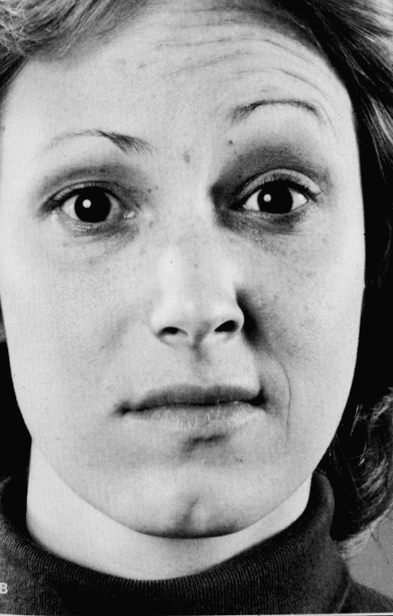
Etiology
Infection:- viral like herpes simplex or Zoster virus]
2. Vascular
3. tumor
4. local traumatic injury

Slide 129
Pathophysiology
Bell's palsy results in a unilateral paralysis of the facial muscles of expression.
Facial paralysis may be central or peripheral in origin.

Slide 130
If Central facial paralysis
Is an upper motor neuron paralysis or paresis
In this situation, the client can not voluntarily show his or her teeth on the paralyzed side
but can show them with emotional stimulation, such as that causing smiles or laughter.
This phenomenon is called voluntary emotional dissociation

Slide 131
Continue…
Inflammatory reaction around the nerve usually at the internal auditory meatus, which is often associated with infections
Can result from hemorrhage, tumor, meningitis, or local trauma.

Slide 132
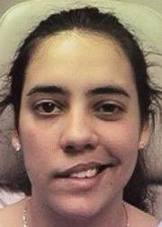
Clinical manifestations
Typical assessment findings on the affected side include:
Unilateral facial weakness
Mouth drooping
Drooling saliva
Distorted face
Lost of taste
Inability to close eyelid
Incomplete eye closure
Excessive tearing-
when attempting to close the eyes
Inability to raise eyebrows,
Inability to puff out the cheek
Bell’s phenomenon-
upward rolling of the eyes when attempting to close them

Slide 133
Diagnosis
Careful Hx/clinical presentation
Electromyography

Slide 134
Medical & nursing management
Analgesics if discomfort occurs from hepetic lesion
Corticosteroids to decrease nerve tissue edema
Massage the face to maintain muscle tone
Give frequent mouth care
Protect the eye with an eye patch. Eyelid can be taped at night or apply TTC eye ointment artificial tears solutions, sunglasses,
Instruct to chew on unaffected side
Watch for adverse effects of steroids use

Slide 135
Continue…
Apply moist heat to the affected side of the face-to reduce pain
Help the pt maintain muscle tone: massaging the face with a gentle upward motion 2-3x daily for 5-10mins
Exercise by grimacing in front of a mirror
Offer psychological support
Provide a soft, nutritionally balanced diet, eliminating hot foods & fluids

Slide 136
Complications
Corneal abrasion/ulcer
Infection (masked by steroid use)
Poor functional recovery

Slide 137
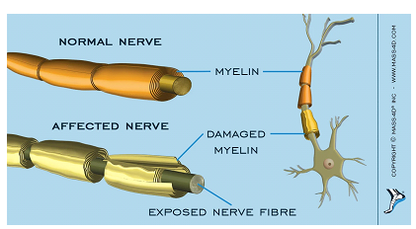
Guillain–Barré syndrome
Guillain-Barre Syndrome (GBS) is an acute condition that involves progressive muscle weakness or paralysis
It can affect anyone at any age, but more common in adult and male gender
The syndrome can affect the nerves that control muscle movement as well as those that transmit pain, temperature, and touch sensation

Slide 138
Etiology
It is an autoimmune disorder in which the body’s immune system attacks its own nervous system, causing inflammation that damages the cover (myelin sheath) of the nerve.
This damage (called demyelinazation) slows or stops the conduction of impulses through the nerve.
The exact cause of GBS and why it affects one person and not another is not well understood

Slide 139
Continue…
The autoimmune process may be spontaneous or may be triggered by some specific disease or exposure.
Cases have been seen in patients who have had various viral and bacterial infections including HIV infection, and in patients who recently had a vaccination (such as for rabies or swine flu).
Respiratory infections are most frequently reported, followed by gastrointestinal infections

Slide 140
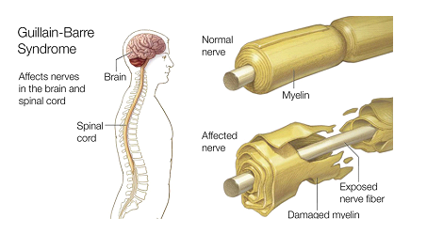
Risk factors
Infections ( campylobacter jejune).
Influenza virus
CMV
EBV
Zika virus
HBV, A,B, C &E
HIV
M. Pneumonia
Surgery
Hodgkin’s lymphoma
Vaccine influenza
Being male and adult

Slide 141
Pathophysiology
Infectious agents
Induce antibodies production in immune system
cross-react with specific gangliosides and glycolipids,
such as GM1 and GD1b, that are distributed throughout the myelin in the peripheral nervous system

Slide 142
Patho. Continue….
Antibodies that cross-react with ganglioside GM1 in myelin, resulting in immunologic damage to the peripheral nervous system
lymphocytic infiltration of spinal roots and peripheral nerves (cranial nerves may be involved as well)
Results in defects in the propagation of electrical nerve impulses, with eventual absence or profound delay in conduction, causing flaccid paralysis

Slide 143
Clinical manifestation
Two-thirds of patients develop the neurologic symptoms 2-4 weeks after what appears to be a benign respiratory or gastrointestinal infection
The initial symptoms are fine paresthesias or tingling in the toes and fingertips, followed by lower extremity weakness
That may ascend over hours to days to involve the arms, cranial nerves, and in severe cases the muscles of respiration

Slide 144
C/M Continue…
Early in the course, patients frequently complain of aching or sciatica-like lower back or leg pain
Prickling, pins and needles sensations in your fingers, toes, ankles, wrists
Weakness in the legs
Unsteady or inability of walking

Slide 145
C/M Continue…
Difficulty of eye and facial movement including speaking, chewing, or swallowing
Difficulty of bladder or bowel function
Tachycardia
Low or high blood pressure
Difficulty of breathing

Slide 146
Physical examination
Symmetric limb weakness with diminished or absent reflexes
Minimal loss of sensation despite paresthesias
Signs of autonomic dysfunction are present in 50 percent of patients, including
Cardiac dysrhythmias
Orthostatic hypotension
Transient or persistent hypertension
Paralytic ileus
Bladder dysfunction
Abnormal sweating

Slide 147
Diagnosis
History
P/E : neurologic examination, loss of deep tendon reflex
CSF analysis
Nerve conduction velocity – tests the speed at which impulses travel through a nerve.
Electromyography (EMG) - measures the electrical activity of muscles fibers.

Slide 148
Management and nursing intervention
Most pts. can fully recovered by treat symptoms and shorten duration with supportive treatment of cardiac , respiratory ,BP, infections
There is no known cure For GBS but up on early intervention of rehabilitation therapy we can halt the diseases progress
Prevent complications like immobility and infection
Plasmapheresis or exchanging plasma through machine to decrease severity and IV immunoglobulin to hasten recovery
Respiratory and cardiac monitoring

Slide 149
Continue…
Give ventilation support in ICU and its care
Balance diet to prevent muscle and tissue break down
Physiotherapy position and ROM
Prevent thrombosis, pressure sore, and contracture
Bowl, bladder and metal status monitoring
NB. Hypoxia , rapid decline Respiratory function, poor/weak cough, and suspected aspiration should be considered for intubation with FCV<15ml/kg

Slide 150
Complication
Breath difficulty
Residual weakness
Heart /BP problem
Bowl and bladder dysfunction
Blood clot
Pressure sores
Relapse

Slide 151
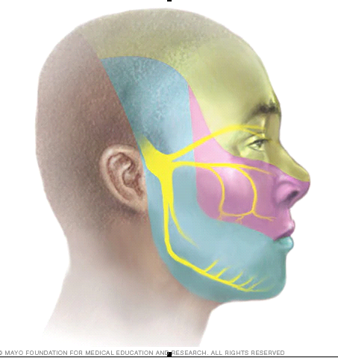
Trigeminal Neuralgia

Slide 152
Trigeminal Neuralgia
Trigeminal neuralgia is a condition of the fifth cranial nerve that is characterized by paroxysms of pain in the area innervated by any of the three branches.
The pain ends as abruptly as it starts and is described as a unilateral shooting and stabbing sensation.

Slide 153
Trigeminal nerves

Slide 154
Trigeminal Neuralgia…
The unilateral nature of the pain is an important diagnostic characteristic.
Associated involuntary contraction of the facial muscles can cause sudden closing of the eye or twitching of the mouth.
Although the cause is not certain, vascular compression and pressure are suggested causes.

Slide 155
Trigeminal Neuralgia…
Trigeminal neuralgia is most likely to occur in the fifth or sixth decade of life, and it is more common among women and in people with MS compared to the general population.
The patient lives in constant fear of attacks.

Slide 156
Trigeminal Neuralgia…
Paroxysms can occur with any stimulation of the terminals of the affected nerve branches, such as washing the face, shaving, brushing the teeth, eating, and drinking.
To avoid stimulating these areas, try not to touch or wash their faces, shave, chew, or do anything else that might cause an attack. These behaviors are a clue to the diagnosis.

Slide 157
Medical Management
Pharmacologic Therapy
Antiseizure agents, such as carbamazepine, relieve pain in most patients with trigeminal neuralgia.
Carbamazepine is taken with meals.
If pain control is still not achieved, phenytoin may be used as adjunctive therapy
Antispasmodic(muscle relaxant):Gabapentin and baclofen are also used for pain control in alone or in combination with anticonvulsants.

Slide 158
Surgery intervention for TGN
Microvascular decompression: the procedure involves small incision behind the ear and relocating or removing blood vessels that are in contact with the trigeminal root to stop the nerve from malfunctioning.
Brain stereotactic radiosurgery (Gamma knife). In this procedure, a surgeon directs a focused dose of radiation to the root of your trigeminal nerve to damage the trigeminal nerve and reduce or eliminate pain
Glycerol injection: inject small glycerol via needle injection to face at base of skull to root site of trigeminal nerves to damages the trigeminal nerve and blocks pain signals.

Slide 159
Surgical ……
Balloon compression : Hallow needle insert with threads of thin, flexible tube (catheter) with a balloon on the end through the needle. Your doctor inflates the balloon with enough pressure to damage the trigeminal nerve and block pain signals.
Radiofrequency thermal lesioning : This procedure selectively destroys nerve fibers associated with pain by inserting an heated electrode through the needle and sends a mild electrical current through the tip of the electrode to for scar or lesion of nerve

Slide 160
Nursing Management
Preventing Pain
Washing the face, combing the hair, or brushing the teeth may produce acute pain.
Providing cotton pads and room-temperature water for washing the face,
Instructing the patient to rinse with mouthwash after eating if tooth brushing causes pain.
Performing personal hygiene during pain-free intervals are all effective strategies.

Slide 161
Parkinson’s disease

Slide 162
Degenerative disease
Parkinson's disease
It is a progressive disease of insidious onset usually occurring in the second half of life.
Degenerative changes in the basal ganglia lead to deficiency in the neurotransmitter dopamine.
Parkinson disease (PD) is one of the most common neurologic disorders, affecting approximately 1% of individuals older than 60 years

Slide 163
Continue…
It is causing progressive disability that can be slowed, but not halted, by treatment.
The 2 major neuropathologic findings in Parkinson disease are:
loss of pigmented dopaminergic neurons of the substantia nigra pars compacta and
The presence of Lewy bodies and Lewy neurites
Various other forms of Parkinsonism cause similar clinical manifestations but have known causes. These include.

Slide 164
Continue…
Post encephalitic Parkinsonism, which occurred after the large epidemic of encephalitis
Drug-induced Parkinsonism, occurring after long-term use of phenothiazine.
Toxin-induced Parkinsonism, sometimes resulting from carbon monoxide, mercury, or manganese exposure
Trauma to the brain

Slide 165
Risk factors
Genetic causes: of Parkinson disease account for approximately 10% of cases.
Environmental causes:- includes use of pesticides, living in a rural environment, consumption of well water, exposure to herbicides, and proximity to industrial plants or quarries
Being male and age>60 years old
After self-injection of 1-methyl-4-phenyl-1,2,3,6-tetrahydropyridine (MPTP) affect mitochondria

Slide 166
Continue…
Oxidation hypothesis: Free radical not removed H2O2
Alpha-synuclein conformational changes and aggregation: Abnormally aggregated alpha-synuclein is the major component of Lewy bodies and Lewy neurites,
Melanoma : Parkinson patients have about a 4-fold increased risk of having preexisting melanoma
Diabetes: In a large cohort study, researchers found that individuals with type 2 diabetes had a 32% increased risk of developing later Parkinson's disease than those without diabetes

Slide 167
Pathophysiology
PD involves degeneration of dopamine producing cells in the substantianigra, which leads to degeneration of dopaminergic neurons in the basal ganglia
Once cell loss in the substantia nigra reaches 80% m. manifestation appear.
The net result of the loss of dopaminergic neurons is an imbalance of dopamine in relation to acetylcholine (Ach) in the basal ganglia, which leads to clinical manifestations of PD.

Slide 168
Continue…
The following are the 2 major neuropathologic findings in Parkinson disease:
Loss of pigmented dopaminergic neurons of the substantia nigra pars compacta
The presence of Lewy bodies and Lewy neurites not spesfic due increase with age, found in atypical PD/ represent the presymptomatic phase of Parkinson disease

Slide 169
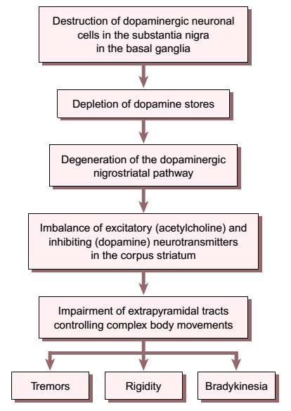
Pathophysiology of Parkinson’s disease

Slide 170
Clinical manifestations
1. Tremor at rest
2. Rigidity
3. Bradykinesia (slow movement)
4. Flexed posture of the neck, trunk and limbs
5. Loss of postural reflexes; and
6. Freezing movement
7. The face appears stiff, mask-like, and without expression

Slide 171
C/M continue…
The speech is low in volume, monotonous in tone, and slow
Dysarthria (poorly articulated words)
Salivation from the mouth because of the lack of spontaneous swallowing
Symptoms of autonomic dysfunction (eg, constipation, sweating abnormalities, sexual dysfunction, seborrheic dermatitis)
Weakness, malaise, depression

Slide 172
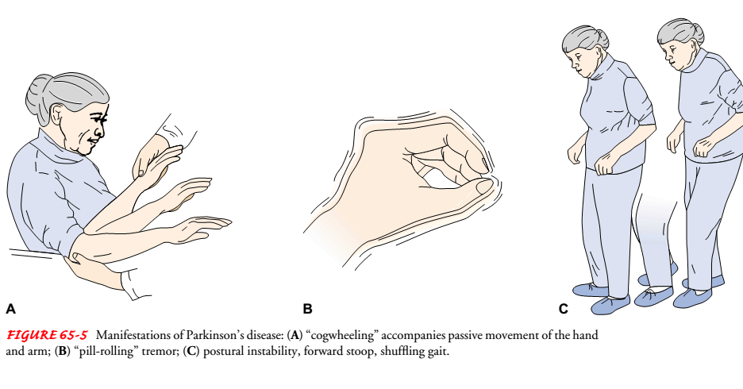

Slide 173
Diagnosis
Patient history and presence of the 2 of three cardinal manifestations:
Tremor
Muscle rigidity and
Bradykinesia
Postural instability/phenobaribitol toxicity

Slide 174
Management
Symptomatic drug therapy
Usually provides good control of motor signs of Parkinson disease for 4-6 years
Levodopa/carbidopa: The gold standard of symptomatic treatment
Monoamine oxidase (MAO)–B inhibitors: Can be considered for initial treatment of early disease
Dopamine agonists (eg, ropinirole, pramipexole): Monotherapy in early disease and adjunctive therapy in moderate to advanced disease
Anticholinergic agents (eg, trihexyphenidyl, benztropine): Second-line drugs for tremor only

Slide 175
Treatment for non-motor symptoms
Sildenafil citrate (Viagra): For erectile dysfunction
Polyethylene glycol: For constipation
Modafinil: For excessive daytime somnolence
Methylphenidate: For fatigue (potential for abuse and addiction)
Deep brain stimulation: impulse stimulation in the brain.

Slide 176
Surgical management
Thalamotomy or surgery to the thalamus
Does not involve destruction of brain tissue
Reversible
Can be adjusted as the disease progresses or adverse events occur
Bilateral procedures can be performed without a significant increase in adverse events

Slide 177
Nursing Intervention
Monitor drug treatment so dosage can be adjusted to minimize side effects
If the patient has surgery
watch for signs of hemorrhage and increased ICP by frequently checking level of consciousness & vital signs
Encourage independence
The patient with excessive tremor may achieve partial control of his body by sitting on a chair & using its arms to steady himself-remember the fatigue may cause him to depend on others
Help the patient overcome problems related to daily activities

Slide 178
Patient Education
Educate about:-
Decision making;
Disease state;
Psychosocial support with professionals.
Prevention of falls.
Addressed at appropriate times in the disease course
Additional information finical support and nursing home

Slide 179
Alzheimer's disease (AD)
It involves progressive decline in two or more areas of cognition, usually memory and language, calculation, visuospatial perception, constructional praxis, judgment, abstraction, or personality.
AD is the most common form of dementia among people 65 years of age an older /snile dementia/

Slide 180
Continue…
AD marked by cognitive and behavioral impairment that significantly interferes with social and occupational functioning.
It is an incurable disease with a long preclinical period and progressive course

Slide 181
Incidence
Nearly half of all people over age 85 years have AD.
Etiology and risk factors
Exact cause is not known
Risk factors;
Genetic factors
Down's syndrome

Slide 182
Pathophysiology
Specific neuropathologic and biochemical changes found in patients with Alzheimer’s disease include:
Neurofibrillary tangles (a tangled mass of nonfunctioning neurons) and
Senile or neuritic plaques (deposits of amyloid protein) in the brain
This neuronal damage occurs primarily in the cerebral cortex and results in decreased brain size

Slide 183
Continue….
In AD, plaques develop in the hippocampus, a structure deep in the brain that helps to encode memories, and
The plaque also develop in other areas of the cerebral cortex that are involved in thinking and making decisions
Biochemically, the enzyme active in producing acetylcholine, which is specifically involved in memory processing, is decreased.
Cells that use the neurotransmitter acetylcholine are the ones principally affected by this disease.

Slide 184
Stages Alzheimer's diseases
Preclinical AD
Mild
Moderate
Sever

Slide 185
1. Preclinical Alzheimer disease
A patient completely normal on physical examination and mental status testing.
Specific regions of the brain (eg, entorhinal cortex, hippocampus) are likely to be affected decades before any signs or symptoms appear

Slide 186
2. Mild Alzheimer disease
Signs of mild AD can include the following:
Memory loss
Confusion about the location of familiar places
Taking longer to accomplish normal, daily tasks
Trouble handling money and paying bills
Compromised judgment, often leading to bad decisions
Loss of spontaneity and sense of initiative
Mood and personality changes; increased anxiety

Slide 187
3. Moderate Alzheimer disease
Increasing memory loss and confusion
Shortened attention span
Problems recognizing friends and family members
Difficulty with language; problems with reading, writing, working with numbers
Difficulty organizing thoughts and thinking logically
Inability to learn new things or to cope with new or unexpected situations

Slide 188
Continue…
Restlessness, agitation, anxiety, tearfulness, wandering, especially in the late afternoon or at night
Repetitive statements or movement; occasional muscle twitches
Hallucinations, delusions, suspiciousness or paranoia, irritability
Loss of impulse control: Shown through behavior such as undressing at inappropriate times or places or vulgar language
Perceptual-motor problems: Such as trouble getting out of a chair or setting the table

Slide 189
4. Severe Alzheimer disease
Patients cannot recognize family or loved ones and cannot communicate effectively.
They are completely dependent on others for care
Weight loss
Seizures, skin infections, difficulty swallowing
Groaning, moaning, or grunting
Increased sleeping
Lack of bladder and bowel control
Death mostly aspiration pneumonia.

Slide 190
Diagnosis finding
Clinical examination:
The clinical diagnosis of AD is usually made during the mild stage of the disease, using the above-listed signs
Lumbar puncture:
levels of tau and phosphorylated tau in the cerebrospinal fluid are often elevated in AD, whereas amyloid levels are usually low;
Imaging studies: for ruling out potentially treatable causes.

Slide 191
Volumetric studies of the hippocampus and 2-fluoro-2-Deoxy-D-glucose positron emission tomography (FDG-PET) with or without amyloid imaging have been employed for early detection and differentiating dementia etiologies
Autopsy studies
Lab studies to R/o metabolic & drug related causes of dementia:
CBC
ESR
BUN
Creatinine values
LFT

Slide 192
Management
There is no cure for AD
Actylcholinesterase inhibition for → allowing more Ach to be available for nerve impulse transmission:
Donepezil 5 mg/day (max. dose 10 mg)
Galantamine 4 mg, po BID (max dose 12 mg)
Rivastigmine1.5 mg.po BID (max dose 6mg)

Slide 193
Pharmacologic treatment of behavioral problems
Problems
Suspiciousness, paranoia
Correct sensory impairment: low - dose antipsychotics
- Loxapine (5-25mg/day)
- Risperidone (1-4mg/day) observe for
Extrapyramidal symptoms (EPS) =>
restlessness, drooling, stiffness, log
wheel rigidity
- Haloperidol (0.25-1mg/day)
Anxiety
- Benzodiazepine
e.g. oxazepam
- Treat the underlying physical problems
(pain, dyspnea, urinary urgency)
Acute catastrophic reaction
- Lorazepam 1-4 mg IM
- Haloperidol 2-5 mg IM

Slide 194
Insomnia
- Low dose of antipsychotic
Depression
- Antidepressant therapy trazodone 25-50mg at night
Angry or violent out bursts
- Very difficult to control
- Behavior log is key to determine
relationship to stimuli such as:
- Pain from arthritis or other chronic
illness
- Urinary problems
- Constipation
- Low dose anti psychotic
- Risperidone, loxapine, clozapine
- Carbamazepine

Slide 195
For impaired verbal communication
Speak slowly & simply, with a firm volume and low pitch
Decrease environmental stimuli
Approach the client calmly & with assurance
Taking care not to place any demands on the client

Slide 196
Continue…
Make sure that all verbal & non-verbal communication cause are concordant
Use multiple sensory modalities (visual, auditory, and tactile) to send the message but not all forms at the same time
Elicit listening behavior by reaching out and touching, holding a hand, putting an arm around the waist

Slide 197
For altered thought process
Apply interventions to enhance memory:
Reorient the client by placing a calendar and clock in obvious place
Repetition is useful for ensuring maximal retention of information by the client

Slide 198
For risk for injury R/T impaired judgment
Teach family members how to eliminate hazards:
Electrical devices
Toxic substances
Loose dugs
Hot tap water
Inadequate lighting
In the inpatient setting the patient should wear an ID badge in case he/she lost
Dangerous objects should be kept out of reach
Avoid cooking

Slide 199
Prevention
There are no proven modalities for preventing AD, but: evidence suggests that healthy lifestyles can reduce the risk of developing the disease;
The following may be protective :
Physical activity
Exercise
Cardiorespiratory fitness
Diet

Slide 200
Multiple Sclerosis
It is an immune-mediated, progressive demyelinating disease of the CNS.
MS may occur at any age but typically manifests in young adults between the ages of 20 and 40 years; it affects women more frequently than men.
Autoimmune activity results in demyelination.
Notes:
Demyelination refers to the destruction of myelin, the fatty and protein material that surrounds certain nerve fibers in the brain and spinal cord; it results in impaired transmission of nerve impulses.

Slide 201
Multiple Sclerosis…
Multiple factors play a role in the initiation of the immune process.
Genetic predisposition is indicated by the presence of a specific cluster of human leukocyte antigens on the cell wall.
The presence of this factor promote susceptibility to factors, such as viruses, that trigger the autoimmune response activated in MS.
Notes:
A specific virus capable of initiating the autoimmune response has not been identified.

Slide 202
Multiple Sclerosis…
It is believed that DNA on the virus mimics the amino acid sequence of myelin, resulting in an immune system cross-reaction in the presence of a defective immune system.

Slide 203
Pathophysiology…
Sensitized T cells typically cross the blood–brain barrier; their function is to check the CNS for antigens and then leave.
In MS, the sensitized T cells remain in the CNS and promote the infiltration of other agents that damage the immune system.
The immune system attack leads to inflammation that destroys myelin.

Slide 204
Pathophysiology…
Demyelination interrupts the flow of nerve impulses.
Demyelinated axons are scattered irregularly throughout the CNS.
The areas most frequently affected are the optic nerves; the cerebrum; the brain stem and cerebellum; and the spinal cord.
Eventually, the axons themselves begin to degenerate, resulting in permanent and irreversible damage.

Slide 205
Clinical Manifestations
80% - 85% of patients with MS have a relapsing remitting course.
With each relapse, recovery is usually complete; however residual deficits may occur and accumulate over time, contributing to functional decline.
Fifty percent of those with the RR course of MS progress to a secondary progressive course.

Slide 206
Clinical Manifestations…
Quadriparesis, cognitive dysfunction and visual loss.
The primary symptoms most commonly reported are fatigue, depression, weakness, numbness, difficulty in coordination, loss of balance, and pain.
Blurring of vision, diplopia, and total blindness.

Slide 207
Clinical Manifestations…
Fatigue affects 87% of people with MS; 40% of that group indicate that fatigue is the most disabling symptom.
Depression, heat, anemia, and medication may contribute to fatigue.
Avoiding hot temperatures, effective treatment of depression and anemia, and physical therapy may control fatigue.

Slide 208
Clinical Manifestations…
Lesions on the sensory pathways cause pain.
Additional sensory manifestations include paresthesias, dysesthesias, and proprioception loss.
Many people with MS need daily analgesics.
In some cases, pain is managed with opioids, antiseizure medication, or antidepressants.

Slide 209
Clinical Manifestations…
Spasticity (muscle hypertonicity) of the extremities and loss of the abdominal reflexes result from involvement of the main motor pathways of the spinal cord.
Cognitive and psychosocial problems may reflect frontal or parietal lobe involvement.
Some degree of cognitive change occurs in about half of patients

Slide 210
Clinical Manifestations…
Involvement of the cerebellum or basal ganglia can produce ataxia and tremor.
Bladder, bowel, and sexual dysfunctions are common.
Secondary complications of MS include UTI, constipation, pressure ulcers, contracture deformities, dependent pedal edema, pneumonia, reactive depression, and decreased bone density.

Slide 211
Clinical Manifestations…
Emotional, social, marital, economic, and vocational problems may also be a consequence of the disease.
Exacerbations and remissions are characteristic of MS.
During exacerbations, new symptoms appear and existing ones worsen; during remissions, symptoms decrease or disappear.
Relapses may be associated with periods of emotional and physical stress

Slide 212
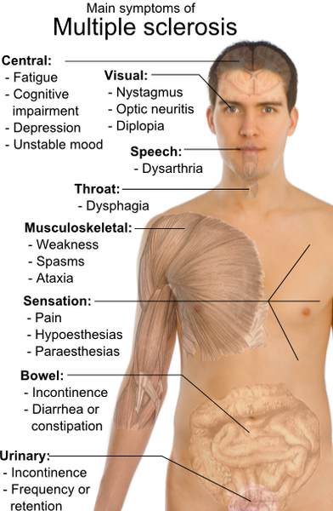
Sum up MS S/S

Slide 213
Assessment & diagnostic Findings
The diagnosis of MS is based on MRI findings.
Underlying bladder dysfunction is diagnosed by urodynamic studies.
Neuropsychological testing may be indicated to assess cognitive impairment.
A sexual history helps to identify changes in sexual function.

Slide 214
Medical Management
No cure exists for MS.
Relieve the patient's symptoms and provide continuing support
The goals of treatment are to delay the progression of the disease, manage chronic symptoms, and treat acute exacerbations.
Symptoms requiring intervention include spasticity, fatigue, bladder dysfunction, and ataxia.
Immunosuppressive agents

Slide 215
Myasthenia Gravis
Myasthenia gravis, an autoimmune disorder affecting the myoneural junction, is characterized by varying degrees of weakness of the voluntary muscles.
Women are affected more frequently than men, and they tend to develop the disease at an earlier age (20 to 40 years versus 60 to 70 years of age for men).

Slide 216
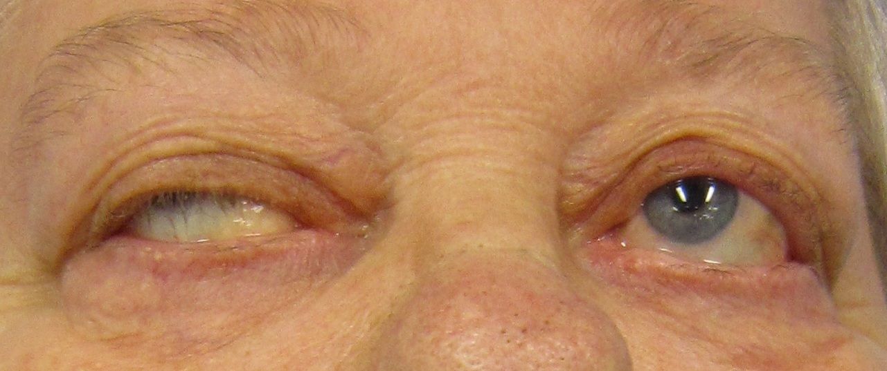

Slide 217
Pathophysiology
Antibodies directed at the acetylcholine receptor sites impair transmission of impulses across the myoneural junction.
Therefore, fewer receptors are available for stimulation, resulting in voluntary muscle weakness that escalates with continued activity.
Notes:
Normally, a chemical impulse precipitates the release of acetylcholine from vesicles on the nerve terminal at the myoneural junction.
The acetylcholine attaches to receptor sites on the motor endplate and stimulates muscle contraction.
Continuous binding of acetylcholine to the receptor site is required for muscular contraction to be sustained.

Slide 218
Clinical Manifestations
The initial manifestation of myasthenia gravis usually involves the ocular muscles.
Diplopia and ptosis are common.
Majority of patients also experience weakness of the muscles of the face, throat and generalized weakness.
Weakness of the facial muscles results in a bland facial expression.

Slide 219
Clinical Manifestations…
Laryngeal involvement produces dysphonia (voice impairment) and increases the patient's risk for choking and aspiration.
Generalized weakness affects all the extremities and the intercostal muscles, resulting in respiratory failure.
Myasthenia gravis is purely a motor disorder with no effect on sensation or coordination.

Slide 220
Assessment and Diagnostic Findings
An acetylcholinesterase inhibitor test is used to diagnose myasthenia gravis.
The acetylcholinesterase inhibitor stops the breakdown of acetylcholine, thereby increasing availability at the neuromuscular junction.
Edrophonium chloride, a fast-acting acetylcholinesterase inhibitor, is administered IV to diagnose myasthenia gravis.

Slide 221
Assessment and….
Thirty seconds after injection, facial muscle weakness and ptosis should resolve for about 5 minutes.
Immediate improvement in muscle strength after administration of this agent represents a positive test and usually confirms the diagnosis.
Atropine should be available to control the side effects of edrophonium, which include bradycardia, sweating, and cramping.

Slide 222
Assessment and….
Repetitive nerve stimulation demonstrates a decrease in successive action potentials.
The thymus gland, a site of acetylcholine receptor antibody production, may be enlarged in myasthenia gravis.
An MRI scan is used to identify an enlarged thymus gland.

Slide 223
Medical Management
Management of myasthenia gravis is directed at improving function and reducing and removing circulating antibodies.
Therapeutic modalities include administration of anticholinesterase medications and immunosuppressive therapy and thymectomy

Slide 224
Pharmacologic Therapy
Pyridostigmine bromide, an anticholinesterase medication, is the first line of therapy.
It provides symptomatic relief by inhibiting the breakdown of acetylcholine and increasing the relative concentration of available acetylcholine at the neuromuscular junction.

Slide 225
Surgical Management
Thymectomy can produce antigen-specific immunosuppression and result in clinical improvement.

Slide 226
Complications
Respiratory Failure
A myasthenic crisis is an exacerbation of the disease process characterized by severe generalized muscle weakness and respiratory failure.

Slide 227
Stroke

Slide 228
Cerebrovascular Disorders/Stroke
Cerebrovascular disorders: is an umbrella term that refers to any functional abnormality of the central nervous system (CNS) that occurs when the normal blood supply to the brain is disrupted
Stroke - the primary cerebrovascular disorder
Stroke: is a damage to the cells of the brain following a vascular abnormality
Types
Ischemic stroke
Hemorrhagic stroke

Slide 229
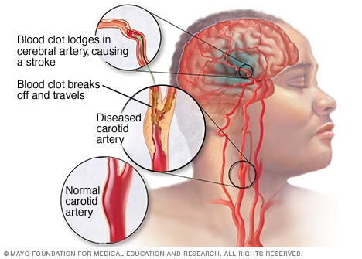

Slide 230
1. Ischemic stroke
Also referred as “brain attack” and accounts 80% of stroke.
A sudden loss of function resulting from disruption of the blood supply to a part of the brain due to narrowed or blocked of the arteries to your brain.
Sub types of Ischemic strokes
five different types according to their cause:

Slide 231
Continue…
A. large artery thrombosis (20%), -
due to atherosclerotic plaques in the large blood vessels of the brain
Thrombus formation and occlusion at the site of the atherosclerosis result in ischemia and infarction.
B. small penetrating artery thrombosis (25%)
affect one or more vessels
are the most common type of ischemic stroke

Slide 232
C. Cardiogenic embolic stroke (20%)
Are associated with cardiac dysrhythmias, usually atrial fibrillation
Emboli originate from the heart and circulate to the cerebral vasculature, most commonly the left middle cerebral artery, resulting in a stroke
Can be prevented by early use of thrombolytic

Slide 233
Continue…
D. Cryptogenic (30%)
have no known cause
E. Other (5%)
Contributed by different factors such as cocaine use, coagulopathies, migraine, and spontaneous dissection of the carotid or vertebral arteries

Slide 234
Continue…
Strokes using the time course are commonly classified in the following manner:
(1) Transient ischemic attack (TIA)
(2) Reversible ischemic neurologic deficit
(3) Stroke in evolution;
(4) Completed stroke

Slide 235
Cause
Ischemic stroke is cause by blockage of blood supply to the brain due thrombus; thrombotic stroke and embolus; embolic stroke:-
Risk factors
Non-modifiable risk factors include:
Advanced age- people over the age of 55
Gender- men are more affected
race – blacks

Slide 236
Continue…
Modifiable risk factors for ischemic stroke include:
hypertension
cardiovascular disease
high cholesterol
Obesity
smoking
diabetes

Slide 237
Pathophysiology
In an ischemic brain attack, there is disruption of the cerebral blood flow due to obstruction of a blood vessel.
This initiates a complex series of cellular metabolic events referred to as the ischemic cascade
The ischemic cascade begins when cerebral blood flow falls to less than 25 mL/100 g/min
neurons can no longer maintain aerobic respiration

Slide 238
Continue…
Anaerobic respiration large amounts of lactic acid change in the pH(acidosis) insufficient ATP production, disturbance in cell depolarization leading to decrease/ cessation of Cell function

Slide 239
Clinical Manifestations
An ischemic stroke can cause a wide variety of neurologic deficits,
depending on:
the location of the lesion (which vessels are obstructed)
the size of the area of inadequate perfusion, and
the amount of collateral (secondary or accessory) blood flow.

Slide 240
clinical presentations include:
Numbness or weakness of the face, arm, or leg, especially on one side of the body
Confusion or change in mental status
Trouble speaking or understanding speech
Visual disturbances
Difficulty walking, dizziness, or loss of balance or coordination
Sudden severe headache

Slide 241
Motor loss C/M
A stroke is a lesion of the upper motor neurons
Results in loss of voluntary control over motor movements
A disturbance of voluntary motor control on one side of the body may reflect damage to the upper motor neurons on the opposite side of the brain
Hemiplegia (paralysis of one side of the body) - common
Hemiparesis or weakness of one side of the body

Slide 242
Continue…
Initially flaccid paralysis and loss of or decrease in the deep tendon reflexes are observed
Later at about 48 hrs. deep reflexes reappear spasticity (abnormal increase in muscle tone) of the extremities on the affected side occur

Slide 243
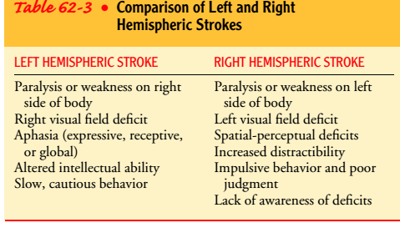

Slide 244
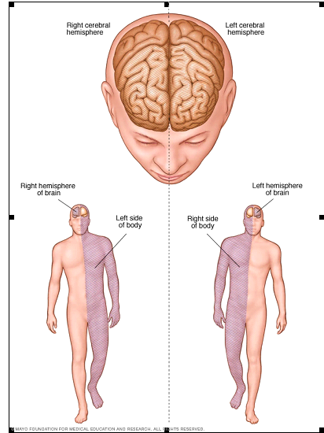

Slide 245
Assessment and Diagnostic Findings
Careful history
Complete physical and neurologic examination
CT scanning
Cerebral angiography
Doper flow studies
Ecocardiography

Slide 246
Medical Management
Non-surgical medical management - for Patients who have experienced a TIA or mild stroke from atrial fibrillation or from suspected embolic or thrombotic causes
Warfarin sodium (Coumadin)
Aspirin 50 and 325 mg/d – if warfarin is contraindicated
Heparin
Recombinant tPA (tissue plasminogine activator of a serine protease enzyme which convert plasminogine to plasmin to break down clots.

Slide 247
Increased intracranial pressure (ICP) and its associated complications may occur following a large ischemic stroke
Methods to reduce ICP include:
Administering an osmotic diuretic (eg, mannitol)
Maintaining PaCO2 within the range of 30 to 35 mm Hg and avoid hypoxia
Elevation of the head of the bed to promote venous drainage and to lower increased ICP

Slide 248
Methods to reduce ICP include ConT’d…
Intubation with an endotracheal tube to establish a patent airway, if necessary
Continuous hemodynamic monitoring
Maintained SBP less than 180 mm Hg& DB Pless than 100 mm Hg.
Frequent Neurologic assessment

Slide 249
Prevention
Primary prevention of ischemic stroke is the best approach.
Stroke risk screenings
Identifying high-risk individuals or groups to prevent risk factors.
Educating the patients and the community about recognition and prevention of stroke
Interventions of the underlined diseases or life style modifications will reduce stroke risk

Slide 250
2. Hemorrhagic Stroke
Hemorrhagic strokes account for 15% of cerebrovascular disorders which is due to leaking or ruptured of arteries in the brain.
It is primarily caused by an intracranial or subarachnoid hemorrhage
The caused is bleeding into the brain tissue, the ventricles, or the subarachnoid space

Slide 252
Cause hemorrhagic stroke
Primary and secondary causes
Primary intracerebral hemorrhage:
A spontaneous rupture of small vessels accounts for approximately 80% of hemorrhagic strokes
It is primarily caused by uncontrolled hypertension

Slide 253
Continue….
Secondary intracerebral hemorrhage:
Arteriovenous malformations (AVMs: the rupture of an abnormal tangled of thin blood vessels
Intracranial aneurysms( weak spot in B/d vessels of brain)
Certain medications over used (e.g., anticoagulants and amphetamines).

Slide 254
Pathophysiology
Depends on the cause and type of cerebrovascular disorder
Symptoms are produced when an aneurysm or AVM enlarges and presses on nearby cranial nerves or brain tissue or, more dramatically, when an aneurysm or AVM ruptures, causing subarachnoid hemorrhage

Slide 255
Continue…
Damage to the brain tissue occur due to:
Increase in ICP resulting from the sudden entry of blood into the subarachnoid space, which compresses
Injures
Secondary ischemia of the brain due to the vasospasm that frequently accompany subarachnoid hemorrhage

Slide 256
Clinical Manifestations
The patient can present with a wide variety of neurologic deficits
Rupture of an aneurysm or AVM usually produces:
Sudden , unusually severe headache
loss of consciousness for a variable period
Pain and rigidity of the back of the neck (nuchal rigidity) and spine due to meningeal irritation.

Slide 257
Continue…
Visual disturbances (visual loss, diplopia, ptosis)
Tinnitus, dizziness, and hemiparesis
Coma and death /in sever cases/

Slide 258
Prognosis depends on:
The neurologic condition of the patient,
Age patients ,
Presence of associated diseases, and
The extent and location of an intracranial bleeding

Slide 259
Assessment and Diagnostic Findings
Careful history
Complete physical and neurologic examination
CT scanning
Cerebral angiography
LP- to detect increase in ICP

Slide 260
Medical Management
Goals
to allow the brain to recover from the initial insult (bleeding)
to prevent or minimize the risk for rebleeding
to prevent or treat complications

Slide 261
Management consists of:
Bed rest with sedation to prevent agitation and stress,
Vasodilators- to manage or prevent vasospasm
Surgical management to prevent rebleeding.
Analgesics (codeine, acetaminophen)
Use of elastic compression stockings to prevent deep vein thrombosis

Slide 262
Prevention
Managing hypertension and other significant risk factors
Avoid smoking, excessive alcohol intake, and high cholesterol
Stroke risk screenings provide an ideal opportunity to lower hemorrhagic stroke risk by identifying high-risk
Individuals or groups and educating the patients and the community about recognition and prevention

Slide 263
Complication
Cerebral edema
Aspiration pneumonia
Seizures
Limb contracture
DVT
Ischemic to hemorrhagic stroke
Depression
hypotension/hypertension

Slide 264
Cerebral aneurysm
a localized dilation of a cerebral artery that results from a weakness in the arterial wall
Causes
not known
Predisposing factors include
Atheroma
Hypertension
Defective formation of collagen in the arterial wall
congenital weakness in the vessel
trauma

Slide 265
Types aneurysms
Fusiforms or spindle aneurysms
shaped distensions occur mainly in the abdominal aorta and less commonly in the iliac arteries
They are usually associated with atheromatous changes
Saccular aneurysms
bulge out on one side of the artery
When they occur in the relatively thin walled arteries of the circulus arterious (circle of will is) in the brain they are sometimes called ‘berry’ aneurysms

Slide 266
They may be associated with defective collagen production, with atheromatous changes or congenital
Dissecting aneurysms
occurs mainly in the arch of the aorta due to infiltration of blood between the endothelium and tunica media, beginning at a site of endothelial damage

Slide 267
Pathophysiology
A cerebral aneurysm is a sac formed by dilation of the walls of an artery with in the cranial cavity
Symptom occurs when the aneurysm compresses near by nerves or when it ruptures.
Prognosis
half the patients suffering subarachnoid hemorrhages die immediately
another 20% die later from recurring hemorrhage)

Slide 268
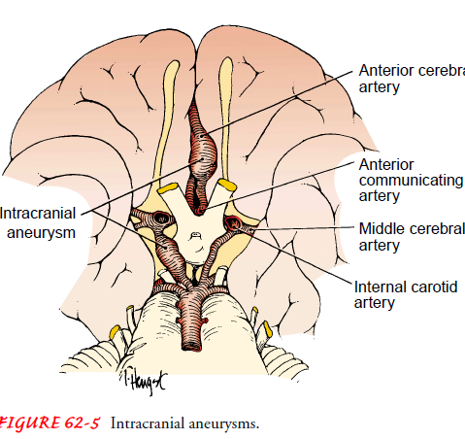

Slide 269
Clinical manifestations
Unilateral headache
Pain in the eye
Diplopia
Tinnitus
Rigidity of the back of he neck & spine
Ptosis of the eyelid
Hemiparesis

Slide 270
Complication
three major threats:
Death from increase ICP /Pressure/:
Increased ICP may push the brain downward, impair brain stem function, and cut off blood supply to the part of the brain that supports vital functions.
Rebleed
after initial bleeding episode, a clot forms and seals the rupture, reinforcing the wall of the aneurysm for 7 to 10 days

Slide 271
However, after the seventh day, fibrinolysis begins to dissolve the clot and increases the risk of rebreeding
This rebreeding produces symptoms similar to those accompanying the initial hemorrhage.
Rebleeds during the first 48 to 72 hours following initial hemorrhage are not uncommon and contribute to the high mortality.

Slide 272
Vasospasm:
Why this occurs isn't clearly understood. Usually, vasospasm occurs in blood vessels adjacent to the aneurysm, but it may extend to major vessels of the brain, causing ischemia and altered brain function
Thrombosis and embolism
May result in DVT and or pulmonary embolism
Hydrocephalus
Due to occlusion of CSF flow

Slide 273
Diagnosis
Angiography (arteriography) reveals an unrruptured cerebral aneurysm
LP can detect blood in the CSF & ↑ ICP
Skull X-ray may show calcification in the walls of a large aneurysm
CT scan locates the clot & identifies hydrocephalus, areas of infarction & extent of blood spillage with in the cisterns around the brain

Slide 274
Medical management nursing intervention
Treatment
Aims to reduce the risk of rebleeding by repairing the aneurysm
Usually, surgical repair (by clipping, legation, or wrapping the aneurysm neck with muscle) takes place 7 to 10 days after the initial bleed
When surgical correction is risky ( in very elderly patients or those with heart, lung, or other serious diseases), or when the aneurysm is in a particularly dangerous location or surgery is delayed because of vasospasm, conservative treatment should be given

Slide 275
Nursing intervention
accurate neurological assessment
patient and family teaching, and psychological support
patient care
maintain a patent airway
supplementary oxygen
Position the patient to promote pulmonary drainage and prevent upper airway obstruction
Give frequent nose & mouth care
bed rest in quiet, darkened room (keep the head of the bed flat or under 30⁰, as ordered)
limited visitors
avoidance of coffee, other stimulants, and strenuous physical activity
restricted fluid intake

Slide 276
These include:
Bed rest in a quiet, darkened room; if immediate surgery isn't possible, such bed rest may continue for 4 to 6 weeks
Avoidance of coffee, other stimulants, and aspirin
Codeine or another analgesic, as needed
Hydralazine or another hypotensive agent if the patient is hypertensive
Phenobarbital or another sedative to reduce stress
Aminocapric acid, a fibrinolytic inhibitor, to minimize the risk of rebleed by delaying blood clotting

Slide 277
Prevention of complication
Turn the patient often. Encourage deep breathing & leg movement
Warn the patient to avoid unnecessary physical activity
Assist the patient with active ROM exercises. If the patient is paralyzed, perform regular passive ROM exercises
Monitor V/s, intake out put
Watch for danger signals => decreased level of consciousness unilateral enlarged pupil, worsening of hemiparesis, increased BP, slowed PR, worsening of headache, nuchal rigidity, persistent vomiting

Slide 278
Continue…
Restrict fluids, as ordered, monitor IV infusions to avoid increased ICP
If the patient has facial weakness, assist him during meals, placing food in the unaffected side of his mouth. If he can't swallow, insert a NGT as ordered
If the patient can eat provide a high-bulk diet (salads, fruit) to prevent straining at stool, which can increase ICP

Slide 279
Continue…
Administer hydralazine or another hypotensive agent, as ordered
Administer aminocaproic acid I.V in 5% DW, PO or as ordered. Give at least every 2 hrs. to maintain therapeutic blood levels
If the patient can't speak establish a simple means of communication, or use cards. Try to limit conversation to topics that won't further frustrate the patient. Encourage his family to speak to him in normal tone, even if he doesn't seem to respond
Provide emotional support, and include the patient's family in his care as much as possible

Slide 280
Meningitis

Slide 281
Meningitis
It is an inflammation of the meninges of the pia mater, the arachnoid, and the cerebrospinal fluid
It is classified as septic or aseptic.
Septic meningitis is caused by bacteria.
In aseptic meningitis, the cause is viral or secondary to lymphoma, leukemia or HIV.

Slide 282
Couse of meningitis
Bacterial
Viral
Fungal
Parasitic
Drugs like: NSAIDs, metronidazole, and IV immunoglobulin

Slide 283
Meningitis…
The most common pathogens causing septic meningitis are
Streptococcus pneumoniae and Neisseria meningitidis.
Outbreaks of N. meningitidis infection are most likely to occur in dense community groups, such as college campuses and military installations.

Slide 284
Risk factors
Although infections occur year round, the peak incidence is in the winter and early spring.
Factors that increase the risk for bacterial meningitis include
Tobacaco use and
viral upper respiratory infection.
Otitis media and mastoiditis
immune system deficiencies

Slide 285
Pathophysiology
An infectious agent can gain access to the CNS and cause meningeal disease via any of the 3 following major pathways:
Invasion via bloodstream: common rout infections
A retrograde neuronal: olfactory and peripheral nerves pathway (eg, Naegleria fowleri or Gnathostoma spinigerum)
Direct contiguous spread: sinusitis, otitis media, congenital malformations, trauma, or direct inoculation during intracranial manipulation)

Slide 286
Continue…
Once the causative organism enters the bloodstream, it crosses the blood–brain barrier and proliferates in the CSF.
CSF circulates through the subarachnoid space, where inflammatory cellular materials from the affected meningeal tissue enter and accumulate.
While once infectious agent reach to the brain by crossing BBB the blood-brain barrier can become disrupted
Finally cause meningeal irritation

Slide 287
Diagnosis
Hx/ P/E
Complete blood count (CBC) with differential
Serum electrolytes, Syphilis test,
Serum glucose (which is compared with the CSF glucose)
Blood urea nitrogen (BUN) or creatinine and liver profile

Slide 288
Continue…
Blood, nasopharynx, respiratory secretion, urine or skin lesion cultures or antigen/polymerase chain reaction (PCR) detection assays
CSF studies demonstrate decreased glucose, increased protein levels, and increased white blood cell count cloudy or turbid in color of CSF in bacterial cause.
Neuroimaging (CT of the head or MRI of the brain)

Slide 289
Clinical Presentation
The classic triad 95% of bacterial meningitis consists of the 2 of the following:
Fever
Headache
Neck stiffness/ altered LOC
Other symptoms can includes:
Nausea, vomiting, sleepiness, confusion, irritability, delirium, and coma.
Patients with viral meningitis may have a history of preceding systemic symptoms (e.g. myalgias, fatigue, or anorexia

Slide 290
Clinical Manifestations…
Meningeal irritation results in a number of other well-recognized signs common to all types of meningitis:
Neck rigidity: This is an early sign.
Positive Kernig's sign-90 degree knee & hip flexion then extend pain is feel
Positive Brudzinski's sign: Hd flex to chest cause knee flex
Photophobia (extreme sensitivity to light)
Notes:
Neck rigidity: Any attempts at flexion of the head are difficult because of spasms in the muscles of the neck. Forceful flexion causes severe pain.
Positive Kernig's sign: When the patient is lying with the thigh flexed on the abdomen, the leg cannot be completely extended.
Photophobia (extreme sensitivity to light): This finding is common, although the cause is unclear.

Slide 291
Management
Initial measures include the following:
Shock or hypotension – Crystalloids
Altered mental status – Seizure precautions and treatment, along with airway protection
Stable with normal vital signs – Oxygen, IV access, and rapid transport to the emergency

Slide 292
For bacterial meningitis:-
Prompt initiation of empiric antibacterial therapy as appropriate for patient age and condition
After identification of the pathogen and determination of susceptibilities, targeted antibiotic therapy as appropriate for patient age and condition
In certain patients, consideration of intrathecal antibiotics( spinal cord injection administration)
Supportive: Steroid (typically, dexamethasone) therapy
For Viral meningitis: are benign and self-limited, but in certain instances, specific antiviral therapy may be indicated, if available.

Slide 293
Continue…
Specific therapy for appropriate for the causative pathogen, as follows:
Fungal meningitis:
Cryptococcal (amphotericin B, flucytosine, fluconazole),
Coccidioides immitis (fluconazole, amphotericin B, itraconazole),
Histoplasma capsulatum (liposomal amphotericin B, itraconazole), or
Candida (amphotericin plus 5-flucytosine)

Slide 294
Continue…
Tuberculous meningitis (isoniazid, rifampin, pyrazinamide, ethambutol, streptomycin)
​Parasitic meningitis (amebic [Naegleria fowleri] or acanthamebic) - Variable regimens. mostly supportive and Antifungal amphotercin B b/c antiprotozal cause reaction of died parasite to tissue

Slide 295
Nursing intervention
Provide appropriate fluid and medication timly
Attain adequate cerebral tissue perfusion through reduction of ICP: Control BP
Maintain normal body temperature: infection
Protection against injury. Position hd neck midline with pillow
Enhance coping measure:
Accurate perception of environmental stimuli: quit env’t
Prevent complication with early detection

Slide 296
Complications include:-
visual impairment,
deafness,
seizures,
paralysis,
hydrocephalus,
septic shock

Slide 297
Brain abscess
It is a collection of pus that develop in response to infection or inflammation of brain parts .
Uncommon life threatening infection or inflammation with subsequent abscess formation.
It may be at intracranial, subdural, and epidural based on location
More common in male than female

Slide 298
Cause
Infection (bacterial, fungus, parasitic
Trauma
Tumor

Slide 299
Pathophysilogy
It occurs :
Contagious Suppurative infection: direct extension by osteomyelitis, sinusitis, otitis media, dental infection
Direct inoculation: spread of infection agent from open trauma
Hematogenous spread: systemic infection through blood like: circulation cardiac ,lung infection

Slide 300
Clinical presentation
Head ache
Fever
Seizure
Nausea and vomiting( due to preasure)
Mental status change like:
Muscle weakness, hemiparalysis, speech difficulty, poor coordination.
Stiff neck, back, shoulder pain, blurred or double vision and papilledema.

Slide 301
Diagnosis
HX.
Blood analysis: CBC
Image : CT scan, MRI
Biopsy through aspiration pus

Slide 302
Treatment of brain abscess
RX dependents on:
Size of abscess
Cause of abscess
Patients condition
Broad spectrum Antibiotics: long term
Antifungal , Antiviral, antiparasite,
Corticosteroids to reduce edema
Supportive anticonvulsant
Surgical drainage: if pressure continue build, not respond to medication; gas in the abscess and risk of burst the abscess

Slide 303
Nursing management
Asses patients ability to think , reason, and remember.
Monitor vital sign and fluid intake and out put
Teach patients about treatment and procedure
Advice patients and families about neurological deficits (seizure, hemiparesis)
Frequently asses neurological status (LOC, speech, CN function)
Aware sign of post OP infection and increase ICP
Administer drugs and continue monitoring of side effects
Support and take safety measure

Slide 304
Head injury
A break in the continuity of the skull caused by forceful trauma
It is broadly classification like:-
scalp,
skull
brain

Slide 305
Scalp injury
It is a minor injury
Trauma beneath the tissue of the scalp
It results abrasion, contusion, laceration, or hematoma.
Dx. inspection and palpation
Mgt. Irrigation, and suturing and antibiotics

Slide 306
Skull fracture
Etiology and pathophysiology
Head injuries results from trauma & are frequently seen after motor vehicle accidents
These injuries can result in Fractures:
Linear - a simple break in the bone
Depressed - a break that results in fragments of bone penetrating the brain tissue
Basilar- break of the bone in back and bottom of skull

Slide 307
Basilar skull is :-
Most serious
Connect to sinus cavity
Allow entry to fluid and air to brain
c/m:-
Bruises of eye; raccoon eye,
Briuses behind ear; Battel’s sign,
CSF drain in ear; Otorrhea,
CSF in nose; rhinorrhea

Slide 308
Brain injury
Two types brain injury:-
Closed:- it is blunt type trauma
no opening through skull and Dura
Open:-penetrating type and inters in to the brain tissue
When bleeding developed in the cranial voult
It is most serious brain injury of intracranial hemorrhage.

Slide 309
Intracranial Hemorrhages
Epidural : a hematoma forms blood between the dura and the skull,
may result from a laceration of the middle menigeal artery
Subdural: a hematoma forms blood between the Dura and arachnoid layers,
Generally follows venous damage to 48hrs, 48hrs-2wk, 3wks above (acute, sub acute, chronic respectively )

Slide 310
Continue…
Intracerebral- due to damage of cerebral vasculature or brain parenchyma,
Mild: LOC about 0-20min; GCS is 13-15.
Moderate: LOC about 20-6hr; GCS is 9-12.
Sever: LOC 6hr & above ; GCS 3-8 .

Slide 311
Concussion
Results from a blow to the head-a blow hard enough to jostle the brain & make it hit against the skull,
It causing temporary neural dysfunction, but not hard enough to cause cerebral contusion.
Cause: - a fall to the ground
- a punch to the head
- an automobile accident

Slide 312
Clinical Manifestation
Dizziness
Spot before eye
LOC for few seconds
Frontal and Temporal lobe involvement:- bizarre irrational behavior and temporal amnesia & disorientation respectively
Management:- observation and advice dangerous sign like difficulty of awaking and speaking, confusion, sever head ache, weakness on one side.

Slide 313
Contusion
Bruising of the brain tissue with slight bleeding of small cerebral vessels in to surrounding tissues as a result of a severe blow to the head
Crashed portion of brain to inner surface of skull
Cause: - trauma by a blunt instrument
- automobile accident

Slide 314
Clinical Manifestation
LOC for considerable period
Weak pulse and shallow respiration
Cold and pale skin
Involuntary urination and defecation
Management
Clear airway
Control bleeding internal and external
Check v/s

Slide 315
Clinical manifestation brain injury
- Lethargy
- Indifference to surrounding
- Signs of increased ICP
- Lack of orientation to PPT
- Paresthesia
- Labored respirations
- Positive babinsk sign (stroking bottom of
foot causes dorsiflexion of foot)
- Coma
- Dilation & fixation of pupil

Slide 316
Diagnosis
A history of trauma
Neurologic exam. E.G. Assess LOC using glasgow coma scale, mental status, cranial nerve & motor function, deep tendon and abdominal reflexes & orientation to PPT
Skull x-ray to R/O fractures, shift in brain tissues from the midline
CT/MRI scan identifies ischemic or necrotic tissue

Slide 317
Management
1. Control seizures with anticonvulsants
2. Maintain adequate fluid & electrolyte balance
3. Surgical intervention in cases of depressed skull fractures with hematoma

Slide 318
Nursing roles
Observe for signs of increased intracranial pressure
Provide neural checks every 15 min for several hours progressing to every hour & then every 4 hours
Maintain airway
If surgery is indicated, see care of patient undergoing brain surgery
Institute seizure precautions, administer anticonvulsants

Slide 319
Spinal cord injuries
SCIs include fractures, contusions, and compressions of the vertebral column usually the result of trauma to the head or neck.
Injury to the spinal cord can range in severity from:
mild flexion extension "Whiplash" injuries to
complete transection of the cord with permanent quadriplegia

Slide 320
Continue…
Trauma to the cord can occur at any level most commonly occurs in the :
5th, 6th and 7th cervical (neck)
The 12th thoracic
The 1st lumbar vertebrae
These vertebrae are the most susceptible because there is a greater range of mobility in the vertebral column in these areas.

Slide 321
Causes of SCI
A. Traumatic
Falling from a height
Falling awkwardly while doing gymnastics
Diving into a shallow pool and hitting the bottom
Being thrown from a horse or from a motor bicycle
Sudden deceleration/stopping of a motor vechicle. (for e.g. in a head-on crash)
A heavy object falling across the back
Injury to the head
Gunshot or knife wound

Slide 322
Continue…
B. Non-traumatic –
Cervical spondylitis with myelopathy (spinal canal narrowing with progressive injury to the cord and roots)
Myelitis (infective or non infective)
Osteoporosis, causing vertebral compression fractures
Tumors
Vascular diseases, usually infarction or hemorrhage

Slide 323
Pathophysiology
SCIs most often occurs as a result of injury to the vertebrae
The cord is injured as the result of acceleration, deceleration, or another force (e.g. impact) applied to the spine.
The forces injure the spinal cord by compressing, pulling, or tearing the tissues.
Microscopic bleeding occurs immediately after injury, primarily in the gray matter of the cord with in the first hours, edema develops & often spreads along segments of the spinal cord.
The edema of the cord leads to temporary loss of sensation & function

Slide 324
Clinical manifestation
When only the bones of the spinal column are damaged, there may be:
Pain in the neck or the back at the level of the injury; this may be masked by other more painful injuries
A step, irregularity, or twist in the normal curve of the spine
Tenderness on gently feeling the spine

Slide 325
Continue….
When the spinal cord is also damaged, there may be:
Loss of sensation
Abnormal sensations, for e.g. burning or tingling.
The casualty may cause also limbs feel "Stiff", "heavy", or "clumsy"
Breathing difficulties

Slide 326
Purpose of care of patient with spinal cord injury
To restitute the casualty if necessary
To maintain an open airway
To prevent further injury
To arrange urgent removal to hospital

Slide 327
Precautions of spinal cord injury
Do not move the casualty from the position found, unless he/she is in danger or becomes unconscious.
If he/she must be moved, used a scope stretcher or a log-roll.

Slide 328
Complications of spinal cord injury
Incomplete spinal cord lesions result in:
Total sensory and motor paralysis, loss of bladder & bowel control (usually with urinary retention and bladder distention),
loss of sweating and vasomotor tone, and marked reduction of BP from the loss of peripheral vascular resistance

Slide 329
Continue…
Complete spinal cord lesions result in:
Paraplegia (paralysis of the lower body)
Quadriplegia (paralysis of all four extremities)
High cervical cord injury results acute respiratory failure => cause death
Respiratory dysfunction is related to the level of injury. The muscles contributing to respiration are the abdominals & intercostals (T1 to T11) and the diaphragm.

Slide 330
Diagnostic findings
Spinal x-ray
CT - scans
MRI - to locate the level of the lesion

Slide 331
Medical management
Immobilization to stabilize the spine & prevent cord damage
Provide analgesics
Give antibiotics to prevent infection
Cervical injuries require:
Hard cervical collar
Skeletal traction

Slide 332
Continue…
Lumbar and dorsal fractures require:
Bed rest on firm support (such as bed board)
Analgesics
Muscle relaxant until the fracture stabilizes (usually 10 to 12 weeks)
Later, exercises to strengthen the back muscles, and a back brace to provide support while walking

Slide 333
Continue…
An unstable dorsal or lumbar fracture requires
A plaster cast
Turning frame
Laminectomy for severe fracture
(An operation in which the arches of one or more vertebrae in the spinal column are removed so as to expose apportion of the spinal cord for removal of tumor disc protrusion or pressure from)

Slide 334
Nursing Management
Immobilize the patient on a firm surface, with sandbags on both sides of his head.
Tell the patient not to move his head
Offer comfort & reassurance
If surgery is indicated, administer prophylactic antibiotic
Catheterize the patient to avoid urinary retention
Explain traction methods to the patient & his family & reassure them traction devices do not penetrate the brain
If the patient has a halo or skull tongs traction device, cleans pin sites daily, trim hair short, & provide analgesic for persistent headache

Slide 335
Continue…
Turn the patient often to prevent pneumonia, embolism, & pressure sore.
Perform passive R.O.M exercises to maintain muscle tone
Suggest appropriate diversionary activities to fill the long hours immobility
Watch closely for neurologic changes
Report changes skin sensation & loss of muscle strength
Before discharge, instruct the patient about continuing analgesics or other medication & follow up care

Slide 336
I THANK YOU!!!!!!
I wish you all the best “students’’

