Slide 1
Nutritional Requirement
Content
◦ Definition of nutritional requirement
◦ Importance of knowing nutritional
requirement
◦ Dietary reference intakes
◦ Nutrient requirement at critical stages
◦ Factors affecting nutritional requirement

Slide 2
Learning objectives:
At the end of the session students are expected to:
- Rationale of knowing nutritional requirements
- Describe the principle behind estimation of nutritional requirement
- Know the different factors that affect nutritional requirement

Slide 3
Introduction
What is nutritional requirement?
A nutritional requirement is defined as the
lowest continuing intake level of a nutrient that, for a specified indicator of adequacy, will maintain a defined level of nutriture in an individual.
Nutriture- bodily condition with respect to nutrition and especially with respect to a given nutrient.

Slide 4
Why do we know nutritional requirements?
Determining food and nutrition adequacy of population food intakes
Determining nutrient needs, and evaluating and ensuring the adequacy of ration quality and quantity for vulnerable groups (refugees, in times of conflict or famine ).
Providing information to manufacturers of infant formula and processed complementary foods

Slide 5
Dietary reference intakes (values)
A set of standards that define the amount of energy, nutrients and other dietary components that best support health.
Include:
Estimated Average Requirement (EAR)
Recommended Dietary Allowance (RDA)
Lower reference nutrient intake (LRNI)
Adequate Intake (AI)
Tolerable Upper Intake Level (TUL)

Slide 6
Estimated average requirement (EAR)
It is the average daily nutrient intake level that meets the needs of 50% of the “healthy” individuals in a particular age and gender group.
50% of subjects would not have their needs met.

Slide 7
Reference Nutrient intake ( RNI) or Recommended Dietary Allowance (RDA)
The daily amount of a nutrient considered adequate to meet the known nutrient needs almost all (97.5 percent) apparently healthy individuals in an age and sex-specific population group.
Note: Recommendations are set high enough above the estimated average requirement to meet the needs of most healthy people

Slide 8
Lower Reference Nutrient Intake
(LRNI)
The minimum amount of a nutrient that is enough for only the small number of people who have low requirements (2.5%)
The majority of the population need more

Slide 9
Adequate intake ( Safe intake)
The average daily amount of a nutrient that appears sufficient to maintain a specified criterion.
. These values are based on observed or experimentally determined estimates of nutrient intake by a group (s) of healthy individuals.
At this level there is no risk of deficiency and is below the level where there is a risk of undesirable effects.

Slide 10
Upper tolerable nutrient intake level
The maximum daily amount of a nutrient that appears safe for most healthy people and beyond which there is an increased risk of adverse health effects.
Note: UTNI serves as a reminder to keep nutrient intakes below amounts that increase the risk of toxicity

Slide 11
What is energy requirement?
“…is the amount of food energy needed to balance energy expenditure in order to maintain body size, body composition and a level of necessary and desirable physical activity consistent with long-term good health.
This includes the energy needed for the optimal growth and development of children, for the deposition of tissues during pregnancy, and for the secretion of milk during lactation consistent with the good health of mother and child.” WHO, FAO, UNU

Slide 12
Energy requirement...
Energy requirements are also based on the following factors:
1. Basal metabolism
- Need to maintain vital functions
- Depends on age, sex, body composition ,etc
2. Metabolic response to food
- Needed for digestion , transport and metabolism of nutrients
3. Physical activity
- all daily activities ranging from work to play to rest.
These activities may be occupational, associated with
work, or discretionary, associated with household and
social tasks.

Slide 13
Energy requirement...
4. Growth
- For forming new tissues ,and energy deposited in those tissues.
5. Pregnancy
- Production of fetal and maternal tissues
6. Lactation
- For milk production( secretion) and energy stored in the milk

Slide 14
Nutritional Requirement during critical periods
Contents
Nutrient requirement during:
– Pregnancy
– Lactation
– Infancy
– Old age

Slide 15
Nutrient requirement during pregnancy
Women’s nutrient requirement substantially increase during pregnancy.
When energy and other nutrient intake do not increase, the body’s own reserves are used, leaving a pregnant women weakened.
Pregnant women also require more protein, iron, iodine, vitamin A, folate and other nutrients. Deficiencies of certain nutrients are associated with maternal complication and death, fetal and newborn death, birth defect, decrease physical and mental potential of the child.

Slide 16
Energy requirement during pregnancy
–300 kcal/day extra amount of energy is required (14% more than non pregnant non lactating).
Protein
Needed for the development of new material
tissue as the placenta and the expansion of the uterus, breasts, and blood volume as well as the development of fetal tissue.
– 10 g/day more than RDA is need

Slide 17
Energy requirement during pregnancy
–300 kcal/day extra amount of energy is required (14% more than non pregnant non lactating).
Protein
Needed for the development of new material
tissue as the placenta and the expansion of the uterus, breasts, and blood volume as well as the development of fetal tissue.
– 10 g/day more than RDA is need

Slide 18
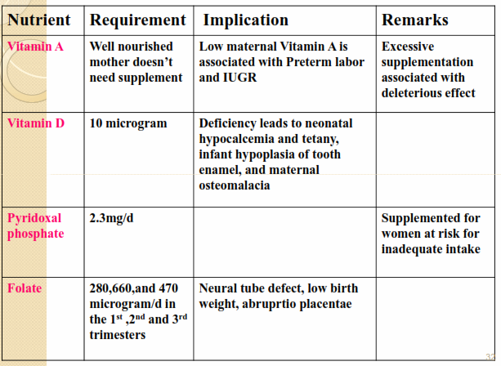
Vitamins and Minerals

Slide 19
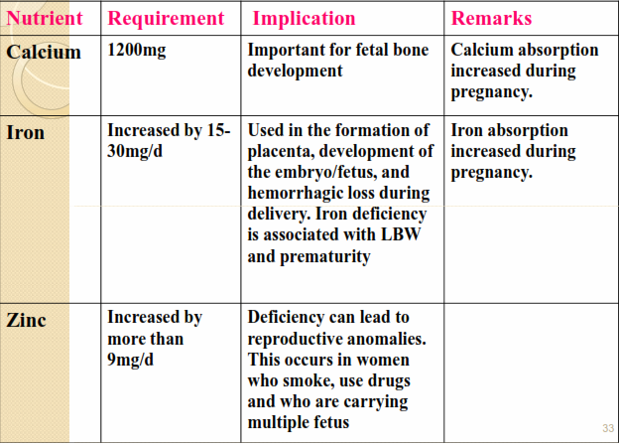

Slide 20
Energy demands of Lactation
◦ Much greater than that of pregnancy.
◦ Attributable to rapid growth of infants.
◦ Some of the energy is derived from maternal stores during pregnancy.
◦ 23% increase in energy demand over a non-pregnant , non lactating woman.

Slide 21
Macro-nutrient need during lactation
Carbohydrate-RDA - 210g/day ( Extra 550-840 kcal.
Protein– RDA- 71g/day (extra 284Kcal)
Lipid-RDA- 30g/day

Slide 22
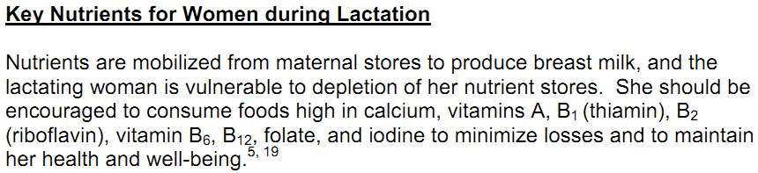

Slide 23
Infancy
Is a period from birth to the completion of first year.
– Characterized by the most rapid growth in human life.
– Length increases by about 40% and weight is tripled.
– Head circumference is also increased by about 30%.

Slide 24
Energy foods and energy nutrients
– A new born requires about 90-120 kcal/kg BW versus an adult requirement of 30-40kcal/kg BW for maintenance.
– Most of the energy is required for BMR followed by for growth.

Slide 25
Protein
– Still the highest period in human life in terms of protein requirement.
– 1.98g/kg of BW is required for proper growth to occur.
– RDA for infants is 2.2g/kg for the first 6 months and then reduced to 2g/kg in the second 6 months.

Slide 26
Fat and fatty acids
- More than half of the energy in BM is derived from fat.
- Essential fatty acids are required in larger amount during infancy (>30% of the total energy).
  Mainly for neurological development.
  Milk is a better source of both omega-3 and 6 PUFAs.

Slide 27
Vitamins and Minerals
Consumption of 700-800 ml of BM provides twice RDA of Vitamin A but same intake will not allow the acquisition of RDA of Vitamin D.
BM is not also a good source of Vitamin K , it is recommended to be given routinely at birth.
If the mother was taking enough Fe during pregnancy , the iron store in the infant is enough for the first 6 months of life.
Fe supplementation is needed after 6 months of life.

Slide 28
Old age
An elderly person requires less energy than a younger individual due to reductions in muscle mass and physical activity.
Some daily nutrients requirements for elderly people differ from those of younger adults. For example, in order to reduce the risk for age related bone loss and fracture, the requirement for vitamin D is increased from 200 IU/day to 400 IU/day in individuals of 51-70 years of age and to 600 IU/day for those over 70 years of age.

Slide 29
Cont’….
However, iron requirement reduced from 18mg/day to 8 mg in elderly women due to better iron conservation and decreased losses in postmenopausal women compared with younger women.
Some elderly people have difficulty in achieving adequate nutrition because of age or disease related impairments in chewing, swallowing, digesting and absorbing nutrients.

Slide 30
cont’…..
Therefore, for older people, as with younger adults,, the diet should follow the principles of a healthy balanced diet ( food guide).
Bread and other cereals and potatoes
Fruit and vegetables
Milk and dairy products
Meat, fish, and alternatives
Foods containing fat and sugar

Slide 31
Nutritional Assessment
Learning Objectives
At the end of this session you should be able to:
Define nutritional assessment.
Identify methods of nutritional assessment.
Describe the advantages and disadvantages of each nutritional assessment method.

Slide 32
Introduction
What is nutritional assessment?
Nutritional assessment is an interpretation of anthropometric, biochemical (laboratory), clinical and dietary survey data to tell whether a person/ group of people is well nourished or malnourished (Over nourished or under nourished).
There are two methods of assessing Nutritional status:
1. Direct method
2. Indirect method

Slide 33
Indirect methods
- include assessment of indicators of the food and nutrition situations in the area/ region of interest by looking at certain data that are closely related to malnutrition or which are aggravated by malnutrition.
- These include:
- Cause specific mortality rates
- Age specific mortality rates
- Meteorological data (rainfall data )
- Production pattern and distribution pattern
- Market price of foods

Slide 34
Direct methods
Involve the direct measurement of body dimensions and proportions, determination of tissue or body fluid concentrations of nutrients, dietary intake, appearance of the clinical symptoms and signs.
They abbreviated as the ABCDs
A=Anthropometry
B= Biochemical/Biophysical,
C= Clinical,
D= Dietary

Slide 35
A. Anthropometric assessments
Anthropometry comes from two words:
- Anthropo = Human, and
- Metry = measurement.
Definition: - Anthropometry refers to measurement of variations of physical dimension and gross composition of human body at different levels and degrees of nutrition (Jelliff, 1966).

Slide 36
Cont’…
Anthropometric measurements could be used both in the clinical and field set-ups.
In the clinical set-ups they are used to assess the nutritional status of:
– severely malnourished patient to assess the impact of nutritional intervention.

Slide 37
Purposes of Anthropometric measurements
Anthropometric measurements are performed with two major purposes in mind:
IN CHILDREN: to assess physical growth
IN ADULTS: to assess changes in body composition or weight.
The following body measurements are good indicators of growth performance of children at different ages when combined with the cut-off points.

Slide 38
Anthropometric measurements of growth
1. Head circumference (HC)
Measured using flexible measuring tape around 0.6cm wide to the nearest 1mm.
It is the circumference of the head along the supra orbital ridge anteriorly and occipital prominence posteriorly.
HC is useful in assessing chronic nutritional problems in under two children.
But after 2 years as the growth of the brain is sluggish it is not useful.

Slide 39
2. Length
A wooden measuring board (also called sliding board) is used for measuring length.
It is measured in recumbent position in children <2 yrs old to the nearest 1mm.
It is always > height by 1-2cm.
An assistance of two people is needed in taking the measurement.

Slide 40
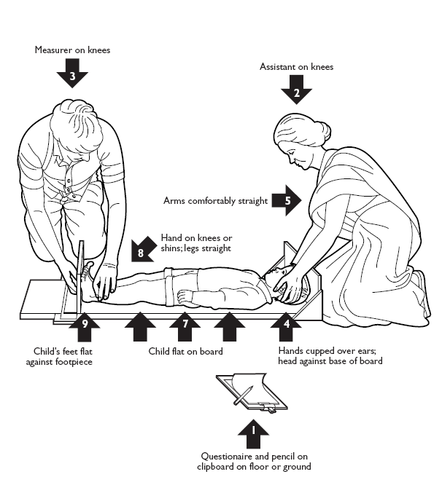

Slide 41
3. Height
Is measured in children > 2 yrs and adults in standing position to the nearest 0.1 cm.
The head should be in the Frankfurt plane during measurement, knees should be straight and the heels, buttocks and the shoulders blades, should touch the vertical surface of the stadiometer (anthropometer) or wall.
Stadiometer or portable anthropometer can be used for measuring.
There is also a plastic instrument called acustat Stadiometer that is cheaper than the conventional Stadiometer.

Slide 42
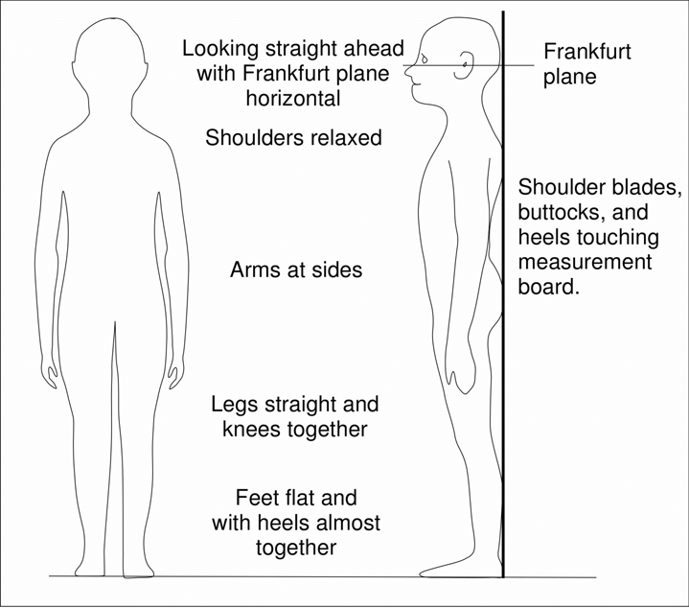

Slide 43
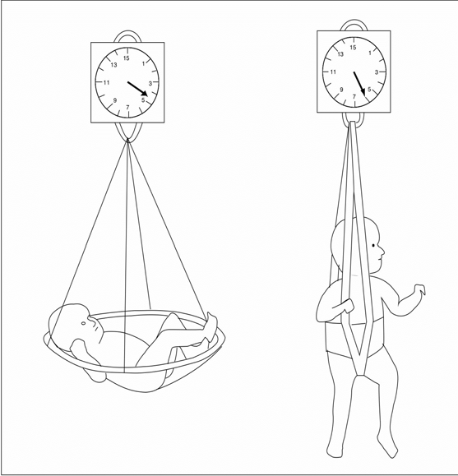
4. Weight
Most accurate and sensitive method of measuring growth is weight gain.
Suspended scale & weighing sling is used for measurement of weight in children < 2 years.
In adults and children >2 years, beam balance is used.

Slide 44
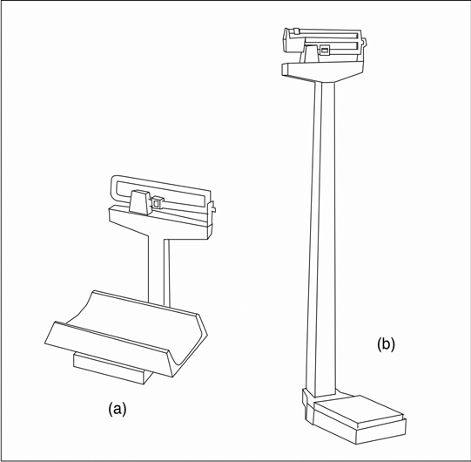

Slide 45
Indices derived from these measurements
What is an index? It is a combination of two measurements or a measurement plus age.
The following are few of them: -
- Head circumference-for age
- Weight -for-age
- Height-for age
- Weight for height

Slide 46
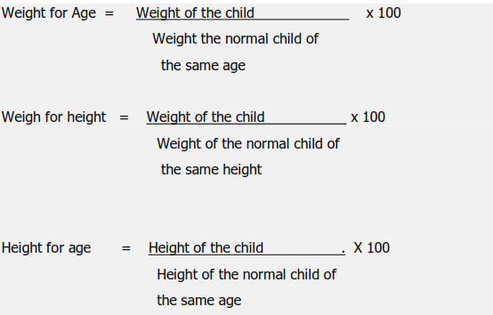
Meanings of the indices derived from growth measurements

Slide 47
Both weight for age and weight for height are indices sensitive to acute changes to nutritional status.
Height for age of children in a given population indicates their nutritional status in the long run.

Slide 48
Indicator
An indicator is an index + a cut-off point.
E.g.
- W F A < 60% = is indicator of severe malnutrition
- BMI < 16 kg/m2 = indicator of severe chronic energy deficiency
- W F H < 7o% = is indicator of severe wasting

Slide 49
Assessment of body composition
Linear growth ceases at around the age of 25-30 years.
Therefore, the main purpose of nutritional assessment of adults using anthropometry is determination of the changes of body weight and body composition.

Slide 50
Assessment of body composition using anthropometry
In assessing body composition we consider the body to made up of two compartments:
The fat mass and the fat free mass.
Total body mass= Fat mass + fat free Mass.
Therefore different measurements are used to assess these two compartments:

Slide 51
Measurements used for assessing fat free mass:
Mid upper arm circumference***
Mid thigh circumference
Mid calf circumference

Slide 52
Mid upper arm circumference(MUAC)
Is used for screening purposes especially in emergency situations where there shortage of human resource, time and other resources as it is less sensitive as compared to the other indices.
It is measured half way between the olecranon process and acromion process using non stretchable tap.
In children the cut-off points are:
- Normal >12.5 cm
- Mild to moderate malnutrition 11.5-12.5cm
- Severe malnutrition <11.5cm

Slide 53
MUAC…
It is a sensitive indicator of risk of mortality.
Useful for screening of children for community based nutrition interventions.
Useful for the assessment of nutritional status of pregnant and lactating women.

Slide 54
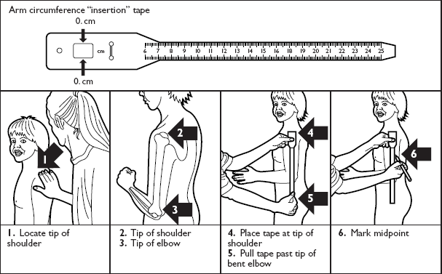

Slide 55
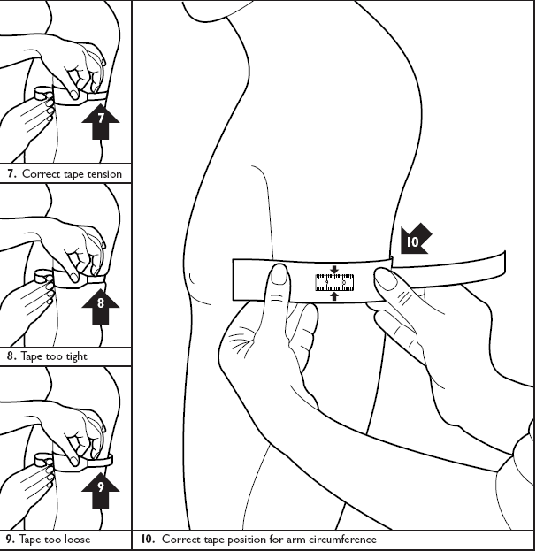

Slide 56
Measurements used to assess fat mass:
Body mass index
Waist to Hip circumference ratio
Skin fold thickness

Slide 57
1. Body mass Index(BMI)
Body mass index the best method for assessing adult nutritional status as the index is relatively independent the height of the person.
Therefore, it is most frequently used for assessing adult nutritional status.

Slide 58
Cut-off points for BMI
> 40 kg/m2 = very obese
30-40 kg/m2 = obese
26-30 kg/m2 = overweight
18.5-25kg/m2 = Normal
17-17.9 kg/m2 = mild chronic energy deficiency
16-16.9kg/m2 = Moderate chronic energy deficiency
< 16 kg/m2 = severe chronic energy deficiency

Slide 59
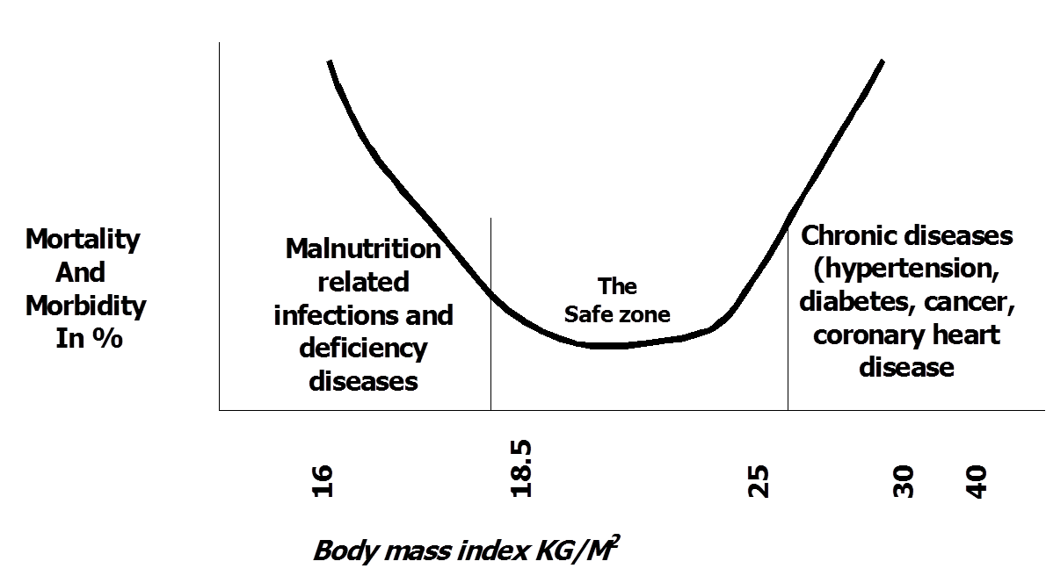
This classification is based on the mortalities and morbidities associated with either extremities

Slide 60
2. Skin fold thicknesses
Provides an estimate of the size of subcutaneous fat depot
Assumptions:
  Thickness to the subcutaneous adipose tissue reflects a constant proportion of the total body fat
  The selected skin fold sites are representative
Selected sites :
  Biceps and Triceps ( mid point of the arm),
  Sub-scapular ( left arm and shoulder relaxed )
Best measured by precision skin fold thickness calipers

Slide 61
Cont’…
which have a constant and defined pressure of 10g/sq.mm through out the range of measured skin folds.
Measurements are made in triplicate until readings agree within ± 1.0 mm
All the measurements should be made on the left side

Slide 62
Measuring Skinfold Fat Thickness at the Triceps Skinfold Site

Slide 63
3. Waist to hip circumference ratio
It is the circumference of the waist measured mid-way between the lowest rib cage and anterior superior iliac spine divided by the circumference of the hip measured at the level of the greater trochantor off the femur( both are measured to the nearest 0.5 cm)
If the ratio is > 1 in male, and > 0.87 in female there is high risk of coronary heart disease.

Slide 64
Waist-to-hip ratio (WHR)

Slide 65
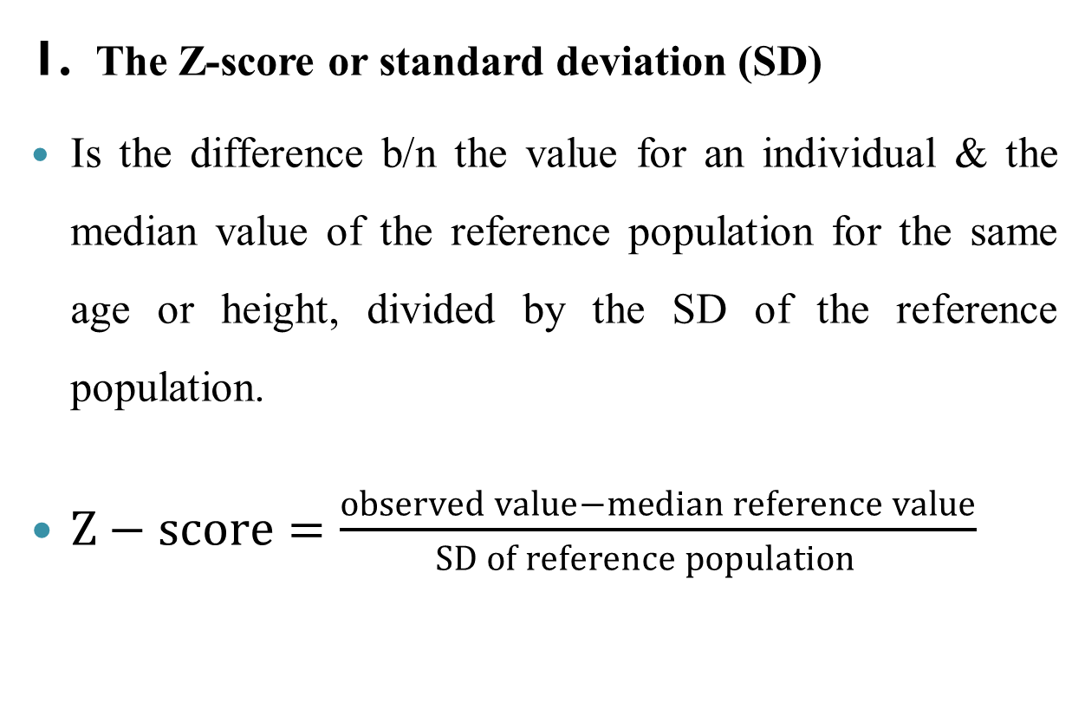
Expressing anthropometric measurements
1. The Z-score or standard deviation (SD)
Is the difference b/n the value for an individual & the median value of the reference population for the same age or height, divided by the SD of the reference population.
$Z−score=\frac{observed value−median reference value}{SD of reference population }$

Slide 66
Class activity
If a 6 years old child has:-
  Weight 13.3 , height 107.5 and
median values are:-
  H/A = 118.5
  W/A = 21.6
  W/H = 17.6 and standard deviation are 4.9, 3.2, 1.6 respectively.
Calculate
  HFA Z score
  WFH Z score
  WFA Z score

Slide 67

2. Percentage of the Median
The median is the value at exactly the midpoint b/n the largest & smallest.
If a child’s measurement is exactly the same as the median of the reference population we say that they are “100% of the median”

Slide 68
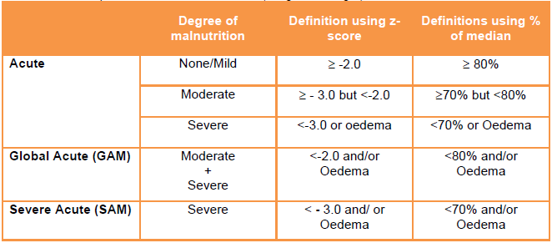
Cut off points for acute malnutrition (weight for height)
Acute malnutrition based on weight-for-Height in z-scores and percentage of the median

Slide 69
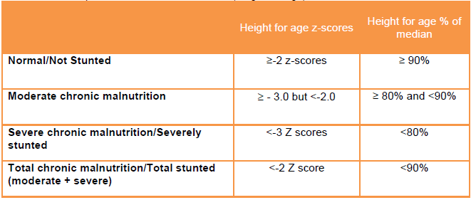
Cut off points for chronic malnutrition (height for age)
Chronic malnutrition based on Height-for-Age in z-scores and percentage of the median

Slide 70
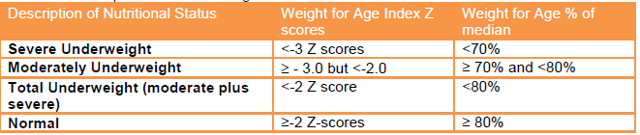
Cut off points for Underweight
Underweight based on Weight-for-Age in z-scores and percentage of the median.

Slide 71
3. Percentiles
The percentile is the rank position of an individual on a given reference distribution arranged in order of magnitude
Percentiles are stated in terms of what percentage of the group the individual equals or exceeds
E.g., the child's height-for-age being at the 80th percentile means that 80% of children of his age in the reference population have a height lower than him
If a boy’s height is 141.8 cm and he is at the 10th percentile, it means 10 percent of boys have a height below 141.8 cm

Slide 72
Quality control measures in anthropometric surveys
The following issues need to be considered in carrying out anthropometric surveys to ensure the quality of data:
Calibration of the instrument after each measurement and after moving the instrument from one room to another.
Standardization of procedures
Verification of at least 10 % of the data by the main investigator.

Slide 73
Cont’…
Training of the data collectors and limiting the coefficient of variation to be less than 3%(CV = standard / mean X 100)
Use one rather than multiple observer for the same subject over time.
Mark anatomic sites of measurement with indelible ink when repeatedly measuring the same subject over a short time span.

Slide 74
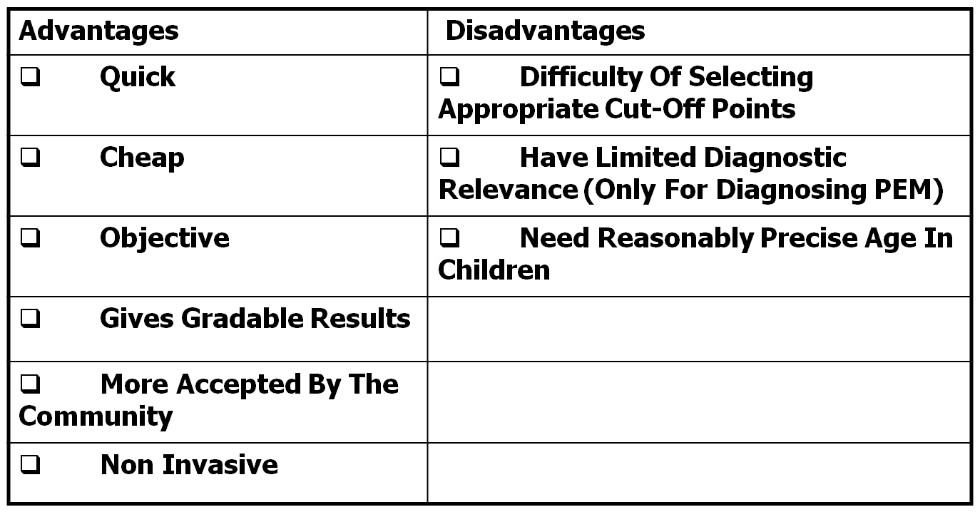
Advantages and disadvantages of Anthropometric measurements

Slide 75
B. Biochemical(laboratory) methods
This involves measurement of the amount of nutrient in a particular storage site in the body fluids (blood, urine, saliva) and tissues (hair and nail).
For example, serum retinol levels to assess vitamin A status. This is generally expensive, time consuming, need highly well trained personnel and sophisticated instrument

Slide 76
C. Clinical methods
This are detection of deviations from the normal state of nutrition just by observing and interpreting clinical signs and symptoms of deficiency or under intake, for instance, see the following.

Slide 77
Cont’…
Advantages
– Fast & Easy to perform
– Inexpensive
– Non-invasive
Limitations
– Did not detect early cases
– Trained staff needed

Slide 78
D. Dietary methods

Slide 79
Methods used to assess current intake
(at a group or individual level)
I. Weighed record method: In this method the subject will be asked to weigh whatever he/she consumes including drinks both before cooking and after cooking and the portion sizes he consumed and the left over.
Advantages:
It is more accurate
There is no respondent memory loss
Disadvantages
High respondent burden
Change of the dietary habit during the survey due fear of burden
Needs literate and numerate respondents
Costly

Slide 80
Cont’…
2. Observed weighed method
In this method the investigator him/herself records the amount and type of food consumed by the study subjects over specified period of time.
This method is usually applied for disabled people, infants and small children, mentally ill people or institutionalized elderly people or patients admitted to a hospital.
Advantage VS disadvantages
The same as the observed weighed

Slide 81
Cont’…
3. Food Diary method
In this method the subject/s are asked to record what ever they eat including beverages for specified period of time with estimation of the portion sizes consumed.
Advantage
  May give relatively accurate estimate of the nutrient intake if done properly.
Disadvantage
  High respondent burden
  Literacy and numeracy of subjects needed
  High coding burden

Slide 82
Methods Used to assess past intake
1. 24 hours dietary recall
In this method, the subjects are requested to remember whatever they consumed within the last 24 hours.
This involves all beverages, snacks deserts etc. That have been ingested from x time yesterday to x time today.
The portion sizes consumed during this time should also be determined by the respondents by assessing them to use either photographs or the common food being consumed at different sizes or by using a line graph etc.

Slide 83
Advantages and disadvantages of 24 hrs dietary recall method
Advantages
Relatively cheap
Quick
Less respondent burden
No chance for the respondents to change their dietary habit
The usual intake of a group can be determined from a single 24 hrs recall
Disadvantages
A single day 24 hrs recall does not indicate the usual intake of individuals
Respondent memory laps
Social desirability bias (the flat slop syndrome)
Has less precision
Accuracy depends on the respondent’s ability to estimate portion sizes

Slide 84
Reasons why a single day assessment does not give the true mean intake
Day of the week effect
Seasonal effects
Consecutive /nonconsecutive days
Random within person variance
Holiday effects(feasts and fasts)

Slide 85
2. Dietary history
This method is used to assess the nutrient intake of an individual or a group from food over a longer period of time, usually to see the association between diet and disease.
Advantages
It gives the dietary habits of an individual or a group of people over a longer periods of time
Less respondent burden
Disadvantages
It is very difficult to validate
It needs a very highly trained interviewer
It gives just a relative if not an absolute information

Slide 86
3. Food frequency questionnaire
• This method is based on the preparation of a food frequency questionnaire, which is based on the local staple diet to determine the frequency of consumption of a particular nutrient.
• This could be achieved through self or interviewer administration of the questionnaire.
• Sometimes the quantities consumed could be included, in such circumstances, the FFQ is called semi quantitative FFQ.
• The following table indicates the frame of a food frequency questionnaire.

Slide 87
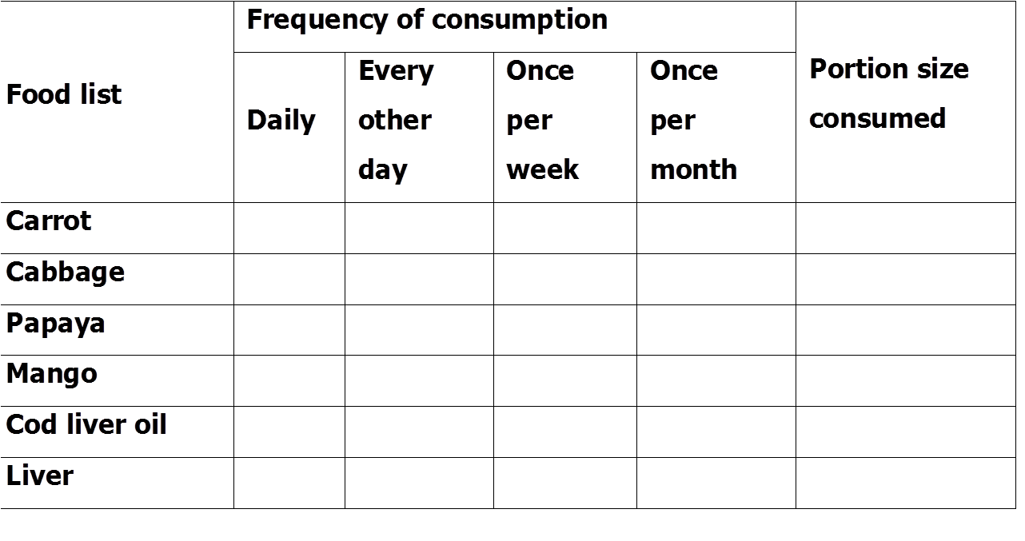
Example of semi quantitative FFQ for Vitamin A friendly foods

Slide 88
Advantages and Disadvantages of FFQ
Advantages
It is usually used for areas where there is a geographically widely scattered study population
It is less costly especially if self administered
Less respondent burden
Disadvantages
It is very difficult to develop especially in multi-cultural society where different staple foods are consumed
It needs literate and numerate subjects

Slide 89
Thank you

Slide 90
Food safety and quality
    Food borne diseases
    Methods of food preservation
    Food additives and preservatives & health implications

Slide 91
Introduction
Food safety: refers to free from all those hazards, whether chronic or acute, that make food injurious to the health of the consumer.
Area of food safety:
  Food hygiene
  Pest control
  Waste management
  Cleaniing and sanitizing
  Hazard identification

Slide 92
Con’t….
Food quality is defined as feature and characteristics that influence product’s value to consumers such as:
appearance(size, color, shape and consistency)
Texture
Flavor(odour and taste), adulteration
Correct labelling with the ingredients, nutritional information,
Packaging,

Slide 93
Food control is defined as:
a mandatory regulatory activity of enforcement by national or local authorities
  to provide consumer protection and
  ensure that all foods during production, handling, storage, processing, and distribution are
    safe, wholesome and fit for human consumption;
    conform to safety and quality requirements; and are honestly and accurately labelled as prescribed by law.

Slide 94
con’t….
Effective national food control systems are essential to protect the health and safety of domestic consumers.
Responsibility for food control in most countries is shared between different agencies or ministries.
For instance; FAO and WHO have a strong interest in promoting national food control systems.
This is particularly important for developing countries as they seek to achieve improved food safety, quality and nutrition.

Slide 95
The principal objectives of national food control systems are:
Protecting public health by reducing the risk of foodborne illness;
Protecting consumers from unsanitary, unwholesome, mislabelled or adulterated food; and
Contributing to economic development by maintaining consumer confidence in the food system and providing a sound regulatory foundation for domestic and international trade in food.

Slide 96
Food borne disease

Slide 97
Introduction
Although food is crucial to the maintenance of life, it can also be responsible for ill health.
In addition to the hazards posed by natural toxins, foods may also act as the vehicle for food borne diseases as microorganisms can cause spoilage of food products, (which affects food quality, and cause food poisoning).

Slide 98
Con’t….
Foodborne illness (disease) occur when a person gets sick by eating food that has been contaminated with microorganism, chemical or natural toxins such as poisonous mushrooms.
The risks of food-borne diseases are becoming increasingly important; in areas where food storage and preparation safety measures are far below the optimum.

Slide 99
Con’t….
In Ethiopia, the problem is high due to many reasons; like poverty and lack of public health awareness, poor water supply, poor personal hygiene and environmental sanitation, etc.
Most food-borne diseases manifest with gastrointestinal signs and symptoms characterized by diarrhea and vomiting but in the cases of botulism and listeriosis, the main symptoms are caused by effects on other ‘extra-intestinal’ parts of the body.

Slide 100
Con’t…
More than 250 different food borne diseases have been described and most of these diseases are infections, caused by bacteria, viruses, and parasites.
Other diseases are poisonings, caused by harmful toxins or chemicals that have contaminated the food, for example, heavy metal contamination (Lead, Mercury and Arsenic).

Slide 101
Classification of Food borne diseases
Depending on the mode of illness food borne diseases are classified as:
    Food borne infections and
    Foodborne poisonings/Intoxications.
Infections can be further categorized in to:
    Invasive infection and
    Non-invasive infection/ Toxicoinfections

Slide 102
Food borne infections
Food borne infection can be acute or chronic.
    In acute infection, the onset of disease is quick and lasts only for a short duration due to a rapid immunological clearance of the microorganism.
    In chronic infections, the disease is prolonged and immune clearance is not effective.
1. Invasive infection: occurs when the microorganism multiplies in food until it reaches the minimum infective dose (MID).
When the food is eaten, the microorganism acts directly on the intestine. E.g. Salmonella invade the ileum to produce watery diarrhoea.

Slide 103
2. Non-invasive infections / Toxicoinfections
Some bacteria cause toxicoinfection, which occurs when ingested bacteria first colonize the mucosal surface and then produce exotoxins in the intestine.
Some spread to lymph nodes, liver, spleen, brain, or other extra intestinal sites and are called systemic infection: .
Toxins can induce toxic effects on the local cells or tissues and in some cases enter blood stream and induce disease. Examples:
    Cholera toxin produced by V. cholerae
    Heat-labile (LT) and Heat-stable (ST) toxins produced by enterotoxigenic E. coli

Slide 104
Food borne intoxications
These are caused by consumption of foods contaminated with:
  preformed toxins of microorganisms.
  Biotoxicants which are found in tissues of certain plants and animals
  Poisonous substances which may be intentionally or unintentionally added to food during production, processing, transportation or storage.
Have short incubation periods(minutes to hours) and characterized by lack of fever.

Slide 105
Food borne intoxications can be classified into:
Bacterial intoxication: staphylococcus, bacillus, clostridium perfringens and botulism
Fungal intoxication: aflatoxin
Chemical intoxication: heavy metals, pesticides and insecticides e.g. DDT
Plant intoxication: toxic mushroom
Poisonous animals: some toxic fishes e.g. puffer fish, tuna fish

Slide 106
Food preservation

Slide 107
Food preservation is aimed at extending the shelf life of foods by reducing or preventing the growth of microorganisms that cause foods spoil.
We consume a lot of processed and packaged food that lies on the retail shelves for quite a long time.
To ensure that this packaged food remains edible and safe for consumption, preservatives are added to it.
These food preservatives are substances that can prevent or delay changes caused by the action of microorganisms, enzymes and/or physical agents once they are added to a given food.
Its high utilization by the food industry is due to the growing demand of chemically stable, safe and durable foods.

Slide 108
Methods of food preservation
Traditional methods
    Cooling
    Freezing
    Boiling
    Smoking
    Sugaring
    Salting
Modern industrial techniques
    Pasteurization
    Vacuum packing
    Freeze drying
    Irradiation

Slide 109
Food additive and health implication
Food additives are substances added to foods to maintain or improve safety, freshness, taste, texture, or appearance.
Some additive also used for sweetening and coloring.
Food additives needed to be checked for potential harmful effects on human health before they can be used.
The Joint FAO/WHO Expert Committee on Food Additives(JECFA) is the international body responsible for evaluating the safety of food additives.

Slide 110
Evaluating health risks of food additives and preservatives
Only food additive that have undergone a JECFA safety assessment and are found not to present an appreciable health risks to consumers, can be used.
The starting point for determining whether a food additive can be used without having harmful effects is to establish the acceptable daily intake (ADI).
ADI is an estimate of the amount of an additive in food or drinking water that can be safely consumed daily over a life time without adverse health effect.

Slide 111
Some food additive can cause reactions
Digestive disorder such as diarrhea
Nervous disorders- hyperactivity, irritability
Respiratory problems- asthma, rhinitis, sinusitis
Skin problems- hives. Itching, rashes, swelling
NB: these reactions occur when the amounts of additives in food or drinking are greater than ADI level.

Slide 112
Quiz-1
Differentiate the term food safety and food quality (2pt)?
Discuss the objectives of food control system(2pt).
What does mean by food borne intoxication (1pt)?

Slide 113
Nutritional Surveillance
Contents
Food & nutrition security
Definition and types of nutrition surveillance
Basic steps in carrying out nutritional surveillance

Slide 114
Food & nutrition security
Food Security is defined as when “all people, at all times, have physical, social and economic access to sufficient, safe and nutritious food which meets their dietary needs and food preferences for an active and healthy life”. (FAO 2000)
A household is food secure if it can reliably gain access to food of a sufficient quality in quantities that allow all its members to enjoy a healthy and active life.

Slide 115
Nutrition security is defined as when secure access to food is coupled with a sanitary environment, adequate health services, and the knowledge and care needed to ensure the good health of all individuals in a household.

Slide 116
Nutritional Surveillance
Definition
It is defined as the measurement of the frequency and distribution of nutrition related diseases or problems using regularly collected and available information.
It comprises the compiling and analysis of nutrition information for decision making relative to national or regional polices or programme planning.

Slide 117
Methods of acquiring data in
Nutritional Surveillance
1. Active surveillance: - the data are collected actively by the group /individuals running the program and hence it takes time and other resources. Information collected is timely and give more reliable data.
Disadvantages
  it is expensive
  it requires skilled human power
  it is for short period of time
  it is directed towards specific disease conditions

Slide 118
2. Passive surveillance: in this type of surveillance, data are obtained from the on going programs and it does not incur too much in terms of cost, time, personnel as compared to the active surveillance,
but as information generated is to a large extent; unreliable, incomplete and inaccurate
data is not available on time
you may not get the kind of information you desire.

Slide 119
3.Sentinel site surveillance
Sentinel site surveillance involves surveillance in a limited number of sites to detect trends in the overall well-being of the population.
The sites may be specific population groups or villages that cover populations at risk.
Trends are monitored for various indicators, including nutritional status, morbidity, dietary issues, coping strategies and food security. Data can be collated and analyzed centrally (centrally-based sentinel site surveillance) or by trained members of the community(community based sentinel survillance

Slide 120
What are potential uses and who are the users of nutritional surveillance information?
Users are:
Ministry of Agriculture
Ministry of Health
Ministry of Economic Development
Food and nutrition planning
Interministerial Coordinating Committee on Food and Nutrition

Slide 121
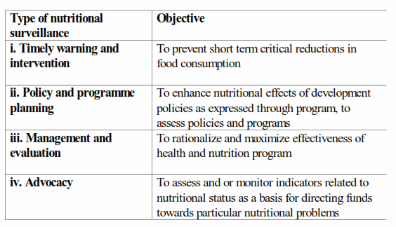
Types of nutritional surveillance

Slide 122
Use of nutritional surveillance information?
1. Timely warning and intervention
Nutritional surveillance was first established to warn governments of poor nations of imminent nutritional crises. It was in part modelled on health surveillance for important infectious diseases.
Certain infectious diseases such as plague and cholera are notifiable to WHO; countries
require that each district or province notify the national ministry of health on a weekly basis of the number of cases of notifiable diseases.

Slide 123
Cont’…
In famines or severe crises, data on famine deaths or serious famine-related malnutrition can be collected and reported.
Unlike outbreaks of serious infectious diseases, famine brings with it many cases of serious malnutrition.
Nutritional surveillance reports on indicators that would warn a government of an approaching nutrition disaster.
As listed above, production patterns, market prices, food stocks and fall in body weights are possible indicators of food crises.

Slide 124
2. Nutrition surveillance for Policy and programme planning
Many kinds of indicators, can be used by governments or local authorities for surveillance to influence policy and programme planning.
For example, anthropometric data may be collected on a regular basis to describe PEM trends over time.
The data may be analysed to discern groups of the population most severely affected.

Slide 125
Cont’…
The next step might be to decide on direct interventions (perhaps supplementary feeding or nutrition education) for the most seriously affected groups and to suggest ways in which existing policies (for example, regarding credit for small farmers to improve agricultural productivity or subsidies for staple foods for the poor in urban areas) might be modified or strengthened to influence nutritional status.

Slide 126
3. Nutritional surveillance for management and evaluation
Surveillance can be used to evaluate programmes aimed at improving nutrition and to assist in their management.
For example, data from growth monitoring over a period of five years might be used to evaluate whether an agricultural credit scheme has improved the nutritional status of children; or
Data on IDD might be used over time to evaluate whether salt iodization activities are influencing iodine nutritional status.

Slide 127
4. Nutritional surveillance for problem identification and advocacy
Conducting surveillance for advocacy mainly involves collecting data on the prevalence of PEM or micronutrient deficiencies or on related indicators and using these data to get support for action.
Support can be solicited in different ways including making the government aware of the problems found or embarrassing the government into taking action by publicizing a serious nutrition problem in the news media.

Slide 128
Summary of use of NS

Slide 129
Nutritional surveillance cycle
The following table illustrates basic steps in nutritional surveillance.
These steps involve assessment, data collection, analysis, decision-making and the enactment of interventions based on the decisions.

Slide 130
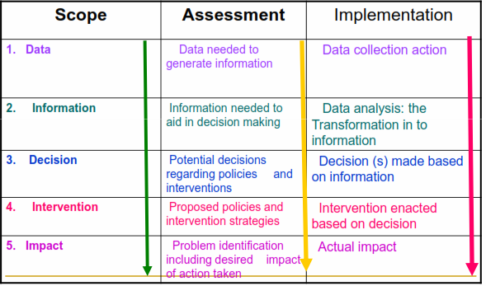
BASIC STEPS IN NUTRITIONAL SURVEILLANCE

Slide 131
Nutritional intervention
Definition- It is a corrective measure that is undertaken to reduce correct avoid the occurrence of over all malnutrition or specific nutrient deficiency or excess.
Based on the underlying cause of the nutritional problem, the nutritional interventions can vary.

Slide 132
1. Nutrition education and promotion of horticultural activities (dietary diversification)
It promotes consumption of different varieties of foods.
Nutritional education needs to focus on the promotion of consumption of different diversities of foods.
Problems that may face this approach
The food promoted must be
- Culturally accepted
- Consumed by the vulnerable
- Target nutrients must be absorbed from the food.

Slide 133
Cont’…
- Good agricultural extension support is needed
- The program must be location specific
- High level of commitment needed
- No immediate changes in nutritional status
Advantages
Long term Sustainability
It is preventive
High community involvement
Seasonality can be offset
Good in areas of chronic malnutrition

Slide 134
Cont’…
Nutritional education should focus on
Cultural malpractices and beliefs in child feeding and weaning.
House hold mal-distribution of food (age, sex basis)
Breast feeding and its benefits
Hygiene- in storage, preparation, ….)

Slide 135
2. Dietary modification
Aimed at modifying the energy, protein, and micronutrient content of foods especially weaning foods, and other infant formulas.
e.g. – The energy and protein content of a food can be improved by fermenting or germinating adding a power flour.
Other methods employed to improve the micronutrient contents of a food include.
Enrichment- addition of a nutrient, which is originally present in the food, above the level found naturally.
Restoration- Replacement of a nutrient lost during harvest, storage or processing.

Slide 136
Cont’…
Standardization- to compensate for the natural variation of foods grown in different geographic areas in their contents of a nutrient.
Fortification- an addition of a nutrient in a food that is not naturally present in order to enhance the consumption of the target nutrient.
Supplementation- administration of nutrients in the form of tablets, capsule, or injection.

Slide 137
3. Economic approaches
A. Food-For-Work (FFW) Projects
In these projects, food is given as full or partial payment of wages to people working in land improvement or community development projects.
This strategy is very effective during food shortages, particularly when it targets the poor.
It allows able -bodied individuals to earn food rather than become reliant on food handouts.

Slide 138
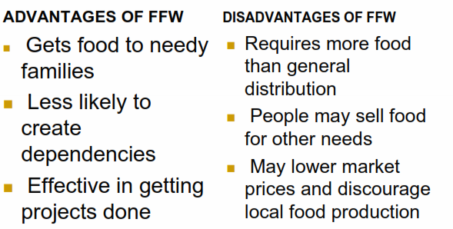
Table : Advantages and Disadvantages of Food-For-Work (FFW) Projects

Slide 139
B. Food stamps
A sort of officially stamped ticket will be given to the poor which they could use for buying food from restaurant etc and this will be paid later on by the government.
Advantage
- They are preventive.
Disadvantage
They are highly targeted to urban people.
They have high administrative cost.
The system can be abused.

Slide 140
C. Income-Generating Projects (IGP)
Relief agencies may issue small loans and training to the most affected families in order to provide them with alternative sources of income once food aid is phased out.
These projects should have a direct impact on improving food production, e.g., digging wells, raising poultry and small livestock, fishing or milling projects.

Slide 141
4. ENA (Essential Nutrition Actions)
Over past 30-40 years nutrition interventions were often…
not integrated
viewed as separate vertical programs
in competition with one another
not action oriented(non-specific)
focused only on GM/P activities

Slide 142
ENA…
In the past 10 years growing consensus is that nutrition interventions need to be…
integrated conceptually& programatically
- infant & young child feeding
- maternal nutrition
- micronutrients
based on proven impact
action oriented with clear guidance « Who should take what action when »
7 action areas

Slide 143
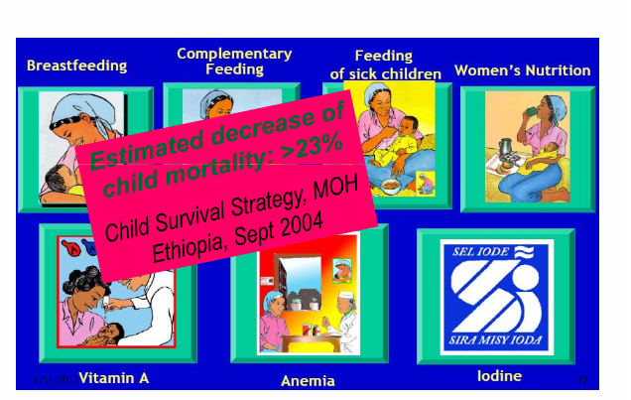

Slide 144
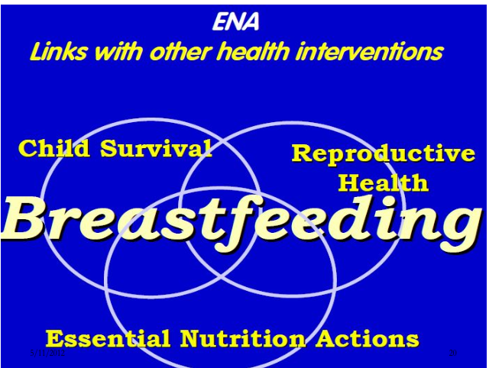

Slide 145
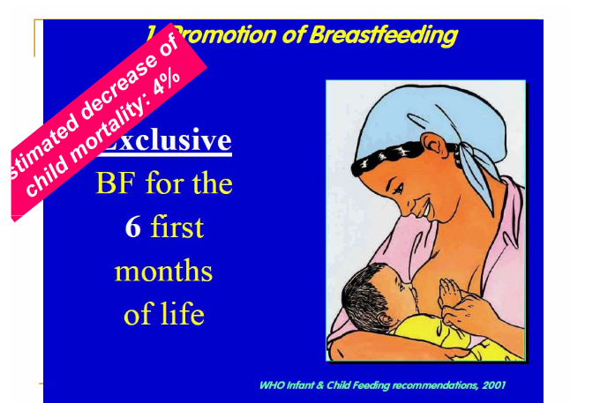

Slide 146
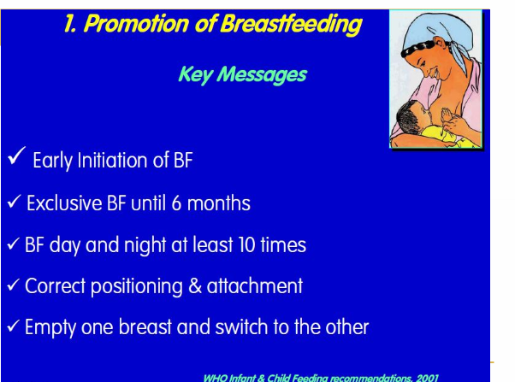

Slide 147
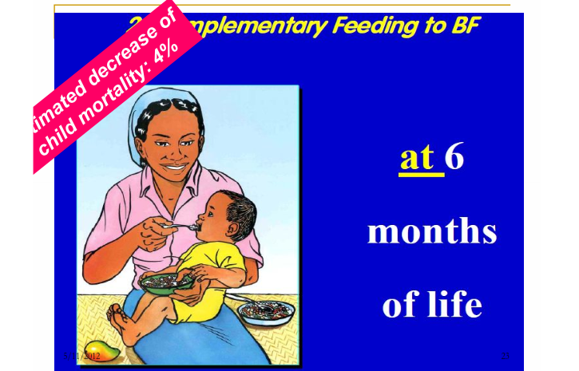

Slide 148
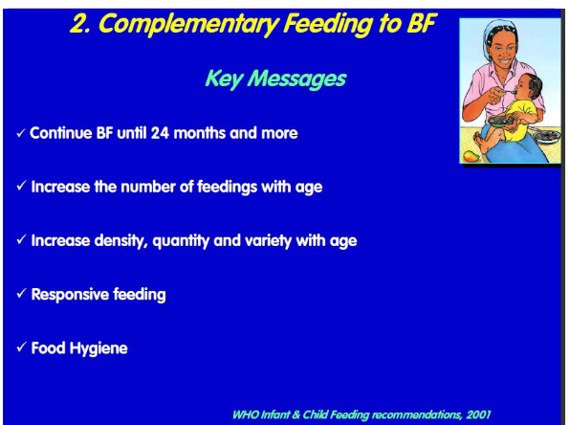

Slide 149
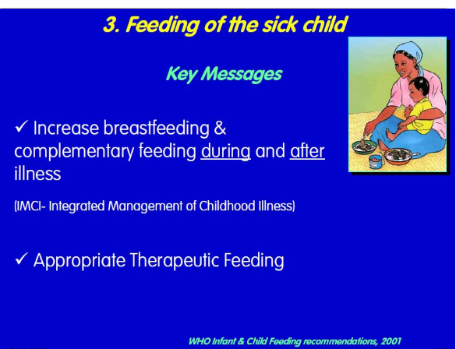

Slide 150
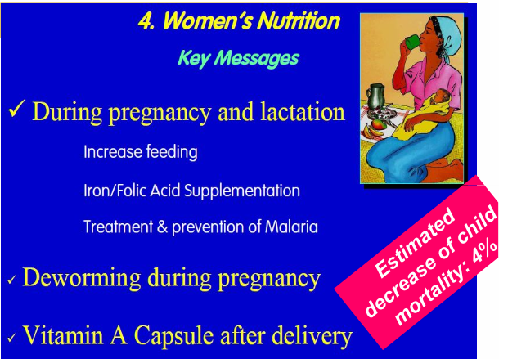

Slide 151
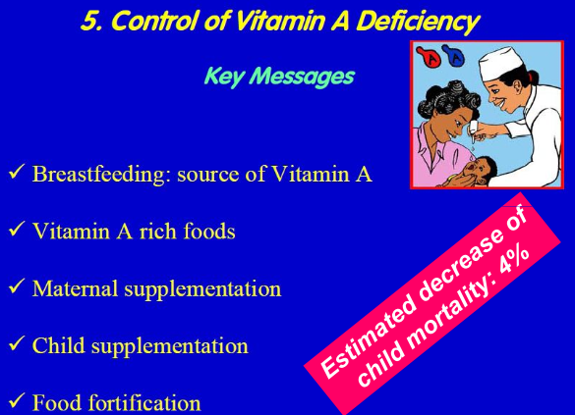

Slide 152
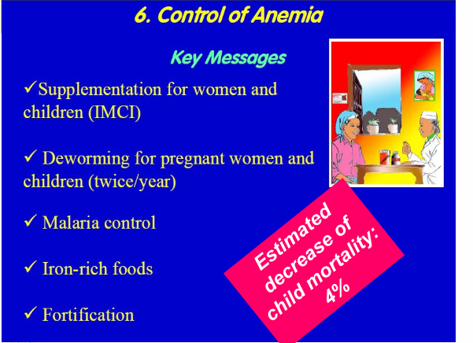

Slide 153
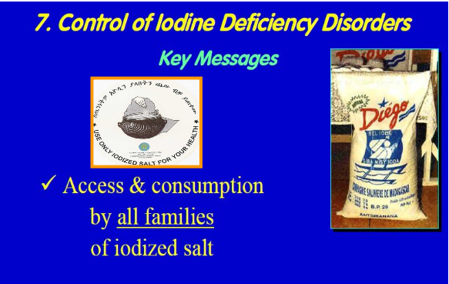

Slide 154
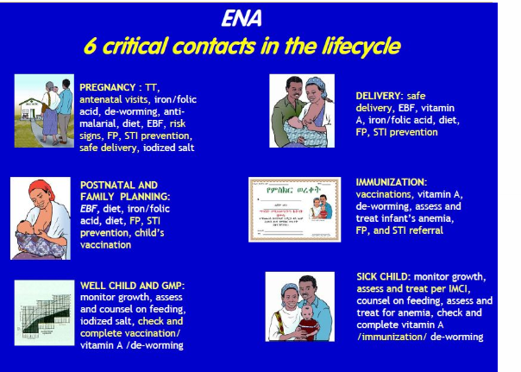

Slide 155
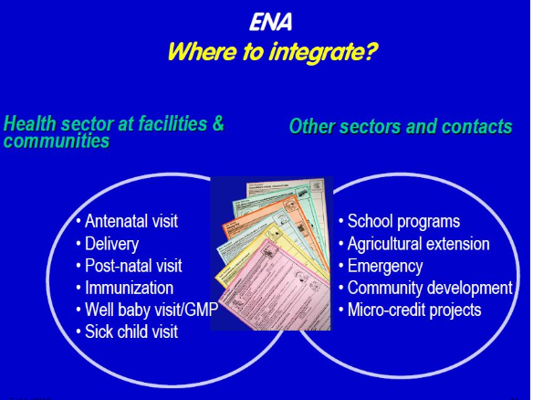

Slide 156
ENA
3 key Program Components
1. Health facility level: integrate ENA actions into existing health contacts at all health services.
2. Community--level: work with community-based organizations & networks from all sectors; and
3. Behavior change: re-inforce ENA actions through behavior change communication at all levels, including inter-personal communication, mass media and community mobilization.

Slide 157
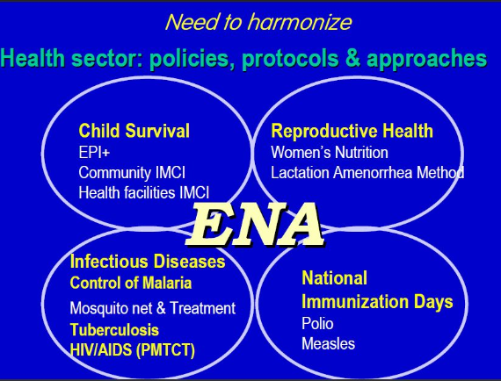

Slide 158
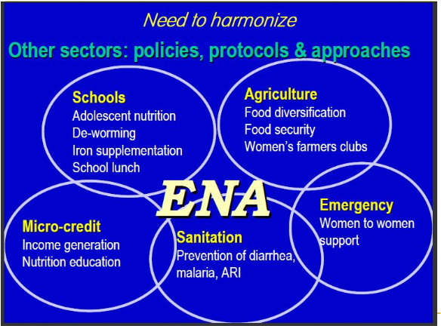

Slide 159
Infant feeding options in the context of HIV/AIDS
Group1: Pregnant women whose HIV status is unknown or who have been tested and are HIV negative:
As before…
- Exclusive breastfeeding 0 to 6 months
- Introduction of Complementary Feeding at 6 months
- Continued breastfeeding to 24months+

Slide 160
Group 2: Pregnant women who have been tested and are HIV positive:
Ideally a woman should be supported through counseling to make an informed choice on how to feed her infant to reduce risk of HIV transmission.
Provision of ARVs to reduce transmission

Slide 161
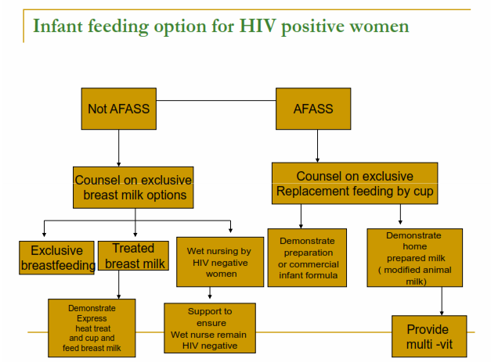

Slide 162
Infant Feeding recommendations for HIV+ women
When replacement feeding IS acceptable, feasible, affordable, sustainable and safe, avoidance of all breastfeeding by HIV-infected mothers is recommended…”
Replacement feeding from birth with breast milk substitutes (cup & spoon).
Key words are affordable and safe
Exclusive replacement feeding (never mix-feed!)

Slide 163
How Can Families Decide? -1
What is meant by ACCEPTABLE?
- There are social and cultural norms about infant feeding.
- Concerns about stigma associated women who do not breastfeed, suspicion of HIV.
What is meant by FEASIBLE?
- There are economic, behavioral, psychosocial aspects for care-giver and infant.
- Resources and skills are required

Slide 164
How Can Families Decide? -2
What is meant by AFFORDABE?
- Able to purchase adequate amount of the formula over the duration it is needed.
- Able to purchase necessary fuel, equipment.

Slide 165
How Can Families Decide? -3
What is meant by SUSTAINABLE?
- It must be practiced every day and night
- Resources must be available throughout
- It should be exclusive over first 6 months
What is meant by SAFE?
- Free from contamination
- Nutritious
- Free from stigma
- Does not spillover to general population

Slide 166
Replacement Feeding Options for HIV+ mothers
commercial infant formula
home prepared infant formula (modified, with additional nutrients)
enriched family diet with BM/V supplements after 6 months

Slide 167
What do we know about the feasibility of commercial infant formula?
High acceptance/adherence in some countries with access to clean water, health care, subsidized cost.
Stigma associated with its use widely reported in Africa
Access to safe water, health care needed
Proper instruction on safe preparation, feeding
Costs are high

Slide 168
When replacement feeding IS NOT acceptable, feasible, affordable, sustainable and safe…
Option 1: Safer breastfeeding
Option 2: Heat treating breast milk
Option 3: Wet nursing by HIV negative woman
Option 4: Early cessation of breastfeeding

Slide 169
Option 1: Safer breastfeeding
Exclusive breastfeeding…
Avoid mixed feeding, especially in early months, as irritates gut and may lead to virus transmission.
Maintain good breast health (higher transmission risk with mastitis or crack nipples…)
Mothers with full-blown AIDS should stop breastfeeding.
Cessation of breastfeeding when AFASS

Slide 170
Option 2: Heat Treating Breast milk
Express breast milk
Heat treat breast milk (bring to boil, then cool)
Cup feed breast milk
Option 3: Wet Nursing
Ensure wet-nurse is HIV negative
Exclusive breastfeeding
Maintain breast health

Slide 171
Option 4: Early Cessation of Breastfeeding
Shorten duration of exposure to HIV virus in breast milk
Stop breastfeeding as soon as replacement feeding is acceptable, feasible, affordable, sustainable, and safe
Key words are affordable and safe
Experience suggests that breastfeeding should/could be stopped at 6 months, but this is dependant on circumstance of mother and family

Slide 172
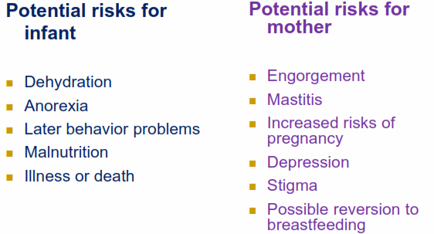
What do we know about the feasibility of early cessation of breastfeeding?

Slide 173
Cont’…
Breast milk contributes > 50% of the nutrient intake of children > 6 months in developing countries.
Replacing breast milk nutrients and energy won’t be easy

Slide 174
How to negotiate with women regarding their Nutrition
Demonstration of Negotiation
Steps of negotiation
ALIDRAA
Ask woman if she is pregnant or lactating, and about her own feeding practices.
Listen to the woman
Identify difficulty(ies) and causes of difficulty(ies)
Discuss different feasible options with the mother
Recommend and negotiate doable actions
Agree which practice will the mother try; mother repeats agreed upon practice
Appointment for follow-up

