Slide 1
Debre Markos University
College of Medicine and Health Sciences
Department of Human nutrition & Food Science
Introduction to Human nutrition For Nursing Students
By
Zelalem A. (Bsc, Msc in Applied Human Nutrition)

Slide 2
Learning Objectives
At the end of this session you should be able to:
Define nutrition, food, diet and nutrients.
Understand the classification of nutrients.
Identify the public health importance of nutrition.
Identify why nutrition matters in Ethiopia.

Slide 3
Introduction to Nutrition
Human nutrition
The science of foods, nutrients and substances there in, their action, interaction and balance in relation to health and diseases.
Nutrition science is the area of knowledge regarding the role of food in the maintenance of good health.
Thus nutrition is the study of food at work in our body“ (The Council On Food And Nutrition Of The American Medical Association).

Slide 4
Cont.,..
Nutrition deals with the nutrients; their characteristics, functions, body’s quantitative need for them, and their food sources, the effect of an inadequate intake and for some nutrients an excessive intake.
With the digestion of food ,absorption of end products, their utilization in the body…….

Slide 5
Cont.,..
Nutrition is the sum of all processes involved in the body including intake, assimilation, and utilization of the proper amounts of nutrients to maintain health, well-being, and productivity.
Good nutrition relies on a diverse, adequate diet and is essential for the development and maintenance of the body from infancy to old age.
Nutritional status can be both the “cause” and the “outcome” of good or poor health.

Slide 6
Food
is anything solid or liquid products derived from plants or animals that has a chemical composition which enables it, when swallowed, to do one or more of the following:
Provide the body with energy to carry out several activities.
Supply nutrients, which normally regulate the production of energy or the process of growth, repair or reproduction.

Slide 7
Diet: foods and beverages a person eats habitually
A healthy diet:
Fulfills energy needs
Provides sufficient amounts of essential nutrients
Reduces risk of disease
Is safe to consume (low contaminants or potentially harmful added substances)

Slide 8
Nutrient
  Chemical substances obtained from food
  Provide energy, structural materials, and regulating agents to support growth, maintenance, and repair of the body’s tissues
  Reduce the risks of some diseases
  Classified as macro and micronutrients

Slide 9
Classification of Nutrients
There are several ways to classify the classes of nutrients.
–Organic or inorganic
–Essential or nonessential
–Macronutrient or micronutrient
–Energy yielding or not

Slide 10
Classifying Nutrients
Essential nutrients – nutrients the body either cannot make or cannot make enough of to meet its needs.
-These nutrients must be obtained from foods (ingested in some manner).
-Examples:
• Vitamins
• Calcium, iron, and other minerals
• Some of the amino acids

Slide 11
Cont’…
Nonessential nutrients
– body can make from other nutrients ingested.
Examples:
• Cholesterol
• Some amino acids

Slide 12
Classifying Nutrients by Composition
Organic nutrients - contain carbon
Examples; - Carbohydrates,
- Lipids,
- Proteins,
- Vitamins
Inorganic nutrients- do not contain carbon
Examples; Minerals & water

Slide 13
Classifying Nutrients …
Energy-yielding nutrients (3):
Carbohydrates
Fats (lipids)
Proteins
Not energy-yielding nutrients (3):
- Vitamins,
- Minerals, and
- Water

Slide 14
Classifying Nutrients by Quantity Needed
Macronutrients: need in relatively large amounts(many grams daily).
- Example:- -Carbohydrates
- Lipids
- Proteins
Micronutrients: need in relatively small amounts
(milligrams or micrograms daily).
- Example; Minerals and vitamins

Slide 15
Public Health Importance (Why we study nutrition?)
  Well nourished child is able to reach his/her full potential
    Physically
    Mentally and
    Intellectually
  Malnutrition remains one of the most common causes of morbidity and mortality among children through out the developing world.
  Malnutrition has been responsible, directly or indirectly, for

Slide 16
  Cont.’….
  60% of the 10.9 million deaths annually among under five children.
  Over two thirds of these deaths which are often associated with inappropriate feeding practices occur during the first year of life.
  Unquestionably, Nutrition is the single most important component of preventive health care and primary determinants of survival.

Slide 17
Why nutrition matters in Ethiopia
Nutrition is important in Ethiopia since there is:
- Recurrent food insecurity at the national and household level
- High rate of both macro and micronutrient deficiency
- Intergenerational link of the under nutrition
DHS from Ethiopia showed that
  47, 38 and 11% of children are stunted, underweight and wasted, respectively.
  24% of under five children are severely stunted and 2% are severely wasted.

Slide 18
Cont.’…
The impact of such high rate of under nutrition was estimated to be huge in terms of:
  Increased susceptibility to infection (diseases)
  Poor physical and mental capacity
  High cost for care of those affected by malnutrition
  Underdevelopment of the country
These all indicating that malnutrition is an important public health problem in Ethiopia.

Slide 19
Macronutrients
Nutrients that are required in large amounts
Include carbohydrates, protein and fat
Energy nutrients
Acceptable Macronutrient Distribution ranges (AMDR): Ranges of intakes for the energy nutrients that provide adequate energy and nutrients and reduce the risk of chronic diseases.
45-65% kilocalories from carbohydrates
20-35% kilocalories from fat
10-35%kilocalories from proteins
✓
✓
✓

Slide 20
Calories that macronutrients provide:
Carbohydrate : 4 kilocalories per gram Protein : 4 kilocalories per gram
Fat : 9 kilocalories per gram
Note:
The estimated mean daily energy requirement for a typical developing country population is 2100 kcal.

Slide 21
Alcohol provides 7 kilocalories per gram
BUT, alcohol is not a macronutrient Reasons:
It is not needed for survival
It interferes with the growth, maintenance, and repair of the body

Slide 22
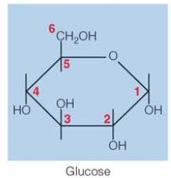
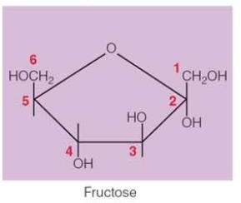
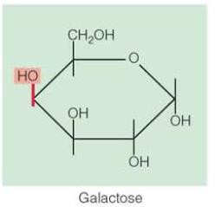
Carbohydrates
Compounds composed of carbon, oxygen, and hydrogen
They are classified as :
Monosaccharaides - single sugars
Glucose – blood sugar
  Part of every disaccharide
Fructose
  Sweetest of the sugars
Galactose
  Found only in a few foods

Slide 23
Disaccharides
Sugars composed of pairs of monosaccharides( maltose, sucrose, lactose)
Maltose – two glucose units
Sucrose – glucose and fructose
Lactose – galactose and glucose Condensation
Links two monosaccharides together Hydrolysis
Breaks a disaccharide in two monosaccharides

Slide 24
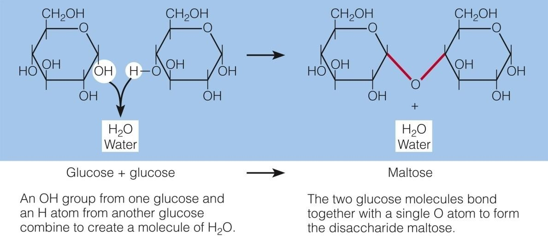
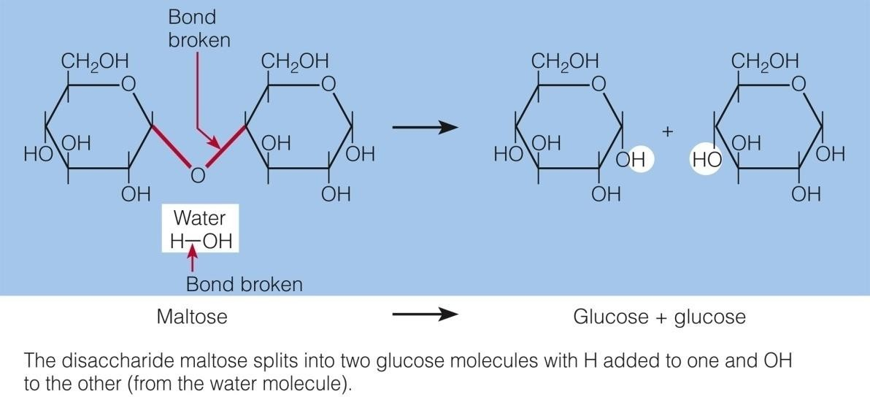

Slide 25
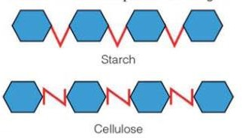
Polysaccharides
Large molecules composed of chains of monosaccharaides
Glycogen
Storage form of energy in the body
Made from many glucose units
Starch
Storage form of energy in plants
Made from many glucose units
Fibers
Non-starch polysaccharides( e.g cellulose)

Slide 26
Fibers are usually divided into two groups based on their solubility:
Soluble fibers
Insoluble fibers

Slide 27
Soluble fibers:
Dissolve in water
Form gels (viscous)
Easily digested by bacteria in the colon( fermentable)
Commonly found in oats, barely, legumes, and citrus fruits
Often associated with protecting against heart disease (by lowering blood cholesterol) and diabetes( by lowering blood glucose ).

Slide 28
Insoluble fibers:
Do not dissolve in water
Do not form gels(non-viscous)
Less readily fermented
Found mostly in whole grains( bran) and vegetables
Promote bowel movement and alleviate constipation

Slide 29
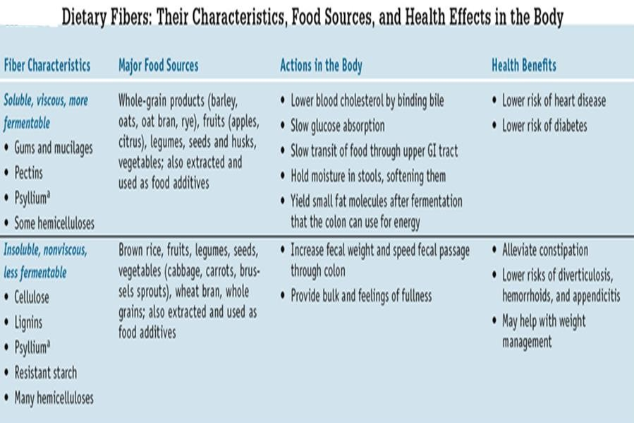

Slide 30
Note:
Starches and sugars are called available carbohydrates because human digestive enzymes break them down for the body’s use.
Fibers called unavailable carbohydrates because human digestive enzymes cannot break their bonds

Slide 31
Roles of carbohydrates in the body
They are the body’s main source of fuel
All tissues and cells in our body use glucose for energy.
They can be stored in the muscles and liver and later used for energy (glycogen).
They are important in intestinal health and waste elimination(eg. Dietary fiber).

Slide 32
Digestion and absorption of carbohydrates
Carbohydrate digestion
The ultimate goal of digestion of sugars and starch is to break down them into small molecules - chiefly glucose- that the body can absorb and use.

Slide 33
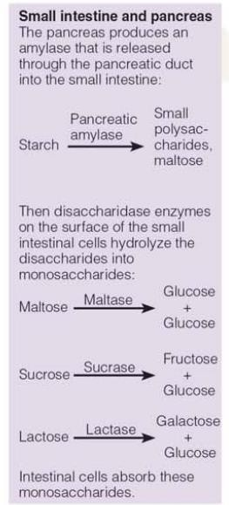
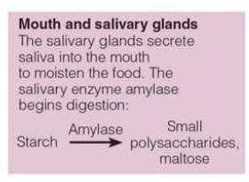
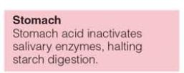
Carbohydrate digestion(Starch)

Slide 34
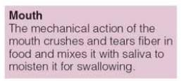

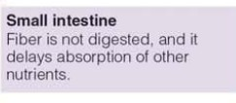
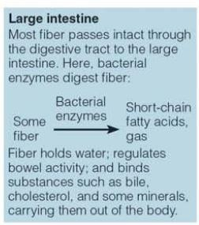
Carbohydrate digestion (Fiber)

Slide 35
Carbohydrate absorption
Glucose absorption
Little absorption: in the lining of the mouth
Much absorption: small intestine
Glucose Active transport Galactose
Fructose : Facilitated diffusion
Liver
Conversion of fructose and galactose into glucose

Slide 36
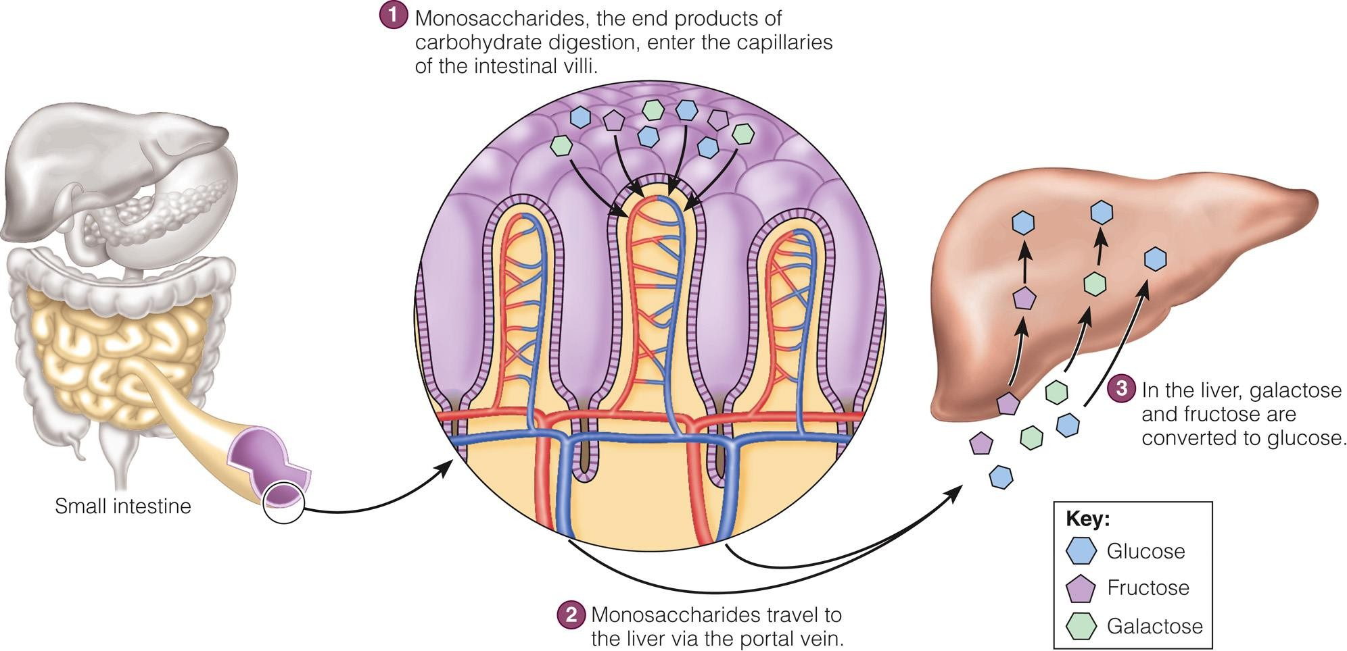

Slide 37
Carbohydrate metabolism
Glucose plays a key role in carbohydrate metabolism
Storing glucose as glycogen
Liver storage (1/3 of total glycogen)
  Condensation of glucose into glycogen by liver cells
  Hydrolysis for release of glucose when needed
Muscle storage( 2/3 of total glycogen)
  Selfishly hoards glycogen
Note:
Glycogen is used as energy storage for less than a day during rest and a few hours during exercise

Slide 38
Using glucose for energy
Glucose fuels most of the body’s cells
Preferred source for brain, nerve cells, and developing red blood cells
Major pathways for cellular breakdown of glucose :
  Glycolysis
  TCA( Krebs) cycle
  Electron transport chain

Slide 39
Making glucose from protein
When there is inadequate supply of carbohydrates from the diet
Gluconeogenesis : conversion of protein to glucose
Protein sparing action: the role of carbohydrates to prevent the use of protein for energy

Slide 40
Making ketone bodies from fat fragments
Inadequate supply of carbohydrates
Fat metabolism shifts
Ketone body formation by combining fat fragments– alternative fuel source during starvation
When production of ketone bodies exceeds their use – Ketosis
Ketosis –disturbs the body’s acid-base balance
Note: The body needs 50 to 100g of carbohydrates to spare body protein and to prevent ketosis

Slide 41
Using glucose to make fat
The way to handle extra glucose
Glucose is broken down to smaller fragments and converted into fat
Fat: permanent energy storage
Note: When carbohydrate is abundant, fat is either conserved or created

Slide 42
Health effects of carbohydrates
Health effects of sugars
Give pleasure in moderate amounts
Detrimental in two ways
Contribute to nutrient deficiencies by supplying energy with out providing nutrients . Eg. Cakes, candies, sodas
Tooth decay/dental caries
Bacteria ferment sugars producing acid

Slide 43
Recommended intakes of sugars
Dietary guidelines
  Choose and prepare foods with little added sugar
DRI
  Added sugars
    No more than 25% of day’s total energy
    Impact on other food groups
WHO and FAO recommendations:
Less than 10% of total energy
Note: Sugars that occur naturally in fruits, vegetables and milk are more acceptable

Slide 44
Health effects of starch and fibers
Prevention of heart disease
High carbohydrate diets especially those rich in whole grains ( exact reason unknown)
they usually tend to have low fat and cholesterol
Foods rich in soluble fibers
  Oat bran, barely, legumes
  lower blood cholesterol by binding with bile acids and their by increasing their excretion
  displace fat in the diet

Slide 45
Prevention of diabetes ( especially type 2)
  High-fiber foods
Mechanism: trap nutrients and delay their transit through the GI tract → glucose absorption slowed
GI health
  High-fiber foods
Increase stool weight, easing passage, reduce transit time →prevent constipation

Slide 46
Prevention of colon cancer
Inverse relationship between dietary fiber and colon cancer
Mechanism:
Binding and removing cancer causing agents from the colon
Soluble fibers stimulate bacterial fermentation of resistant starch and fiber in the colon … production of short chain fatty acids
Short chain fatty acids activate cancer killing enzymes

Slide 47
Weight management
Mechanism:
High-fiber foods tend to be low in fat and added sugars….deliver less energy per bite
Creating feeling of fullness by absorbing water from digestive juices and swelling….delay hunger

Slide 48
Harmful effects of excessive fiber
Displaces energy and nutrient dense foods
Abdominal discomfort, gas, diarrhea
Interfere nutrient absorption such as minerals
Dietary goals
  Balance, moderation, variety

Slide 49
Recommended intakes of starch
DRI for carbohydrates is 45 to 65% of energy requirement
RDA for carbohydrate is 130 g per day ( based on the average minimum amount of glucose used by the brain)
FDA: Daily Value of 300 grams per day by using 60% of kcalories guideline (….. Set for food labels)
Dietary Guidelines encourage a variety of whole grains,
vegetables, fruits and legumes daily.

Slide 50
Recommended intakes of fiber
FDA recommends 25 grams for a 2,000-kcalorie diet.
DRI at 14 g per 1000 kcalorie intake (28 grams for a 2,000
K calorie diet)
American Dietetic Association recommends 20-35 g per day
World Health Organization suggests no more than 40 g per day.

Slide 51
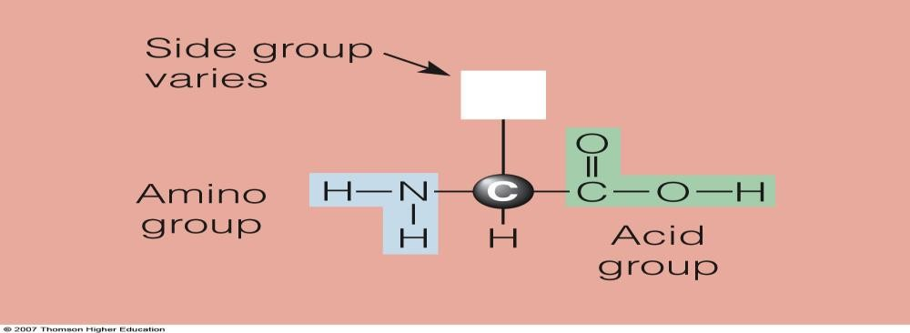
Proteins
Compounds composed of carbon, hydrogen, oxygen and nitrogen atoms arranged into amino acids linked in a chain. Some amino acids also contain sulfur atoms.
Proteins are made up of about 20 different amino acids
Each amino acid has an amino group, an acid
( carboxyl ) group, a hydrogen atom, and a side group.

Slide 52
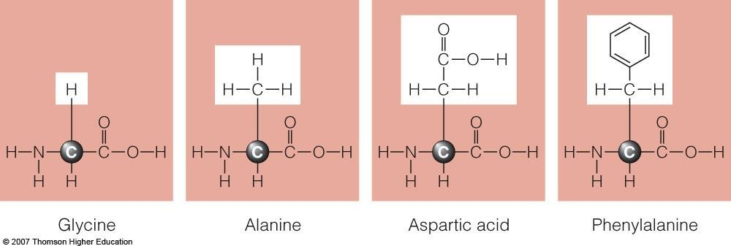
Cont.,…..
It is the side group that makes each amino acid unique.
These unique side groups result in differences in the size, shape and electrical charge of amino acids

Slide 53
Cont.,…..
Amino acids are usually grouped as essential and non essential amino acids
Essential amino acids, also called indispensable amino acids, must be supplied by the foods people consume.
Nonessential amino acids, also called dispensable amino acids, are the ones the body can create.

Slide 54
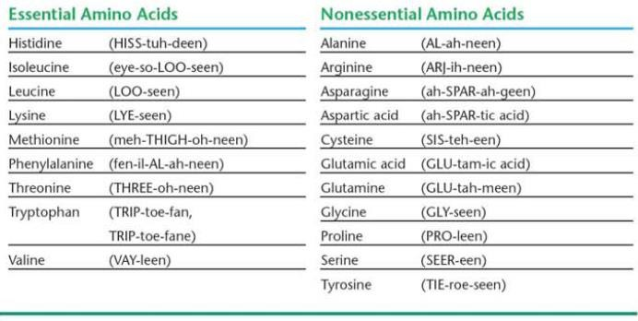
Cont.,…..
Essential and non-essential amino acids

Slide 55
Cont.,…..
Cells link amino acids end to end in a variety of sequences to form thousands of different proteins.
Amino acid chains are linked by peptide bonds in condensation reactions.
Dipeptides have two amino acids bonded together.
Tri peptides have three amino acids bonded together.
Polypeptides have more than two amino acids bonded together.

Slide 56
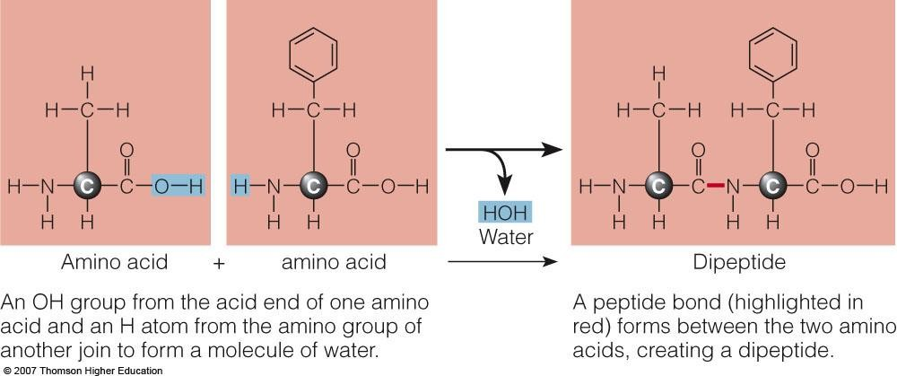
Cont.,…..

Slide 57
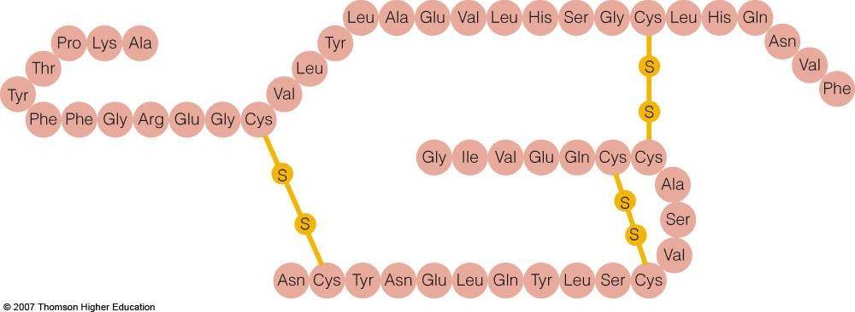
Cont.,…..
Amino acid sequences are all different, which allows for a wide variety of possible sequences.
The sequence of amino acids in each protein determines its unique shape and function.
Eg. Amino acid sequence of human insulin

Slide 58
Cont.,…..
Protein denaturation :the uncoiling of protein that changes its ability to function.
Proteins can be denatured by heat and acid.
After a certain point, denaturation is irreversible
Example:- The hardening of egg when it is cooked, the curdling of milk when acid is added

Slide 59
Digestion and absorption of protein
Proteins in foods do not become body proteins directly.
Instead they supply the amino acids from which the body makes its own proteins.
The goal of protein digestion …..hydrolysis of all peptide bonds to produce free amino acids.
In the mouth:
Chewing and crushing moisten protein rich foods and mix them with saliva to be swallowed
No chemical digestion of protein occurs in the mouth.

Slide 60
Cont.,…..
In the stomach:
Protein is denatured by hydrochloric acid.
Pepsinogen (a proenzyme) is converted into its active form pepsin in the presence of hydrochloric acid.
Pepsin cleaves proteins into smaller polypeptides.
In the small intestine:
Proteases hydrolyze protein into short peptide chains called oligopeptides, which contain four to nine amino acids.
Peptidases split proteins into amino acids.

Slide 61
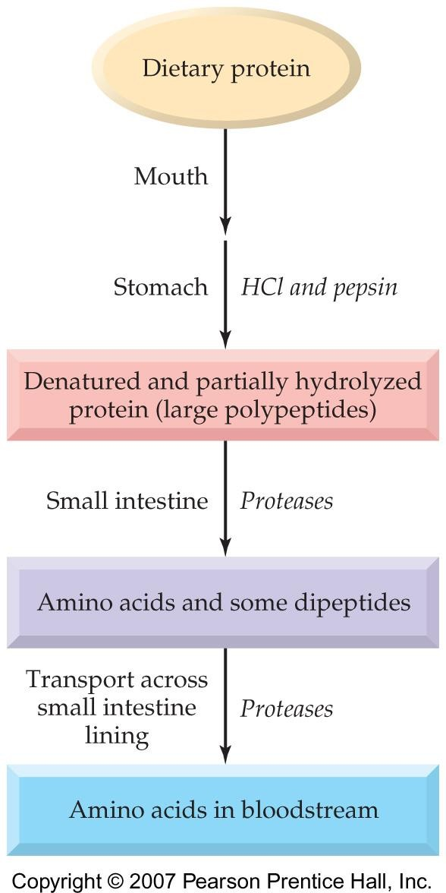
Cont.,…..

Slide 62
Protein absorption
Specific carriers transport amino acids to intestinal cells
Used by intestinal cells for energy or synthesis of necessary compounds
Extra /excess amino acids: transported to the liver

Slide 63
Roles of proteins
As building materials for growth and maintenance
Building blocks of muscles, blood and skin….most of body structures.
Replace dead tissues including the skin, hair, nails, and GI tract lining
As enzymes:
Enzymes are proteins that facilitate anabolic (building up) and catabolic (breaking down) chemical reactions.

Slide 64
As hormones:
Cont.,…..
Hormones regulate body processes and some hormones are proteins. An example is insulin.
As acid-base regulators
Act as buffers by keeping solutions acidic or alkaline
Acids are compounds that release hydrogen ions in a solution.
Bases are compounds that accept hydrogen ions in a solution.

Slide 65
Cont.,….
Mechanism of regulation:
By accepting and releasing hydrogen ions, proteins maintain the acid base balance of the blood and body fluids.
Acidosis is high levels of acid in the blood and body fluids.
Alkalosis is high levels of alkalinity in the blood and body fluids.
Note: The extremes of acidosis and alkalosis lead to coma and death because they denature working proteins

Slide 66
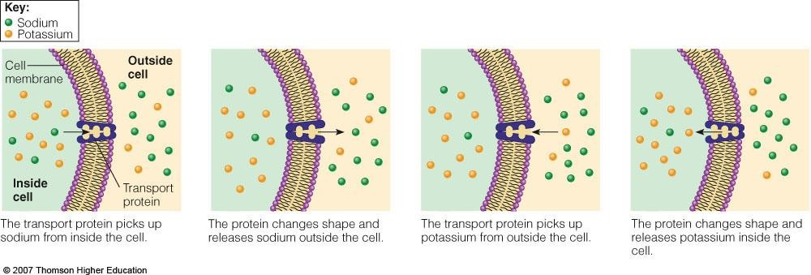
Cont.,….
As transporters
Carry lipids, vitamins, minerals and oxygen in the body
Act as pumps in cell membranes, transferring compounds from one side of the cell membrane to the other

Slide 67
As antibodies
Cont.,….
Fight antigens, such as bacteria and viruses, that invade the body.
As source of energy and glucose
During times of starvation or insufficient carbohydrate intake, proteins will be sacrificed to give energy
The body will break down its tissue proteins to make amino acids available for energy and glucose production..( at the expense of losing lean body tissue)

Slide 68
Other roles
Cont.,….
Blood clotting by producing fibrin which forms a solid clot
Vision by creating light-sensitive pigments in the retina

Slide 69
Protein metabolism
Protein turnover and the amino acid pool
Protein turnover : the continual making and breaking down of protein.
When proteins break down, they free amino acids. These amino acids mix with amino acids from dietary protein to form an amino acid pool within the cell or circulating blood.
Amino acids from food are called exogenous.
Amino acids from within the body are called
endogenous

Slide 70
Nitrogen balance
The amount of nitrogen consumed as compared with the amount of nitrogen excreted.
Zero nitrogen balance is nitrogen equilibrium, when input equals output.
Positive nitrogen balance means nitrogen consumed is greater than nitrogen excreted.
Nitrogen status is positive in growing infants, children, adolescents pregnant women and people recovering from protein deficiency or illness:

Slide 71
Cont.,….
Their nitrogen intake exceeds their nitrogen output ( protein is retained in new tissues: blood, bone, skin and muscle cells)
Negative nitrogen balance means nitrogen excreted is greater than nitrogen consumed.
Nitrogen status is negative in people who are starving or suffering other severe stresses such as burns, injuries, infections and fever. ( The body loses nitrogen as it breaks down muscle and other body proteins for energy)

Slide 72
Cont.,….
Using amino acids to make proteins or non-essential amino acids
Cells can assemble amino acids into the protein needed.
Using amino acids to make other compounds
Eg. Neurotransmitters are made from the amino acid tyrosine.

Slide 73
Using amino acids for energy and glucose
There is no readily available storage form of protein.
When the need arises ( such as inadequate intake of carbohydrates) the body breaks down tissue proteins and uses their amino acids for energy or glucose.

Slide 74
Deaminating amino acids
Nitrogen-containing amino groups are removed
Ammonia is released into the bloodstream and converted into urea by the liver.
Kidneys filter urea out of the blood.
The remaining carbon skeleton joins the TCA
( Krebs ) cycle at different sites to be used as energy source

Slide 75
Using amino acids to make fat
Excess protein is deaminated and converted into fat.
Nitrogen is excreted.
→Protein rich foods can contribute to weight gain

Slide 76
Protein in foods
Eating foods of high-quality protein is the best assurance to get all the essential amino acids.
A diet inadequate in any of the essential amino acids limits protein synthesis.
The quality of protein is measured by its amino acid content, digestibility, and ability to support growth.

Slide 77
Protein quality
Digestibility:
Depends on protein’s food source
– Animal proteins :90-99% absorbed.
– Plant proteins :70-90% absorbed.
– Soy and legumes : 90% absorbed.

Slide 78
Amino acid composition
The liver can produce nonessential amino acids.
Cells must dismantle body proteins to produce essential amino acids if they are not provided in the diet.
To prevent protein breakdown, dietary protein should supply at least the nine essential amino acids plus enough nitrogen containing amino groups.
Limiting amino acids : essential amino acids that are supplied in less than the amount needed to support protein synthesis.
Four amino acids are most likely to be limiting: Lysine, Methionine, Threonine, Tryptophan

Slide 79
Reference protein: the standard by which other proteins are measured.
Standard is established based on the essential amino acid requirement of preschool children.
Rationale for the use of the essential amino acid requirements of preschool children as a standard is that if a protein effectively support a young child’s growth and development, then it will meet or exceed the requirements of older children and adults.

Slide 80
High-quality proteins
Contain all the essential amino acids
Animal foods contain all the essential amino acids.
Plant foods are diverse in content and tend to be missing one or more essential amino acids.
Complementary proteins
Combining plant foods that together contain all the essential amino acids
Used by vegetarians

Slide 81
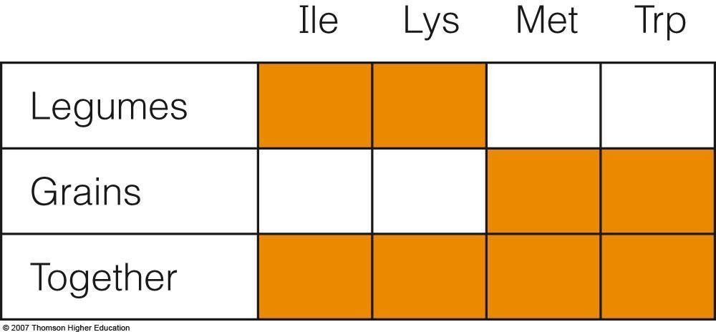
Complementary proteins

Slide 82
Health effects and recommended intakes of protein
Both protein deficiency and excesses can be harmful to health.
Protein deficiencies arise from protein-deficient diets and energy-deficient diets.
High-protein diets have been implicated in several chronic diseases.

Slide 83
Protein-energy malnutrition (PEM)
The most prevalent and devastating form of malnutrition worldwide
Children who are thin for their height may be suffering from acute
PEM ( recent food deprivation)
Children who are short for their age have experienced chronic PEM ( long term food deprivation)
PEM is most prevalent in Africa, Central America, South America, East and South East Asia

Slide 84
Classification:
Marasmus – severe weight loss or wasting
Kwashiorkor – bloated appearance due to water retention (bi-lateral oedema).
Marasmic-kwashiorkor – a combination of both wasting and bi-lateral oedema.

Slide 85
Marasmus (wasting)
A rapid deterioration in nutritional status in a short time can lead to marasmus.
It is characterized by severe wasting of fat and muscle which the body breaks down to make energy.
Wasting can affect both children and adults.

Slide 86
The body of a wasted child tries to conserve energy as much as possible by reducing physical activity and growth, reducing internal body processes and shutting down the body’s response to infection…… Reductive adaptation
This reduced activity results in limited function of the liver, kidney, heart and gut putting the child at risk for:
Low blood sugar( hypoglycemia)
Low body temperature (Hypothermia)
Fluid overload/heart failure
Infection

Slide 87
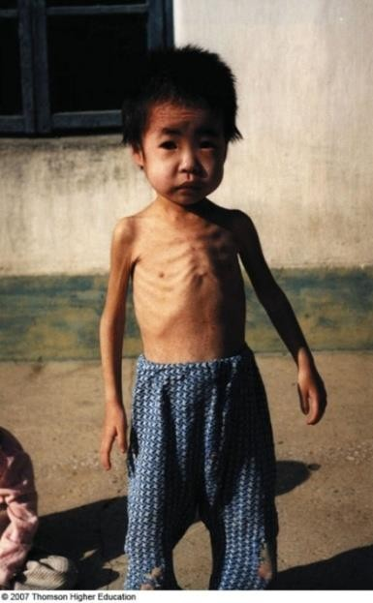
Typical characteristics of a wasted child include:
‘Skin and bones’ appearance
A thin ‘old man’ face
Hair… sparse, thin and dry; easily pulled out
Anxiety and apathy
Good appetite is possible

Slide 88
Kwashiorkor
Kwashiorkor is characterized by bilateral pitting oedema (affecting both sides of the body) in the lower legs and feet which as it progresses becomes more generalized to the arms, hands and face.
Oedema is the excessive accumulation of fluid in body tissues which results from severe nutritional deficiencies.

Slide 89
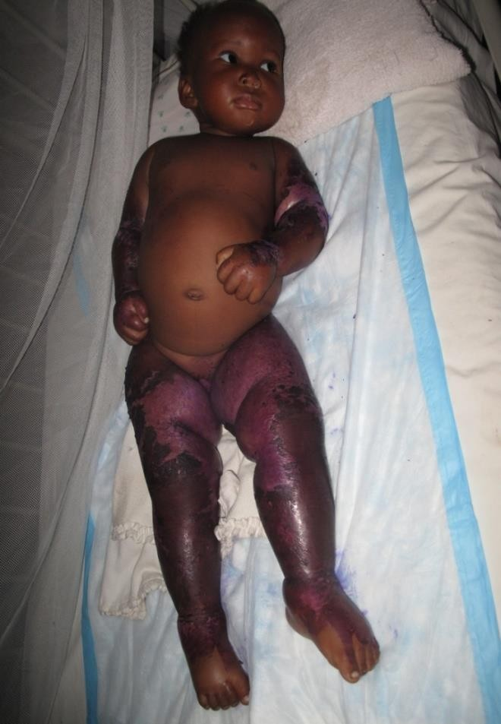
Clinical signs of kwashiorkor include:
Loss of appetite
Apathy and irritability
Changes in hair colour (yellow/orange)
Dermatosis

Slide 90
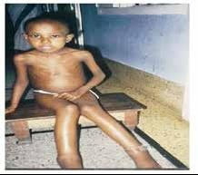
Marasmic-kwashiorkor
Marasmic-kwashiorkor is a mixed form of both marasmus and kwashiorkor and is characterized by the presence of both wasting and bilateral pitting oedema.

Slide 91
Infections
In PEM…..lack of antibodies to fight infections.. usually make the child to be vulnerable to infections
Dysentery due to infection of GI tract…diarrhae
…. depletion of nutrients and body fluid
No synthesis of blood proteins such as hemoglobin…….Anemic and weak
Combination of all these…heart failure and possible death

Slide 92
Health effects of proteins cont’d
Heart disease
Foods high in animal protein also tend to be high in saturated fat.
Cancer
A high intake of animal protein is associated with some cancers.
Is the problem high protein intake or high fat intake?

Slide 93
Adult bone loss (Osteoporosis)
High protein intake has been associated with increased calcium excretion.
Inadequate protein intake may also affect bone health.

Slide 94
Recommended intakes of protein
Protein should contribute 10-35% energy intake Protein RDA
For adults : 0.8 g/kg/day
Assumptions in setting RDA
– People are healthy.
– Protein is mixed quality.
– The body will use protein efficiently.

Slide 95
Lipids
Are a group of organic compounds that are insoluble in water
Classified as :
Triglycerides ( Fats and oils)
Phospholipids
Sterols
Triglycerides: the predominant lipids both in foods and the body
Phospholipids and sterols: make up only 5 percent
of lipids in the diet

Slide 96
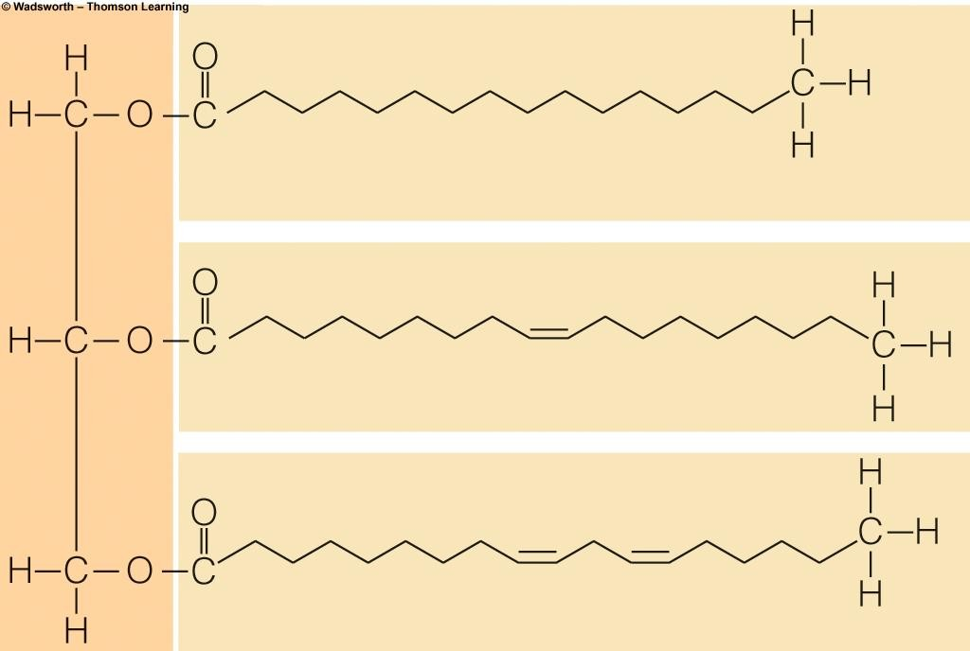
Triglycerides
Lipids composed of three fatty acids and attached to a
glycerol
May be solid (fat) or liquid (oil) at room temperature depending on the degree of saturation of fatty acids and length of carbon chain of the fatty acids constituting it

Slide 97
Functions of fats
In the body, fats provide:
Energy – 9 kcals/gm
  60% of body’s energy needs at rest
  Stored as adipose tissue
Insulation & protection
Cell membrane constituents

Slide 98
Fatty acids
Organic acids that consist a chain of carbon atoms with hydrogens attached-that has an acid group (COOH) at one end and a methyl group (CH3) the other end.
Classification
1. Based on the length of carbon chain
Short chain : 2-4 carbon atoms (eg. Butyric acid)
Medium chain : 6-12 carbon atoms (Caprillic acid)
Long chain : 14-18 carbon atoms (palmitic acid, stearic acid)
Extra long chain : more than 20 carbon atoms (Arachidonic acid)

Slide 99
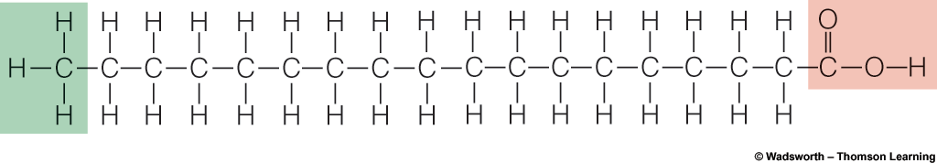
2. Based on degree of saturation
Saturated fatty acids – fatty acids that contain carbon chains filled with hydrogen atoms (no C=C double bonds)
All short or medium chain fatty acids are saturated.
The major saturated fatty acids in the diet are palmitic and stearic acids.

Slide 100
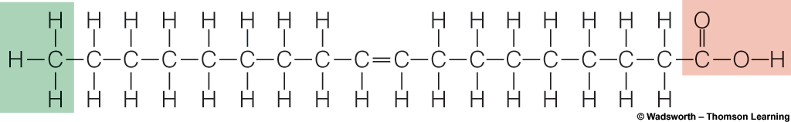
Monounsaturated fatty acids( MUFA)
Fatty acids that contain only one double bond between carbon atoms
The most common MUFA in the diet is oleic acid.

Slide 101
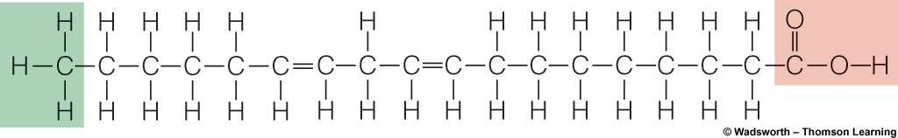
Polyunsaturated fatty acids(PUFA)
Fatty acids which have two or more double bonds between carbon atoms.
Linoleic acid – 18-carbon, polyunsaturated

Slide 102
Saturated fat : Triglyceride containing 3 saturated fatty acids, such as animal fats (butter, lard) and tropical oils (palm, coconut)
Appear solid at room temperature
Monounsaturated fat : Triglyceride containing fatty acids with one double bond; i.e. canola & olive oil
Polyunsaturated fat: Triglycerides containing a high % of fatty acids with more than two double bonds; i.e. corn, safflower, soybean, sunflower and fish oils
Appear liquid at room temperature

Slide 103
Essential fatty acids
The human body knows how to manufacture fatty acids it needs except linoleic and linolenic acids.
These two polyunsaturated fatty acids are essential
and therefore must be provided in diet
Linoleic acid : omega-6 fatty acid Linolenic acid: omega-3 fatty acid
Note: Omega number refers to the position of the double bond nearest to the methyl (CH3) end of the carbon chain

Slide 104
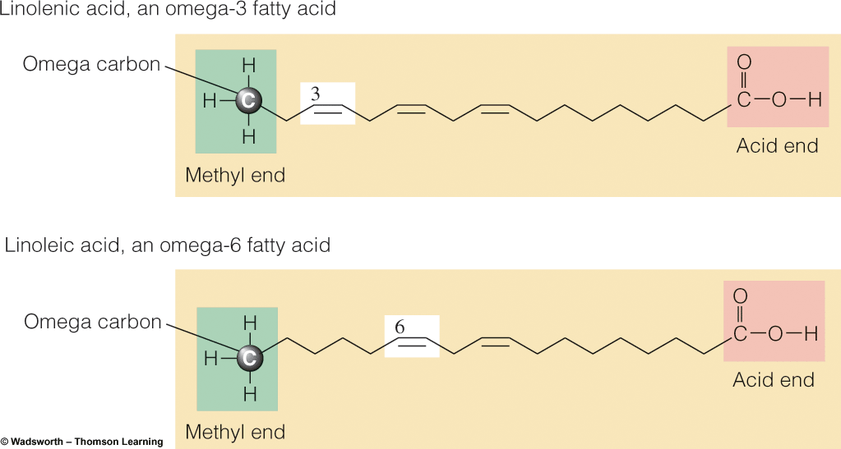

Slide 105
Note:
Cells do not possess the enzymes to make any of the omega -6 or omega 3 fatty acids from scratch, nor can they convert an omega -6 fatty acid to an omega 3 fatty acid or vice versa.
Cells can, however, start with the 18-carbon member of an omega family and make the longer fatty acids of that family by forming double bonds(desaturation) and lengthening the chain two carbons at a time( elongation)

Slide 106
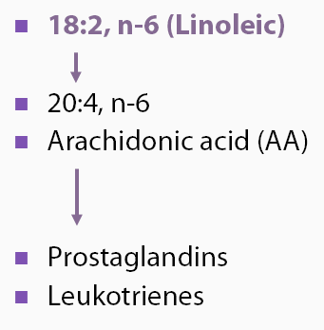
Linoleic acid and Omega - 6 family

Slide 107
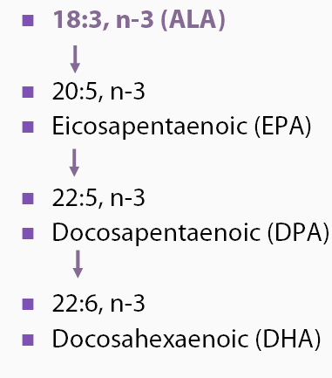
Linolenic (alpha linolenic acid) and Omega -3 family

Slide 108
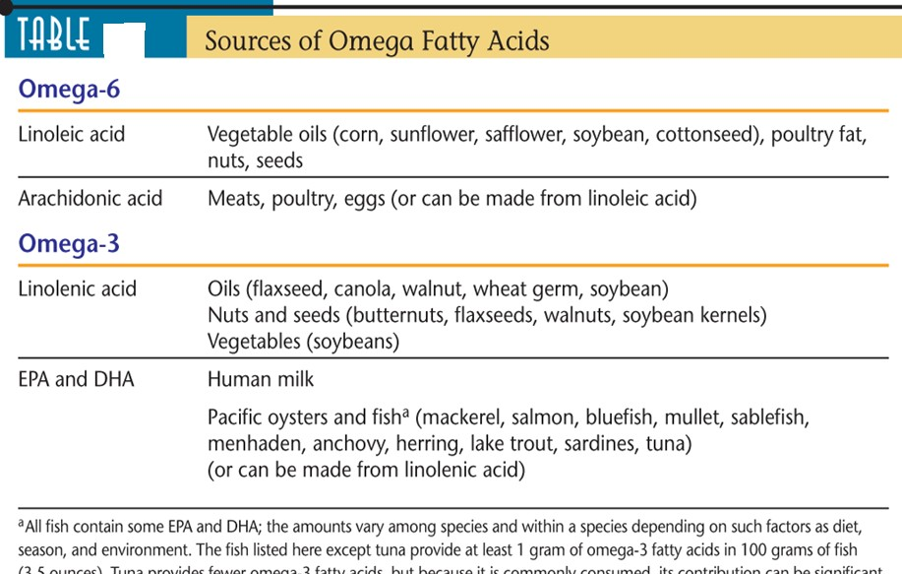

Slide 109
Functions of essential fatty acids:
Play a role in normal growth & development especially in the eyes and brain
Prevent heart disease, hypertension, arthritis & cancer

Slide 110
Hydrogenation
A chemical process by which hydrogens are added to monounsaturated or polyunsaturated fatty acids to reduce the number of double bonds, making the fats more saturated (solid).
Offers two advantages :
It protects against oxidation ( thereby prolonging shelf life) by making polyunsaturated fats more saturated
Alters the texture of foods by making liquid vegetable oils more solid ( e.g margarine)

Slide 111
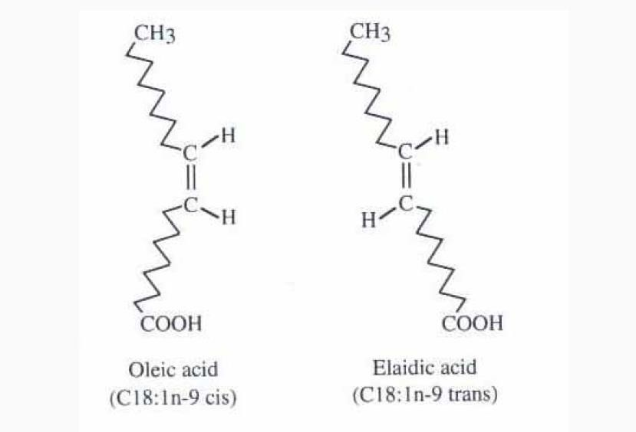
Hydrogenation transforms the shape of a fatty acid to a "trans" form. ( there is usually partial hydrogenation)
In nature, most double bonds are ‘cis’ : the hydrogens next to the double bonds are on the same side of the carbon chain
Trans fatty acid does not occur in nature(occur in small amounts in animal food sources, including human milk) and the body has difficulty digesting it.

Slide 112
Hydrogenated fat is commonly associated with junk food: potato chips, cookies, margarine, etc.
Studies showed that trans fatty acids to be more associated with heart disease than the saturated ("hard") fat found in butter.
Note:
Replacing saturated and trans fat in the diet with unsaturated fat has been shown to decrease the risk of developing heart disease.

Slide 113
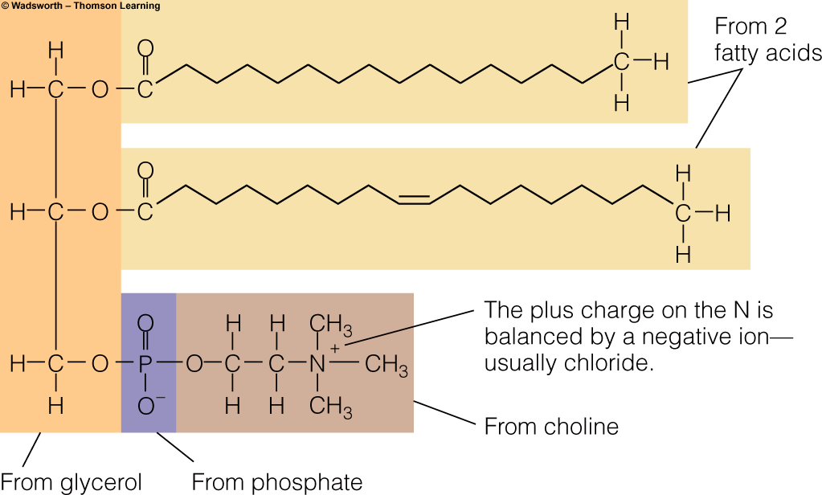
Phospholipids
The best known phospholipid is lecithin
Structure: similar to triglycerides except only 2 fatty acids + choline

Slide 114
Phospholipids in foods: Lecithin
Lecithin is found in egg yolks, soybeans, wheat germ, peanuts
Functions:
Important constituent of cell membranes
Used as emulsifiers (helps keep fats in solution)… in food industries
Note: Lecithin is not an essential nutrient It can be synthesized by the liver

Slide 115
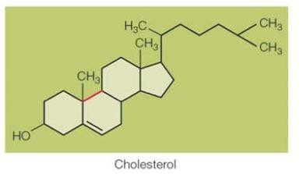
Sterols
Compounds with a multiple ring structure
Cholesterol is the most common sterol
Sterols in foods: food derived from both plants and animals contain sterols but only those from animals contain significant amounts of cholesterol

Slide 116
Roles of sterols
Many vitally important body compounds are sterols
Sex hormones – testosterone
Vitamin D
Bile acids
Adrenal hormones - cortisol
Cholesterol
made from cholesterol

Slide 117
Fat digestion
The goal of fat digestion is to dismantle triglycerides into small molecules that the body can absorb and use.
Triglycerides → monoglycerides, fatty acids, glycerol

Slide 118
Fat digestion
In the mouth
Some hard fats begin to melt as they reach body temperature.
The sublingual salivary gland in the base of the tongue secrets lingual lipase
The degree of hydrolysis by lingual lipase is slight for most fats but may be appreciable for milk fats

Slide 119
In the stomach
The acid stable lingual lipase initiates lipid digestion by hydrolyzing one bond of triglycerides to produce diglycerides and fatty acids.
The stomach’s churning action mixes fat with water and acid.
A gastric lipase accesses and hydrolyzes (only a very small amount of) fat

Slide 120
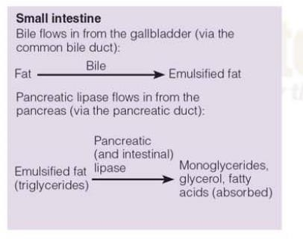
In the small intestine

Slide 121
Lipid transport
Lipoproteins : clusters of lipids and proteins that are used as transport vehicles for fat
Chylomicrons
VLDL = very-low-density lipoproteins
LDL = low-density lipoproteins
HDL = high-density lipoproteins

Slide 122
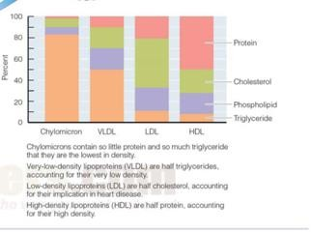

Slide 123
Chylomicrons :
The largest and least dense of the lipoproteins
Transport diet derived lipids (mostly triglycerides) from the intestine ( via the lymph system) to the rest of the body
Cells all over the body remove triglycerides from the chylomicrons as they pass by, so the chylomicrons get smaller and smaller
Remnants of chylomicrons: removed from blood by special protein receptors

Slide 124
VLDL (Very low density Lipoprotein)
Lipids made in the liver and those collected from chylomicron remnants are packaged as VLDL and shipped to other parts of the body

Slide 125
LDL(Low Density Lipoprotein)
As VLDL travels through the body, cells remove triglycerides, causing the VLDL to shrink. As a VLDL loses triglycerides, the proportion of lipids shifts, and the lipoprotein density increases. The remaining cholesterol –rich lipoprotein eventually becomes an LDL.
LDL then circulates throughout the body , making its contents available to the cells of all tissues.

Slide 126
HDL (High Density Lipoprotein)
Fat cells may release glycerol, fatty acids, cholesterol, etc to the blood. The liver makes HDL to carry cholesterol from the cells back to the liver for recycling or disposal.

Slide 127
Note:
HDL transports cholesterol from tissues to the liver ( for break down and excretion)and decreases the risk of chronic degenerative diseases
HDL cholesterol.... Good cholesterol
LDL transports cholesterol from the liver to the tissues and increases the risk of chronic degenerative diseases
LDL cholesterol..... Bad cholesterol

Slide 128
Note: Cholesterol's harmful effects in the body occur when it forms deposits in the artery walls. These deposits lead to atherosclerosis.
Consumption of saturated fats increases LDL level : increases risk factor for coronary heart disease and other chronic non-communicable diseases
Consumption of PUFAs and MUFAs increase the level of HDL: has protective effect from coronary heart disease and other chronic non communicable diseases

Slide 129
Metabolism of lipids
Using fat for energy:
Once the triglycerides are hydrolyzed into fatty acids and glycerol, they will join energy generating pathways to release energy.

Slide 130
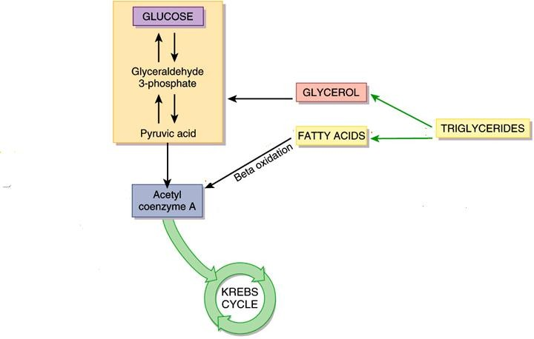
Pathways of lipid metabolism

Slide 131
Storing fat as fat:
Fat: efficient energy storage… gives energy twice of the energy of carbohydrate and protein
Fat cells of adipose tissue: take up and store fat

Slide 132
Health effects of fats
Excess fat intake contributes to many diseases including:
  Obesity
  Diabetes
  Cancer
  Heart disease
How?
    High fat diets = high kcal diets
    High saturated fat intake raises blood cholesterol
    High fat intakes may promote cancer

Slide 133
Desirable blood lipid profile:
Total cholesterol:<200mg/dL
LDL cholesterol: <100mg/dL
HDL cholesterol: >60mg/dL
Triglycerides: <150mg/dL

Slide 134
Dietary recommendations
DRI recommendation:
A diet low in saturated fat, trans fat and cholesterol
Limit total fat intake to <30% of kcals Example: If 2000 kcal diet, then
2000 x .30 = 600 kcals/9 kcals per gram = 65 gms of fat
Limit cholesterol to <300 mg/day
Saturated fat<10% of kcals

Slide 135
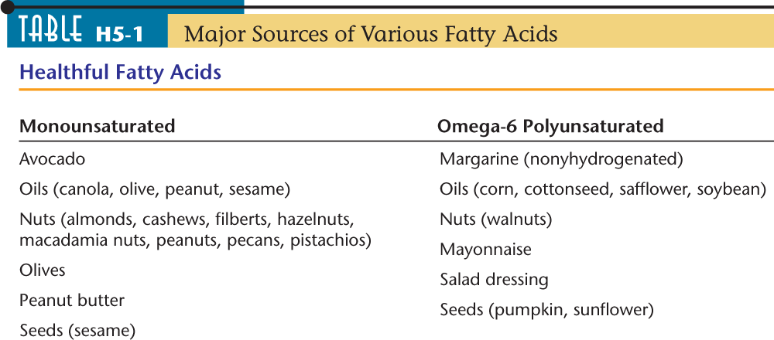
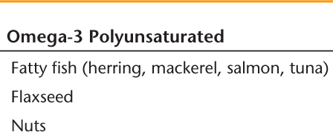

Slide 136
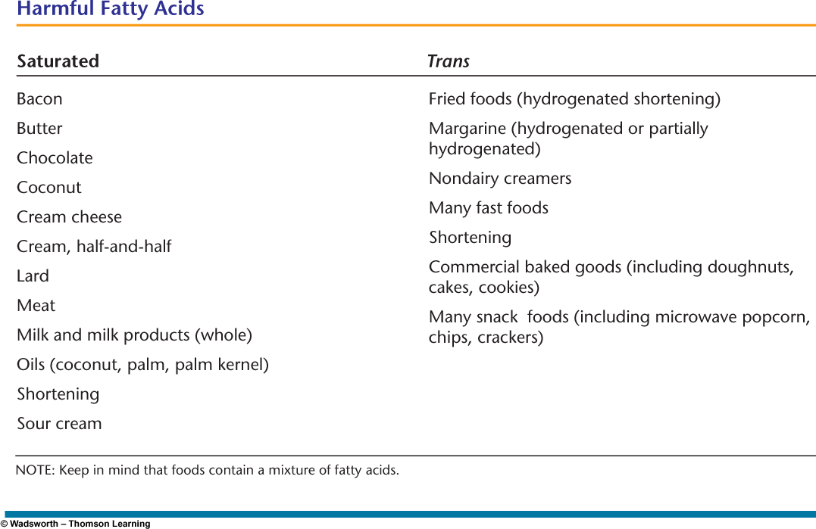

Slide 137
Micronutrients
Include vitamins and minerals
Required by the body in small amount
Do not need to be converted in any way to function in biological processes

Slide 138
Intake of adequate amounts of vitamins and minerals promotes effective physiological processes including reproduction, immune response, brain and other neural functions, and energy metabolism.
Approximately 30% of the world’s population is unable to use their full mental and physical potential as a result of micronutrient malnutrition
In Ethiopia, micronutrient deficiencies are one of the major issues with regard to malnutrition.

Slide 139
Vitamins
Organic substances present in minute amounts in foodstuffs
Can be destroyed during storage and cooking
Necessary for metabolism as co-factors
Cannot be synthesized in ample amounts in the body
Chronic deficiency is likely to cause physical symptoms
Symptoms will disappear once the vitamin level in the body is restored
– Deficiency can cause permanent damage

Slide 140
Bioavailability:
The amount of vitamins available from foods depends not only on the quantity provided by a food but also on the amount absorbed and used by the body-referred to as the vitamin’s bioavailability.
Factors influencing bioavailability:
Efficiency of digestion
Nutritional status
Method of food preparation
Source of nutrient
Other foods consumed at same time

Slide 141
Vitamins include:
Vitamin A
Vitamin B1 (Thiamin)
Vitamin B2 (Riboflavin)
Vitamin B6 (pyridoxine)
Vitamin B12 (Cyanocobalamin)
Vitamin B3( Niacin)
Pantothenic acid (B5)
Folic acid ( B9)
Biotin
Vitamin C (Ascorbic acid)
Vitamin D (Calciferol)
Vitamin E (Tocopherol)
Vitamin K

Slide 142
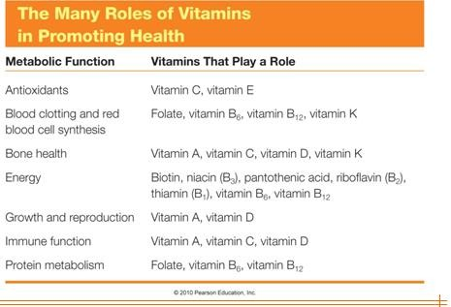

Slide 143
Classification of vitamins
Water soluble vitamins
E.g. B vitamins (thiamin, riboflavin, niacin, vitamin B12 and folic acid) and vitamin C
Fat soluble vitamins
  Vitamins A , D, E, K Solubility influences a vitamin’s:
    Digestion
    Absorption
    Transportation
    Storage
    Excretion

Slide 144
Characteristics of water soluble vitamins
They are widely distributed in natural foods
Vitamin B12 is found only in animal products
Soluble in water and absorbed in the intestine
Move directly into blood
Most travel freely in the body
Excess will be excreted
Deficiency syndrome develops faster
Most of these vitamins function as co-enzymes
They are important for cellular oxidation
They are heat labile

Slide 145
Characteristics of fat-soluble vitamins:
Metabolized along with fats
Enter lymph and then blood
Require transport proteins
Stored in the liver and adipose tissue
Slow to develop deficiency syndrome
Present only in certain foods, mostly in animal products, oily foods, yellow & green vegetable
Excess can be toxic to the body.
They are heat stable

Slide 146
The B Vitamins – As individuals
Do not provide the body with fuel for energy
Assist enzymes with release of energy: coenzymes
Without coenzyme, an enzyme cannot function

Slide 147
Vitamin B1 (Thiamin)
Functions of thiamin
Involved in the metabolism of carbohydrates, amino acids and fats as a coenzyme
E.g Thiamine pyrophosphate( conversion of pyruvate to acetyl-CoA, TCA)

Slide 148
Food sources
Pork, whole grains, enriched or fortified cereals, liver, poultry, fish, eggs, dark green vegetables
Thiamin can be easily destroyed by heat, inactivated by thiaminases and other antithiamins such as tannic and caffeic acids

Slide 149
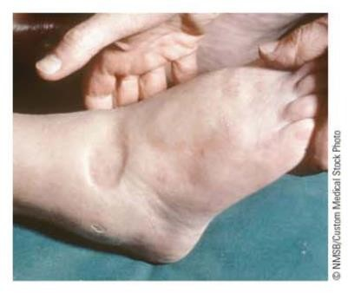

Deficiency of vitamin B1( Thiamin)
Beri-beri
Manifestation
Dry (with muscle wasting) Wet (edema) forms
Deficiency symptoms
Enlarged heart, Cardiac failure, Muscular weakness Apathy, Poor short term memory, Confusion, Irritability, Anorexia, Weight loss

Slide 150
Beri-beri occurs in human-milk-fed infants whose nursing mothers are deficient
It also occurs in adults with high carbohydrate intakes mainly from milled/polished rice and with intakes of anti-thiamin factors.
– Beri-beri is still endemic in Asia

Slide 151
Vitamin B2 (Riboflavin)
Functions
Assists energy release from food by acting as a coenzyme( FMN- Flavin mononucleotide; FAD- Flavin adenine dinucleotide... TCA cycle)
Maintains healthy mucus membrane lining of respiratory, digestive, circulatory and excretory tracts
Preserve integrity of nervous system, skin and eye

Slide 152
Dietary sources
Milk and milk products, dark green leafy vegetables, beef liver, beef and other meats
It is more stable in heat as compared to thiamin and vitamin C but it is more sensitive to light

Slide 153
Deficiency of Riboflavin (Vitamin B2)
Arbioflavinosis
Symptoms
Sore throat
Cracks and redness at corners of mouth
Painful, smooth, purplish red tongue
Inflammation characterized by skin lesions covered with greasy scales
Deficiency most often accompanies other nutrient deficiencies

Slide 154
Niacin (Vitamin B3)
Describes two chemicals : nicotinic acid and nicotin amide
Functions
Maintain normal function of the skin, nerves, and digestive system
Reduce cholesterol and triglyceride in the blood
Assist in the release of energy from CHOs, fat and proteins as a coenzyme (NAD and NADP)
Note: Without NAD, the enzymes involved in every step of the glucose- to- energy pathway cannot function.

Slide 155
Food sources
Widely distributed in most foods
Mostly found in fish, pork, beef, poultry, mushroom, whole grains and all protein containing foods
Can be formed in the body from tryptophan ( 3% of tryptophan is utilized for the synthesis of niacin)

Slide 156
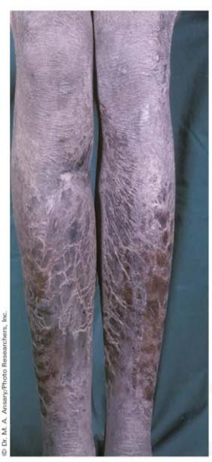
Deficiency of Niacin
Pellagra
At present, pellagra occurs endemically in poorer areas of India, China, and Africa.
It has also been observed in the form of epidemics in emergency
situations
The disease affects the skin, gastro-intestinal tract and nervous systems.
For this reason, it is sometimes called the disease of the 3Ds: Dermatitis , Diarrhoea, Dementia
If left untreated, it can also result in death

Slide 157
Vitamin B6 (Pyridoxine)
Functions
Involved in amino acid metabolism( coenzyme --- pyridoxal phosphate(PLP).....add and remove NH2 groups)
Helps for normal function of brain
Involves in hemoglobin synthesis
Promotes conversion of tryptophan to niacin or serotonin
Can be stored in muscle tissue
Deficiency
Uncommon because it usually occurs in association with a deficit in other B-complex vitamins

Slide 158
Folate
Known as folacin or folic acid or pteroylglutamic acid
It is part of coenzymes THF( tetrahydrofolate) and DHF( Dihydrofolate) used in DNA synthesis and therefore important in new cell formation
Functions:
Convert vitamin B12 to coenzyme form
Synthesize DNA
Regenerate methionine from homocysteine

Slide 159
Foods deliver folate in the ‘bound’ form: that is combined with a string of amino acids, known as polyglutamate.
The small intestine prefers to absorb the free folate form – folate with only one glutamate attached ( the monoglutamate form)
The following figure shows how folate is activated
and absorbed

Slide 160
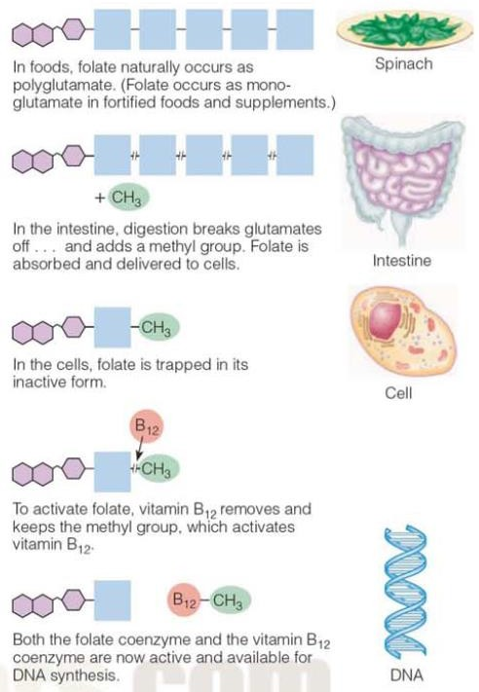

Slide 161
Food sources of folate
Foods with folic acid include leafy green vegetables, fruits, dried beans, peas and nuts.
Diets that contain adequate amounts of fresh green vegetables are good folate sources.
The natural folate is poorly bioavailable.
Folate losses during harvesting, storage, distribution,
and cooking can be considerable.

Slide 162
Because of the poorer bio-availability and stability of food folate, a diet based on food folate will not be optimum in prevention.
Synthetic folate has high bioavailability . Therefore, supplementation or fortification with the synthetic one improves folate status significantly.

Slide 163
Folate deficiency
Impairs cell division and protein synthesis….processes critical to growing cells
In folate deficiency, the replacement of red blood cells and GI tract cells falters.
The two first symptoms of folate deficiency are :
anemia and GI tract deterioration

Slide 164
Populations at risk for folate deficiency
Inadequate intake of folate sources
Pregnant women especially during periods of rapid foetal growth
During lactation, losses of folate in milk also increase the folate requirement
Folate RDA: For women- 400µg/day
Pregnant women: 600µg/day

Slide 165
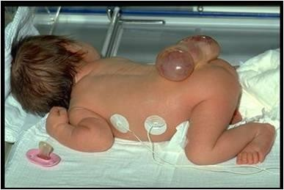
Neural tube defect and folate deficiency
A supplement of 400 µg of folic acid taken near the time of conception will prevent most neural tube defects (NTDs)
Normally, in human embryos, the closure of the neural tube occurs around the 30th day after fertilization. However, if something interferes and the tube fails to close properly, a NTD will occur

Slide 166
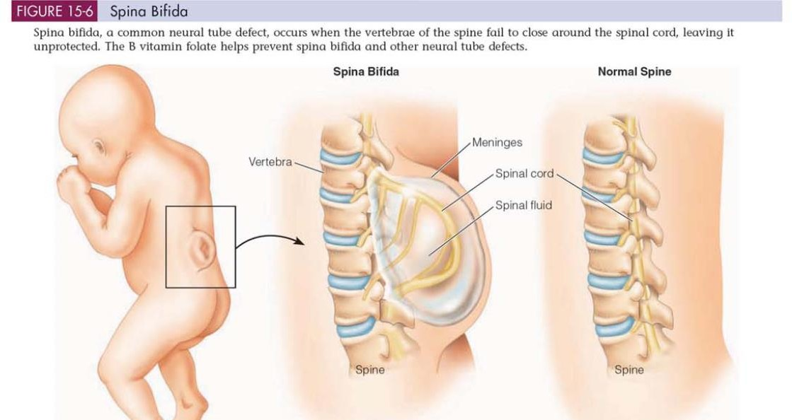

Slide 167
Vitamin B12 (Cobalamine)
Vitamin B12 and folate are closely related : each depend on the other for activation
Functions
Part of coenzymes methylcobalamine and deoxyadenosylcobalamine used in new cell synthesis
Helps to maintain nerve cells
Reforms folate coenzyme
Helps to break down some fatty acids and amino acids

Slide 168
Dietary sources and availability
Most microorganisms, including bacteria and algae, synthesize vitamin B12, and they constitute the only source of the vitamin
Omnivores and carnivores, including humans, derive dietary vitamin B12 from animal tissues or products (i.e., milk, butter, cheese, eggs, meat, poultry, etc.)

Slide 169
Absorption of Vitamin B12
In the stomach HCl and pepsin release vitamin B12 from the proteins to which it is attached to foods
Needs intrinsic factor for absorption
Note : Intrinsic factor- A glycoprotein secreted by the stomach cells that binds with vitamin B12 in the small intestine to aid in the absorption of vitamin B12

Slide 170
Populations at risk for and consequences of vitamin B12 deficiency
Vegetarians
Those with atrophic gastritis ( chronic inflammation of stomach….. HCl and intrinsic factor production diminishes ) → develop B12 deficiency called pernicious anemia ( blood disorder with abnormally large and immature red blood cells)
Supplementation/fortification is therefore important

Slide 171
The B vitamins – In concert
Each B vitamin coenzyme is involved in energy metabolism
Directly
Indirectly Deficiencies
Single B-vitamin deficiencies seldom show up in isolation
Eg. Beriberi and pellagra

Slide 172
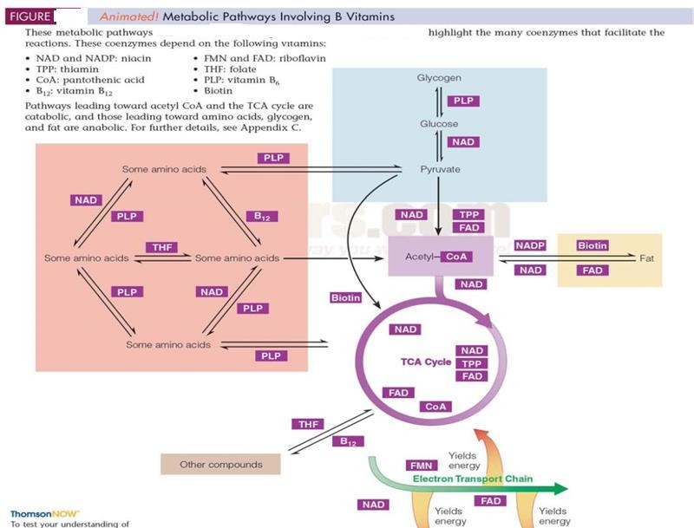
The B Vitamins – In Concert

Slide 173
Vitamin C (Ascorbic Acid)
Important in collagen synthesis and in turn wound healing
Increase iron absorption from food
Stimulates the production of red blood cells
Resistance to infection and neutralizes poisons
Perform as an antioxidant /defends against free radicals
→ Loses electrons easily

Slide 174
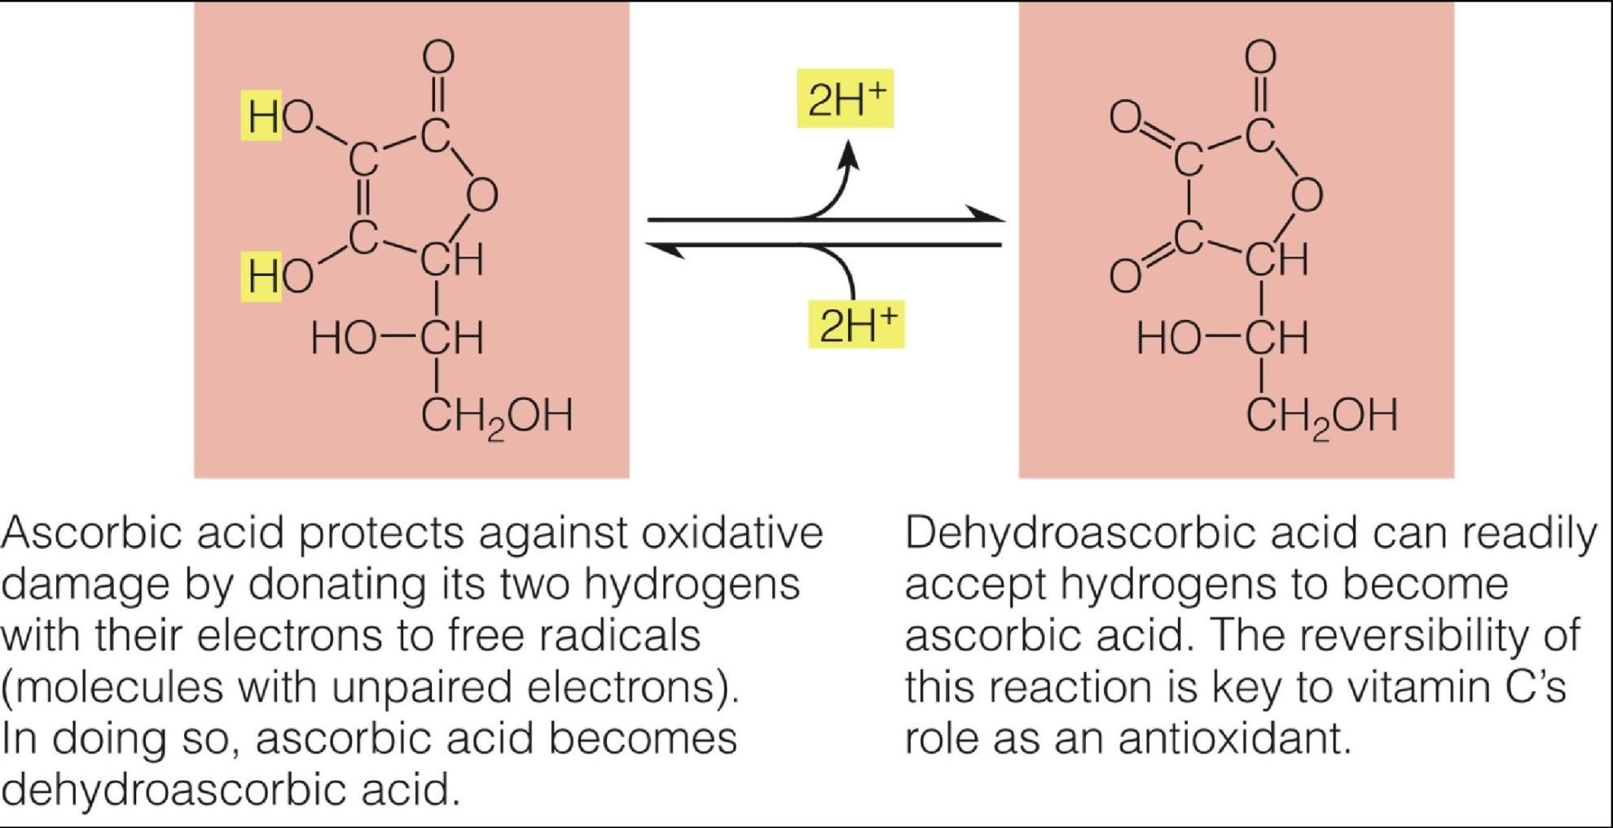

Slide 175
Food sources
Found in citrus fruits, cabbage -type vegetables , dark green vegetables, strawberries, lettuce, tomatoes, potatoes, papaya, mangoes
Vegetables and fruits should not be left soaked in water for a long time since it is soluble in water
Cooking itself destroys about half of the vitamin C present in the food
The best way to make sure of a regular intake of vitamin C is to eat raw fruits or salad every day.
It is also sensitive to oxygen

Slide 176

Vitamin C deficiency
Notable signs of deficiency:
Swollen and bleeding gums, minute haemorrhages (bleeding) in the skin, and slow healing of wounds.

Slide 177
Vitamin C deficiency .....
Scurvy
First found among sea men who stayed on the sea for long time
Manifestation
  Muscle weakness , swollen gum , loss of teeth, painful joints
  Impaired wound healing
  Easy bruising
  Anaemia

