Slide 1

to my course
I hope we will have
a great time!!!

Slide 2
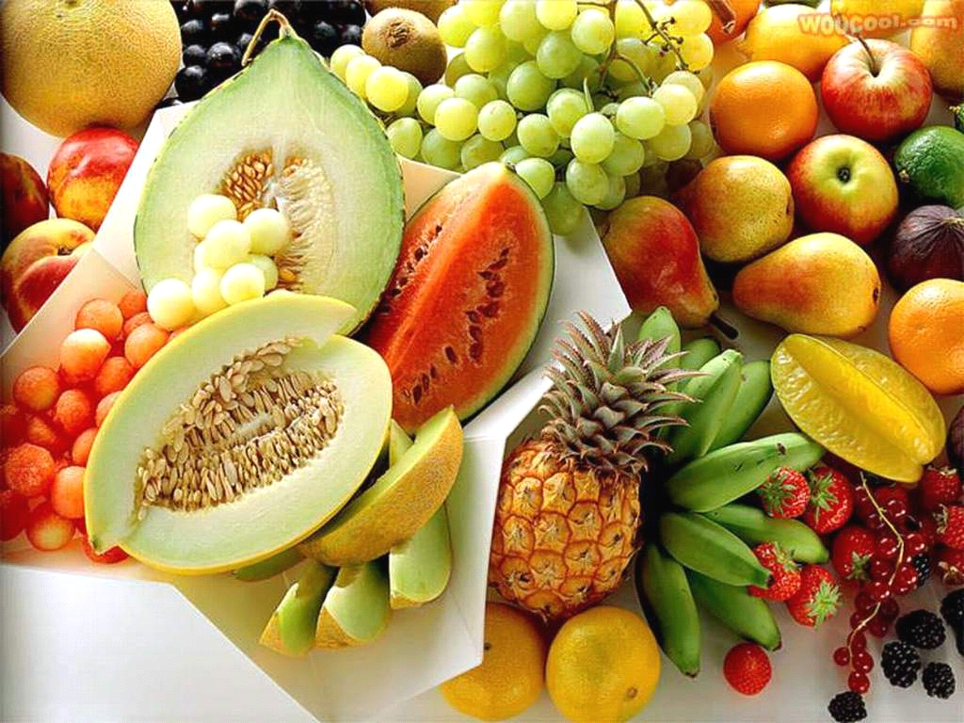
Postharvest physiology and handling of Horticultural crops
By Hulushum w.

Slide 3

Self-Introduction
Hulushum Woreta
Educational background
  Horticulturist
  B.Sc

Slide 4



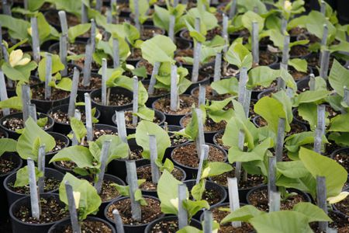
Work Experience
Laboratory /technical assistant

Slide 5
  Class Ground Rule
Punctuality (5min)
Active participation (class +outside class work)
Respecting others idea
Regular class +practical session attendance (>90%)
Mobile silent mode
Side talks (only allowed during discussion)
Having notebook & pen
Energizer

Slide 6
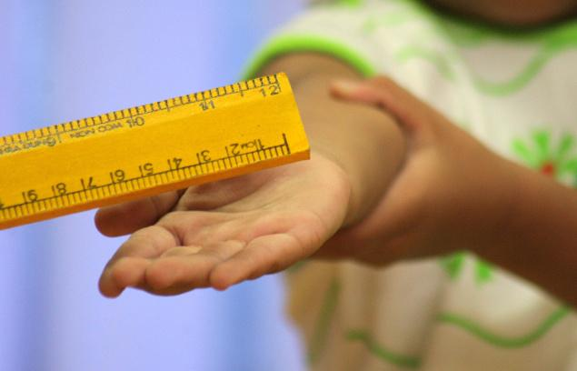
  Punishment
Dancing
Signing
Telling jokes
Cleaning blackboard
Mark (serious case)
My contact
e-mail:- hulushumworeta@gmail.com
My office: B-3, Office No. 22

Slide 7


Chapter learning objectives
After studying this chapter, student should be able to:
Define postharvest physiology and technology
Recognize basic concepts of postharvest physiology
Differentiate the relationship between horticultural crops & postharvest physiology
Explain the significance of post harvest technology
Discuss structure of hort. Crops in r/n to postharvest
Session date =
Session time =
Session Venue: plsc. Class room

Slide 8

Chapter content
1.1. Basic concept of postharvest
1.2. Definitions of PH physiology & technology
1.3. Nature of Hort. Crops
1.4. Importance of PH Handling
1.5. Structure of hort. Crops

Slide 9


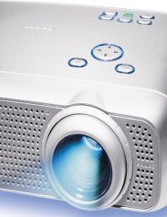
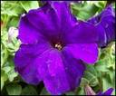
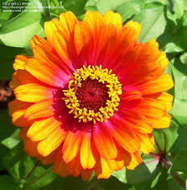
Methods of teaching
Interactive lecture
Group/pair discussion
Question & Answer
Materials
LCD projector
Books (Post harvest.)
Visual aids /teaching material
Assessment
Observation, home take reading
Q & A

Slide 10
Terminology and definitions
Postharvest physiology
the division of plant physiology dealing with functional processes in plant material after harvest.
concerned with plants or plant parts that are
handled and marketed in the living state including
seeds, fruits, vegetables, cut flowers and foliage nursery products, etc.
Postharvest
refers to the time period from harvesting or removal of the plant from its normal growing environment to the time of ultimate utilization, deterioration or death.

Slide 11
Contd…
Post harvest loss
is any change in quantity or quality of a product after harvest
that prevents or alters its intended use or decrease its value
Postharvest technology
all aspects activities/methods used for quality maintenance,
loss reduction, extend shelf life,
value enhancement and by product utilization of the harvested produce.

Slide 12
Differences between durables & perishables
Durables
Perishables
Perishables
Perishables
Low moisture (10-15%)
Small unit size (<1kg)
Very low respiration rate with very small heat generation
Hard texture, not easily damaged
Stable, natural shelf life of several years
Loss mainly caused by external agents, e.g. Molds, insect & rodents
High moisture (50-90%)
Large unit size (up to 5kg or more)
High respiration rate, with high heat production
Soft texture, easily damaged
Short shelf life
Loss caused by both external (diseases, insects, damage) & internal agents (respiration, senescence and sprouting)

Slide 13
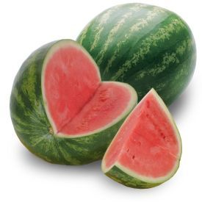
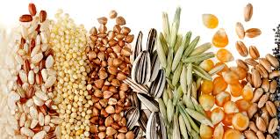
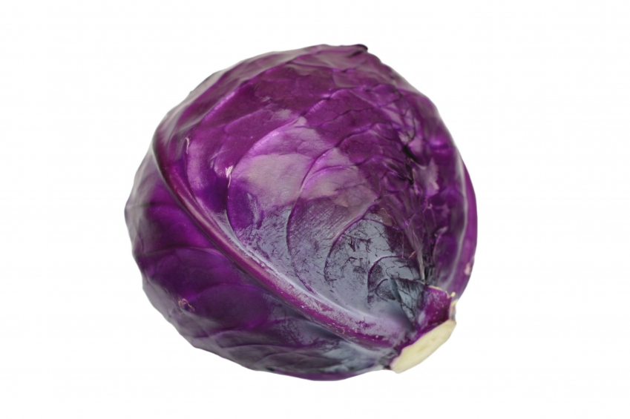
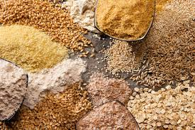
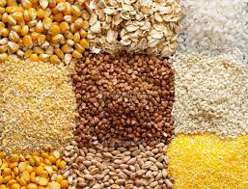
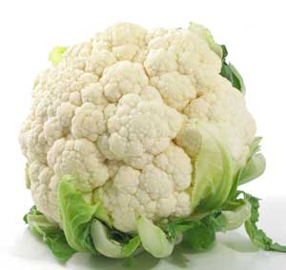
perishables
Cereal crops

Slide 14
Structure of hort. Crops
The physiological changes that take place on harvested products
The way to handle the products depends on the material harvested
Based on structure, horticultural products are categorized as leaves, stems, flowers, fruits, and below ground structures (roots, bulbs and tubers)

Slide 15
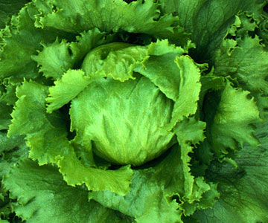
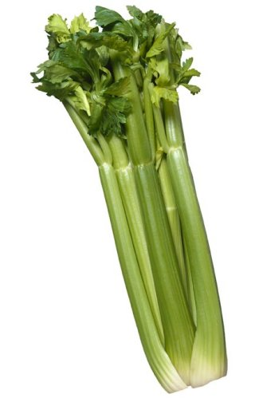
i. Leaves
Harvested leaves of vegetables like spinach, cabbage, lettuce, celery, leek, and onion widely used as food.
When the leaves are on intact plant, they play important role in carbon fixation (photosynthesis) and transpiration (control loss of water and heat removal).
At harvest
  carbon fixation stopped
  stomata closed and
    the continued survival of the leaf depends on the energy and water already present in the leaf.

Slide 16
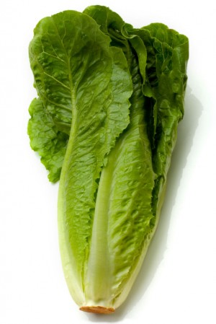
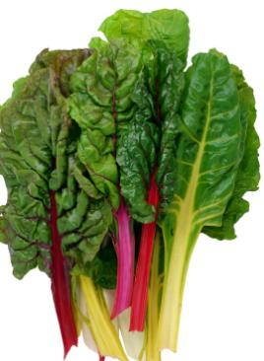
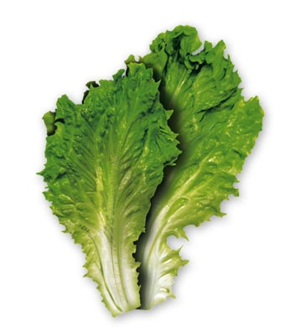
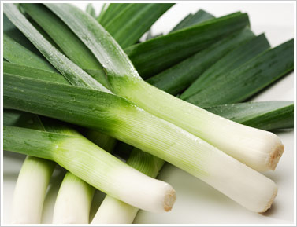
Leaves of most species do not act as long term reserves because of rapid respiration and water loss;
  leaf area is large and
    the harvested material is exposed to sunlight
    water easily evaporate
    which lead to rapid deterioration of the products quality.

Slide 17
ii. Stems
Some vegetables like asparagus (sprouted stem), Brussels (auxiliary buds) and Sugar cane (true stem) have edible stems
these stems are
  young tissues,
  metabolically active
  and it has continued development after harvest.

Slide 18
iii. Flowers
Flowers are composed of compressed shoots that are adapted for reproduction.
Plant breeders have produced various vegetables with dense massed flower heads that can be eaten when the flowers are immature buds.
Flowers of Cauliflower, Broccoli, Artichoke and many ornamentals served as a food.

Slide 19
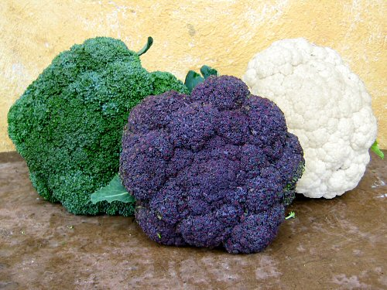
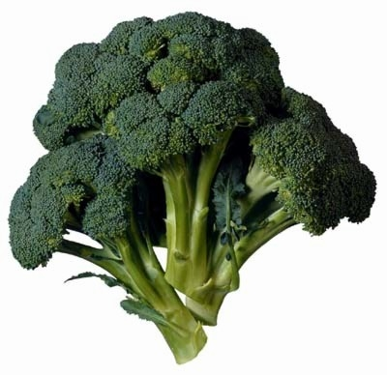

Slide 20
Flowers postharvest handling is very difficult because:
  they have little reserve food;
  contain diverse, young and meristematic parts that affect their postharvest life;
  are meant to live for a short period (source of water and reserves for flowers are stems and leaves attached with flowers).

Slide 21
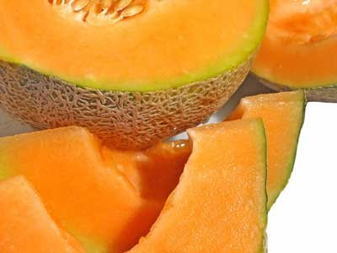
iv. Fruits
Fruit is mature ovary with a number of associated parts. It can be categorized in to:
Fleshy fruits: example Banana, Papaya
Dry fruits: they release their seeds after their
external cover is removed. Example, nuts
Vegetable fruits: they are treated as vegetables
The postharvest behaviour is also
different in each category.

Slide 22
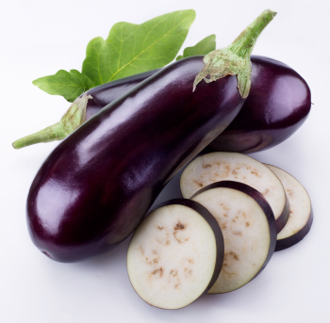
Fleshy fruits: can be classified as
Climacteric fruits: - have the potential to ripen after harvest. Example: Banana, Tomato
Non-climacteric fruits:
must be harvested when they are completely ripe
Example: Citrus, Avocado.

Slide 23
Below ground structures (roots, bulbs and tubers)

Slide 24
Composition of fruits and vegetables
Water
the most abundant constituent and ranges from 65% - 95%.
important component of product quality which maintains turgidity, freshness, firmness, and succulence of the harvested product
part of the weight of the produce and
quantitative loss will happen when the water content of the produce reduced

Slide 25
Contd…
Carbohydrate
are forms of stored energy reserves
the most abundant biochemical constituents,
representing (50 - 80%) of the dry weight & (2% - 40%) of fresh produces
can exist in different forms
Simple sugars: - such as, glucose, sucrose, and fructose; (<1%) concentration.
have sweet flavour and very important components of quality.

Slide 26
Simple sugar contd…
Starch:- is made up of glucose subunits (200 – 200,000 units) and serve as storage of carbohydrates in vegetables, Cassava, Yam, plantain, potato, sweet potato, inset, and unripe fruits like banana
iii. Dietary fiber: exist as cellulose, hemicelluloses and pectin substances, which makes the structural components of fruits and vegetables cell wall.
These carbohydrates are not digested by human beings because of the absence of the enzyme/cellulase/ in the digestive system of humans

Slide 27
Composition contd…
Protein and Amino acids
The protein content in horticultural products varies between 1–2%, about 5% in legumes.
The relative change in the protein and amino acid content and composition in harvested plants is greatest in perishable parts.
Hence, products such as seeds, which are relatively stable physiology when properly stored, do not undergo substantial changes in their protein compositions.

Slide 28
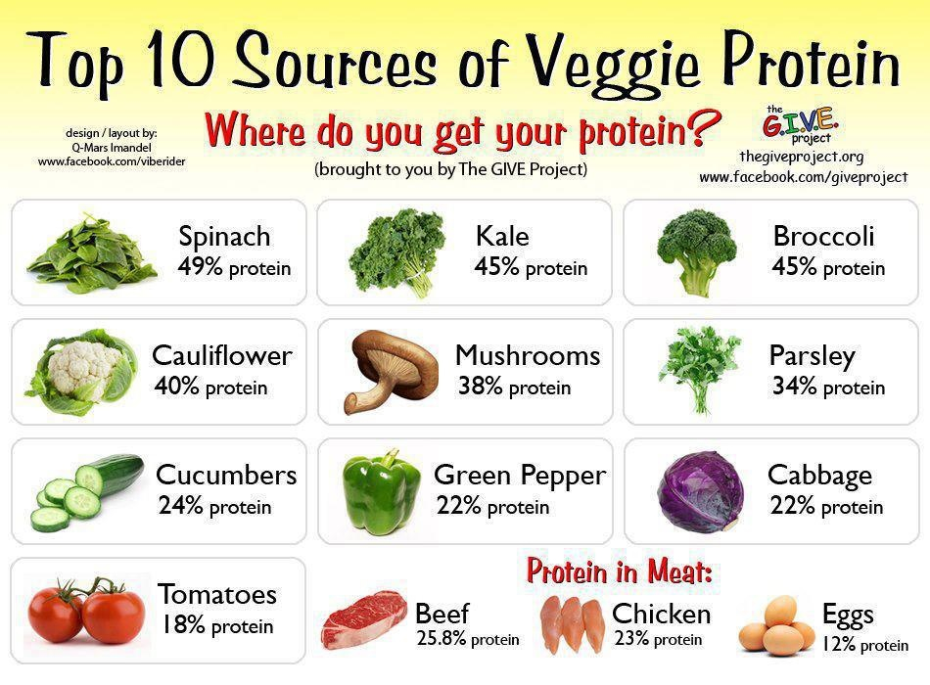
Vegetables with higher source of Protein

Slide 29
Contd…
Lipids
Are organic fats composed of fatty acids.
Fruits like avocado and olives contain high concentration of lipids (15 – 20%) and many seeds in the form of storage compounds.
Plant lipids serve as storage form of carbon, and functions as components of cellular membranes & cuticular waxes.
Among the lipids, waxes, cutin and subrin are the protective compounds of the outer surface of plants.
Waxes and cutin acts as protective coating on above ground parts where as subrin; found on underground plant part and on healed surface of wounds.
Waxes are extremely important during postharvest storage; limit water loss from tissue and impede the invasion of pathogens.

Slide 30
Contd…
Vitamins
Vitamins are groups of organic compounds required relatively in small amount for normal metabolism and growth.
Plant products provide major source of the vitamins required by the humans.
Exception would be B_{12,} synthesized only by microorganisms, and vitamin D, obtained from ultraviolet irradiation

Slide 31
Table 1.1. Important vitamins derived from fresh produces
Vitamin | Name | Source
A | Retinol | From carotene in dark green leaves, tomato, carrot, papaya, sweet potato
B₁ | Thiamine | Pulses, green vegetables, fruit cereal grains
B₂ | Riboflavin | Green leafy vegetables and pulses
B₆ | Pyridoxine | Bananas, peanuts
PP | Niacin (nicotinic acid) | Pulses, peanuts
- | Folic acid | Dark green leaves, broccoli, spinach, beets, cabbage, lettuce, avocados
C | Ascorbic acid | Dark green leaves, spinach, cauliflower, sweet pepper, citrus, guava, mango, papaya

Slide 32
Contd…
All vegetables and fruits contain important minerals, such as potassium, calcium, magnesium, phosphorus, iron, and zinc.
Minerals are basic components in metabolic pathways that produce valuable phytochemicals for normal human health.
The contents of minerals in vegetables is variable; green vegetables have higher amounts of calcium and iron than root vegetables.
Calcium is not only associated with preventing osteoporosis, but also appears to have protective effects in some types of cancer, most recently colon cancer.

Slide 33
Contd…
Organic acids
Organic acids are major components of fruits and some vegetables.
The acidity of fruits arises from the organic acids that are stored in the vacuole, and their composition can vary depending on the type of fruit.
In general, young fruits contain more acids that may decline during maturation and ripening due to their conversion to sugars (gluconeogenesis).
Organic acids are present in a significant concentration in a number of harvested plants, and the level of organic acids present often represents important quality parameters in many fruits

Slide 34
Contd…
Volatile compounds
are gaseous at ambient temperature.
They are sources of aroma of foods, ornamental and floral species.
Include esters, lactones, alcohols, acids, aldehydes, ketones, acetyls, hydrocarbons, and some phenols, ethers.
Volatile compounds synthesized in three different ways.
1. Naturally by enzymes found within tissue, creates odour of fresh fruits, vegetables and flowers.
2. Enzymatically during damage to the tissue of the product.
3. Direct chemical reactions (heating, cooking, during processing).
Synthesis and degradation of volatiles will continue after harvest, but it is not desirable and lead to quality deterioration.

Slide 35
Contd…
Plant pigments
Plant colours are due to the presence of pigments within the plants and their interaction with sun light.
Plant pigments includes chlorophyll, Carotenoids, Flavonoids e.t.c.

Slide 36
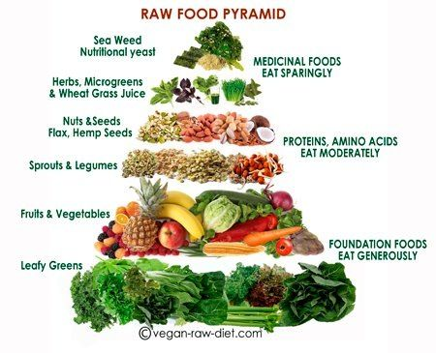

Slide 37

1.4. Importance of Post-harvest Handling
Activity 1.1. Why the study of postharvest physiology & technology of horticultural crops is so important?

Slide 38

High value crop (nutritional importance)
Economic advantage
Perishables & short shelf-life
Living after harvest
Quantity and quality of food supply will be maintained.
Reduce postharvest loss
Medicinal value (vitamins, minerals, fiber)

Slide 39
The needs of postharvest management
For two main reasons
Biological reason
harvested products continue to metabolize after they have been harvested.
The biological activities between harvested and unharvested products are not the same.
Respiration in harvested products may result in depletion of reserve materials in the harvested part and cause in reduction of utilized parts.
Therefore proper management is mandatory.

Slide 40
Needs of management contd…
Economic reason
If farmers /producers have got the mechanism to keep the products for long period during the time of surplus,
they can sell the products when there is good price.
This mechanism can also helpful to avoid market fluctuation

Slide 41
Chapter two
Physiological aspects of produce in relation to postharvest

Slide 42

Chapter learning objectives
After studying this chapter student should
be able to:
Differentiate between stages of growth
Comprehend different physiological processes of harvested materials
Explains the relationships between respiration, shelf life and quality
Identify the role of transpiration and quality of horticultural crops
List factors affecting respiration and transpiration
Recognize the role of phyto-hormones to post harvest
Explain fruit ripening and its process

Slide 43

Content
  2.1. Growth & development
  2.2. Respiration
    Significance of respiration in postharvest biology
    Factors affecting respiration rate
    Control measure to minimize respiratory losses
  2.3.Transpiration
    Water and postharvest life
    Factors that affect transpiration
    Methods of controlling transpirational losses
  2.4. Role of phyto-hormones to PHP
  2.5. Fruit ripening

Slide 44
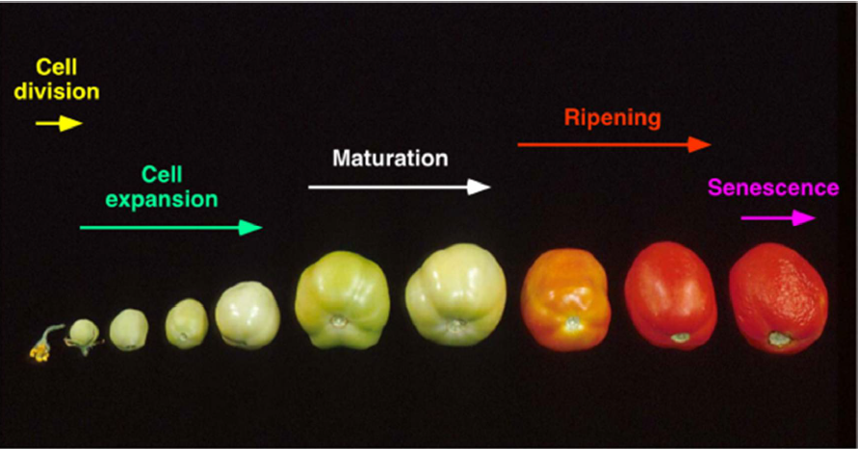

Slide 45
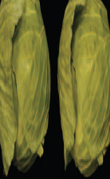
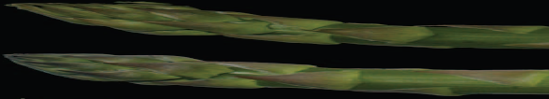

3.1. Growth & Development
Growth: - the time of active cell division and enlargement which leads to increase in size or volume.
Maturity: - the time period when the plant has completed its active growth (vegetative stages, stages of flowering and seed production) stages.

Slide 46
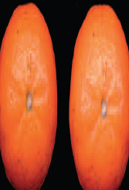
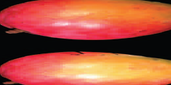


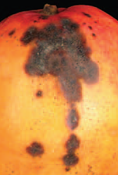

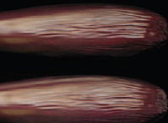
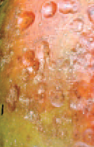
Ripening: - the developmental stage of fruits and vegetables which is characterized by a series of diverse physical and chemical changes and follows maturation.
Senescence: - refers to the time when a series of deteriorative changes occur leading to the natural death of the plant

Slide 47
Growth and development
  Growth: an irreversible increase in number and size of a cell, organ or organism & it is not uniform in living organisms throughout the life span.
it may be fast at some stage, slows down and stops at a particular time; later in life death occurs.
Growth in plants is indeterminate and localized (meristem cells present at specific site): plants keep growing as long as they live.
Development is associated with morphogenesis and differentiation.
  Morphogenesis - development of shape and structure of an organism; and
  Differentiation - change in cells, tissues or organs to carry out different functions.
Hence, development is a series of changes such as growth, differentiation and maturation, which an organism undergoes throughout its life.

Slide 48
  Phases of growth:
Lag Phase – This is the initial phase of growth when the rate of growth is very slow.
Log (logarismic) Phase – It shows rapid growth and is maximum for the entire life span.
Stationary Phase – Here the rate of growth starts decreasing and finally it stops.

Slide 49
Growth Curve

Slide 50
Contd…
Growth - involves cell division and subsequent cell enlargement, which accounts for the final size of the produce.
Maturation - usually commences before growth ceases and includes different activities in different commodities.
Growth and maturation are often collectively referred to as the development phase.
Senescence - is defined as the period when synthetic (anabolic) biochemical process gives way to degradative (catabolic) process, leading to ageing and finally death of the tissue.
Ripening - is a phase of qualitative change which occurs in fruits particularly, after completion of maturation, acceptable taste and flavour.
Ripening occur during the later stages of maturation and is the first stage of senescence.

Slide 51
Maturity Determination
Determination of maturity can be grouped into physical, chemical, physiological, computational, electronic etc. based on the principles used for measuring various parameters.
Physical methods – based on skin color, fruit shape, size, firmness, specific gravity, aroma
    Skin color: During maturity or ripening, fruits usually change their color from deep green to yellow, orange or red (Papaya, banana, mango..) etc.
    Shape: shape of fruits can change during maturation. E.g.: Banana becomes less angular.

Slide 52
Contd….
    Size: the fruit reaches its full size.
    Firmness: As fruits mature and ripen the tissues soften. The softening can be estimated by pressing with fingers or using a penetrometer.
Specific gravity: determined using the “weight in air and the weight in water method” as described by Fong and Redshaw (1973).
Sg = WA
WA- WW
Where; Sg = Specific gravity
WA = Weight in Air,
WW = Weight in Water
    As fruits mature their specific gravity increases.
    This method is rarely practiced.
    Aroma: Most fruits synthesis volatile chemicals as they ripen.

Slide 53
Contd…
ii. Chemical methods – based on the sugar, acid and starch content of fruits
Sugar: As the fruit ripens, starch is broken down to sugars. Amount of sugars indicate the stage of maturity or ripeness.
Sugar constitutes the major portion of soluble solids of the fruit juice. Measurement of total soluble solid (TSS) is done using refractometer.
2. Starch: Starch content in developing fruit of pear and apple provides harvest maturity.
3. Acidity: The acidity of much type of fruit changes during maturity and ripening.
In citrus, mango, pineapple and many other fruits acidity progressively decrease as the fruit matures on the tree.

Slide 54
Contd…
iii. Physiological methods – based on respiratory behavior of the fruits
Climacteric fruits: in which there is a distinct rise in respiration during ripening, can be sampled and kept at high temperature and respiration rate is measured.
Climacteric fruits are harvested at full maturity stage and ripen after harvest.
Maximum respiration starts immediately after harvest. E.g. apple, avocado, banana, mango, papaya, peach etc.
Non-climacteric fruits: Harvested at full ripening (90-95%) complete color development.
Rate of respiration is less than climacteric fruits. E.g. grapes, citrus fruit, pineapple etc.

Slide 55
Respiration
Respiration is the process by which stored organic materials (carbohydrates, proteins, fats) are broken down into simple end products with a release of energy.
Horticultural produces respire by taking up O₂, giving off CO₂ and heat.
C₆H₁₂O₆+ O₂ = CO₂ + H₂O + 682kc energy (heat)
Therefore, losses of stored food reserves (glucose) and moisture hasten senescence and thereby reduce food value, loss of flavor (esp. sweetness).
Before harvest, losses due to respiration and transpiration are replaced by flow of sap, which contain H₂O, photosynthates & minerals.
These functions continue after harvest, but the produce is removed from mother plant, thus entirely depend on own food reserves & moisture.

Slide 56
Contd…
In general, the rate of deterioration of harvested commodities is proportional to their respiration rate.
Commodities with high respiration rates will have short potential storage lives.
Commodities with low respiration rates will have long potential storage lives.
According to their respiration behavior during maturation and ripening, fruits are classified to either climacteric or non-climacteric.
Climacteric fruits – show a large increase in respiration and ethylene production during ripening.
Non-climacteric fruits – show no change in their generally low respiration and ethylene production rates during ripening.

Slide 57
Contd…
At last, respiration rates (and deterioration) varies among different types of commodities:
Storage organs (nuts, tubers) – have low respiration rates.
Meristem tissues (asparagus, broccoli) – have very high respiration rates.
Commodities harvested during active growth (spinach, green onions, bean sprouts) – have high respiration rates.
Mature fruit (citrus, grape) – have low respiration rates.

Slide 58
Significance of respiration in postharvest biology
A. Shelf life and respiration rate
Correlation between respiration,
postharvest life and quality

Slide 59
In general, there is an inverse relationship between respiration rates and the postharvest life of fresh horticultural crops.
The higher the respiration rate, the more perishable (shorter postharvest life) the commodity.

Slide 60
Factors affecting respiration rate
Which factors do you think can
affect respiration rate?

Slide 61
Several factors influence respiration:
Commodity
Temperature
Variety
Maturity
Climacteric behavior
Availability of oxygen
Presence of carbon dioxide
Ethylene
Other growth regulators
Other stresses (Stress, injuries, etc)

Slide 62
Internal:
Type of tissue or organ:
Leaves > fruits> roots.
Product size:
bigger size > respiration rate.
Stages of development:
young leaves >respiration.
In fruits will depend on their classification as climacteric or non-climacteric.

Slide 63
External:
Mechanical damage and product’s sanitary condition.
Temperature
Atmosphere composition
  Oxygen
  CO2
  Ethylene
Physical barriers
  waxes, plastic films, etc.

Slide 64
Temperature
It is the most important factor
Respiration involves many enzymes whose activity is influenced by temperature.
Limiting one enzyme affects the rest
Generally, for every 10⁰C increase in temperature, the respiration rate increases by twofold.

Slide 65
Commodity
Respiration rate differs for different commodities
In general, leafy & tender vegetables (spinach, peas, corn, broccoli) have very high rates of respiration
Sturdy vegetables like potato & onion have lower rate of respiration
Fruits with well developed skin (Apple, orange, melons, etc.) have lower rate than those with soft skinned (strawberry & raspberry)

Slide 66
The respiratory rate is generally high in the developing stage which generally decrease as the tissues matures
There are two types of fruits
  Climacteric fruits: Manifest appearance of CO₂ or ethylene peak coinciding with ripening or senesce (on or off the tree)
  Non-Climacteric fruits: are fruits that don’t show respiratory or ethylene peak

Slide 67
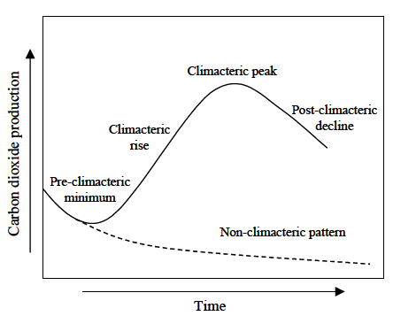

Slide 68
Availability of oxygen
Respiration can take place with or without O₂
But anaerobic respiration is undesirable because of off-flavor production
Oxygen levels higher than air (21%) don’t necessarily increase respiration rate while levels below 20% decrease the respiration rate
The minimum oxygen level necessary to maintain aerobic respiration in a storage chamber is called Extinction point (EP).

Slide 69
Storage chambers should have proper ventilation to maintain O₂ level above the EP.
Waxing alters the skin porosity and rate of diffusion of CO₂ and O_{2.}
The respiratory quotient (RQ) balance is maintained until O₂ reaching the EP level, but once below the EP, it results in a significant increase in the RQ.

Slide 70
Presence of CO₂
CO₂ is a product of respiration
Presence of excess CO₂ favors suppression of respiration
Generally, CO₂ concentration up to 5% has beneficial effects in reducing respiration
while at higher concentrations it also has fungicidal effect. However, the product must be tolerant to high CO₂ level. E.g. Strawberry.

Slide 71
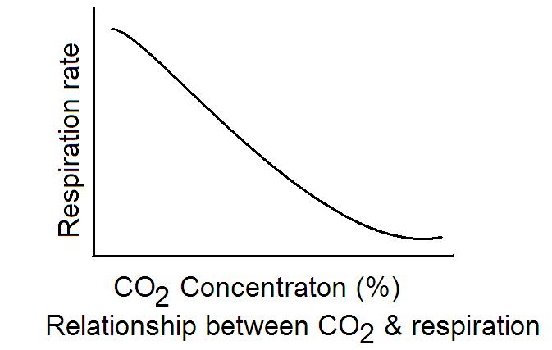

Slide 72
Ethylene
It is a very physiologically active compound even in trace amounts
It has profound influence on respiration rate & ripening of fruits
Commercially used as ripening agent
It is produced in trace amounts as a result of respiration

Slide 73
Growth regulators
Several PGR used pre and post-harvest application have influence on product quality and respiration rates
  Accelerated ripening (Alar)
  Higher yield & greater diseases resistance –GA
  Improved color-Alar
  Prevention of abscission-NAA
  Sprout inhibitor (MH)
  Fruit thinning (Ethephon)

Slide 74
Other stresses
Injury (Chilling injury, freezing injury, physical and mechanical damage) –results in hastening respiration rates.
  Isolated enzyme & substrates
  Contact is created
  Trigger various biochemical reactions
    Browning
    Softening of tissue

Slide 75
Mechanical damage during
the postharvest chain
Temperature - affects the degree of response/
severity of mechanical damage.
Compromise natural barriers -increasing water
loses and pathogenic infections.
Impact
Respiration
Ethylene
Time

Slide 76
    Control measures to minimize
    respiratory losses (Think-pair-share/10min)
How do you think we can
minimize respiratory losses to prolong
shelf life and maintain quality of
produces?

Slide 77
Control measures
Temperature
Harvest at cool times
Cool down & transfer produce to cold store as fast as possible
Maintain lowest permissible temperature
Maintain the cold storage properly (good air circulation & refrigeration)

Slide 78
Control measures
Temperature
Harvest at cool times
Cool down & transfer produce to cold store as fast as possible
Maintain lowest permissible temperature
Maintain the cold storage properly (good air circulation & refrigeration)

Slide 79
Product protection from sun heat (full sunlight) after harvesting.
Pre-cooling treatments to remove field heat.
Refrigeration.
Maintaining the cold chain.

Slide 80
A key factor affecting product deterioration rate.
is the most effective tool for extending the shelf life of fresh horticultural commodities.
Has a significant effect on spores germination and pathogenic growth.

Slide 81
Temperatures above or below the
optimal range, can cause product
deterioration due to:
Freezing.
Chilling injury.
Heat injury.
TºC

Slide 82
Freezing:
Freezing point of perishable commodities is relatively high (ranging from -0.3 - 0.5 º C).
Freezing produces an immediate collapse of tissues and total loss of cellular integrity.

Slide 83
Chilling Injury:
Some commodities (mainly tropical and sub-tropical) respond unfavorably to storage at low temperatures well above their freezing points, temperatures called the chilling threshold temperature or lowest safe temperature.

Slide 84
Heat injury:
Direct sources of heat can rapidly heat tissues to above the thermal death point of their cells, leading to localized bleaching or necrosis or general collapse.

Slide 85
Transpiration
Define transpiration.

Slide 86
Transpiration: in simple terms it means loss of water from the produce due to evaporation.
Moisture loss from the produce occurs in two ways
  Evaporation
  Vapor diffusion processes
Moisture

Slide 87
Transpiration is the second most important factor with respect to quality loss during storage and transportation
Transpiration contributes to cooling of the produce

Slide 88
Transpiration represents economic loss
  3-4%moisture loss can make the produce unsalable
  Actual moisture loss that commodities can withstand varies from
    3% for leafy vegetables to
    5% for common vegetables to
    About 10 % of onions

Slide 89
In addition, transpiration can result serious quality loss
  Appearance
  Texture
  Flavor
Wilting, shriveling, shrinkage, drying, dehydration, desiccation, etc are results of transpiratory activity

Slide 90
Transpiration occurs through specialized tissues
  Gas & water from fruits and vegetables exchange occurs through specialized surface structures
    Stomata, guard cells, lenticels, cuticle, cuticular membrane, corky tissue & suberin
    Leaves may contain as many as 50,000 stomates per cm² while orange peel may contain about 1500 stomates per cm².

Slide 91
Factors influencing transpiration
Surface characteristics
  Surface area to volume ratio
Humidity
Water vapor pressure (wvpd), temperature
  At any given temp (air or produce), transpiration increases as the RH (wvp) of the air decreases as there is increased wvpd.
  At any given temp of the produce and a given RH of air, lower air temp (lower than produce) will have a high initial transpiration rate (larger wvpd).

Slide 92
Respiration
Respiration produces heat and moisture
The heat if not removed efficiently, can rise the produce temperature and hence its transpiration

Slide 93
Air Movement
Air movement assists in better heat transfer to effectively transfer the heat of respiration and any sensible or field heat associated with the produce.
On the other hand, promotes the mass transfer in terms of removing moisture transpired by the produce from its neighbor.
This results in further transpiration

Slide 94
Physical/Mechanical damage
  Wounds, cuts etc caused mechanical or physical damages increase the transpiration rate because
    They expose the cellular components directly to the environment without the normal protection that was previously offered by the protective tissue

Slide 95
Methods of controlling transpirational losses
Maintain as high RH in the chamber as possible.
  For this, several techniques (humidification, jacketed storage) are employed
Maintain a low temperature difference between the produce and the cooling coils.
  This will reduce the chances of the cold air being cooled below its dew point.
  This is achieved by maintaining large cooling surfaces, better refrigeration capacity, moderate high air speeds, proper stacking of produce, and prompt pre-cooling of produce prior to storage

Slide 96
3. Protect from mechanical and physical injuries
4.Regulate moisture loss by controlling the permeability of the produce tissue.
  Primarily this is achieved by waxing (apples, citrus, cucumber, bell pepper, banana, etc)
  A good wax should have low toxicity, rapid drying characteristics, strong adherence characteristics, high gloss and low cost.

Slide 97
5. Prepackage in polymeric films
  The produce is allowed to transpire to accumulate the moisture to the maximum level which will automatically suppress the subsequently transpiration.
6. Curing
7. Wetting floors in storage rooms.
8. Adding crushed ice in shipping containers.
9. Sprinkling produce with sanitized, clean water during retail marketing of the product.

Slide 98
Fruit ripening
Ripening is the process by which fruits attain their desirable quality; flavour, colour, palatable nature and other textural properties.
Ripening of fruit undergoes many physico-chemical changes that determine the quality
On the basis of ripening behavior, fruits are classified as climacteric and non-climacteric fruits.

Slide 99
Climacteric fruits
Fruits that enter ‘climacteric phase’ after harvest i.e. they continue to ripen.
During the ripening process the fruits emit ethylene along with increased rate of respiration.
Ripe fruits are soft and delicate
These fruits are harvested hard and green, but fully mature and are ripened near consumption areas.
Small dose of ethylene is used to induce ripening process under controlled temperature & humidity.

Slide 100
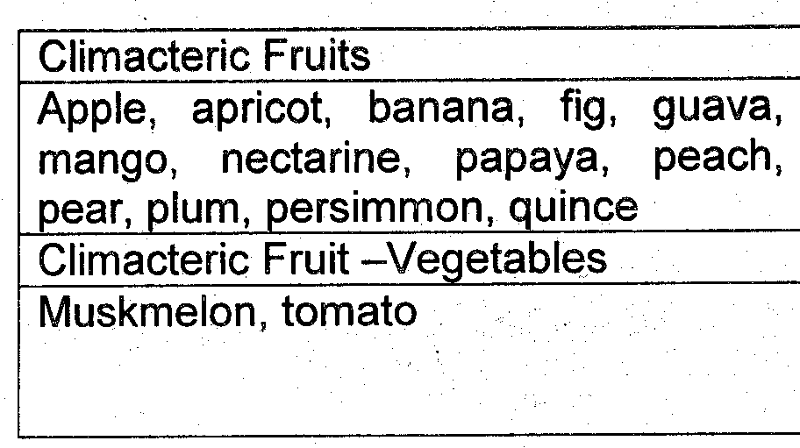

Slide 101
Non-climacteric fruits
Non-climacteric fruits once harvested do not ripen further.
Non-climacteric fruits produce very small amount of ethylene and do not respond to ethylene treatment.
There is no characteristic increased rate of respiration or production of carbon dioxide.

Slide 102
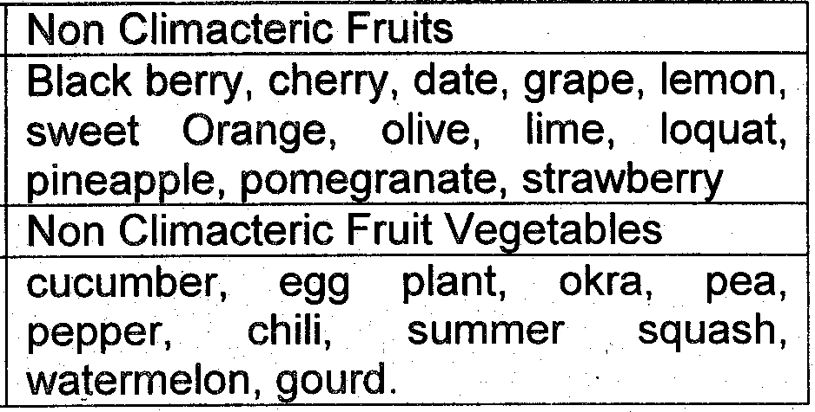

Slide 103
Ripening process
Series of non reversible changes in the fruit & they transformed non-edible fruits into edible one.
  Physio-chemical changes
  Respiration
  Hormonal changes

Slide 104
ethylene
The hormone______________ initiates the ripening response:
Unripe Fruit
Ripe Fruit
physical condition
chemical cause
Enzyme Produced
chemical cause
physical condition
green
chlorophyll
hydrolase
anthocyanin
red
hard
pectin
pectinase
less pectin
soft
sour
acid
kinase
neutral
neutral
mealy
starch
amylase
sugar
sweet + juicy
odorless
large orgs
hydrolases
small orgs
odor

Slide 105
Physio-chemical changes
Seed maturation
Softening
Change in respiration rate
Change in pigmentation and composition
Change in the level of hormone.

Slide 106
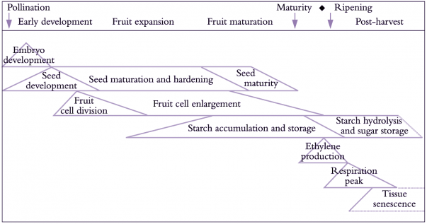

Slide 107
i. Softening/textural change
It affects the edibility of the fruit & duration handling
It may be essential or detrimental (in fruits which are consumed in unripe state like cucumber, squash)
It is the beginning of senescence and if it is beyond the limit, it leads to loss of quality

Slide 108
Resulted in b/c of hydrolysis of cellulose, hemicelluloses, and pectin substances by enzymes
  Enzymes that can break down polymers to monomers that can be absorbed.
    Starch – requires amylase
    Cellulose- requires cellulase
    Pectin- pectinase, etc.

Slide 109

ii. Change in composition:
A series of compositional changes takes place during ripening
Conversion of starch into sugar
Develops sweetness of the fruit and increase quality
  b/c the glucose served as a precursor for the synthesis of flavour and aroma elements
In some fruits, total conversion of starch into sugar is take place
E.g. Banana
 | Starch | Sugar
Mature/green | 20 – 30% | 1%
During ripening | 1% | 14 – 15%

Slide 110
The highest amount of sugar present in the fruits after it has been harvested is attained in different ways
Climacteric fruits
Sugar content increased after harvest due to hydrolysis of starch present in the fruit
Non-climacteric fruits
Harvested when they are fully ripe
The increased sugar content in the ripened fruit is attained through transport from the mother plant

Slide 111
b. Change in the level of organic acids
The level of OAs during ripening decreases except in banana and pineapple
The reduction of OAs during ripening is due to
  utilization of acids as a respiratory substrate
  served as C-skeleton for the synthesis of new molecules.

Slide 112
Most fruits & Vegetables contain organic acids in excess of the requirement of TCA & other metabolic pathways
The excess is stored in vacuole
  Lemon
  Passion fruit

Slide 113
The dominant acids are:
  Citric acid (Citrus)
  Malic acid (Banana)
  Others are:
  Tartaric acid (Grapes)
  Oxalic acid (Spinach)
  Iso-citric acid (Black berries)

Slide 114
Organic acids have biochemical importance
Also contribute to the taste, particularly of fruits
  The balance between sugar and acids gives rise to the desirable taste of specific produce

Slide 115
Some fruits & vegetables in which citric & malic acids are the major acids present
Citric Acid
    Berries
    Citrus
    Guava
    Pear
    Pine apple
    Tomato
    Beet root
    Leafy Vegetables
    Legumes
    Potato
    plum
Malic Acid
    Apple
    Banana
    Cherry
    Melon
    Onion
    Broccoli
    Carrot
    Celery
    Lettuce

Slide 116
c. Change in pigmentation
Colour is used as
  an index for the degree of ripeness (e.g. Mango, tomato, papaya and banana)
  a criterion in determining ripening by consumers.
Colour change occur during ripening due to two processes
i. Unmasking of already existing colours
Chlorophyll is degraded by the enzyme chlorophylase
Carotenoids (responsible for orange and red colour)
Anthocynins (responsible for pink, red, purple or blue colours)
  become unmasked and reflect new colour of the product

Slide 117
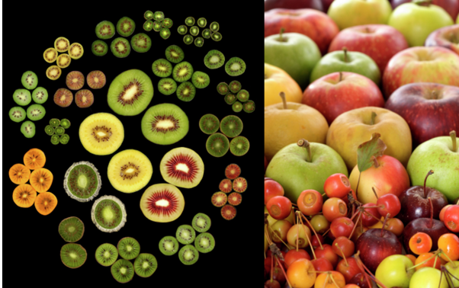

Slide 118
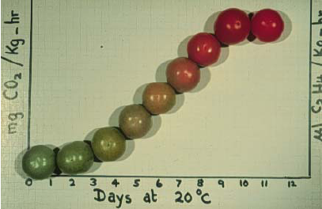
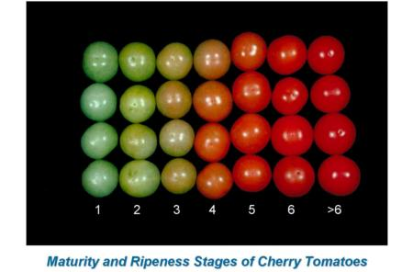
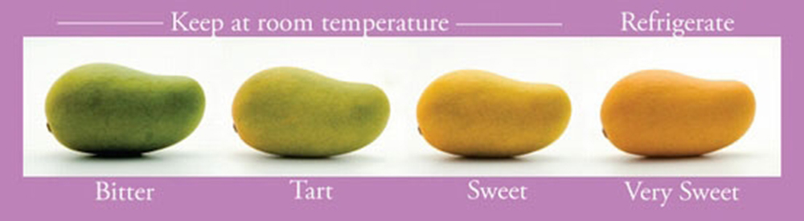

Slide 119
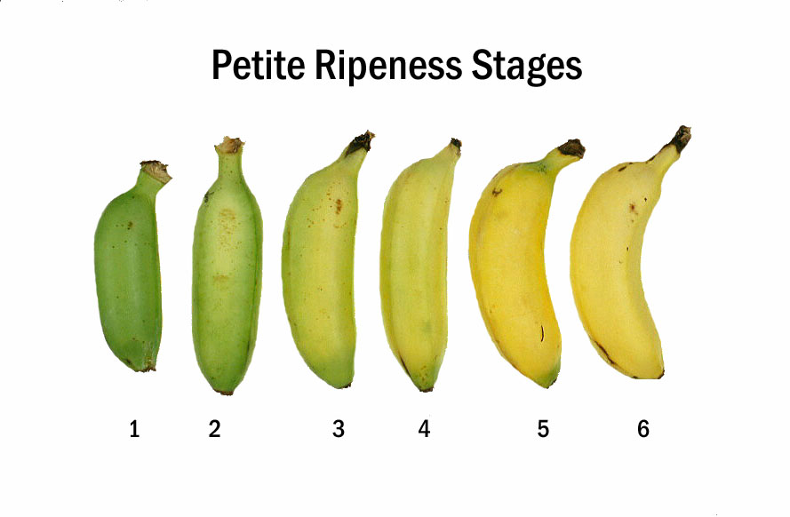
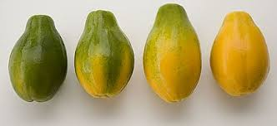

Slide 120
ii. Synthesis of new pigments
Some fruits like Avocado and Apple retain their colour during ripening through synthesis of new pigments
Climacteric fruits have the ability to develop their colour after harvest (Tomato, Banana)
Non-climacteric fruits can’t develop colour after harvest

Slide 121
Summary (30min)
Differentiate between stages of growth
Comprehend different physiological processes of harvested materials
Explains the relationships between respiration, shelf life and quality
Identify the role of transpiration and quality of horticultural crops
List factors affecting respiration and transpiration
Recognize the role of phyto-hormones to post harvest
Explain fruit ripening and its process

Slide 122
Chapter 3. Major Causes of Postharvest Losses

Slide 123
Session date =
Session time =
Session Venue: plsc. Class room
Chapter learning objectives
At the end of this chapter students will be able to:
Define postharvest loss, food loss & waste
Estimate extent of postharvest loss of perishables
Describe the consequences of loss
Discuss the natures & causes of post harvest losses
Recognize PH loss assessment

Slide 124
Chapter Content
3.1. Introduction
3.2. Definition
3.3. Extent and types of post harvest losses
3.4. Consequences of postharvest loss
3.5. Causes of postharvest losses
3.6. Postharvest loss assessment

Slide 125
Methods of teaching
Interactive lecture
Group/pair discussion
Question & Answer
Materials
LCD projector
Books (Post harvest.)
Visual aids /teaching material
Assessment
Observation, Market
assessment, home take reading
Q & A

Slide 126
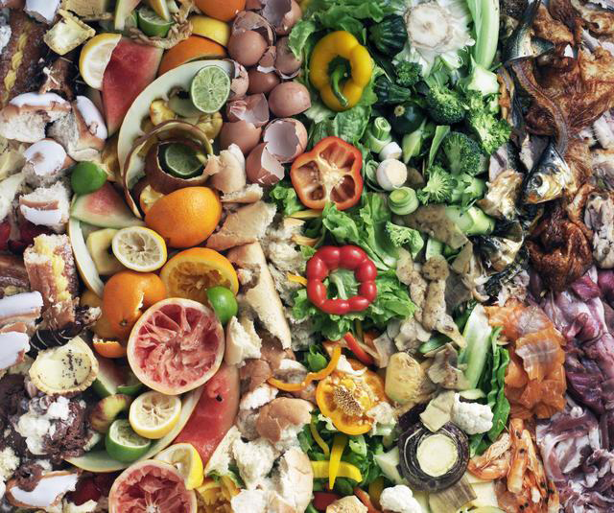

Slide 127
4.1. Introduction
Food security : global top priority (zero hunger challenge)
870 million people are chronically undernourished => 12.5% of the world population or 1 in 8 people (FAO, 2012).
1.3 billion ton of food is never consumed => 1/3 of all food produced (FAO, 2011).
In 2050 there needs to be enough food for the world population estimated to be 9 billion people by then ?????

Slide 128
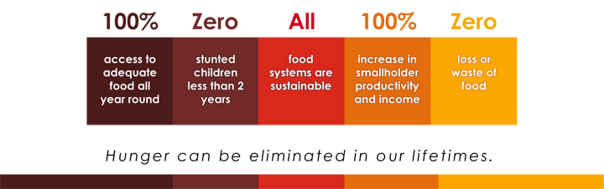
Food security : global top priority (zero hunger challenge)

Slide 129
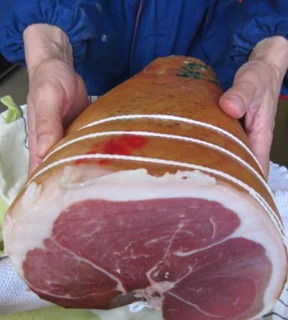
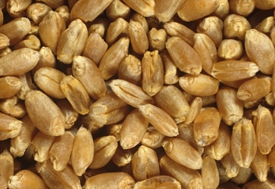
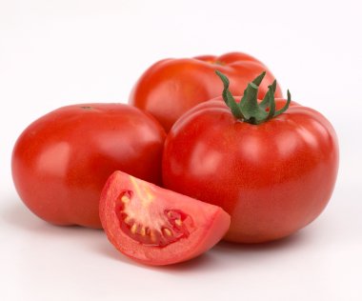
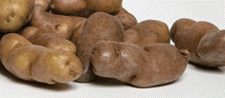
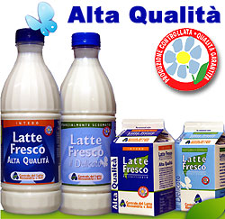

Global Food Losses and Food Waste
The current situation
1.3 billion ton
( 1 300 000 000 000 kg )
1 / 3
Roughly 50% of this happens in
developing countries

Slide 130

Activity 3.1. Differentiate between Food loss and waste

Slide 131
Food losses (supply side):
decrease in edible food mass or its nutritional value throughout the part of the supply chain that specifically leads to edible food for human consumption;
takes place at production, postharvest and processing stages in the food supply chain.
Food waste (demand side):
food losses occurring at the end of the food chain (retail and final consumption);
relates to retailers’ and consumers’ behavior.

Slide 132
3.2. Definition
Activity 3.2. What is Post harvest loss?
When do we say a given perishable crop is lost?

Slide 133
Post harvest loss is any change in the quantity or quality of a product after harvest that prevents or alters its intended use or decrease its value.

Slide 134
Losses can occur at any stage after harvest
Activity 3.3. Where is the beginning of
postharvest loss?
Culling after harvest
Field and packaging house grading
Storage loss
Transit loss
Retail loss
Consumer loss
The best quality goes to the market
The poor quality goes to waste and some part to secondary market

Slide 135

Bourne's graphic representation of the food pipeline (1977)

Slide 136
Ramswamy (2009)

Slide 137

Extent & types of post harvest losses
Activity 3.4. How big is the extent of post harvest loss?

Slide 138
Post-harvest losses vary greatly across commodity types, with production areas and the season of production. (How???)
Only rough estimates are available
5 to 25 % in developed countries
20 to 50 % in developing
In Ethiopia, some perishables have shown up to 80% loss
Loss of product = much more than just the cost of the commodity

Slide 139


Slide 140





Slide 141


a
b

Slide 142



Slide 143


Slide 144
Types of post harvest losses
The types of postharvest loss could be:
Quantitative loss:- complete physical loss or loss of weight or volume
Qualitative loss:- loss of nutritional value, sensory/change in aroma, flavour, color, texture and freshness
Economic/marketability loss

Slide 145
Consequences of postharvest loss
Food security
Nutrition, food quality and safety
Economy and distribution
Environment

Slide 146

Economic and food crises → (moral) obligation to save on use of scarce resources and to avoid waste

Slide 147

Pollution

Slide 148

Causes of postharvest losses
Activity 3.5. What are the major causes of loss after harvest? (Discuss in Group)

Slide 149
Bourne (1977), Salunke & Desai (1989)
Primary causes
Biological & microbiological-consumption or damage by insects, pests, animals and microorganisms, i.e. molds and bacteria
Chemical and biochemical-(undesirable reactions between chemical compounds present in the food such as browning, rancidity, enzymatic changes, etc.)
Mechanical-(Spoilage and damages caused by abrasion, bruising, crushing, puncturing, etc.)

Slide 150
Diseases and insect-pests
Fresh produce can become infected before or after harvest by diseases widespread in the air, soil and water.
Post-harvest diseases can also be spread by:
  Field boxes contaminated by soil or decaying produce or both.
  Contaminated water used to wash produce before packing.
  Decaying rejected produce left lying around packing houses.
  Contaminating healthy produce in packages.

Slide 151

Chapter 4. Postharvest handling to maintain quality
  Chapter outline
Harvesting and field handling
Temperature management
Relative humidity management
Common packinghouse managements
Packaging materials

Slide 152
Learning objectives
At the end of this section students will be able to:
Understand and apply post harvest handling and management practices to maintain quality
Contents
  Pre-harvest and harvesting management
  Temperature & Relative humidity management
  Common packing house management
  Storage
  - In ground storage - Low temp. ventilated storage
  Ice refrigeration - Mechanical refrigeration
  Design construction & management of cold stores
  Controlled & Modified atmospheric storage
  Hypobaric (sub atmospheric) storage
  Processing and preservation

Slide 153


Slide 154
Introduction
The rate of postharvest deterioration is
influenced by:
• Temperature/Time
• Relative humidity
• Atmospheric composition
• Ethylene
• Diseases
• Etc.

Slide 155
Introduction contd….
Principles for effective postharvest handling
• Low temperature - Rapid cooling and maintaining produce at proper low temperature
• Avoid injury - Careful handling and proper protection
• High humidity – maintaining relative humidity at > 90%
• Avoid ethylene caused damage – proper ethylene
management
• Manipulate atmospheric composition – Lower oxygen
concentration and/or elevate carbon dioxide concentration
• Reduce postharvest diseases - Eliminate harmful pathogens
and control their damage

Slide 156
Postharvest Technology
• Technological innovations developed to maintain the freshness and quality of harvest
produces
-Temperature management
- Ethylene management
- Disease management
-Storage and Packaging technology and
-Humidity management
- Quality management

Slide 157
Handling
Handle with care => minimum injury occur => increase quality
Harvesting
Harvest is a specific and singe deliberate action to separates the food stuff with or without non edible portion from its growth medium.
E.g. - Plucking of F, V & Flowers - Reaping of cereals
- Lifting of fish from water
- lifting of tuber or roots from soil etc.
The most important factors for harvest are
when, how and where

Slide 158
Postharvest handling contd…
Postharvest handling is the stage of crop
production immediately following harvest, including
cooling,
cleaning,
sorting
grading
and packing
Crops destined for storage should be as free as possible from skin breaks, bruises, spots, rots, decay, and other deterioration.

Slide 159
Objectives of harvesting/grower
To harvest good quality crop in good conditions
To keep harvested produce in good conditions
To deliver the crop to a buyer as soon as possible
planning of harvesting
Once the objective is clearly distinct planning is needed
make contact with buyers
Organizing the harvest operations interms of time, labor and equipments
Supervision of all stages

Slide 160
Planning of harvest contd…
Timing
Involves stage of development/maturity
It also mean weather condition
Also considered time of the day
=>heat load-harvesting done when temperature is low=early in the morning
=>RH-Evening/night=loss of water decrease

Slide 161
Contd…
Labour
Availability of labour should be considered as required
Knowledge of workers must be considered
Training should be done
The techniques of harvesting also demonstrated for them
The use of harvest containers should explained to them

Slide 162
Harvesting and field handling
Employing improper harvesting methods results damage by
Cuts - with sharp object during harvesting/ handling
Bruising - caused by
Compression-due to over filling of boxes, over load in transportations, bulky storing.
Crash – due to dropping or something hitting the produce
Vibration – occur due to lose packing in transportation
Different methods of harvesting
The goals of harvesting are to gather a commodity from the field at the proper level of maturity, with a minimum damage and loss, as rapidly as possible, and at a minimum cost.
Harvesting methods i. Hand harvesting and
ii. Mechanical harvesting

Slide 163
Harvesting methods
iHand Harvest
Primary advantages
Accurately select for maturity, allowing accurate grading and multiple harvest
Handle fruit with a minimum of damage
Rate of harvest can be easily increased by hiring more workers
Hand harvest requires a minimum of capital investment
The main problem with hand harvest is labor supply for farmers who cannot offer a long employment season.
In spite of this problem, quality is an important aspect in successful marketing of fresh market commodities that hand harvest is still the dominant method of harvest.
An important precaution at harvest is to
Avoid contaminating produce with pathogens.
Harvested produce should be kept under shaded tree or using shade nets.

Slide 164
Harvesting methods contd…
Mechanical Harvest
Main advantages of mechanical equipment
Potential of rapid harvest
Improved conditions for workers
Reduced problems associated with hiring and managing hand labor
Effective use of mechanical harvesting equipment requires many skills not associated with hand harvest.
The equipment must be operated by dependable, well-trained people.
Improper operation of the equipment results in very costly damage to the expensive machinery and quickly damages a lot of commodity.

Slide 165
Contd…..
Mechanical harvest problems
Damage to perennial crops (e.g., damage to bark from a tree shaker)
Lack of processing and handling capacity to handle the high rate of harvest
Technological obsolescence before equipment is paid for
Social impacts of lower labor requirements
Packing in the field and transport to packinghouse can be effected by:
Polyethylene bags: Clear polyethylene bags are used to pack banana bunches in the field, which are then transported to the packinghouse.
Baskets: made from bamboo
Wooden field boxes: made of thin pieces of wood bound together with wire.
Bulk bins: Bulk bins of 200-500 kg capacity are used for harvesting fresh fruits and vegetables.

Slide 166

Mechanical harvesting

Slide 167

Contd…

Slide 168
On-Field Temperature Management
Generally, produce should be harvested in the morning so that it will be at the coolest possible temperature during the delay between harvest and initial cooling.
Harvesting in late afternoon allows transportation to a local market during the cool night hours.
Produce should be shaded to protect it from solar heat gain.
Reduce the time between picking and initial cooling; this is particularly critical because fruits and vegetables transpire and respire at high rates at field temperatures.

Slide 169
Cool Chain for export quality
      Cold store at the farm
      Refrigerated truck from farm to the airport
      Cold store at the airport
      Loading the aircrafts directly from the cold store in a short time
      Cargo aircraft maintains cold store temperature in hold
      Off loading direct into a cold store in the receiving country
      Refrigerated truck to market and then to the customers

Slide 170
Temperature management
Temperature
Is the most important factor governing the postharvest life FVF plants.
The optimum storage temperature varies depending upon spp.
For temperate and subtropical spps temperature just above freezing point is optimum.
Most tropical fruits and vegetables store well at +10°C, however low temperature causes chilling injury.
increase in temperature hastens ripening and increases ethylene (C₂H₄) production.

Slide 171
Technology for temperature management
1. Precooling
2. Temperature management during transport and
display
3. The cold chain system

Slide 172
precooling
The rapid removal of field heat from fresh produce prior to storage or marketing
field heat
The heat that horticultural product contain at harvest
The heat contained by the product at harvest
Very important practice

Slide 173
Importance of removing field heat
Reduce the rate of ripping and subsequent deterioration
Reduce water loss
Slow down growth of decaying organism

Slide 174
Methods of pre-cooling
Room cooling
Putting produces in refrigerated room
2.Forced air cooling
Air is forced to enter into the product =>removes much heat=>it reduces the time required to refrigerator room by 1/6th- 1/10th
3.Haydro cooling
Adding cold shower
4.top icing
Direct spraying of ice on the product

Slide 175

Room cooling
Cool produce in cold storage room
Cooling rate is slow, not suitable
For large quantities
Cold rooms are used as temporary
storing space after other precooling
treatments

Slide 176


Packaging icing
Add crushed ice on top or in between of vegetables
Keep produce cool during transportation
Ice is easy to obtain
Low cost, little techniques
Commonly used for leafy vegetables and beans

Slide 177

Hydrocooling
Use ice water to cool produce
Submerge or showering
Faster than room cooling
Produce must not be damaged by water
Apply either before or after packaging

Slide 178

Forced-air cooling
A method developed to enhance the efficiency of
room cooling
Cold air was forced to pass the surface of produce due to pressure drop on two sides of container
Suitable for leafy and fruit
vegetables

Slide 179


Tunnel type forced-air cooling

Slide 180


Zero energy cooling chamber (ZECC)

Slide 181

Pre-cooling sample video

Slide 182


Technology for ethylene management
1. Avoidance
2. Removal
3. Inhibition of C2H4 production
4. Inhibition of C2H4 action

Slide 183




Technology for avoidance of ethylene
Sources of ethylene in environment
a) Produces – ripening fruits, stressed, injured or
infected plant material
b) Internal combustion engines
c) Burning or cigarette smokes
d) Soil microorganisms

Slide 184


Technology for avoidance of ethylene
Eliminating sources of ethylene
Ventilation
Physical absorption
-Zeolites is the active component in ethylene absorbing
polyethylene films developed for modified atmosphere
packaging
Chemical removal- Ethylene oxidizers –Potassium permanganate (KMnO4)

Slide 185
Technology for removal of ethylene
Ventilation
Ventilate the air in storage room periodically with fresh, ethylene-free air from out side
2. Physical absorption
Zeolites is the active component in ethylene absorbing polyethylene films developed for modified atmosphere packaging
Available as: • BioFresh® • PeakFresh®

Slide 186



Contd…
3. Chemical removal
Ethylene oxidizers – Potassium permanganate (KMnO4)

Slide 187
Technology for Inhibition of ethylene production
Low temperature
Chemical inhibitors of C2H4 biosynthesis enzymes
Antisense technology

Slide 188
Technology for inhibition of ethylene action
Low temperature
High CO2
Low O2
STS (Silver thiosulfate)
1-MCP (1-Methylcyclopropene

Slide 189

Technology for disease management
1. Preventive practices
2. Curative practices

Slide 190
Disease management contd…
1. Preventive practices
a. Avoidance of the pathogen (Field practice)
b. Host resistance (resistant varieties)
c. Exclusion (sorting, grading, sanitation)*
d. Eradication (elimination or reduction of inoculum)*
e. Reduction of physical damage*
f. Protection/prevention (chemical, biological,
physical)(cold temperature*)
* Main postharvest practices for susceptible crops)

Slide 191
Contd…
2. Curative practices – postharvest decay control
a. Chemical treatments
b. Physical treatments
c. Bio-control

Slide 192
Relative humidity management
The factor that controls
-rate and direction water exchange
-Growth of molds
Exchange H2o b/n product and environment
WhenΨp>ΨE =>H2o flow from the product to the env’t
whenΨP<ΨE => H2O flows from env’t to the product
When Ψp=ΨE => equilibrium condition

Slide 193
Relative humidity management contd….
Low humidity causes water loss, desiccation and wilting.
Humidity - horticultural produces should be kept at 80-95% RH for maintenance of freshness/turgidity.
Produce start showing wilting symptoms when they have lost 10-15% of their fresh weight.
The rate of transpiration from the produce is reduced with the increases of high RH.
High humidity + high temperature favors development of decay.

Slide 195
Storage and Packaging technology and Humidity management
1. Controlled atmosphere (CA) and Modified
atmosphere (MA) storage
2. Modified atmosphere packaging (MAP)
3. Controlled humidity packaging (CHP)
4. High temperature storage

Slide 196
Contd…
Controlled atmosphere (CA)
Modified atmosphere (MA) storage
• CA or MA refers to the modification of atmospheric
composition around the commodity
➢ Reduced oxygen (O2)
➢ Increased carbon dioxide (CO2)
➢ Removing carbon dioxide (CO2)
➢ Removing ethylene and other volatiles
• CA needs to control the gas composition, MA is less
precision
• Used as a supplement to proper temperature and
relative humidity management (cold storage)

Slide 197
Technology for Quality management
• Fruits and vegetables are categorized and packed
according to their quality (sorting and grading)
• Growers and packers need effective tools in quality
measurement
• Quality parameters commonly used in postharvest
handling operation:
➢ Weight, size, shape, color, appearance, defects and
damage, texture(firmness), sugar content, acidity
➢ Other maturity and freshness related parameters

Slide 198
Tools and methods for quality measurement
• Sensory methods – visual, touch and feel, sound
• Instrumental methods
➢ Destructive or Non-destructive
➢ Chemical or Physical
✓ Fruit firmness tester - physical, destructive
✓ Color meter – physical, non-destructive
✓ Refractometer – physical destructive
✓ Acid-base titrator – chemical, destructive
✓ Size or weight sorter – physical, non-destructive

Slide 199


Slide 200


Slide 201


Slide 202
Common packinghouse managements
Packaging is the act of putting the produce inside a container along with packing materials
to prevent movement and to cushion the produce
such as plastic or moulded pulp trays, inserts, cushioning pads, etc
Functions of packaging
For convenient handling
Protect the produce from damage during transport, storage and marketing
May prevent contamination with chemicals
Provide information to buyers, such as variety, weight, number of units, selection or quality grade, producer’s name, country and area of origin

Slide 203

Some vegetables
in the ﬁnal package in the
super market and ready
for consumers

Slide 204
Packing house operations
Dumping
should be done gently either using water or dry dumping
Done by immersing the produce in water
Pre-sorting
done to remove injured, decayed, misshapen fruits
save energy and money
limit the spread of infection
Washing and cleaning
Washing with chlorine solution (100–150 ppm) can
also be used to control inoculums build up
Sizing/grading- can be done manually or by automatic grading lines

Slide 205


Packaging

Slide 206

Packaging materials & methods

Slide 207

Micro packaging

Slide 208
Common packinghouse managements contd…
Preliminary postharvest operations
Washing and sanitation, curing of roots, tubers, and bulb crops
Operations prior to packaging
FV are subjected to treatments to improve appearance and maintain quality.
These preparatory treatments include cleaning, disinfection, waxing, and tagging (brand name stamping on individual fruits).
Cleaning: includes chemical treatments - insecticides and pesticides in the field.
Most of these chemicals are poisonous to humans, even in small concentrations.
Therefore, all traces of chemicals must be removed from produce before packing.
Disinfection: After washing fruits and vegetables, disinfectant agents are added to the soaking tank to avoid diseases development among consecutive batches of produce

Slide 209
Contd…
The main purpose of blanching is to deactivate oxidative enzymes that could deteriorate vegetables and fruits.
It also reduces the initial microbial load by inactivating heat sensitive microorganisms.
The temperatures used are lethal for yeasts, most moulds and aerobic microorganisms.
Sorting: is necessary to remove blemished and damaged fruit and vegetables and to grade fruit according to market specifications.
Electronic sorting
Hand sorting

Slide 210
waxing fruits
Wax layer restricts
the gases interchange.
Air in the internal
Cavity

Slide 211
Packaging material
Packaging of fruits and vegetables
Modern packaging must comply with the following requirements:
The package must have sufficient mechanical strength to protect the contents during handling, transport, and stacking.
The packaging material must be free of chemical substances that could transfer to the produce and become toxic to man.
The package must meet handling and marketing requirements in terms of weight, size, and shape.
The package should allow rapid cooling of the contents. Furthermore, the permeability of plastic films to respiratory gases could also be important.

Slide 212
Contd…
Waxing: Artificial wax is applied to:
    Provides a protective coating over entire surface
    Seals small cracks and dents in the rind or skin
    Seals off stem scars or base of petiole
    Reduces moisture loss
    Reduce respiration rate
    Extends shelf life
    Enhances sales appeal
Brand name application: Some distributors use ink or stickers to stamp a brand name or logo on each individual fruit.
Blanching: Blanching is a mild and short heat treatment (45-70 ºC), used only on plant material as vegetables and fruit

Slide 213
Contd…
Ease of opening and closing might be important in some marketing situations.
The package must either exclude light or be transparent.
The package should be appropriate for retail presentations.
The package should be designed for ease of disposal, re-use, or recycling.
Cost of the package in relation to value and the extent of contents protection required should be as low as possible.
Classification of packaging: packages can be classified as follows:
Flexible sacks; made of plastic jute, such as bags (small sacks) and nets
Wooden crates
Cartons (fiberboard boxes)
Plastic crates
Pallet boxes and shipping containers
Baskets made of woven strips of leaves, bamboo, plastic, etc.

Slide 214
Selection of packaging material
Mechanical resistance(strength)
Ease to assemble, fill, close and stock
Ventilation
Cost –effective
Duration and reliability

Slide 215
Postharvest treatment of fresh produce
Washing-is accomplished to reduce /remove
Sap e.g. mangoes
Dirt e.g. root and tuber crops
Debris e.g. Banana
Clean water must be used
Clean water + disinfectant
Curing-prepare produce for long term storage
Root crops-curing s carried out in order to replace /strengthen damaged parts
Kept temperature above the ambient level for 5-6 days
High RH>50%

Slide 216
Curing contd…
Bulb crops-curing means drying
Outer skin, green leaves, roots
Leave bulbs in the field for a few days after harvest
Done under warm and dry conditions

Slide 217
Postharvest treatment contd…
Inhibition of sprouting
Potato and onion sprouted after some time of harvest
Sprouting/dormancy depends on
The degree of maturity, if matured=> dormant
The variety
=>reduction of sprouting can be done by
Chemical sprout suppressant
e.g. Maleic hydrazide (MH-Onion)
3-chlorisophyl-N-phenyl carbonate (CIPC)

Slide 218
Contd…
Controlled ripening-applied on
Climacteric fruits
Ripening can be accomplished with the use of ethylene
-chemical ethylene
-Natural ethylene produced in the fruit
-Traditional method of ethylene production –smoke
-High temperature +high RH

Slide 219
Contd…
Degreening of citrus
- tropical citrus doesn’t develop yellow color while ripening
- can be done by the use of ethylene
Waxing
Make the product shiny=>attract the consumer appeal
Reduce diffusion of water
Citrus,cucumber,etc.

Slide 220

summary

Slide 221
Contd…
Keys to success in postharvest handling of fruits and
vegetables
• Initial quality
• Harvest at the correct maturity
• Careful handling to minimize physical damage
• Select, classify and pack carefully
• Proper management of environmental conditions:
Temperature
Relative humidity
Atmospheric composition (O2, CO2, C2H4)
Ventilation
• Proper sanitation procedures

Slide 222







Chapter 6. Storage of horticultural crops
Production is only half the battle (Harris,1988)

Slide 223
Chapter objectives
Dear students, at the end of this chapter you will be able to:
Recognize different pre-storage treatments
Differentiate between storage structures (both modern & traditional)

Slide 224
  Chapter content
  6.1. Pre storage treatments
  6.2. Traditional & modern storage structures

Slide 225
Methods of teaching
Interactive lecture
Group/pair discussion
Question & Answer
Materials
LCD projector
Books (Post harvest.)
Visual aids /teaching material
Assessment
Observation, home take reading
Q & A

Slide 226
storage
Storage is the holding of fresh produce under conditions that will prolong their post harvest life
refers to long term holding of commodities in environmental conditions intended to delay
deterioration.
This ensures availability of the commodities for a longer period since production is usually
seasonal…e.g.??
Controlled condition
Temperature
Relative humidity
Gas atmosphere

Slide 227

Three principles that govern the storage of horticultural crops
They keep better when cold
They are damaged by freezing
They shrivel or wilt in dry air

Slide 228
Good storage conditions should:
Reduce losses due to evaporation, respiration, sprouting and attack by fungal or bacterial diseases
Produce are kept to a right physiological stage
The quality of produce is maintained at the desirable level

Slide 229
Why do we store fruit & vegetables?

Slide 230
Purpose of storage
To ensure regular supply of seasonal produce
To extend the traditional marketing period
To avoid price drops due to local seasonal gluts
To hold fruits intended for processing
To reduce losses during long-term storage of onions, garlic and potatoes

Slide 231
Storage should consist of:
Proper temperature
Proper moisture
Adequate air distribution

Slide 232
N.B. begin with a high quality product, well ventilated storage facility commodities stored together should be capable of tolerating the same temperature, relative humidity and level of ethylene in the storage.

Slide 233
Factors affecting storage life
Natural senescence
  Storage potential of the product is affected by
    Structure of the produce
      SA:V => affect water and heat loss from the surface
      Presence/absence of protection
    Composition of the produce
      Reserves within the produce
      Water level within the produce
      Solute level within the produce

Slide 234
  Developmental stage/maturity level
    Young and actively growing tissues
    Ripening
  Dormancy
    Affect development after harvest
    Extending dormancy period will have importance on ↑ing the storage life of produce

Slide 235
ii. Temperature
An ↑ in temp => an ↑ in rate of respiration (Q₁₀ value)=> ↓ shelf life
Cooling is the foundation of quality protection and storage
  ↓es the physiological processes
  Arrests the development of decay
Optimum temperature
  The temperature at w/c maximum storage is attained
  Varies from product to product
Factors to be considered for optimum temp are:
  The required length of storage
    Chilling injury
      Tropical fruits and vegetables ≥ 10⁰C
      Temperate fruits and vegetables 4 – 10⁰C

Slide 236






Pre storage treatments of fruits and vegetables
Next

Slide 237
Pre storage treatments of fruits and vegetables
What are pre-storage treatments?
These are the treatments given to a commodity (fruits and vegetables) generally after harvesting to reduce postharvest losses, enhance storage life and retain quality.
Any examples of pre-storage treatments?
Cleaning/ Washing
Sorting
Grading
Waxing
Packing
Pre cooling
Curing
Desapping
Chemical treatments
Irradiation
Vapour heat treatment
Next

Slide 238
Pre storage treatments of fruits and vegetables
1. Cleaning
This is a treatment given to remove adhering dust, dirt, extraneous matter, pathogenic load etc. from the surface of a commodity. Cleaning basically sanitizes the produce and avoid entry of undesirable contents to enter the packaging and storage line.
Methods of cleaning
i. Dry method (Dusting etc.)
ii. Wet method (Washing)

Slide 239
Pre storage treatments of fruits and vegetables
i. Dusting
This method is mainly used to remove the adhering soil, etc from commodity i.e. potato, root vegetables, carrot, radish etc.
Dusting helps to shed undesirable load (weight) of the commodity and thus reduce transportation cost.
It also removes pathogenic microorganisms present in the soil from the surface of the vegetables.
End
Previous
Next

Slide 240
Pre storage treatments of fruits and vegetables
ii. Washing
This method is used in most fruits and vegetables. Washing is done at the pack house through automated washing system fitted with overhead sprayers and smooth rotating brushes to clean and wash the fruits.
Washing with clean water mixed with a neutral detergent such as Teapol, Sandovit or Indtron at 0.1% (1 ml / litre of water) is effective.
The process of cleaning and washing will take 3-5 minutes. The temperature of water should be at room temperature (27⁰C).
End
Previous
Next

Slide 241


Slide 242


Slide 243
Pre storage treatments of fruits and vegetables
2. Sorting and Grading
This may be done manually or by using a machine. Fruits are graded on the basis of their colour, size and weight and sorted for freeness from damage/ diseases.
At the sorting and grading table, trained workers wearing gloves sort out the oversized and undersized fruits, immature/scarred/blemished fruits, diseased/insect damaged fruits and as well as fruits with sap injury (in mango) under the supervision of quality supervisor.
The segregated fruits in the grader machine kept in plastic crates are removed at the end each working shift from the process area and are distinctly labeled for disposal.
End
Previous
Next

Slide 244
Pre storage treatments of fruits and vegetables
Difference between sorting and Grading
Sorting | Grading
1. Undesirable type of fruits i.e. diseased, damaged, deformed are removed | 1. Fruits and vegetables are categorized according to difference in their weight, size, colour, maturity etc.
2. Done primarily to reduce spread of infection to other fruits | 2. Done to fetch better price in the market.
End
Previous
Next

Slide 245


Slide 246





Slide 247
Pre storage treatments of fruits and vegetables
3. Waxing / Coating
It is the process of applying wax on the surface of commodity by spraying, dip or immersion, brushing, fogging or foaming.
Some fruits develop natural fruit wax on their surface at the time of maturity. i.e. plum, apple, citrus, grapes etc.
This has its role in reducing water loss fro the commodity and thus reducing shriveling and weight loss. While handling care is taken to touch the fruits as minimum as possible to retain as much of the natural wax on the fruit.
End
Previous
Next

Slide 248
Pre storage treatments of fruits and vegetables
Advantage of Waxing
Improve appearance of fruit
Reduce moisture loss by 30-50% and retards wilting/ shriveling
Heals minor injuries
Protects fruits from minor infections
Provides modified atmosphere and increase shelf life
Acts a carrier for various chemicals etc
End
Previous
Next

Slide 249
Pre storage treatments of fruits and vegetables
Types of waxes
Paraffin wax, carnauba wax, bee wax etc
Examples of some commercial formulations:
Tal-Prolong, Semper Fresh for apple, Frutox, Waxol, Nipro fruit wax for apple, and citrus, Ban seel for banana, Nu-coat flo for citrus, Brilloshine L for apples, avocado, melons
End
Previous
Next

Slide 250
Contd….
Storage can be
large scale for different purpose
- to stabilize price
- to increase availability of fresh
Small scale-own use
- supper markets
- small business

Slide 251











Slide 252
Pre storage treatments of fruits and vegetables
4. Pre-cooling
It is the prompt cooling of the commodity immediately after harvest (generally within 24 hrs of harvest), to its safe storage temperature , which aims at removal of field heat.
Rate of cooling depends on
Initial product temperature
Rate of flow of cooling media around the commodity
Temperature difference between produce and cooling media
There are different cooling methods followed for different commodities. Some fungicides may be mixed in water during hydro-cooling to reduce decay incidence

Slide 253
Pre storage treatments of fruits and vegetables
5. Chemical treatment
Various chemicals are applied to fruits and vegetables in order to control postharvest diseases and pest infestations.
i) Dipping:
The commodity is immersed in water containing appropriate concentration of chemical which is toxic to the pathogen.
However, the concentration of chemical should not be toxic to the fruit/ vegetable and should not endanger public health.
The effectiveness of the fungicidal solution may also be enhanced by hearting the water in which the fruit is being dipped.
End
Previous
Next

Slide 254
Pre storage treatments of fruits and vegetables
ii) Cascade application:
Commodity is passed below a shower of diluted chemical.
iii) Dusting:
Active chemical is diluted with an inert powder i.e. talc for uniform application and reduced wastage.

Slide 255
Pre storage treatments of fruits and vegetables
6. Curing
It is technique where the commodity is left in the field itself in a heap under shade for few days.
It is an effective operation to reduce water loss during storage
from hardy vegetables viz., onion, garlic, sweet potato etc. In case
of onion curing is a drying process intended to dry off the necks and
2-3 outer scales of the bulbs to prevent the loss of moisture and the attack by decay during storage.
The outermost layer, which may be contaminated with soil, usually falls away easily on curing. The dry under-layer should have an attractive appearance. Onions are cured generally when they have lost 3 to 5% of their weight. Generally, are dried in the field by stacking in a warm, covered area with good ventilation.
Contd….
End
Previous
Next

Slide 256

List & discuss types of storage commonly used in your area.

Slide 257
Traditional & modern storage structures
In-ground storage
  Pit storage
  Clamp storage
Small scale storage technologies
  Pot in pot storage
  ZECC (Zero energy chamber cooling)
  Charcoal cooling
  Ventilated onion storage
  Diffused light potato storage
Cold storage

Slide 258


Pit storage

Slide 259




Slide 260


Clamp storage

Slide 261
  Pot in pot storage, cooler or refrigerator
It uses a porous outer earthenware pot
Lined with wet sand, contains an inner pot within which the food is placed
Can be used to cool any substance.
This simple technology requires only a flow of relatively dry air and a source of water.

Slide 262






Slide 263
ZECC (Zero Energy chamber cooling)
Technology developed in India (S.K. Roy and his team)
It is called ZECC because it uses no external energy
Constructed from porous clay bricks
Cavity between the walls is filled with clean sand and

Slide 264
The bricks & sand are kept saturated with water
Fruits & vegetables are loaded inside, and the entire chamber is covered with a bamboo or rush mat, which is also kept moist.
During the hot summer months, this chamber can maintain an inside temperature between 15 & 18 °C and a relative humidity of about 95% (Roy, 1989).

Slide 265




Slide 266
Construction Instructions (400 bricks, fine sand)
Make floor with brick 165 cm x 115 cm.
Erect the double wall of bricks to a height of 67.5 cm leaving a cavity of 7.5 cm.
Drench the chamber with water. Soak the fine river bed sand with water.
Fill the 7.5 cm cavity between the double walls with this wet sand.
Make top cover with a bamboo frame (165 cm x115 cm) and straw or dry grass.

Slide 267
A thatch or tin roof made over the chamber will provide protection from direct sun or rain or snow (shade structure)
Store fresh produce in plastic crates inside the chamber (6 to 8 crates, depending on size).
Cover the top of the crates loosely with a sheet of plastic to protect from dust and free moisture
Keep the sand, bricks and cover wet (water twice per day or set up a gravity fed drip system)

Slide 268


Slide 269


Slide 270


Slide 271


Slide 272


Slide 273


Slide 274

Charcoal cooling
Designed to provide an environment with lower temperature & higher level of RH
It works on the principle of a porous structure to which water is added; as air flows across this “wet wall” the air temperature is decreased due to the loss of heat through the evaporation of water.
The temperature is normally lowered by about 5 to10 ⁰C, depending on the relative humidity of the ambient air.

Slide 275



Slide 276


Materials required
Timber
Wooden poles
Nail (different sizes)
Charcoal
Stone, cement, sand and concrete
Wire netting/mesh
Door
Plastic sheet
Roof tiles/ Grass thatch

Slide 277





Slide 278

Inside of the Charcoal Cool Room Store

Slide 279



Evaporative Cooler

Slide 280


Ventilated onion storage
Onions & garlic must be stored at lower RH, with good ventilation, to prevent the development of decay, rooting & sprouting
  Raised platform
  Mesh walls
  Cover for shade & protection from rain

Slide 281


Ventilated Onion
Storage
Stored onion up to 6 months with 15% losses.

Slide 282




Slide 283
Diffused light storage
POTATO SEED STORAGE
Seed tubers should be stored in a diffused light store (DLS).
In DLS tubers can be stored 8-9 months with out much loss.
They can also produce 3-4 sprouts, which are green, and strong consequently yield will be high.
If possible seed store should be covered with aphid proof screen to avoid insect entrance.

Slide 284


Diffused light storage

Slide 285



Slide 286


Chapter 7. Postharvest disease of horticultural produces

Slide 287

Chapter learning objectives
Dear learner, at the end of this chapter you should be able to:
Recognize how post-harvest disease occur
List major factors influencing post-harvest disease of hort. Crops
List major post-harvest disease of fruit & veggies
Discuss management of post-harvest disease

Slide 288
Chapter content
Development of Postharvest Diseases
    Pathogens
    Infection Process
    Sources of Postharvest Diseases
Factors influencing postharvest disease of horticultural crops
    Pre-& post harvest factors
Management of Postharvest Diseases
    Pre-& post harvest measures

Slide 289


Slide 290


Slide 292



Slide 293


Slide 295
Development of Postharvest Diseases
How does disease occur?
Why does disease occur?

Slide 296


Slide 297
    Sources of Postharvest Diseases
Air
Water
Soil
Poor sanitation
Poor handling practices

Slide 298
Factors influencing postharvest disease
Commodity type
Cultivar susceptibility to postharvest disease
Pre-harvest factors, Harvesting and Handling
Inoculum Level
PH environment (Temp, RH, Moisture & air)
Conditions Pertaining to the Host Tissues (Acidity Level (pH), Fruit Ripening Stage, Effects of Ethylene)
Produce handling methods
Sanitation and post-harvest treatment

Slide 299


Slide 300

Botrytis rot
B. Sclerotinia
white mold
C. Sclerotium rot
D.Penicillium rot

Slide 301


Post Harvest Diseases of Tropical & Sub-Tropical Fruits (Avocado, Banana, Mango and Papaya) and Their Management
AVOCADO
The most important post harvest diseases of avocado fruits are: Anthracnose, fruit rot, and stem end rot.
1. Bacterial Soft Rot
Cause
The bacteria Erwinia carotovora and E. herbicola
Management
Harvest fruit carefully to prevent surface injuries.
Avoid harvesting fruit when they are wet, or washing them in dip tanks before packing.
Clipping the fruit and leaving the fruit stalks intact during packing will reduce the disease.
Chlorinate the water if washing is unavoidable.
Symptoms
Externally, the fruit has a darkened metallic sheen. Internally, the flesh is grey, softened and sometimes liquid, and there is a rancid smell.

Slide 302


Post Harvest Diseases of Tropical & Sub-Tropical Fruits (Avocado, Banana, Mango and Papaya) and Their Management
AVOCADO
Avocado anthracnose
Pathogen: Colletotrichum gloeosporioides
its damage is enhanced by wounds created by wind, insects, and other pathogens that assist penetration subsequent disease development
Symptoms:
Fruit lesions start as circular, slightly sunken, brown to black spots
Management
Since all varieties of avocado are susceptible, good anthracnose control depends on adequate control of other diseases and avoidance of cuts and bruises to the fruit in handling.

Slide 303
Post Harvest Diseases of Tropical & Sub-Tropical Fruits (Avocado, Banana, Mango and Papaya) and Their Management
Management of Avocado Anthracnose
Choice of planting location
Cropping system (appropriate spacing 25 feet (around 8 m))
Collect and bury the rotting avocado
Pruning (lower branches and the small branches which are not productive and to improve on aeration)
Sanitation (Use clean, sanitized harvesting tools and fruit-carrying baskets)
Chemical (mancozeb)

Slide 304

Post Harvest Diseases of Tropical & Sub-Tropical Fruits (Avocado, Banana, Mango and Papaya) and Their Management
Avocado Stem-end rot
Pathogen:
Stem end rot is mainly a postharvest disease and can be caused by several fungal species
Dothiorella dominicana,
Lasiodioplodia theobromae and
Phomopsis spp
Symptom:
A dark rot develops from the stem end as fruit ripen after harvest. In fruit from drier areas, stem end rot may be more serious than anthracnose
Management
avoiding harvesting of immature fruit and postharvest treatments with chemicals or hot water
During harvest, allow some of the plant stem to remain attached to harvested fruits

Slide 305

Post Harvest Diseases of Tropical & Sub-Tropical Fruits (Avocado, Banana, Mango and Papaya) and Their Management
Management
Dipping the bunches or hands in Thiobendazole or Benomyl and/or using fungicide impregnated cellulose pad for packing is recommended.
Management
Dipping the bunches or hands in Thiobendazole or Benomyl and/or using fungicide impregnated cellulose pad for packing is recommended.
BANANA
Banana Crown rot
Pathogen:
This disease is caused by one or more of the following fungi:
Thielaviopsis paradoxa,
Lasiodiplodia theobromae,
Colletotrichum musae,)
Symptoms:
a brown to black color develops on the “crown” where the hand was severed from the bunch
Frequently, a layer of whitish mold later develops on the cut crown surface
Management
Dipping the bunches or hands in Thiobendazole or Benomyl and/or using fungicide impregnated cellulose pad for packing is recommended
Avoid damage on the crown when we harvest the pproduce

Slide 306
Post Harvest Diseases of Tropical & Sub-Tropical Fruits (Avocado, Banana, Mango and Papaya) and Their Management
Mango
Phytophthora Postharvest Fruit Rot
Cause agent
The oomycete Phytophthora palmivora
Symptoms
Initial symptoms are confined to the blossom end of fruit
Management
Copper fungicide sprays used for anthracnose control will help to control the disease in the field (covering the lower branches is essential)
Remove all infected fruit from the orchard

Slide 307

Post Harvest Diseases of Tropical & Sub-Tropical Fruits (Avocado, Banana, Mango and Papaya) and Their Management
MANGO
Mango Anthracnose
Pathogen: Colletotrichum gloeosporioides
Symptoms
dark brown to black decay spots before or after picking.
Fruits may drop from trees prematurely
Management:
Integrated disease management practices
Management of mango anthracnose consists of five approaches:
site selection
cultivar selection
cultural practices in the field (sanitation, plant spacing, intercropping,
fungicide sprays in the field
postharvest treatments (physical, chemical)
  Refrigerate (10°C),
  Hot water dip (dip fruits for 15 minutes at about 49-55°C, depending on variety)

Slide 308
Post Harvest Diseases of Tropical & Sub-Tropical Fruits (Avocado, Banana, Mango and Papaya) and Their Management
Mango
Aspergillus Fruit Rot
Cause The fungi Aspergillus spp
Symptoms
Large, tan, watery lesions are covered by a large mass of black, sooty fungal growth
Infection occurs through natural openings in the peel, wounds, or areas of the skin where injury
Management
Do not harvest immature fruit.
Remove reject fruit from the packing shed; clean and sanitize the packing shed and equipment regularly.
Handle fruit carefully to avoid damaging the skin.
Avoid contact with the ground while bleeding sap from fruit.

Slide 309
Post Harvest Diseases of Tropical & Sub-Tropical Fruits (Avocado, Banana, Mango and Papaya) and Their Management
Mango
Phytophthora Postharvest Fruit Rot
Cause agent
The oomycete Phytophthora palmivora
Symptoms
Initial symptoms are confined to the blossom end of fruit
Management
Copper fungicide sprays used for anthracnose control will help to control the disease in the field (covering the lower branches is essential)
Remove all infected fruit from the orchard

Slide 310

Post Harvest Diseases of Tropical & Sub-Tropical Fruits (Avocado, Banana, Mango and Papaya) and Their Management
PAPAYA
The major post harvest diseases of papaya are anthracnose (Colletotrichum gloesporioides), and Black stem-end rot (Phoma caricae-papayae)
Papaya Anthracnose
Pathogen: Colletotrichum gloesporioides
Symptoms
The flesh beneath the spots becomes soft and watery, which spreads to the entire fruit.
Management
removing the fruit as soon as it matures, removing all dead leaves and fruit from the vicinity of the plants, and removing infected fruits from the trees. Under conditions of severe disease pressure that would be found in more rainy, humid climates, fungicides may be used.

Slide 311

Post Harvest Diseases of Tropical & Sub-Tropical Fruits (Avocado, Banana, Mango and Papaya) and Their Management
Black stem-end rot of papaya
Pathogen: Phoma caricae-papayae
Symptoms:
This pathogen attacks fruit pedicel.
After harvest, the disease lesion on fruits appears in the stem area which becomes dark-brown to black
Management
hot water postharvest dip (48ºC for 20 min) is effective in controlling this disease
field sprays with protective fungicides should reduce field inoculum levels and reduce disease incidence

Slide 312
Management of Postharvest Diseases
How can a post-harvest disease prevented or controlled?

Slide 313
Pre-harvest measures
Production factors
Avoidance of the pathogen (Cultural practices)
Host resistance (Resistant varieties)
Exclusion (Quarantines)*
Eradication (Eliminating or reducing inoculum-Sanitation)*
Protection/Prevention (Chemical or biological
or physical treatments – Cold temperature)*
Therapy (Physical or chemical treatments)

Slide 314

Post-harvest
Prevention from injury (sorting, grading, packing)
Cleaning of the product /hygiene practice/
Hot water treatment
Drying
Biological control
Hot air /steam/
Waxing or coating
Irradiance
Chemical treatments and natural products
Manipulating PH environment

Slide 315


Slide 316


Slide 317


Slide 318


Slide 319


Slide 320




Physiological disorders

Slide 321


Slide 322
Summary
Reduction of post-harvest losses can increase food availability to the growing world population, decrease the area needed for production, and conserve natural resources.
Strategies for loss prevention include:
  Use of genotypes that have longer post-harvest-life;
  Use of integrated crop management systems and Good Agricultural Practices that result in good keeping quality of the commodity; and
  Use of proper post-harvest handling practices in order to maintain the quality and safety of fresh produce

Slide 323
COURSE OBJECTIVES
Explain the structure of horticultural crops and importance of postharvest physiology and technology
Differentiate agricultural food types, sources (animal and plant), the six food groups, nutrient composition, variety in food selection and diet requirements

Slide 324
Identify the major causes and extent of postharvest loss
Discuss growth and development, respiration, transpiration and role of ethylene in harvested products
Analyze principles & techniques of harvesting, temperature and RH management and packaging house operations
Identify compatibility of fruits & vegetables for storage, pre-storage treatments and methods of storage

Slide 325
Recognize disease development, factors influencing postharvest disease and postharvest disease management
Identification of disease, physiological disorders and post-harvest laboratory equipment's & chemical
Classify agricultural food items into major food groups based on their nutrient compositions
Assess the major postharvest loss of fruit and vegetables at local market

Slide 326
Communicate nutrition information related to production, post-harvest handling problems and curative activities
Practice quality assessment (TSS, TA, firmness, color) of horticultural products
Demonstrate immediate post-harvest handling techniques to preserve nutritional values of crops
Maintain levels of competence and standards of good character

