Slide 1
Debre Markos University Department of Computer Science Artificial Intelligence (CoSc 4142 – 4CrHr) sgirmaw@gmail.com

Slide 2
Learning objectives: at the end of the class, you should be able to:
- Describe what is Artificial intelligence?
- Assess the History of Artificial intelligence
- Identify the goals of Artificial intelligence
- To know application area of Artificial intelligence
- To know the research area of AI
3

Slide 3
– Describe what is Artificial intelligence?
- Assess the History of Artificial intelligence
- Identify the goals of Artificial intelligence
- To know application area of Artificial intelligence
- To know the research area of AI
4

Slide 4
What is Artificial intelligence?
▪ Is an area of science and engineering that emphasizes the creation of intelligent machines that work and react like humans.
oIt is related to the similar task of using computers to understand human intelligence,
▪ Build and understand intelligent entities or agents
5

Slide 5
Cont’d
• It is a branch of computer science concerned with:
The study and creation of computer system exhibit some form of intelligence.
System that learn new concepts and tasks System can reason and draw conclusions
Can understand NLP
6

Slide 6
Cont’d
• Artificial Intelligence is the synthesis and analysis of computational agents that act intelligently.
• An agent is something that acts in an environment.
• An agent acts intelligently if:
- its actions are appropriate for its goals and circumstances
- it is flexible to changing environments and goals
- it learns from experience
- it makes appropriate choices given perceptual and computational limitations
7

Slide 7
Cont’d
• The concern of AI is to enable computers behave like human and emulate the reasoning power of humans
• in order to do tasks that require human intelligence.
- Which task requires intelligence?
- Complex arithmetic operations
- For instance, Solving 220 * 350?
- Mundane tasks/routine
- Example, Natural language understanding; face recognition
- Expert tasks:
- which require specialists knowledge
- Example, Medical diagnosis; computer maintenance
8

Slide 8
- Describe what is Artificial intelligence?
- Assess the History of Artificial intelligence
- Identify the goals of Artificial intelligence
- To know application area of Artificial intelligence
- To know the research area of AI
9

Slide 9
History of AI
•Formally initiated in 1956 and the name AI was coined by
John McCarthy.(Stanford University)
• Shifts from procedural to declarative programming paradigm.
- Rather than telling the computer how to compute a solution, a program consists of a knowledge base of facts and relationships.
- Rather than running a program to obtain a solution, the user asks question so that the system searches through the KB to Simulate human mind and learning behavior to determine the answer.
- Simulate human mind and learning behavior (Neural Network, Belief Network, Hidden Markov
10
Models, etc. )

Slide 10
History of AI…
• Development of knowledge-based systems: (1969-1979) the key to power
- Performance of general-purpose problem solving methods is weak for many complex domains.
- Use knowledge more suited to make better reasoning in narrow areas of expertise (like human experts do).
- Early knowledge intensive systems include:
• MYCIN (1976): used for medical diagnosis. etc.
• The Dendral program (1969): solved the problem of inferring molecular
structure (C6H13NO2).(A chemical analysis expert system)
11

Slide 11
History of AI…
• A1 becomes an industry (1980-present)
o to build intelligent computers running Prolog.
▪ AI becomes a science (1987-Present)
▪ The emergence of intelligent agents (1995-present)
12

Slide 12
- Describe what is Artificial intelligence?
- Assess the History of Artificial intelligence
- Identify the goals of Artificial intelligence
- To know application area of Artificial intelligence
- To know the research area of AI
13

Slide 13
Goals of artificial intelligence
▪ To Create Expert Systems: The systems which exhibit
intelligent behavior, learn, demonstrate, explain, and advice its
users.
▪ To Implement Human Intelligence in Machines: Creating systems that understand, think, learn, and behave like humans.
14

Slide 14
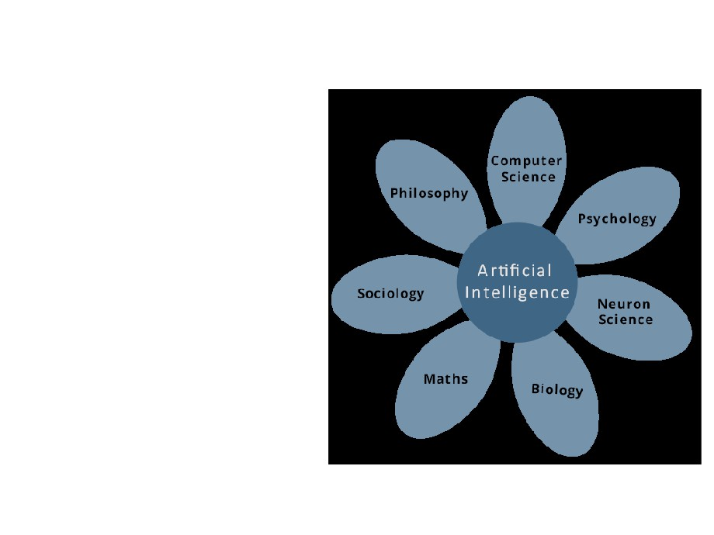
The foundation of AI
With different disciplines:
• Philosophy
• Mathematics
• Law
• Economics
• Computer engineering
15

Slide 15
Views of AI
• AI is found on the premise that:
- workings of human mind can be explained in terms of computation, and
- computers can do the right thing given correct premises and reasoning rules to achieve a specified goal.
Views of AI fall into four categories:
Thinking humanly
Thinking rationally
Acting humanly
Acting rationally
16

Slide 16
Thinking humanly: The Cognitive Modeling
• Reasons like humans do
- Programs that behave like humans
• Requires understanding of the internal activities of the brain
- Cognitive modeling is an area of computer science that deals with simulating human problem solving and mental task processes in a computerized model.
•AI can develop automated intelligent machine which can perform different activities which associated with human thinking activities such as decision making, problem solving, adapt new env’t and learning new things.
Example. write a program that plays chess.
- Instead of making the best possible chess-playing program, you would
17
make one that play chess like people do.

Slide 17
Acting humanly: The Turing Test
Can machines act like human do? Can machines behave intelligently?
• Turing Test: Operational test for intelligent behavior
• Suggested major components required for AI:
knowledge, reasoning, language/ image understanding, learning
How to make computers act like humans?
• Natural Language processing (enable computers communicate in human language, English, Amharic, Oromifa..)
• Knowledge representation (schemes to store information, both facts and inferences, before and during interrogation)
• Automated reasoning (use stored information to answer questions and to draw new conclusions)
• Machine learning (adapt to new circumstances and to detect & extrapolate patterns)
• Computer vision (recognize objects based on patterns in the same way as the human visual system does)
18
hear & take actions)

Slide 18
Thinking Rationally: The Laws of Thought
• A system is rational if it thinks/does the right thing through correct reasoning.
• The AI system should represent facts and concepts about the world via logic
• Aristotle: provided the correct arguments/ thought structures that always gave correct conclusions given correct premises.
- Aleazar is a man; all men are mortal; therefore Aleazar is mortal
- These Laws of thought governed the operation of the mind and initiated the field
19
of Logic.

Slide 19
Acting rationally: The rational agent
• Doing the right thing so as to achieve one’s goal, given one’s beliefs.
- AI is the study and construction of rational agents (an agent that perceives and acts)
• Rational action requires the ability to represent knowledge and reason with it so as to reach good decision.
- Learning for better understanding of how the world works
20

Slide 20
Strong AI vs. Weak AI
•Artificial Intelligence (or AI) is the concept that it is possible for a computer to think in the same sense as humans do.
• Week AI-
- Thinking focused towards the dev’t of technology capable of caring out pre-planned moves based on some rules and applying these to achieve a certain goal.
oUses models of its problem domain given to it by programmer.
o A system that uses a set of pre-programmed rules to apply them to any task to reach a successful completion.
- argues that computers can only appear to think and are not actually conscious in the same way as human brains are.
- For example, weak AI researchers see their contribution as things like expert systems
used for medical diagnosis, speech recognition and data mining, which use "intelligent"
21
models, but they do not help create a conscious agent

Slide 21
Strong AI vs. Weak AI…
•Strong AI
-Developing technology that can think and functions similar to humans, not just mimicking behavior in a certain domain.
- Machines the ability to reason, think and do all functionality that a human is capable of.
- Figure out its own model based on raw inputs.
-aims to create an agent that can replicate humans intelligence completely; i.e.., it can think, reason, imagine, etc., and do all the things that we currently associate with the human brain.
-Have self awareness, feel emotions, dream, consciousness, think etc.
22

Slide 22
- Describe what is Artificial intelligence?
- Assess the History of Artificial intelligence
- Identify the goals of Artificial intelligence
- To know application area of Artificial intelligence
- To know the research area of AI
23

Slide 23
Application of AI
▪ Playing Games
- AI plays crucial role in strategic games such as chess, poker, tic-tac-toe, etc., where machine can think of large number of possible positions based on
heuristic knowledge.
▪ Expert Systems
Eg Flight-tracking systems, Clinical systems
- There are some applications which integrate machine, software, and special information to impart reasoning and advising. They provide explanation and advice to the users.
▪ Vision Systems
- Systems that recognize objects based on patterns in the same way as the human visual system does.
24

Slide 24
Cont’d
▪ Natural Language Processing
- It is possible to interact with the computer that understands natural
language spoken by humans.
Eg. Machine Translation, text- to-speech, summarization of text,
Eg Automatic voice output
▪ Speech Recognition
- Some intelligent systems are capable of hearing and comprehending the language in terms of sentences and their meanings while a human talks to it. It can
handle different accents, slang words, noise in the background, change in human’s
noise due to cold, etc.
▪ Handwriting Recognition
Software that reads the text written on paper by a pen or on screen by a stylus. It can recognize the shapes of the letters and convert it into editable
text.
25

Slide 25
Cont’d
▪ Classification of text (Politics, Economic, Social, Sports, etc,)
▪ Automated fraud detection
▪ Automated face recognition ▪ Signature Recognition
Industrial robots for moving, spraying,
• Intelligent Robots
painting, precision checking, drilling, cleaning, coating, carving etc.
- produce mechanical device capable of controlled motion; which enable computers to see, hear & take actions
- In addition, they are capable of learning from their mistakes and they can adapt
to the new environment.
26

Slide 26
- Describe what is Artificial intelligence?
- Assess the History of Artificial intelligence
- Identify the goals of Artificial intelligence
- To know application area of Artificial intelligence
- To know the research area of AI
27

Slide 27
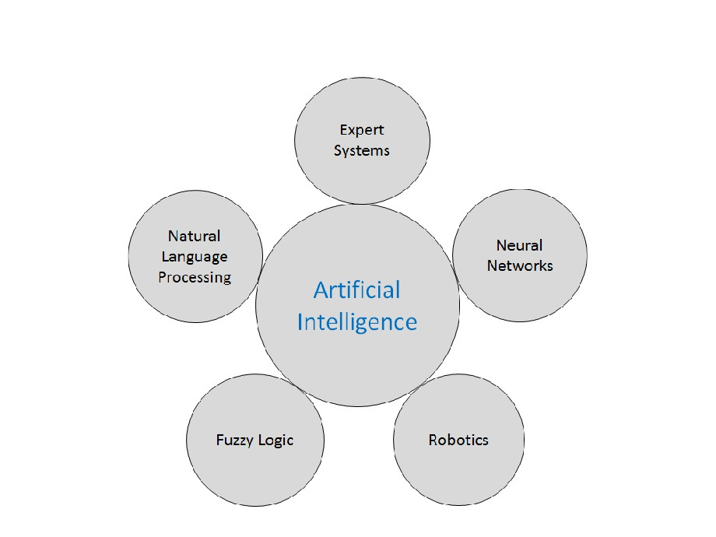
Research Areas of AI
28

Slide 28
What can AI do today?
Some application of AI
Robotic vehicles
Speech recognition
Autonomous planning and scheduling
Game playing
Spam fighting
Logistics planning
Robotics
Machine Translation

Slide 30
Assignment I (due: 5 days)
•Discuss one of the following concepts. Refer at least five sources (books, articles). present in class and send via email.
• Application areas (answer questions like what; how; challenges; application)
- Natural Language Processing [1]
- Natural Language Generation [2]
- Speech Recognition; Speech synthesis ; Speaker Identification [3]
- Optical Character Recognition (OCR),Writer identification [8]
- Face recognition; script recognition [4]
- Knowledge discovery in databases [5]
- Computer vision and robotics[6]
29

Slide 31
አመሰግናለሁ !!!
30

