Slide 1
Climate change and society
Women and Climate Change

Slide 2
Content
Introduction
Women/Climate Change Connections
Climate Change impact on Women
Women Contribution to Climate Change
Women’s Role in Combating Climate Change Impacts

Slide 3
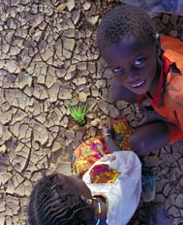
Climate Change will affect the entire global environment…
Sea levels could increase by 50cmper year
Water availability could decline
Seasonal rainfall patterns could
be severely disrupted
Frequency and intensity of extreme-weather events could increase –>
  loss of life, injury, mass population
  dislocations, and economic devastation of poor countries.

Slide 4
….cont’d
Human Health could suffer from a combination of effects :
  - Heat stress, water shortages, and malnutrition
  - Respiratory illnesses
  - Infectious diseases

Slide 5
CC Produced by the wealthy but the Suffering is for the poor
As a global environmental challenge
  created and driven by high-consumption lifestyles,
  lies outside the sphere of influence of poor communities and poor countries.
Those with special burdens and/or vulnerabilities : women, ethnic minorities, and people living with HIV/AIDS are feeling yet another pressure in global warming – one that is fundamentally unjust.

Slide 6
Climate Change affect the poorest people first and most
Housing
- People living in poverty are more likely to live in unplanned, temporary settlements, which are erected on unsuitable land – most prone to the risks of flooding, storm surges, and landslides.
Economics
- Most eke out a precarious economic existence - subsistence farming or fishing - and have no savings or assets to insure them against external shocks
Health
-They lack sanitation and their limited access to clean water, poor diet, and inadequate health-care provision undermine their resistance to infectious diseases

Slide 7
……Cont’d
Communications:
Their lack of social status and the informal nature or remoteness of their settlements means that they do not receive adequate warnings of impending disasters.
Aid:
Relief efforts are least likely to reach them.
No relief:
Lack of education and official neglect means that they have little alternative after disasters but to remain in or return to the disaster-prone areas, with diminished assets, and await the next, calamitous event.

Slide 8
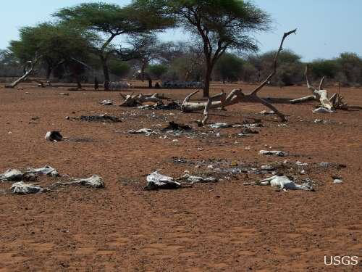
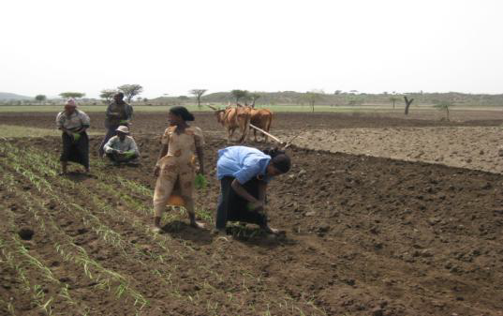
Climate change destroys livelihood of the poor
Poor rural family can not survive if rain fail

Slide 9
Women/Climate Change Connections
Women are more severely affected by climate change and natural disasters, due to
social roles
- The roles and responsibilities of women, such as collecting water and fuel wood frequently lead them to be more directly dependent on natural resources that tend to be highly sensitive to climate change.

Slide 10
…Cont’d
cultural barriers
- Restrictive dress codes affect the mobility of women in a way that may prove deadly during catastrophes, particularly floods.
- Skills that could be essential to survival in a disaster, such as tree climbing and swimming, are often taught only to boys.

Slide 11
…Cont’d
Women tend to be reluctant to go to safe shelters during disasters for fear of losing their children and their household assets.
Lack of access to information tends to make women more vulnerable than men in the face of natural disasters: women may not receive warning information transmitted to men in public spaces

Slide 12
…Cont’d
Discrimination:
-The economic marginalization of women makes them to have fewer assets and a more inadequate resource base than men to effectively respond to the effects of climate change.
- women still face gender-based cultural and legal constraints to ownership of land and access to natural resources, credit and so on.

Slide 13
…Cont’d
Women are underrepresented in decision-making about
    - Climate change,
    - Greenhouse gas emissions
    - Discussions and decisions about adaptation and mitigation.

Slide 14
…Cont’d
    Poverty
- 70 percent of those who live on less than a dollar a day are women.
- Women work two thirds of the world’s working hours, yet receive only 10 percent of the world’s income.
- Women own only 1 percent of the world’s property.

Slide 15
…..Cont’d
50% to 80% of the world’s food production is done by women but own less than 10% of land.
Globally, only 8 percent of cabinet members are women and 75% of the world’s 876 million illiterate adults are women.
Women account for 58% of unpaid employment and only 10 to 20 of every 100 landowners are women.

Slide 16
Climate Change impacts on Women
In developing countries, women living in poverty bear the burden of climate change consequences.
A) More work to fetch water, or to collect fuel, and fodder
-Flooding, drought and desertification
can extend the burdens of women and girls to collect water and fuel wood, forcing more girls in more communities to forego education.

Slide 17
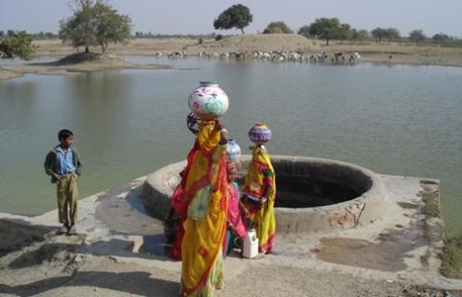
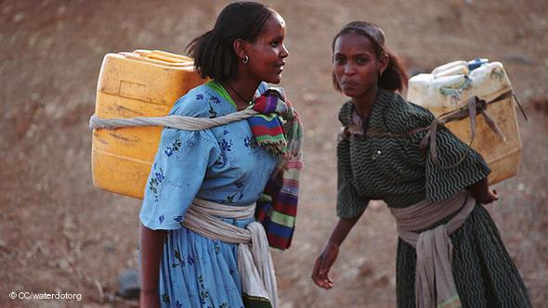
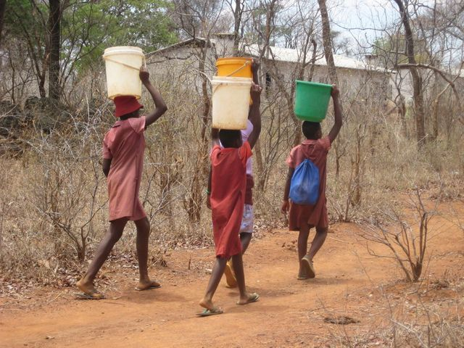
…Cont’d
Time spent by women and girls
on collecting water from distant sources
often prevents them from gaining an
education and earning a formal wage,
entrenching them in poverty.

Slide 18
…Cont’d
The reduction or disappearance of forest products used by women as fuel, food, or medicines will harm the wellbeing and quality of life for them and their families.
Permanent temperature change will reduce agro-biodiversity and traditional medicine options that women rely on.

Slide 19
…Cont’d
  B) Increased male-out migration:
  - more women left behind with additional agricultural and household duties
- In cases of crop failure due to harsh climatic conditions, cultural traditions often make it easier for men to leave their farms in search of employment elsewhere, leaving women behind to struggle to feed their families and make ends meet.

Slide 20
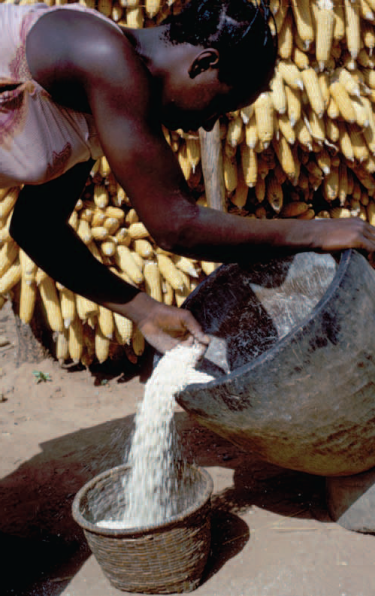
…Cont’d
=>Fewer resources to cope with seasonal and episodic weather and natural disasters

Slide 21
…Cont’d
Migration of populations, given extreme changes and disasters, could interrupt and limit the opportunities for education.
Climate change will magnify the existing
gender inequalities, thereby significantly hampering efforts to achieve the MDGs.

Slide 22
…Cont’d
Women and children are 14 times more likely to die in ecological disasters than men.
2004 Tsunami in Aceh, Sumatra
  - In Aceh, more than 75% who died were women.
  - As so many mothers died-> infant mortality, early marriage of girls, neglect of girls' education, sexual assault, trafficking in women and prostitution.

Slide 23
…Cont’d
1991 cyclone and flood in Bangladesh, 90% of victims were women.
  - Warning information
  - Confinement
  - Not swimmers
  - Care giving
  - Risk of sexual assaults

Slide 24
Women’s Contribution to Climate Change
  Women are under represented in high-income groups, and over represented as heads of low-income households.
  Women are under represented in high-income groups, and over represented as heads of low-income households.
Women produce less green house gas
  Industrial countries bear the main responsibility for greenhouse gas emissions.

Slide 25
Women and Adaptation to Climate Change
Gender-based vulnerabilities notwithstanding, it is a mistake to assume that women are simply victims in the face of climate change. Their accumulated wisdom in resource management equips them with unique skills that are valuable for the design of community-based adaptive solutions.
to survive and effectively cope with the impacts of climate change. Many women play important roles as:
- community leaders,
- natural resource managers, and
- caregivers
Women possess knowledge and experience that are critical in designing effective climate change adaptation strategies.

Slide 26
…Cont’d
Women effectively mobilize the community in the different phases of the risk management cycle.
Women are often in a better position to note environmental hazards manifesting in multiple forms,
-patterns of sicknesses in the children in the neighborhood or
-changes in the water (such as strange smells)

Slide 27
…Cont’d
The key sectors concerning women‘s activities to adapt to climate change are
Agriculture:
- Agriculture pays 95% of family life sustenance in many rural areas.
-Women produce half of the food.
the role of women to produce and successfully harvest includes:
- Early preparation of farms
- Practice tilling cultivation
- Planting early

Slide 28
…Cont’d
- Plant multiple crops
(both drought & non drought resistant)
- Utilization of compost manure
- Making water edges around the farms
- Plant trees around the farms.
Note:-These tasks can be performed by all people in families but women are in the front line in doing and advocating its implementation.
Even after harvesting, women are responsible for making sure they select and save seeds for the coming season.
Notes:
These tasks can be performed by all people in families but women are in the front line in doing
and advocating its implementation. Even after harvesting, women are responsible for making
sure they select and save seeds for the coming season.

Slide 29
…Cont’d
Forests
- Since firewood collection is the responsibility of women in most communities, women have been at the fore front of initiating tree nurseries and planting activities around their homes and in farms in order to restore the loss of trees being cut for firewood and charcoal making.
Moreover, women have been constructing and using fuel saving stoves to reduce the demand of firewood.

Slide 30
Water
At the communal level, women are always in-charge of the control and management of communal taps or water points. They always look after the streams and wells from being polluted by the children and animals.

Slide 31
…Cont’d
Food Security
- Women in most communities have the responsibility to care for the household’s food security including the production, collection and storage of food.
- Consequently, women prepare, process and store vegetables and fruits during the growing season in order to use them in the dry season.
-The storage of surpluses is an effective risk averting measure that woman can undertake against future livelihood failures.

Slide 32
…Cont’d
Health
- Due to climate change and global warming, there is increased disease incidences in many rural areas e.g. malaria.
- Sometimes, they are responsible with no resources to support. In adapting to such situations, rural women revert to the use of low cost traditional medicines and indigenous knowledge and health care.

Slide 33
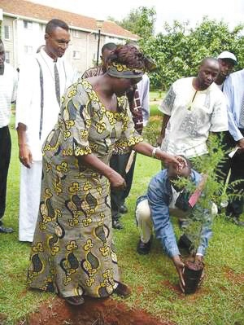
Women’s Empowerment
Linked to Climate Change Solutions
In November 2006, Kenya’s Greenbelt Movement, founded by Wangari Maathai, signed an emissions reduction purchase agreement to reforest two mountain areas in Kenya.
Women’s groups will plant thousands of trees, providing rural women with income and economic independence.
The trees will capture 350,000 tons of carbon dioxide, restore soil lost due to erosion, support regular rainfall essential to Kenya’s farmers.

