Slide 1
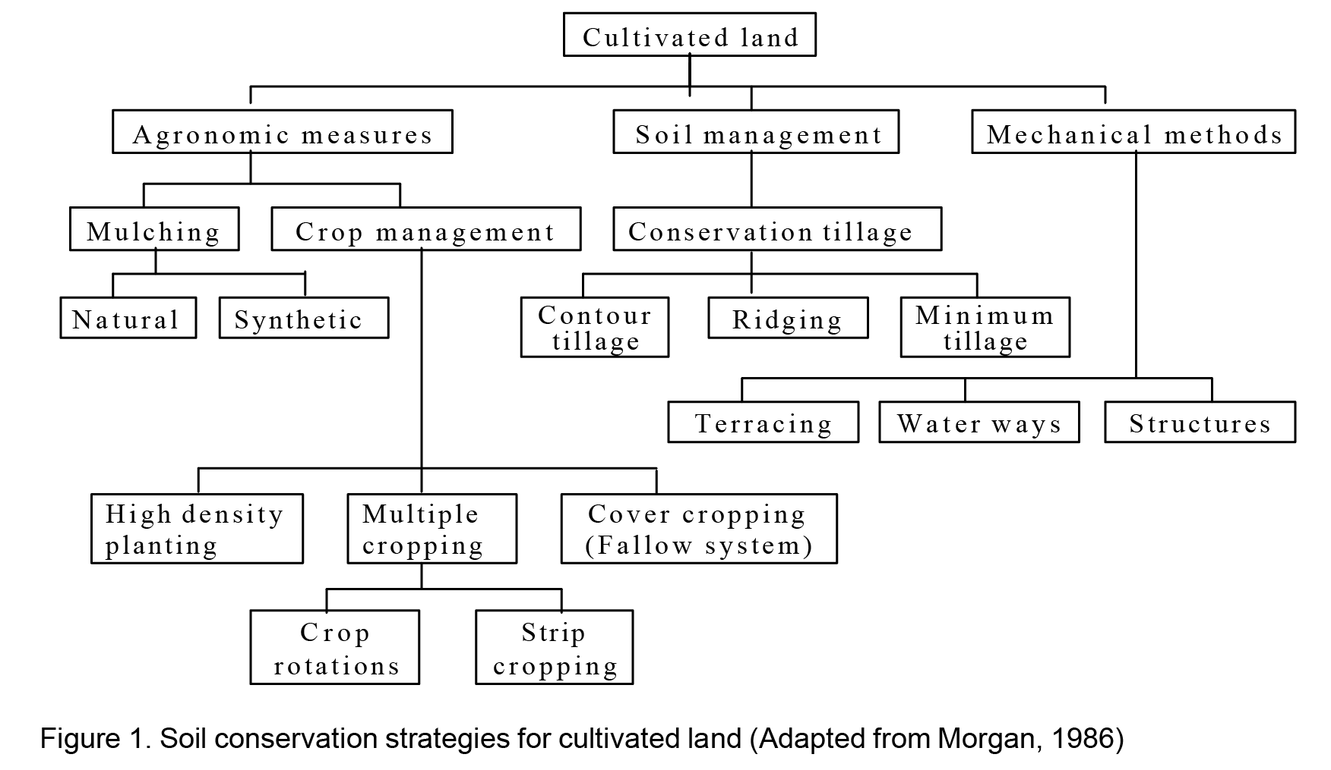
Physical conservation measures

Slide 2
Physical/Structural soil and water conservation measures
1. Level Soil Bunds
2. Stone Bunds
3. Stone Faced Soil Bunds
4. Level Fanya Juu
5. Bench Terracing
6. Hillside Terraces
7. Hillside Terrace with Trenches

Slide 3
Flood Control and Improved Drainage
  Waterways (Vegetative and Stone Paved)
  Cut-off Drains
  Graded Soil Bund
  Graded Fanya Juu
  Improved Surface Drainage for Increasing Productivity of Vertisols and Soils with Vertic Properties

Slide 4
Bund spacing
In spacing bunds, the following conditions are important to be considered.
  Bunds should allow adequate space for farming
  Should not unnecessarily be far apart, so that there is high run-off, which breaks the structure
  The VI should not exceed 2m. If it is more than this it affects the stability of the bund
  A vertical interval of 1m is very appropriate to land with slope less than or equal to 12%
  The cultivable land should not be less than 7m for ox plough farming conditions.

Slide 5
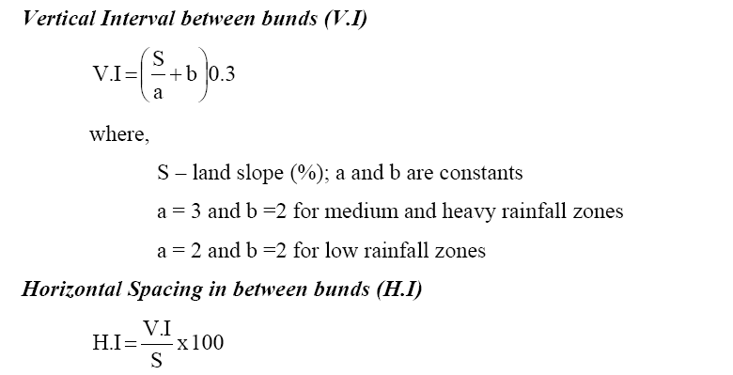
V.I = [0.3(2+ (slope% /3)]
Medium and heavy rainfall
V.I = [0.3(2+ (slope% /2)]
Low rainfall
V.I = (S D) / 100
Where V.I – Vertical interval
S – The ground slope in percentage
D – The cultivable strip in m (the horizontal ground distance)

Slide 6
Table- Spacing of bunds expressed in vertical interval (V.I and H.I)
Slope % | Soil depth >75 cm |  | Soil depth 50-75cm |  | Soil depth 25-50cm
 | VI m | HI m | VI m | HIm | VI m | HI m
5 | 1 | 20 | 0.7 | 15 | 0.5 | 10
6 | 1 | 17 | 0.7 | 12 | 0.6 | 10
7 | 1 | 14 | 0.8 | 12 | 0.7 | 10
8 | 1 | 12 | 0.8 | 10 | 0.7 | 9
9 | 1 | 11 | 0.9 | 10 | 0.8 | 9
10 | 1 | 10 | 0.9 | 9 | 0.8 | 8
11 | 1.1 | 10 | 0.9 | 8.9 | 0.9 | 8
12 | 1.1 | 9 | 1 | 8.8 | 0.9 | 8
13 | 1.2 | 9 | 1 | 8.8 | 1 | 8
14 | 1.2 | 8 | 1.1 | 7.8 | 1 | 7
15 | 1.2 | 8 | 1.1 | 7.7 | 1 | 7
16 | 1.3 | 8 | 1.1 | 7.7 | 1 | 6
17 | 1.3 | 8 | 1.2 | 7.7 | 1.1 | 6
18 | 1.3 | 7 | 1.2 | 6.7 | 1.1 | 6
19 | 1.3 | 7 | 1.2 | 6.6 | 1.1 | 6
20 | 1.4 | 7 | 1.2 | 6.6 | 1.1 | 6

Slide 7
Use the following table to determine V.I
  Given soil Type and mean annual rainfall mm.
  VI=SX + Y S=slope %
Soil type | Mean annual rainfall mm
 | 1000-1400 Value of x | 1400-1500 Value of x | >1500 Value of x
Easy Erodible (sandy soil) Value of Y | X=0.65 Y=1.2 | X=0.7 Y=1.2 | X=0.8 Y=1.2
Moderately Erodible soils (silt + loamysoil) Value of Y | X=0.65 Y=1.5 | X=0.7 Y=1.5 | X=0.8 Y=1.5
Less erodiables soil (Clay soil) Value of Y | X=0.65 Y=2 | X=0.7 Y=2 | X=0.8 Y=2

Slide 8
Steps in the layout and construction
Materials required
  A line level or two (for checking)
  Two graduated staffs (pole)
  A nylon string 11 meter long and
  Four men
Steps (level terrace)

Slide 9
Level Soil Bund
A level bund is an embankment along the contour, made of soil, with a basin at its upper side.
The bund reduces or stops the velocity of overland flow and consequently soil erosion.
Level bunds are about 50–75 cm high and have a bottom width of 100–150 cm and a water retention basin on their upper side.
Usually, tied ridges, placed in the basin about every 10 m help to prevent runoff from flowing sideways and to concentrate overflow at one point along the bund

Slide 10
Objectives/remarks
. The bund reduces and stops the velocity of runoff and consequently reduces soil erosion and the steady decline of crop yields.
. They are impermeable structures, unless provided with spillways, intended to:
  retain all rainfall, and hence, increase the moisture retention capacity of the soil profile and water availability to plants, and
  increase the efficiency of fertilizer applications if any.
. Through their water retention effect, the bunds may allow some crop yield even in drought years.
. Soil bunds are entry points for further stabilization and application of organic residues or compost (especially if applied in the first meters behind the bund where soil is deeper).
Level Soil Bund

Slide 11
Suitability
  Suitable mostly in semi-arid and arid parts of the country but also in medium rainfall areas with well drained soils.
  Commonly practiced in dry and moist weyna dega areas under traditional systems.
  Applied generally on cultivated lands with slopes above 3% and below 15% gradient.
Minimum surveying and tools requirements
  Layout: One water line level, two range poles graduated in cm and 10 meters of string (a team of three people layout approx 2-3 ha/day).
  Work: shovels, pick axes and wooden compactors (the proportion of shovels and pick axes depend on type of soil).
Level Soil Bund

Slide 12
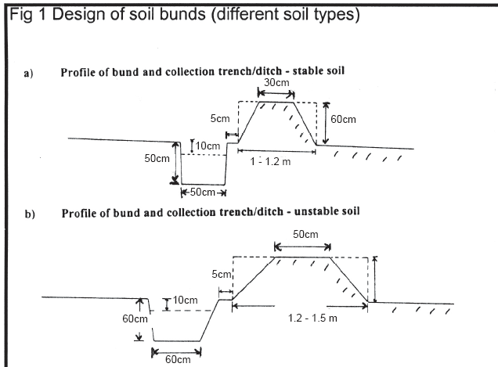
Level Soil Bund

Slide 13
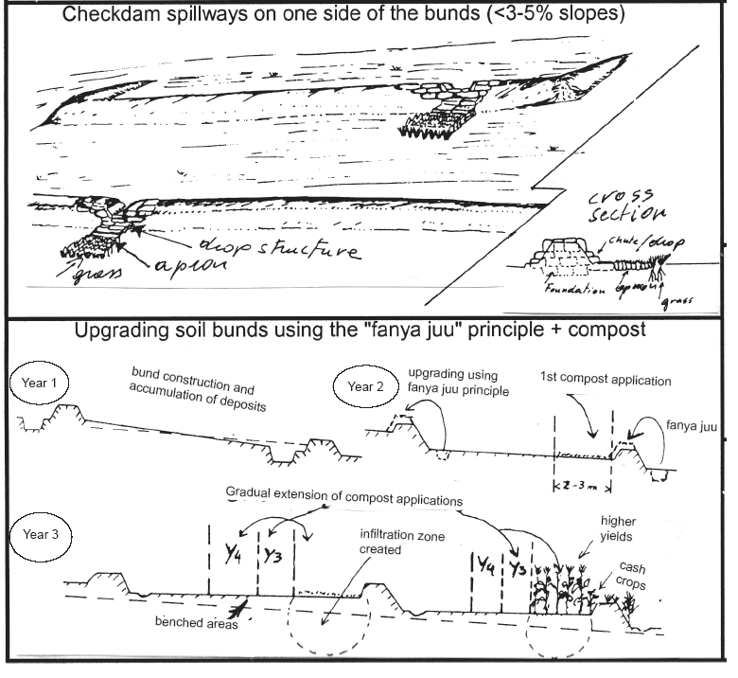
Level Soil Bund

Slide 14
Min. technical standards
Height:
  min. 60 cm after compaction.
Base width:
  1-1.2m in stable soils (1 horiz: 2 vertical) and 1.2-1.5m in unstable soils (1 horiz:1 vertical).
Top width:
  30 cm (stable soil) - 50 cm (unstable soil).
Channel:
  shape, depth and width vary with soil, climate and farming system.
Ties (if appropriate):
  tie width dimension as required, placed every 3-6 m interval along channel.
Length of bund:
  30-60 m in most cases, higher (max 80m) on slopes 3-5% - need to be spaced staggered for animals to cross.
Level Soil Bund

Slide 15
Layout and vertical intervals (VI)
Vertical intervals: follow a flexible and quality oriented approach:
  . Slope 3-8% VI = 1-1.5 m
  . Slope 8-15% VI = 1-2 m
  . Slope 15-20% VI = 1.5 - 2.5 m (only exceptional cases - reinforced)
Caution:
  soil bunds > 15% to max 20% only if space reduced and with trench, short bunds - above 15% better apply stone faced or stone bunds).
  Layout along the contours using line level – discuss spacing with farmers (to avoid curving a lot or cutting the plough line.
  Make bund length max 50-80m (the > the slope the < the length).
WORK NORM:
  150 PDs/Km
Level Soil Bund

Slide 16
Integration opportunities/requirements
1.Integration with bund stabilisation:
  using grasses (indigenous such as “sembelete”, “dasho”, others, etc.) + legume shrubs (pigeon peas, sebania, acacia saligna, etc.) in dense rows by direct sowing (15-30 cm).
2. Agronomic practices:
  contour plowing and compost (start 1st year applying 2-3 m strips above the bunds - where soil is deeper and moisture is higher).
3. Grow cash crops along bunds
  especially after 1-2yrs of composting, in single or wider strips as required. In addition to cash crops plant specific seasonal crops along bunds to use residual moisture (sunflowers, gourd, tomatoes, cucumbers, etc.).
4. Control grazing –
  avoid animals to graze between bunds for at least 1 year.
Level Soil Bund

Slide 17
Modifications/adaptation to standard design
1. Bunds that cross depression points without following exact contour lines:
  Reinforcements at depression points + keys
2. Bunds following farm boundaries:
  “corner bunds”+ reinforcement + keys + cut & fill
    - applicable only in areas with slope < 5%.
3. In slopes < 3-5% and without lateral slopes bunds can be provided with spillways (lateral, side-checkdam, gated, etc.)
  - Test measure first.
4. Upgrading soil bunds and application of COMPOST
Level Soil Bund

Slide 18
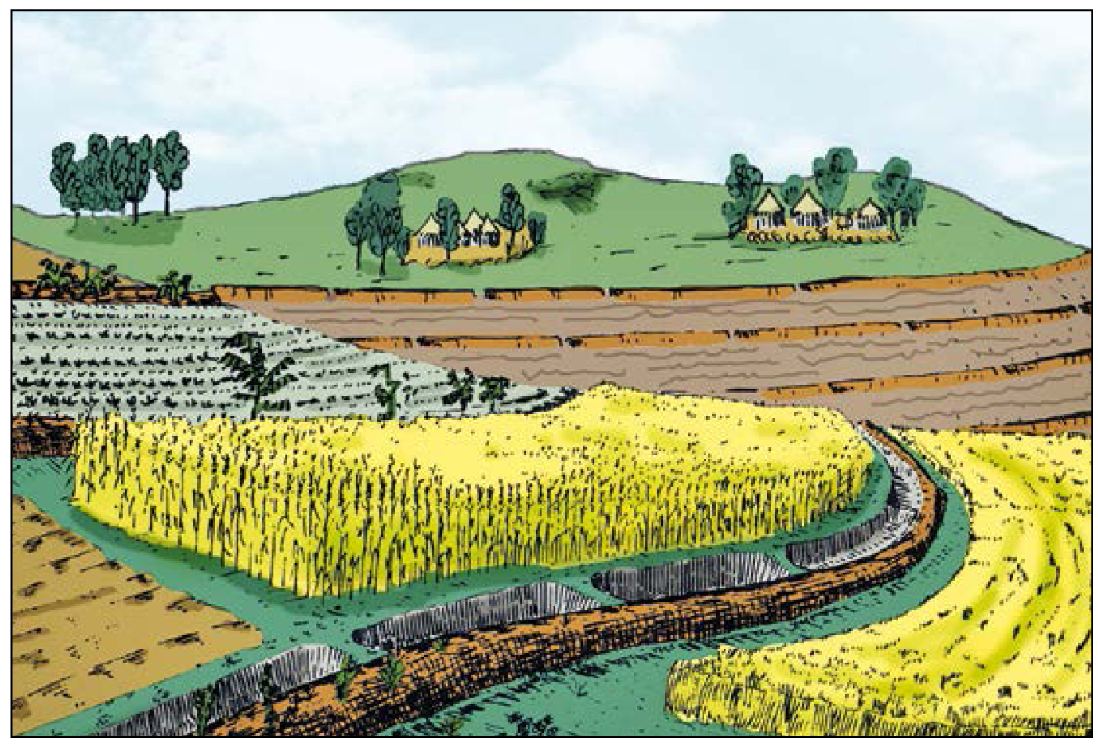
The level bund in front of the slope follows a horizontal line.

Slide 19
STONE BUNDS/STONE LINES
In lands where there are a lot of stones, Stone-Lines can be used to conserve soil water and reduce soil erosion.
  Stone-Lines are laid along the contour in the fields
Oobjectives
  . The stone bund reduces and stops the velocity of runoff and consequently reduces soil erosion and the steady decline in fertility and crop yields.
  . They are semi-permeable structures unless sealed with soil in their upper side.
  They increase the moisture retention capacity of the soil profile and water availability to plants, and increase the efficiency of fertilizer applications if any.
  . Through their water retention effect the stone bunds may allow some crop yield even in drought years.
  . Stone bunds are entry points for application of organic residues or compost, especially in the first 2-3 meters behind the bund where soil is deeper).

Slide 20
Suitability
  . Suitable mostly in semi-arid and arid parts of the country but also in medium rainfall areas with deep and well drained soils.
  .Applicable in a broad range of land uses in all agroclimatic areas, particularly in cultivated lands with some level of stoniness.
  Also common in treatment of degraded hillsides.
  Stone bunds also possible in large gully networks combined with vegetative stabilization and tree planting.
Minimum surveying and tools requirements
  Layout: One water line level, two range poles graduated in cm and 10 meters of string (a team of three people layout approx 2-3 ha/day)
  Work: crowbars, sledgehammers, shovels, and pick axes of shovels and pick axes depend on type of soil
STONE BUNDS

Slide 21
Min. technical standards
· Height:
  60-70cm up to100 cm (lower side).
· Total Base width:
  (height/2) + (0.3-0.5 m).
· Top width:
  30-40 cm.
· Foundation:
  0.3 m width x 0.3 m depth.
· Grade of stone face downside:
  1 horiz : 3 vert.
· Grade of stone face upper side:
  1 horiz : 4 vert.
· Grade of soil bank (seal) on upper side:
  1 horiz : 1.5-2 vert.
. Bunds need to be spaced staggered for animals to cross.
. Max bund length 60-80 meters.
STONE BUNDS

Slide 22
Layout and vertical intervals (VI)
Ground Height of bund (m) Vertical Interval (m) Distance apart (m)
slope %
5 0,50 1,00 20
10 0,50 1,50 15
15 0,75 2,20 12
20 0,75 2,40 10
25 1,00 2,50 8
30 1,00 2,60 8
35 1,00 2,80 6
40 1,00 2,80 5
50 1,15 2,80 4
WORK NORM: 250 PDs/Km
STONE BUNDS
Caution:
Although the table shows the possibility to build stone bunds up to 50% slope they should not be constructed above 35% slope under Ethiopian conditions).
Discuss spacing with farmers and in case of lateral slopes try to maintain lines as straight as possible by applying reinforcements on depression points

Slide 23
Integration opportunities/requirements
1. Integration with bund stabilisation:
  using grasses (indigenous such as “sembelete”, “dasho”, others, etc.) + legume shrubs (pigeon peas, sebania, acacia saligna, etc.) in dense rows
  . Pigeon peas can also be planted annually.
  Stone bunds can be stabilized further by planting drought resistant plants such as sisal,
2. Agronomic practices:
  contour plowing and compost (start first year applying 2-3 m strips above the bunds - where soil is deeper and moisture is higher).
3. Grow cash crops along bunds
  (especially after 1-2 years of composting) in single or wider strips as required. Plant specific crops along bunds to use residual moisture (sunflowers, gourd, tomatoes, cucumbers, etc.).
4. Control grazing –
  avoid animals to graze between bunds for at least 1 year and place bunds in staggered position and do not end a bund in a depression point.
STONE BUNDS

Slide 24
Modifications/adaptation to standard design
  a) Bunds that cross depression points without following exact contour lines: Reinforcements at depression points + keys
  b) Stone bunds with spillways (lateral, side-checkdam )
  c) Stone bunds provided with trenches
  d) Stabilization of stone bunds and application of COMPOST
Management requirements
  . Stone bunds can be upgraded to become stone walled level terraces –
    The upgrading occurs through raising the stone wall after 1-2 years. In this case it is essential that the foundation and the stone walls are well constructed.
  . Apply cut & carry for any grass growing on bunds (sealed with soil side).
STONE BUNDS

Slide 25
Limitations
. Bunds can create temporary waterlogging if not integrated with fertility management.
. If too narrow spaced can take unnecessary space out of production + some rodents.
STONE BUNDS

Slide 26
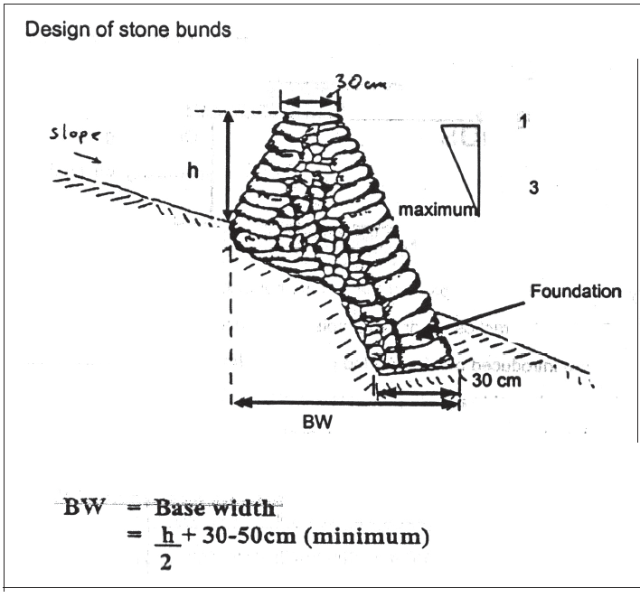
STONE BUNDS

Slide 27
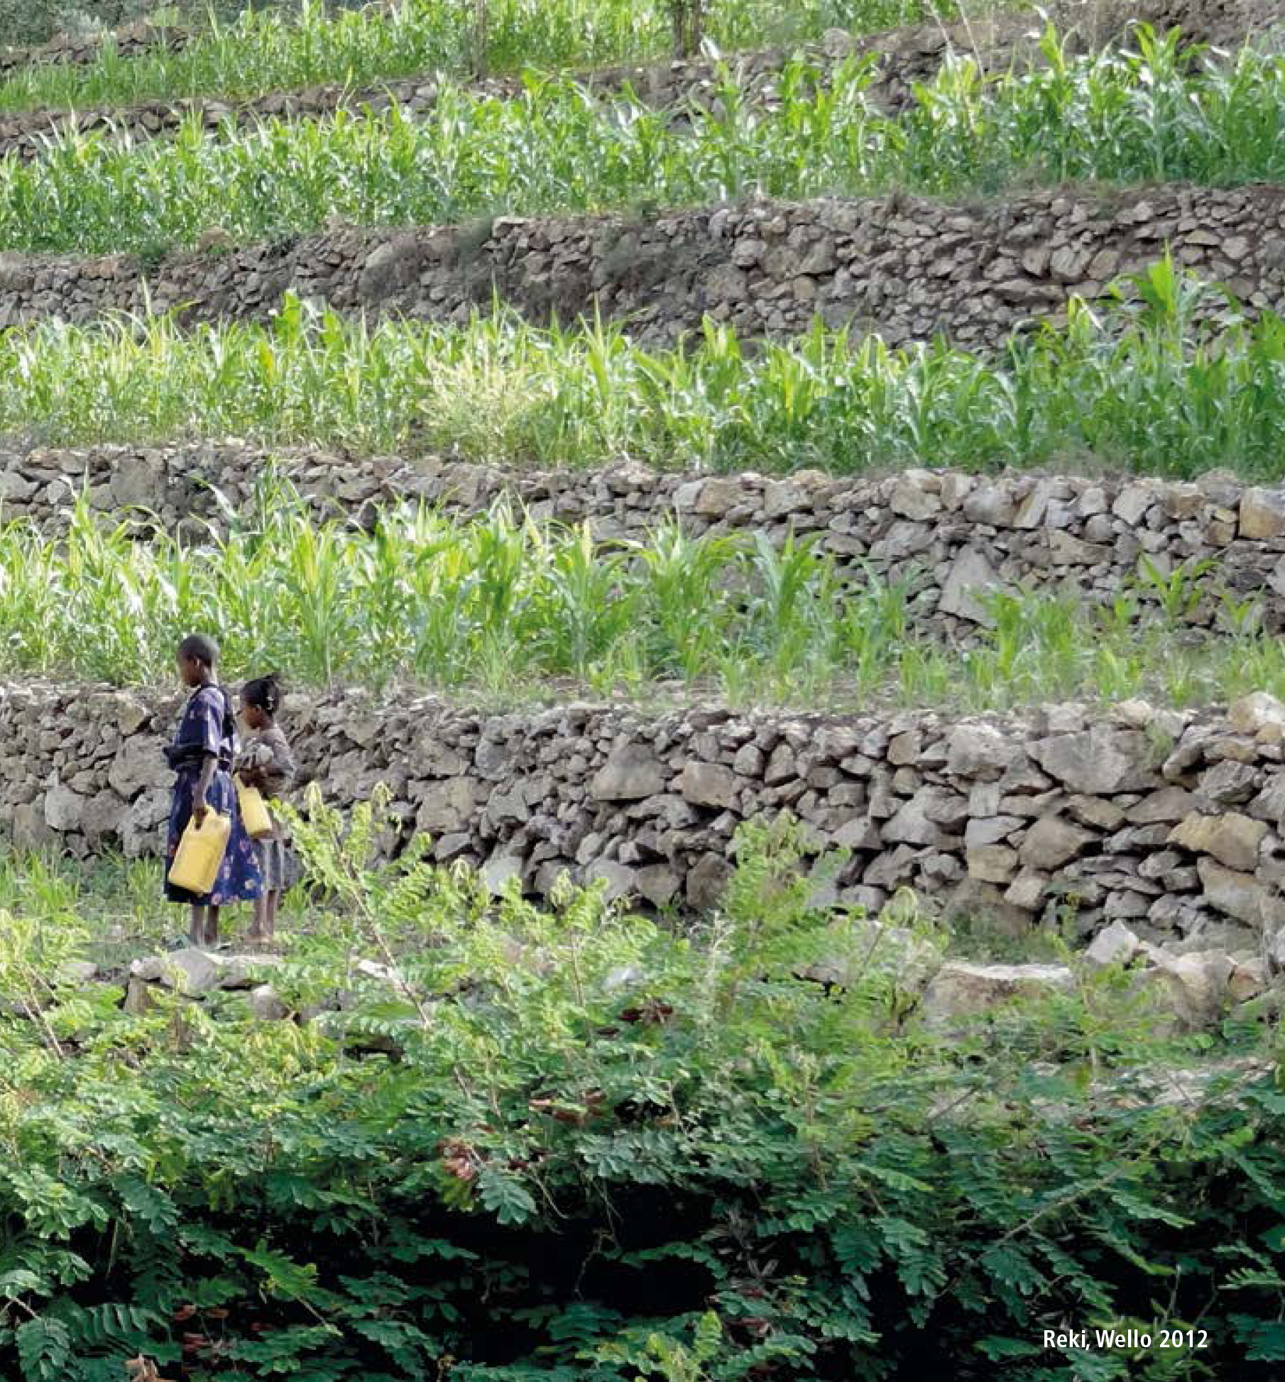
STONE BUNDS

Slide 28
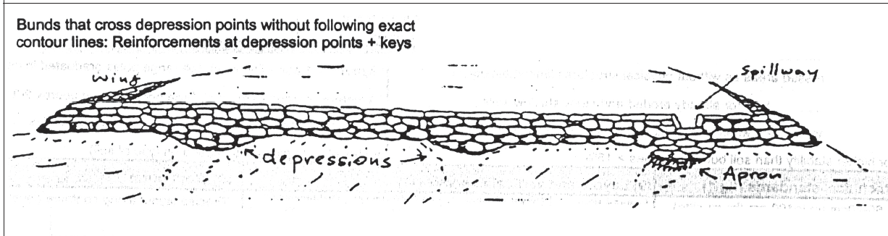
STONE BUNDS

Slide 29
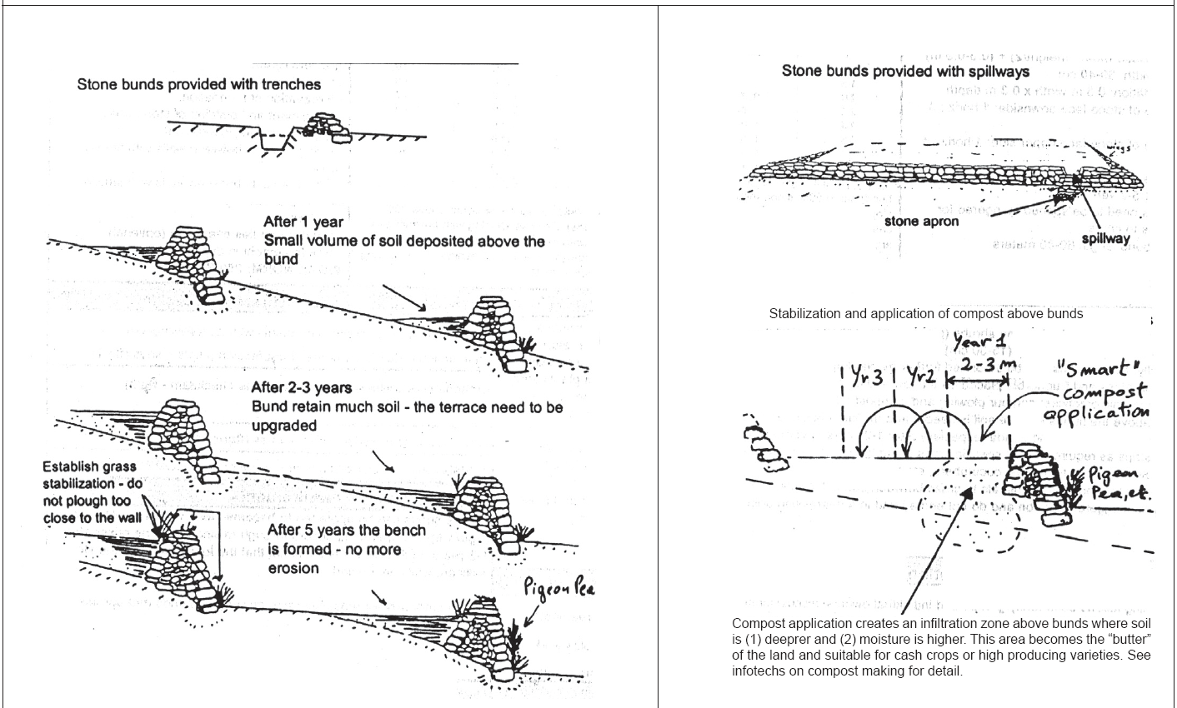
STONE BUNDS

Slide 30
STONE FACED SOIL BUNDS
Stone faced soil bund are soil bunds that are strengthened at one or both side of its face.
        Objectives/remarks
  The stone faced bunds are reinforced soil bunds in one or both their sides. It has the same objectives of soil and stone bunds
  Provided they are well constructed stone faced soil bunds offer strong resistance against runoff.
  Stone faced bunds are suitable in areas with high stoniness and stable soils, combined with trenches and vegetative stabilization.
  Suitable for dry areas and combined with other moisture conservation measures like tie-ridging and compost applications above bund or benched area.

Slide 31
Suitability
. As per the soil bunds but more suitable in drier areas and terrains with slight lateral slopes to strengthen soil bunds. The stone faced preferred on lower side of bunds as more stable than double faced stone faced.
Stone faced bunds largely applied both in traditional and new introduced systems.
Applicable in a broad range of land uses, particularly in cultivated lands with some level of stoniness.
STONE FACED SOIL BUNDS

Slide 32
Potential to increase/sustain productivity and environmental protection
  . High in moisture stressed areas as without physical structures limited biological options are available, particularly for already eroded and stony shallow soils.
  . Able to retain and accumulate water in ditches dug behind the bund if necessary .
  Allows for higher stability in slopes between15% and 35% max (single faced only).
7) Minimum surveying and tools requirements
  Layout:
    One water line level, two range poles graduated in cm and 10 meters of string (a team of three people layout approx 3-5 ha/day)
  Work:
    crow bars, sledge hammers shovels, and pick axes of shovels and pick axes depend on type of soil)
STONE FACED SOIL BUNDS

Slide 33
Min. technical standards
  Grade of lower stone face: 1 horiz. to 3 vertical;
  · Grade of upper stone face (if any): based on soil embankment grade;
  · Grade of soil: 1 horiz. to 1.5 vertical on stable soils and 1 horiz. to 2 vertical on unstable soil;
  · Lower stone face riser foundation: 0.3 depth x 0.2-0.3 width;
  · Upper stone face riser foundation: 0.2 x 0.2 m;
  · Stone size: 20 cm x 20 cm stones (small and round shape stones not suitable);
  · Top width: 0,4-0,5m;
  · Height: min. 0,7 and max. 1 m (lower stone face);
  . Channel or trench along bund;
  · Ties required every 3-6 m along trench/channel.
STONE FACED SOIL BUNDS

Slide 34
Layout and vertical intervals (VI)
a) Slope range: 3-35% max
b) Follow VI from soil bunds. Between slopes 5-15% add 10% to distance between bunds as stability of stone faced bunds is higher than soil bunds.
  . Slope 3-8% VI = 1-1,5 m
  . Slope 8-15% VI = 1-2 m
  . Slope 15-30% VI = 1.5-2.5 m
Above 30% slope only in very stable soils or shift to stone bunds.
c) Soil depth 50-100 cm
d) Use line levels and follow contours. In gentle slopes (< 8%) avoid sharp curving along depression points and fill by plowing.
STONE FACED SOIL BUNDS
WORK NORM: 250 PDs/Km

Slide 35
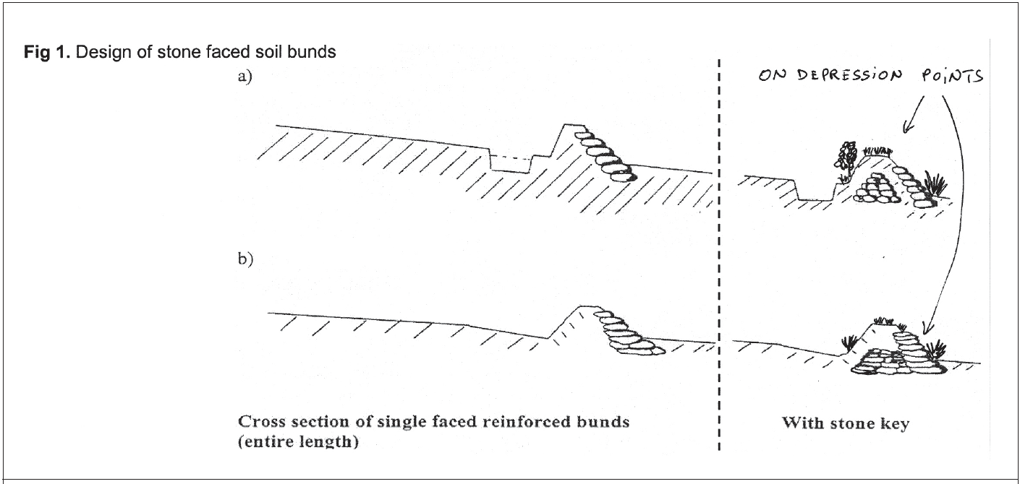
STONE FACED SOIL BUNDS

Slide 36
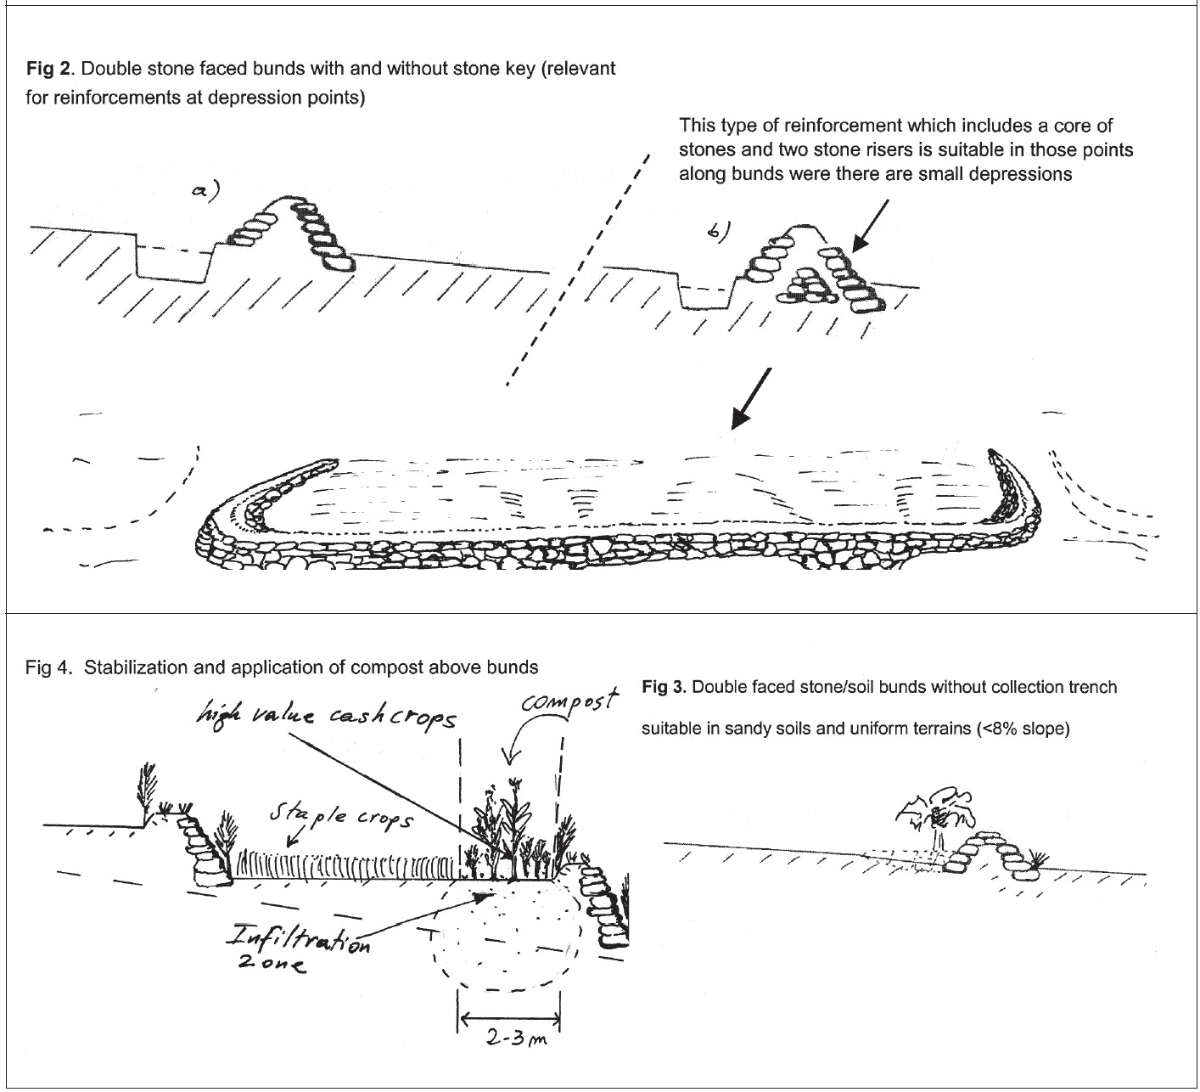
STONE FACED SOIL BUNDS

Slide 37
Integration opportunities/requirements
1. Integration with bund stabilisation:
  using grasses (indigenous such as “sembelete”, “dasho”, others, etc.) + legume shrubs (Pigeon peas, Sebania, Acacia saligna, etc.) in dense rows by direct sowing (15-30 cm) on upper side of bund and berm. Pigeon peas also planted annually. Lower part of the stone wall can also be stabilized by planting drought resistant plants such as Sisal, Aloes and Euphorbia in thick rows.
2. Agronomic practices:
  contour plowing and compost (start first year applying 2-3 m strips above the bunds - where soil is deeper and moisture is higher).
3. Grow cash crops along bunds
  (especially after 1-2 years of composting) in single or wider strips as required. Plant specific crops along bunds to use residual moisture (sunflowers, gourd, tomatoes, cucumbers, etc.).
4. Control grazing –
  avoid animals to graze between bunds for at least 1 year and place bunds in staggered position and do not end a bund in a depression point.
STONE FACED SOIL BUNDS

Slide 38
LEVEL FANYA JUU (FJ)
A level Fanya Juu (‘throw uphill’ in Swahili language) is an embankment along the contour, made of soil and/or stones, with a basin at its lower side.
The Fanya Juu re-duces or stops the velocity of overland flow and consequently soil erosion.
By contrast with the Level Bund, the soil in a Fanya Juu is moved upslope for construction.
The water retention basin is thus at the lower side of the wall.
Tied ridges about every 10 metres are also used here to prevent runoff from flowing sideways.

Slide 39
Objectives
.The FJ reduces and stops the velocity of runoff and consequently reduces soil erosion and the steady decline of crop yields
They are impermeable structures intended to retain rainfall, and hence, increase soil moisture, water availability to plants, and increase the efﬁciency of fertilizer application if any.
Fanya juus bench quicker than soil bunds but are not as efﬁcient in moisture conservation and more prone to breakages/ overtopping.
LEVEL FANYA JUU (FJ)

Slide 40
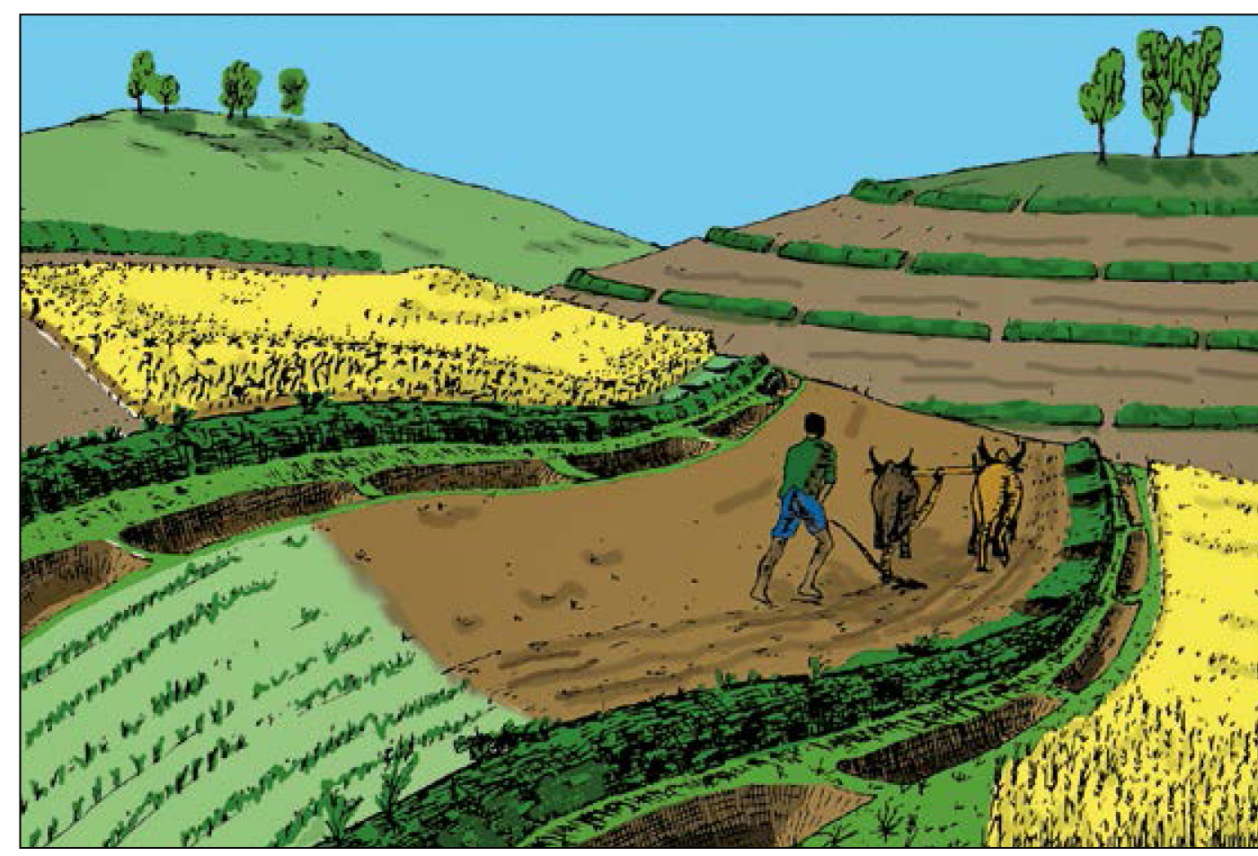

Slide 41
Suitability
Suitable mostly in moist weyna dega/medium rainfall areas with deep and well drained soils.
Can also be practiced in upper ranges of semi-arid conditions, particularly on gentle slopes and well drained soils.
Can be applied generally on cultivated lands with slopes above 3% and below 15% gradient.
Fanya juus are best constructed in uniform terrains with deep soils that do not have traverse slopes (depressions).
LEVEL FANYA JUU (FJ)

Slide 42
Potential to increase/sustain productivity
The main advantages of fanya juu derive from its capacity to become a bench terrace in a short number of years.
  However, fanya juus contribute to increase productivity only if well managed and integrated with soil fertility improvement practices, particularly vegetative stabilization and composting.
Minimum surveying and tools requirements
  Layout:
    One water line level, two range poles graduated in cm and 10m of string (a team of three people layout approx 2-3 ha/day).
  Work:
    shovels, pick axes and wooden compactors
LEVEL FANYA JUU (FJ)

Slide 43
Min. technical standards
  Height: min. 60 cm after compaction.
  Base width: 1-1.2m in stable soils (1 horiz: 2 vertical) and 1.2-1.5m in unstable soils (1 horiz: 1 vertical).
  Top width: 30 cm (stable soil) - 50 cm (unstable soil).
  Collection ditch: 60cm W x 50cm D.
  Ties: placed every 3-6 m interval along channel. .
  Length of bund: up to 60 m in most cases, max 80 m.
  FJ need to be staggered to allow animals to cross ﬁelds as required.
LEVEL FANYA JUU (FJ)

Slide 44
Layout and vertical intervals (VI)
Vertical intervals:
ﬂexible and quality oriented approach. .
  Slope 3-8% VI = 1-1,5 m .
  Slope 8-15% VI = 1-2 m .
  Layout along the contour using line level - discuss spacing with farmers and in case of lateral slopes shift to soil bunds for higher water accumulation and apply reinforcements and keys.
WORK NORM:
  200 PDs/Km
LEVEL FANYA JUU (FJ)

Slide 45
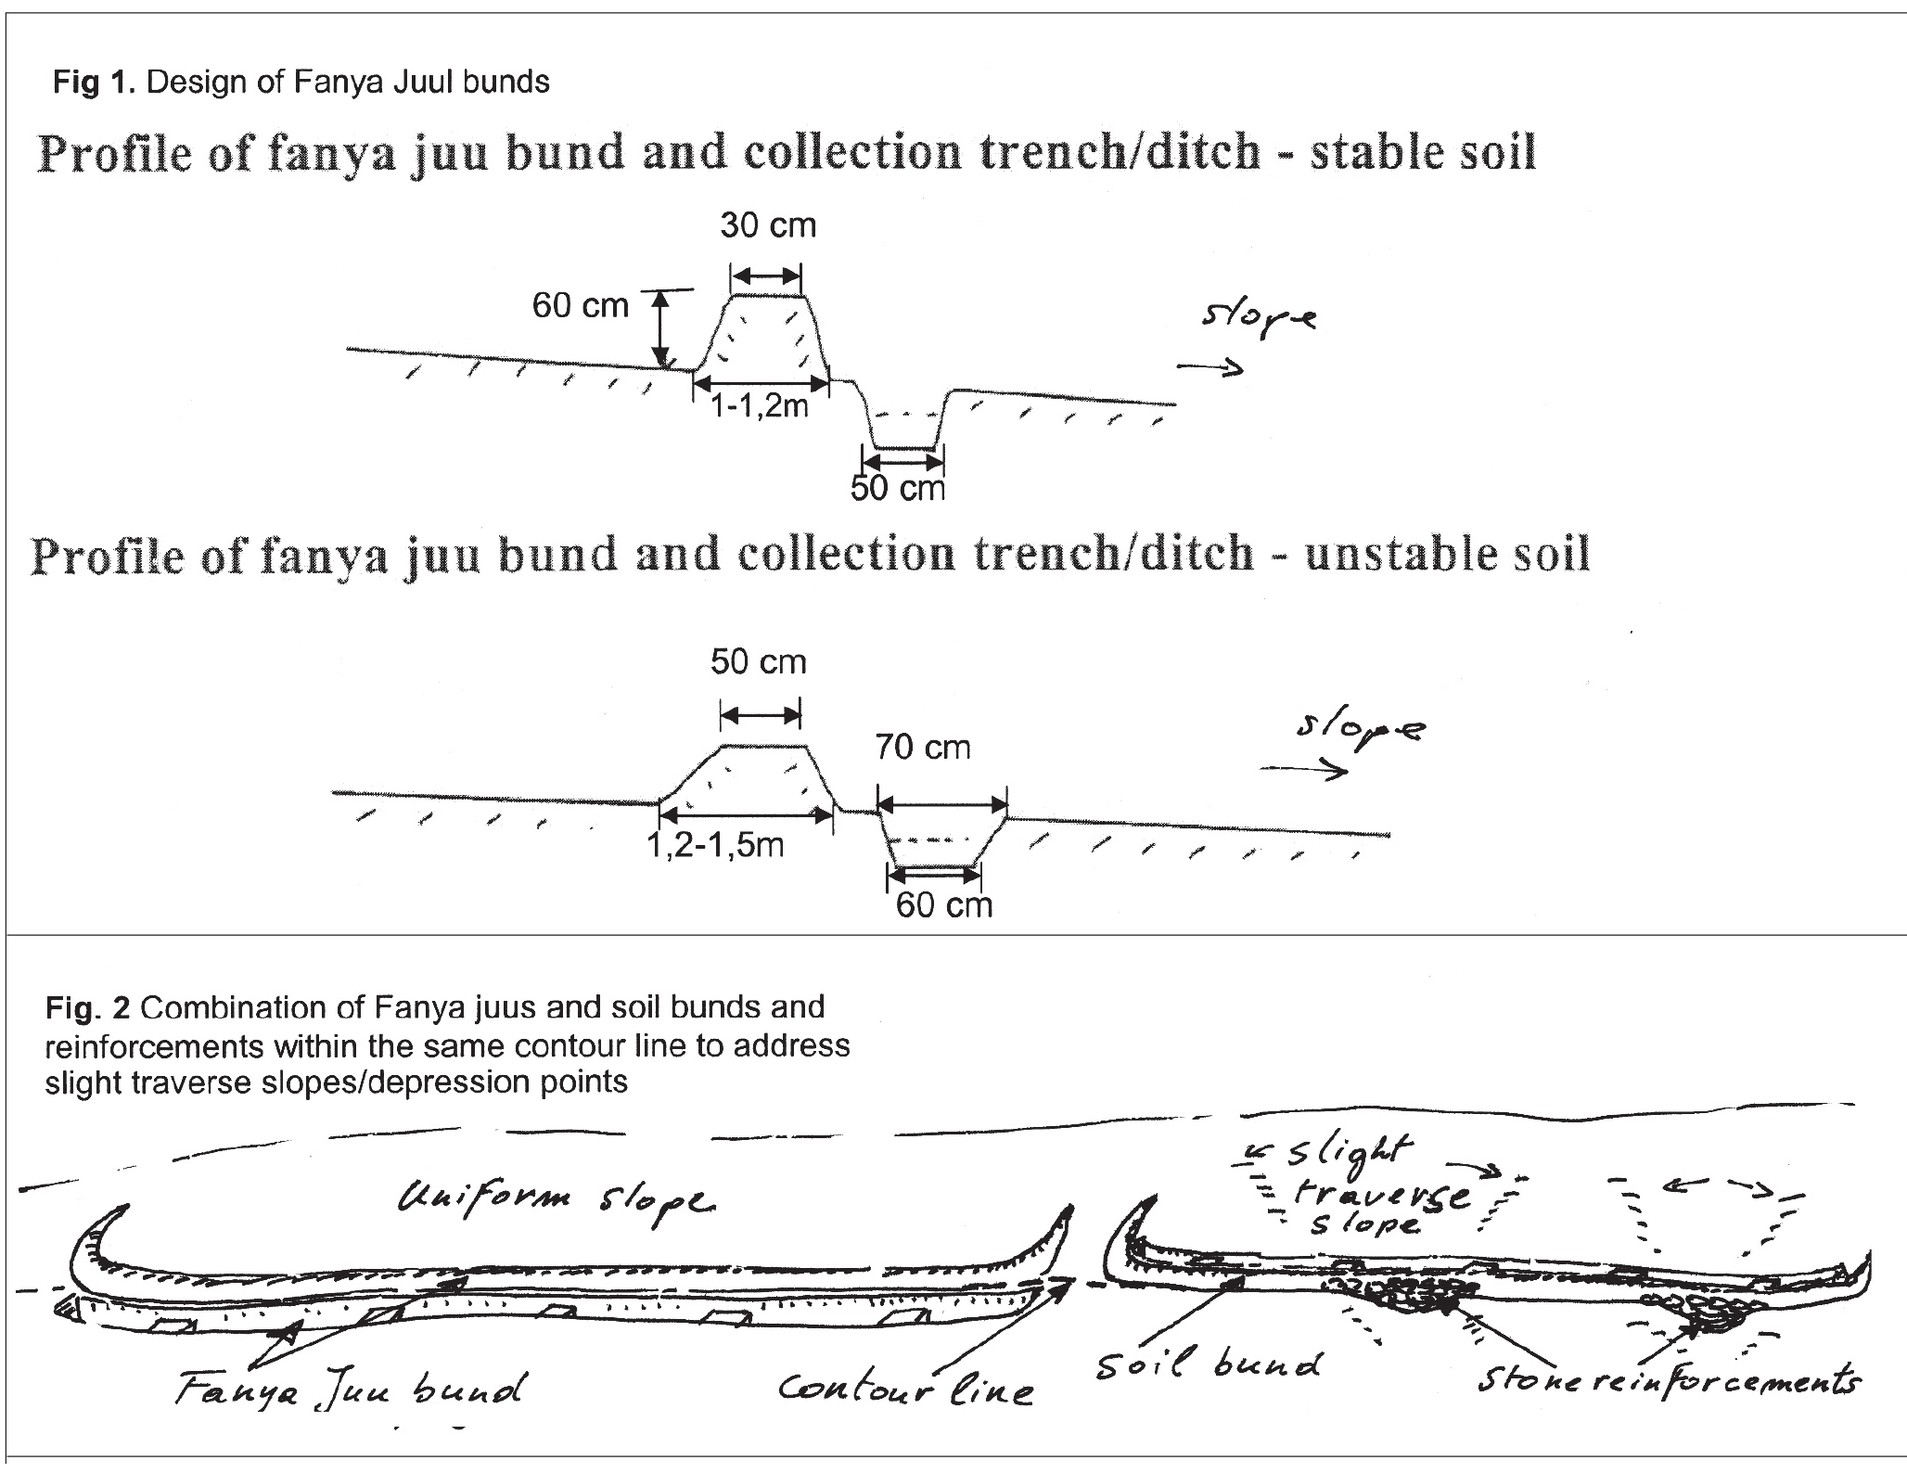
LEVEL FANYA JUU (FJ)

Slide 46
Integration opportunities/requirements
1. Integration with bund stabilisation:
  Fanya Juus need the embankment stabilised in the upper side to allow excess water to overtop without creating damage.
  Grass planted with other shrubs is most suitable. Plantation is recommended on upper and lower side of fanya juu.
  Agronomic practices:
    contour plowing and compost (start ﬁrst year applying 2-3 m strips above fanya juu - where soil is deeper and moisture is higher).
  Grow cash crops along bunds (especially after 1-2 years of composting) in single or wider strips as required.
  Control grazing, staggered position of fanya juus + same as soil bunds.
LEVEL FANYA JUU (FJ)

Slide 47
Modiﬁcations/adaptation to standard design
a) Combination of Fanya juus and soil bunds and reinforcements within the same contour line to address the problem of slight traverse slopes/depression points.
b) Combination of Fanya juus alternated with soil bunds along the slope. This method is to allow some excess runoff not captured by the fanya juu to get trapped by the upper trench of the soil
c) Upgrading of soil bunds using the fanya juu principle after 1-2 years
LEVEL FANYA JUU (FJ)

Slide 48
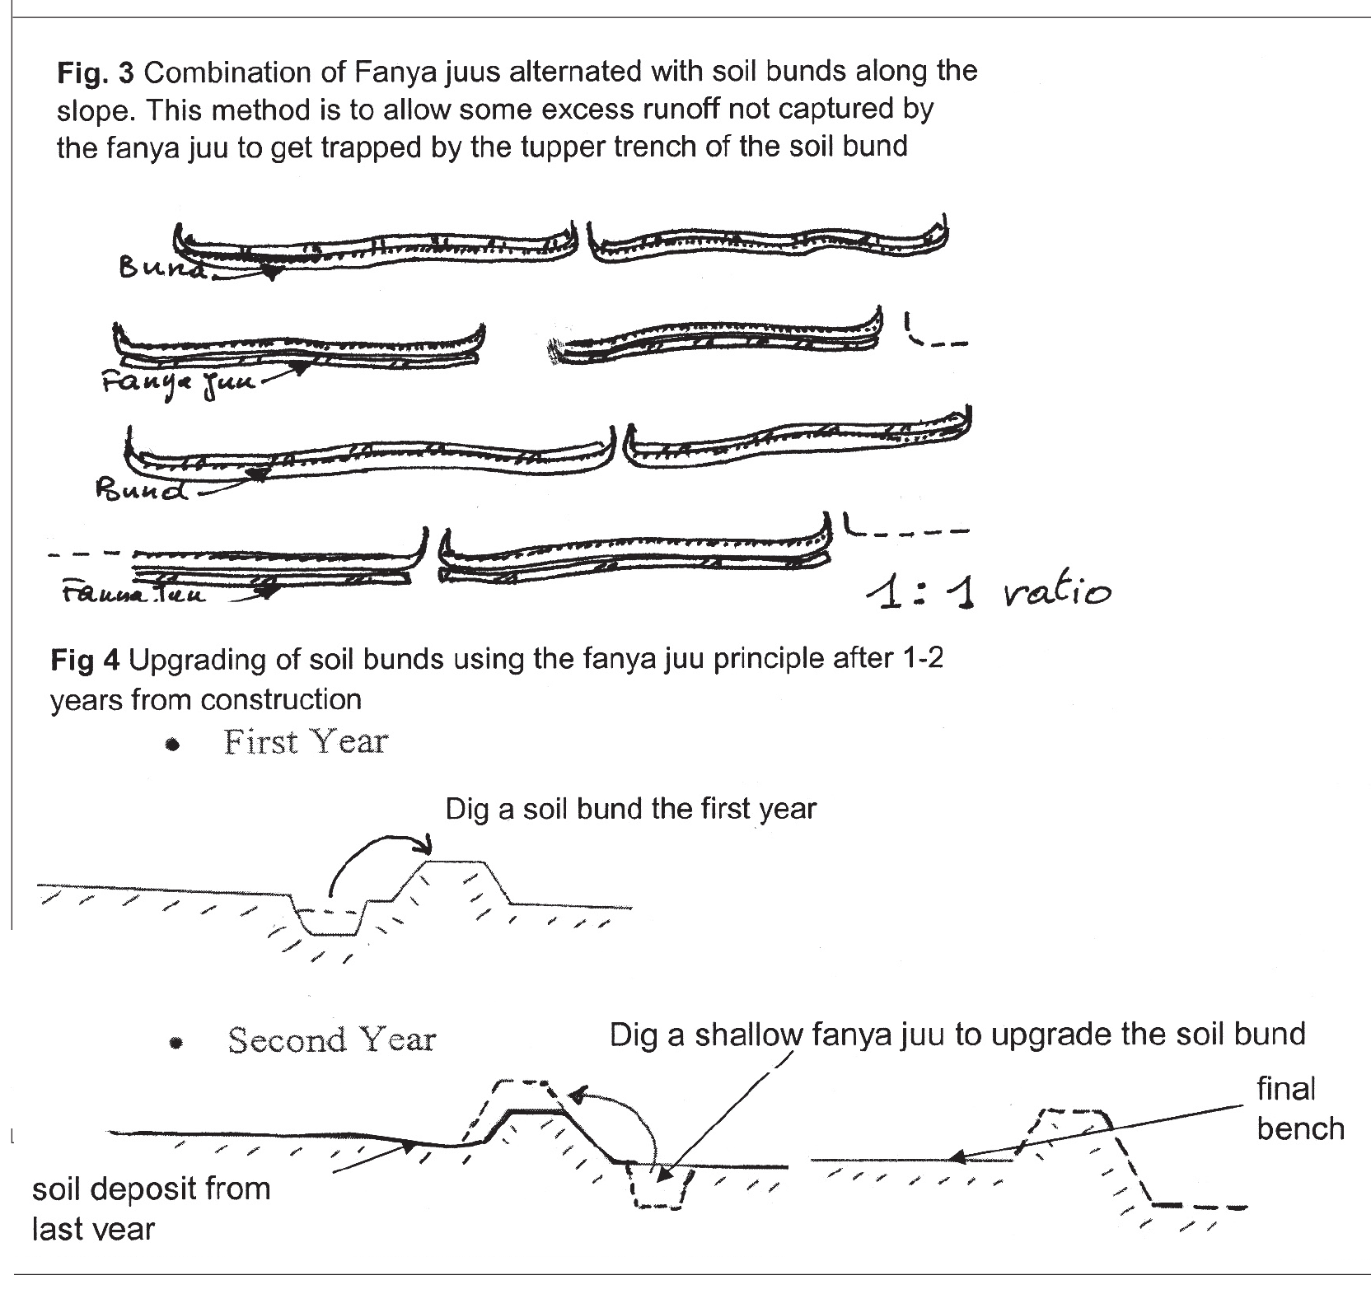
LEVEL FANYA JUU (FJ)

