Slide 1
Contour Farming
Contour farming is the practice of tilling, planting, and performing all cultural operations following the contour lines of the field slope.
This practice contrasts with up- and down-slope farming, which is the least desirable practice on highly erodible sloping lands.
Contour farming is being adopted in modern agriculture across the world for soil erosion control. Contouring creates furrows perpendicular to the predominant field slope.
These furrows retard the runoff velocity, reduce the runoff transport capacity, enhance water infiltratibility, reduce sediment transport, and discharge excess runoff at non-eroding velocities.
Furrows on the contour create irregular field surface which reduces runoff velocity. Deep and permeable soils respond better to contouring.

Slide 2
Contour farming effectively reduces rate of erosion in soils with slopes of up to 10%
On steeper slopes, contour cropping can still be used to control erosion but must be accompanied by other conservation practices such as grass waterways to safely discharge runoff water from the contour rows.
Contour cropping in combination with reduced tillage and residue return reduces runoff and soil erosion and increases crop yields as compared to up-and-down slope tillage.
Annual soil erosion were measured at 65.3Mg ha⁻¹ for up-and-down tillage, 45.4Mg ha⁻¹ for contour hedgerows, 43.7Mgha⁻¹ for strip cropping, and only 37.8Mg ha⁻¹ for contouring (Poudel, 1999).

Slide 3
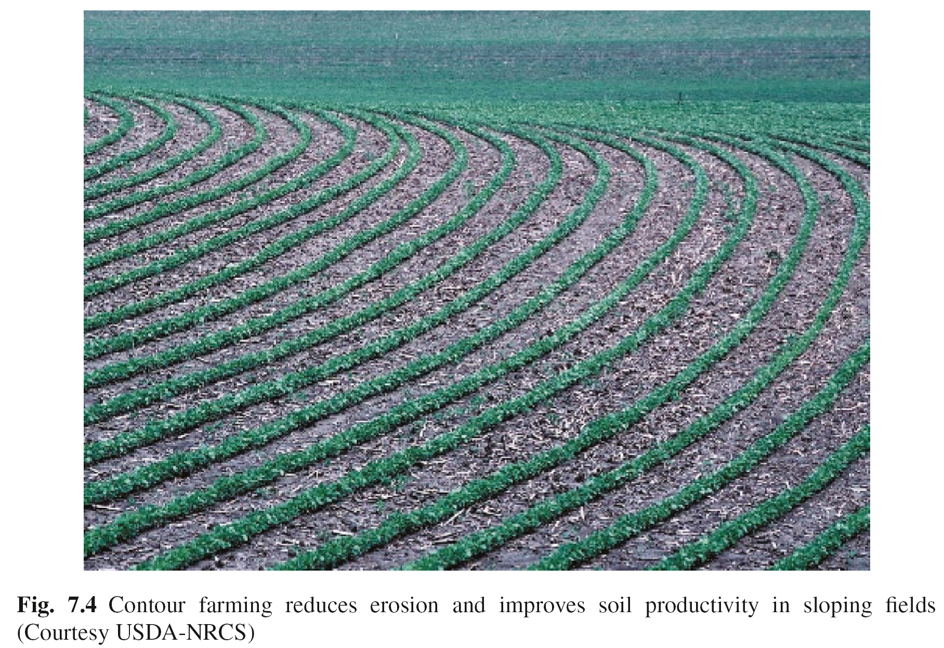

Slide 4
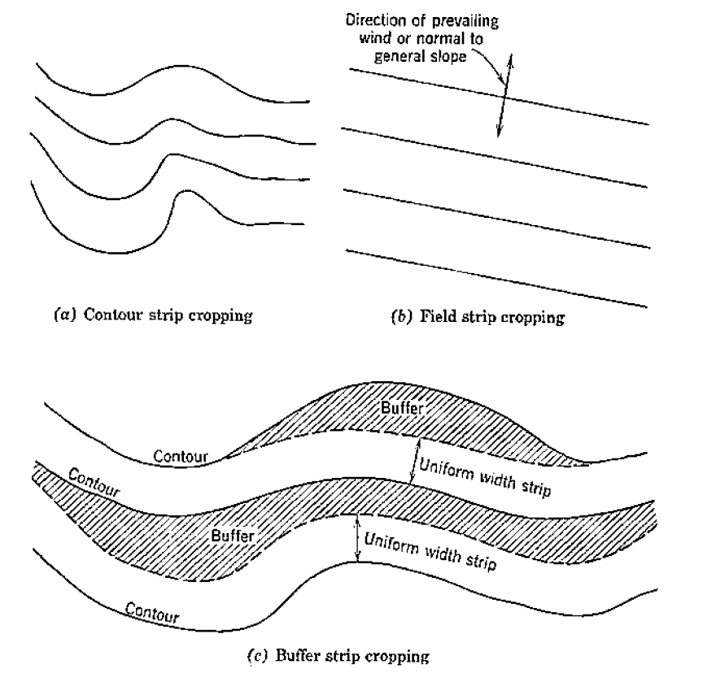

Slide 5
Strip Cropping
Strip cropping refers to the practice of growing crops in alternate strips of row crops or forage/grass.
Strip cropping system is an effective practice to reducing soil erosion because it breaks sloping landscapes in wide segments with diverse vegetative cover which intercepts runoff and promotes water infiltration, thereby reducing runoff and soil erosion.
Strip cropping is often integrated with rotations where strips are planted to different crops each year.
Hay, pasture or legume forages are also commonly used in strips in rotation with row crop crops.
The sod or perennial grass is particularly effective at slowing runoff and filtering out sediment. Strip cropping established perpendicular to the dominant slope reduces soil erosion as compared to bare soil or up-down slope cropping or tillage.
Notes:
Strip Cropping.
Strip cropping consists of a series of alternate strips of various types of crops laid out so that all tillage and crop management practices are performed across the slope or on the contour. Strip cropping is not a single practice; it is a combination of several good farming practices such as crop rotations, contour cultivation, proper tillage operations, stubble mulching, and cover cropping.
The three general types of strip cropping are:
Contour strip cropping consists of layout and tillage held closely to the exact contour and with the crops following a definite rotational sequence.
This cropping system involves planting row crops in strips on the contour of the ﬁeld slope
It provides added erosion control and plant and crop diversity because it combines contour- and strip-cropping.
Strip-cropping on the contour is more effective than contouring alone for reducing soil erosion in ﬁelds with severe erosion hazard.
Contour strip cropping systems can reduce soil erosion to <40% as compared to systems without these practices or with contouring alone
The grass, legumes or small grains used in strips slow runoff and trap sediment leaving row crops. Permanent grass/legumes strips must be maintained between strips in soils with severe erosion. The strips can be used as trafﬁc lanes for cultural operations. The mixture of grass and legumes provides hay and beneﬁts to wildlife habitat and plant diversity. Permanent strips also provide nesting, food, shelter to small animals.
2. Field strip cropping consists of strips of a uniform width placed across the general slope; when used with adequate grassed waterways the strips may be placed where the topography is too irregular to make contour strip cropping practical. Field strip cropping for wind erosion control consists of parallel strips placed crosswise to the direction of the prevailing wind
3. Buffer strip cropping consists of strips of some grass or legume crop laid out between contour strips of crops in the regular rotations; they may be even or irregular in width; they may be placed on critical slope areas of the field. Their main purpose is to give more protection from erosion. The use of buffer stripes depends on cropping systems, topography, and type of erosion hazards.

Slide 6
Crop yields between strip cropping and monocultures may not significantly differ in most cases, but the greatest benefit with strip cropping is to soil erosion control.
The width of the strips depends on soil slope, erosion potential, crop type, and equipment size.
Narrow strips reduce flow lengths more effectively than wide strips.
The width of strips must match the equipment turn or width for cultivation. On gentle slopes of up to 5%, a strip width of about 30m is recommended, while on steeper slopes the width must be less than 20m
Proper spacing of strips is important to effectively reduce soil erosion.

Slide 8
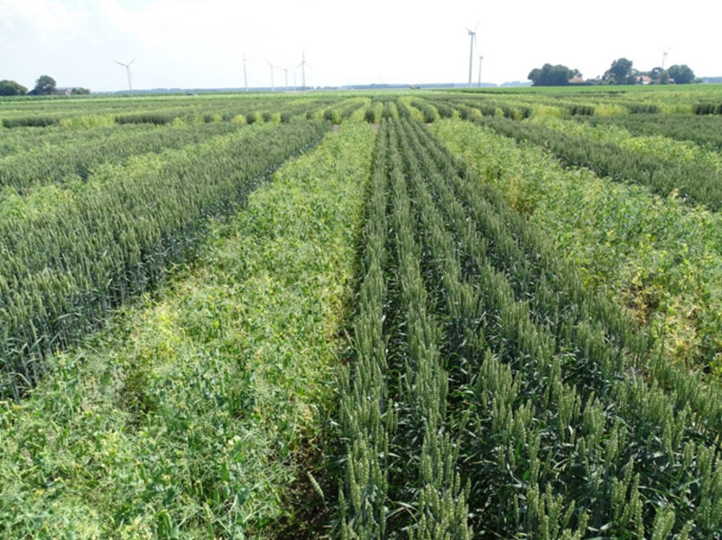
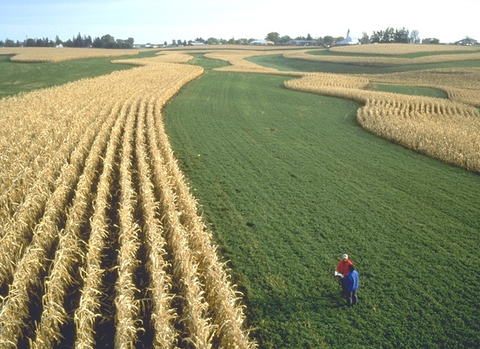

Slide 9
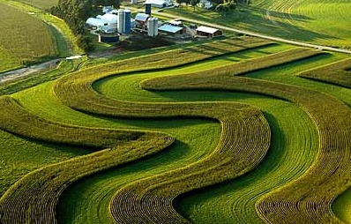

Slide 10
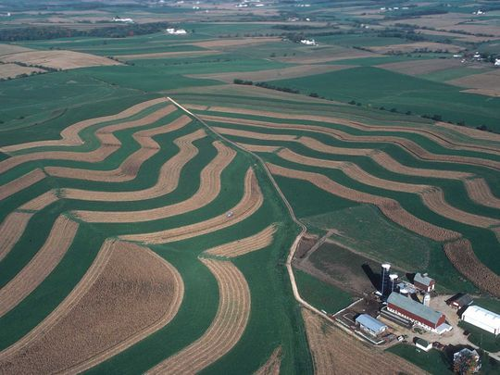
Contour strip cropping protects the soil from erosion and improves land aesthetics (Courtesy USDA-NRCS)

Slide 11
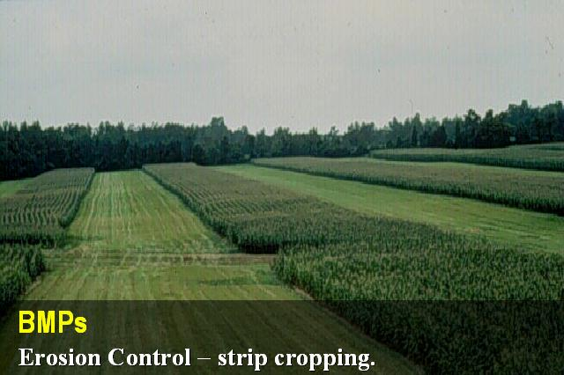

Slide 12
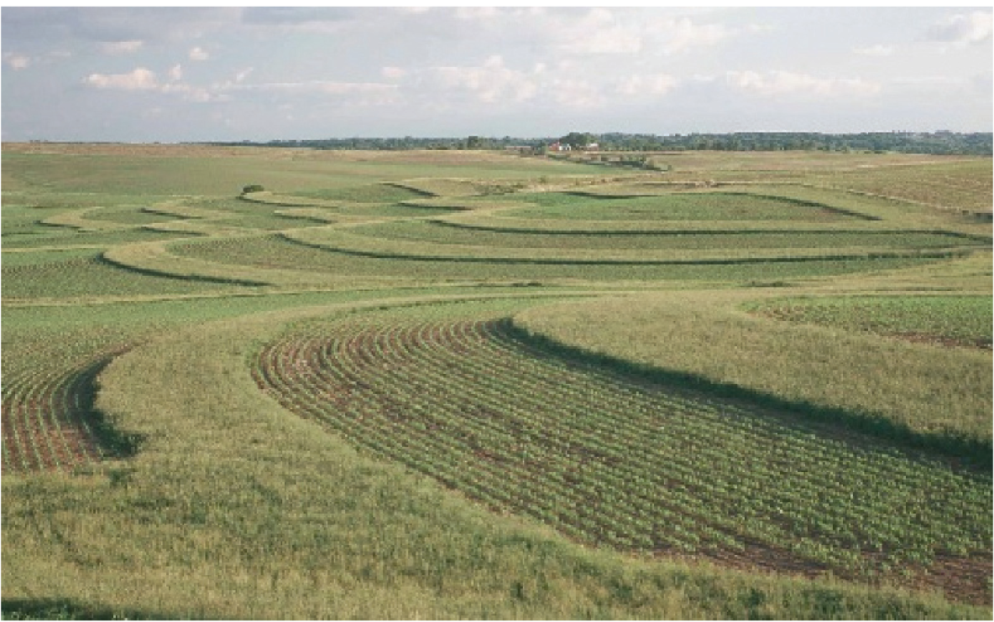
Grassed buffer strips on the contour integrated with ﬁeld crops (Courtesy USDA-NRCS)

Slide 13
Grass strips/barriers
Grass barriers are narrow strips of dense, tall, and stiff-stemmed perennial grass established perpendicular to the ﬁeld slope to control soil erosion while decreasing slope width.
Grass barriers:
Decrease the ﬁeld slope width by forming benches or natural terraces upslope of the grass barriers with time.
Pond runoff above them reducing the kinetic energy of runoff and increasing the inﬁltration opportunity time of runoff water.
Reduce the formation of ephemeral gullies by intercepting and dispersing the concentrated-type ﬂow.

Slide 14
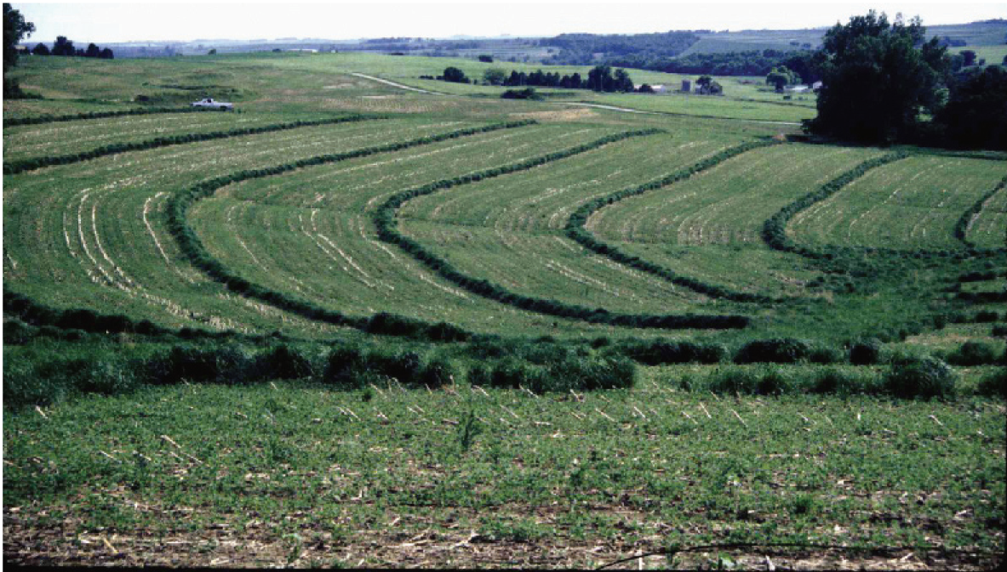
Switchgrass barriers parallel to row crops

Slide 15
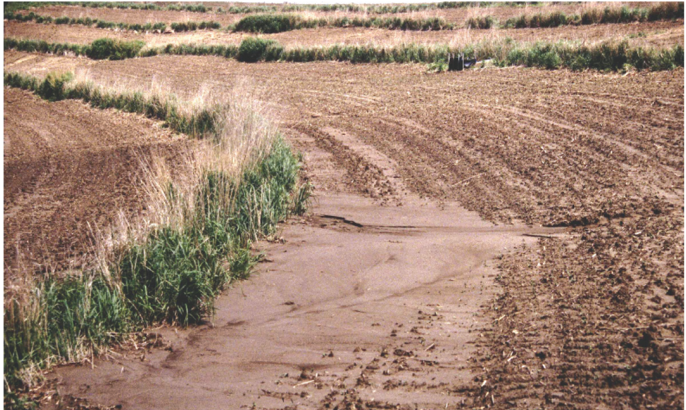
Grass barriers trap sediment above them (Courtesy Larry A. Kramer USDA-ARS, Deep Loess Research Station, Council Bluffs, Iowa)

Slide 16
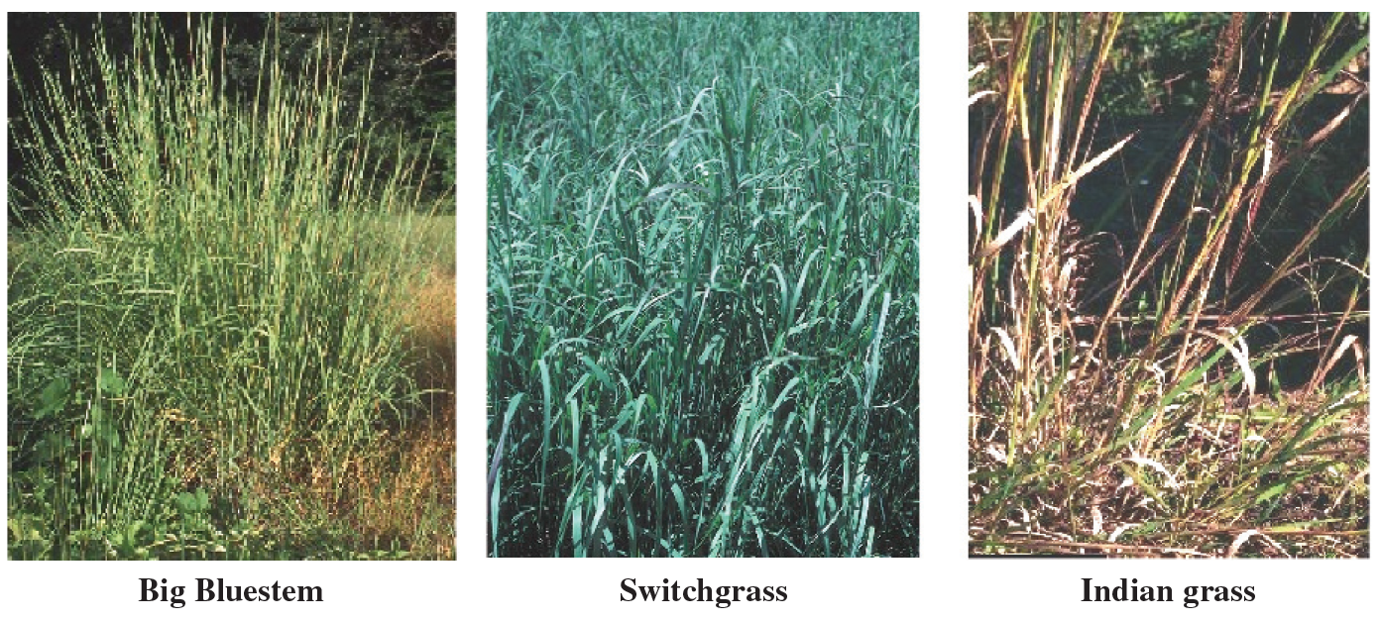
Runoff ponding retains about 90% of particles coarser than 0.125 mm and about 20% of particles <0.032 mm (Meyer et al., 1999).

Slide 17
Alley Cropping
Definition
Alley cropping is a farming system in which rows of trees or shrubs are planted along contours between rows of crops for soil and crop yield improvement.
reduces soil erosion
Improve soil fertility
Increase yield
Technical specification
design the layout according to the objective of the alley cropping
Increase crop yield
soil erosion control

Slide 18
Vertical interval is 1m for erosion control
Alley cropping is effective up to 5% slope, or
Up to 10% slope alternate with bunds
Is recommended for area with rainfall > 700mm
Good textured soil with depth >100 cm
When fertility is the objective:
The optimum hedgerows spacing for optimum green material production is 4m.
when the area is moisture deficit 8m spacing is recommended
Criteria for selecting appropriate alley spacing species:
Establish easily | Regenerate readily after pruning
Grow rapidly | Are easy to eradicate
Have deep root system | Provide useful by products
Produce heavy foliage | Need to leguminous

Slide 19
Management
quite free grazing
Weeding
Gap filling
Pruning/cutting, periodically,
Benefits
Provide green manure /mulch and recycle nutrient
Suppress weeds during fallow period through mulch
Improve soil condition for soil microbes
Control erosion
Fix nitrogen

Slide 20
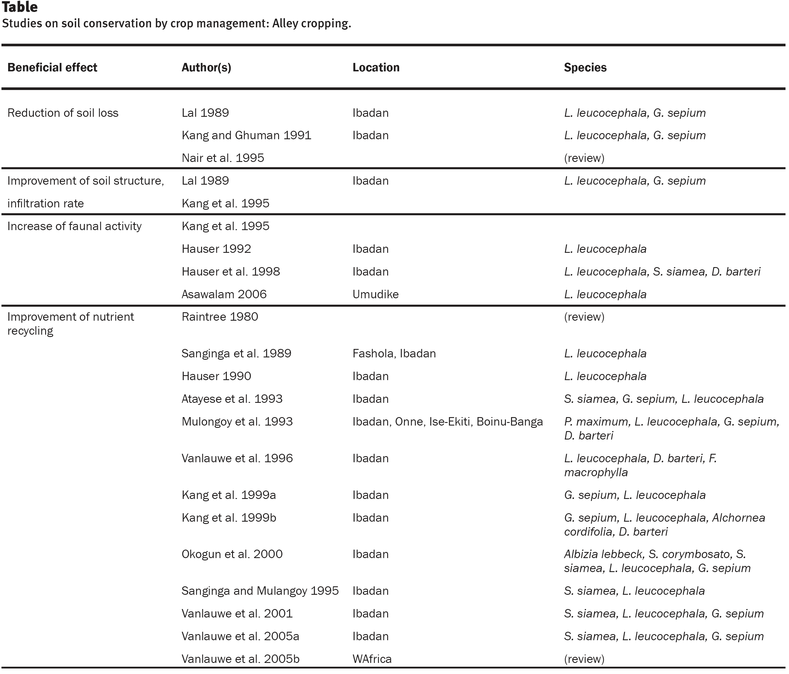

Slide 21
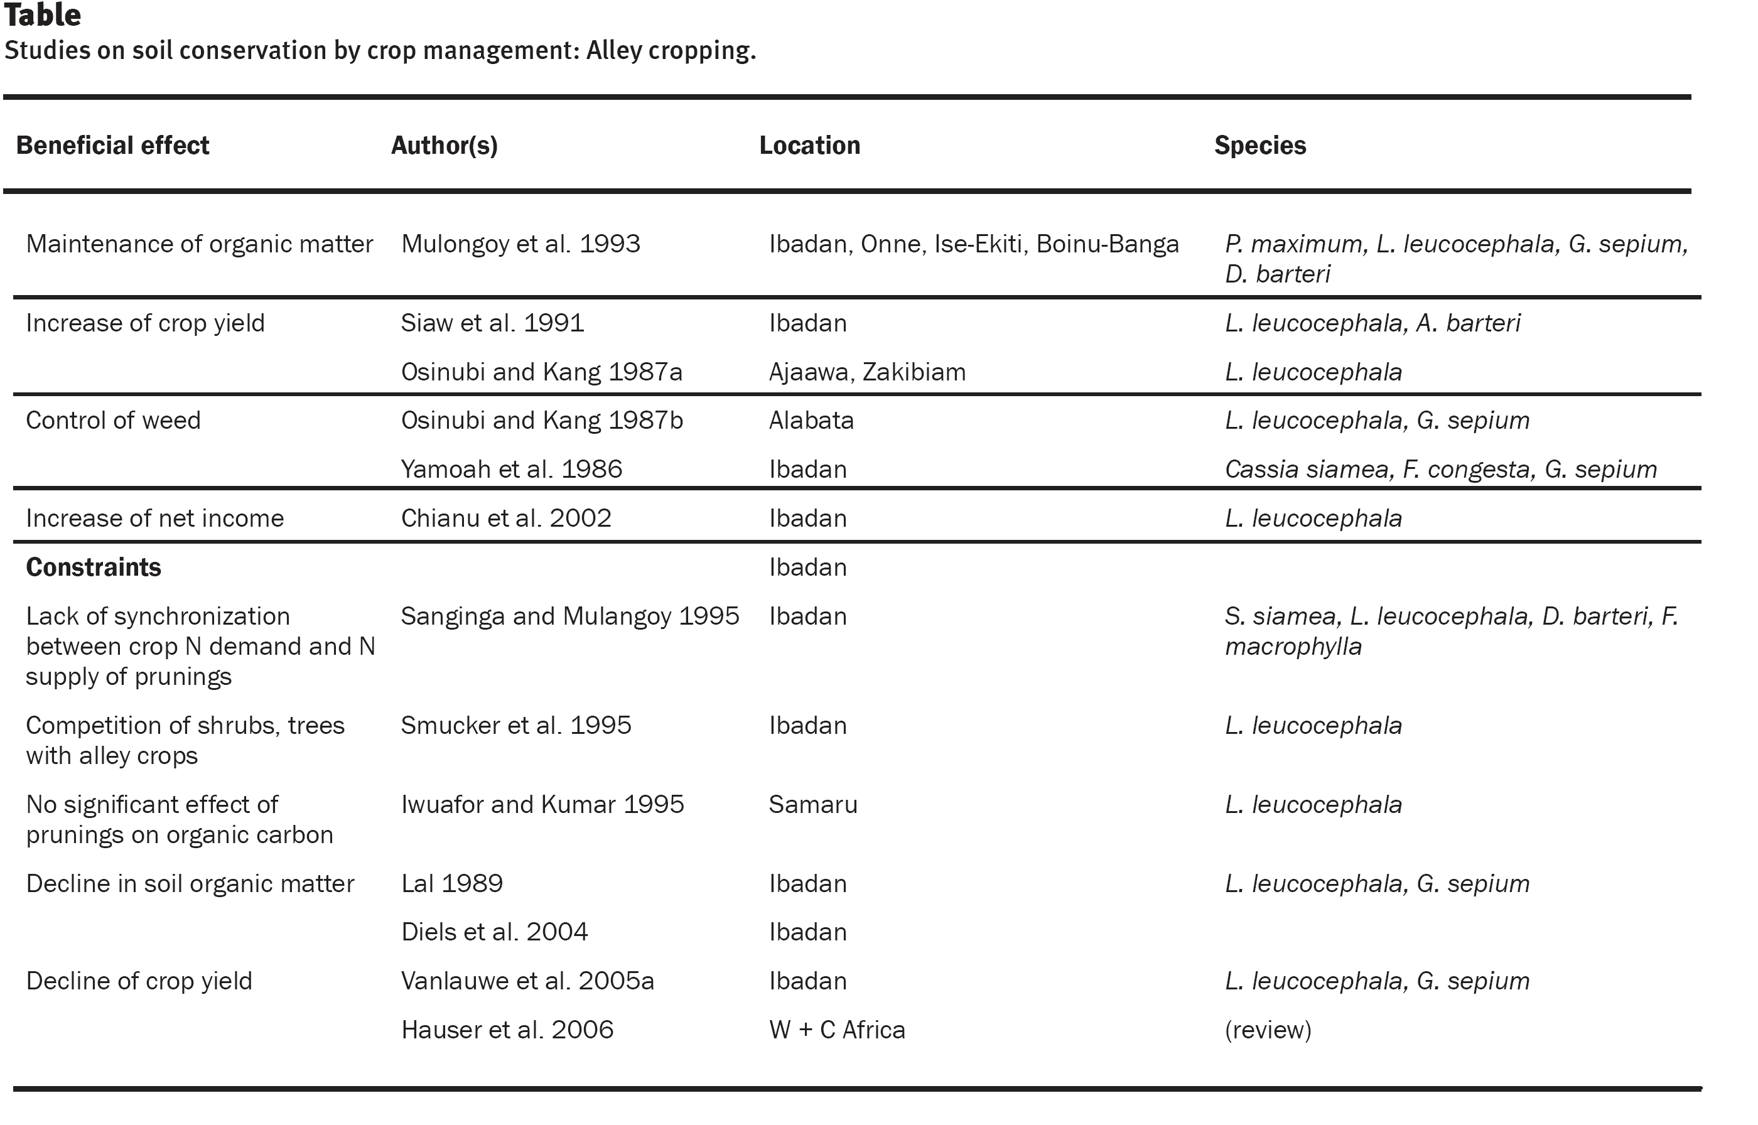

Slide 22
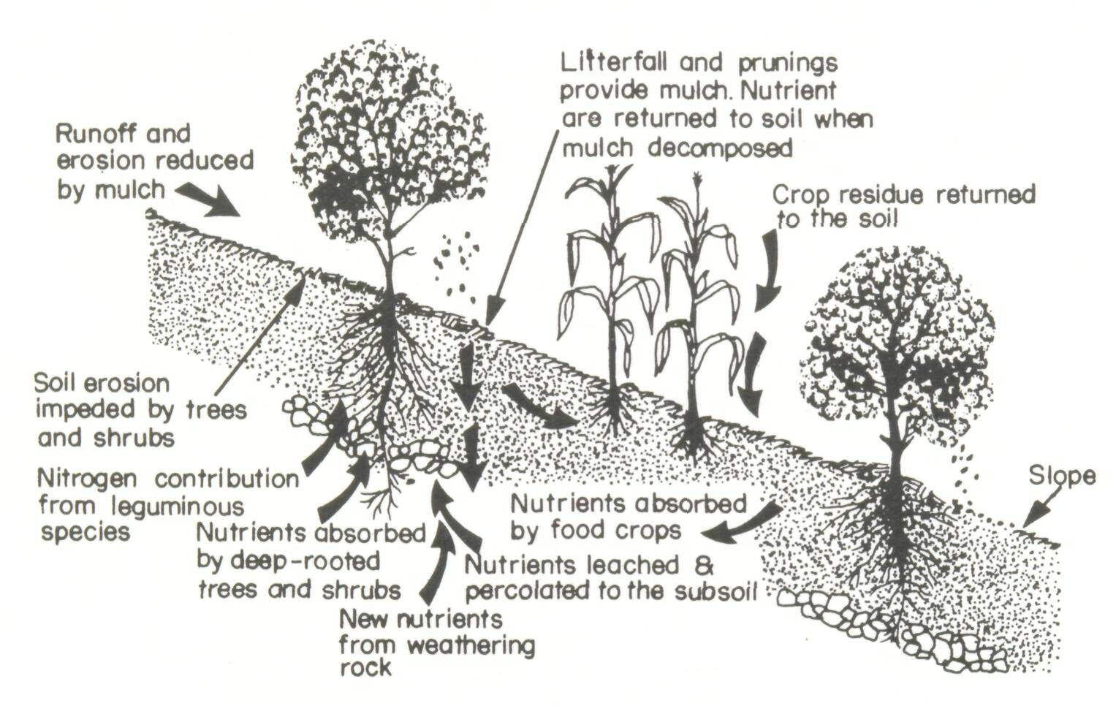

Slide 23
Agroforestry
Definition
Agroforestry refers to land-use systems in which trees or shrubs are grown in association with agricultural crops, pastures or livestock, and in which there are both ecological and economic interactions between the trees and other components.
it covers combinations of trees with plants or animals, and that there must be interactions between the tree and non-tree parts of the system
The main components of agroforestry systems are trees and shrubs, crops, pastures and livestock, together with the environmental factors of climate, soils and landforms.
Other components (e.g. bees, fish) occur in specialized systems.

Slide 24
The definition of agroforestry stress two characteristics common to all forms of agroforestry and separate them from the other forms of land use, namely:
the deliberate growing of woody perennials on the same unit of land as agricultural crops and/or animals, either in some form of spatial mixture or sequence;
there must be a significant interaction between the woody and non-woody components of the system, either ecological and/or economical.

Slide 25
TABLE: Various Types of Positive and Negative Impacts of Trees on Crops under AFS
Positive Effects | Negative Effects
Soil fertility enrichment | Shading
Improvement of microclimate | Resource competition
Maintenance of water quality | Allelopathy (chemical interference)
Weed and pest management | Invasive behavior of some of the
Biodiversity conservation | introduced species
Enhancing food security | Harboring of harmful pathogens and pests
Alleviating poverty
Carbon sequestration and greenhouse
gas mitigation
Habitat for wildlife
Phytoremediation

Slide 26
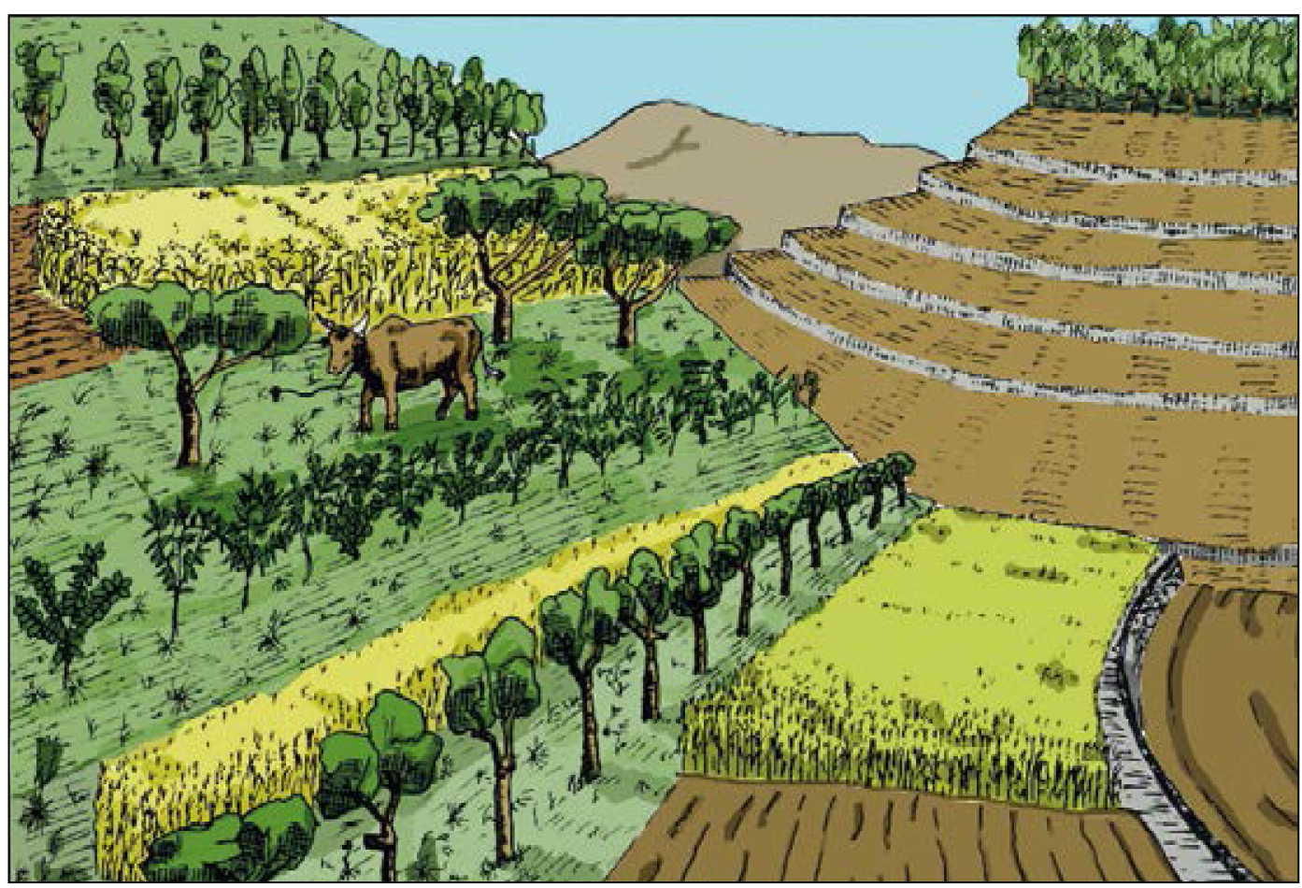
Alley cropping on a steep slope. Rows of trees and hedges alternate with strips of grassland or cultivated land.

Slide 33
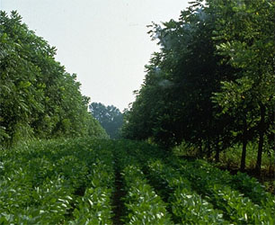
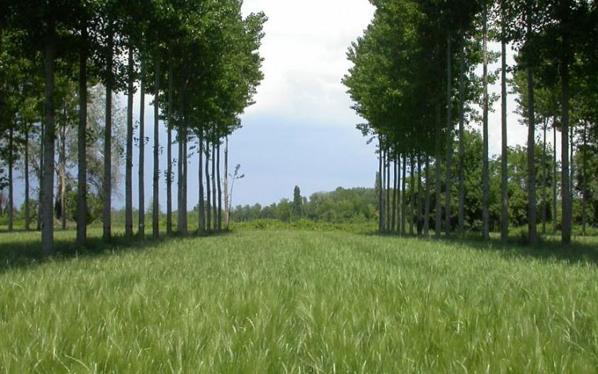
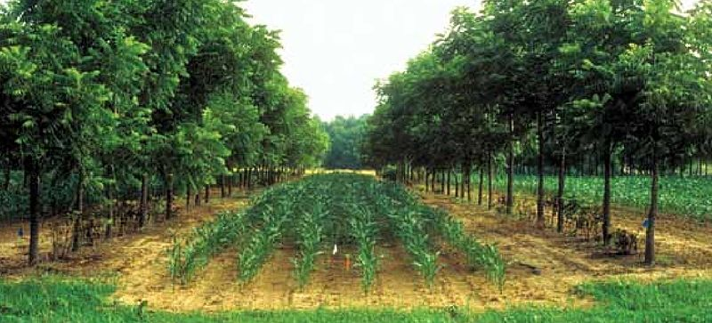

Slide 34
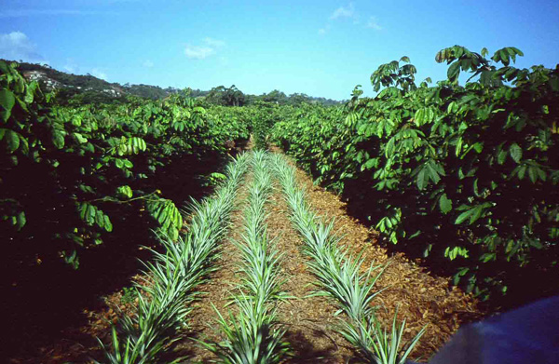
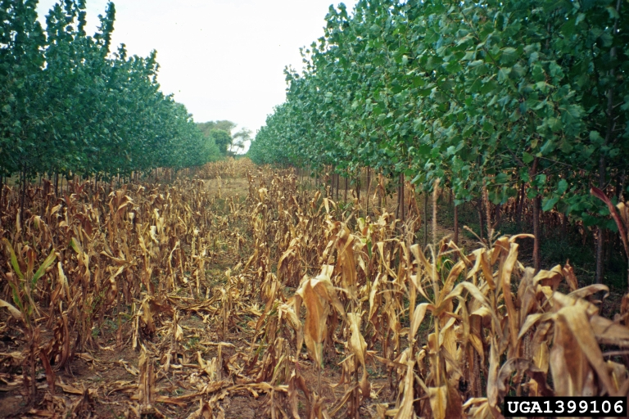
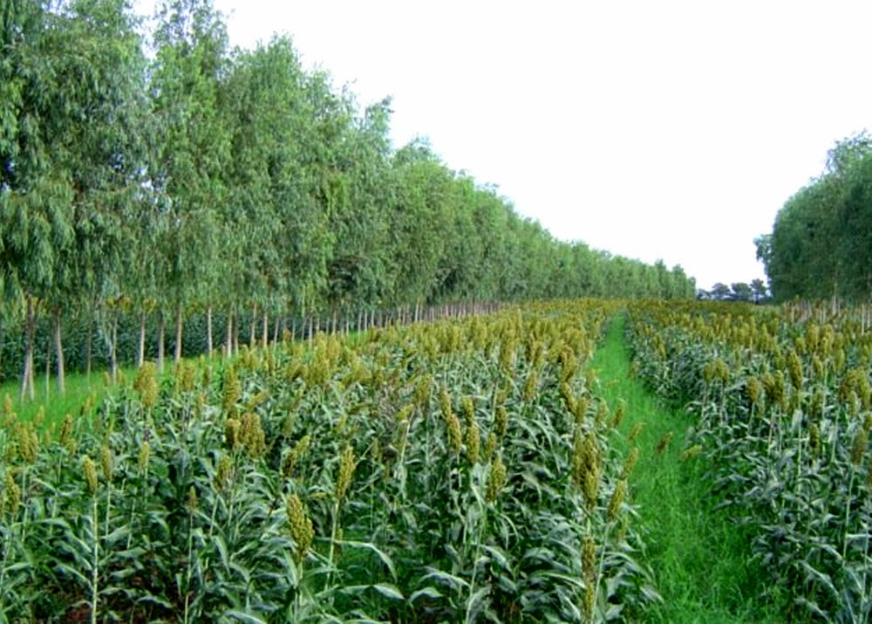

Slide 35
Table: Agroforestry practices.
MAINLY AGROSYLVICULTURAL (trees with crops)
Rotational:
Shifting cultivation
Improved tree fallow
Taungya
Spatial mixed:
Trees on cropland
Plantation crop combinations
Multistory tree gardens
Spatial zoned:
Hedgerow intercropping (barrier hedges, alley cropping) (also agrosylvopastoral)
Boundary planting
Trees on erosion-control structures
Windbreaks and shelterbelts (also sylvopastoral)
Biomass transfer

Slide 36
MAINLY OR PARTLY SYLVOPASTORAL (AGROSILVIPASTORIAL)
(trees with pastures and livestock)
Spatial mixed:
Trees on rangeland or pastures
Plantation crops with pastures and tree
Spatial zoned:
Live fences
Fodder banks
TREE COMPONENT PREDOMINANT
(see also taungya)
Woodlots with multipurpose management
Reclamation forestry leading to multiple use
OTHER COMPONENTS PRESENT
Entomoforestry (trees with insects)
Aquaforestry (trees with fisheries)

