Slide 1
Soil and Water Conservation Engineering and Management NRIWM5342 3 (2+1) Cr. hrs
Instructor’s Name:
Tadele Amdemariam (Dr.)
Phone : 0936321744
Email: tadelemtb@hotmail.com

Slide 2
Objectives
At the end of successful completion of the course will enable students to;
Identify the processes, types and mechanics of erosion
Identify the causes and consequences of erosion
Apply different assessment and estimation models of erosion hazard estimation
Understand the strategies and principles to be followed in planning erosion control activities
Explain the importance of different soil and water conservation measures
Plan and implement physical/mechanical and agronomic/biological erosion control measures to different land use and agro ecological zones.
Able to Use of remote sensing and GIS for planning soil and water conservation techniques.
Describe different water harvesting techniques

Slide 3
CHAPTER 1: INTRODUCTION
1.1 Objectives, aims of soil and water conservation,
1.2 Defining goals; identifying goals (on farm and off-farm)
1.3 Past approaches, new concepts,
1.4 Relative importance of the agronomic and structural measures in relation to:- erosion control, maintenance of fertility and soil and water status and production
CHAPTER 2: EROSION CONTROL MEASURES; AGRONOMIC MEASURES
2.1. Principles of erosion control,
2.2. Crop management;
2.3. Control and management of denuded lands
2.4. Control and management of grasslands,
2.5. Choice of the appropriate measures

Slide 4
CHAPTER 3: SOIL MANAGEMENT
3.1. How the soil is treated and managed.
3.2. Maintenance of soil fertility and structure,
3.3. Means of increasing the resistance of the soil to erosion
3.4. Improving the soil physical and chemical properties.
3.5. Soil management practices
3.5.1. Appropriate tillage practices
3.5.2. Application of fertilizers and manure
3.5.3. Mulching
3.5.4. Incorporation of organic material and crop residue into the soil

Slide 5
CHAPTER 4: EROSION CONTROL STRUCTURES; DESIGN AND SELECTION
4.1. Principles, effects of structure;
4.2. Different soil conservations structures
4.3. Design of structures; runoff estimation
4.4. Design parameters
4.5. Selection criteria
4.6. Applications for different circumstances
4.7. The layout, construction and maintenance;
4.8. Construction of conservation structures

Slide 6
CHAPTER 5: GULLY EROSION AND ITS CONTROL
5.1. Gully classification, initiation and development
5.2. Thresholds of influencing factors, models
5.3. Impacts and assessments,
5.4. Control measures at the head, floor and sides of gullies;
5.5. Check dams; types and design
CHAPTER 6: EVALUATION AND PLANNING SOIL AND WATER CONSERVATION
6.1. The need for evaluation;
6.2. The BMP approach; Steps in evaluation
6.3. Participatory planning approach
6.4. PRA as diagnostic method and different tools, methods
6.5. LLPPA

Slide 7
CHAPTER 7: THE CONCEPT OF RAINWATER HARVESTING
7.1. What is water harvesting?
7.2. What are the principles?
7.3. What are the benefits of water harvesting?
7.4. Impacts of water harvesting
7.5. Water harvesting techniques
7.6. Design considerations
CHAPTER 8: POLICY, SOCIAL AND ECONOMIC ISSUES

Slide 8
Practical: Design and construction aspect of some soil and water conservation
Assessment method Continuous exams
Assignments Write-up & Presentation
Reflection of group discussion
Practical (Field/Lab) works
Attendance, professional conduct and participation
Continuous Assessment 50%; Final examination (50%)

Slide 9
Reference
Hans H. 1986. Soil conservation in Ethiopia. Community forest and soil conservation development department, MoA. Addis Ababa, Ethiopia.
Morgan, R.P.C., 2005. Soil Erosion and Conservation. Carlton, Australia
Suresh, R., 2002. Soil and Water Conservation Engineering. New Delhi, India
Arakeri. 1987. Principles of Soil Conservation and Water Management. IBH Publishing Co., New Delhi, India.
Suresh, R., 2002. Soil and Water Conservation Engineering. New Delhi, India
Morgan, R.P.C., 2005. Soil Erosion and Conservation. Carlton, Australia
FAO. 1993. Field measurement of soil erosion and runoff. Natural resource management and environment department. FAO Soils Bulletin (FAO). 0253-2050, no. 68. Rome, Italy.

Slide 10
Objectives, aims of soil and water conservation
Soil is the most fundamental and basic resource.
Soil is a non-renewable resource over the human time scale.
Humans cannot survive without soil because it is the basis of all terrestrial life.
Soil is a vital resource that provides food, feed, fuel, and fiber.
World soils are now managed to:
(1) meet the ever-increasing food demand,
(2) filter air,
(3) purify water, and
(4) store carbon (C) to offset the anthropogenic emissions of CO₂.

Slide 11
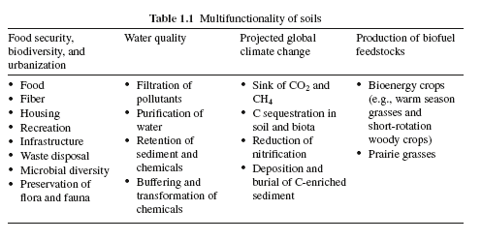

Slide 12
Soil is a non-renewable resource over the human time scale.
It is dynamic and prone to rapid degradation with land misuse.
Productive lands are finite and represent only <11% of earth’s land area but supply food to more than 7.2 billion people increasing at the rate of 1.3% per year
The on- and off-site estimated costs of erosion for replenishing lost nutrients, dredging or cleaning up water reservoirs and conveyances, and preventing erosion are very high and estimated at US$ 38 billion in the USA and about US$ 400 billion in the world annually.
In the USA, the estimated cost of water erosion ranges from US$ 12 to US$ 42 billion while that of wind erosion ranges from US$ 11 to US$ 32 billion

Slide 13
Water and wind erosion are two main agents that degrade soils.
Water erosion affects nearly 1,100 million hectares (Mha) worldwide, representing about 56% of the total degraded land while wind erosion affects about 28% of the total degraded land area (Oldeman, 1994).
Since the late 1960’s, nearly one-third of the world’s arable land has been lost by erosion and continues to be lost at a rate of more than 10 million hectares per year.

Slide 14
At global scale, an estimate to about 1960 Mha of land are prone to erosion, which represents about 15% of the earth’s total land area, of which 50% is severely eroded, and much of that is being abandoned.
Soil erosion rates ranges between 0.5 to 350Mgha⁻¹ y⁻¹
The current cultivated land area is almost equal to the land area abandoned since the dawn of agriculture.r⁻¹.
Annually, about 75 × 10⁹ Mg of soil is lost worldwide, representing approximately US$400 billion per year for losses in nutrients, soil, and water, equivalent to US$70 per person per year (Lal, 1998).
Soil erosion constitutes a major threat to food production particularly in densely populated and rapidly growing regions of the world.
About 6 × 10⁹ Mgyr⁻¹ of soil is annually lost in India and China (Pimentel, 2006).

Slide 15
In the United States, an estimated 4 X 10⁹ tons of soil and 1.3 x 10¹¹ tons of water are lost from the 1.6 x 108 hectares of cropland each year.
This translates into an on-site economic loss of more than $27 billion each year, of which
$20 billion is for replacement of nutrients and
$7 billion for lost water and soil depth

Slide 16
In Ethiopia, 88% of the human population, 60% of the livestock, and 90% of the agriculturally suitable area is concentrated in the highlands more than 1500 m above sea level (Constable, 1985)
Land degradation affects:
over 40 million hectares and
~70% of Ethiopia’s highland population.
Each year, 1.9 billion tons of soil are lost to erosion,
110 billion cubic meters of water are lost as runoff
Soil nutrient loss costs USD 100 million
Net deforestation that equals 200,000 hectares (Tadesse 2012).
Soil erosion by water is the dominant degradation process and occurs particularly on cropland, with annual soil loss rates on average of 42 tons/ha for croplands, and up to 300 tons/ha in extreme cases (Hurni 1993).

Slide 17
Soil Erosion - Principles
Definition –
The detachment and transportation of soil material by different agents.
Types of soil Erosionon
Geological erosion
Accelerated erosion
The common forms of soil erosion are:
Splash, sheet, rill, gully, streambank,
Factors of soil Erosion
amount and type of vegetation, slope, amount of rainfall, soil type, and human activities.

Slide 18
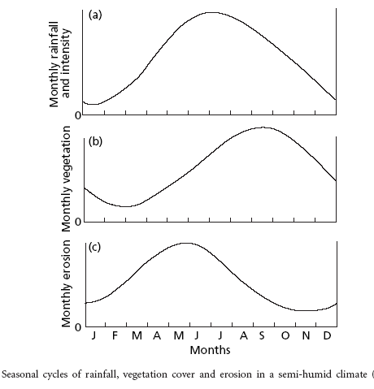

Slide 19
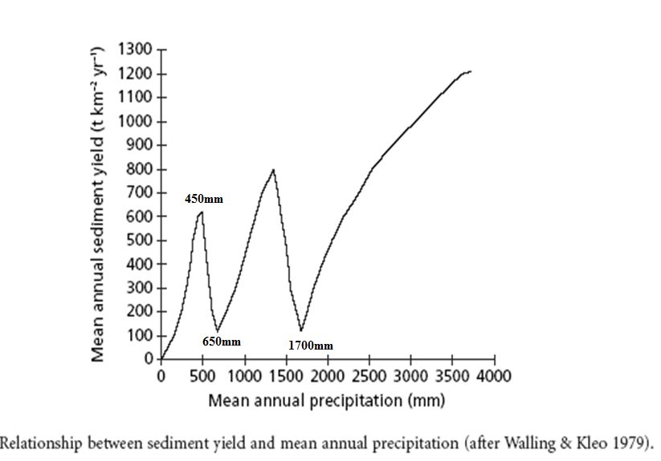

Slide 20
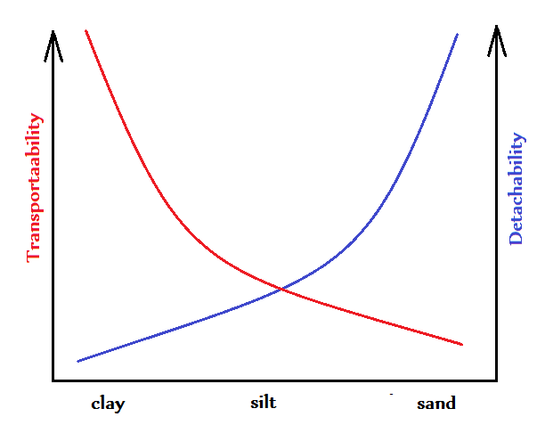
Relation of soil separates to detachability and transportability

Slide 21
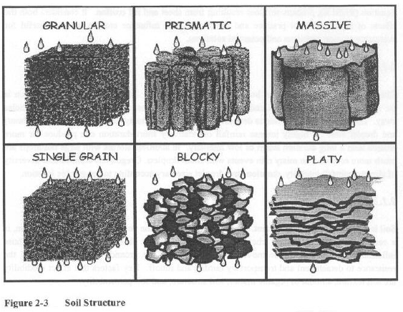

Slide 22
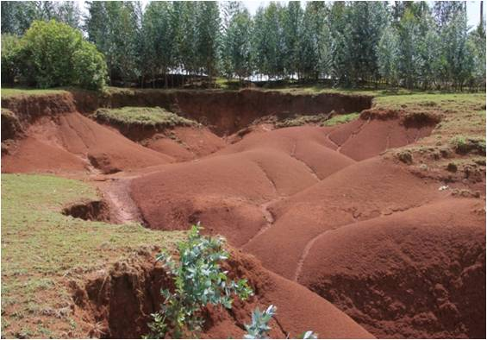
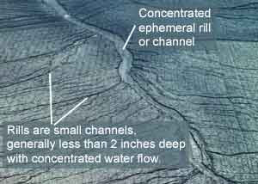
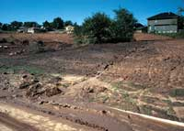
GULLY EROSION
There are many farms that are losing large quantities of topsoil and subsoil each year due to gully erosion.

Slide 23
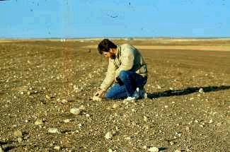
EROSION BY WIND
The rate and magnitude of soil erosion by wind is controlled by the following factors
Erodibility of Soil
Soil Surface; Roughness
Soil moisture
Climate
Unsheltered Distance
Vegetative Cover
Wind removes smaller soil particles and leaves rocks exposed on the surface

Slide 24
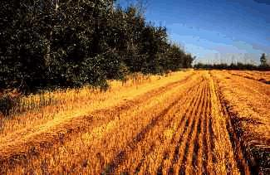
Shelterbelts
Field shelterbelts reduce wind erosion and conserve soil moisture.

Slide 25
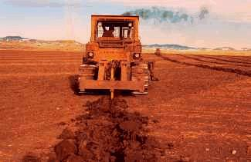
Ripping is an emergency measure to reduce wind erosion on clay soil

Slide 26
Control wind erosion with a crop residue cover and shelterbelts.

Slide 27
Relative importance of the agronomic and structural measures in relation to:- erosion control, maintenance of fertility and soil and water status and production
Terms for soil and water conservation technologies and approaches are not consistently used and mean different things to different people – and even to the same people at different times
Terrace
Bunds
Ditches
Stonewalls
Earth bunds
Grass strips
Graded ditches
Infiltration ditches
Enclosure
Fanya juu
Cutoff drain
waterway
Appearance
Appearance and materials
Slope and drainage
Land management
Way of constructions
Function and impact

Slide 28
SWC classification
Management measures such as land use change, area closure, rotational grazing, etc.
Involve a fundamental change in land use
Involve no agronomic and structural measures as a priority
Often result in improved vegetative cover
Often reduce the intensity of use
Agronomic measures such as mixed cropping, contour cultivation, mulching, etc.
Are usually associated with annual crops
Are repeated routinely each season or in a rotational sequence
Are of short duration and not permanent
Do not lead to changes in slope profile
Are normally independent of slope

Slide 29
Vegetative measures such as grass strips, hedge barriers, windbreaks, etc.
Involve the use of perennial grasses, shrubs or trees
Are of long duration
Often lead to a change in slope profile
Are often zoned on the contour or at right angles to wind direction
Are often spaced according to slope
Structural measures such as terraces, banks, bunds, constructions, palisades (strong fence), etc.
Often lead to a change in slope profile
Are of long duration or permanent
Are carried out primarily to control runoff, wind velocity and erosion
Often require substantial inputs of labor or money when first installed
Are often zoned on the contour / against wind direction
Are often spaced according to slope
Involve major earth movements and / or construction with wood, stone, concrete, etc.

Slide 30
Combinations in conditions where different measures are complementary and thus enhance each other’s effectiveness.
Any combinations of the above measures are possible, e.g.:
Structural: terrace with
Vegetative: grass and trees with
Agronomic: ridges

Slide 31
Each of these (soil management, vegetative, structural and agronomic conservation measures) conservation categories is split up into subcategories.
The main criteria are the appearance, the materials used and the management involved in the technology.
Over all management
Management measures (such as land use change, area closure, rotational grazing, etc.) involve a fundamental change in land uses; often result in improved vegetative cover; and often reduce the intensity of use. ; involve no agronomic and structural measure
Change of land use type:
e.g.
enclosure, resting, protection,
change from crop to grazing land, from forest to agroforestry, from grazing land to cropland, etc.

Slide 32
Change of management / intensity level:
e.g. from monocropping to rotational cropping,
from continuous cropping to managed fallow,
from laissez-faire to managed,
from random (open access) to controlled access (grazing land forest land e.g. access to firewood), from herding to fencing, adjusting stocking rates, etc.
Layout according to natural and human environment:
exclusion of natural waterways and hazardous areas, separation of grazing types, distribution of water points, salt-licks, livestock pens, dips (grazing land)
Major change in timing of activities:
land preparation, planting, cutting of vegetation
Control / change of species composition:
reduce invasive species,
selective clearing,
encourage desired species,
controlled burning / residue burning

Slide 33
Agronomic measures / soil management
Agronomic measures (such as mixed cropping, contour cultivation, mulching) are usually associated with annual crops; are repeated routinely each season or in a rotational sequence; are of short duration and not permanent; do not lead to changes in slope profile; are normally not zoned; and are normally independent of slope.
Vegetation / soil cover:
better soil cover by vegetation,
early planting,
relay cropping,
mixed cropping / intercropping,
contour planting / strip cropping,
cover cropping, retaining more vegetation cover,
mulching, temporary trash lines, others

Slide 34
Organic matter / soil fertility:
legume inter-planting,
green manure,
applying manure / compost / residues (organic fertilizers),
applying mineral fertilizers (inorganic fertilizers),
applying soil conditioners (e.g. use of lime or gypsum),
rotations / fallows (associated with overall management), others
Soil surface treatment:
conservation tillage (zero tillage, minimum tillage and other tillage with reduced disturbance of the top soil),
contour tillage,
contour ridging (crop and grazing land), done annually or in rotational sequence,
Subsurface treatment:
breaking compacted subsoil (hard pans):
deep ripping, “subsoiling”,
deep tillage / double digging, others

Slide 35
Vegetative measures
Vegetative measures
(such as grass strips, hedge barriers, windbreaks, etc.)
involve the use of perennial grasses, shrubs or trees;
are of long duration;
often lead to a change in slope profile;
are often zoned on the contour or at right angles to wind direction and
are often spaced according to slope:

Slide 36
Tree and shrub cover:
Dispersed trees (in annual crops or grazing land),
Aligned trees (in annual crops or grazing land): e.g. live fences, hedges, barrier hedgerows, alley cropping),
Trees in blocks (e.g. woodlots)
Grasses and perennial herbaceous plants:
dispersed, aligned (grass strips)

Slide 37
Structural measures
Structural measures (such as terraces, banks, bunds, constructions, palisades, etc.)
often lead to a change in slope profile;
are of long duration or permanent;
are carried out primarily to control runoff, wind velocity and erosion;
often require substantial inputs of labor or money when first installed;
are often zoned on the contour / against wind direction;
are often spaced according to slope; and

Slide 38
involve major earth movements and / or construction with wood, stone, concrete, etc.:
bench terraces- level, forward sloping/outward sloping, backward sloping/back sloping/reverse
Bunds/banks – levele (tied, non-tied), graded (tied, non-tied), semi-circular, v-shaped, trapezoidal,
Graded ditches – waterways, cut-off drains
Level ditches, pits : infiltration, retention, sediment/sand traps
Dams/pans - store excess water
Reshaping surface (reducing slope/topsoil retention

Slide 39
SWC – principles of functioning
To describe these principles, it is useful to regroup the above-mentioned SWC categories into four groups with similar functions:
(1) vegetative and agronomic SWC
(2) structural SWC in humid areas,
(3) structural water conservation in arid areas, and
(4) wind erosion control

Slide 41
Principles of functioning – vegetative / agronomic SWC
Vegetative and agronomic measures create effects both above and below the soil surface.
Plants, plant residues, but also stones, coarse clods (soil aggregates), etc. form an increased surface roughness that in turn enforces a reduction of runoff velocity, accumulation of eroded particles, and provide an extended time of infiltration.
In addition, plants and mulch reduce the effect of rain splash, decreasing the amplitude of the surface temperature and thus help reduce evaporation losses.

Slide 42
Plants also help increase infiltration in many ways:
(1) directly through their roots, and
(2) indirectly by increasing organic matter and thus improving aggregate stability and the soil structure.
Selected plant types improve soil fertility by fixing macronutrients such as Nitrogen.
Improved soil fertility, in turn, serves again for better plant growth.

Slide 44
Principles of functioning – structural SWC in humid areas
Catchments in humid areas often face a general problem of surplus overland flow.
The first task may therefore be to protect the uncovered cultivated parts from external sources of water – the so-called runon.
when there is less protective vegetation available, it is mostly drainage channels or ditches, so-called cut-off drains that serve as a runon control.
On cultivated fields, structural measures such as ditches, terraces, bunds etc. help interrupt (decrease) slope length. With time, also the slope angle will be diminished when structures gradually develop into terraces.
To safely drain excess water, these structures are graded. Both reduced slope length and slope angle help slow down runoff velocity, encourage accumulation of eroded particles, and extending the time of infiltration.

Slide 45
Cut-off drains and terrace channels collect a lot of runoff that needs to be safely drained out of the cropping area and out of the catchment.. Waterways these purpose.
waterways can be natural or artificial drainage lines that should be protected from erosion themselves, for example by a dense ground cover (grass, stones) or wooden / stone check-dams.
Waterway – or gully – protection measures focus also on reducing runoff velocity and enforcing accumulation of eroded material

Slide 47
Principles of functioning – structural SWC
In arid areas rainwater is commonly insufficient for production.
Only a certain part of a slope – e.g. 50% - will be used as cropping area, while the remaining part serves as external “catchment” for collecting / harvesting rain water to be drained onto the cropping area.
The catchment area needs both runoff and infiltration management.
Soil crusts must often be broken to enable infiltration. Mulching can minimize evaporation losses.
With time, soil structure (aggregate stability) and organic matter content can be gradually improved.
At the same time, structures of different shapes – half moon and rectangular forms – will keep overland flow as long as possible in the cropping area. Excess water will be drained around or through these structures (via spillways) onto the next cropping area and structure downslope.

Slide 48
In this manner, slope length is reduced to minimize erosion risk during heavy rainfall events. Consequently, runoff velocity is reduced, accumulation of eroded particles is enhanced, and infiltration increased

Slide 49
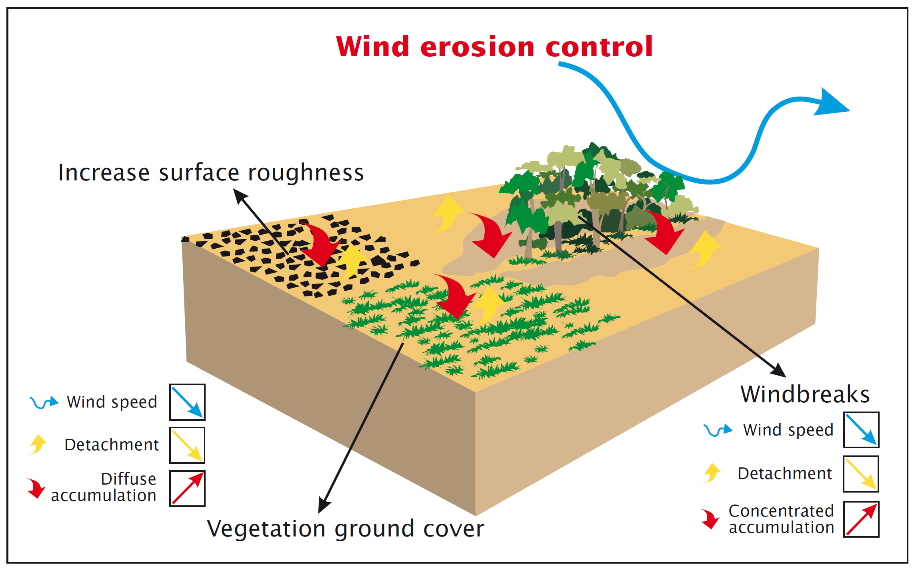

Slide 50
Principles of functioning – wind erosion control
Controlling wind erosion can be separated into prevention of detachment and re-accumulation of already eroded materials.
In both cases, wind speed must be diminished.
Increased surface roughness, either by plants or large soil aggregates and clods reduce wind speed near the soil surface, eroded particles accumulate in diffuse accumulations, and detachment is largely decreased.
Barriers, so-called windbreaks consisting of higher trees, bushes and ground cover, reduce wind speed in the first couple of meters above ground. Typically, accumulations of eroded material concentrate immediately before and after the barrier

Slide 51
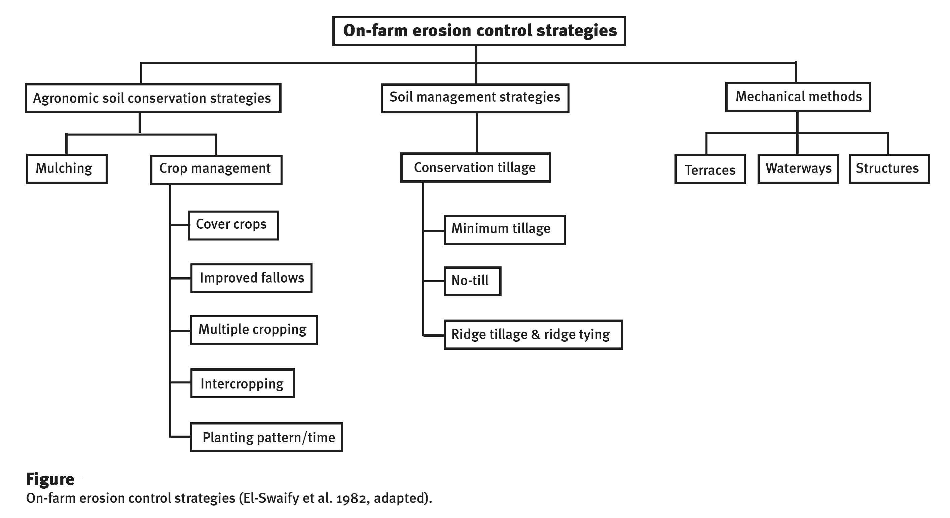
Vegetative measures
Grass strips
Alley cropping
Dispersed trees on farm land

Slide 52
General principles for the development of soil management strategies
OBJECTIVES OF SOIL MANAGEMENT FOR AGRICULTURE
The main objective of soil management for agriculture is to create
favorable conditions for good crop growth,
seed germination,
emergence of the young plants,
root growth,
plant development, grain formation and harvest.
Desirable edaphological conditions are as follows:
physical conditions that favor seed germination (aggregate size, moisture content and soil temperature).
a surface structure that does not impede emergence of the young plants
a soil structure, porosity and consistency in the uppermost horizon that favours the initial growth of the young plant and its roots. Early
a structure, size and continuity of the pores in the subsoil that allows free penetration and development of the roots.
an adequate and timely supply of nutrients that coincides with crop demand during the growth cycle.

Slide 53
the lack of toxic substances in the soil. A high degree of saturation of the Effective Cation Exchange Capacity (ECEC) with aluminum or manganese, soluble salts, or an excess of exchangeable sodium may be toxic to many crops.
an adequate and timely supply of moisture to the crop throughout its cycle, particularly at critical growth stages.
an adequate and timely supply of oxygen to the crop roots and the aerobic soil microorganisms.
high biological activity in the soil.
stable conditions in the cropped area so that flooding, water erosion or high winds do not harm the crops.

Slide 54
PRINCIPLES FOR THE DEVELOPMENT OF SOIL MANAGEMENT PRACTICES
There are nine general principles that should be considered as basic guidelines for the development of strategies for soil management systems:
increase the soil cover,
increase the soil organic matter content,
increase infiltration and water retention,
reduce the runoff,
improve the rooting conditions,
improve the fertility and productivity,
reduce production costs,
protect the field, and
reduce soil and environmental pollution.

Slide 55
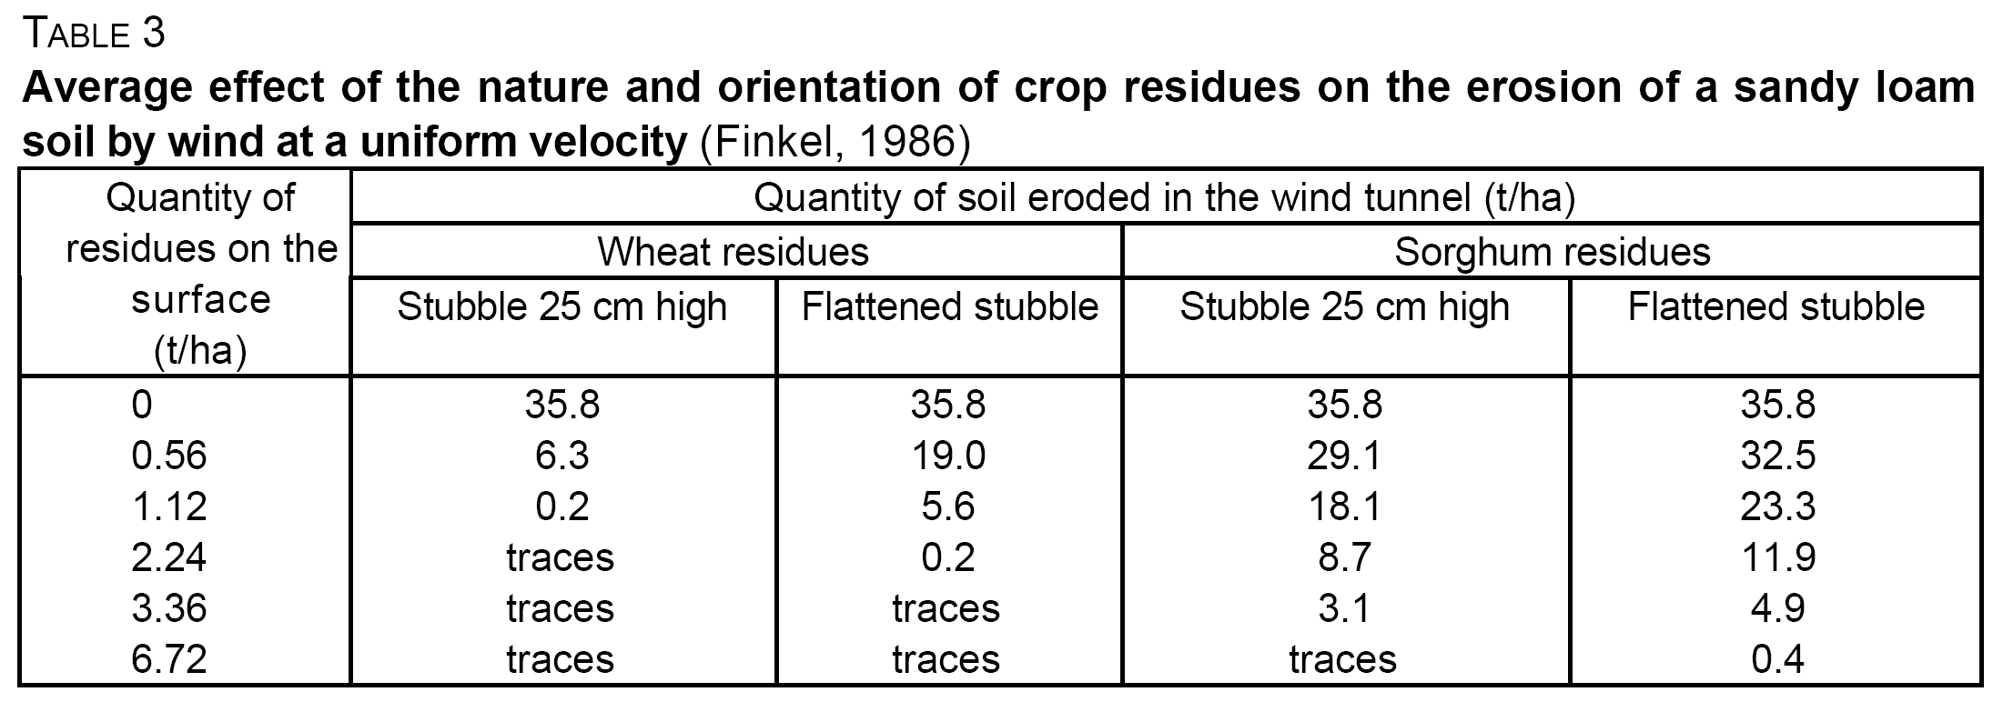
1. Increase the soil cover
This is the most important principle for sustainable soil management as it brings multiple benefits:
Reduction of water and wind erosion
There is evidence that a 40 percent soil cover reduces the soil losses due to splash erosion to values of less than 10 percent of what would be expected from same soil when bare

Slide 56
Mulch cover and soil loss from two simulated rainfalls (Barber and Thomas, 1981)
Mulch Cover Soil loss (t/ha) _________________________
(t/ha) (%) 1st Storm 2nd Storm Average ____________
0 0 1.40 6.27 3.84
1 46 0.22 1.70 0.96
2 67 0.12 0.83 0.48
4 79 0.03 0.26 0.15 ___________
Average 0.44 2.27 1.36 ___________

Slide 57
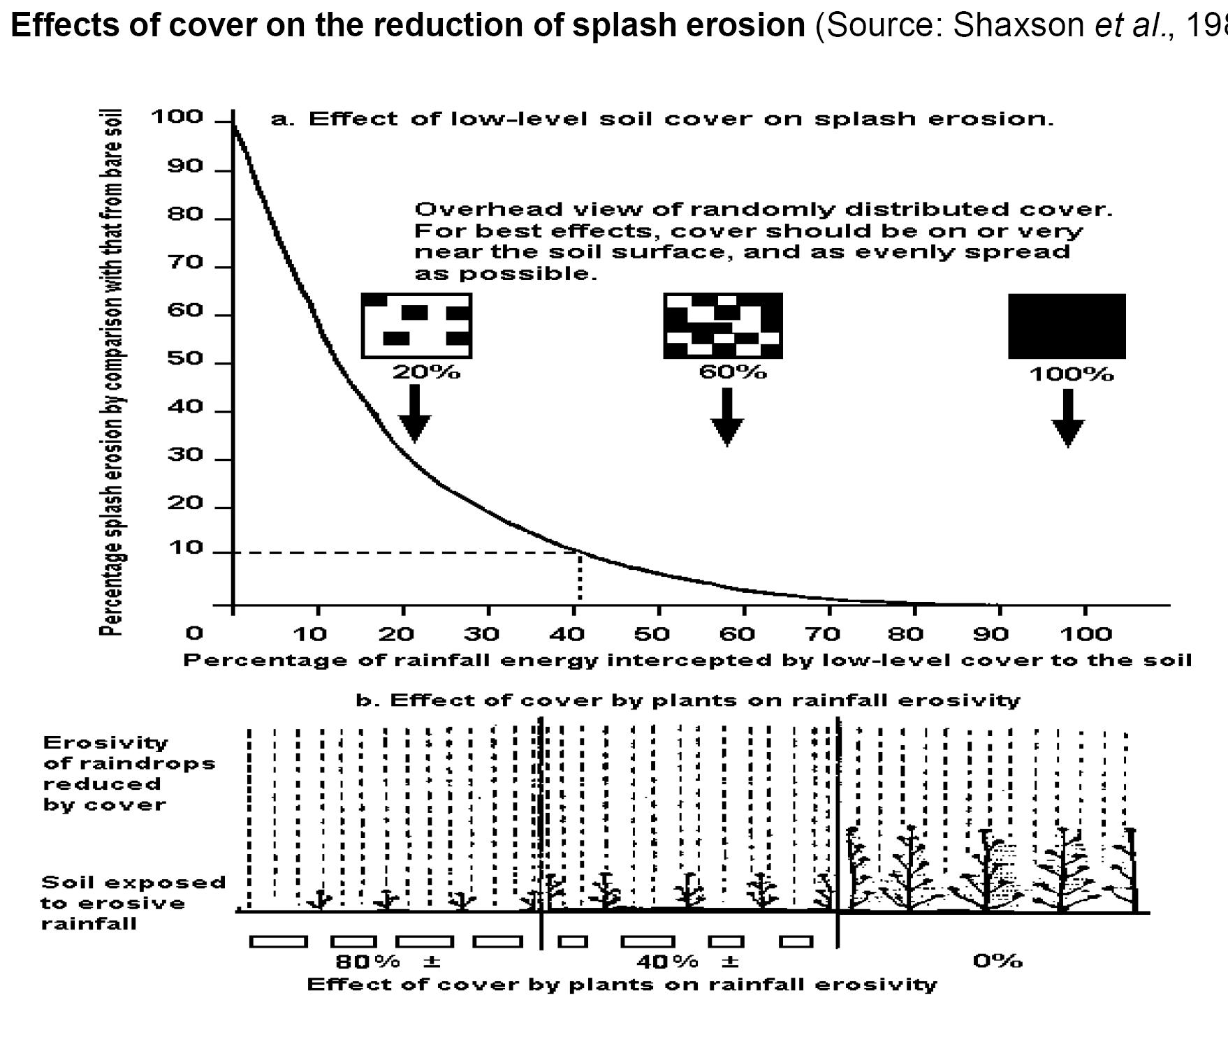
1. Increase the soil cover

Slide 58
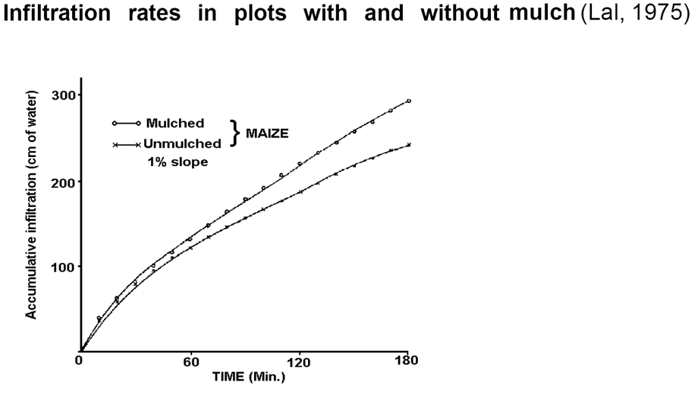
1. Increase the soil cover
Increase of the rainfall infiltration rate
The soil protection provided by cover prevents the formation of surface crusts and maintains a higher infiltration rate. Figure below shows the difference in infiltration rates for a soil in Nigeria, with and without cover

Slide 59
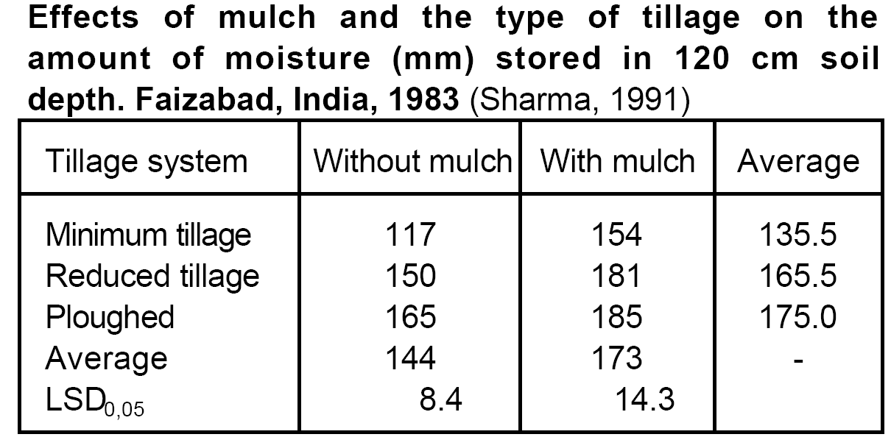
1. Increase the soil cover
Reduction of moisture loss by evaporation and increase in moisture availability
The combination of improved infiltration and lower moisture loss through evaporation results in increased moisture availability for the crop.

Slide 60
1. Increase the soil cover
Reduction of the temperature
The presence of a cover substantially reduces the daily maximum temperature in the first 5 cm of soil depth.
For many crops, temperatures above 40°C inhibit seed germination and temperatures higher than 28-30°C at 5 cm depth restrict the growth of seedlings of many crops (Lal, 1985).
Improvement of conditions for germination
Increased moisture and lower temperatures create better conditions for seed germination.
The data compares zero tillage with conventional tillage, representing contrasting systems with and without cover.

Slide 61
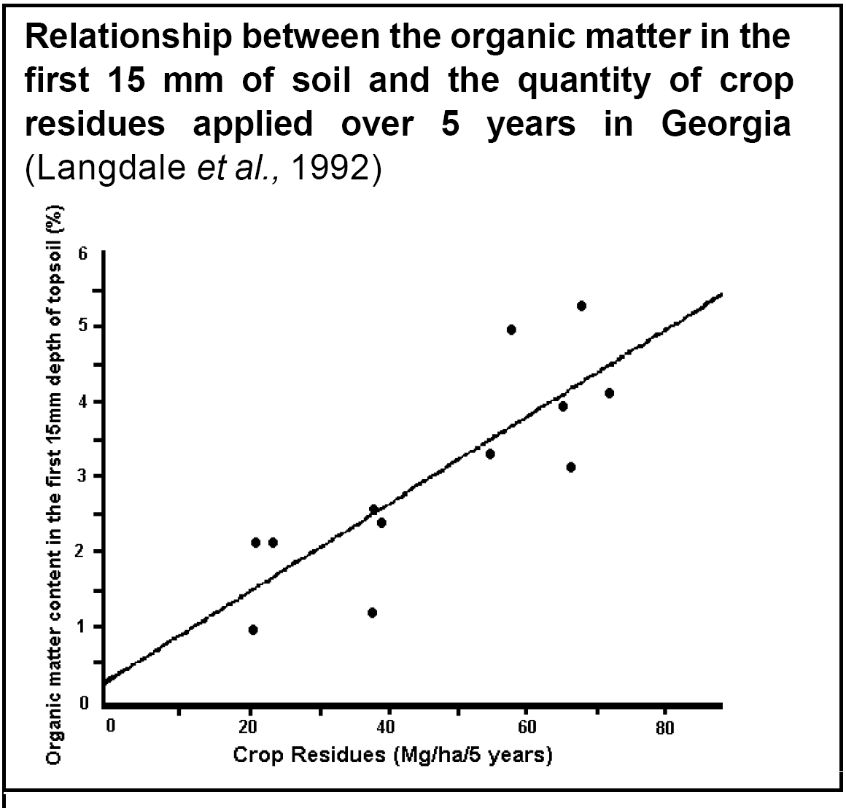
1. Increase the soil cover
Increase in organic matter content of the surface soil layer
The highest increase in the organic matter content initially occurs in the first 15 mm depth of soil under zero tillage, and as time passes, the organic matter content of the deeper layers also increases

Slide 62
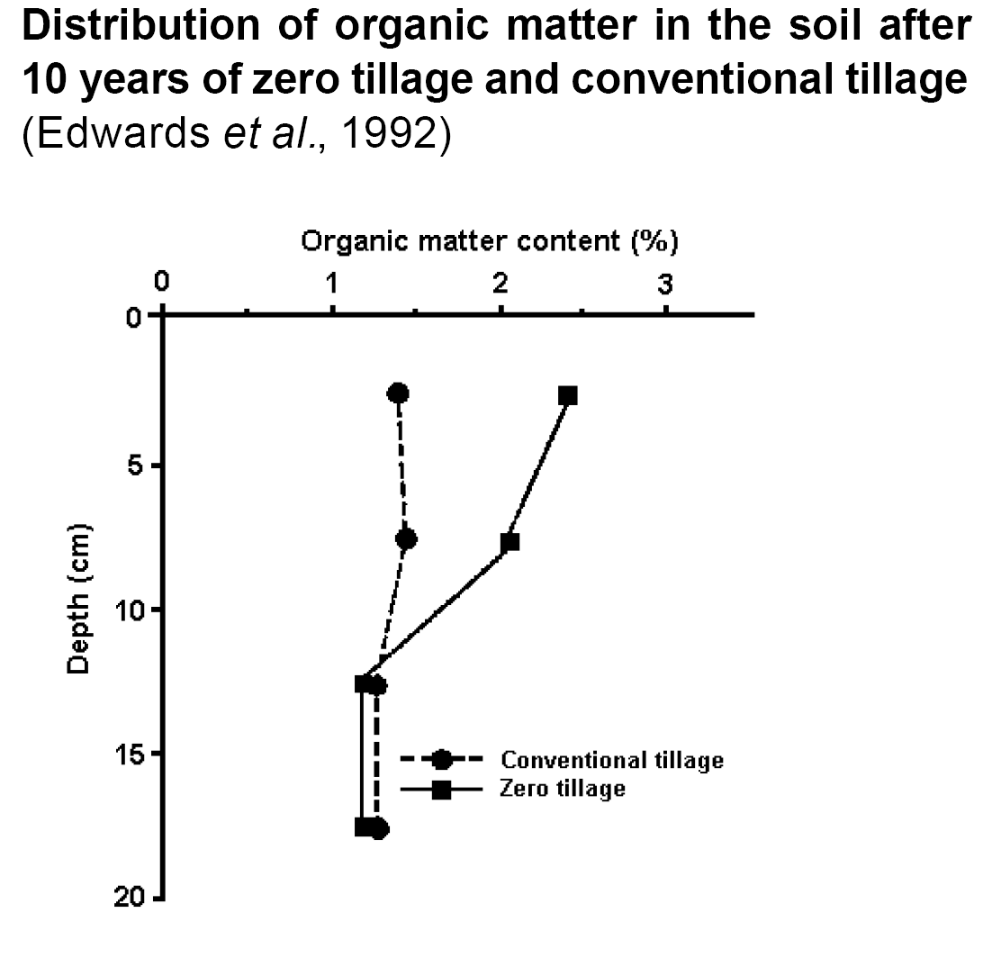
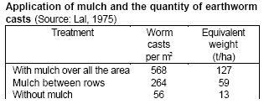
1. Increase the soil cover
Improvement of the structural stability of the surface aggregates
The increase in the organic matter content of the soil improves the resistance of the aggregates to erosion and to crusting.
Stimulation of biological activity in the soil
Optimum conditions of moisture and temperature stimulate the activity of the micro-organisms and of the fauna.

Slide 63
1. Increase the soil cover
Increased porosity
The increase in the activity of the macro-fauna results in increased soil porosity (Lal et al., 1980), particularly the macro-porosity that serves as a by-pass for drainage of the major proportion of the rainfall.
Suppression of weed growth
a good residue cover helps to suppress the emergence of many weeds.

Slide 64
Mechanisms to achieve a better cover are as follows:
1. Increase the soil cover
Leave all the crop residues in the field, do not burn them, do not carry them away from the field and do not graze them, or at least reduce grazing to a minimum.
Practice a system of conservation tillage that leaves the residues on the soil surface
Apply organic materials as manures or mulch to increase the soil cover.
Increase the production of biomass in the field by sowing cover crops, intercrops, relay crops and increase the population density of the crops.
Sow crops that produce large quantities of residues within the overall crop rotation.
Increase the chemical fertility of the soils through the application of fertilizers and organic manures so as to produce greater quantities of biomass.
Leave the dead weeds on the surface as a cover

Slide 65
2. Increase the soil organic matter content
This principle is intimately related to increasing soil cover
The beneficial effects of an increase in soil organic matter:
Increase in the stability of surface aggregates
This leads to greater resistance of the aggregates to crusting, water and wind erosion, and a higher infiltration rate.
Increase of the moisture retention capacity of the soil
The increase is often not very great, except in very sandy soils.
Increase in the capacity of the soil to retain nutrients
This is attributed to the increase in the cation exchange capacity of the soil,

Slide 66
3. Increase the water infiltration rate and moisture retention capacity
The beneficial effects of increasing infiltration rate and moisture retention capacity of soils are
·Reduction of crop moisture deficit
·Increase of the yield and production of the crop biomass
·Reduction of runoff.
Mechanisms to increase soil infiltration rates and moisture retention capacity
Maintain a protective cover of residues over the soil to avoid the formation of surface crusts that would impede the infiltration of the rain.
Create surface roughness between the crop rows to delay crust formation and thus encourage water infiltration.

Slide 67
4. Reduce the runoff
The beneficial effects of reducing runoff are as follows:
reduction of the losses of soil, water, nutrients, fertilizers and pesticides.
increase the moisture available to the crop and consequently grain yield and biomass production.
Measures to reduce runoff once it has commenced are considered below.
Collect the runoff in structures within which the water can infiltrate.
The size, number and distance between the structures must be sufficient to collect all the runoff and avoid overspill that could cause erosion.
Construct structures that collect and lead the runoff away from the field.
Establish permeable barriers along the lines of contour to reduce runoff velocity,

Slide 68
Create small barriers that impede the runoff and give more time for water infiltration.
Improve the permeability of compact layers that are impeding moisture percolation to greater depth, so increasing the moisture retention capacity of the profile.
Apply organic fertilizer to increase the moisture retention capacity of the soil.
Reduce the slope of the land to give more time for rainwater infiltration, for example by constructing bench terraces, orchard terraces or individual terraces.

Slide 69
5. Improve the rooting conditions
The beneficial effects of improving the conditions for roots are:
·improved root development and growth, and as a result the absorption of moisture and nutrients by the crop;
·reduced probability that the crops will suffer from drought.
Mechanisms for improving crop rooting conditions are as follows:
Carry out deep tillage to loosen any compacted or hardened massive layers that are impeding root penetration.
Improve drainage by installing drainage channels where soils are poorly or imperfectly drained, and where a lack of oxygen impedes root development.

Slide 70
6. Improve the fertility and productivity
Beneficial effects produced by improving the chemical fertility and soil productivity are:
increased yields;
increased production of crop biomass
Mechanisms to increase chemical fertility and productivity of the soils are as follows:
Undertake a careful analysis of the nutritional state of the soil
Take advantage of using whatever organic materials are locally available for the improvement of soil fertility,
Introduce crop rotations to increase soil productivity
Avoid wastage of nutrients. Do not allow burning of residues or stubble, nor the export of nutrients out of the farm,

Slide 71
Increase the soil organic matter content, particularly in sandy soils with generally low fertility.
Try to substitute the use of nitrogenous fertilizers by sowing legume crops as part of the rotation, as intercrops, relay crops or as cover crops.
Take advantage of the processes of nutrient recycling, particularly in zones suffering serious leaching problems. Introduce crops with deep rooting systems that absorb nutrients from the deeper layers which are normally beyond reach of most crops.
Overcome soil toxicity problems due to high levels of aluminum or manganese. This may be achieved through the substitution of the crops or varieties with other, more resistant crops or varieties

Slide 72
7. Protect the field
The field should be protected against the effects of flooding, erosion by water, landslips, strong winds and wind erosion.
The principles for protection against flooding are as follows:
Install diversion canals to capture the runoff that enters the field divert and discharge it into a drainage course, avoiding any erosion
Provide maximum soil cover, increase the infiltration rate and reduce the runoff.

Slide 73
8. Reduce pollution of the soil and the environment
The principles to reduce pollution of the soil and the environment are as follows:
Apply integrated weed and pest management measures, rather than just using pesticides.
Train farmers in methods to correctly manage agrochemicals.
Apply soil conservation practices to reduce to a minimum the amount of sediments and pesticides removed from the land.

Slide 74
Soil Management Strategies
Conservation Tillage
Conservation tillage can be deﬁned as any practice that leaves at least 30 per cent cover on the soil surface after planting.
Conservation tillage describes the method of seedbed preparation that includes the presence of residue mulch and an increase surface roughness as key criteria.
Some plants produce toxic material during the breakdown of their residue, which can hinder the germination and establishment of the next crop.
Since this is a particular problem in monocultures of maize and wheat, conservation tillage is also dependent on the use of crop rotations.

Slide 75
Conservation tillage
Minimum Tillage:
Minimum tillage describes a practice where soil preparation is reduced to the minimum necessary for crop production and where 15% to 25% of residues remain on the soil surface.
The minimum tilled plots retained moisture and this, in turn, reduced the cracking which plays a major role in promoting high inﬁltration of water in these soils.
As with no tillage, there is concern that by not breaking up the soil, the technique will lead to a less porous surface with a resulting increase in runoff and erosion
Despite the higher runoff, annual soil loss was lower under minimum tillage, at 1.6 t ha⁻¹ compared with 4.1 t ha⁻¹ from conventional tillage.

Slide 76
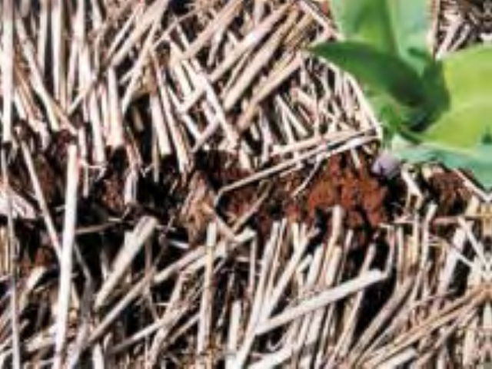
No-Till:
No tillage describes the system whereby tillage is restricted to that necessary for planting the seed.
Drilling takes place directly into the stubble of the previous crop and weeds are controlled by herbicides.
Generally between 50 and 100 per cent of the surface remains covered with residue.
The technique has been found to increase the percentage of water-stable aggregates in the soil compared to tine or disc cultivation and ploughing

Slide 77
No-till or zero-tillage is characterized by the elimination of all mechanical seed bed preparation except for the opening of a narrow strip or hole in the ground for seed placement. The surface of the soil is covered by crop residue mulch or killed sod.
It is not suitable, however, on soils that compact and easily seal because it can lead to lower crop yields and greater runoff.
no tillage was not always effective in the ﬁrst year of its operation because of the low percentage crop residues on the surface

Slide 78
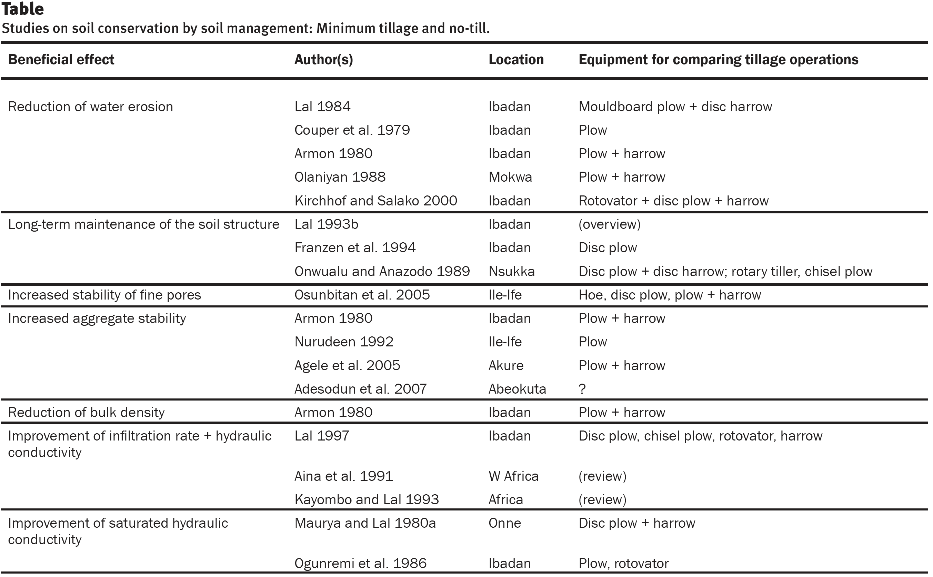

Slide 79
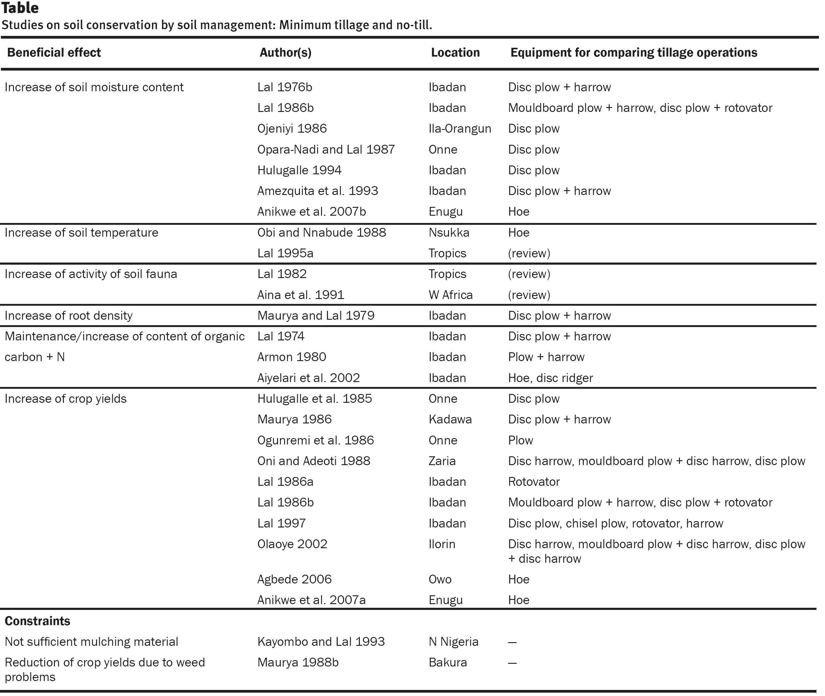

Slide 80
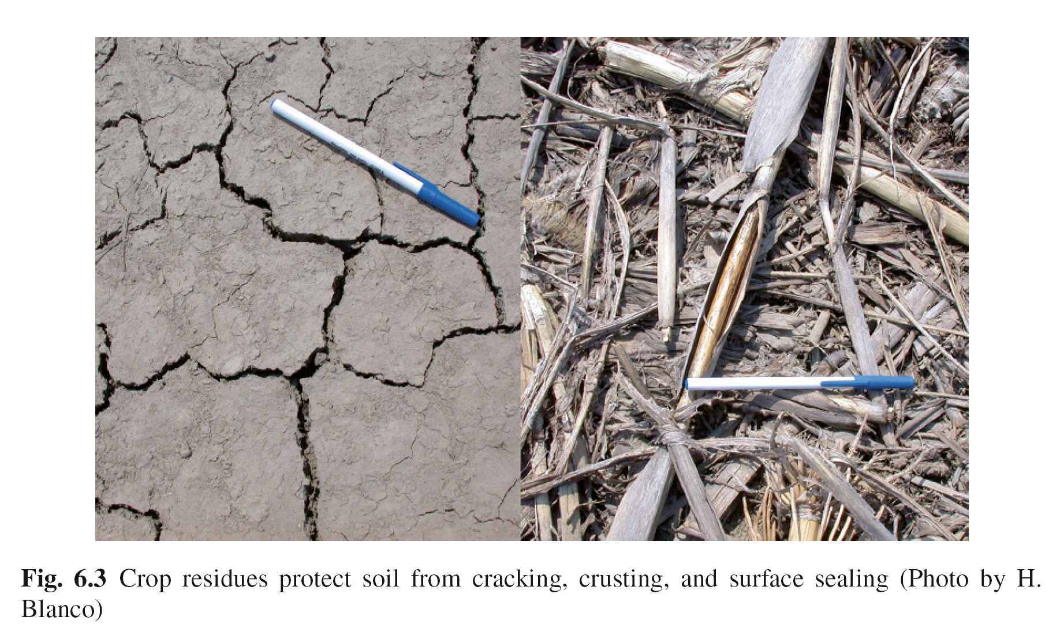

Slide 81
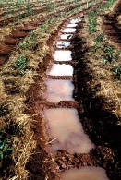
Ridge Tillage and Ridge Tying:
Ridge tillage is the practice of planting or seeding crops in rows on the top, along both sides or in the furrows between the ridges which are prepared at the beginning of every cropping season. Tied ridging or furrow diking
Contour Tillage
Contour tillage is the farming practice of plowing across a slope following its elevation contour lines.
The rows formed have the effect of slowing water runoff during rainstorms so that the soil is not washed away and allows the water to percolate into the soil.
The effectiveness of contour tillage varies with the length and steepness of the slope.
It is inadequate as the sole conservation measures for lengths greater than 180 m at 1° steepness.
The allowable length declines with increasing steepness to 30 m at 5.5° and 20 m at 8.5°.

Slide 82
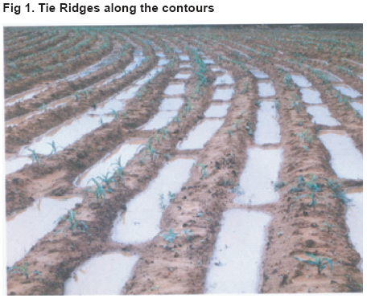

Slide 83
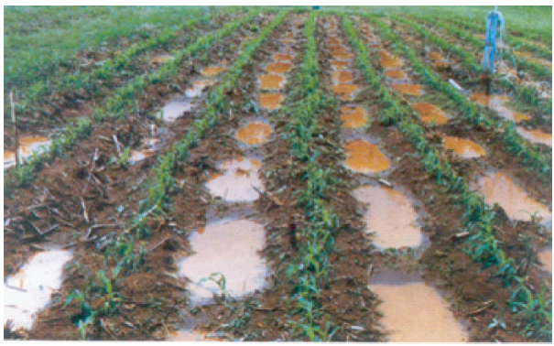

Slide 84
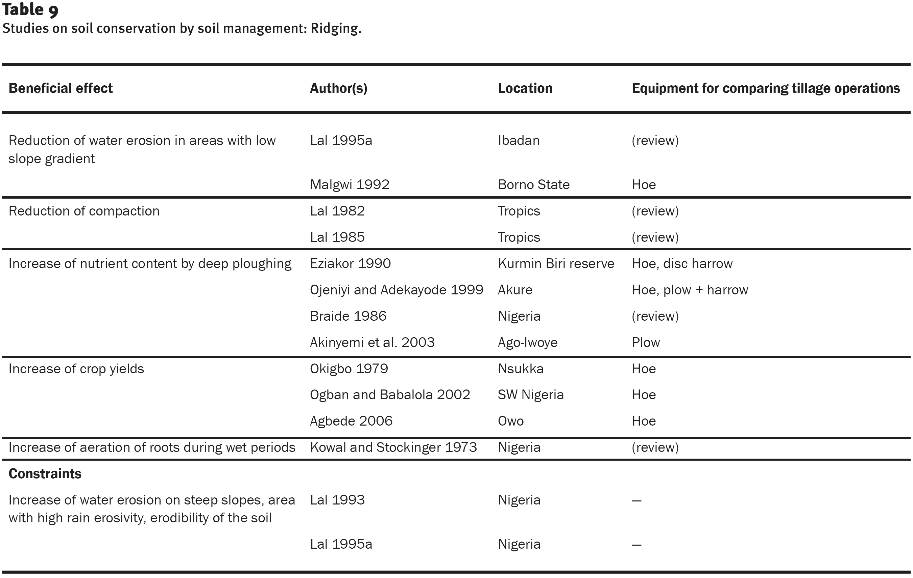

Slide 86
Strip tillage
With strip tillage, the soil is prepared for planting along narrow strips, with the intervening areas left undisturbed.
The plough–plant system:
caused least soil compaction,
conserved most soil moisture and
reduced losses of organic matter, nitrogen, phosphorus and potassium.

Slide 87
Mulching
Mulch is a layer of material placed between the soil surface and the atmosphere.
Different types of material such as:
residues from the previous crop,
brought-in mulch including
grass,
perennial shrubs,
farmyard manure,
compost, byproducts of agro-based industries, or
inorganic materials and synthetic products can be used for mulching
Mulch’s impact in reducing the splash effect of the rain, decreasing the velocity of runoff, and hence reducing the amount of soil loss has been demonstrated in many field experiments conducted on several areas

Slide 88
There are various investigations on the beneficial effects of mulch on the physical, chemical, and biological soil properties which influence the soil’s erodibility.
bulk density and penetration resistance of the soil are decreased by mulching.
The infiltration and the transmissivity of the soil improved with mulch
Crop residues also reduce the soil temperature by some degrees in the upper centimeters of the topsoil and provide better moisture conservation by reducing the intensity of radiation, wind velocity, and evaporation.
Study indicated 40% increase in maize grain yield when 2 t ha⁻¹ mulch were added and of 80% when 4 t ha⁻¹ mulch were added.
In general, mulching is likely to be a useful erosion control technology
Soils with shallow surface horizon, a high sand content and soils located in semi-arid areas will benefit from this technology as the water holding capacity will be improved

Slide 89
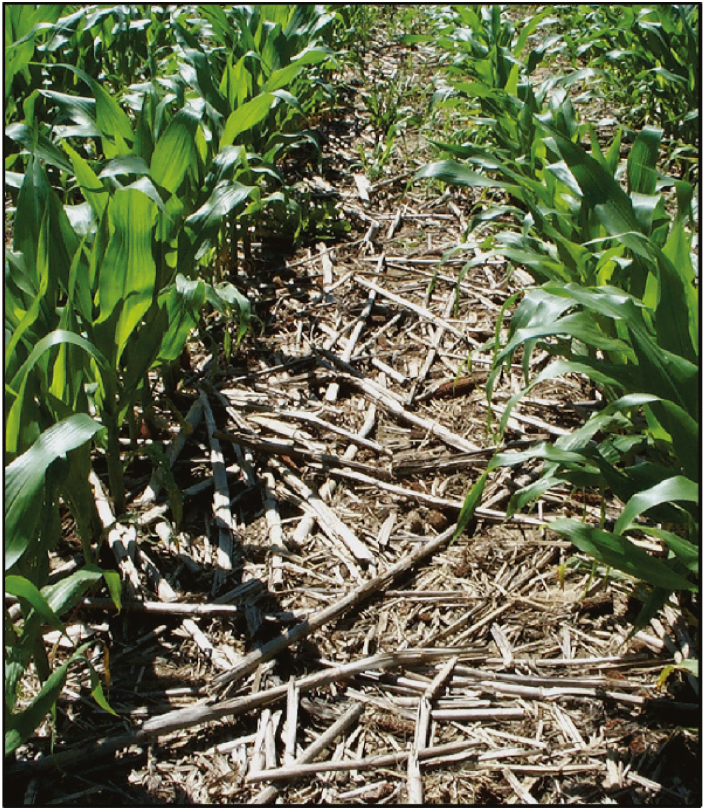
Difﬁculties with weed control, operating with large amounts of residue and, in many cases, lower yields have prevented the widespread take-up of stubble-mulch tillage.
Nevertheless, the system has be used successfully to control wind erosion and conserve moisture in drier wheat-growing areas

Slide 90
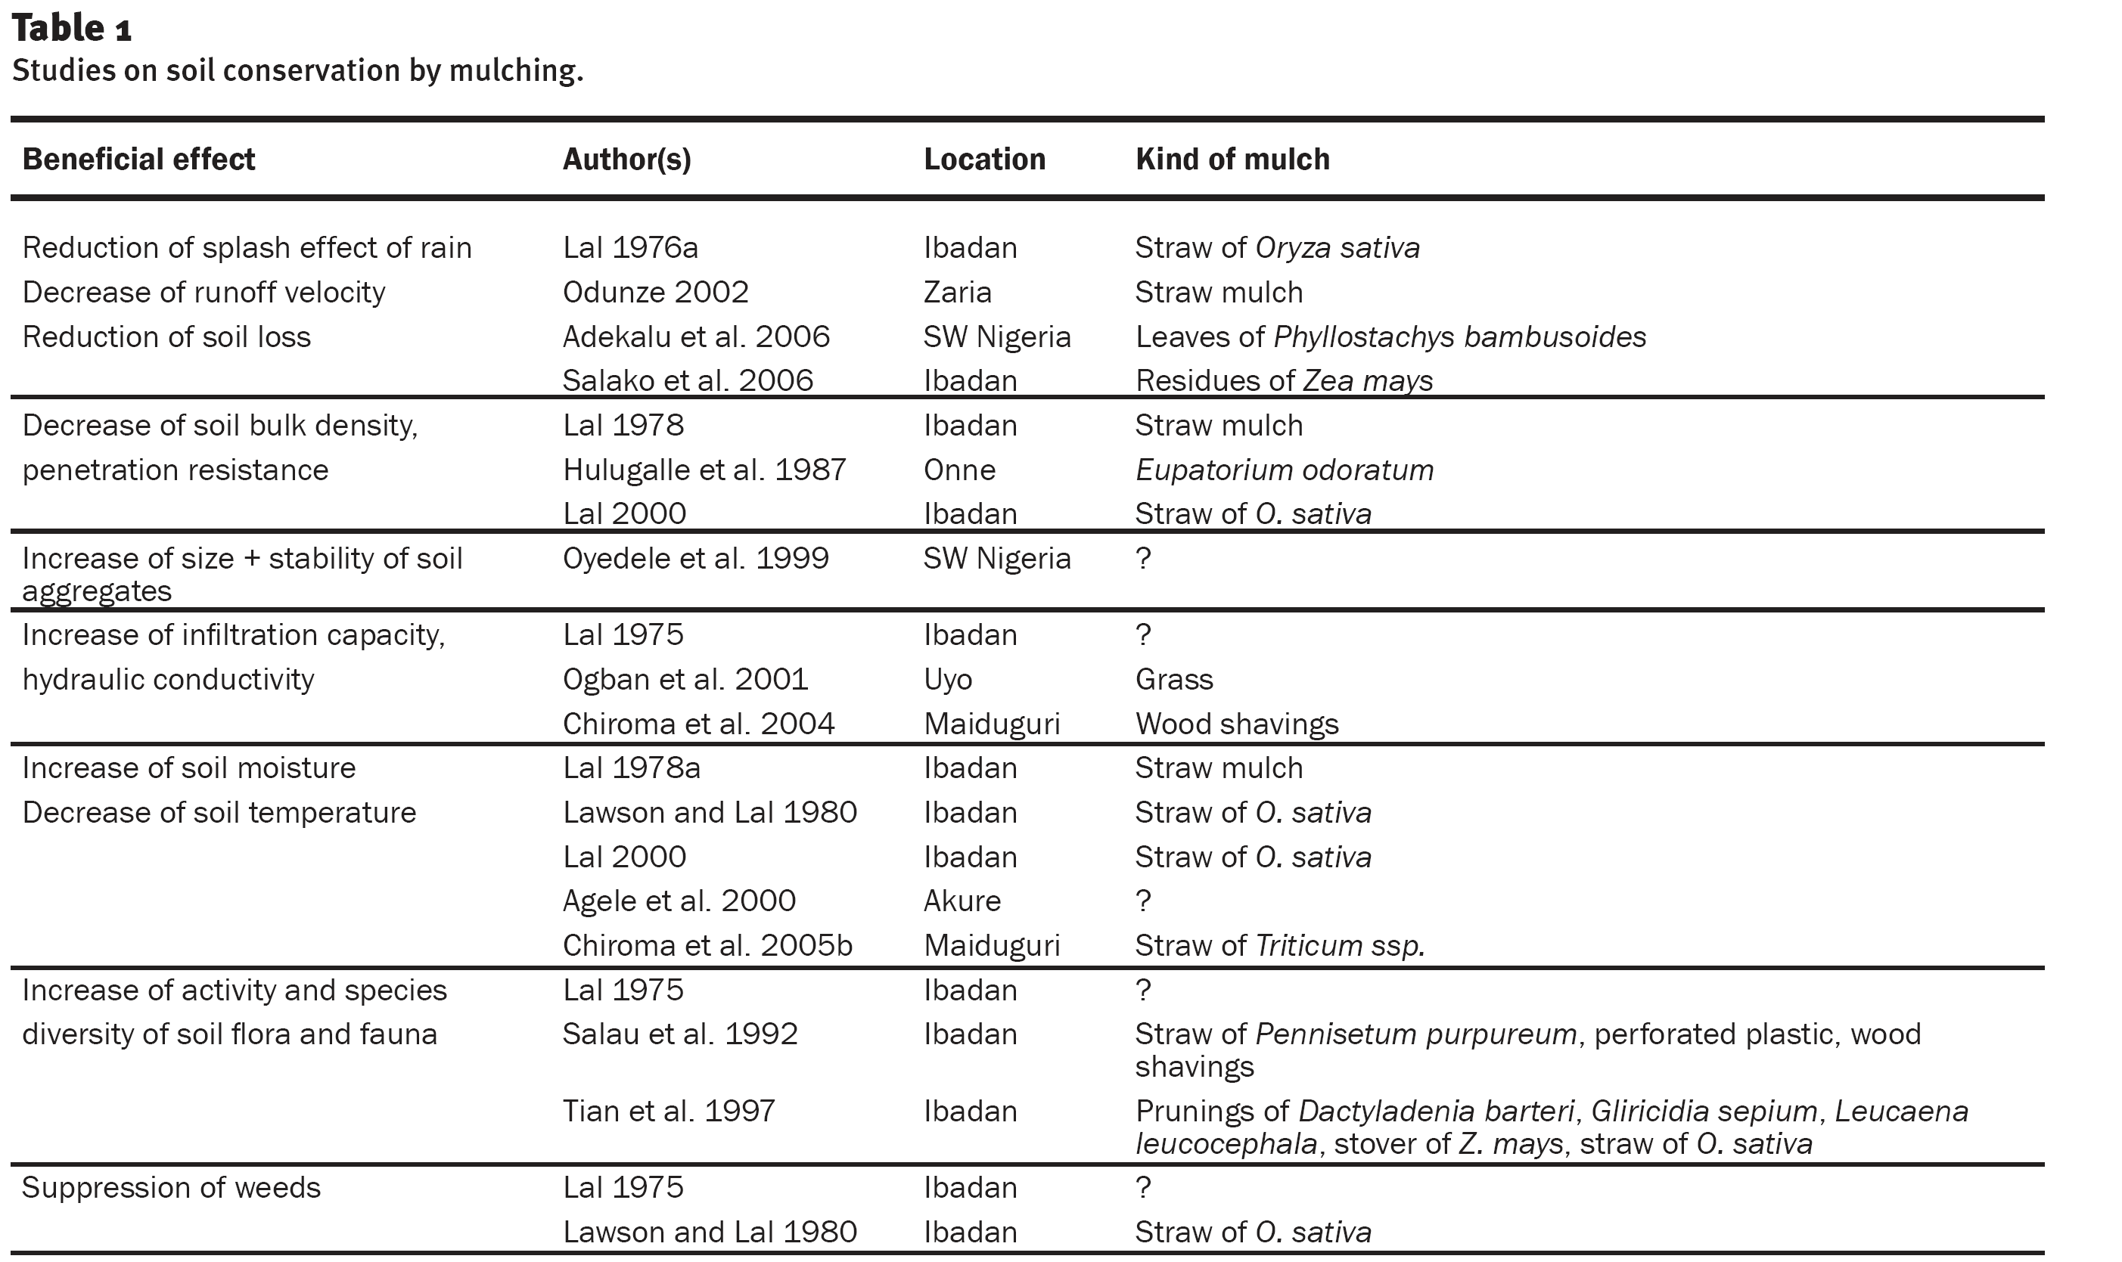

Slide 91
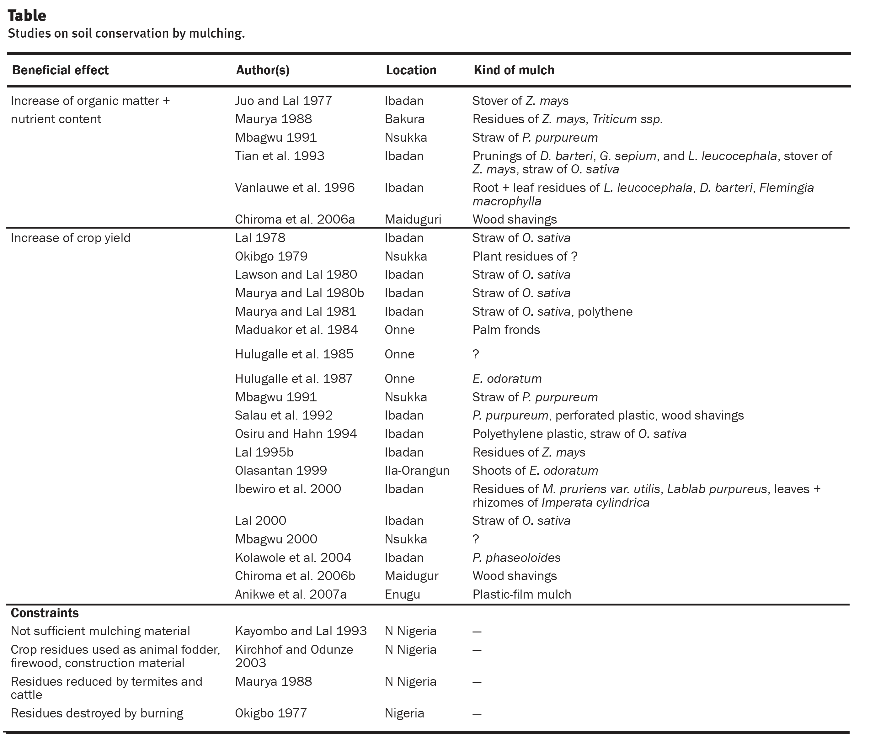

Slide 92
Strip farming
This is a method by which strips of row crops and closely growing crops, planted on the contour, are alternated.
Strip farming is a method of farming used when a slope is too steep or too long, or when other types of farming may not prevent soil erosion.
Strip farming helps to stop soil erosion by creating natural dams for water, helping to preserve the strength of the soil.

Slide 93
Cropping Systems (Agronomic practice)
A cropping system refers to the type and sequence of crops grown and practices used for growing them. It encompasses all cropping sequences practiced over space and time based on the available technologies of crop production
Conserving soil and water and maintaining long-term soil productivity depend largely on the management of cropping systems, which influence the magnitude of soil erosion and soil organic matter dynamics.
Management of cropping systems implies:
management of tillage,
crop residue,
nutrients,
pests, and practices for soil conservation

Slide 94
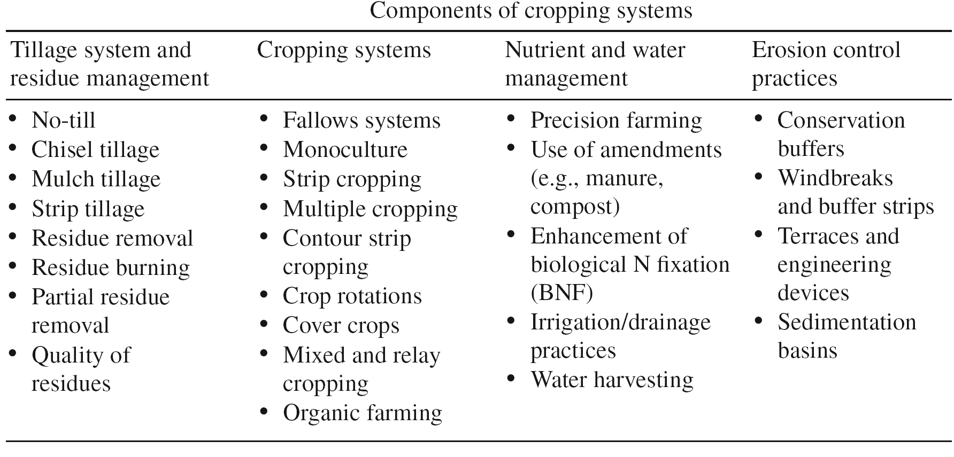

Slide 95
Fallow Systems
Fallow systems consist of leaving a cropland either uncropped, weed-free or with volunteer vegetation for at least one growing season in order to control weeds, accumulate and store water, regenerate available plant nutrients, and restore soil productivity
intensive plowing degrades soil structure, accelerates organic matter decomposition, reduces water infiltration, and increases soil erosion hazard.
Reduction in saturated hydraulic conductivity can increase runoff rates in fallow lands.
Growing grass and legumes in place of bare fallow rotations is useful to providing permanent vegetative cover to soil and improve soil biological activity and nutrient cycling.

Slide 96
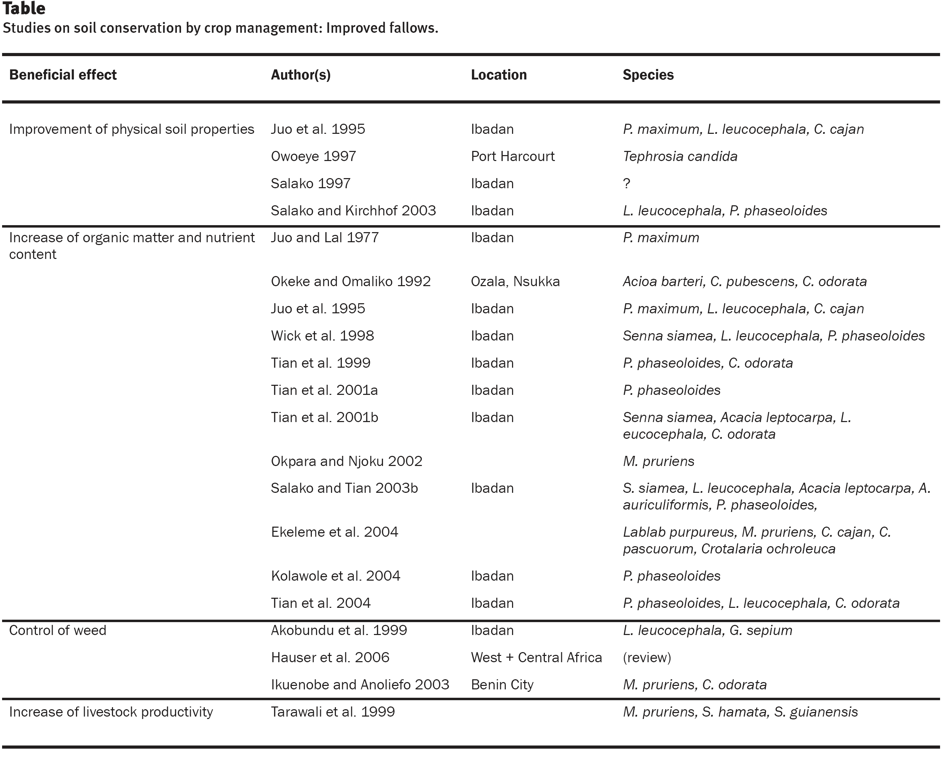

Slide 97
Monoculture
Monoculture refers to a cropping system in which the same crop is grown in the same field on a continuous basis.
Monocropping makes planting and harvesting easy, but it makes the soil susceptible to erosion hazard, weed invasion, and pest and disease infestation
It requires a periodic application of synthetic chemicals to supply nutrients and combat diseases with the attendant negative impacts on water quality.
Monocropping with intensive tillage that leaves soil bare following harvest exacerbates soil erosion and eliminates crop and biological diversity.

Slide 98
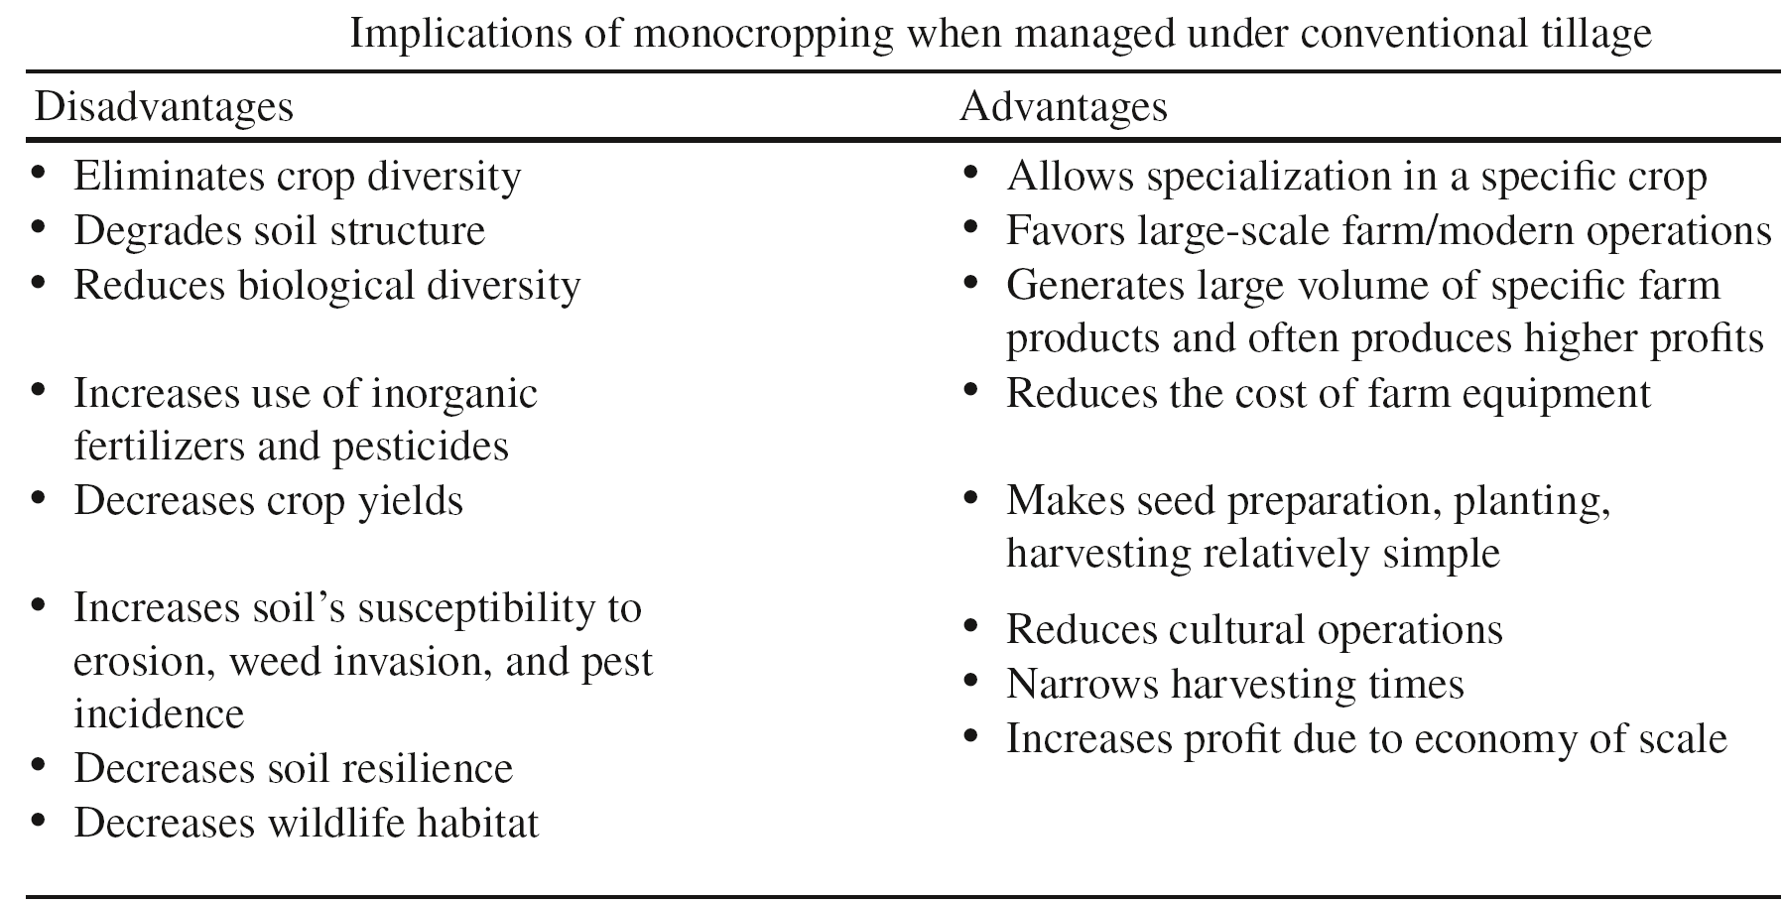

Slide 99
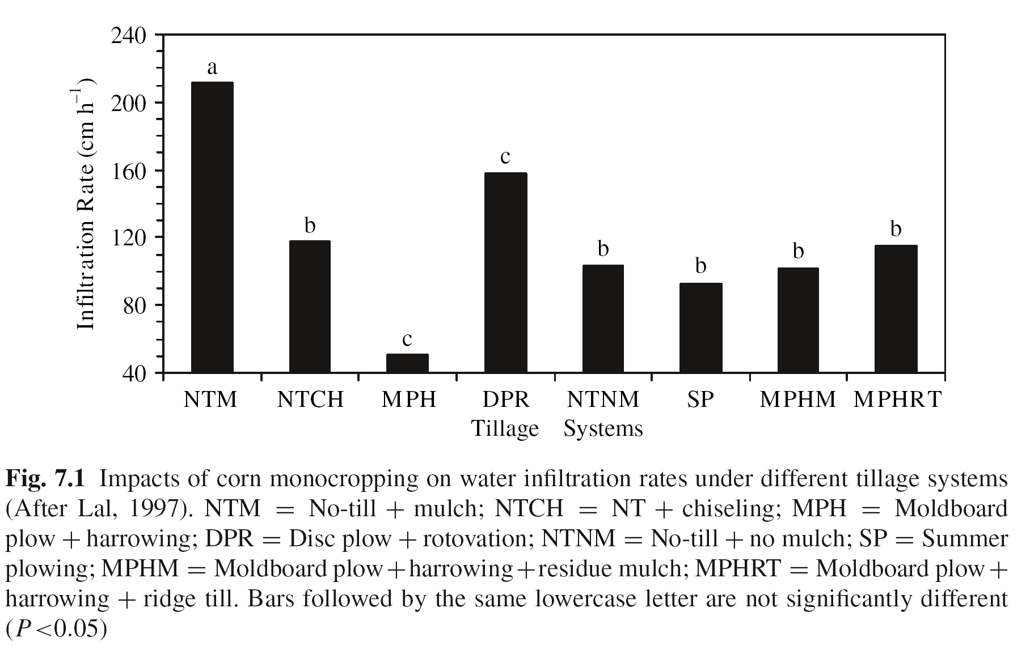

Slide 100
Crop Rotations
Crop rotations are systems in which different crops are grown sequentially on the same field in alternate seasons or years.
Switching crops in a recurring fashion under a planned sequence contrasts with continuous monoculture.
Planting three or more different crops before returning to the original crop constitutes long-term rotations.
The larger the number of crops involved in a rotation, the greater the benefits to soil productivity and plant diversity.
Crop rotation is one of the simplest and the most desirable strategies of soil and water conservation.

Slide 101
There are three main types of rotations based on the duration
1. Monoculture. It is confined to a single crop with no diversity.
2. Short rotation. It is basically a 2-yr rotation (e.g., corn-soybean).
3. Extended rotation. It refers to >2-yr rotations (e.g., corn-oat-wheat-clovertimothy).
Based on the crop and plant species used, crop rotations are classified as:
1. Annual. It refers mostly to monoculture (e.g., corn).
2. Annual-perennial. It includes rotations with row crops and perennials (e.g., corn-alfalfa)
3. Diverse. It includes more than three crops (e.g., corn-oats-wheat-hay).

Slide 102
Rotating different crops is an ecologically viable alternative to monocropping and is relevant to addressing agricultural and environmental concerns.
Long rotations are preferred over monocropping and short-rotations.
Extended crop rotations are useful practices to conserve soil and water and sustain agricultural production
Short-rotations, depending on the crops, may not be any better than monocropping for conserving soil and water.

Slide 103
Benefits of crop rotations
1. reduce soil erosion,
2. improve soil properties,
3. increase organic matter content,
4. improve soil fertility,
5. increase crop yields,
6. reduce build-up of pests,
7. increase net profits,
8. improve wildlife habitat,
9. reduce use of chemicals, and
10. reduce water pollution

Slide 104
Soil Erosion
Rotations which include high above- and below-ground biomass producing forages and crops reduce soil erosion hazard.
Growing cereals and legumes alternatively with row crops provides a dense and permanent vegetative cover that stabilizes the soil underneath, reducing soil erosion hazard.
Compared to continuous row crops, rotations with hay or pasture systems reduce soil erosion by 80–90%, while short rotations reduce it by <30% compared to monocropped systems (Jankauskas et al. 2004).
The lower soil erosion hazard with crop rotations is due to improved soil stability against slaking and detachment, which are critical processes of soil erosion.

Slide 105
Soil Physical Properties
Rotating with crops characterized by high above- and below-ground biomass production plant species
reduces soil bulk density,
increases aggregation,
improves soil macroporosity, and
stabilizes soil.
Improvements in soil structural stability occur when rotations are used in combination with no-till farming as a result of positive interactions between crop diversity and absence of soil disturbance.
Plant available water content is higher in no-till rotation systems compared to conventionally managed monocropped systems.

Slide 106
The degree of improvements in soil properties caused by rotations depends on
the amount of residue left after harvest and the root biomass. Crops such as corn leave more residue than left after harvest and the root biomass.
Crops such as corn leave more residue than soybean and, thus, protect the soil against from erosive energy of raindrops and crusting.
JCrop rotations reduce bulk density and increase aggregate stability in contrast to monocrops (Karlen et al., 2006). soybean and, thus, protect the soil against from erosive energy of raindrops and crusting.
Crop rotations reduce bulk density and increase aggregate stability in contrast to monocrops (Karlen et al., 2006).

Slide 107
Nutrient Cycling and Input
Crops vary in their ability to absorb, maintain, and supply nutrients.
While row crops (e.g., corn) extract and reduce most of the essential nutrients in the soil, combination of corn with legumes (e.g., soybean, alfalfa) reduces N losses.
Rotations with legumes have the ability to enhance microbial activity, fix atmospheric N, and supply non-synthetic N to succeeding crops.
Crop rotations also reduce the loss of nutrients by reducing soil erosion. In essence, long rotations improve nutrient cycling and storage by:
(1) supplying nutrients,
(2) reducing nutrient loss in runoff, and
(3) improving soil biological activity.

Slide 108
Reduce Pesticide Use
Infestation by insects, nematodes, diseases, and weeds is specific to a crop. Thus, rotating crops interrupts and eliminates the pest cycles and reduces the use of pesticides. The reduction in use of pesticides and synthetic fertilizers with crop rotations results in less non-point source pollution.
The effectiveness of crop rotations for controlling pests depends on the nature and specificity of pests. Rotations are effective measures whenever the pests are:
(1) specific to a crop and field,
(2) not widely spread across crops, and
(3) do not increase under the absence of host crops.

Slide 109
Increase Crop Yields
One of the immediate and direct benefits of crop rotation is the increase in crop yields (Bauder, 1999).
For example, corn grown after alfalfa or soybean often produces higher yields than continuous corn systems.
Crop rotations reduce production costs and increase net profits by increasing crop yields and by reducing inputs (e.g., fertilizers, pesticides).
Crop rotations adopted in conjunction with no-till agriculture save energy by elimination of tillage.
Economic benefits are often more in longer than in shorter rotations (>3 yr).

Slide 110
Cover Crops
Cover crops are an integral component of cropping systems to conserve soil and water.
They protect soil against erosion, improve soil structure, and enhance soil fertility.
Cover crops with legumes and mixture of plants enhance performance of crop rotations.
A well-structured system with cover crops and rotations restores soil productivity. Legume cover crops enhance biological nitrogen fixation and biomass input.
When used synergistically, crop rotations in conjunction with cover crops reduce incidence of insects and weeds and diseases, improve soil productivity, and accentuate sustainability and profitability.

Slide 111
Cover Crop
Cover crops are innovative conservation practices, and are speciﬁcally grown for:
protecting soil against erosion,
improving soil properties,
enhancing soil fertility,
suppressing weeds,
ﬁxing N,
increasing soil organic matter content,
increasing crop yields,
recycling nutrients,
preventing leaching of nutrients, and
improving water quality

Slide 112
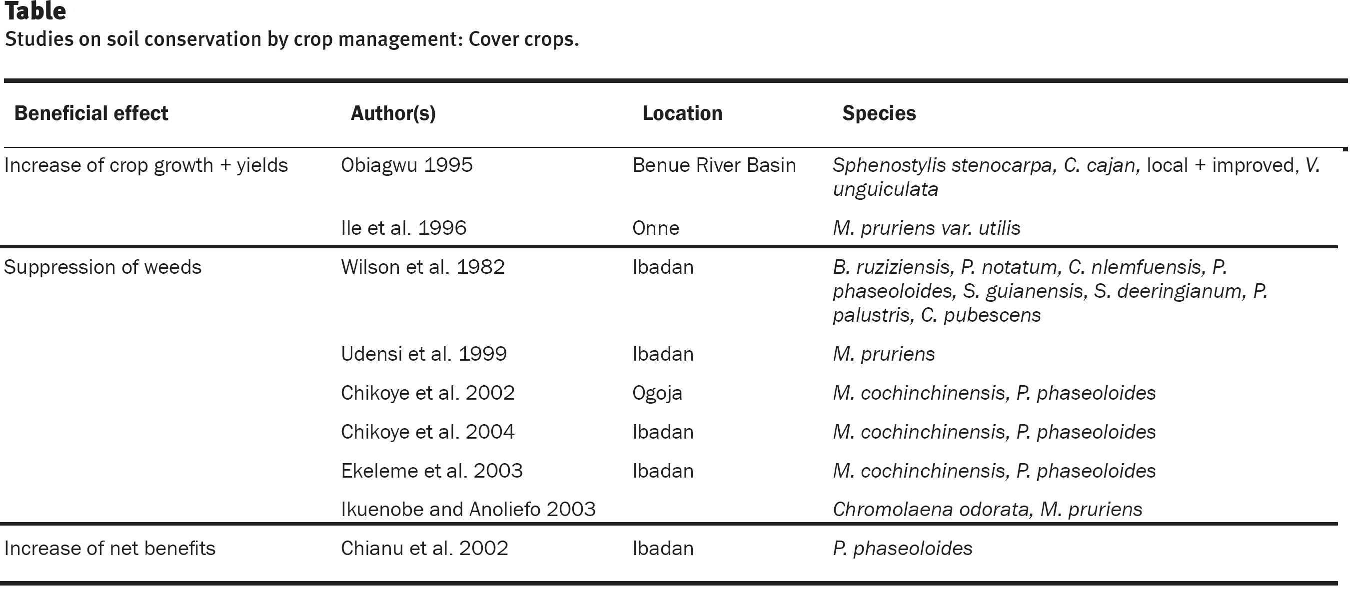

Slide 113
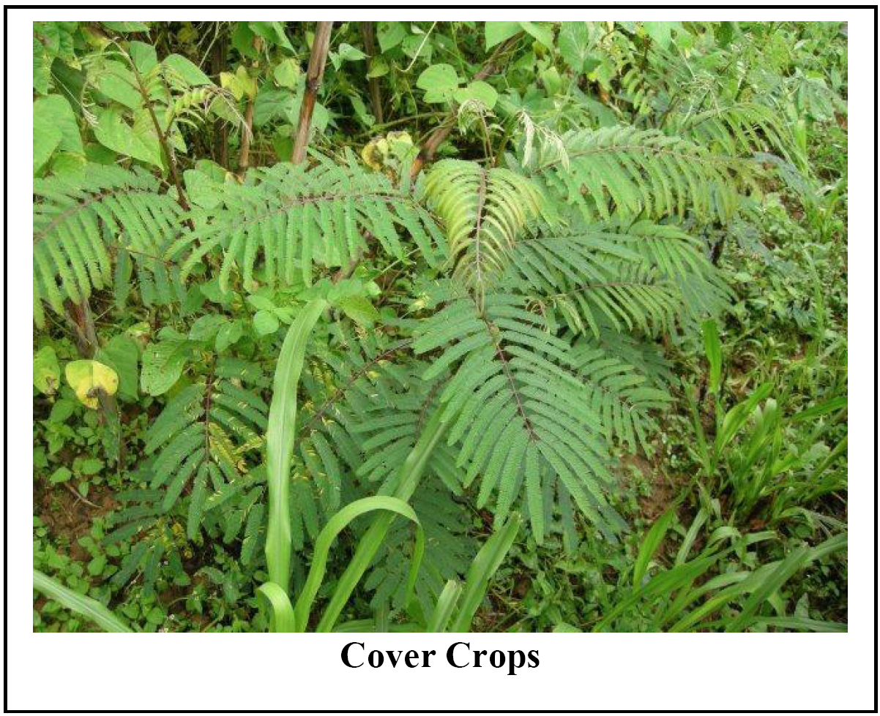

Slide 114
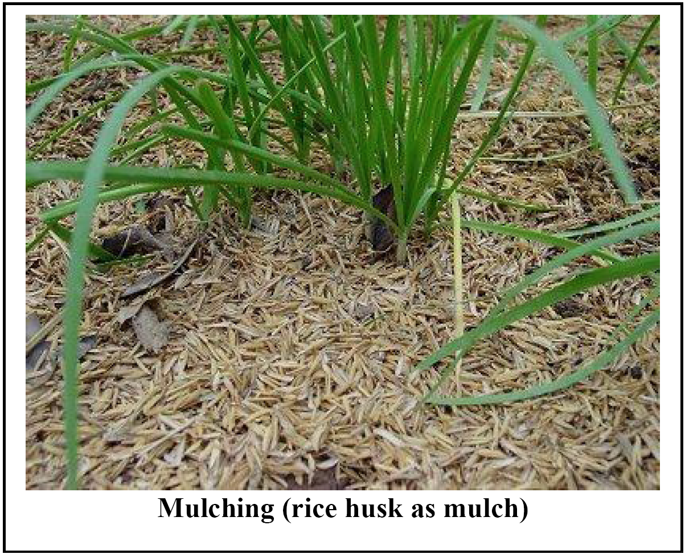

Slide 115
Row Crops
Row crops refer to crops grown in parallel rows
Corn, wheat, rice, soybean, cotton, peanuts, sorghum, sugarcane, sugar beets, and sunflowers are examples of row crops.
Soil erosion is a major concern in intensive row cropping systems under plow tillage system of seedbed preparation.
The unprotected wide space between rows exacerbates risks of rill and gully erosion.
Reducing space between rows has important implications to soil and water conservation and crop yields.
Crops grown in narrow spaced rows provide better protection against raindrop impacts by forming a close canopy.
Higher canopy cover or closed canopy cover in narrowly spaced row crops as compared to wide rows reduces evaporation and decreases soil’s susceptibility to erosion.
The closed canopy cover rapidly shades the soil surface, reduces soil temperature and weed proliferation although vehicular traffic can be difficult.

Slide 116
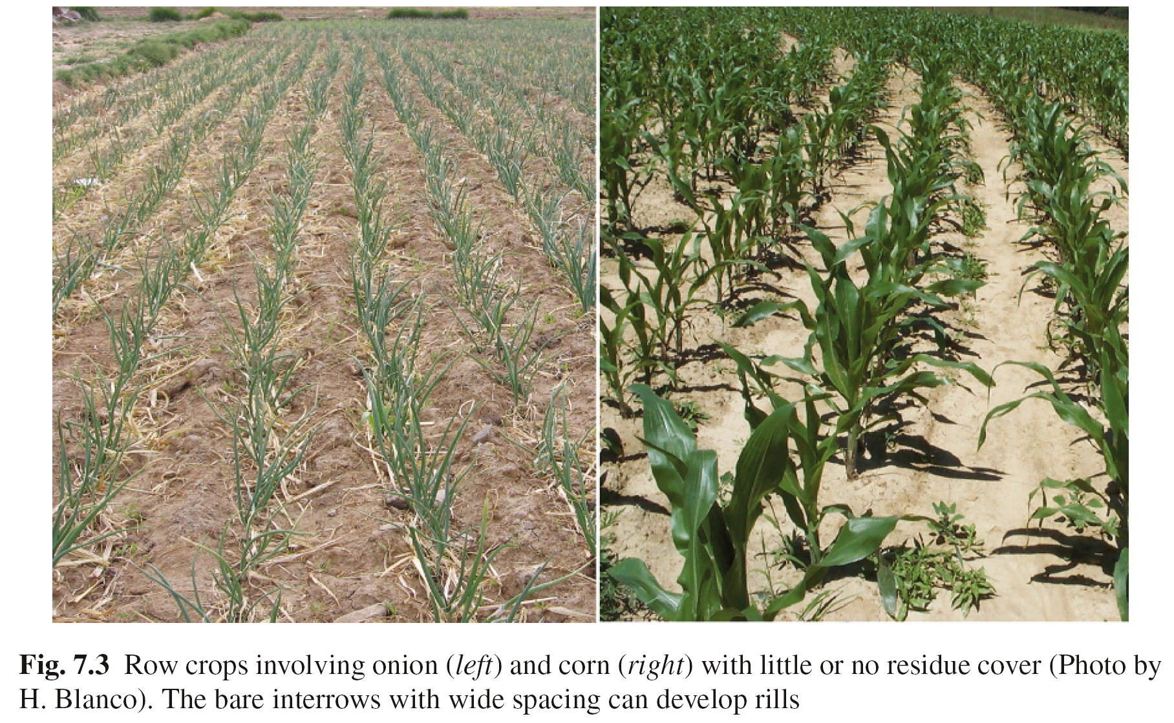

Slide 117
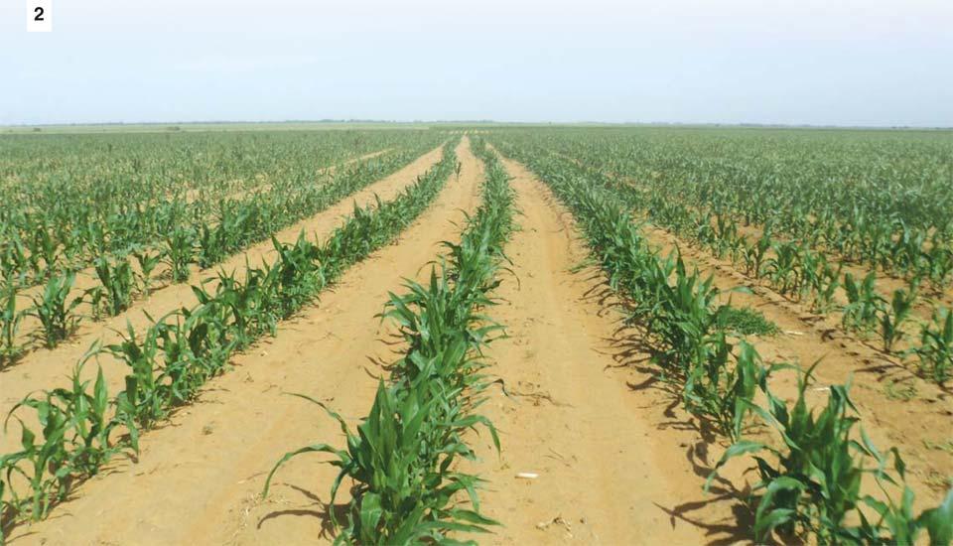

Slide 118
Multiple Cropping
Multiple cropping is a system where different crops are simultaneously planted on the same field during the same season a year.
it allows an integration of food crops, farm animals, conservation grass buffers, and trees into the same piece of land.
Multiple cropping is advantageous because it:
allows the production of diverse food crops,
offers better soil erosion control by continuous growing of crops with variable biomass production and rooting systems,
reduces risk of total loss of crops from adverse climate conditions (e.g., drought resistant) or diseases,
provides diversified farm products from a small piece of land, reducing production costs.
improves soil fertility and reduces soil erodibility by planting grass, grain crops, and legumes,
reduces disease pressure and use of synthetic fertilizers, herbicides, and pesticides
allows planting crops in different seasons, spreading the harvest and supply of produce.

Slide 119
Double Cropping
Double cropping consists of planting crops following harvest of the first on the same land during the same year.
This practice thus consecutively produces two crops on the same land in one year.
Harvesting wheat in early summer and planting corn or soybeans on the same land to be harvested in fall is a common example of double cropping in temperate regions.
Double cropping is suited to regions with long growing seasons.
double cropping is advantageous because it provides a protective vegetative cover all year long while improving farm income and breaking up pest cycles.

Slide 120
Relay Cropping
Relay cropping consists of inter-seeding the second crop into the first crop before harvesting.
It allows the production of a second crop during the same year. The same crop or different crops can be planted in relay cropping, which provides a continuous supply of food.
In temperate regions, the second crop often follows winter wheat.
Relay cropping is appropriate if:
(1) there is sufficient time for the production of a second crop before the first frost, and
(2) there is adequate soil water supply to sustain a second crop.
Water availability is the main determinant of relay cropping.
In soils with limited water holding capacity, relay systems rely on irrigation or adequate rainfall although irrigation increases the production costs.
Relay cropping is difficult in arid and semi-arid regions due to limited supply of water.

Slide 121
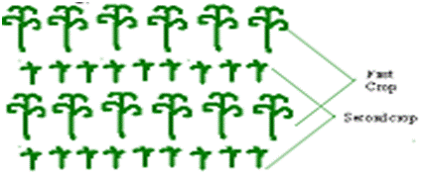

Slide 122
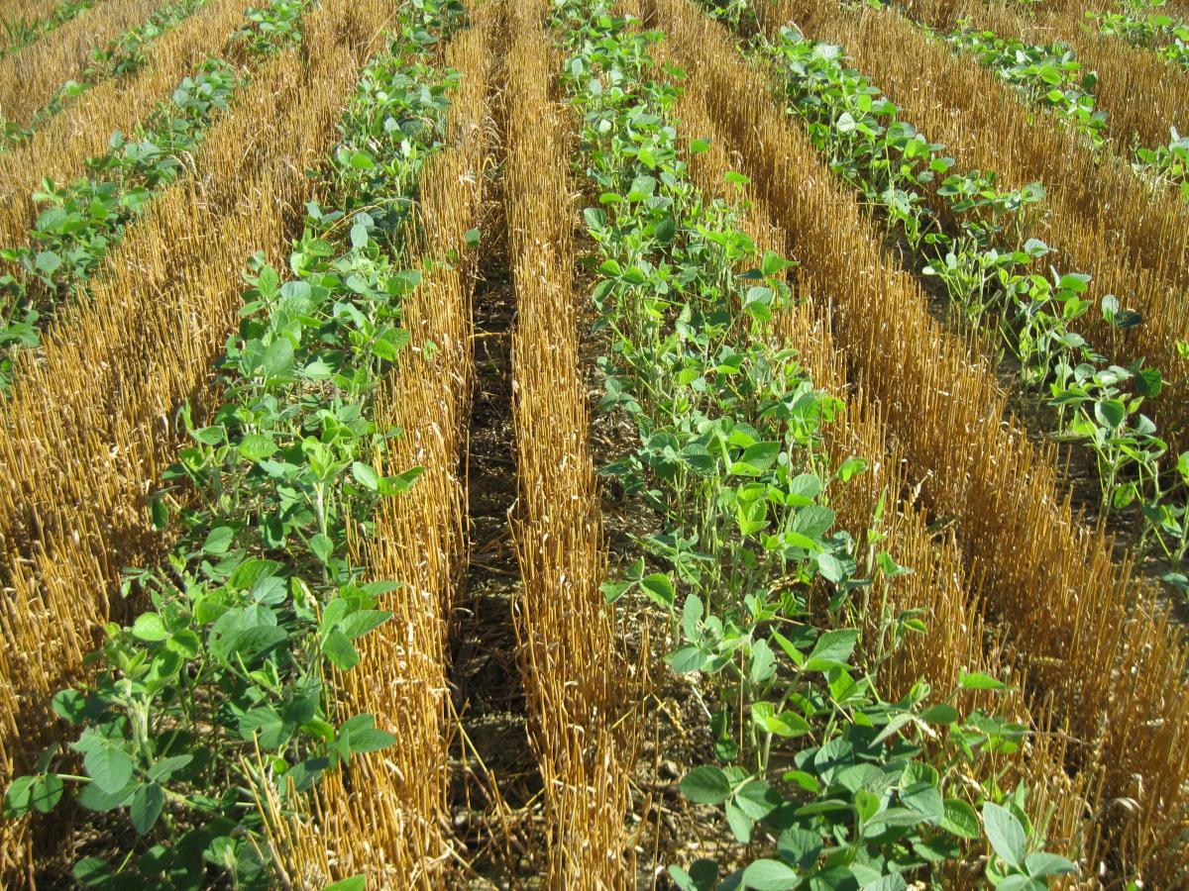

Slide 123
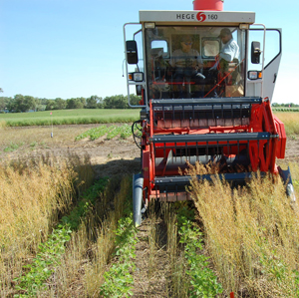

Slide 124
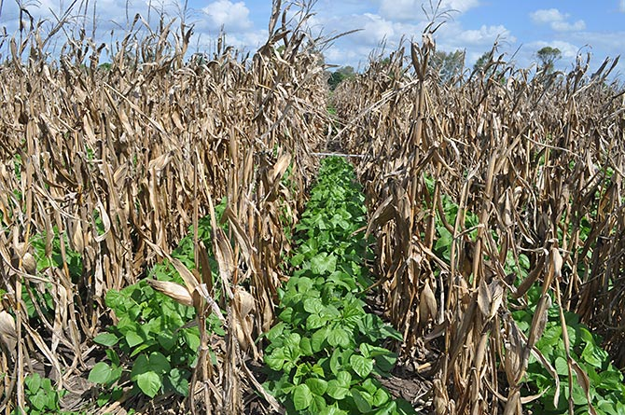

Slide 125
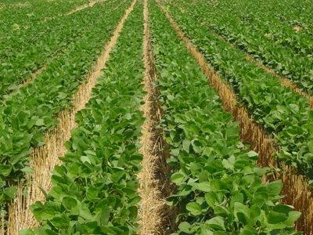

Slide 126
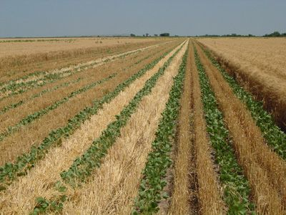
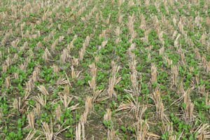
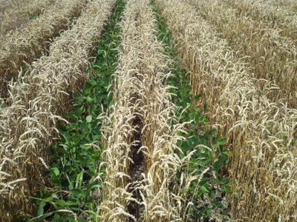

Slide 127
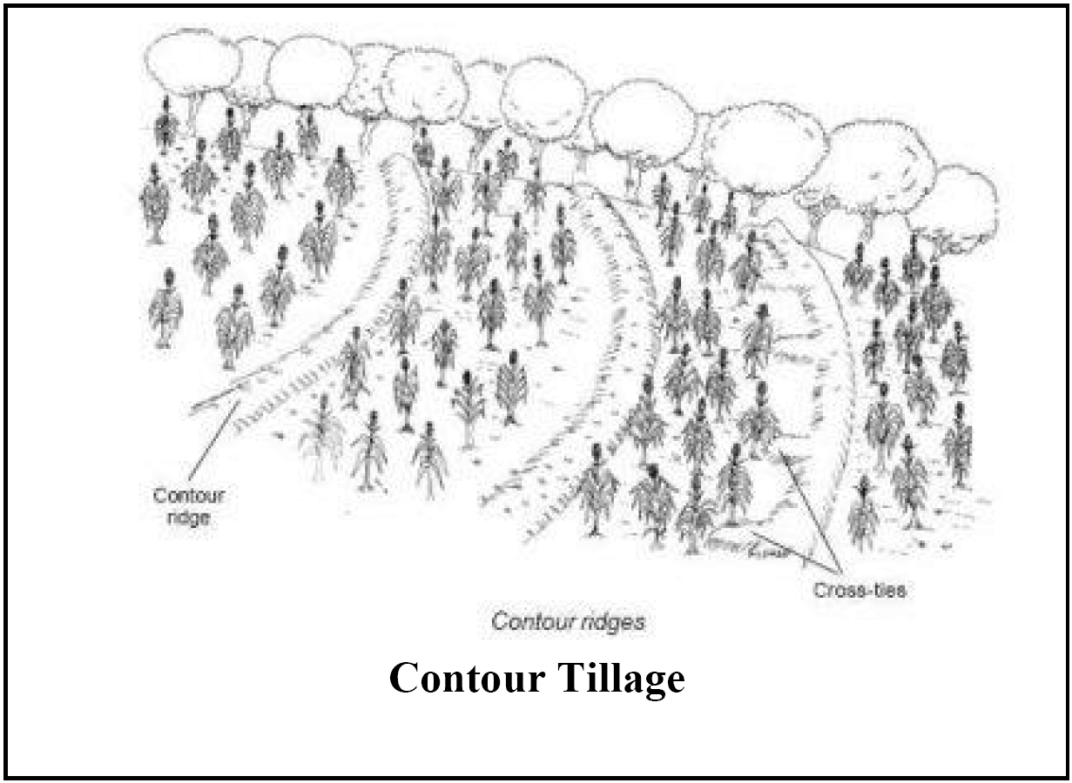

Slide 128
Intercropping
Intercropping is a multiple cropping system where two or more crops are grown simultaneously on the same field.
The different crops can be planted in alternating rows or sections.
Intercropping mixes different plant species with contrasting height, foliage, biomass, and other agronomic characteristics.
It is a recommended system for soil and water conservation.
Intercropping takes into account all beneficial interactions between and among crops while creating possible negative interactions caused by the neighborly effects. It minimizes pest problems and improves soil fertility.
Intercropping with trees (agroforestry) allows planting annual crops between rows of trees and has multiple benefits.

Slide 129
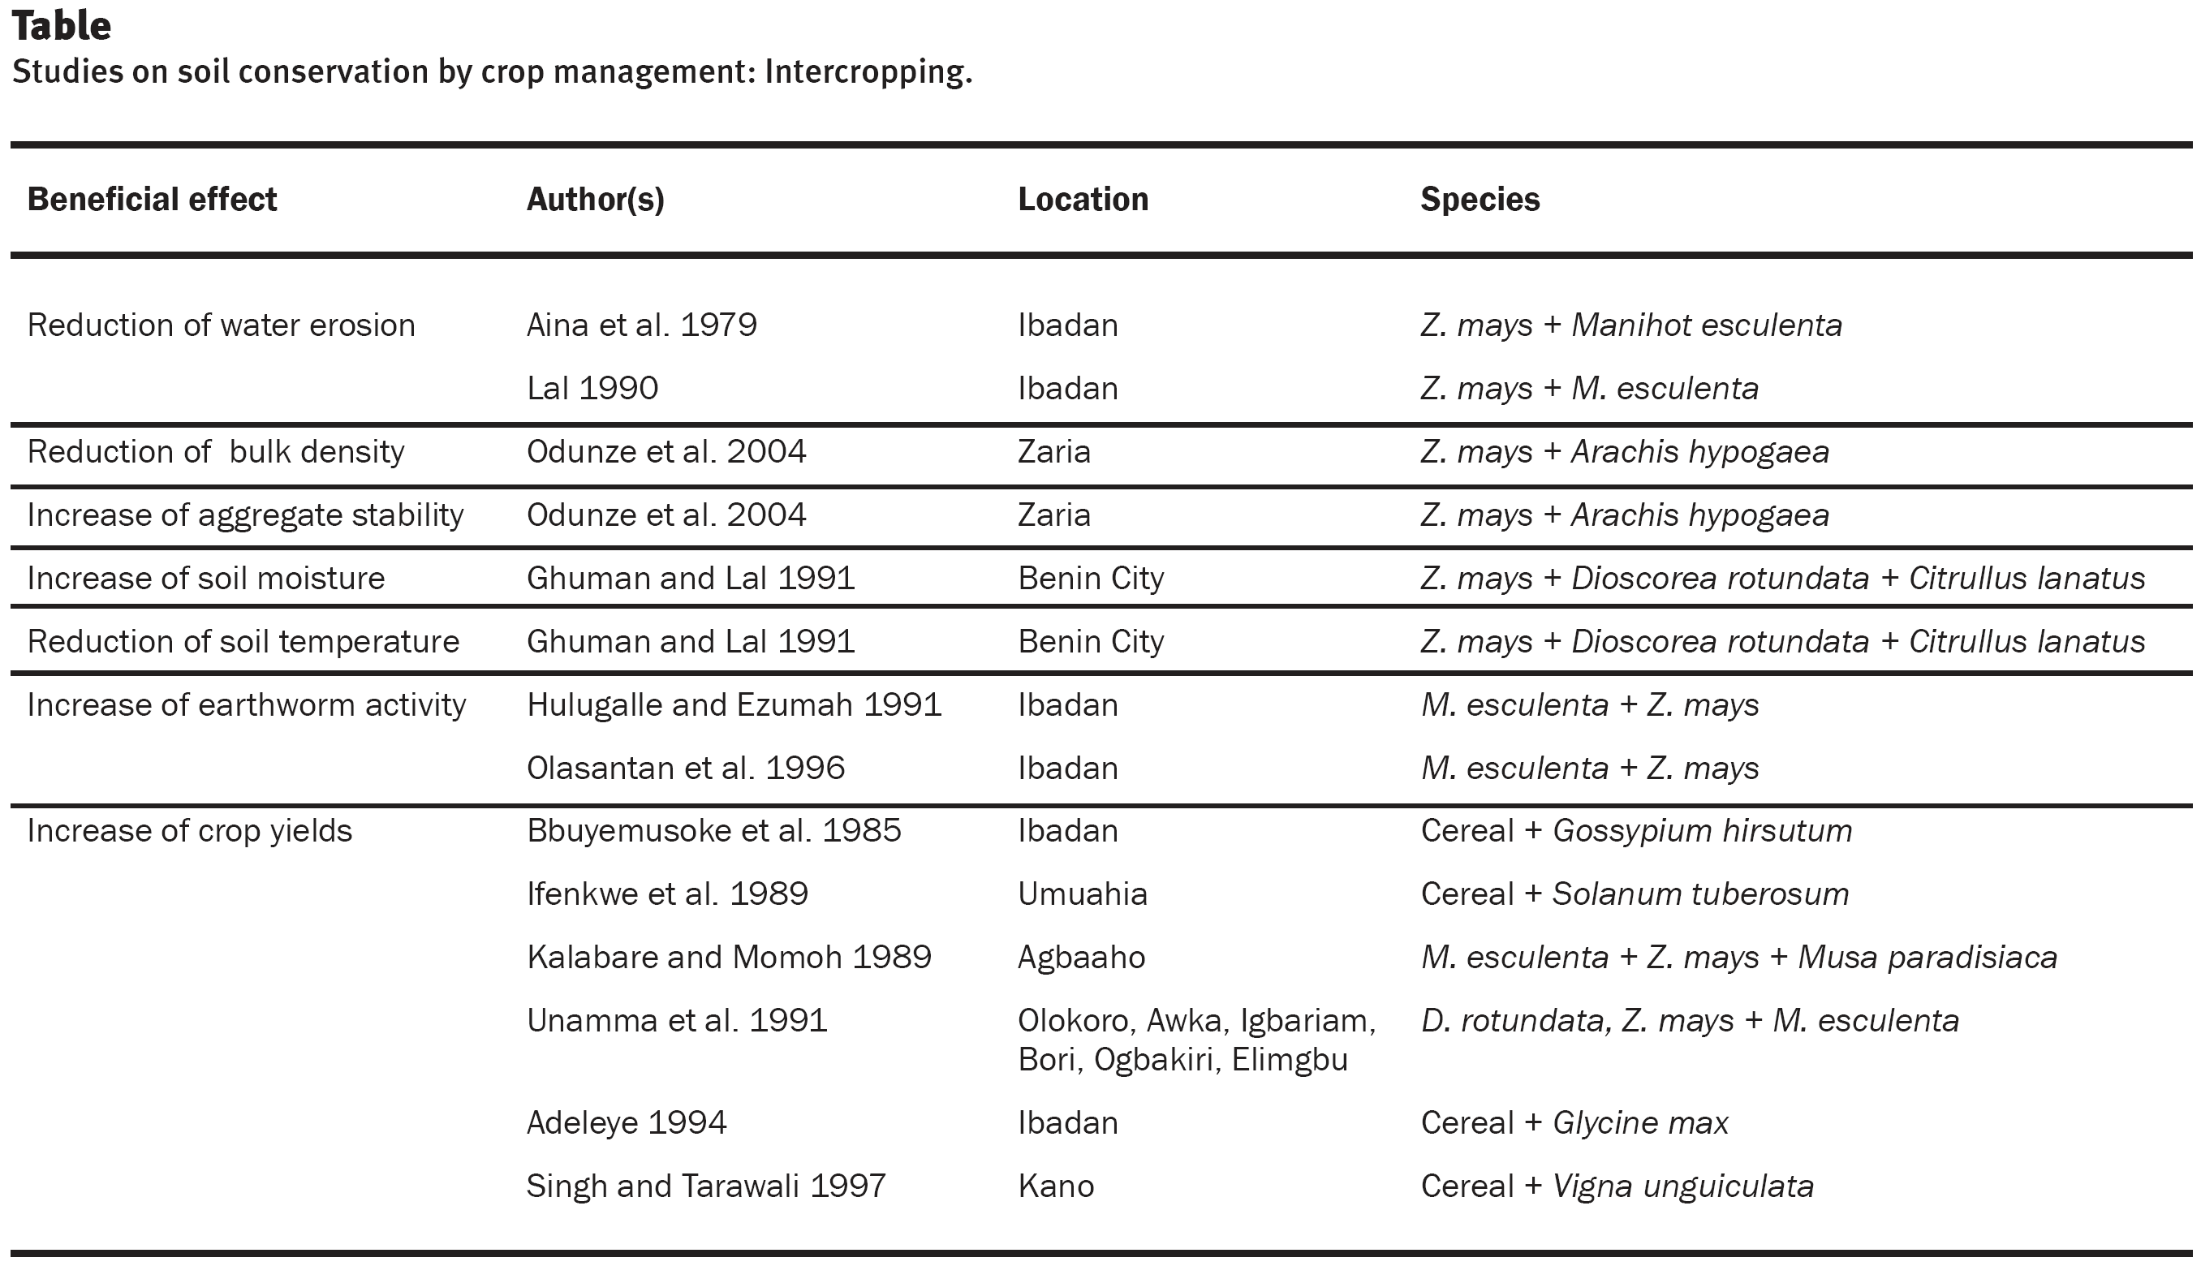

Slide 132
22222222
2

