Slide 1
Irrigation and drainage
Course Titles/Codes: NRIWM5332
Course credit 2 (1 + 1)
The course consists 7 chapters

Slide 2
Basics of the course
The course deals on
Irrigation definition and Why irrigation
Merits and demerits of irrigaton
Basic soil water and plant relationships;
Irrigation water requirements,
Irrigation efficiencies, and methods of irrigation;
Planning for irrigation systems;
Design and management in irrigation systems;
Sources of conflicts in irrigation systems and management;

Slide 3
Conti.
Principles of land drainage, design and layout of surface and sub-surface drainage systems.
Water supply:
Irrigation water quantity and quality assessment and management, conjunctive use of surface and groundwater resources or wastewater re-use for irrigation.
Design of irrigation systems and structures.
Design of drainage systems and structures.

Slide 4
Objectives of the course
To introduce students to basic concepts of soil, water, plants, their interactions, as well as irrigation and drainage systems design, planning and management.
To develop analytical skills relevant to the areas mentioned above, particularly the design of irrigation and drainage projects.

Slide 5
Conti.
State the role of soil physical and chemical properties to soil water accessibility
Determine soil moisture using various methods
Apply formulae to calculate crop water requirements
Apply CROPWAT software to calculate crop water needs
Computer applications and simulation modeling or understand the computer applications in irrigation and drainage designs
Examine quality water for irrigation
Explain appropriate irrigation methods for different crops, soils and climatic zones

Slide 6
Conti.
Understand the basic soil-plant-water parameters related to irrigation
Understand how to estimate the quantity of water required by crops using manual and computer methods.
Be able to plan and design irrigation and drainage projects.
Design channels and other irrigation structures required for irrigation, drainage, soil conservation, flood control and other

Slide 7
Conti.
Construct different water harvesting schemes
Understand the principles of drainage systems in irrigation scheme
Set irrigation schedules for different crops
Understand soil characteristic and agronomic aspects for water harvesting
Explain the most applicable soil-storage water harvesting techniques (micro catchment, macro catchment and floodwater harvesting) and apply them on field
Apply suitable on farm water management techniques for crop production

Slide 8
Chapter-1
Irrigation Definition
Water is the most important input required for plant growth for agriculture production.
Irrigation can be defined as replenishment of soil water storage in plant root zone through methods other than natural precipitation.
It is the application of artificial water to cropland to meet its consumptive use which cannot provided by rainfall.

Slide 9
Conti.
Irrigation is the application of water to the soil to supplement natural precipitation and provide an environment that is optimum for crop production
Archaeological investigation has identified evidence of irrigation where the natural rainfall was insufficient to support crops.
Irrigation is the controlled application of water to croplands.

Slide 10
Type of irrigation
Supplementary irrigation: in areas with rainfall for a part of the season or year
Total irrigation: in areas of no rainfall

Slide 11
Early history of irrigation development
Irrigations seen to have found its roots in the history of mankind since earliest beginning.
It helps reduce the uncertainties, particularly the climatic uncertainties in agriculture practices.
Perennial irrigation was practiced in the Mesopotamian plain by coaxing water through a matrix of small channels formed in the field.
Ancient Egyptian practiced Basin irrigation using the loading of the Nile to inundate land plots which had been surrounded by dykes.
The Ancient Nubians developed a form of irrigation by using a waterwheel like device called a sakia.
In Sub-Saharan Africa irrigation reached the Nile River region cultures and civilizations by the first or second millennium BCE and was based on wet season flooding and water harvesting.
The Qanats, developed in ancient Persia in about 800 BCE, are among the oldest known irrigation methods still in use today.

Slide 12
Conti.
The irrigation works of ancient Sri Lanka, the earliest dating from about 300 BCE, under continuous development for the next thousand years, were one of the most complex irrigation systems of the ancient world.
Terrace irrigation is evidenced in pre-Columbian America, early Syria, India and China.
Study of the history of irrigation, development of irrigation technology, sustainability of the old irrigation systems provides an insight into the factors that have sustained the outcomes over the generations.

Slide 13
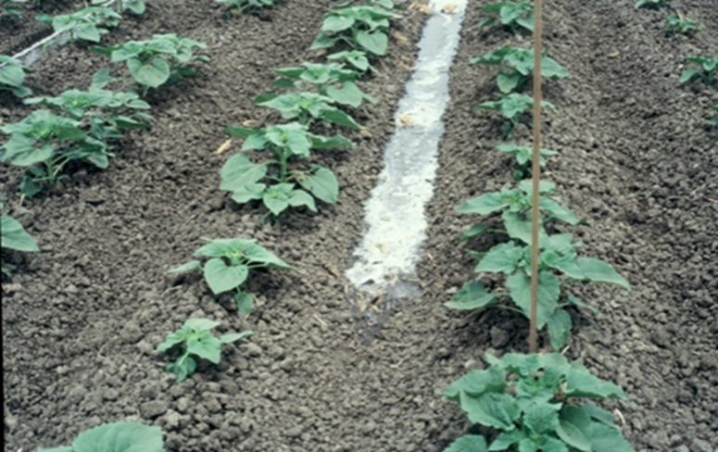

Slide 14
Why Irrigation or the need for irrigation
Rainfall is not sufficient to supply the water need of crops
Rainfall is not distributed uniformly
Variable crop-water requirements
And for the following direct or indirect benefits
it can ensure good productivity
Main conveyance/irrigation canals can be used for flood protection, recreation and navigation
It can promote fish and wildlife preservation
it makes the agricultural industry profitable and competitive

Slide 15
Conti.
it can increase the value of land properties
it can result in more employment and income
Dams constructed for irrigation may serve also for hydropower
Etc.

Slide 16
Generally
The basic principles of irrigation are quite simple.
However, the practical application of these principles can provide complications.
Because, Crops are exposed to energy originating from the sun, and/or wind.
Much of the energy is dissipated by evaporating water from leaf surfaces, which is commonly referred to as transpiration.
Water may also be evaporated from the soil surface and the combination of evaporation from leaf and soil surfaces is evapotranspiration (ET).
Water transpired from the leaf surface is replaced by extracting water from the soil and transporting it through the root and stem system.

Slide 17
Cont.
The soil serves as a reservoir from which the plant extracts water to meet the demands of transpiration.
The quantitative storage capacity depends on both the type of soil and the rooting depth of the crop plants.
Soil texture and structure which result in large pore sizes, have lower storage capacity than soils with smaller pore sizes.
More deeply rooted crops have a higher storage capacity as compared to shallow rooted crops.
Irrigation is therefore, the practice of recharging the storage capacity that has been depleted by ET when natural precipitation is not adequate to meet the ET demands.
The time to irrigate is usually before the soil is too dry for water to be extracted by the plant at a rate to meet the transpiration rate. If the rate of water movement to the leaf surface is less than the rate of transpiration, the plant responds by closing stomata to reduce the water loss.

Slide 18
Generally irrigation uses
to supply the essential moisture for plant growth;
To Supply Water Partially or Totally for Crop Need
i.e. to create an optimal soil moisture regime for maximizing crop production and quality while at the same time minimizing the environmental degradation inherent in irrigation of agricultural lands.
to leach Excess Salts or dilute salts from the soil
To Cool both the Soil and the Plant
To improve Groundwater storage
To Facilitate continuous cropping

Slide 19
Conti.
Throughout the world, irrigation (water for agriculture, or growing crops) is probably the most important use of water (except for drinking and washing a smelly dog, perhaps).
Estimates vary, but about 70 percent of all the world's freshwater withdrawals go towards irrigation uses
Large-scale farming could not provide food for the world's large populations without the irrigation of crop fields by water gotten from rivers, lakes, reservoirs, and wells. Without irrigation, crops could never be grown in the Sab-Sahara African countries

Slide 20
In general
Irrigation is critical for food security in semi-arid and arid areas.
Advancement in water resources development, agricultural production and irrigation technology are matched by the magnitude of the still facing problems of quantity, quality and cost of water for irrigation.
Major constraints include among others: water scarcity and fluctuation, depleting resources, frequent droughts, degradation of water quality; prohibitive costs of dams and water reservoirs and technological uncertainty and high cost of non-conventional sources, rapid urbanization, abandonment and desertification of agricultural land.
An increase in the amount of water used for agriculture has resulted in the need for water savings and measurements in the agricultural sector
So it needs management practices
Irrigation water management deals with the frequency of irrigation, depth of water to be applied, and measures to increase the uniformity of applications.
Irrigation management should be a set of practices designed to maximize efficiencies and minimize the labor and capital requirements of a particular irrigation system.

Slide 21
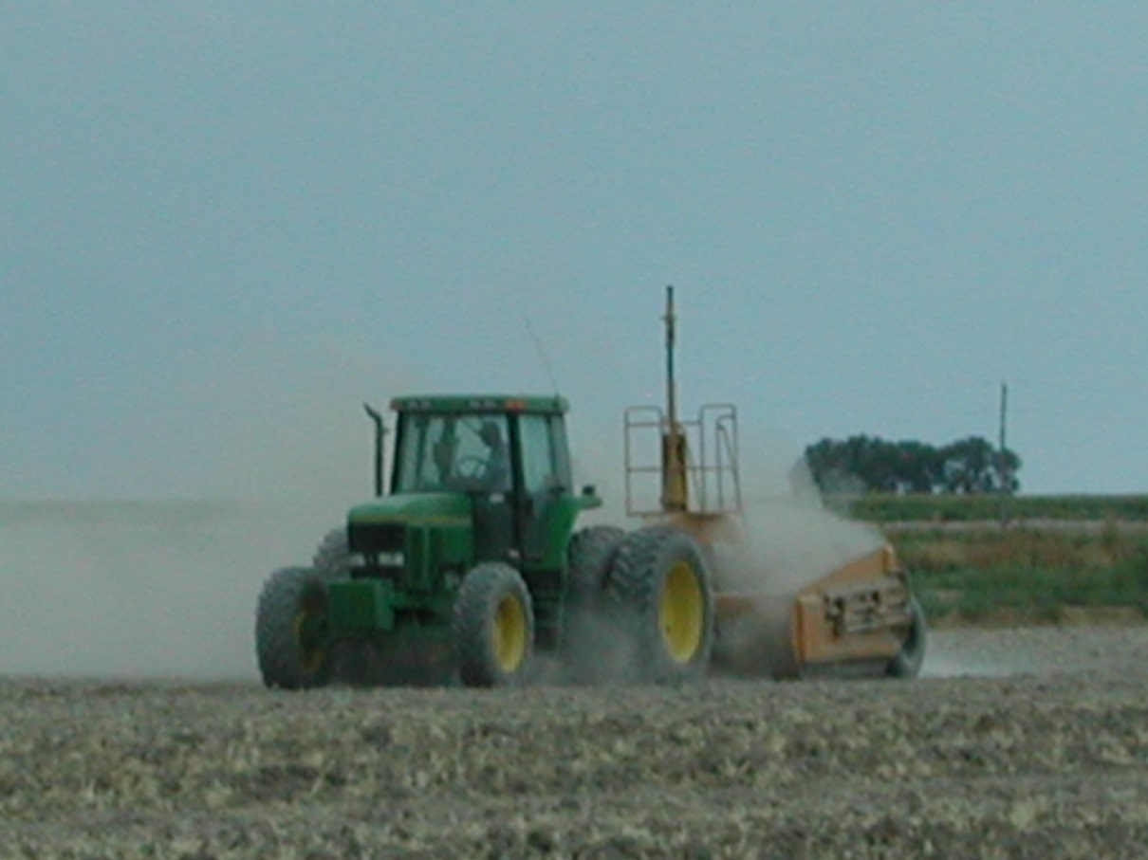
There are a number of irrigation methods exist
Factors considered for selection of irrigation method
Or
SELECTING AN IRRIGATION METHOD FOR OPTIMAL WATER MANAGEMENT
Compatibility. The irrigation system for a field or a farm must be compatible with the other existing farm operations, such as land preparation, cultivation, and harvest.
Level of Mechanization
Size of Fields
Cultivation
Pest Control

Slide 22
2. Economic Considerations.
The type of irrigation system selected is also an economic decision. Important costs include:
energy
water
land preparation
maintenance
labor
taxes

Slide 23
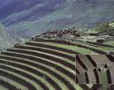
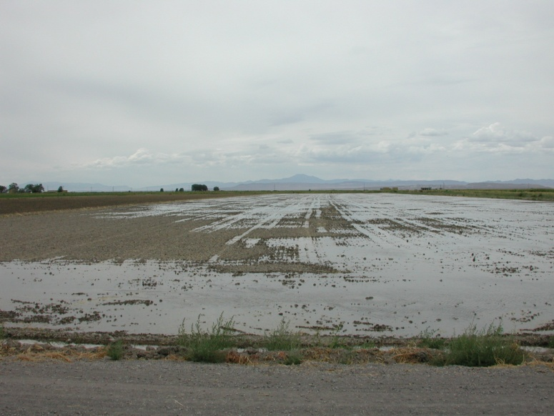
3. Topographic Limitations
Restrictions on irrigation system selection due to topography include:
groundwater levels
the location and relative elevation of water source,
field boundaries,
the location of roads
power and water lines and other obstructions,
the shape and slope of the field

Slide 24
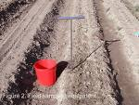
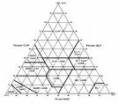
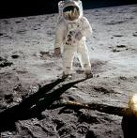
4. Soil Characteristics
The soil type usually defines:
soil moisture-holding capacity
the intake rate
effective soil depth

Slide 25
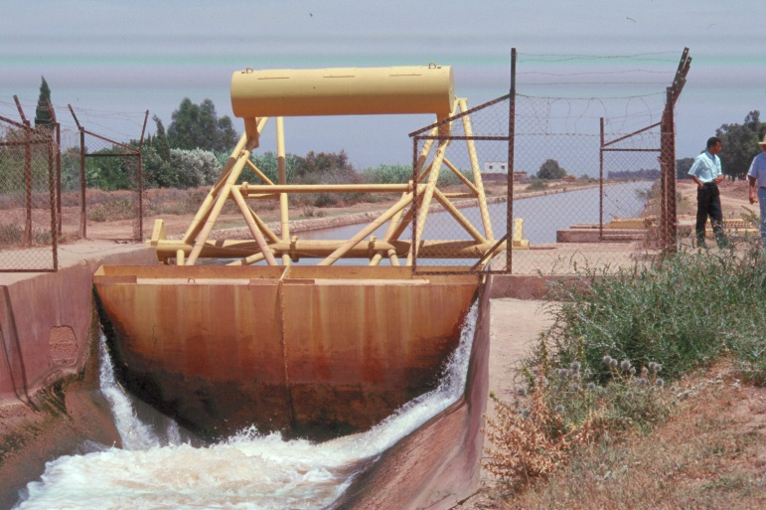
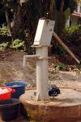
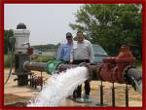
5. Water Supply
The quality, quantity, and temporal distribution characteristics of the source of irrigation water have a significant bearing on the irrigation practice

Slide 26
6. Crop Factors
Crop characteristics that influence the choice of irrigation system are:
The tolerance of the crop during germination, development and maturation to soil salinity, aeration, and various substances, such as boron
The magnitude and temporal distribution of water needs for maximum production
The economic value of the crop

Slide 27
7. Environmental Impact
There is now an extensive body of knowledge about the human and environmental impact of large-scale water control and storage
The impact of water impoundment is not confined to the problems noted above but has far-reaching consequences.
Dams and reservoirs have inundated arable and pasture land as well as places of historical or cultural value to communities
Labour factor
Drainage, Salinity and water logging problems

Slide 28
8. Geological and geo-technical factors
e.g. For construction of dams (foundation and etc.)
To drill water wells
Sensitive to sedimentation
Areas sensitive to tectonic effect
Hazard areas

Slide 29
9. External influences
Marketing for product
Foreign currency for employing advanced technology
Administrative (e.g. conflict between farmers)
Political factors

Slide 30
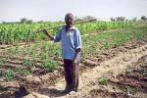
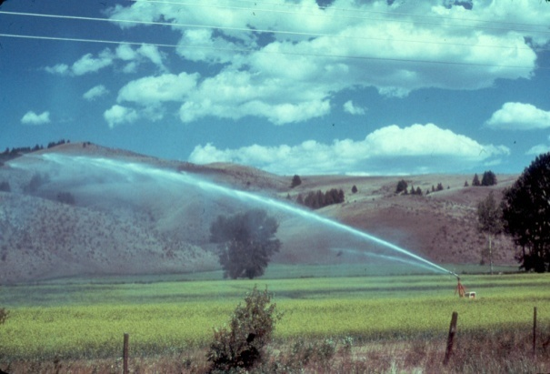
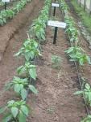
There are generally three types of irrigation system
Surface Irrigation
Furrow, Border, Basin (Fig 1)
Sprinkle Irrigation (Fig 2)
Center Pivot, Wheel Line, Solid Set, etc.
Micro, Drip, or Trickle Irrigation (Fig 3)
Drip, micro-sprinkler, etc.

Slide 31
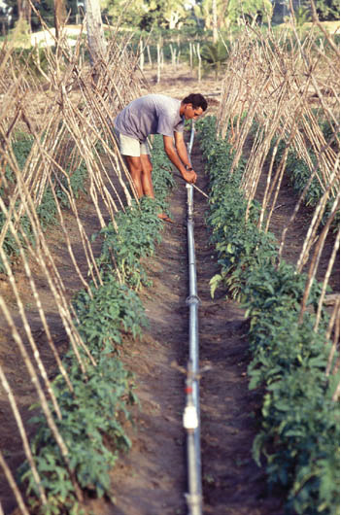
Or

Slide 32
2. Sources of water for irrigation
The most common sources of water for irrigation are
Surface water (lakes, streams, ponds and etc.),
Groundwater (shallow or deep, spring and etc.)
Harvested water (macro and micro dams, roof,)
In fact, from irrigation point of view; all needs
Quantity and quality of water
Engineering works necessary to obtain water e.g. underground needs pumping
Conveyance System: e.g. water flow via open channels by gravity or via pipes by closed conduits
Water measuring devices e.g. weirs, orifice, flumes, current meters

Slide 33
All sources are part of the water cycle
Water can occur in three physical phases: solid, liquid, and gas
Depending upon the place of occurrence, water can quickly change its phase and called hydrologic cycle
Which is the continuous movement of water within, above and below earth surface
It has no beginning or end.
Hydrologic cycle is ultimately driven by solar radiation, which evaporates water from the ocean and lifts it up in the atmosphere

Slide 34
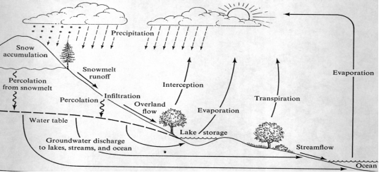

Slide 35
The hydrologic cycle
Can be visualized as a series of storages and a set of activities that move water among these storages.
Among these, oceans are the largest reservoirs, holding about 97% of the earth’s water.
Of the remaining 3% freshwater, about 78% is stored in ice in Antarctica and Greenland.
About 21% of freshwater on the earth is groundwater, stored in sediments and rocks below the surface of the earth.
Rivers, streams, and lakes together contain less than 1% of the freshwater on the earth and less than 0.1% of all the water on the earth.

Slide 36
Major components of the hydrologic cycle:
Precipitation (rainfall, snowfall, hale, sleet, fog, dew, drizzle)
interception,
Depression storage, Evaporation (open water)
Transpiration, Infiltration, Percolation, Moisture storage in the unsaturated zone, and runoff (surface runoff, interflow, and base flow)

Slide 37
Evaporation and transpiration are
The two processes that move water from the Earth’s surface to its atmosphere.
Evaporation is movement of free water to the atmosphere as a gas.
Transpiration is the movement of water through a plant to the atmosphere.
Both processes can be termed as evapotranspiration
This may occurred from shallow zone or deep groundwater
(needs crop root depth identification)
As water rises higher in the atmosphere, it starts to cool or condense and become a liquid again. The process is called.
Results the formation of clouds
The clouds gets too heavy, the water falls back to the earth as
precipitation

Slide 38
Precipitation
Partly infiltrated down through the soil layer
But
Infiltration rate varies both spatially and temporally due to a number of factors.
Soil type, geology, morphology, intensity, duration, depth,
Infiltration rate, total infiltrated water (cumulative) and infiltration capacity also varied with time, rainfall intensity and frequency,
Early time or when the soil is completely full of water
Rather it drains quickly (gravitational water)
But
Portion that remains in the soil zone is the field capacity

Slide 39
Cont.
The infiltrated may also
Stored in the unsaturated zone or
Percolated down below saturated zone (water Table)
Part of rainfall also flows as Runoff to areas of lower elevation, either to
Lakes
Oceans
Rivers and streams
Directly or In the form of base flow, stream flow or stream discharge
This part is vital for surface water harvesting

Slide 40
Which source is better?
Factors ruled to select sources of irrigation water are
Availability
Quantity
Quality
Sustainability
Accessibility
Economic to use the available water
Technology
Political and administrative influences

Slide 41
Water availability
Due to various factors e.g. climate, topography,….
distribution of water varied a lot over the year, or even between one year and another.
The possibility of supplying water to irrigation is then;
Depends primarily on the availability of the water at its source.
The supply also depends on
the capacity of the facility installed to withdraw from the water source
Technicians to be used
It is thus, important to know how much water one can tap from a given water source over the course of a season or a year,

Slide 42
Either in
Developing a new irrigation scheme,
Extending an existing scheme,
Changing the cropping season,
Adding a second or third irrigation season,
Switching from a low water demand crop to a crop such as rice with high water requirements.

Slide 43
The irrigation water supply also depends,
On two factors:
Whether the water source itself has a limited flow or a limited volume,
Whether the facilities that control the tapping (gate, well, pump) and conveyance (canal, pipe) have a limited capacity.
There may also exist water regulations

Slide 44
Methods of tapping water from water sources
How delivered from either of these all sources to the desired site or irrigation scheme??
Either through
Gravity from lower level of the fields in the irrigation scheme;
Pumping

Slide 45
E.g. Rivers
All over the world uses a river water as sources of irrigation water
Yet, the flow of river fluctuates over time
These small local rivers which respond quickly to rainfall in their catchment area, fluctuate greatly over relatively short periods of time;
Other rivers with a large catchment area, where the rains are spread over a greater area and for a longer period of time show little fluctuation or vary only over a long period of time.

Slide 46
Tapping water from rivers
Direct river diversion
Without any structures, dams or other devices.
The offtake canal is directly excavated through the river bank and no gate is provided.
There is no control of the discharge into the canal.
But the diverted discharge depends on the water level in the river, depth of the canal;
Then flow will be high during periods of high water and low during periods with a low water level.

Slide 47
to avoid changes in the discharge, a control gate can be installed.
The gate can then be opened completely when the river level is low, and
opened only partly when the water level is high

Slide 48
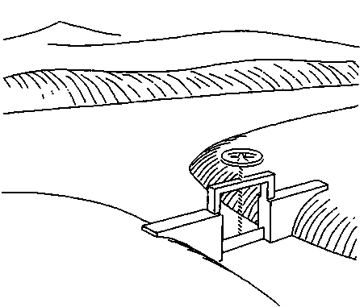

Slide 49
Advantage
The system of water abstraction is it’s relatively low cost. However, the method can only be used when the river water level, even at low flows, is higher than the land which is to be irrigated.
River diversion using a weir: To avoid the problems caused by fluctuating water levels in a river, a weir can be built across the river.
During periods of high river discharges, water will flow over the weir.
The water level upstream of the weir will show little variation during the year, and it will remain higher during the dry season than it would without the weir.
Pumping from a river

Slide 50
other surface Sources
Streams, lakes, farm ponds and etc.
Streams should be gauged to ensure that there is enough water for irrigation.
Rivers or streams can also be dammed to raise the height of flow and make more water available for irrigation.
Farm ponds can also be dug to store water from rivers or channels (e.g. field station) or to collect water from rainfall

Slide 51
Reservoirs and lakes
Water availability in lakes and reservoirs
Natural (Tana) or artificial (Abay Dam) lakes
The amount of lake water available for irrigation may be calculated as the difference between the water available in the lake and the amount lost due to evaporation and seepage.
For large irrigation schemes, local or national authorities will be responsible for evaluating the available quantity of water.
It can also estimate the evaporation and percolation losses and will have information on other uses for the water.

Slide 52
Reservoirs
The amount of water that can be stored in a reservoir depends on:
-River discharge (which in turn depends on rainfall) -Height of the dam (when closing the river in a valley) -Area of the reservoir (in the case of an artificially excavated storage area).
Either a dam built across valley
Or a natural depression or dead river branch alongside the river, or by constructing a storage reservoir.
Cost for building, maintenance, etc.

Slide 53
Water tapping from a reservoir
Gravity
Pumping from
Canal
Therefore, accurate computation of surface water is critical

Slide 54
Groundwater
Found in the aquifer system(rocks or soils)
Groundwater availability
Availability of groundwater is less irregular than that of small rivers.
Aquifers at shallow depths, however, are likely to be very thin with a limited storage capacity for groundwater.
Pumping from wells
Shallow groundwater
Deep groundwater

Slide 55
Generally
Agricultural activities is dominate (69%), followed by industrial purpose (22%) and domestic purposes (8%) of worldwide usage of water
The same is true in Africa that water's crucial role in accomplishing the continent's development goals is widely recognized
Agriculture, households and industry use about 85%, 10% and 5% of water usage respectively.

Slide 56
Though,
approximately 75% of the Earth’s surface is covered by water
all of these resources are not potentially available to humans since freshwater is required by the agricultural sector, industries, and domestic and recreational users
Thus, as the world population continues to grow, the ability to source clean water is becoming a more pressing concern and focus is placed on the availability, distribution and use of freshwater resources on a global scale
As a result peoples around the globe have been overexploited both surface and groundwater resources intensively throughout the world

Slide 57
Conti.
Global water availability and water use is challenging as the resource varied significantly in space and time owing to the erratic distribution of rainfall, complex geological and landscapes
Especially, surface water
Has limited availability
Spatio-temporal variability
Less reliability,
Thus, in planning sustainable economic developments and domestic uses is not guaranteed on it
In contrast, groundwater has several inherent advantages:
continuous availability and
excellent natural quality
affordable developmental cost
high buffering capacities in the face of rainfall variability compared with surface water resources.

Slide 58
Rate of groundwater utilization and rate of depletion in water table
Groundwater supplies water to billions of people and is important for agricultural irrigation and the health of ecosystems
Presently, it is a major and most reliable source of water supply for industries, domestic and irrigation activities throughout the World
Because of the above reasons
The contributions of the groundwater resources all over the world have estimated by different researchers
It accounts for as much as 33% of total water withdrawals worldwide

Slide 59
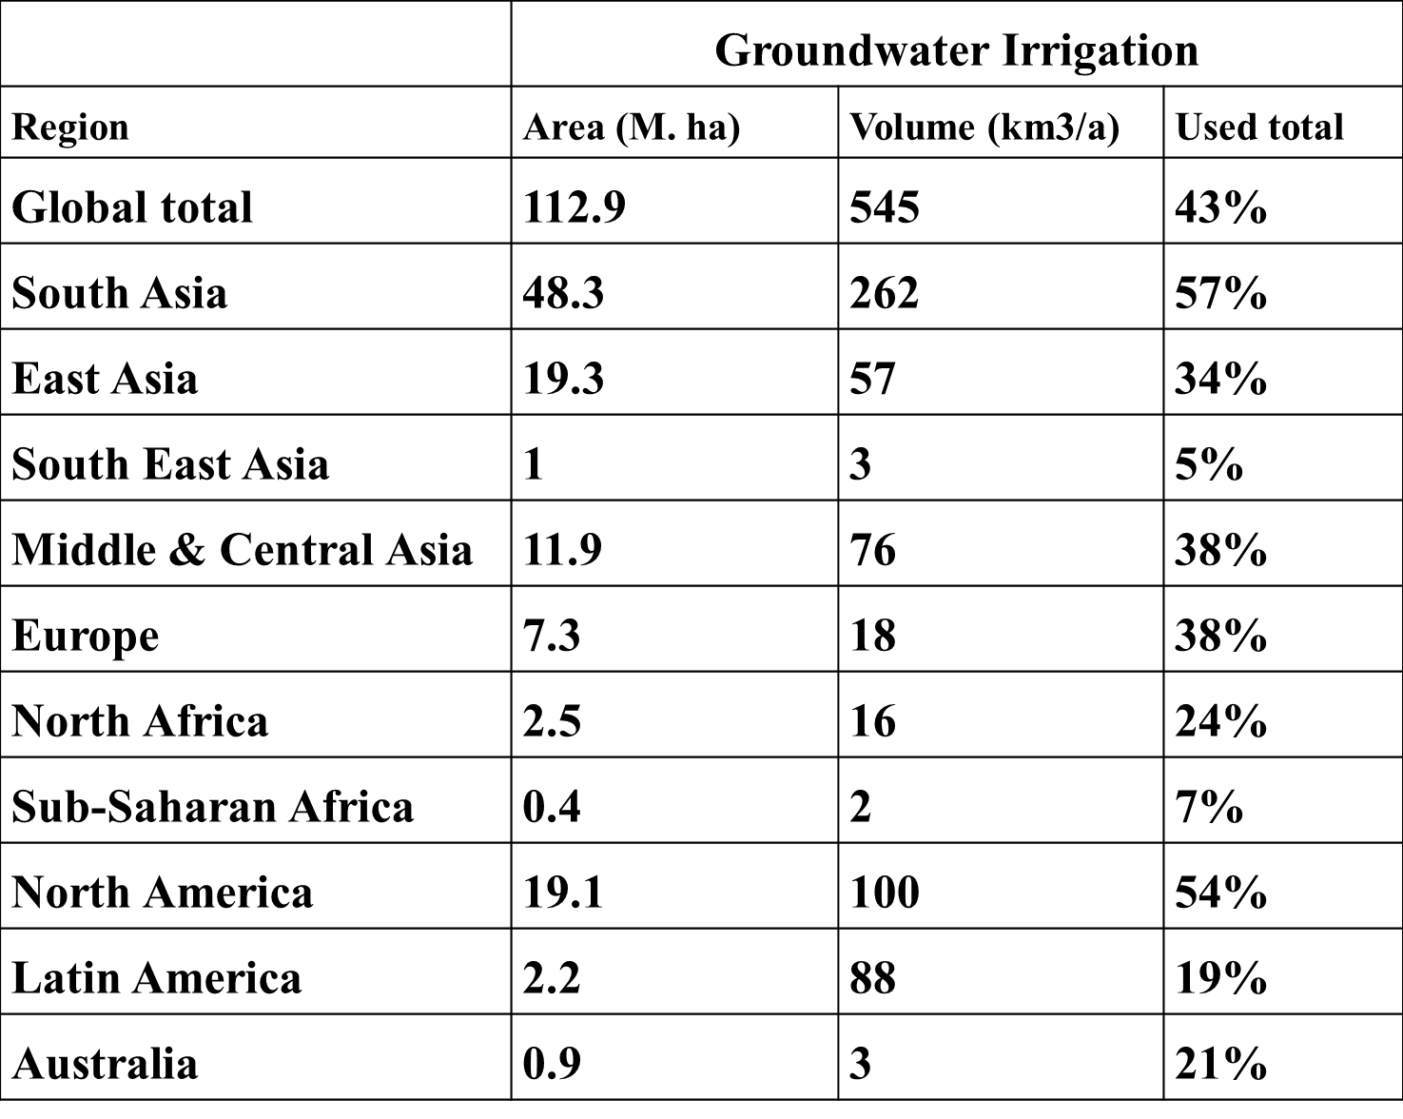
Global GW Consumption
Rate

Slide 60
Harvested water
Water harvesting is defined as the “collection of runoff for its productive use.
Runoff may be harvested from roofs and ground surfaces, as well as from intermittent or ephemeral watercourses.
Ground surface
As ponds
Reservoirs and dams
All are termed as floodwater harvesting.
Productive uses include provision of domestic and stock water, concentration of runoff for crops, fodder and tree production and, less frequently, water supply for fish and duck ponds.

Slide 61
Springs and waste water
e.g. industrial water and sewage: but determine quality before use.

Slide 62
1.2. Basic Soil-water – plant relationship
Physical properties of soil
Entry of water in to the soil
Infiltration process
Factors affecting Infiltration
Soil water conditions
Soil moisture conditions
soil moisture content
Soil water classification

