Slide 1
Climate Change Mitigation Options in Waste Management Areas: Some Success stories and lessons from East Africa
Getinet Assabu (Ph.D.)
Debre Markos University ,
College of Agriculture and Natural Resources Department of Natural Resources Management

Slide 2
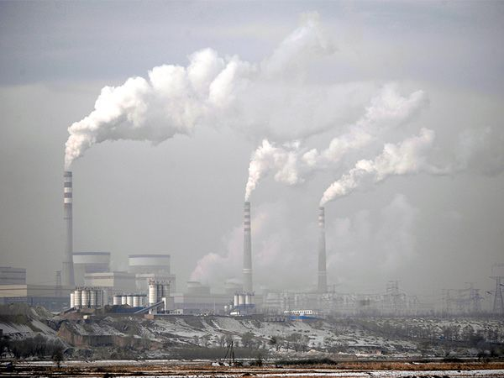
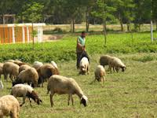
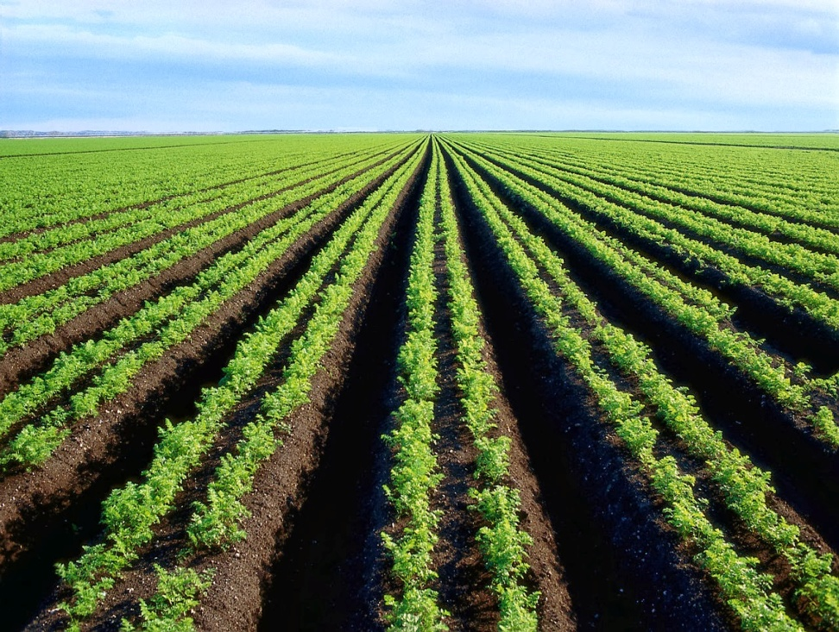
Introduction
In past 200 years, Greenhouse has increased due to anthropogenic activities such as
Industrial activities
Agricultural production

Slide 3
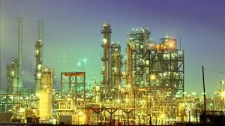
Production and use of fossil fuels

Slide 4
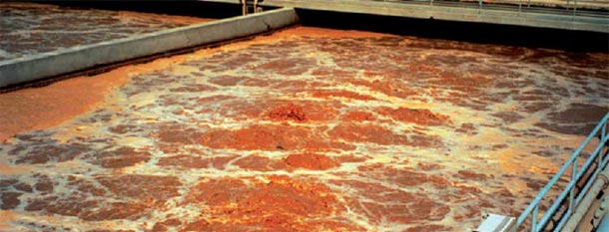
Greenhouse gas emission from waste water treatment becomes a growing concern

Slide 5
Cont’…
GHG emission from post-consumer waste and wastewater treatment represents approximately 3% of total global anthropogenic GHG emissions
methane represents 90% of waste sector emissions (Bogner et al., 2008).
Worldwide wastewater:-
  is the fifth largest source of anthropogenic CH4 emissions,
  contributing approximately 9% of total global CH₄ emissions in 2000 (Bani Shahabadi et al. 2010).

Slide 6
India, China, United States, and Indonesia combined account for 49% of the world‘s CH₄ emissions from wastewater.
Global CH₄ emissions from wastewater are expected to grow by approximately 20% between 2005 and 2020 (Gupta, 2012).

Slide 7


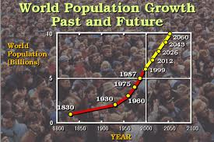
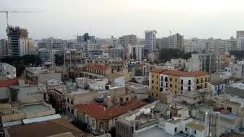
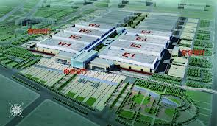
2. Wastewater treatment process

Slide 8
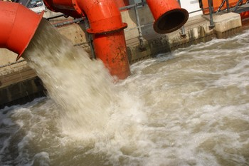

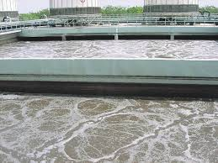
Resulting in significant challenges
Recycling
Collection
Treatment and Disposal

Slide 9
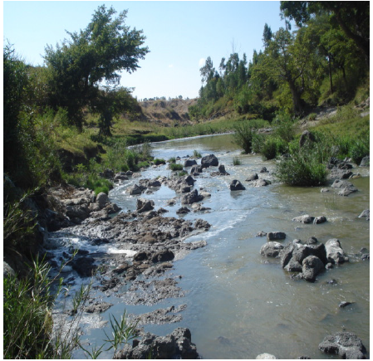
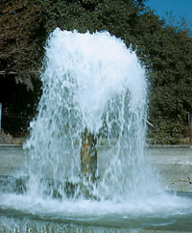

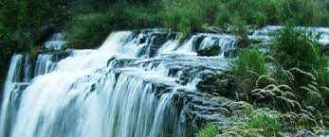
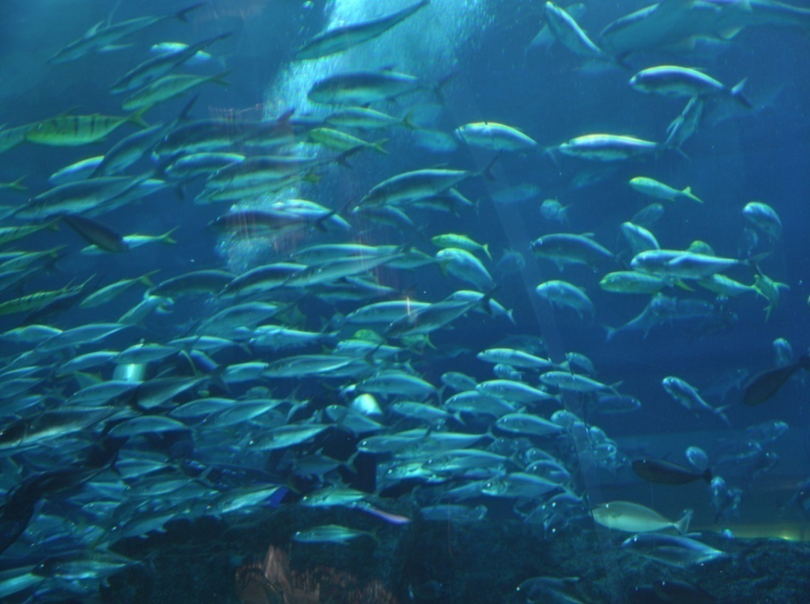

Slide 10
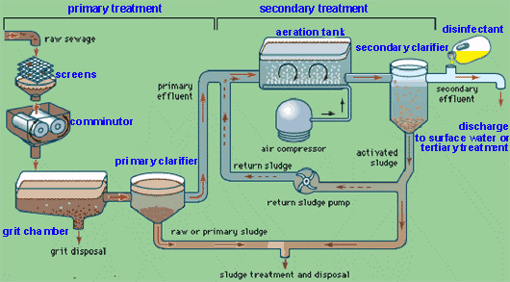

Slide 11
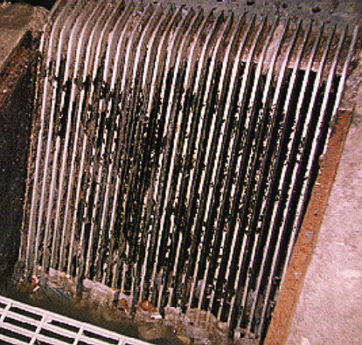
Bar Screen
Catches large objects that have gotten into wastewater system such as bricks, bottles, pieces of wood, etc.

Slide 12
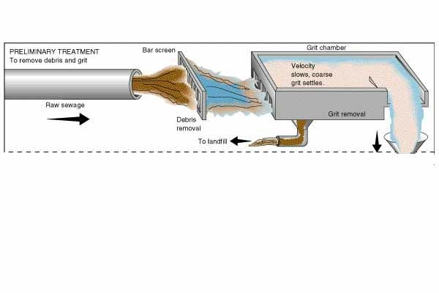
Grit Chamber
- removes rocks, gravel, etc.

Slide 13
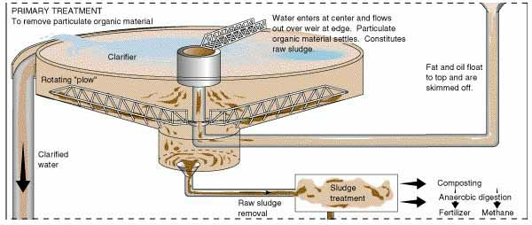
Primary Treatment
  a physical process
  wastewater flow is slowed down and suspended solids settle to the bottom by gravity
  the material that settles is called sludge or biosolids

Slide 14
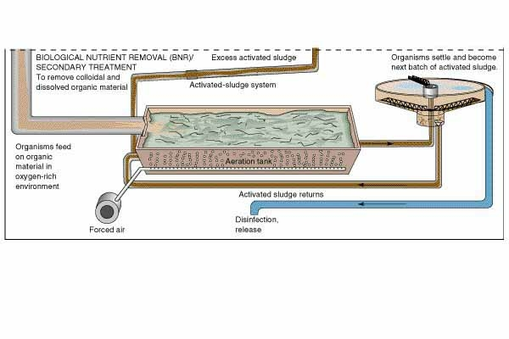
Secondary treatment reduce further the suspended solids and B.O.D. of the wastewater.

Slide 15
2.1. Anaerobic Treatment
COMPLEX ORGANIC MATTER
Proteins
Carbohydrates
Lipids
hydrolysis
1
1
1
Amino Acids, Sugars
Fatty Acids, Alcohols
acidogenesis
INTERMEDIARY PRODUCTS
(C>2; Propionate, Butyrate etc)
1
1
acetogenesis
2
Acetate
3
Hydrogen, Carbon dioxide
5
Homoacetogenesis
4
methanogenesis
Acetotrophic Methanogenesis
Methane
Carbon dioxide
Hydrogenetrophic Methanogenesis

Slide 16
Common anaerobic treatment infrastructure includes anaerobic lagoons, conventional digesters, filter bed reactors, fluidized bed reactors, two stage digesters and high rate digesters such as the Upflow Anaerobic Sludge Bucket (UASB) design (Kurup, 2011).

Slide 17
Anaerobic Contact Reactor
biogas
effluent
influent
mixing
sludge recycle

Slide 18
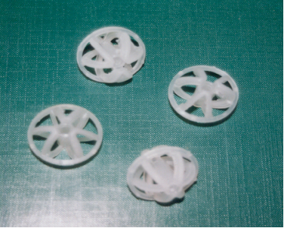
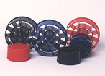
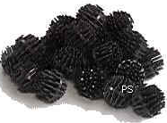
Upflow Anaerobic Filter
Heater
Biogas
Effluent
Perforated
Al plate
Sampling
port
Water
bath
Peristaltic pump
Media
Sludge wastage
Constant temperature
Feeding
recirculation line
tank at 4ºC
Peristaltic
pump

Slide 19
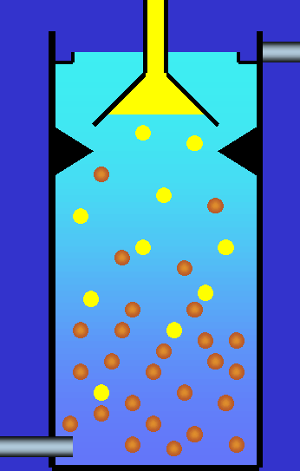
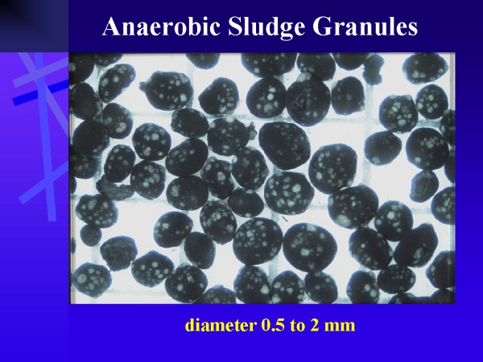
UASB Reactor
Effluent
biogas
Influent

Slide 20
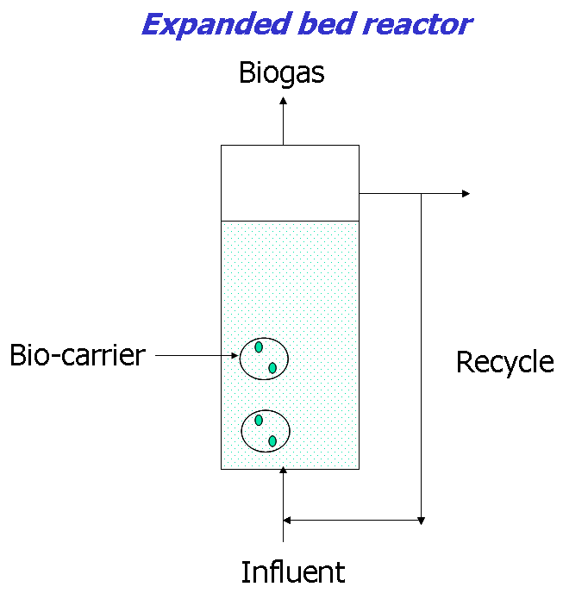

Slide 21
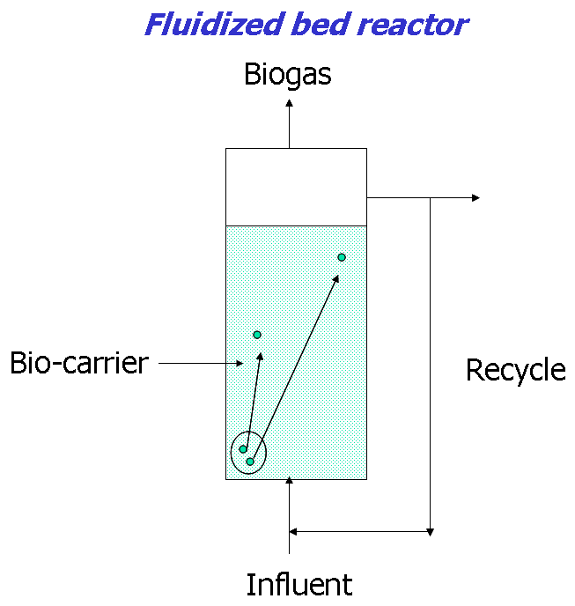

Slide 22
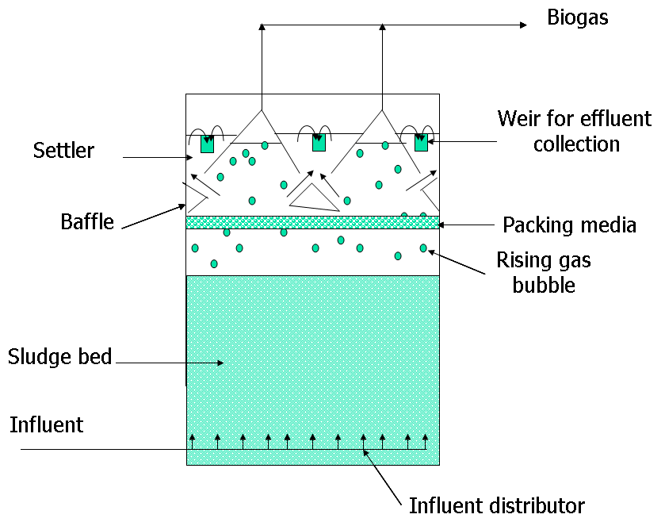

Slide 23
Anaerobic baffled reactor
the wastewater passes overand under the baffles.
Biogas
Sludge

Slide 24
Anaerobic Sequential Bach Reactor

Slide 25
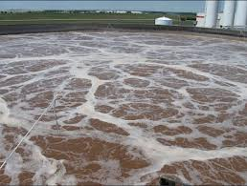
2.2. Aerobic Treatment
Convert OM to biomass and CO₂.
Aerobic treatment is often used as part of a treatment train where digestate and residual material discharged from anaerobic systems undergo mechanical aeration (Kurup, 2011).

Slide 26
2. 3. Biological Nutrient Removal
Biological nutrient removal (BNR);-
  to remove total nitrogen (TN) and
  total phosphorous (TP) from wastewater.
BNR process typically achieved via the following biological steps:

Slide 27
1. Mineralisation/Ammonification;–
  organic compound conversion to inorganic ammonium;
2. Autotrophic nitrification;–
  oxidation of ammonium, primarily to nitrate and nitrite
3. Heterotrophic denitrification;–
  reduction of nitrate and nitrite to nitrogen under anoxic conditions

Slide 28
  3. Greenhouse gas emissions
Wastewater treatment contribute to GHGs;-
Either through treatment processes or energy required for treatment
From the treatment process
    production of methane (CH₄),
    nitrous oxide (N₂O)
    carbon dioxide (CO₂)
From Energy required for treatment
      carbon dioxide (CO₂) (Cakir and Stenstrom, 2005).

Slide 29
3. Sources of greenhouse gas emissions at WWTP
3.1 Methane (CH4) ;- occurs under anaerobic conditions
  Influent works;
  Anaerobic/anoxic tanks as part of activated sludge;
  and Sludge digestion and handling activities.

Slide 30
3.2 Nitrous Oxide;-
The emission of N₂O occurs;
  In the activated sludge units a
  grit tanks,
  pre-sedimentation secondary clarifiers,
  sludge storage tanks and
  anaerobic sludge digesters (Kampschreur et al., 2009).
N₂O is a known intermediate of both nitrification and denitrification processes
N2O emissions from wastewater treatment have only recently been acknowledged in GHG emission methodologies.

Slide 31
4. Strategies for Mitigation of GHG Emissions from Wastewater Treatment
Five key strategies which the wastewater treatment plants could adopt to reduce GHG emissions (Georges et al. 2009),.
1. Source Control:- extensive carbon savings may be accomplished through the control, at the source of priority pollutants of concern, thus avoiding the need for additional wastewater treatment.

Slide 32
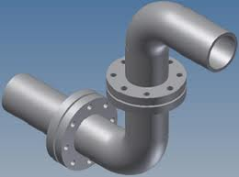
2. Least Carbon End-of-pipe/Process Addition:-
End-of-pipe treatment technologies:
  enhance the carbon content
  of the waste
  increase the operational needs
  for energy.
It is advisable to implement significant changes in the conventional approach to wastewater treatment to reduce significant carbon emissions.

Slide 33
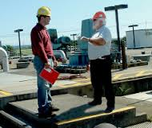
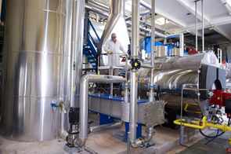
Greater Operational Efficiencies:-
  minimize higher energy demand
  enhances the operational efficiency of the system and reduces GHG emissions

Slide 34
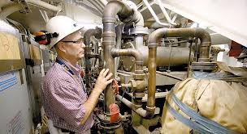
Redesigning of existing wastewater treatment system to
lower energy alternative

Slide 35
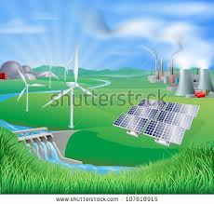
5. Renewable Energy Generation:- This strategy aims at on-site energy generation, or generation within the wastewater treatment facility.

Slide 36
5. Development of Integrated Process for Agro-process Waste Water Treatment and Renewable Energy Generation in East Africa

Slide 37

5.1. Introduction
rapid expansion of agro-processing industries in Eastern Africa.
environmental degradation,
  discharge of untreated or partially treated wastewater
  greenhouse gas emissions,
  and consequently climate change.

Slide 38
In addition, the current treatment processes do not integrate
    pollution reduction,
    Energy agro-process wastewaters.
    and nutrient recovery
Thus, they do not contribute to the energy supply or nutrient resources for improved agricultural productivity and climate change mitigation.

Slide 39
This paves way;-
  for nutrient depletion from arable land,
  increased deforestation rates,
  increased GHG emissions
  and enhanced climate change.
To address these challenges and use the little available resources efficiently,
avoid duplication of efforts is necessary

Slide 40
International/regional networking amongst expert scientists and private sector organizations in the region to develop and support appropriate technologies that mitigate climate change
  Addis Ababa University (Ethiopia),
  University of Dar Es Salam (Tanzania) and
  Makerere University (Uganda)
collaborative project to develop bioprocesses that produced biogas while treating the wastewater.

Slide 41
Project Focus on
Slaughterhouse and banana wine process effluents in Uganda and Tanzania, respectively
Tannery effluents in Ethiopia,
biogas production,
biogas production,

Slide 42
Goal:
Contribute to climate change mitigation, environmental sustainability, and agricultural development in Eastern Africa through integrated waste management innovation systems
Project outcomes
Pollution levels in water discharges at pilot test sites of partner countries in E. Africa reduced by up to 80%.
2) Biogas recovery, water and nutrient reuse from agro-process wastewater enhanced by 80% at partner pilot sites in Eastern Africa
3) GHG emissions from agro-process wastewater at pilot test sites of partner countries reduced by 80%

Slide 43
Project outcomes
Pollution levels in water discharges at pilot test sites of partner countries in E. Africa reduced by up to 80%.
2) Biogas recovery, water and nutrient reuse from agro-process wastewater enhanced by 80% at partner pilot sites in Eastern Africa
3) GHG emissions from agro-process wastewater at pilot test sites of partner countries reduced by 80%

Slide 44
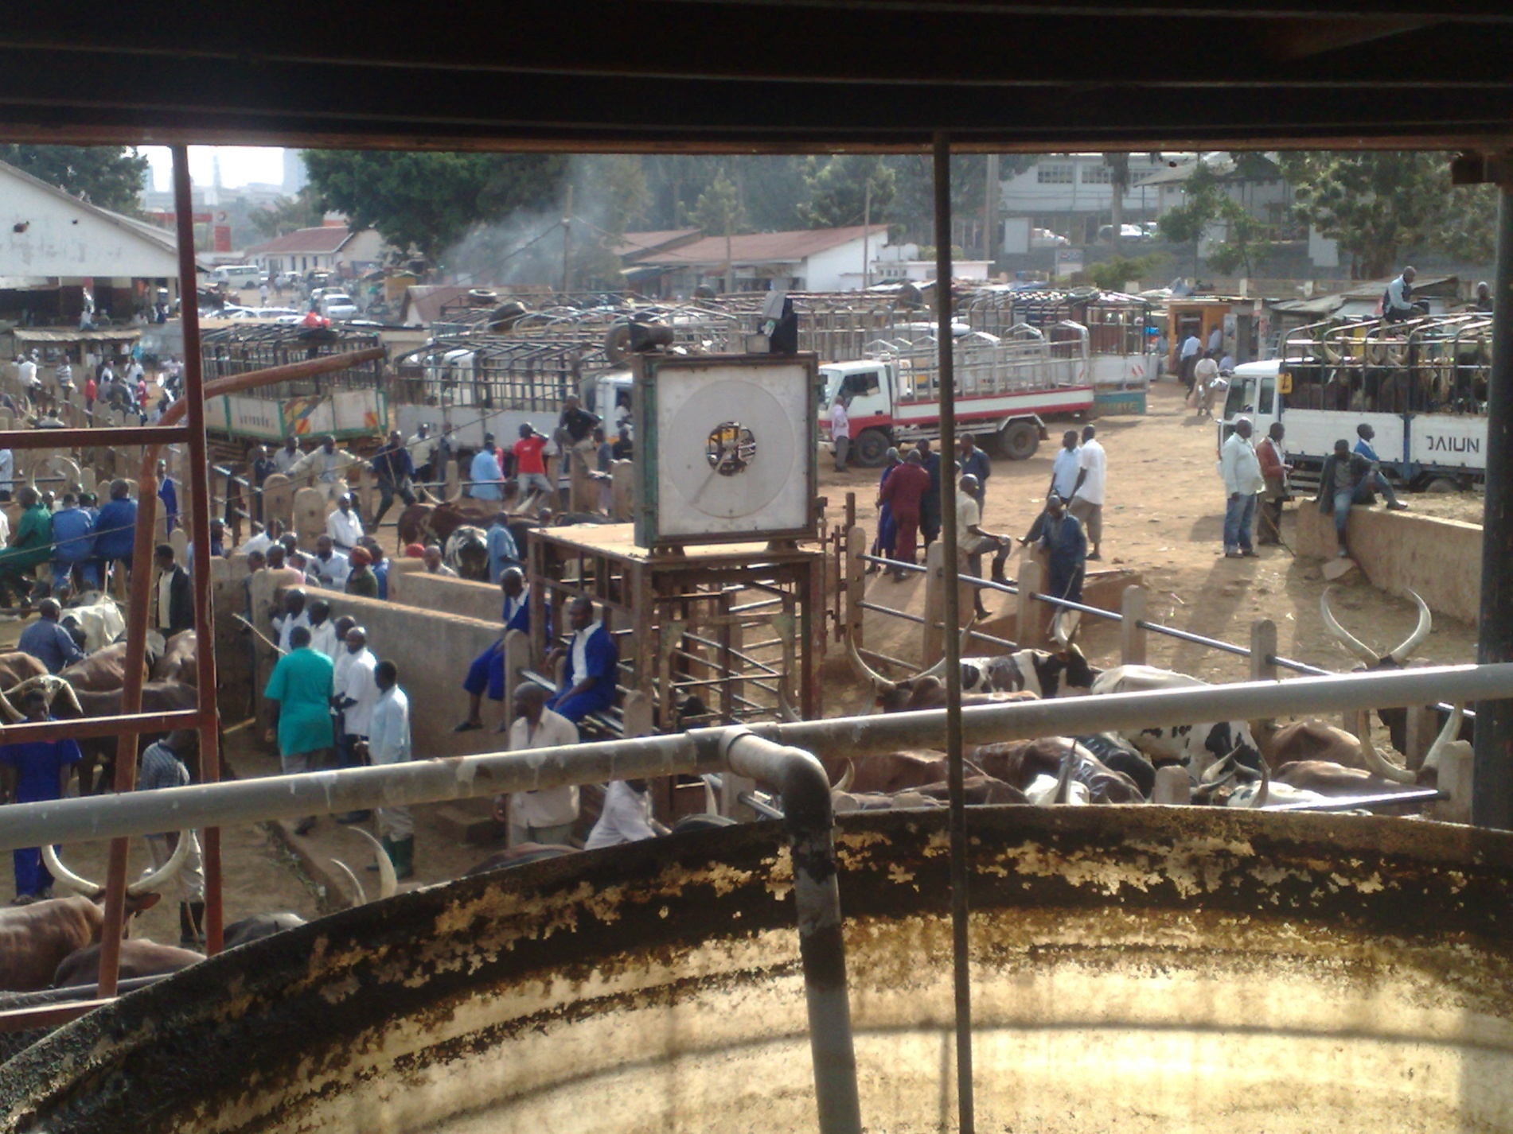
Progress in Uganda

Slide 45
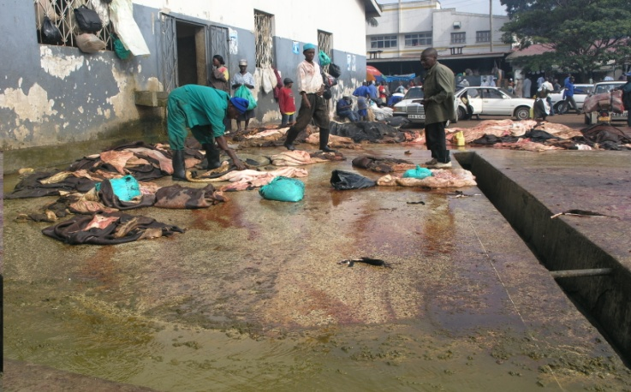
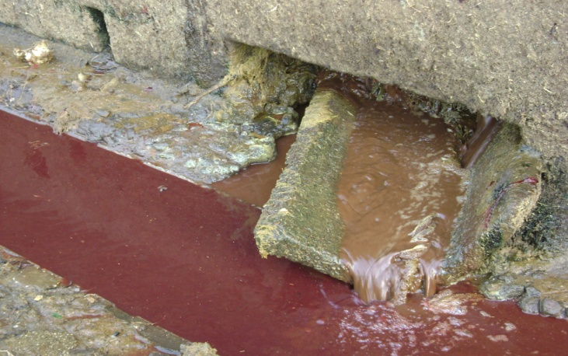
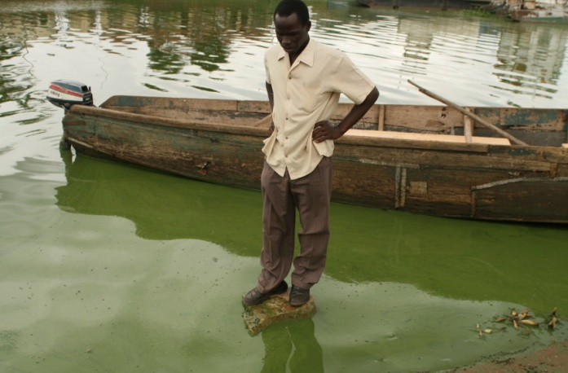

Slide 46


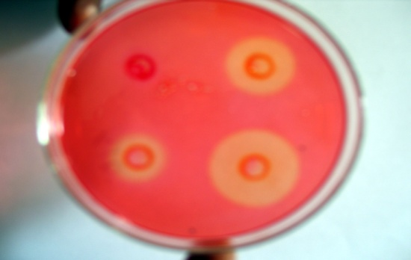
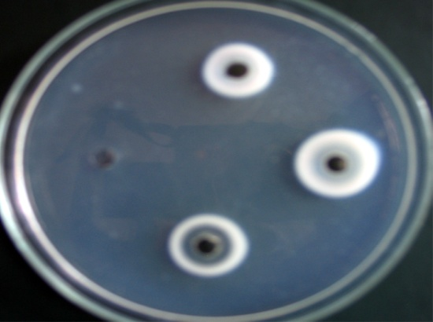
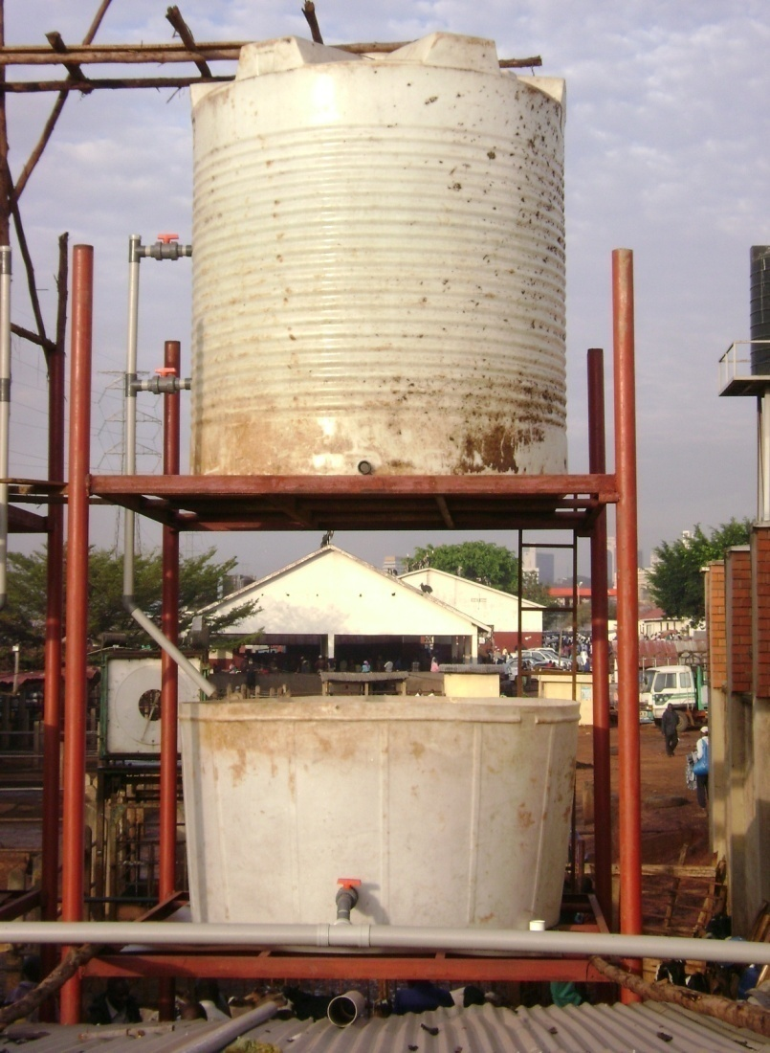
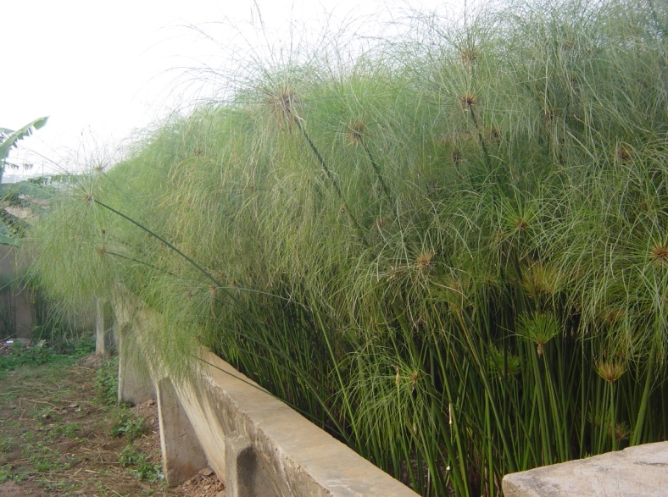
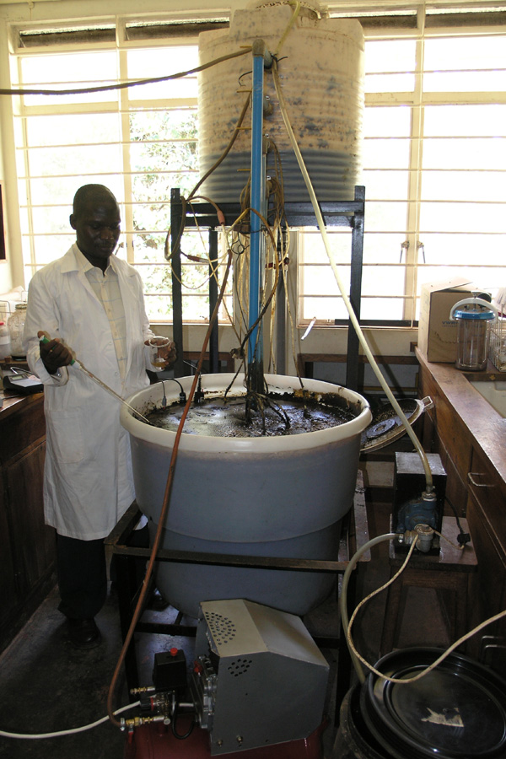
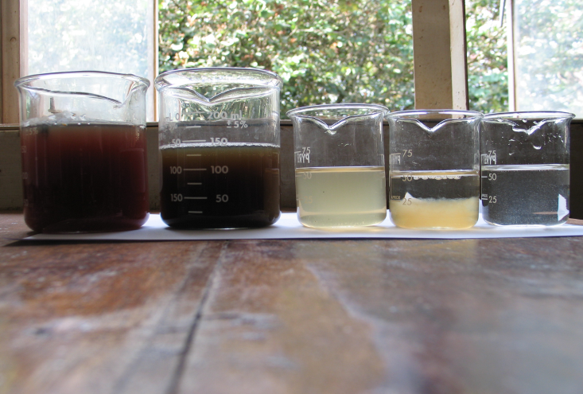
Process cycle

Slide 47
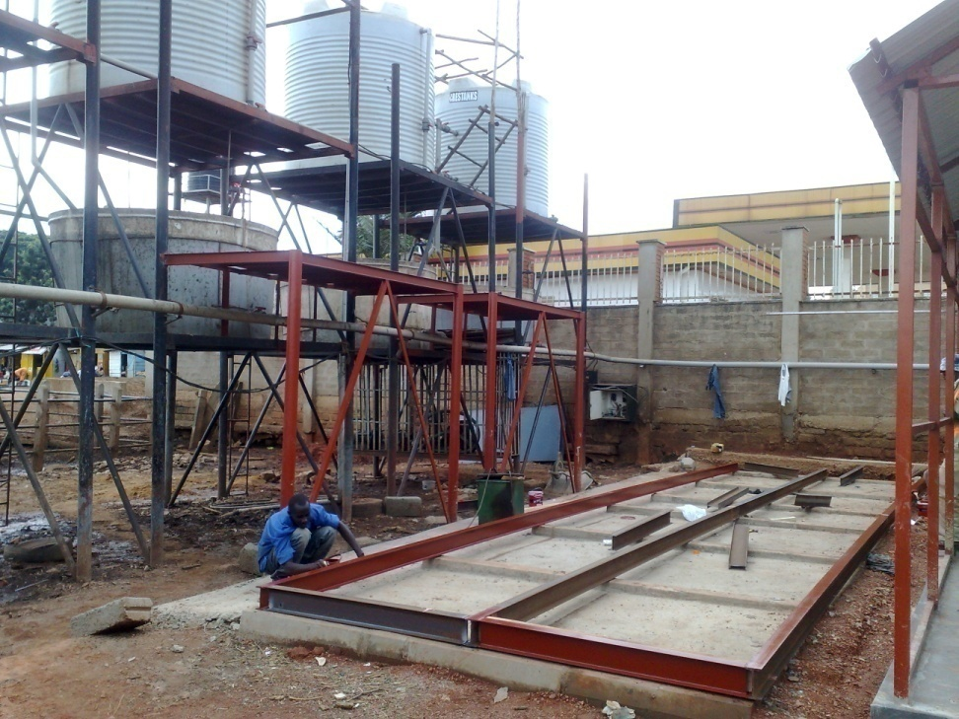
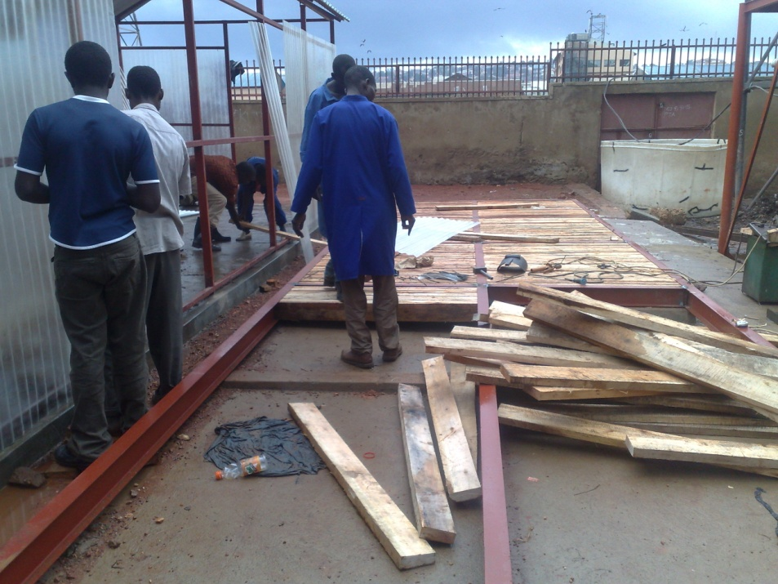
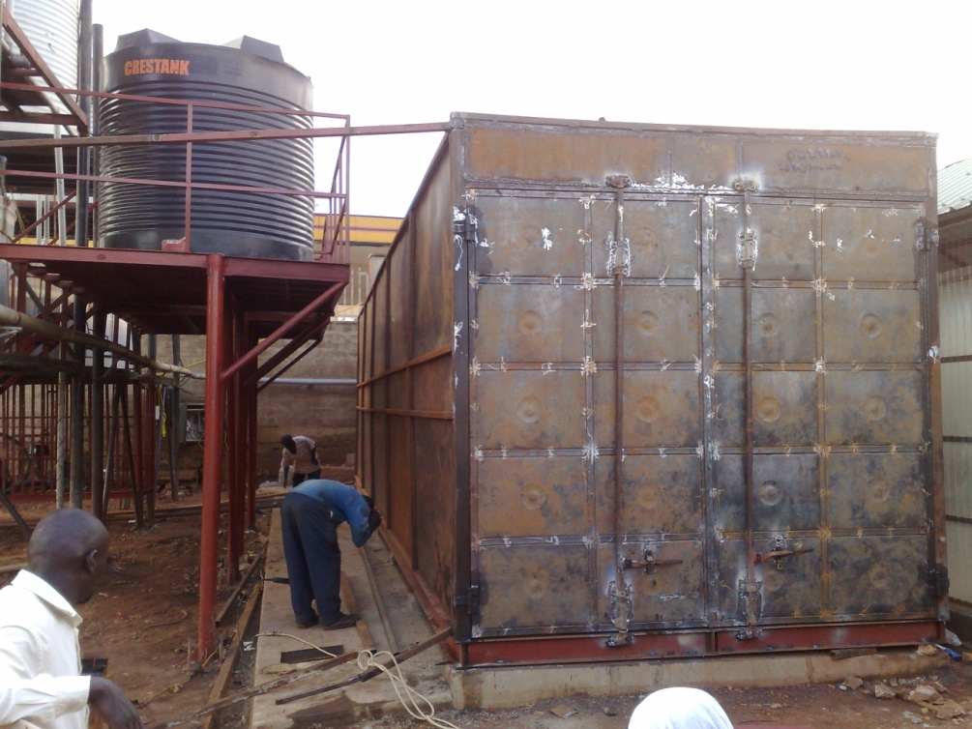
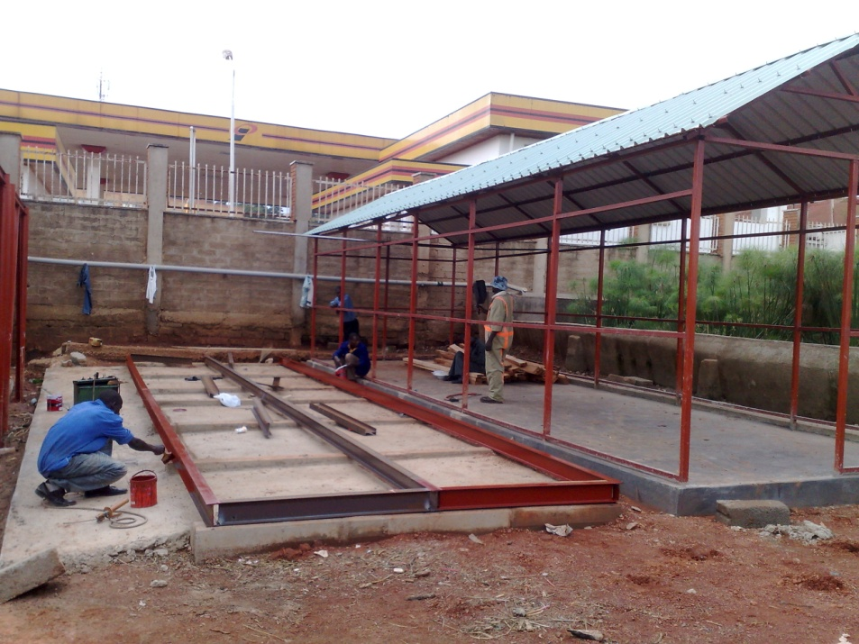

Slide 48
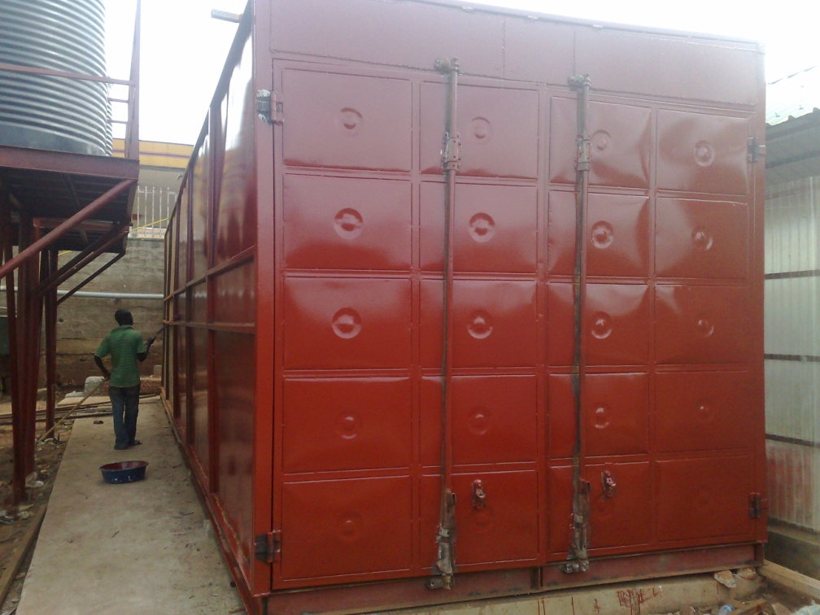
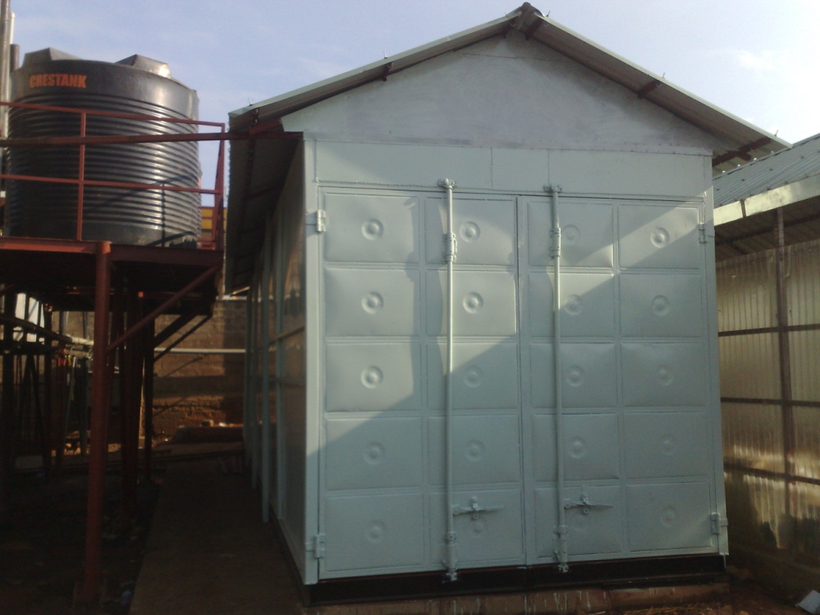
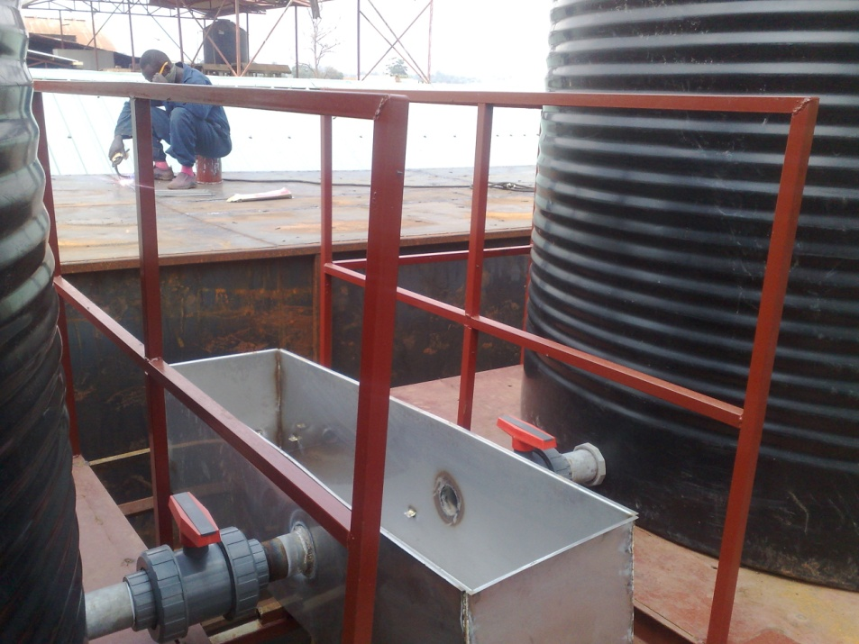


Slide 49





Slide 50




Slide 51

Progress in Tanzania

Slide 52

Progress in
Ethiopia

Slide 53








Slide 54




Slide 55


Slide 56


Slide 57


Slide 58


Slide 59
Challenges in the Ethiopian Component of the project;-
  Procurement system
  Bureaucratic nature of our system
  Understanding problem
  Lack of the necessary support for all concerned bodies including your minister

Slide 60








