Slide 1
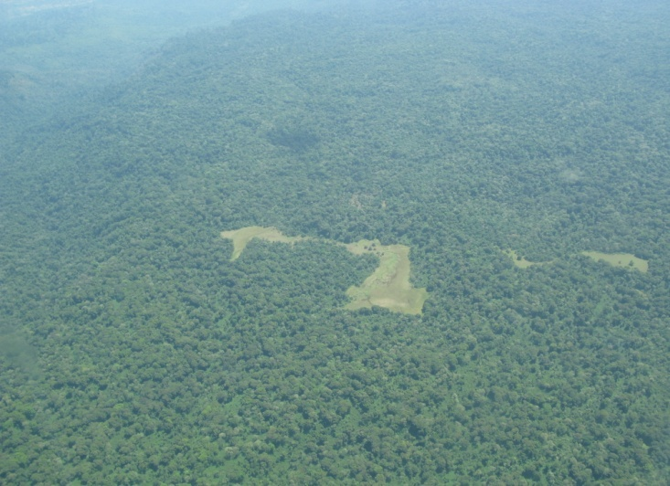
REDD+ Process in Ethiopia and Status of REDD+ Readiness
Getinet Assabu (PhD)
Debre Markos University
College of Agriculture and Natural Resources
Department of natural Resources Management

Slide 2
Climate resilient green economy
(CRGE): Vision
Vision: middle income country and carbon neutral by 2025 by sustaining the current fast economic growth rate.
Business As Usual (BAU Scenario):
  GHGs emissions from 150 million tons of CO2e in 2010 to 400 million tons of CO2e in 2030
  Unsustainable natural resource use: Unsustainable growth (depleting natural capital)
Ethiopia has officially declared to pursue green growth path (CRGE strategy) during COP-17 in Durban.
Norway responded quickly to support

Slide 3
Pillars of the Green Economy
Improved crop and livestock production efficiency for reduced emissions
Protecting and re-establishing forests (REDD+)
Expanding electricity generation from renewable sources (clean) for domestic and regional markets
Leapfrogging to modern and energy-efficient technologies in industry and transport sectors, and buildings
Notes:
Assess Land Use, Forest Policy and Governance *
Organize its REDD Readiness Management **
Design its national REDD Strategy
Design its REDD Implementation Framework
Assess the Impacts of REDD Strategy
Assess the Investment and Capacity Building Needs
Establish its national Reference Scenario
Design its national Monitoring, Verification & Reporting System
Design a Readiness Management System (optional)
3

Slide 4
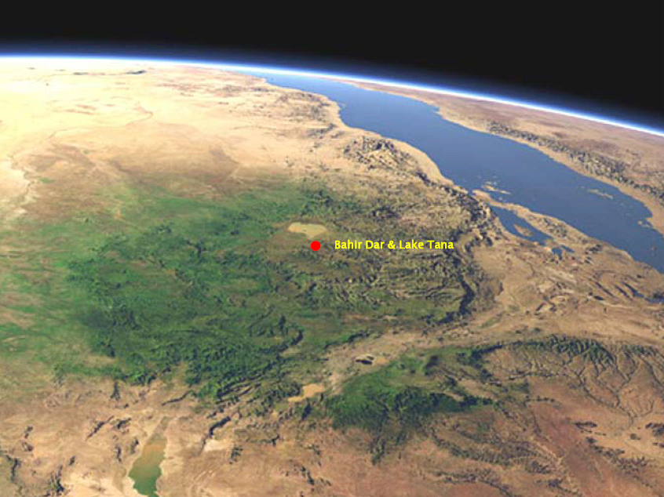
Ethiopia REDD+ Potential
2.76 billion tons of C (Yitebitu Moges et al ., 2010)
Carbon tower of the Horn?
Notes:
4

Slide 6
REDD+ Objectives and Benefits
Objective of R-PP (REDD+ Readiness)
  To make Ethiopia ready for REDD+ implementation
  Readiness: one of the REDD+ phases
    technical,
    institutional and
    legal readiness
  International requirements and standards: Baselines, MRV, ESMF, ect

Slide 7
REDD+ Objectives and Benefits
Benefits of REDD+
  Income from carbon trading for the contribution to CC mitigation
  Enhances the performance strategic of forest sector
    Water bottle
    Bread basket
    Tourism
    Income from forest and carbon
    Biodiversity conservation’
    Improved environment
  Enhances the adaptive capacity of communities

Slide 8
REDD+ Process in Ethiopia
  REDD+ process started in 2008; EPA letter of intent to participate and R-PIN submitted to Forest Carbon partnership Facility (FCPF)
  R-PIN approved in 2009 (Ethiopia REDD+ participant country)
  R-PP developed in 2010-2011 and approved in May 2011
  REDD+ organized as one of the four pillars of the green economy strategy of CRGE
  Ethiopia Grant Agreement Signed for R-PP implementation in October 2012
  REDD+ Readiness Phase Officially Launched- January 2013
Notes:
Assess Land Use, Forest Policy and Governance *
Organize its REDD Readiness Management **
Design its national REDD Strategy
Design its REDD Implementation Framework
Assess the Impacts of REDD Strategy
Assess the Investment and Capacity Building Needs
Establish its national Reference Scenario
Design its national Monitoring, Verification & Reporting System
Design a Readiness Management System (optional)
8

Slide 9
Key Elements of REDD+ Readiness
Capacity building
Consultation and participation of stakeholders
Establishing the National REDD+ Management body
Developing the National REDD+ Strategy and associated Social and Environmental Safeguards
Establishing the Reference Emissions levels/Reference Levels/Baseline Emissions
Establishing the Measurement, Reporting and Verification (MRV) system
Creating REDD+ implementation framework (enablers)
REDD+ Piloting

Slide 10
Progress: Mobilizing Financial resources
:
14 million USD- Budget solicited and made available
  FCPF (World Bank) 3.6 million USD
  Norway 5 million USD
  DFID (UK) 5 million USD
Additional resources mobilized: Oromia Emission Reduction Program Design: 3 million USD
Norway pledged more (partnership agreement)

Slide 11
Progress: Establishing REDD+ Management Structure
  REDD+ Secretariat established and operational (key staff onboard)
  REDD+ SC established(One meeting held)
  REDD+ TWG established (One workshop conducted)
  3 Taskforces (REDD+ Strategy, SESA and REL/MRV)
  Regional Focal Persons identified
  Oromia Steering Committee

Slide 12
CRGE Inter-ministerial Committee
Ministry of Environment and Forest
State Minister, Environment Sector
State Minister, Forest Sector
Federal REDD+ Steering Committee
Federal REDD+ Technical Working Group
REDD+ Secretariat
National Coordinator
Task Forces
REDD+ Strategy, RL/MRV, Safeguards
Technical Team
Safeguards Specialist, International MRV Specialist, Pilot Coordinator, International TA.
Admin Team
Finance Management Specialist, M&E Specialist, Procurement Specialist, Communications Specialist
Regional REDD+ Management Structure

Slide 13
Progress: Developing REDD+ Strategy
  Firm being recruited for study on Causes of Deforestation and Forest Degradation and Identification of Strategic Options in Ethiopia
  REDD+ Task Forces being established
  International Workshop on ‘Linking local REDD+ project to National Strategies’ held in Hawassa

Slide 14
Progress: Developing REDD+ Strategy
SESA /ESMF as an instrument to develop sound strategy
  Safeguards Specialist recruited at the REDD+ Secretariat
  Two workshops held
  Firm being recruited for SESA and ESMF
  SESA Task Force established

Slide 15
Progress: Establishing REL/MRV System
  Two workshops (road map and decision support tool)
  REDD+ MRV Road map developed (NICFI)
  Agreement of GoE with FAO (NFI, MRV, baselines) for TA going on
  Implementation of activities on this component largely to be handled by FAO)- international expertise
  RELs/ MRV Task Force established
  International MRV Specialist being recruited

Slide 16
Progress: REDD+ Piloting
REDD+ Pilots
Simultaneous actions on Readiness and REDD+ Pilots
Oromia REDD+ Program (Jurisdictional level piloting)
  Lessons will feed the national REDD+ Strategy
  Potential to generate up to 70 million USD until 2020
  First workshop on Oromia Emissions Reduction Program design held in Hawassa (May 2&3) and further Stakeholders meeting held on 8th October
To small scale pilots in other Regional States to be supported by the additional finance (guidelines and consultancy)
Technical Guideline for REDD+ pilots developed (guideline) for REDD+ pilots
National Coordinator for REDD+ Pilots recruited

Slide 17
Progress…
Other activities:
  Annual Work plan for FY 2013/14 and Procurement Plan developed and approved
  Support to the Ministry of Environmental protection and Forestry (organization structure and ToRs for 90 staff_ 5 weeks)
  Discussion with FAO
  Discussion with UN-REDD
  Collaboration and networking (NICFI/Norway Embassy, SCIP/DFID, GIZ,CIFOR, DeveloPPP)
  Develop Oromia REDD+ Program and support and promotion
  Discussions with Projects developing REDD+ pilots
  Collaboration with PACJA (facilitated two workshops)
  REDD+ Promotion

Slide 18
Progress: Consultation and participation
7 REDD+ awareness creation workshops to national and regional stakeholders
1 TOT-Capacity building
0ne international workshops

Slide 19
Progress: Creating enabling conditions
Political commitment of GoE-New institutional setup- Ministry of Environment and Forest
REDD+/CRGE as a trigger

Slide 20
Opportunities: Enabling Conditions
Political commitment-New institutional setup- Ministry of Environmental Protection and Forestry

Slide 21
Challenges
Late start of the project and disbursement as of July
Slow staff recruitment process
Transfer to new ministry- time!

Slide 22
