Slide 1
Social and Environmental Considerations of REDD+

Slide 2

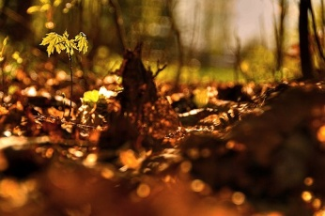
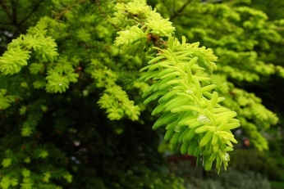
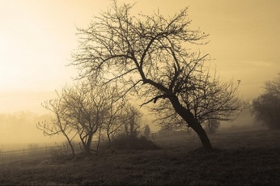
Contents
Can REDD+ be win-win-win?
Social Benefits and Risks
Environmental Benefits and Risks
Small Group Activity
Notes:
REDD has the potential to provide benefits for the climate, for people whose livelihoods depend on the forest, and for biodiversity. This presentation is an introduction to the potential social benefits and risks of REDD and will be followed by a panel discussion by experts on poverty, representatives of indigenous and forest peoples and/or others.

Slide 3
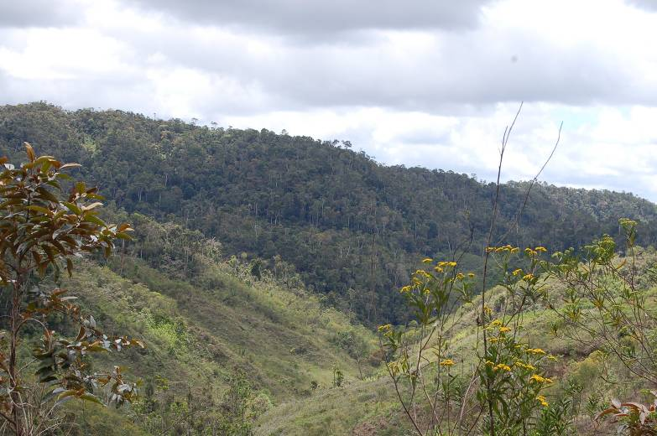
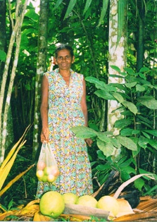
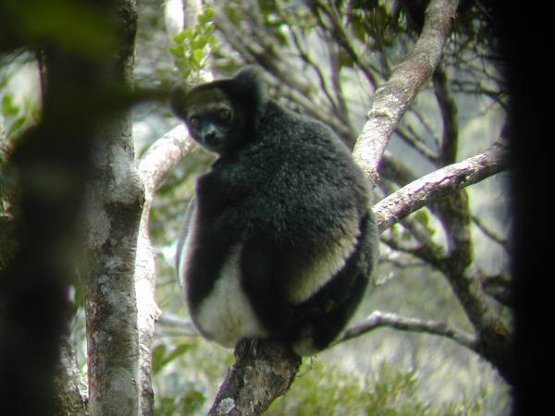
Can REDD+ be win-win-win?
Climate Benefits
Social Benefits
Environmental Benefits
Notes:
REDD was quickly embraced by environmentalists because of its potential to stop deforestation in the tropics, where biodiversity is concentrated. There are also significant social implications to REDD and people involved in poverty reduction and indigenous peoples issues point out that while there is a potential to provide significant social benefits, there are risks that must be mitigated.

Slide 4
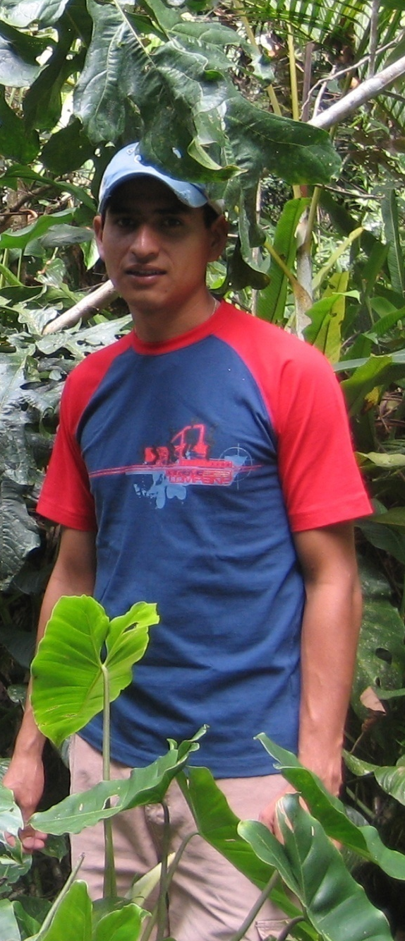
Potential Social Benefits
Economic benefits
Long-term revenues for local people
Job creation
Build Capacity
Potential for complementary activities
- sustainable forest management
- ecotourism
Maintain traditional livelihoods/cultural values associated with forests
Change your image in here

Slide 5
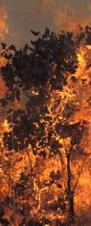
Potential Social Benefits (more…)
Improved provision of other ecosystem services
    - Water quality/regulation
    - Soil conservation
    - Reduced disease risk
    - Reduced fire risk
    - Maintain populations of pollinators
Change your image in here

Slide 6
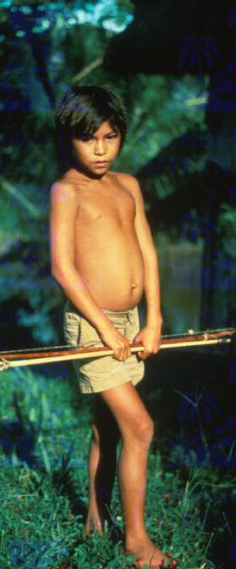
Social Risks
Loss of control of forests to gov./elite
Evictions / expropriations
Unequal / abusive contracts
Reduced access to land for cultivation
Potential social conflicts due to rearrangement of power / wealth
Increase in food, other commodity prices
Corruption, lack of accountability, transparency
Change your image in here
Notes:
The complexities of REDD bring risks that REDD could benefit only elites with access to capital and technical capacity, and new influxes of capital could create new problems…

Slide 7
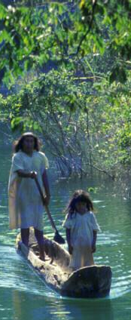
Maximizing Benefits and
Reducing Risk
  Include participation of forest-dependent people in design of REDD
  Include safeguards:
    Respect customary and traditional tenure and use rights
    Require free, prior, and informed consent
  Could include ‘pro-poor’ provisions
  Develop market for REDD projects with exceptional social benefits?
Change your image in here
Notes:
Social safeguards– particularly for the most vulnerable and politically marginalized groups, often those that live in remote forest areas such as indigenous peoples, who are often excluded from decision making and discriminated against
importance of information in local languages, representants chosen by each group according to their own procedures
we are aiming for ‘equity’ or fairness in the agreements that result in land-use change and emissions reductions, so that those with greatest opportunity cost or greatest contribution to generating emissions (eg as local stewards) receive appropriate incentives. Ownership of land, and hence, emissions reductions, is a contentious issue. Where ownership is customary, by definition Not recognised in formal legal framework and potentially not in national policies, then rights are more vulnerable.
mention pro-poor gold level for CCBS 2nd edition

Slide 8
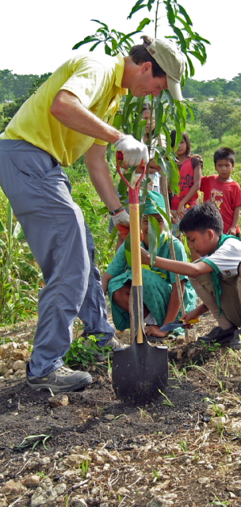
References on Social Considerations of REDD
Peskett, et al. 2008 Making REDD work for the poor.
Smith, J. and Scherr, SJ 2002. Forest Carbon and Local Livelihoods: Assessment of Opportunities and Policy Recommendations.
Griffiths, T. 2007. Seeing ‘RED’ ‘Avoided Deforestation’ and the rights of indigenous Peoples and local communities.
Peskett, L. and Harkin, Z. 2007. Risk and responsibility in Reduced Emissions from Deforestation and Degradation.

Slide 9
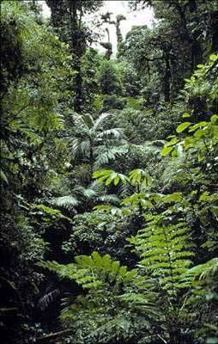
Potential Environmental Benefits
Biodiversity Conservation
Maintenance of other ecosystem services
  Rainfall regulation
  Water quality/regulation
  Soil conservation
  Reduced disease risk
  Reduced fire risk
  Maintain populations of pollinators
  cultural values
Allow for complimentary activities
e.g. tourism, timber, others

Slide 10
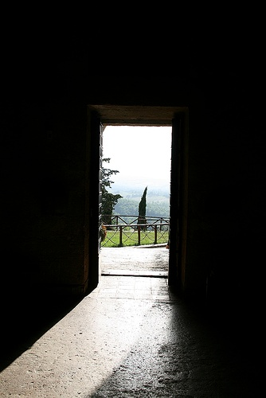
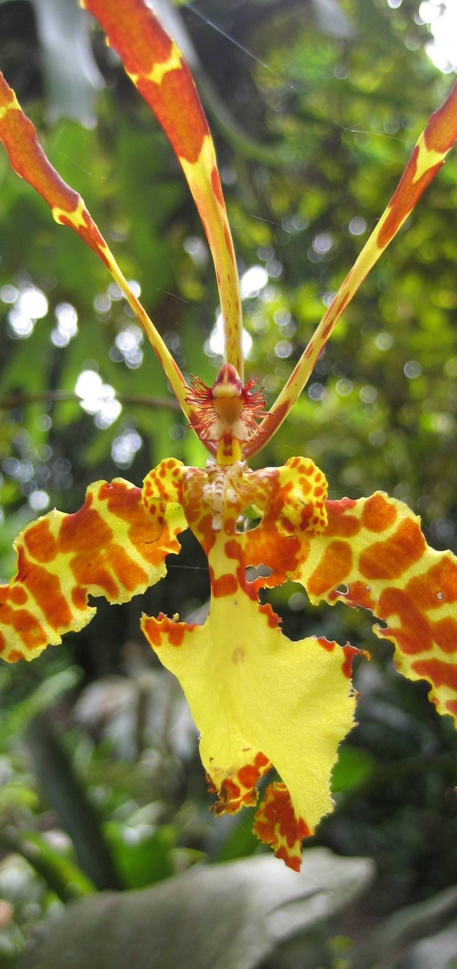
Environmental Risks: low carbon/high biodiversity areas
At Risk??
Better for REDD
Biodiversity Value
Carbon Value

Slide 11
Environmental Risks: maintaining ecosystem function
Protected forest
Protected forest
Bad for biodiversity?
Small forest remnants with low connectivity
Good for biodiversity?
Maintains viable plant & animal populations

Slide 12
Other Environmental Risks
Create perception that forest is only valuable for its carbon.
International leakage if not all countries participate.
Other unintended consequences?

Slide 13
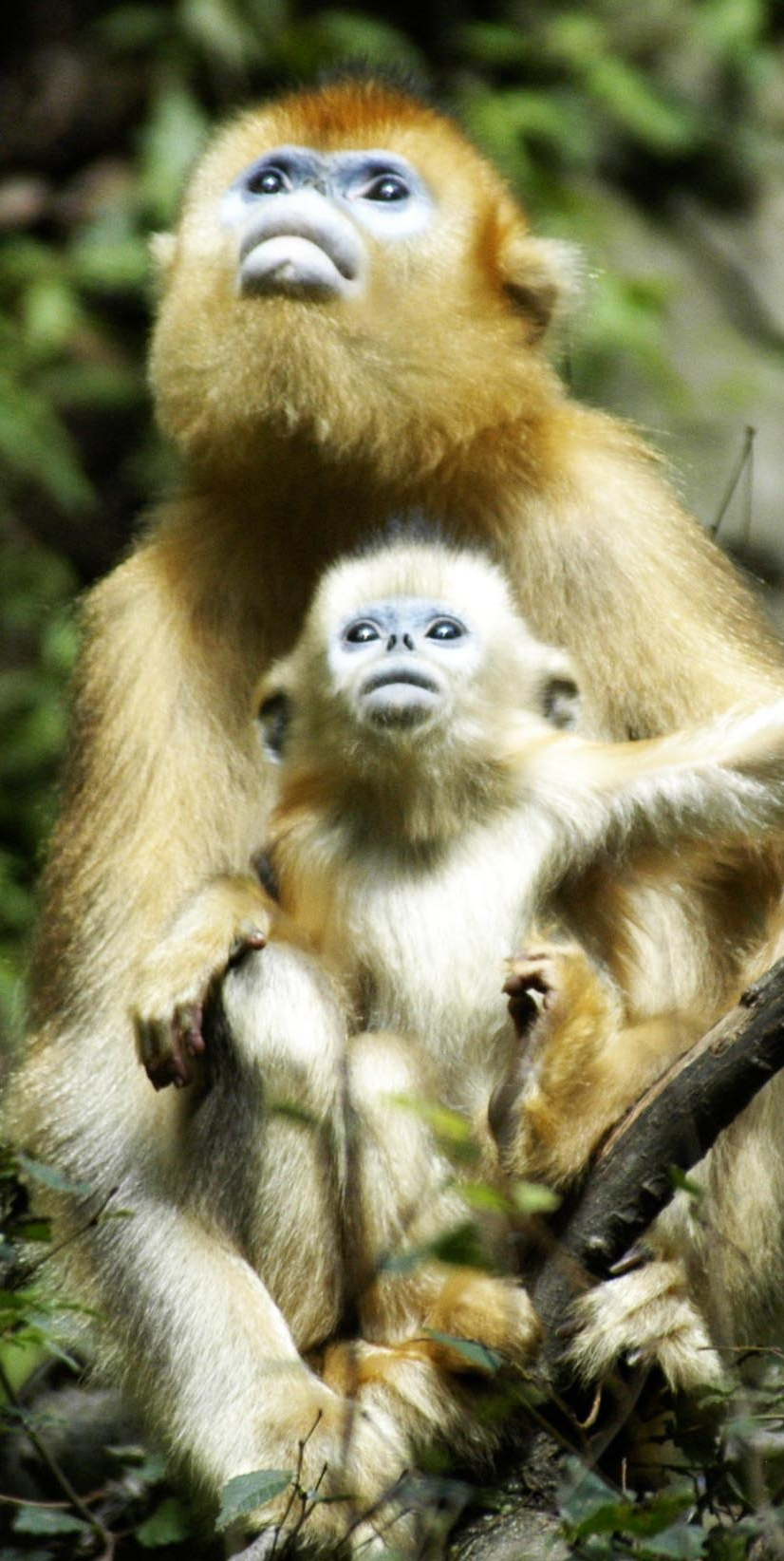
Maximizing Benefits & Reducing Risk
Scheme must reduce international leakage
Policies to reduce land conversion in low carbon/high biodiversity areas.
Price premium for REDD in exceptional biodiversity areas?
  -Apply standards like CCBA gold level
Need for monitoring of land conversion in all habitats.

Slide 14
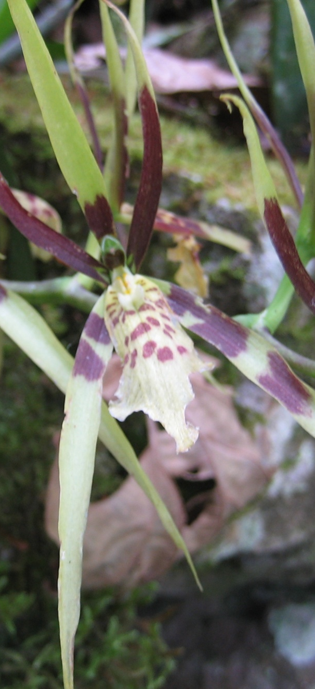
References
Kapos, V. et al. 2007. Reducing Emissions from Deforestation: A Key Opportunity for Attaining Multiple Benefits
CCBA. The Climate, Community & Biodiversity Standards.

Slide 15

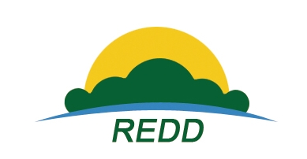

Thank you!
REDD Training Course

Slide 16
Contributors
Contributors to this presentation include:
  Steve Panfil (CCBA)
  Joanna Durbin (CCBA)

Slide 17
Questions for the group work
  Social
  Who will benefit most from REDD and what benefits will they receive?
  Which groups are most at risk and what is the risk?
  How can these risks be mitigated?
Environmental
Which are the areas under greatest threat in Kenya and Tanzania?
Are these places also priorities for biodiversity conservation?
What are some ways in which REDD could have negative effects on biodiversity in Kenya and Tanzania?
How could these risks be mitigated?

