Slide 1

REDD+ International Policy Context
Notes:
This presentation will provide an overview of the complicated world of international REDD+ policy.

Slide 2


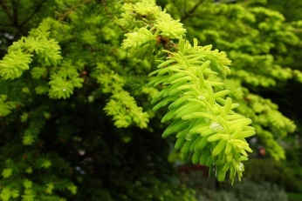

Content
History of international climate change negotiations
The treatment of forests in climate negotiations
Main policy issues surrounding REDD+
Notes:
We will start with a brief history of the climate change negotiations in general. Then we will discuss how forests have been dealt with in the negotiations in the past and describe the current policy context for REDD+. Finally, we will describe the main outstanding policy issues on REDD+

Slide 3

International Climate Negotiations

Slide 4

International Climate Negotiations
COP-14 Poznan
Kyoto Protocol negotiated
COP-13 Bali
COP-15 Copenhagen
1992
1996
2000
2004
2008
2012
Rio Treaty
Marrakesh Accords
1st Commitment Period
UNFCCC enters into force
Kyoto Protocol enters into force
Notes:
This is a timeline summary of the main events in the international climate negotiations. [Just focus on the negotiation of the kyoto protocol and the main points of the protocol; then describe how long it took to debate the rules and decide on the marrakesh accords and then that the kyoto protocol entered into force without the US. Then describe Bali and the roadmap and how it brought us to Copenhagen].
Rio Treaty (1992)
Created the United Nations Framework Convention on Climate Change (UNFCCC)
The goal of the UNFCCC: “to stabilize atmospheric concentrations of greenhouse gases at a level that would prevent human-induced actions from leading to dangerous anthropogenic interference with the global climate system.”
The UNFCCC also states that “such a level should be achieved within a time-frame sufficient to allow ecosystems to adapt naturally to climate change, to ensure food production is not threatened, and to enable economic development to proceed in a sustainable manner.”
The Convention also seeks to “cover all relevant sources, sinks, and reservoirs of greenhouse gases.”
The United Nations Framework Convention on Climate Change (UNFCCC) enters into force (1994)
UNFCCC is ratified by 192 countries (including the U.S.)
The UNFCCC did not create commitments for Parties, but laid out a process for negotiating specific commitments
Parties to the UNFCCC must:
Gather and share information on:
Greenhouse gas emissions
National policies
Best practices
Launch national strategies for addressing greenhouse gas emissions and adapting to expected impacts
Cooperate in preparing for adaptation to the impacts of climate change
Convention bodies:
Conference of the Parties (COP): is the "supreme body" of the Convention, that is, its highest decision-making authority. It is an association of all the countries that are Parties to the Convention.
Subsidiary Body on Scientific and Technical Advice (SBSTA): provides the COP with advice on scientific, technological and methodological matters
Subsidiary Body on Implementation (SBI): gives advice to the COP on all matters concerning the implementation of the Convention
The Kyoto Protocol is negotiated (1997)
Key elements of the Kyoto Protocol:
Principle of ‘common but differentiated responsibilities’ between Parties: Recognizing that developed countries are principally responsible for the current high levels of GHG emissions in the atmosphere as a result of more than 150 years of industrial activity, the Protocol places a heavier burden on developed nations
Parties:
Annex I: Industrialized countries
Non-Annex I: Developing countries
Binding targets for Annex I countries for reducing greenhouse gas emissions: 5% below 1990 levels from 2008-2012
All six major GHGs included
Includes flexible incentive-based implementation mechanisms
Flexible mechanisms:
International Emissions Trading (IET): trading of carbon credits between Annex I countries
Joint Implementation (JI): investing in emission reduction projects in Annex I countries
Clean Development Mechanism (CDM): Investing in emissions reductions projects in developing countries
The Marrakesh Accords are negotiated (2001)
Established the rules for how the mitigation targets laid out in the Kyoto Protocol will be achieved
Including emissions from land use change in developing countries as an eligible mitigation strategy was controversial due to concerns about permanence, leakage, additionality, and the technical capacity to measure and monitor emission reductions
Since the mitigation targets had already been set in the Kyoto Protocol, including new sources of emissions reductions (i.e. from land use change in developing countries) was seen as an “offset” rather than an additional reduction in emissions
Emissions reductions from avoided deforestation in developing countries was not included as an eligible mitigation strategy
Kyoto Protocol enters into force (2005)
The Kyoto Protocol was ratified by 182 countries (not including the U.S.)
First Commitment Period of the Kyoto Protocol begins (2008)
None
First Commitment Period of the Kyoto Protocol ends (2012)
None
The 13th Conference of the Parties (COP-13) in Bali, Indonesia (December 2007)
The Bali decision calls for the inclusion of REDD as part of a post-2012 mitigation strategy.
The ‘Bali Road Map’ conclusively states that the technical capacity to accurately measure and monitor emissions reductions from reduced deforestation and degradation exists.
The decision includes in its preamble a clear acknowledgement that degradation also leads to emissions and needs to be addressed when reducing emissions from deforestation.
It also explicitly recognizes that the needs of local and indigenous communities have to be considered.
Finally, it calls for demonstration activities and capacity-building for countries that may not be ready to engage in the mechanism by 2012.
UNFCCC meetings in Bangkok to discuss post-2012 agreement (June 2008)
A work program for negotiating a post-2012 agreement was established
The UNFCCC bodies meet five times during the year to discuss post-2012 agreement (2008)
The Ad-hoc Working Groups (AWG), Subsidiary Body on Scientific and Technical Advice (SBSTA), and the Subsidiary Body on Implementation (SBI) meet to discuss all of the methodological issues related to a post-2012 agreement)
)
The 14th Conference of the Parties (COP-14) in Poznan, Poland (December 2004)
A negotiating text for the post-2012 agreement will potentially be tabled for discussion amongst the Parties
The 15th Conference of the Parties (COP-15) in Copenhagen (December 2009)
Goal: to solidify a post-2012 global agreement on climate change

Slide 5

Convention Bodies
COP: Conference of the Parties
MOP: Meeting of the Parties
SBSTA: Subsidiary Body on Scientific and Technical Advice
SBI: Subsidiary Body on Implementation
AWG-KP: Ad-Hoc Working Group on the Kyoto Protocol
AWG-LCA: Ad-Hoc Working Group on Long-Term Cooperative Action
Notes:
For those new to the UNFCCC process, each UN Convention has a “COP”, or Conference of the Parties. The COP is tasked with negotiating decisions related to the scope and responsibilities of the UNFCCC and its signatories.
The UNFCCC, with the signing of the Kyoto Protocol, also has a “MOP”, or Meeting of the Parties. The MOP is tasked with negotiating decisions related to the scope and responsibilities of the Kyoto Protocol and its signatories, a subset of the UNFCCC.
These two bodies are the final decision making venues for all issues brought before the UNFCCC and Kyoto Protocol. Throughout the year, and at COP/MOPs, the UNFCCC hosts science and technical meetings (SBSTA) and implementation meetings (SBI) and informal workshops. These formal and informal meetings debate and review complex climate issues, that eventually allow countries to come to a decision they are interested in adopting.
Two other important bodies are the Ad-hoc Working Group on the Kyoto Protocol which negotiates the future of the Kyoto Protocol after the first commitment period (which ends in 2012) and the Ad-hoc Working Group on Long-term Cooperative Action which negotiation future action on climate under the Convention (and includes countries that have not signed the KP (US) and issues that were not included in the KP (adaptation and REDD+ for example)).

Slide 6
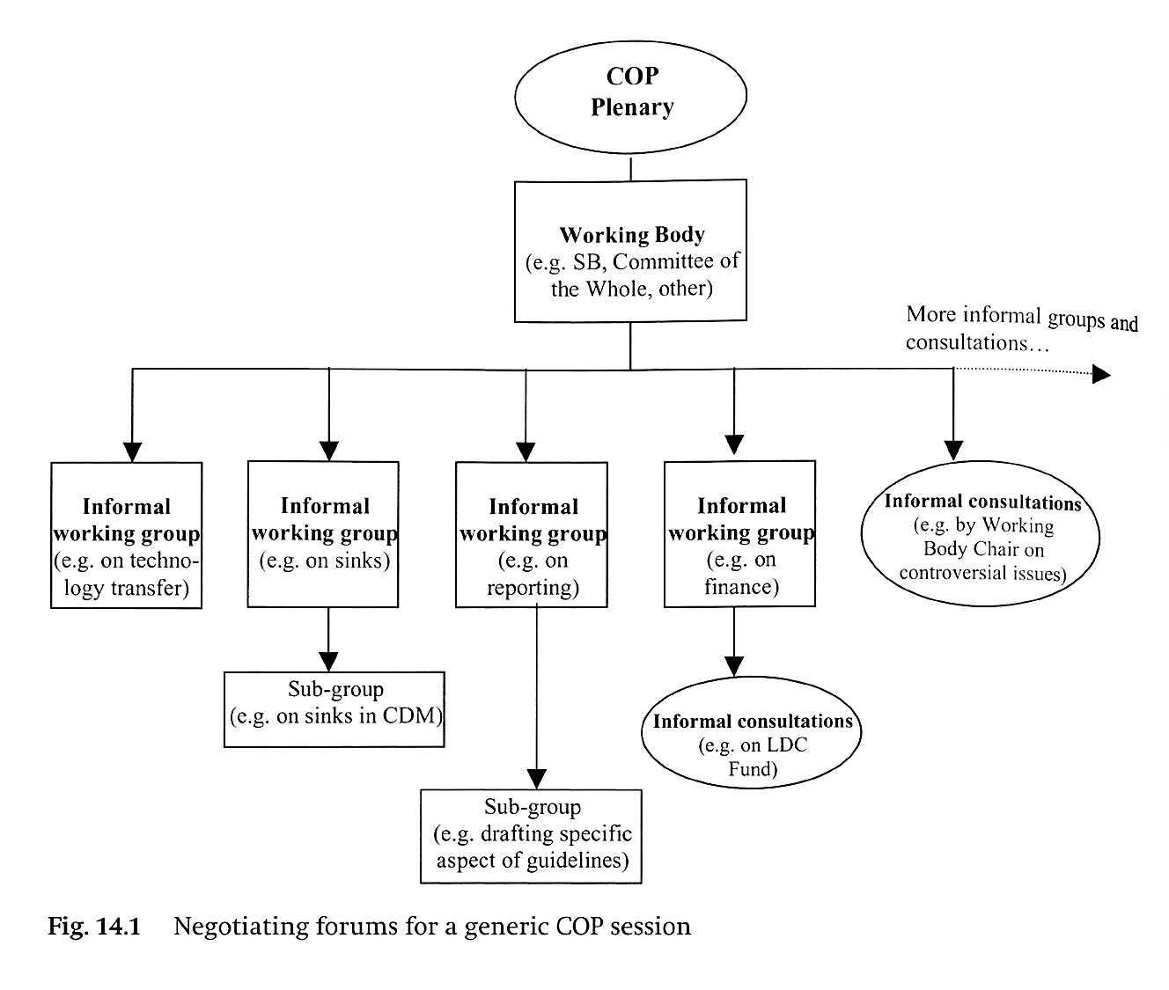
Notes:
If this slide looks complicated, it is because the negotiations are complicated! They have been described as the most complex negotiations ever attempted. The basic structure is like this: The COP is the overarching governing body. The working groups described in the last slide will meet to discuss specific aspects of the negotiations. Within those working groups, smaller groups called contact groups or informal working groups will meet to discuss specific topics. REDD+ for example has it’s own contact group within the negotiations. A facilitator will be designated to run the contact group. That facilitator will hold sessions in which all countries are invited to negotiate together, but also hold informal consultations with certain countries or groups of countries to work through difficult issues. The contact group will try to reach a consensus on a text and then report that text to the working group (the AWG-LCA in the case of REDD+) which would, in turn, report the broader work of the group as a whole to the COP. The COP is the only body that can officially adopt decisions.

Slide 7
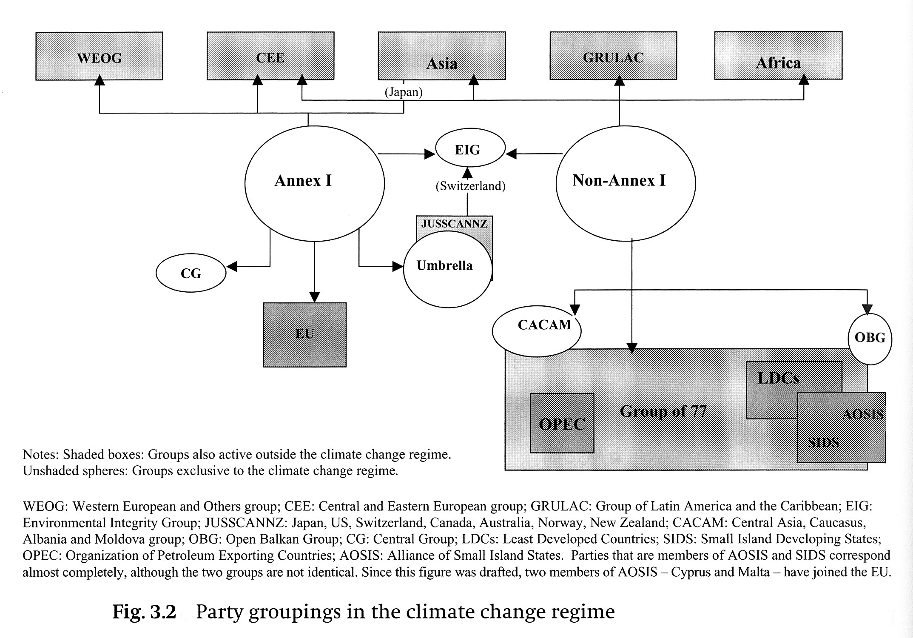
Notes:
If the last diagram, looked complicated this one is even worse! These are some of the negotiating blocs within the negotiations.
Main negotiating blocs:
European Union (EU)
Strong concern; desires collective, harmonized action
Umbrella countries (led by U.S.)
Somewhat more skeptical of international cooperation; prefers maximum flexibility to achieve goals
U.S. – more internal division on climate change than other countries
Group of 77 and China (developing countries)
Smaller influential groups:
AOSIS (Alliance of Small Island States)
OPEC
Regional groups (eg, Africa; GRULAC in Latin America)
Individual negotiators can wield large influence

Slide 8
Forests in International Climate Agreements
Notes:
Now that you fully understand how the climate negotiations work ;-) let’s look at how forests have been treated in those negotiations.

Slide 9
Forests and International Climate Agreements
The Convention
  Parties provide national inventories of anthropogenic emissions by sources and removals by sinks of all GHGs, including those from LULUCF
The Kyoto Protocol
  In Annex I: LULUCF emissions are under the cap
  In Non-Annex I: Only afforestation and reforestation included in the CDM
Notes:
Under the Convention, all countries (Parties) must provide a national inventory of their emissions and removals from land-use, land-use change, and forestry in their country.
Under the Kyoto Protocol, emissions from LULUCF are included under the “cap” or limit placed on developed countries (Annex-I) – so any emissions or reductions from that sector are accounted for. In developing countries (non-Annex I) there are no requirements, but afforestation and reforestation projects can be implemented and the credits sold into the clean development mechanism. [describe cdm briefly]. There are currently no incentives for developing countries to reduce their emissions from deforestation and degradation. Avoided deforestation was omitted from the CDM because countries worried that the technical capacity and methodologies did not exist to account for avoided emissions accurately enough. Also, they were concerned that the project approach would just lead to leakage.

Slide 10
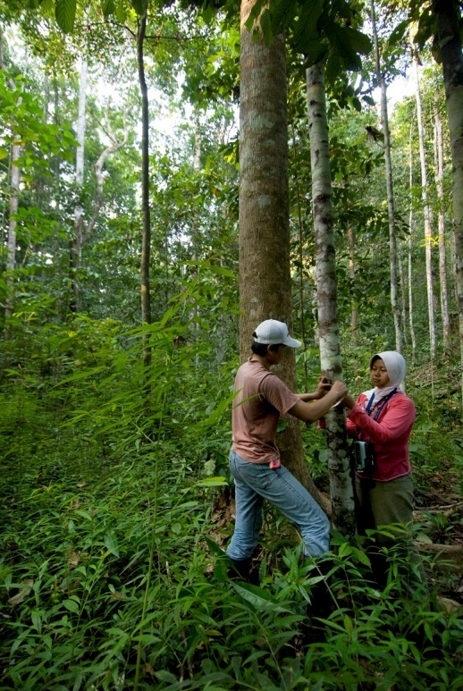
History of REDD+
In 2005, the Coalition for Rainforest Nations proposed including REDD in a post-2012 framework
  What was different?
    Greater importance placed on deforestation emissions
    Improvements in technology
    Proposed national approach
At COP-13 REDD+ was included in the Bali Action Plan
Notes:
However, after the KP was negotiated, significant advantages in technology and methodologies made accounting for avoided emissions possible and credible. This advanced technology also highlighted the importance of the emissions from deforestation. In 2005, the Coalition for Rainforest Nations (which represents about 40 tropical countries) proposed including REDD most of the countries because they recognized the importance of addressing deforestation for mitigating climate change, the improvements in technology and in a post-2012 framework. Their proposal was welcomed by the development of credible methodologies made accounting for avoided emissions possible and credible, and the approach that was proposed was a national approach which reduced the threat of leakage. Two years of negotiations ensued and REDD+ was included as an integral part of the negotiations to establish a post-2012 framework at COP-13 in 2007 in Bali, Indonesia.

Slide 11
Copenhagen: SBSTA Decision
Reference emission levels and reference levels transparent and based on historic data, adjusted for national circumstances
Countries should establish transparent and robust monitoring systems that include remote sensing and field inventories
Countries should use the most recent IPCC guidance and guidelines
Need for full and effective engagement of indigenous peoples and local communities in monitoring
Requests Parties to identify drivers of deforestation and activities that could result in reduced emissions and increased removals, and stabilization.
Notes:
After Bali, two years of intense negotiations on REDD+ ensued. At Copenhagen, there were three major outcomes on REDD+: a decision on technical and methodological issues from SBSTA, progress on the policy issues in the AWG-LCA, and the inclusion of REDD+ in the Copenhagen Accord.
This slide describes the key points included in the SBSTA decision

Slide 12
Copenhagen: Draft AWG-LCA Negotiating Text
Consensus:
  Principles
  Safeguards
    Indigenous peoples and local communities
    Biodiversity and ecosystem services
  Scope = REDD+
  Phased approach
Outstanding Issues:
  Scale
  Financing
  Level of Ambition
  REDD+ = NAMA?
Notes:
Despite a lack of progress in the overall negotiations, negotiations on REDD+ made significant progress in the AWG-LCA. Consensus was reached on several issues. However, consensus was not possible on four important issues. We will describe these issues shortly.

Slide 13
Copenhagen Accord
« We recognize the crucial role of reducing emissions from deforestation and forest degradation and the need to enhance removals of greenhouse gas emission by forests and agree on the need to provide positive incentives to such actions through immediate establishment of a mechanism including REDD-plus, to enable the mobilization of financial resources from developed countries. »
Notes:
REDD+ was also included in the Copenhagen Accord. This is the paragraph that was included. The COP “took note” of the Copenhagen Accord – this means that it’s status in the negotiations is up for interpretation – some countries see it as very important and the basis for a post-2012 framework, others do not feel it should play a role in future negotiations.

Slide 14
Pathway Forward to Cancun
Within the UNFCCC, negotiations will continue on LCA text
  May 31-June 11 in Bonn
  Two other intersessionals
  COP-16, Cancun Mexcio, Nov/Dec 2010
Other processes may provide input as well
  Paris-Oslo: Creating an interim partnership arrangement
Notes:
This slide describes the pathway forward on REDD+ to Cancun.

Slide 15
Outstanding Policy Issues on REDD

Slide 16

Key Outstanding Policy Issues
Scale: National or Sub-national
Funding: Market or Fund
Level of ambition
REDD+ = NAMAs?
Notes:
These are the main outstanding policy issues on REDD+. We will examine each in turn.

Slide 17

Scale: National, Sub-national, Nested
Source: Angelsen, A., C. Streck, L. Peskett, J. Brown, and C. Luttrell. 2008. What is the right scale for REDD? In: Moving Ahead with REDD: Issues, Options and Implications.
Notes:
One of the main outstanding issues in the negotiations is the level at which incentives are granted for REDD+. This is an important issue because it will determine the level at which carbon accounting will occur and it will impact the level of involvement of local (sub-national) stakeholders in the implementation of REDD+.
This diagram is a summary of the three options:
National approach: international incentives flow only to national government
Subnational approach: international incentives flow directly to sub-national actors (state/municipal governments, communities, local NGOs, project developers, etc)
Nested approach: international incentives flow directly to the national government and directly to sub-national actors. Before these incentives can be allocated to various actors, accounting will need to be harmonized across scales.
We will examine this issue more in detail later on, so will not spend too much time describing it now.

Slide 18
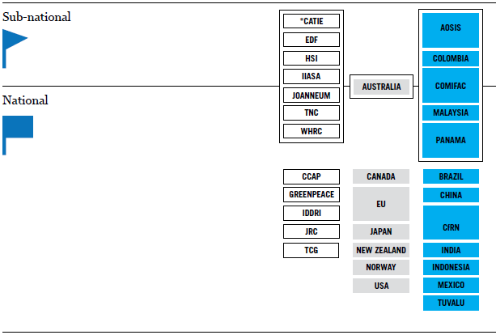

Scale
Source: Little REDD+ Book
Notes:
This shows the positions of various countries and NGOs. The ones in the box support a combination of national and sub-national approaches (sequential approaches and/or nested approaches).
Source: Little REDD+ Book

Slide 19

Credit trading
Potential to generate large amounts of money
Concerns:
  Reduces focus on industrial emissions reductions
  REDD credits may have adverse impact on carbon markets
Market
Created through voluntary donations or some sort of tax or levy linked to the carbon markets
Emissions reductions are additional
Concerns:
  Will it raise sufficient levels of funding?
Fund
Funding: Market or Fund
Notes:
Another outstanding issue in the negotiations is the sources of finance for REDD+. The two main potential sources for REDD+ are public funds or market finance. This slide summarizes the pros and cons of each approach. The ultimate decision on this issue depends a lot on the overall financial architecture for the climate agreement as a whole.

Slide 20
Financing
Source: Little REDD+ Book
Notes:
This slide summarizes the positions of various NGOs and countries. (Market-linked means that they support market crediting for REDD+ but would like that market to be separate from the overall carbon market). The little orange triangle means they specifically support a phased approach to REDD+ with various sources of finance for each phase.
Source: Little REDD+ Book

Slide 21
Level of ambition
Should there be a global goal for reducing emissions from deforestation?
  50% reductions by 2020; net zero deforestation by 2030(?)
Should it be linked to financial commitments?
  How much is needed to meet the goal?
  Sources?

Slide 22
REDD+ = NAMAs
Is REDD+ a Nationally Appropriate Mitigation Action or a separate framework?
Integration may promote efficiency
NAMA negotiations far behind
NAMAs not well defined

