Slide 1
Course Name: Integrated pest Management
(PLPP5342)
Meseret Tadesse (MSc, Ass. prof)
Debre markos University
Department of Plant Sciences
Semister II, 2020

Slide 2
Chapter One Introduction
IPM refers to the management of pathogens, weeds, vertebral pests as well as insects.
Integrated pest management, which combines
biological control,
host plant resistance
appropriate farming practices,
minimizes the use of pesticides,
reduces costs
environmentally friendly
contributes to the sustainability of agriculture.

Slide 3
IPM – a system that maintains the population of any pest, or pests, below the level that causes damage, and which minimizes adverse impacts on society and environment.
IPM – a process by which information is collected to reduce pest population impacts in a planned, coordinated way.
Requires:
Information
Strategy

Slide 4
Currently, there are more than 72 definitions for IPM. However, most of definitions put chemical (pesticides) as a last resort.

Slide 5
Characteristic Features of IPM
In IPM it is not advisable to kill all pests.
A system of non-chemical pest control methodologies given priority before a decision is taken to use pesticides.
No single technology or pest management tactic acting alone will remain durable and effective.

Slide 6
IPM is based on the following principles:
Rely on non-chemical measures.
Manage pests, rather than trying to eradicate them.
Chemical control used as last option, when only needed.
Minimum two and above compatible management systems should be applied.
All tactics of IPM should be cost effective.

Slide 7
Define “Pest”

Slide 8
Definition of “Pest”
From an agricultural point of view, an animal or plant out of context is regarded as a pest.
An injurious and noxious living organism which pose problems (British Columbia Pesticide Control Act,1997).
Any organism that interferes with the activities of Plants.
Organisms that cause economic damage.

Slide 9
Pests:
Pathogens (including fungi, bacteria, and viruses
Weeds (parasitic and non parasitic)
Nematodes (roundworms)
Arthropods (including insects, mites, and other jointed-legged invertebrates)
Vertebrates (including, birds rodents and other mammals)
Generally, Pests are all biotic agents that adversely affect crop production.

Slide 10
A pest must cause injury
In order for an organism to be considered a pest, a damaging stage of the organism must be present in high numbers.
Pests cause:
i) Injury to crop plants, forests and ornamentals
ii) Destruction or value depreciation of stored products.

Slide 11
Things required to “make” a pest
Pest species must be present at the right stage
Environmental criteria must be met.
Crop must be a susceptible variety and growth stage.

Slide 12
Pathosystem concept
Pathogen – host – environment triangle must all be right in order for an outbreak of pests.
When pest – crop – environment right, leads to “damage”.

Slide 13
Pest categories
The damage they cause:
1. Key pest
are the most severe and damaging pests.
The general equilibrium points (GEP) lies above damage boundary (DB) and EIL.
Intervention may bring the population temporarily below the EIL but it rises back rapidly and repeated intervention (sprays) may be required to minimize damage.
Perennial threat to crops and are not being satisfactory controlled with the available technology.
Examples: cotton boll worms, chick pea pod borer, sugarcane borers.

Slide 14
Concept of economic injury level

Slide 15
2. Major pest
Here the general equilibrium points (GEP) is close to the EIL.
The population crosses EIL frequently and repeated control measures are necessary but economic damage is avoided by timely interventions.
Examples: sucking pests like cotton leaf hopper and white fly, leaf hopper on rice, sugarcane whitefly

Slide 16
3. Minor pest
The GEP lie below both EIL and damage boundary.
Under favorable environmental conditions, the population may cross EIL and DB for usually a short interval.
easily amendable to available control measures
a single application of insecticide is to prevent economic damage.
Examples: cotton strainers, gray weevils, thrips and mites on vegetable crops

Slide 17
4. Sporadic pest
negligible but in certain years under favorable environmental conditions, they appear in a virtually epidemic form crossing many times over DB and EIL.
Under such conditions, the pest has to be controlled by undertaking suitable management strategies.
highly sensitive to abiotic conditions.
Examples: hairy caterpillars, cut worms and grass hoppers

Slide 18
5. Potential pest
presently not causing any economic damage and therefore, as such should not be labeled as pests.
Their GEP lies below the DB and does not cross EIL even under favorable conditions.
However, any change (cropping pattern, cultural practices) may push their GEP higher and there will be economic damage if management options are undertaken in indiscriminate manner.

Slide 19
Chapter Two
Economic Importance of Pests

Slide 20
Plant diseases and their effect on crop plants
Plant Disease
disturbance from plant pathogen or environmental factor that interferes with plant physiology.
physiological and/ morphological deviation of a susceptible host by a pathogen or unfavourable environment manifested by symptoms.
Causes changes in plant appearance or yield loss

Slide 21
Symptom: the external and internal reactions of a plant as a result of disease.
Sign: the pathogen or its parts or products seen on a host plant.
A pathogen is a parasite which derives its food and or multiplies on, or in, the host plant. It may be a fungus, a bacterium, virus, nematode or even a parasitic plant.
The majority of plant pathogens are fungi.

Slide 22
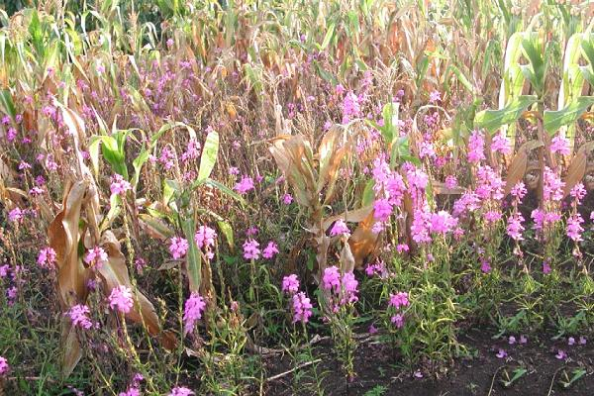
Plant disease results from:
Direct damage to cells
Toxins, growth regulators, that affect metabolism
Use of nutrients and water or interference with their uptake

Slide 23
Losses Caused by Plant Diseases
The kinds and amounts of losses caused by plant diseases vary with:
plant or plant product
pathogen
environment
control measures practiced, and
the combinations of these factors
Plant diseases:
Damage plants and plant products
Reduce quantity and quality of plant produce
Limit the kinds of plants that can grow
Make plants poisonous to humans and animals
Cause financial losses

Slide 24
Plant Pathology and Its Definitions
Plant pathology /Phyto pathology:
Scientific study of plant diseases caused by Pathogens and environmental conditions.
deals with the cause of plant disease (pathogen and environmental condition) and interaction between disease causing agents and methods of preventing disease.
deals with Organisms that cause infectious disease include fungi, bacteria, viruses, protozoa, nematodes and parasitic plants.

Slide 25
Plant pathology also studies about:
Pathogen identification,
disease etiology (cause of the disease),
disease cycles,
Plant disease resistance, and
management of plant diseases.
Plant Pathology as a science posses four disciplines namely Bacteriology, Virology, Mycology and Nematology.

Slide 26
CAUSES OF PLANT DISEASES
Infectious diseases are those that result from infection of a plant by a pathogen.
Non-infectious diseases (abiotic diseases) caused by environmental stress and damage by weather and other environmental factors.
A plant becomes diseased when it is attacked by a pathogen or by an abiotic agent
Pathogens are parasitic organisms that cause biotic disease.

Slide 27
Fungi
Diverse and widespread
generally microscopic,
eukaryotic,
spore-bearing organisms that have cell walls.
lack chlorophyll
More than 100,000 are saprophytic.
Live on dead organic matter
More than 10,000 species causes disease in plants.
Plant pathogens

Slide 28
Obligate parasites or biotrophs:
grow and multiply only by remaining, with their host .
Nonbligatory parasites:
require a host but can complete their cycles on dead organic matter, or
they can grow and multiply on dead organic matter as well as on living plants.

Slide 29
Characteristics of Plant Pathogenic Fungi 1. Morphology
Most fungi have mycelium.
The individual branches of the mycelium are called hyphae.
Growth of the mycelium occurs at the tips of the hyphae.
2. Reproduction
through vegetative, sexual and asexual means.
A. Vegetative means
by mycelial and hyphal growth.
Fungi that lack both asexual and sexual spores

Slide 30
B. Sexual reproduction
In fungi Sexual reproduction has three distinct phases:
(i) Plasmogamy: a union of two protoplasts which brings two sexually different nuclei within a cell:
(ii) Karyogamy: fusion of two compatible nuclei to form zygote; and
(iii) Meiosis: division of the diploid nucleus to reduce the number of chromosomes to the haploid number.

Slide 31
C. Asexual reproduction
In asexual reproduction, the spores are known as mitospores.
Mitospores include zoospores, sporangiospores, aplanospores, conidia
Sporangiospores ---are born in sac called sporangium.
zoospores -----motile by means of flagella
Aplanospore-----non-motile.
Conidia: all asexual spores, except sporangiospores.

Slide 32
Bacteria as Plant Pathogen
Prokaryotic microscopic organisms
Most plant pathogenic bacteria are:
rod- shaped except Streptomyces (filamentous).
have delicate, threadlike flagella
When a single bacterium is allowed to grow in a solid medium, its progeny produces a visible mass called a colony.
Colonies of most species are whitish or grayish, but some are yellow.
Don’t usually produce resistant resting spores

Slide 33
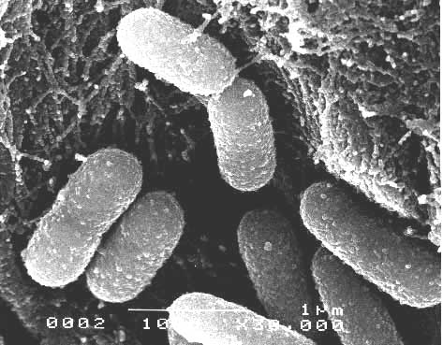
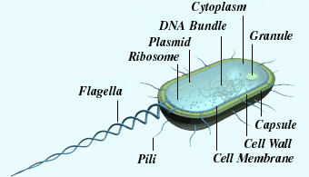
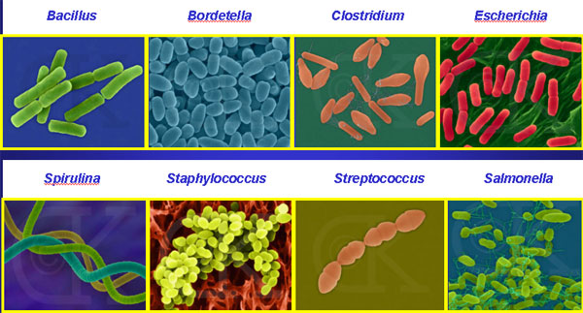
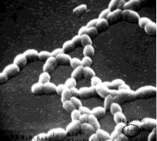

Slide 34
2.2.2. Classification of Bacteria
Plant pathogenic Bacteria are classified in five genera: Corynebacterium, Agrobacterium(crown gall), Erwinia (blights, wilts and soft rots) , Pseudomonas and Xanthomonas (black rot ).

Slide 35
Bacterial infections
The infected head tissue often takes on a tan color
Becomes moist and mushy
Develops a foul odour
The leaf
Results in classic spotting of leaves.
Reduces photosynthesis and cell respiration of plant material

Slide 36
Reproduction
reproduce by the asexual process binary fission.
Bacteria reproduce at rapid rate.
Under favorable conditions, bacteria may divide every 20 to 50 minutes, one bacterium conceivably could produce one million progeny bacteria in less than a day.
However, because of
the diminution of food and nutrient supply,
accumulation of metabolic wastes, and
other limiting factors, reproduction slows and may finally come to a stop.

Slide 37
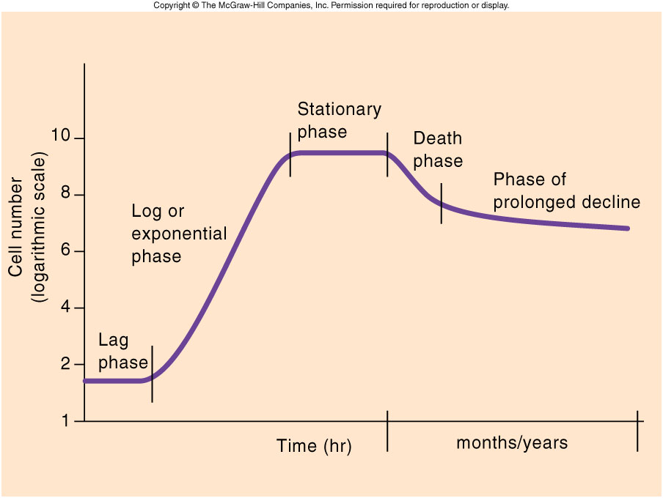
The Growth Curve
characterized by five distinct phases.
Fig. The Growth Curve
Notes:
The lag phase is the period of apparent inactivity in which the cells are adapting to a new environment and preparing for reproductive growth.
Exponential phase: the number of cells doubled every generation and increases as a function of the exponent (2¹, 2², 2³, 2⁴,…., 2^{n}).
Number of cells produced > Number of cells dying
Cells enter the stationary phase when they have exhausted their supply of energy and nutrients.
Number of cells produced = Number of cells dying
The death phase is the period which the total numbers of viable cells in the population decreases as cells die off at exponential rate.
Number of cells dying > Number of cells produced
The Prolonged Decline Phase: is marked by a very gradual decrease in the number of viable cells in the population lasting for months to years.

Slide 38
VIRUS AS PLANT PATHOGEN
multiplies only in living cells and has the ability to cause disease.
Viruses do not divide and do not produce any kind of reproductive structures such as spores.
They multiply by inducing host cells to make more viruses.
Viruses cause disease not by consuming cells or killing them with toxins, but by utilizing substances during multiplication, taking up space in cells, and disrupting cellular processes.

Slide 39
Characteristics of Plant Viruses
Viruses cannot be viewed and detected by the methods used for other pathogens.
differ greatly from all other plant pathogens
Transmission of Plant Viruses
Modes of transmission include
vegetative propagation, mechanically through sap, through seed, pollen, dodder, and by specific insects, mites, nematodes, and fungi.

Slide 40
Viral Diseases
400 viruses infect plants
Viruses are transmitted from plant to plant by living factors: insects, mites, fungi and nematodes
Or non-living factors: rubbing, abrasion or other mechanical means (including grafting or other forms of vegetative propagation)
Occasionally transmitted in seed.

Slide 41
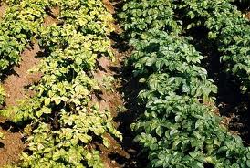
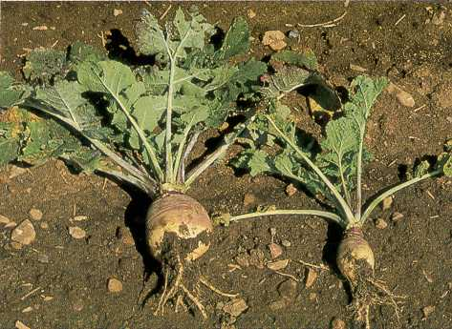
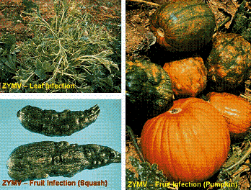
Viral Disease Symptoms
The symptoms of most virus diseases can be put into four categories:
Lack of chlorophyll formation in normally green organs
Stunting or other growth inhibition
Distortions
Necrotic areas or lesions

Slide 42
NEMATODES AS PLANT PATHOGEN
Nematods are unsegmented roundworms.
Nematodes cause crop losses
directly by their parasitic activities on the plants they infect and
indirectly by acting as vectors for plant viruses.
The rhizosphere is particularly rich habitat for many kinds.
When soil is heavily infested losses may be total.
Example: Meloidogyne spp, root-knot nematode of almost all crop plants

Slide 43
Nematode Diseases
Plant pathogenic nematodes = pests
Infect roots & bulbs (below-ground)
Foliar nematodes (above-ground)
Also vectors of plant viruses
As they feed, they weaken & stress plants – also predispose to other problems
Causes bulb & root decline, and root knots
Spread by splashing water, and infested soil & plant parts

Slide 44
Phytoplasmas as Plant Pathogen
Phytoplasma are bacteria like organisms.
They differ from true bacteria in that they are much smaller, and in that they lack, a cell wall.
Symptoms of Phytoplasma infections
Flowers become green in color (virescence)
plant part become overly branched
flattening of plant parts (fasciations)

Slide 45
Non-infectious Plant Disease
No primary parasite is involved
brought about by abnormal conditions of temperature, light, disturbance of water relationship, nutritional imbalance, the toxic action of fungicides or other applied chemicals, or by Injury.
As they are non-infectious epidemic development of the condition does not take place.
non-parasitic disturbances predispose plants to infection through injury, permitting pathogens to enter and damage the plant.

Slide 46
Effect Of Disease On Plant Physiology
Effect of Pathogens on Photosynthesis
Photosynthesis is the basic function of green plants
plant pathogens reduce photosynthesis, by affecting the chloroplasts

Slide 47
2. Effect of Pathogens on Translocation of water and nutrients in the Host Plant
Example,
If water movement to the leaves is inhibited, the leaves cannot function properly, photosynthesis is reduced, and few or no nutrients are available to move to the roots, which in turn become diseased.

Slide 48
3. Effect on Transpiration
the destruction of cuticle and epidermis results in an uncontrolled loss of water from the affected areas.
If water absorption and translocation cannot keep up, wilting of leaves follow.

Slide 49
4. Effect of Pathogens on Respiration
When plants are infected by pathogens, the rate of respiration generally increases.
This means that affected tissues use up their reserve carbohydrates faster than healthy tissues would.
After that, respiration declines to normal levels or to levels even lower than those of healthy plants.

Slide 50
Diagnosis of Plant Diseases
To diagnose a plant disease it is necessary to first determine whether the disease is caused by a pathogen or an environmental factor.
Control measures depend on proper identification of diseases and of the causal agents.

Slide 51
KOCH’S POSTULATES Steps
1. The suspected causal agent must be present in diseased plant
2. The pathogen must be isolated and grown in pure culture,
3. The pathogen from pure culture must be inoculated on healthy plants of the same species and it must produce the same disease
4. The pathogen must be re-isolated in to pure culture and its characteristics must be exactly like those observed in step (2)

Slide 52
Cont…
Figure 1. The diagrammatic representation of the Koch’s postulate

Slide 53
Pathogenesis (Disease development) and Disease Cycle in plants
In order disease to occur three things must interact: virulent pathogen, susceptible host and conducive environmental factor.
The interactions of the three components of disease are generally referred to as the “disease triangle.”

Slide 54
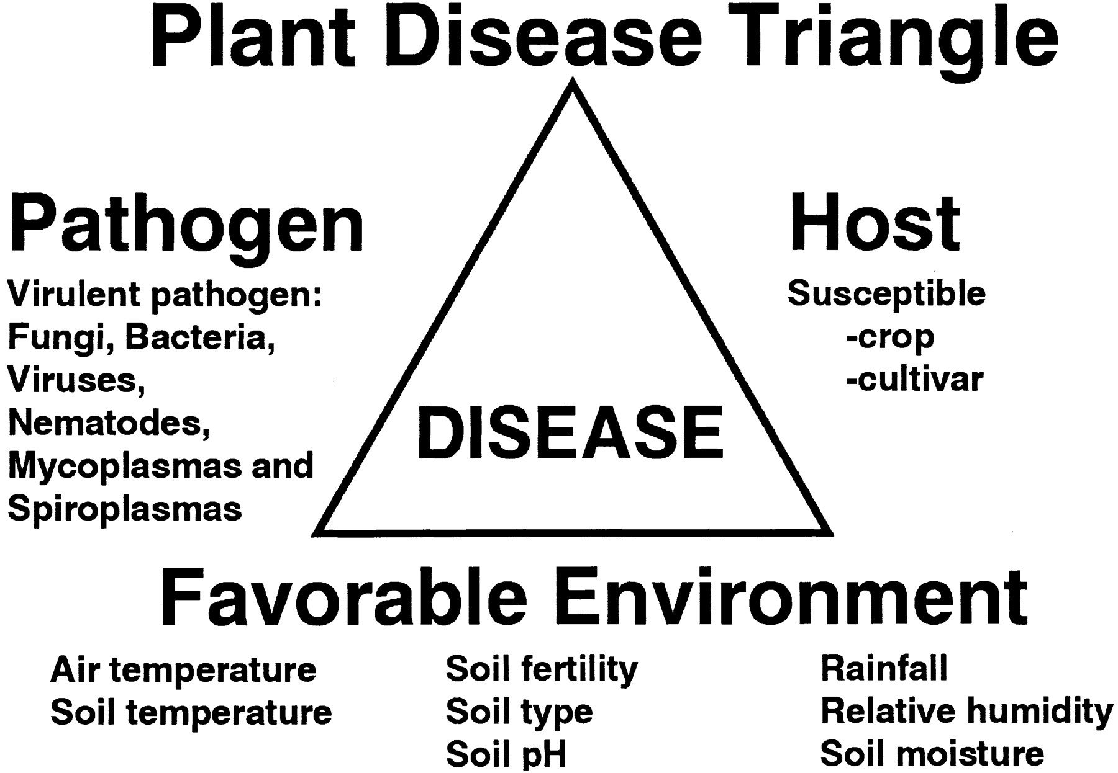

Slide 55
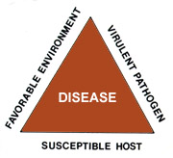
Disease Pyramid
The interaction of components of plant disease can be expanded to include time and humans.
Time is often considered as the fourth component of plant disease development.
The four components together can quantify the amount of disease.
The human equation can affect the three components of the disease triangle and should be considered as a fifth component in disease development.

Slide 56
The Elements of an Epidemic
Figure. The disease tetrahedron.

Slide 57
Disease cycle
chain of events to the development and perpetuation of the disease and the pathogen.
The primary events in a disease cycle are:
inoculation
penetration
infection
colonization (invasion)
growth and reproduction of the pathogen
dissemination of the pathogen, and
survival of the pathogen in the absence of the host, i.e., overwintering (oversummering) of the pathogen.

Slide 58
Inoculation
is the initial contact of a pathogen with an infection court.
inoculum is any part of the pathogen that can initiate infection.
Examples of inoculums:
In fungi: - spores
In bacteria, protozoa, viruses, and viroids: - individual microbs
In Nematodes: - adult nematodes and nematode juveniles.
In parasitic higher plants: plant fragments or seeds.

Slide 59
Penetration
Pathogens penetrate plant surfaces by:
direct penetration – nematodes & some fungi
through natural openings- some bacteria & nematodes
through wounds - bacteria
Penetration does not always lead to infection.
Direct penetration
the most common type of penetration by fungi and nematodes
the only type of penetration by parasitic higher plants.
None of the other pathogens can enter plants by direct penetration.

Slide 60
2. Penetration through wounds
All bacteria, most fungi, some viruses, and all viroids can enter through wounds.
viruses and protozoa enter plant through wounds made by their vectors
3. Penetration through natural openings
Many fungi and bacteria enter plants through stomata.
Stomata are most numerous on the lower side of leaves and open in the daytime but are more or less closed at night

Slide 61
Cont…

Slide 62
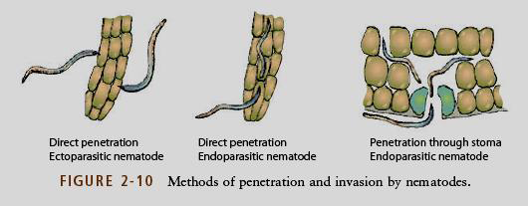
Cont…

Slide 63
Infection
Process by which pathogens establish contact with susceptible cells and procure nutrients.
Successful infections result in the appearance of symptoms.
N.B”: For a successful infection to occur it is not sufficient that a pathogen comes in contact with its host.
The period of time between penetration by a pathogen and the first appearance of symptoms is called Incubation period .

Slide 64
Invasion
Fungi that cause vascular wilts invade the xylem vessels of plants.
Bacteria invade tissues intercellulary
Most nematodes invade tissues intercellularly, but some can invade intracellularly
Viruses and protozoa invade tissues intracellularly.
protozoa invade phloem sieve tubes

Slide 65
Invasion

Slide 66
Growth and reproduction of the pathogen (Colonization)
Pathogens continue to spread until the infection is stopped or the plant is dead
actively move
rapid reproduction

Slide 67
Reproduction:
Fungi – spores, inter‐ and intra‐, surface and interior
Bacteria – cell division, inter and intra‐, surface and interior
Viruses – intra‐, inside cells only
Nematodes – inter‐ and intra‐, surface and interior
NB. Rate varies on pathogen present, environment, and host

Slide 68
Dissemination of the Pathogen
Two types pathogen dissemination exist:
active dissemination and
passive dissemination.
The inoculum of most pathogens is carried to host plants passively by wind, water insects.
A few pathogens, such as nematodes, oomycetes, zoosporic fungi, and bacteria, can move short distances on their own power. Such type of dissemination is known as active dissemination.

Slide 69
Dissemination of pathogen

Slide 70
Survival of the pathogen without a host
(over wintering stage)
Fungi- mycelium in cankers, bud scales, seeds, tubers, and plant debris; spores; and sclerotia
Bacteria: same way as fungi infected plants, seeds, tubers and plant debris; in the bodies of insect vectors.
Viruses: survive only in living plant tissues; roots of perennial plants, seeds of some hosts, and insect vectors.
Nematodes: Survive as eggs in the soil; or life stages that are dormant in seeds and bulbs

Slide 71
Decision rules of pest management
In order to arrive at a definite and practicable concept, different categories of pest are designated in terms of general equilibrium position (GEP), the economic injury level (EIL) and damage boundary (DB or ETL).
ETL or DB:The lowest levels of injury where the damage can be measured and tolerated.
Control measures are taken at this stage so that the pest does not exceed EIL.

Slide 73
General equilibrium position (GEP):- The average density of a population over a long period of time.
Economic threshold level (ETL):- Population density at which control measure should be implemented to prevent an increasing pest population from reaching the EIL. ETL is always less than EIL. It provides sufficient time for control measures.
Economic injury level (EIL):-The lowest population density that will cause economic damage.

Slide 74
Changing status of pests
Why the status of pest changed through time?
1. High yielding varieties
When altering the genetic makeup of the crop plants to increase yield with little or no attention to pest attack, natural resistance may be lost or greatly reduced.
Efforts to breed plants more palatable to human taste by elimination of such factors as bitterness may also results in development of more susceptible varieties.

Slide 75
2. Monoculture
Larger the area that is planted to a single crop, the greater the potential for pest problems.
Generally, same crops are maintained in a given area year after year helps in survival and multiplication of the pest throughout the year.
Large scale monocultring of cotton, paddy sugarcane and vegetable crops has resulted in rapid increase in number and intensity of pest attacks.

Slide 76
3. Nutrients of the soil
Altering the nutrients level in the soil affects the concentration of nutrients in the host plants, which, in return, influence the pests that are feeding on the plant.
High levels of nitrogenous fertilizers significantly increase the incidence of most pests.

Slide 77
4. Pesticides
The large scale indiscriminate use and abuse of pesticides has resulted in increased attacks of pests on many crops.
This may be due to development of pesticide resistance, resurgence of pests or out breaks of secondary pests.
The pesticides may kill natural enemies of target pests or potential pest.
They may also alter crop physiology to make the plant more susceptible to attack by pests.

Slide 78
5. Cultural practices
New agronomic recommendation like
closer spacing,
sowing dates,
harvesting procedures, etc, are essentially meant for exploiting the full genetic potential of high yielder varieties (HYVs), but,
They are simultaneously favorable to most pests.

Slide 79
Chapter 3 Effects of pests on crop plants
1. Consumption of Plant Parts
The ingestion of plant leaf represents an energy gain by the pest and an energy loss by the plant.
Example: consumption of leaves results in reduced photosynthetic area, which then results in yield loss.
Pests may directly consume fruits and seeds, or damage the roots, which reduce top growth.
Insects feed and consume plant tissues or plant sap by chewing, sucking or boring.

Slide 80
When chewing insects feed directly on flowering or fruiting structures, substantial yield loss can occur.
The most serious type of damage is when the part to be harvested is damaged by the pest.
For example, most root crops (potato, sugar beet, etc) can tolerate partial defoliation of leafs without noticeable loss of yield because the part to harvested is the tuber (root).
But, partial defoliation of leaves of cabbage is not tolerable.

Slide 81
Many crops can tolerate up to 30 percent defoliation without apparent yield loss.
So often damage to the other parts of the plant body is not nearly as important as that to the part to be harvested.
Nematodes, insects, and vertebrates may consume plant sap, plant parts, or entire plants, which can result in plant death.

Slide 82
2. Physical Damage
The feeding of arthropods and nematodes makes wounds or holes that serve as entry points for pathogens. The resulting pathogen then damages the produce or even kills the plant.
Physical damage can also cause loss of plant structural strength;
for example, maize, can collapse in response to maize stalk borer damage; the stalk borer insect bores through the maize stalk.

Slide 83
3. Loss in Quality
The seed will be infested and contaminated with pests.
Grains are holed and often discoloured.
Food prepared from infested produce may have an unpleasant odor or taste.
Weed seeds can be present in harvested products, such as cereal grains.

Slide 84
4. Vectoring of Pathogens
The most important form of damage is when the insect acts as a vector for a parasite or pathogen.
The simplest form of dispersal is known as mechanical transmission; typically the insect picks up the parasite on its body surface while feeding on the plant, and it may either deposit the parasite on to another plant.
But many insect pests are fluid feeders (sap-suckers on plants), and these can mechanically transmit pathogens and parasites by contamination.

Slide 85
In agriculture, almost all virus diseases are spread by feeding insects- aphids (Aphididae), leafhoppers (Cicadellidae), plant hoppers (Delphacidae) and some other bugs are the main groups of vectors.
Pathogens vectored by insects are an extremely important problem, and are often the most serious impediment to increase crop yields in developing countries.

Slide 86
5. Weight Loss
Estimates of weight loss vary widely with:
the commodity (type of crop stored-maize, wheat or teff, etc),
the locality (environmental condition of the storage area) and;
the storage practices (whether the crop is stored in sack, ‘gotera’ or silos, etc.) involved.
For grains or grain legumes in the tropics, stored under traditional conditions, a loss in the range of 20-30 percent might be expected over a full storage season.

Slide 87
6. Promotion of Mould Development
Insect moulds, and the grains themselves produce water during respiration:
C₆H₁₂O₆ + 6O₂ → 6H₂O + CO₂
This carbon dioxide increases the heat content of the storage environment.
In humid conditions, without adequate ventilation, the CO₂ and H₂O together will result in mould development and causes severe losses.

Slide 88
7. Reduced Germination and Nutritional Value in Seed Material
Damage to the embryo of the seed will usually prevent germination (the seed will unable to germinate after sowing);
Removal of the embryo by storage pests will also reduce the protein content of the grain.

Slide 89
8. Chemical Toxins, Elicitors, and Signals
pests produce chemical compounds which can damage host plants or induce host physiological responses such as defensive reactions.
Some of these compounds are toxic to host tissues and produce direct, local host responses such as stress or necrosis at the site where the pest attacks the plant.

Slide 90
As a general rule, when pests produce and release chemicals, plant physiology, plant growth, and yield will be reduced.
Pathogens release enzyme and toxins.
Weeds may release allelochemicals which inhibit the growth of competing plants.
Nematode species inject chemical signals into host plants and cause physiological responses in the host, including the abnormal growth seen as galls produced on roots following infection by the rot-knot nematode.

