Slide 1
Advanced Forest Management
Principles and elements of forest management : Sustainable forest management theories, methods of forest inventory for forest management planning, Approaches of forest yield regulation and prediction (Height growth, biomass, volume, age and diameter distribution) Forest project planning and evaluation for making decision in final forest harvesting and tree replanting: Studying various case studies discuss on current topics in forest resource management.

Slide 2
Course outline
Introduction
  Defining forest management
  Objectives in forest management
  The scope of forest management
Principles and elements of forest management:
  Land classification
  Growth projection and Yield prediction
  Prescriptions
Sustainable forest management
  The concept of sustainability
  Principles of sustainable forest management
Approaches of forest yield regulation
  The concept of normal forest
  Yield regulation for even-aged forest stands
  Yield regulation for uneven-aged forest stands
Decision making in forest management and project planning

Slide 3
References
Clutter, J. L and et al. 1983. Timber management: a quantitative approach.
FAO. Guidelines for the management of tropical forests. FAO. Rome.
Lawrence S. Davis & K. Norman Johnson. Forest Management. McGraw-Hill Book Company
William A. Leuschner. Introduction to Forest Resource Management. John Wiley & Sons.
Philip, M. 1983. Measuring trees and forests.
T.E. Avery and H.E. Burkart. Forest Measurements. McGraw-Hill International Editions.

Slide 4
Forest management
Encompasses all the process and practices undertaken in a forest area in order to lead and coordinate activities in forestry towards achieving some defined goals or objectives.
Attempts to effectively integrate the biological, social and economic factors, which influence the decisions made towards the implementation of one or more specified objectives.
Is the practical application of scientific, technical, and economic principles in forestry

Slide 5
Forest management is the process of applying the scientific, technical and economic principles of forestry in the planning, organization and implementation of forestry activities in order to achieve the objectives of forest owners (society).
  requires a plan
  assessment of the activities necessary to meet the objectives.
  recognition of the important ecological and social concerns associated with a forest
  the application of silvicultural practices so that a forest remains healthy and vigorous
The range of forest management activities can include
  tree planting, weed control, fertilization, precommercial thinning, commercial thinning, final harvests, road construction, fire control, etc
Each activities involves a cost and a benefit
Choosing the type of activities, their timing, and placement is therefore important

Slide 6
Objectives of forest management
Objectives are desired points the forest organization wishes to reach or the purpose that an organization strives to achieve
Organization often have more than one objective
Objectives can be classified as:
  Major(primary) and minor (secondary) objectives
  Direct and indirect objectives
Objectives are defined at different levels
  National/regional wide objectives
  Project/local/forest based objectives
  Compartment level objectives

Slide 7
Nation Wide objectives – often defined at sectoral policy levels
  Produce enough forestry products for the need of the people on a long term base
  Increase the forest cover and prevent desertification
  Maintain or enhance the biodiversity resources
Project level:
  Production of lumber, construction poles and fuel wood for the local market
  Generate enough revenue to cover the cost of the project and allow additional investment
  Generate maximum revenue in the long term.
Compartment/stand level:
  Maximum volume production of saw timbers.
  Production of good quality saw timber.
  Production of electric power transmission poles.
  Production of round wood up to maximum diameter.

Slide 8
Scope of forest management
Forest management Is the practical application of scientific, technical, and economic principles in forestry

Slide 9
Sustainable Forest Management
Related to the concept of sustainable development
  Sustainable development is development which meets the needs of the present without compromising the ability of future generations to meet their own needs
Rationales for SD
  Unequal distribution of benefits of development
  negative impacts of development on the environment
Three aspects of SD
  Economic - able to produce goods and services on a continuing basis
  Environmental - avoiding over-exploitation of renewable resource systems or and depleting non-renewable resources
  Social - distributional equity, adequate provision of social services
Therefore, sustainable forest management will ensure that the values derived from the forest meet present-day needs while at the same time ensuring their continued availability and contribution to long-term development needs
  wood and -wood products, water, food, fodder, medicine, fuel, shelter, employment, recreation, habitats for wildlife, biodiversity, carbon sinks and reservoirs, and for other forest products

Slide 10
Contd.
Achieving SFM requires
  Understanding the factors/driving forces of unsustainable forest management, forest decline, or deforestation
    Immediate (direct) causes
    Underlying causes
  Understanding the principles that guide SFM
  Understanding the conditions that ensure SFM
Immediate causes – factors that directly result in deforestation
  Clearing for agricultural expansion, forest fires, logging
Underlying causes - fundamental forces that originate from factors distant from agents of deforestation but influence their action
  Market failure
  Misguided policy interventions
  Population increase

Slide 11
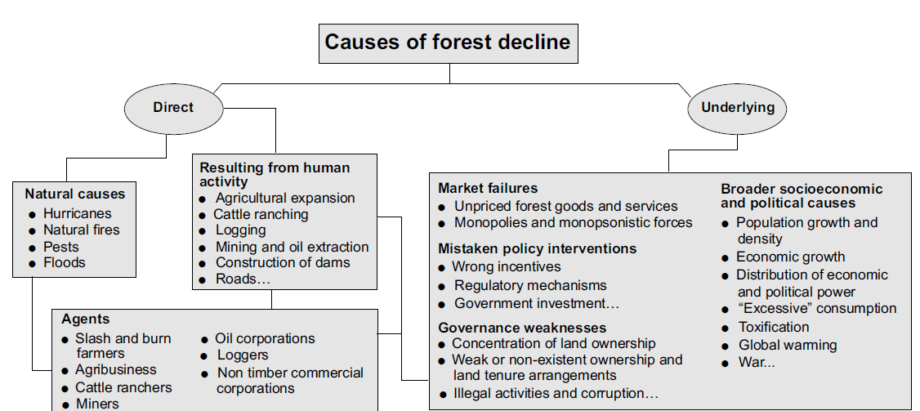

Slide 12
Planning for sustainable forest management requires answering:
  Why and how SFM? ---- Principles of SFM
    Maximizing the welfare of today’s and future society by maintaining the economic, environmental/ecological, social functions of forests
  How do we plan, implement, and monitor SFM? – developing criteria and indicators related to the above functions of forests
Principles of SFM –
  top-level statements - fundamental truths or laws - which embody human wisdom about SFM.
  refer to a function of the forest or to a relevant aspect of the social system that interacts with it
    SFM should assure people’s well-being
    SFM should assure healthy forest ecosystem
    There should be conducive environment for SFM (policy, law, regulations, institutions, etc)

Slide 13
Criteria and Indicators (C&I) of SFM
Criteria - standards by which progress towards meeting the Principles can be judged
  define the particular state or conditions of the forest that we would expect to see if the Principle it supports is adhered to
  relates to a key management factor which may be described by one or more qualitative, quantitative or descriptive indicators.
Indicators - Indicators are the components or variables of the forest or management system that imply or ‘indicate’ the state or conditions required by a Criterion
  Are measurements to assess and evaluate the effects of forest management action, or inaction

Slide 14
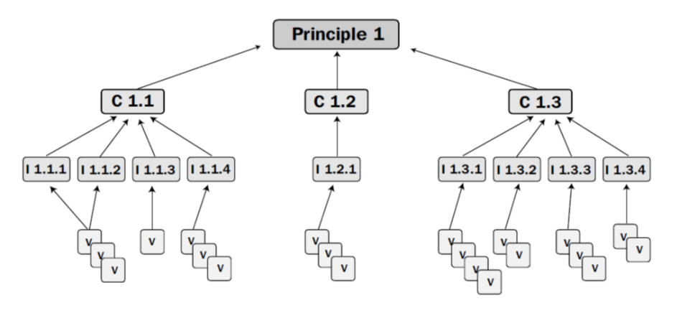

Slide 15
C 2.1 The processes that maintain biodiversity in managed forests are conserved
  I 2.1.1 Landscape pattern is maintained
  I 2.1.2 Change in diversity of habitat as a result of human interventions should be maintained within critical limits
  I 2.1.3 Community guild structures do not show significant changes in the representation of especially sensitive guilds, pollinator and disperser guilds
  I 2.1.4 The richness/diversity of selected groups show no significant change
  I 2.1.5 Population sizes and demographic structures of selected species do not show significant change, and demographically and ecologically critical life-cycle stages continue to be presented
  I 2.1.6 The status of decomposition and nutrient cycling shows no significant change
  I 2.1.7 There is no significant change in the quality and quantity of water from the catchment
  I 2.1.8 Enrichment planting, if carried out, should be based on indigenous locally adapted species
C 2.2 Ecosystem function is maintained
  I 2.2.1 No chemical contamination to food chains and ecosystem
  I.2.2.2 Ecologically sensitive areas, especially buffer zones along watercourses, are protected
  I.2.2.3 Representative areas, especially sites of ecological importance, are protected and appropriately managed
  I.2.2.4 Rare or endangered species are protected
  I.2.2.5 Erosion and other forms of soil degradation are minimized
C 2.3 Conservation of the processes that maintain genetic variation
  I.2.3.1 Levels of genetic diversity are maintained within critical limits
  I.2.3.2 There is no directional change in genotypic frequencies
  I.2.3.3 There are no significant changes in gene flow/migration

Slide 16
The basic principle of tropical forest management comprise the following elements:
  National Policy and Legal framework
  Security of Tenure of Forest Resources and Land
  Effective Forest Protection
  Knowledge on Sustainability of Tropical Forest Ecosystems
  Maintenance of Site Productivity
  Forest Management Planning
  Goals and Objectives for Forest Management
  Definition of Forest Resources
  Application of Appropriate Silvicultural Systems
  Minimisation of Adverse Environmental Impacts
  A Regard for the Interests of Forest-Dependent Communities
  Commercial Sustainability and Business Management
  Monitoring of Managerial Performance

Slide 17
The Principle of Sustainable Yield
The sustained yield of a forest is the total amount of material it can yield annually or periodically in perpetuity (for all time), without reducing the value of the forest.
  It is the yield a forest can produce continuously at a given intensity of management.
  implies continuous production so planned as to achieve a balance between increment (growth) and cutting (harvest).
Sustained yield important for the following reasons
  keeps industries or markets constantly supplied and avoids periods of shortage or surplus
  promotes the establishment of stable prices which benefits both buyers and sellers
  make the best use of equipment and personnel allocated to the operations
  helps to provide steady employment for workers
  leads to a steady flow of regeneration and tending operations in the forest
  produces a regular flow of income for the owner of the forest

Slide 18
Elements of Forest Management
Includes land classification, growth and yield predictions, prescriptions development
Land classification
  is the first element since it sets the stage and context of the activities and yield prediction.
  classifying the forest management unit into homogeneous units with regard to relevant characteristics is is important
  done by considering some relevant features of the forest area are related to physical characteristics, vegetation characteristics, and development characteristics
  Physical characteristics
    includes the set of attributes used to characterize the permanent, physical nature of forest land, including topography, soils, bedrock, climate, hydrology
  Vegetation characteristics
    are the set of attributes used to characterize tree and other vegetation currently growing on forestland, including height, age, basal area, volume, diameter, etc.
  Development characteristics
    include the set of attributes used to characterize the organization, development and accessibility of forest land for human use, including ownership, roads, building etc

Slide 19
Example:
Physical characteristics:
  Slope: Gentle (G), moderate (M), steep (S)
Vegetation characteristics
  Forest type: Natural (N) vs Plantation (P)
  Natural Forest vegetation: closed (NC), disturbed (ND), open (NO)
  Plantation forest Vegetation: Cupressus (PC), Eucalyptus (PE), mixed (PM)
Development Characteristics
  Accessibility to roads: close (<1km) (RC), far (> 1km) (RF)
  Settlements: close (<5km) (SC), far (>5km) (SF)

Slide 20
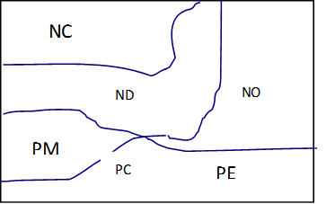
Physical characteristics
Vegetation characteristics

Slide 21
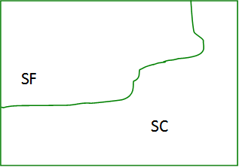
Accessibility
Settlement

Slide 22
Forest map

Slide 23
Stands type: All forestland that has the same defined combination and attribute range of the physical, vegetation, and development characteristics chosen to classify the forest into homogeneous types with regard to some basic land characteristics in order to predict timber yield and other responses of the land to treatments with confidence
  E.g. All open natural forests situated on gentle slope area (at the foot of the mountain) that are close to the roads and surrounded by settlements
  All closed natural forests located on the mountains sides situated in the remotest parts of the forest and away from the surrounding communities
Stand: A homogeneous, geographically contiguous parcel of land, all of the same stand type and larger than some defined minimum size
Management unit/Block: An area of forest for which an approved Forest Management Plan is in operation.
usually defined by watershed, ownership, or administrative boundaries for purposes of locating and implementing prescriptions.
Compartment: is usually the smallest permanent subdivision (management units) of a forest.
  are permanently defined for the purpose of locating, describing, and record keeping and as a basis for the planning and management of all forest activities
  should be clearly demarcated on the ground and its boundaries should, as much as possible, follow natural features such as roads, rides, main ditches, banks or other surveyed lines.

Slide 24
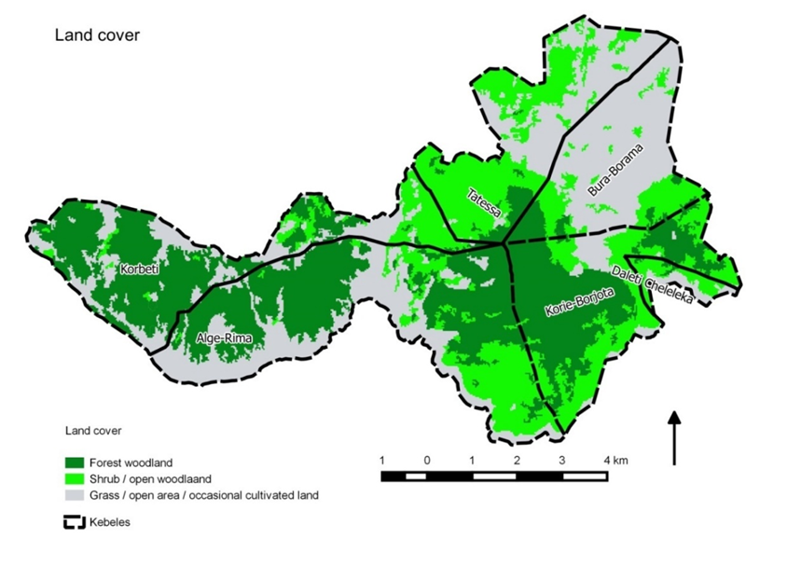
Land cover classification of JamaUrji farmers managed forest area

Slide 25
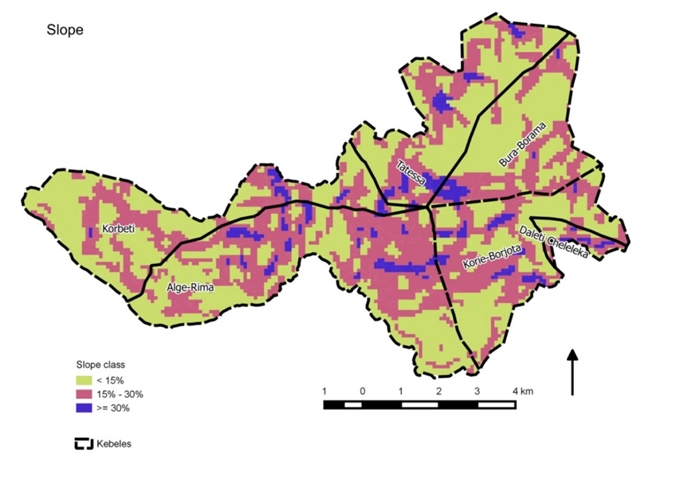
Slope class of JamaUrji Farmers managed natural forest area

Slide 26
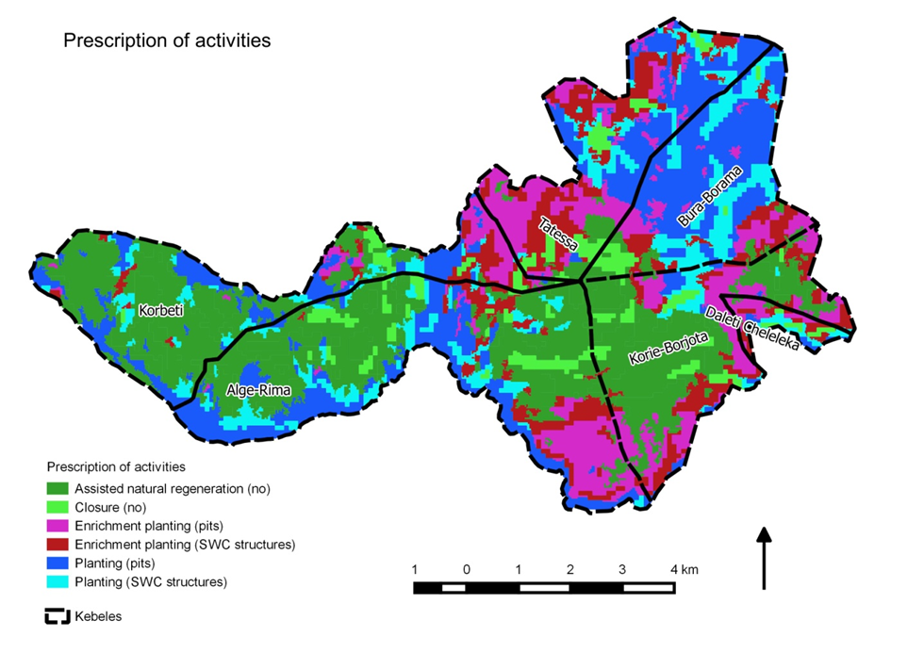
JamaUrji farmers managed natural forest; Forest management prescription activities

