Slide 1
CHAPTER 3
WATERSHED DELINEATION AND CHARACTERISATION
    3.1. Identifying priority watersheds
    3.2. Measuring Watershed Areas
    3. 3. Basin Order and Channel Order
    3.4. Watershed morphology and characteristics affecting water yield and quality

Slide 2
Watershed delineation, measuring watershed areas and identifying priority watersheds
  Major Contents
    Watershed delineation
    Measuring Watershed Areas
    Identifying priority watersheds
  Learning outcomes
    identify data/tools sources, type of data used in watershed delineation and limitations in these data/tools
    able to delineate watersheds
    Able to prioritize critical watersheds

Slide 3
Definitions related to watershed delineation
  Outlet: the location at which the design is being made
  Watershed: the land area that sheds water to the outlet during a rainstorm
  Watershed boundary: consists of the line drawn across the contours joining the highest elevations surrounding the basin/watershed
Watershed delineation is the process of identifying the drainage area of a point or set of points.
For many years, Water Engineers have been using EMA (Ethiopian Mapping Agency) paper maps for watershed delineation.
The maps are in UTM coordinates and in 1:50,000 scale with 20m contour interval

Slide 4
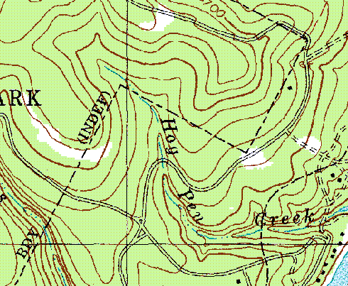
Water flows in the direction of the terrain steepest downhill slope.
Streamlines do not flow towards drainage divides, and do not intersect them.
Sources of data for watershed delineation are
  Topographic maps = manual use
  DEMs (Digital Elevation Models) = using GIS
Contour map

Slide 5
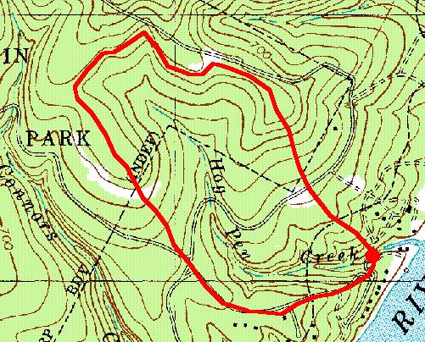
Topographic Maps: fundamental source of data for delineating and studying watersheds
These maps are wealth of information
  Topographic contour lines,
  locations of cities and buildings,
  roads, road types, railroads,
  water bodies,
  forested land,
  stream networks and benchmarks.
Watershed boundaries/drainage divides are found along the highest points of the terrain and they always divides the different watersheds.

Slide 6
Contour lines do not cross each other.
Elevation of the lines is always shown on the contour lines and having equal contour intervals.
If any two lines cross each other on the map, it means that one line is contour and other could be a drainage channel or a road or a power line etc.

Slide 7
On contour map:
  A depressed area (valley, rivers) is represented by a series of contour lines “pointing” towards the highest elevation
  A higher area (ridge, hill) is represented by a series of contour lines “pointing” towards the lowest elevation

Slide 8
  How a typical ridge line would look on a contour map
  How a typical valley section would look on a contour map

Slide 9
Watershed delineation steps using topographic maps
  There are two basic steps to follow in watershed delineation.
    Step 1: Choose the point of the watershed outlet.
      This is generally our point of interest for designing a structure or monitoring location.
    Step 2: Delineate the watershed boundary by drawing perpendicular lines across the elevation contour lines for land that drains to the point of interest.

Slide 10
  To trace the boundary, - start at the outlet & then draw a line away on the left bank, maintaining it always at right angles to the contour lines. (The line should not cross the drainage paths)
  Continue the line until it is above the headwaters of the stream network.
  Return to the outlet and repeat the procedure with a line away from the right bank.
  Two lines should join to produce the full watershed boundary.

Slide 11
Watershed delineation

Slide 13
Boundary defined by all points that shed water to the outlet
Identify ridge lines from topo-sheet
Water will travel perpendicular to the elevation contours which is the direction that maximize slope
Watershed boundary is delineated by drawing lines perpendicular to the elevation contour lines for land that drains to outlet

Slide 14
Area calculation of delineated watershed:
procedure for calculating the watershed area is as follows:
  1. Trace the ridgeline (watershed boundary) on the transparent graph paper.
  2. Count the 1 sq cm box on the graph paper.
  Then count the 1 sq mm box in an incomplete box.
  Example: Assuming that the scale of map is 1:50000 and the number of complete 1 sq cm box are 30.
    What is the area of the watershed?
    Solution:1 cm = 50000 cm = 500 m
    1 x 1 sq cm = 500 x 500 sq m = 250000sq m = 25 ha
    1 Sq cm = 25 ha. Hence, area of watershed = 30 x 25 = 750 ha

Slide 15
Assignment I
Identify a major watershed on the topo maps and carry out the following analysis
Characterize the watershed:
  Name the watershed
  Delineate the watershed and describe how you identified the boundary
  Identify and delineate sub-watersheds (How many and name them)
  Calculate the watershed area
Please report your analysis in one page within a week

Slide 16
Conditions for watershed prioritization
Analyzing Watershed conditions
  It is describing and collecting data in a watershed using appropriate methods, techniques and tools
  To prioritize a watershed it is important to analyze watersheds at different levels
Levels of analysis of watersheds:
  National level: reconnaissance and to categorize or classify major watersheds in a country (using remote sensing techniques and aerial photographs)
  Regional and district level: semi-detailed survey designed for certain clusters of watersheds for regional development planning (remote sensing and ground data collection for master planning purpose, e.g., river basins)

Slide 17
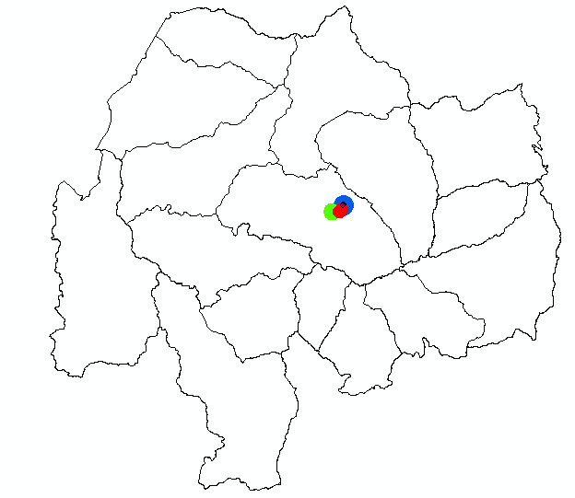

Slide 18
  Watershed and sub-watershed level: a detailed survey for the purpose of local development planning (e.g., woreda level analysis)
  Community and farm level: very detailed analysis of a particular community or farm for a specific watershed management objective
Operational watershed size: (Basin, Watershed, Sub-watershed, Community watershed)
Classification of watersheds
  Mini watershed < 100 ha
  Micro watershed = 100 and 1000 ha
  Milli watersheds = 1000 to 10000 ha
  Sub watershed = 10000 to 50000 ha
  Macro watershed > 50000 ha

Slide 19
  In participatory community watershed management, the size of a watershed is decided based on the community or communities who depend on the watershed, i.e. community boundary. Why?
  Because the decision making unit for any watershed is the community.
  Therefore, the starting point for any watershed development planning is the community and its surroundings.
  The optimum size of a community watershed that should be considered as a planning unit is recommended to be in the range of 200 and 500 ha.
  If it is more than 500, it will be difficult to organize the community.

Slide 20
Is it the same for dry and wet areas?
  In wet areas, villages or communities are found in a more dense condition and resources in watersheds are influenced by the presence of high rainfall and numerous streams.
  Smaller size is preferred for effective and successful management.
  In dry areas, villages or communities are more scattered and rainfall may not be problematic and the size of watersheds can be larger.

Slide 21
Identifying watersheds at a woreda level:
  Mapping and delineating boundaries:
  Major watersheds and critical watershed units/sub-watersheds within a woreda can be identified using a 1: 50, 000 topo map (standard map)
  Major watersheds approximately ranging between 6000 and 20, 000 ha
  critical watershed units ranging between 2000 and 6000 ha, containing more than one administrative unit or Kebele and several communities map

Slide 22
Identifying watersheds at the community level
  Within the broader sub-watershed units, community watersheds can be identified and delineated with a range between 200-500 ha, based on community boundaries
  Community boundaries often do not coincide with watershed boundaries and may have possible scenarios:
    Scenario 1: Community boundaries may be completely located within a specific sub-watershed - ideal but usually does not happen
    Scenario 2: Part of the community land is located in one watershed and partly in another; e.g., when a stream dissects or borders two communities
    Scenario 3: Community land is included as part of one sub-watershed

Slide 24
After identifying major watersheds, critical/sub-watersheds and community watersheds, priority watersheds will then be ranked based on standardized selection criteria.
This could be based on the objective and urgency of the problem which in turn based on watershed information resulted from conducting the watershed analysis or survey
Read on WOCAT 2010, A Framework for Documentation and Evaluation of Sustainable Land Management

Slide 25
Conducting the watershed analysis or survey
  For any sort of survey or analysis, start by collecting available information from secondary sources
  Biophysical analysis (survey)
    Watershed physical conditions
    Land use and vegetation
    Water resource related problems
  Socioeconomic and institutional analysis (survey)
    Socioeconomic and infrastructural conditions
    Policy and institutional needs

Slide 26
Biophysical survey
Characterizing the watershed (general information)
  Watershed name
  Structural zones
  Stream order and density
  Length and Shape
  Drainage area or size,
  Number of sub-watersheds
Tools and methods: Topo maps, participatory mapping and transect walk to quantify the characteristics of the watershed

Slide 27
Area determination
  Old methods
    Dot counting
    Grid square
  Current methods
    Planimeter
    GIS (boundary delineation by GPS point collection)
Slope calculation
  % slope = Vertical distance
  Horizontal distance
  Techniques and tools: Clinometers, Line level, RS and GIS (from DEM) to produce slope map

Slide 28
Data collection (quantitative and qualitative)
  Geology and soil data
    Existing reports, with field checking and verification
    Soil survey
    Techniques: Profile pit sampling & description, samples using soil augers
  Climatic data
    Nearby weather stations or national meteorological center
  Land use land cover data
    Current: current images or current aerial photo analysis, ground truthing,
    Historical: personal communication, historical maps, aerial photos, images
    Techniques: using various GIS and RS methods

Slide 29
Land capability data
  Secondary sources
  Use slope and soil data to develop land capability classes
Soil erosion data
  From secondary sources (e.g., EHRS)
  Field observation (major erosion features and indicators, e.g., rills and gullies or sediments in trails and channels)
  Gully classification based on depth
  Runoff plots
  Aerial photo and image analysis (for gully erosion)
  Erosion Models (Process based: SWAT, WEPP, Cs-137; Mathematical: USLE)

Slide 30
Vegetation data
  Type and area cover
  Structure, composition, diversity, volume
  Techniques: RS and GIS; aerial photos; inventory and statistical analysis
  Tools: Hypsometer, diameter tape, caliper, relascope
Water resources data
  Water quantity can be measured by analyzing the water balance (to determine shortages and seasonal fluctuations)
  Water use can be analyzed by determining demand and consumption for different purposes (irrigation, domestic, industries), from secondary sources and questionnaire surveys
  Water quality analysis can be done using chemicals and laboratory works

Slide 31
Socioeconomic and institutional analysis (survey)
  Socioeconomic and infrastructural conditions
    Existing reports (secondary sources)
    Questionnaire Survey (household, institutions, industries, etc…)
    Interviews and observations
  Policy and institutional needs
    Method: Review of policies, laws and regulations
    Agriculture and related land use laws and acts
    Forest and range land laws and acts
    Water resource development related laws
    Environmental protection laws and acts

Slide 32
Identifying priority watersheds
  The need for watershed management is most urgent, and is most likely to achieve a positive and measurable impact in watersheds where essential watershed functions are already or likely to become critically impaired through human intervention.
  for example watersheds with a significant negative impact on water quality and / or quantity can be considered to be “sensitive” or “critical”.
  these critical watersheds can be resulted from high rates of deforestation, land use change and population growth

Slide 33
  An approach that is used to identify critical watersheds is the concept of priority watersheds.
  there is no universally accepted definition of a critical watershed, but the following alternative definitions have been given:
    An area considered as critical regarding the risk of soil erosion, typically an area with watershed that lacks permanent forest cover.
    Sensitive cross-border areas and other areas where the interests of the Basin as a whole are impacted or potentially impacted.
    Watersheds that are in a critical condition, with steep slopes, a high rate of land use change or deforestation and high increases in the population, etc.

Slide 34
There are two broad classes of criteria that can be used to define and identify critical watersheds:
  Static criteria: These are criteria that do not change easily over time.
    They include high elevation, steep slopes, prone to erosion landforms and absence of permanent forest cover.
  Dynamic criteria: These are criteria that may change quickly over time.
    Such rates of change could reflect changes in the water quality and quantity, deforestation rate and population growth.

Slide 35
Using dynamic criteria or a combination of static and dynamic criteria to identify critical watersheds seems more appropriate than solely using static criteria.
Because watershed functions are impacted on by human interventions that are undertaken to use natural resources.
Dynamic criteria are direct or indirect indicators for such human interventions and change, and thus indicate areas where human activities do actually or are very likely to influence and critically impair essential watershed functions.
Recent and reliable geographically referenced information is required to actually identify critical watersheds using criteria that have been agreed upon

Slide 36
Watershed classification is one approach that can help to identify critical watersheds, by mainly using static criteria.
It should be noted though that methods to classify watersheds differ around the world, as the method will depend on the intended use of the results.
For instance, the classification of a watershed for the purpose of hydropower generation will look rather different from one that addresses erosion issues.

Slide 37
  Hence, there are varying ways in which different countries classify watersheds based on the specific prioritization purposes.
    For example priority classification depended on the so-called “sediment yield index” which was composed of measures of erosion intensity (terrain, slope, soil class, susceptibility to erosion, vegetation cover and extent of the erosion process) and a delivery ratio indicating transportability of sediments to reservoirs
    Others regard to water resources degradation mainly through soil erosion which established a watershed classification system and corresponding watershed classification data and maps

Slide 38
Based on the topography of the landscape and vegetation cover five watershed classes (class 1 is the most sensitive and class 5 the least sensitive to water resource degradation through erosion) can be calculated by means of statistical analysis
Watershed Class 1 (Protection Forest): Comprise areas with very steep slopes and rugged landforms, which are commonly upland and headwater areas that are critical for water and soil resources management.
  These areas should be under permanent forest cover.
  The other existing land uses that are based on traditional rights and practices should be considered carefully with regard to their impact on water and soil conservation

Slide 39
Watershed Class 2 (Commercial Forest): Comprise areas with steep slopes, usually found at a higher elevation.
  In general the landforms are less susceptible to water and soil degradation than those categorized under class 1.
  Conservation and production forests, as well as agroforestry and grazing, if they are accompanied by strict conservation measures.
Watershed Class 3 (Agroforestry): Comprise areas with moderate to steep slopes that have less erosive landforms, located in upland areas and on foot slopes.
  Recommendations include a wider range of acceptable land uses than those for WSC classes 1 and 2.
  Areas may be used for commercial forests, grazing and combinations of trees and agricultural crops, if appropriate conservation measures are being applied.

Slide 40
Watershed Class 4 (Upland Farming): Comprise areas with gently sloping lands, where there is a moderate need for water and soil conservation.
  In these areas a wide range of land uses related to agriculture and forestry are possible.
Watershed Class 5 (Lowland Farming): Comprise areas with gently sloping land and flat areas that are suitable for a wide range of land uses such as the cultivation of paddy rice, other agricultural uses and forests.

Slide 41
It should be noted that these are recommendations and they do not exclude other land uses, provided that adequate care is given to soil conservation.
As an example of this, the recommended land use for areas in class 1 is forest cover.
However there are many cases which clearly show that forest cover is not the one and only solution for conserving steep watersheds.

Slide 42
Other considers soil erosion rate to prioritize watersheds
  Prioritization of micro-watersheds involves ranking of the different micro-watersheds according to the order in which they ought to be taken up for treatment with conservation technologies by considering the amount of soil loss occurring
Eg the case of chemoga watershed

Slide 43
Prioritization of micro-watersheds
Soil loss (t ha⁻¹ y⁻¹ | Priority classes | Severity classes | Micro-watershed | Area (ha) | Per cent of total area | Per cent of total soil loss
>125 | I | Very severe | SW_8, SW_9, SW_10, SW_12, SW_14 | 8552.2 | 24.7 | 50.9
80–125 | II | Severe | SW_6, SW_13, SW_15, SW_16, SW_17, SW_18 | 11 650.4 | 33.6 | 35.7
50–80 | III | Very high | SW_7, SW_11 | 2219.3 | 6.4 | 4.6
25–50 | IV | High | SW_4, SW_5 | 3731.3 | 10.8 | 4.7
12–25 | V | Moderate | SW_3 | 4182.3 | 12.1 | 3.0
<12 | VI | Low | SW_1, SW_2 | 43513 | 12.5 | 1.1

Slide 44
Watershed conditions for the perspective of restoration of watersheds
Defining Watershed Condition
Watershed condition is the state of the physical and biological characteristics and processes within a watershed that affect the hydrologic and soil functions supporting aquatic and terrestrial ecosystems.
It reflects a range of variability from natural pristine (functioning properly) to severely altered state or impaired.
Watersheds that are functioning properly are referred to as healthy watersheds.
In general, the greater the departure from the natural pristine state, the more impaired the watershed condition is likely to be.

Slide 45
Watersheds that are functioning properly have 5 characteristics (Williams et al. 1997):
  They provide for high biotic integrity, which includes habitats that support adaptive animal and plant communities that reflect natural processes.
  They are resilient and recover rapidly from natural and human disturbances.
  They exhibit a high degree of connectivity longitudinally along the stream, laterally across the floodplain & valley bottom, and vertically b/n surface & subsurface flows.
  They provide important ecosystem services, such as high quality water, the recharge of streams and aquifers, the maintenance of riparian communities, and the moderation of climate variability and change.
  They maintain long-term soil productivity.

Slide 46
Watershed condition classification is the process of describing watershed condition in terms of discrete categories (or classes) that reflect the level of watershed health or integrity.
The USDA US Department of agriculture FSM (Forest Service Manual) uses three classes to describe watershed condition (USDA Forest Service 2004).
  Class 1 watersheds exhibit high geomorphic, hydrologic, and biotic integrity relative to their natural potential condition.
  Class 2 watersheds exhibit moderate geomorphic, hydrologic, and biotic integrity relative to their natural potential condition.
  Class 3 watersheds exhibit low geomorphic, hydrologic, and biotic integrity relative to their natural potential condition.

Slide 47
The FSM classification defines watershed condition in terms of “geomorphic, hydrologic and biotic integrity” relative to “potential natural condition.”
In this context, integrity relates directly to functionality
  They define geomorphic functionality in terms of attributes such as slope stability, soil erosion, channel morphology, and other upslope, riparian, and aquatic habitat characteristics.
  Hydrologic functionality relates primarily to flow, sediment, and water-quality attributes.
  Biological functionality is defined by the characteristics that influence the diversity and abundance of aquatic species, terrestrial vegetation, and soil productivity.

Slide 48
In each case, functionality is evaluated in the context of the natural disturbance regime and other important factors within the context of a watershed
the three watershed condition classes are directly related to the degree of watershed functionality:
  Class 1 = Functioning Properly.
  Class 2 = Functioning at Risk.
  Class 3 = Impaired Function
A Class 1 watershed that is functioning properly has minimal undesirable human impact on its natural, physical, or biological processes, and it is resilient to the desired condition when disturbed
By contrast, a Class 3 watershed has impaired function because some physical, hydrological, or biological threshold has been exceeded.

