Slide 1
  3.4 Watershed morphology and characteristics affecting water yield
    3.4.1 Water yield estimation and quality
    3.4.2 Watershed management practices to modify water resources

Slide 2
Watershed morphology and characteristics affecting water yield

Slide 3
Surface hydrological behavior is a function of the watershed characteristics like geomorphology, topography, land use–land cover, geology, and soil
It is rapid or delayed hydrological response, which often makes a watershed vulnerable to flooding
Morphometric parameters such as stream order, drainage density, stream frequency, and elongation ratio play a key role in governing the surface hydrology of the watershed
Hence, it is very important to holistically assess the watershed characteristics in order to analyze the hydrological response of watersheds,

Slide 4
Watershed hydrology is greatly affected by its morphometry
Specially runoff potential has a direct relationship with many of the morphometric parameters such as
  Stream order
  Mean bifurcation ratio
  drainage density,
  stream frequency,
  drainage texture, and
  Elongation ratio
The greater the values of these parameters the greater is the runoff potential of the watershed and vice versa.

Slide 5
Whereas some parameters have an inverse relation with runoff potential.
  such as
    length of overland flow,
    circulatory ratio,
    form factor (inverse of shape index)
    basin shape, and
    compactness coefficient

Slide 6
Stream order
  Since higher stream order is associated with more discharge and higher velocity of the stream flow, it is deduced that the surface runoff and sediment load from higher stream order watersheds is more as compared to lower stream order watersheds
Mean bifurcation ratio
  Rb = Nu/Nu +1
  where
    Rb = bifurcation ratio;
    Nu = total no. of stream segments of order ‘‘u’’;
    Nu +1 = number of segments of the next higher order

Slide 7
The possibility of variations in watershed geometry and lithology introduces unequal bifurcation ratio from one order to the next and tends to be constant throughout the succession
Thus, mean bifurcation ratio is an indicator of structural complexity and permeability of the terrain and is thus negatively correlated with the permeability of a watershed.
A watershed with Higher mean bifurcation ratio specifies early hydrograph peak during the storm events compared to a watershed with lower mean bifurcation ratio

Slide 8
Drainage density (D_{d}) = Lu/A
  where
    D_{d} = drainage density;
    Lu = total stream length of all orders;
    A = area of the watershed (km²)
Hydrology of a watershed fluctuates considerably in response to the changes in the drainage density
A watershed with higher D_{d} may be resulted from
  impermeable subsurface material,
  sparse vegetation, and
  mountainous relief

Slide 9
On the other hand a watershed with lower D_{d} may be resulted from
  permeable subsurface material,
  good vegetation cover, and
  low relief
Hence, high D_{d} reflects that it has a highly dichotomized drainage basin with a quite rapid hydrological response to rainfall events

Slide 10
Stream frequency Fs = Nu/A
  where
    Fs = stream frequency;
    Nu = total no. of streams of all orders;
    A = area of the watershed (km²)
Stream frequency is highly correlated to permeability, infiltration capacity, and relief of watersheds
High Fs thus indicates that the watershed has rocky terrain and very low infiltration capacity which contributes towards more runoff potential and vice versa
A watershed with a high Fs is associated with early discharge peak that could result in flashfloods (high potential runoff) as compared to a watershed with lower Fs that shall take some time to peak because of the lower runoff rates.

Slide 11
B
Length of overland flow Lg = 1/D x 2
  where
    Lg = length of overland flow;
    D = drainage density
Length of overland flow affects the hydrological and geomorphic development of drainage basins
A watershed with higher Lg indicates that it has gentler slopes and longer flow paths compared to a watershed with lower Lg.
It means that in a watershed with lower Lg, surface runoff will take less time to reach the outlet, thereby making it more potential runoff compared to a watershed with higher Lg.
Hillslope length = B
A = 2B L
D_{d} = L/A = 1/2B
∴ B= 1/2D_{d}
L

Slide 12
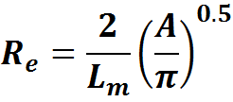
Elongation ratio =
  where
    Re = elongation ratio
    A = area of the watershed (km²);
    L_{m} = watershed length
This indicated that if Elongation ratio of a watershed is comparatively higher it is less elongated and will comparatively attain hydrograph peak quicker than more elongated one
And thus increase its runoff potential in the event of stormy rainfall.

Slide 13
Shape index Sw = Lm²/A
  where
    Lm = Watershed length;
    A = Area of watershed
Shape of a watershed essentially affects the water and sediment yield from the drainage basin.
Which one has higher runoff potential?
  A watershed with Shape index of 3.94
  OR
  A watershed with a shape index of 7.14
  AND WHY?

Slide 14
Compactness coefficient Cc = Pc/Pu
  where
    Pc = perimeter of watershed;
    Pu = perimeter of circle of watershed area
Compactness coefficient expresses the relationship of a basin with that of a circular basin having the same area.
Circular basin yields the shortest time of concentration before peak flow occurs in the basin.
If Cc = 1, then the basin completely behaves as a circular basin.
Cc > 1 indicates that the basin has more deviation from the circular nature and will have the longest time of concentration before attaining peak flow
  Resulted in delayed runoff potential.

Slide 15
Drainage texture Rt = Nu/P
  where
    Rt = drainage texture;
    Nu = total no. of streams of all orders;
    P = perimeter (km)
If there is a very high number of streams in a watershed there is also high drainage texture =very fine texture
Since very coarse texture watersheds have large basin lag time followed by coarse, fine, and very fine texture classes, it clearly indicates that very fine textured watershed has shorter basin response time as compared to the very coarse watershed, making its downstream have high runoff potential and vulnerable to flooding.

Slide 16
Slope
  Watershed hydrology is strongly influenced by the hill slope processes
  A watershed with a higher proportion in terms of area can produce more runoff potential than a watershed with the minimum area that falls in the lower slope ranges

Slide 17
Parameter | Area proportion in watershed A | Area proportion in watershed B | Compare for runoff
Slope (% area)
Level (0⁰–0.3⁰) | 0.04 | 0.1 | More in A
Nearly level (0.3⁰–1.1⁰) | 0.72 | 1.73
Very gentle slope (1.1⁰–3.0⁰) | 4.19 | 10.13
Gentle slope (3.0⁰–5.0⁰) | 5.58 | 13.41
Moderate slope (5.0⁰–8.5⁰) | 8.65 | 19.22
Strong slope (8.5⁰–16.5⁰) | 13.98 | 20.69 | More in B
Very strong slope (16.5⁰–24⁰) | 14.41 | 11.98 | More in A
Extreme slope (24⁰–35⁰) | 24.60 | 13.66
Steep slope (35⁰–45⁰) | 18.42 | 6.92
Very steep slope (45⁰–90⁰) | 9.42 | 2.17

Slide 18
Land cover
  The type and distribution of land cover has profound impact on the surface hydrology and other land surface processes
  The differences in the extent and type of LC shall considerably affect runoff potential patterns and magnitude in different watersheds, though the total flow (base flow + surface flow) may not be the same because:
    Experimental studies specifically designed to evaluate the influence of subsurface topography on baseflow are needed.
    Comprehensive empirical comparisons that link soil hydrology and baseflows under land-use gradients that incorporate more detail than the broad categories of forest, agriculture, and urban land use.
  Read on articles that focus on such conditions

Slide 19
Land cover parameters for watershed runoff potential comparisons
Parameter | Area proportion in watershed A | Area proportion in watershed B | Comparative runoff potential
Land cover (% area) |  |  | A | B
Agriculture | 16.35 | 35.83 | higher | lower
Impervious surface | 19.97 | 5.55 | higher | lower
Forest | 34.04 | 20.85 | lower | higher
Wasteland | 4.22 | 1.68 | higher | lower
Pasture | 2.13 | 1.08 | lower | higher
Snow | 8.40 | 15.89 | lower | higher

Slide 20
Different land-cover types can substantially affect water yields; these effects can be important in upland catchments/watersheds, where the potential for water production is usually greatest
Based from New Zealand’s history of paired catchment studies, which are now being integrated into global syntheses of the effects of vegetation change on water yield
These syntheses have confirmed that different land covers usually deliver different water yields, seasonally and annually, as well as in times of high and low flows.

Slide 21
Influences of changing land use and vegetation cover on water yield are particularly important in the upper source areas, where environmental changes may result in reduced downstream flows and groundwater availability.
Attention should be given for indigenous species (specially grasses and alpine vegetations)
  Research findings highlighted that the importance of the indigenous tall tussock grassland (at most, lightly grazed) in maximizing water yield in comparison with a range of other vegetation types in New Zealand .

Slide 22
V-notch weirs recording water yield from each of the adjacent paired catchments at 460–670 m, New Zealand.
Pinus radiata was planted in 1982 over 67% of the 310-ha catchment
while the adjoining lightly grazed reference 218-ha catchment remains dominated by narrow-leaved snow tussock (Chionochloa rigida) grassland.
The annual water yield difference (pine–snow tussock) between the two catchments up to 2004 is shown at the base.

Slide 23
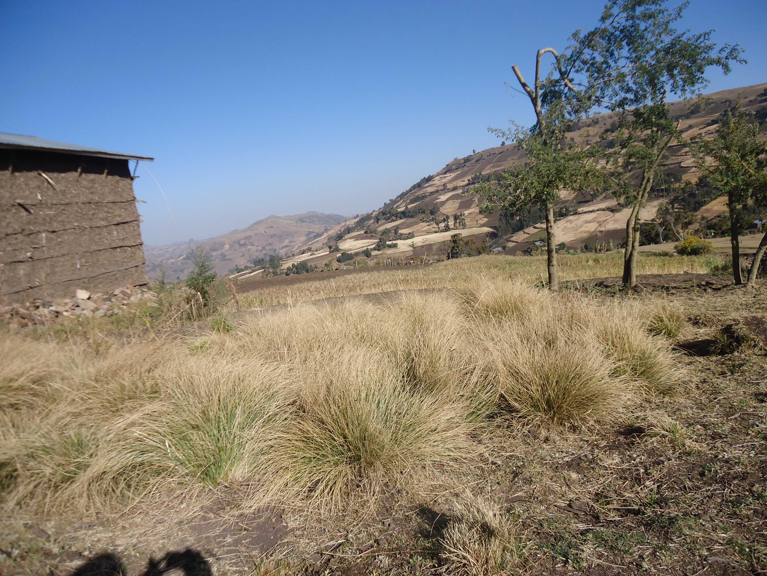
Amost Similar grass in choke mount

Slide 24
On the other hand Invading alien woody species have a potential to reduce water yield
Promotional material for the South African Working for Water program. This poster emphasizes the degree to which invading alien woody species reduce water yield (from a 1200 mm annual rainfall) as the invasive trees gain increasing dominance in the system (percentages indicate water yields).

Slide 25
The land use and topography combined effect
  The effect of land use type on streamflow generation has been widely reported around the world
  Land use types have significant impact on hydrological processes, such as evapotranspiration, surface runoff, and consequently, streamflow generation
  Land use may significantly influence the temporal variations of streamflow in a watershed
  For example, forest may produce higher or lower stream water yield than pasture or other agricultural lands because forest region has higher precipitation interception, evaporation, transpiration and higher soil infiltration
  Hence, the impact of land use on streamflow generation might vary from region to region, especially when it is coupled with other factors in a watershed

Slide 26
Most commonly, impacts of land use or topography on streamflow generation can be examined separately from paired-watersheds with different land use and similar topography or different topography but similar land use
However, watersheds might be characterized by contrasting land use and topography,
For example, agriculture is usually developed in flat regions and hence forest in flat region could be converted to agriculture around the world while forest exists in steep regions and usually are critical zones for soil erosion and could be protected by governmental laws.

Slide 27
The agriculture-forest dominated Shibetsu River Watershed (SRW, Eastern Hokkaido, Japan) has coupled flat topography/agriculture and coupled steep topography/forest characteristics and show an example for such conditions
Land use and topographic characteristics for three headwater watersheds, i.e., agricultural
watershed (AW), mixed agriculture-forested watershed (AFW), forested watershed (FW), and the
whole Shibetsu River Watershed (SRW).

Slide 28
Watershed | Area (km2) | Land Use (%) |  | Percentage of Areas with Slopes |  | Relief Ratio
 |  | Agriculture | Forest | 0-10% | >10%
AW | 14.3 | 73.5 | 23.5 | 97.6 | 2.4 | 0.0146
FW | 70.0 | 14.5 | 84.4 | 37.2 | 62.8 | 0.0553
AFW | 36.6 | 58.9 | 37.1 | 79.7 | 20.3 | 0.0362
SRW | 672.0 | 40.8 | 53.7 | 70.0 | 30.0 | 0.0173

