Slide 1
        Introduction to geomorphology
        Basin Order and Channel Order

Slide 2
1. Introduction
What is Geomorphology?
  Geomorphology is the branch of geology dealing with the origin, evolution and configuration of the natural features of the earth's surface.
    It originates from the Greek words geo, which means earth, and morphology, which refers to the scientific study of form and structure.
    Geology is the science of rocks, mountains and valleys which is the basic foundations of watersheds.
    Most geologic development is controlled by processes taking place deep within the earth.

Slide 3
Geomorphology is concerned with the external forces of nature that change rocks, mountains and valleys after they are formed on the surface of the earth.
These forces include weathering which is the impact of climate and life on the earth’s crust and can be divided into two types- physical and chemical.
Physical weathering is the mechanical separation of rocks into smaller particles that are then transported, deposited and incorporated into soils and sediments.
Water can play a critical role in physical weathering as it freezes and thaws within the parent material
Wind and water erosion can also play an important role in physical weathering.
Finally, life itself plays an important role in weathering.

Slide 4
Chemical weathering occurs where the minerals in rocks interact with water to form new materials, at the expense of the original structure of the rocks.
Water brings the minerals in rocks into contact with a variety of different elements that can break them down.
Furthermore, organisms such as bacteria, fungi and plants will speed the chemical weathering through their own metabolic processes.
Physical and chemical weathering often work together to reduce parent material to smaller and smaller particles.
For example, as physical weathering takes place and reduces rocks to smaller particles, the surface area exposed to chemical weathering agents and water is greatly increased.

Slide 5
Fluvial Geomorphology
  Water is one of the most important agents for both chemical and physical weathering.
  Water has the ability to decompose rock, move a soil particle, or alter the shape of an entire hillside.
  These geomorphic processes are very important to watersheds by shaping the landforms in which water will be transported.
  From a watershed perspective, the three critical processes are:
    weathering of the earth’s crust to form soil particles;
    erosion by water of those soils to yield waterborne sediment; and,
    transportation and deposition of that sediment within and through the watershed.

Slide 6
Geomorphology that relates to water movement in the landscape is called fluvial geomorphology.
Two of the main fluvial processes are overland flow and stream (channel) flow.
  Overland flow consists of water from precipitation or snowmelt that does not infiltrate into the soil and moves over the surface of the landscape and it transports eroded particles to streams in the water column
  Stream flow is the water running within a drainage feature such as a stream channel which can then transport the sediment load downstream
  The processes of erosion, transport and deposition of sediment can lead to:
    Degradation which is lowering the elevation of the land surface, or
    Aggradation which is increasing the elevation of the land surface

Slide 7
These processes result in two main types of fluvial landforms that are shaped by water.
  Erosional fluvial landforms are shaped by the progressive removal of rock or material (degradation) that may include ravines or mountain peaks.
  Depositional fluvial landforms are built from transported and deposited material that include alluvial fans, deltas, or floodplains.
All these are important watershed characteristics that can be used for structural zone for different purposes like management and hydrologic purposes

Slide 8
The Nile River delta

Slide 10
Geomorphologic Characteristics
  It is quantitative land form analysis: Flowing water & associated mass gravity movements acting over long periods of time which is responsible for development of surface geometry
    Geomorphologic characteristics of watershed:
      Are used to systematic description of watershed
      Can tell us geometry and its stream channel system
      Used to measure the linear aspects of drainage network, aerial aspects of drainage basin and relief aspects of channel network

Slide 11
Linear aspects of drainage networks
  Stream/channel Order
    Stream order is the degree of stream branching of streams within a Watershed.
    First order stream are defined as those channels that have no tributaries.
      In this case, the flow is depend entirely on surface overland flow to them.
    The junction of 2 first order stream forms a 2nd order (2 or more first order)
      Please note that when a low order stream segment joins to the higher order stream segment, then the order of the stream remained as it is
    Second order channel receives flow from the two first order channel that form it and from overland flow from the ground surface and might receive flow from another first order channel that flow directly in to it.

Slide 12
Third order channel is formed by the junction of two second order channels.
  It receives flow not only from the two second order channels that form it, but also direct overland flow and possibly from first order channels that flow directly in to it and possibly from other second order stream that might join it.
In general, n^{th} order stream is formed by two or more stream of order (n-1)^{th} & of lower order
In a watershed, the principal order is the order of the principal channel
Numerical ordering begins with the tributaries at the streams headwaters being assigned the value one and such method is the Strahler method which is the most commonly used
The main assumption behind this ordering system is that when two similar order streams join to create the next higher order stream, mean discharge capacity is doubled.

Slide 13
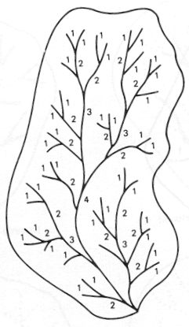
Stream/channel orders

Slide 14
In the Shreve method (Figure bellow) the stream order of the two streams contributing to a junction are added and provide the rank number of the stream below the junction.
The rank of a particular stream represents the total number of the first-order streams that have contributed to it.
It assumed that the contributing area of each first order stream is approximately the same and that discharge is neither lost nor gained from any source other than the tributaries (which is not always true),
then the Shreve number is roughly proportional to the magnitude of discharge in the stream to which it refers.

Slide 15
Strahler’s stream order has been applied to many river systems and it has been proved statistically to be related to a number of drainage-basin morphometry elements.

Slide 16
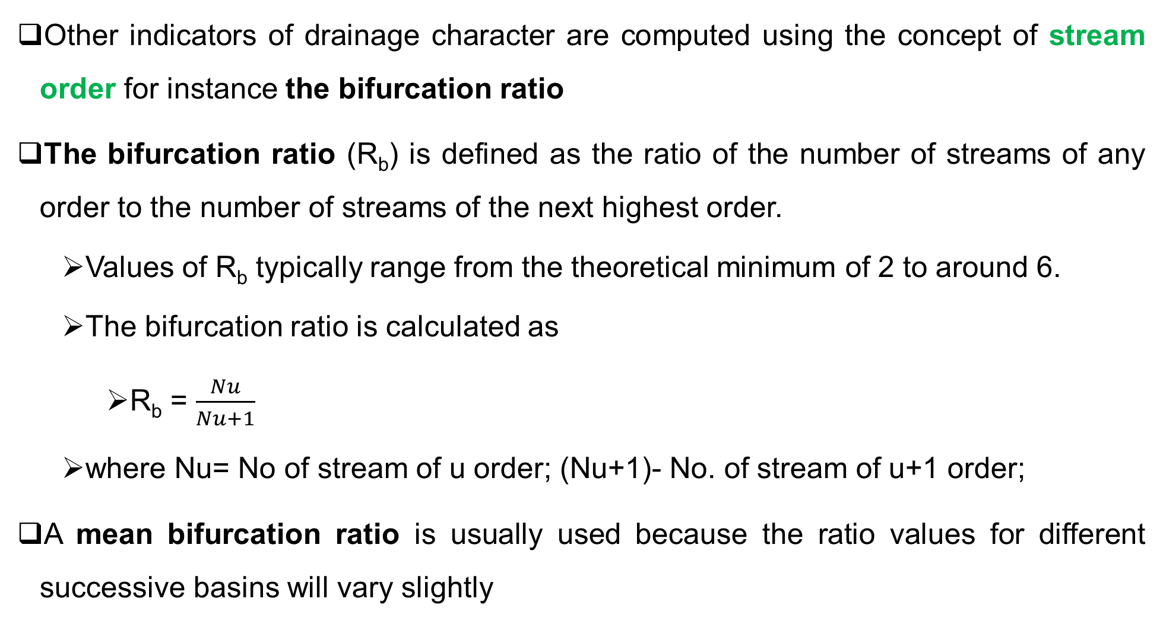
Other indicators of drainage character are computed using the concept of stream order for instance the bifurcation ratio
The bifurcation ratio (R_{b}) is defined as the ratio of the number of streams of any order to the number of streams of the next highest order.
  Values of R_{b} typically range from the theoretical minimum of 2 to around 6.
  The bifurcation ratio is calculated as
    R_{b} = $\frac{Nu}{Nu+1}$
  where Nu= No of stream of u order; (Nu+1)- No. of stream of u+1 order;
A mean bifurcation ratio is usually used because the ratio values for different successive basins will vary slightly

Slide 17
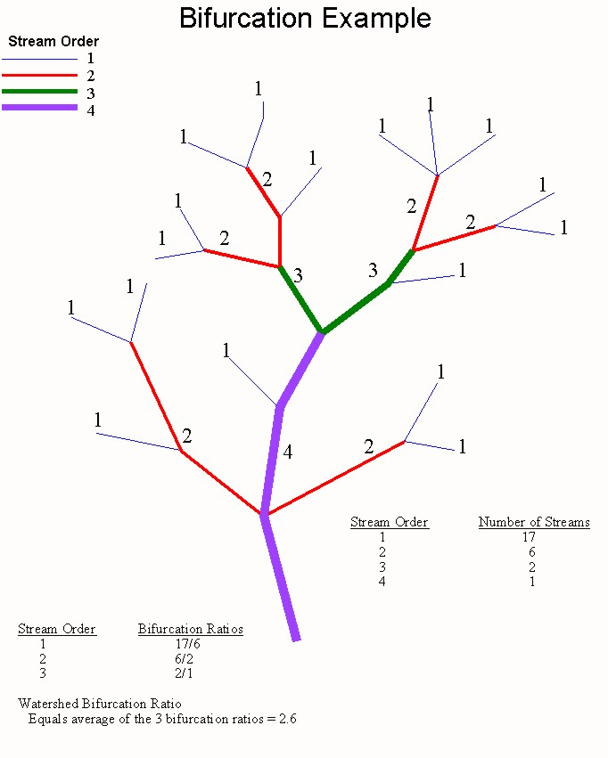

Slide 18
Determine the number of each stream order and calculate the bifurcation rate of the watershed shown in Figure bellow
Calculate the average bifurcation ratio the watershed with the following information.
Order | 1 | 2 | 3 | 4 | 5
Number of streams | 140 | 41 | 15 | 6 | 1

Slide 19
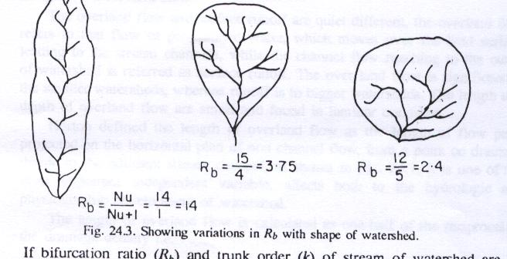
Bifurcation ratio indicates the shape of basin, branching pattern, surface erodibility.
Higher values show an elongated basin where there are narrow, alternating outcrops of soft and resistant strata whereas lesser represents circular basin with lesser structural disturbances with stable drainage
Watersheds with different shapes showing variation in Rb

Slide 20
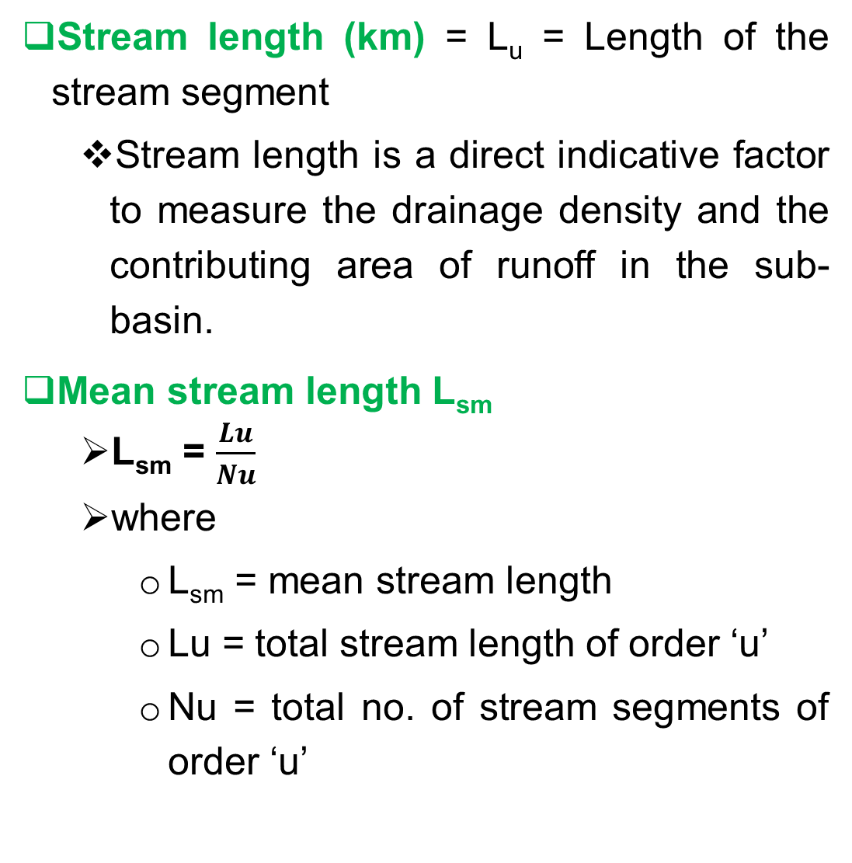
Stream length (km) = L_{u} = Length of the stream segment
  Stream length is a direct indicative factor to measure the drainage density and the contributing area of runoff in the sub-basin.
Mean stream length L_{sm}
  L_{sm} = $\frac{Lu}{Nu}$
  where
    L_{sm} = mean stream length
    Lu = total stream length of order ‘u’
    Nu = total no. of stream segments of order ‘u’
Mean stream length is a characteristic of the drainage network components and its associated sub-basin surface
The mean stream length is calculated by dividing the total length of the stream in an order by the number of stream segments of the same order

Slide 21
Stream length ratio R_{L}
  The stream length ratio can be calculated by dividing the mean length of the stream segment of the given order by the next lower order
  R_{L} = L_{u}/L_{u-1}
  Where
    R_{L} = stream length ratio
    L_{u} = total stream length of order ‘u’
    L_{u-1} = total stream length of its next lower order

Slide 22
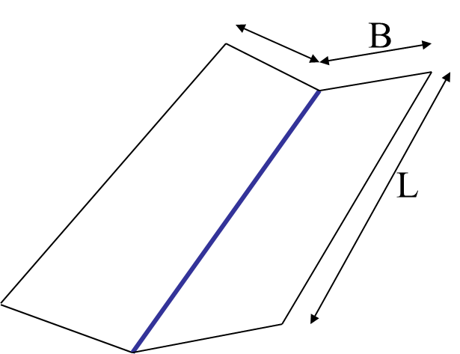
Length of overland flow (L_{g} )
    L_{g} = 1/D_{d}*2
Where,
  L_{g} = length of overland flow
  D_{d} = drainage density
Length of overland flow is one of the most important independent variables affecting hydrologic development of drainage basins
The surface runoff flows from the terrain into a defined stream through the downslope.
It is defined as the length of flow path projected to the horizontal of the non channel flow from a point on the adjacent stream channel
D_{d} = L/A
Hillslope length ≈ 1/2D_{d}
Hillslope length = B
A = 2B L
D_{d} = L/A = 1/2B
∴ B= 1/2D_{d}

Slide 23
Aerial aspects of drainage basin
Drainage Area (A):
  the single most important watershed characteristic (for hydrologic design) as it reflects the volume of water that can be generated from rainfall
  the volume of water available for runoff may be assumed as product of rainfall depth & drainage area.
    drainage area input to all models.
  Overland flow, more in small watersheds as there is less network of drainage systems while in large watersheds channel flow is dominant
  land use affects flow in small watersheds while in larger watersheds it is counteracted by channel predominance
  Intense rainfall, more responsive in small watersheds

Slide 24
Watershed/Basin Length (L_{b}):
  The basin length L_{b} is basically defined as the longest dimension of a basin parallel to its principal drainage channel, which is usually considered as the longest drainage channel in the watershed.
  Basin length is defined in more than one way:
    the greatest straight-line distance between any two points on the perimeter,
    the greatest distance between the outlet and any point on the perimeter, or
    the length of the main stream from its source (projected to the perimeter) to the outlet.
      important in hydrologic computations; for example, used in computing time parameter -measure of travel time of water through a watershed

Slide 25
Watershed length

Slide 26
Basin Perimeter (P)
  Basin perimeter is the outer boundary of the watershed that enclosed its area.
  It can be measured along the divides between watershed and may be used as an indicator of watershed size, shape and drainage density

Slide 27
Drainage Density (D_{d})
  Drainage density is a measure of how frequently streams occur on the land surface.
    It is the total length of stream within a watershed divided by the area
  It reflects a balance between erosive forces and the resistance of the ground
  surface, and is therefore related closely to climate, lithology, and vegetation
  Drainage density is useful for analysis of terrain, rocks, relief, soils, groundwater, erodibility and discharge of water and sediment
  A high drainage density reflects highly dissected basins, and relatively rapid response to a rainfall input, while low drainage density reflects a poorly drained basin with low hydraulic response.

Slide 28
Drainage density (km/km²) D_{d}
  D_{d}= Lu/A
  Where
    D_{d} = drainage density
    Lu = total stream length of order u
    A = area of the basin (km²)

Slide 30
Drainage Texture (D_{t})
  Drainage texture is one of the important concept of geomorphology which means that the relative spacing of drainage lines.
    It is total number of stream segments of all orders per perimeter of that area
  Drainage texture is depend on the underlying lithology, infiltration capacity and relief aspect of the terrain.
    D_{𝑡} = 𝑁𝑢/𝑃
      Where, D_{𝑡} = Drainage texture;
          𝑁𝑢 = Total no. of streams of all orders;
          𝑃 = Perimeter (km)

Slide 31
Stream Frequency (F_{s})
  The stream frequency (or channel frequency) F_{s} as the number of stream segments per unit area.
    F_{s}=Nu/A
      Where, F_{s}=Stream frequency;
          Nu=Total no. of streams of all orders;
          A=Area of the basin (km²)
  Stream frequency indicates nature of subsurface materials, relief, infiltration rate, permeability, stream population, vegetative cover and have relationship with drainage density
  Sub-watersheds with dense forest may show less frequency of streams in drainage network whereas agricultural lands may show higher frequency

Slide 32
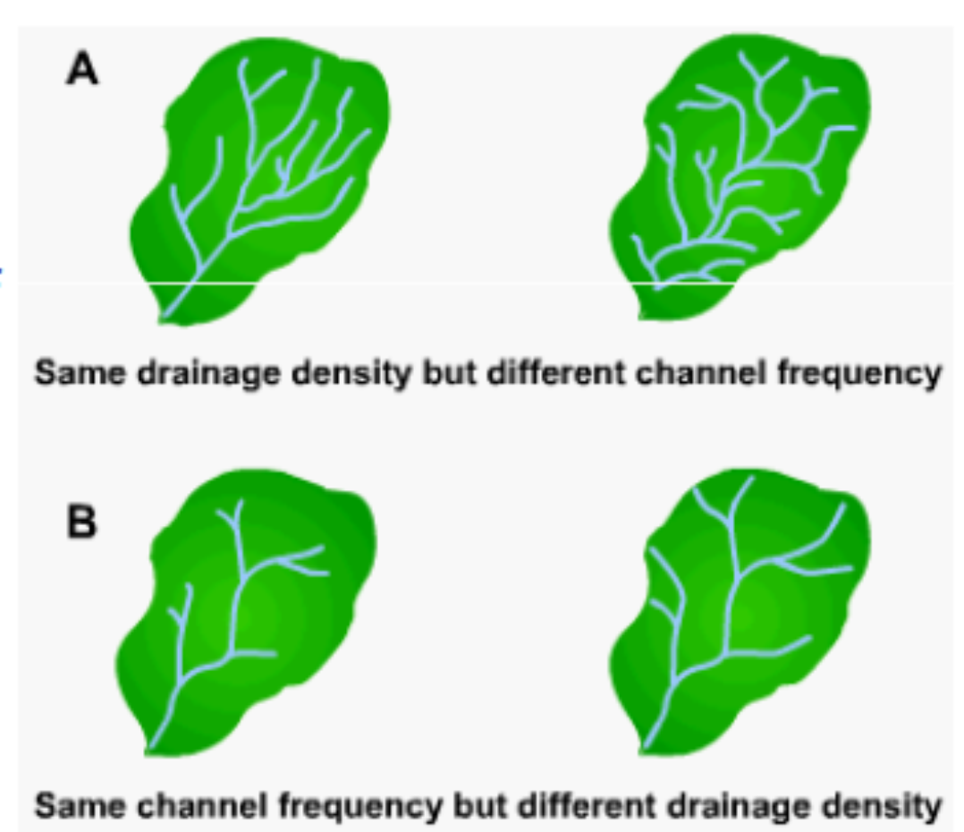

Slide 33
Basin Shape
  Basin shape reflects the influence of such factors as initial slope, inequalities in rock hardness, structural controls, and recent geomorphic and geologic history of the drainage basin.
  Basin shapes and their patterns are quite useful in the interpretation of geomorphic features, and their study represents one of the more practical approaches to the understanding of the structural and lithologic controls on landform evolution due to drainage patterns being influenced by many factors.
  Numerous symmetrical and irregular forms of drainage areas are encountered in practice.

Slide 34
A frequently occurring shape is a pear shape in plain view, as shown in Figure below
Typical watershed shape.
Cross section along x – x₁ approximating a U-shaped valley.
Cross section along x – x₁ approximating a V-shaped valley.
Transverse section along y – y₁.

Slide 35
Depending upon the interaction of climate and geologic processes, the lateral section, the cross section along x – x₁ of a watershed, may approximate a U-shaped valley (Figure b) or a V-shaped one (Figure c).
Based on the transverse section, the cross section along y – y₁ (Figure d), the basin slope increases toward the upstream area of the watershed.

Slide 36
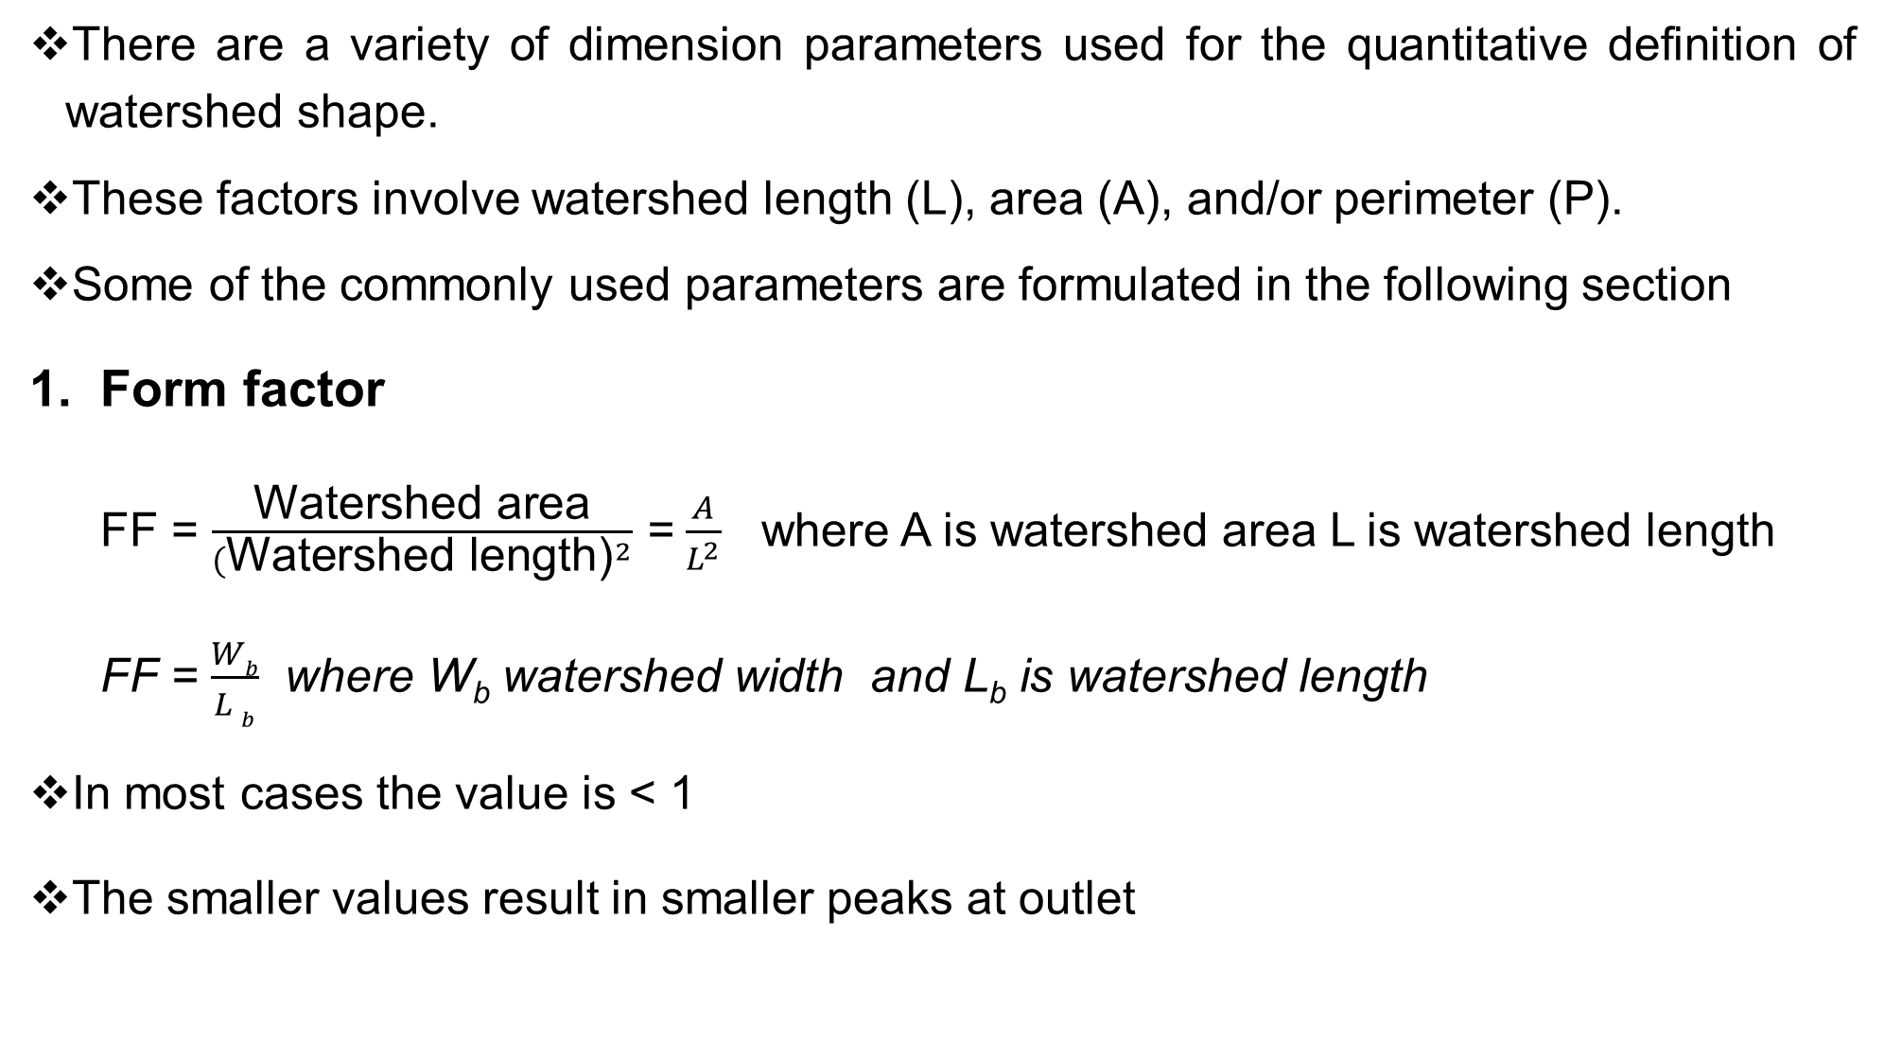
There are a variety of dimension parameters used for the quantitative definition of watershed shape.
These factors involve watershed length (L), area (A), and/or perimeter (P).
Some of the commonly used parameters are formulated in the following section
Form factor
  FF = $\frac{\text{Watershed} \text{area}}{{(\text{Watershed} \text{length}\text{)}}^{2}}$ = $\frac{A}{L^{2}}$ where A is watershed area L is watershed length
  FF = $\frac{Wb}{L b}$ where W_{b} watershed width and L_{b} is watershed length
In most cases the value is < 1
The smaller values result in smaller peaks at outlet

Slide 37
The form factor indicates shape and length of basin.
The elongated watershed estimates less value and nearly circular watersheds show higher values
Example 1 Calculate the form factors of the schematic watersheds shown in Figures below 1. FF= 0.288; 3. FF = 0.577

Slide 38
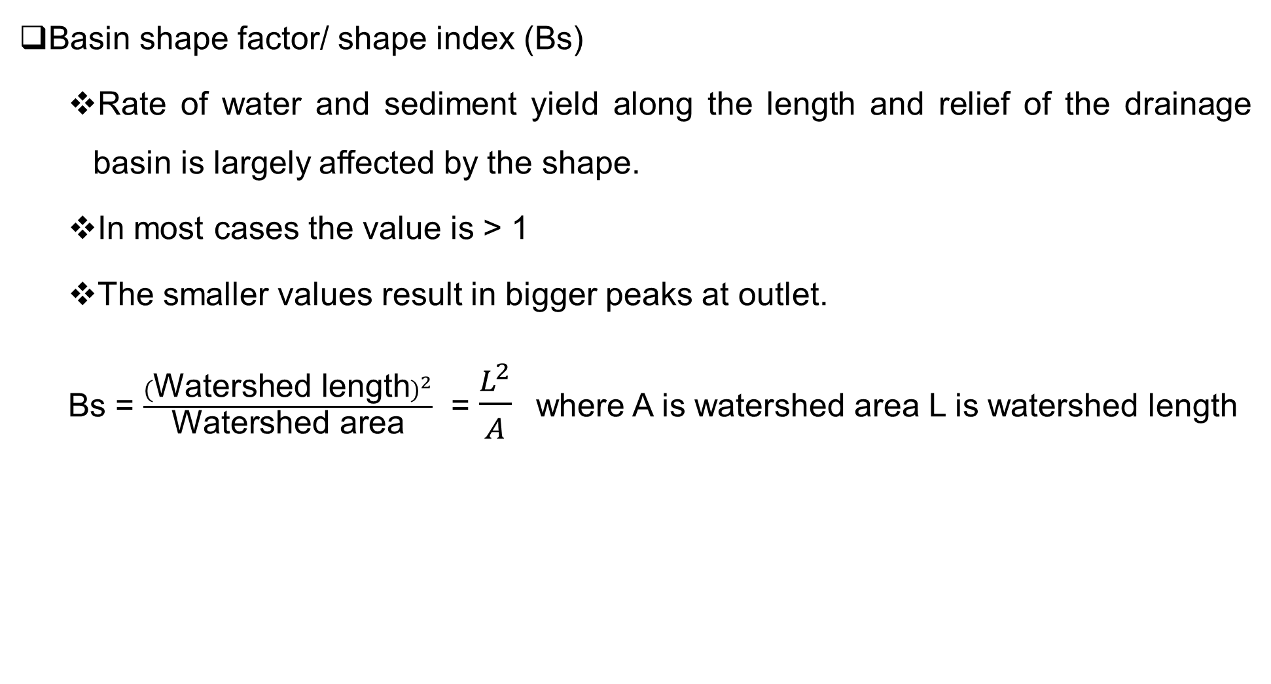
Basin shape factor/ shape index (Bs)
  Rate of water and sediment yield along the length and relief of the drainage basin is largely affected by the shape.
  In most cases the value is > 1
  The smaller values result in bigger peaks at outlet.
  Bs = $\frac{{(\text{Watershed} \text{length})}^{2}}{\text{Watershed} \text{area}}$ = $\frac{L^{2}}{A}$ where A is watershed area L is watershed length

Slide 39
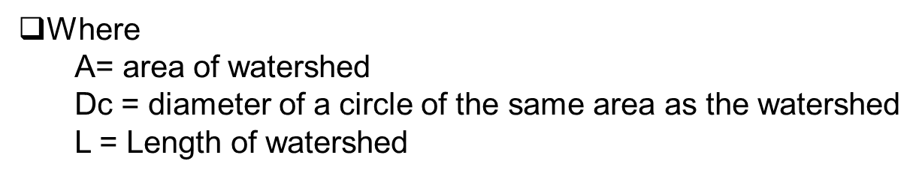
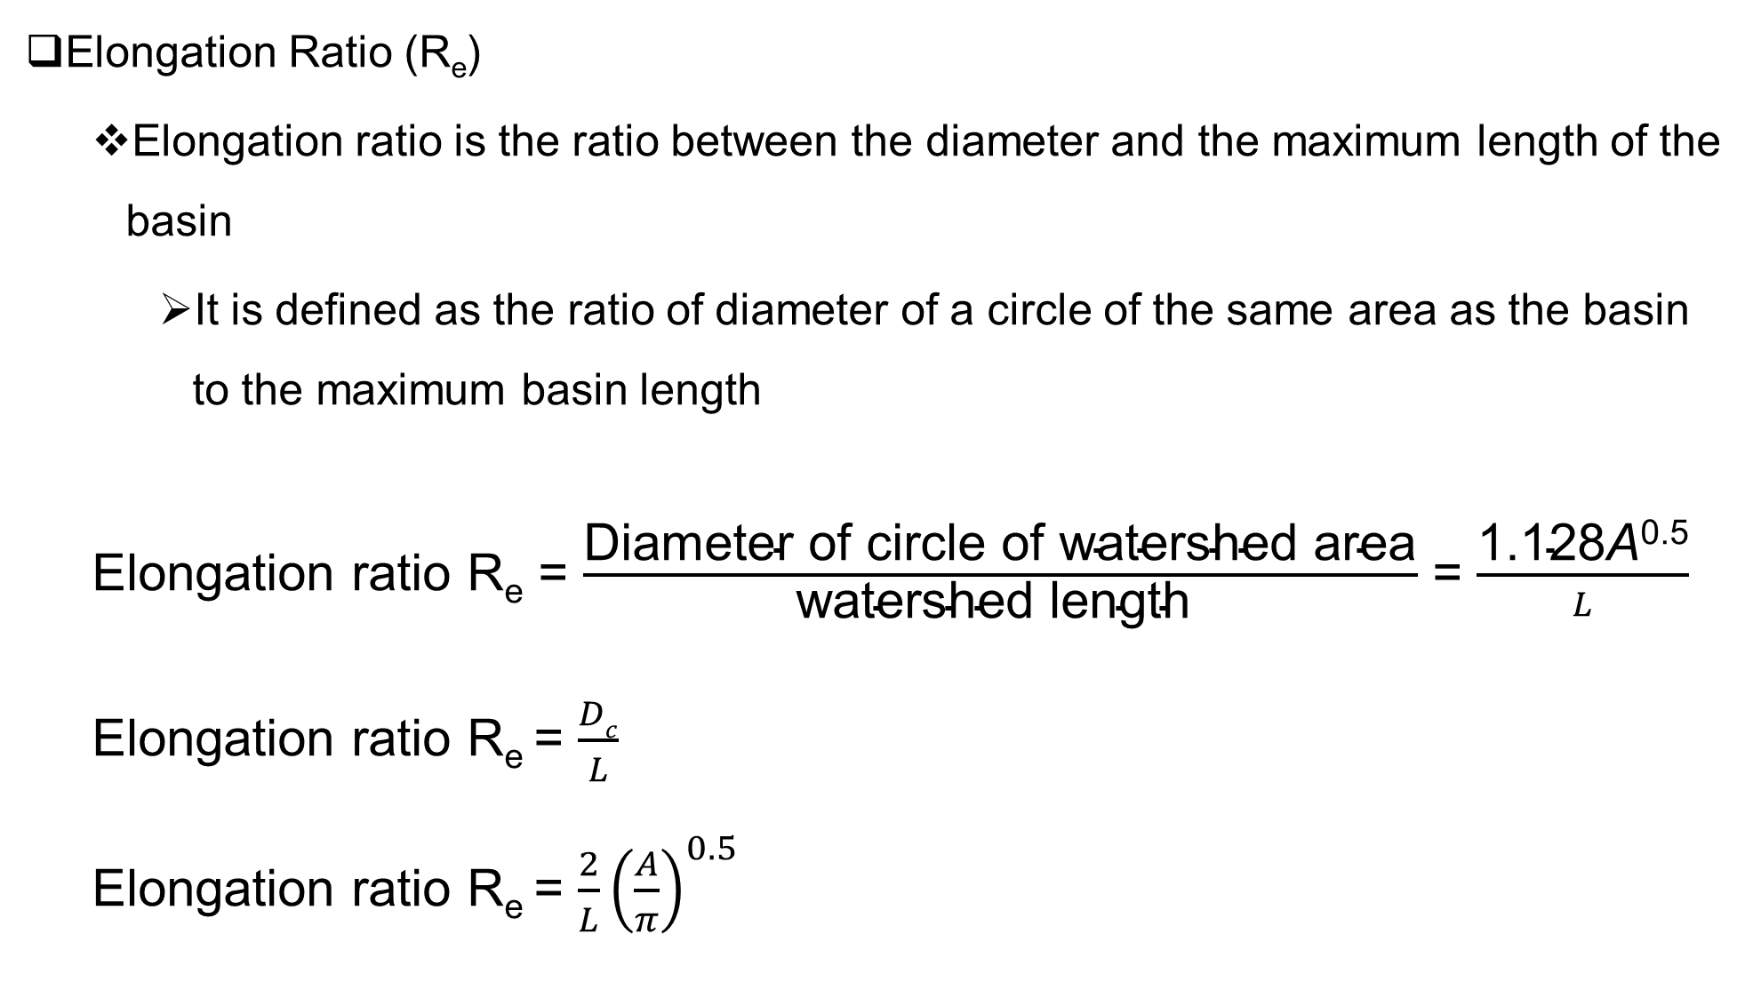
Elongation Ratio (R_{e})
  Elongation ratio is the ratio between the diameter and the maximum length of the basin
    It is defined as the ratio of diameter of a circle of the same area as the basin to the maximum basin length
  Elongation ratio R_{e} = $\frac{\text{Diameter} \text{of} \text{circle} \text{of} \text{watershed} \text{area}}{\text{watershed} \text{length} }$ = $\frac{\text{1.128}\text{A}\text{0.5}}{L}$
  Elongation ratio R_{e} = $\frac{Dc}{L}$
  Elongation ratio R_{e} = $\frac{2}{L}{\left(\frac{A}{π}\right)}^{0.5}$

Slide 40
Elongation ratio indicates shape, hydrology, slope, infiltration and runoff
Higher elongation ratios show more infiltration capacity of land surface and less runoff
Strahler states that this ratio runs b/n 0.6 and 1.0 (value is ≤1) over a wide variety of climatic and geologic types.
The varying slopes of watershed can be classified with the help of the index of elongation ratio, i.e.
  circular (0.9-1.0)
  oval (0.8-0.9)
  less elongated (0.7-0.8)
  elongated (0.5-0.7) and
  more elongated (< 0.5).
Therefore, the smaller values result in smaller peaks at outlet.

Slide 41
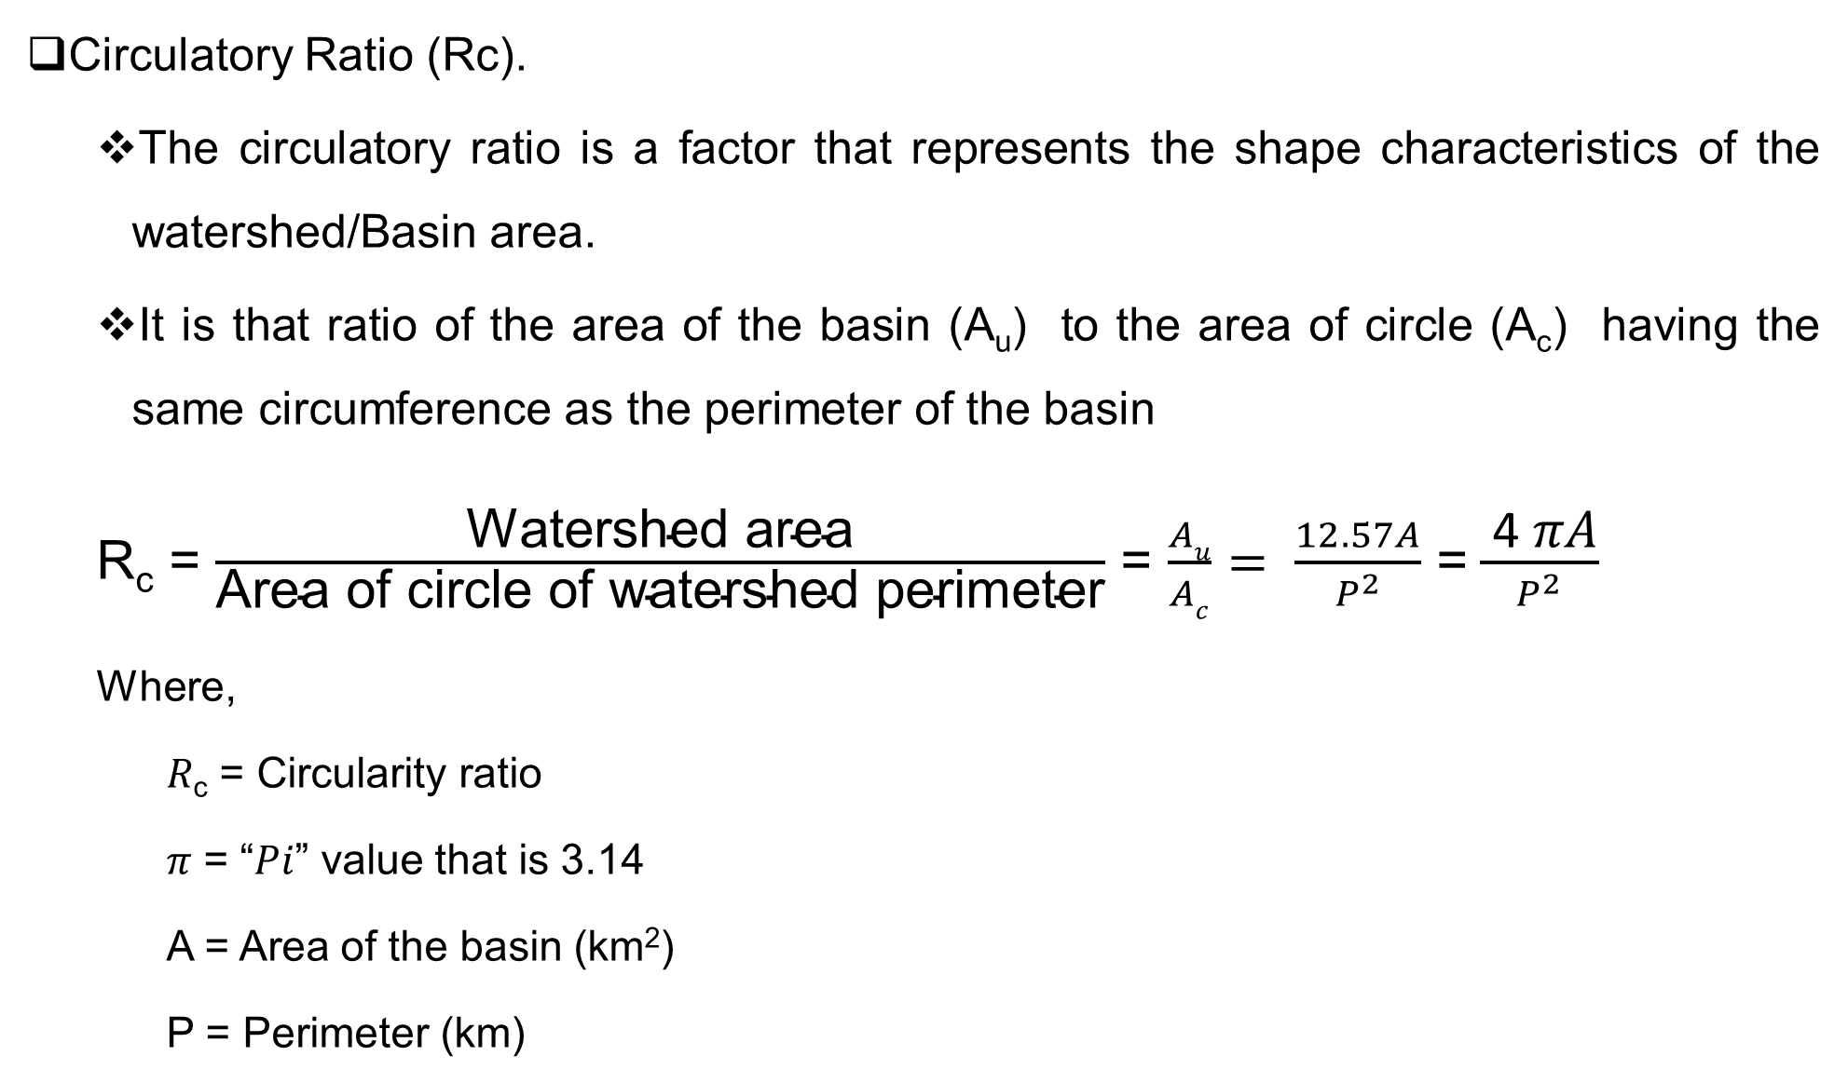
Circulatory Ratio (Rc).
  The circulatory ratio is a factor that represents the shape characteristics of the watershed/Basin area.
  It is that ratio of the area of the basin (A_{u}) to the area of circle (A_{c}) having the same circumference as the perimeter of the basin
  R_{c} = $\frac{\text{Watershed} \text{area}}{\text{Area} \text{of} \text{circle} \text{of} \text{watershed} \text{perimeter}}$ = $\frac{Au}{Ac}= \frac{12.57A}{P^{2}}$ =$\frac{ \text{4 }\text{π}\text{A}}{P^{2}}$
  Where,
    𝑅_{c} = Circularity ratio
    𝜋 = “𝑃𝑖” value that is 3.14
    A = Area of the basin (km²)
    P = Perimeter (km)

Slide 42
In most cases the value of R_{c} is ≤1
The smaller values result in smaller peaks at outlet
Hence, R_{c} can have a significant influence on the hydrological response of the watersheds as basin shape, and the arrangement of stream segments combine to influence the size and shape of flood peaks

Slide 43
Example
  Calculate the circularity ratio of a watershed with an area of 30 km² and a perimeter of 20 km.

Slide 44
Compactness Coefficient (C_{c}).
  Compactness coefficient expresses the relationship of a basin with that of a circular basin having the same area.
  The Compactness coefficient of a watershed directly corresponds to the infiltration capacity of the watershed.
  Compactness coefficient indicates erosion risk and relationship of hydrology of the basin which dependent mainly on slope in the watersheds
  compactness coefficient of a watershed is the ratio of perimeter of watershed to circumference of circular area, which equals the area of the watershed.

Slide 45
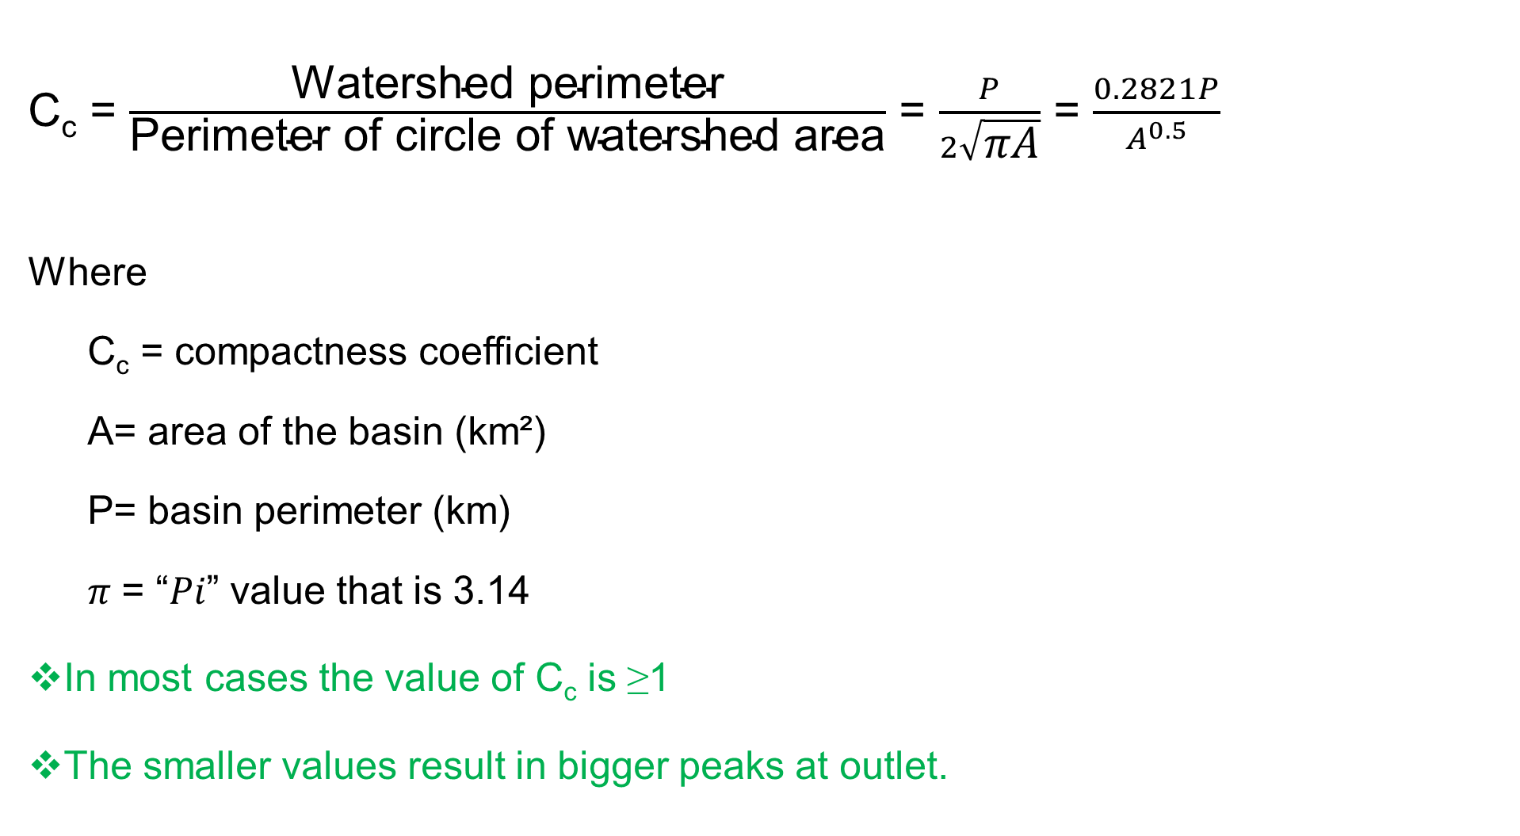
C_{c} = $\frac{\text{Watershed} \text{perimeter}}{\text{Perimeter} \text{of} \text{circle} \text{of} \text{watershed} \text{area}}$ = $\frac{P}{2\sqrt{\text{π}\text{A}}}$ = $\frac{0.2821P}{A^{0.5}}$
Where
  C_{c} = compactness coefficient
  A= area of the basin (km²)
  P= basin perimeter (km)
  𝜋 = “𝑃𝑖” value that is 3.14
In most cases the value of C_{c} is ≥1
The smaller values result in bigger peaks at outlet.

Slide 46
The watershed shape may influence the hydrograph shape, especially for small watersheds.
For example, if a watershed is long and narrow, then it will take longer for water to travel from watershed extremities to the outlet and the resulting runoff hydrograph will be flatter, as shown in Figure (a) below.
For more compact watersheds, the runoff hydrograph is expected to be sharper with a greater peak and shorter duration, (Figure b) because it is more likely to be covered by the area of maximum rainfall intensity of local storms.
For a watershed that is partly long and narrow, and partly compact, the runoff hydrograph is expected to be a complex composite of hydrographs, as shown in Figure c.
However, other factors have a greater effect on the hydrograph shape than does the basin shape.

Slide 48
Slope and relief aspects of drainage network
Watershed slope (S):
  It determines the flood magnitude and speed:
    Naturally, the steeper the slope of a field, the greater the amount of runoff.
    Soil erosion by water also increases as the slope length increases due to the greater accumulation of runoff
  the average slope of the watershed can be determined from the topographic map of the watershed by using different formula
    For very small watershed, the average slope can be taken as the ratio of difference in elevation between the watershed outlet and the most distant ridge (Δ H) and approximate average length of the watershed (L)

Slide 49
Watershed average slope
length of the average elevation line between two subsequent contour lines
d_{i}= distance between two subsequent contour lines

Slide 50
Watershed average slope
length of the average elevation line between two subsequent contour lines
d_{i}= distance between two subsequent contour lines

Slide 51
Slope analysis is helpful to identify the potential sites for watershed management.
Slope is significantly affecting the morphometric aspects and drainage characteristics in most watersheds.
Slope plays key role in formation of amount of runoff, rate of infiltration, drainage density, intensity of flood, quantity of erosion and soil depth, etc.

Slide 52
Relief
  is defined as the elevation difference between the reference points located in the drainage basin
  The elevation difference between the highest and lowest points on the valley floor of a drainage basin is its total relief
  Maximum relief is the elevation difference between the highest point and the lowest points
  Maximum basin relief is the elevation difference between the basin outlet and the highest point located on the perimeter of the basin
      Rh is the relief ratio
      H is the relief (m)
      HL is the horizontal distance (m)

Slide 53
There is a strong correlation between hydrological characteristics and the relief ratio of a drainage basin.
It measures the overall steepness of a drainage basin and is an indicator of intensity of erosion processes operating on the slopes of the basin.
The areas with high relief and steep slope are characterized by high value of relief ratios.
Low value of relief ratios are mainly due to the resistant basement rocks of the basin and low degree of slope.
The Rh normally increases with decreasing drainage area and size of a given drainage basin

Slide 54
Ruggedness Number
  The ruggedness number is the product of basin relief and drainage density.
  It is usefully relationship with steepness and length to understand the relief and drainage density
  Ruggedness values indicate nature of relief, drainage density, slope, soil erosion, topography, lithology and discharge through the streams
  Higher value indicates irregular topography, lithological heterogeneity, high drainage density and high soil erosion
  The low ruggedness value of watershed implies that area is less prone to soil erosion and have intrinsic structural complexity in association with relief and drainage density.

Slide 55
Drainage Patterns
When viewed by looking down at Earth’s surface from the air or on maps, the tributaries of various stream systems may form distinct drainage patterns (also called stream patterns).
Two primary factors that influence drainage pattern are bedrock structure and surface topography.
Dendritic: The most common form.
  It develops in regions underlain by homogeneous material (the subsurface geology has a similar resistance to weathering so there is no apparent control over the direction the tributaries take).
  Tributaries join larger streams at acute angle (less than 90 degrees)

Slide 57
Parallel: Forms where there is a pronounced slope to the surface.
  A parallel pattern also develops in regions of parallel, elongate landforms like outcropping resistant rock bands.
  Tributary streams tend to stretch out in a parallel-like fashion following the slope of the surface.
  A parallel pattern sometimes indicates the presence of a major fault that cuts across an area of steeply folded bedrock.

Slide 58
Trellis: drainage is usually evidence of folding where parallel outcrops of erodible rocks form valleys between more resistant ridges
  Short tributary streams enter the main channel at sharp angles as they run down sides of parallel ridges
  Tributaries join the main stream at nearly right angles.

Slide 59
Rectangular: Found in regions that have undergone faulting.
  Streams follow the path of least resistance and thus are concentrated in places were exposed rock is the weakest.
  Movement of the surface due to faulting off-sets the direction of the stream.
  As a result, the tributary streams make shape bends and enter the main stream at large angles.

Slide 60
Radial: Develop around a central elevated point.
  This pattern is common to conically shaped features such as volcanoes.
  The tributary streams extend the headward reaches upslope toward the top of the volcano.

Slide 61
Centripetal: The opposite of the radial as streams flow toward a central depression.
  During wetter portions of the year, these streams feed ephemeral lakes, which evaporate away during dry periods.
  Salt flats are created in these dry lake beds as salt dissolved in the lake water precipitates out of solution and is left behind when the water evaporates away

