Slide 1
National issues of IWM
When started watershed management in Ethiopia?
  The traditional type?
  The modern types?
What types of WM approaches have been implemented in Ethiopia?
What are the opportunities and challenges to implement WM in Ethiopia?
How IWM is important issue for planning of dams and reservoirs in Ethiopia?
How IWM is important issue to secure food in Ethiopia?
How IWM is important issue for climate change adaptation in Ethiopia?
what are others national issues related IWM in Ethiopia?

Slide 2
  The traditional types?
    Gedeo Indigenous Agroforestry System with great combination of natural and cultural civilization is back to the Neolithic period (5000 years).
    more than 69% has been found on very steep slopes
    the landscape carries the highest population density in Africa
    sustained and preserved through traditional administration
    Farmers have been benefited for centuries to self-reliant in food and wood security without losing the environmental services and enhance adaptive capacity of smallholders to climate change

Slide 3
can be a best example for the countries to learn:
  how to harmonize population pressure with sustainable production and conservation.
  how to manage a watershed in rugged landscapes.

Slide 4
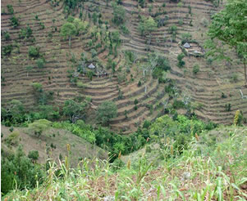
Konso Indigenous Hillside Bench Terraces dated back to more than 400 years
The terraces retain soil from erosion, collect and discharge water for agricultural activities.
It is as a means of the community survival strategies in climate change by managing a watershed in dry and rugged landscapes.
Conservation based Agriculture, Konso 80% of the 2354 km² terraced

Slide 5
The modern types?
  prior to the 1974 revolution, soil degradation did not get policy attention it deserved in Ethiopia
  Following the 1974 famine that killed about a million people, the Government launched a massive SWC program in many parts of the country
  Led by the Soil and Water Conservation Division (SWCD) of the then MoA, relief food aid was used to undertake soil and water conservation and aforestation work, mainly in areas hit by the drought

Slide 6
Afforestation and soil conservation activities were implemented massively in drought affected areas using the available relief food and vegetable oil.
Thus, the idea of ‘Food for Work’ was born and remained to be the single most important driving force for natural resources conservation in Ethiopia.
For such programm implementation ‘watersheds’ were selected.
Up to 1986, food aid used for payment of conservation and related works

Slide 7
Achievements of national soil conservation programme in the ten-year period from 1979 and 1990
Work activity | Unit | Achievement
Soil and stone bunds | Ha | 771,000
Hill side terraces for afforestation | Ha | 233,000
Check dams | Ha | 12,000
Closed area for natural regeneration | Ha | 390,000
Land planted with different species | Ha | 448,000
Total |  | 1,854,000

Slide 8
However, evaluation revealed that most conservation structures were not maintained and subsequently they have disappeared (40% of the terracing was broken after a year, Closed areas returned to their original condition and plantation were misappropriated )
Amongst others, the salient causes includes:
  Wrongly applied techniques,
  Inappropriate technology preferences,
  Insufficient research support,
  Low public awareness, and
  Low technical capabilities of field technicians

Slide 9
The major causes for the wide spread destruction of farmland terraces are identified to be:
  Narrow spaced strips, (difficult for farm operations and reduced land).
  Weeds and rodents became widespread
  Aggravating degradation by grazing pressure due to large closure and plantation
  water logging due to level terraces in high rainfall areas.
  Technical problems encountered in the design and lay out of structures
  Willingness of the beneficiaries has not been considered
  Maintenance could not be done without food for work
  Inability for close supervision to the campaign based implementation.

Slide 10
The watershed approach was strictly soil erosion control and ultimately rehabilitation of degraded lands.
Top-down planning approach was pursued that gave local people little opportunity for discussion and participation
The role of local people was limited to provision of labor for the payment they get
This made the local people see the initiative as additional burden and reduced farmer’s involvement in maintenance and protection of structures.

Slide 11
Focused on physical conservation measures.
  Biological and agronomic conservation practices have been overlooked.
  The physical conservation measures have not been linked to indigenous ones
  The introduced SWC technologies were biased to standards
  Again these technologies are biased towards reducing soil loss rather than to increasing agricultural production.
The approach did not consider land capability for sustained production in all watershed lands.
Rehabilitation of degraded areas was seen as watershed management.
The approach didn’t include the socio-economic transformation

Slide 12
Therefore, it needs a change in future approach
  Should involve farmers and consider their interests.
  The integrated and bottom up watershed management approach should concentrate on both the community and the individual farmer
  Needs to take into consideration biological and production aspects.
  IWM approach in future should capitalize on local as well as on other countries experience.
  Due to the experience gained at all levels, set of measures were gradually refined, and urgent need for applied research to assist the activities

Slide 13
Natural resources management activities by communities:
The Case of (MERET) ‘Managing Environmental Resources to Enable Transitions’ WM Project
After few years of experience in 1980, the need to reorganize the massive SWC effort in the country understood
Thus MoA and WFP began implementing a land rehabilitation project with FFW being the major component to implement project activities, known as Project ETH 2488,(4 phases b/n 1980 and 2002, until MERET in 2003).
It focus on large scale SWC and land rehabilitation program linked to watershed development.

Slide 14
The activities of Project ETH 2488 were concentrated on selected large watersheds located mainly in the highly degraded highlands of Ethiopia.
The selection of these watersheds was based on severity of land degradation and exposure to drought -understanding of biophysical and socio‐economic condition not considered.
Later MoA provide with basic information indicating that clearer understanding of biophysical and socio‐economic factors affecting land rehabilitation programs.

Slide 15
Hence, the “top down” planning approach focused on technical and physical works alone would not lead to the desired environmental objectives.
Moreover, focusing on large watersheds has resulted in less participation and ownership feelings of communities and creates problem on sustainability of activities.
It was then realized that watershed development needed to be more participatory, considering the community and shall focus on smaller watersheds.
  Attempts were made to improve technical quality and implement a people–based approach.
  FAO was started to upgrade the technical capacity of experts at different levels.

Slide 16
By the end of 1992, WFP and the MoA developed the Local Level Participatory Planning Approach (LLPPA), and produced a set of Guidelines
Based on field experience, this approach was revised four times, i.e., in 1994, 1996, 1997 and 1999, to accommodate new technologies and methods until it heavily contributed to the birth of the National Community Based Participatory Watershed Development (CBPWD) guideline in 2005.

Slide 17
The LLPPA guideline incorporated good practice such as awareness raising, participatory planning, community participation and the latest version incorporated InfoTech’s1.
This approach changed the whole picture of SWC in the country where quality, sustainability, livelihood and environmental impacts of measures were highly valued than fulfilling quotas.
In comparison to previous land rehabilitation initiatives strong emphasis was placed on household income‐generating activities and innovative approaches towards conversion of degraded landscapes to productive lands.

Slide 18
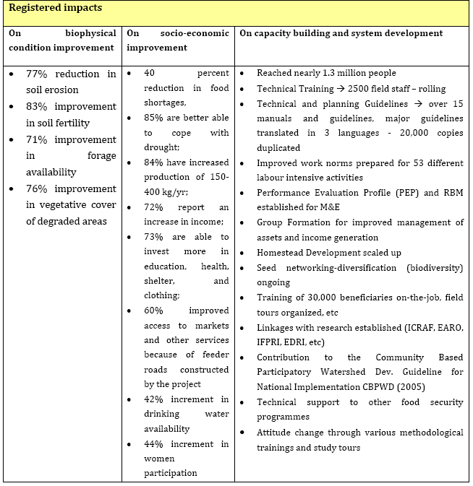
Impacts of MERET project (adopted from FAO/WFP, 2005)

Slide 19
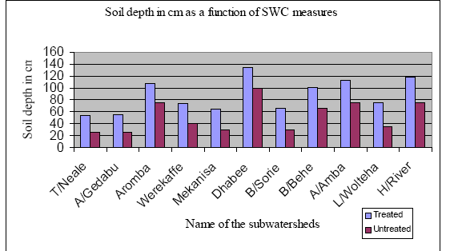
Soil Depth in CM as a function of SWC measures in 11 watersheds of MERET project Source, FAO/WFP, 2004.

Slide 20
Lessons Drawn From the MERET Project
From the last 25 years journey of MERET many useful lessons for successful implementation of the WM projects of the country have been drawn.
Resulted in high degree of flexibility to accommodate diverse ecological and socio‐economic and cultural settings.
The use of LLPPA as a planning and implementation tool:
This was backed by:
    easy‐to‐use guideline;
    well organized InfoTech’s to give more options and flexibility for the field staff
    other reference materials and appropriate in‐service training.

Slide 21
2) Focused and efficient capacity building at all levels:
  for beneficiary community members, field staff and
  implementing institutions was an essential lesson.
3) Institutional arrangement:
  The mandates of the donor and implementing agency at all levels has to be clearly demarcated and accepted by each party.
4) The need for resources and long-term commitment:
  The type and amount of resources needed could vary depending on the stage of the development process but certainly it needs well organized planning and long‐term commitment.

Slide 22
5) The need for flexibility and continuous learning to accommodate new thinking and needs of beneficiary communities:
  MERET has got continuous learning from field experience and high degree of flexibility to accommodate new ideas and adoption of them to local conditions.
6) One would not attempt to have a perfect start but establish a system that allows learning and modifications overtime accordingly.
7) Linking conservation with improving land productivity and household income:
  The main objective of the watershed initiative tends to enhancement of rural livelihood through sustainable land management.

Slide 23
8) Introduction of natural resources based income generating activities, value adding,
  linkage with market and effective integration among the various activities
9) Participatory Monitoring, Evaluation and plan revision:
  Monitoring and Evaluation systems are important elements of any project that helped many communities to learn from each other and to observe effects of better doings and undoing.
10) The importance of following watershed logic and identify smaller units within the larger unit:
  There was a need to disaggregate the bigger plan into smaller watershed plans to allow greater participation of communities, improve their ownership feeling, and successful implementation of the project.

Slide 24
Experiences of research on IWM in Ethiopia
As mentioned above, the impact of land degradation on soil productivity in Ethiopia was fully realized after the 1973/74 drought-driven famine.
To reverse the situation, the government launched very extensive soil conservation programs throughout the country.
Hence, soil conservation research project initiated at the national level, with the objective of supporting the national effort by providing the necessary data for the proper implementation of SWC measures and
Building the national capacity to undertake research in the area of SWC

Slide 25
Although the experience of Research on IWM has not been as extensive as development in Ethiopia, some are
The Soil Conservation Research Project (SCRP) started in 1982 and Ethiopian Highland Reclamation Study (EHRS), under the helps of FAO with World Bank and UNDP support, began in 1983.
These two projects produce substantial scientific information on the extent and severity of land degradation in the country.
The findings of these two studies provided the core diagnostic information for the project and the country for succeeding years; even to date.

Slide 26
Experiences of SCRP on IWM
The project was initiated and carried out by the University of Berne (Switzerland) in close and mutual collaboration with the SWC department of MoA
The following are some of the major tasks undertaken by the project:
  1. Monitoring of erosion processes:
  2. Measurement of catchment discharge and sediment yield
  3. Monitoring the impacts of soil and water conservation measures

Slide 28
Policies towards soil conservation in Ethiopia
Polices related to land at different time played an important role in land management in Ethiopia (Wagayehu, 2003; Bekele, 1998).
During the feudal regime, (prior to 1974)
  insecure land tenure system created disincentive for adoption of SWC
  The agricultural sector did not get the policy attention rather industrial development agenda.
  Therefore, policy attention towards industry combined with complex system of land tenure hindered the effort to conserve land

Slide 29
The military regime that took over in 1974 proclaimed land reform.
  abolished feudal land tenure system and
  eliminated large holding, landlessness and
  absentee landlordism.
  However, it could not succeed triggering adoption of conservation practices because of socialist orientation policies.
  For instance, until the late 1980s, agricultural input and output marketing remained under state monopoly while prices were fixed below the free market level.

Slide 30
The current government has made changes in economic policy.
Agricultural sector in general and smallholder in particular received policy attention in the current government
Different policies and strategies that favor proper use and management of agricultural land have been created so far to restore incentives for improved land resource management. which include
  Rural Development Policy and Strategy (MoARD, 2002),
  Food Security Strategy (MoARD-FSD, 2002),
  Natural Resource and Environment Policy, and
  Land Administration and Use,
  Forest Conservation and Development Policies.

Slide 31
Current Integrated Watershed Management experience in Ethiopia
As a result of realizations of importance of WM to livelihood improvements and poverty reduction in addition to resource conservation:
  Expansion of WM practices to high potential agricultural area
  A lot of intuitions have been crated (many universities & colleges offer NRM & WM)
  Watershed committee have been established at all levels (up to community level)
  Research institutes have watershed management as a one thematic area
    Numerous guidelines have been prepared including National Community Based Participatory Watershed Development (CBPWD) guideline in 2005.
  Training for capacity building, experience sharing etc. are common practices

Slide 32
Major lessons learnt on IWM, including SWC, agricultural practices, livelihood interventions, Community Dynamics in diffèrent parts of the country are:
  Community participation in combination with strong local institutions and leadership is crucial (commitment, discipline, hard work, and voluntary contributions)
  Local governance is important in the successful mobilization of communities for IWM.
  The creation of awareness at the community level and capacity building are crucial to bring attitudinal change with respect to IWM.
  Effective policies and by-laws that regulate community contributions and the implementation of IWM strategies is essential to ensure enforcement of existing regulations.

Slide 33
The participation of relevant stakeholders at different levels, including development organizations (e.g. WFP, GTZ and others), regional bureaus and communities, is crucial for the success of IWM for improved livelihood security.
The introduction of area closure and controlled grazing is possibly one of the most important interventions, not only in the context of IWM, but also with respect to livelihood security.
Challenges identified included the high level of natural resource scarcity, the need to overcome resistances and to bring attitudinal change, the complexity of coordination and mobilization of communities and the potential of community conflicts.

Slide 34
Interventions in IWM have to have direct benefits with respect to increased incomes for rural communities to be sustainable.
  Thus, it is proposed to promote high value fruit and horticultural crops and to establish better market access for these products.
Scaling up existing best practices is a major challenge to the sustainability of IWM.
  Technologies to be scaled up have to be affordable to farmers and suitable to prevailing conditions.
  Scaling up should be supported by capacity building and the strengthening of local institutions.

