Slide 1
Integrated Watershed Management
3(2+1)
CHAPTER ONE
    1.1. Watershed definition and basic concepts
    1.2. Watershed Management
    1.3. Integrated watershed management
    1.4. Why watershed approach?
    1.5. Principles of IWSM
    1.6. National issues

Slide 2
Learning outcomes
At the end of the topic students are be able to:
  Define watershed and watershed management
  Know historical overview of watershed management
  Know basic principles of watershed management
  Explain rationale for using watershed for planning and development
  Know watershed characteristics which affect watershed function

Slide 3
Introduction
  1.1. Watershed definition and basic concepts
    Definitions of watershed
      “Topographic, hydraulic and hydrologic units within a basin” (Horton, 1945)
      A limited, convenient and usually clearly defined and unambiguous topographic unit, available in a nested hierarchy of sizes on the basis of stream ordering (Strahler, 1964)

Slide 4
An open physical system in terms of inputs of precipitation and solar radiation, and outputs of discharge, evaporation and reradiation (Lee, 1964)

Slide 5
  As a development unit, Gibbs (1986) defined it as: “a readily defined, functional unit established by a relationship between physical and cultural influences”.
  An “ecosystem” in itself, consisting of production, protection, and multipurpose subsystems (Paembonan,1985).

Slide 6
Sub-protection system
Multipurpose subsystems
Sub-production system

Slide 7
Protection sub system
Production sub system

Slide 8
According to British usage:
  Catchment is the area from which runoff occurs, and,
  watershed is the boundary of a catchment.
According to American usage:
  Watershed is the total area catching the runoff, and,
  Divide (or drainage divide) is the boundary between two watersheds.
Catchment is also called a Drainage Basin

Slide 9
Rivers can be seen as veins of a leaf, extending all over a drainage basin up to their divides.
When rain falls on a watershed it finally ends up in a river system.
A river channel is the lowest point in the surrounding landscape.
Its purpose is to convey excess water from a drainage basin, which will include the products of weathering and additional loads of solutes produced by man.
This property makes a drainage basin/watershed an integrator and its operation is reflected in the quantity and quality of the river run-off.

Slide 10
Watershed/drainage area also is the area bounded by a drainage divide and draining all the water incident upon it through a common outlet (stream or river), or to a common point/place (lake, pond).
Or simply, all the land within the confines of a drainage divide.
Watershed, catchment, drainage area, river basin, drainage basin, are all terms used interchangeably.
BUT generally: Watershed, catchment and drainage area are used for small streams and rivers, while,
Drainage basin and river basin are used for large river systems with numerous sub-watersheds or sub-catchments nested within it.

Slide 11
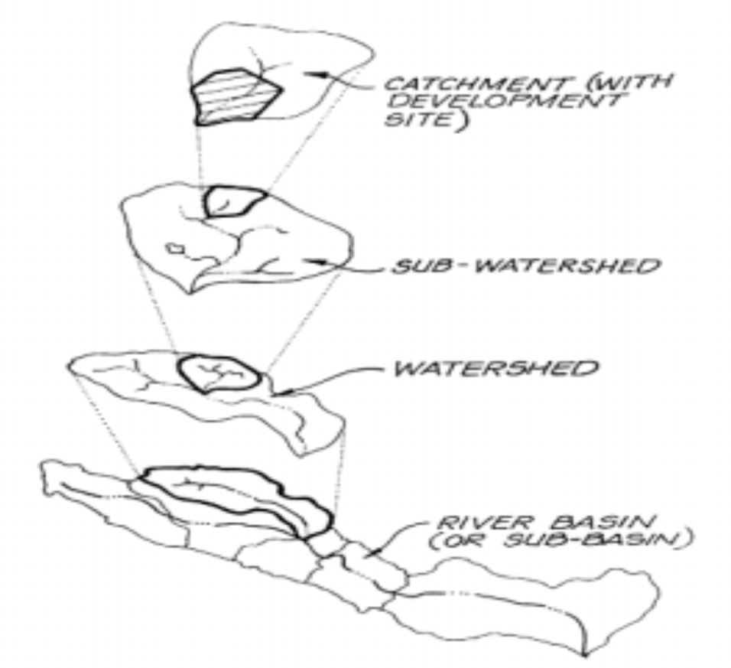

Slide 12
Where are the boundaries of a watershed?
  A “divide” or “drainage divide” is the line drawn through the highest elevated points within a watershed that can limit a watershed and the boundary between two or more watersheds.
  A water divide is categorized into:
    Surface water divide –highest elevation line b/n watersheds that defines the perimeter and sheds water into adjacent basins, and it can be delineated on a topographic map according to the relief of the landscape.
    Subsurface water divide –which refers to faults, folds, tilted geologic strata (rock layers), etc., that cause sub-surface flow to move in one direction or the other.

Slide 13
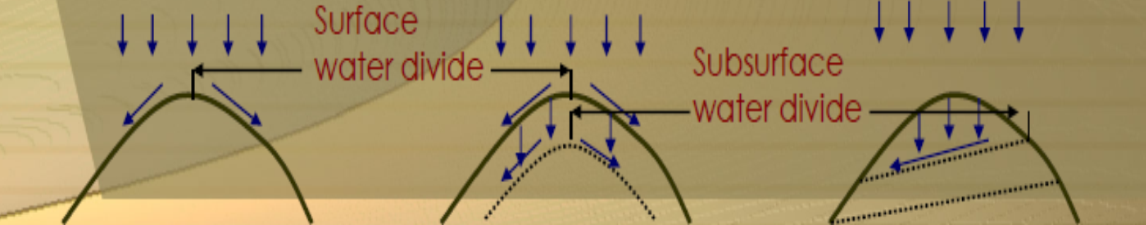
  In many catchments the area which supplies a river system with groundwater not coincident with the surface catchment because ground water may flow from a distant area.
  In such a case a groundwater catchment should be delineated based on an analysis of the groundwater contour lines or piezometric surface.

Slide 14
The dip of folded or tilted bedrock can transfer water across watershed boundaries where geologic layers are unfractured and relatively impermeable.

Slide 15
Generally:
  A watershed embraces all its natural and artificial (manmade) features, including its surface and subsurface features: climate and weather patterns, geologic and topographic history, soils and vegetation characteristics, and land use.
  Watersheds are biophysical systems that define the land surface that drains water and waterborne sediments, nutrients, and chemical constituents to a point in a stream channel or a river defined by topographic boundaries.
  Watersheds are the surface landscape systems that transform precipitation into water flows to streams and rivers, most of which reach the oceans.
  Watersheds are the systems used to study the hydrologic cycle and they help us understand how human activities influence components of the hydrologic cycle.

Slide 16
Brief History of watershed management
Watershed Management is a new concept with a long history during which it has been understood in different ways.
For thousands of years people have attempted to control the flow and quality of water and its management activities have been documented since these early times (e.g. irrigation of agricultural land).
In addition, conflicts about water use are known from Mesopotamia 4,500 years ago, but the management of water was not done within watersheds.
“Despite this long experience in water use and water management, humans have failed to manage water well”.

Slide 17
So, the concept of watershed management has existed for millennia.
The Atharva Veda text from 800 BC contains what may well be the first written reference to watershed management which states that: ‘‘one should take proper managerial action to use and conserve water from mountains, wells, rivers and also rainwater for use in drinking, agriculture, industries’’ (Chandra 1990).
In the West, Benjamin Franklin recognized the need for watershed management as early as 1790.
However, watershed management as a holistic concept was not defined until the mid-20th century.

Slide 18
Two historical processes gave rise to the birth of watershed management concept:
  Restoration activities to rehabilitate the Alps in Europe in the 1890s
    (developed land restoration and flood control techniques)
  The conservation movement in USA 1930s-Soil Conservation Service
    (developed soil and water conservation techniques)

Slide 19
1944- Society of American Foresters coined the term watershed management
  “The management of natural resources of a drainage basin primarily for the production and protection of water supplies and water-based resources for:
    the control of erosion and floods, and
    the protection of aesthetic values associated with water.”

Slide 20
Development of Modern (new concept) watershed management
1950-1970: Pioneer WM Projects in India, Chile, Argentina, Nepal, Jamaica
1950-1975: Publications such as WM,SC Manuals, FAO Conservation Guides
1950-1980: Series of seminars on ‘Management of Mountain Watersheds’ in Asia, Latin America initiated by European Forestry Commission
1950-1980: Study tours of experts from developing countries to USA, Europe, China

Slide 21
1960s: Awareness on the importance of upstream-downstream linkages in a watershed
1960-1980: WM training centers in Asia, India, Middle East, Latin America
  Asia and Latin America: Strong watershed management programs
  Africa: Weak and lagging programs, little or no research and little innovation of WM techniques

Slide 22
Watershed Management and Sustainable Development
1987: UN ‘The Brundtland Report’ ‘our common future’ coined ‘sustainable development’:
  New parading in development- satisfying current needs with out compromising the chances of the future generation
1992: Agenda 21 of the Rio conference emphasized the need for IWM for sustainable development
  Key statements
    ‘Sustainable mountain development’
    ‘Combating deforestation’
    ‘Combating desertification and drought’

Slide 23
2002: World Summit on Sustainable Development
2002: International Year of the Mountains
  Hence, watershed management is a key approach to bring about a sustained development without harming the environmental balance.

Slide 24
Reading assignment 1
Discuss about the history of watershed management in Ethiopia
When started watershed management in Ethiopia?
  The traditional type?
  The modern types?
What types of WM approaches have been implemented in Ethiopia?
What are the opportunities and challenges to implement WM in Ethiopia?
How IWM is important issue for planning of dams and reservoirs in Ethiopia?
How IWM is important issue to secure food in Ethiopia?
How IWM is important issue for climate change adaptation in Ethiopia?
what are others national issues related IWM in Ethiopia?

Slide 25
Why are watersheds so important to us?
for farmers
  increased productivity and higher profits
  improved water availability
  improved soil quality and better drainage
  improved livelihoods
for local community:
  lower land-development costs
  reduced flooding and water logging
  reduced soil erosion and land degradation
  increased agricultural productivity
  improved livelihoods options
  improved land management
  less socio-economic conflicts
C. for larger society:
  reduced risks from floods to downstream cities and farmlands
  reduced sedimentation in agricultural productive areas and dams
  better conservation of natural resources
  higher resilience of communities

Slide 26
In General
Watersheds (collectively or individually) provide us critical natural services that sustain or enrich our daily lives by:
  Supply drinking water
  Provide food and energy
  Habitats for plants and animals
  Regulate local climate
  Natural scenery and amenities for recreation
  Maintain biological diversity
All these services from WM can be attained through:
  Better water & land management
  Stability of land use in lower areas
  Arresting soil erosion, improving soil moisture, reducing floods & droughts
  Developing water, land and biomass resources with a focus on social and environmental aspects
  Judicious use of natural resources - active participation of stake holders, in harmony with the ecosystem

Slide 27
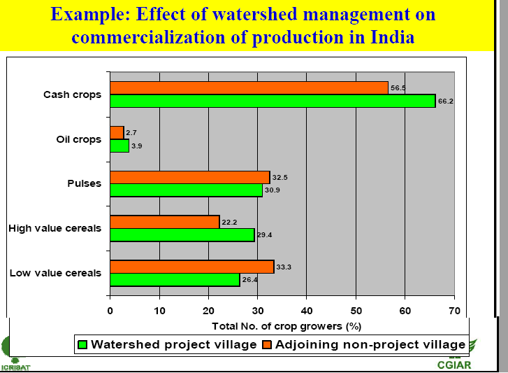

Slide 28
How does a watershed affect us?
  Everybody lives in a watershed.
  Everybody is connected by a network of watersheds (e.g., we cross a number of rivers, ditches, or channels every day on our ways).
  Each stream we cross is part of a large network of several streams that drain to rivers or the sea).
  Upstream and downstream occupants are linked biologically, physically, economically and socially.
  Inappropriate land use activities in upland areas may bring adversities to downstream area.
  Flooding in the lowland areas (recent examples)

Slide 29
2006 Dire Dawa flooding
2006 upper Awash flooding

Slide 30
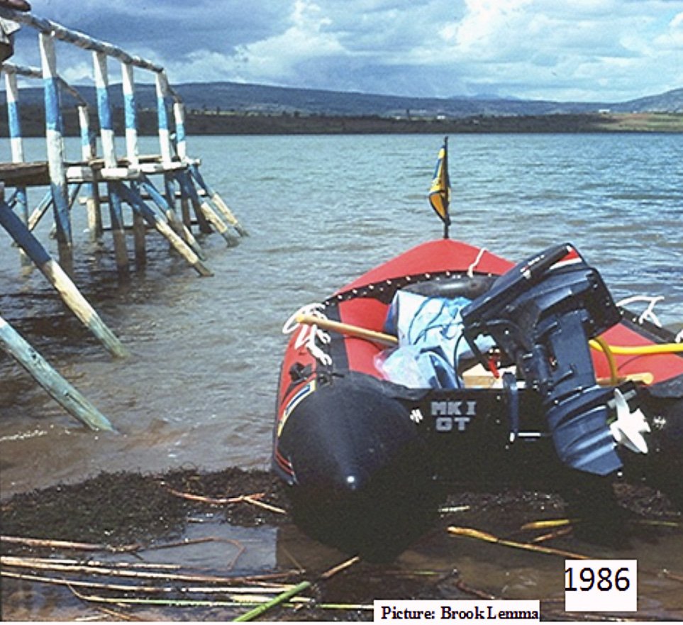
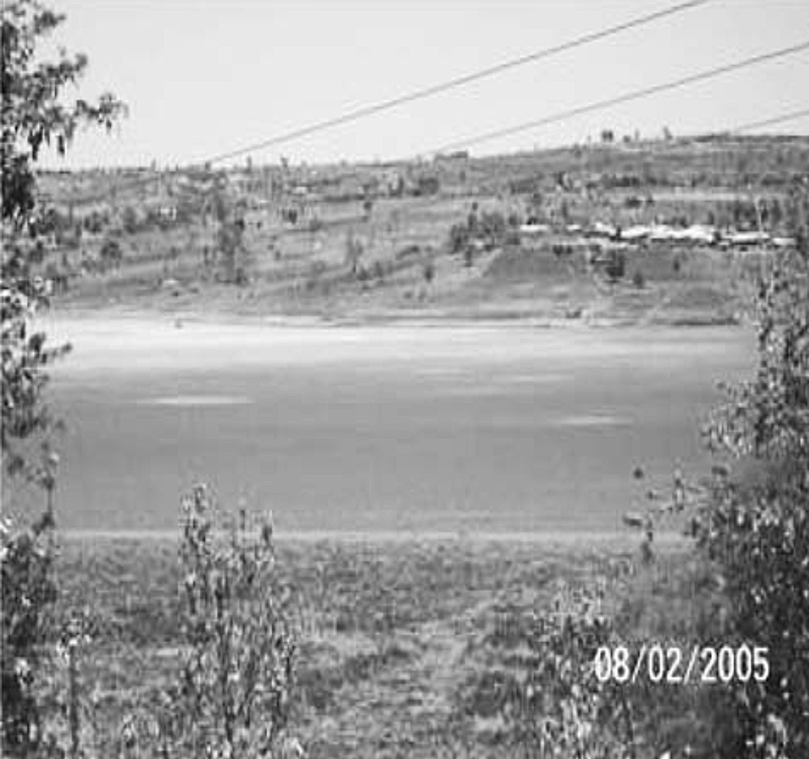
Consequences of Watershed Deterioration
Low productivity - agriculture, grasslands, forests - reduction in biomass
Declination of groundwater level causing increase in cost of irrigation
Siltation of reservoirs, lakes and channels
Frequent floods and droughts
Erosion and denudation
Water quality & quantity problems
Poverty – social problems
Lake Haramaya as seen in a better condition during 1986 upper one and dried up since 2005 (Source: T. Alemayehu et al., 2007).

Slide 31
What is watershed management?
  The process of formulating and carrying out a course of action involving manipulation of the natural system (resources) in a watershed to achieve specified objectives (development, conservation, protection etc…) and to provide desired goods and services without adversely affecting the soil, vegetation and water resource base.

Slide 32
Watershed management is the process of organizing and guiding land, water, and other natural resources used in a watershed to provide the appropriate goods and services while mitigating the impact on the soil and watershed resources.
It involves socio-economic, human-institutional, and biophysical inter-relationships among soil, water, and land use and the connection between upland and downstream areas
It can broadly be defined as ‘‘the study of the relevant characteristics of a watershed aimed at the sustainable distribution of its resources and the process of creating and implementing plans, programs, and projects to sustain and enhance watershed function that affect the plant, animal, and human communities within a watershed boundary’’

Slide 33
Why a watershed approach?
Considering the multitude concepts and definitions of WM, the following key characteristics of a watershed that drive management approaches are:
  The need for integrated land and water management:
      Management approaches must consistently address the interaction of Natural resources (vegetation, soils, and water) in the watershed.
      Thus, WM programs adopt integrated resource management approaches.

Slide 34
  The causal link b/n upstream land and water use and downstream impacts:
      Upstream land and water management inevitably has impacts on the downstream
    Quantity of water flows and operation of reservoirs and irrigation schemes,
    Quality of water, biodiversity, carbon sequestration, Natural disaster vulnerability
    Hence, WM programs are typically oriented toward problem solving in uplands

Slide 36
The multiplicity of stakeholders:
    An extensive range of stakeholders, typically, organizations dealing with
      Agriculture,
      Animal husbandry,
      Forestry,
      Water, Irrigation,
      Rural development,
  Physical planning,
  Land tenure;
  Local governments;
  Community institutions,
  NGOs, and so forth
    share important goods and services from watersheds
    This institutional density creates a management challenge and requires WM approaches to create broad and inclusive institutional platforms

Slide 37
The resource depletion and poverty nexus:
    Upland areas are typically more fragile and less productive where NRM and rural poverty are commonly linked
    With frequently extensive land use practices and fragile resource base, uplands are vulnerable to overexploitation and depletion of natural resources
    Agricultural productivity declines, often aggravating the poverty problem.
    Hence, improving NRM in upland areas requires attention to the problems of the poor, particularly poverty reduction and local institutional development.
Thus, WM programs generally have to focus on the farming systems of the poor in upland areas in order to achieve poverty reduction and conservation objectives

Slide 39
Why a watershed approach? .......
  A watershed is recognized as the ideal and appropriate hydrological unit for planning and executing development programs to use natural resources for a sustained and optimum production with minimum damage to the environment.
  Watershed boundaries are natural basis in resource use planning and management because watershed is a logical unit for considering the effects of land use on soil and water.
  Enables planners to harmonize the use of soil, water and vegetation in a way that conserves these resources and maximize their productivity.

Slide 40

Managing Land & Water at watershed scale, appropriate- environmentally, financially & socially
impact | Basin size (km²)
 | 0.1 | 1 | 10 | 100 | 1000 | 10000 | 100000
Average flow | X | X | X | X | _ | _ | _
Peak flow | X | X | X | X | _ | _ | _
Base flow | X | X | X | X | _ | _ | _
Groundwater recharge | X | X | X | X | _ | _ | _
Sediment load | X | X | X | X | _ | _ | _
Nutrients | X | X | X | X | x | _ | _
Organic matter | X | X | X | X | _ | _ | _
pathogens | X | X | X | _ | _ | _ | _
Salinity | X | X | X | X | X | X | X
Pesticides | X | X | X | X | X | X | X
Heavy metals | x | x | x | x | x | x | x
Environmental scale - watershed defined by natural hydrology - Resources becomes a focal point in order to understand factors that contributes the problem.
Eg.

Slide 41
  Financial and social benefits of watershed approach
    Core of watershed approach - better understanding of environmental factors.
    Tasks such as modeling, monitoring & reporting under watershed framework - saves time and money.
    People’s participation -pillar of watershed approach - gives sense of ownership; greater public involvement & ensures sustainability of interventions planned.

Slide 42
What is Integrated watershed management?
What does ‘integrated’ mean?
  Using the terminology ‘integrated’ always leads to the assumption to ‘compose and coordinate to form a whole’.
  In the context of Integrated Watershed Management the term ‘integrated’ demonstrates that all aspects of watershed management will always be considered for each individual activity.
  There are never ‘stand-alone’ actions possible:
    Each activity in a watershed is influencing the whole watershed - and the whole watershed is influencing each activity

Slide 43
Precipitation in the mountains occurs and surface runoff is collected by a dam
tentative consequence 1 | tentative consequence 2
evaporation is increasing due to the water collection in the dam: less water will be available for downstream users | storage of water allows stream flow in dry season: downstream user benefit from continuous water availability
Which assumption is correct?
Integrated approach to discuss the tentative consequences is needed
Factors to be considered for both tentative consequences:
evaporation rates difference between natural and anthropogenic retention areas water source protection climate predictions economic and ecologic benefit and/or disadvantage of dams community involvement etc

Slide 44
What is Integrated watershed management?
Integrated
Management
Watershed
Goals: Resouces, People
• Socioeconomic developement
• Natural Resource management
Deciosion
• Choice
• Administration
Geographical unit
• Issue of Scale
IWM: Making a choice or taking decision to bring about economic
developments along with a sustained use and management of natural resources in a geographical unit called watershed.

Slide 45
IWM as a process of formulating and carrying out a course of action involving the manipulation of natural, agricultural and human resources in a watershed to achieve resource objectives, taking into consideration the social, economic and institutional factors operating within the watershed.
Integration of natural (land, water, vegetation), economic & social resources to upgrade human welfare in a quality environment.
The integrated concepts of WM provide a framework for sustainable development, while WM practices provide the tools for making that framework operational
The concept recognizes the interrelationships among land use, soil, and water, and the linkages between uplands and downstream areas

Slide 46
In an IWM, a participatory, integrated, multidisciplinary and multi-sectoral approach is necessary.

Slide 48
Social aspects such as gender issues, disadvantaged groups, distribution equity, and ownership should be dealt with.
The holistic and joint efforts of communities & government agencies are needed.
Good communication skills at all levels are equally essential
It requires decentralization and linkages between central, district, and local-level organization and institutions
Read on Participatory VS Collaborative Watershed Management

Slide 49
Underlying concepts in WM
  WM is an undertaking to maintain the equilibrium between elements of the natural ecosystem of vegetation, land and water on one hand and human activities in utilizing the elements on the other hand.
In specific terms
  People are positively and negatively affected by the interactions of water with other resources in a watershed
  People influence the nature and severity of such interactions by the ways in which they exploit resources and the quantity they use
  The effects of these interactions follow watershed boundaries, not political boundaries

Slide 50
  Water flows downhill regardless of how people define their political boundaries.
  What is done in the upstream of one political unit (country, community or landowner) can significantly affect another political unit occupying downstream
  Because such interactions cut-across political boundaries, what may be sound use of resources from the point of view of one political unit may not be sound use of resources in a broader societal point of view.
  Given all these interactions and effects, ecologically sound management of watersheds becomes good economics for all stakeholders only if the costs and benefits are appropriately distributed among the political units, communities, and individuals that carry out watershed management practices and those that benefit from them.

Slide 51
Misconceptions
  A common misconception is that watershed management is based only on physical interrelationships. But, a sound watershed management involves economic and institutional interrelationships as well.
  Though the capital to build roads, to provide education, energy and health services for upland populations is usually generated by commercial and industrial enterprises in the valley bottoms and plains, this concept is not well recognized by the political players.

Slide 52
What are the Principles and objectives of WM?
Principles
  1. Watersheds are natural systems that we can work with.
    WS are practical, tangible management units that people can understand
    WS are manageable natural systems that help us understand and appreciate nature's interrelated processes.
    Watershed can be regarded as a complete system that may include products or outputs leaving the system, inputs coming to the system and interaction (+, -) between its components

Slide 53
  2. Watershed management is continuous and needs a multi-disciplinary approach.
  A sound and effective resource management is:
    Continuous or never ending (a continuous process)
    Involves all those affected by management decisions (all stakeholders)
    Reflects the integrated nature of nature itself (disciplinary solutions incomplete )
  Watersheds are practical for integrating these efforts in a framework of common goals.

Slide 54
3. A watershed management framework supports partnering, using sound science, taking well-planned actions and achieving results.
  A sound watershed management framework:
    Uses sound science (science based knowledge about the watershed)
    Facilitates communication & partnerships (sharing information among actors)
    Fosters actions that are well-planned and cost effective
    Stimulates actions and tracks results
  Three core elements of a successful watershed management framework:
    The management unit (watershed), which agreed up on by partners to provide a functional, practical basis for integrating efforts
    Stakeholder involvement, with clearly defined roles and responsibilities
    The management cycle- watershed management is a never ending job

Slide 55
4. A flexible approach is always needed.
  Watersheds vary in their characteristics and change through time.
  Therefore, watershed management is a dynamic, continuously readjusting process to accommodate these changes.
5. Watershed management must be participatory
  the community is motivated to function and contributes as a group to perform various tasks and involve in all stages(planning, implementation and monitoring and evaluations) of watershed development activities.
6. Watershed management must be build up on local experience, strength
  Local knowledge is essential to improve the existing technologies and to adopt new ones

Slide 56
7. Watershed management must be realistic, integrated, productive and manageable
  Integrated conservation and development base is the guiding principles of watershed management.
  Management is not only for the sake of conservation it must include both conservation and production

Slide 57
Watershed management objectives:
Maintain sound ecological balance as well as life support systems
Ensure the sustainable use of all the renewable natural resources.
Ensure sustainability of ecosystem by managing the human-land-water system
Improve peoples livelihoods and socioeconomic conditions
Maximize agricultural productivity per unit area and per unit of water
Protect hill slope areas through various SWC methods & reduce land degradation
cover non-arable area effectively through afforestation, horticulture, and pasture land development based on land capability class
Regulate stream flow, improve ground water recharge and reduce surface runoff, flooding and sedimentation of reservoirs
Maintain and improve water yield and quality

Slide 58
Principals of Integrated Watershed Management
  utilizing natural resources according to its sustainable capability
  secure adequate vegetation cover during the rainy season
  conserving as much rainwater as possible at the place where it falls
  effective utilization of surface and groundwater resources
  avoiding gully formation and control soil erosion
  increase groundwater recharge
  ensuring sustainability of the ecosystem benefitting the man-animal-plant-water-land complex in the watershed
  improving infrastructural facilities with regard to storage, transportation, and marketing
  preventing water pollution and increasing WASH (water and sanitation hygiene) facilities
  solving water conflicts within the watershed
  securing access to water

Slide 59
Challenges in watershed approach
Watershed management is complicated by the fact that watersheds rarely correspond to human-defined boundaries.
Watershed development often distributes benefits and costs unevenly, making it a likely source of disagreement and conflict (fundamental social problem).
The challenge is to bring all the stakeholders to be part of a win-win scenario (who pays what and who benefits what)
The concept of watershed and its management is not well understood by the governments and the public at large.

Slide 60
Summary:
A watershed management approach:
  Provides a context for integration
    Using practical, tangible management units that people understand
    Focusing and coordinating efforts
    Finding common ground and meeting multiple needs

Slide 61
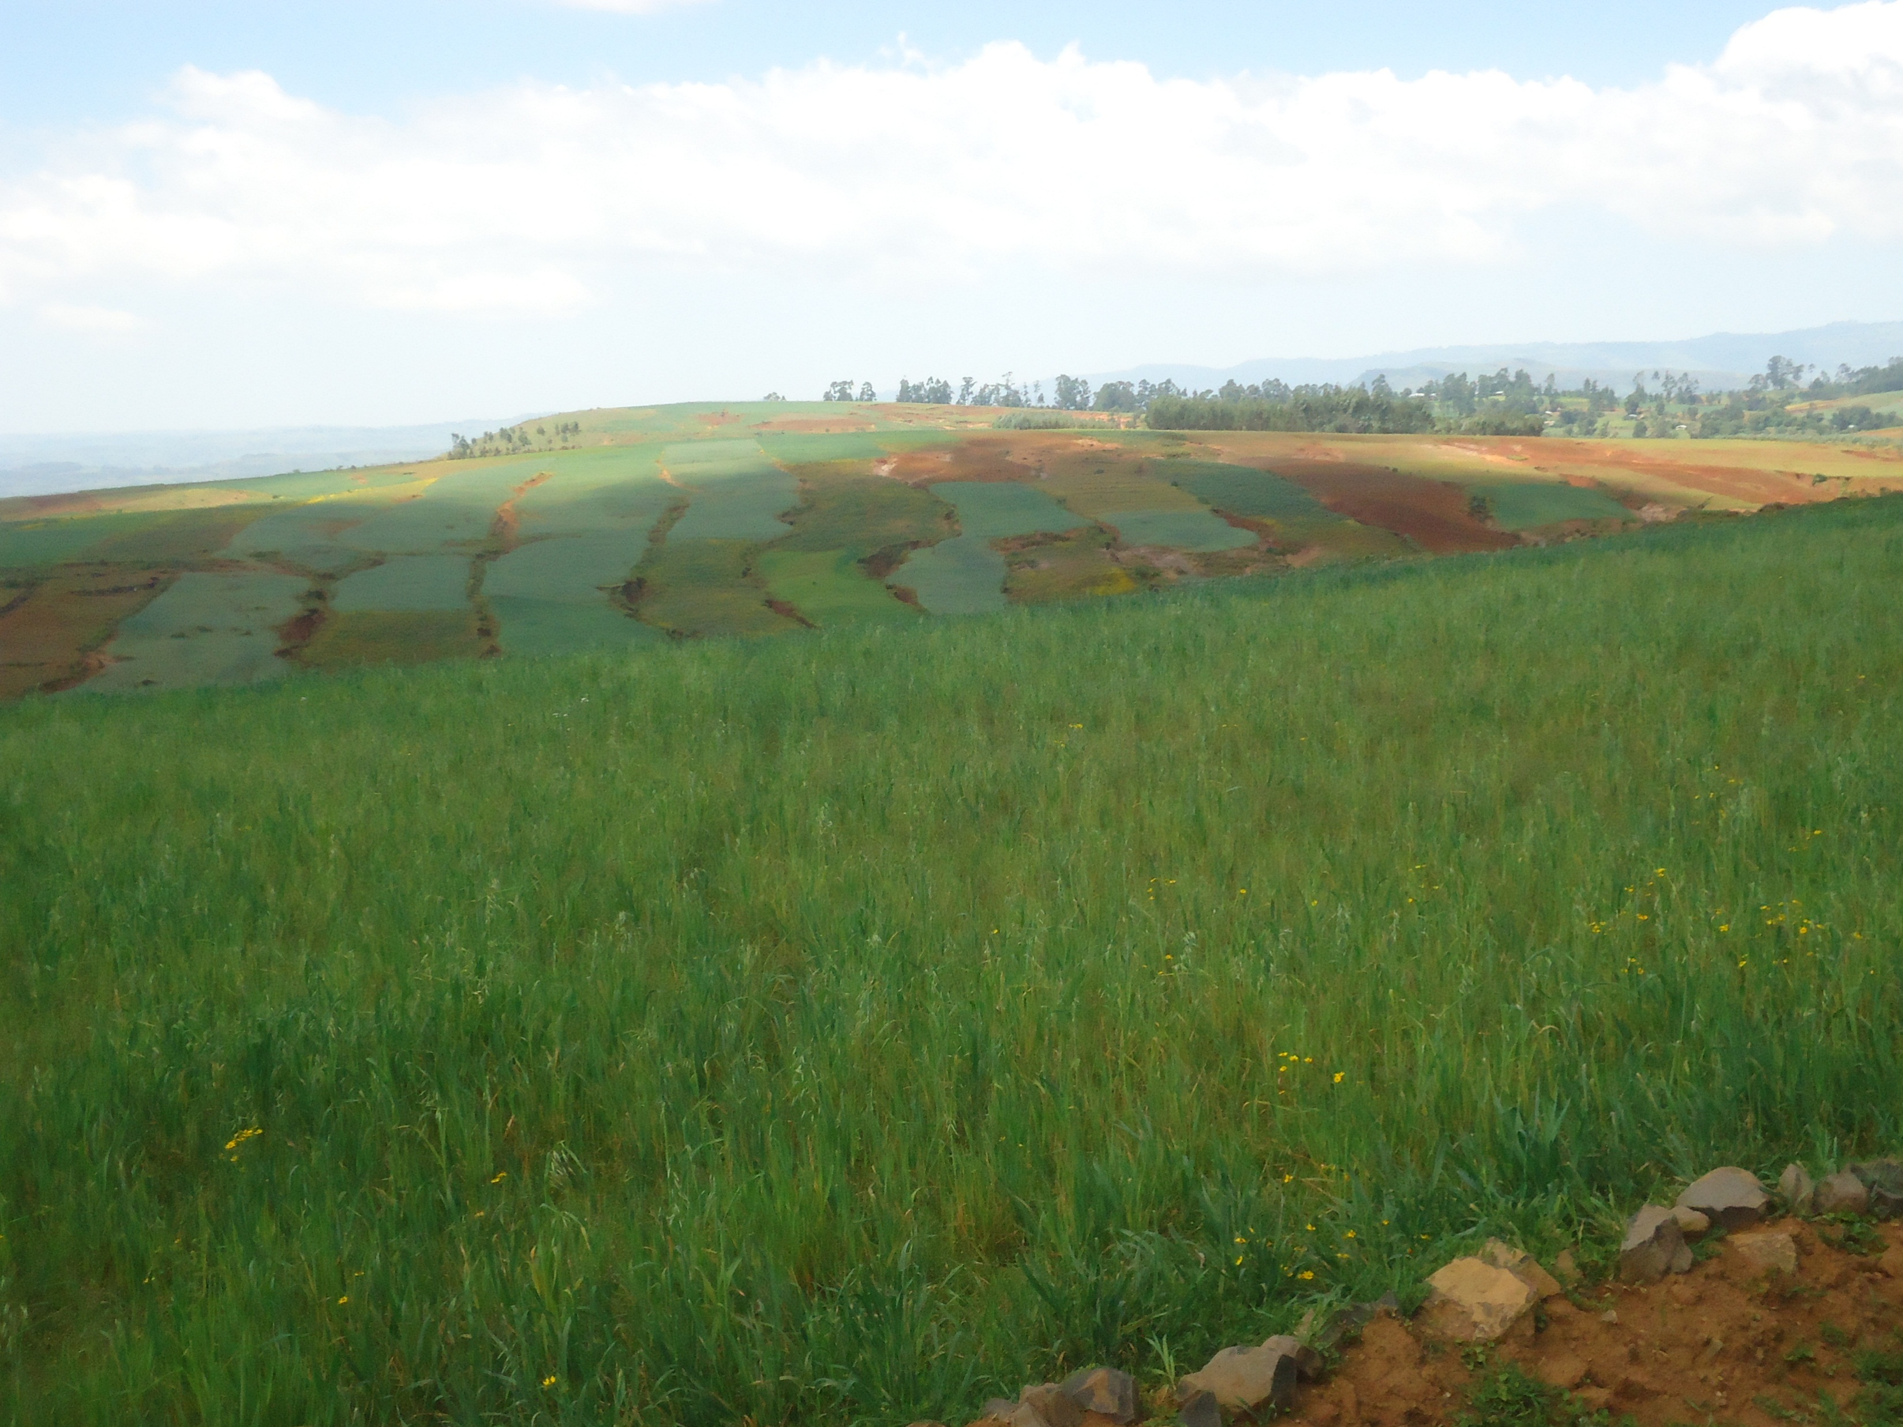
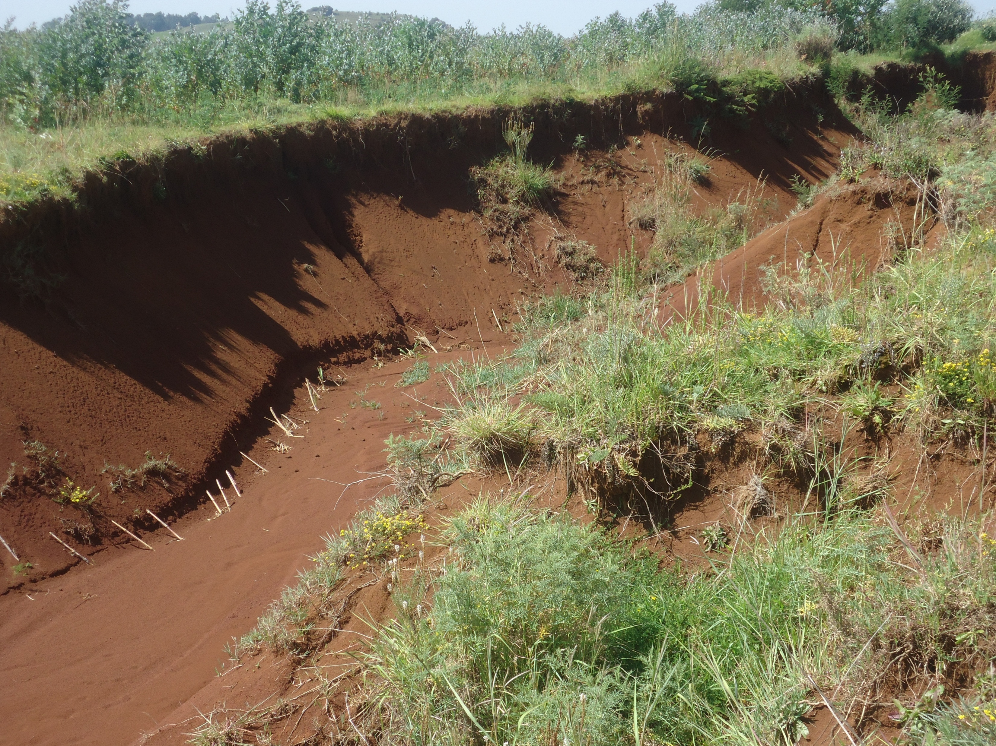
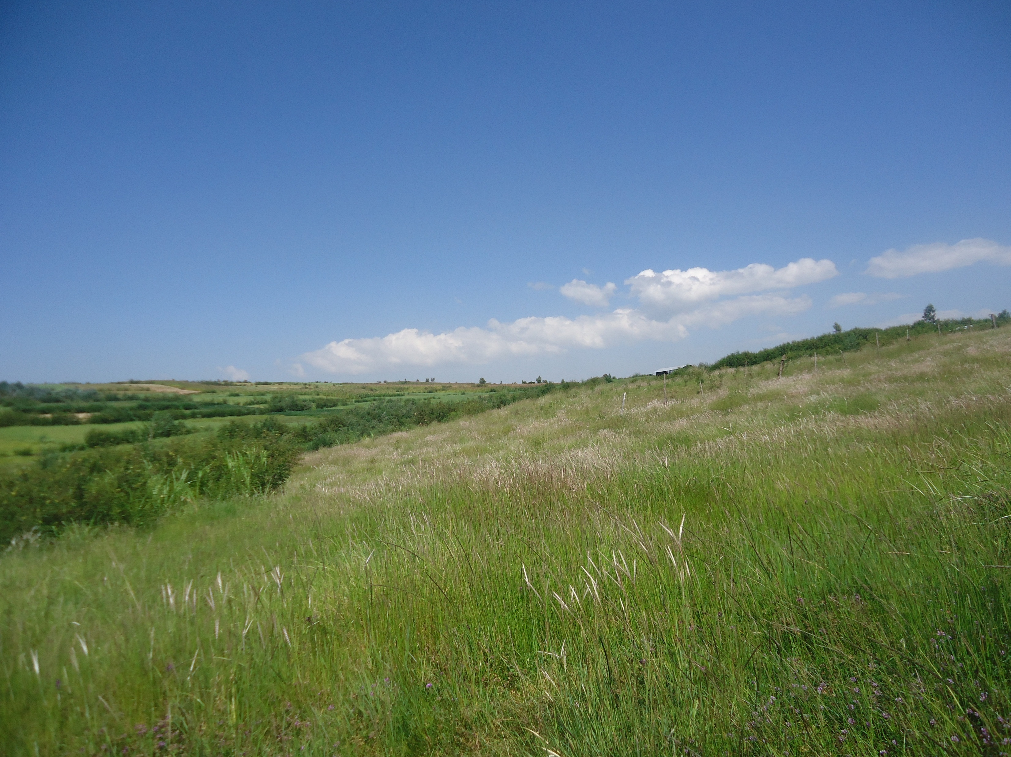
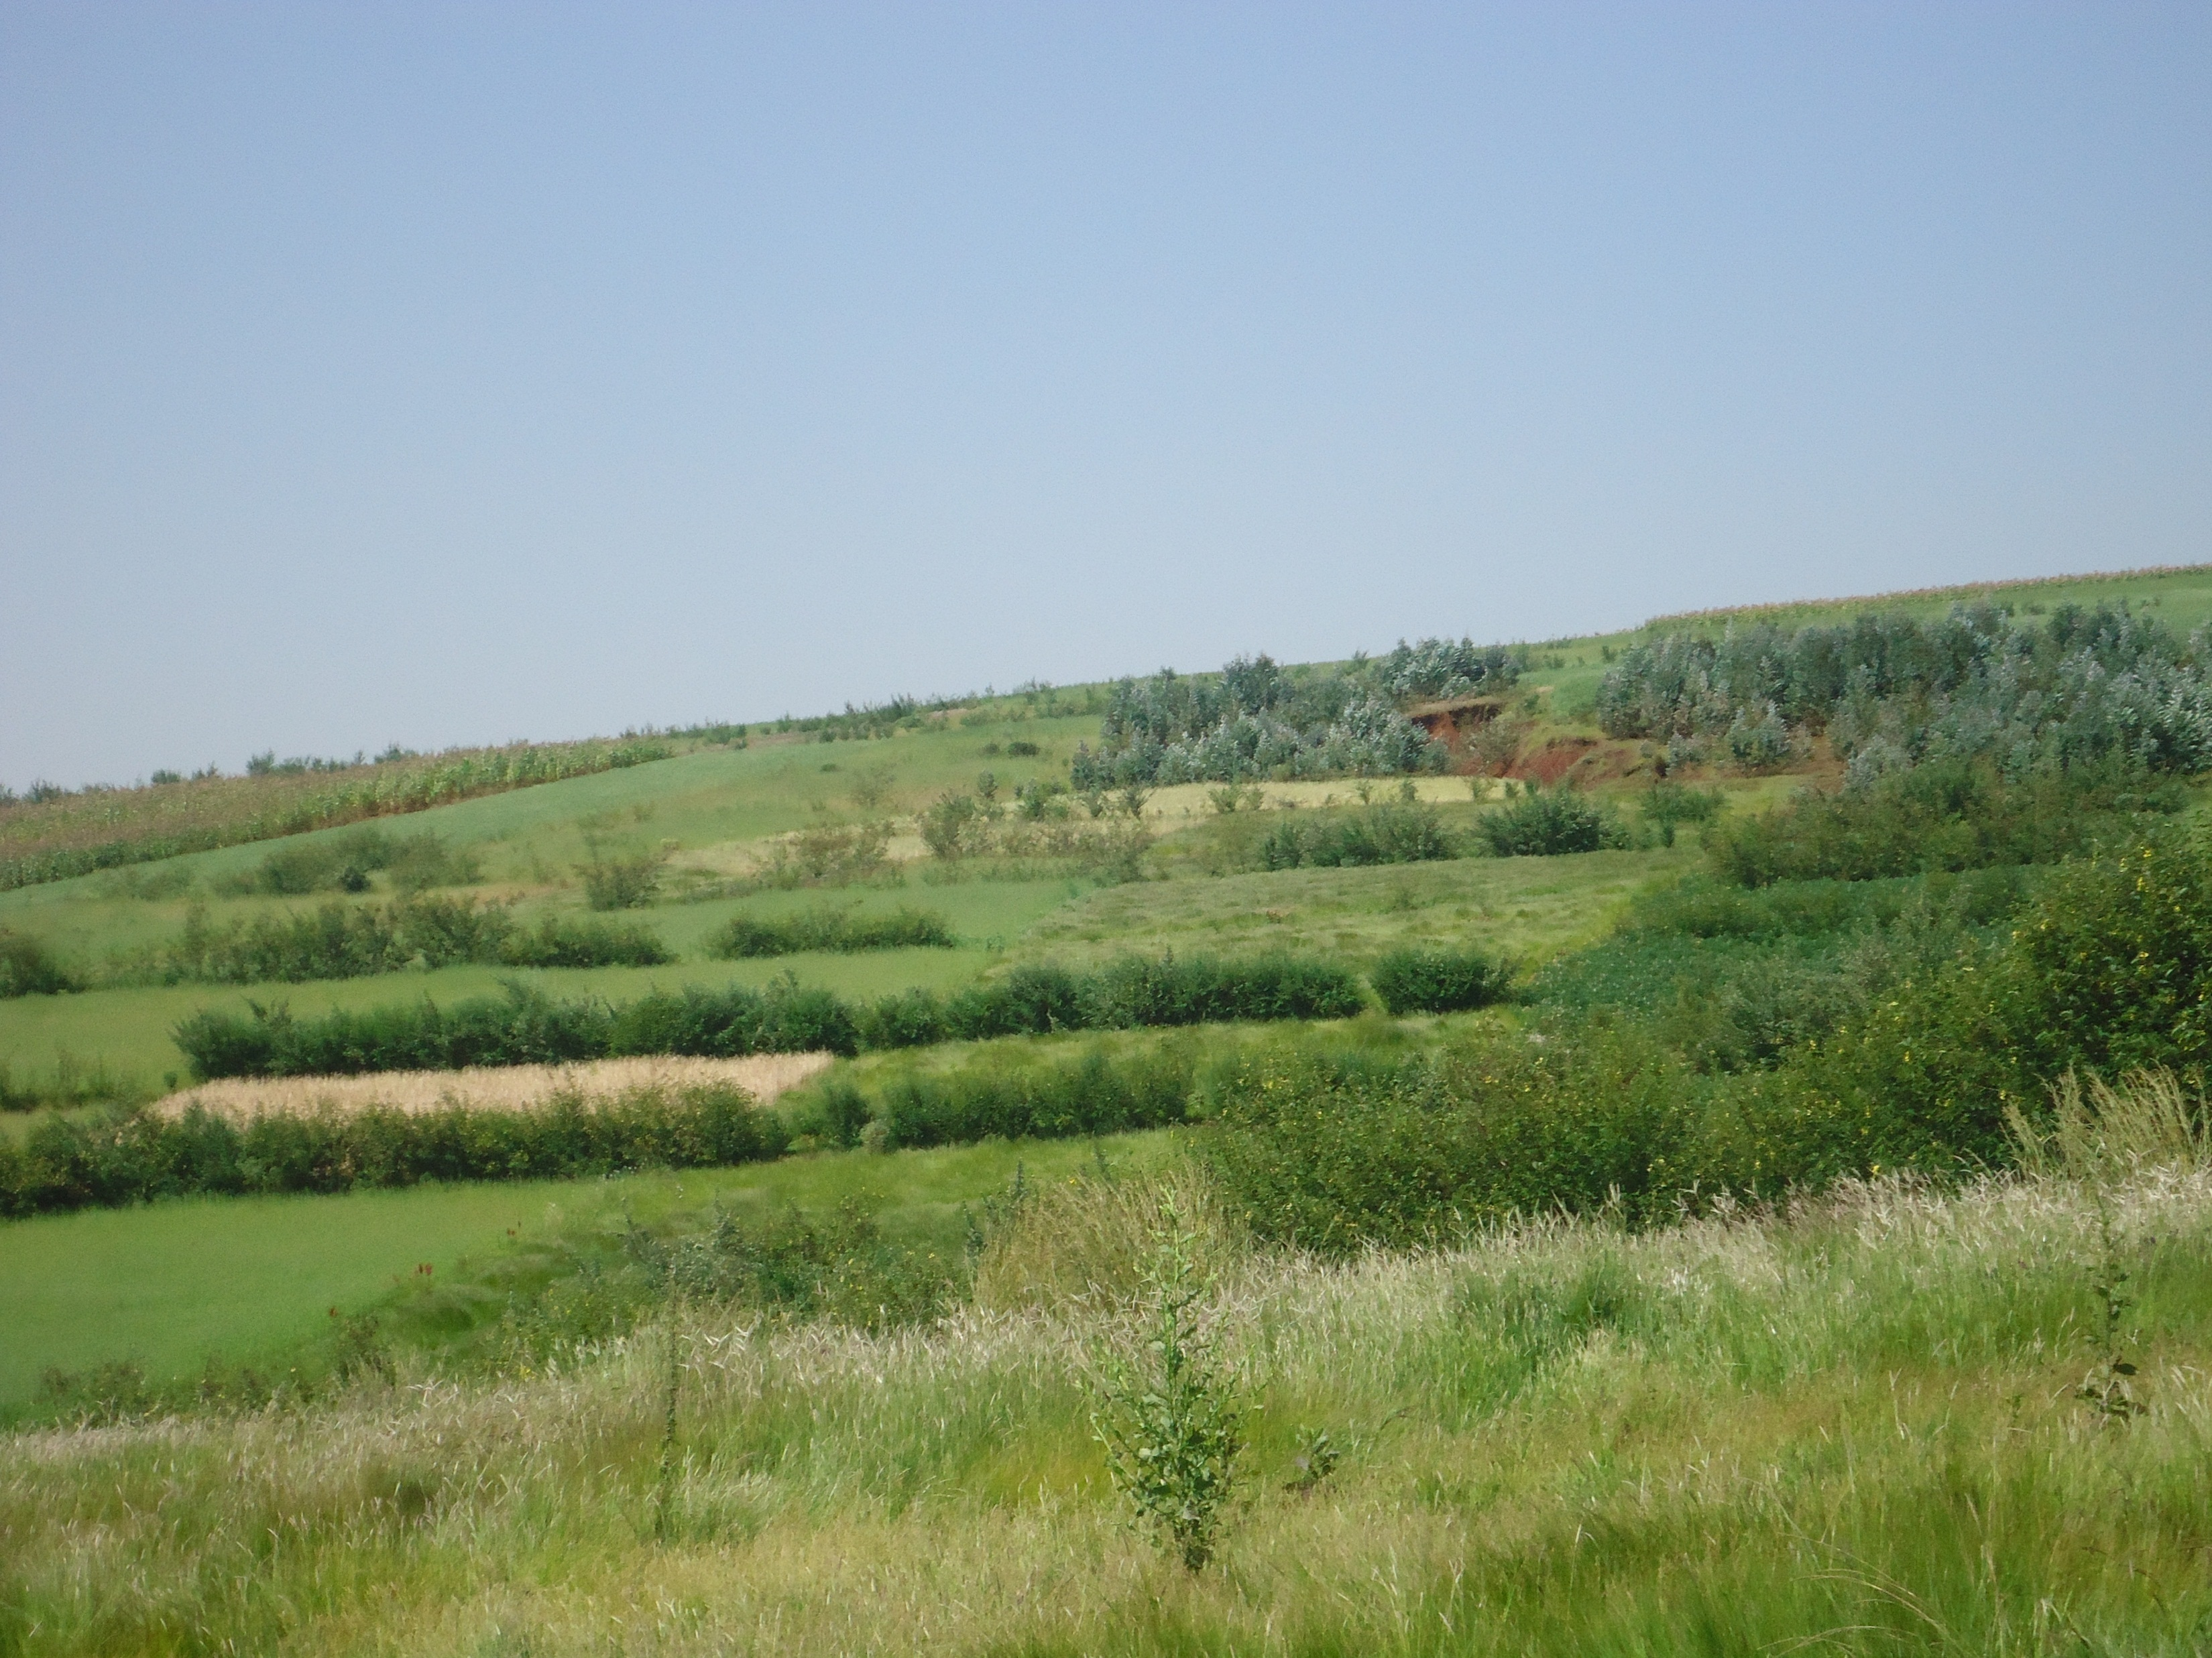
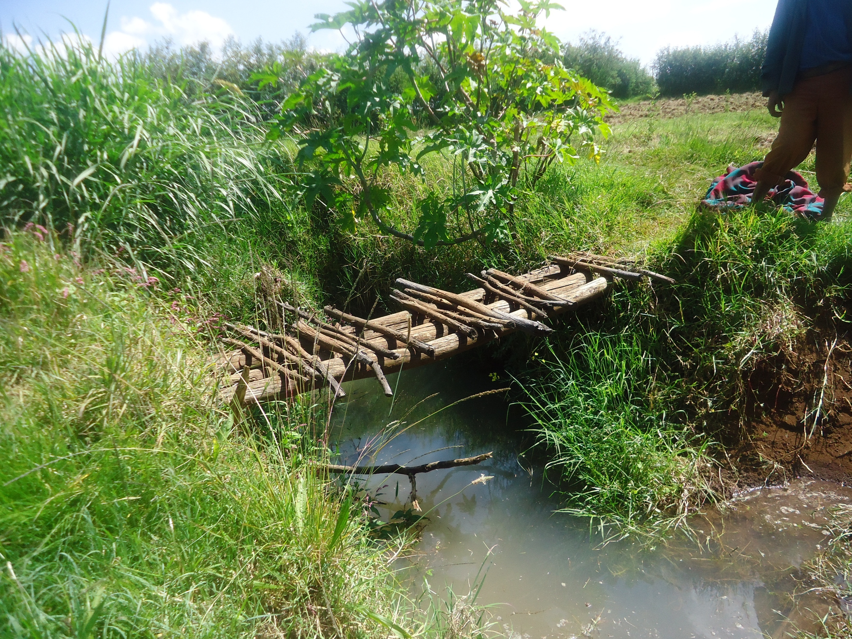
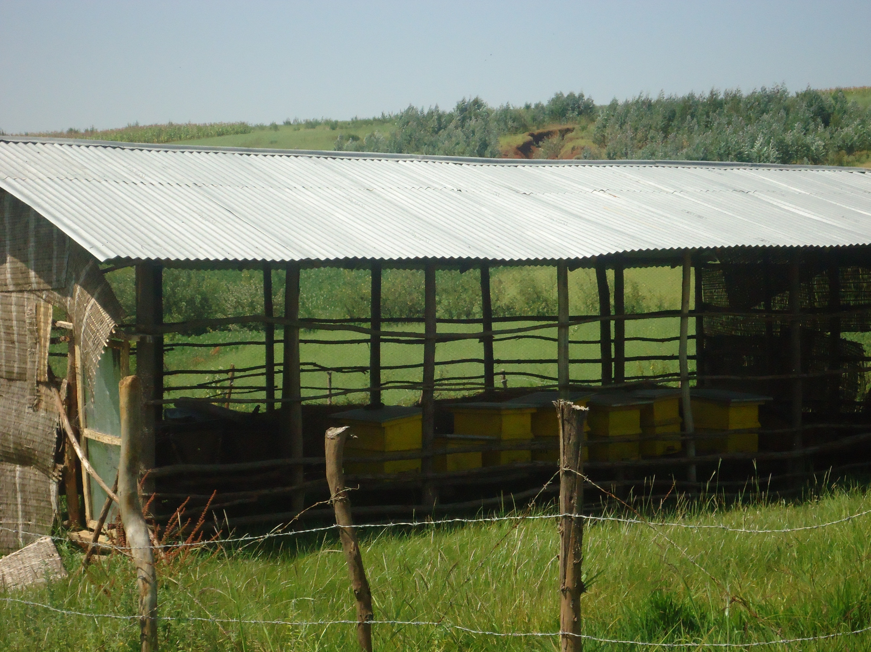
2. It provides a better understanding and appreciation of nature by
  Understanding nature's interrelated processes
  Linking human activities to nature's response
  Appreciating how nature's processes can benefit people
  Identifying the ways to work with watershed processes

Slide 62
  3. It yields better management by
    Generating ecologically-based, innovative, cost-effective solutions
    Forging stronger working relationships all stakeholders
    Supporting consistent and continuous management

