Slide 1
6. Economics of Pollution Control

Slide 2
Pollution
Waste: something that is an unwanted by-product of economic activity.
Emissions or discharges: Any waste flow into the environment.
Pollution: Any chemical or physical change in the environment due to waste emission that is harmful to any living organism.
Given that not all emissions of waste damage the environment

Slide 3
Pollution: It refers to the release of substances into the environment that creates inconvenience or endanger to humans and other living things.
Much of it comes from natural resources
Human activity adds more contaminants
Industrial activity both harms human health and disturbs natural ecology

Slide 4
Pollutants
Pollutants: A waste material that pollutes air, water or soil.
a. A stock pollutant is a pollutant for which the environment has little or no absorptive capacity.
Examples:
i. Non biodegradable bottles
ii. Heavy metals
iii. Some synthetic chemicals (e.g., dioxins)

Slide 5
b. A fund pollutant is a pollutant for which the environment has some absorptive capacity.
Examples:
i. Carbon dioxide
ii. Waste paper products
Local pollutants cause damage near the source of emissions while,
Regional pollutants cause damage at greater distances.

Slide 6
Economics of Pollution
Pollution is developed from the concept of externalities.
Pollution results from a production or consumption process in which the conversion of inputs into outputs is not efficient in a physical sense;
That is some of the inputs become waste products.
Residuals from economic process enter into the environment and damage it.

Slide 7
The extent of this damage however, depends on the absorptive capacity of the natural environment.
Whenever the residuals outweigh the absorptive capacity of the environment then, pollution occurs.
Economists are concerned with the effects of pollution on welfare and are thus interested in the damage done to the environment as a whole.
In this sense, pollution can be defined as the net flows exceeding the absorptive capacity of the environment and which have damaging effects upon human welfare and the ecological system in general.

Slide 8
Pollution affects the magnitude and size of environmental resources.
For example,
It affects the growth of plants, animals, as well as the quality of physical assets.
It can also affect the quality of air and water that exist in the environment.

Slide 9
Efficient Level of Pollution
Identifying efficient level of pollution is very crucial in pollution abatement and control.
There are costs and benefits of pollution emissions.
Benefits of pollution: if a required emissions standard is made less restrictive,
the relaxation of the pollution abatement constraint allows the production of goods that could not otherwise have been made.

Slide 10
Existing technology cannot produce goods and services without pollution and hence a trade-off between production and pollution exists.
With both benefits and costs, economic decisions about the appropriate level of pollution involve the evaluation of a trade-off.

Slide 11
We call the costs of pollution ‘damages’.
Net benefits of pollution = Benefits of outputs associated with pollution (minus) damages resulting from pollution
The socially-optimal level of pollution abatement requires maximizing net benefit from pollution.

Slide 12
Pollution damage costs represent the total monetary value of all the various damages resulting from the discharge of untreated waste into the environment.
Damage costs include:
Losses in profit
Losses in utility
The cost of defensive (self-protection) measures
Let the damage (D) is a function of emission (M), ie D = D(M)
It is assumed that D is an increasing function of pollution emissions(M).

Slide 13
Marginal Damage Cost (MDC): The social cost of the damage to the environment in monetary terms, resulting form each additional unit of waste emission.
The marginal pollution damage cost curve actually represents what people are willing to pay to avoid damage or the demand function of environmental quality.
Exogenous factors affecting the marginal damage cost:
Changes in people’s preference for environmental quality
Changes in population
Discovery of new treatment(s) to damage caused by environmental pollution
A change in the nature of the assimilative capacity of the environment

Slide 14
Benefits of pollution are less obvious
Production without emission is too costly
As allowable emission rises, it will reduce the abatement costs that would otherwise be incurred: cost saving
The larger is the emission, the greater is the cost saving: benefits of pollution
B = B(M)

Slide 15
Marginal Abatement Cost (MAC): Cost of each successive unit of reduction in the amount of pollution.
Abatement costs include:
Costs of installing to remove pollutants from discharges
Costs of using “clean” production technologies
Costs of reducing emissions by operating polluting plants at lower output
Costs of premature closure of polluting production facilities

Slide 16
Total damage is thought to rise at increasing rate with the size of emission
So marginal damage cost is increasing with M
Total benefit will rise at a decreasing rate as emission increases
Per unit pollution abatement cost will be more expensive at greater level of pollution reduction
So marginal benefit (abatement / control cost) will fall with M

Slide 17
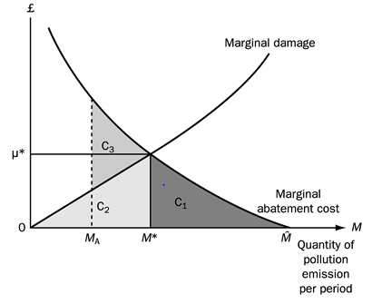
Efficient level of pollution MDC=MAC

Slide 18
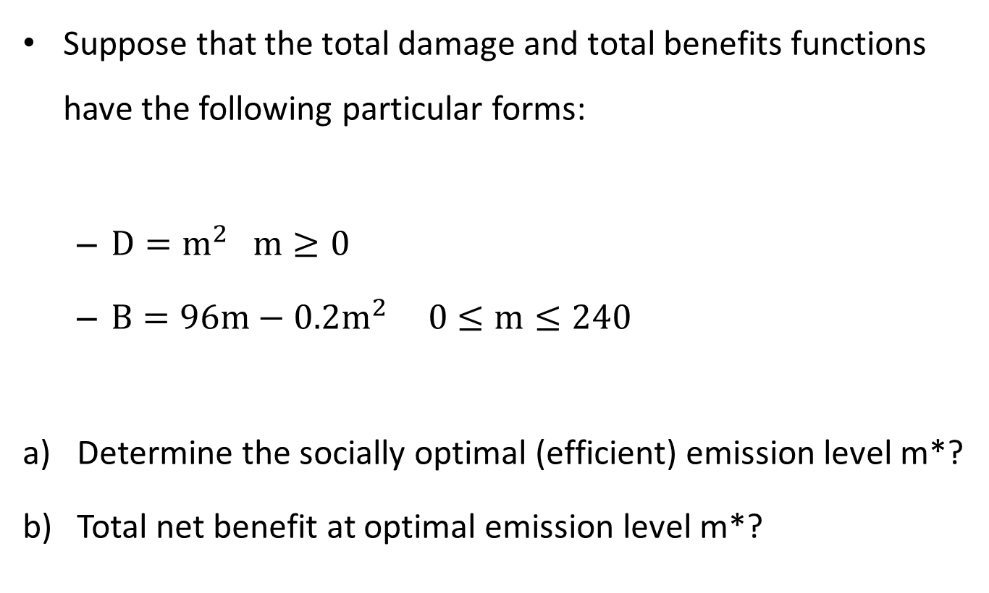
Example 1: Socially optimal level of pollution
Suppose that the total damage and total benefits functions have the following particular forms:
${D=m}^{2} m≥0$
${B=96m−0.2m}^{2} 0≤m≤240$
Determine the socially optimal (efficient) emission level m*?
Total net benefit at optimal emission level m*?

Slide 19
Pollution Control Instruments
Many instruments available for achieving pollution abatement targets.
How to choose instruments?
There are different criteria for choosing the control instruments

Slide 20
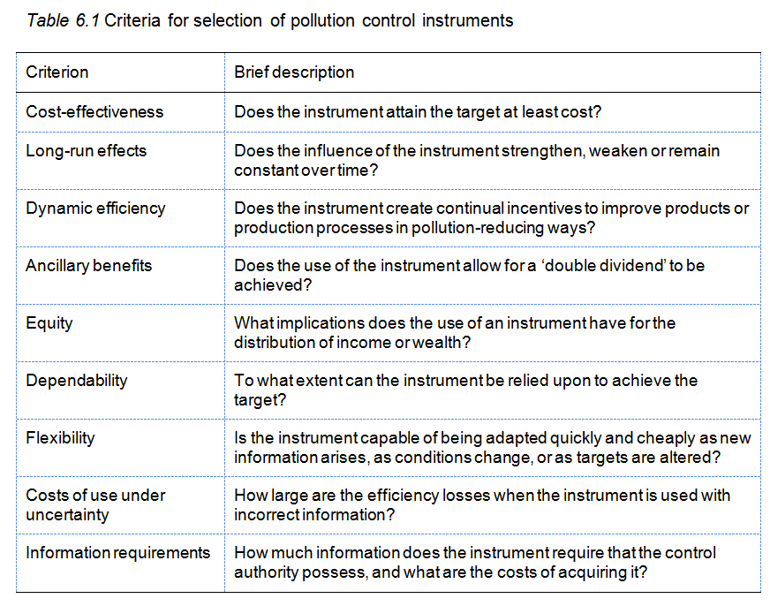

Slide 21
Pollution control instruments available for internalization of externalities:
Institutional approaches
Command and control regulations
Economic incentives (market-based) instruments

Slide 22
1. Institutional approaches
One approach to achieving emissions targets is to improve existing social or institutional arrangements that facilitate environmental damage-reducing voluntary decentralized behaviour.
Facilitation of bargaining
The likelihood of bargaining taking place is low unless enforceable property rights exist
Bargaining is facilitated by the existence of relatively small number of affected parties

Slide 23
Intertemporal bargaining: current and future generation
Unable to bring efficiency in public goods due to:
Non-excludablity
Indivisibility (non-rival)
Government’s role: Facilitate for cost effectiveness through defining property rights, identifying pollution producers and recipient, disclosing information

Slide 24
Liability
Codification of liability for environmental damage
Role of the judiciary system to bring about efficient outcome
Existence of general legal principle which make organizations/persons liable for the adverse external effects of their action
Problem: damage becomes apparent a long time after the relevant pollutants were discharged

Slide 25
Development of social responsibility
Education and socialisation programmes promoting ‘citizenship’
Pollution happen, in the final analysis, because of self-interest, thoughtless and uncoordinated behaviour
Encouraging people to act as responsible citizens
Educational institutions
Mass communication media
‘cultural’ instruments that promote
‘social responsibility’
help achieve specific targets (environmental goals) and to promote ethical behavior.

Slide 26
2. Command and control regulations (emission standard)
Dominant method in most countries
C & C operate by imposing mandatory obligations/ restrictions
Legal limit on the amount of a pollutant that an individual source is allowed to emit.
Direct control over polluters
Externalities are by-products in the production of intended final output
The extent will depend on:
Which goods are being produced and in what quantities-inputs
Production technique
Location of emission source

Slide 27
C & C regulations can be designed to intervene at any of the above stages, but commonly
Non-transferable emission license
Impose minimum technology requirements
Location
C & C regulations can be:
Uniform
Differentiated – require information

Slide 28
Non-transferable emissions licences
It creates licences (also known as permits or quotas) for that total allowable quantity for a particular pollutant.
After adopting some criterion for apportioning licences among the individual sources,
These licenses are non-transferable; that is, the licences cannot be transferred (exchanged) between firms.
Therefore, each firm’s initial allocation of pollution licences sets the maximum amount of emissions that it is allowed.

Slide 29
Successful operation of license schemes is unlikely if polluters believe their actions are not observed, or
if the penalties on polluters not meeting license restrictions are low relative to the cost of abatement.

Slide 30
Instruments which impose minimum technology requirements
Consist of regulations which specify required characteristics of production processes or capital equipment used.
In other words, minimum technology requirements are imposed upon potential polluters.
Sometimes the specific technique adopted is sometimes negotiated between the government and the regulated parties on an individual basis.

Slide 31
Location
Pollution control objectives , in so far as they are concerned only with reducing human exposure to pollutants,
could be met by separating the locations of people and pollution sources.
This is only relevant where the pollutant is not uniformly mixing, so that its effects are spatially differentiated.
Location decisions of this kind will not be appropriate where we are concerned about wider ecosystem impacts or where pollution is uniformly mixing

Slide 32
3. Market-based mechanism
Market based mechanism create incentives to:
Change their behaviour
Change structure of pay-offs
May take the form of:
Tradeable/transferable emission permits
Emission tax – imposition of taxes on polluting emissions
Abatement subsidies- the payment of subsidies for emissions abatement

Slide 33
Advantages:
Static efficiency
Dynamic efficiency
Revenue
Robustness to negotiated emission
Cost limiting properties

Slide 34
Limitations
Uncertain environmental impact
Geographical differences
Compatibility with business decision-making structure
Monopoly polluters
Administrative costs

Slide 35
Transferable Emission Permits
Essentially, the main idea behind transferable emission permits is to create a market for pollution rights.
A pollution right simply signifies a permit which consists of a unit (pound, ton, etc.) of a specific pollutant.
In general, the system of transferable permit operate on the basis of the following basic postulates:
It is possible to obtain legally sanctioned right to pollute
These rights (permits) are clearly defined

Slide 36
The total number of permits and the initial distribution of the total permits among the various polluters are assigned by government agencies.
In addition, polluters emitting in excess of their allowances are subject to a stiff monetary penalty
Pollution permits are freely transferable.
That is, they can be freely traded in the marketplace.

Slide 37
Principal Advantages of Emission Permits
They are least interventionist
They are cost-effective, especially when the number of parties involved in the exchange of permits is large
They provide observable prices for environmental services
They can be applied to a wide range of environmental problems

Slide 38
Disadvantages of Transferable Emission Permits
The mechanisms used to distribute permits among potential users could have significant equity implications.
The idea of permits to pollute conveys, to some, a reprehensible moral and ethical value.
The applicability is questionable for pollution problems with an international scope.

Slide 39
They are ineffective when there are not enough participants to make the market function.
Permits can be accumulated by firms for the purpose of deterring entrants or
by environmental groups for the purpose of attaining the groups’ environmental objectives.

Slide 40
Emissions taxes/ Emissions charges
Direct charges based on quantity and/or quality of a pollutant
An emission charge is a per-unit of pollutant fee, collected by the government.
Charges are economic incentives.
Each firm will independently reduce emissions until its marginal control cost equals the emission charge. This yields a cost-effective allocation
A difficulty with this approach is determining how high the charge should be set in order to ensure that the resulting emission reduction is at the desired level.

Slide 41
Environmental Subsidies
Financial payments designed to reduce damaging emissions or conserve scarce resources.
Two forms:
Subsidy for the cost of pollution abatement
Provide no incentive for abatement in the absence of other policy measures
May increase response to other policy measures
Aim to avoid effect on competitiveness
Marginal abatement subsidy
Would function as abatement incentive
May have the same effect as Pigouvian tax

Slide 42
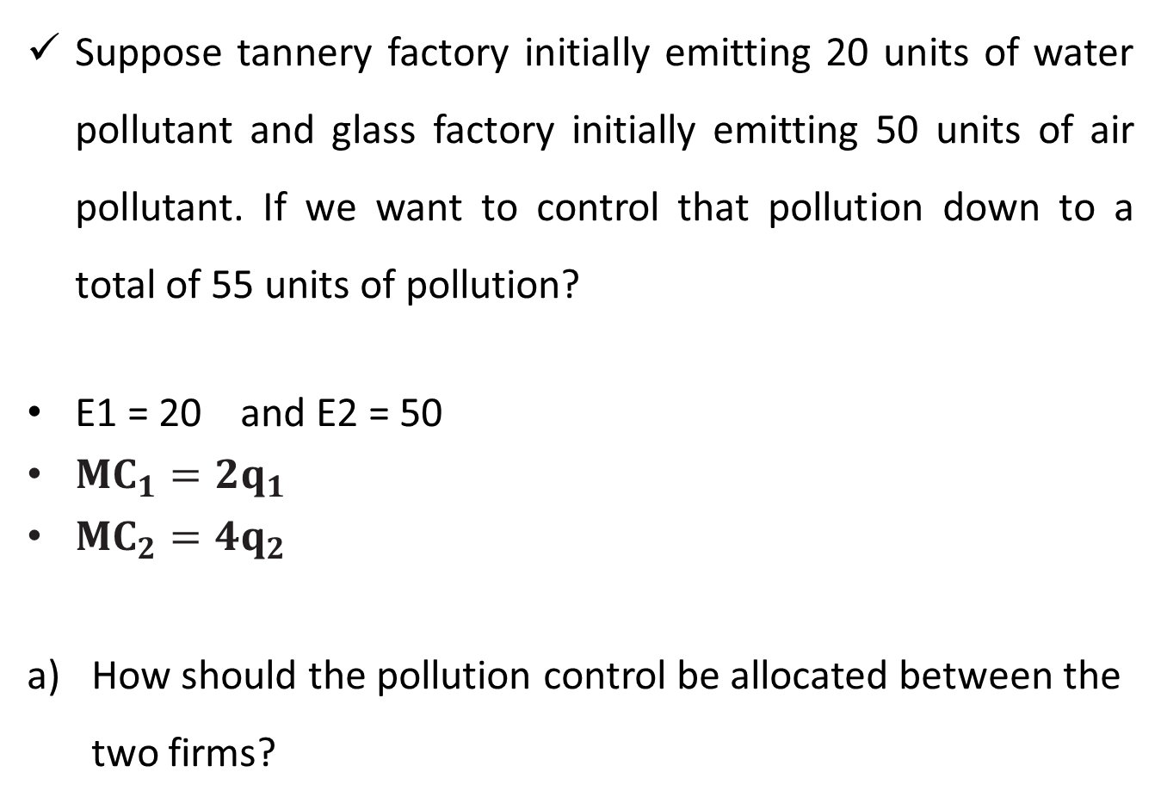
Example 2: Cost-effective pollutant emission
Suppose tannery factory initially emitting 20 units of water pollutant and glass factory initially emitting 50 units of air pollutant. If we want to control that pollution down to a total of 55 units of pollution?
E1 = 20 and E2 = 50
${MC}_{1}={2q}_{1}$
${MC}_{2}={4q}_{2}$
How should the pollution control be allocated between the two firms?

Slide 43
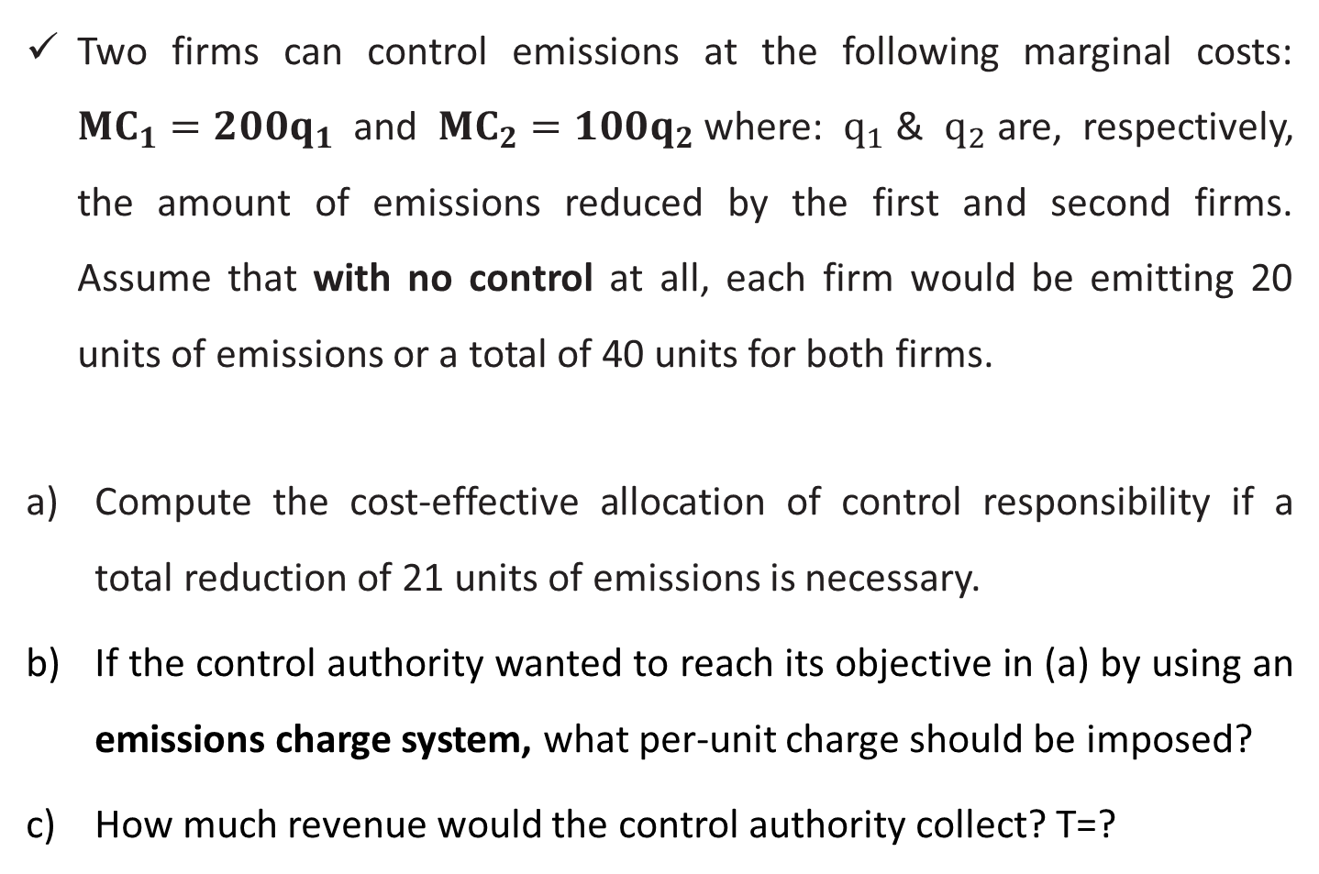
Example 3: Cost-effective pollutant emission
Two firms can control emissions at the following marginal costs: ${MC}_{1}={200q}_{1}$ and ${MC}_{2}={100q}_{2}$where: $q_{1}$& $q_{2}$are, respectively, the amount of emissions reduced by the first and second firms. Assume that with no control at all, each firm would be emitting 20 units of emissions or a total of 40 units for both firms.
Compute the cost-effective allocation of control responsibility if a total reduction of 21 units of emissions is necessary.
If the control authority wanted to reach its objective in (a) by using an emissions charge system, what per-unit charge should be imposed?
How much revenue would the control authority collect? T=?

Slide 44
The End

