Slide 1
5. Economics of Renewable Resources

Slide 2
Flow Renewable resources
Such as solar, wave, wind and geothermal energy.
These energy flow resources are non-depletable.

Slide 3
Stock Renewable Resources
Living organisms: fish, cattle and forests, with a natural capacity for growth
Inanimate systems (such as water and atmospheric systems): reproduced through time by physical or chemical processes
Arable & grazing lands as renewable resources: reproduction by biological processes (such as the recycling of organic nutrients) and physical processes (irrigation, exposure to wind etc.).
Are capable of being fully exhausted.

Slide 4
Key points of interest on renewable resources?
  Private property rights do not exist for many forms of renewable resource
  The resource stocks are often subject to open access; tend to be overexploited
  Policy instruments: relative merits

Slide 5
5.1 Economics of Fishery
Fishery economics is the production, distribution, consumption, all financial aspects of the fishing and seafood industry.
Fishery can be thought as stocks of fish and the enterprises that have the potential to exploit them.
The fish stock measured in terms of biomass, is the natural capital of the system.

Slide 6
Fisheries and Economic Development
Fisheries have multiplier effects on economic development in various ways:
Direct contribution to GDP
Forward and backward linkages (indirect contribution to GDP)
Source of economic profits that can be reinvested (economic growth impacts)
Source of government taxation income
Labor employment & training (creation of human capital)

Slide 7
1) Biological Models of Fish Stock Growth
Fishery resource use decision is influenced by the requirement that the use must be allocated over time to give equal opportunity to future generation.
This requires maintaining maximum sustainable fish yield overtime (MSY) by controlling fish exploitation effort.
Factors determining fish population dynamics:
  Birth rate
  Mortality rate
  Growth rate

Slide 8
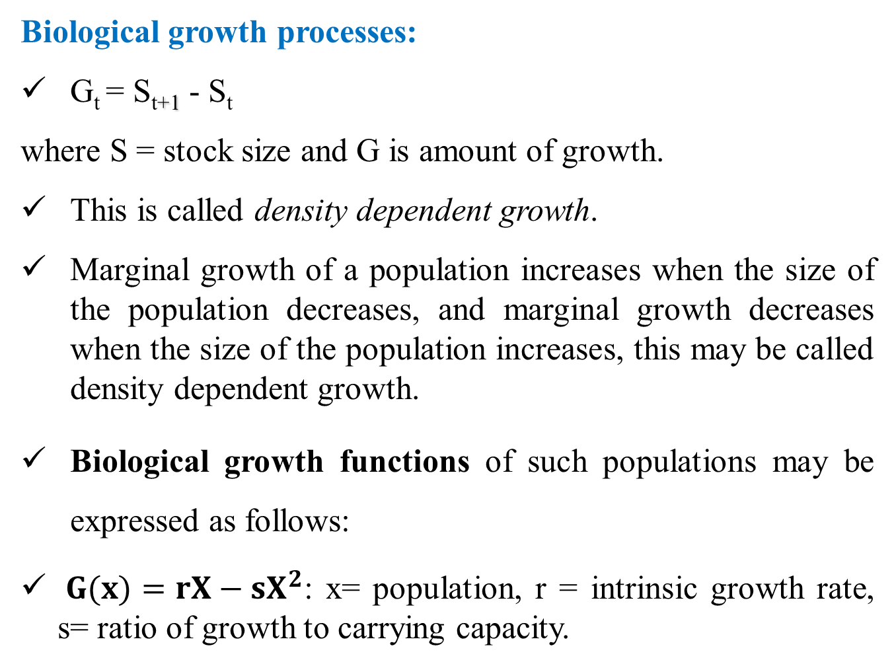
Biological growth processes:
G_{t} = S_{t+1} - S_{t}
where S = stock size and G is amount of growth.
This is called density dependent growth.
Marginal growth of a population increases when the size of the population decreases, and marginal growth decreases when the size of the population increases, this may be called density dependent growth.
Biological growth functions of such populations may be expressed as follows:
${G(x)=rX−sX}^{2}$: x= population, r = intrinsic growth rate, s= ratio of growth to carrying capacity.

Slide 9
In continuous time notation:
G = G(S)
Example: (simple) logistic growth:
Where g is the intrinsic growth rate (birth rate - mortality rate) of the population.
Notes:
Biological growth processes
In order to investigate the economics of a renewable resource, it is first necessary to describe the pattern of biological (or other) growth of the resource. To fix ideas, we consider the growth function for a population of some species of fish. This is conventionally called a fishery.
We suppose that this fishery has an intrinsic (or potential) growth rate denoted by g. This is the proportional rate at which the fish stock would grow when its size is small relative to the carrying capacity of the fishery, and so the fish face no significant environmental constraints on their reproduction and survival. The intrinsic growth rate g may be thought of as the difference between the population’s birth and natural mortality rate (again, where the population size is small relative to carrying capacity). Suppose that the population stock is S and it grows at a fixed growth rate g. In the absence of human predation the population grows exponentially over time at the rate g and without bounds. This is only plausible over a short span of time.
Any population exists in a particular environmental milieu, with a finite carrying capacity, which sets bounds on the population’s growth possibilities.
A simple way of representing this effect is by making the actual (as opposed to the potential) growth rate depend on the stock size. Then we have what is called density-dependent growth.
Now let us suppose that under a given set of environmental conditions there is a finite upper bound on the size to which the population can grow (its carrying capacity). We will denote this as SMAX.
A commonly used functional form which has the properties of “compensation” and a maximum stock size is the simple logistic function, in which the constant parameter g > 0 is what we have called the intrinsic or potential growth rate of the population.

Slide 10
MSY
S_{MAX}
S_{MSY}

Slide 11
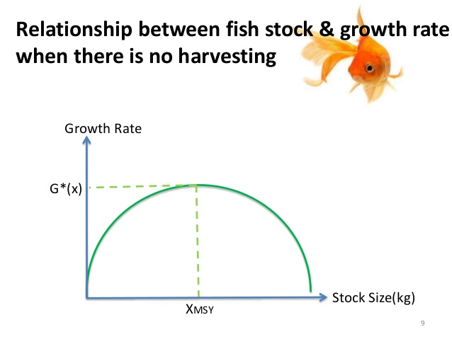

Slide 12
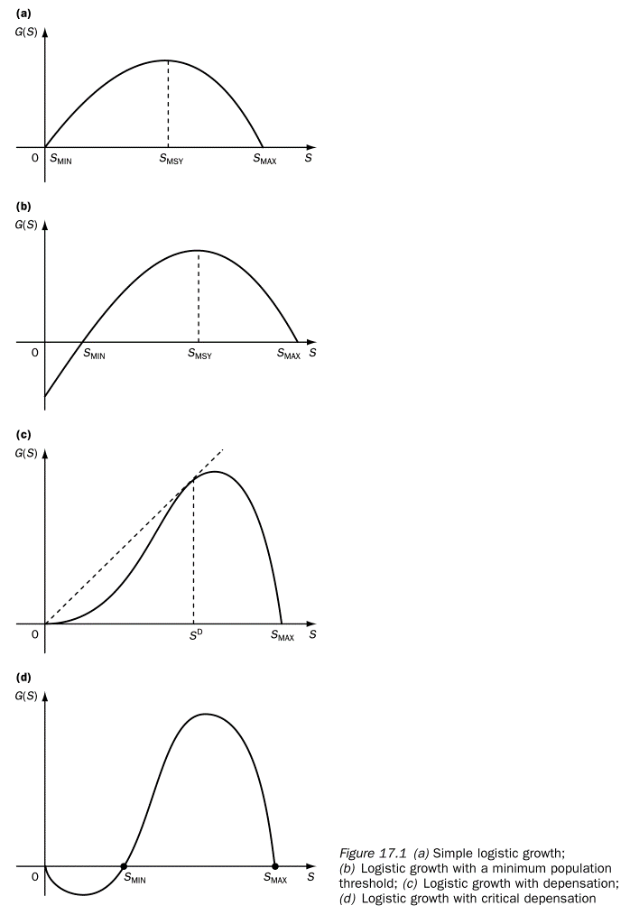
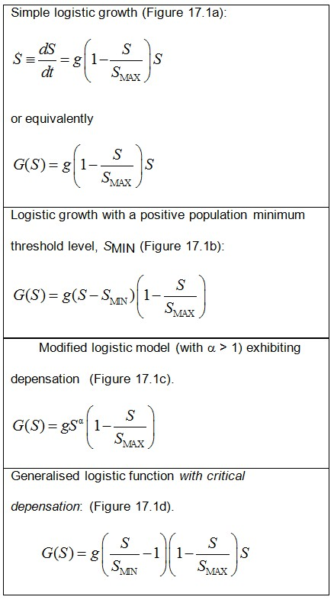

Slide 13
Figure 5.1 Steady-state harvests
Stable harvest where G(x) = H
G, H
Notes:
Much of our attention will be devoted to steady-state harvests.
Consider a period of time in which the amount of the stock being harvested (H) is equal to the amount of net natural growth of the resource (G).
Suppose also that these magnitudes remain constant over a sequence of consecutive periods.
We call this steady-state harvesting, and refer to the (constant) amount being harvested each period as a sustainable yield.
With steady-state harvesting the resource stock remains constant over time.
What kinds of steady states are feasible? To answer this, look at Figure 17.2. There is one particular stock size (SMSY) at which the quantity of net natural growth is at a maximum (GMSY). If at a stock of SMSY harvest is set at the constant rate HMSY, we obtain a maximum sustainable yield (MSY) steady state.
A resource management programme could be devised which takes this MSY in perpetuity.
It is sometimes thought to be self-evident that a fishery, forest or other renewable resource should be managed so as to produce its maximum sustainable yield.
Economic theory does not, in general, support this proposition.
HMSY is not the only possible steady-state harvest. Indeed, Figure 17.2 shows that any harvest level represented by a point on the growth curve is a feasible steady-state harvest, and that any stock between zero and SMAX can support steady-state harvesting. For example, H1 is a feasible steady-state harvest if the stock size is maintained at either S1L or S1U. Which of these two stock sizes would be more appropriate for attaining a harvest level of H1 is also a matter we shall investigate later.

Slide 14
Steady-state harvests
Let H = harvest and G = net natural growth (G)
In steady-state harvesting G = H and so = dS/dt = 0 (the resource stock size remains constant over time).
There are many possible steady states or sustainable yields.

Slide 15
There is one particular stock size at which the quantity of net natural growth is at a maximum.
    Maximum sustainable yield (MSY) steady state.
Many people believe that a renewable resource should be managed to produce its maximum sustainable yield.
Economists do not agree that this is always sensible (but it may be in some circumstances).

Slide 16
Bioeconomic modelling
Biological model predicts the development of the stock without any economic activities → natural equilibrium
For economic analysis production function is needed, how the resource is harvested h = Ex
Further, we need prices to build objective functions for the agents interested in harvesting the stock → economic equilibrium

Slide 17
Schäfer-Gordon model
Gordon (Journal of Political Economy 1954), Schäfer (1957), Scott (JPE 1955)

Slide 18
Biology
Logistic growth F(x)
Biomass x

Slide 19
Logistic function
R: intrinsic growth rate
x: fish stock
K: carrying capacity of the ecosystem

Slide 20
Production
Harvest function:
E: Fishing effort
q: Catchability

Slide 21
Sustainability
F(x) = h
Steady state

Slide 22
Steady state fish stock
Notes:
Graafisesti!

Slide 23
Steady state harvest
Insert steady state stock into production function :
Notes:
Graafisesti

Slide 24
Economics
Assumptions:
Fish price per kg constant
Unit cost of effort c constant (constant marginal cost).
Note marginal revenue not constant.

Slide 25
Optimum
Maximise economic yield by choosing E.
max
FOC:
(7)
Notes:
Graafisesti!

Slide 26
Comparative statics
dE/dR > 0
dE/dK > 0
dE/dc < 0
dE/dp > 0
dE/dq ?

Slide 27
Open access
Unregulated fishing. E.g. no international fisheries agreement.
Fishers (countries) enter into the fishery until profits (rent) is equal to zero.

Slide 28
Open access effort

Slide 29
2) Bio-economic Modelling of Fishery
Bioeconomic model = biological models + economic models
Bioeconomic analysis simulates by combining biological and economic models to provide full information on fisheries utilization and likely policy reforms.
Biological analysis can be used to predict the likely changes in stock sizes resulting from given fishing mortality rates and growth rates.
This can be useful for decision making because it allows for a comparison of status quo and effects of a policy change.

Slide 30
The two models can be combined by calibrating coefficients which transform fishing days into fishing mortality rates.
By combining the two, a bioeconomic model allows for the study of how changes in stock size affect profits and how changes in fishing activity affect stock size.
Conceptual framework for biological & economic models…

Slide 31
Steps in bioeconomic modelling?
Conceptual framework
Sampling (fishing areas, fishermen, ….)
Data collection
  Data: Effort data, biological data, economic data
  Time: Cross sectional or timeseries
Bioeconomic analysis
  Biological parameters
  Economic parameters
Bioeconomic simulation (sensitivity analysis, OMY, MSY, MEY levels)
Fishery policy implication
  Fishing days, fish catch quota,
  Tax/subsidy,
  Fishing technology, …..)

Slide 32
Biological Analysis
Fish mortality rates
Stock size
Fish growth rate
Fig 5.2 Conceptual framework for biological model

Slide 33
Economic Analysis
Fish price
Fishing profit
Fish stock
size
Fishing cost
Days fished
Fig 5.3 Conceptual framework for economic model

Slide 34
Bioeconomic Modelling
Fish price
Fish mortality rates
Fishing Profit
Fish birth rate
Fishing cost
Stock size
Fish growth rate
Days fished
Fig 5.4 Conceptual framework for bioeconomic modelling

Slide 35
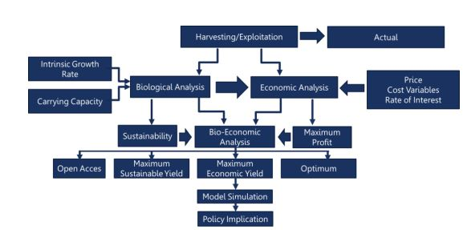

Slide 36
Objectives of bioeconomic modelling?
Bio-economic simulation help:
To indicate fishery dynamics (economic & biologic changes) in relation with the initial values.
To evaluate the effectiveness & efficiency of different policy instruments (taxes/subsidies, control of fleet size, age at first capture trough, gear control, price intervention).
To show the time lag between management decisions and their consequences (short & long term consequences)

Slide 37
Basic biological theory and economic theory needed to study bio-economic equilibrium.
Fishery bioeconomic equilibrium can be studied in two ways:
  Open access fishery
  Private property fishery

Slide 38
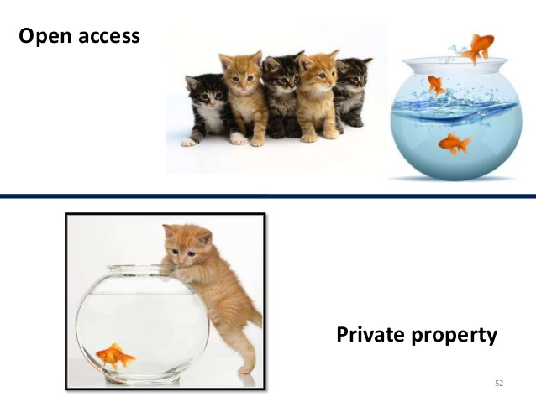

Slide 39
Open access equilibrium
When all of the excess profits or economic rent of fishery equal to zero.
TR – TC = 0
The fishery is no longer attractive to new entrants.

Slide 40
The Sustainable Fisheries Model
Costs
Value,
$
Sustainable
revenues (yield)
OSY
MSY
Effort
Sustainable
biomass
Biomass

Slide 41
Short run and Long run Analysis
We can determine fishing efforts (number of days at sea per year) and harvests using short run and long run simulations:
Current fishing effort is taken as reference point to determine MSY & MEY in the short-run and long-run.

Slide 42
Short-run sustainable fishery policy
All costs are fixed and other variable costs.
Reference point | No of vessel | Effort (day at sea) | Total revenue | Variable cost | Wage | Fixed | Total cost | Net benefit
Current situation | 60 | 145 | 4000 | 1000 | 850 | 3000 | 4850 | -850
Breakeven (BE) | 60 | 120 | 5000 | 950 | 1050 | 3000 | 5000 | 0
MSY | 60 | 80 | 8500 | 500 | 500 | 3000 | 4000 | 4,500
MEY | 60 | 60 | 12000 | 250 | 350 | 3000 | 3600 | 8,400

Slide 43
Long-run sustainable fishery policy
All inputs can be varied (reduced or increased), hence all costs variable.
Because the fisherman can adjust to change inputs in the long run as per the tendency of the prevailing economy.
Reference point | No of vessel | Effort (day at sea) | Total revenue | Variable cost | Wage | Fixed | Total cost | Net benefit
Current situation | 60 | 60 | 3500 | 1000 | 850 | 1250 | 3100 | 4,00
OMY (BE) | 40 | 72 | 3500 | 950 | 800 | 1750 | 3500 | 0
MSY | 20 | 65 | 8000 | 500 | 500 | 850 | 1,850 | 6,150
MEY | 10 | 32 | 10000 | 450 | 550 | 800 | 1,800 | 8,200

Slide 44
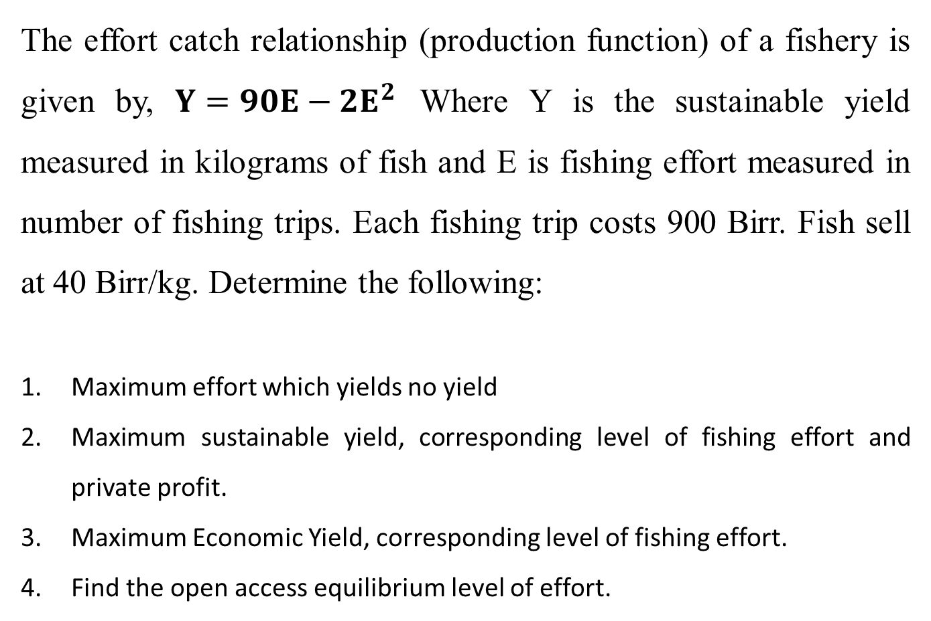
Example 1: Fishery harvest function
The effort catch relationship (production function) of a fishery is given by, ${Y=90E−2E}^{2}$ Where Y is the sustainable yield measured in kilograms of fish and E is fishing effort measured in number of fishing trips. Each fishing trip costs 900 Birr. Fish sell at 40 Birr/kg. Determine the following:
Maximum effort which yields no yield
Maximum sustainable yield, corresponding level of fishing effort and private profit.
Maximum Economic Yield, corresponding level of fishing effort.
Find the open access equilibrium level of effort.

Slide 45
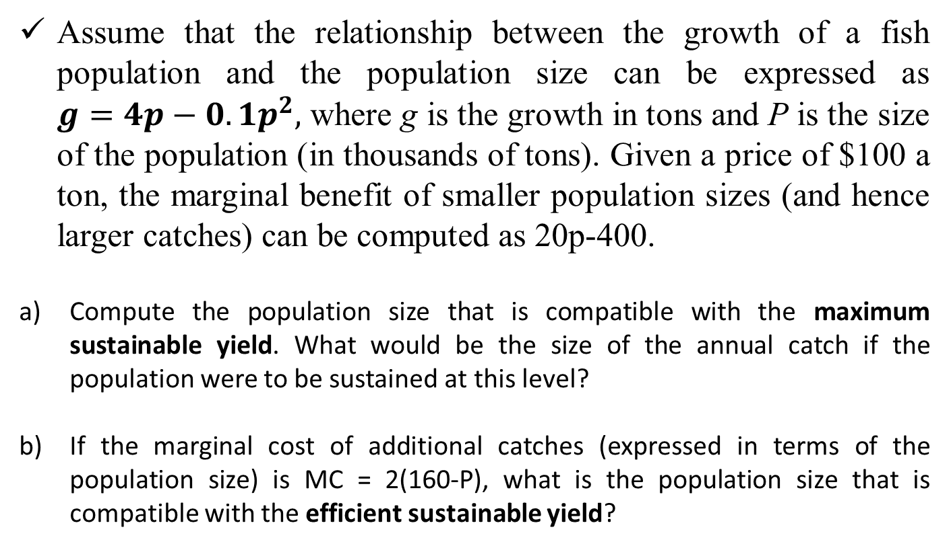
Example 2: Fishery biomass growth function
Assume that the relationship between the growth of a fish population and the population size can be expressed as ${g=4p−0.1p}^{2},$ where g is the growth in tons and P is the size of the population (in thousands of tons). Given a price of $100 a ton, the marginal benefit of smaller population sizes (and hence larger catches) can be computed as 20p-400.
Compute the population size that is compatible with the maximum sustainable yield. What would be the size of the annual catch if the population were to be sustained at this level?
If the marginal cost of additional catches (expressed in terms of the population size) is MC = 2(160-P), what is the population size that is compatible with the efficient sustainable yield?

Slide 46
5.2 Economics of Forestry
Multiple use of forestry requires optimal biological and economic rotation age.
Efficient forest management not straightforward:
    Multiple uses of forests
    Conflicting uses
    Slower maturity
    Irreversibility

Slide 47
1) Biological Rotation Age
The biological growth of a tree is denoted by Mean Annual Increment (MAI).
Tree growth depends on different biophysical features:
  Soil type, fertility, …
  Tree species
  Tree size (diameter)
  Density of stand
  Disease, temp, …

Slide 48
Forest growth cycle:
  Volume increases (first increasing rate, then decreasing rate)
  Maturity (biological optimal age)
  Mortality
When to harvest a tree stand using biological criteria?

Slide 49
Forest Biology
Stand
Volume
S(t)
Maturity
Mortality
MAI
Time (years)
t*

Slide 50
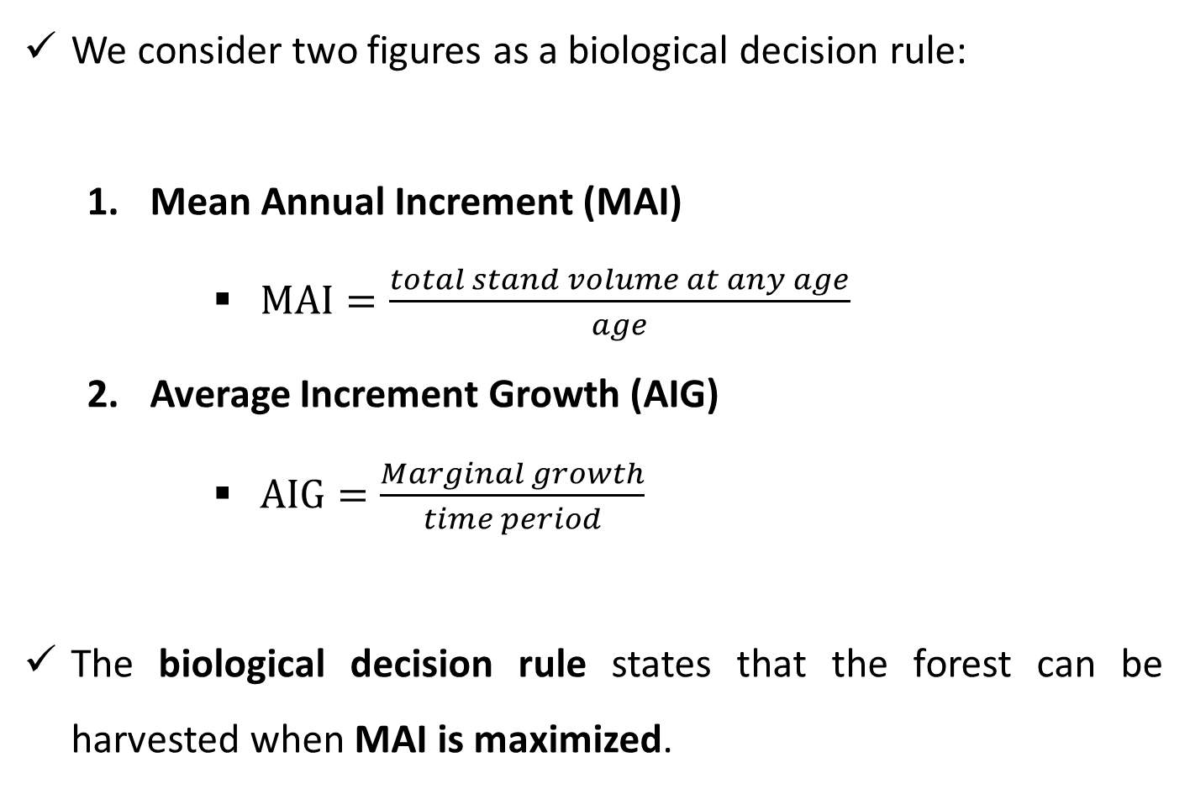
We consider two figures as a biological decision rule:
  Mean Annual Increment (MAI)
      $MAI=\frac{total stand volume at any age}{age}$
  Average Increment Growth (AIG)
      $AIG=\frac{Marginal growth}{time period}$
The biological decision rule states that the forest can be harvested when MAI is maximized.

Slide 51
The rotation age that maximizes the MAI is defined as the optimal biological rotation age.
Tree age with maximum volume per tree age (MAI) alone is considered.
But, biological harvesting criteria fails to consider economic criteria (costs, prices, revenue, and time value of money).

Slide 52
2) Economically Optimal Rotation Age
Economically optimal time of harvest is when the net present value (NPV) of the forest is maximized.
Must compare annual growth in timber value against the cost of holding the timber for an extra year.
Must consider the marginal benefits and marginal costs of growing the forest one additional year.

Slide 53
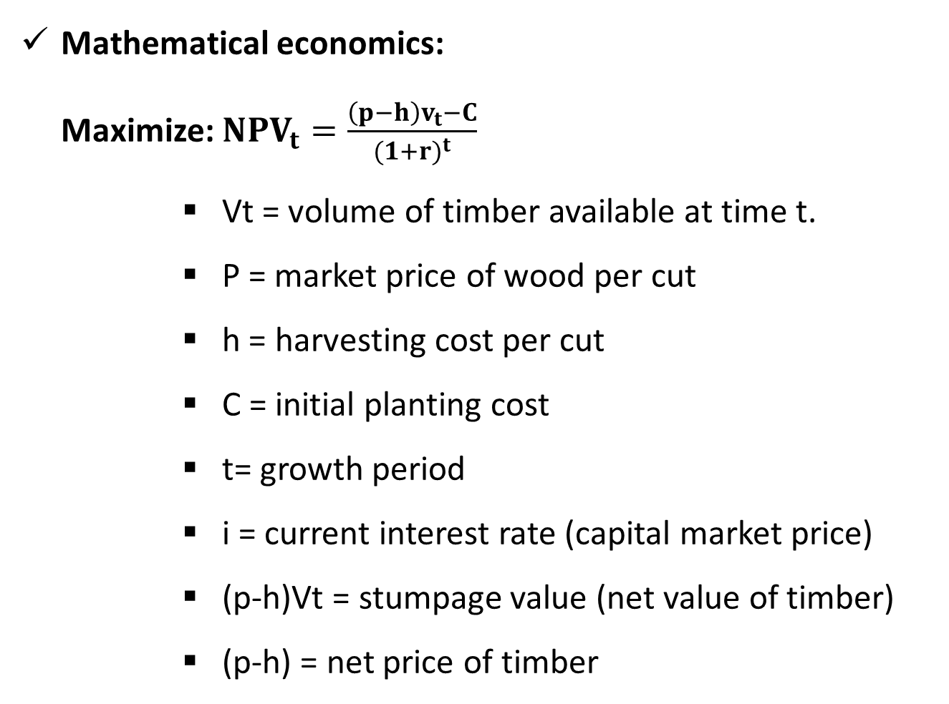
Mathematical economics:
Maximize: ${NPV}_{t}=\frac{\left(p−h\right)v_{t}−C}{{(1+r)}^{t}}$
      Vt = volume of timber available at time t.
      P = market price of wood per cut
      h = harvesting cost per cut
      C = initial planting cost
      t= growth period
      i = current interest rate (capital market price)
      (p-h)Vt = stumpage value (net value of timber)
      (p-h) = net price of timber

Slide 54

Economic optimum age:
$$i=\frac{\frac{dS}{dt}}{St} or iSt= \frac{dS}{dt}$$
i = interest rate
S = function of stand volume
t = time in years

Slide 55
Forest bioeconomic decision (p= 15 birr, h = 10 birr, r = 12%, planting cost = 850)
Biological |  |  |  | Economic
Age (years) | Volume | MAI | AIG | Stumpage value | Planting cost | Net benefit | Discount factor | NPV
5 | 860 | 172 | 172 | 4300 | 850 | 3450 | 0.567427 | 1957.623
10 | 1876 | 187.6 | 203.2 | 9380 | 850 | 8530 | 0.321973 | 2746.432
15 | 4560 | 304 | 536.8 | 22800 | 850 | 21950 | 0.182696 | 4010.183
20 | 9800 | 490 | 1048 | 49000 | 850 | 48150 | 0.103667 | 4991.555
25 | 12560 | 502.4 | 552 | 62800 | 850 | 61950 | 0.058823 | 3644.104
30 | 17580 | 586 | 1004 | 87900 | 850 | 87050 | 0.033378 | 2905.548
35 | 24590 | 702.57 | 1402 | 122950 | 850 | 122100 | 0.01894 | 2312.517
40 | 25600 | 640 | 202 | 128000 | 850 | 127150 | 0.010747 | 1366.455
45 | 4590 | 102 | -4202 | 22950 | 850 | 22100 | 0.006098 | 134.7663
50 | 2730 | 54.6 | -372 | 13650 | 850 | 12800 | 0.00346 | 44.29032

Slide 56
Biological decision:
  Harvest when the tree reaches the age of maximum MAI.
  It is 35th year.
Economic decision:
  Harvest when the tree reaches the age of maximum NPV.
  It is at 20th year.

Slide 57
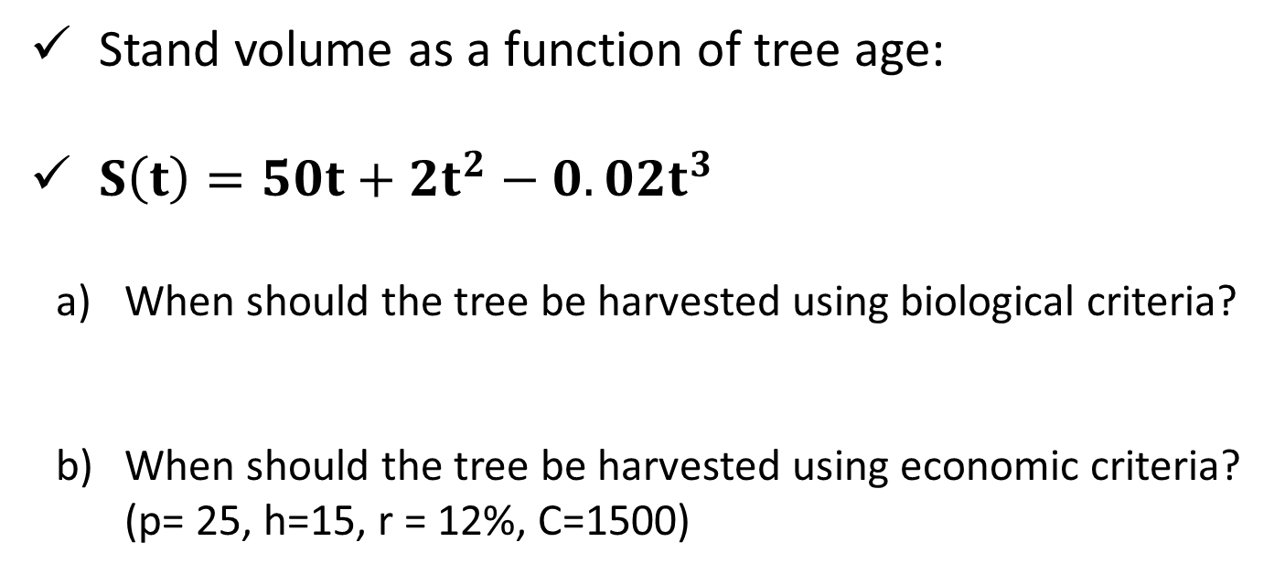
Example 2: Optimal forest harvest time
Stand volume as a function of tree age:
${S\left(t\right)=50t+2t}^{2}−0.02t^{3}$
When should the tree be harvested using biological criteria?
When should the tree be harvested using economic criteria? (p= 25, h=15, r = 12%, C=1500)

Slide 58
Renewable resources policy
Command-and-control
Quantity restrictions on catches (aggregate total allowable catches)
Fishing season regulations (time closure)
Area closure (endangered areas)
Technical restrictions on the equipment used (e.g: restrictions on fishing gear, mesh or net size, or boat size).
Incentive-based policies
Restrictions on open access/property rights
Fiscal incentives (tax/subsidy)
Establishment of forward or futures markets
Marketable permits (‘individual transferable quotas’, ITQ)

