Slide 1
3. Economic Analysis Methods in Natural Resource Management

Slide 2
3.1 Economic Analysis of
  Natural Resource Management
Economic analysis is all about evaluation of the impact, feasibility, and effectiveness of environmental projects on social, financial, economic, health, environmental aspects using economic analysis tools.

Slide 3
Fig 3.1 Illustration of Interventions, Impacts, and Tools
NRM Intervention
Social
Economic Environmental impact
Impact
Feasibility
Effectiveness
Economic Analysis Tools

Slide 4
Economic evaluation studies evaluate the outcomes and costs of interventions in relation to interventions designed to improve natural resource base (soil, water, forest, wildlife, ….).

Slide 5
Economic evaluation comparatively analyses the costs and effects of two or more interventions.
A new intervention is compared with the existing natural resource management strategy/ies (the standard intervention or no intervention at all).

Slide 6
Which economic analysis methods/tools do we have at hand to prioritize or choose natural resource management interventions?

Slide 7
3.2 Economic Analysis Methods/Tools in NRM
We do have handy tools to make informed decisions and policy reforms in Natural Resources Management:
Cost-effectiveness Analysis (CEA)
Cost-benefit Analysis (CBA)
Impact Analysis
Multicriteria analysis (MCA)

Slide 8
Remember please:
No any tool is best in itself.
One complements what is missing on the other.
They are necessary decision-support tools, but are not sufficient to choose and prioritize development intervention.

Slide 9
1. Cost-Effectiveness Analysis (CEA)
CEA is finding the least cost of realizing an outcome(effect) from among a number of possible alternative interventions.
It is the extent to which the program has achieved or is expected to achieve its results at a lower cost compared with alternatives.

Slide 10
It estimates inputs (costs) in monetary terms and outcomes (benefits) in non-monetary quantitative physical terms.
Example:
Reductions in soil erosion hazards
Increase in ground water potential
Improvement in biodiversity
Increase in forest density
Increased employment opportunities
Reductions in illegal encroachment

Slide 11
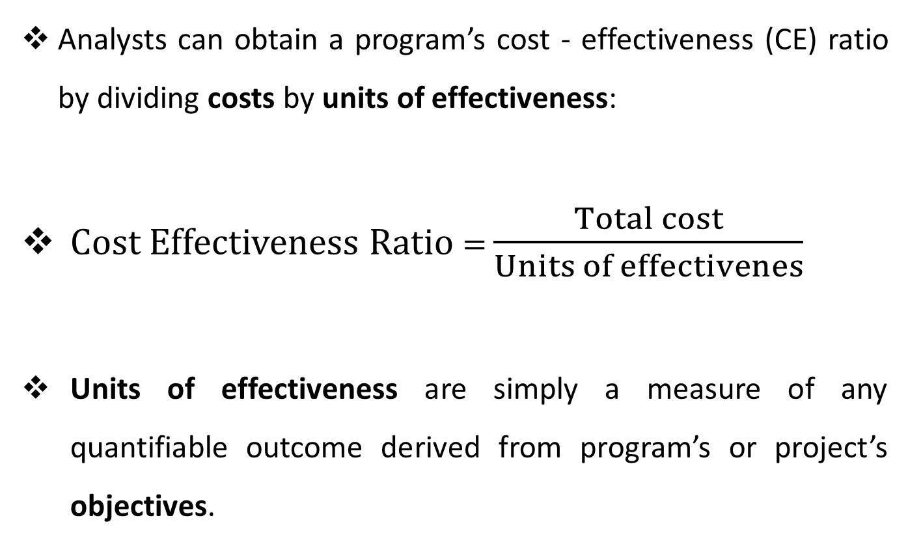
Analysts can obtain a program’s cost - effectiveness (CE) ratio by dividing costs by units of effectiveness:
Cost Effectiveness Ratio = $\frac{Total cost}{Units of effectivenes}$
Units of effectiveness are simply a measure of any quantifiable outcome derived from program’s or project’s objectives.

Slide 12
Example 1:
Program | Soil conservation program
Objective | To save soil from erosion
Alternatives | Constructing gabion check-dam
 | Agroforestry campaign
 | Plantation at mountains and bare areas
 | Terracing
Cost-Effectiveness measure:
(Total cost of a given alternative)/(Amount of soil saved in physical units, e.g: 5,000 ton/year)

Slide 13
By dividing costs by the number of outcome measures, we can calculate a cost-effectiveness ratio, interpreted as “Birr per outcome achieved”.
Compare this CE ratio to the CE ratios of other alternative policy options to determine which policy costs less per unit of outcome (e.g # soil saved).
We focus on one primary outcome in CEA, but the analyst can CE ratios for other multiple outcomes of interest as well.
CEA becomes more complex when there are multiple outcomes.

Slide 14
Program/project | Biodiversity restoration
Objectives | To achieve higher amount of species diversity
 | To restore forest coverage
 | To maximize timber production
Alternatives | Establishing national parks
 | Fencing marginalized areas
 | Plantation at mountains
Cost-Effectiveness measures:
Total cost/Species diversity in physical units
Total cost/Forest coverage in physical units
Total cost/Timber harvest in physical units

Slide 15
Example 1: using CEA to choose climate change adaptation options
Suppose climate modeling projections for the coming 10 years simulate that climate change would hardly hit 18,000 households while top 4 climate change adaptation project interventions available:
Crop diversification
Tree plantation
Household based-irrigation schemes
Drought tolerant varieties

Slide 16
Costs (monetary term) and outcomes (physical term):
Adaptation Projects | Costs (Birr) | Outcomes (# adapting households) | CE ratio
Crop diversification | 14 million | 1,000 households | 14,000
Tree plantation | 15 million | 2,000 households | 7,500
Household based-irrigation | 45 million | 8,000 households | 5,625
Drought tolerant varieties | 110 million | 12,000 households | 9,166.7
Which adaptation intervention is cost-effective?

Slide 17
Example 2: using CEA to choose alternatives to secure biodiversity conservation (3 goals + 3 alternatives)
Alternatives
Goals | 1. Establish protected area | 2. Community involvement | 3. Financial incentives, tax harmful activities | Weights
1. Improve an indicator of biodiversity | +5% | +1% | +8% | 3
2. Employment | -1% | +2% | -1% | 1.5
3. Other environmental benefits | +2% | 0% | +7% | 1
Cost | $1m | $0.6m | $2m | -
Weighted score of benefits | 15.5 | 6.0 | 29.5 | -
Cost-effectiveness indicator | 0.064 | 0.1 | 0.067 | -
Which biodiversity conservation is cost-effective?

Slide 18
These goals are not equally important:
  Take ‘other environmental benefits’ benchmark (numeraire).
  Employment is 1.5 times important (weight = 1.5).
  Conserving biodiversity is 3 times important (weight = 3).
  Aggregating weighted benefits by summing benefit scores.
  E.g: Community invol’t = (1*3)+(2*1.5)+(0*1) = 6

Slide 19
Limitations of Cost-Effectiveness Analysis
Disregarding multiple outcomes by selecting one.

Slide 20
2. Cost-Benefit Analysis (CBA)
Measures both inputs and outputs in monetary terms.
Evaluates if implementing an intervention (policy, program, project) is worth from societal perspective.

Slide 21
 | Intervention (program or project)
 | Public (society) | Private
Perspective | Society/country | Individuals
Objective | Selection of projects benefiting most to national economy | Profitability
Pricing (costs & benefits) | Economic price | Market prices
Analysis | Economic cost benefit analysis | Financial cost benefit analysis
Methods | ENPV, EBCR, EIRR, PBP | FNPV, FBCR, FIRR, PBP

Slide 22
BCA is calculated as the ratio of discounted values of benefit streams to discounted values of cost streams.
A project or policy is profitable to society if the economic (social) benefits exceed the economic(social) costs.

Slide 23
Decision Rules
The basic decision rule for accepting a project or policy:
1. NPV
  Accept the project if NPV is positive
  Reject the project if NPV is negative
2. IRR
  Accept the project if IRR> r
  Reject the project if IRR< r

Slide 24
3. BCR
Accept the project if BCR > 1
Reject the project if BCR<1
4. NBCR
Accept the project is NBCR > 0
Reject the project if NBCR< 0

Slide 25
Rigorous CBA requires:
  Access to extensive empirical data
  Collecting primary data
  High level technical skill on the part of the analysts
  Long time to carry out data analysis

Slide 26
Steps of Cost Benefit Analysis
1. Identify cost and benefit items of the intervening project
2. Valuation of costs and benefits
    Market price for Financial analysis and
    Economic price for Economic analysis
3. Cost Benefit Analysis/feasibility study/ using
    Discounted measures (NPV, BCR, NBCR, IRR) and
    Non-discounted measures (PPB, Ranking many projects)

Slide 27
Example 1: CBA of biodiversity conservation
Project year
Costs & benefits | Year 1 | Year 2 | Year 3 | Year 4 | Year 5
Benefit | 0 | 540,000 | 2,040,000 | 4,040,000 | 6,040,000
Cost | 200,000 | 200,000 | 500,000 | 500,000 | 600,000
DF@ r=10% | 0.909 | 0.826 | 0.751 | 0.683 | 0.621
Discounted benefit | 0 | 446040 | 1532040 | 2759320 | 3750840
Discounted cost | 181800 | 165200 | 375500 | 341500 | 372600
PVB = (DB-DC) | -181800 | 280840 | 1156540 | 2417820 | 3378240
NPV = ΣPVB | 7,051,640

Slide 28
Example 2:
Comparing: Mining vs conservation of biodiversity?
Which policy option/intervention should we pass on?
How can we decide either?
    CBA comparison of mining and conservation.

Slide 29
 | Mining | Conservation
What to compare? | CBA | WTP if no property right
 |  | WTA if there is property right
Decision | WTP > CBA = conservation WTP < CBA = mining

Slide 30
How we aggregate WTP?
To obtain biodiversity conservation benefit estimate from respondents, a WTP question rather than a WTA will be prepared.
Prepare WTP question survey:
Collect socio-economic and environmental valuation questions (WTP) in double-bounded choice formats like:
    A. 0-10 birr B. 10-20 C. 20-30, or
    A. 10-20 birr B. 20-30 C. 30-40

Slide 31
2. Aggregation of environmental conservation value:
Multiply median/mean WTP amount by the number of respondents (say 14,000 households).
This results in an estimate of the value for conserving the biodiversity (say 405 million).
3. Comparison of WTP and NPV of project
Aggregate WTP is compared to NPV of mining project (209 million) at 5% discount rate.
4. Decision on which policy option to implement

Slide 32
Example 3:
Should Sentera wetland be for farmland or preserved?
As chief environmental decision maker, how can you persuade investment office?
How can we decide?

Slide 33
3. Impact Analysis
Impact evaluation is the systematic identification of the effects – positive or negative, intended or unintended – on individual households, institutions, and the environment caused by a given development activity such as a program or project.
Impact evaluation helps us better understand the extent to which activities reach the poor, and the magnitude of their effects on people’s welfare.

Slide 34
Thematically, impact evaluation ranges:
  Social-economic impact
  Health impact, and
  Environmental impact analysis (EIA).

Slide 35
Spatially, impact evaluations ranges:
Large scale sample surveys in which project populations and control groups are compared before and after, and possibly at several points during program intervention;
Small-scale rapid assessment and participatory appraisals where estimates of impact are obtained from combining group interviews, key informants, case studies and available secondary data.

Slide 36
Spatial unit of analysis for economic impact evaluation:
  Micro level (household, firm, ecosystem, watershed)
  Meso level (regional) and
  Macro level (nation wide) to substantiate (quantify) the impact of NRM project interventions.

Slide 37
Economic Impact evaluation models using Stata software:
  DID: baseline (before) & follow-up (after) data
      Package: ssc install diff
      Syntax: diff y, t(treated) p(time)
  PSM (treatment vs control data)
      Package: ssc install psmatch2, replace
      Syntax: psmatch2 t x1 x2, out(y)
  GPSM (if intervention increases by 25%, 50%, 75%)
  Endogenous switching regression (movestay)
  CGE (macro level impact simulation)

Slide 38
Consider for instance the basic macroeconomic equation in an open-economic system:
Y = C + I + G + X-M
What happens to national income (economic impact) if land rehabilitation project interventions are made in an area where there has been severe land degradation? What would be their multiplier effect at national economy?
  Consumption?
  Income?
  Employment created?
  Yield improvement?

Slide 39
Example 1: Micro level Impact Evaluation
Impact = f(New program, socio-economic, bio-physical …)
The Impact of [NRM Program] on [Social, Env’tal, Economic…]
Comparison of groups is the next step!

Slide 40
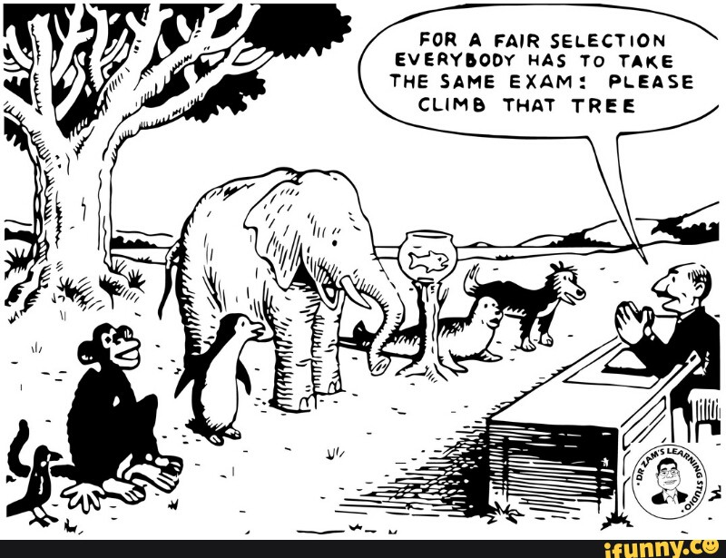
Comparison Context?

Slide 41
Intervention Grouping:
The intervention has two groups:
Treatment group/Experimental group:
Treated with NRM intervention
Control group:
Not treated with NRM intervention

Slide 42
Random groups | Pre-test | Intervention (t) | Post-test
Treatment group | Measure outcome variable (Y) | ‘Treatment’ | Measure outcome variable (Y)
Control group | Measure outcome variable (Y) | ‘No treatment’ | Measure outcome variable (Y)

Slide 43
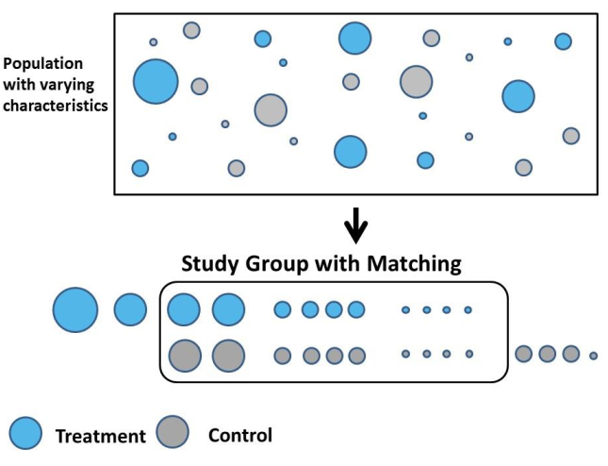

Slide 44
Intervention 1: Crop Diversification
Research Title 1:
“Impact of Crop Diversity on Food Security of Households”
Stata Syntax (impact evaluation regression):
teffects psmatch (y) (t x1 x2, probit), ate
teffects psmatch(outcome) (treatment covariates, probit), ate
teffects psmatch (food2200) (cropdiv age market, probit), ate

Slide 45
Intervention 2 : Conservation Agriculture
Research Title 2:
“Impact of Conservation Agriculture on Yield of Households”
Stata Syntax (impact evaluation regression):
teffects psmatch (y) (t x1 x2, probit), ate
teffects psmatch(outcome) (treatment covariates, probit), ate
teffects psmatch(yield) (ConservationAgri age market, probit), ate

Slide 46
Examples of Micro “Intervention-Impact” scenarios
NRM Intervention | Impact Evaluation | Data sources
Conservation Agriculture | Food security, yield, soil fertility | Field data, household survey, extension office, NRM office
Organic fertilization | yield, soil fertility | Field data, household survey, extension office, NRM office
Water harvesting technologies | Food security, poverty, livestock feed, crop yield | Field data, Household survey, NRM office, BoFED
Mountain ecosystem management | Wetland sust’y, irrigation access | Field data, Household survey, BoIWE, NRM office
Tree plantation | Soil fertility, vegetative cover, wildlife | Field survey, Household survey, BoIWE, NRM office

Slide 47
Examples of Macro “Intervention-Impact” scenarios
NRM Intervention | Impact Evaluation | Data sources (time series )
National parks expansion | Tourism revenue, national income, employment, wages, | Tourism office, MoFED, HICES, EWCA
Biodiversity conservation | Economic growth, species richness | MoFED, BoFED, EWCA, EIB
Mountain ecosystem management | Irrigation water + Hydropower sustainability | MoEFCC, MoFED, HICES,
Eco-tourism investment | Aggregate consumption, national income, public spending, ..) | EWCA, Tourism office, MoFED

Slide 48
4. Multicriteria Analysis (MCA)
CBA is applied for strategies that have clearly identified,
quantifiable outputs and monetary values.
CEA is more useful approach if outputs can be quantified but difficult to value in monetary terms.
Both, CBA & CEA considers only economic criteria leaving non-economic questions not answered!

Slide 49
What if project outputs are non-economic (neither quantifiable nor monetizable)?
Multi-criteria analysis (MCA) is preferred.
MCA is an innovative approach to guide priority setting in national policy and planning.

Slide 50
Where outputs cannot easily be quantified, MCA which scores project performance rather than quantifying it, may be more helpful than CBA & CEA.
It covers economic and non-economic criteria (social, cultural, ethical, environmental, political, health,…….).

Slide 51
It is also called “qualitative CBA”.
It is a community-based process led by facilitators and develops “shared learning dialogues”.
It involves a significant effort to bring in all community members who are likely to be most affected (e.g by climate change, soil erosion, land degradation, …) requiring chosen intervention.

Slide 52
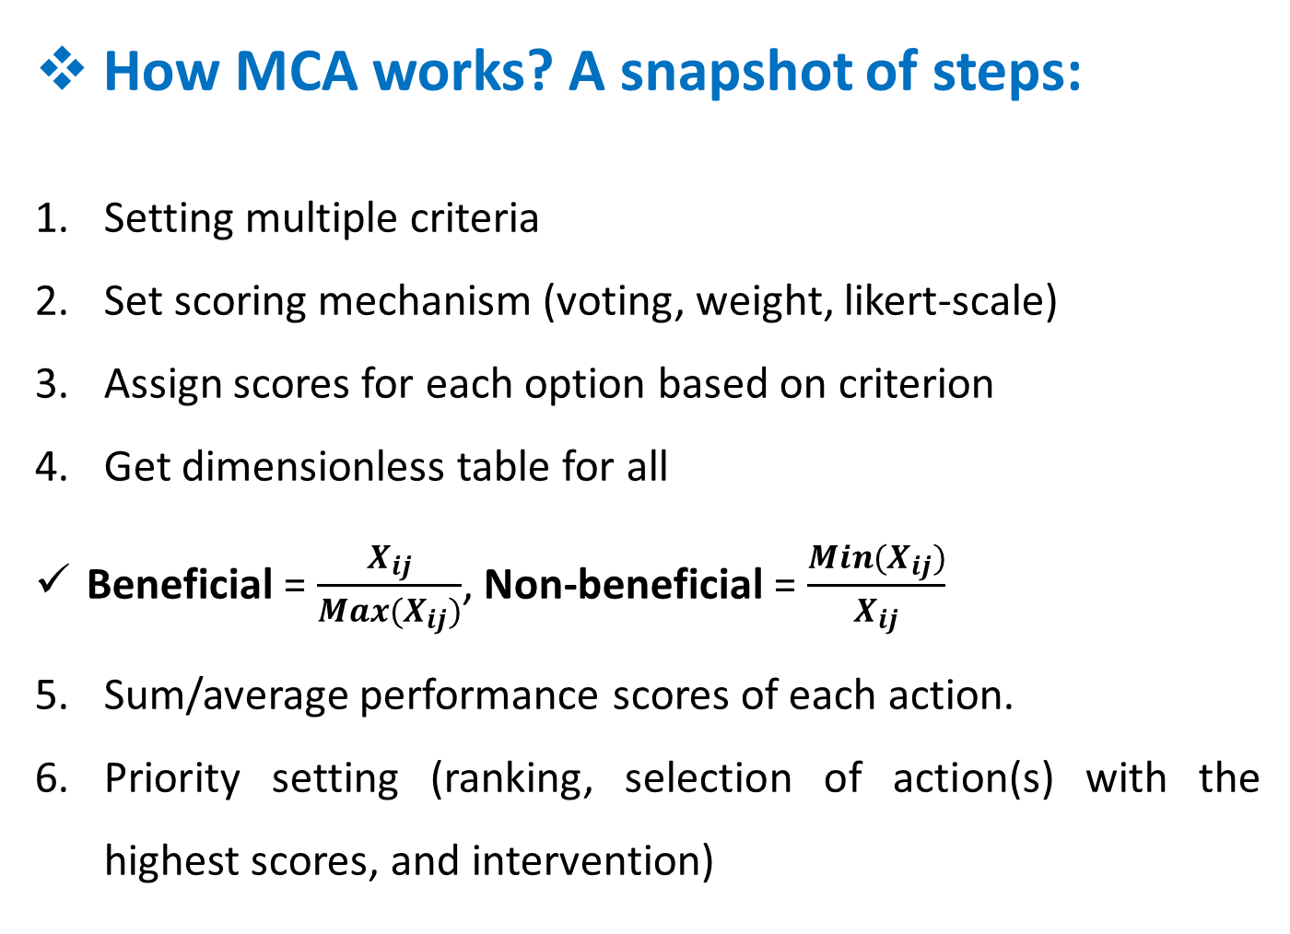
How MCA works? A snapshot of steps:
Setting multiple criteria
Set scoring mechanism (voting, weight, likert-scale)
Assign scores for each option based on criterion
Get dimensionless table for all
Beneficial = $\frac{X_{ij}}{Max(X_{ij})}$, Non-beneficial = $\frac{{Min(X}_{ij})}{X_{ij}}$
Sum/average performance scores of each action.
Priority setting (ranking, selection of action(s) with the highest scores, and intervention)

Slide 53
Sampling Techniques in MCA?
Deliberative polling:
Gather affected community
Inform future challenges and allow them for choice/voting.
2. Jurors group:
Engage high level experts
Supposed to represent community
They scrutinize information, cross-examine evidences, and prioritize policy recommendations.
3. Choice Experiment
Larger sample size with attribute setting
Mixed logit regression (mxlogit syntax)

Slide 54
Example 1: Adaptation strategy choice: qualitative CBA
Suppose climate change affected communities are allowed to prioritize adaptation strategies:
Both economic and non-economic criteria set
Members of the community provide scoring
Scoring facilitator monitors the process
Scoring scale from 0-5 done

Slide 55
Based on MCA, which strategy should be chosen first?
 | Cost scores |  |  |  | Benefit scores |  |  |  | B/C ratio
Adaptation strategies | Envtl | Ecoc | Social | Total | Envtl | Econc | Social | Total
Minimum tillage | 0 | 2 | 1 | 3 | 5 | 4 | 4 | 13 | 4.33
Planting degraded land | 0 | 3 | 1 | 4 | 5 | 5 | 5 | 15 | 3.75
Construct check-dam | 1 | 5 | 3 | 9 | 5 | 4 | 4 | 13 | 1.44
Protect water sources | 0 | 4 | 3 | 7 | 5 | 5 | 5 | 15 | 2.14

Slide 56
Based on MCA, which transport option should be installed?
 |  | Transport options (passing through forest)
Multiple criteria |  | Only Highway | Highway + Buses | Railway | Weight
 | Provision cost (million dollars) | 250 | 300 | 500 | 0.3
 | Co2 emission (thousand tones/year) | 1,000 | 800 | 200 | 0.3
 | Wildlife negative impact (qualitative) | 3 | 3 | 2 | 0.2
 | Time saving (million hours/year) | 10,000 | 8,000 | 6,000 | 0.2

Slide 57
Dimensionless performance scoring & ranking
 |  | Transport options (passing through forest)
Multiple criteria |  | Only Highway | Highway + Buses | Railway | Weight
 | Provision cost (million dollars) | 1.00 | 0.83 | 0.50 | 0.3
 | Co2 emission (thousand tones/year) | 0.20 | 0.25 | 1.00 | 0.3
 | Wildlife negative impact (qualitative) | 0.67 | 0.67 | 1.00 | 0.2
 | Time saving (million hours/year) | 1.00 | 0.80 | 0.60 | 0.2
 | Performance score | 0.694 | 0.618 | 0.77
 | Ranking | 2nd | 3rd | 1st

Slide 58
Based on MCA, which energy policy should be prioritized?
 |  | Energy policies
Multiple criteria |  | Electricity | Solar | Firewood | Wind | Weight
 | Provision cost (million dollars) | 5000 | 200 | 6000 | 4000 | 0.1
 | Affordability (qualitative) | 1 | 3 | 1 | 2 | 0.2
 | Environmental impact | 1 | 1 | 3 | 1 | 0.4
 | Social equity (million households covered) | 200 | 4,000 | 6,000 | 100 | 0.3

Slide 59
Dimensionless performance scoring & ranking
 |  | Energy policies
Multiple criteria |  | Electricity | Solar | Firewood | Wind | Weight
 | Provision cost (million dollars) | 0.04 | 1 | 0.0333 | 0.05 | 0.1
 | Affordability (qualitative) | 0.3333 | 1 | 0.3333 | 0.667 | 0.2
 | Environmental impact | 1 | 1 | 0.3333 | 1 | 0.4
 | Social equity (million households covered) | 0.0333 | 0.6667 | 1 | 0.017 | 0.3
 | Performance score | 0.481 | 0.900 | 0.503 | 0.544
 | Ranking | 4th | 1st | 3rd | 2nd

Slide 60
Summary Table on economic tools comparison
Tool | Type of Analysis | Application | Criteria for choosing alternatives | Level of rigor | Resource requirements
Cost Benefit analysis | Economic
Cost Effectiveness Analysis | Economic + quantifiable outputs
Multi-criteria Analysis | Economic + non-economic

Slide 61
3.3 Estimating Economic Loss from NR Damage
Where there are environmental losses arising from an environmental impact, those losses are known as “damage costs” or, more fully, “environmental damage costs”. These costs will be assessed using the option of total economic value (TEV).
Essentially, TEV is the economic value attached to the environmental assets in question, as measured by the WTP to conserve those assets. A project or policy may have a negative impact on that TEV so we can write:
Damage Cost = –ΔTEV

Slide 62
While monetary evaluation techniques of environmental damage have
improved considerably, few aggregate damage estimates are available. Where there are estimates (Germany and Netherlands in the mid-I980s) they vary by large amounts owing to different approaches.
While the Dutch estimate shows damage of only 1/2 to 1% of GDP, the German estimate is roughly 6% of GDP. Both studies take pollution effects such as health, material, agricultural and ground water damage into account.
While such aggregate estimates are, at best, "ball-park" numbers, they show that measured aggregate damage is a significant cost to the economy.
No aggregate estimates over time are available for any country. Anecdotal evidence suggests that environmental pressures may have increased in some respects, but may have diminished in others such as with the large reductions of traditional air and water pollutants achieved in certain countries.

Slide 63
Natural Resource Damage Assessment (NRDA)
Three steps:
Damage assessment and significance
Primary restoration options,
Compensatory restoration options

Slide 64
Damage Assessment and Significance
Definition of the status of the resource prior to the incident causing damage;
Assessment of the scale of damage;
Impact assessment; and
Determining whether damage is ‘significant’.

Slide 65
2. Primary restoration options
Setting restoration targets;
Identifying primary restoration options;
Selecting primary restoration options;
Estimating interim losses

Slide 66
3. Compensatory Restoration Options
Setting the objectives for compensatory restoration options;
Monetary compensation and/or resource compensation;
Identifying the compensatory options; and
Selecting the compensatory options

