Slide 1
2. Environmental Valuation Methods

Slide 2
Ecosystem services
What is environmental valuation?
Why valuation of ecosystem services is needed?
How can we measure/quantify ecosystem services?
    Methods of valuation of ecosystem services

Slide 3
Ecosystem Services
We all receive multitude of ecosystem services/benefits/ from natural resources and processes that are supplied by natural ecosystems (MEA, 2005).
  Provisioning (production of food and water)
  Regulating (control of climate and disease);
  Supporting (nutrient cycling and pollination) and
  Cultural (spiritual and recreational benefits).

Slide 4
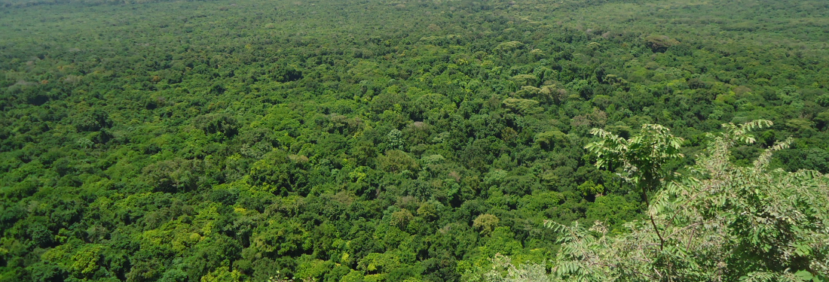
Fact: Biodiversity Pays mankind Everything!
Paradox: Yet, mankind pay nothing?

Slide 5
2.1 What is Environmental Valuation?
Ecosystems are multifunctional providing various goods and service to economic agents and support economic activities.
These services have social, economic, and cultural benefits.
Increased investments in ecosystem services leads to increased production of ecosystem goods.
This will fuel sustainable economic growth and ecological restoration.

Slide 6
Markets do not exist for many types of environmental benefits.
Specialized non-market valuation methods may need to be employed….Ecosystem valuation!
Ecosystem valuation is attaching monetary value to non-marketed environmental goods and services of ecosystem.
In the absence of measurable benefits, the concern is that the value of these vital resources will be ignored by policy-makers.

Slide 7
2.2 Why Environmental Valuation is needed ?
Can humans/economy continue indefinitely at the expense of mother earth?
……….…………Impossible!!!
Free-ridership: a person who tries to benefit from a service without paying for it.
  Individuals/organizations enjoying ecosystem benefits without paying for its cost of preservation.
...............So what?

Slide 8
1) To raise awareness (send the correct signal to users on the status of the environmental good)
Example:
Choke Biodiversity facing greater THREAT unless we save it???
  No/limited alternative livelihood option for farming community
  Illegal encroachment and agriculture on marginal land
  High dependence on mountain ecosystem
  Continued high water scarcity on downstream areas (Dejen, Shebel, and Enebse-Sar-Midir,...) is attributed to loss of choke- water tower =>“El-Nino in 2008 E.C.”
  Greater erosion on downstream areas......
  Current status/trend of resource depletion from a given time to date!!!!

Slide 9
2) To justify and formulate environmental conservation policies
  Advocacy of biodiversity conservation
    Human/business survival =f(Environment survival)
  Policy/Institutional Framework (MoEFCC, EIB)
  No enough Legal Framework (rules & regulations)
    Mainstreaming biodiversity loss across all sectors (public and private)
    e.g., Municipality, water bureaus, Hydroelectric power plants, Hotels, Many farms (rural and urban), ....

Slide 10
3) To integrate values of environmental goods and service in decision making.
Means of evaluating the trade-offs involved in environmental policy choices.
  e.g1. Lake Tana case
  a) Investing against Sedimentation of Lakes and Hydroelectric power plants
  ………vis-à-vis………
  b) Investing on conservation of upstream biodiversity?
  =>Which policy option would be sustainable, less costly, and with positive multiplier effects?

Slide 11
Assessment of benefits and costs should be available to policymakers in choosing among alternative policy options.
  e.g2. Dire Dawa case in 2000E.C
  Government investing on mountain ecosystem (SWC)
  vis-à-vis
  b) Huge Flood control investments?
=>Which policy choice would have been sustainable and less costly?

Slide 12
4) Provide a stimulus to conserve the ecosystems that offer the most valuable services.

Slide 13
2.3 How can we measure/quantify ecosystem services?
The value of ecosystems can be estimated using total economic value (TEV)

Slide 15
TEV = Use values +Non-use values
  Use Value= Direct use + Indirect use
    Direct use = Consumptive and Non-consumptive
    Indirect use = Maintenance of the hydrological system, climatic stabilization (carbon sequestration) and soil stabilization
  Non-use value = Bequest value + Existence value + Option values

Slide 16
Use value: represents the utility enjoyed by people who directly use some of the environmental goods and services (usually presently).
  e.g. a bird sanctuary yields use value to bird watchers

Slide 17
Non-use values: reflect value that people assign to aspects of the natural environment that they care about but do not use.
Also known as passive-use values or existence values
    Existence values are controversial because they are difficult to measure:
      E.g. Someone might value for the existence of wildlife park but have no interest in actually visiting such park

Slide 18
  Existence value: benefit an individual derives for knowing that a resource exists or continue to exist regardless of the fact they never seen or use the resource
  Bequest value: benefit that individual drive from knowing that resource will be available for their children.
Option value: value the people place on the resource to use it in the future.
  E.g. option value to natural forest includes the value of discovering medicinal plant in the area some time in the future.

Slide 19
Steps in estimating values
Description of ecosystem
Identification of the stakeholders (users, non-users and all affected parties)
Identification of the ecosystem uses
Categorisation of the uses into direct, indirect uses and non-uses
Selection of valuation techniques based on data availability, types of uses existing information

Slide 20
1) Description of Ecosystem
The description of the ecosystem should be in terms of spatial coverage, species composition both flora and fauna, the ecosystem functions and service.
It helps the valuer to have an in-depth understanding of the products, functions and services and ultimately the beneficiaries

Slide 21
To describe the Ecosystem
Reconnaissance field visits
Literature review
GIS maps and Ariel surveys

Slide 22
2) Identification of functions and goods/ services
List all the products, functions and service of the ecosystem
List the different uses of the identified products, functions and services

Slide 23
Identification of functions and goods/ services
Functions | Goods and Services
Regulation | e.g. storm and flood protection
Habitat | e.g. maintenance of biological and genetic diversity
Production | e.g. improve crop resistance to pathogens and pests
Information | e.g. enjoyment of scenery

Slide 24
3) Stakeholder identification
A stakeholder is defined as an individual, group of individuals or organisations that have an interest and will be affected by change in ecosystems either directly or indirectly.
Stakeholders determine the value of ecosystems through their WTP or as input in production processes
These are users, non-users, policy makers, conservationists at local, regional and international levels

Slide 25
Aspects for Stakeholders Identification
Identification of the different uses and non-uses of ecosystem services
Establish the association between ecosystem functions and services and production processes

Slide 26
4) Selection of valuation Techniques
Select the appropriate technique of environmental valuation to arrive at final total economic value.

Slide 27
2.3 Methods of Economic Valuation
Based on consumer choice theory and demand estimation
Methods | Revealed preference | Stated preference
Direct | Market price | Contingent valuation method
 | Simulated markets
Indirect | Travel cost method | Attribute based Model
 | Production function | - Conjoint analysis
 | Hedonics (property Values, wage Values) | - Choice experiments
 | Avoidance cost | - Contingent ranking
 | Replacement cost

Slide 28
2.3.1 Revealed Preference Approach
Choice behavior in well-functioning competitive markets reveals consumer value.
In cases there is no direct market for an environmental good, WTP can sometimes be inferred from choices people make in related markets.
One category of revealed preference infers to WTP from the choice to incur travel costs to enjoy a recreational experience

Slide 29
Travel cost method
Though some environmental goods and service are not traded, their value can be inferred to through costs incurred in travelling to them. E. g. tourist area, water,
The TCM offers a way of measuring the value of a non-marketed recreational resource
The costs are in terms of value of time and money

Slide 30
Recreation area demand: “price” is the trip cost and the quantity demanded is the number of trips taken to the recreation area in a given time period.
The area under the site demand curve is consumer surplus, a measure of the economic value of accessing the site for recreational purposes.

Slide 31
Identify the area of interest
Zone the area of interest into concentric patterns
Determine visit from each zone
Estimate visitation rate
Determine the costs of travel
Derive the demand curve
Area under the demand curve is the consumer surplus and indicate WTP

Slide 32
Production function methods
Production Functions is an indirect valuation technique as it involves establishing the association or contribution of the ecosystem service as a factor input in production processes.
Ecosystems contribute to economic production processes at both household and national levels
Their contribution can be established and valued in monetary terms.

Slide 33
Steps
Identification of all economic production processes: production processes or economic activities occurring within the proximity of the ecosystem should be identified.
The rational for identifying the production processes is to allow for an in-depth evaluation of the economic activities and select those that have a functional relationship with the ecosystems.

Slide 34
Investigating the relationship between identified economic activities and ecosystems services.
Statistical model to establish the impact of ecosystem on production processes: based on the information collated and compiled above, empirical equations are derived.
Valuing the contribution of the ecosystem to production processes

Slide 35
Hedonic Method
It is an indirectly observable methods
To measure the marginal WTP for Discrete changes in an attribute
an alternative to neoclassical consumer theory in which a class of differentiated products is completely described by an array of objectively measurable general category of hedonic methods
Hedonic study is widely employed to value changes

Slide 36
Hedonic property value approaches: Use market price of house and to break down sales price in to components based on house characteristics such as size and location.
Hedonic wage approaches: similar but attempt to isolate components of wages.
E.g. high risk occupation demand higher wage

Slide 37
Hedonic Method
Hedonic regression methods can be used to estimate the value of product quality attributes in markets that feature product differentiation.
E.g. contribution of environmental attributes such as view, air quality, proximity to parks, and neighborhood safety to house price.

Slide 38
Based on the premises that though ecosystem (mangrove ecosystems) functions and services are not marketed they have attributes that affect the value of marketed goods and services.
The contribution of ecosystem to the value of marketed goods is established and valued. This method is mostly used to estimate values of ecosystem based on values of properties and it defines the WTP by individual for ecosystem aesthetic values.

Slide 39
Steps in Hedonic Method
Step 1- identification of properties mainly residential houses and agricultural land field in the proximity of ecosystem
Step 2- determine the variables that determine the value of properties: this stage necessitate identification of all independent variables that positively and negatively have an impact on the value of properties (houses or agricultural field).

Slide 40
Collection of time series or cross sectional data on independent variable
Estimating the aesthetic or protective value of ecosystem. The coefficient for the ecosystem variables is interpreted as the percentage contribution of system to the value of property under investigation.

Slide 41
Other Revealed Valuation Approaches
Defensive behavior and replacement cost: The cost of defensive behavior (e.g., buying bottled water due to groundwater contamination) reveals something about the value of uncontaminated groundwater.
Replacement cost does not provide a WTP estimate for the actual natural resource, rather it reflects the cost of replacing it with a manufactured alternative.

Slide 42
Benefits transfer: The practice of adapting estimated benefits derived from an existing study to a new setting or context.
One can transfer specific numerical estimates, such as an estimate of WTP, or
one can transfer an entire estimated function, such as those described for CVM, TCM, etc.
Must be done carefully!

Slide 43
2.3.2 Stated Preference Approach
Estimate non-market value of environmental goods using survey research methods.
This approach is used in situations where no markets for environmental or related goods.

Slide 44
Involves the use of survey questionnaires to elicit hypothetical willingness-to-pay (WTP) information.
Examples:
  Estimate non-market value of dam removal and fish habitat restoration in case of Lake Tana.
  WTP to avoid ecosystem damages associated with Bahire-Giorgis and Chira-wonz watershed.

Slide 45
Contingent Valuation Method
Controversial because:
  Hypothetical survey responses rather than actual (revealed) value.
  CVM provides only way to estimate non-use values.
  Non-use values tend to be much larger than use values in aggregate. More people care about a site than actually visit the site.

Slide 46
Contingent Valuation Method
Stated preference technique
Questionnaire based
Direct method
Valuation of a hypothetical scenario
It is called “contingent valuation” because the valuation is contingent on the hypothetical scenario put to respondents

Slide 47
Contingent Valuation Method
Can be used to value both use and non-use values of ecosystem services
WTP or WTA questions
For the individual to reveal the correct WTP or WTA, they must be provided with the adequate and non-bias information on the status of the ecosystem to be valued.

Slide 48
Contingent Valuation Method
Carried out by putting direct questions to individuals to determine throw much they would be willing to accept (WTA) when the respondents are familiar with the environmental goods or services.
less reliable when the object of the valuation exercise is more abstract aspect, such as existence value .
If the survey instruments are not carefully designed and implemented susceptible to bias

Slide 49
Steps in CVM
Developing survey instrument
Defining stakeholders to be interviewed (sampling techniques and size)
Soliciting information from the selected samples Data analysis and interpretation of the results

Slide 50
CVM Questionnaire Design
Background Questions:
General background: Questions on general characteristics of the respondents – information for checking the validity of the valuation results
Respondents’ tastes and socio-economic characteristics - should , come at the end of the questionnaire

Slide 51
CVM Questionnaire Design
Respondent’s knowledge of the commodity in question, e.g. background questions concerning the respondent’s visits to a recreation site should cover such issues as:
  Attitudes towards environmental issues;
  Proximity of their home to the site;
  Frequency of visits; duration of trip;
  Reason for visit, etc.
  These questions should be asked at the beginning of the interview

Slide 52
CVM Questionnaire Design
To avoid bias, interviewer must make sure the respondent is aware of:
  budget constraints
  their right to refuse to pay for the good
If the event of a negative response, the reason must be recorded
a ‘zero valuation’ is implied if:
  respondent may not be able or willing to pay anything

Slide 53
CVM Questionnaire Design
a ‘protest bid’ is implied if:
  respondent may find it too difficult to establish a monetary valuation;
  respondent may disapprove of the concept of expressing environmental resources in monetary terms
  may be hostile towards the institutional context.

Slide 54
Format of WTP question
  CVM can be designed in discrete or open ended
  Discrete
    Binary discrete: dichotomous choice format (y/n): Are you WTP a given $X amount for to the contingent environmental improvement?
      There are empirical studies showing the need to include the don’t know option
      How to deal with don’t response? Drop it, treat as no, or impute them using econometric model
  Open ended-continuous response

Slide 55
Format of WTP question
Open Ended:
  “How much are you willing to pay for public good A?”
  continuous response
  Less specific responses, Substantial number of zero.

Slide 56
Format of WTP question
Bidding Game:
1) “Are you willing to pay X for public good A?”
2) If Yes to (1), “Are you willing to pay Y for public good A?” (Y>X)
3) If Yes (2), “Are you willing to pay Z for public good A?” (Z>Y).
4) if Yes to (3) …
5) If No to (1), “Are you willing to pay T for public good A?” (T<X) …

Slide 57
Format of WTP question
There are two major type of bidding games
Single bid games: an interviewer, after describing a good and ask the respondents to state the maximum price (WTP) or the minimum level of compensation (WTA)
Iterative bid games : in this case the respondent is asked whether he/she would pay or accept a specified amount for the described change or goods by varying iteratively until the maximum WTP or minimum WTA is reached.

Slide 58
Format of WTP question
Dichotomous or Discrete Choice CV (Referendum format):
  “Are you willing to pay X for public good A?” => STOP
Discrete Choice CV with follow-up (Double Bounded):
1) “Are you willing to pay X for public good A?”
2a) If Yes to 1, “Are you willing to pay Y for public good A?” (Y>X)
=> STOP
2b) If No to 1, “Are you willing to pay Z for public good A?” (Z<X)
=> STOP

Slide 59
Format of WTP question
Payment Cards:
  Choose a WTP point estimate from a list of values
Take–it–or–level experiments:
respondents are randomly divided into sub–samples or cells.
Each sub –samples is then asked the same questions, but each is offered a different amount of money and is asked either to take it or leave it.

Slide 60
Format of WTP question
Trade–off games:
Participants must choose between different bundles of goods
Environmental good is increased but at a price
Respondent may then choose between these the price of the increase is then varied until the respondent sees no advantage in one alternative over the other .

Slide 61
Format of WTP question
Payment Vehicle: refers to the methods of payment
Mechanism through which the WTP/WTA values are to be raised/distributed
Valuation question needs a realistic institutional context - usually an appropriate payment (or bid) vehicle (instrument).
Methods of payment also matters households WTP

Slide 62
Key considerations in selecting a payment vehicle:
  Familiarity – does the respondent understand the payment vehicle?
  Credibility – does the payment vehicle represent a realistic situation?
  Empathy – is the respondent favourably or unfavourably disposed towards the recipient of the funds?
  Feasibility – is the recipient of the funds capable of delivering the improvement?
  Universality – would all the respondents be affected by the payment vehicle?

Slide 63
Conjoint Analysis
Is an attribute based method
Like CVM, it is the survey based technique that derive willingness to pay by having respondents choice between alternative states of the world
Each state of the world has a specified set of attribute and a price.
Unlike CVM, respondents choose among alternative states of the world instead of stating a WTP (WTA).

Slide 64
Choice Experiment
Is attribute based method
Is a binary discrete choice CVM format for valuation of attributes of a given goods and services.
Respondents are expected to choice between a bundle of attributes which could be labeled as alternative
Commonly used in recent years

Slide 65
Contingent ranking
Is also survey based method
Respondents are given a set of hypothetical situation that differ in terms of the environmental amenity available (not in terms of bundle of attributes) and are asked to rank among them.
Used to look at the trade-offs between environmental amenity and other characteristics.
To compare environmental amenity with characteristics expressed in monetary value

Slide 66
“Open-ended” Elicitation Format
Respondent simply asked to state maximum WTP for a specific environmental change
The advantages of the open ended:
Quick and easy to administer and analyse;
Can be performed with a smaller sample size;
Avoids ‘anchoring’ effects - respondents influenced by suggested starting value.
Main drawbacks: strategic bias, more likely
  The respondent may need a reference point to bound value judgement
  Respondent must be familiar with the affected commodity in question.

Slide 67
“Dichotomous Choice” or “Referendum” Elicitation Format
  range of values for the max WTP of individuals pre-set
  sample of respondents is divided into sub-samples
  value within the pre-set range is assigned to each sub-sample
  Each respondent asked whether WTP assigned value for proposed change
Answer not the max WTP – only consent or refusal to pay a given amount
Random utility theory ( econometric models) are required to estimate the respondent’s mean and median WTP values.

Slide 68
If the valuation study is being done to support a benefit/cost analysis of an environmental improvement, the gross benefit of the improvement can be estimated from the additional total WTP generated by the improvement.
  For example, the gross benefit of improving a city sanitation and infrastructure can be inferred from increased home prices in the area.

Slide 69
  Total WTP is the area under the market demand curve, and represents our estimate of the gross value of the good in question at the prevailing market price.
  The concept of WTP: The public does not possess property rights to the environmental improvement, and thus must purchase it from those who currently have the right to engage in pollution or other damaging activity.
  Concept of WTA: The public already possesses property rights to the environmental improvement, and thus must be compensated in return for infringing upon those rights

Slide 70
  The economic value of an environmental improvement is the dollar amount that people consider to be of equivalent value to the improvement.
  Environmental valuation can be measured using WTP, as was described above, or by estimating willingness to accept (WTA).
  While WTP is the maximum amount of money someone would voluntarily pay to obtain the improvement, WTA is the least amount of money they would accept to forego the improvement.

Slide 71
Valuing Benefits
  When WTP and WTA values are relatively small in proportion to someone’s budget, and there are ready substitutes for the environmental improvement in question, economic theory suggests that the difference between WTP and WTA will be small.

Slide 72
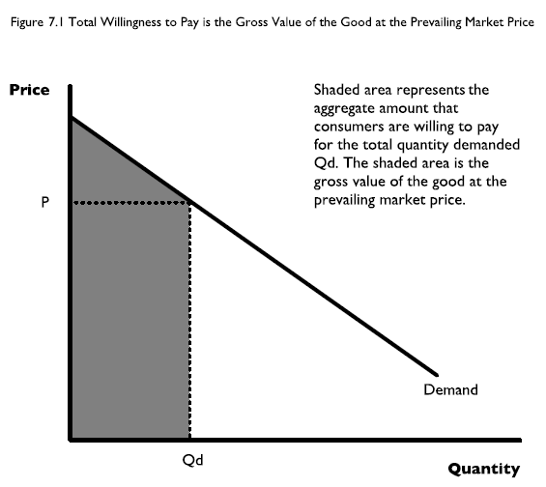

Slide 73
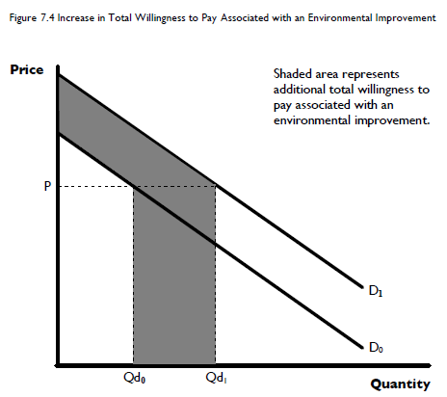

Slide 74
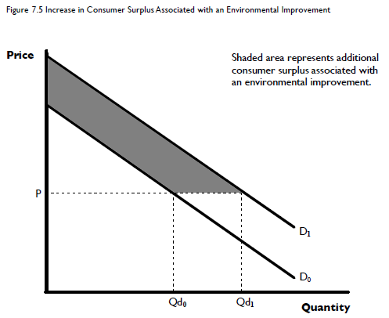

Slide 75
  Each point on a market demand curve represents the maximum price that consumers are willing to pay (WTP) to consume a given quantity of the good.
  Individual WTP values are then aggregated to estimate the total benefit of each policy option.

Slide 76
Those who benefit from an environmental improvement may have to also incur a cost. Examples:
  Recreational visitors must incur a travel cost and an entry fee.
  Taxpayers may be asked to pay higher taxes in return for an environmental improvement.
  Home buyers may have to pay higher prices for homes that are close to a new regional park.
In such cases the appropriate benefit measure for an environmental improvement may be the increase in estimated consumer surplus.

Slide 77
Ecosystem Service Valuation (ESV) Methodology
There are different methodologies used for ESV:
  Integrated Valuation of Ecosystem Services and Tradeoffs (InVEST)
  Global ecosystem value coefficients developed by Costanza et al (1997)

Slide 78
Integrated Valuation of Ecosystem Services & Tradeoffs (InVEST)
  Is a spatially explicit modeling tool
  Consists of a suite of models that use LULC patterns to map and estimate levels and economic values of ecosystem services, biodiversity conservation, and the market value of commodities provided by the landscape

Slide 79
Integrated Valuation of Ecosystem Services & Tradeoffs (InVEST)
  Examples of ecosystem services and commodity production that InVEST can model include:
    Water quality, water provision for irrigation and hydropower, storm peak mitigation, soil conservation, carbon sequestration, pollination, cultural and spiritual values, recreation and tourism, timber and non-timber forest products, agricultural products, and residential property values.

Slide 80
Integrated Valuation of Ecosystem Services & Tradeoffs (InVEST)
  Can be run at different levels of complexity, making it sensitive to data availability and an understanding of system dynamics
  Results can be reported in either biophysical or monetary terms, depending on the needs of decision makers and the availability of data
  However, biodiversity conservation results are reported in biophysical terms only

Slide 81
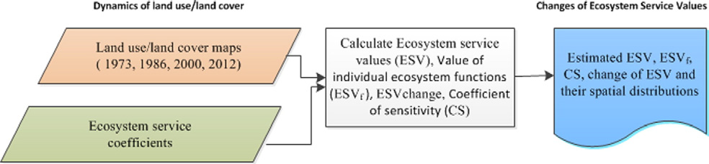
Global Ecosystem Value Coefficient
Uses two basic data inputs:
  Land use/Land cover (LULC) change data
  Ecosystem service value coefficients

Slide 82
Land use/Land cover (LULC) change data
The provision of ecosystem services is directly correlated to the situation of ecosystems (LULC types in a given area)
Dynamics of LULC can cause changes in ESVs
It may increase the provision of some services while decreasing others that affect the ability of biological systems to support human needs or the other way round
The magnitude of changes in LULC depends on data acquisition and analysis

Slide 83
Land use/Land cover (LULC) change data
  Procedures in LULC analysis include:
  Multi-spectral satellite imagery acquired for different
    Years
    Spatial scales
  Atmospheric correction and geometrical rectification
  preprocess and process using ERDAS imagine software

Slide 84
Land use/Land cover (LULC) change data
  Image rectification, restoration, enhancement, image classification and accuracy assessment
  Supervised/unsupervised image classification
  Collect ground control points (GCP) from each land use as a classification training site
  Compute image space signature separability

Slide 85
Land use/Land cover (LULC) change data
  Classify the acquired image in to different land uses using maximum likelihood classification algorithm
  Assessing overall
    producer’s accuracy
    user’s accuracy
    Kappa statistics
  All this analysis will be conducted in ArcGIS

Slide 86
ESV estimation
There have been many studies in the past few decades aimed at estimating the value of a wide variety of ecosystem services
A large (but scattered) amount of information available which is useful for ecologists, economists, policy makers and the general public
From this, information (data) has been gathered and used to estimate ESV per unit area

Slide 87
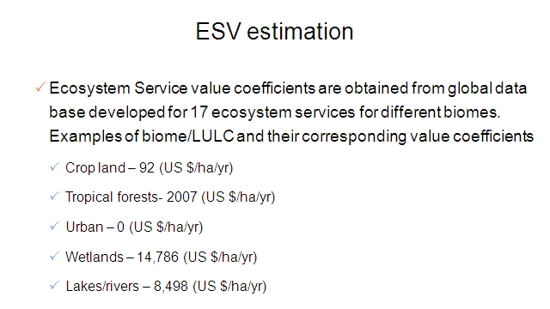

Slide 88
ESV estimation
  Ecosystem Service value coefficients are obtained from global data base developed for 17 ecosystem services
  These coefficients are based on “willingness to pay” of individuals for ecosystem services
  These value coefficients will be multiplied by the area of LULC types identified
  The global biomes/LULC types are used as proxies for the identified LULC types

Slide 89

ESV estimation
  ESV=
  Where ESV– Ecosystem Service Value
  A_{k -} is the area
  VC_{k -} the value coefficient for LULC category k

Slide 90

ESV estimation
  ESV_{f} =
  Where ESV_{f}– is the estimated ecosystem service value of function f
  A_{k -} is the area
  VC_{fk} -- the value coefficient of function f (US $) for LULC category k.

Slide 91
ESV estimation
  Coefficient of Sensitivity (CS)
    Taking in to account uncertainties in the value coefficients used
    biomes used as proxies for LULC types are not perfect matches
    Sensitivity analyses will be conducted to determine the percentage change in ESVs for a given value coefficient following standard economic method

Slide 92
ESV estimation
  The value coefficients for each LULC will be adjusted by 50% and the corresponding coefficient of sensitivity (CS) will be calculated using the equation below
  This method help to determine the robustness and reasonability of estimation of ESV for each LULC

Slide 93
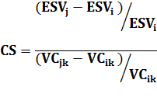
ESV estimation
  Where CS is Coefficient of Sensitivity
  _{and} are initial and adjusted total estimated ecosystem service values
  VCik and VCjk = initial and adjusted value coefficients (US $) for LU/LC type ‘k’

Slide 94
Case studies and findings from Ethiopia
  Kindu et al (2016) found that LULC change from 1973 -2012
    natural forests, grass lands and woodlands decreased significantly
    the area covered by settlement and cultivated land increased tremendously over the years
    Tree patches and plantations also increased moderately
    Water body decreased but not drastically

Slide 95
Case studies and findings from Ethiopia
  ESV between 1973 -2012
    Total loss of US$ 45.9 million
    ESVs revealed a significant reduction of the total values over the study period due to the drastic reduction of natural forest, wood land and grass lands which represents the highest proportion
    Individual ecosystem services decreased

Slide 96
Case studies and findings from Ethiopia
  Tolessa et al (2016) found LULC change from 1973 -2014
    Forests, grass lands and shrub lands decreased significantly
    Settlement and cultivated land increased over the years
    Bare land showed an increased at first (1973-1984), then decreased (1984-2001), increased (2001-2014), overall decreased (1973-2014). So, it did not show a consistent trend.

Slide 97
Case studies and findings from Ethiopia
  ESV between 1973 -2014
    Net ESV reduced by 68% (US$ 36.3 million )
    The main cause of this reduction was reduction in forest and shrub land
    Supporting service reduced by 37.8%

Slide 98
Policy implications
Based on the above two case studies:
  Forests, wood lands, shrub lands and grass lands are vital for integrity of ecosystems to provide the desired ecosystem service at landscape level.
  Payment for ecosystem services (PES) shall be devised to protect the existing resources and developing a new one.

Slide 99
  Making tradeoffs between conservation and production at landscape level is very vital for optimal production and protection.
  Ecological degradation is still unfolding in Ethiopia with its multifaceted problems that could affect the livelihoods of millions of rural communities dependent on land resources.

Slide 100
Limitations of the method
    Uncertainties exist within the value coefficients
    Use of those biomes/LULC as proxies for our local context since these biomes/LULC classes are not perfect matches
    Ecosystem service value coefficients assume spatial homogeneity of services within LULC
    May under/over estimate ESV

