Slide 1
Chapter 2
Runoff, Hydrograph, and Stream gauging

Slide 2
Definitions
What is runoff?
If the rain intensity continuous to exceed the infiltration capacity of the soil, the difference appears as rain fall excess, which initially accumulates on the ground as surface detention, and then flows as overland flow on the basin surface before entering a stream channel.
The water that reaches the stream channel of a basin after fulfilling the interception, depression storage and infiltration needs of the basin is called surface runoff.
The amount of water within a river or stream is of great interest to hydrologists.

Slide 3
Runoff and surface runoff are two different terms and should not be confused.
Runoff includes all the water flowing in the stream channel at any given section.
Surface runoff includes only the water that reaches the stream channel without first percolating down to the water table.
Surface runoff is also called as Direct Runoff (DRO); and Runoff is also called as Discharge or Stream flow.

Slide 4
Yield of a Drainage Basin
  Yield of a drainage basin is the same as runoff, with the only difference that it is expressed over long periods, while the runoff is expressed for short periods,
  Thus, the yield = the total volume of water flowing per year, such as Mcum/year;
  while the runoff is the instantaneous rate expressed as volume of water flowing at a given section of the river in one second or one hour, such as in m³/s or m³/hr.

Slide 5
Constituents of Surface Runoff
  Surface runoff is the water that reaches the stream channel without first percolating down to the water table this may be divided into two parts:
    True surface runoff = Water flows directly over the ground surface.
    sub-surface runoff/stream flow = A part of the water that infiltrates through the soil moves laterally and before joining the water tables joins the river channel.
      Since it reaches the stream so quickly that it is difficult to distinguish it from true surface runoff and the ground water flow is often time long delayed before it reaches the stream.
      For this reason, sub-surface runoff is always treated as a part of surface runoff.

Slide 6
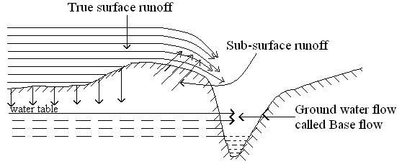
Constituents of Runoff
  The runoff of a river stream consists of the following three constituents:
    Direct precipitation over the surface of the stream.
    Surface runoff consisting of true surface runoff and sub-surface stream flow.
    Ground water inflow, popularity called base flow.
Constituents of Surface Runoff and of Runoff

Slide 7
The Direct precipitation provides a very small portion of the total flow that depends upon the lake area of the stream channel.
However; the evaporation from those water surfaces may nearly or more than balance the precipitation on them and therefore, be ignored.
Hence, the runoff of a river can be supposed to be consisting of surface runoff and ground water inflow only and it can write as:
  Runoff = Surface runoff + Ground water inflow (i.e. Base flow)

Slide 8
Thus, total streamflow hydrographs are usually conceptualized as being composed of:
  Direct Runoff, which is composed of contributions from surface runoff including quick interflow.
  Baseflow, which is composed of contributions from delayed groundwater flow.

Slide 9
HYDROGRAPHS
Components of hydrograph
  A hydrograph is a graph showing discharge versus time or
  A hydrograph is a plot of stream discharge as a function of time
  The various components of a natural hydrograph are shown in the following figure
  At the beginning, there is only base flow gradually depleting exponentially.
  After the storm commences, the initial losses like interception and infiltration are met and then the surface flow begins.
  The hydrograph gradually rises and reaches its peak value after a time t_{p} (called lag time or basin lag) measured from the centroid of the hyetograph of net rain.

Slide 10
Thereafter it declines and there is a change of slope at the inflection point, where there is gradual withdrawal of catchment storage.
the ground water table declines and the hydrograph again goes on depleting in the exponential form called the ground water depletion curve or the recession curve.
If a second storm occurs now, again the hydrograph starts rising till it reaches the new peak and then falls and the ground water recession begins

Slide 12
In general hydrograph has the following major components
  Rising limb
    Ascending portion representing rising discharge due to gradual increase in flow in stream
    Slope depend on storm and basin characteristics
  Crest Segment
    Indicate the peak flow
    Controlled by storm and watershed characteristics
    Multiple peaks –due to occurrence of two or more storms of different intensities in a closer interval

Slide 13
Falling limb (recession limb)
  From point of inflection at the end of crest segment to base flow.
  Inflection point indicate the time at which rainfall stopped
  Shape independent on storm characteristics but dependent on watershed characteristics

Slide 14
Factors affecting runoff and its hydrograph
The main factors affecting runoff:
  Drainage characteristics: basin area, basin shape (form and compactness), basin slope, soil type and land use, drainage density, and drainage network topology.
    Most changes in land use tend to increase the amount of runoff for a given storm.
  Rainfall/climatic characteristics: rainfall intensity, duration, and their spatial and temporal distribution; and storm motion, as storms moving in the general downstream direction tend to produce larger peak flows than storms moving upstream.

Slide 15
Watershed Factors that Affect Runoff (cont’d)
  Size- area of watershed
  Shape of watershed
  Topography – slope of watershed
  Aspect of watershed
  Geology
  Soil
  Land cover

Slide 16
Effect of watershed area
  1mm of rain on 1km² of watershed represents an input of 1,000 m³ of water or about 250,000 gallons of water.
  If a watershed, of 10 km² receives an annual precipitation of 300 mm, it is inputting about 3.0 1 billion m³.
  Small basin –flow dominated by overland flow that joins channel quickly, peak flow occur quickly

Slide 17
Shape of basin= Effect on Hydrograph by Shape of catchment

Slide 19
Shape of watershed

Slide 20
Drainage density and channel frequency
  Drainage density affects travel time of precipitation to channel

Slide 21
Higher the drainage density, quicker the peak flow, recession limb is steeper with narrow hydrograph
Lesser the drainage density, slow moving rising limb and wide base width

Slide 22
Stream slope affects stream velocity
  More the stream slope higher the slope of recession limb, reduce base width of hydrograph
  Small slope make recession limb flatter, base width wider
Nature of valley
  Greater valley slope higher the slope of recession limb
Landuse
  Vegetation increases loss of water
  Higher the vegetation density, lesser the peak flow
Surface depression
  Presence of ponds delay and modify flow pattern
  Decreases peak flow and wide base width

Slide 23
Climatic factors
  Form of precipitation
    Rainfall and snow fall –rainfall tends to produce runoff rapidly generating hydrograph with high peak and narrow base
  Rainfall Intensity
    Affect volume of runoff , occurrence of peak flow, duration of surface flow
    Higher the intensity quicker the peak flow and conical hydrograph
  Duration of rainfall
    Longer the duration more the volume
    Longer duration, peak flow occur after longer time and hydrograph is flatter with broad base

Slide 24
Distribution of rainfall
  When heavy rain occur near outlet
    Peak flow occur quickly
  When heavy rain occur in upper areas
    Peak flow occur after few hours
    Lower peak and broad base (more time taken for flow to reach outlet)
Direction of storm movement
  Affects amount of peak flow and surface flow duration
  Upward direction –lower peak and broad base
  Downward direction –sharp peak and narrow base

Slide 25
Distribution of rainfall and runoff hydrograph
Runoff Hydrograph affected by movement of rainfall

Slide 26
STREAM GAUGING
  Methods of measuring stream flow
    The most satisfactory determination of the runoff from a catchment is by measuring the discharge of the stream draining it, which is termed as stream gauging.
    Streamflow is the heartbeat of a watershed
    A gauging station is the place or section on a stream where discharge measurements are made.

Slide 27
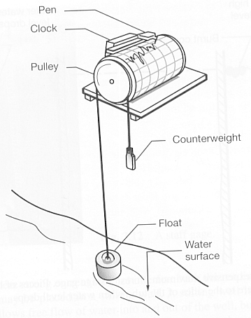
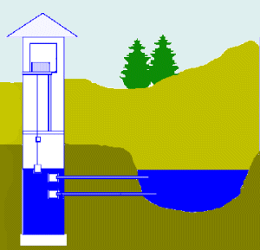
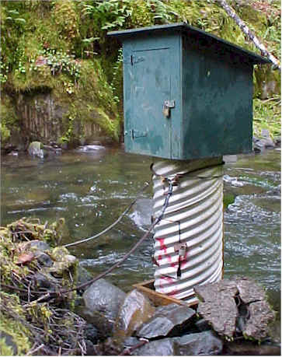
Continuous Measurement - Water Level Recorders
The Stage of a Stream
Float moves up / down with water surface

Slide 28
How do we measure how much water is in a stream?
Volumetric measurements-
  Work on very low flows, collect a known volume of water for a known period of time
  Volume/time is discharge or Q
Cross-section/velocity measurements
Dilution gaging with salt or dye
Artificial controls like weirs
Empirical equations, e.g. Manning’s equation

Slide 29
Velocity – Area Method of discharge measurement
By measuring the cross-sectional area of the stream and the Average stream velocity, you can compute discharge
Q = VA units are L³/t (volume / time)
Where
  Q is discharge
  V is velocity
  A is cross-sectional area

Slide 30
Area - velocity method Q= AV

Slide 31
The velocity distribution in a cross-section of a stream

Slide 32
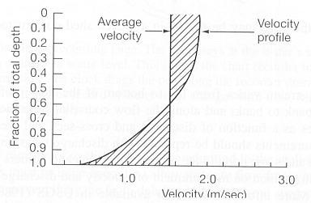
0.6 depth
If stream is deep, take average of measurements at 0.2 and 0.8

Slide 33
(1) Three-points measuring method
Vm = 0.25×( V_{0.2} + 2V_{0.6} + V_{0.8} )
(2) Two-points measuring method
Vm = 0.50×( V_{0.2} + V_{0.8} )
(3) One-point measuring method・・・・・V_{m} = V_{0.6}
(4) Surface measuring method・・・・・・V_{m} = 0.8×V_{s}
where, V_{m}: Mean velocity Vs: Surface velocity
V_{0.2}: Velocity at the depth of 20% below the water surface
V_{0.6}: Velocity at the depth of 60% below the water surface
V_{0.8}: Velocity at the depth of 80% below the water surface

Slide 34
The cross section of the stream at the gauging site is divided into elemental strips of equal width b and the current meter is lowered to a depth of 0.6 d below water surface in shallow depths (one-point method) and to depths of 0.2d and 0.8d (two-points method) in deep waters, at the center of each strip
  the mean velocity is taken as that at 0.6d below water surface in shallow water (one-point method), and
  the average of the velocities at 0.2d and 0.8d below the water surface (two-point method) in deep waters
The discharge in each elemental strip is determined and the discharge in the stream is the sum of the discharges in all the elemental strips.

Slide 35
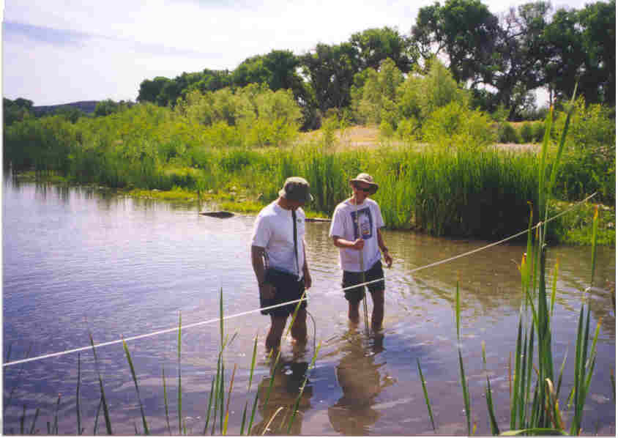

Slide 36
Current meter gauging

Slide 37
Mid-section method. In this method, the vertical in which the velocity measurements are made (by one-point or two-points method) is taken as the middle of the strip, and the water depth (d) in the vertical (determined by sounding) is taken as the mean depth of the strip
  If b is the width of strip (usually same for all strips) then the discharge in the elemental strip is given by:
stream discharge, Q = ∑ ΔQ
In this method, the discharge in the two-triangular bits near the ends are not included in the discharge computation

Slide 39
Mean-section method.
  In this method, the elemental strip is taken between two verticals and the mean depth is taken as the average of the depths in the two verticals (determined by sounding).
  The width of the strip is distance b between the two verticals.
  The velocity in the strip is taken as the average of the mean velocity determined in the two verticals (by one-point or two-points method)

Slide 40
The discharge in the elemental strip is given by
The mean section method is considered to be slightly more accurate, but the mid-section method is faster and is generally used.

