Slide 1
CHAPTER 2
PROCESSES AND STORAGE OF WATER IN THE ATMOSPHERE AND VEGETATION ZONE

Slide 2
Precipitation

Slide 3
CLOUDS AND PRECIPITATION FORMATION
  Clouds are important features of the climatic system that could affect different climatic variables such as temperature, pressure, and humidity.
  Cloud formation and development are also related to climatic variables.
  Clouds are the key regulator of the Earth’s average temperature.
  Some clouds contribute to cooling because they reflect some of the sun’s shortwave radiation back to space.
  Other clouds contribute to warming because they act like a blanket and trap some of the heat at the Earth’s surface and in the lower atmosphere.
  Cloud systems also help spread the sun’s energy evenly over the Earth’s surface.

Slide 4
CLOUD FORMATION
  Clouds are, in essence, massive collections of tiny water droplets and crystallized water molecules.
  The different shapes, textures, and other features of clouds depend largely on the conditions under which they form and later develop.
  For instance, temperature, humidity, and altitude are all factors that affect cloud formation.
  The main processes contributing in cloud formation are as follows:
  Advection: Water vapor enters the atmosphere through evaporation from open water, the soil, or the leaves of plants and moves by wind

Slide 5
Convection: It is the process of ascending warm air and descending cold air due to their density difference.
  The main step in cloud formation is air mass rising, which is needed for air cooling and reaching the dew point.
  The following mechanisms or processes can result in air mass rising
    Orographic uplift occurs when air is forced to rise because of the physical presence of elevated land.

Slide 6
Convectional lifting is associated with surface heating of the air at the ground surface.
Convergence or frontal lifting takes place when two masses of air come together.
  In most cases, the two air masses have different temperature and moisture characteristics.

Slide 7
Condensation: Cloud formation happens easily when water vapor has something to adhere to, allowing the water vapor to change into its liquid or solid phase.
  A number of particles can act in this function, for example, the commonly called condensation nuclei or freezing nuclei
  Precipitation formation: After condensation, some additional process is necessary for droplets or crystals to grow to a size large enough to fall freely from the cloud and reach the ground as snow or rain.

Slide 8
Precipitation formation
  Precipitation is the release of water from the atmosphere to reach the surface of the earth.
  The term ‘precipitation’ covers all forms of water being released by the atmosphere, including snow, hail, sleet and rainfall.
  The ability of air to hold water vapour is temperature dependent:
    the cooler the air the lesser water vapour is retained.
    If a body of warm, moist air is cooled then it will become saturated with water vapour and it will condense into liquid or solid water
  There need also to be minute particles present in the atmosphere, called condensation nuclei, upon which the water or ice droplets form

Slide 9
So there are three conditions that need to be met prior to precipitation forming:
  Cooling of the atmosphere
  Condensation onto nuclei
  Growth of the water/ice droplets

Slide 10
  Atmospheric cooling
    Atmospheric cooling may take place through several different mechanisms occurring independently or simultaneously.
    The most common form of cooling is from the uplift of air through the atmosphere.
    As air rises the pressure decreases that will lead to a corresponding cooling in temperature.
    The cooler temperature leads to less water vapour being retained by the air and conditions becoming favourable for condensation.

Slide 11
The actual uplift of air may be caused by:
Orographic lifting:
  Air mass being forced to rise over an obstruction such as a mountain range this leads to orographic precipitation
It is the reason why windward slopes receive more precipitation

Slide 12
Convective Lifting:
  Warm air rises from a warm surface and progressively cools down.
  Heating from the earth’s surface leading to convective precipitation
  It is of shower type and its intensity may vary from light showers to high, depending on the temperature and moisture conditions.
  The average life of a convective cell is about half an hour

Slide 13
C. Cyclonic Lifting:
  A cyclonic storm is a large, low pressure weather system that forms when a warm air mass and a cold air mass collide and this leads to cyclonic precipitation.

Slide 14
D. Frontal lifting:
  Warmer air is forced to go above cooler air in equilibrium with a cooler surface.
  When two air masses due to contrasting temperatures and densities clash with each other, condensation and precipitation occur at the surface of contact (frontal surface)
  If a cold air mass drives out a warm air mass’ = a ‘cold front’ and causes intense precipitation on small areas
  if a warm air mass replaces the retreating cold air mass, = a ‘warm front’. causes less intense but is spread over a larger area.

Slide 15
II. Condensation nuclei
  Condensation nuclei are minute particles floating in the atmosphere which provide a surface for the water vapour to be condensed.
  They are commonly less than a micron (i.e. a micro-meter) in diameter.
  Aerosols come from natural sources such as volcanoes or forest fires, as well as from human activities such as air pollution or small dust particles, sea salts and smoke particles are the common condensation nuclei.
  Cloud seeding is a technique generating artificial rainfall by the provision of condensation nuclei (silver iodide, potassium chloride etc.,) into clouds.
  This approach was first noticed through the discovery of extra heavy rainfall occurring over a paper mill in South Africa that was emitting potassium chloride from its chimney stack

Slide 16
III. Water droplet growth
  Water or ice droplets formed around condensation nuclei are normally too small to fall directly to the ground;
    Because the forces from the upward draught within a cloud are greater than the gravitational forces pulling the microscopic droplet downwards.
  In order to overcome the upward draughts it is necessary for the droplets to grow from an initial size of 1 micron to around 3,000 microns (3 mm).

Slide 17
The vapour pressure difference b/n a droplet and the surrounding air will cause the droplet to grow through condensation slowly.
  When the droplet is ice, the water vapour sublimates onto the ice droplet.
  This will create a precipitation droplet faster than condensation onto a water droplet,
The main mechanism by which raindrops grow within a cloud is through collision and coalescence.
Two raindrops collide and join together (coalesce) to form a larger droplet that may then collide with many more before falling towards the surface as rainfall or another form of precipitation.
As a droplet is moved around a cloud it may freeze and thaw several times, leading to different types of precipitation

Slide 18
Forms of precipitation
Rain
  Liquid water droplets between 0.5 and 7 mm in diameter
  It can be classified based on intensity as,
    Light rain up to 2.5 mm/h
    Moderate rain 2.5 mm/h to 7.5 mm/h
    Heavy rain > 7.5 mm/h
Snow
  Precipitation in the form of ice crystals which usually combine to form flakes (ice crystals fused together), with an average density of 0.1 g/cm³.
Drizzle
  Rain-droplets of size less than 0.5 mm and rain intensity of less than 1mm/h and uniform water droplets is known as drizzle
  It occurs from low clouds (stratus type)

Slide 19
Glaze
  When rain or drizzle touches ground at 0ºC, glaze or freezing rain is formed.
Sleet
  It is frozen raindrops of transparent grains which form when rain falls through air at subfreezing temperature.
  a combination of snow and rain
Hail
  It is a showery precipitation in the form of irregular pellets or lumps of ice of size more than 8 mm (diameter of hails ranges from 5 to 50 mm).
  Sometimes hail stones fall in very large sizes weighing more than 500 gm each.
  Hails are caused by the rapid ascent of moist air.

Slide 20
Dewfall
  The same process of condensation occurs in dewfall, only in this case the water vapour condenses into liquid water after coming into contact with a cold surface.
  In humid-temperate countries dew is a common occurrence in autumn when the air at night is still warm but vegetation and other surfaces have cooled to the point where water vapour coming into contact with them condenses onto the leaves and forms dew.
  Dew is not normally a major part of the hydrological cycle but is another form of precipitation.
  While drizzle, rain, snow and hail form in the air and fall to the ground, dew forms directly on the ground or on the cool surfaces of objects on the ground.

Slide 21
Presentation of rainfall data
Hyetograph
  Plot of rainfall intensity against time, where rainfall intensity is depth of rainfall per unit time
Point rainfall
  It is also known as station rainfall. It refers to the rainfall data of a station

Slide 22
Mass curve of rainfall
  Plot of accumulated precipitation against time, plotted in chronological order.

Slide 23
PRECIPITATION DISTRIBUTION
The amount of precipitation falling over a location varies both spatially and temporally.
The different influences on the precipitation can be divided into static and dynamic influences.
Static influences are those such as altitude, aspect and slope; they do not vary between storm events.
Dynamic influences are those that do change and are by and large caused by variations in the weather.

Slide 24
At the global scale the influences on precipitation distribution are mainly dynamic being caused by differing weather patterns, but there are static factors such as topography that can also cause major variations through a rain shadow effect
At the continental scale large differences in rainfall can be attributed to a mixture of static and dynamic factors.
At smaller scales the static factors are often more dominant, although it is not uncommon for quite large variations in rainfall across a small area caused by individual storm clouds to exist.

Slide 25
Static influences on precipitation distribution
Altitude
  It has already been explained that temperature is a critical factor in controlling the amount of water vapour that can be held by air.
  The cooler the air is, the less water vapour can be held.
  As temperature decreases with altitude it is reasonable to assume that as an air parcel gains altitude it is more likely to release the water vapour and cause higher rainfall.
  This is exactly what does happen and there is a strong correlation between altitude and rainfall: so-called orographic precipitation.

Slide 26
Aspect
  The influence of aspect is less important than altitude but it may still play an important part in the distribution of precipitation throughout a catchment.
  slopes with aspects facing away from the predominant weather patterns will receive less rainfall than their opposites.

Slide 27
Slope
  The influence of slope is only relevant at a very small scale.
  Unfortunately the measurement of rainfall occurs at a very small scale (i.e. a rain gauge).
  The difference between a level rain gauge on a hillslope, compared to one parallel to the slope, may be significant.
  It is possible to calculate this difference if it is assumed that rain falls vertically – but of course rain does not always fall vertically.
  Consequently the effect of slope on rainfall measurements is normally ignored.

Slide 28
Rain shadow effect
  Where there is a large and high land mass it is common to find the rainfall considerably higher on one side than the other.
  This is through a combination of altitude, slope, aspect and dynamic weather direction influences and can occur at many different scales

Slide 29
Precipitation Measurement
Hydrological analysis needs to know how much precipitation has fallen and when this occurred which usually expressed as a vertical depth of liquid water in millimeters or inches depth, rather than by volume such as liters.
The measurement is the depth of water that would accumulate on the surface if all the rain remained where it had fallen.
Snowfall may also be expressed as a depth and for hydrological purposes it is most usefully described in water equivalent depth (i.e. the depth of water if the snow melted); (250mm snow equivalent to 25mm water depth)
This is a recognition that snow takes up a greater volume (as much as 90 per cent more) for the same amount of liquid water.

Slide 30
The measurement of precipitation is very important; there are essentially three different methods for precipitation measurements:
  Measurement by weather RADARS (Radio Detection And Ranging):
    It is a type of radar used to locate precipitation, calculate its motion, estimate its type (rain, snow, hail, etc.), and forecast its future position and intensity.
    The radar signals reflected by the rain are helpful in determining the magnitude of storm precipitation and its areal distribution in real time
    The more water there is in a cloud the more electromagnetic energy is reflected back
    The quicker the reflected wave reaches back to ground the closer the cloud is to the surface.

Slide 31
Studies have shown a good correlation between reflected electromagnetic waves and rainfall intensity.
Therefore, this can be thought of as a surrogate measure for estimating rainfall derived using several calibrating rain gauges.
Although portable radar can be used for rainfall estimation, their usage has been limited by the high cost of purchase

Slide 32
Measurement by satellite:
  It is a type of satellite that is primarily used to monitor the weather and climate of the Earth and cloud systems.
  The atmosphere-down approach of satellite is quite different from the ground-up approach of radar i.e, the sensor is looking at the top of a cloud rather than the bottom.
  It is well established that a cloud most likely to produce rain has an extremely bright and cold top
  One of the problems is that it is sometimes difficult to distinguish between snow reflecting light on the ground and clouds reflecting light in the atmosphere.
  It provides an indirect estimate of precipitation over an area but is still a long way from operational use.

Slide 33
  It is an effective tool where there is poor rain gauge coverage and for oceans and inaccessible land regions.
Measurement by standard gauges:
  This is the traditional and long-established method.
  Time series are developed using this method, and if the sampling location is moved, the time series should be adjusted.
  This method provides point measurements; thus, it may not be representative even for a small area.
  There are sampling error and poor spatial averaging as well as recording and instrument errors.

Slide 34
I. Rainfall measurement
The instrument for measuring rainfall is a rain gauge that measures the volume of water that falls onto a horizontal surface delineated by the rain gauge rim.
The volume is converted into a rainfall depth through division by the rain gauge surface area.
There is a considerable scientific literature studying the accuracy and errors involved in measuring rainfall.
Any errors in measurement will be amplified hugely because the rain gauge collection area represents a small sample size.

Slide 35
The four main sources of error in measuring rainfall that need consideration in designing a method for the accurate measurement of rainfall are:
  Losses due to evaporation
    Such losses can be reduced by designing the rain gauges as funnel shaped.
  Losses due to wetting of the gauge
    water may stay on the surface of the funnel and can be lost to evaporation
    The loss may be significant if the rain is falling as a series of small events on a warm day.
    In order to lessen this loss it is necessary to have steep sides on the funnel and to have a non-stick surface like copper and non-adhesive plastics.

Slide 36
  Over-measurement due to splash from the surrounding area
      the sloping sides of the funnel to reduce evaporative losses may help to create very little splash-out
      To overcome the splash the rain gauge can be raised up above the ground
  Under-measurement due to turbulence around the gauge.
    The rain gauge presents an obstacle to the wind and the consequent aerodynamic interference leads to a reduced catch
    The amount of loss is dependent on both the wind speed and the raindrop diameter

Slide 37
The effect of wind turbulence on a raised rain gauge. An area of reduced pressure (and uplift) develops above the gauge in a similar manner to an aircraft wing. This reduces the rain gauge catch.
A rain gauge sitting above the surface to avoid splash.
Baffles surrounding a rain gauge to lessen the impact of wind turbulence. The gauge is above ground because of snow cover during the winter

Slide 38
Siting of a rain gauge
For sitting a rain gauge the following considerations are important:
  The ground must be level and in the open and the instrument must present a horizontal catch surface.
  The gauge must be set as near the ground as possible to reduce wind effects but it must be sufficiently high to prevent splashing, flooding etc.
  The instrument must be surrounded by open fenced area of at least 5.5 m x 5.5 m.
  No object should be near to the instrument at least less than twice the height of the obstruction.
  Care needs to be taken to allow for the future growth of trees to keep the mentioned height

Slide 39
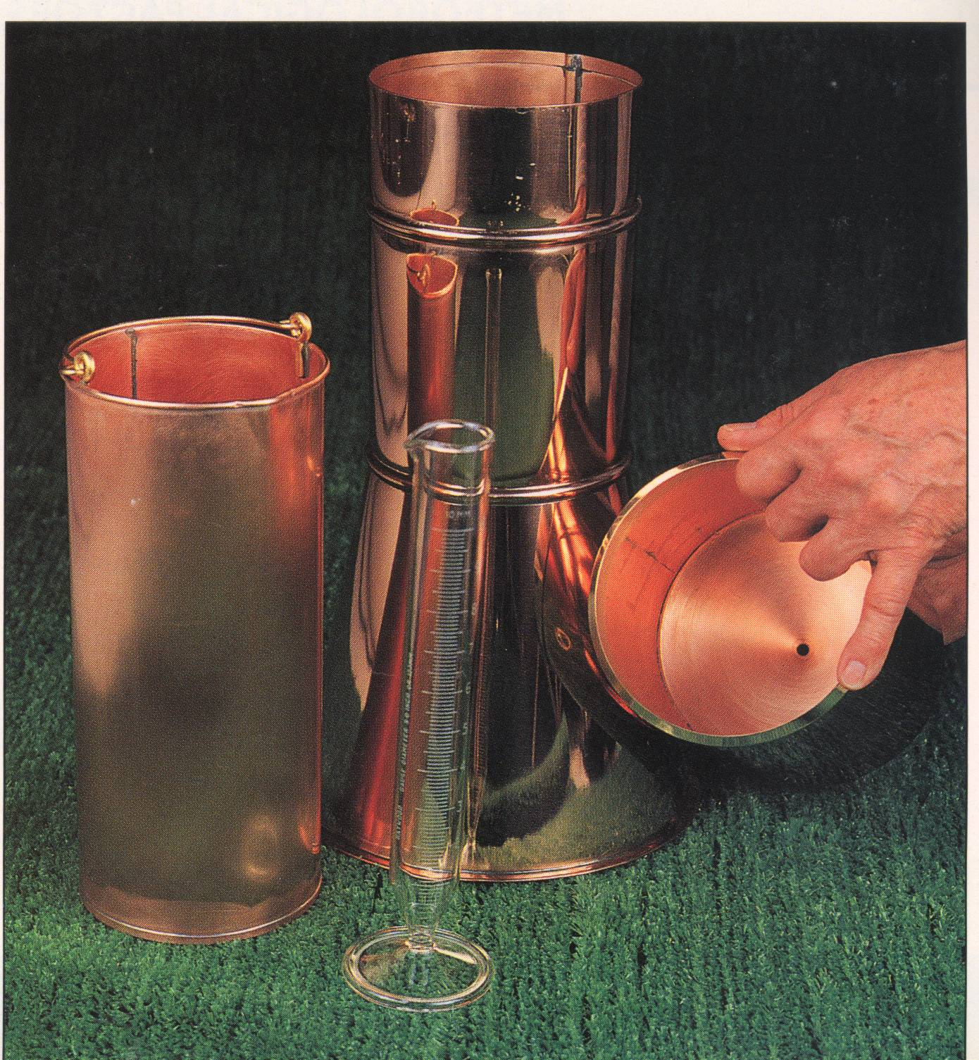
Types of rain gauges
Rainfall may be measured by a network of rain gauges which may either be of
  Non-recording or
  Recording type

Slide 40
The non-recording rain gauge consists of
  a funnel with a circular rim of 12.7cm diameter
  a glass bottle as a receiver.
  The cylindrical metal casing is fixed vertically to the masonry foundation with the level rim 30.5 cm above the ground surface.
The rain falling into the funnel is collected in the receiver and is measured in a special measuring glass graduated in mm; when full it can measure 1.25 cm
the non-recording rain gauge gives only the total depth of rainfall for the previous 24 hours (daily rainfall) and does not give the intensity and duration of rainfall during different time intervals of the day.

Slide 41
Recording Rain Gauge
  This is also called self-recording, automatic or integrating rain gauge.
  This type of rain gauge has an automatic mechanical arrangement consisting of
    a clockwork,
    A drum with a graph paper fixed around it and
    a pencil point, which draws the mass curve of rainfall.
  From this mass curve,
    the depth of rainfall in a given time,
    the rate or intensity of rainfall at any instant during a storm,
    time of onset and cessation of rainfall, can be determined.

Slide 42
The self-recording rain gauge is generally used in conjunction with an ordinary rain gauge exposed close by means of which the readings of the recording rain gauge can be checked and if necessary adjusted.
There are three types of recording rain gauges
  tipping bucket gauge,
  weighing gauge
  float gauge.

Slide 43
Tipping bucket rain gauge.
  This consists of a cylindrical receiver 30 cm diameter with a funnel inside
  Just below the funnel a pair of tipping buckets is pivoted such that when one of the bucket receives a rainfall of 0.25 mm it tips and empties into a tank below, while the other bucket takes its position and the process is repeated.
  The tipping of the bucket activates on electric circuit which causes a pen to move on a chart wrapped round a drum which revolves by a clock mechanism.
  This type cannot record snow.

Slide 44
Tipping bucket gauge

Slide 45
Weighing type rain gauge.
  when a certain weight of rainfall is collected in a tank, which rests on a spring-lever balance, it makes a pen to move on a chart wrapped round a clock driven drum
  The rotation of the drum sets the time scale while the vertical motion of the pen records the cumulative precipitation.
Weighing type rain gauge

Slide 46
Float type rain gauge.
  In this type, as the rain is collected in a float chamber, the float moves up which makes a pen to move on a chart wrapped round a clock driven drum
  When the float chamber fills up, the water siphons out automatically through a siphon tube kept in an interconnected siphon chamber.
  The clockwork revolves the drum once in 24 hours.
  The clock mechanism needs rewinding once in a week when the chart wrapped round the drum is also replaced.

Slide 47
Float type rain gauge

Slide 48
Rain gauge Network
  The World Meteorological Organization (WMO) recommends the following densities.
    In flat regions of temperate, Mediterranean and tropical zones:
      Ideal - 1 station for 600 - 900 km²
      Acceptable - 1 station for 900 - 3000 km²
    In mountainous regions of temperate, Mediterranean and tropical zones:
      Ideal - 1 station for 100 - 250 km²
      Acceptable - 1 station for 250 - 1000 km²
    In arid and polar zones : 1 station for 1500 - 10, 000 km² depending upon the feasibility.

Slide 49
II. Snowfall measurement
  The measurement of snowfall has similar problems to those presented by rainfall, but they are often more extreme.
  There are two methods used for measuring snowfall:
    using a gauge like a rain gauge; or
    measuring the depth that is present on the ground.
  Both of these methods have very large errors associated with them
    Mostly snowflakes are more easily transported by the wind than raindrops.
    When the snow reaches the ground it is easily blown around or drifting.
    But the liquid water is either absorbed by the soil or moves across the surface.
    Uneven distribution of the snow surface: likely to be deeper in certain situations.

Slide 50
Rain gauge modification to include snowfall
  One modification that needs to be made to a standard rain gauge in order to collect snowfall is a heated rim so that to melt to be collected as liquid water.
    But providing a heated rim is no simple logistic exercise as it needs a power source which is difficult in remote areas
  A second modification is to raise the gauge well above ground level so that as snow builds up the gauge is still above this surface
    But the raising of the gauge leads to an increase in the turbulence errors described for rain gauges

Slide 51
Moving from Point Measurement to Spatially Distributed Estimation (mean precipitation over an area)
The rainfall measurement techniques mainly concentrated on measuring at a precise location (or at least over an extremely small area).
In reality the hydrologist needs to know how much precipitation has fallen over a far larger area, usually a catchment that needs to move from point measurements to spatial averaging.
As the rainfall over a large area is not uniform, the average depth of rainfall over the area is determined by one of the following methods

Slide 52
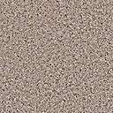
This can be accomplished by either of the following methods
P1
P3
P5
P2
Average Rainfall
P4
P6

Slide 53
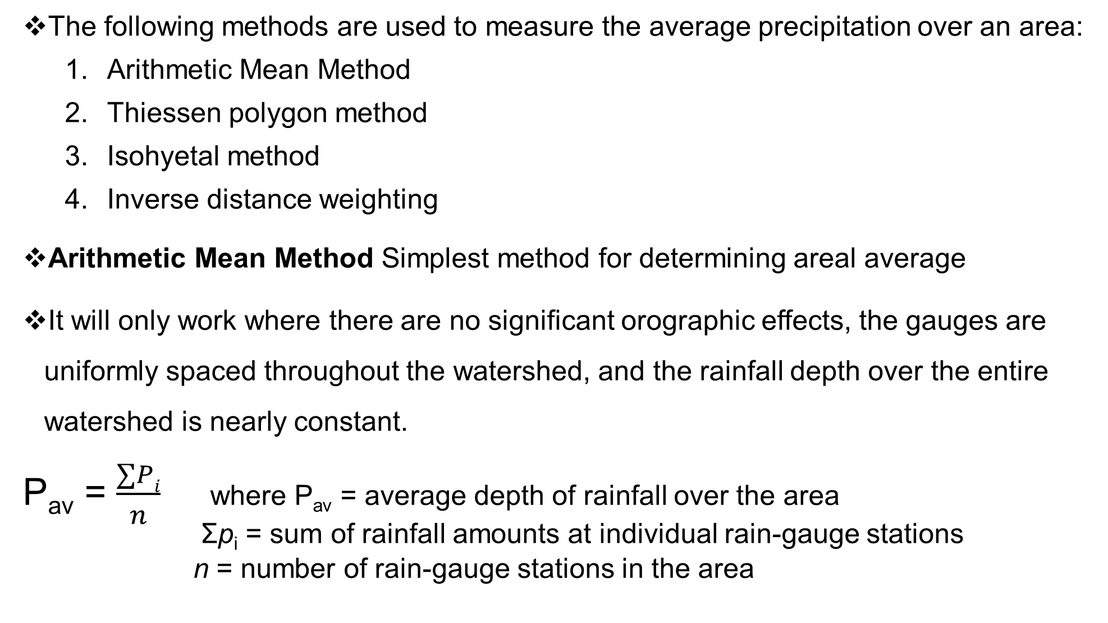
The following methods are used to measure the average precipitation over an area:
  Arithmetic Mean Method
  Thiessen polygon method
  Isohyetal method
  Inverse distance weighting
Arithmetic Mean Method Simplest method for determining areal average
It will only work where there are no significant orographic effects, the gauges are uniformly spaced throughout the watershed, and the rainfall depth over the entire watershed is nearly constant.
P_{av} = $\frac{∑Pi}{n}$ where P_{av} = average depth of rainfall over the area
Σp_{i} = sum of rainfall amounts at individual rain-gauge stations
n = number of rain-gauge stations in the area

Slide 54
stations | Observed rainfall (mm) p_{i}
P2 | 20
P3 | 30
P4 | 40
p5 | 50
 | 140
Average rainfall = 140/4 =35mm

Slide 55
Thiessen polygon method
  This method assumes that any point in the watershed receives the same amount of rainfall as that measured at the nearest rain-gauge station.
  Here, rainfall recorded at a gauge can be applied to any point at a distance halfway to the next station in any direction
Steps
P1
Step 1: Draw the area concerned to a suitable scale, showing its boundary, locations of the raingauges in the area and outside but close to the boundary
P2
P4
P5
P3
P6
P7

Slide 56
P1
P2
Step 2: Join location of the raingauges to form
a network of triangles
P4
P5
P3
P6
P7

Slide 57
Thiessen Method : Steps
P1
P2
Step 3: Draw perpendicular bisectors to the triangle sides. These bisectors form polygons around the stations
P4
P5
P3
P6
P7

Slide 58
Steps 4
Step 4: Delineate the formed polygons and measure their areas using a planimeter or by converting them into smaller regular geometric shapes (i.e. triangles, squares, rectangles, etc.)
P1
A1
A2
P2
A4
A3
P4
P5
A5
P3
A6
P6
A7
P7

Slide 59
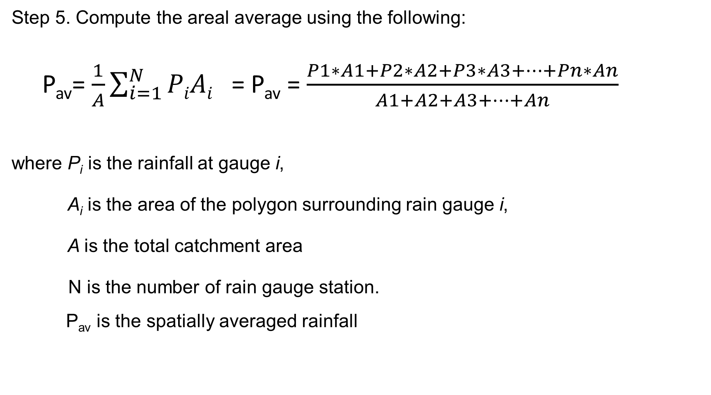
Step 5. Compute the areal average using the following:
P_{av}= $\frac{1}{A}\sum_{i=1}^{N}{PiAi }$ = P_{av} = $\frac{P1∗A1+P2∗A2+P3∗A3+…+Pn∗An}{A1+A2+A3+…+An}$
where P_{i} is the rainfall at gauge i,
A_{i} is the area of the polygon surrounding rain gauge i,
A is the total catchment area
N is the number of rain gauge station.
P_{av} is the spatially averaged rainfall

Slide 60

Example 1
Pav = $\frac{P1∗A1+P2∗A2+…+Pn∗An}{A1+A2+…An}$ = $\frac{14415}{685}$ = 21.04mm
P1
A1
A2
P2
A4
A3
P4
P5
A5
P3
A6
P6
A7
P7

Slide 61
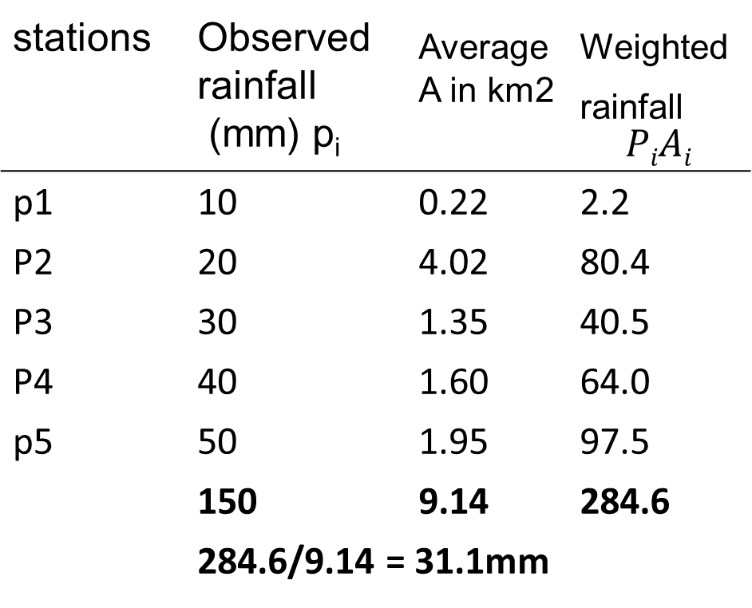
Thiessen polygon method example 2
stations | Observed rainfall (mm) p_{i} | _{Average A in km2} | _{Weighted rainfall} $$PiAi$$
p1 | 10 | 0.22 | 2.2
P2 | 20 | 4.02 | 80.4
P3 | 30 | 1.35 | 40.5
P4 | 40 | 1.60 | 64.0
p5 | 50 | 1.95 | 97.5
 | 150 | 9.14 | 284.6
 | 284.6/9.14 = 31.1mm

Slide 62
The isohyetal method
In this method, the point rainfalls are plotted on a suitable base map and the lines of equal rainfall (isohyets) are drawn giving consideration to orographic effects and storm morphology
The average rainfall between the successive isohyets taken as the average of the two isohyetal values are weighted with the area between the isohyets, added up and divided by the total area which gives the average depth of rainfall over the entire basin
where A_{1–2} = area between the two successive isohyets P₁ and P₂

Slide 63
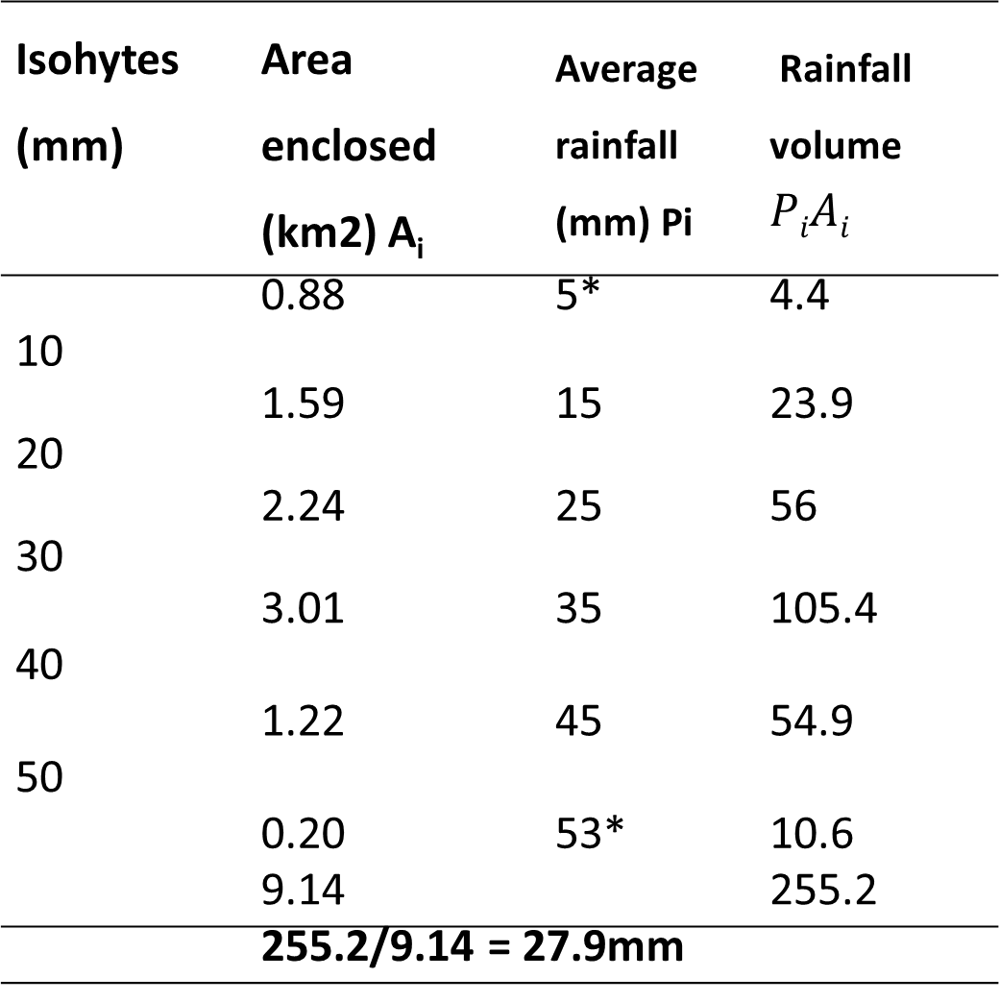
Isohyet methods
Isohytes (mm) | Area enclosed (km2) A_{i} | _{Average rainfall} _{(mm) Pi} | _{Rainfall volume}$PiAi$
 | 0.88 | 5* | 4.4
10
 | 1.59 | 15 | 23.9
20
 | 2.24 | 25 | 56
30
 | 3.01 | 35 | 105.4
40
 | 1.22 | 45 | 54.9
50
 | 0.20 | 53* | 10.6
 | 9.14 |  | 255.2
 | 255.2/9.14 = 27.9mm

Slide 64
Inverse distance weighting (IDW) method
  Prediction at a point is more influenced by near measurements than by distant.
  The prediction at an ungauged point is inversely proportional to the distance to the measurement points.
Steps:
  Compute distance (di) from ungauged point to all measurement points

Slide 65
b) Compute the precipitation at the ungauged point using the following formula:
  N= number of gauged points

Slide 66
Conditions for the methods
  Arithmetic Average
    Gages must be uniformly distributed
    Individual variations must not be far from mean rainfall
    Not accurate for large area where rainfall distribution is variable
  Thiessen Polygon
    Areal weighting of rainfall from each gage
    Does not capture orographic effects
    Most widely used method
  Isoheytal
    Most accurate method
    Extensive gauge network required
    Can include orographic effects and storm morphology

Slide 67
Adjustment of precipitation data
Check for continuity and consistency of rainfall records
  Normal rainfall as standard of comparison
  Normal rainfall: Average value of rainfall at a particular date, month or year over a specified 30 - year period.
Check for Continuity: (Estimation of missing data)
  Given the annual precipitation values P₁, P₂, P₃, …, P_{m}→ at neighboring M stations1 ,2, 3, …, M respectively
  it is required to find the missing annual precipitation P_{x} → at station X not included in the above M stations
  N₁, N₂, N₃, …, N_{m} & N_{x} → normal annual precipitation at all M stations and at X respectively

Slide 68
then to check for continuity
  Arithmetic Average Method: This method is used when normal annual precipitations at various stations show variation within 10% w.r.t station X
  2. Normal Ratio Method Used when normal annual precipitations at various stations show variation >10% w.r.t station X

Slide 69
Example 1
  The annual normal rainfall at stations A,B,C and D in a basin are 80.97, 67.59, 76.28 and 92.01cm respectively. In the year 1975, the station D was inoperative and the stations A,B and C recorded annual precipitations of 91.11, 72.23 and 79.89cm respectively. Estimate the rainfall at station D in that year

Slide 70
Solution
The variations are
92.01 - 80.97 = 11.04; (11.04/92.01)*100 = 11.99%
92.01 – 67.59 = 24.42; (24.42/92.01)*100 = 26.54%
92.01 – 76.28 = 15.73; (15.73/92.01)*100 = 17.09
All the variations are above 10% therefore one can use the normal ratio method

Slide 71



Thus,
P_{D} = $\frac{92.01}{3}\left[\frac{91.11}{80.97}+\frac{72.23}{67.59}+\frac{79.89}{76.28}\right]$ = 99.41cm
Example 2: in a certain year the total rainfall of station A is 75 cm and the neighboring station B has no record. The aar at A and B are 70 cm and 80 cm, respectively, the missing year’s rainfall at B (say, PB) can be found by simple proportion as:

Slide 72
Example : Estimation of Missing Rainfall Data, Stations from Ethiopia
% Diff < 10 Arithmetic Average
P_{x} = 1/3 (195.7 + 186.5 + 243.3)
Px = 208.5mm

Slide 73
Example : Estimation of Missing Rainfall Data, Data from India
% Difference > 10 Normal Ratio method
P_{x} = 1/3 (978/1120 x 107 + 978/935 x 89 + 978/1200 x 122)
P_{x} = 95.3mm

Slide 74
  Test for consistency of record
    Causes of inconsistency in records:
      Shifting of rain gauge to a new location
      Change in the ecosystem due to calamities
      Occurrence of observational error from a certain date

Slide 75
Test for consistency of record
  Double Mass Curve Technique
    When each recorded data comes from the same parent population, they are consistent.
  The consistency of records at the station in question (say, X) is tested by a double mass curve by plotting the cumulative annual rainfall at station X against the concurrent cumulative values of mean annual rainfall for a group of surrounding stations, for the number of years of record.

Slide 76
A break in the double mass curve in the figure indicates that a change occurred in that year

Slide 77
Adjusting the data to the condition before change is equivalent to bringing the observed points on the line after the change vertically to the line that is the extension of the line before the break.
If the slope of the line prior to the change is m1 , and that after the change is m2 then the adjustment factor is ,
  which is m1/m2 the multiplier applied to the post-change observed data to obtain the adjusted data

Slide 78
Year | Annual rainfall of A | Cummulative of A | Mean Yearly of Surrounding stations | Cummulative of Surrounding stations
1996 | 1430 | 1430 | 1410 | 1410
1995 | 1100 | 2530 | 1260 | 2670
1994 | 1170 | 3700 | 1100 | 3770
1993 | 1100 | 4800 | 1230 | 5000
1992 | 1200 | 6000 | 1150 | 6150
1991 | 1220 | 7220 | 1430 | 7580
1990 | 1280 | 8500 | 1150 | 8730
1989 | 750 | 9250 | 950 | 9680
1988 | 1120 | 10370 | 1230 | 10910
1987 | 1250 | 11620 | 1350 | 12260
1986 | 1380 | 13000 | 1440 | 13700
1985 | 1210 | 14210 | 1360 | 15060
1984 | 1760 | 15970 | 1730 | 16790
1983 | 1400 | 17370 | 1080 | 17870
1982 | 1240 | 18610 | 970 | 18840
1981 | 1760 | 20370 | 1320 | 20160
1980 | 1480 | 21850 | 1350 | 21510
1979 | 1740 | 23590 | 1410 | 22920
1978 | 1420 | 25010 | 1270 | 24190
1977 | 1580 | 26590 | 1260 | 25450
table

Slide 79
Double mass curve

Slide 80
Slope of Original line:
  =(15970-1430)/(16790-1410) = 0.945
Slope of Deviated line
  =(26590-15970)/(25450-16790) = 1.226
Difference in slope
  = (1.226-0.945)/0.945 = 29.72% > 10%
Correction
  =0.945/1.226 = 0.771

Slide 81
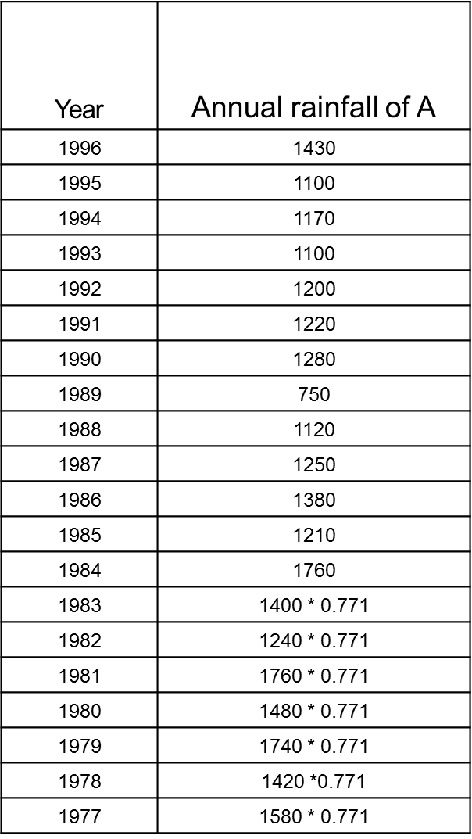
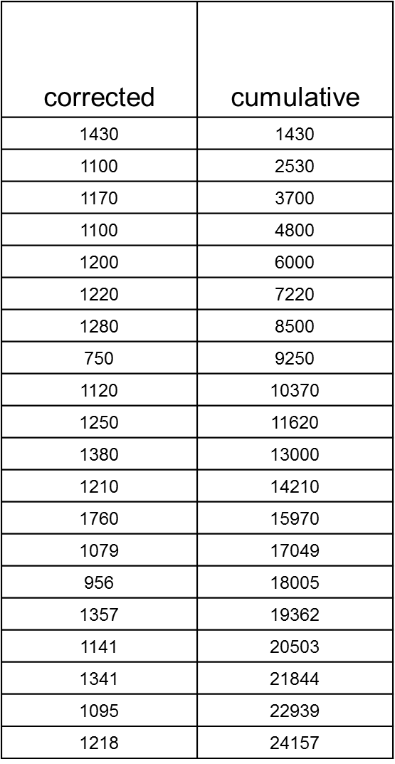
Corrected
Correction

Slide 83
  From the plot, the year in which a change in regime has occurred is indicated by the change in slope of the straight line plot.
  The rainfall records of the station x are adjusted by multiplying the recorded values of rainfall by the ratio of slopes of the straight lines before and after change in environment.

