Slide 1
Agricultural Knowledge and Innovation system

Slide 2
  Definition of a system
Greek word “systema” to mean “an organized relationship among functioning units or components.”
System:
  an interrelated components working together for some purpose.
  takes input from outside, processes it, and sends the resulting output back to its environment.
  collections of people using information technology and processes that define how people carry out their work.
  also includes informal interactions that take place in an organization Ex. emails, phone calls.
  has nine characteristics: components(subsystem), interrelated components, boundary, purpose, environment, interfaces, input, output and constraints.

Slide 3
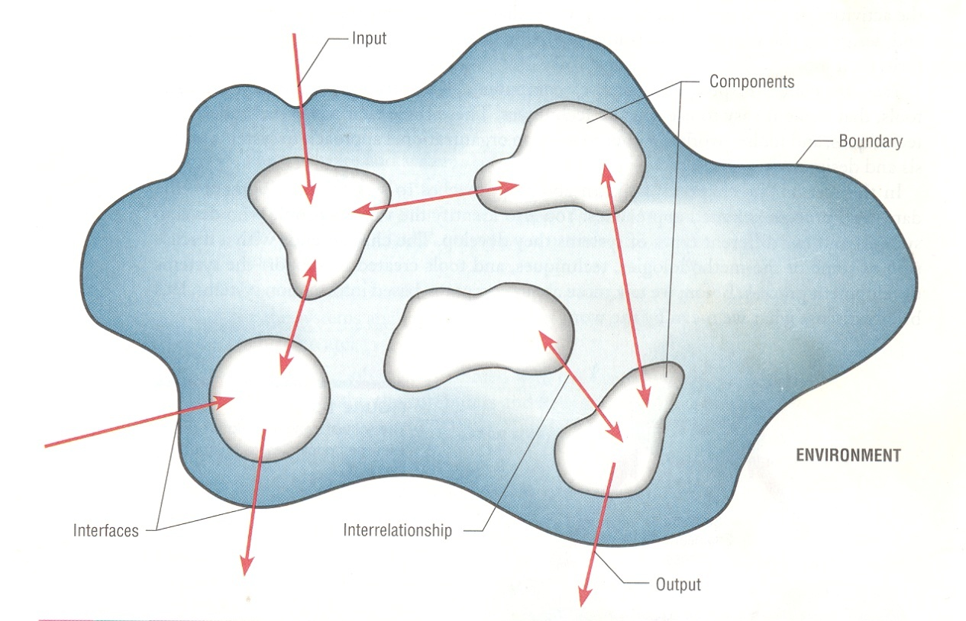
Characteristics of System

Slide 4
System
is a set of interrelated components, with a clearly defined boundary, working together to achieve a common set of objectives by accepting inputs and producing outputs in an organized transformation process.
A System has nine characteristics:
Components – A component is either an irreducible part or an aggregate of parts , also called as a subsystem
Interrelated Components - The function of one component is tied to the functions of the others. Output from one is input for another, the dependence of a part on one or more other parts.

Slide 5
3. Boundary A system has boundary, within which all of its components are contained and which establishes the limits of a system, separating it from other systems.
Components within the boundary can be changed whereas systems outside the boundary cannot be changed.
4. Purpose All components work together to achieve the overall purpose of the system.
5. Environment A system exist within an environment, everything outside the system’s boundary that influences and / or interacts the system.

Slide 6
6. Interfaces The points at which the system meets its environment and there are also interfaces between subsystems.
7. Input System takes input from its environment
8. Output System returns output to its environment as a result of its functioning to achieve the purpose. Output from individual subsystems may be inputs to other subsystems.
9. Constraints – There are limits to what the system can do (capacity, speed, and capability), some of these constraints are imposed inside the system and others are imposed by the environment.

Slide 7
Kinds of systems
Based on their interaction with the environment:
  open system
  closed system
Based on existence/visibility:
  (1) system as observable matter and
  (2) system as unobservable mind image.

Slide 8
Open system
is a system that regularly exchanges feedback with its external environment.
are systems, of course, so inputs, processes, outputs, goals, assessment and evaluation, and learning are all important.
Healthy open systems:
  continuously exchange feedback with their environments,
  analyze that feedback,
  adjust internal systems as needed to achieve the system’s goals, and
  then transmit necessary information back out to the environment.

Slide 9
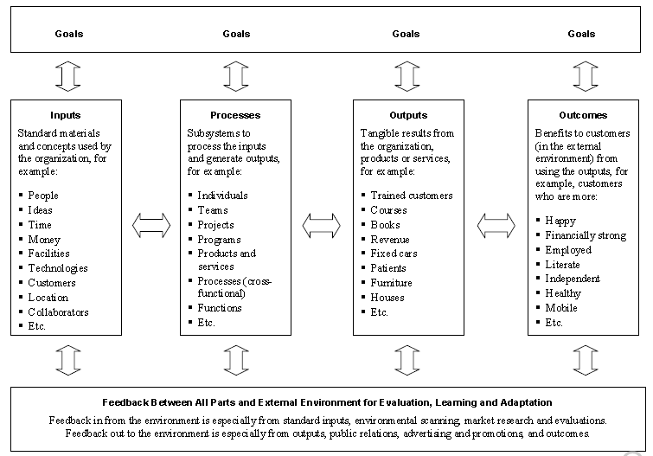
Overview of the Open System of an Organization

Slide 10
Closed system
is an isolated system that has no interaction with its external environment.
Closed systems with outputs are knowable only through their outputs which are not dependent on the system being a closed or open system.
Closed systems without any output are knowable only from within.
Closed system: no interaction/influence
Open system: dynamically interacts: Inputs-Transform/Process-Outputs

Slide 11
Exercise
Explain:
1. the difference between open and closed system.
2. the advantages and disadvantages of open and closed system.
Can you give examples for each?

Slide 12
System as observable matter
Systems and the components are observable and “real” objects. This real system (living or non-living things) is called “hard system”.
if we consider about the real objects as a system to understand or to gain some kind of function or solve some kind of problem it is called “hard system thinking” or “systematic” approach.
The natural scientists follow hard systems (systematic) approaches (real objects) to measure or manipulate this world by using mathematical models and theories.
E.g. you can imagine how ICT is playing the role in world we live now; you may be surprised how plant and animal scientists had discovered high productivity crops and animals by following hard system thinking through genetic engineering.
Example: functioning computer as a whole system and Human body as a system.

Slide 13
System as unobservable mind image
we cannot observe these systems like real (hard) systems. Analogous to natural (hard) scientists, social science scholars have been considering social issues like community, laws, politics, organization, society etc. as a system to understand the sub-systems and manipulate like hard systems (e.g. computer and our body).
E.g. we say political system, legal system etc. However, we cannot observe these systems like real (hard) systems mentioned above.
Here, the reality is in the mind of an observer and the observer should negotiate the meaning of that mind reality with other observers to reach on some kind of agreement to try to get purposeful emergent property.

Slide 14
Again, the emergent property cannot be engineered by professionals like computer and body. E.g. ensuring justice in the world is the “emergent property” of legal systems of the world or a given country.
In system terms, Social system is also called “human activity system” or “soft system” thinking
E.g. What we exactly know is that social system is something human beings collectively and purposefully create in mind to make use of natural resources (e.g. agriculture, mineral, etc.) and manmade resources (e.g. computer, car, etc.).

Slide 15
Emergent properties of a system
is a property that arises as a result of assembling components together into a system.
exist at system level and the key is the interaction of a system with its environment.
do not exist at component level. But individual component design can have a profound effect on emergent properties and safety and security are classic emergent properties.
are properties of the system of a whole that depend on the system components and their relationships.

Slide 16
Emergent properties result from the arrangement and interaction of parts within a system and these properties characterize nonbiological entities as well.
For example, a functioning bicycle emerges only when all of the necessary parts connect in the correct way.

Slide 17
  Scientific paradigms
Paradigm: is Greek word for model, pattern.
Webster’s Dictionary defines “Paradigm” as: “an outstandingly clear or typical example or archetype.”
Universally recognized scientific achievements that provide model problems and solutions to a community of practitioners
Three theories of knowledge in science (Scientific paradigms (positivism, constructivism, relativism)).

Slide 18
Positivism
The world exists externally to ourselves, it is external and objective and we can find out the singular truth about it (the object/phenomenon you are studying)
Its properties should be discovered through objective, detached methods (affecting the theory/methodology/methods used/developed)
Knowledge (your contribution)
  can only be based on hard, observed and tested facts
  mainly based on description, explanation and/or prediction of a limited number of fairly straightforward issues
  generalisation to a population is sought /required
Linked to the scientific method and hypothetico-deductive research

Slide 19
Positivism is a philosophical theory stating that certain ("positive") knowledge is based on natural phenomena and their properties and relations.
Thus, information derived from sensory experience, interpreted through reason and logic, forms the exclusive source of all certain knowledge.
Verified data (positive facts) received from the senses are known as empirical evidence; thus positivism is based on empiricism.

Slide 20
Limitations of Positivism
    Deterministic – assumes that there is an orderly world, regular and predictable and consistent in cause and effect
    Objectivist – assumes we can detach ourselves meaningfully from the world and study/observe it
    Singular – assumes there is a singular reality and a singular truth or law to explain it can be discovered
    So why is this problematic?

Slide 21
Post -positivism
There is an external reality but we can never achieve perfect knowledge of that
Mixture of deduction and induction
Critical realism and onwards…
Multiple approaches
/methods-theoretical/methodological triangulation
‘Strong’ objectivity

Slide 22
Interpretivism
Perspectival - The world exists according to how it is experienced, interpreted and perceived by people
  So there is an external world, but it is viewed/perceived/interpreted differently by different groups/individuals (research object/phenomena)
The world should be understood through attention to those different interpretations (affecting the theory/methodology/methods used/developed)
knowledge is based on understanding and interpretation of experience (knowledge/contribution)
Highly context specific
reflexive (not objective) co-construction of data
Inductive
Qualitative methods

Slide 23
Constructivism
Constructivist epistemology is a branch in philosophy of science maintaining that scientific knowledge is constructed by the scientific community, who seek to measure and construct models of the natural world.

Slide 24
We construct ourselves and our experiences and interpretations. There is no ‘bottom’ reality in constructivism, everything is constructed (our object of knowledge)
  Constructions sediment over time into ‘discourses’ but these are historically specific, highly changeable, multiple and contested
  Constructions that become sustained facts do so as a result of social, historical and political vicissitudes
Linked to Poststructuralist thought, deconstruction, discourse analysis (our mode of engagement)
Knowledge
  an account of constructions and how they work and their consequences
  how constructions are mobilised and operated
  a critique of “facts” (can be any phenomenon) as constructions

Slide 25
Dual continuum of research philosophies
Constructivism
Interpretivism
Post Positivism
Positivism
Realism
Relativism

Slide 26
  Change in professionalism
new institutional settings suggest enhancing participation in development interventions which has an implication for a knowledge management strategy.
contextual (process) planning of systemic inquiry can easily respond to policy questions.
This approach guides to the exploitation of local diversities. To achieve this three aspects have to be integrated.
These are:

Slide 27
a)Participatory methods: support local innovativeness
b)Interactive learning environment: encourages participatory methods by creating attitude changes, in which each knowledge source is valued and recognized.
c)Institutional support: for scaling up (dissemination) of the methods

Slide 28
This condition provides the best opportunity for building upon already existing knowledge of the producers through facilitation.
Facilitation of learning processes with local groups leads to changes from the Transfer of Technology (TOT) to new professionalism.

Slide 29
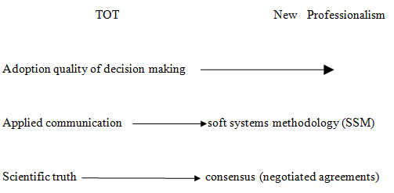

Slide 30
In general, systems approach help as a tool to improve performance of institutions through enabling them to shift to the ‘new’ line of thinking that goes further away from controlling with emphasis on enabling.

Slide 31
Relativism
Relativism is the idea that views are relative to differences in perception and consideration. There is no universal, objective truth according to relativism; rather each point of view has its own truth

Slide 32
Chapter Two
The challenges to extension science and its preoccupation with knowledge Systems
Extension= adult education programs in England
  Helped to expand - or extend - the work of universities
Later adopted in the USA
Terminologies:
  In Arabic: “guidance”
  In Dutch: ” lighting the path”
  In German: “advisory work”
  In French: “popularization”…etc

Slide 33
  Models of Extension
Models of extension services defined by
    The approach of service delivery (supply-driven, demand-driven, participatory vs top-down)
    Providers of extension services
    Funders of services
Most countries follow a combination of models.
Each model is evolving in response to new realities and emerging opportunities
There is no one size-fits-all model –so far

Slide 34
Models of Extension Services
Traditional supply-driven: Provided and financed by government & donors
Demand-driven, participatory & pluralistic extension services: Financed by government, donors & other funders and provided by public, NGOs & private providers
Private extension services: Provided by private extension agents & financed by cooperatives; farmers, NGOs, etc
NGOs: Financed by NGOs, provided by private or public agricultural extension agents (AEA)
A combination of models

Slide 35
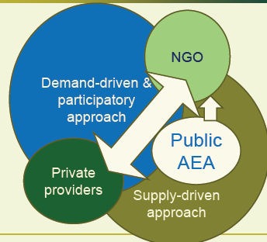
Agricultural extension models –method of service provision & providers

Slide 36
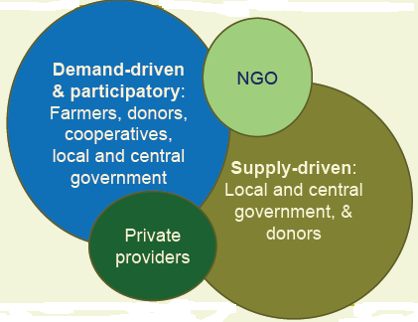
Agricultural extension models –sources of funds for each model

Slide 37
Gemo et al. (2005) listed six basic extension models in Africa, all of them imported from other continents.

Slide 38
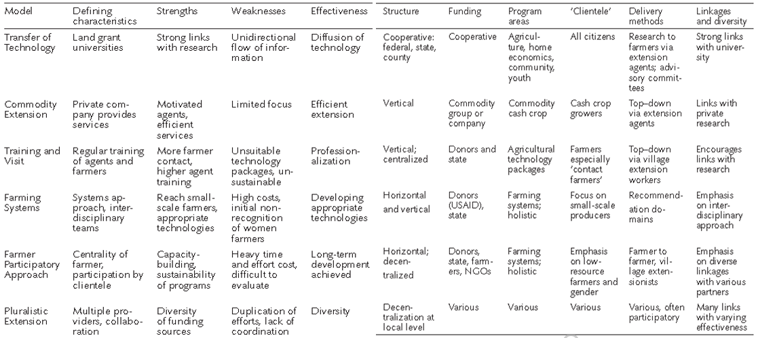

Slide 39
Knowledge Dynamics
What does Knowledge dynamics mean?
What makes knowledge to have dynamic nature?
Knowledge dynamics means the change in knowledge and information required as the context in which social actors operate change because of certain factors (resource, institutional, political, natural, demographic, policy, etc…).

Slide 40
Knowledge dynamics occurs whenever change in one of the features the system components/resources takes place.
Knowledge is constituted by the ways in which people categorize, code, process information’s and impute meaning to their daily life experiences.

Slide 41
Knowledge dynamics can be conceived of as systemic outcomes and patterns based on the interplay and aggregation of flows, and
Therefore involving scaling up towards large systems of interacting agents and across longer temporal frames.
Specific flows can be used in explaining the performance of the knowledge economy, its distributional outcomes (for example equality), innovation and adoption patterns (of codification supports for example).

Slide 42
There is no need to equate knowledge to professional science. Every body has certain aspects of knowledge. It is not the property of the educated alone.
Knowledge emerges out of a complex process involving social, situational, cultural and institutional factors.
Knowledge dynamics recurs/return to react to changing or newly emerging agricultural problems or to react /adapt to externalities.
The concept of knowledge dynamics is helpful to recognize the context in which interventions and technologies work efficiently.

Slide 43
Knowledge Processes
Studying knowledge processes is valuable in order to understand the roles and functions of the different actors involved at various phases in which knowledge is transformed from its abstract to the more concrete and applicable forms.
What are the processes?
The processes involve certain steps: knowledge generation /production/ creation, knowledge dissemination, knowledge transformation (oral, written, simple, meaningful, and relevant), knowledge exchange, knowledge utilization and knowledge storage and retrieval.

Slide 44
In the agricultural development process knowledge generators include farmers, researchers, change agents, policy- makers, project managers, investors, system scientists; national and international NGOs, etc.
knowledge processes involve certain steps:
Knowledge generation /production/ creation
Knowledge Transformation (oral/written, simple, meaningful, relevant)
Knowledge dissemination
Knowledge Exchange
Knowledge Utilization
Knowledge storage and retrieval

Slide 45
Knowledge Systems perspectives
the actors in the system adjust themselves in a certain way which is hard to predict to achieve the objectives in a synergistic way.
Features of Knowledge systems perspectives:
The stem from reflective (thoughtful/deep) practice rather than from scientific inquiry; (stimulation of imagination)
Different actors at many different levels make decisions affecting the innovation of agriculture.
Continuing power struggles among actors is an indicative for the type of innovation.
Complex innovation theaters have to accommodate arbitrariness, allowing those concerned to make their own judgments in terms of means and ends by creating space for contextualization, (re) appreciation of views, positions, and relationships among social actors.

Slide 46
Chapter Three
Knowledge Systems and Natural Resource Management
Natural resources are of two types:
  Renewable resources and
  non renewable resources.
Renewable resources are replaced through natural processes at a rate that is equal to or greater than the rate at which they are used, and depletion is usually not a worry. Some common examples include:
  Air (wind)
  Fresh water
  Soil
  Living organisms (trees)
  Sunlight

Slide 47
Nonrenewable resources are exhaustible and are extracted faster than the rate at which they formed. Some common examples are:
  Fossil fuels (coal, oil, natural gas)
  Diamonds and other precious gems and minerals
  Types of metals and ores
  Resources

Slide 48
  Conflict resolution on common resource use
What is conflict? Why conflict?
Between whom is the conflict?
What are the methods of conflict resolution?

Slide 49
Conflict is disagreement and the desire to own some resources for the self while the others also have the same interest. Resources in which conflict may arise include:
  Land
  Water
  Communal grazing land
  Forest etc
  Can you explain by giving examples for each?
Conflict can be between individuals, organizations, kebeles, districts, regions, countries etc.
  Can you explain by giving examples for each?

Slide 50
How are conflicts resolved in your area?
By agreement and mediation between the parties themselves.
By the local conflict resolution system
Using the legal system
Can you take local examples about this conflict resolution mechanisms?
What is the advantage of each?
Which one do you think should be used so that conflicts will be minimum?

Slide 51
Note:
Conflicts vary from place to place, as livelihood also varies.
For example, for pastoralist, grazing land and water may be the critical resource which can be source of conflict while irrigation water will be for high land crop producing areas.
Boarder/ location will be source of conflict for:
  gold mining areas
  Farmers
  Towns and cities
Can you explain any source of conflict in your area?

Slide 52
CONFLICT OVER NATURAL RESOURCES
People have different uses for natural resources as forests, water, pastures and land, and want to manage them in different ways.
Knowing about these different needs and interests can help to inform successful management so that everyone benefits as much as possible.
However, such differences can also lead to conflict when:
there is competition over material goods, economic benefits, or property;
parties believe that their needs cannot be met;
parties perceive that their values, needs or interests are under threat.

Slide 53
DIFFERENT OPTIONS FOR MANAGING CONFLICT
Avoidance: acting in ways that prevent a conflict from becoming publicly acknowledged.
Negotiation: voluntary process in which parties reach agreement through consensus.
Mediation: using a third party to facilitate the negotiation process. (The mediator does not have the authority to impose a solution.)
Arbitration: submitting a conflict to a mutually agreeable third party, who renders decision.
Adjudication: relying on a judge or administrator to make a binding decision.
Coercion: threatening or using force to impose a position.

Slide 54
There are three main social systems of conflict management that involve a third party:
customary systems for managing conflict based on local values and customs;
national legal systems based on legislation and policy;
collaborative conflict management based on promoting joint decision-making and seeks voluntary agreement among disputants in win–win solutions.

Slide 55
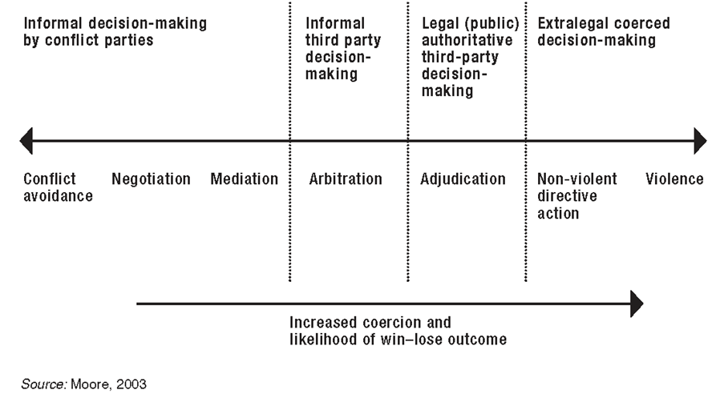
Continuum of conflict management approaches

Slide 56
The ten steps of collaborative conflict management
Step 1: Preparing entry
Step 2: Entering the conflict scene
Step 3: Analyzing the conflict
Step 4: Broadening stakeholder engagement
Step 5: Assessing options
Step 6: Preparing negotiations
Step 7: Facilitating negotiations
Step 8: Designing agreement
Step 9: Monitoring the agreement
Step 10: Preparing exit
Milestone A:Entry
Milestone B:Broadening of Community engagement
Milestone C:Negotiation
Milestone D: Exit

Slide 57
Step 1: Preparing entry
The mediators clarify their role and prepare the contacts with conflict parties. They examine background information on the conflict, and develop the best strategy for approaching the different parties to the conflict.
Step 2: Entering the conflict scene
This is the first direct contact that the mediators have with the conflict parties. The mediators first meet the conflict parties separately and learn how they frame the conflict. They then clarify their own role in moving the process forward, and secure a commitment to start mediation.

Slide 58
Step 3: Analyzing the conflict
The mediators clarify their assumptions about the conflict, and analyze the different stakeholders’ positions. The mediators should continue only if:
the conflict analysis indicates that existing conflict management mechanisms are unlikely to succeed; and
their own intervention will do no harm.

Slide 59
Step 4: Broadening stakeholder engagement
In this process, the mediators gradually hand over control and responsibility to the conflict stakeholders. Mediators help the stakeholders to analyze the root causes of the conflict, the different stakeholders involved, and their own positions, strengths, interests and needs.
Step 5: Assessing options
The mediators now help the different stakeholders to generate options for resolving or managing the conflict. The merits of each option are assessed, and the options are prioritized.

Slide 60
Step 6: Preparing negotiations
Negotiations need careful preparation. This includes preparing the people involved, exploring strategies and planning the negotiation setting.
Step 7: Facilitating negotiations
At this step, differences are narrowed, often through the shifting of viewpoints from positions to interests and needs. The negotiations are complete when the conflict parties can agree on options for settling the conflict. These options are brought together, in preparation for moving towards a single agreement that is acceptable to everyone.

Slide 61
Step 8: Designing agreement
Once the conflict parties have agreed on which options to consider, they need to reach agreement on how these options will be implemented and how implementation will be monitored. The mediators’ role in this process also has to be clarified.
Step 9: Monitoring the agreement
The mediators may take various roles in the implementation and monitoring process of agreements. These roles need to be clarified with the conflict stakeholders.

Slide 62
Step 10: Preparing exit
The mediation team needs to develop a system for handing over responsibility to implement and monitor the agreement to the stakeholders or a trusted local mediator. The team may also develop strategies that build further the communities’ capacity to solve future problems.

Slide 64
Process management involves five main tasks:
fostering collaboration (create a feeling to negotiate);
avoiding further escalation of tensions or conflicts: “do no harm or signs of favoritism towards one side”;
opening space for restoring relations;
managing information;
building the capacity of weaker stakeholders to participate and of stronger stakeholders to understand broader issues.

Slide 65
  Social dilemma in watershed management
Water is one of the resources that serves many purposes.
It must be used wisely so that it will not lead to conflict
  Irrigation
  Drinking (both for humans and animals)
  Path (flood)
Can you explain watershed management system in your area?
Can you take local examples of conflict and its resolution
The same procedures discussed above need to be followed in conflicts related water.

Slide 66
  Practical: Simulation exercise on conflict resolution
Conflict resolution
  Theoretical
  Video

Slide 67
End
End

Slide 68
Chapter Four
Strengths and weaknesses of AKIS
  Strengths of AKIS
based on an equal partnership between farmers, researchers and extension agents who can all learn from each other and contribute their knowledge and skills.
aim to strengthen rural people's problem-solving, planning and management abilities;
promote farmers' capacity to adapt and develop new and appropriate technologies / innovations
recognize that communities are not homogenous but consist of various social groups with conflicts and differences in interests, power and capabilities.
03

Slide 69
links people and institutions to promote mutual learning
generate, share and utilize agriculture-related technology, knowledge and information.
The system integrates farmers, agricultural educators, researchers and extensionists to harness knowledge and information from various sources for better farming and improved livelihoods.
This integration is suggested by the “knowledge triangle” displayed below.

Slide 70
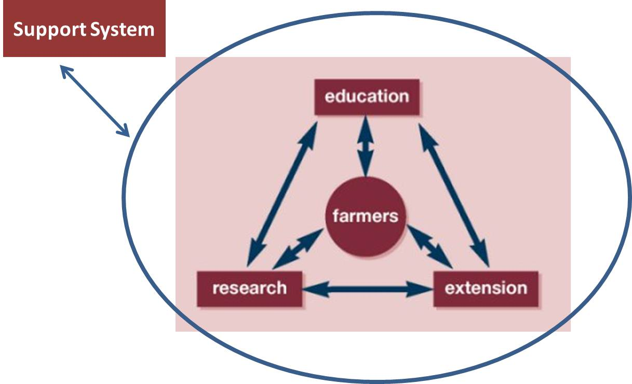
knowledge triangle

Slide 71
Education

Slide 72
  Weaknesses of AKIS
Many farmers fail to benefit from technological and other advances
the AKIS/RD institutions have not been responsive enough in addressing the problems and opportunities facing farmers
Education, research and extension institutions, particularly in the public sector, have been slow to exploit the potential of economic liberalization, democratization and decentralization.
AKIS are governed by public policy but consistent AKIS policies do not exist
Monitoring of AKIS (input, system, output) is fragmented
The high level of attention to “innovation” in the policy domain and the lack of research for evidence-based policy are inconsistent.

Slide 73
Some concepts about AKIS
AKIS is originally a theoretical concept (based in observations) that is relevant to describe national or regional AKIS: they exist
AKIS are quite different between countries / regions
Some countries have restructured their AKIS considerably
AKIS components are governed by quite different incentives
AKIS are governed by public policy but consistent AKIS policies do not exist
Monitoring of AKIS (input, system, output) is fragmented
The high level of attention to “innovation” in the policy domain and the lack of research for evidence-based policy are inconsistent.
new opportunities exist for raising AKIS/RD effectiveness
New concepts are emerging for participation in learning and problem solving

Slide 74
Consider the AKIS in your area and
explain:
  Its strengths
  Weaknesses
What do you suggest to make the AKIS in your area more:
  Accessible
  Sustainable
  participatory

Slide 75
End
End

Slide 76
Chapter Five
Reasons for Studying Agricultural Knowledge Systems
Designing and implementing agricultural policy
Promoting sustainable changes
Improving institutions’ performance

Slide 77
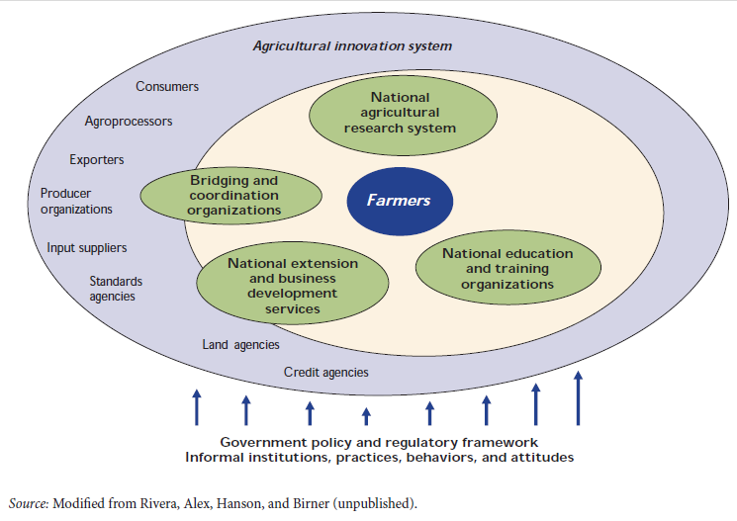
An Agricultural Innovation System

Slide 78
Why do we study Agricultural Knowledge Systems?
To understand theater of innovations
To recognize specific situations
To get clear picture of knowledge producers and users
To design purposeful interventions
To design appropriate development strategy
No single social actor can guide comprehensive processes towards innovations.

Slide 79
Designing and implementing agricultural policy
Designing policy at country level needs to consider all areas (from top to bottom) so that it will be an all inclusive.
Interactions and linkages all need to be carefully identified and considered during designing agricultural policy

Slide 80
All concerned stakeholders need to be involved
  Policy makers
  Agriculture office at different levels
  Development agents
  Farmers
  Research centers
  Students
  Researchers
  consultants
  Agricultural input suppliers
  Traders etc

Slide 81
  The following among others need to be studied
  financial, human and other resources
  natural resources and potential
  Challenges
  opportunities
  Feedbacks etc
implementing agricultural policy needs to be based on policy designed on study.

Slide 82
Promoting sustainable changes
When an organization studies its Agricultural Knowledge Systems and perform its tasks accordingly, then:
there will be wise and efficient use of resources
  Time
  Human
  Financial
  infrastructural etc
Identifying Inputs, processes and outputs and their interactions, customers and other actors related to the system helps to achieve sustainable changes in the organization.

Slide 83
Improving institutions’ performance
The performance and success of institutions is determined by different factors including the following:
  Human, financial, infrastructural resources
  rules, procedures and their implementation
  Managerial skills
  Organizational culture
  Skilled human resource
  Application of technologies and scientific procedures
Therefore, to improve institutions’ performance studying the Agricultural Knowledge Systems is important. How?

Slide 84
The following things can be studied
Available gaps
Potential resources
Limitations/scarcity
Feedbacks
  Corrective measures can be taken
  Strengthen the good works
Resource allocation
Implementation of productive
  Kaizen
  BPR
Application of technologies/computerized systems
  Database management system
  Employee performance monitoring ,evaluation and reward system

Slide 85
End
End

Slide 86
Chapter Six
Soft Systems Practices in Development Intervention
  Distinction between hard and soft systems
  Assumptions in soft systems methodology (SSM)
  Stages of SSM

Slide 87
Cont…
Hard systems are suitable for problems that need quantitative approach.
The tendency of hard system is that it considers people as passive entity, rather than understanding their dynamic and ever changing relationships and motivations.
Soft systems are suitable to study unquantifiable variables which are usually too difficult, if not impossible, to measure quantitatively in hard systems approaches.

Slide 88
Cont…
Soft systems are so appropriate to approach the problem situation qualitatively and quantitatively in order to understand the changing:
  motivations
  opinions
  relationships and
  interactions within and between farmers, development agents, agricultural knowledge managers, and agricultural researchers etc

Slide 89
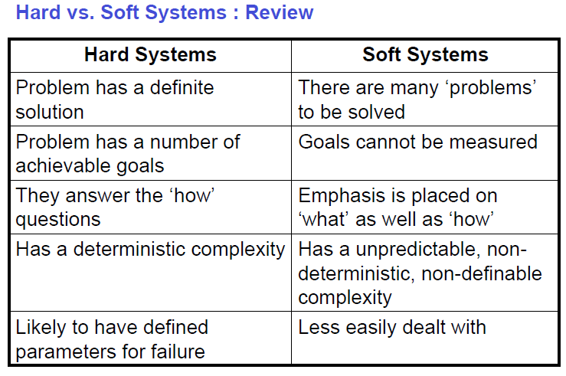
Cont…

Slide 90
Cont…
Hard systems methods/approaches | Soft systems methods/approaches
Physical entities | A social construct
Objective (positive) empirical results | Subjective (interpretive) methods
Systematic world | Systemic mind
Rigid method | Flexible methods
Content-oriented | Process-oriented
Scientific procedures | Creative/intuitive
Analyst – expert role – dominant | Analyst – facilitator role - participative
Outcome: computer simulations & models | Outcome: organizational learning
One ‘single and optimum’ solution | Number of possible solutions
Do the thing right | Do the right thing

Slide 91
Cont…
Hard versus soft systems
 | Hard systems | Soft systems
System objectives | Predefined | Variable, according to the purpose of the system
System elements | Fixed Variable | according to the purpose of the system
System environment | Not relevant | Relevant and, owing to focus, arbitrary
System boundaries | Fixed Variable | Variable, according to the purpose of the system
System relations | Fixed linkage mechanisms | Chaotic variable interaction
System performance | Fixed through input–output relations | Determined by structure and objectives
Source: Hartwich and Meijerink, 1999.

Slide 92
  Assumptions in soft systems methodology (SSM)
There are five assumptions in the application of the soft systems methodology in the knowledge management process.
It is the process of managing, taking a particular view on what managing is and what a knowledge manager does. Knowledge manager in any field of activity is reacting and trying to cope with an ever-changing flux of interacting events and ideas. Managing means reacting to the flux: perceiving and evaluating it, deciding up on action which itself becomes part of the on-going ideas/events in flux, leading to new perceptions and evaluations and further actions.

Slide 93
Cont…
2. Given the above broad view of meaning SSM assumes that different individuals, being relatively autonomous, make different evaluations leading to different actions. The manager has to hope with these differences.
The figure shows the interaction of events and ideas through time leading to new decisions and action. This indicates how knowledge required to solve old problems may not be relevant to solve new problems.
Thus, new knowledge needs to be generated to solve new problems through time. For instance, we need a new crop variety to perform under moisture stress or a new antivirus for a newly invented computer virus.
The knowledge manager should either invest in the creation of knowledge needed to solve the problems or search where this knowledge is available in a larger system or learn from others who experienced similar problem and the knowledge they used.

Slide 94
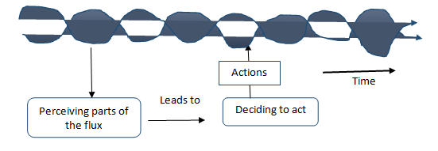
Fig: Life world: a flux of interacting events and ideas

Slide 95
Cont…
3. The systems ideas are helpful in consciously articulating the processes of knowledge management. As a system connects actors trying to improve performance within or across organizations their interaction enhances knowledge management through creation or sharing knowledge.
4. The concept of SSM is largely rooted in that of the “designed and natural” systems. But the concepts of those systems lack adequacy in describing the complex human situations. The new concept going along these two systems is “human activity system” aiming at constituting interconnected links to contribute to a purposeful whole.

Slide 96
Cont…
5. SSM learns by comparing pure models of purposeful activity (in the form of models of Human Activity Systems (HAS)) with perceptions of what is going on in a real world problem situation.
The knowledge manager can look into these alternatives for action (changes to be introduced) to prevent crime based on their costs and benefits in promoting behavioral change to potential criminals who could otherwise be a threat to the peace and security of the society.

Slide 97
Cont…
6. SSM is an articulation of a complex social process in which assumptions about the world - the relevant myths and meanings as well as logic of achieving purposes that are expressed in the systems models- are teased out, challenged and tested.
This makes the methodology having a real participatory nature.

Slide 98
  Stages of Soft Systems Methodology (SSM)
Since SSM supplements “experience” by an explicit use of systems thinking, it involves “ debate that helps to define changes which would bring about improvement, and seeks to motivate people to take action to implement the defined changes.
There are seven stages in SSM.
Users of the SSM cycle do not necessarily move straight forward from stay 1 to 7 because for different problem situations different stages can be emphasized.
It embraces flexibility as far as the logical connection b/n stages are kept in mind.

Slide 99
The seven stages in SSM
Identifying the problematic situation that it is desired to intervene in
Researching the situation and building a 'rich picture' (interpretive representation) of it
Selecting perspectives and building 'root definitions' (key processes that need to take place within the desired system)
Developing a conceptual model of the change system
Comparing the model with the real-world situation
Defining the changes to be implemented
Taking action.

Slide 100
Stages 1 & 2: Finding out (Sense making)
combines entering the considered problematic situation and expressing the problem situation.
There are three phases in these stages
1. Pictures of the situation are assembled by recording elements of slow- to-change structure. Which gaps on knowledge exist?
2. Recording the dynamic elements of continuously changing process in identifying aspects sensitive to time, for instance, new innovation, and
3. Forming a view of relating structure to process (looking into the knowledge level of the actors and how it affects work process in an organization) to create a climate of the situation.

Slide 101
Cont…
These phases will lead to getting clear/rich picture of the situation of an organization.
Stage 3: Formulating Root Definitions (Rds)
The knowledge manager is expected to design mechanisms of solving the problem by designing the system.
An essential activity in this stage is trying to formulate root definitions based on the CATWOE questions from which models can be built. This can be described as:

Slide 102
CATWOE
C-customer: a customer is an individual or organization which could be victims/beneficiaries of the purposeful activity
A- actors: these are again individuals or organizations or groups which will be involved in undertaking activities in inducing change. The knowledge manager could rise the question “Who would do the activities and what level of capacity exist?”
T- Transformation: which includes the conversion of inputs into outputs through a certain process. The changes to be introduced to undertake purposeful activity require different kinds of inputs for different levels and types of outputs. The knowledge manager asks the questions “What kinds of inputs generates which types of outputs?”

Slide 103
Cont…
W –Worldviews: different individuals do have different world views which are influenced by the previous exposure and expectations over outcomes of certain actions. Thus, the knowledge manager needs to understand the different world views (windows of thoughts) and asks the questions “What view of the world makes this definition meaningful?”
O – Owner: These are stakeholders who have shared concerns over the outcomes and may be a barrier or cooperator in the process of implementation of the changes. They need to be carefully identified at earlier stage. The knowledge manager could ask the question “who could stop undertaking a specific activity?”
E –Environment: there are several factors (social, ecological, economic, and political) external to the system but affect the smooth functioning of a particular system. A useful question is “Which constraints in our environment does this system take as given?

Slide 104
Stage 4: Building Conceptual Models
The building process consists of describing the activities that have to be carried out in the system named in the root definitions and structuring them according to logical dependencies.
In this case, emphasis would be placed on the operational part of the system that would achieve the transformation.
However, any system model is a combination of an operational system and a monitoring and controlling system.

Slide 105
Cont…
how could the system fail? Along these, one can identify three aspects that can be considered as possible sources of a system’s failure, including:
Effectiveness: which involves the right thing to do where one has to be linking objectives with outcomes
Efficiency: that indicates the identification of the resources needed and reducing costs needed to generate better outcomes, i.e. making the transformation processes easier and cheaper. For example, the use of information technology to monitor work processes.
Efficacy: this involves the use of appropriate means and instruments, as a measuring processes and performance.

Slide 106
Stage 5: Comparing models and “Reality”
At this stage, the models from stage 4 provide the knowledge manager a means for perceiving reality and initiating a discussion from which “changes” to improve the problem situation.
The key tasks include focusing on differences between models and perceived reality.
Such comparison of the differences help to refine further and narrowing the gap between the perceived reality and the models.

Slide 107
Stage 6. Defining changes
The purpose of comparison from stage 5 is to use the differences between models and reality to discuss possible changes which could bring about improvement in the problem situation.
to define changes comparisons made at stage 5 which ultimately leads to the question: how can we define systemically desirable and cultural feasible changes?

Slide 108
Stage 7: Taking action
stage where implementation of the proposed action takes place
It is the stage at which the knowledge manager ensures that the changes are accepted as “systemically desirable and culturally feasible “where the soft systems methodology in the knowledge management is completed by implementing changes.

Slide 109
End
End

Slide 110
Chapter Seven
Indigenous and Scientific Knowledge Systems
Definition of Indigenous and Scientific Knowledge
IK is the ideas, experiences, practices and information that either have been generated locally or are generated elsewhere but have been transformed by local people and incorporated into their way of life.
The term scientific knowledge is attributed to some facts and principles that are acquired through the long process of inquiry and investigation.
The investigation takes a long time because it goes through various aspects to come to a conclusion and the aspects include all the laws, theories, concepts and models.
It is a kind of knowledge that is acquired by the systematic study and is organized in accordance with some general principles.

Slide 111
Indigenous knowledge is the knowledge that people in a given community have developed over time, and continue to develop.
It is:
  Based on experience.
  Often tested over centuries of use.
  Adapted to local culture and
  environment.
  Dynamic and changing.

Slide 112
Other names used / terms that seem to replace the word ‘indigenous knowledge’ include:
  traditional knowledge,
  local knowledge,
  “unscientific” knowledge
  farmers’ knowledge.
“Scientific” knowledge is often referred to as western knowledge

Slide 113
Differences between indigenous knowledge (IK) and scientific knowledge (SK)
There are three basic differences:
Substantive grounds
Methodological and epistemological differences
Contextual differences

Slide 114
Substantive grounds
refers to the subject matter history and distinctive characteristics of IK and SK.
  IK is anchored to a particular “social group” in a particular “setting” at a particular time.
  IK is concerned with immediate and concrete necessities of people daily lives whereas SK makes (constructs) general explanation and does not give emphasis to daily lives.
  IK encompasses non-technical insights-ideas, wisdom, perceptions and innovative capabilities.

Slide 115
Methodological and epistemological differences
SK is open, systematic, objective and analytical. It builds on prior achievements for advancement; however, IK is closed, non-systematic, holistic rather than analytical, without an overall conceptual framework.
IK advances on the basis of new experiences, not on the basis of deductive logic (Banuri, et al, 1993).
IK supporters attack on the dogmatism /rigidity and intolerance of scientists towards insights and methods of inquiry outside the established and institutionalized science.
IKs have of closed nature

Slide 116
Contextual differences
IK is specific to local context in terms of social group and time (temporal and spatial differences) whereas SK is diverted from such epistemic framework to attain universal validity.

Slide 117
Similarities between IK and SK
The Danger of Dichotomizing/dividing between IK & SK.
This notion reflects the similarities between the two.
- In the face of evidence that suggests contact, diversity, exchange, communication, learning, and transformation among different systems of knowledge and beliefs, it is difficult to adhere to the view that separates IK&SK.

Slide 118
Evidences from the past indicate that the failure of technical solution-oriented development policies and, programs is attached to making a clear distinction b/n IK&SK. This ignored the contexts in which they were implemented (Agrawal, 1995).
- Thus emphasis must be given to the continuous interaction or interweaving of IK & SK in which SK provides theoretical framework and IK helps to discern the cultural situation in which policies are implemented.
Bridging the dichotomy implies associating science with culture making the indigenous of the ‘ western’ knowledge.
- The above situation can happen if there is a suitable environment for conservation of indigenous knowledge.

Slide 119
  Local group networks and information management
Iks are area specific and tied to the religious, cultural and other socio-economic factors.
Mostly they are found in the heads of the knower and transferred through oral communication.
Both non-government and government organizations can help to build the legitimacy of local knowledge by developing strong R&D projects.
To attain legitimacy of local knowledge, additional significant reorientations and strong actions are needed in national and international agricultural R&D institutions.

Slide 120
Local group networks: in most of the Iks, there is no as such a well established network though there are Iks which are commonly practiced. Examples: Indigenous knowledge of Konso People in Ethiopia (Terracing, Contour Ploughing, crop rotation, fallowing etc)
Can you mention Iks in your area and explain the network of communication and information management?
The lists may include:
  Agricultural knowledge
  Diseases and medicine (trees, shrubs, animals)
  Conflict management
  Seasonal changes and timing

Slide 121
Status of Indigenous knowledge
Some IK is lost naturally as techniques and tools are modified or fall out of use. During the last decades, however,-development processes and population changes have accelerated this loss, endangering the survival of IK.
What can we do to preserve this endangered species? Here are some ideas:
  Raise awareness about the value of IK for development.
  Help communities conserve their IK
  Record and use lK in applied development projects
  Document IK and make the information available to people working in development.
  Make IK available to the communities from which it was obtained.
  Observe intellectual property rights when recording IK

Slide 122
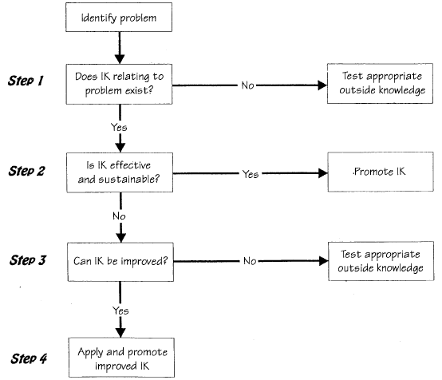
Decisions when using IK in Projects

Slide 123
Major Difficulties and Challenges in IKs
Access
Bio-piracy = The practice of commercially exploiting naturally occurring biochemical or genetic material, especially by obtaining patents that restrict its future use, while failing to pay fair compensation to the community from which it originates.
Bio-prospecting = The search for plant and animal species from which medicinal drugs and other commercially valuable compounds can be obtained.
Benefit Sharing
Term ‘Indigenous Knowledge
IKS and Commercialization
Ownership: Individual, Communities
Partnerships

Slide 124
How to elevate the status of IK?
“Local solutions to local problems”
End
Think globally and act locally

Slide 125
Example 1:
In East haraghe zone, Haramaya district:
Onion is used stop bleeding. Two onions will be pilled and put inside a cloth and put on the fire to have some temperature. Then the close will be put on the bleeding body part.
During summer time, in East Gojjam zone,as a replacement to umbrella, people construct hard cover made from grasses called “Gessa” and use it during rainy season.

