Slide 1
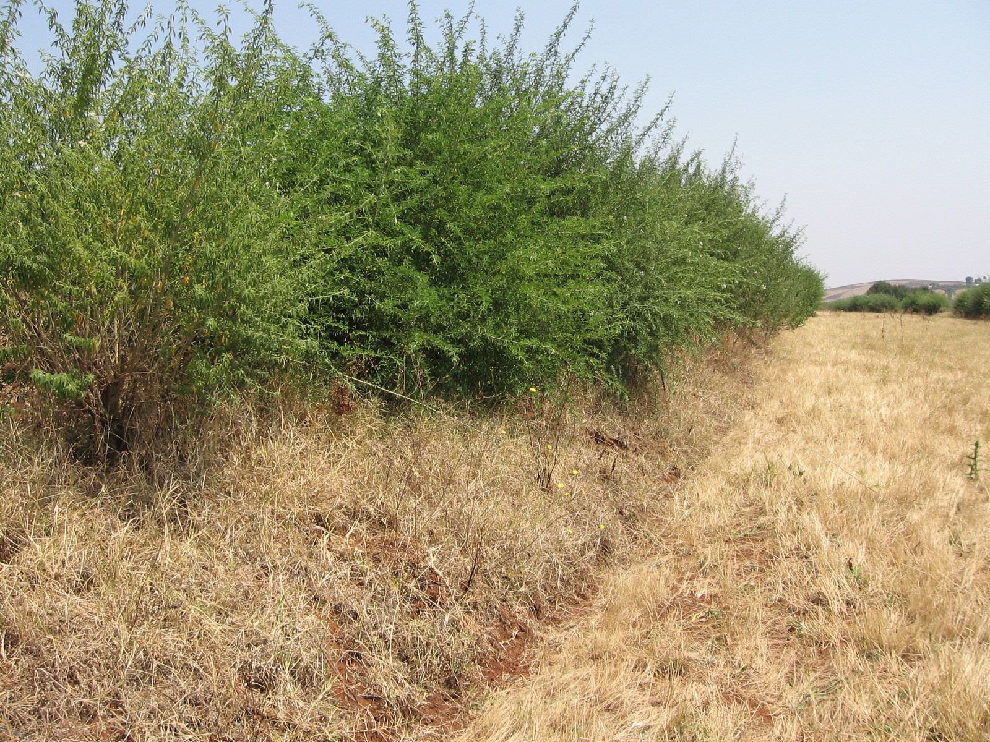
.
.

Slide 2
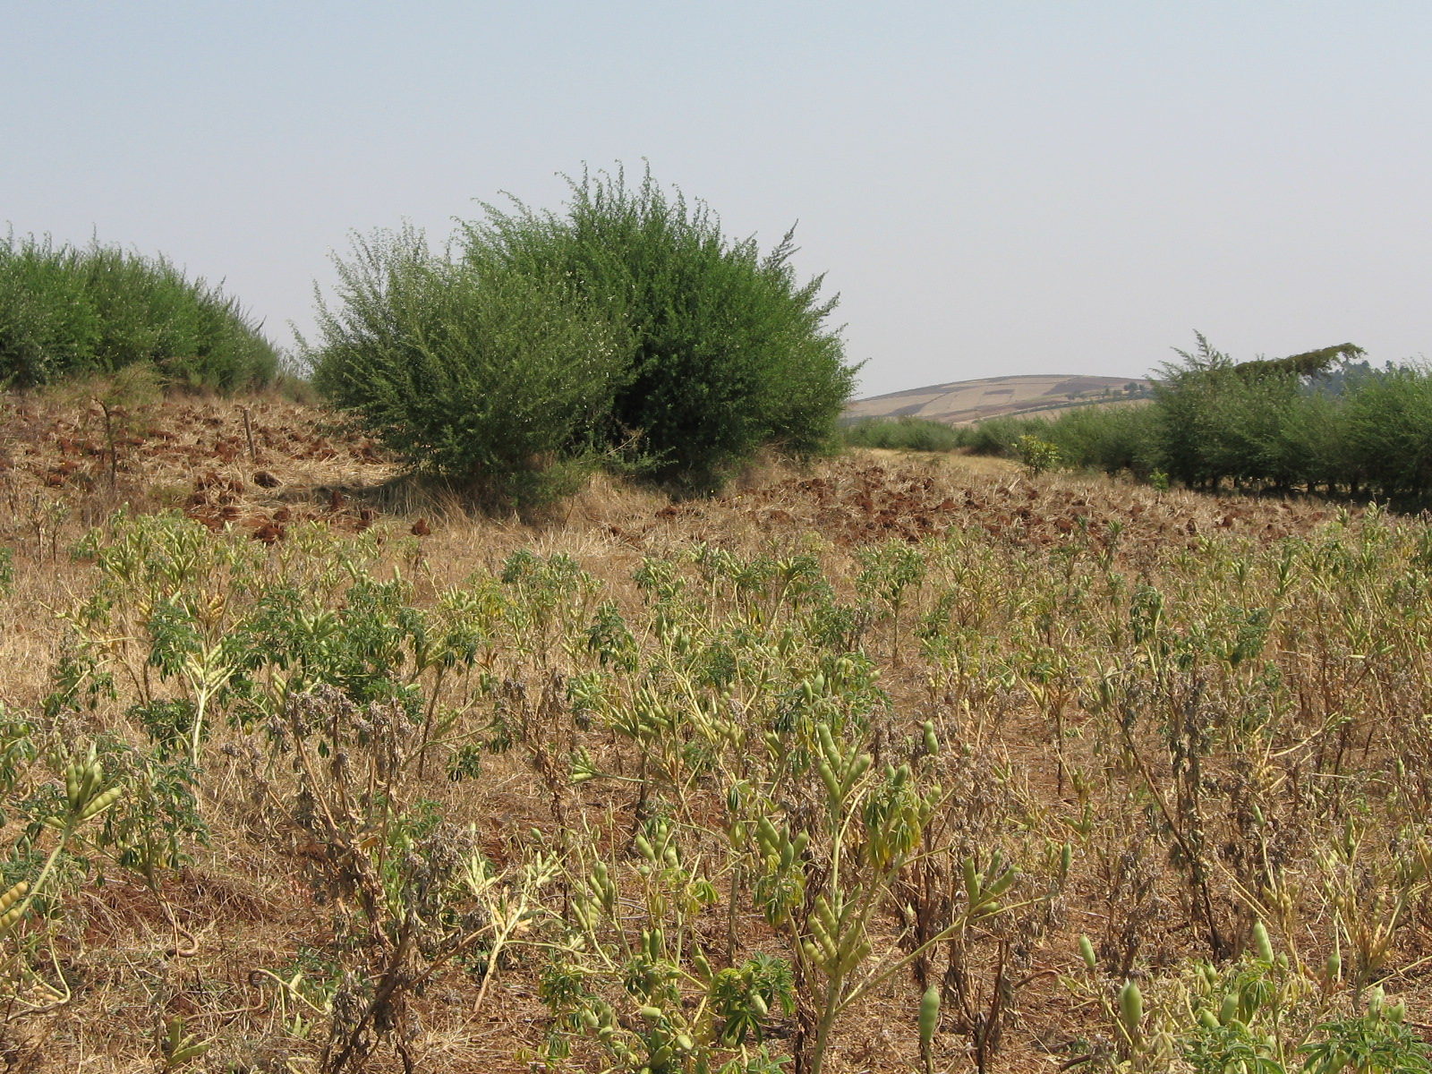
.
.

Slide 3
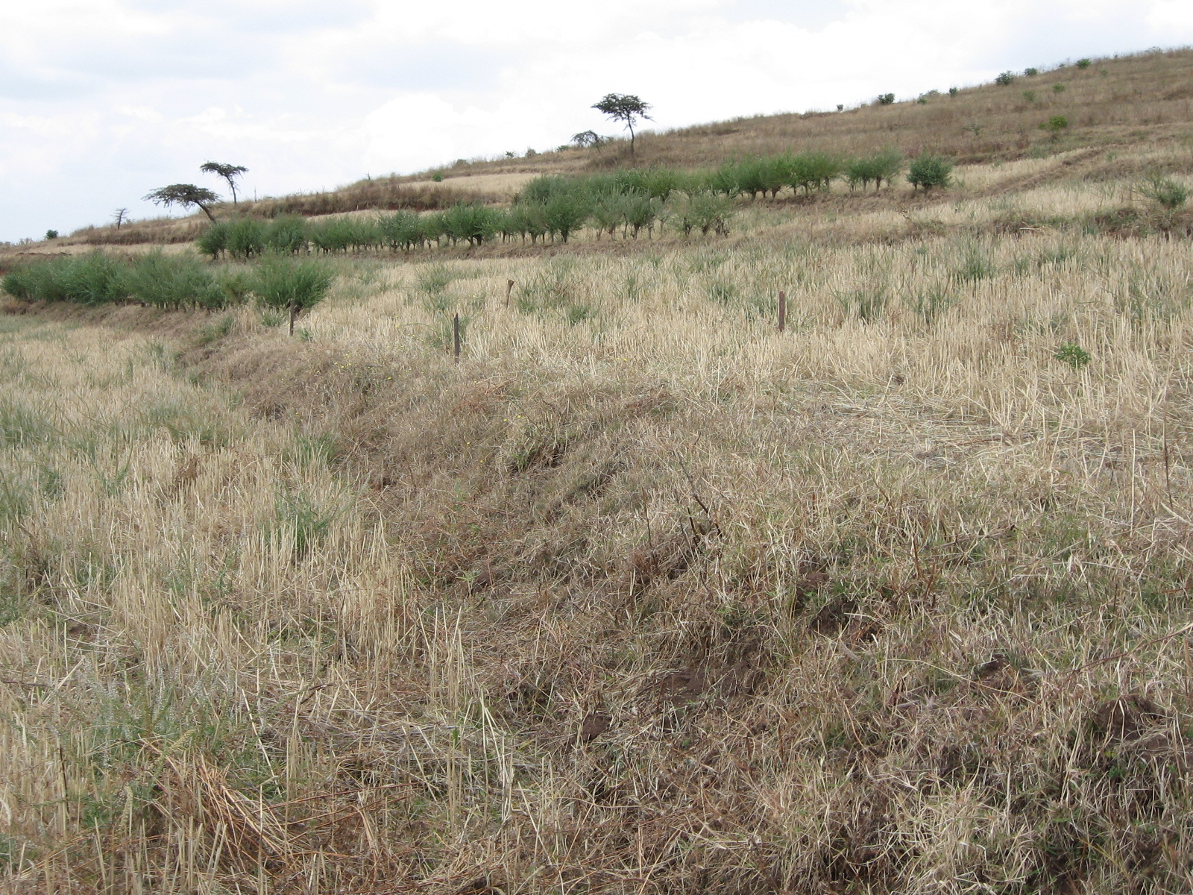
.
.

Slide 4
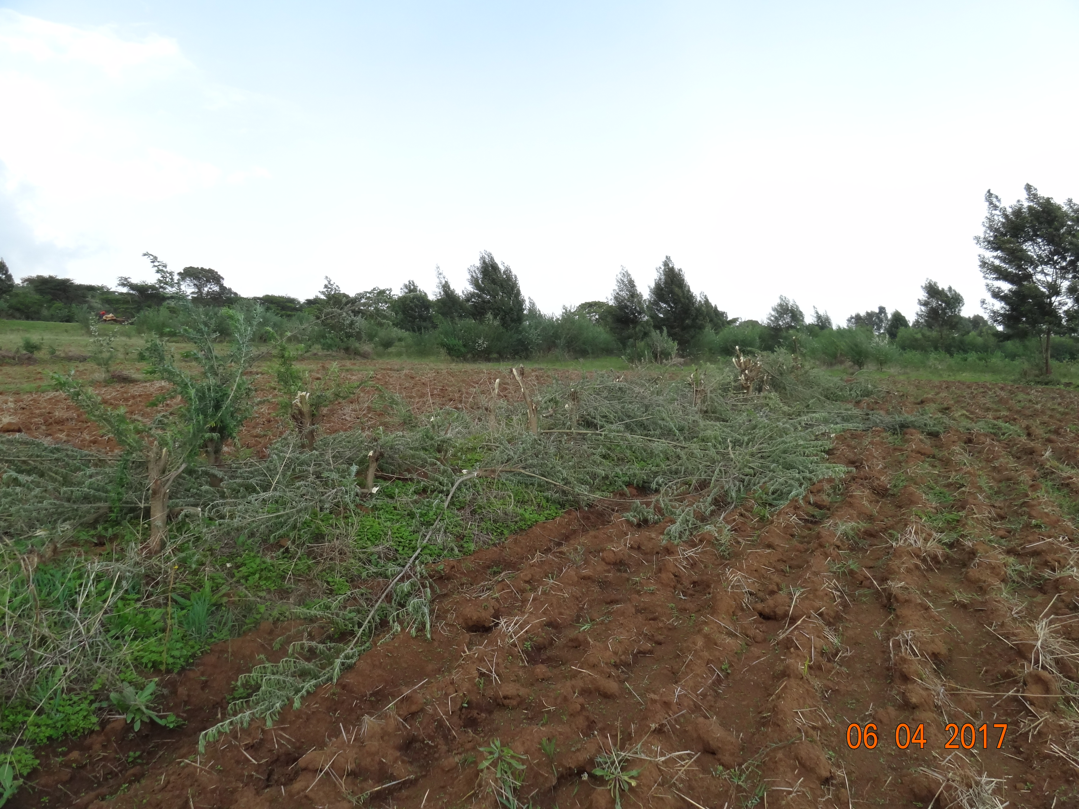
.
.

Slide 5
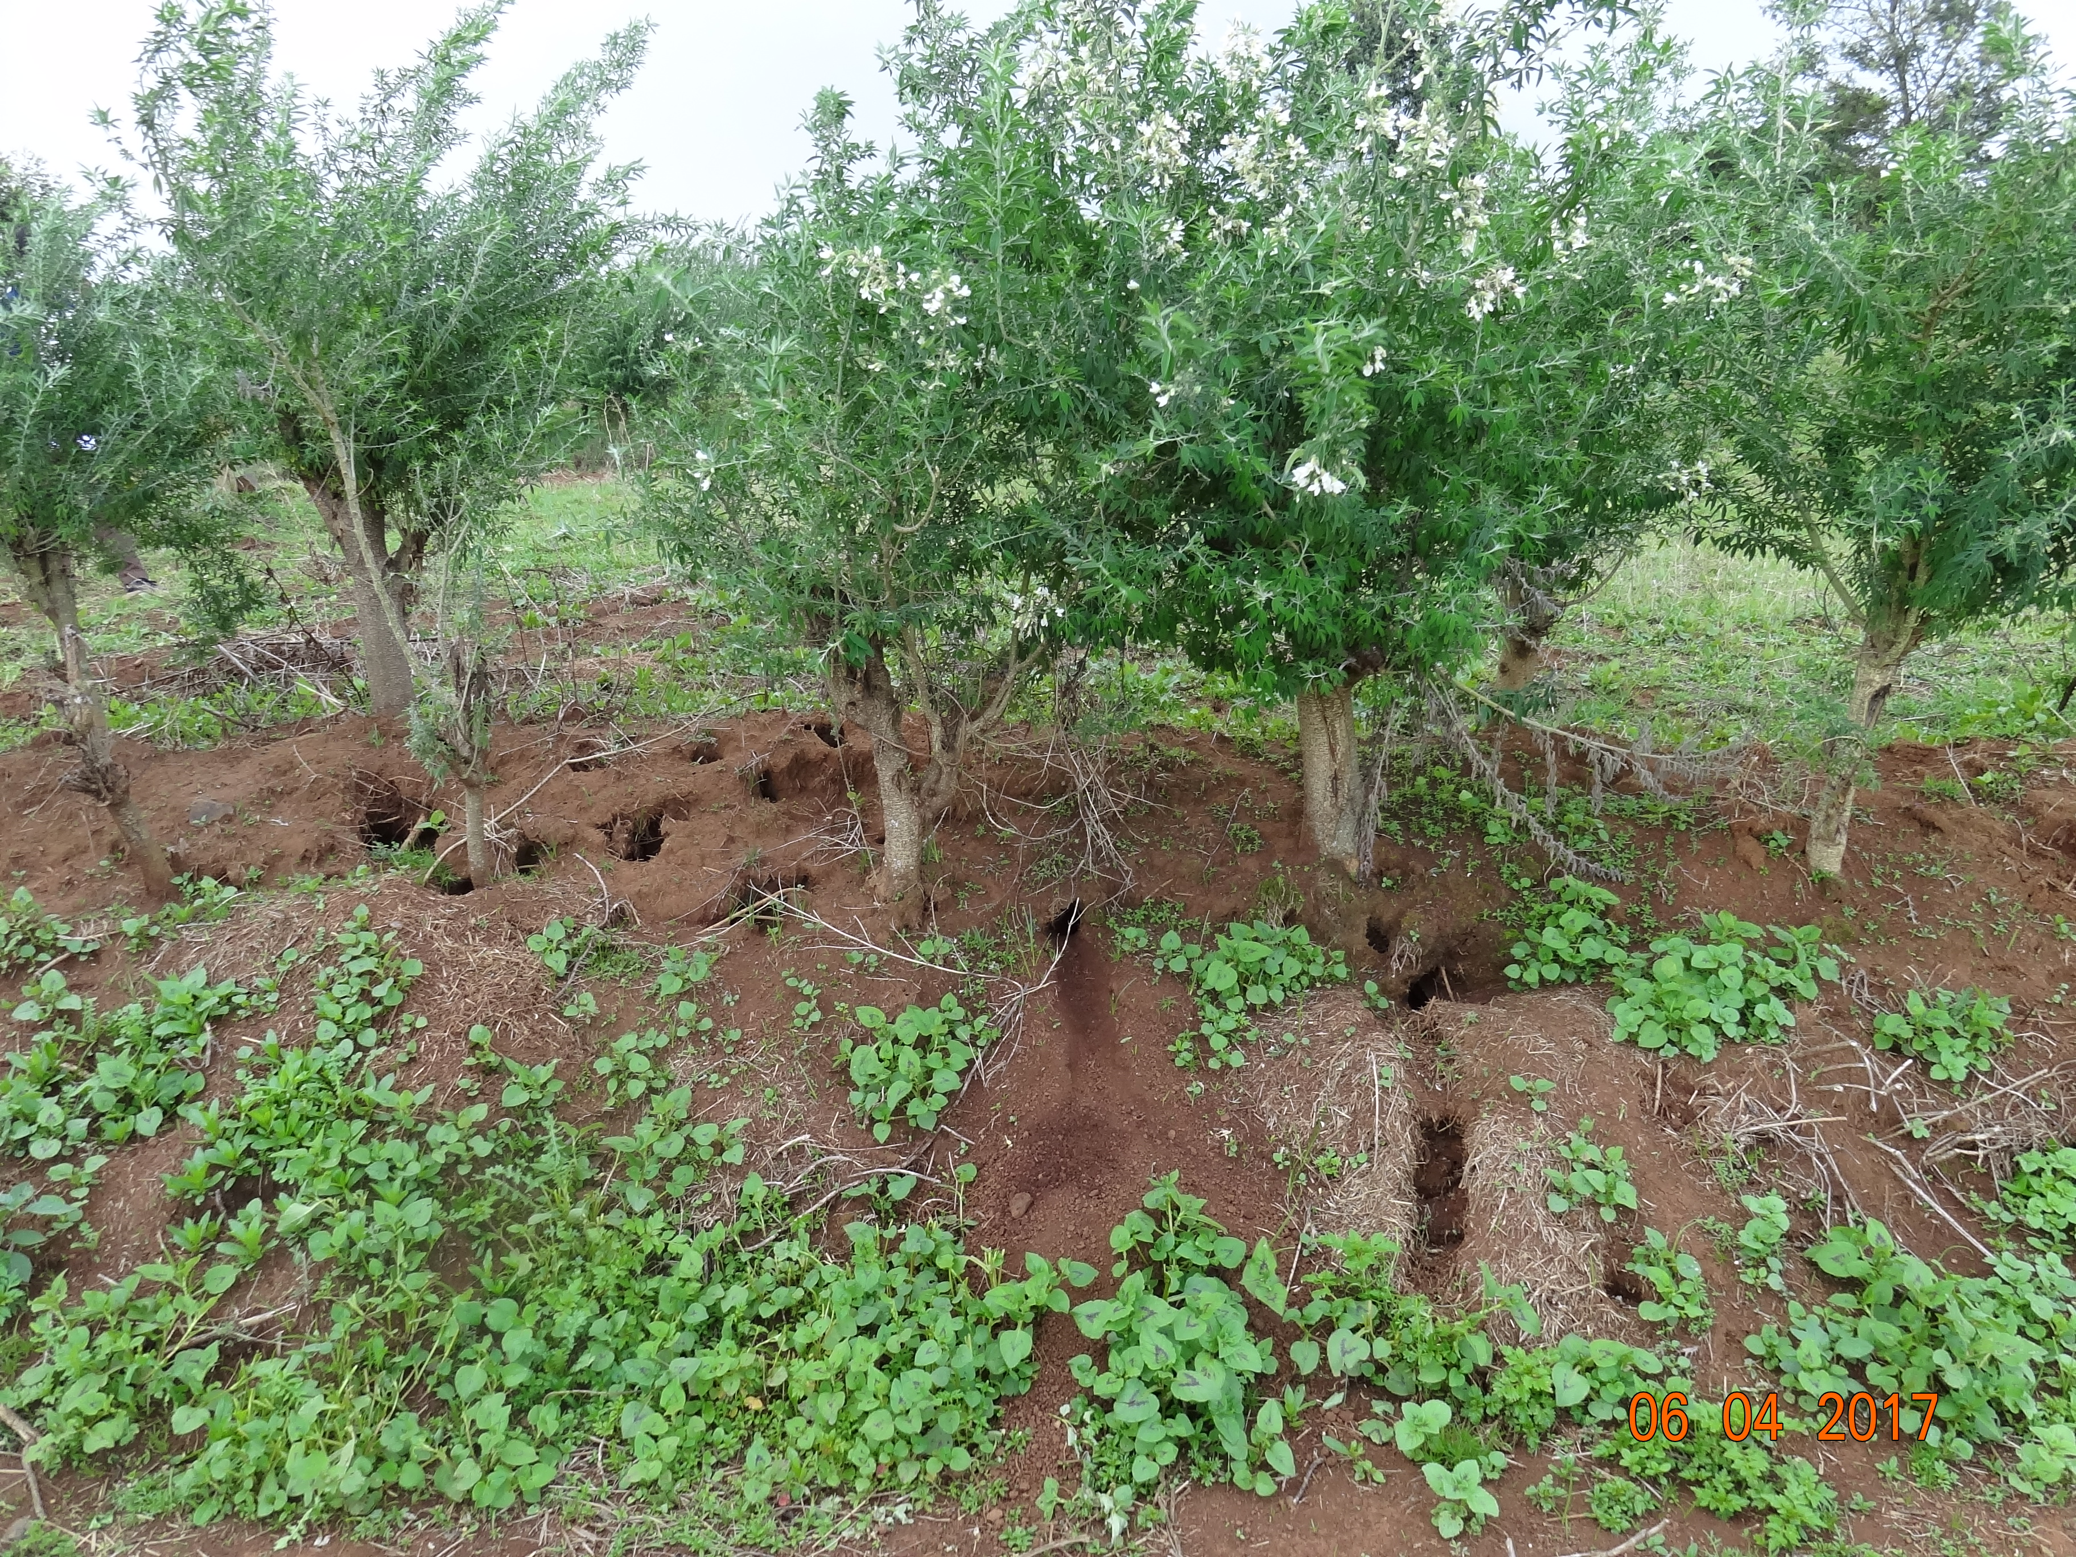
.
.

Slide 6
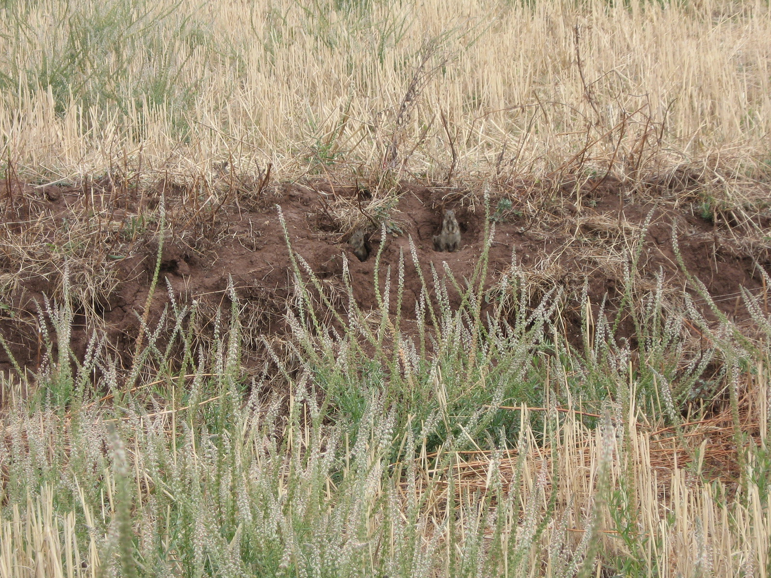
.
.

Slide 7
BENCH TERRACE (BT)
A bench terrace is a conservation structure where a slope is converted into a series of steps, with a horizontal cultivated area on the step and steep risers between two steps.
In Ethiopia, a bench terrace is usually developed from bunds and Fanya Juus over a period of 5–15 years through careful maintenance and buildup.
Bench terraces are level along the contour in dry to moist agroecological zones.
In moist to wet agroecological zones, they are graded to drain excess runoff sideways to the next river or waterway.

Slide 8
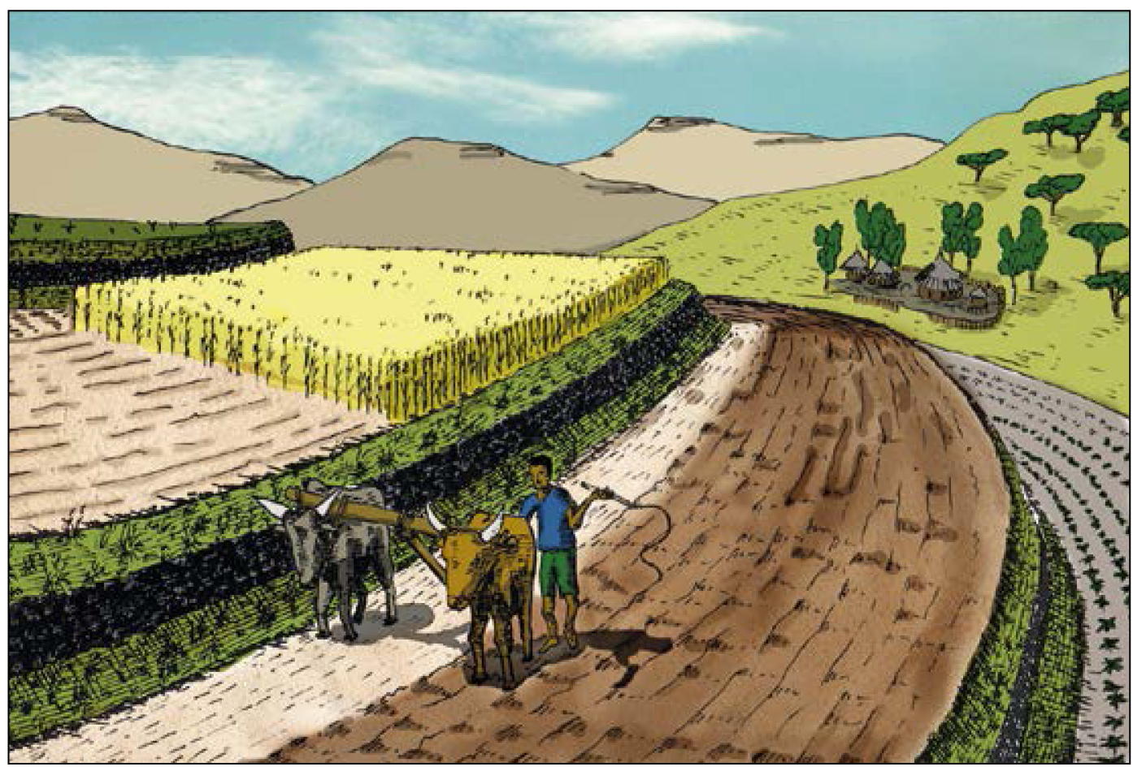
The bench terraces shown here are slope slightly outwards. They have been developed from stone-faced bunds still visible in the middle of the riser slope. Above and below the stone wall, there are grasses and legumes which can be used for fodder. Ploughing is automatically along the contour. Erosion from such terraces is reduced to almost zero.

Slide 9
Objectives
The terrace in most cases converts a steep slope into a series of steps, with nearly horizonal benches to reduce velocity of runoff, reduce the soil erosion and the decline in crop yields
Suitability,
Suitable mostly in moist weyna dega/medium rainfall areas with deep and well drained soils.
Applied generally on cultivated lands and unused steep hill-sides of slopes of average 12 to 58% considering the various land use types (cereal, fruits,etc.).
BENCH TERRACE

Slide 10
Minimum surveying and tools requirements
Layout:
  One water line level, two range poles graduated in cm and 10 meters of string (a team of three people layout approx 1-2 ha/day)
Work:
  shovels, pick axes and wooden compactors
Potential to increase/sustain productivity and environmental protection
  High in moisture stressed areas and ease plowing operations. .
  Need to properly balance the distribution of top soil on the bench to sustain yield.
  Able to retain/store water on the benches and provide sufﬁcient time to inﬁltrate into the soil.
  Allows stabilization and optimize use of compost and fertilizers.
BENCH TERRACE

Slide 11
Min. technical standards
Width:
  For areas of cultivation by hand: 2-5m is suitable.
  For animal driven cultivation: more than this is desirable.
  The more the depth of soil and the less the slope, the wider the bench terrace.
Height :
  The height of the riser(terrace) is the vertical interval
    for a reverse slope the change in elevation across the terrace is subtracted.
A Riser
  A Riser has a slope expressed as a ratio of horizontal distance to vertical rise. Can be stone faced, vegetated or grassed.
  Brush-woods can also be applied along BTs.
BENCH TERRACE

Slide 12
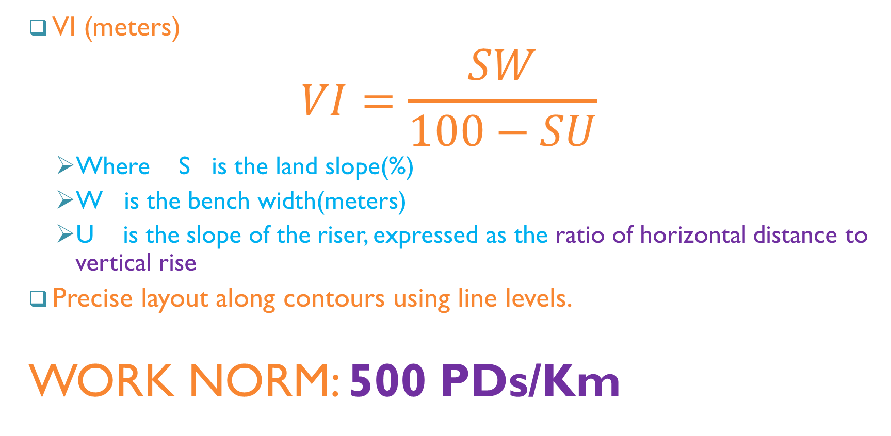
Layout and vertical intervals (VI)
VI (meters)
$$VI=\frac{SW}{100−SU}$$
  Where S is the land slope(%)
  W is the bench width(meters)
  U is the slope of the riser, expressed as the ratio of horizontal distance to vertical rise
Precise layout along contours using line levels.
WORK NORM: 500 PDs/Km
BENCH TERRACE

Slide 13
Integration opportunities/requirements (see also WHSC guideline)
(1) A Bench Terrace should be integrated with waterways to dispose off excess run-off from bench surfaces.
(2) Stones or brush-woods should be used to support/reinforce the riser.
(3) Apply compost starting from 2-3 meters above terrace lip (deeper soil and higher moisture)
(4) Stabilize embankment with grass and legumes (pigeon peas, treelucerne,
BENCH TERRACE

Slide 14
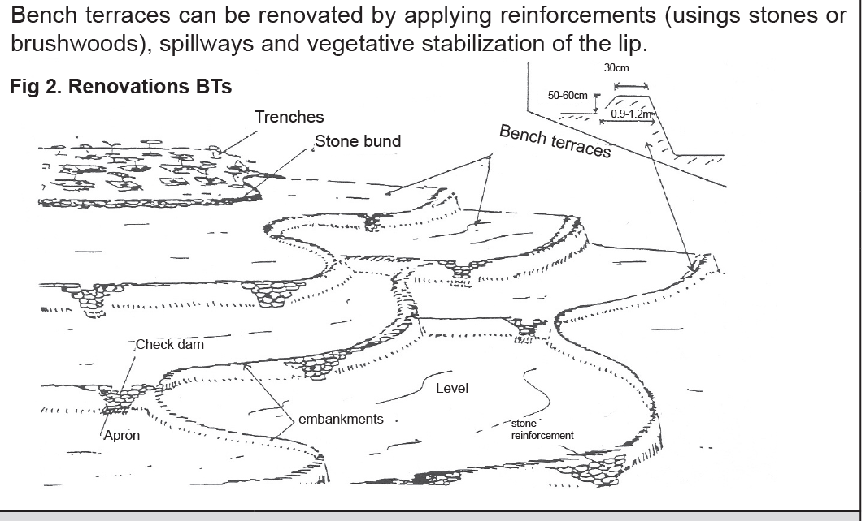
Renovation of existing bench terraces
BENCH TERRACE

Slide 15
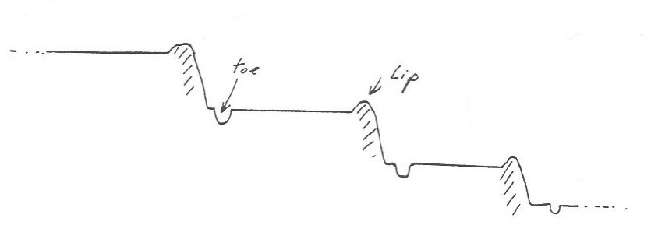
Standard shape
BENCH TERRACE

Slide 16
HILLSIDE TERRACES (HTs)
A hillside terrace is a structure along the contour, where a strip of land is levelled for tree planting.
Hillside terraces are up to 1 m wide and constructed at about 2–5 m vertical intervals.
Hillside terraces are only applied if there is a strong reason to justify their construction.

Slide 17
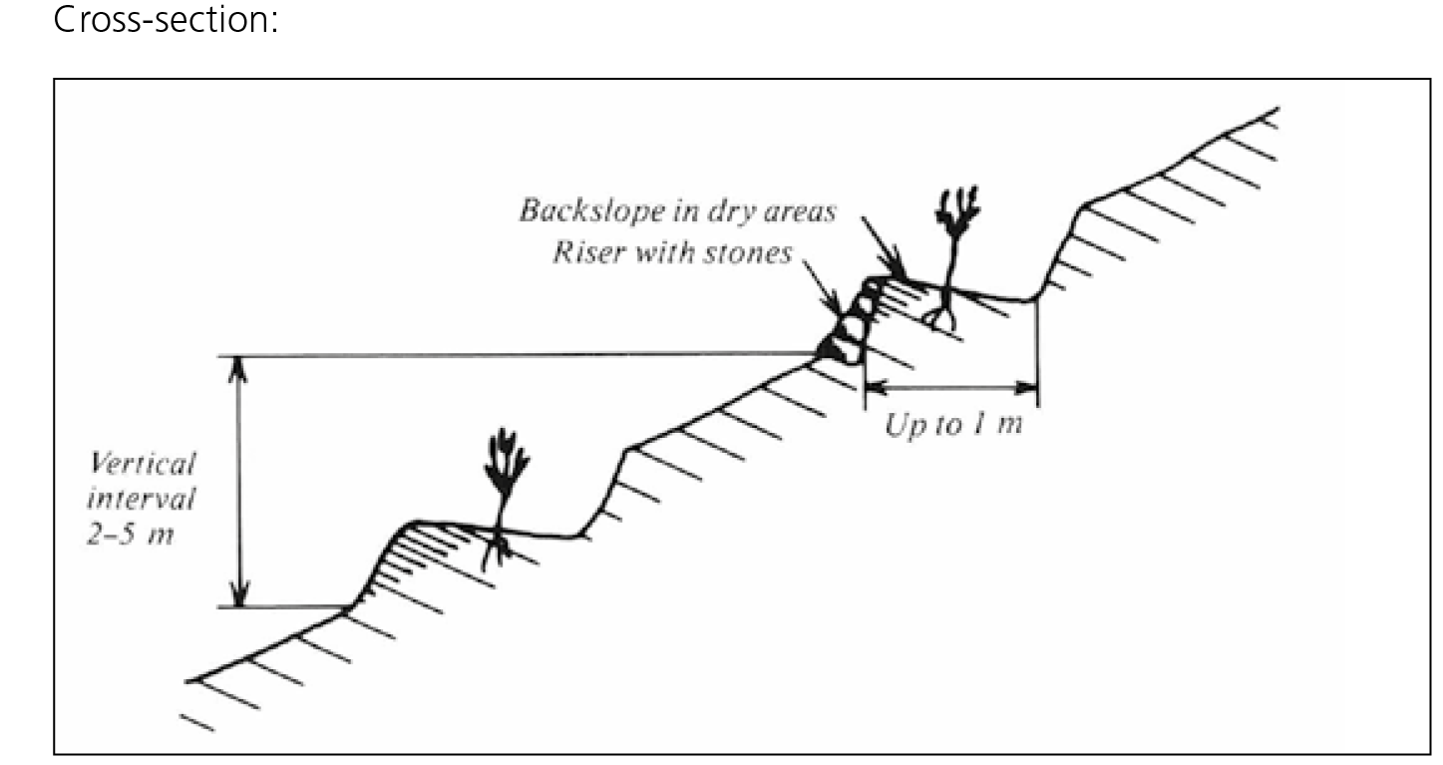

Slide 18
Suitability
Suitable mostly in semi-arid and arid parts of the country but also in medium rainfall areas with deep and well drained soils.
Commonly practiced in dry and moist weyna dega areas for the growth of trees and support of area closure.
Applicable in steep hillsides - community closures with steep slopes (max 50%).
In dry areas and shallow soils need to be combined with other measures (eyebrow basins, etc)
HILLSIDE TERRACES (HTs)

Slide 19
Potential to increase/sustain productivity and environmental protection
. Good potential to improve degraded hillsides - mostly for area closure and multi-purpose tree and fodder tree plantations.
When combined with sound moisture conservation (trenches, etc.) and proper management it can signiﬁcantly improve watershed rehabilitation, biomass production and recharging of water tables.
Layout
  One water line level, two range poles graduated in cm and 10 meters of string (a team of 3 people layout approx. 1ha/day).
Work:
  crow bars, sledge hammers shovels, and pick axes
HILLSIDE TERRACES (HTs)

Slide 20
Min. technical standards
Slope range:
  20-50% .
Vertical Interval (VI):
  2-3 meters .
Height or stone riser:
  min 0.5 m (range 0.5-0.75 m) ·
Width of terrace:
  min 1.5 m (range 1.5-2m) ·
Foundation:
  0.3m depth x 0.3 m width foundation ·
Grade of stone riser:
  well placed stone wall (grade 1 horiz to 3 vert.) ·
  In lower rainfall areas (most cases) hill-side terrace have 5-10% gradient back-slope
HILLSIDE TERRACES (HTs)

Slide 21
Layout and vertical intervals (VI)
Layout:
  One water line level, two range poles graduated in cm and 10 meters of string (a team of 3 people layout approx 1ha/day).
Work:
  crow bars, sledge hammers shovels, and pick axes.
WORK NORM:
  250 PDs/Km
HILLSIDE TERRACES (HTs)

Slide 22
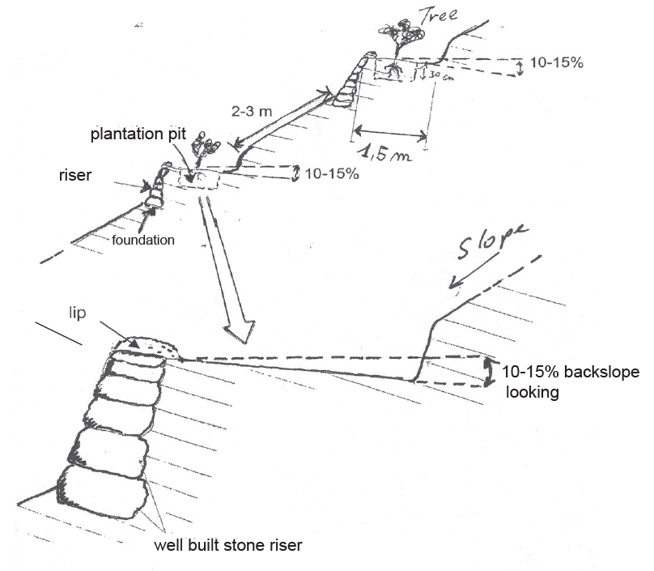
Inward looking HT (for moisture stressed areas)
HILLSIDE TERRACES (HTs)

Slide 23
Integration opportunities/requirements
1. Series of trenches (2-3 lines) can be constructed in between HTs (starting 2-3 meters above the terrace.
  Apply soil and tree management practices. Control grazing and closure necessary.
2. Fodder, legume and cash crops can be planted at the top of the stone raiser or at its toe: using grasses (indigenous such as “sembelete”, “dasho”, others, etc.) + legume shrubs (pigeon peas, sebania, acacia saligna, trilucerne etc.) in rows by direct sowing (15-30 cm).
3. Hillside terraces, like stone bunds, can be stabilized by drought resistant plants such as Sisal, and Euphorbia placed on the lower side of the stone wall.
4. Integration with strong check dams along depression points and small gullies
HILLSIDE TERRACES (HTs)

Slide 24
Management requirements
. Controlled grazing is a precondition for hillside terraces.
Terraces should be stabilized, possibly with drought resistant species. .
Fodder and crops growing on terraces should not be uprooted but cut and carried.
Modiﬁcations/adaptation to standard design
  A)Double slope hillside terraces in very dry areas (ﬁg 2).
  b) Hillside terraces with trenches (see related infotech)
HILLSIDE TERRACES (HTs)

Slide 25
HILLSIDE TERRACES + TRENCHES (HTTs)
HTTs is highly labour intensive - combine both effects of hillsides and trenches constructed immediately above the terrace stone riser,
generally suitable for steep slopes (up to 50%) and shallow-medium depth soils (although common in other type of soils).
Suitable for tree/shrubs planting and very effective in controlling runoff and erosion.

Slide 26
Min. technical standards
Stone riser height: 0.75-1 m from ground level .
Stone riser foundation: 0.3-0.4 mD x 0.3 mW .
Top width: 0.5 m (0.25 m stone riser and 0.25 m soil), ·
Grade of stone riser: 1 horiz: 3-4 vertical, ·
Grade of soil bank: 1 horiz: 1.5 (unstable soils) to 2 vertical (stable soil), ·
Base width: based upon slope, ·
Size/place of trench: 50 W x 50 cm D x terrace length - placed 0,75-1m above stone wall. ·

Slide 27
Size/place of ties: within trenches ties are placed at 2-3m intervals based upon plantation requirements and half way the depth of the trench (0.25 m) with 0.6m horiz. length x 0.5 cm width for planting seed-lings. ·
A 30x30x30 cm plantation pit is placed in the middle of the tie or in front of the trench (between berm and embankment) with lateral spacing depending on tree and shrubs planted (1-3 metres)· .
Max length of HTTs: 50-80m. HTTs should wing up laterally, before depression points
ORK NORM:
  330 PDs/Km

Slide 28
