Slide 1
Debremarkos University
NRM (3rd year)
Climate Change adaptation and mitigation
Lecture Note
Zigijit K.

Slide 2
1. Introduction
What are terminologies in climate change?
Adaptation
Mitigation
Adaptation Assessment
Climate change
Climate Variability
Maladaptation
Resilience
Sensitivity
Vulnerability
Vulnerability assessment

Slide 3
What are terminologies in climate change?
Adaptation - Adjustment in natural or human systems in response to actual or expected climatic stimuli or their effects, which moderates harm or exploit beneficial opportunities.
Various types of adaptation can be distinguished, including
  anticipatory and reactive adaptation,
  private and public adaptation, and
  autonomous and planned adaptation
Mitigation- mitigation refers to actions taken to lower the concentration of greenhouse gasses in the atmosphere and thereby reduce the extent to which the global climate system changes relative to how we have know it to be in the recent past. Mitigation involves:
  reducing or eliminating emissions of GHGs at the source
  sequestering greenhouse gases out of the atmosphere

Slide 4
What are terminologies…
Adaptation Assessment - The practice of identifying options to adapt to climate change and evaluating them in terms of criteria such as availability, benefits, costs, effectiveness, efficiency, and feasibility
Climate change – Refers to a statistically significant variation in either the mean state of the climate or in its variability, persisting for an extended period (typically decades or longer).
Climate Variability - Climate variability refers to variations in the mean state and other statistics (such as standard deviations, the occurrence of extremes, etc.) of the climate on all temporal and spatial scales beyond that of individual weather events.

Slide 5
What are terminologies…
Maladaptation – Any changes in natural or human systems that inadvertently increase vulnerability to climatic stimuli; an adaptation that does not succeed in reducing vulnerability but increases it instead
Resilience – Amount of change a system can undergo without changing state.
Sensitivity – Is the degree to which a system is affected, either adversely or beneficially, by climate related stimuli.
Vulnerability – The degree to which a system is susceptible to, or unable to cope with, adverse effects of climate change, including climate variability and extremes.

Slide 6
What are terminologies…
Vulnerability assessment identifies who and what is exposed and sensitive to change.
  A vulnerability assessment starts by considering the factors that make people or the environment susceptible to harm, i.e.
    access to natural and financial resources;
    ability to self-protect;
    support networks and so on

Slide 7
2. Overview of climate change
Before talking about climate change history it is important to learn about the IPCC
Why? Because the IPCC tells as:
  about climate change history and science
  About the causes of climate change
  Impact of climate change
  Impact management (adaptation and mitigations…)

Slide 8
Over View …
The IPCC
  Has more than 2000 scientist and experts
  assesses the best scientific literature
  identifying the key climate uncertainties
  stimulating and coordinating targeted research to climate change
    Based on these scientific literature the IPCCC create a report about climate change
  This is to answer important climate change questions

Slide 9
Over View…
Especially the fourth (FAR) of IPCC report assessed the science of climate change in better understanding
  it is helpful to review the long historical perspective that has led to the current state of climate change knowledge

Slide 10
Over View…
In 19th centaury
  The history of scientific discovery of climate change was recognized
  the natural greenhouse effect is firstly identified
In the late 19th century,
  Argument of human emissions of greenhouse gases could change the climate
  Many other theories of climate change were advanced
  Impact of volcanism and solar variation were identified
  the warming effect of carbon dioxide gas became a convincing issue,
  The cooling effect of human induced aerosols was recognized

Slide 11
Over View…
During the 1970s,
  scientific opinion increasingly favored the global warming viewpoint
By the 1990s,
  Issue of GHGs were deeply involved in most climate changes agendas,
  human emissions were bringing serious global warming problem.
  most work has been oriented toward producing reports of the Intergovernmental Panel on Climate Chang

Slide 12
3. Science of climate change
Over the last 150 years, human activities, most notably through Burning of fossil fuels such as coal, petroleum, and natural gas have released large quantities of GHGs, mainly: CO_{2,} CH₄ and N₂O
  The four major GHGs are CO_{2,} CH₄ and N₂O and H₂O
Concentration of these and other GHGs above the threshold-
  causes global warming through trapping of infrared radiation.

Slide 13
Science of climate change…
Global climate change poses great risks particularly to poor people whose livelihoods depend directly on
  agriculture,
  forestry, and other
  natural resources like fishery
  Developing countries including Ethiopia in Africa who have contributed least to GHG emissions: but are the most vulnerable to CC and V. why?
  Because developing countries have limited adaptive capacity as compared to the developed countries:

Slide 14
Science of climate change...
Why developing countries have limited adaptive capacity as compared to the developed countries ?
  limited financial resources, skills and technologies and
  their excessive reliance on climate sensitive economic sectors such as rainfed agriculture, fisheries and forestry

Slide 15
Science of climate change…
The potential adverse effects of climate change on Ethiopia’s agricultural sector are a major concern hence, the agricultural sector in Ethiopia is largely rainfed and it accounts for about:
    >42 percent of national GDP,
    90 percent of exports,
    85 percent of employment

Slide 16
Science of climate change…
The climate system is a complex, interactive system consisting of
  The atmosphere,
  The land surface,
  The snow and ice and oceans
  The other bodies of water, and
  The living things.
The atmospheric component of the climate system most obviously characterizes climate;

Slide 17
Science of climate change

Slide 18
4. Climate changes
  Evidence of climate change
  Causes of climate change
  Impact of climate change

Slide 19
What is climate change?
Climate change – shifting/ changing/variation of the mean state of the different climatic elements
  The shifting/changing should be statistically significant
  It should be persisting for an extended period (typically decades or longer).

Slide 20
Evidence of Climate Change
Will not be the same everywhere
  Some places will be wetter, others will be drier
  Polar regions will see greater increases in temperature than tropical regions
Includes changes in
  Earth’s average temperature
  Patterns and amounts of precipitation
  Ice and snow cover
  Sea level
  Extreme weather events
    Drought
    Flooding

Slide 21
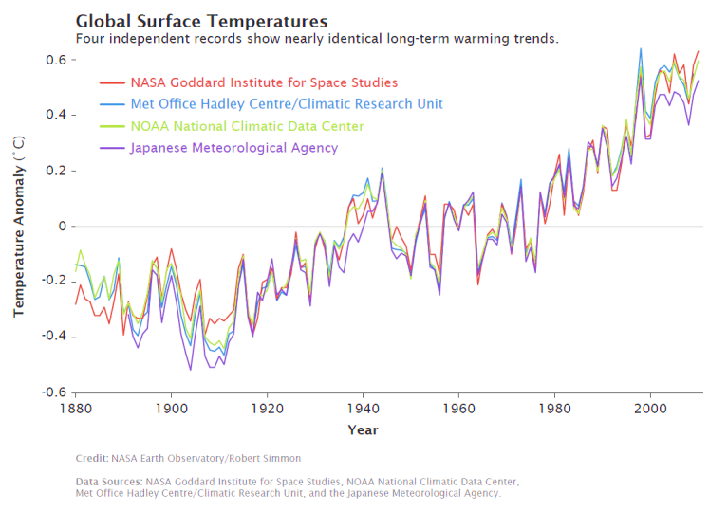
1. Temperature (1880-2010)
Notes:
Image Credit:
NASA Earth Observatory, Robert Simmon
Image retrieved from http://www.nasa.gov/pdf/509983main_adjusted_annual_temperature_anomalies%20_final.pdf

Slide 22
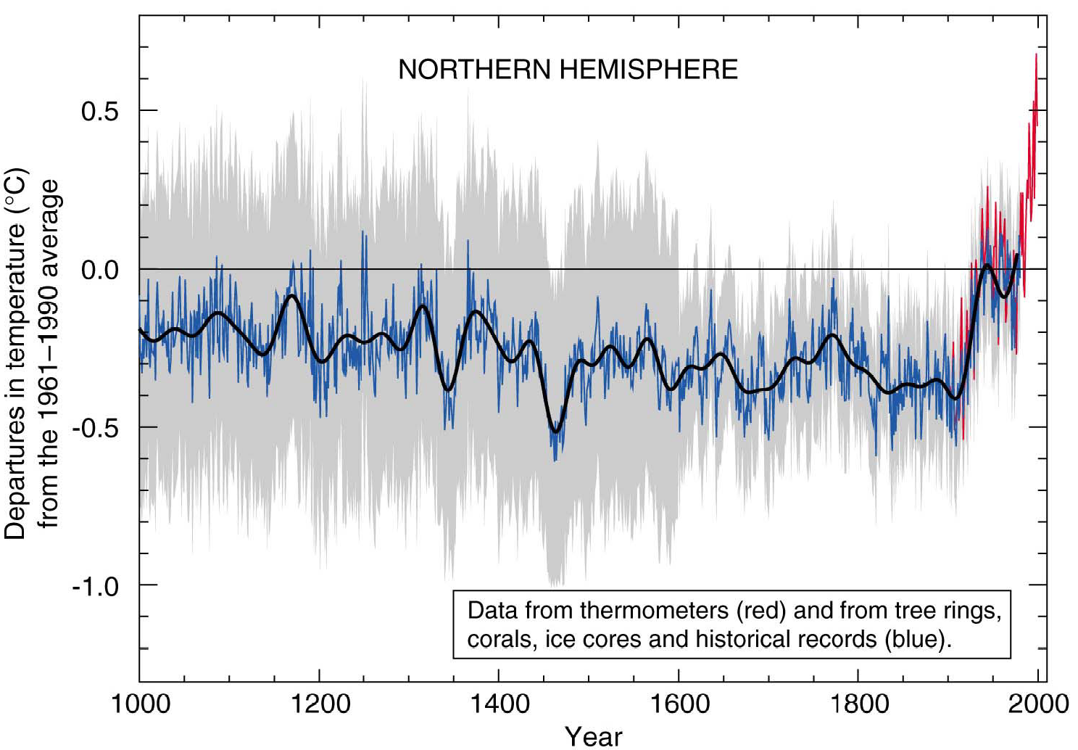
1. Temperature (1000-2000)
Variations of the Earth’s surface temperature for the past 1,000 years
Notes:
Image Credit:
Intergovernmental Panel on Climate Change (IPCC). (2001). Climate change 2001: The scientific basis. Contribution of working group I to the third assessment report of the Intergovernmental Panel on Climate Change. [Houghton, J.T.,Y. Ding, D.J. Griggs, M. Noguer, P.J. van der Linden, X. Dai, K. Maskell, and C.A. Johnson (Eds.)]. Cambridge, United Kingdom and New York, NY, USA: Cambridge University Press. 881pp.
Image retrieved from http://www.ipcc.ch/ipccreports/tar/wg1/figspm-1.htm

Slide 23
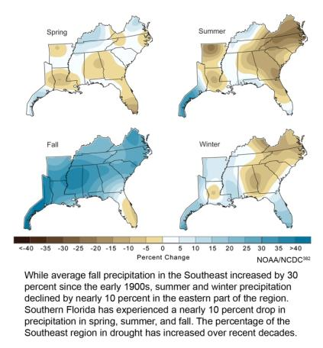
2. Precipitation
Observed Precipitation Changes: 1901-2007
Statistically Significant Trends in Precipitation Anomaly (inches/decade): 1895-2011
 | Winter | Spring | Summer | Fall | Annual
Southeast | ----- | ----- | -0.10 | +0.27 | -----
Notes:
Image Credit (left):
U.S. Global Climate Research Program (USGCRP). (2009). Global climate change impacts in the U.S. Washington, DC: Cambridge University Press.
Image retrieved from http://nca2009.globalchange.gov/sites/default/files/11-Southeast-pg-111%20top.jpg
Chart Data Source (right):
Kunkel, K. E., Stevens, L. E., Stevens, S. E., Sun, L., Janssen, E., Wuebbles, D., & Dobson, J. G. (2013). Regional climate trends and scenarios for the U.S. National Climate Assessment. Part 9. Climate of the contiguous United States, NOAA Technical Report NESDIS 142-9, p. 19.

Slide 24
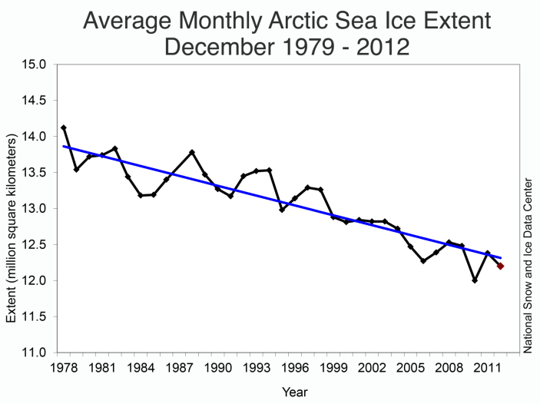
3. Sea Ice
Notes:
Image Credit:
National Snow and Ice Data Center, 2013
Image Retrieved from http://nsidc.org/arcticseaicenews

Slide 25
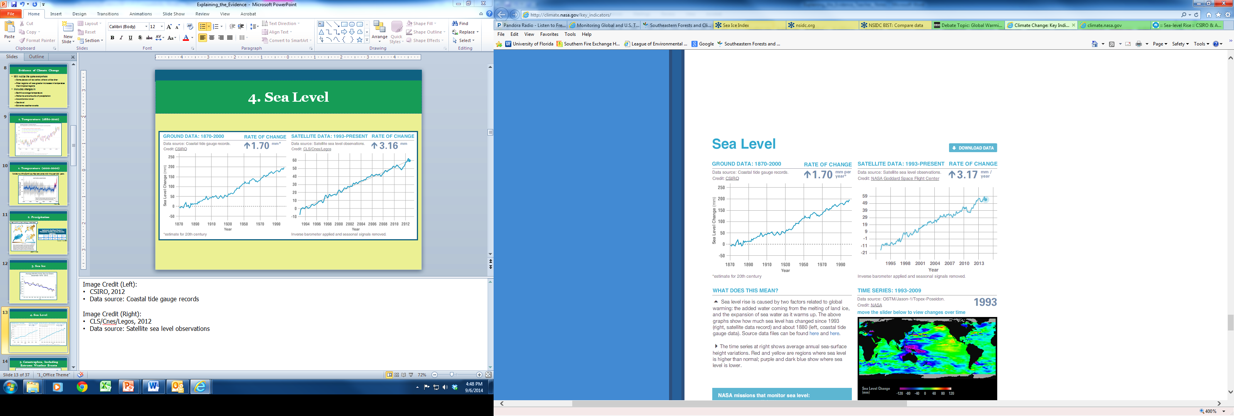
4. Sea Level
Notes:
Image Credit (Left):
CSIRO, 2012
Data source: Coastal tide gauge records
Image retrieved from http://climate.nasa.gov/key_indicators/
Image Credit (Right):
NASA Goddard Space Flight Center, 2014
Data source: Satellite sea level observations
Image retrieved from http://climate.nasa.gov/key_indicators/

Slide 26
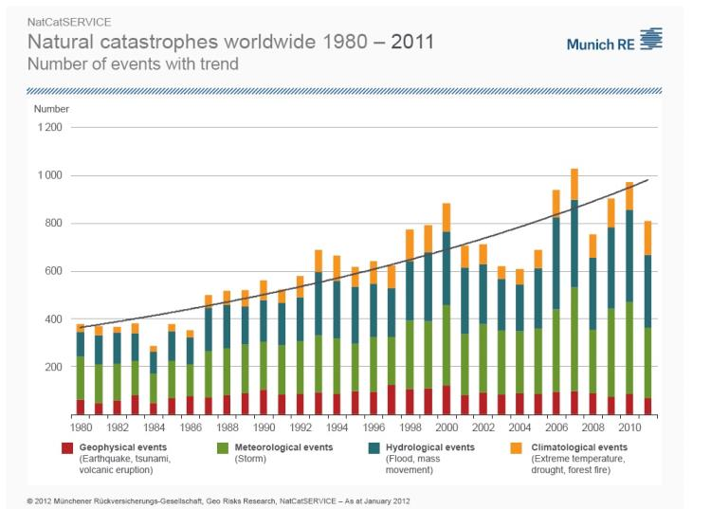
5. Catastrophes, Including
Extreme Weather Events
Notes:
Image Credit:
Münchener Rückversicherungs-Gesellschaft, NatCatSERVICE
Image retrieved from http://www.munichre.com/en/reinsurance/business/non-life/natcatservice/index.html

Slide 27
Causes of Climate change
Over accumulations of air pollutants (aerosols and GHGs) in the atmosphere causes for climate change via:
  Absorbing of infrared radiation causes global warming (GHGs)
  Scattering, absorbing and/or reflecting the UV radiation which causes global cooling ( aerosols)
Air pollutants are emitted:
  Naturally
  Anthropogenicaly

Slide 28
Climate is Affected by Several Factors
Historical Climate Change
Solar radiation
Ocean composition
Greenhouse effect
Albedo effect
Continental land arrangement
Volcanic eruptions
Recent Climate Change
Solar radiation
Ocean composition
Greenhouse effect
Albedo effect
Continental land arrangement
Volcanic eruptions
Fossil fuel combustion
Land-use change from human activities

Slide 29
Natural Causes
Before the Industrial Revolution, human activities released very few gases into the atmosphere and all climate changes was happened naturally.
  The major sources of natural causes to climate change in general, and global warming and cooling in particular are
  volcanic eruption,
  ocean spray,
  natural forest fire
  Nitrification and de-nitrification
These events release greenhouse gases and aerosols into the earth atmosphere which causes to climate change

Slide 30
Natural Causes
Some greenhouse gases occur naturally in the atmosphere, while others result from human activities.
Naturally occurring greenhouse gases include
  water vapor, sulfur oxides
  carbon dioxide; aerosols and other
  methane,
  nitrous oxide, and
  ozone.
Certain human activities, however, add to the levels of most of these naturally occurring gases.

Slide 31
Anthropogenic Causes
In recent times, human activities have caused, and are continuing to cause, great changes to the composition of the atmosphere.
The major concern of both scientific and public communities is the enhanced greenhouse effect caused by anthropogenic activities.
The findings of the IPCC have shown that climate change is already having strong impacts on human societies and the natural world, and is expected to do so for decades to come.

Slide 32
Anthropogenic Causes cont….
The report by the IPCC in 2007 revealed that human activities are the major or dominant cause of climate change.
Human activities are responsible for most of the global warming observed over the past 50 years.

Slide 33
Anthropogenic Causes cont….
Accoriding to IPCC report about 70% emissions of GHG between 1970 and 2004 is due to human activities.
This is mostly through
  burning of fossil fuels (crude oil, coal) and
  clearing and burning of forests for logging, mining, agriculture and commercial uses.

Slide 34
Anthropogenic Causes cont….
Very powerful greenhouse gases that are not naturally occurring include
  hydrofluorocarbons (HFCs),
  perfluorocarbons (PFCs), and
  sulfur hexafluoride (SF6),

Slide 35
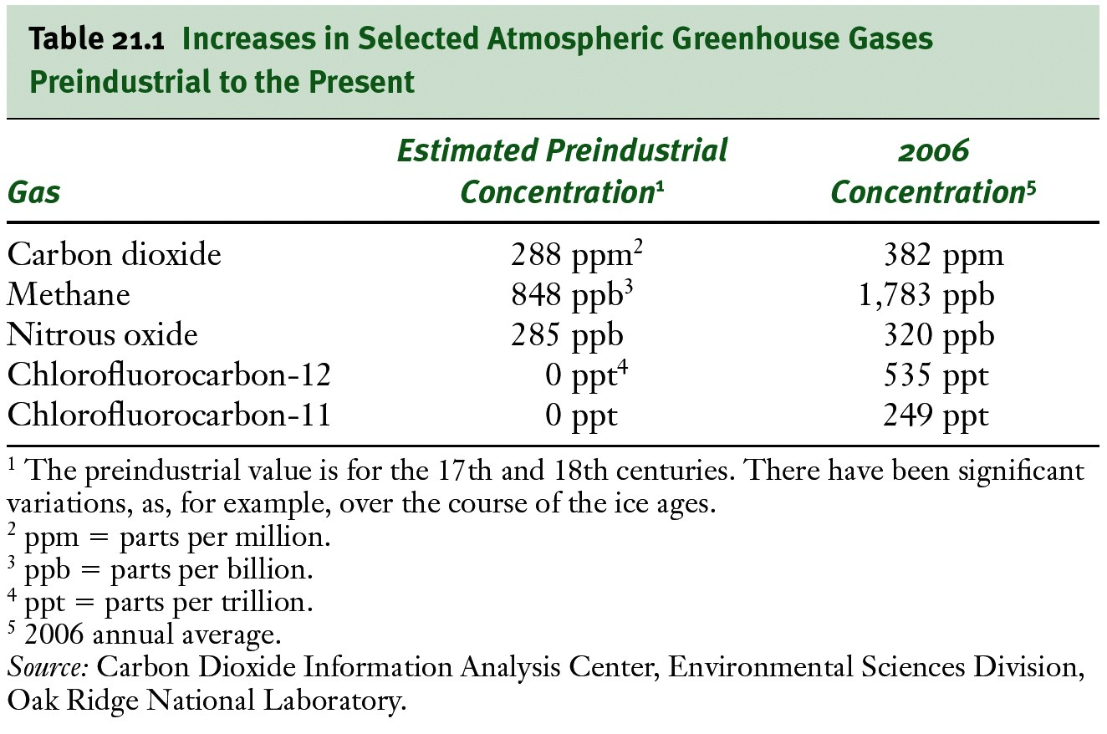
Causes
Greenhouse gas concentrations increasing

Slide 36
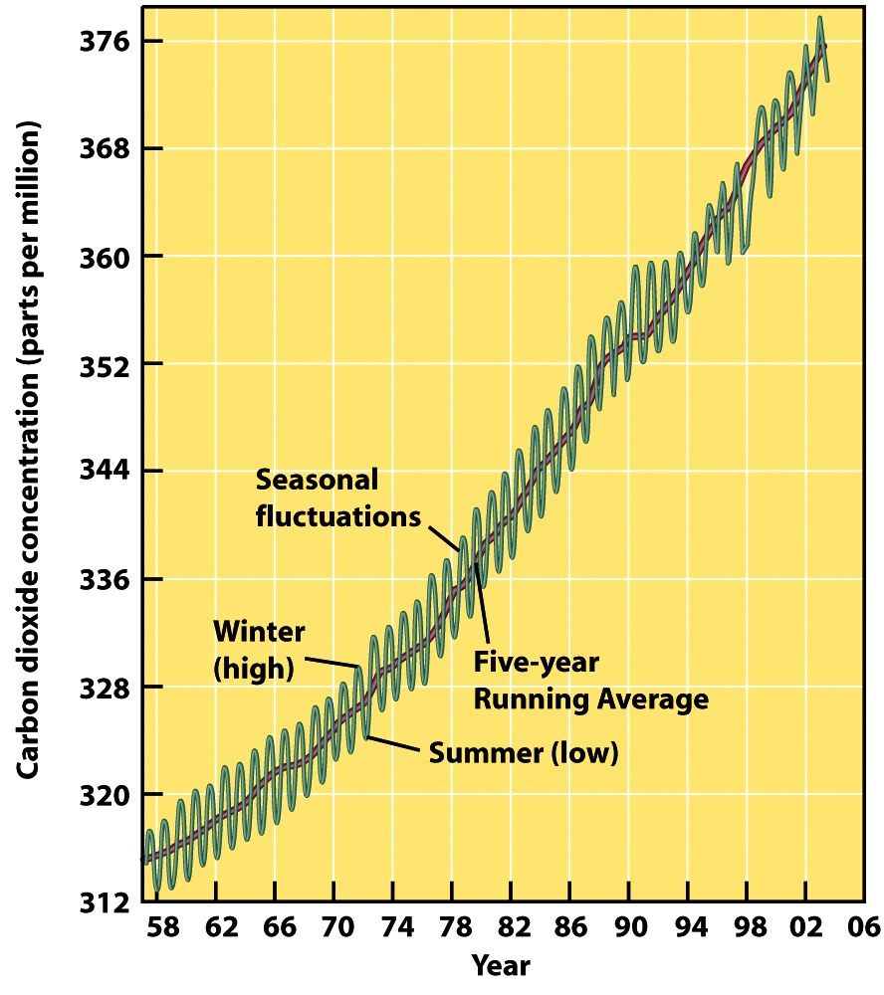
Causes
Increased concentration of CO₂ (right)
  Burning fossil fuels in cars, industry and homes
  Deforestation
  Burning of forests

Slide 37
We Have Also
Altered the Atmosphere
Greenhouse Gas | Pre-1750 Tropospheric Concentration | Recent Tropospheric Concentration | Change in Tropospheric Concentration
Carbon dioxide (CO₂) | 280 ppm | 393 ppm | 40%
Methane (CH₄) | 700 ppb | 1874 ppb | 168%
Nitrous oxide (N₂O) | 270 ppb | 324 ppb | 20%
Chlorofluorocarbons (CFCs) | 0 | 21-529 ppb (different for each CFC) | NA
Ozone (O₃) | 25 ppb | 34 ppb | 36%
ppm = parts per million
ppb = parts per billion
Notes:
Chart Data Source:
T.J. Blasing, Carbon Dioxide Information Analysis Center
Data retrieved from http://cdiac.ornl.gov/pns/current_ghg.html

Slide 38
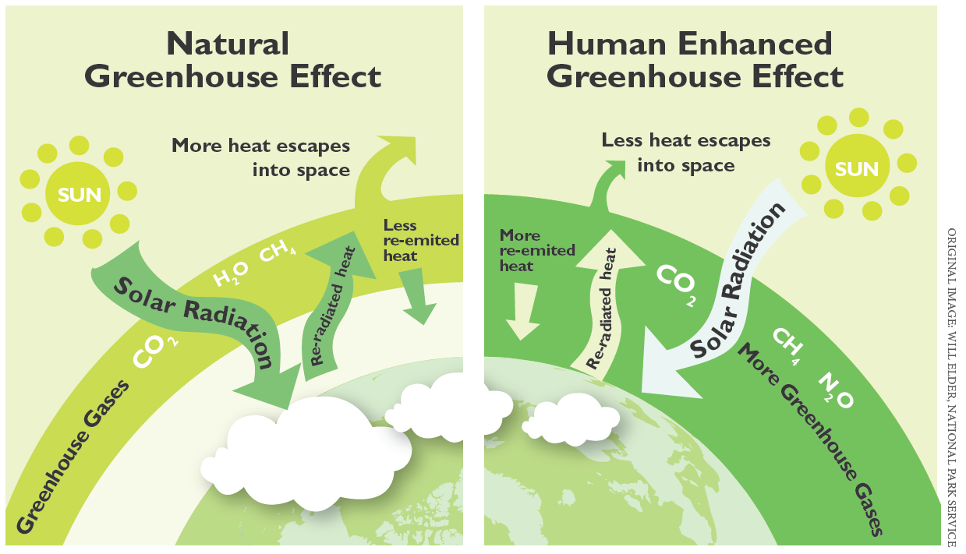
Notes:
Image Credit:
Will Elder, National Park Service (original)
Image retrieved from http://www.nps.gov/goga/naturescience/climate-change-causes.htm

Slide 39
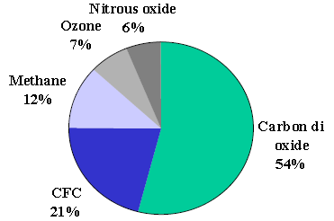
%Share of Greenhouse Gases
CO₂ has changed the most.
CO₂ stays in the atmosphere a long time.
The Ethiopia emits more CO₂ than other greenhouse gases.
We can do something about it.
%Share of Greenhouse Gases

Slide 40
Sources of GHGs emission
Carbon dioxide is released to the atmosphere when solid waste, fossil fuels (oil, natural gas, and coal), and wood and wood products are burned.
Methane emissions result from the decomposition of organic wastes in municipal solid waste landfills, and the raising of rise, from ruminant animals etc

Slide 41
Sources of GHGs emission cont…
Nitrous oxide is emitted during agricultural and industrial activities, as well as during combustion of solid waste and fossil fuels.

Slide 42
What Does All This Mean?
97% of climate scientists combine this and other evidence to draw these conclusions:
  Earth’s climate is currently changing due to global warming.
  Changes are not the same at all locations on Earth.
  Future changes may be more rapid than historical changes.
  Human activities are responsible for most of the climate change being observed.

Slide 43
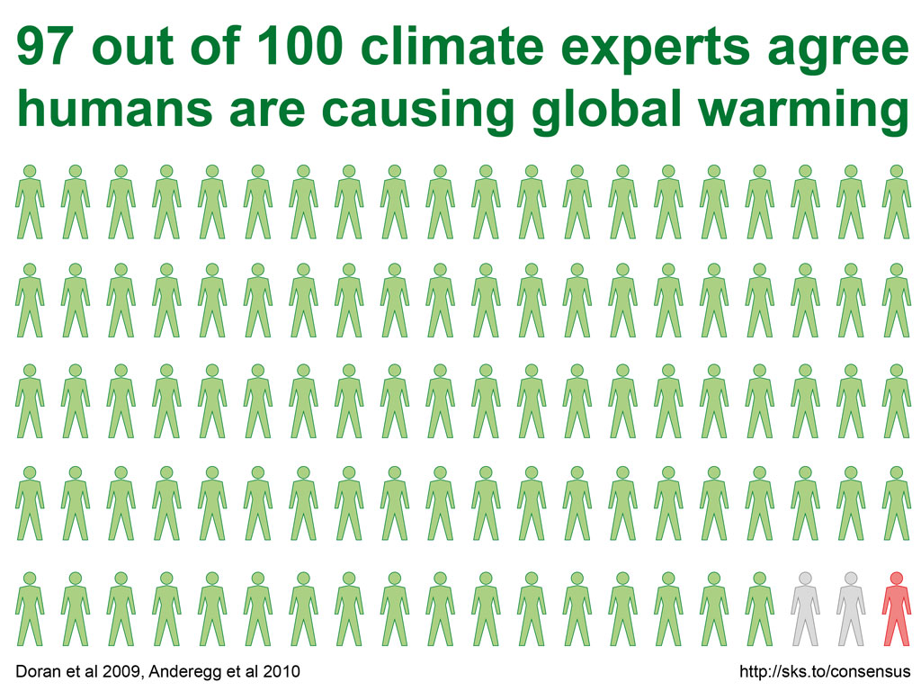
Agreement Among Climate Scientists
Notes:
Image Credit:
John Cook, Skeptical Science
Image retrieved from http://www.skepticalscience.com/graphics.php?g=19

Slide 44
Greenhouse Effect
The Sun powers Earth’s climate, radiating energy at very short wavelengths, predominately in the visible or near-visible (e.g., ultraviolet) part of the spectrum.
Roughly one-third of the solar energy that reaches the top of Earth’s atmosphere is reflected directly back to space.
The remaining two-third is absorbed by the surface and, to a lesser extent, by the atmosphere.
To balance the absorbed incoming energy, the Earth must re-emit the same amount of IR radiate energy back to space.

Slide 45
Greenhouse Effect
Because the Earth is much colder than the Sun, it radiates at much longer wavelengths, primarily in the infrared part of the spectrum
Much of this thermal radiation emitted by the land and ocean is absorbed by the atmosphere, including clouds and GHGs, and reradiated back to Earth.
This is called the greenhouse effect

Slide 46
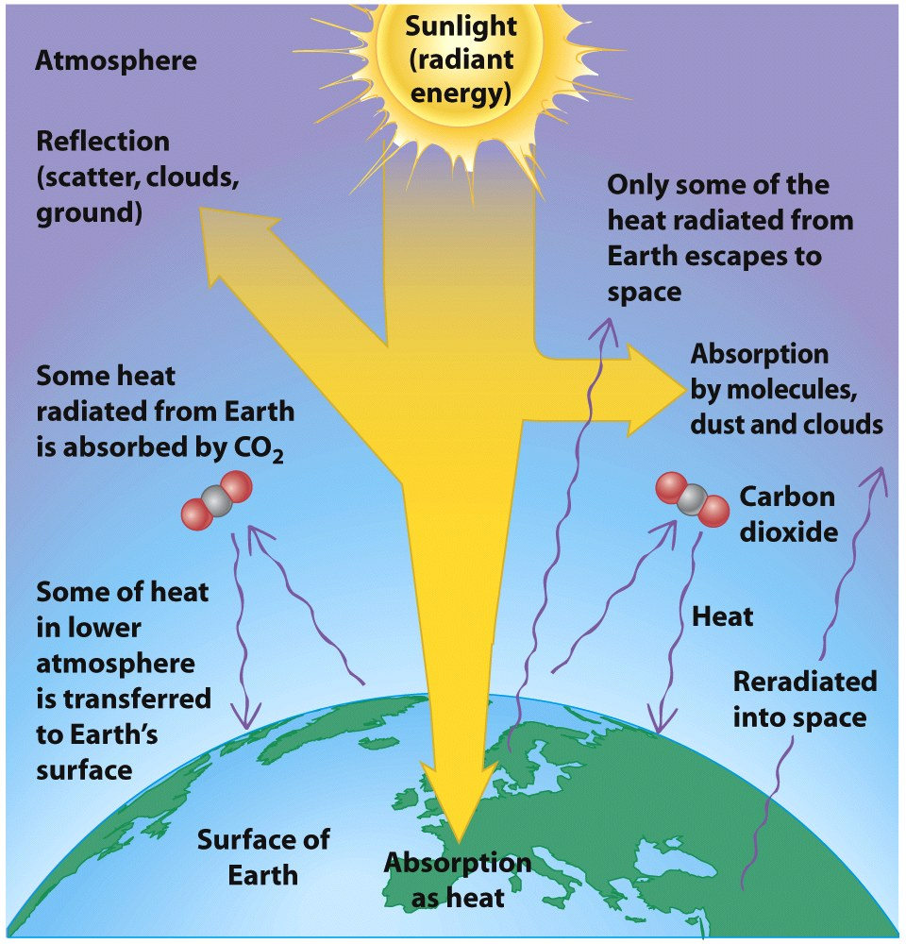
Greenhouse Effect

Slide 47
Video: The greenhouse effect
http://www.youtube.com/watch?v=ZzCA60WnoMk

Slide 48
Other Pollutants Cool the Atmosphere
Atmospheric Aerosols tend to cool the atmosphere
  Both human and natural sources
  Tiny particles that remain in troposphere for weeks or months
  Contain many chemicals, but often contain sulfur
Complicates models of climate change

Slide 49
4. Vulnerability and Effects of Global Climate Change
What is vulnerability?
Vulnerability is a central concept to adaptation.
  Vulnerability to climate change is the “degree to which a system is susceptible to, or unable to cope with, adverse effects of climate change, including climate variability and extremes” (IPCC 2001).
Vulnerability is a function of exposure, sensitivity, and adaptive capacity.
  High exposure or sensitivity and low adaptive capacity causes high vulnerability.

Slide 50
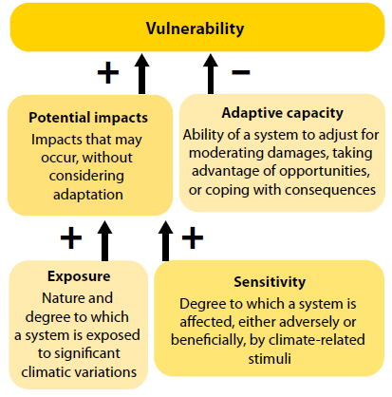

Slide 51
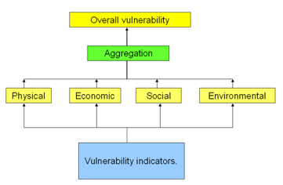
Overall vulnerability calculation.
The vulnerability indicators, defining the physical, economic, social and environmental vulnerability can be aggregated and combined into an overall vulnerability value.

Slide 52
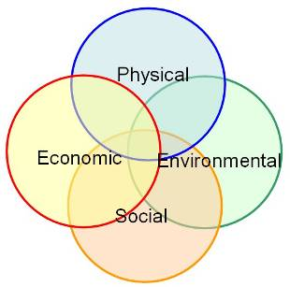
Characteristics of vulnerability.
Vulnerability is:
  multi-dimensional (e.g. physical, social, economic, environmental, institutional, and human factors define vulnerability);
  dynamic i.e. vulnerability changes over time;
  scale-dependent ( vulnerability can be expressed at different scales from human to household to community to country resolution;
  site-specific.
(Source: UN-ISDR).

Slide 53
Vulnerability and Effects of Global Climate Change
1. Melting Ice and Rising Sea Levels
Sea level rise caused in 2 ways
  Thermal Expansion
    Water expands as it warms
  Melting of land ice
    Retreat of glacier and thinning of ice at the poles
Melting has positive feedback
  Increased melting decreases ice, which decreases albedo leading to further warming

Slide 54
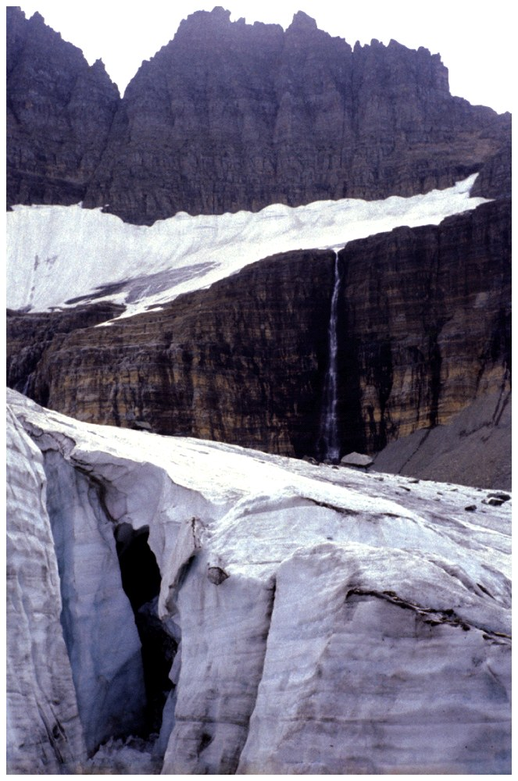
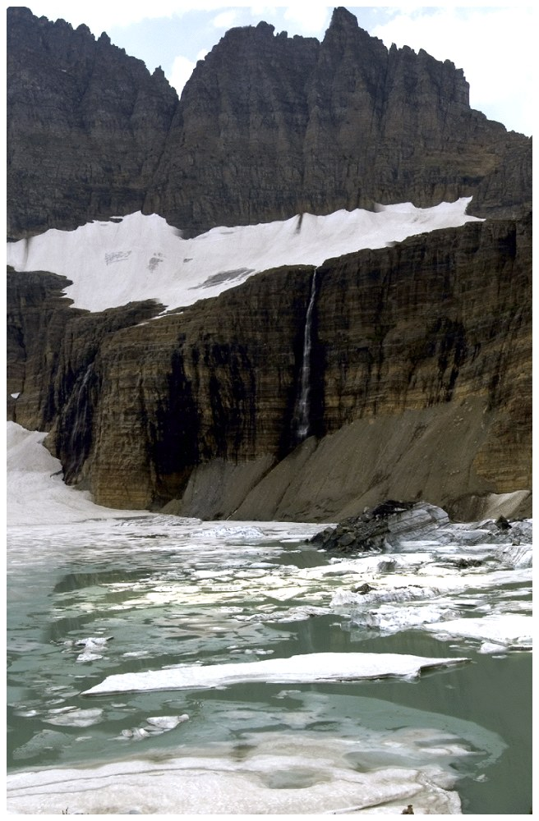
Melting Ice and Rising Sea Levels
1957
1998

Slide 55
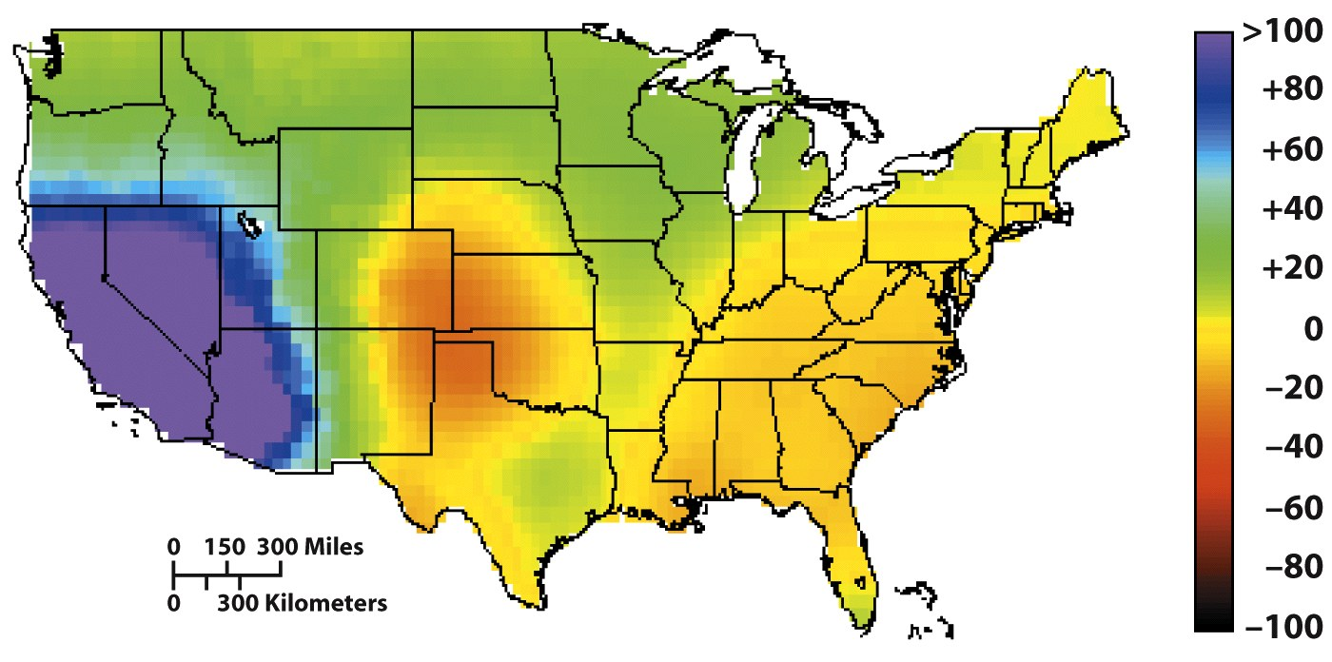
Effects of Global Climate Change
2. Changing Precipitation Patterns
Some areas will get more water, some areas will have greater droughts
  Ex: Hurricanes will likely get stronger

Slide 56
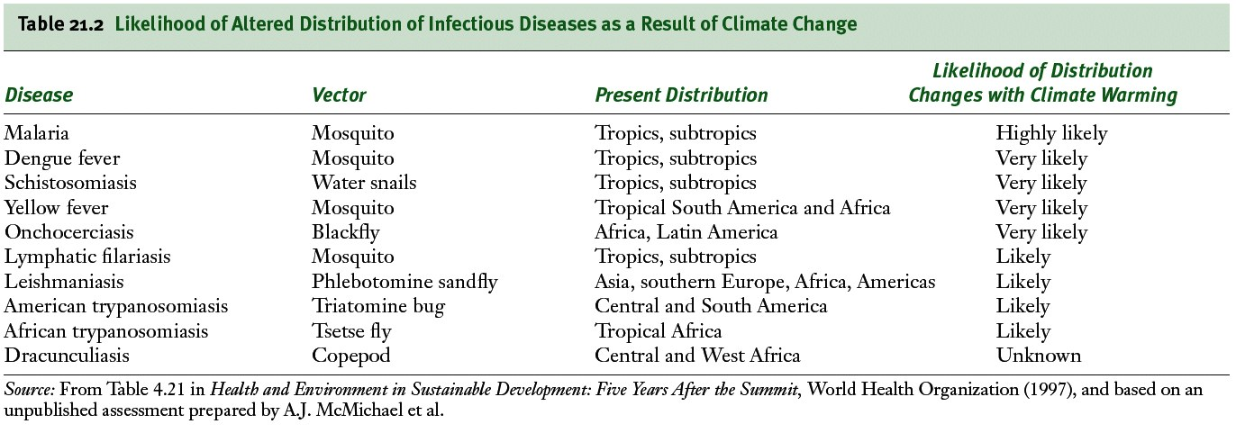
3. Effects on Human Health
Increased number of heat-related illnesses and deaths

Slide 57
4. Effects on Agriculture
It is difficult to anticipate impact of climate change on agriculture
  Productivity will increase in some areas and decrease in others
Rise in sea level will inundate flood plains and river valleys (lush farmland)
Effect on pests is unknown
Warmer temperatures will decrease soil moisture- requiring more irrigation
Location (i.e. elevation and altitude) where certain crops can be grown may have to change

Slide 58
Potential Impact of Climate Change and Variability in Ethiopia
Climate related hazard in Ethiopia include
  drought,
  flood (heavy rain),
  strong wind and frost,
  heat wave (high temperature),
  lighting e.t.c

Slide 59
Impact of Climate Change and Variability cont…
The major adverse impact of climate variability in Ethiopia includes:
drought
  Food insecurity arising from occurrence of drought and flood
  In Africa between 75-250 million and 350-600 million people will be under water stress by the 2020s and 2050s, respectively.
  Climate change is predicted to reduce the area of land suitable for rainfed agriculture by an average of 6%, and reduce total agricultural GDP by 2 to 9%

Slide 60
Impact of Climate Change and Variability cont…
  For example, one recent study estimated that African farmers, on rainfed land will lose $28 per hectare per year for each 1ºC rise in global temperatures
  Droughts in Ethiopia can shrink household farm production by up to 90% of a normal year output and could lead to the death of livestock and human beings

Slide 61
Impact of Climate Change and Variability cont…
  Outbreak disease such as
    malaria,
    dengue fever,
    water borne disease such as cholera,
  Heavy rainfall
    that tend to accelerate land degradation
    Damage to communication road and other infrastructure

Slide 62
Flood
The other climate related hazard that affects Ethiopia is flood
  E.g. In 2006 the main rain season (June - September) flood causes the following disaster
  More than 250 peoples died and about 250 peoples are unaccounted for Dire Dawa
  More than 10,000 peoples in Dire Dawa have been homeless
More than 364 peoples was died southern Omo and more than 8350 peoples were displaced over southern, where around 14 villages were flooded
More than 16, 000 peoples over west Shewa have been displaced

Slide 63
5. Dealing with Global Climate Change
Climate change adaptation
Climate change mitigation

Slide 64
4. Dealing with Global Climate Change
To avoid the worst of climate change, we should take appropriate measures
Two ways to attempt to manage climate change i.e.
  Through Mitigation
    Focuses on limiting greenhouse gas emissions to moderate global climate change
  Through Adaptation
    Focuses on learning to live with to the environmental changes and societal consequences brought about by global climate change

Slide 65
Adaptation - Adjustment in natural or human systems in response to actual or expected climatic stimuli or their effects, which moderates harm or exploit beneficial opportunities.
Depending on its timing, goal and motive of its implementation, adaptation can either be
  anticipatory and reactive adaptation,
  private and public adaptation, and
  autonomous and planned adaptation

Slide 66
Types of adaptation
1.Reactive or Anticipatory:
  Reactive adaptation takes place after the initial impacts of climate change have occurred.
  Anticipatory adaptation takes place before the impacts become apparent.
  In natural systems, there are is no anticipatory adaptation

Slide 67
Types of adaptation…
2.Private or Public: The distinction is based on whether adaptation is motivated by private (individual households and companies) or public interest (government).
3. Planned and Autonomous:
Planned adaptation is consequence of deliberate policy decision,
Autonomous adaptation involves changes that a systems will undergo in response to changing climate regardless of any policy, plan or decision

Slide 68
Forests and adaptation
How do forests relate to adaptation?
The linkages between forests and adaptation are twofold
  First, as climate change will affect forests, adaptation measures are needed for forests to reduce negative impacts and maintain ecosystem functions (adaptation for forests).
  Second, forest ecosystems contribute to adaptation by providing local ecosystem services that reduce the vulnerability of local communities and the broader society to climate change (forests for people‘s adaptation).

Slide 69
Forests and mitigation
How do forests relate to mitigation?
  As we know deforestation and forest degradation cause 15-20% of global GHG emissions. If we conserve our forest we can mitigate climate change
  Forests contribute to mitigation because of their capacity of remove carbon from the atmosphere and to store it as biomass.
The IPCC LULUCF report distinguishes three main mitigation activities in the forestry sector:
  afforestation
    converting long-time non-forested land to forest
  reforestation
    converting recently non-forested land to forest; and
  avoiding deforestation
    avoiding the conversion of forests to non-forested land

Slide 70
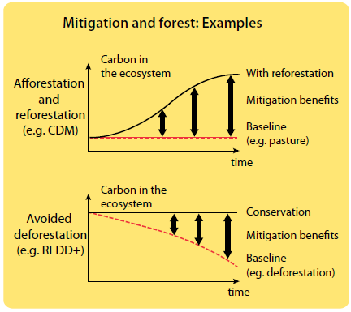

Slide 71
How do international mechanisms consider forests for mitigation?
Only afforestation and reforestation projects are eligible under the Clean Development Mechanism (CDM).
Reducing emissions from deforestation and forest degradation (REDD+), an initiative now at the top of the international negotiation agenda, is based on financial incentives to preserve forests and thus maintain or increase carbon stocks of the forest ecosystem.
  A REDD+ approach has been proposed for financing not only forest conservation but also the enhancement of forest carbon stocks (e.g. with reforestation) and sustainable forest management.

Slide 72
Ways to mitigate climate change impact
  Reducing the demand for carbon-intensive goods and services
  Creation of sinks for storing carbon through natural resource management (carbon sequestration)
  Reduce deforestations,
  improving energy efficiency
  Modify agricultural practices to reduce emission of greenhouse gases

Slide 73
Similarity and difference between adaptation and mitigation

Slide 74
Adaptation and Mitigation
What are mitigation and adaptation?
  Mitigation and adaptation are the two strategies for addressing climate change impacts.
  Mitigation is an intervention to reduce the emissions sources or enhance the sinks of greenhouse gases.
  Adaptation is an ‘adjustment in natural or human systems in response to actual or expected climatic stimuli or their effects, which moderates the harm or exploits beneficial opportunities.

Slide 75
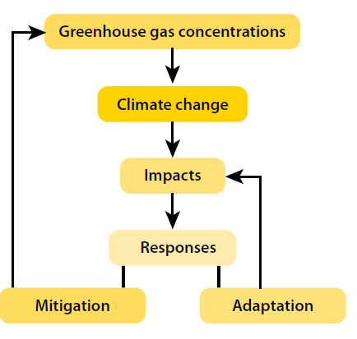
Adaptation and mitigation

Slide 76
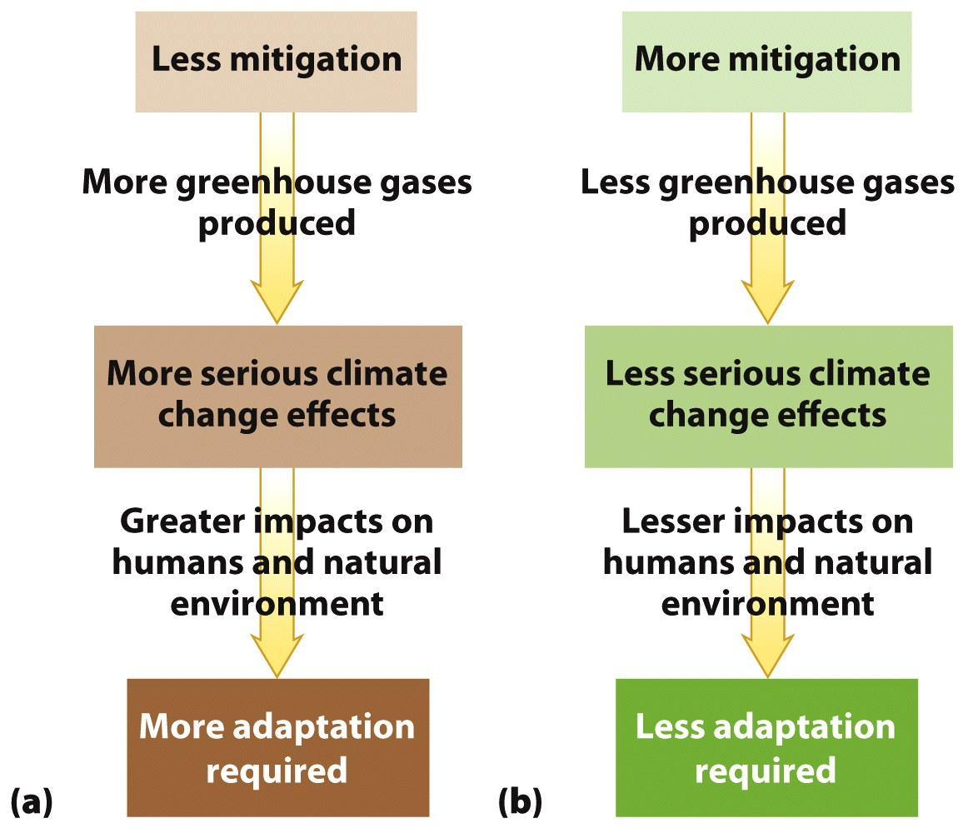
Relationship Between Mitigation and Adaptation

Slide 77
How do adaptation and mitigation differ?
Adaptation and mitigation present some notable differences, particularly in their objectives.
  Mitigation addresses the causes of climate change (accumulation of GHGs in the atmosphere), whereas adaptation addresses the impacts of climate change.
  Both approaches are needed.
    On the one hand, even with strong mitigation efforts, the climate would continue changing in the next decades and adaptation to these changes is necessary.
  On the other hand, adaptation will not be able to eliminate all negative impacts and mitigation is crucial to limit changes in the climate system.

Slide 78
What are the other differences between adaptation and mitigation?
Adaptation and mitigation differ in terms of spatial scales:
  even though climate change is an international issue, adaptation benefits are local and mitigation benefits are global.
  Adaptation and mitigation also differ in terms of temporal scales and concerned economic sectors (look next slide)

Slide 79
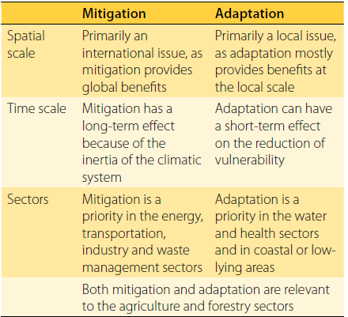
The spatial and temporal different b/n adaptation and mitigation?

Slide 80
Global Response to Climate Change
As economic grew:
  more fossil fuels were burnt,
  more forest areas were cleared for agriculture and
  more pollutants were produced
To reduce the impact of the above activities on the environment 20 years of efforts was made by
  scientist,
  NGOs,
  international organizations and
  several governments
Those are generally to get the international community agree on a coordinated action to address climate change

Slide 81
Stockholm Conference
The Stockholm Conference is generally regard as the starting point for international effort on climate variation and climate change.
  This is a meeting of the international community that was convened in Stockholm, Sweden in1972 with view to resolving the alarming environmental issue of the time.
  In1979, the first world climate conference in Geneva expressed concern about the atmospheric commons

Slide 82
Stockholm Conference cot…
Even though, this event reportedly attended primarily by scientist it received a little attention by policy-makers
In the 1980 a serious of conference and workshop were held in Villach , Austria, where scenarios for future emission of all the significant greenhouse gas were considered

Slide 83
IPCC
In 1988 IPCC which consists of international group of scientist to record and continuously monitor the developmental change in the climate system has been established.
The IPCC was established and sponsored by the:
  World Meteorological Organization (WMO) and
  the United Nation Environmental Program (UNEP).
The IPCC consist of over 2000 scientist and technical experts.

Slide 84
Cont….
However it does not conduct new research. Instead its mandate is to assess publish scientific literate on
  how human-induced change to the atmosphere,
  cause by an increase in the emission of greenhouse,
  are likely to influence world climate pattern;
  how this intern would affect a range of system and process important to human society, and
  what range of economy and social response options exist.

Slide 85
Cont…
The IPCC panel is organized in three working groups
  Working group one (WG I) focus on the scientific information of climate change
  Working group two (WG II) on impact, vulnerability and adaptation
  Working group three (WG III) on formulation of response strategies including mitigation measures.

Slide 86
The UN Framework convention on climate change (UNFCCC)
The UNFCCC was adopted in may,1992 in New York as response to the world concern over the climate change issue.
  It is supposed to be the main vehicles for promoting international response to climate change
  But it entered to to force in march 1994 and
  It has achieved near universal ratification by more than 190 countries on the UN member states.

Slide 87
UNFCCC cont…
The convention has set the objective of
  prevention dangerous interface with the climate system and
  To stabilization of atmospheric GHG concentration
Those are to prevent dangerous anthropogenic interference with the climate system

Slide 88
Cont…
The convention (article 4 (1)) provide that all parties make general commitment regarding to:
  The establishment of national inventory of GHG emission and sink
  The promotion of scientific and technical cooperation
  The sustainable management of forest, ocean, and ecosystem
The convention also has classified a certain parties as
  annex I countries and
  give them additional commitment to return their anthropogenic emission to 1990 level by 2000

Slide 89
The Kyoto Protocol to the UNFCCC
Kyoto protocol is the first addition to UNFCCC, in December, 1997.
  It targeting for GHG reduction in most industrialized country.
The targets however ranges from an obligation to reduce emission by 8% (for the European Union and many Central European) to a permission to increase emission by 10% (Iceland) and 8% (Australia).

Slide 90
Cont…
Overall, industralised countries are required to reduced their aggregate emissions to at least 5% below the 1990 level in the period 2008-12.
No new obligation was introduce for developing countries.
But the negotiation was entered in to force on 16, February 2005.

