Slide 1
Chap 8. Poultry Production
The word poultry refer to all domestic birds kept for the production of meat and eggs for human consumption.
It includes domestic
chickens,
turkeys,
ducks,
geese,
quails,
guinea fowl and
ostriches etc.

Slide 2
7.1. Role and Relative Advantages of Poultry
Supply of nutritive food:
it is evident from the composition of egg & poultry meat.
Its protein contain essential amino acids hence supplies protective food to human beings.
It can be started with little initial investment. i. e. it require
Low cost to purchase the animal.
Low cost to purchase the feed.
Space requirement is also low.
Stock number can easily be increased due to
fast reproductive rate which is because of high prolificacy and
short lifecycle which makes them very important.
4. Provides more food at low cost.
Eg. 1kg BW of broiler is obtained from 2 kg feed.

Slide 3
5. Better feed conversion efficiency.
6. Poultry meat has no religious and /or culture restriction.
7. Provides quick return
E.g. Broiler of 1kg can be easily obtained in 4 weeks.
8. Income in poultry farming is round the year.
9. Expansion of poultry enterprise is easy.
10. Provides self-employment to unemployed educated youth.
11. Utilization of all type of labor (retired persons, women, and
children) is possible.
12. Provides good organic manure.
13. Provide poultry litter as feed for ruminants.
14. Require relatively less space, capital and labor.

Slide 4
7.2. Poultry Production System
There are 3 poultry mg’t systems, which are differentiated on the basis of flock sizes and input-output relationships. These are
Extensive System of Production
Semi-Intensive System of Production; and
Intensive System of Production
Extensive System of Production
Here the birds are allowed to run free in large or unlimited area of land.
It is a traditional system in which the chicks experience natural condition.

Slide 5
Unique characteristics of extensive production systems
Low egg production is about 30-60 egg /year/ bird;
Chicken kept are small in number,
Not provided water, feed and health care properly.
Raise chickens with mixed age, breed and sex.
not specialized & market oriented, but only produced as subsistent.
Advantage of this production system
It requires low input or low production cost.
Birds require less management

Slide 6
Disadvantage
Very low in production of both egg and meat.
Chickens are small in size, they are bony and the meat is not tender.
Product loss is often high.
High mortality rate and disease transmission is also high.
Loss of birds due to predators is high.

Slide 7
B. Semi-Intensive System of Poultry Production
It is a system where by chickens wonder within enclosure during day time and is shed up at night in a house.
They are provided with feed and water.
The birds are restricted to certain amount of land.
In this production system, the quality & production performance of chicken is better than the extensive system of production.
C. Intensive Production System
This is a system in which chickens are totally confined in a house and do not run outside at all.
All things required for them are provided in the house.
The chickens are high in production due to provision of balanced food, appropriate shelter, proper health care and other necessary management aspects, which reduce loss from predator and diseases.

Slide 8
Major Characteristics of intensive production System
High production of good quality eggs and tender or soft meat.
Large flock size is kept.
Chickens are kept separately based on their age.
Loss due to predator and disease is minimum.
The operation is specialized & market oriented.
The cost of investment is high.

Slide 9
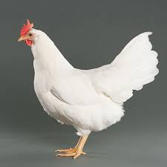
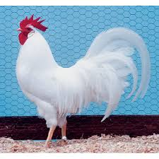
7.3. Breeds of Chicken
Exotic breeds introduced to Ethiopia
1. White leg horn
Varieties: -
single comb dark brown,
single comb light brown and
Rose comb types.
Egg shell color: - white
Use: - egg type chicken and
light in weight
Origin: - from the city of leghorn, Italy where they considered to be originated

Slide 10
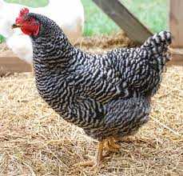
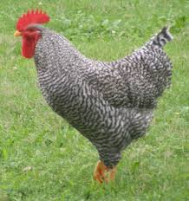
2. Plymouth Rock
Have different varieties
Medium in standard weight
Egg shell color:- brown
Use:- meat and eggs
Origin: - America
Characteristics
They are docile,
normally show broodiness.

Slide 11
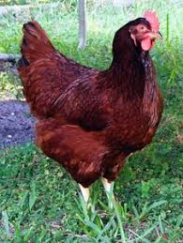
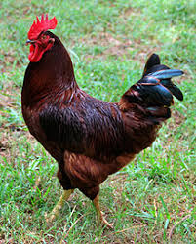
3. Rhode Island Red (RIR)
Varieties:- Single comb,
Rose comb
Egg shell color:- Brown
Use:- A dual purpose medium heavy fowl
Origin:- England
Characteristics
Good choice for the small flock owner.
They handle marginal diets & poor housing conditions than other breeds.

Slide 12
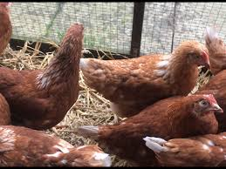
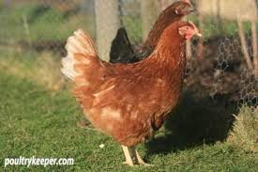
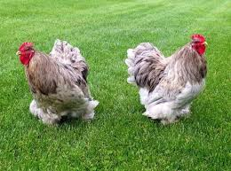
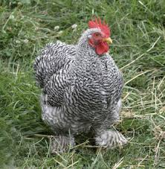
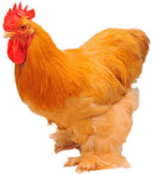
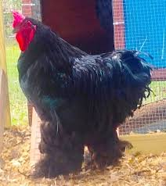
Bovans Brown
Cochin

Slide 13
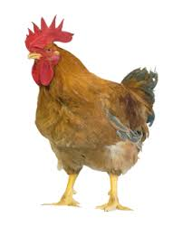
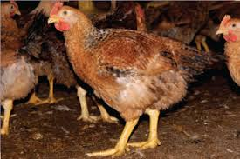
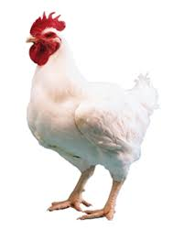
Sasso

Slide 14
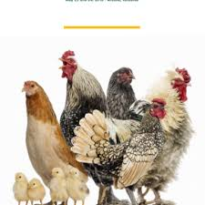
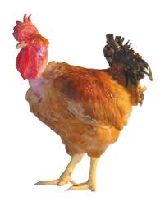
Local Breeds
The different breed types of poultry in Ethiopia are
Tukur,
Melata,
kei,
Gebsima and
Netch.
There characteristics in terms of
Body weight,
Egg production,
Egg weight,
Fertility and
Hatchability for each breeds is provided below.

Slide 15
Local Chicken Breeds of Ethiopia.
Traits | Tukur | Melata | kei | Gebsima | Netch
24 wk body wt (g) | 960 | 1000 | 940 | 950 | 1180
Age at 1st egg (day) | 173 | 204 | 166 | 230 | 217
Eggs /bird/ yr | 64 | 82 | 54 | 58 | 64
Egg wt (g) | 44 | 49 | 45 | 44 | 47
Fertility (%) | 56 | 60 | 57 | 53 | 56
Hatchability (%) | 42 | 42 | 44 | 39 | 39

Slide 16
Characteristic of Ethiopian local chickens
Annual egg production ranges from 54- 82 eggs.
have slow growth rate.
Male birds weight < 1.5 kg.
Chick mortality is high.
Attain sexual maturity at an average age 7 months (214 days).

Slide 17
7.4. Major Constraints of Poultry Production in Ethiopia
Low genetic potential of the birds
Low weight
Low meat and egg production
Slow growth
Low feed conversation efficiency and broodiness character.
Disease and inadequate health care.
Low level of Technology.
no hatcheries and equipment of watering and feeding.
High cost of formulated ration.
Limited use of poultry products in the diet.
Inadequate capital
No market regulations
Poor handling of the product

Slide 18
7.5. Incubation
a) Natural method
are a regular incubation method under scavenging system of poultry keeping.
eggs are incubated with the help of broody hens.
Selection of the best brooding hen
A broody hen used for incubating should be:-
healthy
show specific broody characteristics (good sitter)
They should not be too small (good body size).
be able to collect as many eggs as possible in her nest.
Have good amount of feather.

Slide 19
Optional number of eggs to be kept under the brooding hen
The size of the hen,
the size of the egg and
the state of the weather decide the number of eggs to be placed under her.
Birds which have good size & feathers can incubate & hatched about 14 eggs under favorable conditions.
The right time of incubation or the best time to set a hen is at night because at this time she is more likely to settle down to her job.
b) Artificial Methods of Incubation
is a method that used to incubate & hatch out a larger number of eggs without a broody hen by artificial incubator.

Slide 20
The most important requirement for artificial hatching is that the incubator should be clean & disinfected.
Eggs serve for hatching purpose should have proper size.
The size of eggs depends up on breed and strains of chicken.
Medium size eggs are preferred over too small or too large for hatching purposes.
size of medium egg varies from 50-60 gm average 56.7 gm.
The shape of hatching eggs should be oval.
avoid mis-shaped which reduced hatchability.
eggs must be fertilized.
On average, 1 cock is needed for every 10 hens for high fertility.

Slide 21
Hatching eggs should not be stored for more than 7 days.
The temperature & RH during storage should be 10-20⁰_{c} & on average 75%).
Position and Turning of Eggs in the Incubator.
Normally, hatching eggs store and incubate in the small- end down position.
For the 1st days of incubation, egg should be turned at least twice a day starting from 24 hours after setting for about 17 days.
However, modern incubators turn eggs in every hour at 45º as it
Prevent embryo from sticking to one side of the shell.
Helps for equal distribution of heat or temperature.
Avoid malformed chicks & reduce possibility of embryo mortality.
After 18th day there should not be any turning.

Slide 22
The physical conditions like desired level of Temperature, Humidity, Ventilation and Frequent Turning of Eggs are essential for proper incubation.
The eggs maintained at a Temperature of:-
38.9⁰c in the first 18 days of incubation
37.6⁰_{c} for the last 3 days in hatching the reduction in Temperature is because of the chicks started to produce heat by themselves
The eggs maintained at a RH of:-
50-65% in the first 18 days of incubation
75- 80% for the last 3 days in hatching

Slide 23
7.6. Managing Young & Growing Chicks
Brooding period: is the period of growth, during which supplementary heat is provided for the chicks.
It is a period where young chicks require a lot of care such as provision of heat, ventilation, feed, water and health care etc.
It ranges from day old -4 weeks in tropic or
from day old -8 weeks in temperate areas.

Slide 24
Method of brooding
There are two types of brooding methods
Natural brooding
means the taking care of chicks (supplementation) of heat by the hen.
A good mother brood about 12-15 chicks or twice more number than the eggs incubated by herself, even if the number of chicks to be brood depend upon.
The size of the hen
Weather condition
The feather covers of the birds.

Slide 25
2. Artificial brooding
is taking care of chicks by the use of special appliances or instrument that supply heat, which is called foster mother.
Based on the heat sources available there are different kinds of artificial brooder like.
Kerosene brooder
Electric brooder
Hay – box brooder
Charcoal brooder
Battery brooder

Slide 26
The necessary condition for successful brooding is Temperature.
Young chicks must be exposed to a relatively higher temperature to assist its development.
The optimum Temperature of brooding 35-32⁰c during 1st week and
then reduced by 2-3⁰c each week until the ambient temperature is attained at 20 ⁰c.
Heating guidelines
Age (weeks) required ambient temperature
0-1 35-32⁰c
1-2 32-29⁰c
2-3 29-26⁰c
3-4 26-23⁰c
4-5 23-20⁰c

Slide 27
The best guide of the temperature requirement of the chicks is the state of the chicks.
When chicks are crowded together near the heat source this shows the surrounding temperature is too cool so it is necessary to increase the heat source of the brooder or to add another brooder.
When chicks move further from heat source it is an indication of excessive heat supply of the brooder.
If the chicks are evenly distributed from heat source, this indicates the adequate heat supply of the brooder.
If the chicks huddled together to one side of the brood guard, this indicates a draft (force) of heat in one side only.
Importance of Ventilation.
To supply fresh air (O₂) to chicks
To remove CO₂ & ammonia, which cause respiratory problem.

Slide 28
7.7. Managing Layers
Lighting: - If the day length is increased by using artificial lighting, laying hens are encouraged to lay more eggs.
However, day length must not be increased during growing period of the young chicks until just before they start laying .
So, it is important to have 14 - 16 lights in layers house.
But, if we do not do so, egg production will decrease due to the shorter day length.
2. Debeaking: - is the cutting of the points of the beaks.
It can be done at any age of the bird except during the laying phase because if it is done at this time, the egg production decreases due to stress.

Slide 29
3. Health care
To avoid disease outbreak in the area.
Vaccinate the chickens at the right time.
General sanitary measure is the best to prevent disease outbreak & transmission.
4. Culling
is removing unproductive hens and sick chicken from the flock during production period.
Advantages of culling
High level of egg production can be maintained.
Extra cost of feeding for unproductive birds and unhealthy birds is minimized.
More space provided for the remaining birds.
Incidence of disease will be reduced.

Slide 30
Equipment and Materials in Layers Houses
1. Feeder and waterier
2. Laying nest:- is very important equipment in layer house.
Should be relatively dark because don’t want to lay in light place.
It can be made from sheet metal, wood, wire mesh, clay, mud, etc.
It should be place in laying house at least 2 weeks before the onset of egg laying. The reason is to accustom the bird to use the nest.
There are at least two types of nests. Individual nest & Community nest
3. Perch: - It can be made from wood or metal
4. Egg collection basket
5. Drooping boards
6. Weighing scales of feeds and the birds

Slide 31
7.8. Managing of Broilers
Broiler: - is a young chicken of either sex below 8 - 10 weeks of weighing 1.5 - 2.0 kg body weight,
with a tender meat soft,
pliable smooth textured and
flexible breast.
.

Slide 32
Ventilation
The main function of ventilation is
to maintain co₂ at low level,
to remove ammonia from the house and
to maintain required temperature.
Air movement requirements are best determined by observing birds comfort, litter condition and odor build up.
B. Litter using of dry, fresh and clean litter with a depth of 5-7cm is
necessary during broiler production.
C. Debeaking : means cutting of the points of the beaks.
In addition to preventing cannibalism,
Debeaking usually minimize mash feed wastage.
It can be at any time of age except during egg laying phase.
But it is important to debeak at day old to prevent from cause of much stress.
D. Culling: The main purpose is to make the flock profitable because
unhealthy & non-productive birds are removed by culling.

Slide 33
Manipulating factors towards getting profitable average daily weight gain and managing broiler breeder are
1. Selection of breeds
Parental broiler flocks consists of a female line & a male line and those which weigh the most are selected at their 8 weeks of age for breeding purposes.
2. Feeding
Broiler are fed 2 types of ration, broiler starter & broiler finisher.
The former ration is fed up to 5 weeks of age and
the later is continued till the age of marketing.
The starter ration contains
more protein (21-22% CP) and
less metabolisable energy than finisher ration

Slide 34
3. Lighting
Advantages of light
Encourage birds to consume more food and thus, they grow faster.
will encourage activity and increase metabolic rate.
4. Effect of Temperature in Weight Gain
The ideal temperature for broilers in the post - brooding period is within the range 20-25⁰c.
Research suggests that each degree of deviation from the optimum may results in a reduction of body weight at 2 months of about 20g per bird.
Each degree rise in temperature is probably associated with a depression in cumulative food intake of about 50g per bird.
thus, Care must be taken with respect to heat stress in the tropics because broiler breeders are more susceptible to heat stress than birds of laying strains.

Slide 35
5. Disease control
A similar control program is advocated as for laying chickens.
Vaccination
Broiler Breeders
are laying hens that have been bred especially for the production of chicks that will be fattened as broilers.
Characteristics of Broiler Breeders
they have rapid growth rate,
are efficient in food conversion,
are much heavier than the birds used for egg production,
but produce fewer eggs as compared layers (egg laying birds)

Slide 36
Thank You!

