Slide 1
Chapter 2. Livestock production systems & Husbandry
Session objectives
Define what LS husbandry is
Characterize LS production systems of Ethiopia
Identify & describe the different LS feed sources of Ethiopia
Describe the different LS feeding strategies
List & describe the common diseases & parasites of farm animals

Slide 2
Animal husbandry is the mg't & care of farm animals by humans for profit,
in which genetic qualities & behavior, considered to be advantageous to humans, are further developed.
And includes the practice of selectively breeding and raising livestock to promote desirable traits in animals for utility, sport, pleasure, or research

Slide 3
2.1. Livestock Production systems (LPS)
LPS may be classified according to a number of criteria
Integration with crop production
Animal-land relationship
Intensity of production the main ones
Type of product
Other criteria include
size and value of livestock holdings
distance and duration of animal movement
types and breeds of animals kept
market integration of the livestock enterprise, economic specialization,
household dependence on livestock and
farming systems approach

Slide 4
2.1.1. Range Ls production systems
are based on the use of the natural vegetation
the main product is milk and
the main function of livestock is subsistence,
although social and cultural functions are also important
Management is x’ed by the adaptation of the feed requirements of the animal to the environment through migration;
land tenure is communal
are associated with the arid zone where it is too dry for cropping

Slide 5
2.1.2. Crop- livestock (mixed) production systems
Crop livestock Lowland crop LS production
Highland crop LS production.
In theses systems livestock production takes place in arable areas
The systems are based on cropping & on livestock husbandry practiced in association
livestock provides agricultural inputs (work & manure).
Crop residues are converted to high-value animal products.

Slide 6
2.1.3. Landless livestock production systems(LLPS)
LLPS -the importance of land for livestock production is significantly reduced
This is particularly the case with species that do not obtain their feed requirements through grazing, notably pigs & chickens
Ruminants can also be kept in landless production systems,
but require high levels of capital intensity & management (e.g. in beef lots)
are also less dependent on the specific ecological conditions

Slide 7
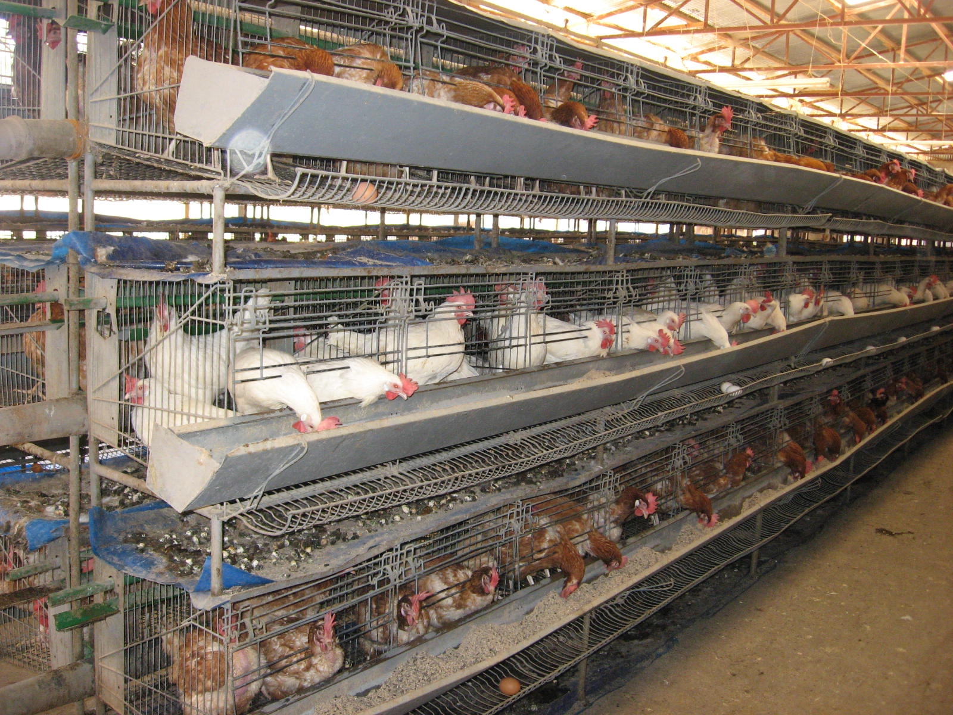
Availability & quality of feed need not be determined by the environment
and the more advanced production systems provide protection from the direct climatic influences.
a. modern poultry farm

Slide 8
2.2. Feeds and feeding of farm animals
2.2.1 Feed resources
Feeds are classified according to the amount of specific nutrients they supply.
Two main classes i.e. roughages and concentrates.
The basic understanding of the classification of feed and the nutrient content of common feeds will make
it easier for producers to make feeding decisions
Roughages/Forages
bulky feeds containing relatively large amounts of poorly digestible material ( >18% CF).

Slide 9
Two categories based upon their moisture content.
Wet - feeds usually contain more than 75% moisture and include:
Pasture
Cultivated fodder crops
Tree leaves
Root crops
Silage, haylage (silage made from partially dried grass)
ii. Dry-contain only 10–15% moisture
a. High quality >10% CP legume hays, alfalfa hay, other legumes
b. Low quality <10% CP Cereal straw, peanut hulls, mature hays

Slide 10
2. Concentrates
A feed or feed mixture having high amounts of protein, carbohydrates and fat
contains less than 18% CF and is usually low in moisture.
rich in either energy or protein and are thus expensive
i. Energy-rich concentrates:
Feeds with high levels of energy
but low in protein content. These can be
Grains & seeds: best energy sources but generally expensive due to use as human food.
Mill by-products: cheaper and widely used (e.g. brans, shorts).
Root crops.

Slide 11
ii. Protein-rich concentrates (plant/animal origin)
Oilseed cakes-
The by-products left after extraction of oil from oilseeds.
The protein & energy contents of these products vary widely depending upon the oil extraction method used
e.g. Soybean meal, cottonseed meal, corn gluten feed, blood meal, bone meal, fish meal
Brewer’s grains-
are by-products of the brewery industry.
Dried brewer’s grains contain about 18% CP & 15% CF.
iii. Vitamins/Minerals
Limestone, dicalcium phosphate, TM salt, vit, pre-mix

Slide 12
Available LS Feed Resources
Natural pasture and browse,
Crop residues and
fallow grazing,
Agro-industrial by-products,
Thinings and leaf strips from maize and sorghum.
See Picture feeds lecture note\Chapter 7_ Nutrition and feeding of Sheep and Goats.pdf

Slide 13
Nutrients (6 nutrient groups)
A nutrient is defined as a chemical element or compound that aids in the support of life.
Nutrients -are substances, supplied by feedstuffs, used by animals for maintenance and production.
They are necessary for cells to live, grow and function properly.
Maintenance: All activities and body processes necessary for staying alive and maintaining an animal’s body weight.
Some specific components include:
Energy to support essential physiological functions.
Maintenance of body temperature.
Repair of body tissue.
Production: Nutrients required above maintenance allow for productive functions such as:
reproduction,
lactation,
extra activity

Slide 14
2.2.2.Feeding Strategy
Strategies for ensuring appropriate nutrition of LS include;
Matching LS prdn system to available feed resources
strategies for increased feed availability is through increasing off take of animals through sale (destocking).
increase the amount of feed available to the remaining animals.
Feed efficiency can also be increased if older, mature animals are sold leaving younger, growing animals that utilize feed nutrients more efficiently

Slide 15
2. More efficient use of agricultural & industrial by-products as
sources of feed
Various means of improving the efficiency of utilization of available feed resources
Supplementation
LS diets are generally based on fibrous feeds that have low digestibility & are deficient in protein, minerals & vitamins.
These characteristics keep intake & productivity low.
Provision of appropriate supplementary feedstuff during critical periods of the year is important to enhance productivity or at least avoid body-weight loss.

Slide 16
This is especially true for livestock consuming poor-quality pasture and crop residue-based diets.
A supplement is a semi-concentrated source of one or more nutrients used to improve the nutritional value of a basal feed
e.g. protein supplement, mineral supplement.

Slide 17
Supplementation may be at various levels for different reasons.
It may be for survival,
maintenance or
for production & reproduction.
It can be done by providing a complete feed or by giving specific nutrients.
It can enable animals
to consume more forage,
to digest the same quantity of forage more efficiently or
to overcome a nutrient deficiency that critically limits performance

Slide 18
Grazing stock may sometimes be supplemented with hay or straw for prevention of nutritional disorders (when the pasture is very lush with high moisture or protein content or where there is a danger of bloat in legume-rich swards).
ii. Fodder conservation
The supply of feed fluctuates in most parts of the tropics
Any surplus forage should be conserved for use during the dry season (supply is scarce and feed quality is poor.)
Hay & silage-making are two main forage preservation methods.

Slide 19
iii. Proper exploitation of natural browse
The widespread traditional use of browse as an available source of quality feed during the dry season is vital to maintaining seasonal and yearly stability of livestock production in drier areas.
Foliage from trees & shrubs in pastoral areas provides more edible biomass than pasture

Slide 20
Moreover, browse remains green & high in protein content when pastures become dry.
Proper & strategic use of these feed resources as supplements during dry periods can help minimize seasonal fluctuation in productivity.
3. Encouraging increased intake

Slide 21
2.3. Common Diseases and Parasites of Farm Animals
Disease- is any deviation from or interruption of the normal structure or function of any part, organ, or system of the body that is manifested by a characteristic set of symptoms and signs and whose etiology, pathology and prognosis may be known or unknown.
Many important livestock diseases that inflict major socio-economic losses in Ethiopia occur every year

Slide 22
Animal diseases are an everyday occurrence to all of the resources-poor countries, as animals of these people are particularly vulnerable to diseases due to:
Presence of a wide range of disease-causing organisms
Lack of knowledge about their management and control
Lack of resources access for animal health and production inputs and services, etc.

Slide 23
Consequences of disease
Loss of money (700 million Birr is lost annually due to helminth (internal parasite) infestation
Loss of animals
Annual disease losses amount
8–10% for cattle
14–16%, for sheep
11–13% for goat populations
Affecting the quantity and quality of livestock products
infectious & economically important animal diseases excludes the country from profitable international markets, thereby greatly reducing the country’s foreign exchange earnings.

Slide 24
5. Treatment costs:-farmers incur direct financial and time costs
responding to animal disease by seeking or providing treatment.
6. Loss of crop farm productivity: - through their effects on
performance, diseases of livestock have additional indirect
impacts on other agricultural enterprise, in particular crops. This
is through lowered traction capacity for ploughing.
7. Disturbance of Human Health (like zoonotic disease)
8. Impairment of Human Welfare:- Animal disease can significantly
reduce farm income, contributing to food insecurity and poor
nutrition.

Slide 25
In general, disease is the product of three factors.
Host: Agent inhabitants (animalsLiving things)
Agent: disease causatives like bacteria, Virus, protozoa, Fungus, Ricketsia, Parasites etc.
Environment: Place where the hosts and Agents live.

Slide 26
Disease occurrence and transmission
Diseases can be classified into
i. Infectious
-Diseases that can be transmitted from a sick animal to sensitive
healthy animals
-causative agents can be bacteria, virus, fungi, several parasites
ii. Non-infectious
mainly related to feed (diet-related) such as mineral deficiencies, toxic plants and poisons
Some non-infectious diseases may be genetic (received from parents) or
due to an injury eg. Lameness

Slide 27
Routes of disease transmission
1. Aerial transmission- airborne transmission of infectious agents.
E.g. - FMD virus shed from ruptured vesicles and taken long distances by air.
Healthy animals can be infected when they inhale the contaminated air.
2. Contact-direct transmission without involvement of transmission factors (e.g., mechanical vectors) & without participation of an external medium.
Transmission may be through bites (e.g., rabies).

Slide 28
3. Inoculation
is the introduction of infectious agents into the body by puncture of the skin, or through a wound (e.g., when tsetse flies infected with Trypanosoma puncture the skin of an animal to feed on blood and transmit the disease).
Introduction of infectious agents by dirty instruments such as during treatment or vaccination using needles that haven’t been sterilized

Slide 29
2.3.1 Common diseases of farm animals Diseases caused by Bacteria
1. Anthrax
It is soil born because, it is found in the soil.
Commonly its root of infection is by ingestion, inhalation and contact with skin.
Clinical findings: -
Sudden death
After death, discharges of thick, dark blood from natural orifices
Fever (42ºc in cattle)- because of bacterium
Oedematous swellings in ventral aspects of the body.
Abortion, bloody diarrhoea (dysentery).
Absence of regormortis (harding of muscle after death).
Spleen of the animal becomes enlarged.

Slide 30
Control: -
Remove the sources of infection
Not open the carcass, complete burning or bury more than three meters deep.
Contaminated bedding, premises (buildings and/or locations), food, etc, should be destroyed or disinfected.
Vaccination of animal’s every year, vaccination should be done 2-4 weeks prior to the season when outbreaks may be expected.
Never eat meat from animals that died suddenly
Report suspected anthrax cases to the veterinary authorities as soon as possible.
Remark: Anthrax is zoontic (transmitted from animals to man and vies versa).

Slide 31
2. Mastitis
It is caused by bacteria
It is defined as an inflammation of the mammary gland
The affected gland gradually loses its production capacity, because of the secretary tissue replaced by fibrous tissue.
The predisposing factors for mastitis are: -
Poor milking hygiene.
Milking machine faults
Teat injuries.
Faulty milking management
Environmental populations ecto-parasites such as ticks, lice etc

Slide 32
Clinical findings.
Milk contains pus, blood or turns watery.
Udder and teat swollen
Animal reject suckling or milking and kicks.
The affected quarter of udder gets dead and gives no milk
Death of the animal may result.
Control: -
Avoid the predisposing factors
The infected cows should be milked at last.
Treatment of the animals.
Cull any cows with persistent mastitis.

Slide 33
Diseases Caused by Virus (FMD, Shoat pox, Newcastle disease, Lumpy skin disease)
Foot and Mouth Disease (FMD)
Transmission: - ingestion, inhalation, contact with infected animals and contaminated materials
Clinical findings: -
Salivation
Fever and there will be vesicle is (1-2 cm) in diameters formation in inter-digital spaces, mouth (tongues, gums, lips, dental pad) & teats
Small vesicles become enlarged and then rapture
Lameness
Smacking of the lips
Abortion
Death in calves

Slide 34
Control and prevention: -
Vaccination of cattle every six months
Restriction of animal movement from country with disease-to-disease free places.
Prohibit (forbid) introduction of animal products in to FMD free countries from countries that have the disease.
When there is an outbreak, separate the infected and held in quarantine until they have recovered and the entire healthy herd may be vaccinated.

Slide 35
2. Sheep and Goat Pox
A viral infection of sheep and goats characterized by lesion on the skin and internal organs
The virus is related to the virus of lumpy skin diseases.
Route of transmission: -
Contact with infected animals and contaminated materials
Inhalation and also by insect biting
The disease in goats is generally less severe.
Clinical signs: -
Wide spread skin lesions develop on the muzzle, ears and areas free from wool or long hair.
Pox lesions under the tail
Fever and discharge in eyes

Slide 36
The lungs contain multiple spherical nodules commonest near pleural surface.
Lesion also occurs in the trachea and alimentary tract.
Excess salivation
Control: -
In endemic area like Ethiopia, routine vaccination is recommended.
In free countries: - avoid the sick or stop importation of animals from places with disease.
Control of biting flies.
In event of outbreaks affected animals should be separated or preferably destroyed and the reminder vaccinated

Slide 37
3. Newcastle Disease (NCD)
It is an acute (sensitive) rapidly spreading viral disease of domestic poultry and other birds
it is extremely contagious and devastating to poultry flocks, causing up to 90-100% mortality.
Route transmission:
- Inhalation and ingestion of food contaminated with the virus.
-Trans-ovarian transmission usually causes embryonic mortality.
Clinical findings: -
According to the strain of the virus the sign may be respiratory, nervous or digestive disorders.
Respiratory signs- Gasping and coughing, sneezing, difficulty in breathing
Nervous signs include- dropping wings, dazing legs twisting head and neck, walking back ward depression, in-appetence and complete paralyses
Digestive disorder like watery and greenish diarrhea.

Slide 38
The sick birds can show signs like swelling of tissue around the eyes and in the neck, eggs become abnormal in color, shape and with watery albumen.
Control: -
Vaccination/ healthy chicks are vaccinated as early as the fourth or even the first day of life.
Good sanitation
Isolation of infected birds
Early diagnosis and treatment
Avoid stress

Slide 39
Diseases Caused by Protozoa (Trypanosomiasis, Coccidiosis)
1. Trypanosomiasis
The protozoa disease of animals and human being caused by some species of the genus trypanosome.
Trypanosomes are divided in to tsetse transmitted and Non- tsetse transmitted.
Clinical findings:
intermittent fever,
increase respiratory and heart rate,
anaemia,
weight loss,
spleen become swollen.
Control: -
Eradication of the tsetse fly,
partial control of tsetse fly can be a accomplished by frequent spraying and dipping of animals, spraying of insecticides on fly breeding areas, bush clearance, use of traps and sterile insect (male) technique

Slide 40
2. COCCIDIOSIS
Acute protozoal disease of cattle, sheep, goats, swine and poultry
Route of infection- by ingestion of infective oocysts. Adult animals (resistant mostly) are source of infection for young animals (very sensitive to the disease)
Clinical findings: -
Bloody diarrhea, dehydration, fever, in appetence, weight loss, emaciation, death (high in birds), and decrease egg production.
Control and prevention
Giving prophylaxis anticoccidials.
Good feeding practices and good management
Give colostrums for new borne
Avoid stresses
Isolate the sick and treat individually
Poultry vaccination or (administered in the drinking water).

Slide 41
2.3.2 Common Parasites of Farm Animals
1. Internal Parasites (GIT parasites, liver fluke, lung worms, ascariasis)
Lung worms
Are worms that cause infection of the lower respiratory tract by any of several parasitic nematodes resulting in bronchitis or pneumonia.
Clinical findings:-
Coughing
Increased respiratory rate
Reduces weight gains & milk yields
Standing with their heads stretched forward, mouths open and drooping saliva.
Nasal discharge (mucous) in sheep.
Control: -
Pasture management
Avoid grazing of calves with other animals & deworm with anthelmintics.
Vaccination for cattle sheep & goats after the infective larvae is attenuated

Slide 42
Liver fluke (Fasciolosis)
Very important disease in ruminants responsible for high mortality and morbidity, characterized by weight loss and anemia.
The preference site for adult fasciole is in the bile duct, but the young fluke are found in the liver.
Clinical findings: -
Acute fasciolosis in sheep causes anaemia, painful, abdomen, and sudden death.
Sub acute fasciollosis causes anemia, and submandibular edema, reduced milk yield, emerged liver with fibrin deposits on the capsule.
In chronic cases cirrhosis, loss of condition, bottle jaw, anaemia.
Control: -
Reduction the population of intermediate hosts (snails).
Strategic treatment
Drainage of the area of the snail distribution is wide spread.
Use of molluscacides (ex. copper sulphate, Endode)

Slide 43
Gastro Intestinal parasites
Are parasites of ruminants, equine and swine
infection in all cases is by ingestion of larva.
Clinical findings: -
Loss of appetite and weight loss
Diarrhoea
No fever
Anaemia & bottle jaw
Edema
Treatment: - Antihelimenthic drugs like
Albendazole, Fenbendazole; Fenbensse
Control: - Isolation of the sick and treat individually
- Avoid pasture contamination.

Slide 44
2. External Parasite (Ticks. Lice, and Flies)
Lice
Lice divided in to biting and Sucking Lice
Suckling Lice- the mouthpart is adapted for sucking of tissue fluids and the blood.
Biting Lice: - Has biting or chewing mouthpart. This attacks birds and other animals, it is called Bird lice.
Flies
Are direct ecto-parasites of animals & human beings.
They have a pair of wings.

Slide 45
Examples of flies are: - Mosquitoes, Biting manges, Black flies, sand flies, houseflies, testes flies.
The effects of lice and flies are: -
Transmitting disease
Irritation and/or inflammatory reaction
Production loss- (egg, wool, milk, yield decrease).
Lameness
Control: -
Use/spray or dipping with insecticides
Disturbing the favorable environment of the insects.
Biological control (introduction of predators to the insect environmental

Slide 46
Ticks
The effects of tick are: -
Anaemia
Worm syndrome
Abscess formation
Tick paralysis
Diseased transmission (Babesiosis, Thererisois, anaplasmosis, Streptotrichosis cowdriosis (heart water) Dermatophilosis, viral infection)
Poor weight gain and reduced milk production
Control of Ticks: - The main method of control is local application of insecticides (acaricides) by dipping or spraying.
Burning of grazing areas
Rotation of pasture
Manual removal
Rear animals with natural resistance to ticks.
Chemical control methods

Slide 47
2.3.3.Nutritional Disorder Diseases
1. Bloat
is a disease of all ruminants.
is characterized by the distension of the rumen and reticulum with gases of fermentation. The animal is unable to get rid of the gas by normal physiological means.
Bloat easily kills ruminants.
Causes of bloat
Bloat can occur when the animal grazes on lush young pasture, particularly if the pasture is wet.
Some plants, e.g. clover, lucerne and alfalfa are especially dangerous in causing bloat but any fast growing plants can cause it.
Sometimes ruminants kept by the household and fed only feed such as dry bread can develop bloat.

Slide 48
Symptoms of Bloat:
a swelling high in the left flank
the animal stops grazing
the animal shows signs of discomfort, and may lie down
lying down and kicking at the belly
increased rate of breathing
breathing is through the mouth which is held open; the tongue protrudes, and there is copious saliva production
If no relief is given, the animal may die within 10 minutes.

Slide 49
Preventing bloat
Avoid moving animals to wet pasture, especially first thing in the morning.
Do not allow very hungry animals to graze a pasture.
Offer dry, cut grass first before turning out to graze.
Keep a watch on animals at pasture.
Treatment
Give a drench (drink) to the animal. The drench used can be one of the following:
Two large spoons of washing up liquid, e.g. Fairy, Lux.
A solution of sodium bicarbonate (cooking or baking soda) and water.
A small amount of kerosene (paraffin) in warm milk.
A small bottle of peanut, soya or linseed oil.
Use a commercially available medicine.
Use of trocar and cannula
2. Nutritional deficiency diseases
Mineral deficiency diseases
Vitamin Deficiency Disease

Slide 50
See you Next Class!

