Slide 1
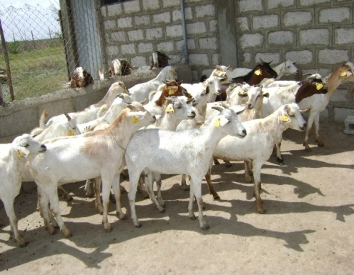
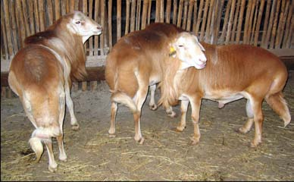
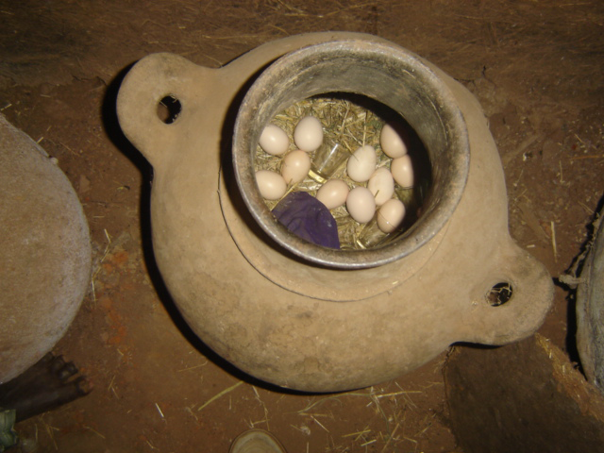
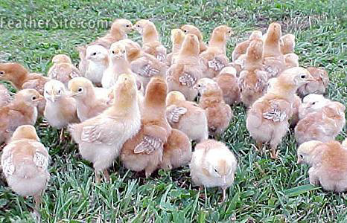
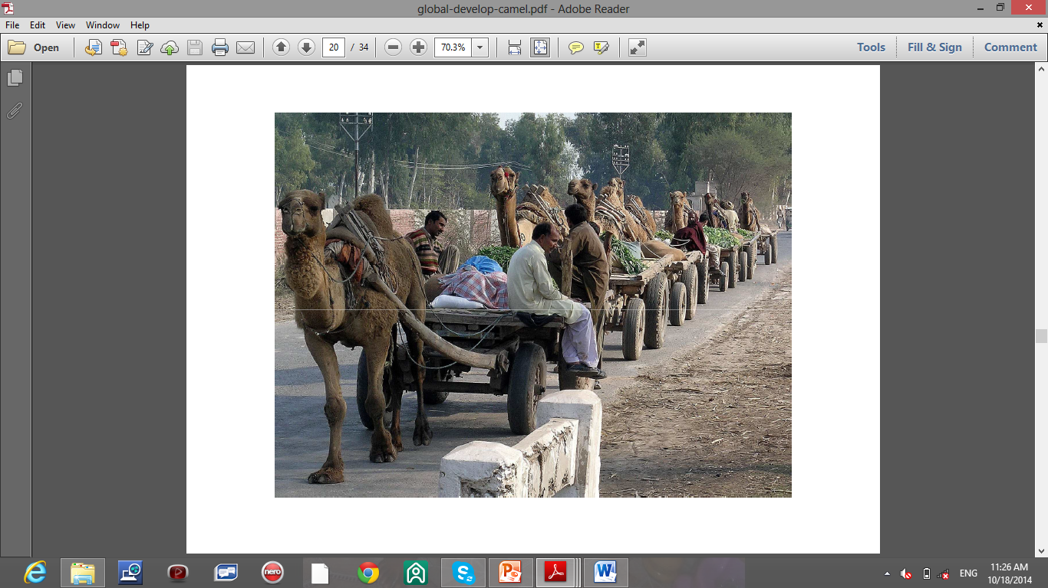
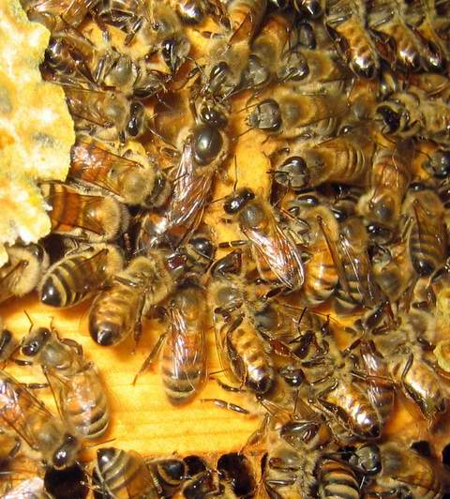
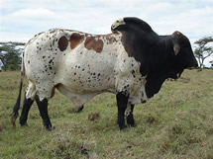
Livestock Production & Management

Slide 2
Chapter 1: Introduction
Objectives
At the end of this session students will be able to
  Define basic terminologies in livestock production
  Describe the importance of LS production
  Describe the major constraints of LS production

Slide 3
Starter
Livestock production
Poverty reduction, How??
Malnutrition (Definition, consequences, mitigation mechanisms
Balanced diet (definition, where can we obtain??

Slide 4
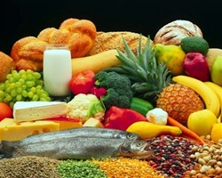
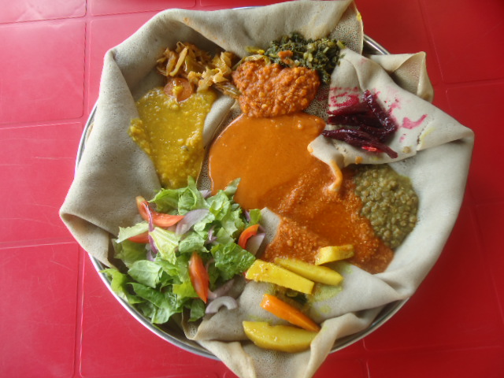
Malnutrition - condition that results from eating a diet in which nutrients are not enough or too much that causes health problems.
This may include too much or too little calories, protein, carbohydrates, vitamins or minerals
Balanced diet -a diet that contains adequate amounts of all the necessary nutrients required for healthy growth and activity.

Slide 5
  Definition of terminologies
Livestock are domesticated animals raised in an agricultural setting to produce commodities such as
  Food (milk & milk processed products, meat, egg, honey)
  Fiber (silk, wool, mohair)
  Labor (traction, transport)
The primary livestock products include
      Cattle - Milk, meat, hides
      Sheep - Meat, wool, skin
      Goat - Meat, milk, skin
      Swine - Meat
      Poultry – Egg/meat

Slide 6
Ethiopia w/c is naturally endowed
  with different agro-ecological zones &
  having suitable env’ntal conditions for livestock production.
  is a home for many livestock species
From the total cattle population 98.95% are local breeds and the remaining are hybrid and exotic breeds.
99.8% of the sheep and nearly all goat population of the country are local breeds.
From total chicken population
      96.61% are indigenous
      2.84 % hybrid
      0.55% are exotic

Slide 7
Some Terminologies in Livestock Production & Management
Cattle: This refers to the entire Bovine species
Cow: Female cattle of mature age which have had one or more parturitions
Heifer: Female cattle of immature age which has not produced any offspring
Bull: A mature male cattle
Calving (Calve): Act of giving birth (parturition) in cattle
Calf: Young cattle of either sex under 1year old & usually not weaned
Bull Calf: Young male cattle under two years of age
Castration:
Steer: Male cattle which has been castrated at early age
Stag: Male cattle which was castrated after reaching sexual maturity
Free Martin: female cattle born as a twin along with a male cattle which is usually sexually sterile
In-calf: Pregnant cow

Slide 8
Sheep: refers to entire ovine species
Ewe: refers to female sheep after reaching sexual maturity and has produced one or more offspring
Ram: Mature male sheep
Lamb: refers to sexually immature sheep of either sex
Lambing: act of giving birth in sheep
Ram Lamb: sexually immature male sheep
Ewe lamb: Sexually immature female sheep
Wither: Male sheep castrated at an early age
Fleece: The wool of a single sheep

Slide 9
Goat: refers to the entire caprine species
Buck/Billy: Mature male goat
Doe/Nanny: Female goat that has given birth once or twice
Kid: Young or sexually immature goat of either sex
Kidding: Act of giving birth in goat
In-Kid: Pregnant goat

Slide 10
Poultry: entire avian species (include domestic fowls, duck, goose, turkey, guinea fowl and pigeon).
Fowl: any vertebrate containing wings and feathers
Chicken: domestic fowl of either sex and any age
Hen: Sexually mature female chicken
Cock: Sexually mature male chicken
Cockerel: Sexually immature male fowl
Capon: male chicken castrated at an early age
Pullet: Sexually immature female chicken
Chick: very young chicken of either sex

Slide 11
Fertility: the ability of an animal to reproduce.
  In poultry is the percent of eggs set which develops an embryo
Set: the acts of placing eggs under a hen or in an incubator
Hatch: the emergency of chick from the egg shell
Hatchability: the percent of eggs set which produce a living chick
Broiler: Poultry of either sex produced for meat purpose and slaughtered between the ages of 8-12 weeks.
Lactation: Act of milk production
Parturition: Act of giving birth to offspring
Concentrate: Feed that is low in fiber but high in TDN
Roughage: Feed that is high in fiber but low in TDN

Slide 12
Udder: refers to the milk gland of an animal
Service: This is mating, coitus, breed, sexual intercourse or copulation between male & female domestic animals. The best results are usually achieved when the female is on heat.
Service can be natural or artificial. Natural service is the direct mating of male and female animals.
Artificial Insemination: is the artificial process of placing the spermatozoa in a position for contact with the female ovum or egg by an instrument other than penis.
Oestrus cycle: the interval from the beginning of one heat period to the start of the next
Heat or estrus: is a regular period in the female mammals when copulation is allowed or
  period of sexual desire in female animal.
Libido: period of sexual desire in male animals

Slide 13
Pregnancy: period from the time of conception to the time the animal gives birth to the offspring. It is described as the growth of fetus within the uterus of the female animal.
Still birth: when the fetus is born dead after a full time pregnancy.
  It could be as a result of prolonged labour in which case the fetus become tired and eventually died or
  infection in the uterus or
  accidental blow on the fetus, in the uterus.
Abortion: when the fetus is born before time.
  This could be as a result of disease (such as Brucella spp).
  when the males are still struggling to mate the pregnant female.
Weaning: removal of young one from milk feeding.
    to cease providing milk in the ration of the young animal
Ruminant: compartmented stomach animal e.g. cattle, sheep & goat

Slide 14
    History of Livestock Domestication
Table 1: Animal types and history of domestication
Animal/type | Time of first domestication | Area of domestication | Current commercial use
Camel | 4000 – 1400 BC | Asia | Mount, Meat, Milk, labor
Cattle | 6000 BC | West South Asia, India, North Africa | Meat, Beef, Veal, Blood, Milk, Leather, labor
Goat | 8,000 BC | South West | Meat, milk, leather
Sheep | 9,000 – 11,000 BC | South West Asia | Meat, milk, wool, leather, mutton & lamb

Slide 15
1.1 The role of livestock production
Generating income to farmers (selling live animal, animal product & by product, crop production…)
Creating job opportunities
Ensuring food security (meat, milk, egg, crop & vege. production
Providing services (traction, transport…
Asset and security function
  Asset- (act as a kind of savings account by being a relatively safe and durable form of storing wealth).
  Security - Buffer unpredicted risks (generate immediate income)

Slide 16
6. Social and cultural functions
    bride price
    aesthetic value (long horns and racing capabilities)
    Prestige (status measure)
7. Supply of industrial raw material
      Hides and skin
      Fiber /wool
      Fertilizer
8. Poverty reduction
9. Sources of natural fertilizer and fuel

Slide 17
10. Foreign currency
  livestock also play a significant role in producing export commodities such as
  hides and skins,
  live animals,
  meat,
  honey, beeswax to earn foreign exchange to the country.
11. Source of employment:
  Some of the livestock (dairy, the meat sectors and small scale processing and marketing etc.) enterprises are labor intensive.
  Backyard goat, sheep and poultry are an important sources of work for landless households especially women and children.

Slide 18
The Livestock subsector contributes about
  17% of the national GDP and
  40-49% of the agricultural GDP
It also contributes 15% of export earnings and
Livestock subsector currently support & sustain livelihoods for 80% of all rural population.
NB. LS prodn. compliment cropping activities through the provision of manure for soil fertility maintenance, draught power for cultivation, transport, cash and food

Slide 19
1.2. Constraints for livestock prodn & productivity
Ethiopia has the largest livestock population in Africa having
  70.79 million heads of cattle,
  28.48 million sheep,
  25.91 million goats,
  24.56 million donkeys,
  11.39 million horses,
  8.08 million mules,
  8.39 million camels, and
  42.51 million poultry (CSA, 2011).
Despite high livestock population and existing favorable environmental conditions, the current livestock output of the country is low.
constraints to livestock productivity can be categorized into two major classes:
  Genetic
  non-Genetic

Slide 20
i. Non-Genetic Constraints
Inadequate feed and nutrition
Scarcity of land for the production of forage
Widespread diseases (parasites, infectious & non infectious diseases) & inadequate veterinary delivery system (availability of the service, drugs & manpower)
Inadequate infrastructure (e.g. market problem)
Policy constraints
Inefficiency of livestock development services with respect to credit, extension, marketing, & infrastructure

Slide 21
ii.Genetic Constraints
Low genetic potential of indigenous livestock is considered by many to be the major bottleneck in the sector.
However, this is not in most cases true where available resources are hardly enough to support local breeds as a result low yielding potential of indigenous livestock breeds can only be considered as a constraint in some resource rich areas or intensive production systems.
No or little information is available on the genetic merits of almost all livestock breeds in the country.

