Slide 1
Chap 7. Sheep and Goat Production
7.1. Distribution and zoological classification of sheep and goats
7.2. Attributes of sheep and goat
7.3. Criteria for breed classification
7.4. Sheep and goats breeds
7.4.1. Common Sheep breeds in Ethiopia and in the world
7.4.2. Common Goats breeds in Ethiopia and in the world

Slide 2
7.1. Zoological Classification of Sheep and Goats
Kingdom Animalia: Animals collectively
Phylum Chordata
Class Mammalia: Mammals or warm blooded, hairy animals that produce their young alive and suckle them for a variable period on a secretion from the mammary gland
Order Artiodactyla: Even-toed, hoofed mammals
Family Bovidae: Ruminants having placenta; hollow, unbranched horns; and nearly universal presence of a gall bladder.
Genus Ovis: The genus consisting of the domestic sheep and the majority of wild sheep. The horns form a lateral spiral.
Species Ovis aries: Domestic sheep
Genus Capra: the genus consisting of the domestic and wild goats
Species Capra hircus: Domestic goats

Slide 3
Distribution of Ethiopian Sheep and Goats
Ethiopia is endowed with diverse ecosystems inhabited by an abundant diversity of animal, plant and microbial genetic resources.
The country's geographical proximity to the historical entry point of many livestock populations from Asia and Europe to Africa and
the diverse topographic and climatic conditions as well as the wide ranging production systems have further contributed to the existence of a large diversity of farm animal genetic resources.

Slide 4
About 26 million sheep are estimated to be found in the country.
About 70-75% of the sheep population is found in the high lands of the country, while the rest is distributed in the low lands.
The number of goats reported in the country is estimated to be about 23 million.
A large proportion is found in the lowlands of the country, raised in large flocks by pastoralists.
Nearly 10 million goats (42% of the total) are found in the highlands.

Slide 5
7.2. CLASSIFICATION OF SHEEP AND GOATS
7.2.1. Criteria for sheep Breed Classification
Commonly sheep are classified based on tail type, coat cover & function/use.
1. Tail type
4 major tail types are identified in domestic sheep:
Long-tailed,
Short-tailed,
Fat-tailed and
Fat rumped.
But all the wild species of sheep had been short-thin tailed type.

Slide 6
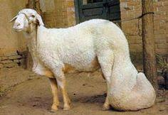
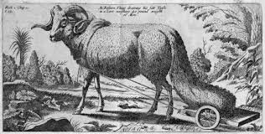
i. Long-tailed sheep breed
a. Long thin-tailed
These breeds are common in Europe, Australia & New Zealand, East & South Africa. E.g. Merinos and Rambouillet.
They have generally fine wool & are mainly kept for wool prodn.
b. Long thick-tailed
They have coarse wool or hair coat cover. e.g. Desert Sudanese sheep.
They are said to have been descended from crossing the:-
Fat tailed (tropical) x Long thin-tailed (temperate) sheep.

Slide 7
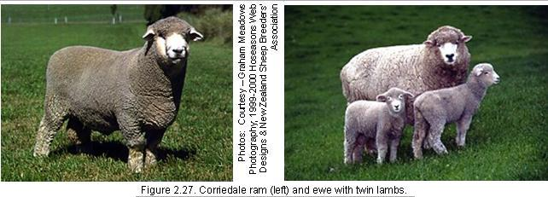
ii. Short-tailed sheep
They are found in northern Europe and Central Asia.
They are mainly of coarse wool producing breed
except the small rain forest sheep that are found in the humid tropics of Africa with hairy coat cover.

Slide 8
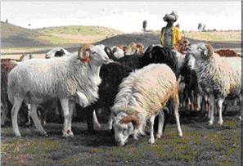
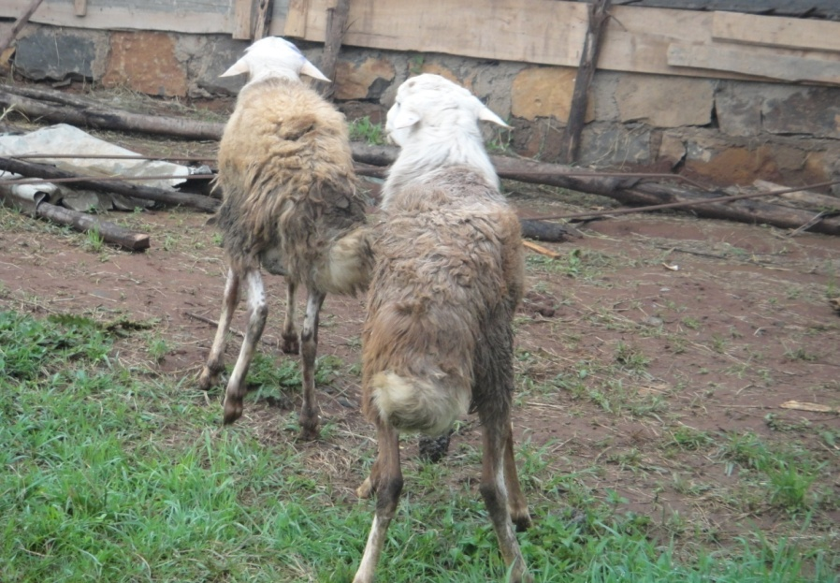
iii. Fat-tailed sheep
Found in west Asia, north and east Africa. e.g. Menz, washera & Arsi-Bale sheep of Ethiopia.
The tail serves as a storage site for excess fat which endures the sheep to withstand long periods of semi-starvation.

Slide 9
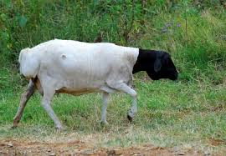
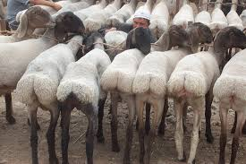
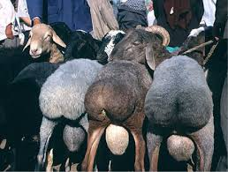
iv. Fat-rumped sheep
In Africa these sheep breed predominate in Somali
they have spread up to south, east & Horn of Africa.

Slide 10
2. Coat Cover
Based on coat cover, domestic sheep can be classified into 3 main groups as wool, hair & fur sheep.
i. Wool sheep
This sheep breed may be further classified into 2 groups.
Fine wool sheep
They yield fine wool for clothing purposes, like sweaters & overcoats.
They are mainly the long thin-tailed sheep of temperate breeds.
Coarse wool sheep
This sheep breed yield coarse wool for carpet/mat making and
are mainly the fat-tailed or fat-rumped tropical sheep breeds.

Slide 11
ii. Hair sheep
They primarily found in the tropics.
The coat cover has almost no commercial value,
but the skin of this has greater value than the wool sheep breed because the skin is thicker.
iii. Fur sheep
Matured sheep of this breed produce coarse wool for carpet or mat making
but they are known for the pelt of the new borne lambs for making overcoats and head wearings/huts.
E.g. Karakul sheep of Ukraine.

Slide 12
3. Function/Primary use
Based on their function sheep can be classified as mutton, wool, fur and milk/dairy types.
Use
Mutton
II. Wool sheep
III. Fur sheep
IIV. Dairy sheep

Slide 13
7.2.2 Methods of Classification of Goat Breeds
Goat breeds are classified according to origin, ear shape and length, function, body size/weight and height at withers.
1. Origin
Based on origin goats may be considered as European, oriental (Asiatic) or African origin.
But classification based on origin may not be exact criterion, because some breeds may be found in different areas due to movement of goats between territories.
There is still some uncertainty in identifying the wild ancestors of goats whether they belong to Asia, Europe or Africa.
This problem limits classification of goats based on the origin.

Slide 14
2. Ear shape and length
This method is less applicable because there is little variation in ear shape and length among the different breeds.
This method should be combined at least with their origin.
3. Function
Goats have been classified in terms of their major functions as meat, milk/dairy and skin or fibre.
But goats in the tropics have not been adequately bred for specific purposes to identify them in terms of their function.
Hence, classification based on function can only apply to some breeds because the majorities are all-purpose (multi-purpose) animals.

Slide 15
4. Body size/weight
It is the most widely used method.
But it requires complete body weight data for individual breeds.
5. Height at withers
Based on height at wither, (of course together with BW & function), goats can be divided into 3 major groups
i. Large breeds
goats measuring over 65 cm at wither & weighing 20-65 kg.
They are dual purpose (meat and milk) goats
ii. Small breeds
Height at wither measures between 51 & 65 cm and
weight 19 - 37 kg.
They are either meat or milk type in function
iii. Dwarf goats
Goats having wither height of < 50 cm and
weight ranging from 18-25 kg are grouped under dwarf goat types.
They are meat type goats.

Slide 16
7.3. Ethiopian Sheep and Goat Breeds and their Characteristics
7.3.1. Sheep breeds/types

Slide 17
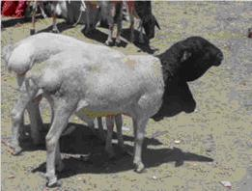
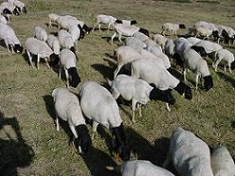
I. Black head Somali sheep
The Blackhead Somali is indigenous to the Ogaden area of the Somali Region.
The breed is also known by various names in eastern Africa and other countries including:-
Blackhead Persian
Blackhead Ogaden sheep.
The Blackhead Somali is distinguished by the black color of the head.
The body is predominantly white but other colors may be observed.
The hair is short, stiff and shiny.

Slide 18
Both rams and ewes are hornless, though males can sometimes have rudimentary horns.
The ears are short and pointed with an outward-forward inclination.
The tail is a fat rump type with a very distinct fat depot having a thin tip sticking straight backward and sometimes hanging down.
The adult weight of Blackhead Somali ewes is between 30 & 35 kg.
It well adapted to the dry, drought-prone environments of the Somali and southern tip of Oromia regions.
Hence they are kept mainly by nomadic people.
This sheep is known mainly for meat and skin Production.

Slide 19
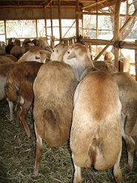
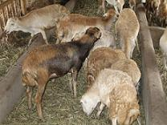
II. Afar sheep/Adal sheep/fat-tailed sheep
It is a small-sized breed with mature weight ranging 30–35 kg.
The natural habitat of the breed is the Middle Awash Valley in eastern Ethiopia, extending as far as Dire Dawa in the east and the town of Bati in the north.
The Afar sheep are hardy and tolerate periods of drought relatively well as the breed evolved under harsh environmental conditions.

Slide 20
Therefore, it is mainly kept by nomadic people.
Hair is short and coarse, the predominant color being solid blond with other colors ranging from shaded white to light brown.
The average observed wither height for adult rams is 66 cm
while that for adult ewes is 61 cm.
Afar sheep weigh about 2.5kg, 13kg and 25.8 kg at birth, weaning (90 days), and one year of age, respectively.
Ewe mature weight is about 31.6 kg.
Twin births are not common.
The breed is known for the production of high quality meat

Slide 21
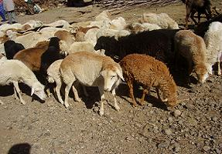
III. Menz sheep
The natural habitat of Menz sheep is North Shoa and parts of Wollo Zone of the Amhara Region.
Menz sheep are the most prominent coarse wool bearing sheep in Ethiopia.
The body is compact and mostly covered with coarse hair with a wooly undercoat.

Slide 22
The people in the area use the coarse wool to make a cloak, locally called “Bernos,” and rugs.
The coat color is black or dark brown, perhaps with white spots on the head, neck and legs.
Other colors such as light brown, roan and white also exist.
The head has a straight profile and is free of any wool cover.
Rams mostly have twisted horns while ewes are usually hornless.
Menz sheep have small ears with a downward-forward inclination.

Slide 23
The tail is short and fat and has a broad base, ending halfway to the hocks with a slight twist at the end.
Menz sheep are not known to be a docile breed.
The mean height at the shoulders is 64 cm and 58 cm for adult rams and ewes, respectively.
Menz sheep weigh about 2.3, 11 & 26–30 kg at birth, weaning (90 days) and one year of age, respectively.
Ewe mature weight is estimated to be about 35 kg.
Twin births are common, sometimes up to 60%.

Slide 24
It is fat-tailed type sheep distributed throughout the Menz and Selale areas of Shewa.
It is adapted to mixed farming systems.
It is probably the local sheep known for wool production.
Shearing is done twice a year with a yield of 1-1.6 kg coarse wool.
The wool is used for different woolen article making.
This sheep type is also kept for meat production.

Slide 25
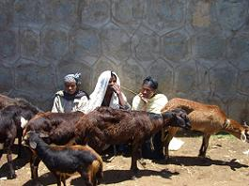
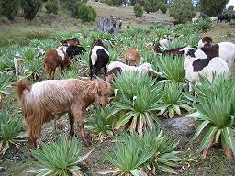
IV. Arsi-Bale sheep
Arsi-Bale sheep are fat-tailed and covered with coarse wool.
They are widely distributed in the highlands of eastern and south-central Ethiopia, in Arsi, Bale, Hararghe and East Shoa zones of Oromia Region and in many parts of the southern region.
The production systems range from agro-pastoral to agricultural and urban.

Slide 26
They are raised mainly in mixed farming systems for meat and skin production.
Arsi-Bale lambs weigh 2.7 kg and 14.2 kg at birth and at 120 days (weaning), respectively.
Males are usually horned
but females are either polled or may have rudimentary horns.
Hair color varies from dark brown to grey, with white spots.

Slide 27
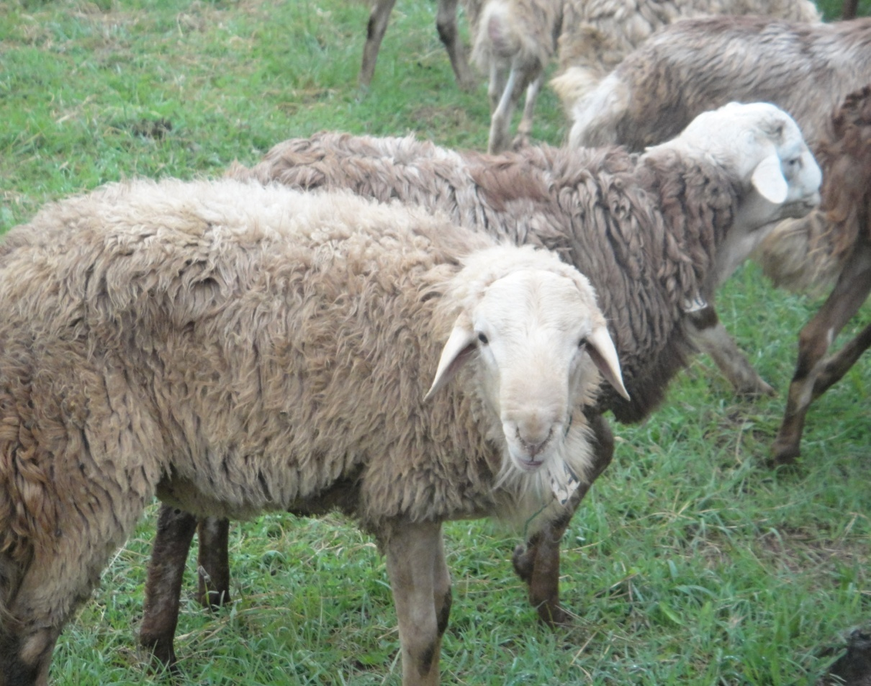
V. Washera (Dangla) sheep
The Washera (Dangla) sheep is found predominantly in West and East Gojam zones of the Amhara Region extending to the south of Lake Tana.
Washera sheep weigh about 2.8, 13.8 and 22.7 kg at birth, weaning and six months of age, respectively.

Slide 28
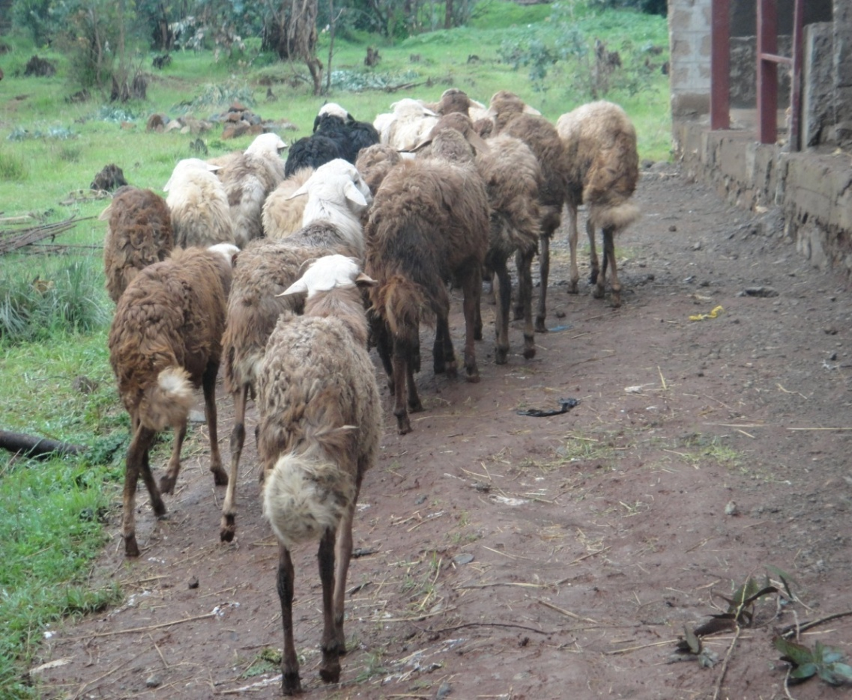
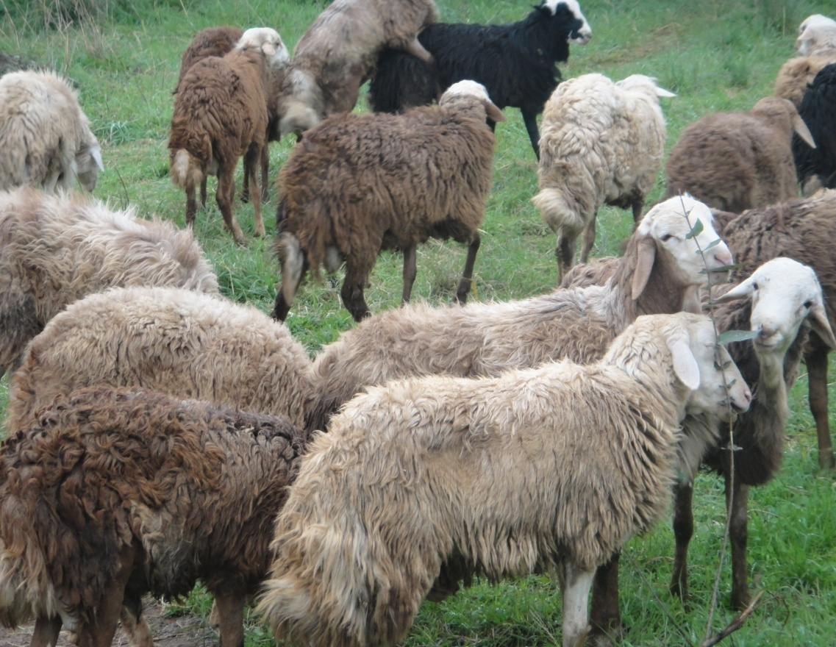
The growth rate after weaning is comparable & even better than some other indigenous breeds.
This indicates the potential of this breed for commercial mutton production for the local & export markets.
Washera sheep have high twinning rates.

Slide 29
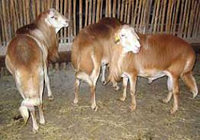
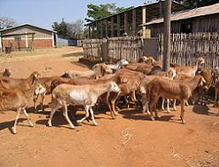
VI. Horro sheep
The good merit of Horo breeds relative to other Ethiopian breeds is
its relative larger size and
it’s prolifically (number of lambs born twining).
a high potential for meat production.

Slide 30
The natural habitat is western & southwestern parts of the country.
The predominant color of Horro sheep is a solid tan (light brown).
It widely distributed in areas covering western Shoa to East and West Wollega, Illubabor and Jimma zones of Oromia Region.
Other colors observed are creamy white, dark brown & sometimes black & spotted.

Slide 31
The body is covered with short, shiny hair.
Both rams and ewes are hornless.
Horro sheep have a relatively long neck without a dewlap
but most have fat deposits below the lower jaw and in the brisket.
Horro sheep are larger than most other indigenous sheep having a mean height of 73 cm and 68 cm at the shoulders for adult rams and ewes, respectively.

Slide 32
Horro sheep weigh 2.8–2.9 kg, 13–15 kg and 25–33.5 kg at birth, weaning (90 days), and one year of age, respectively.
Ewe mature weight is about 38.2 kg.
Twin births are common, sometimes reaching 60% in older (multiparous) ewes.
Hence meat and skin productions are the main purposes of keeping.

Slide 33
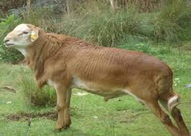
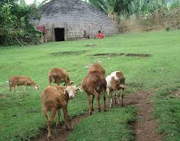
Bonga
Bonga breed the coat color is dominated by red brown and the tail is wide and long with straight pointed end and twisted end.
Both male and female are polled; the ear is long, the hair is short and smooth.
The breed is judged as good for traits like growth rate, meat quality, fattening potential, twining rate and temperament.

Slide 34
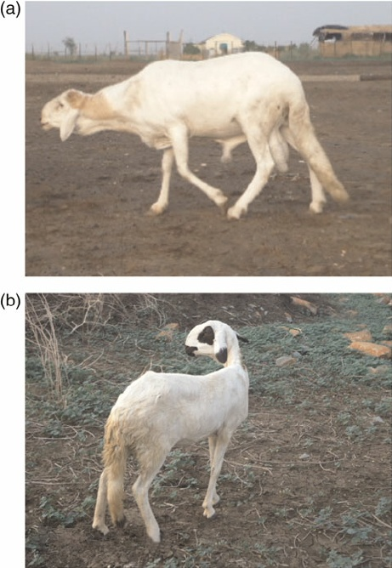
Begait
Begait sheep breed is described as long and thin tailed with muscular body, short and smooth hair and polled for both male and female sexes.
The overall mean body weight and body length of female Begait sheep were 31.4 ± 0.4 kg and 62.5 ± 0.5 cm, respectively.
The corresponding values for male Begait sheep were 34.5 ± 0.5 kg and 66.1 ± 0.5 cm, respectively.

Slide 35
Exotic Sheep Breeds Introduced to Ethiopia
There are many types of sheep in the world kept for a variety of purposes.
Some of these breeds have been imported into Ethiopia at some time in the past in an attempt to improve meat and fiber production of the indigenous breeds, particularly the Menz sheep.
Exotic sheep breeds introduced for their wool & mutton production are Awassi, Hampshire, Blue-de-main, Merino, Romney, Corriedale and Dorper.
Crossbreeding of the Menz breed with the five exotic breeds, namely: Awassi, Hampshire, Bleu-de-Main, Romney and Dorper are being used for development and research activities.

Slide 36
˟
Menz
Awassi

Slide 37
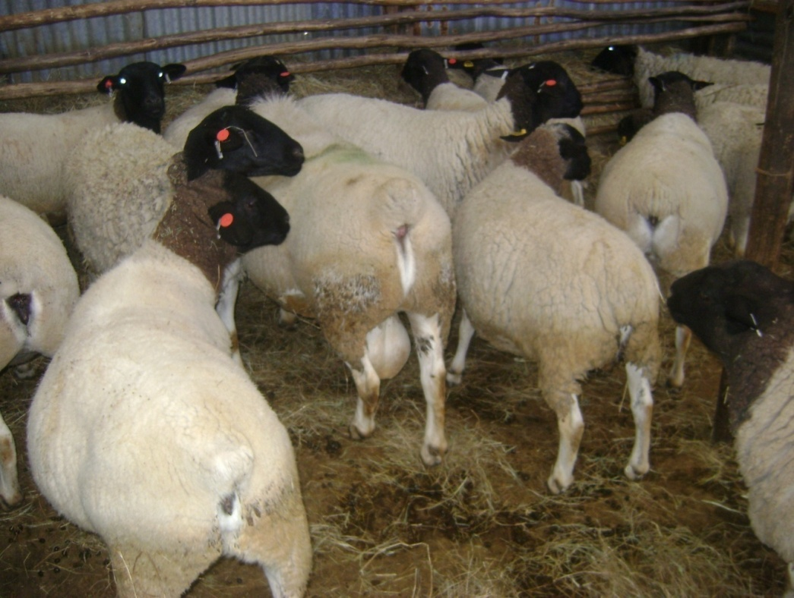
˟
Menz
Dorper

Slide 38
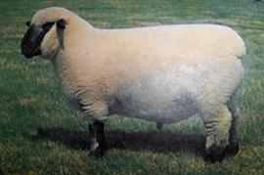
˟
Menz
Hampshire

Slide 39
Attributes of Sheep
Advantages sheep production over the production of other animals.
Sheep has several advantages over cattle in the grazing of poor, naturally occurring non-tillable grazing lands.
Short generation cycles and high reproductive rates which lead to high production efficiency
Marketable at 5 to 6 months of age.
Every year they provide wool and lamb.
Adapted to wider climatic condition areas, where crops cannot be produced.
Require less capital and less complicated management knowhow i.e. their production is easily manageable by women and children.
Sheep are small enough to be consumed by an average rural family in a day or two hence no refrigeration facilities are needed.

Slide 40
6.2.2. Goat Types and Breeds in Ethiopia
There are over 200 breeds of goats in the words.
Ethiopian goats are grouped into four families. These are:
Nubian family- the Nubian goats and Barka (Begayit) goats
Rift valley family- Abergelle, Afar, Arsi-Bale & Woyto-Guji goats
Somali family- Short eared Somali, Long eared Somali & Hararghe highland goats
Small East African family- Western highland, western lowland, central highland and Keffa goats.
Some of the most important goat breeds and their characteristics are presented below.

Slide 42
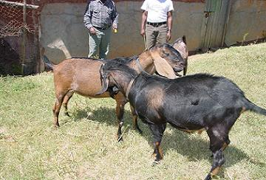
Nubian breed: - They originated in the Middle East (Iraq, Syria and Israel) and moved through Egypt to Sudan.
In Ethiopia, they distributed in North Gondar.
The mg’t systems for Nubian breed are predominantly pastoral.
They also kept mainly for milk and meat production.

Slide 43
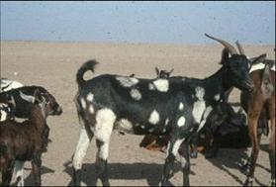
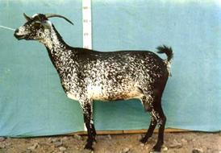
2. Afar (Adal, Dunakil) breed
They are the descendent of the rift valley goat thought to have entered to Ethiopia from Yemen and Saudi Arabia.
They are distributed in arid and semiarid agro-climatic zones.
Free grazing on rangeland areas is the dominant feeding system.
They adapted to arid environments, infrequent watering (every 3-4 days) and traveling long distance.
Afar goats are extensively milked for food, medicine and sale.

Slide 44
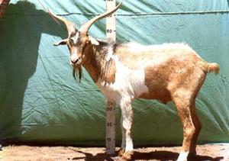
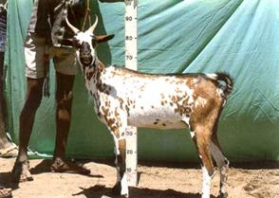
3. Abergelle breed
It is the descendent of the rift valley goat type from southwest Asia.
They are distributed along the Tekeze River in Southern Tigray, northern Wollo and eastern Gondar.
They have good potential in providing milk.

Slide 45
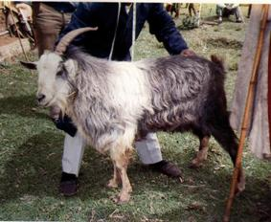
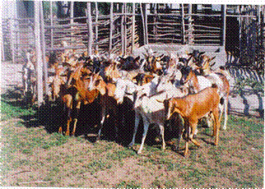
4. Arsi-Bale breed
They are part of the Rift valley origin.
They are distributed in Arsi and Bale up to an altitude of 4000m.
They prefer Woyna dega and Dega agro-climatic zone.
They are often hairy. They are extensively milked.
Their meat is widely eaten.
They are prolific than other goat types in the region.

Slide 46
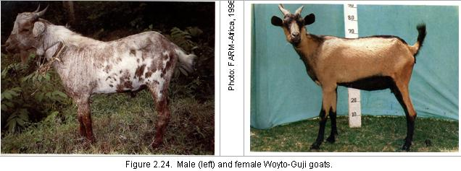
5. Woyto-Guji breed
Origin: - derived from the rift valley family of goats.
Distribution: - in N & S. Omo, S. Sidamo and parts of Wolayta.
Ecological zone: - kola and Woyna dega.
The breed is an important milk producer in pastoral areas.

Slide 47
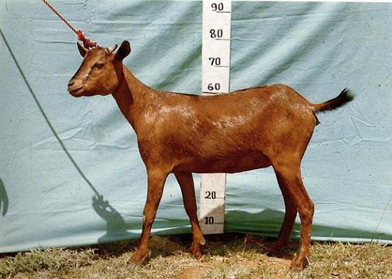
6. Hararghe Highland breed
Origins: -most likely derived from the Somali goat type
Distribution: - In the highlands of E & W. Hararghe.
Ecological zone: - moist Woyna dega and moist kola.
Commonly they are milked for home consumption.
Here goat meat is widely eaten and preferred to sheep meat.

Slide 48
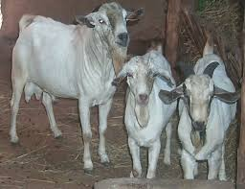
7. Short-eared Somali breed
Origins: - They were introduced from Arabia.
Distribution: - N & E. parts of Ogaden and Dire Dawa.
Agro climatic zones: - Dry kola
They are widely milked and
they have social function as prestige.

Slide 49
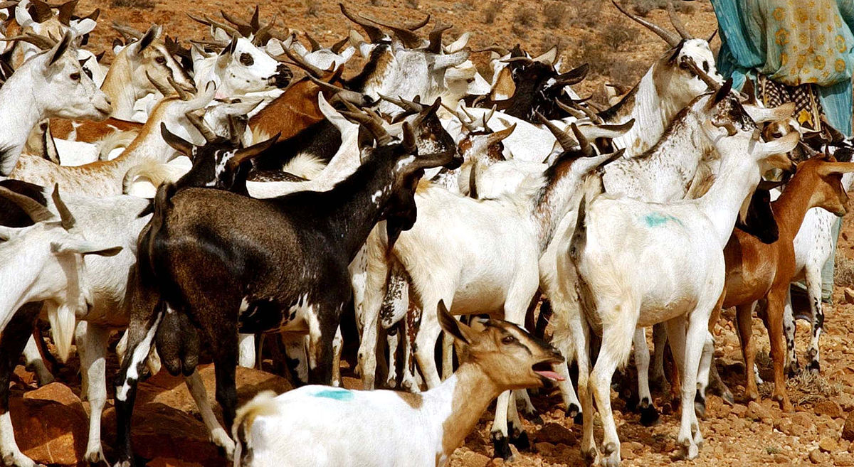
8. Long-eared Somali breed
Origins: - They were introduced from Arabia
Distribution- Ogaden, low lands of Bale, Borana & southern sidamo
Agroclimatic: - Arid and dry kolla
They are extensively milked by the Somali & Borena pastoralists.

Slide 50
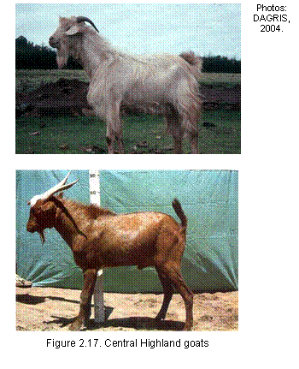
9. Central Highland
Origins: -derived from mixing of different types in the past.
Distribution- central high lands west of rift valley.
Agro climatic: - dega and Woyna dega
Goats are extensively milked in Tigray.
It is believed to have medicinal value

Slide 51
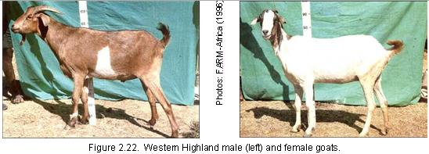
10. Western Highland
Origin: - from past mixing types
Distribution: - Highlands of S. Gondar, Gojjam, Wollega and Western Shoa
Agroclimatic: -Woyna dega and dega
There is a cultural taboo against goat milk in parts of Gojjam.

Slide 52
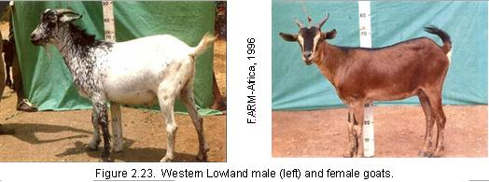
11. Western low land
Origin: -from past mixing types
Distribution: -Western lowlands bordering Sudan in Gojjam, Wollega and Illubabor.

Slide 53
Exotic goat breeds introduced to Ethiopia
The aim of introducing exotic goat breeds was to improve milk production of the local goat breeds.
Anglo-Nubian & Toggenberg are exotic goat breeds that were introduced by FARM-Africa and higher learning institutions.
Thus, crossbreeds between Anglo-Nubian x Hararghe Highland
Anglo-Nubian x Somali are being used for milk production by smallholders in central, eastern, southeastern & southern parts of the country.

Slide 54
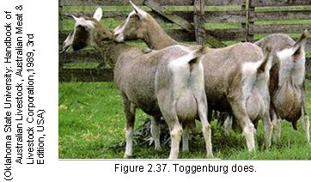
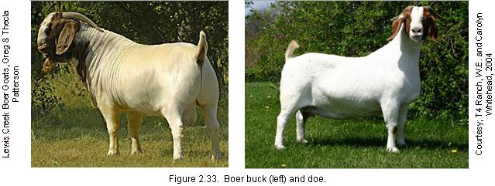
Toggenberg and their crosses with Hararghe Highland are used for research purposes at the Haremaya and Hawasa Universities.
Very recently, Boer goat semen has been imported from the United States of America for crossbreeding studies at the two Universities to improve meat production of local goats.

Slide 55
Economic Importance of Goats
In pastoralist areas, goats are considered very important for households to meet routine cash income needs.
They are considered as the most important means of wealth storage for pastoralists.
They contribute a lot as a source of meat, milk and skin.

Slide 56
Advantage of goats over large ruminants
Requirement of low initial investment.
Keeping goats is not risky (little purchasing power).
Quick maturing with high fertility rate.
They have short generation interval.
Their ease manageability by family labor.
Their ability to adapt a variety of environment.
Goats consume wide varieties of feeds and vegetation than either sheep or cattle.

Slide 57
Easy way of income generation.
Easier for home consumption.
Low cost of feeding, health and management.
Goats are more effective at browsing selectively
The efficiency of converting feed into milk is higher in goats than in other dairy animals

Slide 58
Thank You!

Slide 59
Chapter 7 Camel production

Slide 60
Taxonomic classification
Camels belong to:
Phylum-------Choredata
Class ---------Mammalia
Order --------Artiodactyla
Sub-order --Tylopoda
Family -------Camelidae
Genus ------- Camelus
--------Lama

Slide 61
Genus Camelus:-are old world camels
-are true camels
-are humped
-has two species
Camelus dromedaries
Camelus bactrianus
Genus Lama:- are new world camels
are humpless
has four species
Lama glama (Llama)
Lama pacos (alpaca)
Lama guanicoe (Guanaco)
Lama vicugna (vicuna)

Slide 62
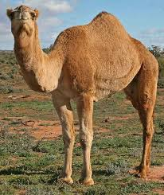
C.dromedaries
C.bacterianus

Slide 63
Llamas
Alpacas

Slide 64
Guanaco
Vicuna

Slide 65
Camelus dromedaries
are Arabian camels with single hump
Lives in hot desert areas
are highly intelligent and easy to train
Larger than Bactrian (long limbs)
Shorter hair coat
Lean tissue and broad feet

Slide 66
Camelus bactrianus
Two humped camels
able to live in snow covered mountain areas
have wooly coat cover and reddish-brown color
Short limbs and fatty tissue

Slide 67
There are around 18.9 million camels alive with 95% being dromedaries
15.4 million (82%) found in the African Continent
Somalia 6.2 -7 million
Sudan 3.2 -3.5 million
Ethiopia 1.4 -2.3 million
Mauritania 1.3 million
Kenya 0.8 - 1 million

Slide 68
Genus Lama:- are new world, South American camels
Llama and Alpacas are domesticated
Guanaco and Vicuna are wild type
They are generally referred to as special ruminants or occasionally as pseudoruminants because of their ruminating habits
Camels do not belong to the same suborder as the other major meat and milk producing domestic herbivores

Slide 69
Camel prefers most of the time to browse top of bushes and trees rather than graze because of its flexible long neck, long legs and cleft upper lip.
In contrast to other ruminants, camel is hornless and has no gall bladder
It has unique ability to walk through long stretches of desert and hence called ‘the ship of desert’
Dentition differs from other ruminants in that there is a pair of well-developed and pointed canine teeth in each jaw
There are long conical papillae on inside of cheeks directed backwards, thus the camel can browse at the thorny plants without any harm.

Slide 70
The camel is a hardy animal, comparatively eats less, goes into so called sleep for short intervals and possesses a long lasting memory.
It is said that it remembers any extraordinary harsh treatment given to it such as heavy beating by its caretaker or the rider and is said to take revenge at an appropriate time.
It has almost no competition for feed with other animals

Slide 71
The importance of camels
symbol of human survival in the desert is tied to the history of the major nomadic civilizations of the hot dry areas
The camel embodies one of the essential elements of the culture and agriculture of these regions
the ideal domestic animal in deserts with long, drier; hot periods of eight months or more and scarce, erratic annual rainfalls between 50 and 550 mm
It is used as a beast of burden for transporting goods and people as well as for providing milk. Milk is often the only regular food source for its owners.

Slide 72
The camel's meat, wool and leather are also widely utilized.
In some parts of East Africa, the animal is bled regularly and its blood consumed fresh or mixed with milk.
The camel is universally highly valued and provides social standing for its owner.
It can flourish where no other domestic animal can survive. This exceptional ability is the result of several anatomical, behavoiral and physiological characteristics

Slide 73
Adaptations of Camels
Adaptations are special characteristics that an organism is born with or developed and which enable it to survive in its natural habitat.
Adaptation of animal to its environment in general is used often for the process of adjustment to the environmental changes.
Adaptations of the camel to the desert environment encompass anatomical, behavioral and physiological changes.

Slide 74
All the desert species have fluctuating body temperature, decline in metabolism and utilization of intestinal water.
The camel, however is able to utilize these mechanisms more effectively when
exposed to direct rays of the sun and
Stayed extremely long periods without drinking water

Slide 75
The desert environment is characterized by (problems desert animals facing)
lack of food and water ( starvation )
sandy or stony ground
thorny plants or trees
hot and windy climate and
presence of natural enemies

Slide 76
Anatomical Adaptations
Head and neck
small head without horns and small bluntly erected ears: to hear the minimal sound vibration and hear for long distance in the desert
Small hairs in ears: to filter the air entered the ears in sandy environment
large and prominent eyes; enable the camel to see in different directions and for long distances

Slide 77
long slit nostrils having wing, so the camel is the only animal that can close its nostril as protection against sand and winds.
Split & hairy, extensible & slightly prehensile and very sensitive upper lip: This modification helps the camel to select its food and avoids thorny plants.
Long arched neck: helping it to manipulate the high tree plants and to explore the enemy from long distances.

Slide 78
Hump: Most of the fatty tissues of camel are stored in the hump than being diffused throughout the body.
The hump acts as food (fat) storage which will be converted to energy and water in case of starvation in the desert.
Skin of camel is attached rather tightly to the underlying tissues and has short fine hairs (Weber) which help in thermoregulation

Slide 79
Long, strong and slender legs, which help to carry heavy loads over long distance and keep its body further away from the hot sand.
More than 65% of the camel’s total weight is supported by the front limbs.
The legs have thick leathery patches on knees which protect it getting burn when it kneels on the hot desert sand.
Broad, flat, leathery pad feet: helps to walk over sandy soils.

Slide 80
Behavioral adaptation
Under conditions of dehydration and intense heat the camel adopts behavioral mechanisms to conserve energy.
The camel squat in the early morning before the ground has warmed up. So that it releases body heat to the ground by conduction.
The camel orientates itself towards the sun; presenting the least possible body area for the absorption of radiant heat.
Any heat absorbed from the ground or the sun would have to be dissipated later in the day.

Slide 81
A group of animals may lie down together, thus presenting an even smaller target area for heat accumulation.
Ingestive behavior; Camels are selective feeders not only with regard to plants but also in respect of the parts of the plants they eat.

Slide 82
Physiological adaptation
Physiological adaptation defined by biologists as the physiological processes involved in adjustments by the individual to climatic changes and changes in food quality, etc.
The requirements for survival in hot arid areas are very important.
Temperature must be maintained and water must be conserved.
The camel losses body heat by sweating more efficiently than other mammals

Slide 83
Thermoregulation
The camel can withstand changes in its internal body temperature that would cause most other mammals to die.
In hot weather, the camel’s body temperature may rise to 42°C (107.6°F). In cold weather, the camel’s body temperature may lower to 34°C (93°F).
In comparison, most mammals, including humans, must maintain their body temperature generally constant at about 37°C (98.6°F).
During the day, the camel's body acts as a heat absorber, and during the cool night of the desert, excess body heat is dissipated by conduction.

Slide 84
Camels do not pant and they perspire very little.
Humans start to sweat when the outside temperature rises above the normal body temperature of 37°C, but the camel has a unique body thermostat.
It can raise its body temperature tolerance level as much as 6°C before perspiring, thereby conserving body fluids and avoiding unnecessary water loss

Slide 85
Energy balance
The camel is able to save considerable amounts of energy by allowing its body temperature to rise during the day, thus absorbing heat that would be dissipated by some form of cooling.
the rises in temperature indicate a sophisticated control mechanism rather than poor regulation.

Slide 86
Water balance
Water is essential to life and the camel has often to survive on limited quantities for long periods of time.
Their bodies do not contain a reserve of water in the stomach or hump as was once commonly believed.
Unlike other mammals, however, the camel can survive as long as 3 weeks without drinking, depending on the water content of its food.
It can survive a water loss of about 40 percent of its normal body weight. In comparison, a loss of 15 percent is usually fatal for humans.

Slide 87
Camels can go without water due to several unique adaptations to their environment.
The camel conserves more water in its body than any other mammal.
The camel loses less water through perspiration and through evaporation of water from the lungs than do most other mammals.
It excretes very little water in its urine and dung.

Slide 88
The structure and function of the kidney have extreme importance in water conservation; the long loops of Henle in the medulla have the function of urine concentration.
The kidney controls water loss in two ways: either by the absolute concentration achieved or by reduction in flow of urine.
The urine can become as thick as syrup and have twice the salt content of sea water.

Slide 89
A reduction in urine flow is also achieved by reducing the glomelular filtration rate.
Concentration of urine not only serves to conserve water but allow camels to drink water even more concentrated than sea water and to eat very salty plant that would otherwise be poisonous .
In addition, the camel’s blood remains fluid when the animal becomes dehydrated because water lost from the blood is replaced by water from other tissues.

Slide 90
This prevents heart failure due to thickening of the blood, which occurs in other mammals suffering extreme dehydration.
Finally, when water becomes available a dehydrated camel is able to consume as much as 57 liters (15 gallons) at once. This allows the camel to restore its body fluids quickly.
The hump is mainly comprised of fat and thus the metabolic water content is high, complete oxidation of fat in the hump results water (20 kg of fat, would release a total of just over 21 kg of water).

Slide 91
Milk and milk quality
Young camels can derive their nutritional and water requirements entirely from milk in times of water restriction.
When lactating camels were subjected to chronic dehydration, milk secretion was not affected.
Camel’s milk contains an average of 70 kal/ 100g milk. It is calculated that 3 - 4 kg of milk would cover the daily caloric requirements of an adult man as 1.8 kg milk would covered a man’s daily protein requirements.
therefore camel milk is an ideal source of nutrition for man in the desert and is often the only source .

Slide 92
Camel milk normally has a sweet sharp taste but sometimes it tastes salty.
The taste is affected by the nutritional and environmental factors.
The camel secretes highly diluted milk with a low fat content whereas, the cow, ewe and goat all secretes concentrated milk when drinking water is scarce.
Chronically dehydrated camels (drinking water for only 1 hr once a week) secrete milk with over 90% water and with only 1% fat; this is super adaptation for a desert environment (normal milk contains 84% water and 4.5% fat).

Slide 93
The physiological explanation of this phenomenon is as lactation is a water losing process for the mother, the hormone ADH and aldosterone are secreted in addition to milk secreting hormones (prolactin and oxytocin).
Oxytocin and prolactin have an antidiuretic (urine concentration) effect while aldosterone and ADH act on the intestines to absorb water and ADH cause the secretion of water into the milk.

Slide 94
See You Next!

