Slide 1
Chapter 4. Dairy Cattle Production
Outline
4.1. Dairy Production Systems in Ethiopia
4.2. Breeds of dairy cattle
4.2.1. Indigenous dairy cattle breeds
4.2.1. Exotic dairy cattle breeds
4.3. Milk and milk products utilization pattern

Slide 2
Objectives
Identify dairy cattle production systems in Ethiopia
Describe the different dairy cattle breeds
Discuss on milk production and utilization patterns

Slide 3
Dairy?
Dairy Cattle?
Dairy – is a farm that produces milk and milk products
Dairy cattle: cattle that is raised primarily to produce milk

Slide 4
4.1. Dairy Production Systems in Ethiopia
Ethiopia holds large potential for dairy development.
Country has diverse topographic & climatic conditions favorable for dairying.
Moreover, rainfall in most of the country is adequate for crop & pasture production.
The favorable climate throughout the country supports use of improved, high-yielding animal breeds and offers a relatively disease-free environment for livestock development.

Slide 5
It is raised in all of the farming systems by pastoralists, agro-pastoralists & crop-livestock farmers.
Ethiopian milk production systems can be broadly categorized based on
  location
  market orientation, scale, and
  production intensity
Accordingly, 5 dairy production systems are distinguished

Slide 6
1. Pastoralism
livestock owners who exploit natural grass lands mainly in the arid areas
Pastoralists are with their herds always and move continually looking for fresh grazing areas.
Nomads have no permanent home while transhumant herders have permanent homes in less arid areas.
The main source of food for pastoralists is milk
the herd is dominated with unimproved Zebu animals
milk production is of subsistent type

Slide 7
2. Agro-pastoralism
Agro-pastoralists are sedentary farmers who grow food crops and also keep livestock.
Their livestock graze on common land, fallow lands and cropland after they harvest.
Livestock are used for drought savings and milk production.
Shifting cultivation is a common practice.
the herd is dominated with unimproved Zebu animals
milk production is of subsistent type

Slide 8
  3. Mixed farming
Food or cash crop cultivation is the main agricultural activity.
Farm size is normally small 1-5 ha, with a moderate to high cropping intensity.
maintenance of soil fertility is one of the main problems of livestock
livestock are kept for consuming of crop residues, improving soil fertility and providing additional food or income from milk or meat
the herd is dominated with unimproved Zebu animals
milk production is of subsistent type

Slide 9
4. Urban and Per-Urban Milk Production
This system occurs around cities, where demand for milk is high.
The main source of feed are
  agro-industrial by- products (e.g. brewery waste & oilseed cake),
  cultivated fodder crops and
  crop residues
The system comprise small & medium size dairy farms located mainly in the high lands of Ethiopia.
Milk is often sold directly to consumers in the city and is the main source of income for the farmers .
the herd is dominated with improved crossbred and high-grade dairy cattle

Slide 10
5. Intensive dairy farming
It is a more specialized dairy farming practiced by state sector and very few individuals on commercial bases.
Most of the intensive dairy farms are concentrated in & around Addis Ababa and are basically based on exotic purebred stock.
This system produces about 2% of the total milk production of the country. milk is the main source of farm income
it is mainly undertaken by small farmers using family labor,
but commercial farmers using hired labor
the herd is dominated with improved crossbred dairy cattle
the production system is market oriented and milk production is for sale (surplus production)

Slide 11
4.2. Breeds of Dairy Cattle
Dairy farming has been part of agriculture for thousands of years, but usually done on a small scale on mixed farms.
There was little distinction between dairy and beef cattle, with the same stock often being used for both meat & milk production.
Today, dairy cows are specialized and most have been bred to produce large volumes of milk, with little or no regard for their production of meat.
Dairy cattle are breeds of cattle raised for their ability to produce large quantities of milk

Slide 12
Most of the cattle breed in the tropics are evolved through natural selection
Most indigenous cattle breeds in the tropics are multipurpose (milk, meat, draught) and that only a few breeds have good milk potential.
4.2.1 Indigenous Dairy Cattle Breeds
The maintenance of farm animal genetic diversity is of crucial importance
  to food production,
  food security and
  the sustainability of farming systems.

Slide 13
Indigenous livestock breeds are important because,
  they are adapted to local conditions and farming systems
  tolerate seasonal variations in climate & forage supply, and
  resist local diseases and parasites.
Indigenous livestock breeds provide an invaluable reservoir of genetic variation and breeding potential for adaptation to changing climatic and farming conditions

Slide 14
No interference has been made by man except few attempts tried in few research sites.
They are not well characterized.
Thus, they are called with references to the place where they dominate. Example:
Begait (dominating northern part of the country around Tigray),
Boran (Dominating southern part of the country around Borena),
Fogera (Northern part of the country around Fogera).
In general, indigenous cattle are multipurpose in their function. i.e. meat, milk and draft.

Slide 15
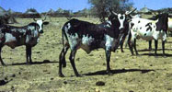
  1. Begait/Barca
  Found in Tigray and west Eritrea.
  It is a tall animal with long legs
  The coat color is variable but black pied is common.
  Hump is very large in male and often falls to one side.
  The head is small and short.
  The cattle have good milk yield and
  They can be genetically improved for milk production.

Slide 16
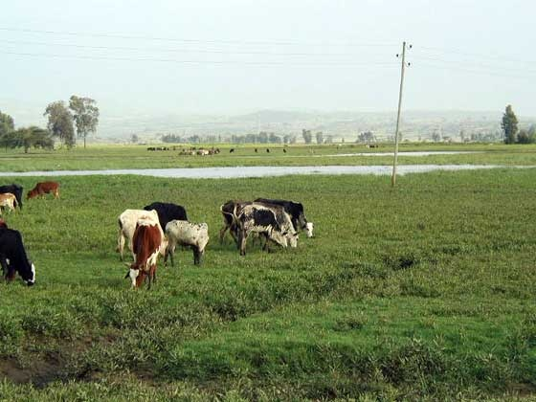
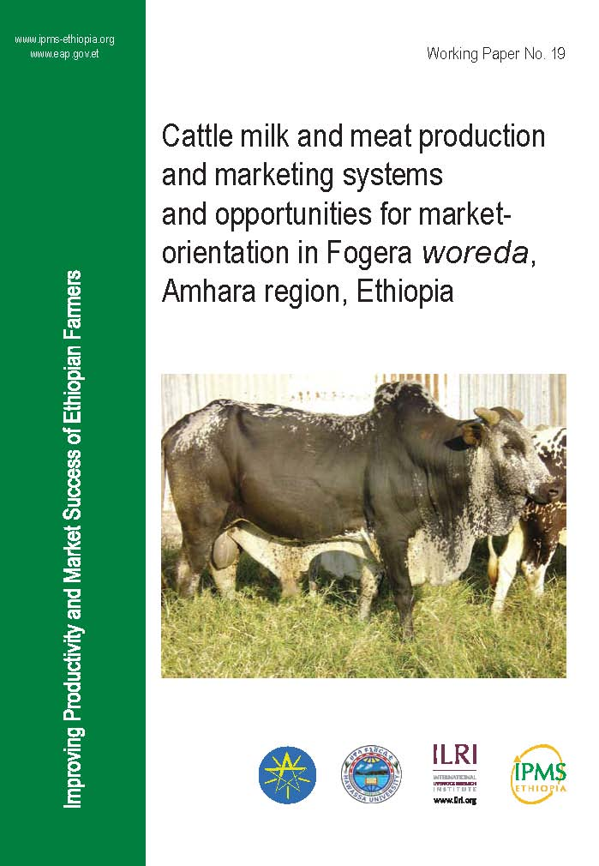
2. Fogera
Found around Lake Tana in Gondar and Gojam.
are large sized being tall animal with long leg.
have black & white or black & gray coat.
Muzzle & hoofs are almost always black.
The horns and hump are very small and the animal is docile.
Currently are used as meat, milk and draught animals;
potentially they are good in milk production and
can be improved genetically for the trait

Slide 17
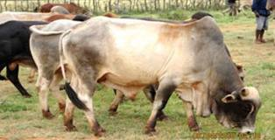
3.Borana
originated from Borana area of south Ethiopia.
At present these breeds are found in Somalia and Kenya.
They are fairly large and long-legged animals with good body conformation.
They are whitish-grey in color;
the male has black color on their hump
The hump is very well developed in the male and smaller in females.

Slide 18
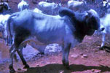
3.Borana cont.…
Horns are usually small, thick at the base, pointed and directed forward.
Have huge body conformation and thick skin,
drought and pest resistant and ability to travel long distance.

Slide 19
3.Borana cont.…
Utility: the breed is used by semi-nomadic people primarily for milk and
  if selected for milk Borana cows are moderately good milker.
  Currently, the breed is used for milk production especially in crossbreeding programs.

Slide 20
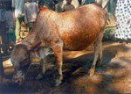
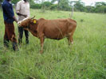
4. Sheko breed
  Found in south western Ethiopian,
  Short horned or polled
  hump less/very small humps
  Known with resistant to trypanosomiasis
  have well shaped udder and
  are kept mainly for their milk.

Slide 21
4.2.2. Exotic Dairy Cattle Breeds
Most temperate breeds are artificially selected for productive traits and
they are improved breeds for either beef or dairy production
Major exotic breeds of dairy cattle include
Holstein Friesian (HF)
  originated in Holland.
  Characterized by its color (shiny black &white),
  large size and exceptional milk production.
  A mature cow annually produces an average of 8000 kg
    of 3.7% butterfat,
    3.2% protein milk.
  mature cow weigh, up to 750 kg

Slide 23
They rank 1st in their milk production and rank 5th in their milk fat content (3.7%).
They are poor grazers,
they need intensive feeding, and they produce more in cool regions.
2. Jersey
Are originated in the island of Jersey in UK
are the smallest dairy breed,
with yellowish-brown or fawn in color.
They have a strong udder attachment

Slide 24
their milk production (4536 kg /lactation),
1^{ts} in their milk fat content (5.4%),
Jersey produces more kg of milk per kg of body weight than any other breed
are relatively good grazers and good in feed conversion efficiency and
can produce well in tropics

Slide 25
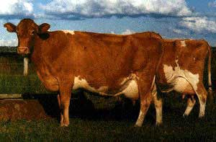
3. Guernsey
Originated in Guernsey Island, in UK
are Yellowish-Brown or Fawn in color.
Their milk is especially yellow in color:
their milk production (4808kg/ lactation)
2nd in their milk fat content (5%)

Slide 26
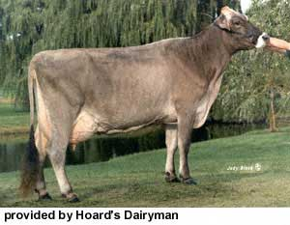
4.Brown Swiss
Originated in Switzerland,
Are solid brown in color.
They are larger breeds, & relatively heat tolerant.
milk production (5488kg/ lactation)
their milk fat content (5%).

Slide 27
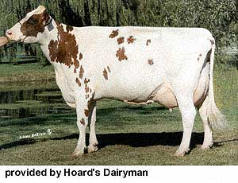
5. Ayrshire
originated in Scotland
red and white in color
They have well developed udder and excellent grazing ability.
milk production (5307kg/lactation)
their milk fat content (4%).

Slide 28
4.3. Milk and Milk products Utilization patterns
Milk
A white fluid secreted by the mammary glands of female mammals for the primary function of meeting the complete nutritional requirements of the calf
Nature’s Most Perfect Food (is a highly nutritious food, but it is also an excellent growth medium for bacteria.
Raw milk has the potential to transfer zoonotic diseases so milk handling procedures must minimize associated health risks

Slide 29
Milk is mainly comprised of
  water (79-90% ), followed by
  lactose,
  fat,
  protein, and
  minerals; and
  minor constituents are enzymes and vitamins
The composition of milk determines its nutritive value and influences the quality of dairy products manufactured from it.

Slide 30
Properties of Milk
    The major properties of milk are
Color
  Normal milk has an opalescent white (shine with wavering light) to yellow color.
Specific gravity
  Milk contains many constituents whose specific gravity is greater than that of water. Therefore milk is heavier than water
Freezing point –
  Pure water freezes at 0⁰c.
  While, milk freezes at -0.55⁰c.
  an increase in freezing point indicates the presence of added water in the milk.

Slide 31
iv. Boiling point
  Water boils at 100⁰c (212⁰F)
  while milk boils at 100.17⁰C (212.3⁰F)
These are influenced by the composition of milk.
They have also great advantage in the processing and testing of milk for adulteration/quality.

Slide 32
Dairy products
Dairy products. Those products derived from milk
Fluid Milk/whole milk
skim milk-To reduce the fat content of milk, creamy layer is trimmed down) /
Butter: - of all the products made from milk, butter is probably the most universally used and liked. Typical butter contains about 82% fat. It is used extensively in cooking and baking.
Cheese: - it is generally made from whole milk, but is may be also made from skimmed milk and cream.
A typical composition of whole- milk cheese would be 30% fat, 24% protein compounds, 2% salt and 40 % water.

Slide 33
5. Butter
6. Yogurt-fermented milk
7. Powdered Milk
8. Ghee (clarified butter)
9. Whey: - it is highest in water content of all the milk by products

Slide 34
4.3. Milk and Milk products Utilization patterns
Most farmers use their own milk for different purpose include
Home consumption in fresh form and fermented ( Igro)
Processing long shelf life products (butter and cheese)
Saving in liquid form
Calf feeding
However, level of utilization pattern varies depending upon
  The production systems
  proximity to urban centers /towns,
  availability of market outlets
  Seasons and
  Economic factors (price).

Slide 35
Species comparison in milk composition
Species | Total solids | Fat | Protein | Lactose | Ash
Human | 12.2 | 3.8 | 1.0 | 7.0 | 0.2
Cow | 12.7 | 3.7 | 3.4 | 4.8 | 0.7
Goat | 12.3 | 4.5 | 2.9 | 4.1 | 0.8
Sheep | 19.3 | 7.4 | 4.5 | 4.8 | 1.0

Slide 36
Advantage of Dairy
Dairy cattle use roughage feeds the otherwise would be wasted.
Dairying provides a steady (stable) income throughout the year.
Labor is used throughout the year.
Death rate is usually low if good management is followed.
Disadvantages of dairy rising
A high capital investment is needed.
The labor requirement is high and the operators are confined to a regular schedule of milking.
training and experiences are needed before entering into the dairy business
it takes relatively longer time to produce a high producing dairy herd

Slide 37
Assignment:
Success and failures of the livestock extension system (Breed improvement, Feed, Technology, Veterinary Service, Artificial Insemination, Market and etc…) in Ethiopia

Slide 38
Wish You Lovely Weakened!

