Slide 1
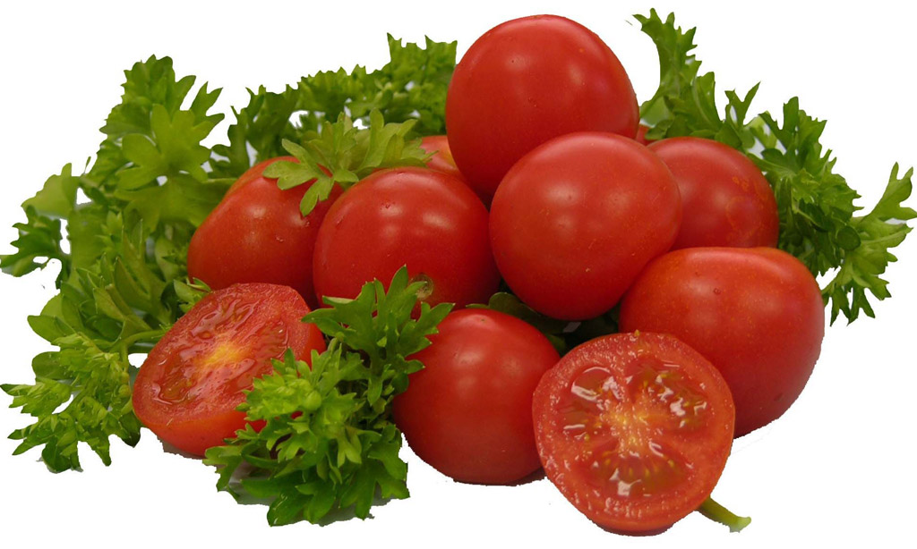
WEL-COME

Slide 2
Seminar on
Tomato Processing: Prospect and Constraints
By
Sayeed A.H. Patel
M.Sc Horticulture (Veg. Sci.)
{Reg. No. 10/317}
Course teacher
Dr. S.S Kulkarni
Grapes Improvement Project
M.P.K.V. Rahuri

Slide 3
contents
Introduction
Landmarks in processing sectors
Present scenario
Important character for tomato cultivar for processing purpose
Classification of tomato on maturity stages by USDA
Standards for tomato products
Flow chart for general tomato processing
Organizations
Case study
Plan schemes
Constraints
Way forward

Slide 4
Introduction
Food Processing is branch of manufacturing that starts with raw material & transforms them into intermediate foodstuffs or edible products (Conner 1988).
It offers an opportunity for the creation of sustainable livelihood and economic development for rural communities.
It customized the nutritional requirement of groups like men, women, infants, children etc.

Slide 5
Landmarks in Processing sectors
In world, 1st tomato processing company was established in Felino, ITALY by a group of local farmer in 1874.
In India, 1st fruits & vegetables processing industry was established in 1935 at Mumbai.
First fruit preservation & canning Institute was established in 1949 at Lucknow.
In 1950, CFTRI was established at Mysore.
FPO was passed by Govt of India in 1955.
2011 has declared as “Year of the Tomato” by National Garden Bureau, California, US.

Slide 6

Present Scenario
India’s share in world tomato Production is only 6.8% and 11.8 % in area.
Indian tomato processing industry prides itself as being the largest in South Asia.
Indian industry is more than twice that of Japan and considerably greater than Taiwan.
In world, USA and Italy accounts tomato processing for 42.2% and 16% respectively.
                Source: Malaisamy and Parimalarangan (June 2007)

Slide 7
Structure of Indian Food Processing Industry

Slide 9
Share of Southern-Hemisphere in world tomato processing
2009 2010 2011 2012 AVERAGE VARIATION
FINAL FINAL PRELIMINARY PRELIMINARY 2008-2010 2011 vs 2010
RESULT FORECAST
Argentina 450 390 355 400 397 -9,0%
Australia 270 265 87 245 229 -67,2%
Brazil 1 150 1 796 1 590 1 500 1 382 -11,5%
Chile 619 864 794 700 664 -8,1%
South Africa 167 140 115 152 - -17,9%
Subtotal WPTC members 2656 3455 2941 2824 - -14,9%
India 130 130 130 - 130 0,0%
Mexico 18 90 30 - 42 -66,7%
New Zealand 65 58 68 - 63 17,2%
Peru 70 56 56 - 65 0,0%
Senegal 70 55 90 - 59 63,6%
Taiwan 20 20 20 - 20 0,0%
Thailand 260 260 260 - 260 0,0%
Venezuela 40 40 40 - 40 0,0%
Subtotal non-members 673 709 694 - 679 -2,1%
Total Southern Hemisphere 3329 4164 3635 - 3503 -12,7%
Note: All figures in 1000 metric tonnes.
Members
Non-Member
Source: World Processing Tomato Council 21 Oct 2011
Notes:
Non-member

Slide 10
Among various tomato products, India exports-
Paste
Ketchup
puree.
58%

Slide 11

QUALITY PARAMETERS FOR tomato processing
Colour: Deep red colour which retains even
after processing.
Viscosity: More viscosity will produce more product.
Pericarp thickness: Should be > 5 mm.
pH: Low acidity i.e < 4.5 which reduce sterilization time.
TSS: High TSS yields more finished product/ tonnes of raw material. It should be more than 5°Brix.
Size and Shape: Should be above 50g and oblong in shape.

Slide 12
Important wild species and variety released for processing purpose
Characters | Wild Species
Colour | S. hirsutum and S. hirsutum f. glabratum
Ascorbic acid | S. pimpinellifolium and S. peruvianum
Acidity | S. pimpinellifolium
Total Soluble Solids (TSS) | S. chmielewskii, S. cheesmanis & S. pimpinellifolium
Punjab chhuhara, Roma, S-152, Pusa Gaurav, Pusa Uphar, Pusa Early Dwarf, Pusa Sheetal, NDT 120, NDT 101, Arka Saurabh, Arka Ahuti, Arka Ashish Pant Bahar, Matri, Rupali, SEVERIANIN etc.
Variety suitable for Processing purpose
Source: Vegetable Crops Vol-3

Slide 13
Reason for Creating GM tomato
For shipping over long distance i.e. nation-wide or for international market.
Ripe fruit have tough skin & can not easily be damaged during handling and processing which maintains quality of end product.
The taste, flavor and nutritional quality of GM tomatoes is superior than non GM.

Slide 14
GM IN TOMATO
Flavr Savr :
  Develop in 1992 by California based company Calgene and got approval in 1994.
  Contains Antisence gene which interferes with enzyme Polygalucturonase involving in fruit softening.
In 2000, concentration of pro-vitamin A was increased by adding Bactarial gene.
Recently world 1st Non-leaking tomato developed by Nunhem’s company.

Slide 15






maturity stages in tomato fruit as classified by USDA :
GREEN The tomato surface is completely green. The shade of green may vary from light to dark.
BREAKERS There is a definite break of color from green to bruised fruit Tannish-yellow, pink or red or 10% or less of the tomato surface.
TURNING Tannish-yellow, pink or red color shows on > 10% but not more than 30% of the tomato surface.
PINK or red color shows on over 30% but not more than 90% of the tomato surface.
LIGHT RED Pinkish-red or red color shows on over 60%but red color covers not more than 90% of the tomato surface
RED means that more than 90% of the tomato surface, in aggregate, is red

Slide 16
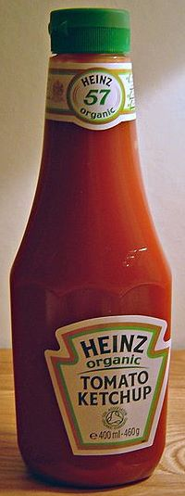
Standards for Tomato product by FAO
Tomato product’s should have -
Acidity 1.2%
pH upto 4.5
Lycopene about 8 mg/100 g fruit pulp

Slide 17
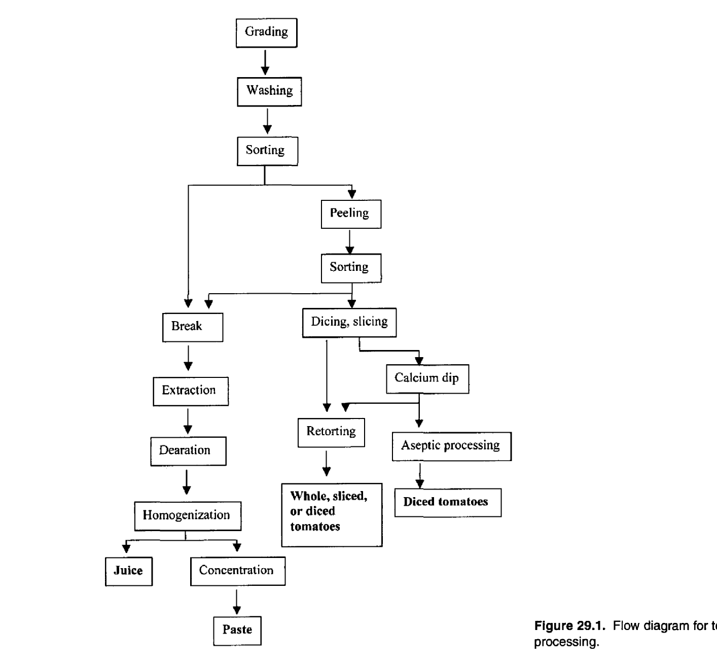

Flow diagram for tomato processing
Source: Post Harvest technology of horticulture crop

Slide 18
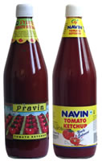





Tomato Products
Tomato Dehydrated flakes
Tomato Ketchup
Tomato chunks
Tomato Chutney
Dehydrated tomato slices

Slide 19

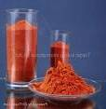

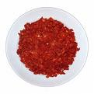
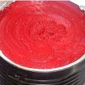

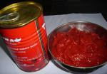
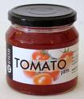
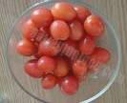


Tomato Products
Pizza Sauce
Tomato Soup
Tomato Powder
Tomato Paste
Canned Peeled Tomato
Tomato Jam
Bottled Tomato
Cherry Tomato (Salad)

Slide 20
Organization’s
The international tomato processing industry is organised around two main professional federations that together account for about 91% of the world’s production.
Headquarter: Avignon, France
World Processing Tomato Council (WPTC) 1988
Mediterranean International Association of Tomato Processing (AMITOM) 1979

Slide 21
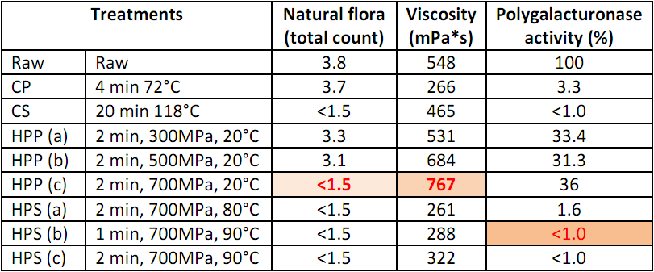
CASE STUDy
Effect of combined high pressure thermal treatment and conventional pasterisation and sterilization process on tomato puree:
Source: Krebber et. al. 2003

Slide 22
PLAN SCHEME
Scheme for Infrastructure Development
  Mega Food Parks Scheme
  Scheme for cold chain, value addition and Preservation infrastructure
Scheme for technology upgradation, establishment, modernization of food processing industries
Quality assurance, codex standard and R & D and Promotional activity
Strengthening of Institutions
  National Institute of Food Technology, Entrepreneurship & Management,
  New Delhi
  Indian Institute of Crop Processing Technology (IICPT) Thanjavur, Tamil
  Nadu.
National Mission on Food Processing launched in April 2012 at Shillong as nodal agency for implementation of scheme

Slide 23
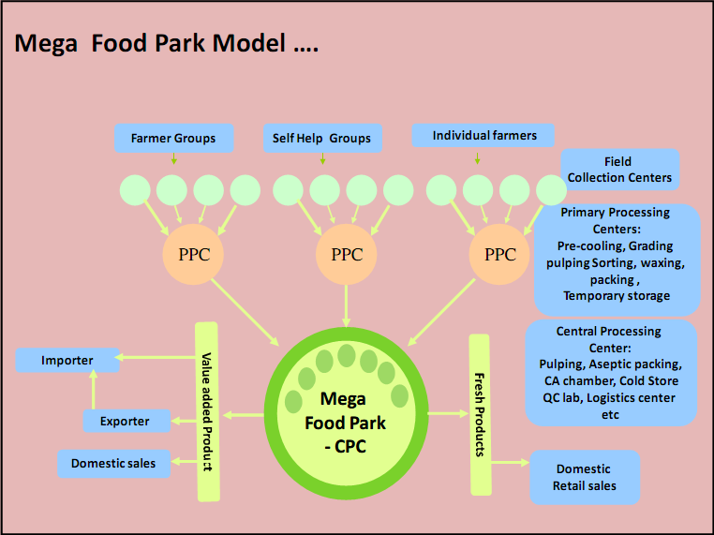
Source: Mega food Park in India, GOI, 2010

Slide 24
CLUSTERS
MPKV AFPL KVK
Rahuri Shrival Baramati
1. Yedgaon 1. Veer & Wathar Col. 1. Hole
2. Pimpalgaon (K) 2. Kelwade 2. Ramkund
3. Bhorwadi 3. Bawada 3. Phaltan
4. Mahalunge Padwal

Slide 25
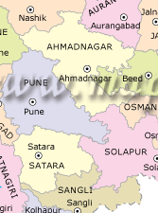
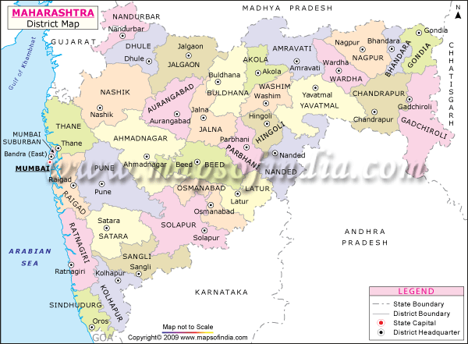
MPKV, Rahuri
Farmers’ clusters
AFPL
Clusters MPKV, Rahuri (4)
Clusters KVK Baramati (3)
Clusters AFPL, Shirval (3)

Slide 26
CONSTRAINTS
No variety released only for processing
Seasonable availability
Short harvest period
Wastages
Hand harvested cause of small scattered area
Poor cold chain
Inadequate and costly refrigerated warehousing and transportation facilities
Pricing rate

Slide 27
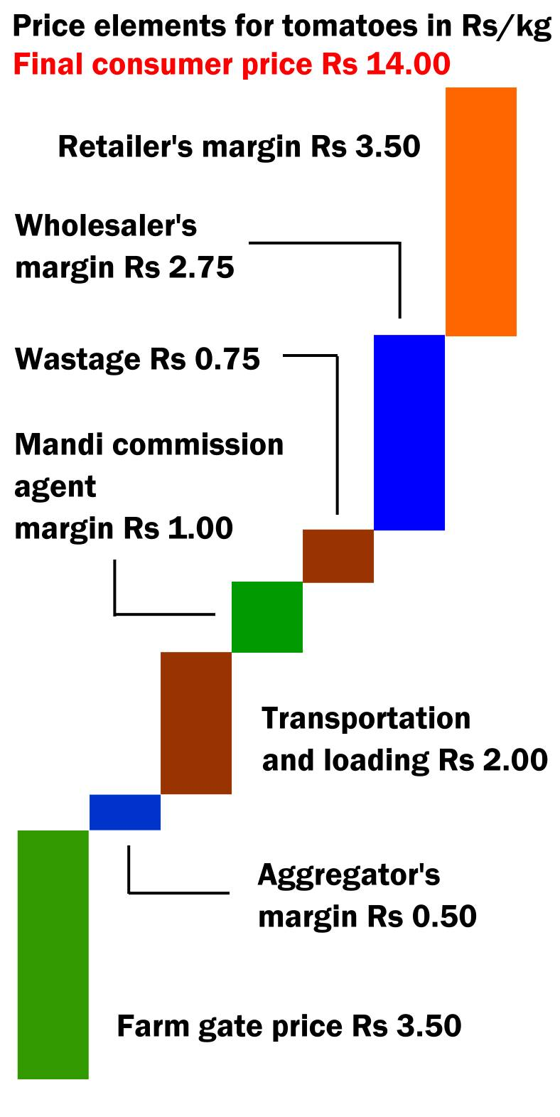

Slide 28
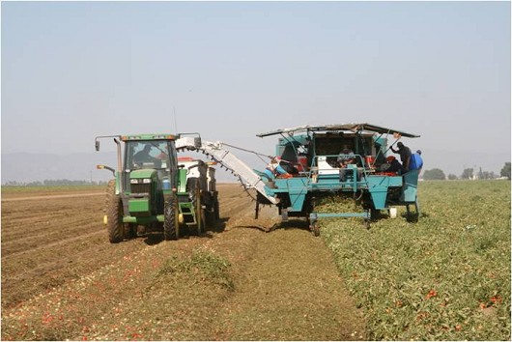

Slide 29
Way-Forward
Plant architecture
Pricing Policies
Farmer – processer linkages
Cost effective technology
Contract farming
Self help or common interest groups
Town and Village Enterprises model
Location of food processing units
Mobile processing unit as in china
Likewise National Grapes Processing Board, tomato processing board should be established

Slide 30



Thank you

