Slide 1
Chapter 5: Introduction to Herbicides
5.1. Classification of herbicides
A) Based on chemical nature
Inorganic herbicides: do not contain carbon atoms in their molecules. May be either:
Acid type: e.g.: Arsenic acid(H₃AsO₄ ), arsonous acid (HAs(OH)₂ , sulphuric acid etc.
Inorganic salts: e.g: sodium arsenate, sodium chlorate, copper sulphate etc

Slide 2
Chapter 5: Introduction to Herbicides
ii) Organic herbicides: contain carbon atoms in their molecules. They may be oils or non oils.
Oils: e.g. Diesel oil, xylene type of aromatic oils etc.
Non-oils: Majority of present day herbicides (about 150).
They differ to each other in their behavior in soil, mode of action etc.
The herbicides are grouped into 31 classes as aliphatic acids, amides, benzoics, carbamates etc.

Slide 3
Chapter 5: Introduction to Herbicides
B) Based on methods of application:
i) Soil-Active Herbicide: applied primarily to the soil rather than to the vegetation.
ii) Foliage-Active Herbicides: applied to weeds after their emergence from the soil.
There may be some herbicides that are both soil-active and foliage-active, for example, 2,4-D, picloram, and atrazine.

Slide 4
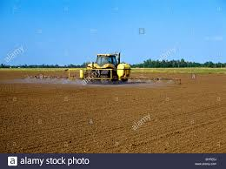
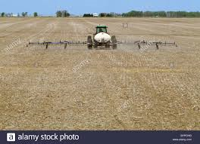
Chapter 5: Introduction to Herbicides
C) Based on time of application:
i) Pre-plant: applied any time before the crop is planted.

Slide 5
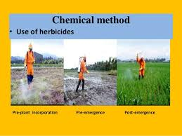
ii) Pre-emergence: Applied soon after planting of a crop.
iii) Post-emergence: applied after the emergence of both the crops and the weeds.

Slide 6
Chapter 5: Introduction to Herbicides
D) Based on selectivity:
i) Selective: kill some plant species when applied to a mixed plant population, without causing serious injury to the other species.
e.g. 2,4-D, atrazine, EPTC, trifluralin, alachlor, butachlor etc.
ii) Non-selective herbicide: is one that kills plants without regard to species
Employed for general vegetation control on industrial sites, fallow land, and in aquatics.

Slide 7
Chapter 5: Introduction to Herbicides
E) Based on mode of action:
i) Contact herbicide: kills plants by coming in contact with the plant tissue rather than as a result of its translocation.
ii) Translocated (systemic): moves within the plant from the point of treatment to its other parts,
It often kills the entire plant Eg Glyphosate.
They are important in controlling perennial weeds.

Slide 8
Chapter 5: Introduction to Herbicides
F) Based on persistence in the soil:
Residual (long persistence): maintains its phytotoxic effects in soil for considerable time. (few weeks to several months)
Non-residual (short persistence): is inactivated in soil immediately, or within a few days, after it reaches the soil.

Slide 9
Chapter 5: Introduction to Herbicides
G) Based on range of control (spectrum):
Narrow spectrum: upon application to a mixed population of weeds, proves active on one, or a very limited number of species.
Are very useful against specific noxious weeds.
Broad spectrum: controls a wide-spectrum of weedy flora at a time.
Most of the present day herbicides belong to this group.

Slide 10
Chapter 5: Introduction to Herbicides
5.2. Mode of action of herbicides:
The sum total of anatomical, physiological and biochemical effects of a chemical on the growth and development of weeds.
The effects may be: chlorosis, defoliation, stunting, necrosis etc.
There are seven major modes of actions of herbicide:
Growth regulation:
Disrupt hormone balance and protein synthesis and thereby cause a variety of plant growth abnormalities.

Slide 11
Chapter 5: Introduction to Herbicides
2. Amino acid synthesis inhibition:
Inhibit specific plant enzymes involved in the synthesis of amino acids
They are readily translocated to areas of high metabolic activity (e.g., meristematic tissues).
They bind with enzymes and result in deficiency of critical amino acids.
This leads in turn to a gradual depletion of proteins vital for normal plant growth and development.

Slide 12
Chapter 5: Introduction to Herbicides
3. Lipid synthesis inhibition:
Prevent the formation of fatty acids, components essential for the production of plant lipids.
Lipids are vital to the integrity of cell membranes and to new plant growth.
They inhibit a single key enzyme involved in fatty acid biosynthesis.
E.g. Sethoxydim, Quizalofop, diclofop, fluazifop

Slide 13
Chapter 5: Introduction to Herbicides
4. Seedling growth inhibition:
Reduce the ability of seedlings to develop normally in the soil.
must be soil-applied.
Plants can take up these herbicides after germination until the seedling emerges from the soil.
They are active at two main sites, shoot and the root.
E.g. Root Inhibitors: Pendimethalin, trifluralin
Shoot Inhibitors: Alachlor, acetochlor, metolachlor

Slide 14
Chapter 5: Introduction to Herbicides
5. Photosynthesis inhibition: Photosynthesis inhibitors block the light reactions of photosynthesis.
They bind to specific sites within the plant's chloroplasts and shut down the photosynthetic (food producing) process.
E.g. triazines, phenylureas, uracils, benzothiadiazoles, and nitriles.

Slide 15
Chapter 5: Introduction to Herbicides
6. Cell membrane disruption:
post-emergence contact herbicides.
They are activated by exposure to sunlight to form oxygen compounds such as hydrogen peroxide.
These oxygen compounds destroy plant tissue by rupturing plant cell membranes.
E.g. Paraquat, Difenzoquat

Slide 16
Chapter 5: Introduction to Herbicides
7. Pigment inhibition: prevent plants from forming photosynthetic pigments.
The affected plant parts become white to translucent.
e.g. Clomazone and Pyridazinones

Slide 17
Chapter 5: Introduction to Herbicides
5.3. Fate of Herbicides in Soil:
All applied herbicides eventually end up in soil through:
i) Drip from the sprayed vegetation
ii) Spray falling in spaces between weeds and crop plants
iii) Decay of sprayed vegetation.
There are two fates of herbicides after reaching the soil:
Transfer and decomposition.

Slide 18
Chapter 5: Introduction to Herbicides
A) Transfer: involves division of toxicants into two parts (soil colloids and soil solution).
It also includes the movement of herbicides from the site of their application/placement to other zones in the soil.
Transfer of herbicides may be through:
i. Adsorption
ii. Movement
iii. Plant removal

Slide 19
Chapter 5: Introduction to Herbicides
i) Adsorption: accumulation of herbicide molecules and ions at specific soil colloid-water interfaces.
Thus a portion of herbicide, held by soil colloid is called adsorbed where as present in soil solution is free herbicide.
ii) Movement: from the site of application to other zones.
Movement may be through:
leaching,
Wash off and runoff.
volatile movement,

Slide 20
Chapter 5: Introduction to Herbicides
Leaching:
Downward movement in soil as solutes with soil water.
May be through diffusion or mass flow.
Volatile movement:
Changed from solid or liquid state to vapor state.
Ester form of herbicides is more volatile than acid and salts.

Slide 21
Chapter 5: Introduction to Herbicides
Runoff: Removal of herbicides through heavy rains in solution form out of target area.
On erodible soils runoff may be followed by washoff.
Washoff: Movement of herbicide molecule adsorbed on soil particulate matter that is suspended in run off.
iii) Plant removal: Crops and weeds both remove a portion of herbicides from soil.

Slide 22
Chapter 5: Introduction to Herbicides
B) Decomposition: a process by which herbicide structures are altered either biologically or chemically.
Herbicide decomposition may be:
a) Microbial decomposition
b) Chemical decomposition
c) Photo decomposition (photolysis)

Slide 23
Chapter 5: Introduction to Herbicides
Microbial: Herbicide Molecules with -OH, -COO, -NH₂ and –NO₂ provide points of attack for the micro-organisms.
Biodegradation may be affected by:
Soil temperature: (activated at 20-30 ºC),
Organic matter: which is used as a source of energy.
Extenders: extend persistence of a herbicide.
E.g. Vorlex (fungicide) is extender for linuron.
Boron is an extender for 2, 4-D,

Slide 24
Chapter 5: Introduction to Herbicides
b) Chemical decomposition:
Reaction with different elements in the soil.
Begins as soon as a herbicide is placed in soil.
c) Photodecomposition (Photolysis):
Decomposition under the direct effect of solar radiation.

Slide 25
Minimizing herbicide persistence in soil:
Basically there are two approaches to reduce herbicide residues in soil. Indirect and direct
Indirect method: the dose of herbicide is reduced without losing its weed control effects. This can be achieved by:
Use of chemical activators and surfactants
Selection of most appropriate time and method of application
Selective stimulation of crops to smother weeds
Supplementing herbicidal control with tillage

Slide 26
The direct method involves
Structural approach: use less persistent than the other types of structure.
Controlled mobility approach:
Enhanced degradation approach: Herbicidal triazines can be degraded faster when soil pH is lowered by application of sulphur
Toxicity prevention approach: Adsorbents and antidotes can be used to protect crops residues.
Trap- crop approach: E.g. sugarcane, maize and sorghum are good trap crops for residues of atrazine

Slide 27
Chapter 5: Introduction to Herbicides
Herbicide selectivity:
More toxicant reaches the site of action inside the target plants (weeds) than in the non-target species (crops).
This may be due to:
Differential absorption
Differential translocation
Differential deactivation of applied herbicide

Slide 28
Chapter 5: Introduction to Herbicides
I) Differential absorption:
It may occur due to many reasons:
Differences in morphology
Differences in growth habit,
Use of adsorbents and antidotes
Granular formulation of herbicides

Slide 29
Chapter 5: Introduction to Herbicides
Differences in morphology:
Certain plant morphology may allow limited retention of aqueous sprays of herbicides on their foliage. Like;
Narrow upright leaves,
Corrugated or finely ridged leaf surfaces
Waxy surfaces,
Pubescent leaves.

Slide 30
Chapter 5: Introduction to Herbicides
Differences in growth habit:
Differences in shoot growth:
When crop rows have a clear advantage in height over the inter row weeds.
Directed spraying of herbicides is a common method
In slow germinating crops, weeds emerge before crop emergence;
by spraying a contact herbicide before more than 10% of the crop is emerged.

Slide 31
Chapter 5: Introduction to Herbicides
ii) Differences in root growth:
Weed seeds germinate from top 1.25 to 1.5 cm of soil.
Most of the crop seeds are planted 5 to 7.5 cm deep.
After the herbicide is applied:
Soil moisture conditions are suitable to leach it to about 2.5 to 3.0 cm soil depth.
Therefore, herbicide absorption will be by germinating weeds.
A principle of selectivity for most pre emergence herbicides

Slide 32
Chapter 5: Introduction to Herbicides
Use of adsorbents and safeners:
Adsorbents: materials having ability to adsorb herbicides which are placed near crop seed.
Achieved by surrounding the germinating crop seed by a layer of adsorbents.
Safeners (Antidotes): chemicals which antagonize phytotoxicity of specific herbicides.
Safeners prove successful against herbicides which inhibit cell division.

Slide 33
Chapter 5: Introduction to Herbicides
Granular formulations:
Granules filter through the crop foliage, leaving little herbicide for absorption.
The granules settle on the moist surface where germinating weeds absorb the herbicide.
II) Differential translocation: the rate of translocation of herbicides varies depending on plant species.
The more toxicant translocated, the more damage occurs.

Slide 34
Chapter 5: Introduction to Herbicides
III) Differential rates of deactivation:
Deactivation may result from processes of:
Metabolism
Reverse metabolism
Conjugation.
A tolerant plant species deactivates the herbicide molecule (ion) rapidly where as susceptible species slowly.

Slide 35
Chapter 5: Introduction to Herbicides
Metabolism: change of molecular structures of the applied herbicide inside the plant to yield a non- phytotoxic product.
Eg. Ribes nigrum is susceptible to 2,4-D. (It metabolizes 2% of applied herbicide in 96 hours).
Whereas Ribes sativum is tolerant to 2,4-D (metabolizes 50% of applied herbicide within 96 hours).

Slide 36
Chapter 5: Introduction to Herbicides
Reverse metabolism:
Change from inactive (less phytotoxic) parent compounds into active (more phytotoxic) intermediate ones.
It is an enzymatic beta oxidation process
It occurs in many leguminous plants like pea, bean and some clovers.
Conjugation:
Coupling of intact herbicide molecules with some plant cell constituents in living plants.
They conjugate it with glucose and form glucoside.

Slide 37
Chapter 5: Introduction to Herbicides
5.4. Herbicide formulation and application
Nomenclature
Any recommended herbicide is known by three names
Common name: which is technically accepted abbreviation of its chemical name E.g.: Common name: 2,4 –D
Chemical name: is full molecular structure; 2, 4-dichlorophenoxy acetic acid
Trade name: is formulation for the consumers by the company
E.g.: Trade name: Knok weed, Weed kill

Slide 38
Chapter 5: Introduction to Herbicides
Herbicide formulation:
Definition: blending of toxicants (active ingredient) with adjuvants to make suitable and safe for field use.
Active ingredients: are the toxic substances that have a herbicidal effect on the target vegetation.
Adjuvants: Materials or chemicals which are added to herbicides in order to improve herbicidal effects.
Kinds of adjuvants may be solvents, humicants, surfactants, antifoaming agents, stickers, stabilizers, etc.

Slide 39
Chapter 5: Introduction to Herbicides
Uses of adjuvants:
To improve the selectivity to non target plants.
To render herbicide safer to user.
To prolong shelf life of herbicide concentration.
To reduce drift hazards.
Some of the forms of herbicide formulation include: (reading Assignment )
Emulsifiable Concentrates (EC), Soluble granules (SG),
Soluble liquids (SL), Soluble powder (SP) and Granules (G)etc..

Slide 40
Chapter 5: Introduction to Herbicides
Emulsifiable Concentrates (EC): An emulsifying agent that is added for uniform distribution of chemicals in water.
Eg: 2,4-D-Ester,
Soluble granules (SG): dry and larger particle size than soluble powder.
Soluble powder (SP): formulated as fine a particle (powder) that dissolve and form a true solution when mixed with water.

Slide 41
Chapter 5: Introduction to Herbicides
Granules (G):made by loading the toxicant on some dry, inert material.
Granules vary in size from 0.04 mm to 1.0 mm in diameter.
Eg: Butachlor, 2,4-D
Herbicides are not used in dust forms for fear of their drift hazards

Slide 42
Chapter 5: Introduction to Herbicides
5.5. Method and time of herbicide application:
1) Methods of herbicide application:
A) Soil application methods:
Soil application methods include:
Surface application, subsurface layering, band application, soil fumigation and herbigation.

Slide 43
Chapter 5: Introduction to Herbicides
i) Surface application: applied uniformly on the surface of the soil either by spraying or by broadcasting.
They may be either left undisturbed or incorporated into the soil physically.
ii) Sub-Surface Layering: It is the application of a herbicide in about 7-10 cm below the soil surface.
iii) Herbigation: Application of herbicides with irrigation water both by surface and sprinkler systems.

Slide 44
Chapter 5: Introduction to Herbicides
iv) Band application: application to a restricted band along the crop rows, leaving an untreated band in the inter-rows.
It is primarily a cost saving device since it reduces the quantity of the applied herbicide.
v) Soil fumigation: Herbicides used for fumigation are called fumigants. They can be applied either by:
(1) Soil injection (chloropicrin)
(2) Releasing it under sealed, plastic covers (methyl bromide)
(3) Direct soil surface application (Metham).

Slide 45
Chapter 5: Introduction to Herbicides
B) Methods of application of foliage-active herbicides:
a) Blanket (over-the-top) Application:
It is uniform application of herbicides to standing crops disregard to the location of the crop plants.
b) Directed Spraying:
Is the application of herbicide to weeds in the inter-rows of crop, avoiding the crop foliage as much as possible.

Slide 46
Chapter 5: Introduction to Herbicides
c) Spot treatment: is the application of herbicides to small patches of weeds, leaving the weed-free gaps untreated.
d) Protected Spraying: by covering the non-target plants with plastic or metallic covers before herbicide application.
2) Time of application of herbicides:
Herbicides are applied to the crop field pre-plant, pre-emergence or post-emergence.

Slide 47
Chapter 5: Introduction to Herbicides
i) Pre-Plant: sprayed before planting a crop and incorporated in to soil in case of volatile herbicides.
ii) Pre-emergence: sprayed immediately after planting within two days, but before the emergence of crop.
iii) Post-emergence: Spray the herbicide when the weeds are in 3-4 leaf stage.

Slide 48
Chapter 5: Introduction to Herbicides
Materials required for spray:
Tank
Nozzle
Chemical,
Spray equipment,
100-200 liter capacity vessel,
3-4 buckets (15-20L capacity),
Two-1L capacity Jug,
Soap,
Shaving blade,
Match box,
pins (paper)

Slide 49
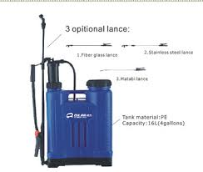
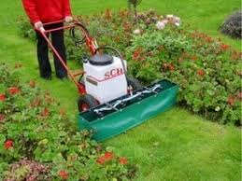

Slide 50
Chapter 5: Introduction to Herbicides
5.6. Calibrating sprayers
It is done to estimate the required amount of spray in a unit area.
Measure the small area. Final out its area in sqm (L x W) = X sqm
Pour measured quantity of water in a lank of sprayer (Water) = AL
Spray the area uniformly with pump and nozzle to be used for spray
Measure the left over water in tank (Water) =B L.
Calculate the amount of water actually used for spraying the plot by subtracting (A-B) = Water used (C liters)

Slide 51
Chapter 5: Introduction to Herbicides
For X sqm. water needed = C liters
Spray liquid for1ha = x 10, 000 (because 1 ha is=10000 sqm)
C= Amount of water used
X = Area in which used
Calculate the delivery rate of the spray
Area treated = 0.01ha, time taken 50 sec/min how many area is sprayed for 60 sec/min
Volume rate of the sprayer 2 litter = 50 sec/min, how much of the volume of water for 60 sec/min

Slide 52
Chapter 5: Introduction to Herbicides
Terms used in connection with herbicide application are:
Nozzle height: from nozzle tip to target sprayed
Swath width: width of the sprayed area
Flow rate: the rate of the liquid droplet from the nozzle
Walking speed:
Application rate: liquid volume which covers a unit area

Slide 53
Chapter 5: Introduction to Herbicides
Three steps to be determined before application are;
Dosage
Sprayer calibration
The amount of herbicide formulation to be added in the tank
Varies with weed, relative humidity, soil, crop and To
Dosage expressed in the form of formulation or AI
If it is give in AI, it has to changed in formulation

Slide 54
Chapter 5: Introduction to Herbicides
Spray drift:
It is a movement of water particles from their site of application to the adjoining field with wind.
It is very harmful to sensitive crops growing nearby.
should be done on calm days.
In windy, strong sunshine time spray should not be done.
Spray drift is mainly dependent upon drop let size, nozzle type, pressure at the time of operation.

Slide 55
Chapter 5: Introduction to Herbicides
To minimize spray drift, different manufacturers may keep different formulations (WP/EC) in the same chemical.
E.g. atrazine is available as 50 WP/EC (trade name atrataf)
Sometimes, the same chemical may have different concentrations of active ingredient.
E.g. atrazine 50 WP/75 WP, 50 EC/55 EC etc.
Therefore, it is very important to note the recommendation before application.

Slide 56
Chapter 5: Introduction to Herbicides
Preparation of solution:
Liquid and wettable powder formulations are sprayed with carrier water.
Granules are broadcasted by uniformly mixing with dry soil or sand.
The herbicide rate/dose is recommended on the bases of common name, active ingredient/acid equivalent.
Because herbicides are available with their trade names in the market.

Slide 57
Chapter 5: Introduction to Herbicides
Example: - if the recommendation of a particular herbicide in a crop is 1.25 kg/ha then how Much commercial product is needed to spray in one ha, if it contains 45 EC or 75 WP.
Formula: recommended quantity of a.i/ha x 100
[a.i] in formulation

Slide 58
Chapter 5: Introduction to Herbicides
5.7. Evaluation of herbicide effects:
Weed Control Efficiency/Weed Susceptibility Index (WSI):
WSI = WC - WT x 100%
WC
Where WC are average weed count or dry weight per unit area in unwedded check plot and
WT is weed count or weight in treated plot per unit area.
Expressed in percent
The Higher the weed control efficiency the better is the herbicide.

Slide 59
Chapter 5: Introduction to Herbicides
Ex: - In a weed control experiment in Groundnut, dry weight of weeds in control plot was 620 kg/ha whereas in herbicide treated plots x and y, the dry weight was 230 and 360 kg/ha respectively. Find out which herbicide is better amongst two?

Slide 60
Chapter 5: Introduction to Herbicides
1. W.C.E for X = 620 – 230 x 100 = 62.9
620
2. W.C.E. for Y = 620-360 x 100 = 41.9
620
The weed control efficiency is higher with x; hence it is better than y.

Slide 61
Chapter 5: Introduction to Herbicides
ii) Weed Index (WI) = YHW-Y x100
YHW
YHW = Average crop yield in hand weeded plot
Y= Average Crop yield in treated plot
Lesser the W.I. better is the efficiency of that herbicide.
We can also compare the efficacy of 2 herbicides with the help of weed index.

Slide 62
Chapter 5: Introduction to Herbicides
Ex:- A weed free plot of Sorghum has given yields of 1500 kg/ha whereas atrazine and simazine treated plots have given yields of 1400 kg and 1450 kg/ha respectively, Calculate the weed index and give which herbicide is better amongst the two?

Slide 63
Chapter 5: Introduction to Herbicides
1. W.I for atrazine = 1500 – 1400 x 100 = 6.66
1500
2. W.I. for simazine = 1500-1450 x 100 = 3.33
1500
Since the weed index is less for simazine; it is better than atrazine

Slide 64
Chapter six: Weed Count and Weed Dry Matter Weight
In weed science data is recorded by population and accumulated dry matter in the weed
Population recorded;
A different time at different growth stage
Placing a quadrant in the plot
Count a weed in it
Number of weed in the quadrant is vary in the plot size and the weed density

Slide 66
Chapter six: Weed Count and Weed Dry Matter Weight
Different weed spp may be counted separately based on the interest
Their may be large variation in weed population and its dry matter accumulation
√x + 0.5 or √x + 1 used to reduce variation
Dry matter of a weed: quadrant is used and taken periodically
Dried in sun and then oven till it dried

Slide 67
Chapter six: Weed Count and Weed Dry Matter Weight
Relative Weed Density (RWD): calculated by the following formula; RWD= NPW x 100%
NPTW
Where NPW is population of a single spp. In per unit area and NPTW is the total population of all spp in per unit area
E.g. If the population of grassy, broad leaved weeds and sedges is 92, 135 and 20 per square meter respectively. Find the relative weed density for each weed species.

Slide 68
Chapter six: Weed Count and Weed Dry Matter Weight
Relative Dry weed weight (RDW)
RDW = DWS x 100
DWTS
DWS is dry weight of a single spp and DWTS is dry weight of total spp.
E.g. The dry weights of Amaranthus viridis, Cyperus rotundas, Chenopodium album, Eleusine indica and Bidens pilosa are 10, 2, 15, 20and 12g respectively in 1 m² area. Find the RDW for all the species.

Slide 69
Chapter six: Weed Count and Weed Dry Matter Weight
Weed Smothering Efficacy: to know the efficiency of intercropping to suppress a weed
WSE = Mdw –Idw x100
Mdw
Where MDW is for the sole cropping and IDW is for intercropping

Slide 70
Importance value index : important to know the succession and dominance of a weed
Formula: sum of RD, RF, RDo
Relative frequency: Frequency of a species x100
Sum frequency of all species
frequency of a species = No. of quadrates in which a species
Total no. of quadrants
Relative dominance: Dominance of a species x 100
Dominance of all species
Where: Dominance (Do) = Absolute density of a species X 100
No of quadrates in which the spp. occurred

Slide 71
Chapter Seven: Aquatic, parasitic and other invasive weeds and their control
Invasive weed biology and control
INA weeds are common problem in Ethiopia and the most common ones are;
parthenium weed (Parthenium hysterophorus),
prosopis (Prosopis juliflora),
water hyacinth (Eichhornia crassipes),
cuscuta(Euphorbia stricta) and
lantana weed (Lantana camara)

Slide 72
Chapter Seven: Aquatic, parasitic and other invasive weeds and their control
Parthenium hysterophrous
Originated in tropical America
A serious weed in both arable and grazing land in Ethiopia
Competitive and do have Allelopatic effect
Do have a health hazard for animal and human
It is the second frequent weed in eastern Ethiopia
Depending on the year and season causes for 47-90% of grain yield of sorghum

Slide 73
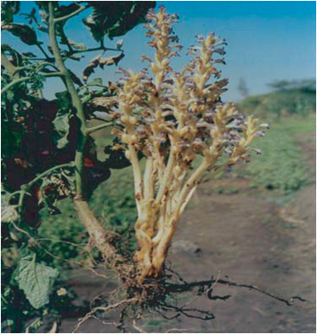

Slide 74
Chapter Seven: Aquatic, parasitic and other invasive weeds and their control
Potential damage:
Reduce a reliability of improved pastures establishment and its production due to,
Vigor's nature it can colonize weak pastures
Can cause a serious allergic reaction when there is contact with a the plant or the pollen

Slide 75
Chapter Seven: Aquatic, parasitic and other invasive weeds and their control
Control method
Prevention and weed seed spread
Pasture management
Sown pasture establishment
Overgrazing
Herbicide control
Biological control

Slide 76
Chapter Seven: Aquatic, parasitic and other invasive weeds and their control
Biology and ecology of major parasitic weeds
Biology and ecology of orebanche spp.(Broomrapes)
Are root parasitic; attack broad leaf plants
Obligate parasite; damage before the parasite emerges
Its seed can survive up to 20 years in the soil
Do not have chlorophyll

Slide 77
Chapter Seven: Aquatic, parasitic and other invasive weeds and their control
The parasite do affect the host by;
Drought stress and wilting
Damage the crop before the parasite is emerges
Reduce the host ability in water and nutrient absorption and photosynthesis by closing a stomata

Slide 78
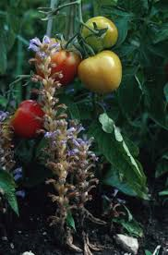
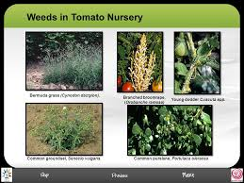

Slide 79
Chapter Seven: Aquatic, parasitic and other invasive weeds and their control
Biology and ecology of striga spp. (Witchweeds)
In Ethiopia it is found in Hareghe, Tigray, wollo,,,,, most common in semi arid areas
maize, sorghum, millet, and teff are main hosts
The seed can survive more than 20 years
Witch weeds are hemi parasitic and affecting sugarcane, corn and other grass like crops
by attaching its root in the host and causes for the death

Slide 80
Chapter Seven: Aquatic, parasitic and other invasive weeds and their control
Striga spp. Are obligate parasite
The seed needs stimulant which exudates from a root of host
Its radicle stop elongation immediately after a contact with he host root and develop haustorium
Sticky hair develop on the surface of haustorium
It reduce the growth by depleting the nitrogen and carbon from the shoot
Best in erratic or limited rainfall areas and under a wide range of soil type

Slide 81
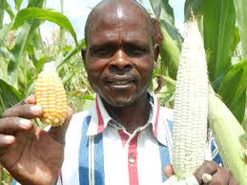

Slide 82
Chapter Seven: Aquatic, parasitic and other invasive weeds and their control
Biology and ecology of cuscuta spp. (dodder)
A stem and obligate parasite
Cuscuta campestris main spp. In Ethiopia.
Seed does not require stimulant for germination
Seeds survive for 5o years in the soil
Infected crops become yellow, reduced their vegetative growth as well as flowers and fruits.
favored by low soil fertility combined with drought stress.

Slide 83
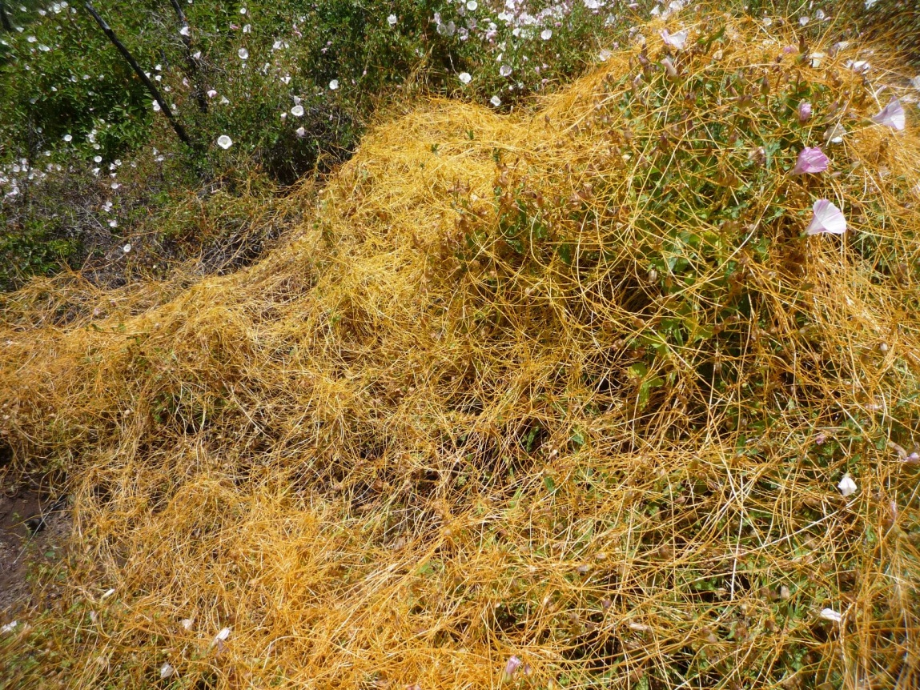

Slide 84
Chapter Seven: Aquatic, parasitic and other invasive weeds and their control
Management of parasitic weeds
Hand puling or hoeing
Crop rotation
Use trap (false hosts), and catch crops
Fertilization
Solarization
Land preparation
Use resistant variety, biological and chemical control

Slide 85
Chapter Seven: Aquatic, parasitic and other invasive weeds and their control
Aquatic weeds: those plants that normally grow and complete at least a part of their life cycle in water.
Based on their relation ship/ botanical classification;
Algae, Ferns, Mosses and Vascular flowering plant
Based on their growth habit they are Classification as:
i) Emerged
ii) Submerged
iii) Free- floating and
iv) Marginal weeds

Slide 86
Chapter 7. Aquatic, parasitic and other invasive weeds and their control
Emerged weeds:
Rooted in the bottom sediments at depths of 30 to150cm
Have floating or erect leaves
With colored flowers that extend well above the water surface.
Reproduction can be both vegetative and sexual.
E.g. Water lily, alligator weed etc.

Slide 87
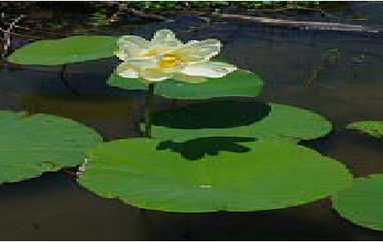
Emerged weeds:
e.g. Nelumbo lutea

Slide 88
Chapter 7. Aquatic, parasitic and other invasive weeds and their control
Submerged plants:
Found below the water surface
May be rooted in bottom sediments or free-floating
Flowers are usually produced above the surface of water.
Have poorly developed vascular systems depend on the buoyancy (prevent from sinking) of water to support.
e.g. hydrilla, myriophyllum spp., filamentous algae

Slide 89
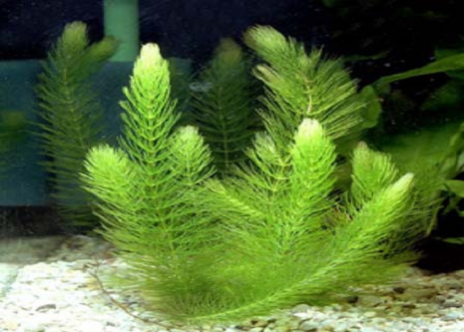
Submerged weeds:
e.g. Ceratophyllum demersum

Slide 90
Chapter 7. Aquatic, parasitic and other invasive weeds and their control
Free floating:
Found on water surface and may lie flat on the water or have tissue well above the surface.
Have well developed vascular system and true roots except duckweed, water meal and mosquito ferns.
Flowers extend above the water surface.
e.g. water lettuce and duckweed.

Slide 91
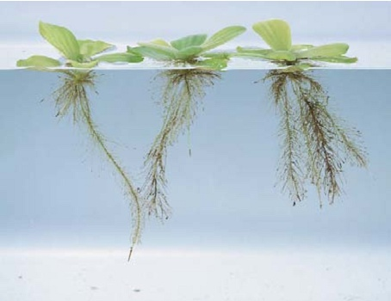
Free floating weeds
e.g. Pistia

Slide 92
Chapter 7. Aquatic, parasitic and other invasive weeds and their control
The harmful effects of aquatic weeds :
i) Obstruct water flow in irrigation
ii) Interfere with navigation, boating, fishing, swimming etc.
iii) Cause undesirable odor and flavors and discoloration of water and fish.
iv) Create health hazards such as mosquito out breaks and blue green algae toxicity to livestock.

Slide 93
Chapter 7. Aquatic, parasitic and other invasive weeds and their control
Beneficial effect of aquatic weeds
Source of food and shelter for aquatic organisms
Used as soil additive
Source of feed when the moisture is extracted
Used as waste treatment through extraction of mineral elements from a water

Slide 94
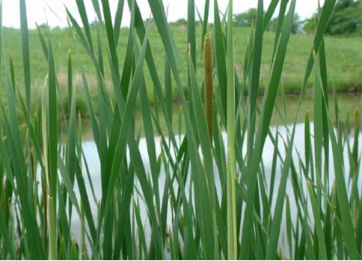
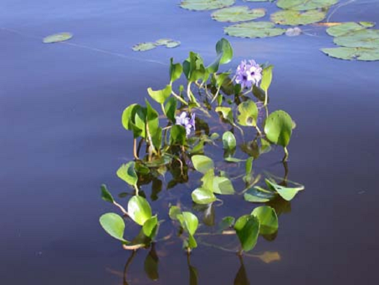
Marginal weeds :
Weeds that can grow on saturated soil above the water surface.
They can grow from moist shore line area into water upto 60-90cm depth.
e.g. Typha angustata
e.g. Eichhornea crassipes

Slide 95
Management of Aquatic weeds
Many aquatic weeds are desirable for fish and other aquatic fauna,
But their rapid and excessive growth poses various problems.
Eradication of aquatic weeds is therefore desirable only in certain situations.
Generally only their excessive growth is to be controlled.

Slide 96
Preventive measures:
Legislative Measures: prohibiting their introduction from one area to another with in the country.
Prevent re-infestation: monitoring major water bodies once cleared from infestation.
Installation of sieves: at the entry points of water from canals into paddy fields.
Desiccation: of ponds and tanks heavily infested with aquatic weeds by draining out water during summer.

Slide 97
Mechanical control measures:
Manual removal: when infestation is limited.
Cutting: for submerged and emerged static weeds under-water weed cutters are used.
Chaining: dragging of heavy chain in canals or lakes by means of a pair of tractors or boats (as the situation may be) to break submersed weeds into fragments.
Netting Small floating weeds like duck-weed (Lemma)

Slide 98
Chemical control:
Control of aquatic weeds with herbicides is efficient, easier, faster and even less expensive.
However, it could prove hazardous
After chemical application usually there should be minimum 7 days waiting period for using water for various purposes.

Slide 99
Biological control:
It is one of the most promising forms of aquatic weed control.
Carp fish : Certain fresh water carp fishes consume large quantities of aquatic weeds.
Ctenopharyngodon idella (Chines grass carp) is promising spp for aquatic weed control.
Even quite a number of water fowls, like geese, ducks, swans etc. feed on aquatic vegetation and filamentous algae.

