Slide 1
Weed and its management in Horticultural crops
Prepared by Tadesu W.

Slide 2
Chapter One: Introduction
Outline:
Definition of weed
Characteristics of weed
Importance of weed
Objectives
Able to understand about feature of weeds.
Able to justify why you need to deal with weed plants as a horticulturalist?

Slide 3
1.1. definition and concept of weed
What are weeds?
  A plant out of place or
  un desirable place or
  A plant with a negative effect
Weed plants are;
  unwanted
  Interfere with agricultural operation
  A harsh environment for a crop is favorable for them
All weeds are unwanted plant but all unwanted plant may not be always weed
Compute a man for soil

Slide 4
Cont,,
In history;
  Man is responsible for weed revolution
    Considered out of a target group as a weed
  Most of a desirable crop wild relatives are considered as a weed
    Those wild relatives used to improve some desirable characteristics of a domesticated crop
      Because weed plants can grow in adverse condition

Slide 5
1.2. characteristics of weeds
Why peoples need for knowing their features;
For developing suitable control method
  By studying the most sensitive stage of a weed
For knowing their adaptation and extent of loss
Weeds have the following characteristics
Tolerance to adverse condition
  By having thick cuticle and deep roots
Example: Calotropis procera and Saccharum spontaneum

Slide 6
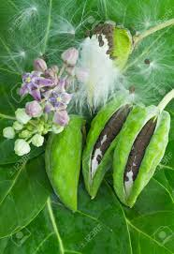
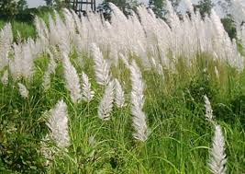
Saccharum spontaneum
Calotropis procera

Slide 7
Cont,,
2. Competitive and aggressive in nature
Can grow near to the crop
Mostly weeds and plants require similar condition for normal growth
  Taller weeds suppress a crop
  Quicker in germination and growth and development
Aggressiveness mainly associated with their habit
3. Resist control or eradication
  Hinder their removal from a crop due to the presence of spines and thorns

Slide 8
Cont,,
  Perennial weeds able to regenerate
  Some tuber weeds are difficult to remove by hand hoeing
4. Morphological similarity with crops
5. high reproductive capacity
  Productive; Produce large number of seeds
  Deposit a large amount of in seed bank
6. Persistent in nature
7. Early seed seating
8. Repeatedly germination in different phase

Slide 9
Cont,,
9. Similarity of seed
10. Deep root system
  Below the plough layer
1.3. Importance of weeds
In general weed makes a life of women and children miserable
40% of yield loss; it may vary based on
  Weed type
  Severity and duration of weed infestation
  Competitiveness of a crop and Climatic condition

Slide 10
Harmful effect of weed
Yield loss, less efficient use of land
  Provide shelter for disease and pests
  Competition
  High population of weed in horticultural crops
    Limit crop choose to grow
    Harvesting cost
    Crop and root damage may occurred
    Soil disturbance

Slide 11
Cont,,,
Added costs from losses due to insect and disease
Erosion of crop quality
  Vegetables become spindly, poorly developed and colored “leafy crops;”
  root crops can become poorly formed;
  fruits undersized, low quality, and poorly shaped; and,
  foreign matter originating from weeds occurring in crop products

Slide 12
Cont,,
More problems in water management
  Reduction of water delivery and drainage system
  Less human efficiency
  Difficult to control weeds
Human health
Forest and pasture lands

Slide 13
Beneficial effect of weeds
In scientific studies
  Chlorella for photosynthesis of higher plants and Datura for inheritance and other…
To check soil erosion: have mat structure that reduces soil erosion
Food security and animal feed: Cactus pear in Tigray region
As mulch
In cottage industry
  Leaves of Typha latifolia are used for preparing mats
Improve soil fertility

Slide 14
Chapter 2: classification of weeds
A need of classification;
Planning, Interpreting and recording control measures
Two method of classification are used;
Scientific and common system of classification
  Scientific classification is universality accepted called botanical classification
    Binomial (genus and species)
    Minimize confusion

Slide 15
Cont,,,
Based on life cycle
  Annual, Biennale and perennial
      Simple annual weeds- can not grow once removed but some able to grow like that of Parthenium and Lantana
  Perennial weeds reproduce vegetatively (underground specialized organ)
    Difficult perennials called pernicious weeds

Slide 16
Cont,,,
Habitat
  Based on their occurrence weeds classified as terrestrial and aquatic
  Terrestrial weeds are classified in to;
Categories | Characteristics
Crop land weeds | In field
Non crop land weeds | In waste land
Grass land weeds | With grasses
Orchard or garden weeds | Fruit and vegetable fields
Plantation crop weeds | Weeds of large tree
Parasitic weeds | Attached to a host
Road side weeds | Located in the road side

Slide 17
Cont,,,
Aquatic weeds: grown in water body
  Complete at least some parts of their life cycle
  Classified in to four;
Categories | Characteristics
Submersed | Vascular, produce vegetative growth beneath the water surface, have true roots, leaves and stems
Emersed | Rooted in the bottom mud, with areal stem and leaves at or above,
Marginal | Emerged weeds grown in moist condition
Floating | Have leaves that float on the water, some are free floating and some are rooted in the mud

Slide 18
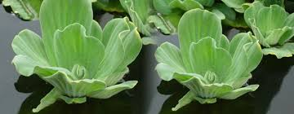

Slide 19
Cont,,
Depends on host
  Parasite: an organ used for attachment and penetration of host called haustorium
    Total parasite : total dependent on host and not preparing food lack of chlorophyll
    Semi parasite : do not dependent on host in their entire life but for part of it
  Independent: all annual and perennial weeds

Slide 20
Cont,,,
Based on their stem: truck developing nature
  Woody: shrubs and under shrubs collectively brush weeds
    Example ;lantana camara
  Semi woody: Croton sparsiflorus
  Herbaceous: succulent and green and common weed types; Amaranthus viridis

Slide 21
Cont,,,
Soil type
  Acidophil
  Basophile
  Neutrophile
Economic use
  Relative weeds: have some economic value
  Absolute weeds: no economic value at all

Slide 22
Cont,,
Based on association
  Season bound: grows in a specific season of the year disregard to the crop species cultivated
  Crop bound: Parasitic to a host crop
  Crop associated weeds
    A crop specific weeds for;
      A need of micro climate
      Mimicry
      Ready for contamination of crop seeds

Slide 23
Chapter 3: weed biology and ecology
3.1. weed biology:
a study of weed in relation to their geography, distribution, life cycle….
Important for weed management and control in agriculture
Propagation and dissemination is vital for spreading of weeds

Slide 24
3.1.1.Reproduction of weeds
Two means of reproduction
  Sexual and asexual
Sexual reproduction: fusion of gametes/ units through fertilization or conjugation
  Most weeds reproduce sexually
  Largely monocots except a few dicot weeds like Canada thistle (Cirsium arvense) and eel grass (Vallisneria spirallis)
  Weed seed production higher than economically important crops (annual and biennial).

Slide 25
Cont,,,
Asexual reproduction
  Part of a mother plant detached and grown as separate plant
  Means of vegetative propagation are;
    rhizomes and root stocks, runners, Stolons, Suckers and Offsets, tubers, bulbs, bulbils and bulblets, stems and roots called vegetative propagules
  Mainly a feature of perennials
  Rhizome and root stock: horizontally growing modified underground shoot while the root stock is a rhizome growing vertically down ward

Slide 26
Cont,,,
Runners: Aerial shoots coming from axils of lower leaves
  Daughter plants of such weeds repeat the process and form big patches.
  Stolons, suckers, offsets are different forms of runners.

Slide 27
3.1.2. dispersal of weed
Three ways of weed seed and fruit dispersal
  A part of reproductive produce may fall near the mother plant,
  A portion of it may be harvested and carried away as contaminant with crops seeds,
  Some may disperse to short and long distance from the mother plant with the help of dispersing agents.
Requirements for effective dispersals of fruits and seeds
  A successful dispersing agent
  An effective adaptation to the new environment

Slide 28
Cont,,,
Common weed dispersal agents
Wind: weeds do have adaption to spread by wind;
  Pappus: parachute like structure of persistent calyx into hairs
  Comose: Weed seeds are covered with special hairs partially or fully
  Feathery persistent style: In some weed fruits, the styles are persistent and feathery
  Baloon: which is modified papery calyx and encloses the fruit loosely along with the entrapped air
  Wings

Slide 33
Cont,,
Water: aquatic weeds
Animals: eat weed seeds and disseminate with excreta
  0.2 to 9.6 percent of the ingested weed seeds are passed in viable form
  Birds peak seeds on their wing and drop
Man: with un cleaned farm materials
  With agricultural produces (satellite weeds)
Manure and silage: FYM is a major source because of the presence of weed seeds in animal dung

Slide 34
Cont,,,
Forceful opening
Artificial dissemination
Dispersal of vegetative propagules
Cultivation of land and transplanting are means of dissemination

Slide 35
    3.1.3. Persistence of Weed and survival mechanism
Ability of invading an environment even if it removed
It differs from hardness; ability to with stand all natural stresses
Persistent results from;
  Prolific seed production
  Dormancy of weed seeds and other propagules
  Vegetative propagation
  Rapid dispersal
  Inherent hardiness and selective invasion
  Evasiveness and Self- regeneration
  Weed succession

Slide 36
3.1.4. weed seed bank
Composed of produced seeds in the area and dispersed from elsewhere
  Weeds allowed to mature are common source of weed seeds in the weed seed bank
  Have hygroscopic awns and deflexed hair for burying
  Any living organism moving in the field helps to burying
Deposit due to dispersal and production and
Withdrawal by germination, senescence, death and predation
250 million weed seed / ha is common

Slide 37
Cont,,,
Weed population could be minimized by 20-50% per annum if there is no additional
Reduction of population caused by;
  natural death of seeds,
  destruction by soil organisms and by germination,
  emergence and varies according to species,
  depth and frequency of cultivation,
  soil type and drainage

Slide 38
3.2. weed Ecology
Interrelation between weeds and their environment
Concerned the growth characteristics and adaptation of a species
Concerned a creation of a new spp.in a population and a population in a communities
Two types of ecology
  Autecology: competition with in same species or with crops
  ( intra/ inter specific)
  Synecology: between two different communities with in the environment

Slide 39
Cont,,
Ecological succession of weed: a process of replacing one another in an orderly sequence over a year
  A new race in a species which develops by cross breeding called Agricultural Ecotypes
    a new ecotype created due to continuous application of chemical called chemotype.
    Due to a continuous application of herbicides minor weeds will come as major weeds called weed shift
Crop weed association: this is due to;
  Morphological similarity
  Seed shedding behavior

Slide 40
Cont,,,
  Escape removal through sieving
  Congenial environment: cropping sequences
  Continuous use of one group of herbicides
  Allelopathic effects
Factors affecting the occurrence of weed
  Physiographic: geographical location
  Edaphic
  Climatic
    Temperature, light and moisture

Slide 41
Cont,,
Weed crop interaction
  Interference: an effect caused by the growing of species in to another.
    involves in competition and amensalism
  Commensalism: relationship of unrelated species
    One gets a food and the other unaffected
  Competition: a relation ship between two plants
    Weed to crop, weed to weed or crop to crop
    A supply of a growth factor become below the demand
    Above ground and under ground competition
On root and by water, nurient and oxygen
On leaf and by light and CO2

Slide 42
Cont,,,
Forms of competition
  Intra specific
  Inter specific
Critical period of weed interference
  The shortest period in which caused for maximum yield loss/
  The shortest period in which taking control measurement to minimize yield loss
  components which can be overlapped are;
    The duration of weed presence before interference and
    The duration that required for weed emergence prevention
Differs from crop to crop and the loss also different for different crop

Slide 43
Cont,,,
Amensalism: chemical/exudates production by living and decay of living organism
  Interfere in germination and growth and development for other species which shares same habitat
  true allelopathy: the released compound are toxic as produced
  Functional: toxic as a result of transformation by microorganism
  coumaric acid, terpenoids, syringic acid, butyric acid, flavonoids, phenolic compounds

Slide 44
Cont,,
Competition threshold: important to do cost effective assessment for weed control
  Damage: important to know the population which causes negative impact
  Period: the period of plant life cycle at which the level of damage differs from other stages
    Measures in plant population/ density
  Economic threshold: indicates to take control measures; break-even point
    Loss should be higher than cost of control
    weed population equals with the crop values increased by a control

Slide 45
Cont,,,
  Action: some action is needed to prevent loss before requiring action; considered as a set of condition
    Prediction of direct effect due to weed crop association
  Density- Biomass: crop yield are reduced by weeds depends
    crop species and cultivar ,weed species present ,location or site and practices that modifies site conditions
    No need of weeding unless the additional cost of weeding is equal to the value of the weeds marginal effect on crop
  Plant identification procedure reading assignment)
    collection and mounting
    Weed density measurement

Slide 46
Chapter 4: principles of weed management
Chapter learning objectives
Define weed management
Differentiate between weed management and weed control
Give explanation on weed management
State the role of different control methods

Slide 47
Chapter contents
4.1. Preventive Weed Management
4.2. Weed control
4.2.1. Physical and Mechanical Methods
4.2.2. Cultural Weed Control
4..2.3. Chemical Weed Management
4.2.4. Biological Weed Management
4.3. Integrated Weed Management

Slide 48
Define weed management?
Differentiate weed management from weed control ?
  Application of a certain principle and suitable method
    improve the vigor and uniform stand of the crop.
    ignore or discourage the invasion and growth of weeds.
Weed management: prevention, eradication and control
Weed control: limiting infestation of weed plants

Slide 49
In weed eradication principle;
  completely eliminate including their vegetative parts and seeds
  it is more difficult than prevention and control
  justifiable only for eliminating a serious weed in a limited area; like perennial weeds in a small areas of land

Slide 50
4.1. Preventive weed management:
  Preventing introduction, establishment and spreading
  A weed control program is not functional unless a good prevention of infestation practiced
  Long term plan

Slide 51
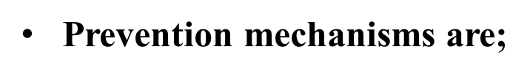
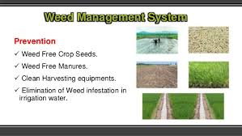

Slide 52
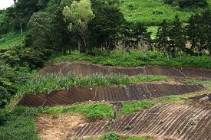
Cont,,,
  Clean seed/planting materials
    By production of weed free crop seed
    Cleaning before storage and at the time of sowing
  Clean a non crop areas
  Quarantine

Slide 53
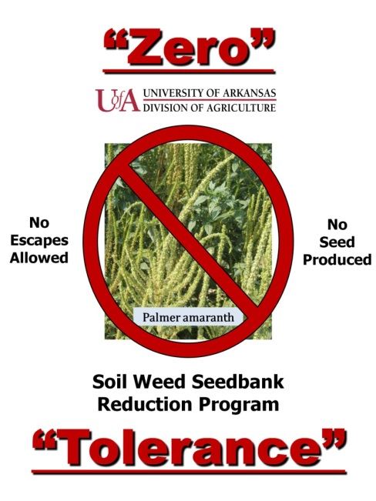
  Prevention of weed movement in to and from other fields

Slide 54
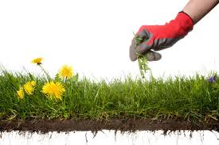
  Use vigilance( keep watching of field); Prevention of establishment

Slide 55
Cont,,,
4.2. Weed control
4.2.1. Physical and mechanical methods
  Hand weeding, digging, mowing, cutting, dredging, mulching, hand hoeing, soil solarization and tillage
Advantages Efficient, cheaper, safer, to crop and farmer. Oldest, effective and economical method Implementation do not require special skills | Disadvantages More labor is required Its success depends on its timely operations when the weeds still young Usually operations limited by too wet or too dry conditions

Slide 56
Cont,,
4.2.2. Cultural weed management
  Crop husbandry practices
  not controlling but reducing, Needs in combination
Common practices
  Proper crop stand and early seedling vigor
  Proper planting method and Planting time
  Crop rotation
  Competitive crop
  Green manure and cover crops

Slide 57
Cont,,,
4.2.3. Chemical weed management
Knowhow is a pre-requisite
Before application it is important to know;
  Chemical selectivity and its dose
  Time and method of application
Merits
  Used to control a weed from the beginning (pre emergence)
  A strong single tool to control when its based on the guideline
  Used for morphologically similar weeds

Slide 58
Cont,,,
  More economical when labor cost is high
  Substitute mechanical method to minimize the damage
  Used when other methods are not favorable
  Important under conservation agriculture
  Flexible in crop management system
Demerits
  Causes unintentionally injury on crops and others
  Most of them are narrow window and others narrow spectrum

Slide 59
Cont,,,
  Less economic for small scale farmers
  Soil and water pollution
  Toxicity for non target organism
  Human health
  Weed shift
  Chemotype

Slide 60
Cont,,,
4.2.4. Biological weed control
Controlling an organism by employing another living organism
Do have prey predator relationship
  Predators
  Parasites
  Pathogens,,,,,

Slide 61
4.3. IWM
Combining controlling methods
    That are compatible and suitable
    To minimize a weed population below injury level
The frame work of the program involves;
  Weed identification----prioritization----feasibility
  combination of control options-----verification
  Monitoring and evaluation------if it is below expectations dropped and develop a new one

Slide 62
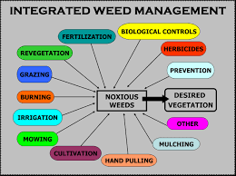

Slide 63
Quiz
Why is that weed eradication is difficult for application especially on large areas?
What is the purpose of proper weed prevention mechanism in weed management mechanism?
Mention at least two advantages of chemical weed control.
Mention at least two disadvantages of mechanical weed control
Define what does a weed management principle mean?

