Slide 1
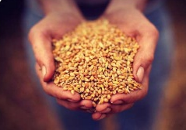
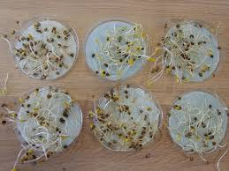
Chapter Six
6. Seed Quality and Testing
  Content
  Seed quality
  Seed testing
    Physical purity analysis
    Seed moisture analysis
    Germination test
    Viability test
    Seed vigor test
    Seed health test
    Varietals (cultivar) purity test
  Seed germination and dormancy

Slide 2
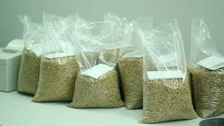
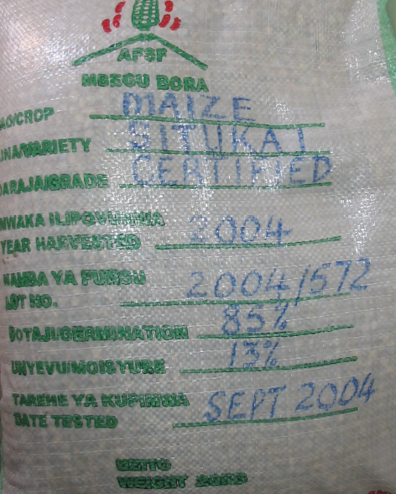
Seed quality
Seed quality is the sum of all properties contributing to seed performance
The main factor affecting crop production potential
High quality seed;
  An adapted variety with high varietal and physical purity
  High germination and vigor
  Free from seed borne pests
  Properly cleaned, treated, tested and labeled.

Slide 3
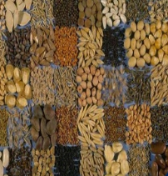
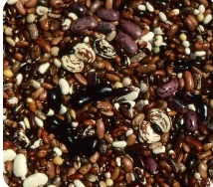
Cont..
Four major components:
Genetic seed quality: true to type
  The inherent genetic make-up of the variety contained in the seed
  Identical in agronomic and other characters
Physical seed quality:
  Free from other crops, weed seeds, sands, dust and chaff; seed size, seed weight and seed lot uniformity.
Physiological seed quality:
  The viability, germination and vigor of seed
Health quality (sanitary seed quality):
  Absence of infection/infestation with seed-borne pests

Slide 4
Seed Testing
Evaluating the seed quality to determine its value for planting.
Objectives;
To determine their quality, i.e. suitability for planting
To identify seed quality problem and their probable cause
To determine the need for drying and processing and specific procedure should be used
To determine if seed meets established quality standards or labeling specification
To establish quality and provide a basis for price and consumer discrimination among lots in the market.

Slide 5
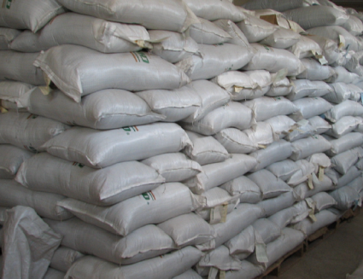
Seed sampling
Physically and financially impossible to examine large number of seeds
Sample; a representative portion of the population
The International Seed Testing Association (ISTA) has established regulations and procedures for sampling of seed.
In sampling a seed lot, a method of sequential sampling is used:
  Primary samples
  Composite sample
  Submitted sample
  Working sample (for testing and evaluation)

Slide 6
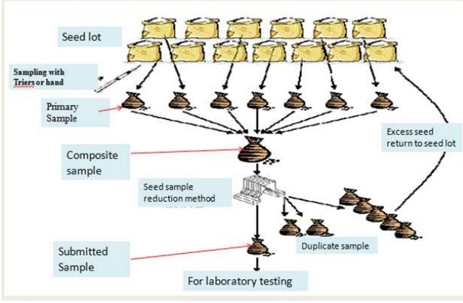
Seed sampling methodology

Slide 7
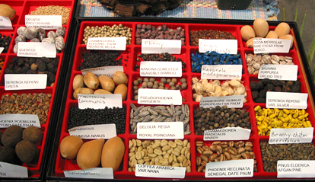
Cont..
Major seed tests:
  Physical purity analysis
  Seed moisture analysis
  Germination test
  Viability test
  Seed health test
  Seed vigor test
  Varietals (cultivar) purity test

Slide 8
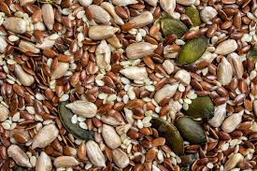

Physical purity analysis
Determines the percentage of pure seed by weight and identifies the composition of any impurities
Separates the working sample into three components:
Pure seed:
Seed that are larger than half the size of a whole seed.
Other crop seed:
Seed or seed like structure of any plant
Inert matter:
Soil, stones, chaffs, stems, leave

Slide 9
Seed moisture content analysis
Seeds lose half their storage life for every 1% increase in seed moisture between 5 and 14%.
Moisture testing is necessary at various stages in the seed chain:
  Before harvesting in order to assess the optimum harvesting (threshing) moisture content
  Before seed drying to assess the drying needs of the lot (for setting drier)
  Before and during storage
  At packing
It is expressed as a percentage of the original wet weight of the seed.
Moisture content (%) = Loss of weight *100
Initial weight of seed

Slide 10
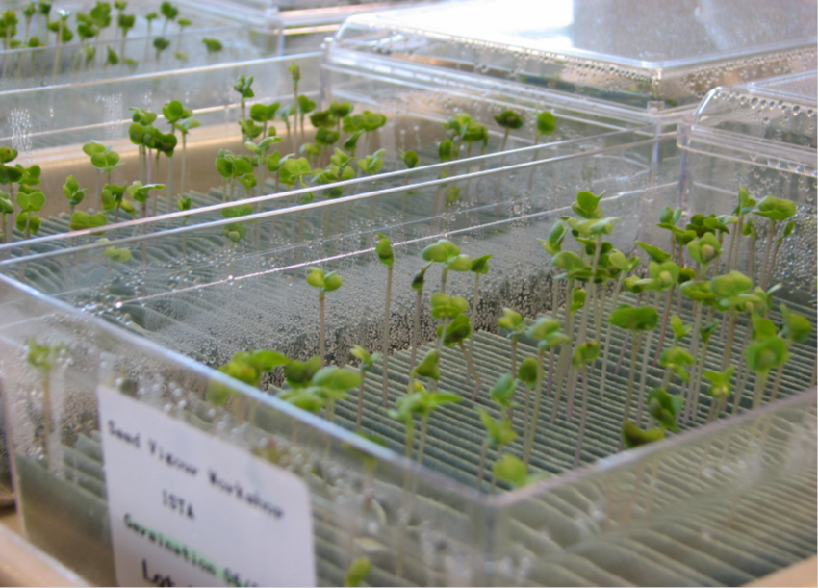
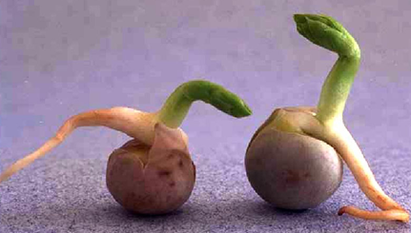
Germination test
Main objective;
  To obtain information about the field planting value of the seed lot.
Definition; the emergence and development of those essential structures from embryo
It indicates the ability of the seed develop into a normal plant under favorable conditions in the soil.

Slide 11
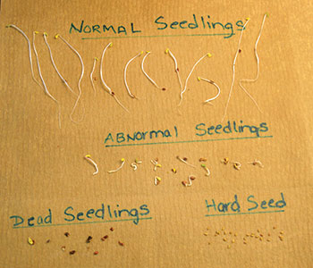
Cont..
  The number of each replicate is interpreted as falling into one of the following;
Normal seedling:
  Well-developed root and shoot system
Abnormal seedling:
  Damaged, decayed, deformed or unbalanced seedling
Hard seed: seeds that has not absorbed water
Fresh un-germinated seed: dormant seed that absorbed water and not discolored or moldy and has a firm turgid texture.
Dead seed: that has absorbed water and a soft, non-turgid texture discolored and is often moldy.

Slide 12
Seed viability test
To most seed technologist and commercial dealers, viability means that a seed is capable of germinating and producing a “ normal” seedling.
In another word; viability denotes the degree to which a seed is
  Alive
  Metabolically active and
  possesses enzymes capable of catalyzing metabolic reactions

Slide 13
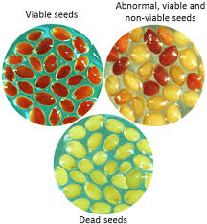
In this context,
A given seed may contain
  Both live and dead tissues
  May or may not be capable of germinating
  This meaning deals with tissue viability as well as viability of the entire seed.

Slide 14
Tetrazolium test
The most commonly used for viability test utilizing 2, 3, 5 – triphenyl tetrazolium chloride (TTC).
Principle; based on the response of all living cells of the seed which can reduces a colorless solution of TTC in to red colored compound.
The reduction of the chemical takes places in the seed by the action of a group of enzymes; dehydrogenase.
The enzymes are involved in H-transfer during respiratory activity of the biological system.

Slide 15
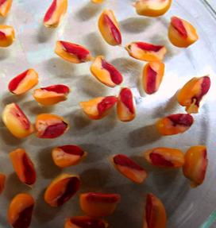
Procedures
Seeds are soaked into water for a few hrs and cut into two longitudinally to expose the embryo
The seeds are then soaked in 1% solution of TTC in the dark for one or two hrs.
The embryo of living seeds will stain reddish while dead embryo and dead part of the embryo will remained unstained

Slide 16
Cont..
Advantages of TTC test
Quick estimate of seed viability
When the seed is dormant, or very slow in germination, a viability test is extremely useful.
Disadvantages of TTC test
It is difficult to distinguish between normal and abnormal seedlings
It doesn’t differentiate between dormant and non-dormant seeds
The knowledge of the seed and the seedling structure is essential for conduction of the test.

Slide 17
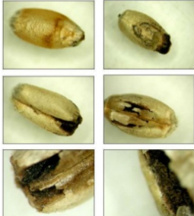

Seed health test
Seeds can be carry seed-borne pathogens such as viruses, bacterial, fungi and nematodes.
Should be simple, cheap, and quick and should facilitate identification of the pathogens.
may be done by visual assessment or more advanced seed health testing.
Visual assessment;
  observing the presence of sclerotic, spots on seeds

Slide 18
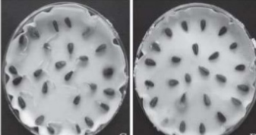
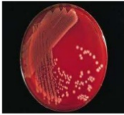
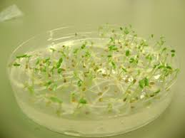
Cont..
More advanced seed health testing methods:
Blotter method:
Incubation of the seed on blotting paper
Seed-borne pathogen can be identified based on vegetative growth rate, emergence of the fruiting bodies and symptoms on the seedlings.
Agar test:
Incubation of the seed on a sterile media or either a general agar or media that specifically promote the growth of certain pathogens

Slide 19
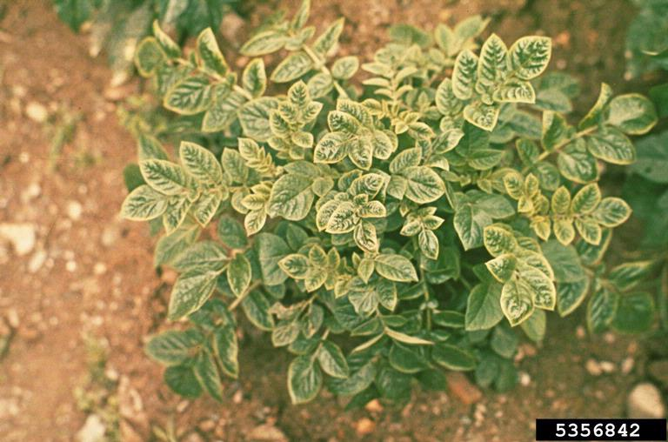
Cont..
Serological technique: Enzyme-Linked-ImmunoSorbant-Assay (ELISA) test
Based on the interaction of antigens and antibodies are specific test for a particular viral diseases.
Grow-out tests:
Observe symptoms on the seedlings.
Notes:
Enzyme-Linked-ImmunoSorbant-Assay, commonly referred to as the ELISA test. Each well contains the virus-specific anti-body bound to its sides. Sap or liquid extracted from tissue or cells is added to the well. In order to minimize possible over-reactions or unwanted reactions, and to titer the virus, the liquid may be diluted several times with a buffer. If the virus is present in the test liquid, it will bind to its anti-body. Wells are rinsed to remove the liquid and its contents that did not bind and therefor not the targeted virus. More of the same anti-body bound to the well is added. This second set of anti-bodies also has an enzyme attached to it which will react with a pigment. These anti-bodies attach to the viruses held by the bound anti-body. After this second reaction, any unattached anti-body is rinsed away. And now, the pigment substrate is added. If the substrate attaches to the enzyme because it is present, it will develop or change color. A color change means the targeted virus is present in the sap or tissue extract and if no change occurs than the virus is absent.

Slide 20
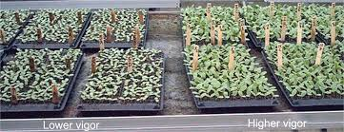
Seed vigor test
The potential for rapid, uniform emergence and development of normal seedlings under a wide range of field conditions.
Affected by;
  Genetic constitution
  Environment and nutrition of the mother plant
  Stage of maturity at harvest
  Seed size and weight
  Pathogen attack
  Mechanical damaged, drying temperature etc.

Slide 21
Varietals purity test
Refers to whether a variety is true-to-type and still has the original genetic make-up.
For pure line varieties, all plants are similar in morphological, physiological, cytological and chemical characters.
Establish whether a field or a seed lot of a variety is sufficiently pure
Controlled by inspection of plants in seed multiplication fields or examining seeds or seedling in the laboratory or growing plants in field plots.

Slide 22
Seed germination and dormancy
Seed Germination physiology
  Imbibition
  Digestion
  Respiration
  Emergence of essential structures

Slide 23
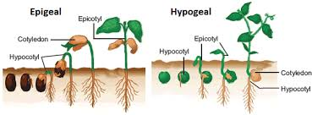
Types of germination;
Hypogeal germination and Epigeal germination

Slide 24
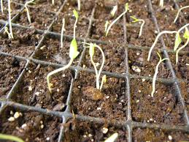
Cont..
Conditions necessary for germination;
  Sufficient moisture
  Suitable temperature
  Aeration
  Light (for certain seed species)

Slide 25
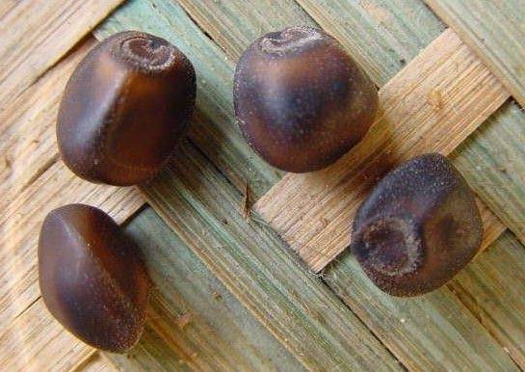
Seed Dormancy
The viable seed of a given species fail to germinate under favorable conditions of moisture, temperature and oxygen
A common misconception with quiescence.
    a resting state of a seed in the absence of a suitable germination condition

Slide 26
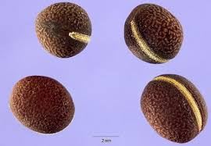
Types of seed dormancy
A. Primary Dormancy: the dormancy that develops during seed development in the mother plant
  Exogenous dormancy
  Endogenous dormancy

Slide 27
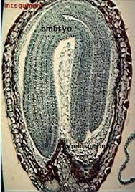
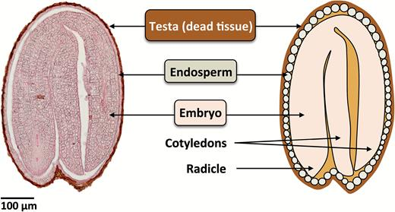
Exogenous dormancy
Dormancy caused by the property of embryo coverings pericarp, testa, endosperm
A form of dormancy in which the essential germination requirements are not available to the embryo
Physical properties of the seed coat;
  Impermeability to water
  Low permeability to gases
  Mechanical restriction of embryo growth.
Notes:
Physical dormancy mechanism (exogenous)- a physical characteristic of the seed or seed coat prevents germination. EX: Hard Seeds

Slide 28

Endogenous dormancy
Due to the inherent property of the seed.
1. Morphological dormancy
underdeveloped and under-differentiated embryos.
2. Physiological dormancy
  Presence of inhibitor and absence of promoter e.g. gibberellins and cytokinins, and ethylene
  Osmotic inhibitors e.g. Sugar and salt compounds
  Metabolic inhibitors; e.g. cyanide (CN₃), phenolic compounds (caumarin), and ABA
Notes:
Physiological dormancy mechanism (endogenous)- a physiological mechanism of the seed prevents germination. EX: Immature embryo, Hormonal inhibition.

Slide 29
Secondary seed dormancy
Seeds, which ordinarily would germinate, immediately if planted under favorable conditions may be thrown into dormancy by an unfavorable environment so that they will not germinate even when conditions become favorable.
The dormancy is due to by being that under unfavorable environmental conditions.
Notes:
Secondary Dormancy – An additional level of Protection to prevent germination. Can be induced under very unfavorable conditions such as drought or cold, etc.

Slide 30
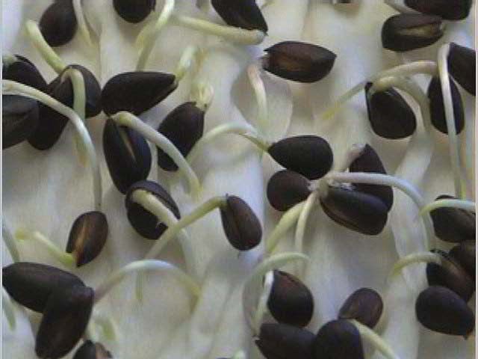
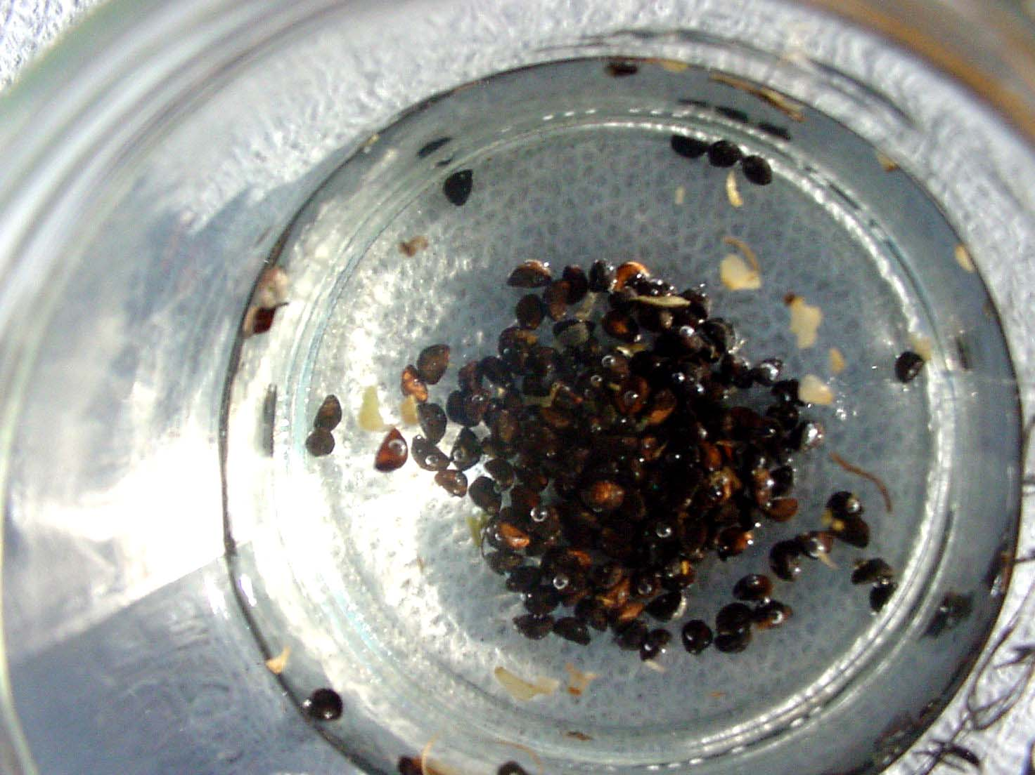
Method of overcoming seed dormancy
Scarification:
  Mechanical or chemical treatments that weakens or rapture the hard seed coat
a. Mechanical scarification
  Seeds rubbed by sand, paper
  Piercing the seed coat
  Immersion of the seed in boiling water
  Vigorous shaking of the seed
Notes:
Seeds are scarified by mixing them with sharp sand and shaking vigorously for 10 to 20 minutes (min).

Slide 31
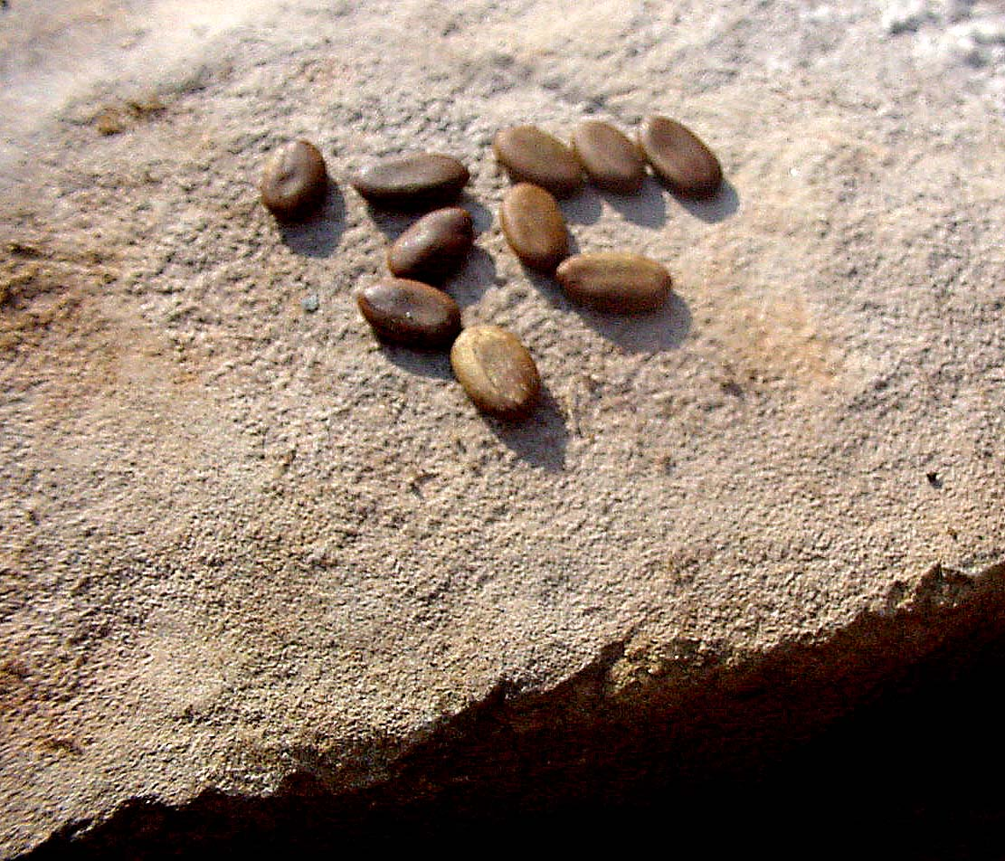
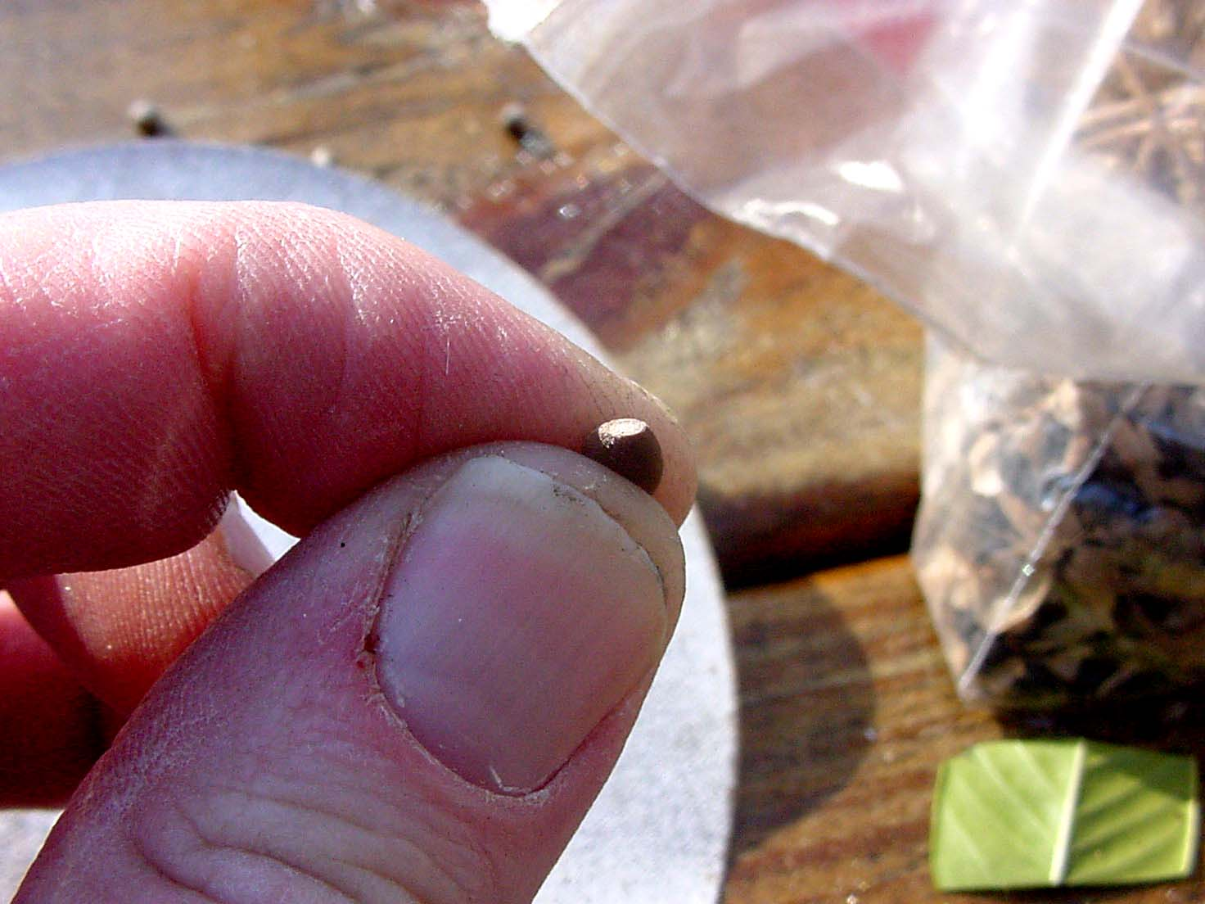
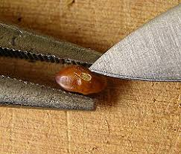
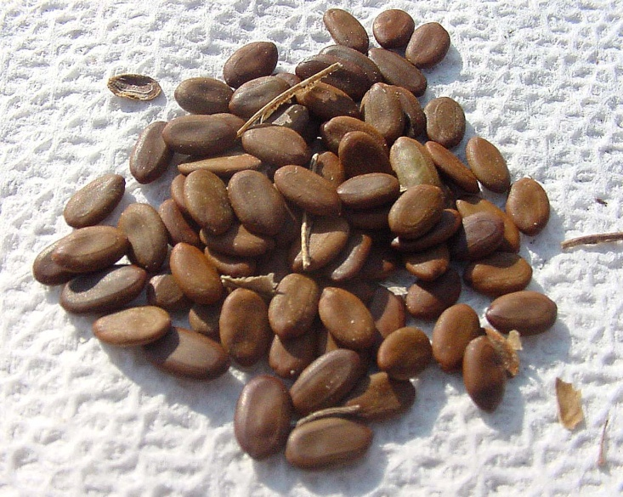
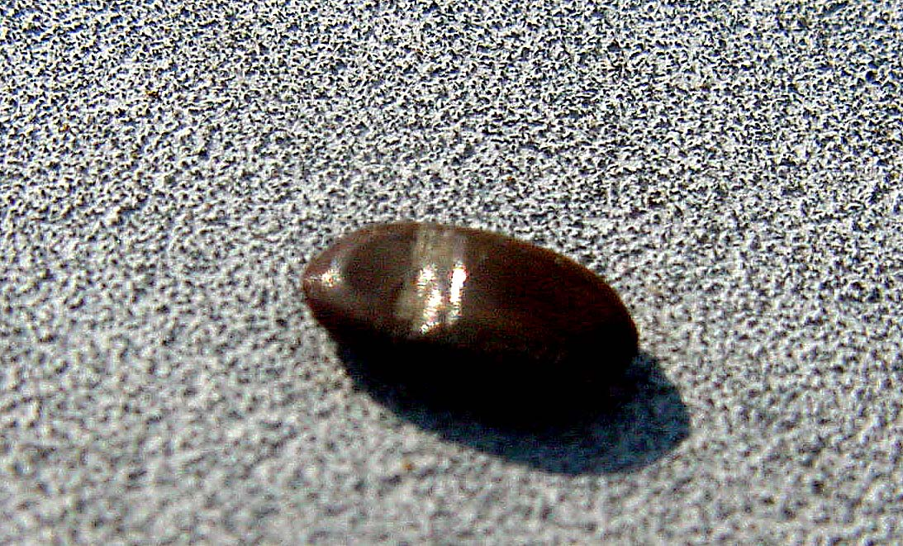
Mechanical Scarification

Slide 32
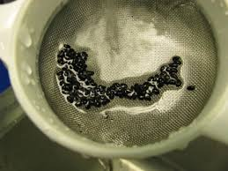
Cont..
b. Chemical scarification
Soaking hard-coated seed in concentrated or diluted sulfuric acid
Selective seed coat enzymes such as pectinase and cellulase
Acetone & alcohol; to dissolve and remove water-insoluble compounds and permit water into the seed

Slide 33
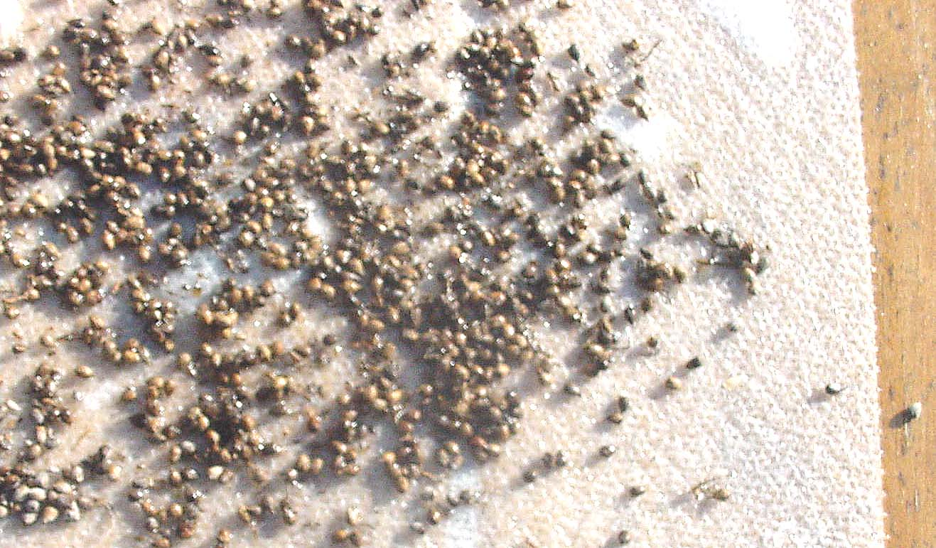
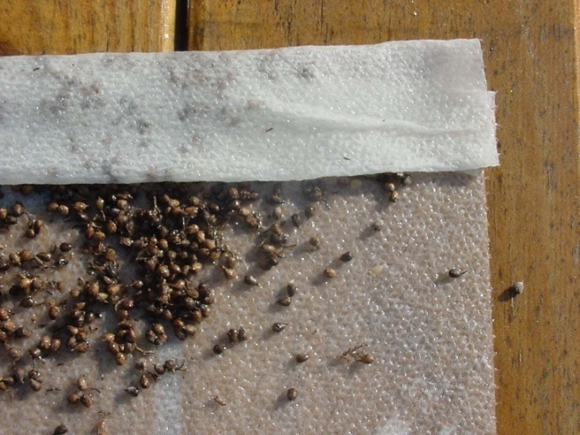
2. Stratifications
  Incubation of seed at low temperature (0-5⁰C) over a moist substratum for 5-10 days
  Some seed may require prolonged stratification (2-6 months at 5-10⁰C).

Slide 34
Cont..
3. Light treatment:
  Continuous or periodic exposure to light can be essential to break endogenous dormancy.
Treatment with growth regulators and other chemicals
  GA₃, Potassium nitrate (0.2%)

