Slide 1
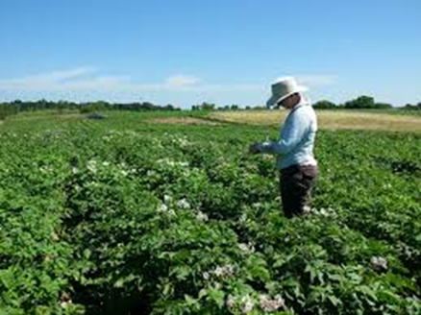
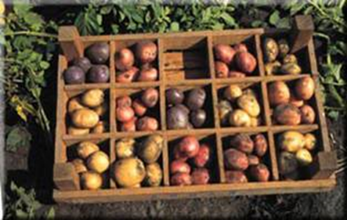
Chapter Seven 7. Variety Development, Seed Certification & Legislation
Outline
Variety development and evaluation
Variety release and registration
Seed certification and legislation

Slide 2
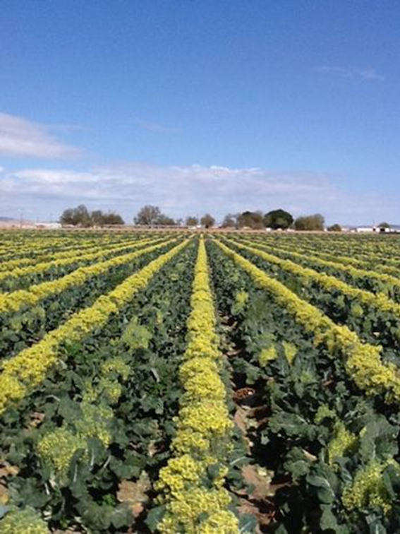
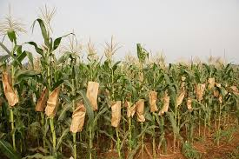
Variety development & evaluation
In Ethiopia, variety development for major crops began in 1966 with establishment of EARO
A principal plant breeding institution for cereals, legumes, oil seeds, fibers, horticultural and forage crops.
Universities are also involved in agricultural research and variety development.
The Ethiopian Pioneer Hibred International (EPHI) introduces and tests hybrids for adaptation and release in Ethiopia.

Slide 3
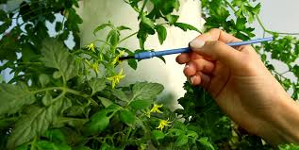
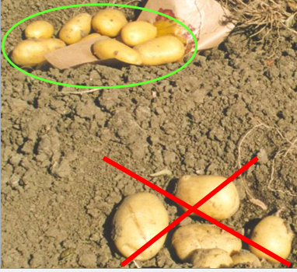
Cont..
New variety can be developed through
Selection
varietal introduction and
hybridization

Slide 4
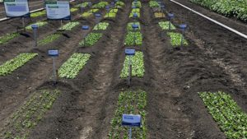
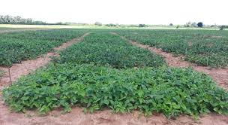
Cont..
The variety development, evaluation, release and registration procedures pass through several stages :
Station trial or observation nursery:
lines are grown in 1-2 rows and compared with checks
record agronomic characters, reactions to disease and yield.
Preliminary Yield Trial (PYT):
One hundred or more entries are evaluated each year
Each entry is grown in a 4-6 row (in more than one site) along check varieties.

Slide 5
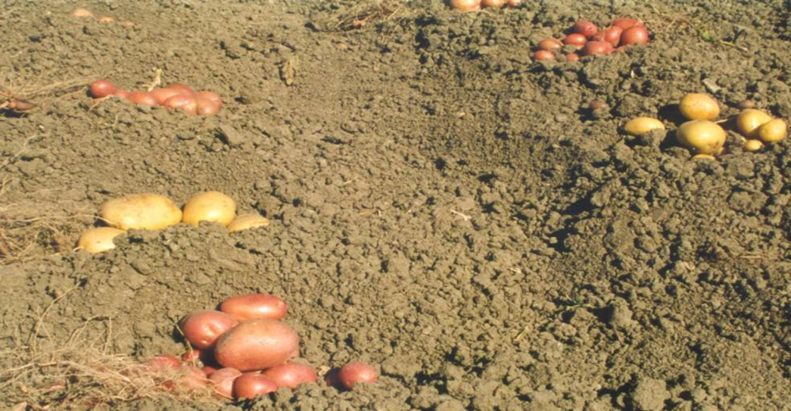
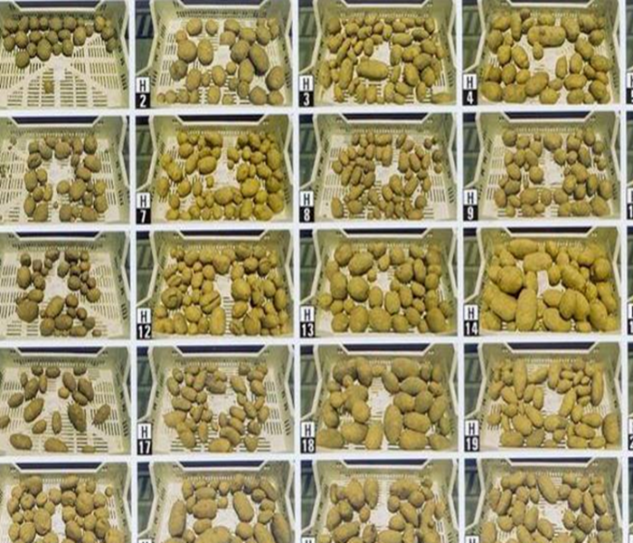
Cont..
3. Pre-National Yield Trial (Pre-NYT):
Varieties and two checks are compared
Each variety is grown in a six row at four or more locations.
Field data recorded and the yield analyzed statistically where 50-70% of the entries advanced to national yield trial (NYT).

Slide 6
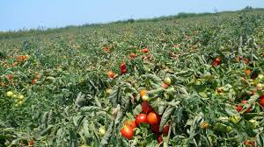
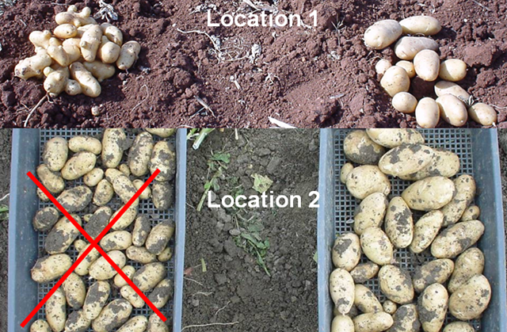
Cont..
4. National Yield Trial (NYT):
Similar procedures are used as Pre-NYT
but with four replications and more test locations and years.
After three years of testing, the promising lines are identified for submission to NVRC.

Slide 7
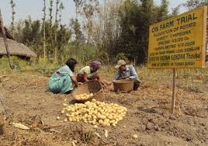
Cont..
5. Farm Verification Trial (FVT):
Promising lines are evaluated on large plots (100m²) on farmers’ fields
The NVRC visits the trials and make its own assessment.

Slide 8
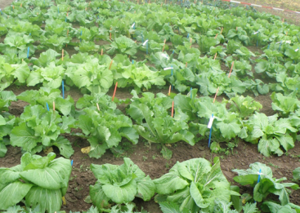
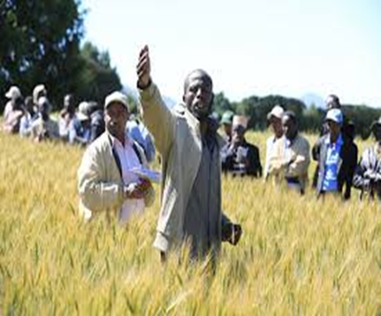
Variety Release & Registration
Since 1984 variety release and registration has become the responsibility of the National Variety Release Committee (NVRC).
The committee is composed of
Breeders (4)
Agronomists (1)
Crop protection specialists (2)
Research/extension (1)
Socio-economists (1)

Slide 9
Cont..
The membership includes
EIAR
Institute of Biodiversity Conservation and Research (IBCR)
Ministry of Agriculture (MoA) and others.

Slide 10
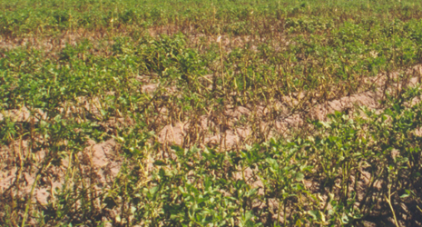
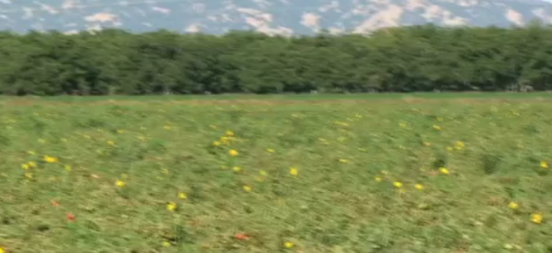
Cont..
Breeders carry out a minimum of two to three year national or regional trials (NYTs) in at least three to six different agro-ecological zones
The variety should be tested for
Yield
Tolerance to pests
Agronomic characters compared with standard/local check.
Superiority in yield, grain quality and acceptable level of distinctness, uniformity and stability are required to grant a release.

Slide 11
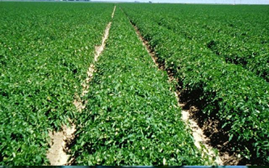
Cont..
The complete data of the promising variety must be submitted to NVRC for review and approval.
The varieties submitted to NVRC will further be evaluated for one season in on-farm verification trials under farmers management practices

Slide 12
Cont..
The NVRC appoints a sub-committee composed of NVRC members and other specialists to report on variety performance after examining the data and field visits.
The report covers
Performance data evaluation
Field performance evaluation and
Recommendations for the NVRC
The Committee may release a variety based on yield superiority, grain color, early maturity, etc.
Upon the release of the new variety breeders will provide small quantity of seed to the chairman of the NVRC who will forward it to the IBCR for the long-term storage.

Slide 13
Seed Certification
A program to maintain and make available high-quality seeds and propagating materials of genetically distinct crop varieties to the public.
Seed certification procedures are designed to ensure
Genetic purity (true-to type)
Physical purity
Good germination
Seed health and
Moisture content

Slide 14
Cont..
The Organization for Economic Cooperation and Development (OECD) has developed standards, schemes and guide relating to varietal certification
The objectives are:
To establish minimum standards for genetic purity
To standardize seed certification regulations and procedures
To encourage the use of high quality seed to facilitate movement of quality seed among the countries
To assist its member agencies in seed promotion, production and distribution
Notes:
The organization for economic cooperation and development (OECD), international seed certifying agency,

Slide 15
Cont..
Seed certification in Ethiopia is done by the Agricultural Inputs Certification Department (AICD) of the ministry of agriculture and rural development.
Other international organizations aims to facilitate the seed certification are;
The International Seed Testing Association (ISTA), designs uniform seed-testing methods
The Union for the Protection of New Varieties of Plants (UPOV) established to promote plant variety protection and to release uniform legislation

Slide 16
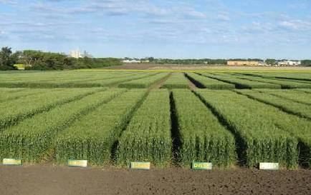
Cont..
The main techniques applied in seed certification are:
1. Eligibility of Varieties
Value for cultivation and use (VCU); determination of agricultural value of new varieties compared to existing commercial varieties
Distinctness, uniformity and stability (DUS) tests; to determine whether or not a new variety is sufficiently distinct from all other varieties and sufficiently uniform and stable

Slide 17
2. Seed Classes
Classes, as well as the maximum number of multiplication in each class, are set for each species.
The number of generations used in the certification system is fixed at the lowest possible level
Restricting the number of generations is one way to preserve quality.
More important with cross-pollinating spp.
Different seed classes are labeled with differently colored for easy identifications.

Slide 18
3. Seed quality standards
Standards are set for field inspection including
Varietal purity/off-type count
Isolation from potentially contaminating crops
Disease and weed
Seed testing and pre and post-harvest quality standards
Seed field that fail to reach these standards are either down-graded or rejected

Slide 19
Cont..
Table 1. Seed certification standards
Factor | Breeder | Basic | Certified
Purity (min) | 98% | 96% | 94%
Inert matter (max) | 2% | 2% | 4%
Other crop seeds (max) | 0% | 0.01% | 0.02%
Other varieties (max) | 0.04% | 0.2% | 0.5%
Germination (min) | 85% | 80% | 70%

Slide 20
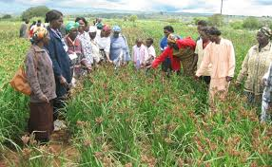
4. Field Inspection
Main objective; to ascertain that the seed being produced is not contaminated both physically and genetically beyond certain specified limit.
This is done during various stages of the cropping season.
Before sowing
At flowering
Before harvesting
After harvesting

Slide 21
Cont..
The objective are;-
Field meets the prescribed land requirement
Seed used for raising seed crop is from approved source
Provided with proper isolation or border rows in hybrid seed production
Planting ratio in hybrid seed production
Properly rogued
True to varieties characteristics and no mechanical mixture, proper harvesting

Slide 22
Possible travel patterns for field inspection

Slide 23
Cont..
Observation during field inspection; off-types, objectionable weed plant, inseparable other crop plant, diseased plant, pollen shedder and shedding tassel

Slide 24
5. Seed inspection
The homogeneity of the seed lot
According to the international seed testing association rules (ISTA), tests are carried out for:
Physical purity
Germination
Moisture
Varietals purity
Seed health
Vigor test
Viability test
1000 grain weight test

Slide 25
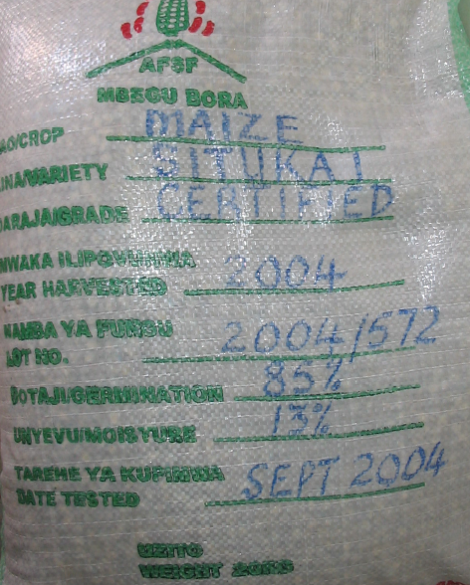
6. Labels
Certification labels are put on every seed container indicates that the seed has met the minimum certification and seed testing standards.
Kind of seed
Name of variety
% purity
% Germination
Weed seeds
% inert matter
Supplier’s address
Validity period of certification

Slide 26
Seed Legislation
The purpose of a seed law is to protect the farmer against purchase of poor quality seed.
Seed quality is much more difficult to judge than the quality of other commodity.
For example, it is impossible to judge, by sight, the germination capacity of seed.
Progress requires safeguarding farmer interests and protecting seed producers and merchants from unfair competition.
Seed laws must be enforceable and must fit the social, economic, and judicial make-up of the country.

Slide 27
Cont..
There are two alternative systems of seed legislation.
The comprehensive regulator system, where law prohibits the sale of seed that does not meet a minimum standard of quality.
Seed producers and trader companies must be registered in order to do business.
The truth in labeling system, where the seller must provide correct information about the seed to be sold.
All seed is allowed to be marketed, but the quality is indicated on the label.
In practice, each country’s seed legislation has its own peculiar characteristics.

Slide 28
Cont..
Control of imports is often included in seed legislation to protect the national seed industry and farmers, or for quarantine purposes.
Quarantine restrictions to seed-borne disease and insect and to weed seed.
If improperly used, they can distort the international seed trade.

Slide 29
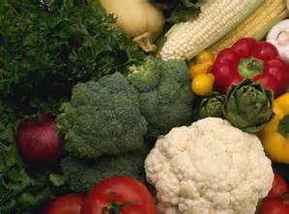
END !!!

