Slide 1
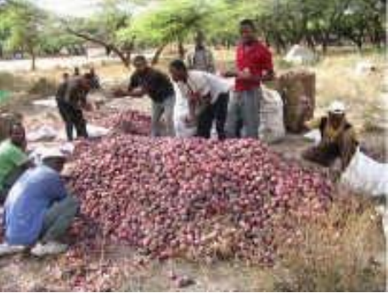
Onion (Allium cepa L.)
One of the most important vegetable crops produced on large scale in Ethiopia.
The area under onion is increasing mainly due to;
Its high profitability per unit area and ease of production
The increases in small scale irrigation areas
Produced both under rainfed and irrigation in the off season.

Slide 2
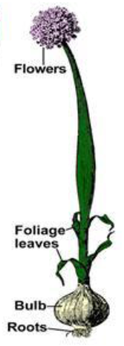
Cont..
A biennial crop, cross-pollinated (insects) > 90% cross
Requires two seasons to produce seed
1st season - bulb formation
2nd season - flower stalk & produces seeds
It requires Vernalization (9 to 17°C) treatment prior to and during the early growth of the seed stalk (inflorescence)

Slide 3
Growth Requirement
Cool condition with an adequate moisture supply is most suitable for early growth of onion, followed by warm, direr conditions for maturation.
In the Upper Awash and the Lake region, during September to February
26-28°C during the day and 11-16º C night with low humidity
Excessive rainfall and cooler conditions during flowering leads to disease and poor fruit set and ripening
A fertile loam soil with pH of 6.0 to 7.0

Slide 4
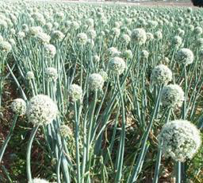
Formation of seed stalk (umbel) is referred to as Bolting
Most varieties bolt readily between 10 and 15⁰C
More than 1 flower stalk can be produced per plant

Slide 5
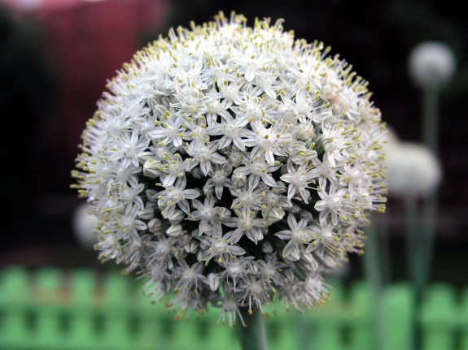
Pollination and isolation
Onion is highly cross pollinated (up to 94%) depending on the availability of pollinators.
Protandry flower
Honey bee hives could be placed on the farm to effect seed setting.
Distance: at least 600 m to 800 m
If there are many varieties, must be covered with insect proof cages
In a commercial production, concentrate on one or two varieties.

Slide 6
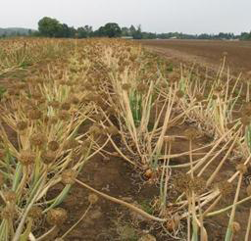
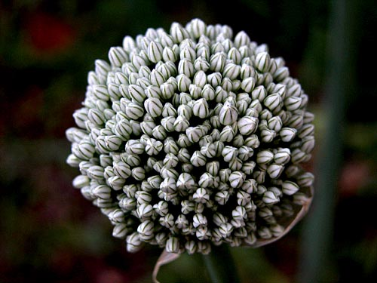
Methods of seed production
Bulb to seed method
Seed to seed method

Slide 7
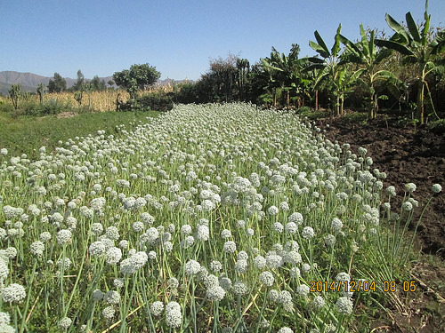
Bulb to seed method
The most commonly used method
When onion bulbs are grown, harvested, stored & re-planted the following season to produce seed

Slide 8
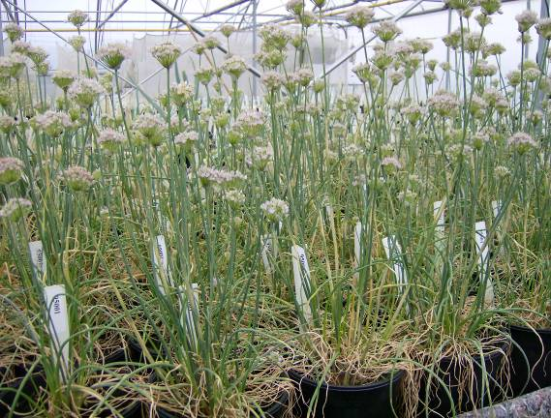
Advantages of the bulb to seed method
It allows/permits the grower to select true-to-types, healthy bulbs, and discard off-type & diseased bulbs
More flower per seed stalk can be grown per plant
Also used to maintain the stock seed/breeder seed
Seed yields up to 20 qt/ha
Disadvantages
relatively expensive
it takes 10-11 ½ months to produce seed

Slide 9
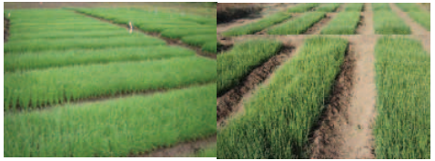
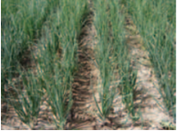
Cont..
In this method, the seed is sown in raised bed at 4-5 cm spacing for raising the seedling.
Transplanting: 12-15 cm length (7-8 weeks after sowing)
Thus, 6-8 kg seed ha⁻¹ is sown.
The seedlings are transplanted in 15x10 cm spacing.
The recommended cultural practices followed to raise healthy bulb crop.

Slide 10
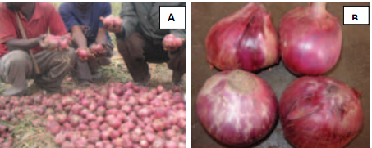
Cont..
The bulb are lifted when the 75% plant show neck fall/top die down.
The bulbs are dried /cured under naturally ventilated place then neck is trimmed leaving 2-3 cm attached with bulb.
The bulbs are roughed based upon the color, shape and size.

Slide 11
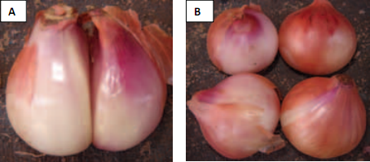
Cont..
The damaged, twin bulbs and long necked bulbs are discarded.
The medium size bulbs weighing (50-80 g) are selected and stored.
Mothers’ bulbs: the bulbs selected for seed production

Slide 12
Planting of bulbs for seed production (2nd year)
Plant the bulbs on well prepared land at the rate of ≈ 15 qt/ha
Use the recommended spacing
Follow strict disease & pest management practices
Rouging off-types

Slide 13
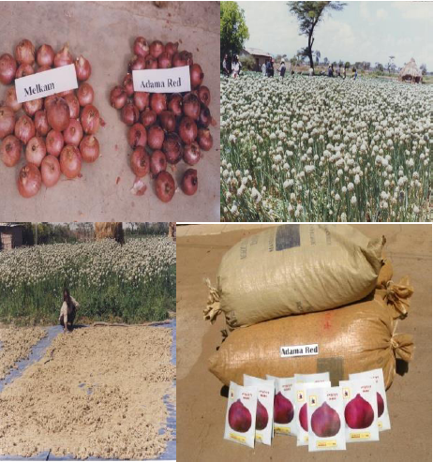
Cont..

Slide 14
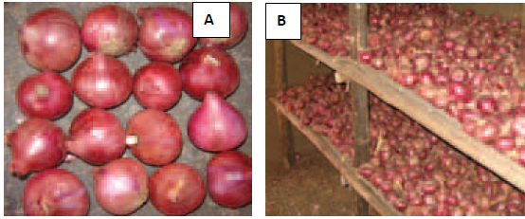
Field inspection
(a) Mother bulb production stage: A minimum of two inspections:
after transplanting of seedlings in order to determine isolation, volunteer plants, off type including bolters and others.
after the bulbs have been lifted to verify the true to type.

Slide 15
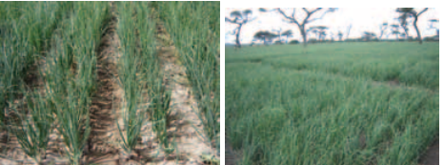
Cont..
b) Seed production stage; A minimum of four inspection:
Before flowering for isolation, volunteer plants, off types including bolters.
The 2nd and 3rd inspection at flowering to check the off type
4th at maturity to verify the true nature of plant

Slide 16
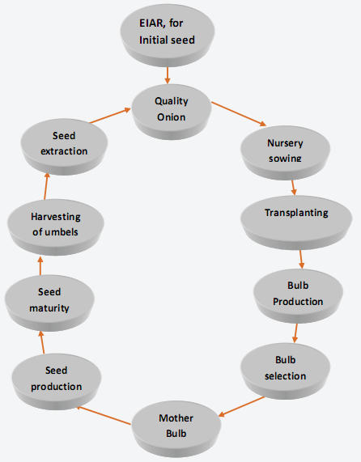
Flow chart for onion seed production

Slide 17
Seed-to Seed Method
Seedlings are transplanted and allowed to over-winter at the same place and allowed to bolt (flowering).
Doesn't allow to examine the mature bulb characters and field is rouged for off-types.
Not popular, since all the varieties are not suitable for annual seed production due to poor bolting habit and lower seed yield.
Not suitable for further multiplication.

Slide 18
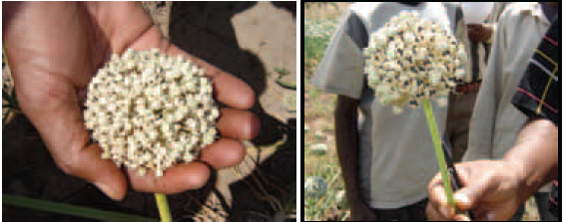
Harvesting
All umbels per plant do not mature at one time due to difference in the stalks to flowering
harvesting may take 3-4 times.
Harvest when 50% black seed is exposed on an umbel
Support in the palm of hand to avoid seed shattering.

Slide 19
Drying of the umbels
The harvested umbels should be dried by spreading the umbels on canvas and putting under shade or
In the morning or late afternoon sun for few days.

Slide 20
Seed extraction
While seed extraction there should not be any damage to seed
The dry umbels are gently mowed and winnowed to separate the seeds from chaffs

Slide 21
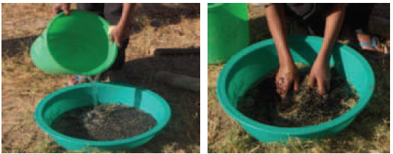
Cont..
The winnowed and unclean seed be put in a bucket and soaked with clean water and left for 3-5 minutes

Slide 22
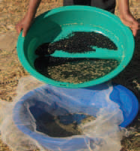
Cont..
Then pure seed be separated from light seeds and other trashes based on their weight
Heavy seeds sinks and poor quality seeds and chaffs floats

Slide 23
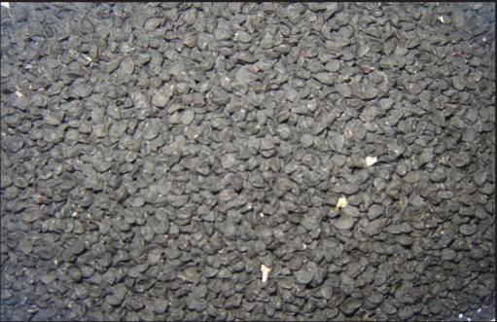
Seed drying
The pure seed settled in a container should be taken immediately and dried under the morning and late afternoon sun or under shade for 3-4 days
Should not be dried in the sun during noon the time

Slide 24
Seed yield
Table 1. Recommended/released onion varieties in Ethiopia

Slide 25
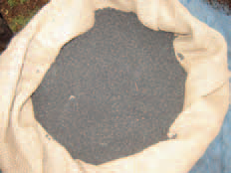
Seed Storage
Onions possess one of the most rapidly deteriorating seeds among major crops.
Store in porous materials such as cloth or paper bags in dry and aerated conditions at 7-9 % moisture.
Don't store in plastic bags for long time.
If seed moisture content is high, normally it loses its viability at faster rate.

