Slide 1

Chapter 2
Development of seed program
Outline
Seed program
Bases of seed program
Types of Seed program
Steps for the development of seed program

Slide 2

Seed program
A scheme of activities planned and implemented to secure rapid and timely supply of good quality seeds in the required quantities.
Has several essential components which are strongly interrelated.
  Breeding
  Variety evaluation and release
  Multiplication
  Processing and storage
  Quality control
  Marketing and distribution
Notes:
A seed program is a complex and integrated organizational concept which can be defined as "an outline of measure to be implemented and
activities to be carried out to secure the timely production and supply of seeds of prescribed quality in the required quantity"

Slide 3
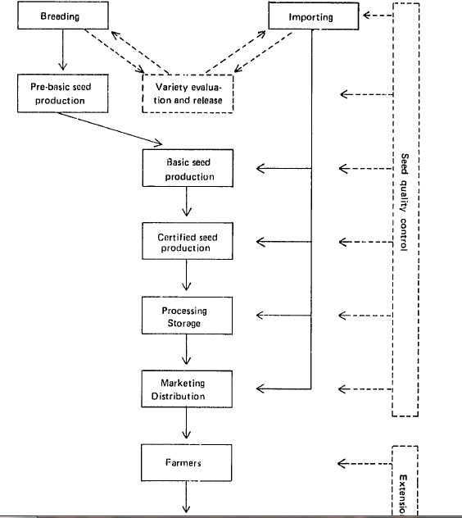

Slide 4
Bases for a seed program
1. High level support
The desire and determination of the government to improve agriculture and supply of essential inputs
Administrative support, understanding and appreciation of the nature and the potential contribution of the seed program
Notes:
A comprehensive seed program has several essential components which are strongly interrelated. The most important of the.e aie"variety breeding, valuation, and secd release; multiplication;processing and storage; seed quality control; aid marketing and distribution. Each stage must be implemented at the proper time and inthe correct sequence. If one component is not operative, the entireseed program will not work properly. A highly sophisticated seedquality control service, for example, useless if the is seed processing pla,':s are poorly designed and unable to produce high quality seed.

Slide 5
2. Productive plant breeding program
Breeding of new varieties is the basis of a seed program
The production of quality seed of traditional varieties seldom generates sufficient benefits to the farmer compensate to for the increased cost of the seed.
The breeding program for a new variety produces small quantities of breeder seed.
    the parent material for further multiplication
Varieties are usually evaluated in field tests for about two/three years.
Notes:
A sound seed program must be supported by strong breeding activities. The production of quality seed of traditional varieties seldom generates sufficient benefits to the farmer compensate to for the increased cost of the seed. The breeding program for a new variety produces small quantities of what is called breeder seed. This seed is the parent material for further multiplication, and the source of all certified seed. before they are released to farmers varieties are usually evaluated in field tests for about three years. In such experiments, which should be conducted in the various ecological zones of the country, the
agricultural value of new varieties is compared with that of existing ones. If possible, such experiments should be carried out under different farming systems.

Slide 6
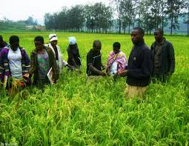
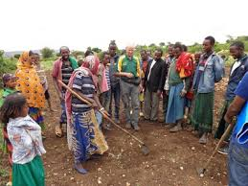
3. Coordinated effort
A coordinated effort to create producer demand
To prepare a sound plan for seed program and to establish a cadre of trained specialists

Slide 7
Types of seed programs
1. Official seed program
The government holds the full responsibility of developing the program and making good quality seed
All seed programs in the world have started with the participation of the government

Slide 8
Cont..
Disadvantages
The concern for return from investment is very low, or even for covering the cost of production
Such programs are often subject to political pressures
Frequent personnel changes hampers the progress
Are not very efficient

Slide 9
2. Semi-official seed program:
Consists of establishing a national agency to produce, process and distribute seeds
This is a more remote form of the government participation
Such agencies operate as autonomous units
Usually more commercial in nature and management than governmental units
More efficient in operation

Slide 10
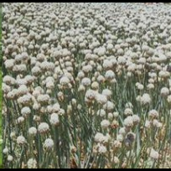
3. Private seed program
Private enterprises handles the production and distribution of seeds.
In developing countries the best approach appears to be to involve various government (official), semi-officials to private agencies in developing the seed program by demarcating their broad responsibilities

Slide 11
Steps involved in the development of seed program
Step I. Collection of pertinent data
The first step in developing the program is to collect the correct statistics or status regarding the following factors:
1. Availability of superior varieties
  The list of available varieties
  Their area of adaptation and yield potential
  Other advantages of the variety
  Information regarding promising varieties
  Information regarding farmers’ preferences for a particular variety/varieties

Slide 12
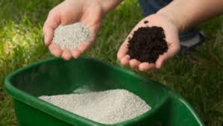
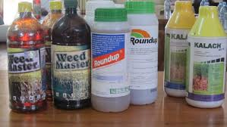
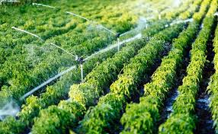
2. Availability of other inputs
Irrigation resources
Fertilizers, chemicals
Other inputs recommended by the breeder

Slide 13
3. Targets for area under high yielding varieties
This indicates the emphasis placed by the government on improved varieties and their likely demand
4. Total area under various crops included in the program, seed rate per hectare, and desired renewal period to calculate total potential demand.

Slide 14
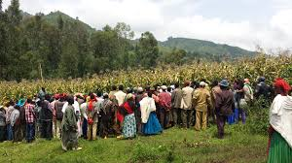
5. Role played by extension agents
The extent to which seeds of high yielding varieties are popularized by extension staff

Slide 15
6. Collection of climatic data
Detailed climatological data is necessary for
  The preparation of a calendar of operations for seed production and processing
  To work out requirements of seed drying, processing, storage and movement of seeds
  In horticultural crops like onion, carrots, cabbages which need vernalization temperature for flower initiation, development and subsequent seed set

Slide 16
Cont..
7. Farm size, methods of cultivation and harvesting
8. Financial resource of seed growers
9. Multiplication scheme

Slide 17
Step II. Assignment of Broad Role to various agencies responsible in the seed industry (stakeholder analysis)
The stakeholders in the Ethiopian seed industry
1. Ministry of Agriculture and Natural Resources
An umbrella organization which coordinates and leads the various activities of the seed industry.
Main tasks; national seed policy, variety registration and release, seed import/export, seed certification, quarantine and extension.

Slide 18

Roles/responsibilities
Planning at the national level to ensure uniform standards and procedures of seed certification
Hasten and facilitate the adoption of new technologies

Slide 19
2. The National Seed Industry Agency (NSIA)
Roles/responsibilities
To ensure the seed industry develops and operates efficiently
To ensure the seed producers and the farming community, as well as the industry using agricultural raw materials benefits from the seed industry
To create an enabling environment for capacity building in research, development and training in the field of genetic resource conservation, crop improvement and seed technology

Slide 20

3. Bio-Diversity Institute (BDI)
Roles/responsibilities
To collect, characterize, conserve, document and utilize the germplasm resources
Provide and make available genetic materials for breeders to develop improved varieties for cultivation
Notes:
Ethiopia is the primary center and diversity of most important agricultural crops. The country is endowed with rich genetic resources. The Institute of Biodiversity Conservation and Research (IBCR) was established in 1975. IBCR is responsible for collection, conservation, characterization and utilization of Ethiopia's germplasm. It is a major source for germplasm for crop breeding for NARS in the country.

Slide 21

4. Research Institutes
Ethiopian Institute of Agricultural Research (EIAR)
A federal agricultural research organization having responsibility of conducting agricultural research (adaptation and generation)
Pre scaling up of agricultural technologies
Providing technical skill development on the use of agricultural technologies

Slide 22



Cont..
2. Regional Research Institutes and Agricultural Universities
  To develop varieties suitable for their regions
Notes:
Apart from EARO, the Alemaya University (AU), the Awassa College of Agriculture (ACA) and the Mekelle University College (MUC) are also involved in agricultural research and variety development.

Slide 23
Cont…
Roles/responsibilities
Guiding, coordinating and promoting agricultural research
Introduction and release of new varieties
Strengthen research in plant breeding and allied subjects
Produce, maintain and multiply breeder’s and foundation/basic seeds
Arrange and provide training on seed technology

Slide 24

5. Ethiopian Seed Enterprise (ESE)
The ESE is the major seed producer in the formal seed system
Roles/responsibilities
Organize large scale production and marketing of improved seeds (basic and certified seeds) developed by the Research Institutions
Notes:
Ethiopian Seed Enterprise was established in 1978 and has operated in its present form since 2002. The company is the largest field crop seed producer and supplier in Ethiopia. It runs six seed production and processing centers, one main and six smaller laboratories, and several other facilities. Ethiopian Seed Enterprise is state owned and is supervised by the Ministry of Agriculture.The Ethiopian Seed Enterprise (ESE) established in 1979. The production of basic seed is the responsibility of ESE. The Enterprise has
three basic seed farms: one for highland crops (Gonde-Ethaya) and two for mid- to lowland crops (Shallo and Kunzila), with an area of 2100 ha and potential annual seed production capacity of 4500 tonnes.

Slide 25
Cont..
Import reliable high yielding varieties
Organize seed cleaning and processing facilities at various locations
Act as a promoter of seed enterprises

Slide 26

6. Ethiopian Pioneer Hybrid Incorporate
Introduces and tests hybrids from parent company for adaptation and release in Ethiopia.
Pioneer Hybrid Incorporated entered into a joint venture with ESE to produce basic seed of improved varieties
Notes:
Pioneer Hi-Bred International, Inc. is one of the world’s largest seed companies. Pioneer develops, produces, and markets hybrid corn, sorghum, sunflower, soybean, alfalfa, wheat, canola, and vegetable seeds. The company dominates most of the markets in which it participates, holding more than a 40 percent share of the North American seed corn market, and even higher shares in European markets. The company was instrumental in one of the most important genetic accomplishments of American agriculture, the development of hybrid corn. Pioneer has in recent years become increasingly involved in the use of biotechnology

Slide 27
Step III. Planning and organization of the seed program
The seed program can be planned and organized based on the following guidelines:
Fix the targets of production on the basis of pertinent data and growers demand
Calculate the production requirements for each seed class in terms of land required
Workout the personnel, equipment and facilities requirement and the associated costs (technical, administration)
Survey on seed marketing and pricing structure
Prepare a detailed calendar of operations

Slide 29
Quiz 5%
What are the three bases (requirement) for the development of seed program ? (1.5 pts)
Mention at least 4 stakeholders involved in Ethiopian seed industry. (2 pts)
Which of the following is/are essential components of seed program ? (1.5 pts)
  Breeding
  Variety evaluation and release
  Seed multiplication
  Processing and storage
  Quality control
  Marketing and distribution

Slide 30
Assignment
Seed formation, development and anatomy
Lettuce seed production
Swish chard seed production
Horticultural seed production in Ethiopia
Challenges and opportunities of horticultural seed production in Ethiopia

